Slide 1
Il sequenziamento di nuova generazionee le sue applicazioni alla trascrittomica parte II

Slide 2
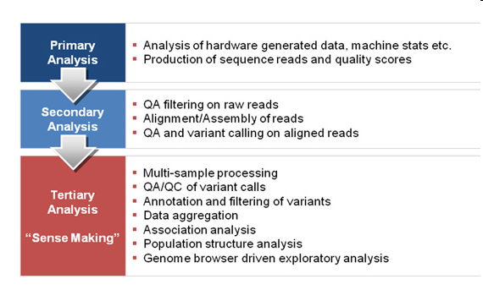

Slide 3
Depth (coverage) in DNA sequencing refers to the number of times a nucleotide is read during the sequencing process. Deep sequencing indicates that the total number of reads is many times larger than the length of the sequence under study. Coverage is the average number of reads representing a given nucleotide in the reconstructed sequence.
Depth can be calculated from the length of the original genome (G), the number of reads(N), and the average read length(L) as N x L/G. For example, a hypothetical genome with 2,000 base pairs reconstructed from 8 reads with an average length of 500 nucleotides will have 2x redundancy. This parameter also enables one to estimate other quantities, such as the percentage of the genome covered by reads (sometimes also called coverage). A high coverage in shotgun sequencing is desired because it can overcome errors in base calling and assembly. The subject of DNA sequencing theory addresses the relationships of such quantities

Slide 4
Sequencing depth represents the (often average) number of nucleotides contributing to a portion of an assembly.
On a genome basis, it means that, on average, each base has been sequenced a certain number of times (10X, 20X...).
For a specific nucleotide, it represents the number of sequences that added information about that nucleotide.
Such depth varies quite a lot depending on the genomic region. In consequence, an average sequencing depth of 30X leaves a lot of small portions of a genome unsequenced while other receive a lot more sequences.
Sequencing Coverage
Sequencing coverage describes the average number of reads that align to, or "cover," known reference bases. The NGS (next-generation sequencing) coverage level often determines whether variant discovery can be made with a certain degree of confidence at particular base positions. Sequencing coverage requirements vary by application, as noted below. At higher levels of coverage, each base is covered by a greater number of aligned sequence reads, so base calls can be made with a higher degree of confidence.

Slide 5
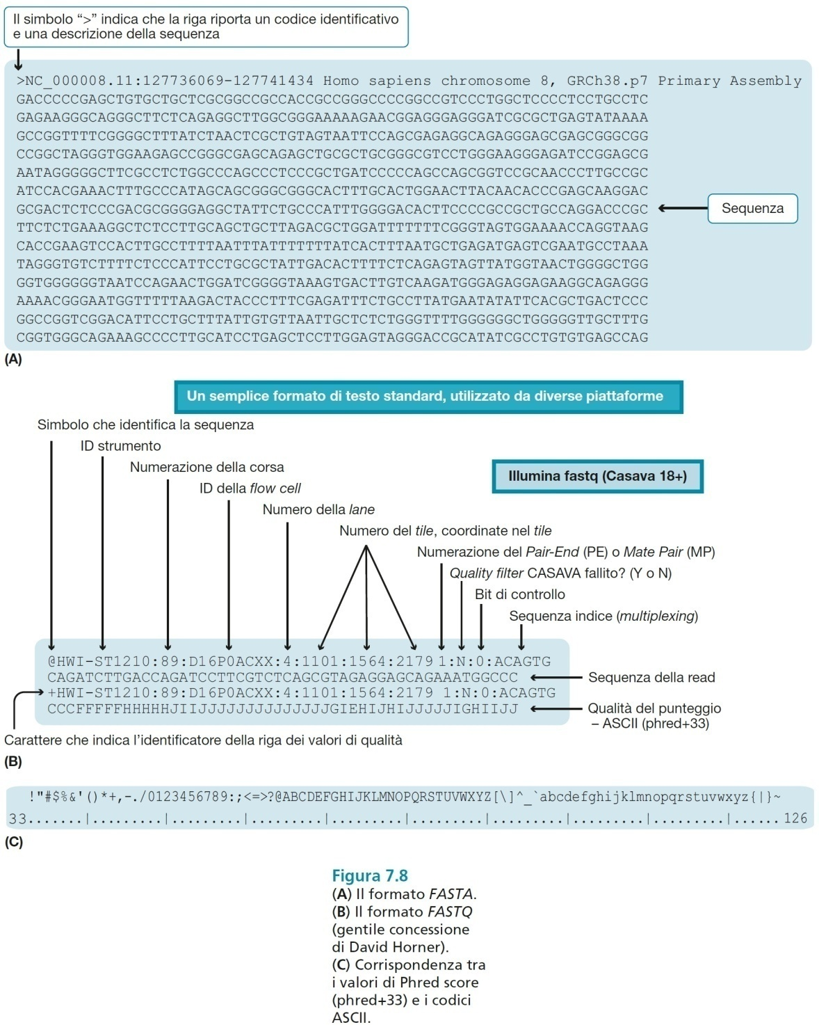

Slide 6
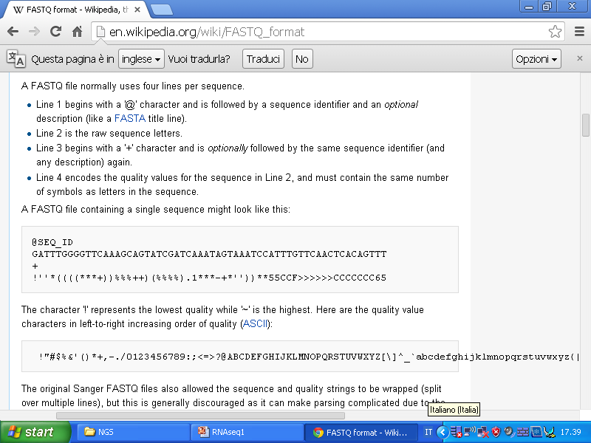

Slide 7
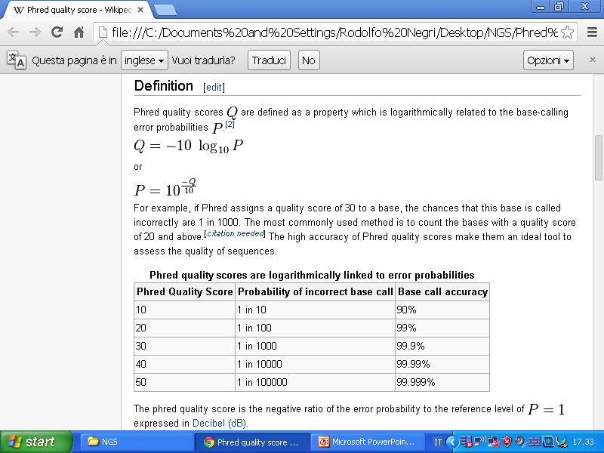

Slide 8
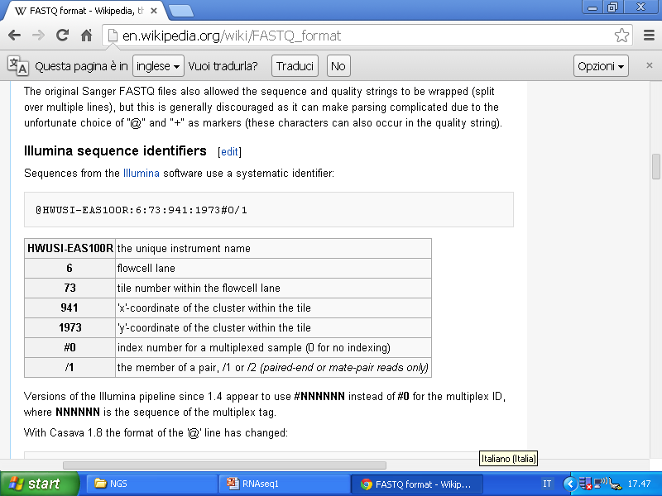

Slide 9
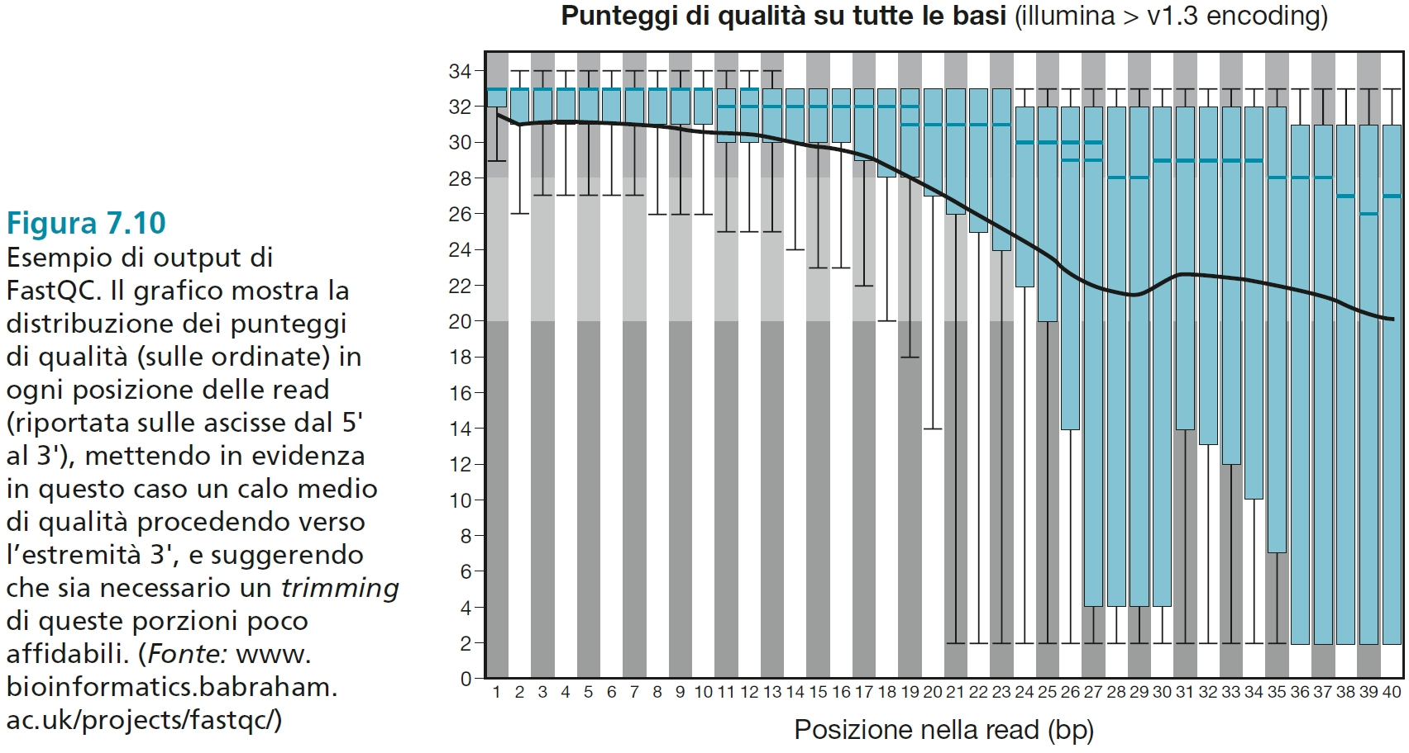

Slide 10
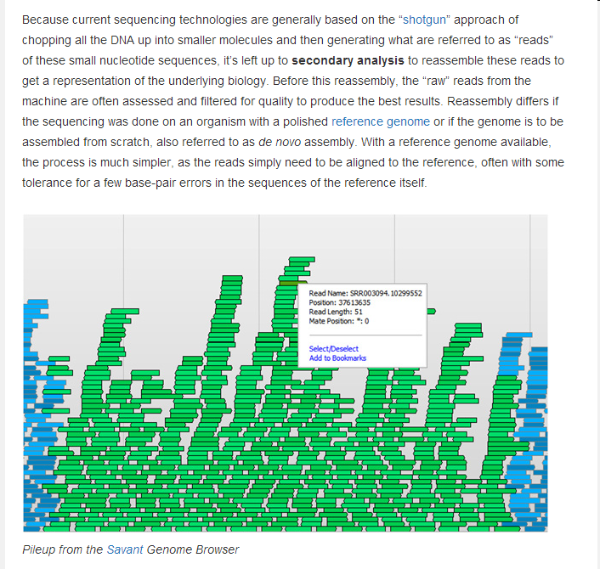

Slide 11
Quantificazione Trascritti
Se B è lungo 2 volte A, una RNAseq library conterrà in media 2 volte più trascritti di B.
Cufflinks conta i reads che mappano in ogni trascritto e poi li normalizza alla lunghezza.
In modo simile, due run della stessa libreria potrebbero produrre differenti volumi di reads.
Le conte devono quindi venir normalizzate alle reads totali.
FRAGMENTS/KILOBASE/MILION MAPPED FRAGMENTS
FPKM noto anche come RPKM (READS/PER KILOBASE per MILION)
in esperimenti single end

Slide 12
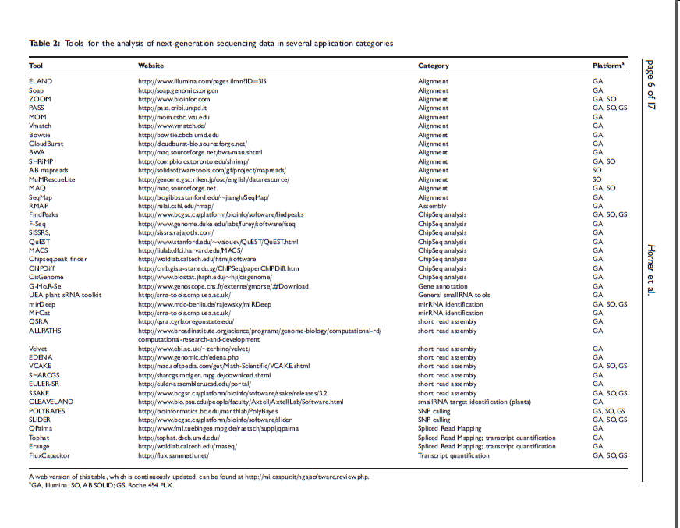

Slide 13
Quando ci sono isoforme multiple di splicing molte reads saranno mappate ad un esone comune.
Cufflinks e Cuffdiff implementano un modello statistico lineare per stimare l’assegnazione di abbondanza ad ogni trascritto che spiega le reads osservate con la massima probabilità.
Siccome i due software calcolano il livello di espressione di ogni variante di splicing, calcolare il livello di espressione del gene è facile: si sommano semplicemente i livelli di tutte le varianti.
Questo è possibile perché FPKM è direttamente proporzionale all’abbondanza. Infatti il livello di espressione di ogni gruppo di trascritti (che partono dallo stesso TSS) può venire calcolato sommando i livelli dei membri del gruppo.

Slide 14
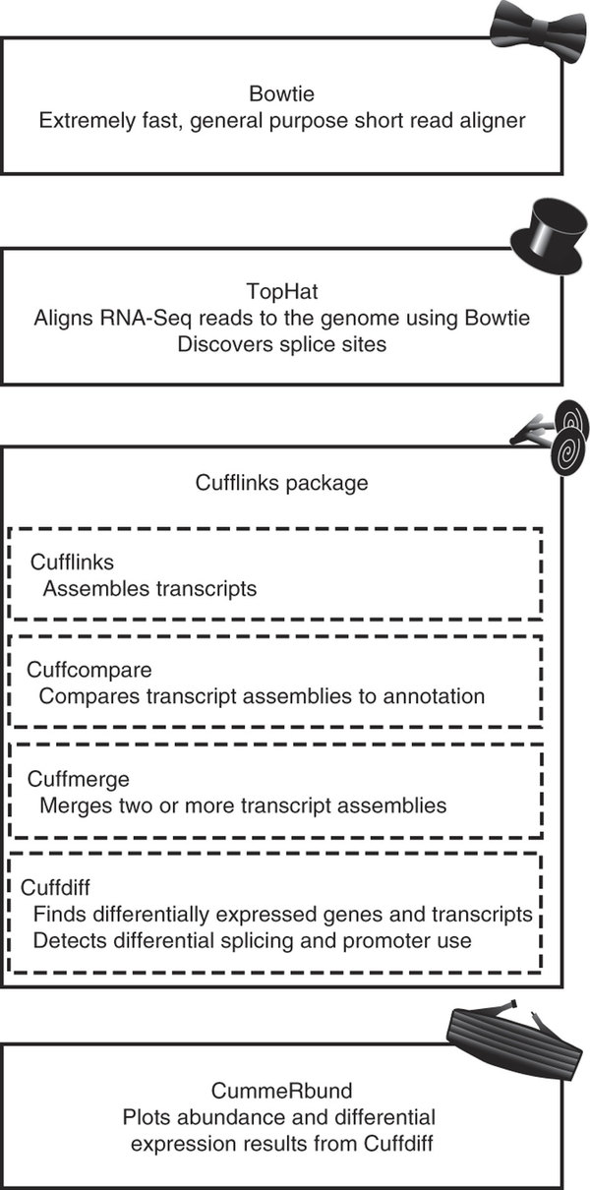
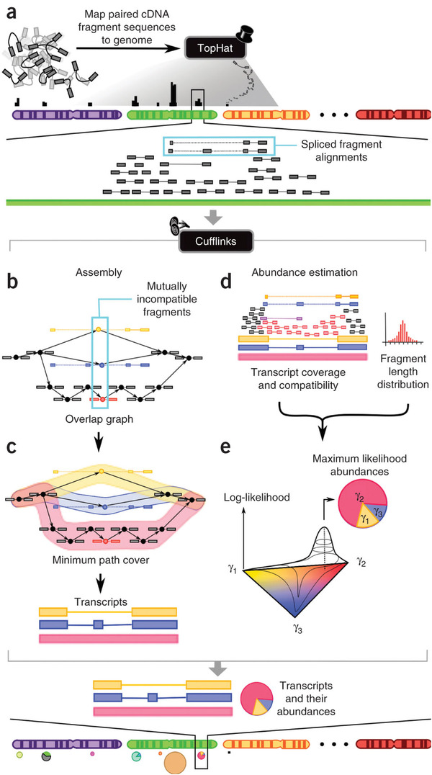

Slide 15
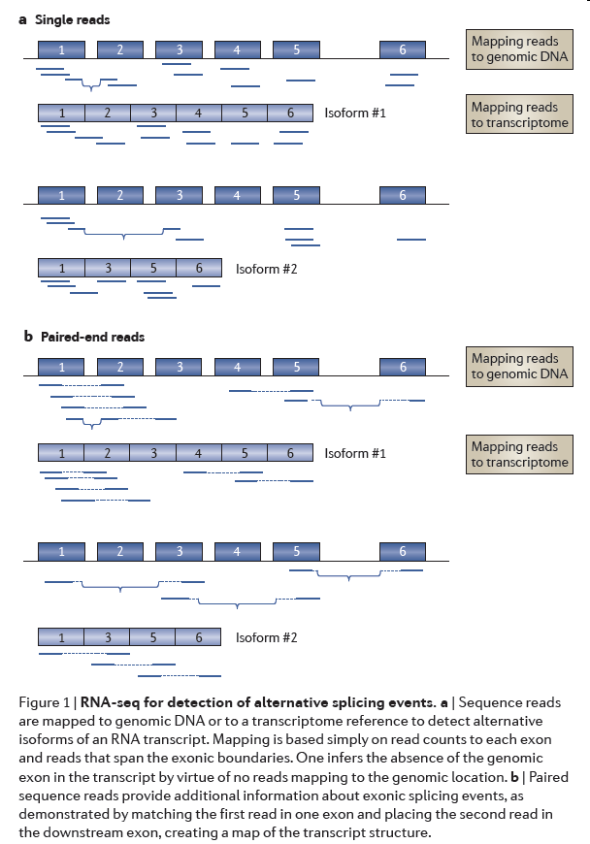

Slide 16
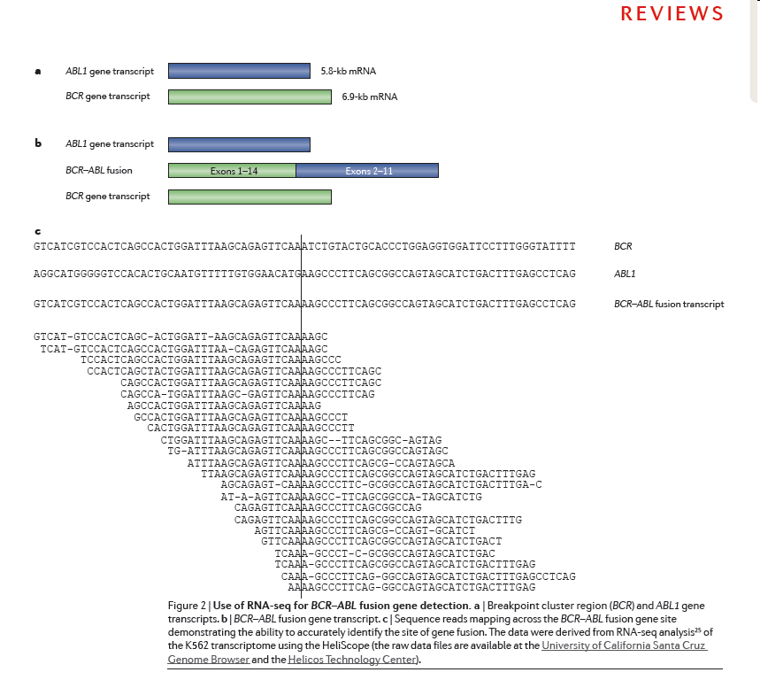

Slide 17
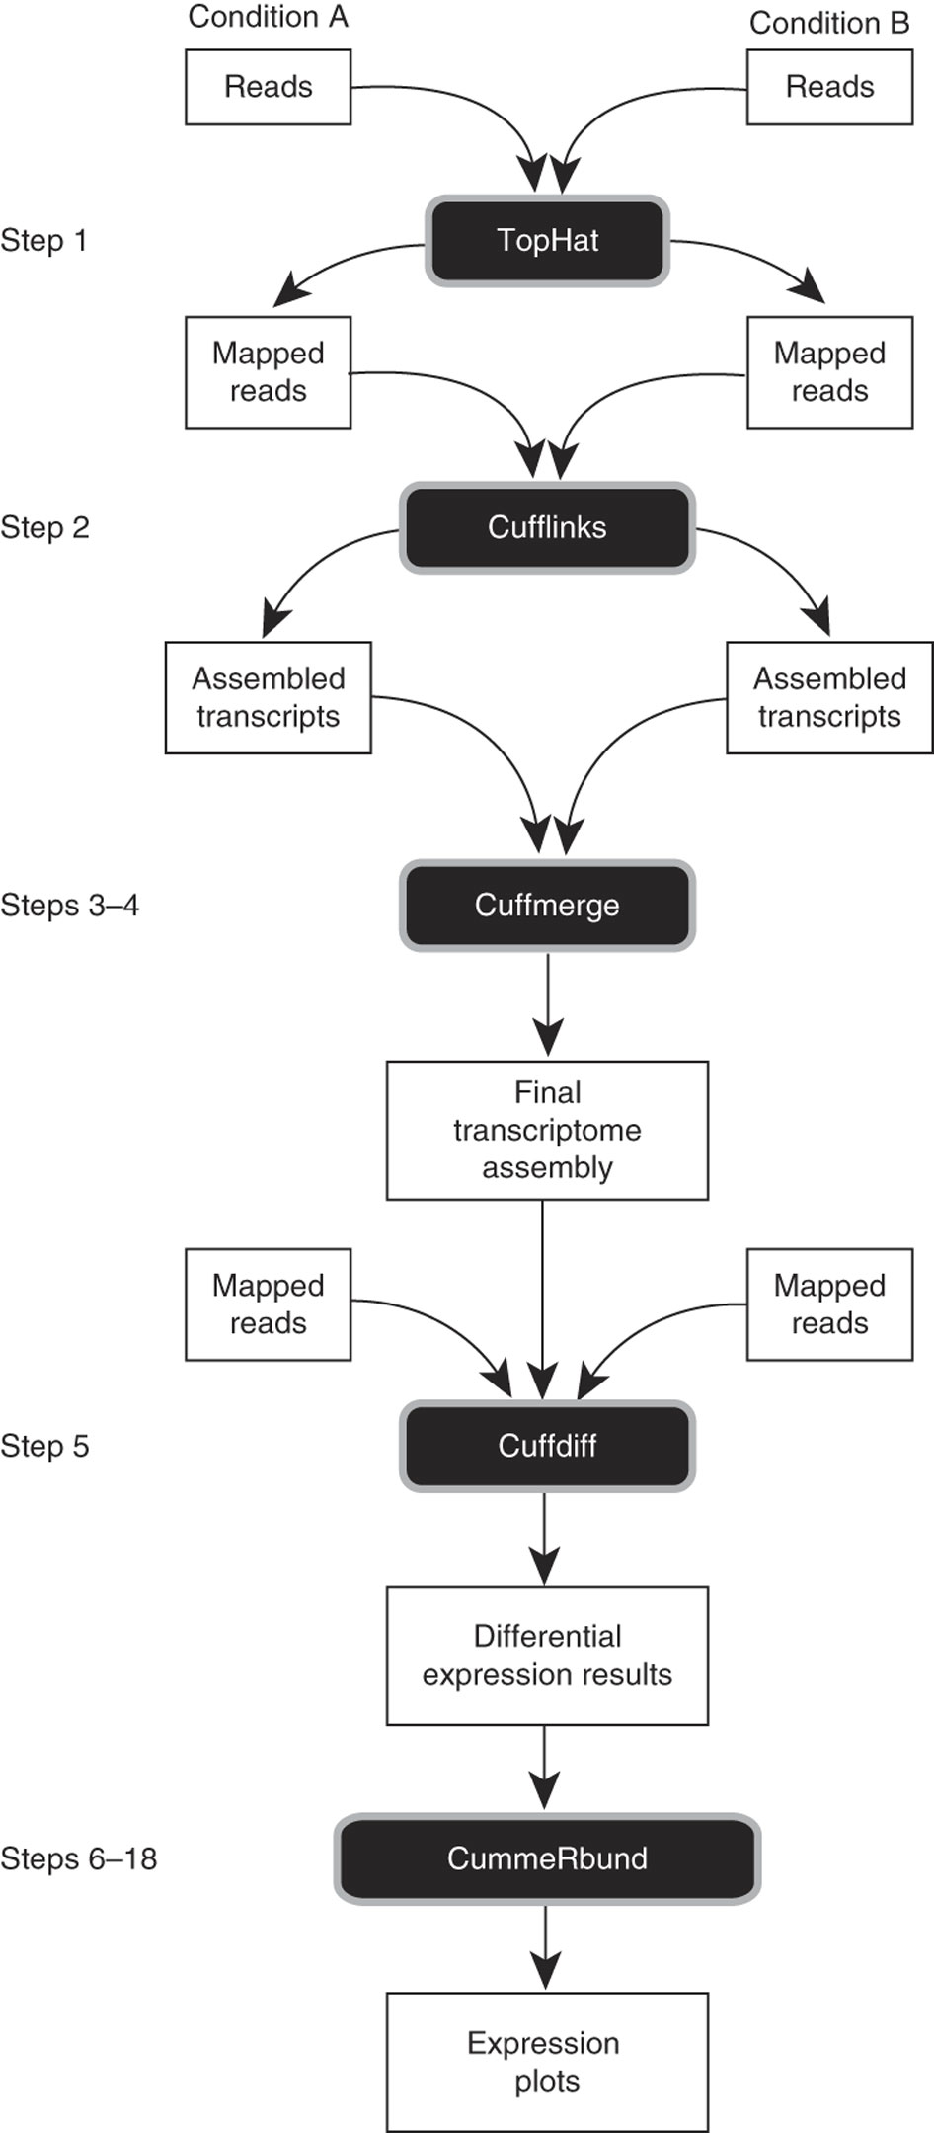

Slide 19
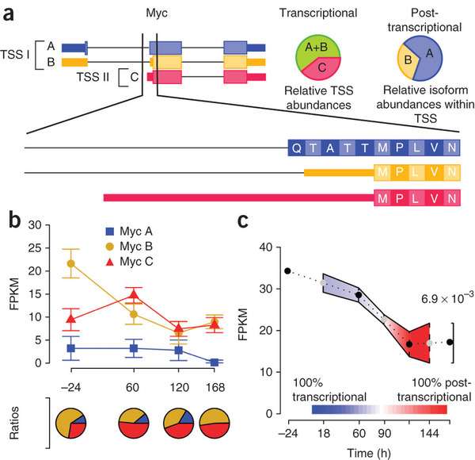

Slide 20
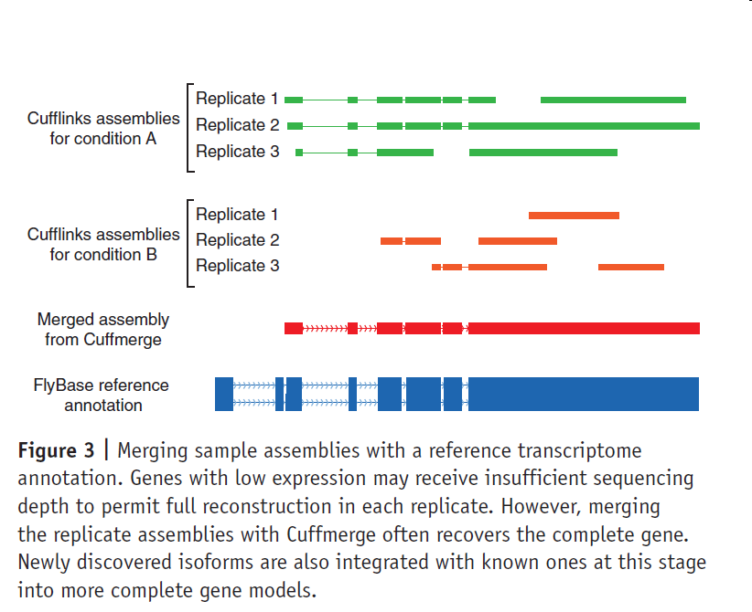

Slide 21
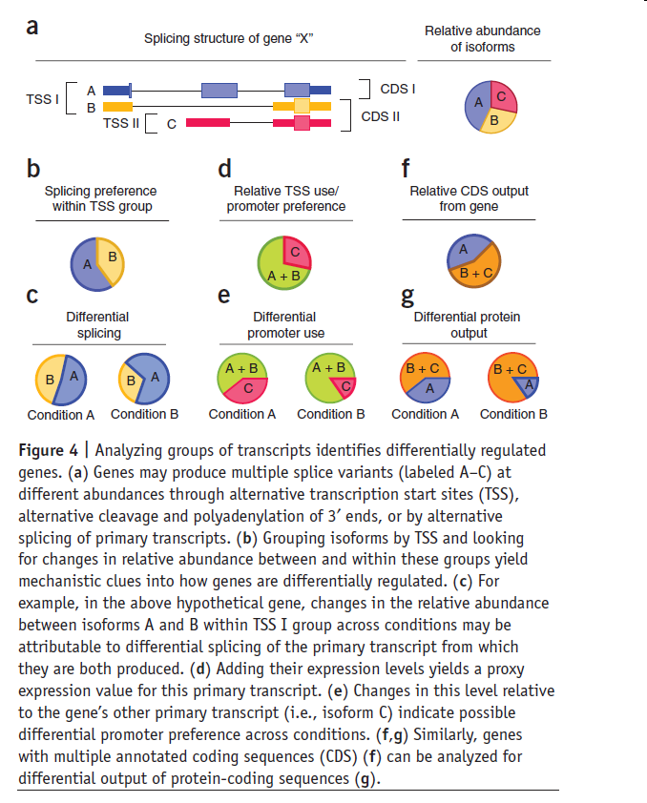

Slide 22
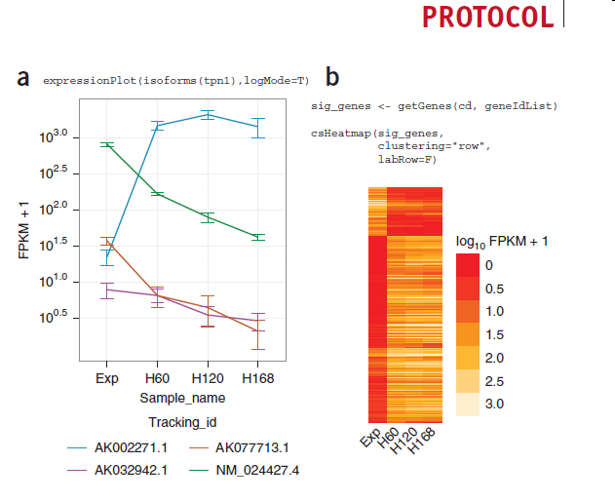

Slide 23
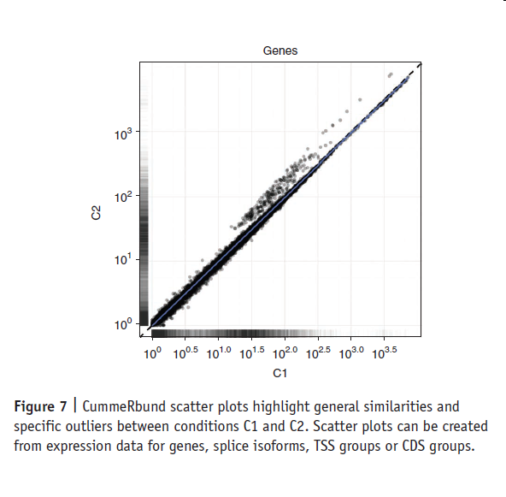
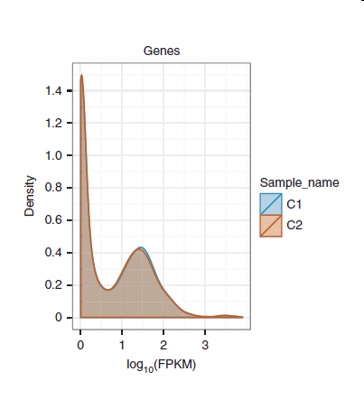

Slide 24
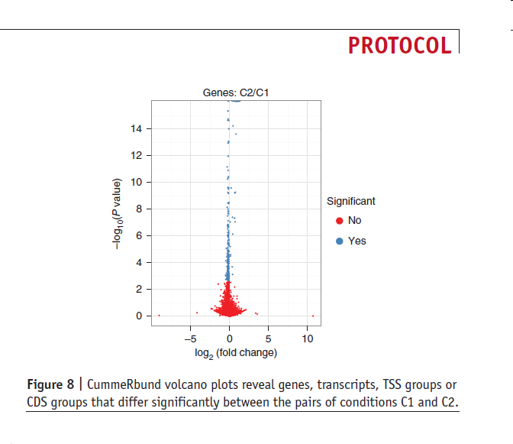

Slide 25
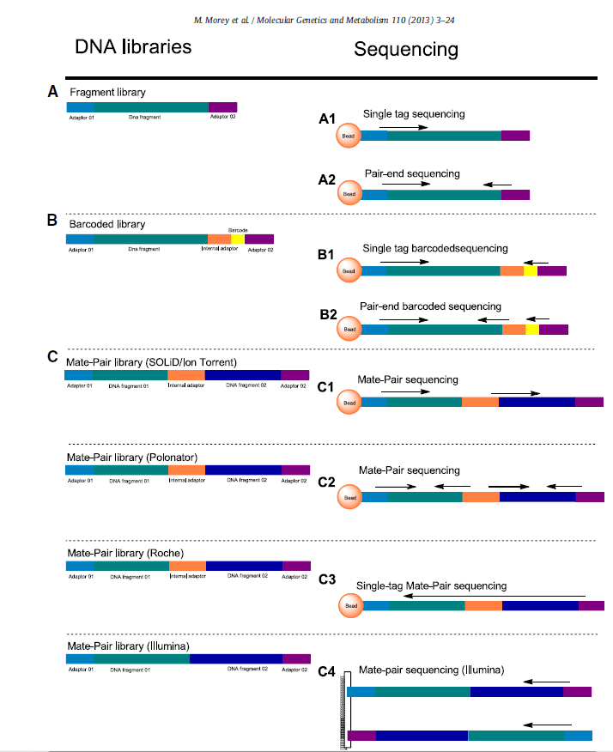

Slide 26
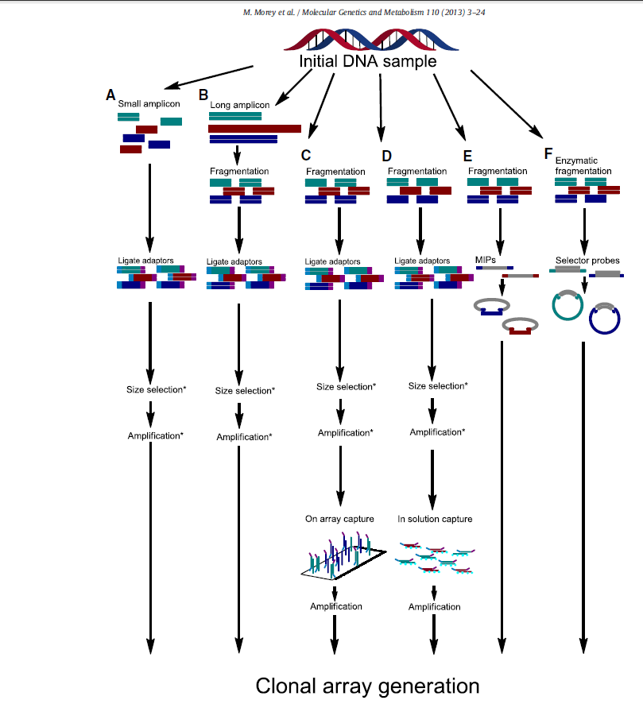

Slide 27
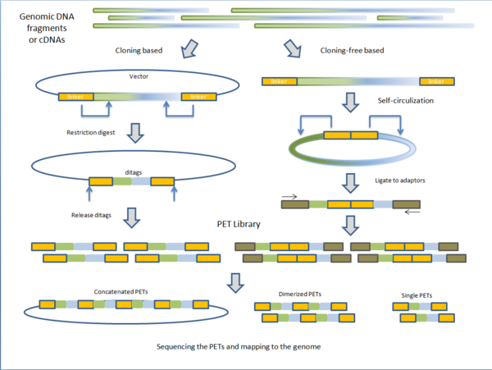

Slide 28
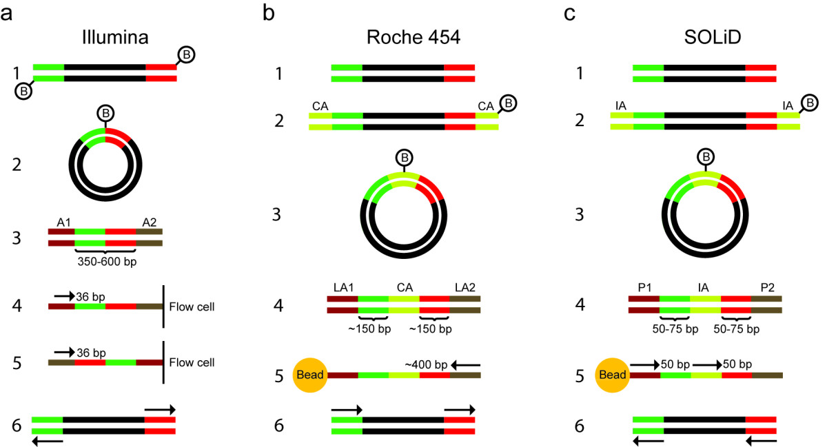

Slide 29
Protocols for RNAseq Libraries
Research article
Comparison of RNA-Seq by poly (A) capture, ribosomal RNA depletion, and DNA microarray for expression profiling
Wei Zhao12, Xiaping He23, Katherine A Hoadley23, Joel S Parker23, David Neil Hayes35 and Charles M Perou1234*
BMC Genomics 2014, 15:419 doi:10.1186/1471-2164-15-419
The electronic version of this article is the complete one and can be found online at:http://www.biomedcentral.com/1471-2164/15/419

Slide 30
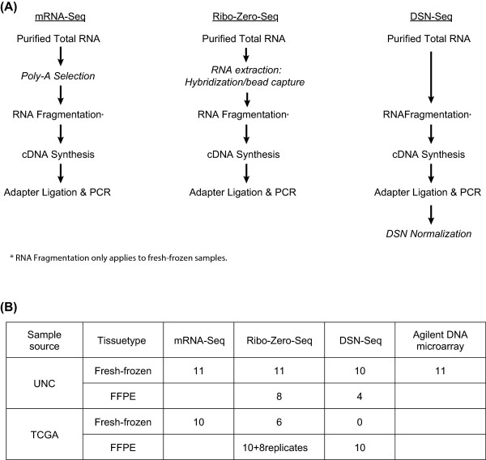

Slide 31
Results
To address the desire to perform RNA-Seq on FFPE materials, we evaluated two different library preparation protocols that could be compatible for use with small RNA fragments. We obtained paired Fresh Frozen (FF) and FFPE RNAs from multiple tumors and subjected these to different gene expression profiling methods. We tested 11 human breast tumor samples using: (a) FF RNAs by microarray, mRNA-Seq, Ribo-Zero-Seq and DSN-Seq (Duplex-Specific Nuclease) and (b) FFPE RNAs by Ribo-Zero-Seq and DSN-Seq. We also performed these different RNA-Seq protocols using 10 TCGA tumors as a validation set.
The data from paired RNA samples showed high concordance in transcript quantification across all protocols and between FF and FFPE RNAs. In both FF and FFPE, Ribo-Zero-Seq removed rRNA with comparable efficiency as mRNA-Seq, and it provided an equivalent or less biased coverage on gene 3′ ends. Compared to mRNA-Seq where 69% of bases were mapped to the transcriptome, DSN-Seq and Ribo-Zero-Seq contained significantly fewer reads mapping to the transcriptome (20-30%); in these RNA-Seq protocols, many if not most reads mapped to intronic regions. Approximately 14 million reads in mRNA-Seq and 45–65 million reads in Ribo-Zero-Seq or DSN-Seq were required to achieve the same gene detection levels as a standard Agilent DNA microarray.

Slide 32
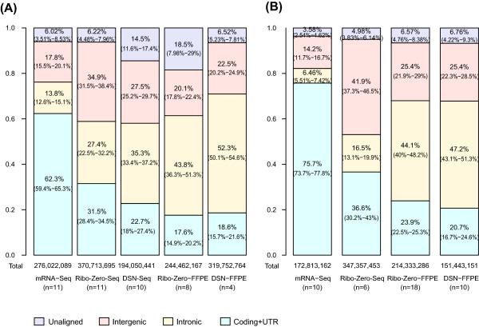
Genome alignment profiles. The percentage of nucleotide bases mapping to three different regions of the genome: exonic/protein coding and UTR (green), intronic (yellow), intergenic (red), and the percentage of unmapped bases (purple). The data is shown separately for the UNC (A) and TCGA (B) datasets.

Slide 33
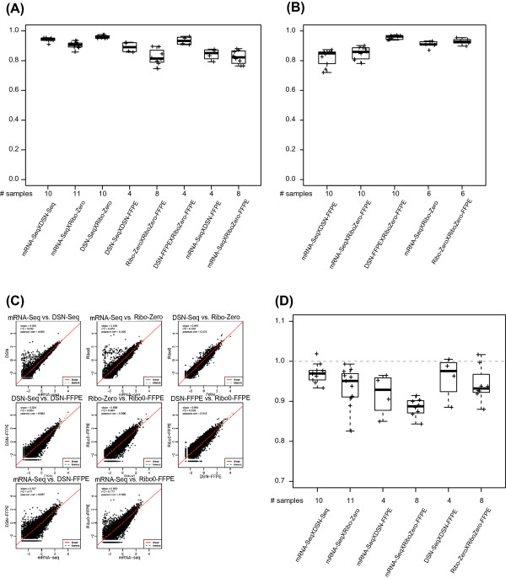
Comparison of gene quantification concordance across RNA-Seq library protocols. Pearson correlation coefficients of RNA-Seq libraries pairs in (A) UNC and (B) TCGA dataset. (C) Scatter plots of libraries of each pair of protocols for breast tumor sample 020578B. (D)Deming regression slope for pairs of RNA-Seq libraries in UNC dataset. A slope of 1 indicates the equivalent sensitivity of the two libraries, whereas a smaller value is indicative of a higher sensitivity of the first term/method in the pair.

Slide 34
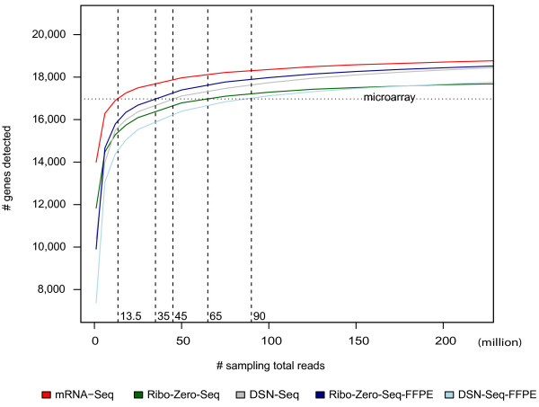

Slide 35
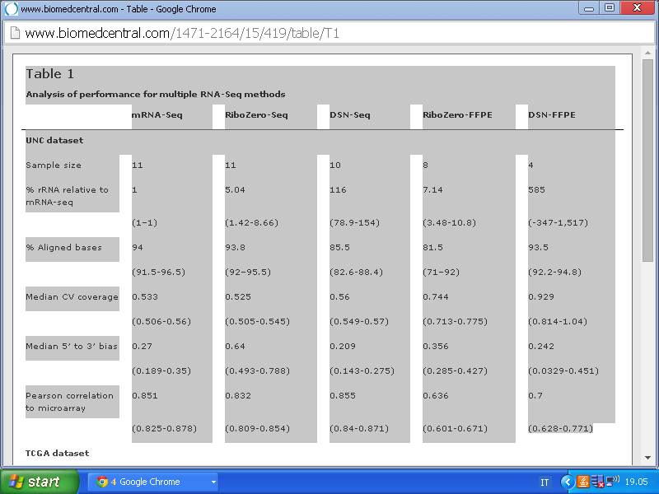

Slide 36
Conclusions
Our results demonstrate that compared to mRNA-Seq and microarrays, Ribo-Zero-Seq provides equivalent rRNA removal efficiency, coverage uniformity, genome-based mapped reads, and consistently high quality quantification of transcripts. Moreover, Ribo-Zero-Seq and DSN-Seq have consistent transcript quantification using FFPE RNAs, suggesting that RNA-Seq can be used with FFPE-derived RNAs for gene expression profiling.

Slide 37
In this study, we demonstrated that compared to mRNA-Seq, Ribo-Zero-Seq provides equivalent rRNA removal efficiency, coverage uniformity, genome-based mapped reads, and reduces 5′- to- 3′ bias. In addition, both Ribo-Zero-Seq and DSN-Seq provide highly consistent quantification of transcripts when compared to microarrays or mRNA-Seq, and substantially more information on non-poly(A) RNA. Moreover, the two rRNA depletion methods have consistent transcript quantification using FFPE RNAs and show high reproducibility.

Slide 43
Quando ci sono isoforme multiple di splicing molte reads saranno mappate ad un esone comune.
Cufflinks e Cuffdiff implementano un modello statistico lineare per stimare l’assegnazione di abbondanza ad ogni trascritto che spiega le reads osservate con la massima probabilità.
Siccome i due software calcolano il livello di espressione di ogni variante di splicing, calcolare il livello di espressione del gene è facile: si sommano semplicemente i livelli di tutte le varianti.
Questo è possibile perché FPKM è direttamente proporzionale all’abbondanza. Infatti il livello di espressione di ogni gruppo di trascritti (che partono dallo stesso TSS) può venire calcolato sommando i livelli dei membri del gruppo.

Slide 44
Quantificazione Trascritti
Se B è lungo 2 volte A, una RNAseq library conterrà in media 2 volte più trascritti di B.
Cufflinks conta i reads che mappano in ogni trascritto e poi li normalizza alla lunghezza.
In modo simile, due run della stessa libreria potrebbero produrre differenti volumi di reads.
Le conte devono quindi venir normalizzate alle reads totali.
FRAGMENTS/KILOBASE/MILION MAPPED FRAGMENTS
FPKM noto anche come RPKM (READS/PER KILOBASE per MILION)
in esperimenti single end

Slide 46
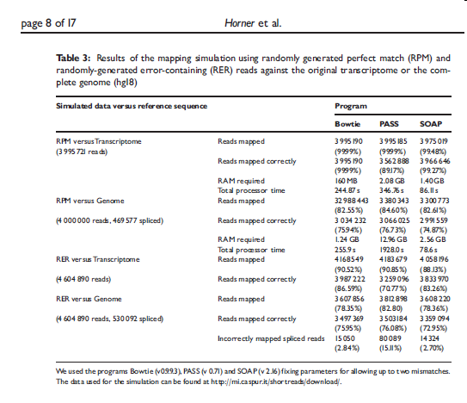

Slide 58
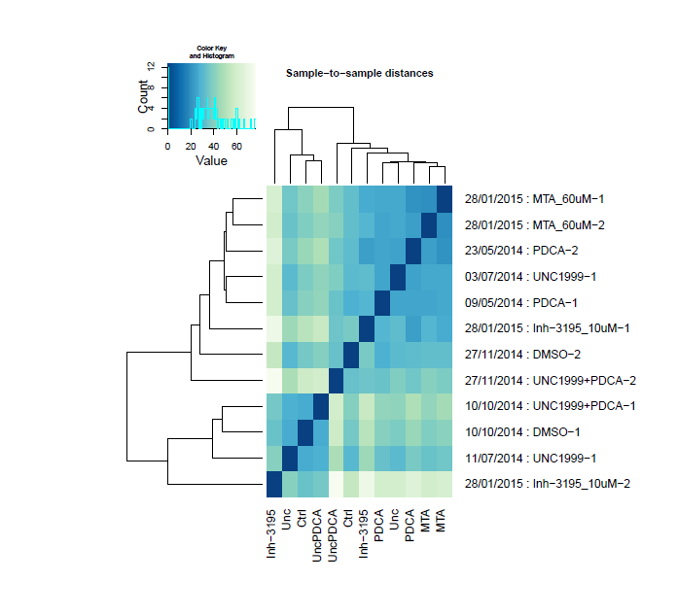
Quality control

Slide 59
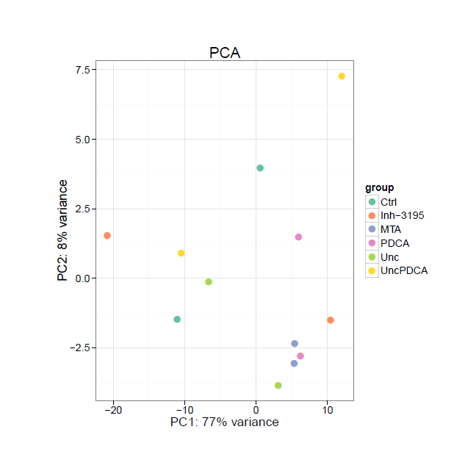

Slide 60
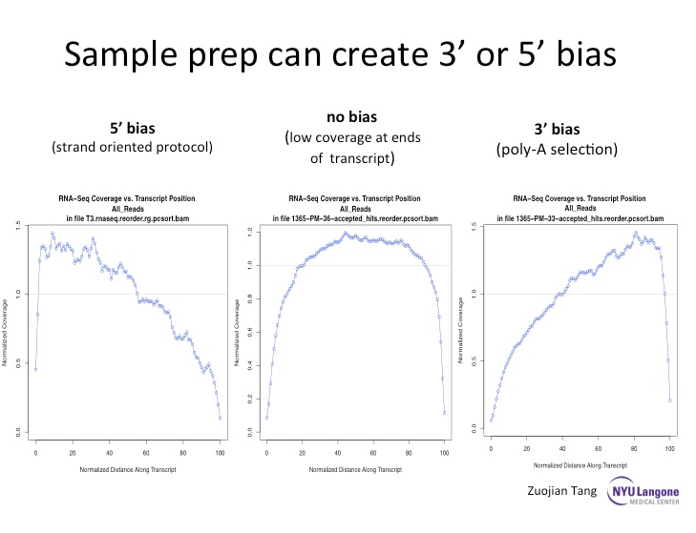

Slide 63
Cap analysis of Gene Expression (CAGE)
One of the
first high-throughput TSS mapping methods wasthe cap analysis of gene expression (CAGe) approach, which was initially developed for Sanger sequencing Sequencing of cloned cDNA products from RNAs with intact 5′ ends (for example,containing a 5′ cap structure). Although useful, the technology required high quantities of input RNA and generated only short reads (~20 nucleotides) per TSS.
Carninci, P. et al. Genome-wide analysis of mammalian promoter architecture and evolution. Nature Genet. 38, 626–635 (2006).
Shiraki, T. et al. Cap analysis gene expression for high throughput analysis of transcriptional starting point and identification of promoter usage. Proc. Natl Acad.Sci. USA 100, 15776–15781 (2003).

Slide 64
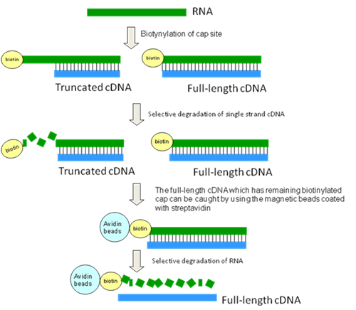
CAP trapping

Slide 65
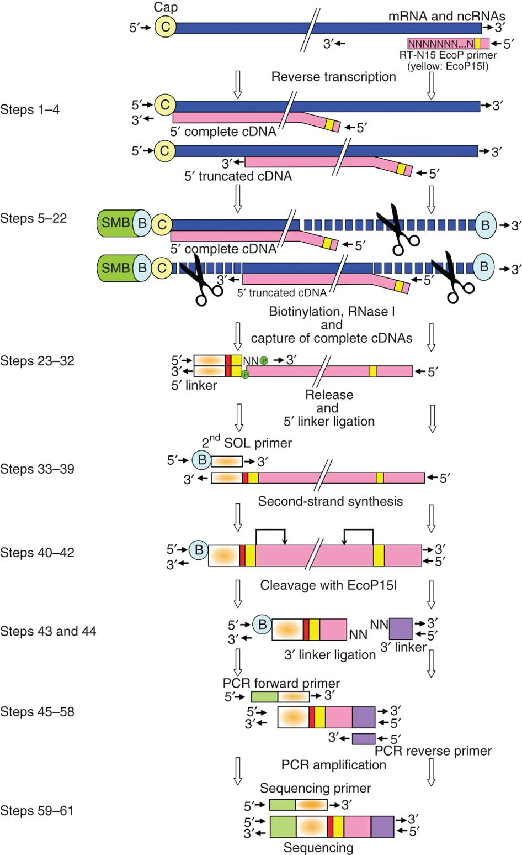

Slide 66
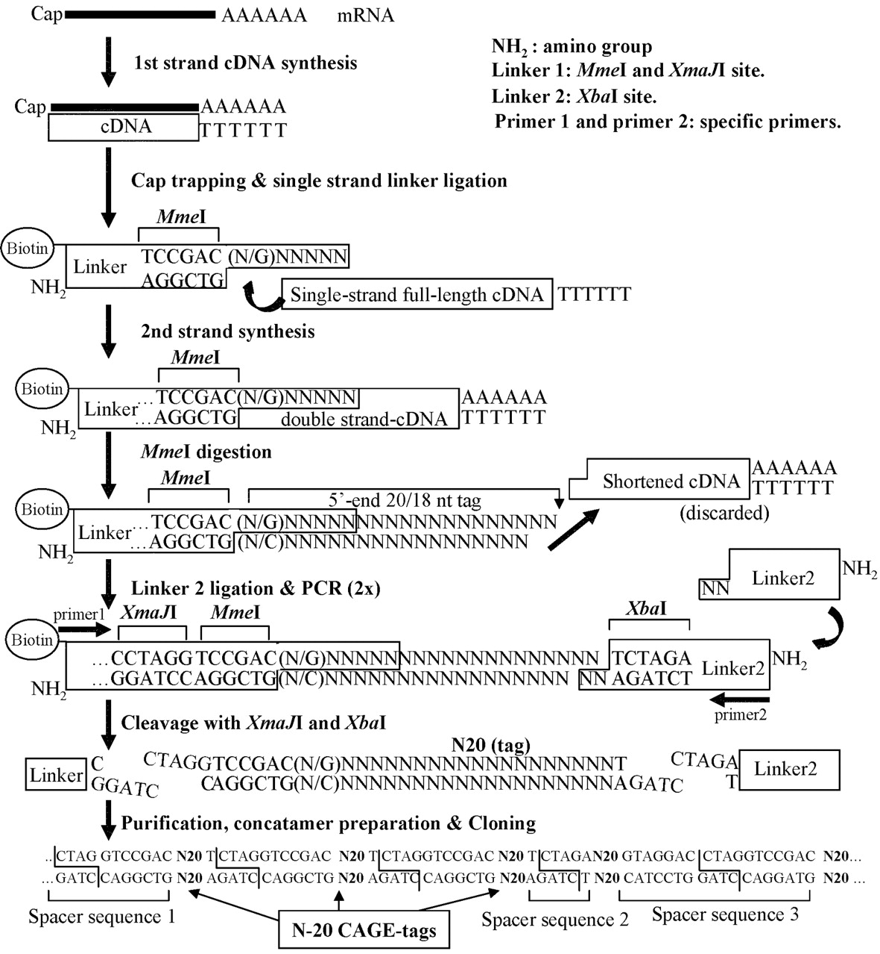

Slide 67
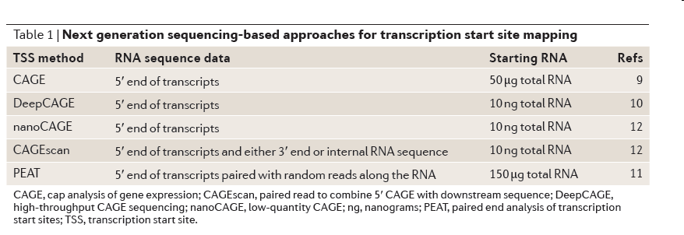
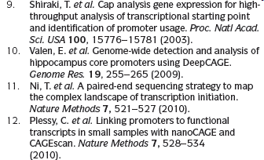
Cap analysis of Gene Expression (CAGE)
Amplification distorts frequency
assesment? (SPIKE in)
Short life discrimination?
(combine with chromatin based
TSS prediction)

Slide 68
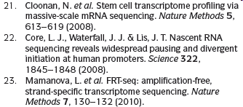
Strand specific RNA-seq
Pervasive presence of antisense transcription
Standard approach requires DS cDNA synthesis which erases DNA strand info
Spourious second strand synthesis by DNA-dependent-DNA polymerase activity DDDP
Solution: Actinomycin D to reduce DDDP (effectiveness? Additional artifacts?)
Protocols:
Ligation of adaptors in predetermined orientation to the ends of RNA or first-strand
cDNA molecules. Orientation of the adaptors are reference for RNA strand info.
b) Direct sequencing of first strand cDNA
c) Chemical marking of the second strand cDNA

Slide 69
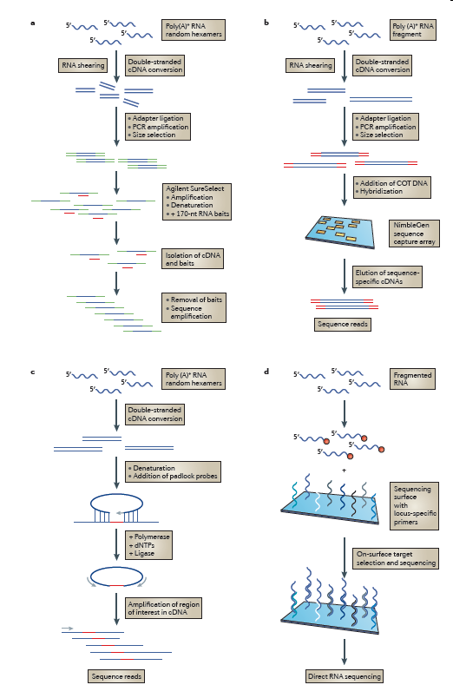
Targeted approaches of RNA-seq
A: Using polyA+ RNA converted to
DS cDNA the Agilent SureSelect
Method uses RNA probes to enrich
Selected cDNAs
B: Custom NibleGen arrays for selecting
cDNAs of interest
C: The generation of DNA molecules with
Sequence-specific complementary
Target sites allows targeting of cDNAs
D: Helicos sequencing surfaces
Containing target-specific oligos
To select desired RNA, DNA and cDNA
Species and sequence regions of interest

Slide 70
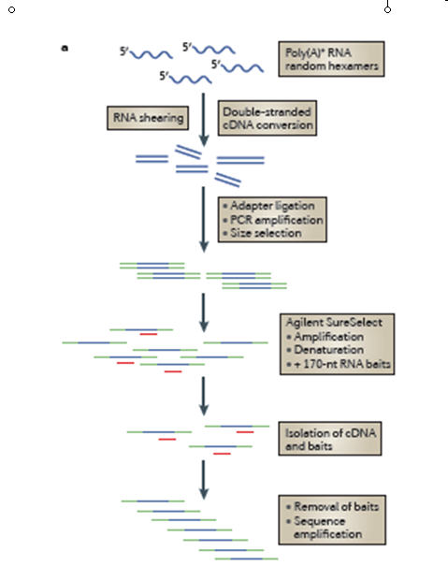

Slide 71
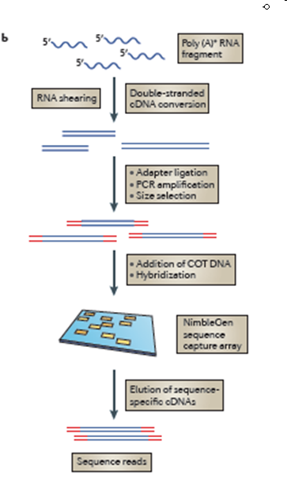

Slide 72
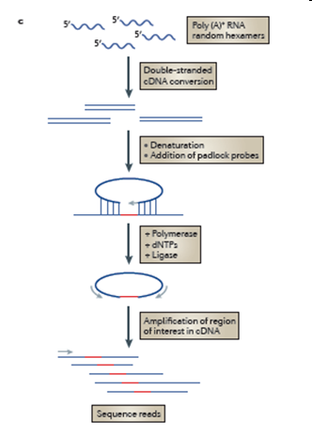

Slide 73
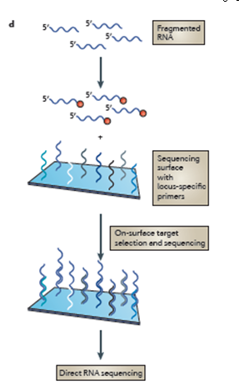

Slide 74
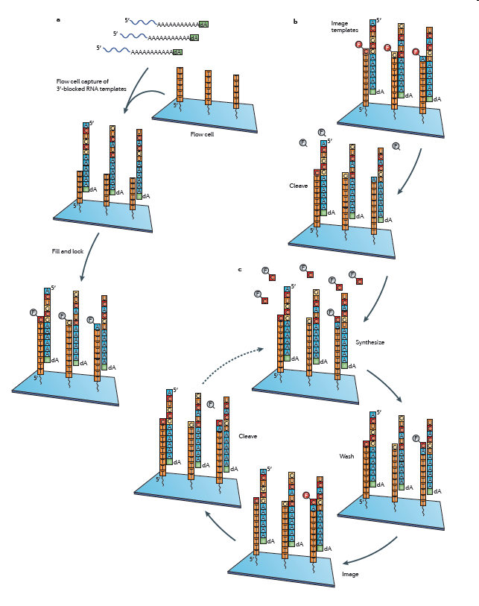
Helicos DRS eliminates
cDNA synthesis and
Requires only few fmoles
RNA containing natural poli-A tails
Can be conbined with microfluidic
cababilities

Slide 75
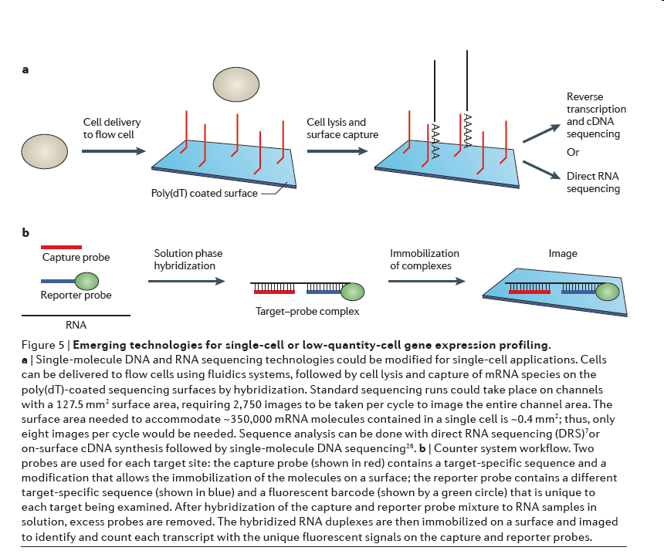

Slide 76
Limited RNA quantity
Ligation Mediated PCR (LMPCR)
Pfeifer, G. P., Steigerwald, S. D., Mueller, P. R., Wold, B. & Riggs, A. D. Genomic sequencing and methylation analysis by ligation mediated PCR. Science 246, 810–813 (1989).
Multiple Displacement Amplification (MDA)
Dean, F. B. et al. Comprehensive human genome amplification using multiple displacement amplification. Proc. Natl Acad. Sci. USA 99, 5261–5266 (2002).
Single-primer isothermal amplification
Dafforn, A. et al. Linear mRNA amplification from as little as 5 ng total RNA for global gene expressionanalysis. Biotechniques 37, 854–857 (2004).
In vitro transcription-based linear amplification (IVT)
Eberwine, J. et al. Analysis of gene expression in single live neurons. Proc. Natl Acad. Sci. USA 89, 3010–3014 (1992).

