Slide 1
Lezione 4: filtri statistici per dati di trascrittomica con microarrays a DNA

Slide 2
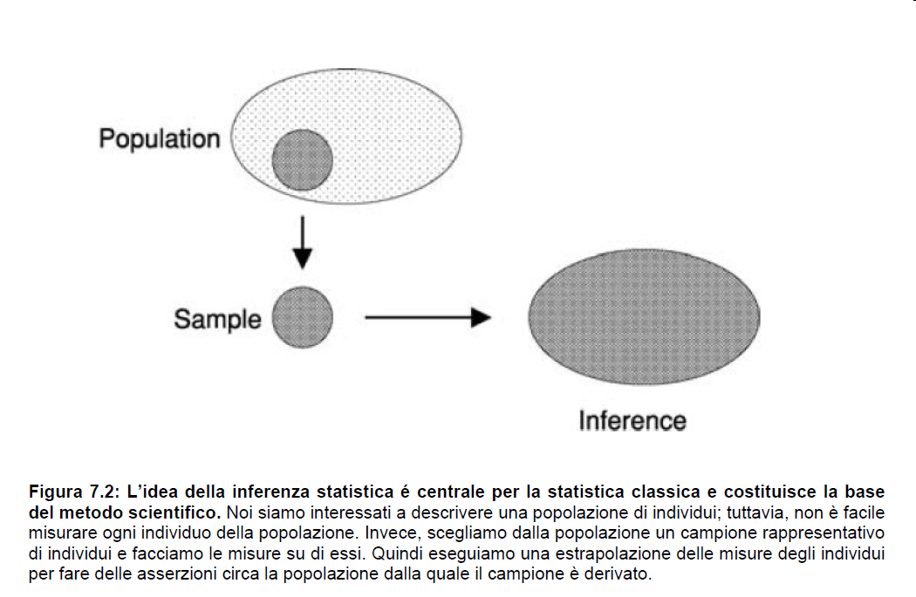


Slide 3
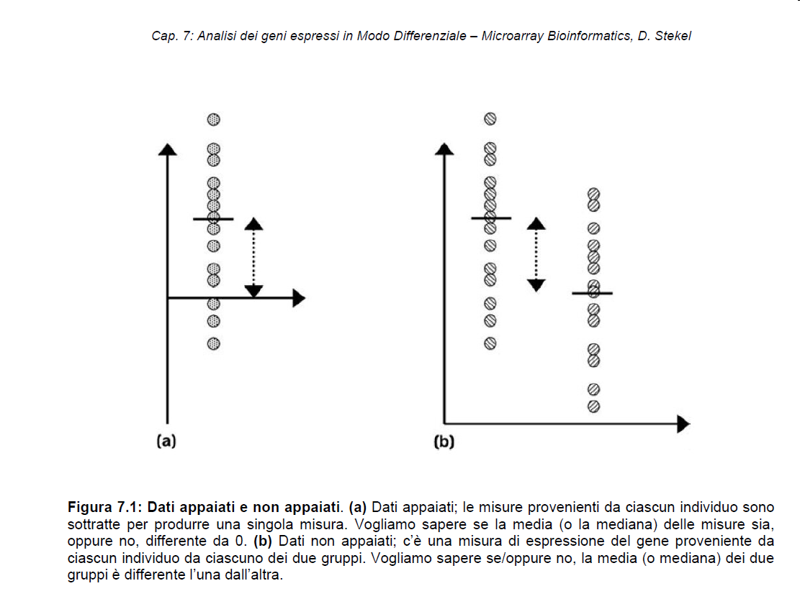
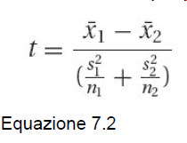
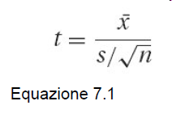

Slide 4
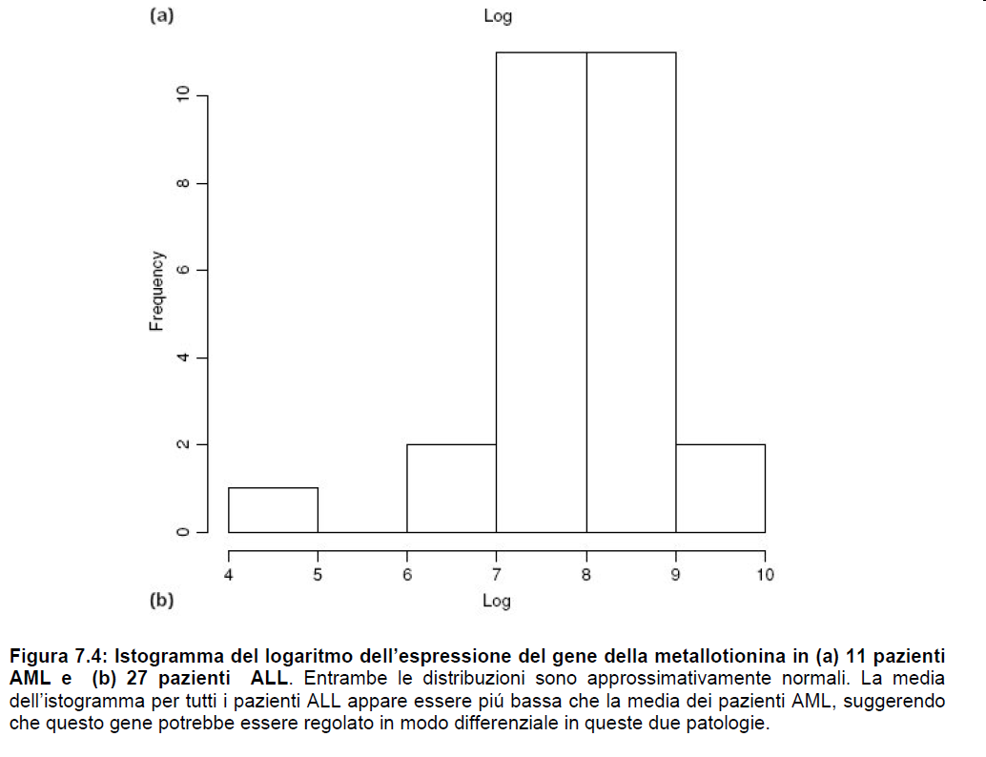

Slide 5
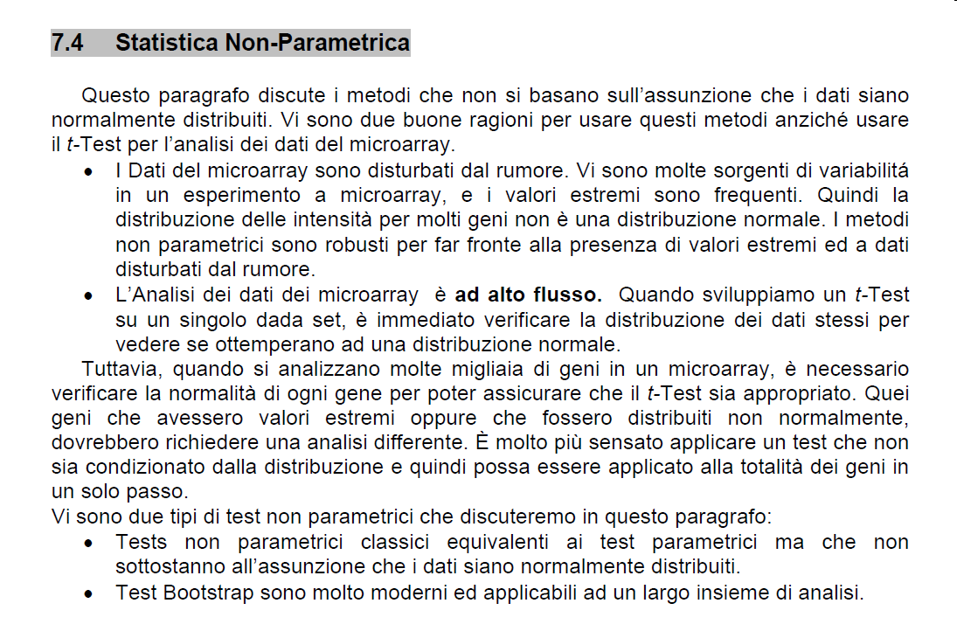

Slide 6
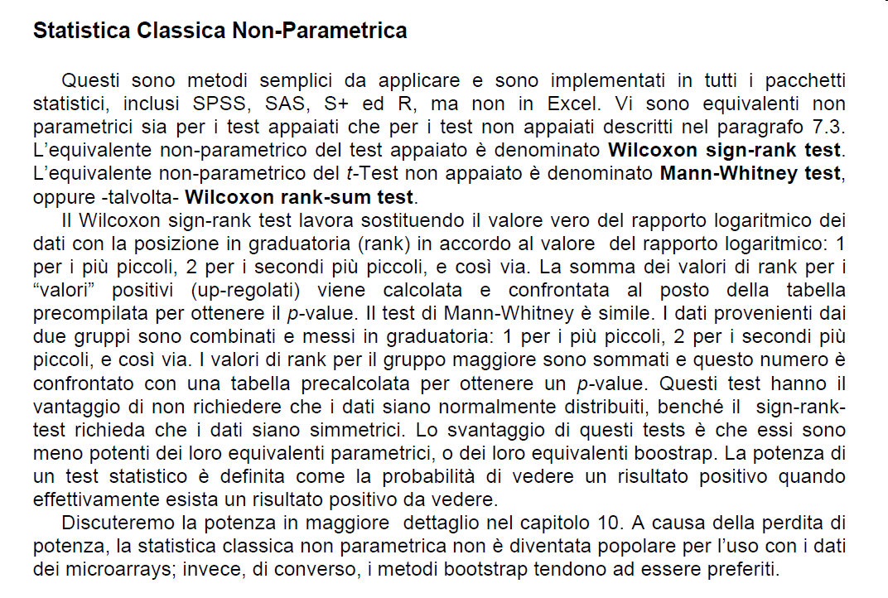

Slide 7
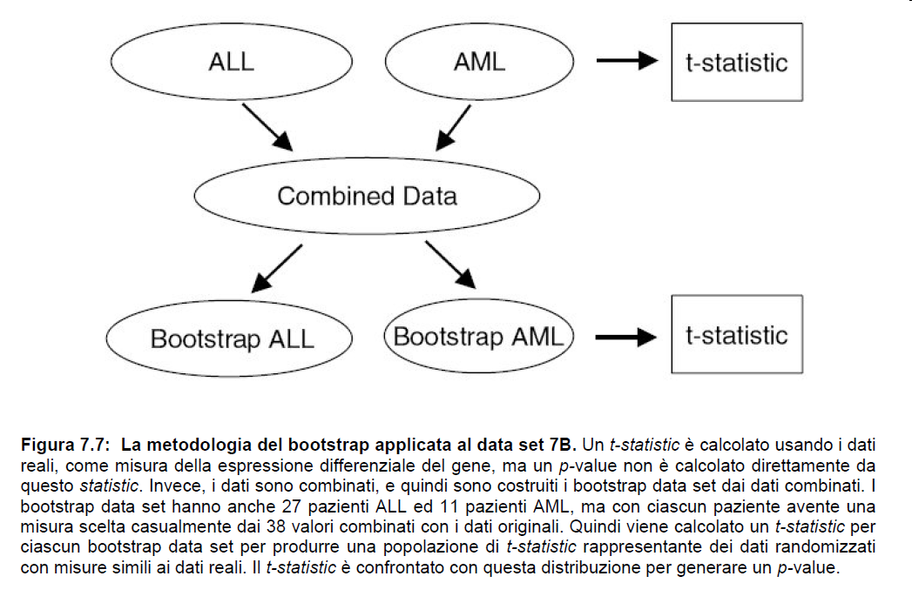

Slide 8
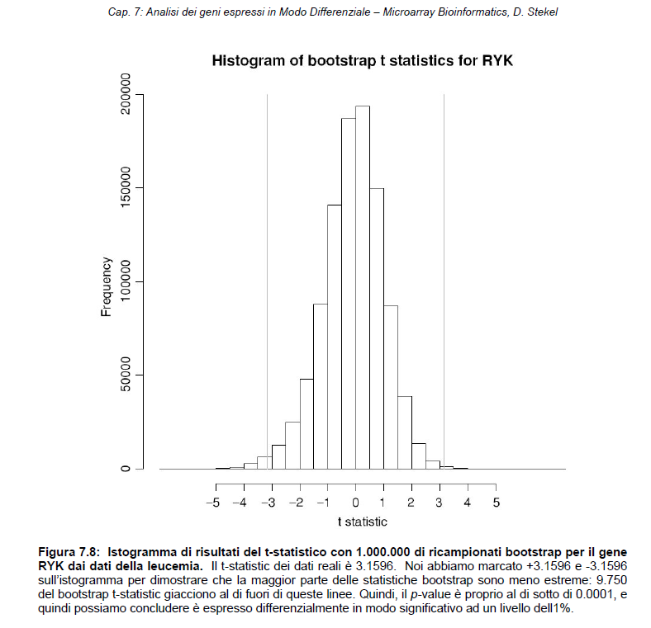

Slide 9
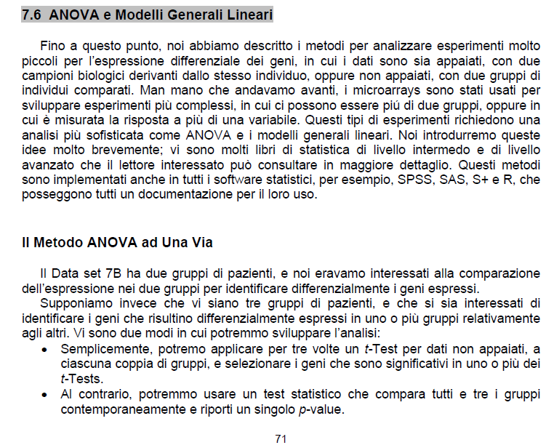

Slide 10
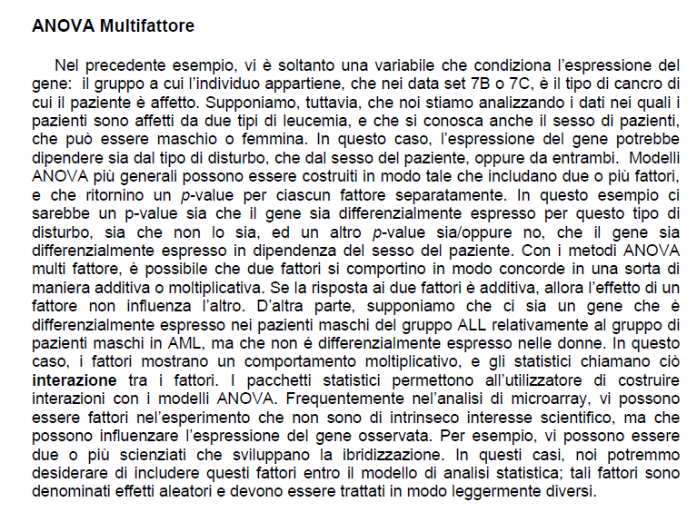

Slide 11
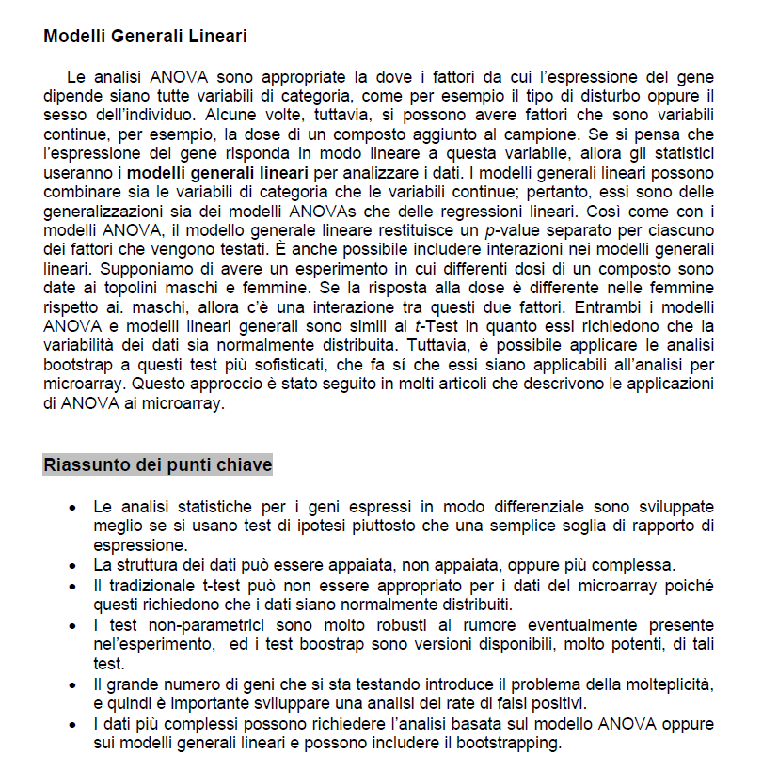

Slide 12

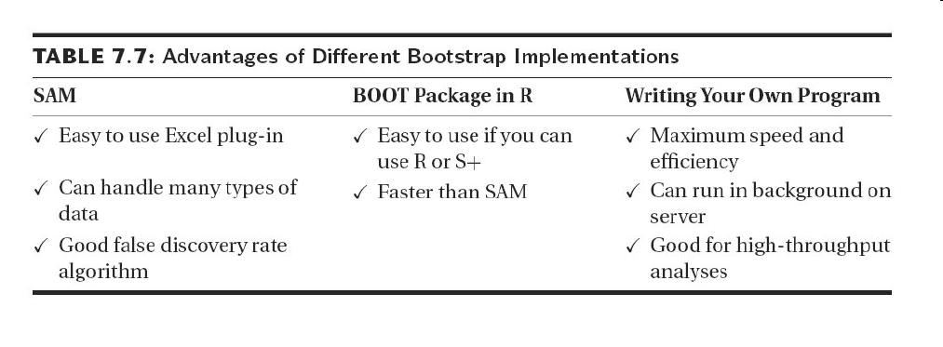

Slide 13
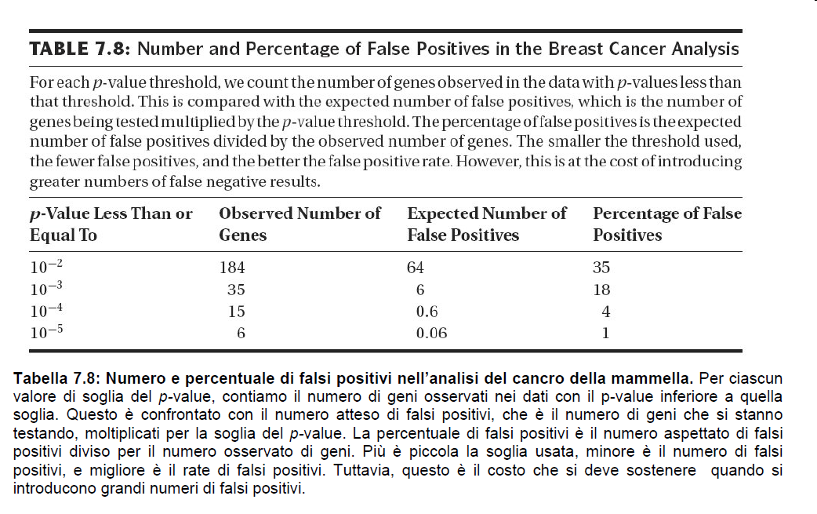

Slide 14
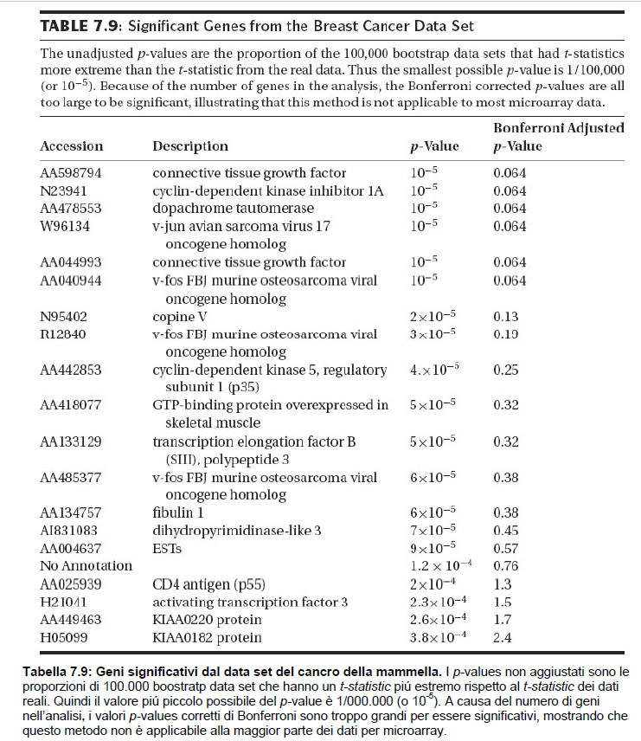

Slide 15
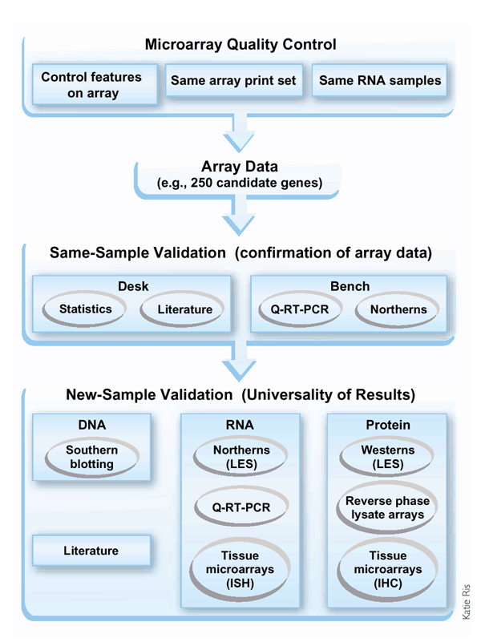

Slide 16
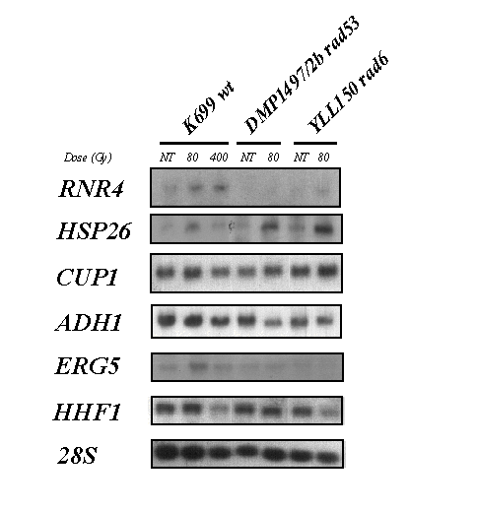








DMP1497/2b rad53
K699 wt
YLL150 rad6
NT
80
400
NT
80
NT
80
TTR1
RNR2
RNR3
RNR4
HSP26
CUP1
ADH1
ERG5
HHF1
28S

Slide 17


Slide 18

NT
0
15'
30'
1h
2h
4h
CUP1

Slide 19
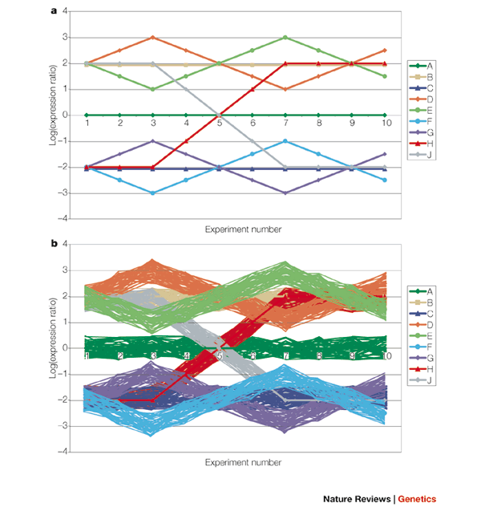
Gene Clustering:
To group genes which show the same modulation trend in function of a variable (time, dose, stage of development, etc.).

