Slide 1
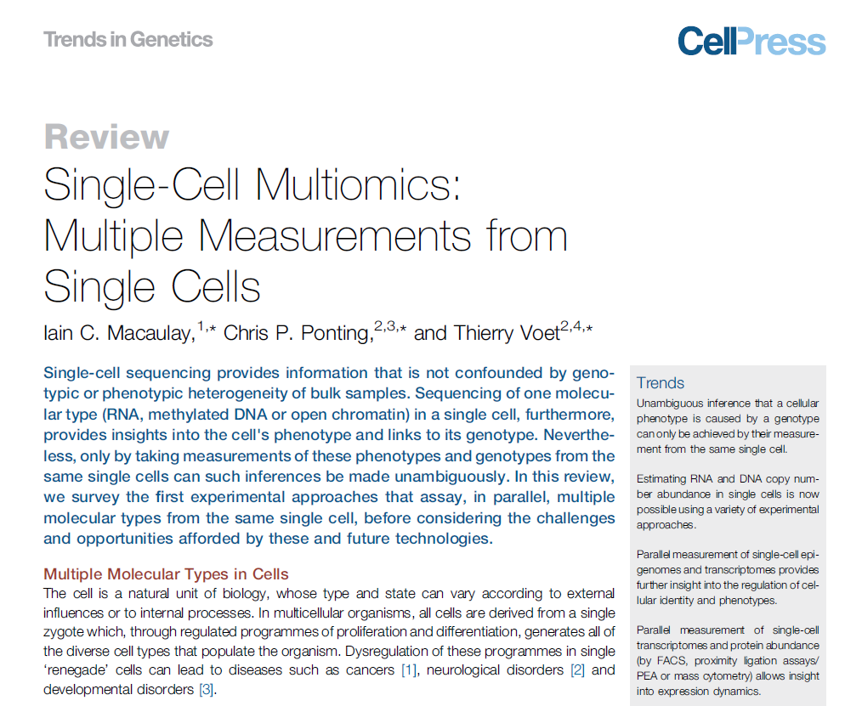

Slide 2
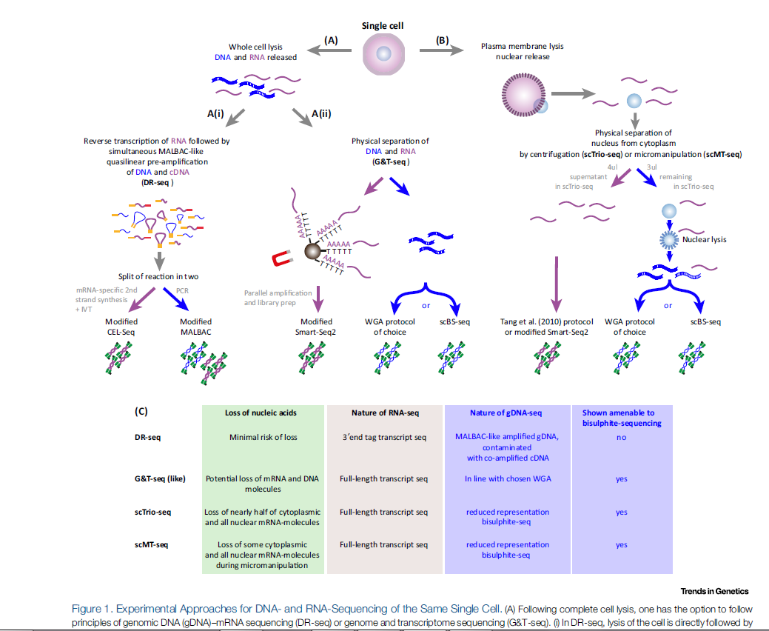

Slide 3
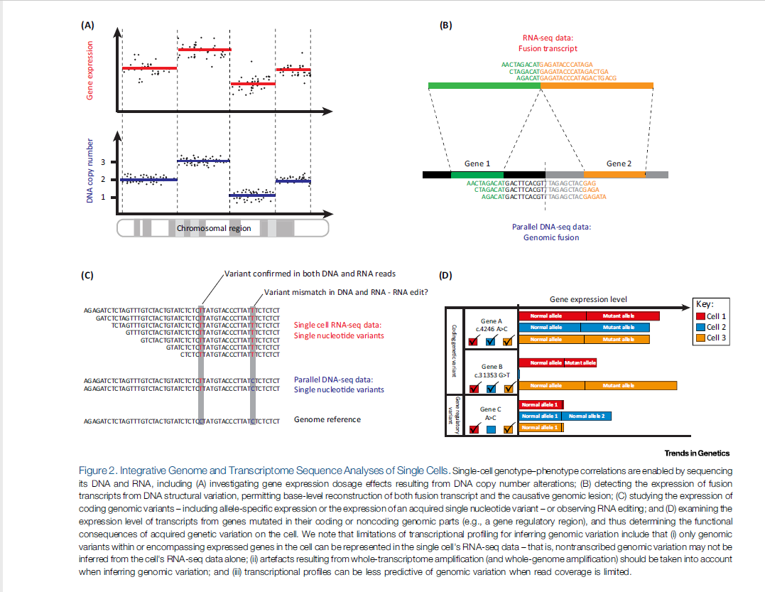

Slide 4
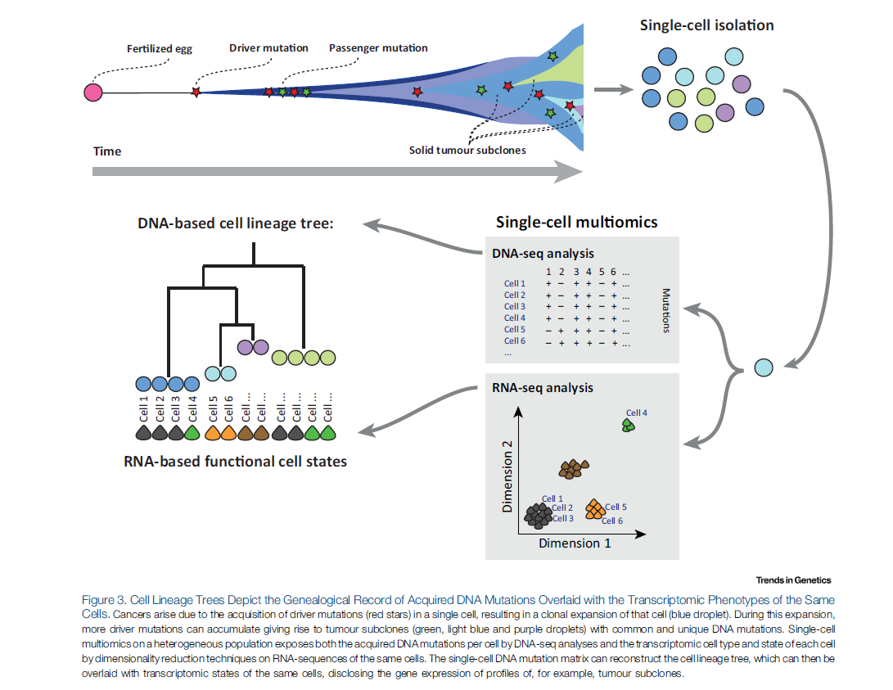

Slide 5
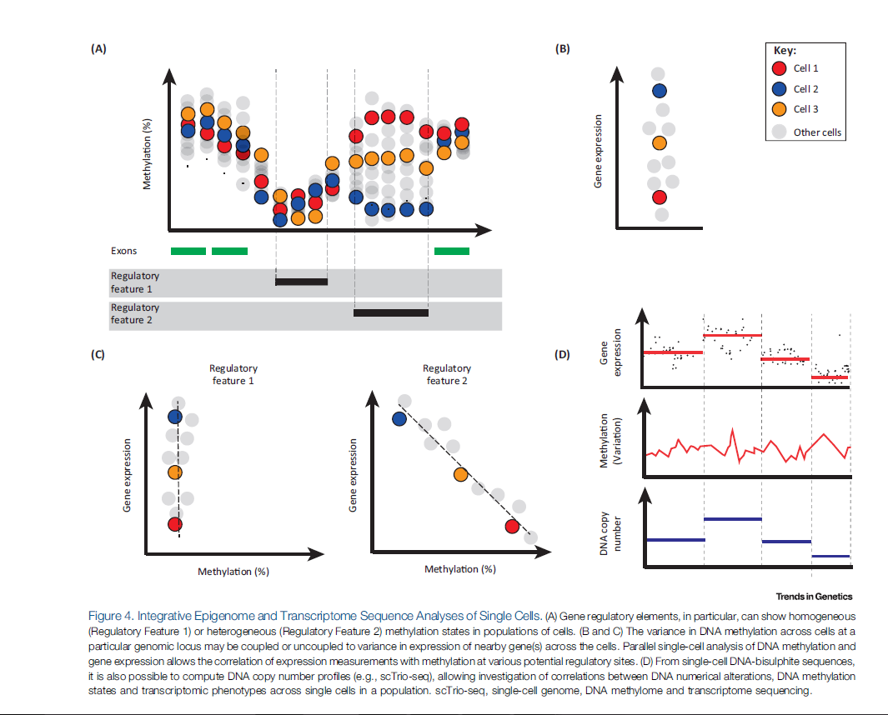

Slide 6
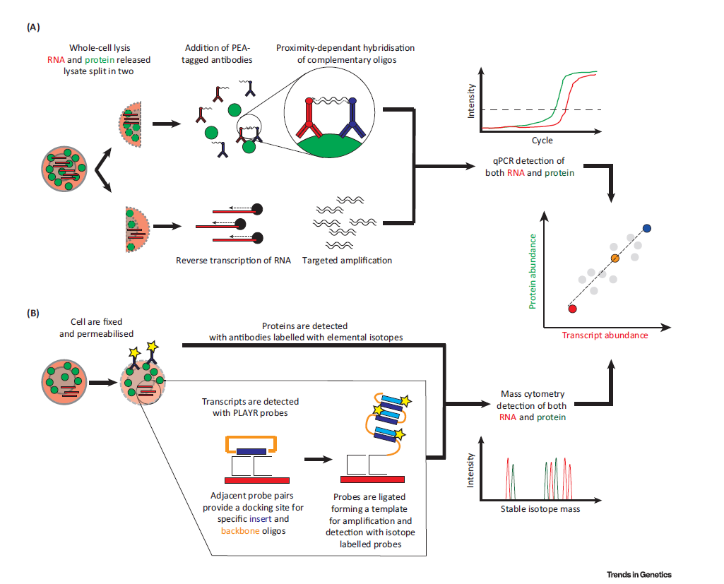

Slide 7
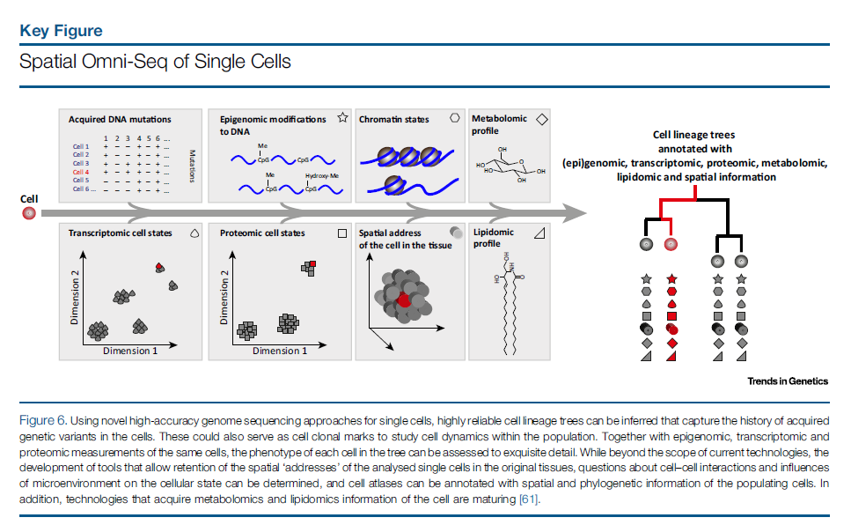

Slide 8
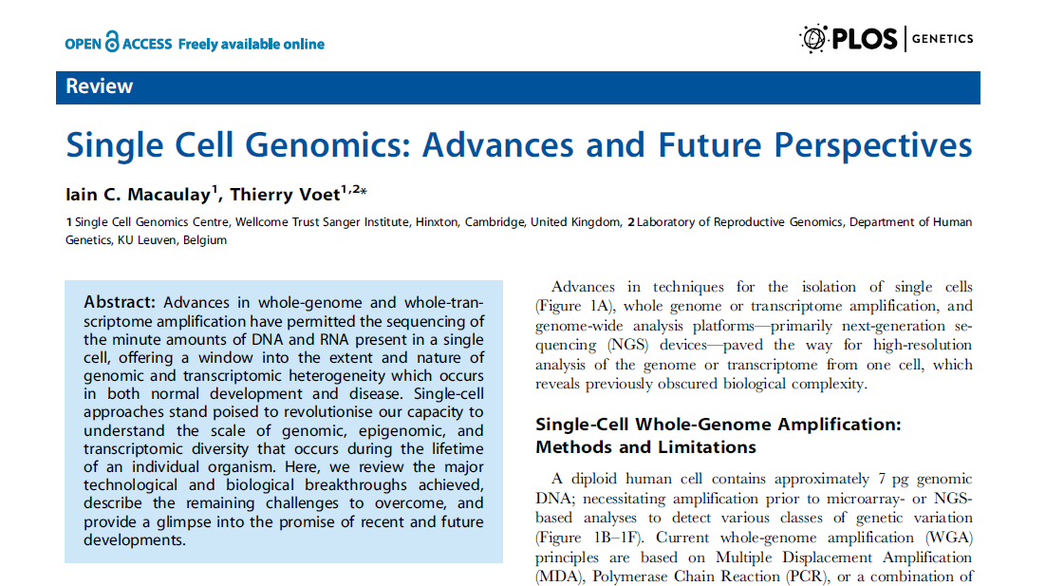

Slide 9
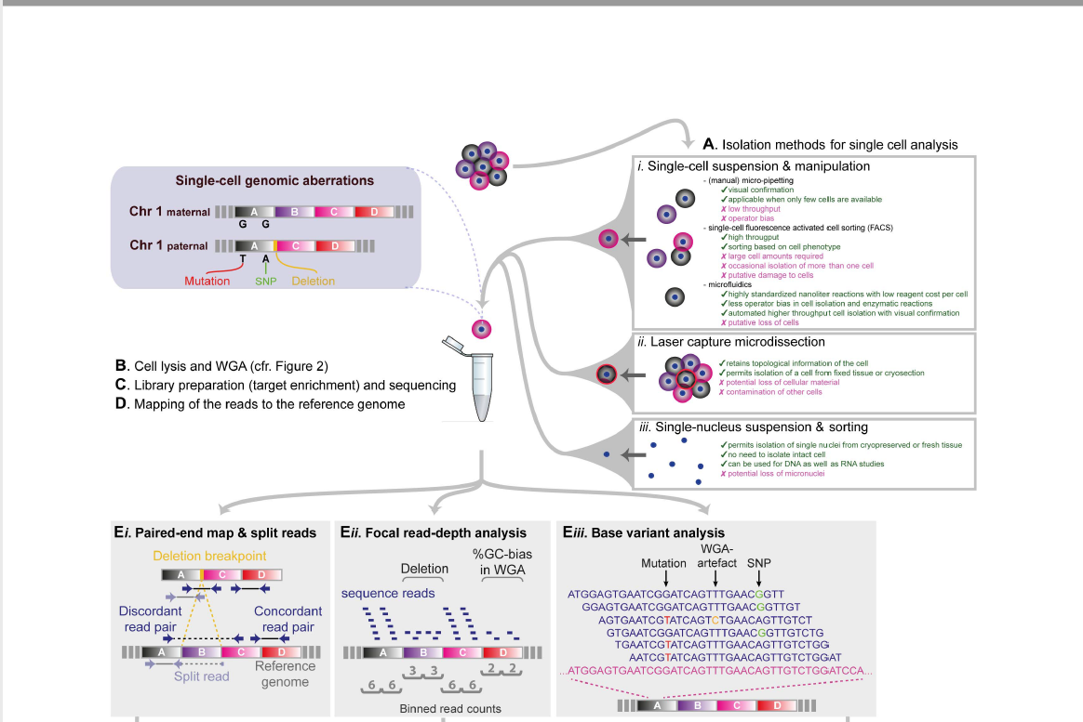

Slide 10
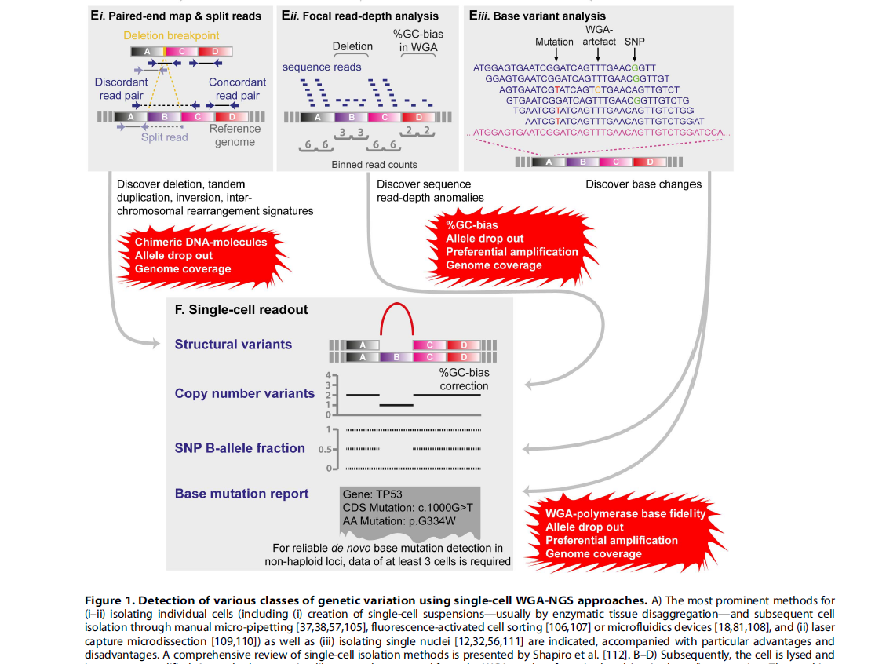

Slide 11
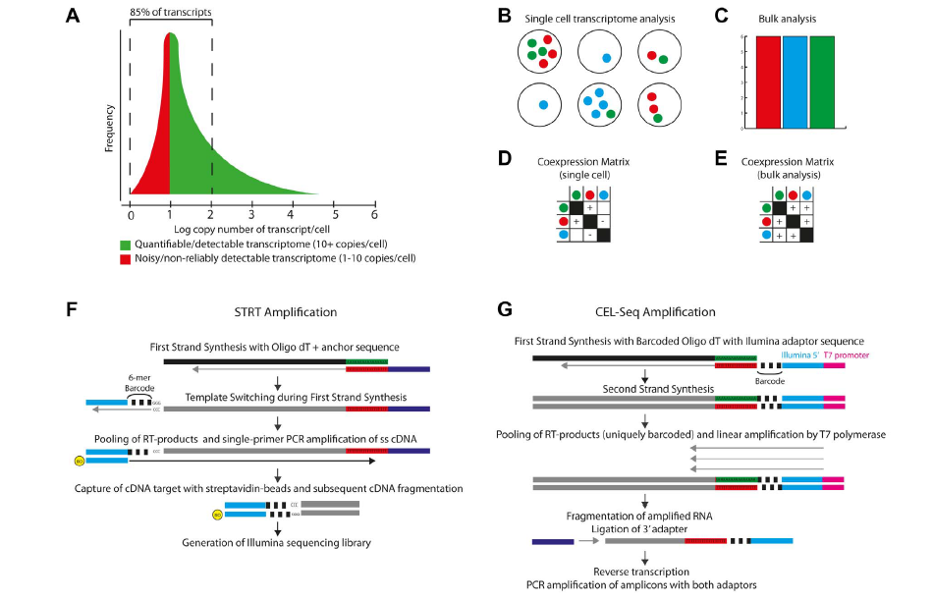

Slide 12
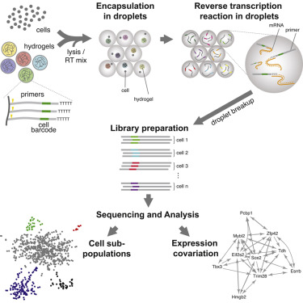

Slide 13
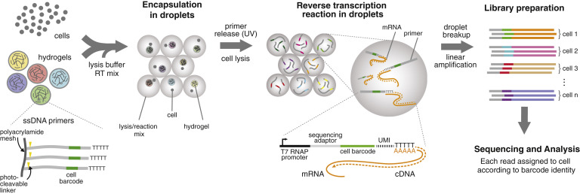

Slide 14
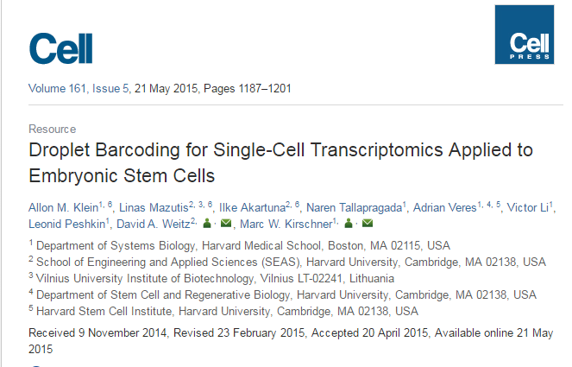
Summary
It has long been the dream of biologists to map gene expression at the single-cell level. With such data one might track heterogeneous cell sub-populations, and infer regulatory relationships between genes and pathways. Recently, RNA sequencing has achieved single-cell resolution. What is limiting is an effective way to routinely isolate and process large numbers of individual cells for quantitative in-depth sequencing. We have developed a high-throughput droplet-microfluidic approach for barcoding the RNA from thousands of individual cells for subsequent analysis by next-generation sequencing. The method shows a surprisingly low noise profile and is readily adaptable to other sequencing-based assays. We analyzed mouse embryonic stem cells, revealing in detail the population structure and the heterogeneous onset of differentiation after leukemia inhibitory factor (LIF) withdrawal. The reproducibility of these high-throughput single-cell data allowed us to deconstruct cell populations and infer gene expression relationships.

Slide 15
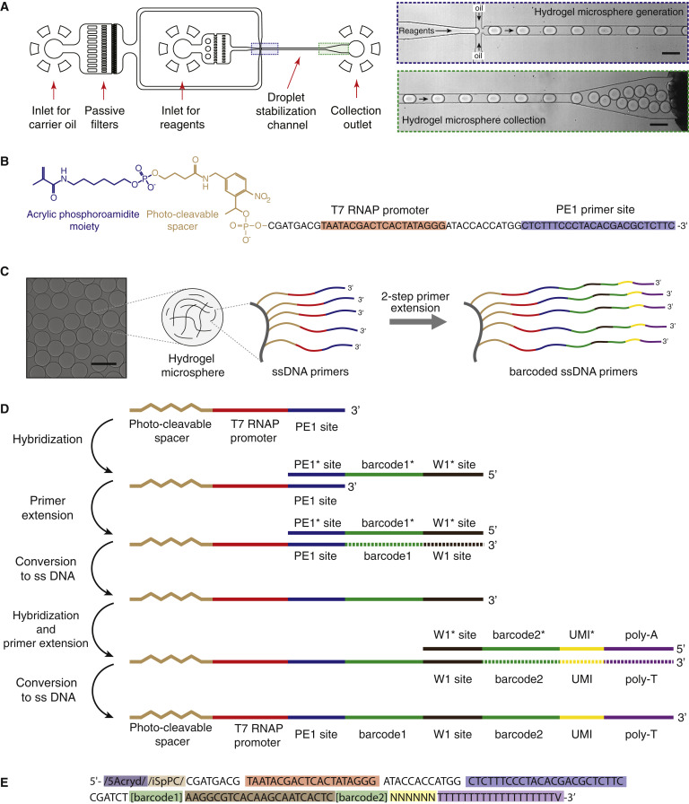

Slide 16
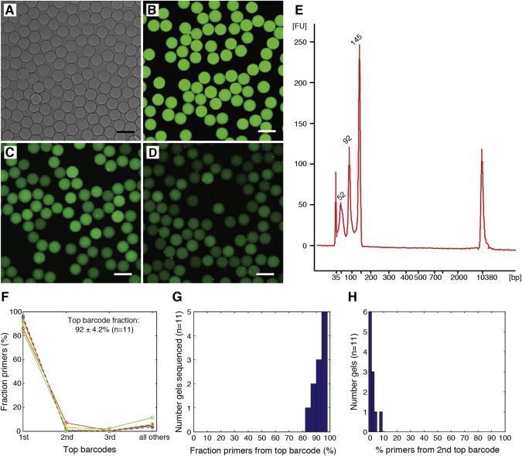

Slide 17
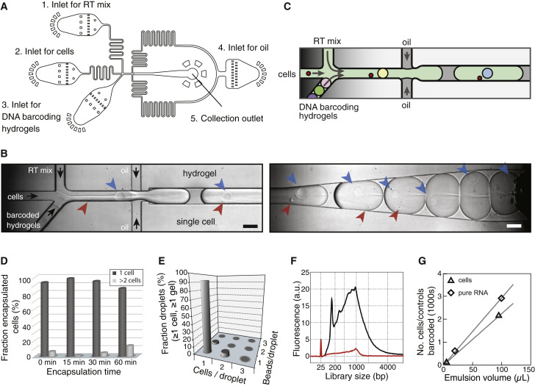

Slide 18
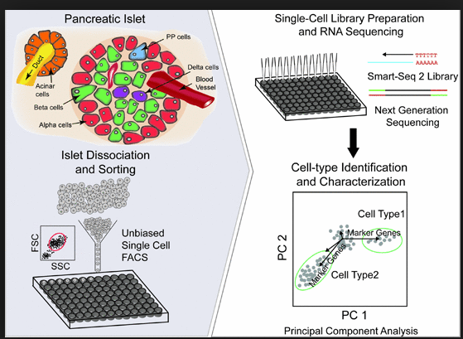
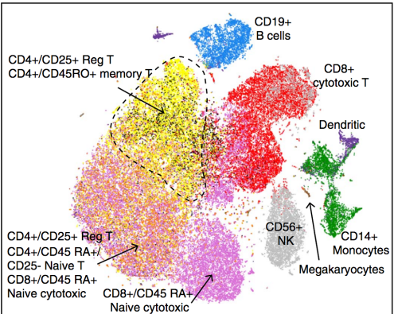

Slide 20
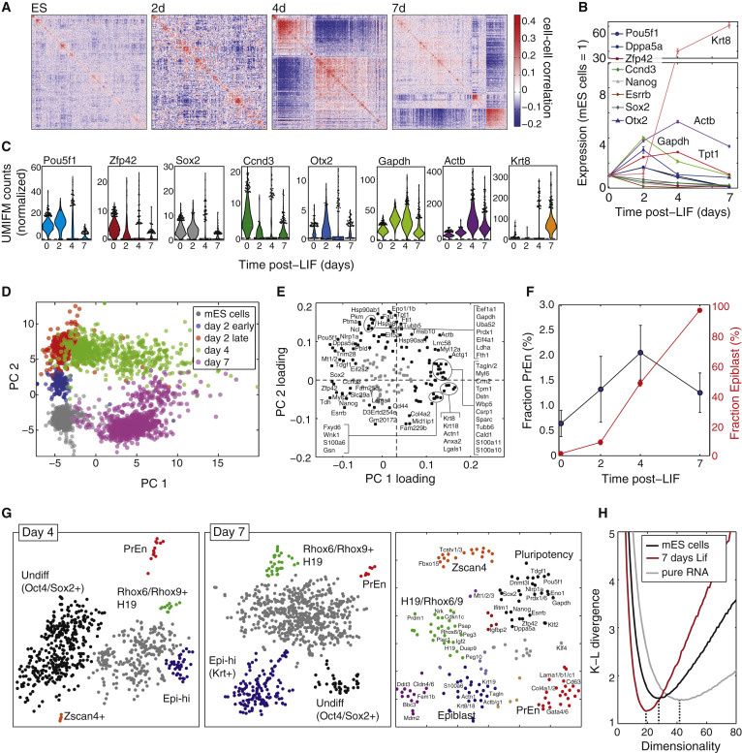

Slide 23
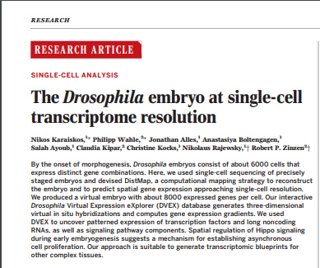

Slide 24
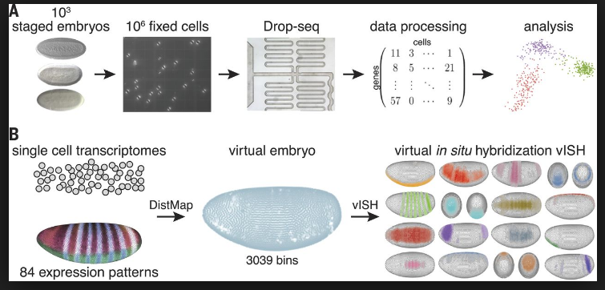

Slide 25
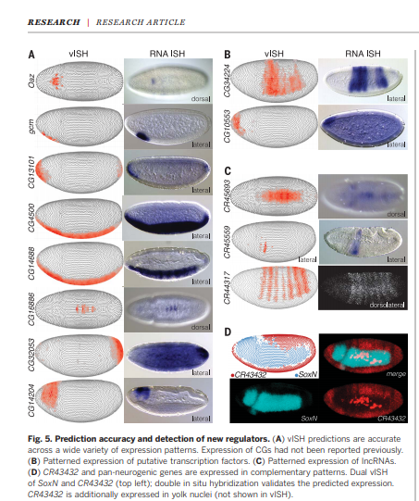

Slide 26
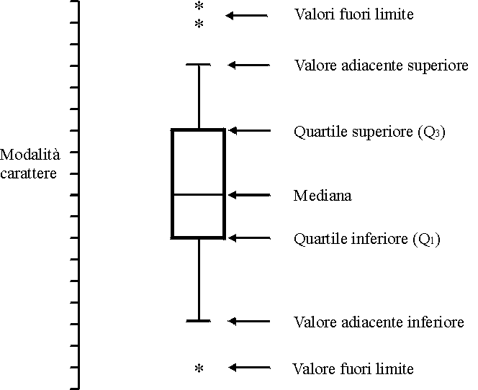

Slide 27
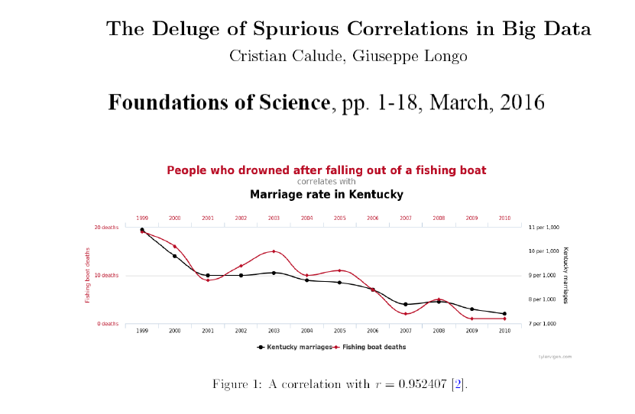

Slide 29
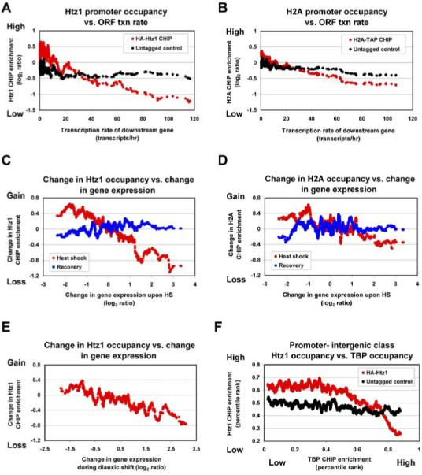

Slide 31
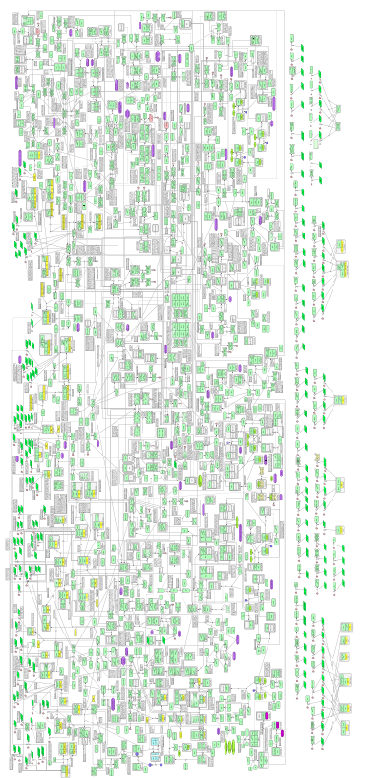
Wiring diagram of the cell cycle network
Kaizu et al, Mol Sys Biol, 2010

Slide 32
If we could develop a model of this wiring:
- We could explain the systems level properties
- We could predict the behavior of the cell on a pc
- We could understand when a molecule is missing
- We could simulate the effect of drugs
- ....

Slide 33
The law of mass action allows us to develop models of molecular networks
Variables are concentrations.
Parameters are rate constants.
Equations can express the time course of protein concentrations.
k_{syn}
k_{deg}
A
Rate of A production=production-degradation

Slide 34
Unfortunately we cannnot make THE cell cycle model
- Most of parameters values are unknown
- Many key molecular players are still unknown
- Explicit introduction of space makes the math difficult
- There is a large cell-to-cell variability that we cannot control

Slide 35
What are the models useful for then?
Fortunately there are parameter-independent properties

Slide 36
Positive feedback loops and bistability
B
B
A
A
Minus-minus
Plus-plus

Slide 37
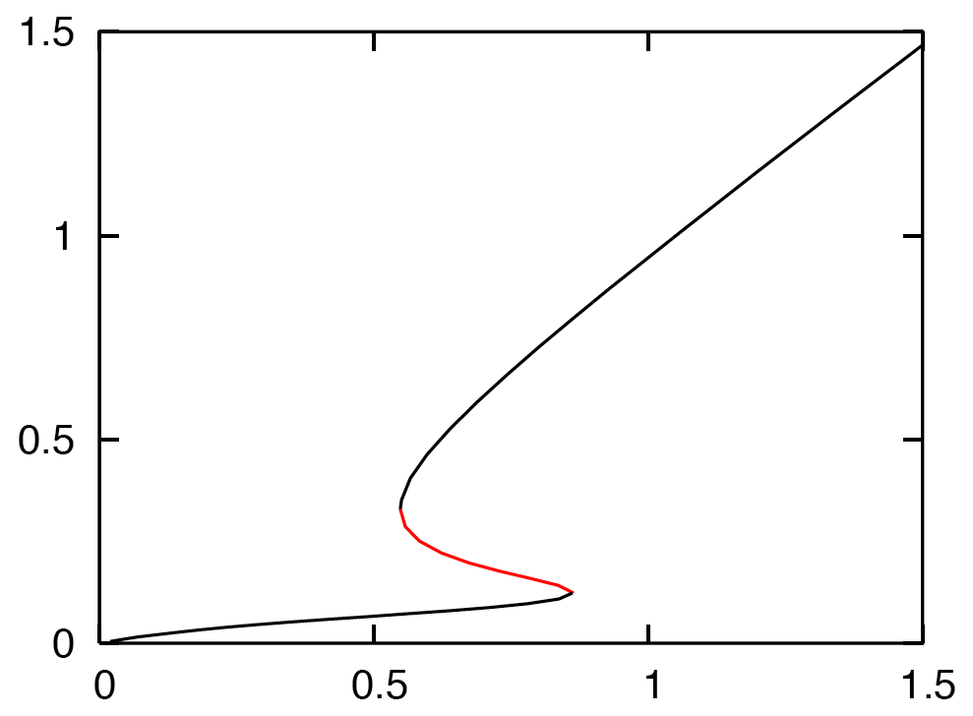
Positive feedback loops and bistability
input
B
A
A
Buzzer
Input

Slide 38
Positive feedback loops and bistability
input
B
A
A
Buzzer
Toggle switch
A
Input
Input

Slide 39
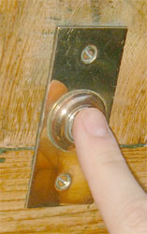
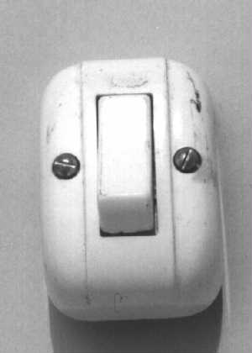
Positive feedback loops and bistability
input
B
A
Buzzer
Toggle switch

Slide 40
Positive feedback loops and bistability
input
B
A
Irreversible toggle switch
A
Input

Slide 41
Positive and 2-component negative feedbacks can oscillate
input
C
B
A
Toggle switch
A
A
Input
time

Slide 42
Relaxation oscillator
input
C
B
A
Toggle switch
A
A
Input
time

Slide 43
Relaxation oscillator
input
C
B
A
Toggle switch
A
A
Input
time

Slide 44
Relaxation oscillator
input
C
B
A
Toggle switch
A
A
Input
time

Slide 45
Relaxation oscillator
input
C
B
A
Toggle switch
A
A
Input
time

Slide 46
Relaxation oscillator
input
C
B
A
Toggle switch
A
A
Input
time

Slide 47
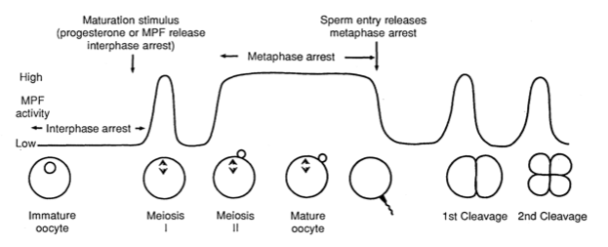
Systems level properties
- S/M oscillations during Xenopus early development
- How is mitosis well separated from S-phase without G phases
Murray and Kirschner, Science, 1989

Slide 48
Molecular network:
MPF is the main regulator of mitosis in Xenopus
MPF
CDK
cyclin dependent kinase
Cyc
cyclin (regulatory subunit)
Cyclin dependent kinase without cyclin is inactive.
Cyclin dependent kinase is present in excess.
The binding of Cyclin and CDK is very spontaneous.
Notes:
Molecular details of the master regulator

Slide 49
CDK
CDK
Cyc
Cyc
CDK
Notes:
When translated into a wiring diagram

Slide 50
Also phosphorylation controls MPF activity
P
Wee1
Wee1
CDK
P
CDK
CDK
Cyc
Cyc
Cyc
CDK

Slide 51
La modellistica dei sistemi biologici è ancora nella sua infanzia ma nel futuro sarà molto importante per una Biologia dei Sistemi veramente efficace

