Slide 1

Grandi progetti di Bioinformatica, Studi di Associazione e Analisi globale della cromatina

Slide 2
Manuela Helmer Citterich, Fabrizio Ferrè, Giulio Pavesi, Chiara Romualdi, Graziano Pesole
Fondamenti di bioinformatica

Slide 3
Capitolo 16
La bioinformatica: tra presente e futuro

Slide 4
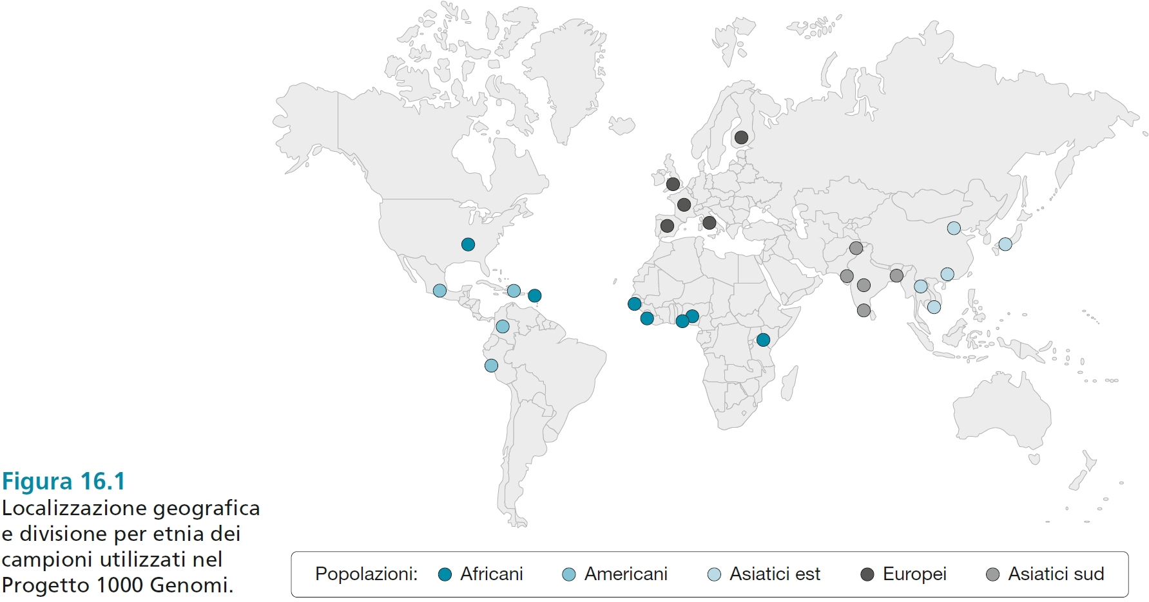

Slide 5
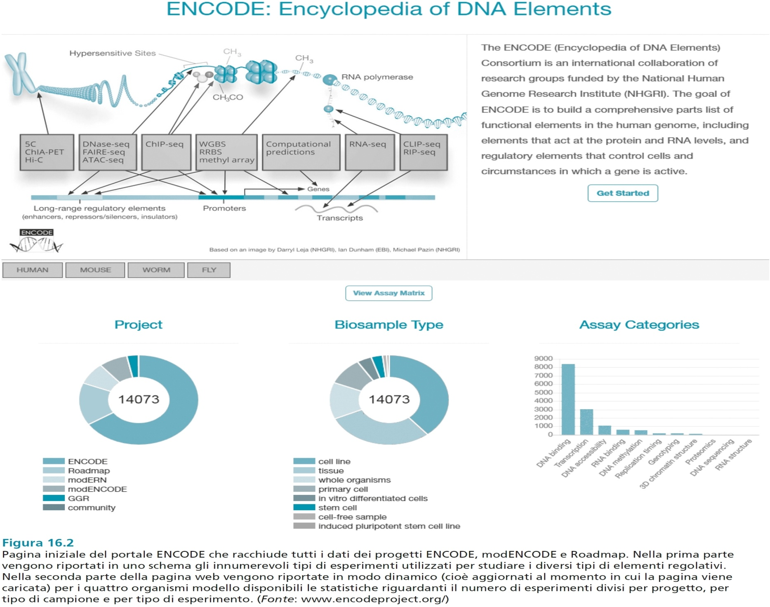

Slide 6
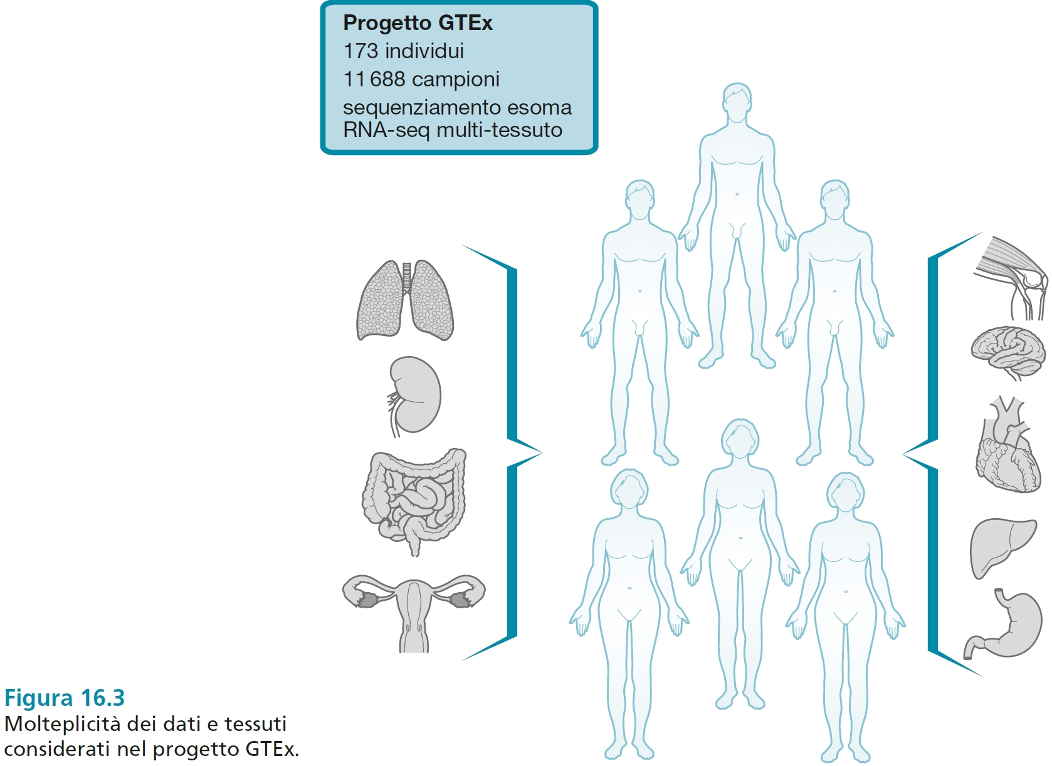

Slide 7
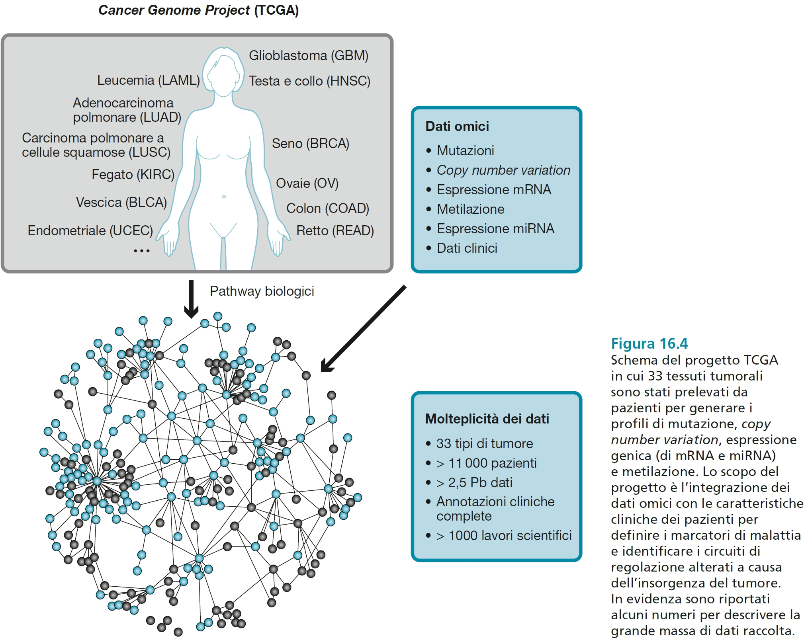

Slide 8
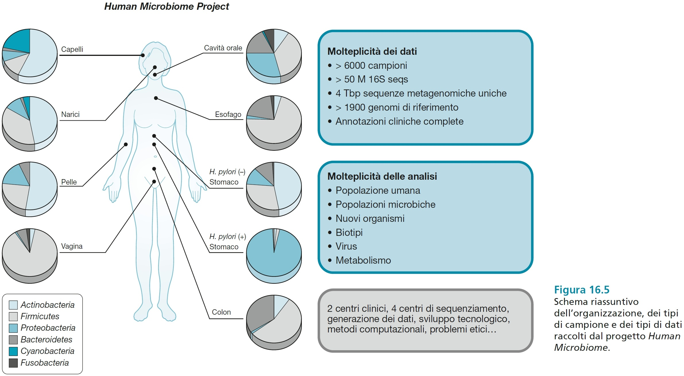

Slide 9
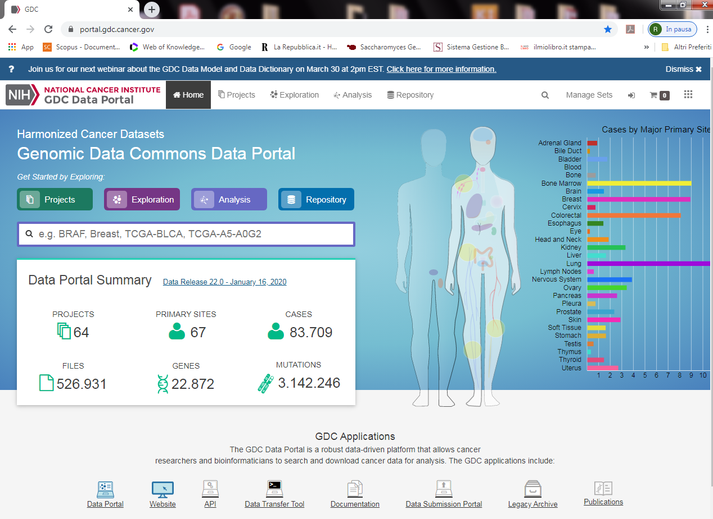

Slide 10
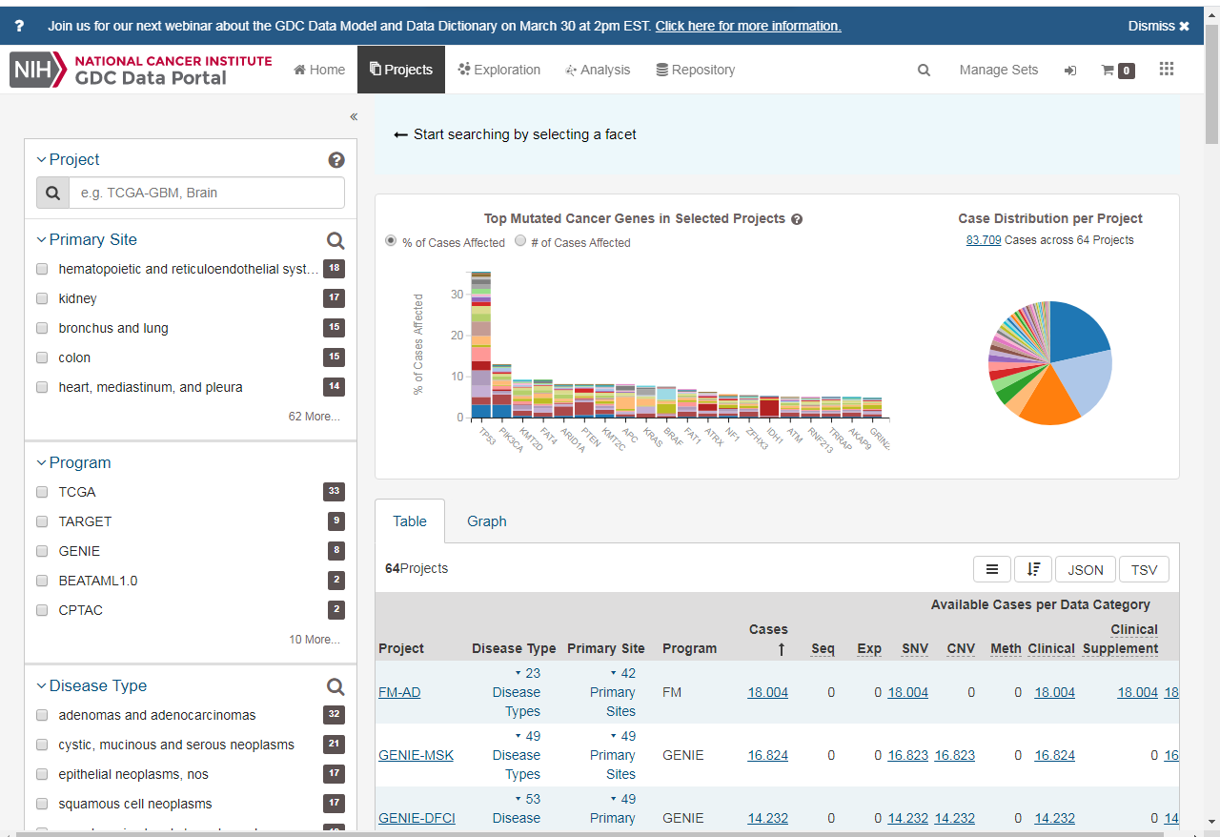

Slide 11
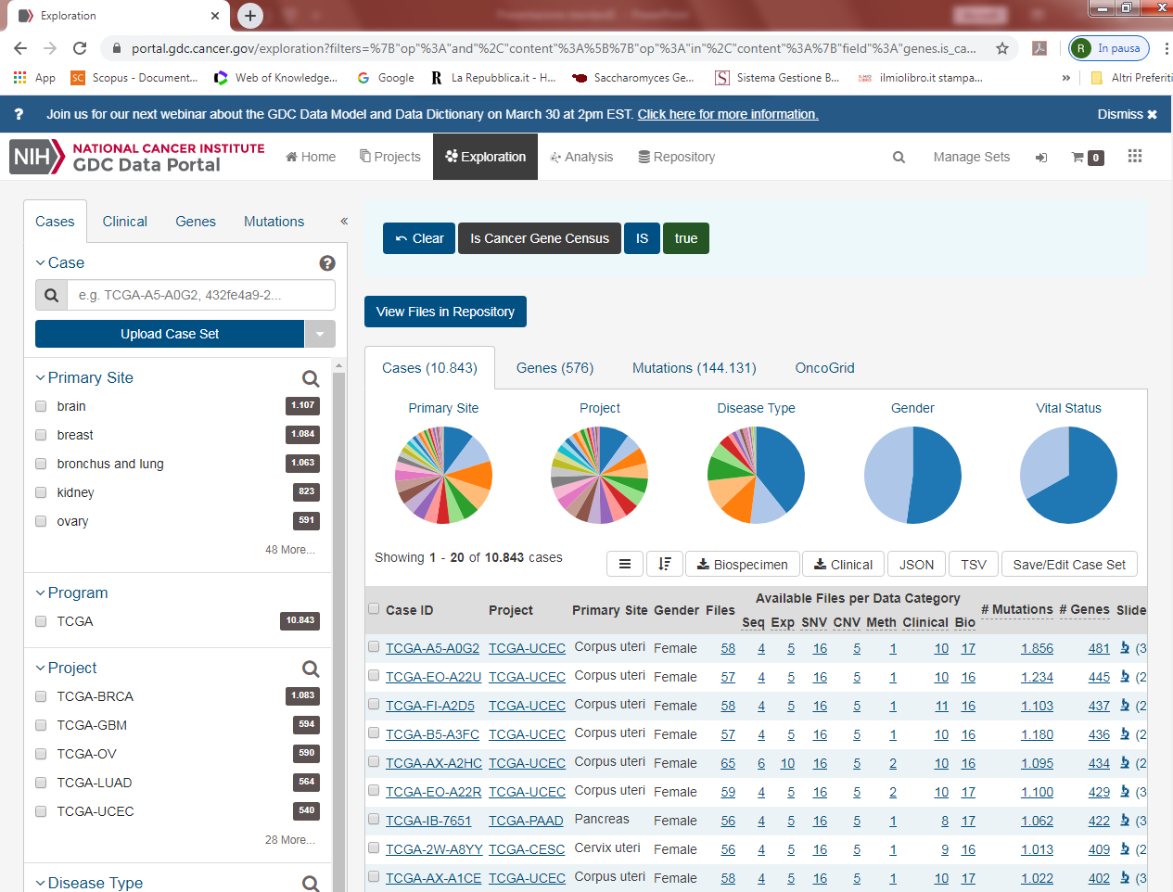

Slide 12
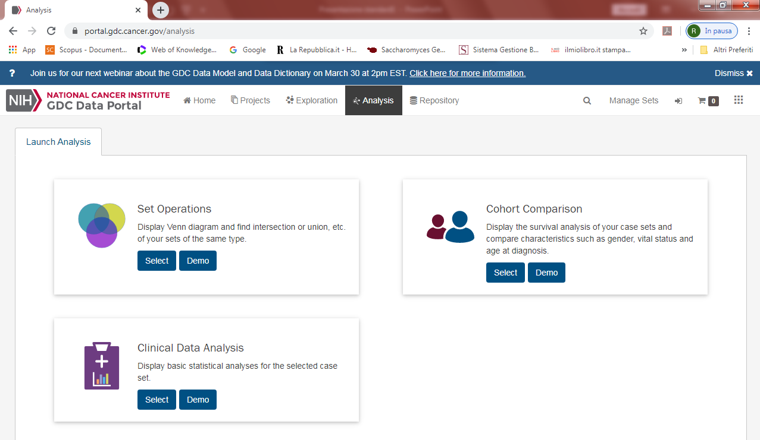

Slide 13
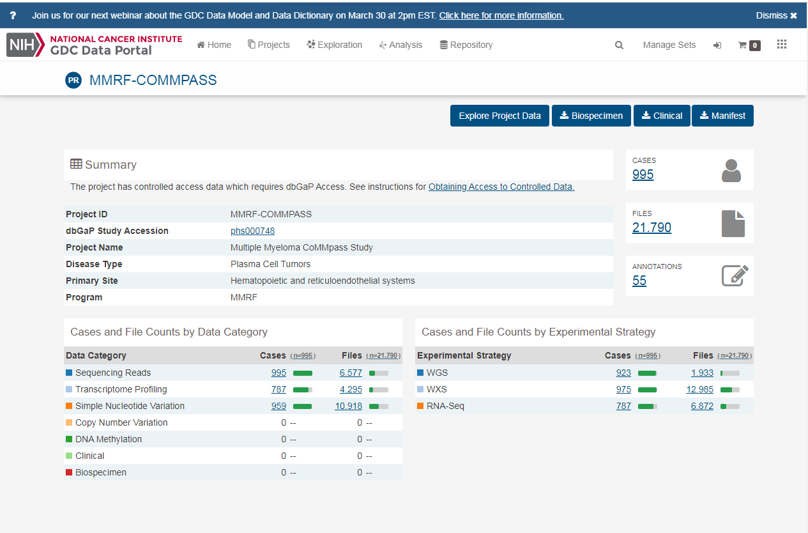

Slide 14
Genome Wide Association Study

Slide 15
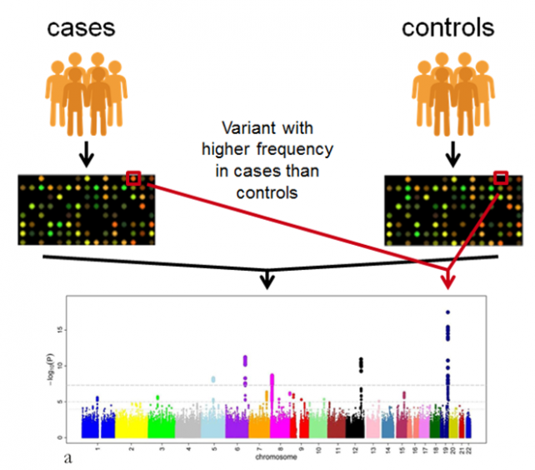
GWAS

Slide 16
eQTL
Expression quantitative trait loci
Correla singole varianti con l’espressione dell’mRNA in un dato tessuto usando studi dell’espressione dell’mRNA su larga scala

Slide 17
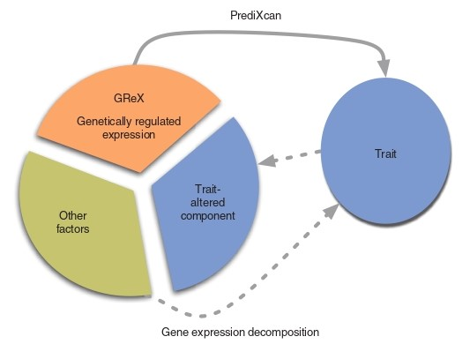
PrediXcan
Il livello di espressione genica di un individuo
(in genere non osservato in un GWAS) è scomposto in una componente di espressione genetica regolata (GReX), una componente alterata dal tratto stesso (ovvero un effetto causale inverso che può verificarsi se lo stato della malattia o altre condizioni alterano i livelli di espressione) e la componente rimanente attribuibile a fattori ambientali e di altro tipo. effetto di mediazione dell'espressione genica quantificando l'associazione tra GReX e il fenotipo di interesse.
PrediXcan testa l’effetto di mediazione dell’espressione genica quantificanto l’associazione fra GReX e il fenotipo di interesse

Slide 18
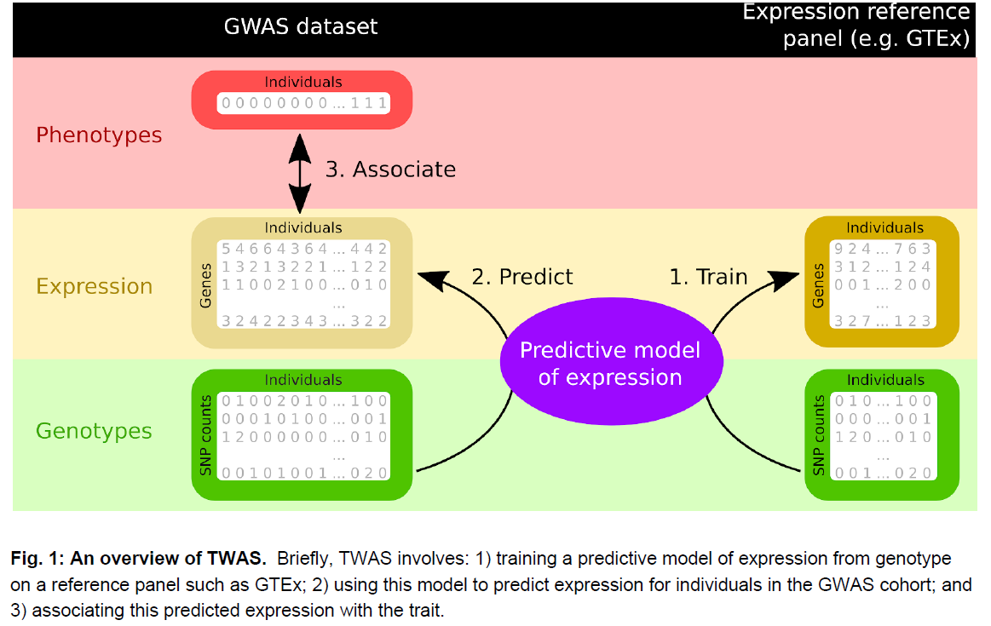
TWAS

Slide 19
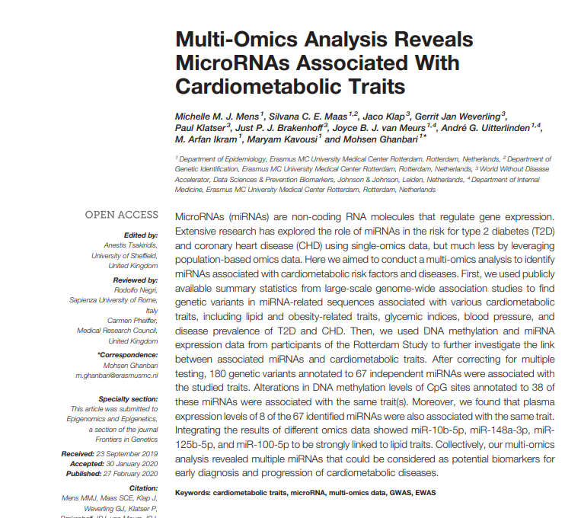

Slide 20
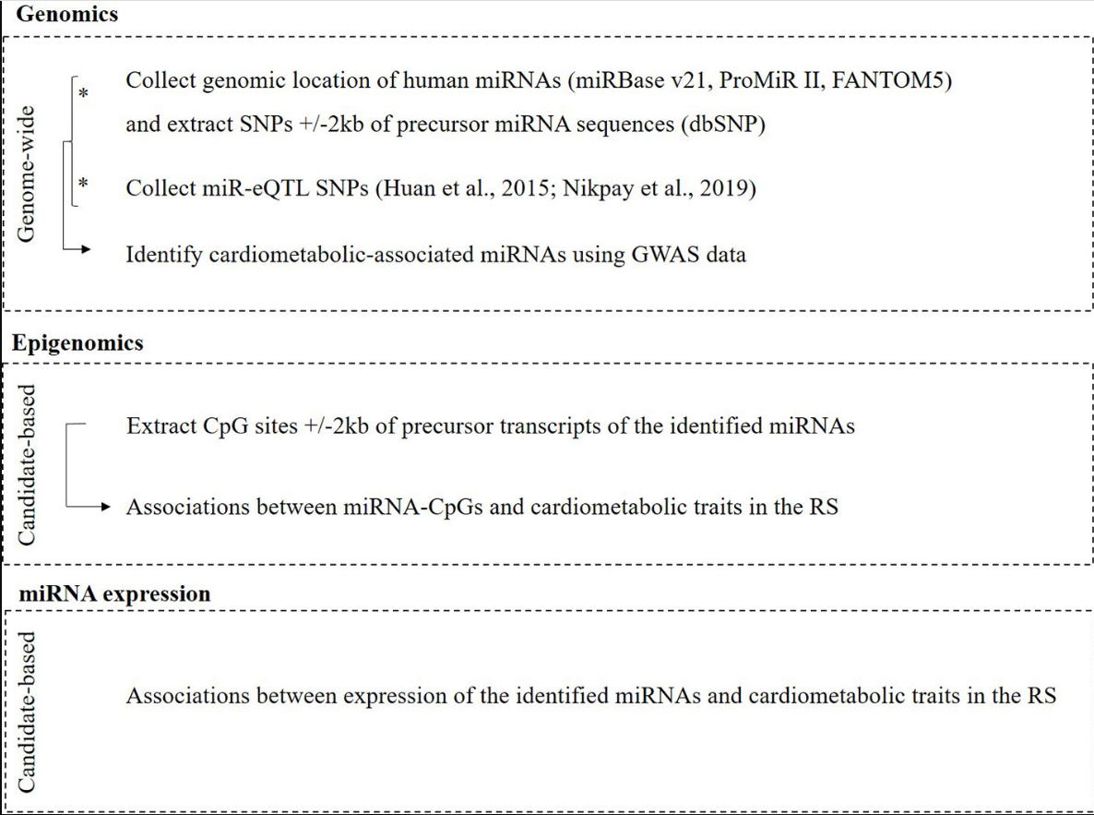

Slide 21
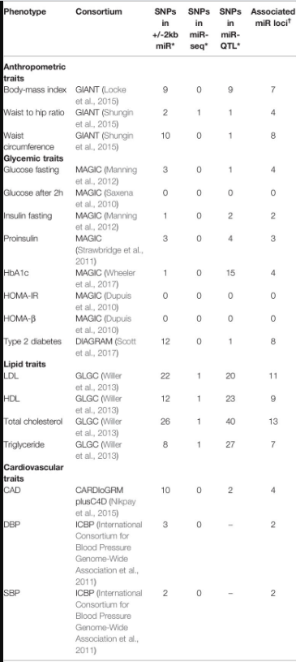
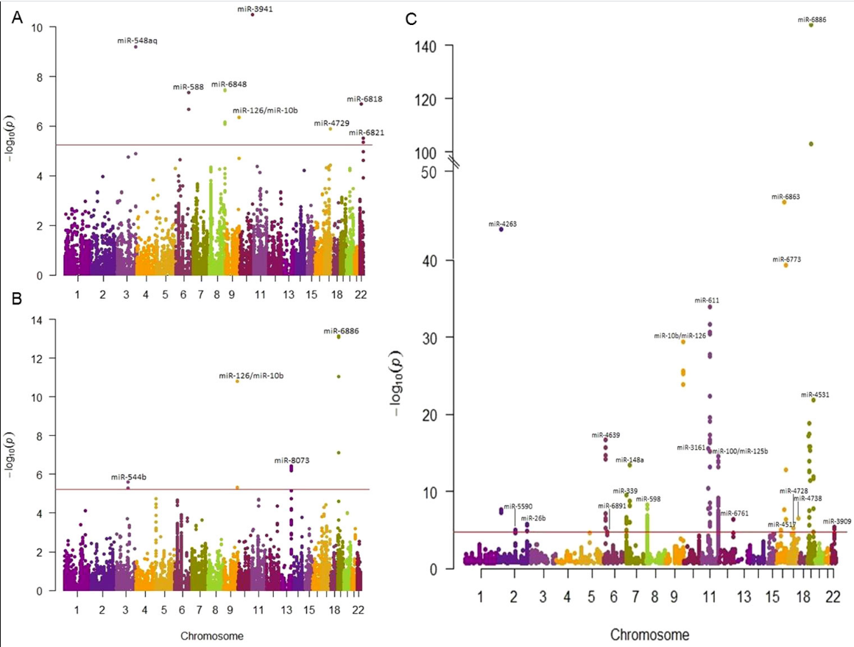

Slide 22
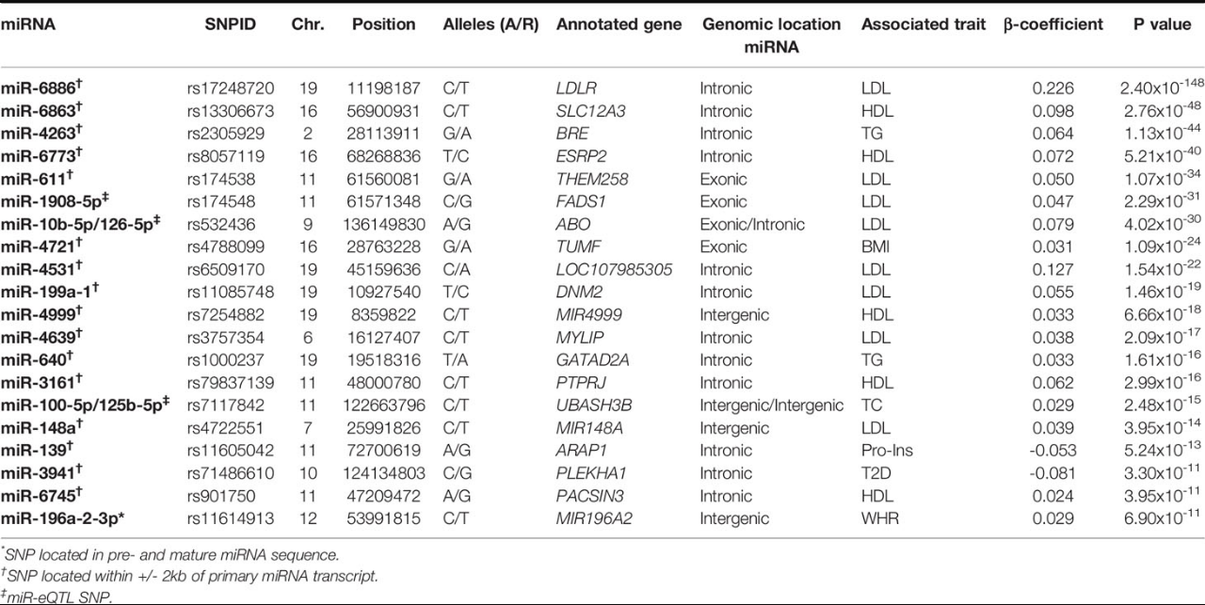

Slide 23
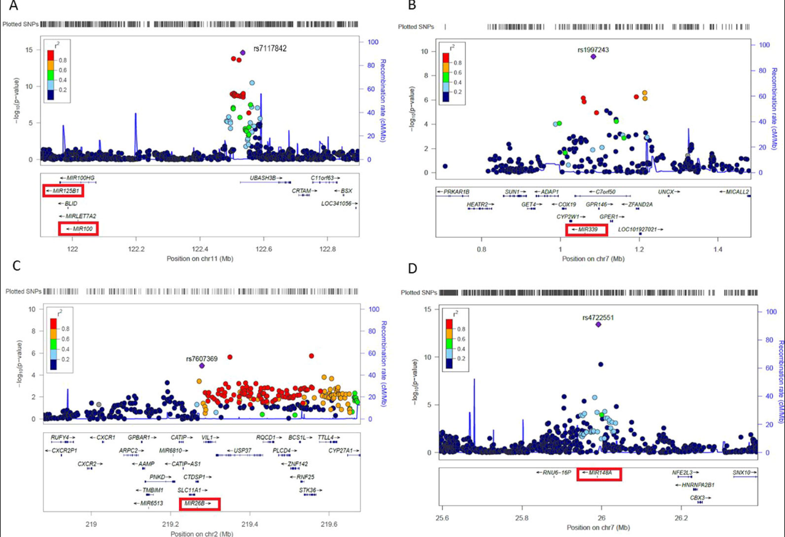

Slide 24
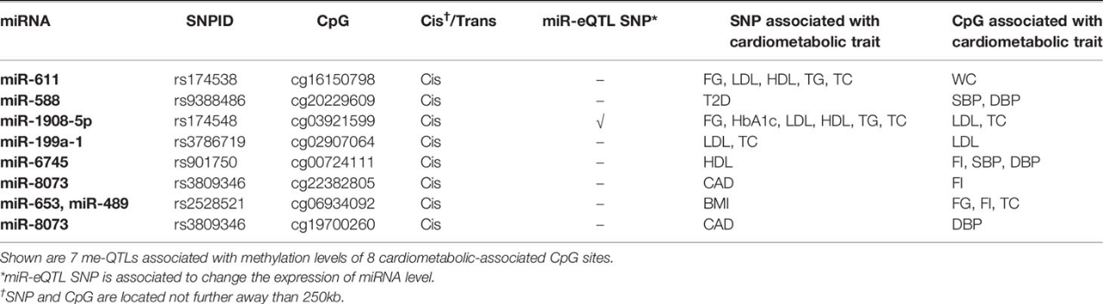
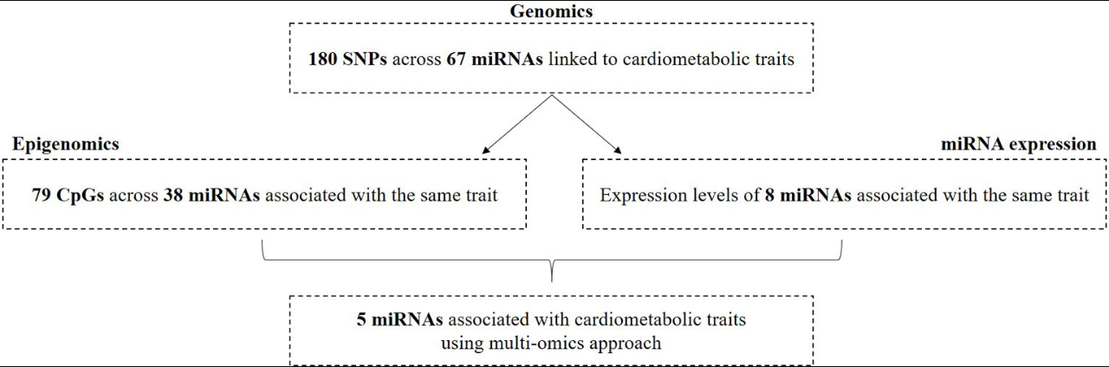

Slide 25
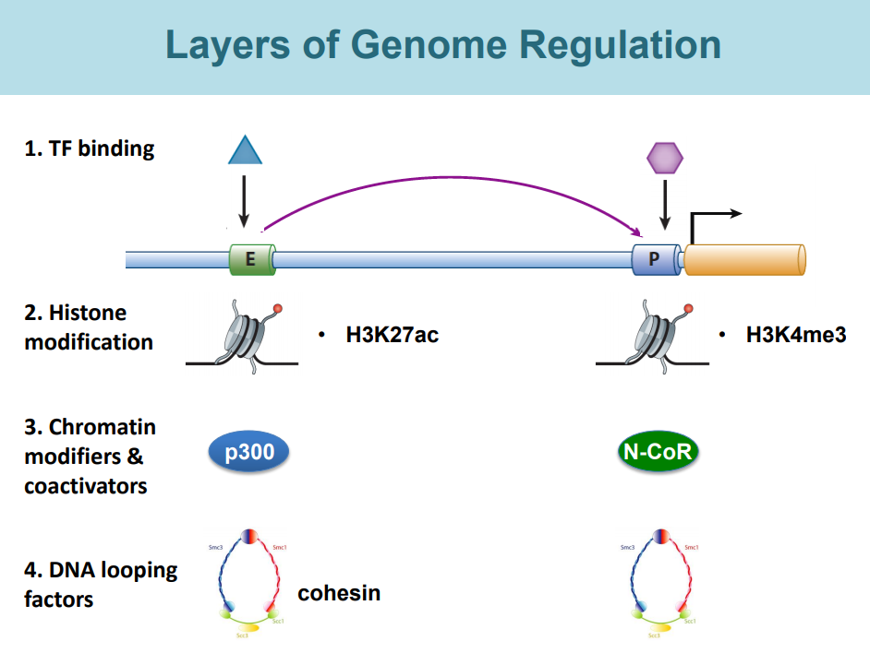

Slide 26
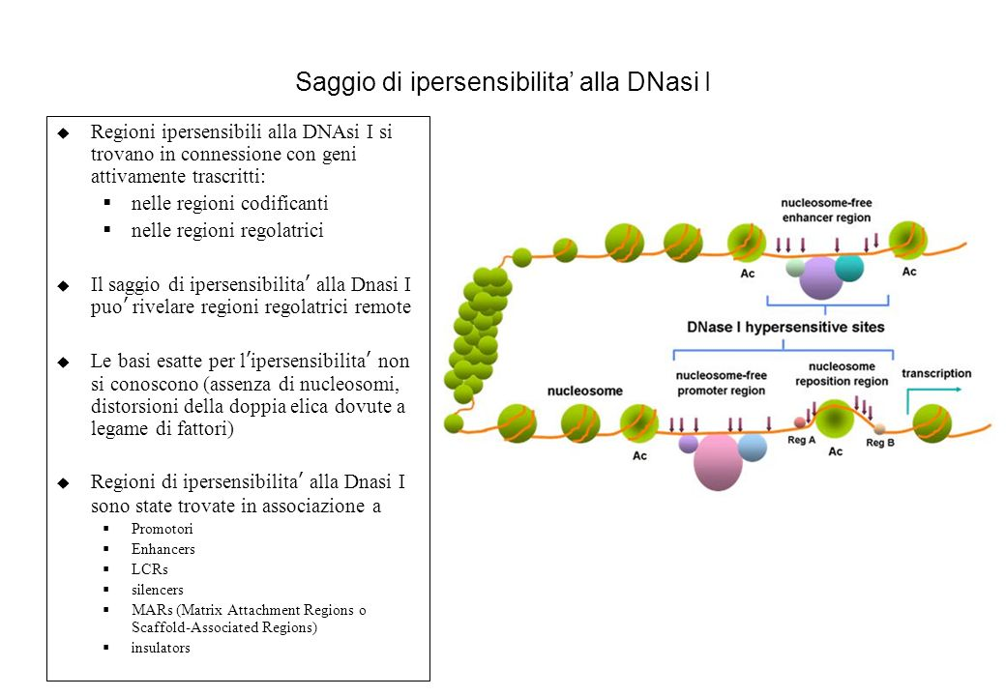

Slide 27
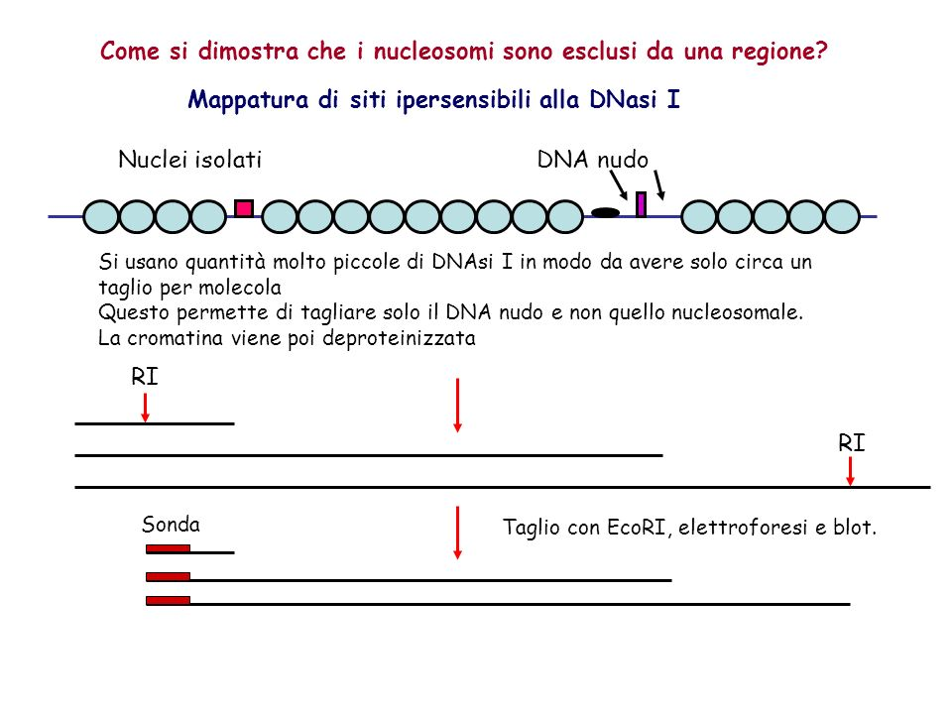

Slide 28
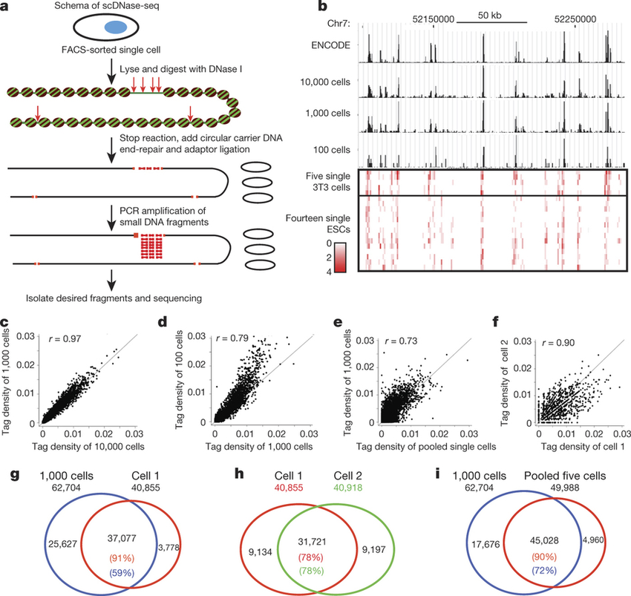

Slide 29
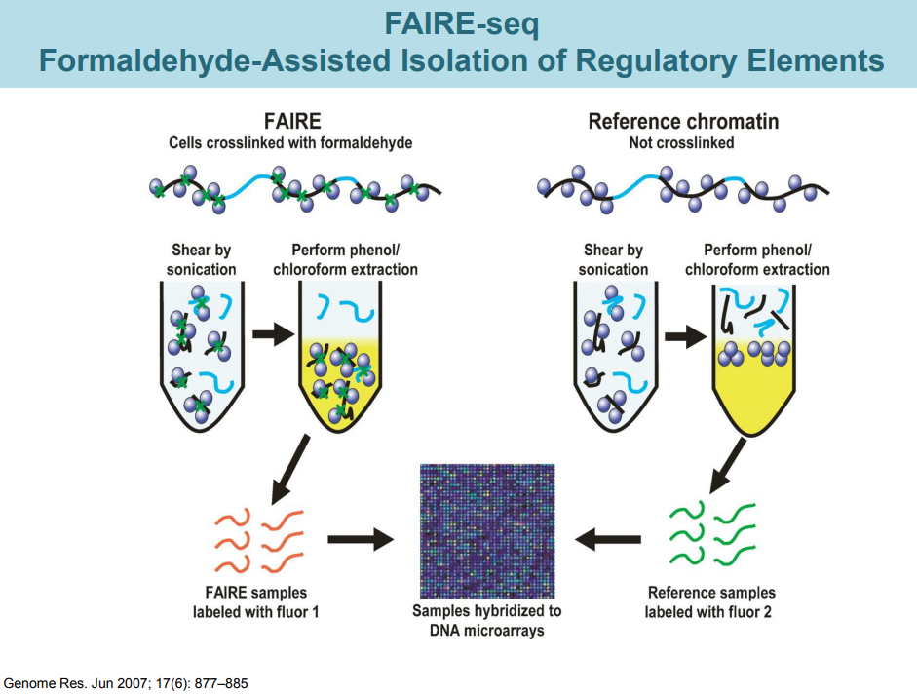
Jason D. Lieb
University of North Carolina

Slide 30
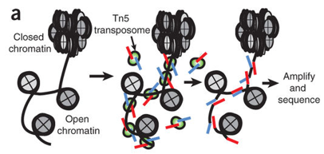
Buenrostro et al, 2013
ATAC-seq: The assay of transposase accessible chromatin
A Method for Assaying Chromatin Accessibility Genome-Wide
This method probes DNA accessibility with hyperactive Tn5 transposase, which inserts sequencing adapters into accessible regions of chromatin.
Sequencing reads can then be used to:
infer regions of increased accessibility
map regions of transcription factor binding and nucleosome position
https://www.youtube.com/watch?v=TXzOXUl0g5Q
Notes:
Transposase Tn5[edit]
Transposase Tn5 dimerisation domaintn5 transposase: 20mer outside end 2 mn complex
IdentifiersSymbolDimer_Tnp_Tn5PfamPF02281InterProIPR003201SCOPe1b7e / SUPFAMshowAvailable protein structures:Transposase (Tnp) Tn5 is a member of the RNase superfamily of proteins which includes retroviral integrases. Tn5 can be found in Shewanella and Escherichia bacteria.^{[5]} The transposon codes for antibiotic resistance to kanamycin and other aminoglycoside antibiotics.^{[3][6]}
Tn5 and other transposases are notably inactive. Because DNA transposition events are inherently mutagenic, the low activity of transposases is necessary to reduce the risk of causing a fatal mutation in the host, and thus eliminating the transposable element. One of the reasons Tn5 is so unreactive is because the N- and C-termini are located in relatively close proximity to one another and tend to inhibit each other. This was elucidated by the characterization of several mutations which resulted in hyperactive forms of transposases. One such mutation, L372P, is a mutation of amino acid 372 in the Tn5 transposase. This amino acid is generally a leucine residue in the middle of an alpha helix. When this leucine is replaced with a proline residue the alpha helix is broken, introducing a conformational change to the C-Terminal domain, separating it from the N-Terminal domain enough to promote higher activity of the protein.^{[3]} The transposition of a transposon often needs only three pieces: the transposon, the transposase enzyme, and the target DNA for the insertion of the transposon.^{[3]} This is the case with Tn5, which uses a cut-and-paste mechanism for moving around transposons.^{[3]}
Tn5 and most other transposases contain a DDE motif, which is the active site that catalyzes the movement of the transposon. Aspartate-97, Aspartate-188, and Glutamate-326 make up the active site, which is a triad of acidic residues.^{[7]} The DDE motif is said to coordinate divalent metal ions, most often magnesium and manganese, which are important in the catalytic reaction.^{[7]} Because transposase is incredibly inactive, the DDE region is mutated so that the transposase becomes hyperactive and catalyzes the movement of the transposon.^{[7]} The glutamate is transformed into an aspartate and the two aspartates into glutamates.^{[7]} Through this mutation, the study of Tn5 becomes possible, but some steps in the catalytic process are lost as a result.^{[3]}
There are several steps which catalyze the movement of the transposon, including Tnp binding, synapsis (the creation of a synaptic complex), cleavage, target capture, and strand transfer. Transposase then binds to the DNA strand and creates a clamp over the transposon end of the DNA and inserts into the active site. Once the transposase binds to the transposon, it produces a synaptic complex in which two transposases are bound in a cis/trans relationship with the transposon.^{[3]}
In cleavage, the magnesium ions activate oxygen from water molecules and expose them to nucleophilic attack.^{[6]} This allows the water molecules to nick the 3' strands on both ends and create a hairpin formation, which separates the transposon from the donor DNA.^{[3]} Next, the transposase moves the transposon to a suitable location. Not much is known about the target capture, although there is a sequence bias which has not yet been determined.^{[3]} After target capture, the transposase attacks the target DNA nine base pairs apart, resulting in the integration of the transposon into the target DNA.^{[3]}
As mentioned before, due to the mutations of the DDE, some steps of the process are lost—for example, when this experiment is performed in vitro, and SDS heat treatment denatures the transposase. However, it is still uncertain what happens to the transposase in vivo.^{[3]}
The study of transposase Tn5 is of general importance because of its similarities to HIV-1 and other retroviral diseases. By studying Tn5, much can also be discovered about other transposases and their activities.^{[3]}
Tn5 is utilized in genome sequencing for fragmentation of the DNA, in the technique called ATAC-seq and also in Illumina dye sequencing.

Slide 31
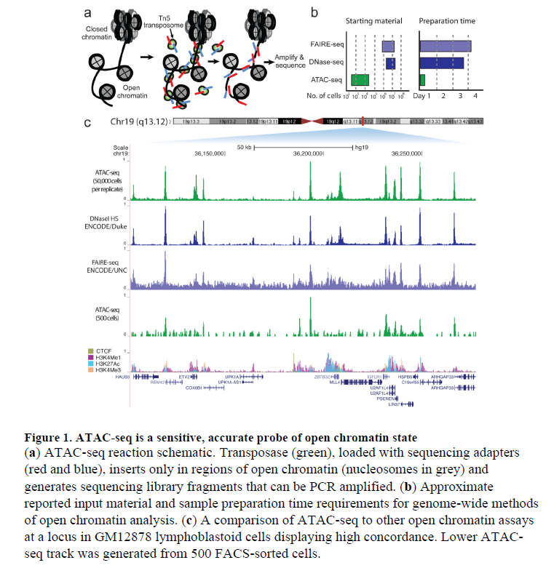
Buenrostro et al. 2013

Slide 32
WHY ATAC SEQ?
fast and sensitive
Native Chromatin (no fixation, cross-linking)
Few cells (now protocols down to single cell)
alternative to DNase-Seq for assaying chromatin accessibility genome-wide
alternative to MNase for assaying nucleosome positions in accessible regions of the genome
MNase-seq (Zaret, 2005) ChIP-seq (Landt et al., 2012) DNase-seq (Song and Crawford, 2010)
PROS → Information-rich, genome-wide analysis methods for understanding this epigenetic structure, providing information on transcription factor binding, the positions of modified and canonical nucleosomes, and chromatin accessibility at regulatory elements such as promoters, enhancers, and insulators
CONS → Methods for assaying chromatin structure and composition often require tens to hundreds of millions of cells as input material, averaging out heterogeneity in cellular populations. In many cases, rare and important cellular sub-types cannot be acquired in amounts sufficient for genomewide chromatin analyses.

Slide 33
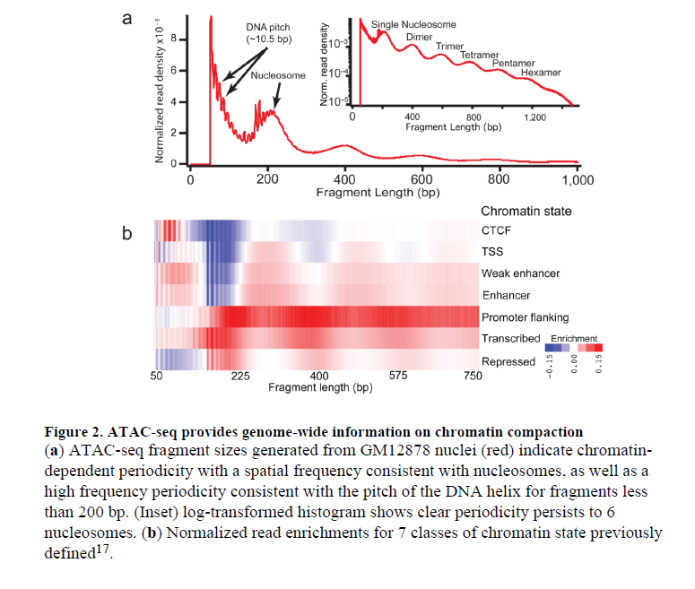
Buenrostro et al. 2013

Slide 34
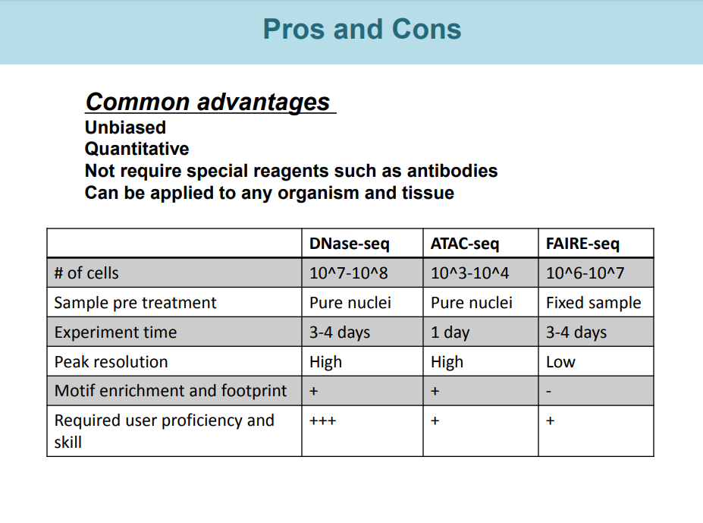

Slide 35
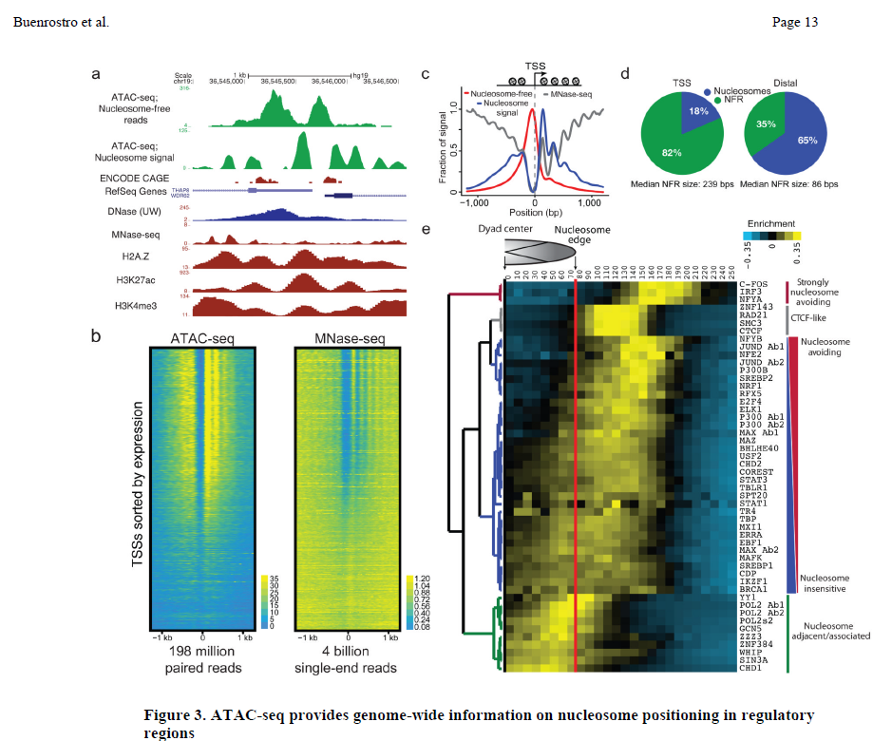

Slide 36
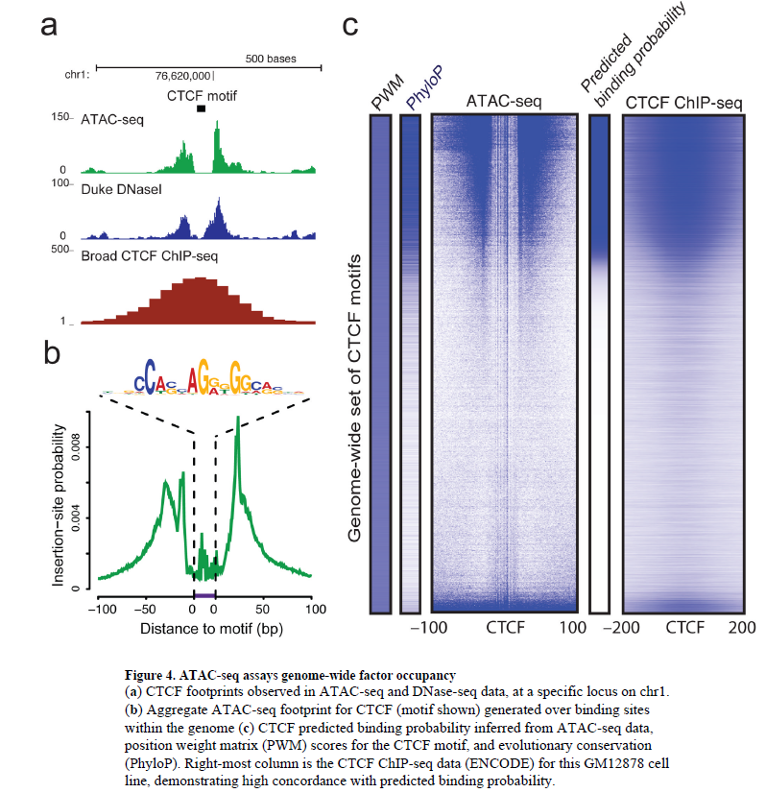
Buenrostro et al. 2013

Slide 37
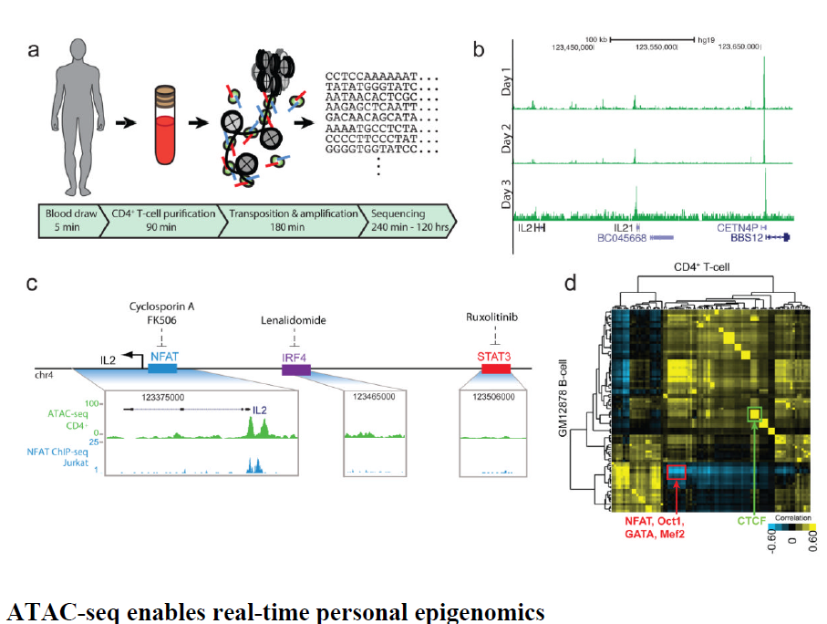
Buenrostro et al. 2013

Slide 38
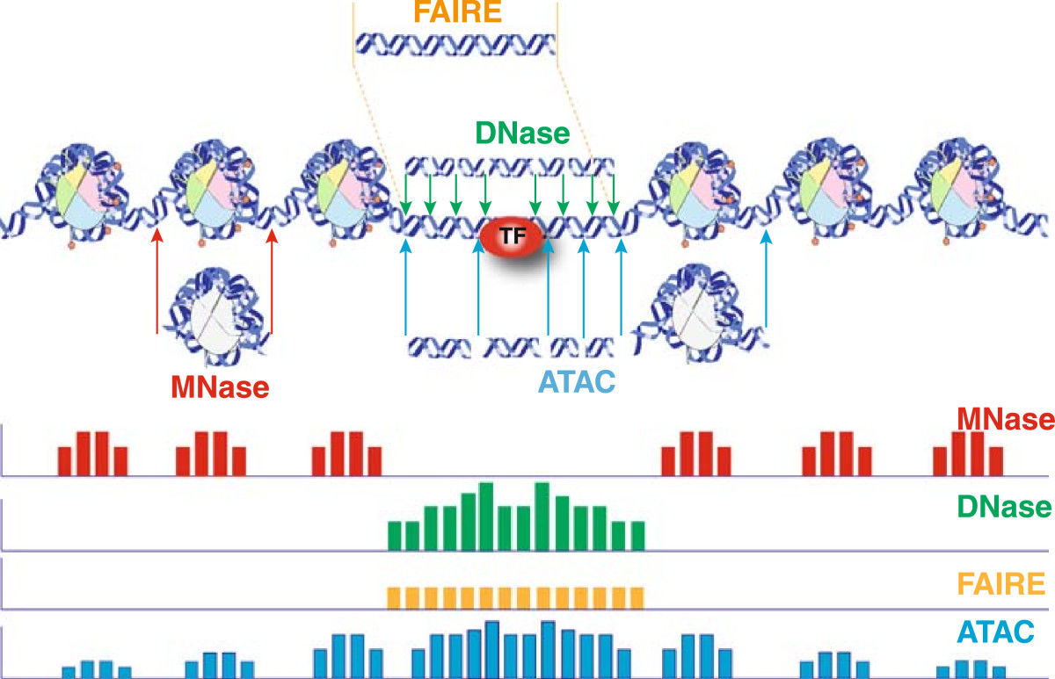

Slide 39
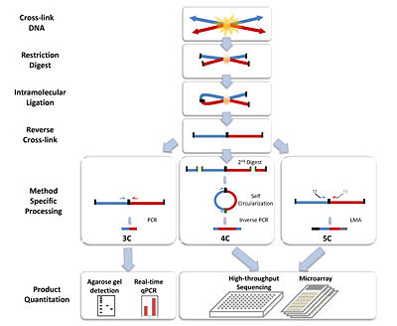
Chromosome conformation capture

Slide 40
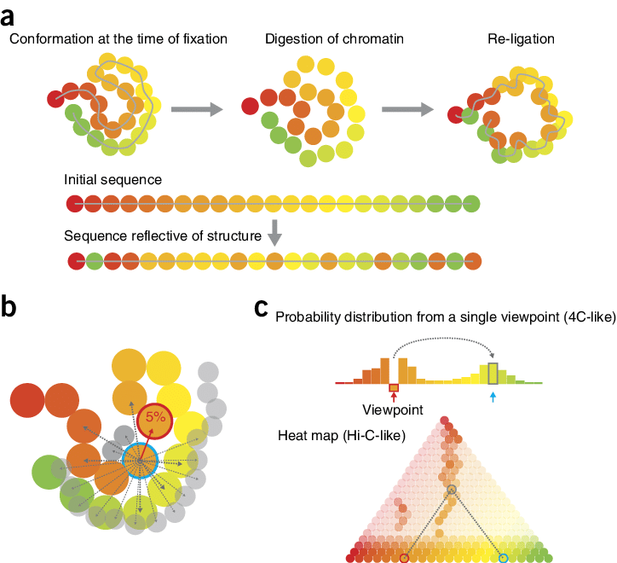
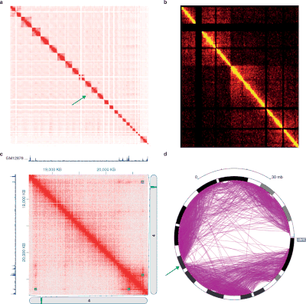

Slide 41
