Slide 1
Analisi delle varianti e delle modificazioni degli istoni

Slide 2

Histone variants
Structural variants
They exist in all species
Can be cell type-specific
Regulated during development
More common in H2A and H2B than in H3 and H4
Some form are highly specialized (CENP A and Macro H2A)

Slide 3
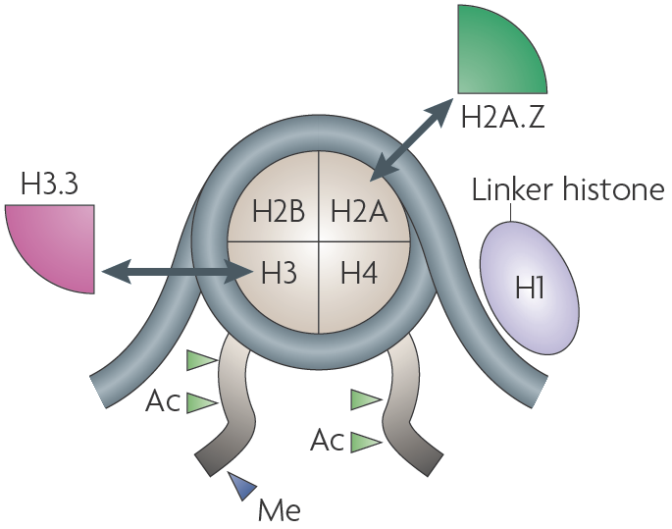
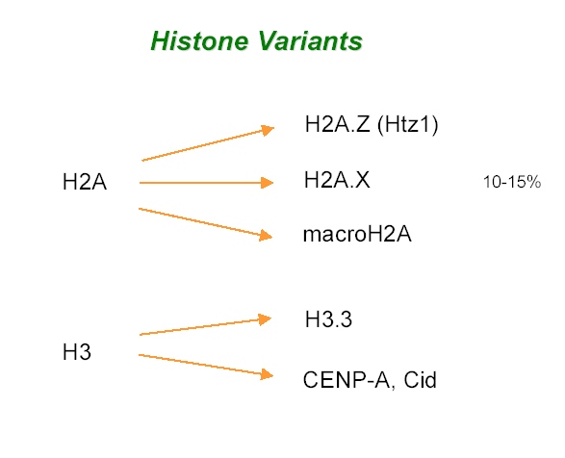
Histone variants

Slide 4
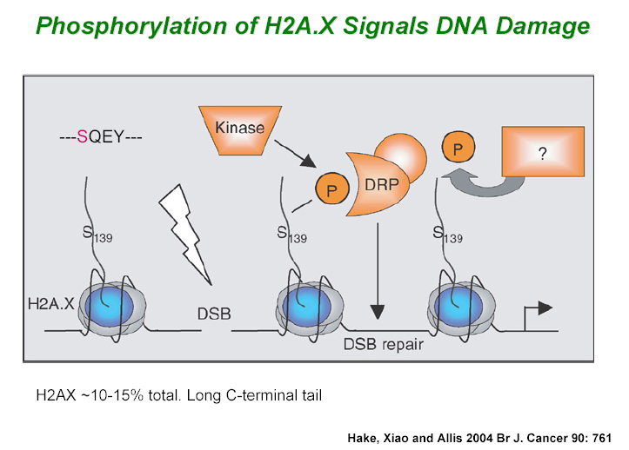
Histone variants

Slide 5
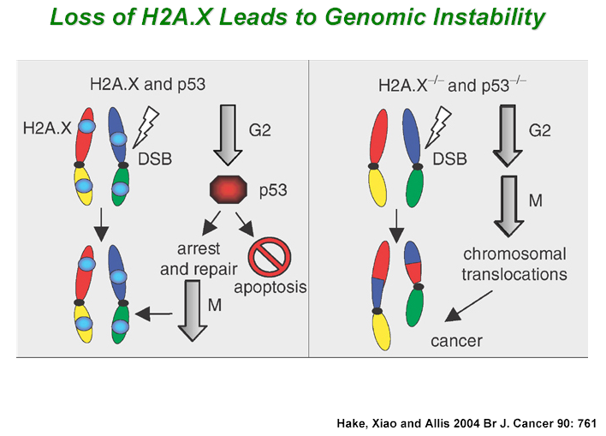
Histone variants

Slide 6
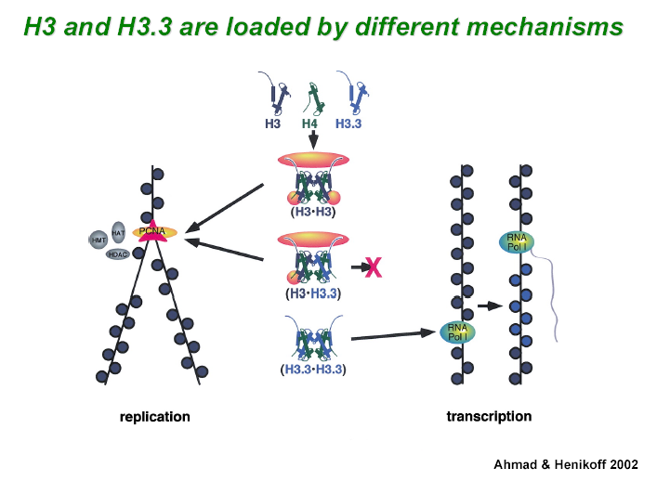
Histone variants

Slide 7
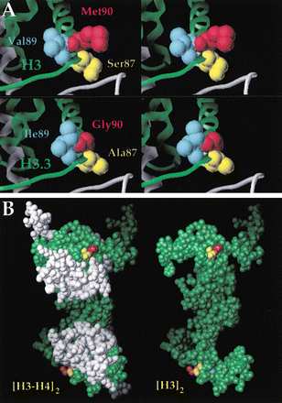
Histone variants
Histone H3.3:
Only 4 aminoacids modified in comparison with H3
Costitutive expression
Can be positioned in replication-independent mode
Substitution oh H3 with H3.3 can lead to transcription and H3 methylation reprogramming
From: Smith, MM Mol Cell 9, 1158 (2002)

Slide 8
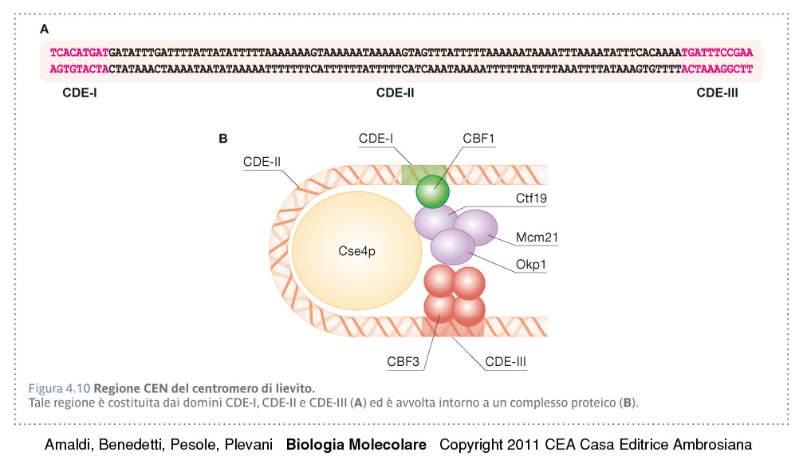
Histone variants

Slide 9
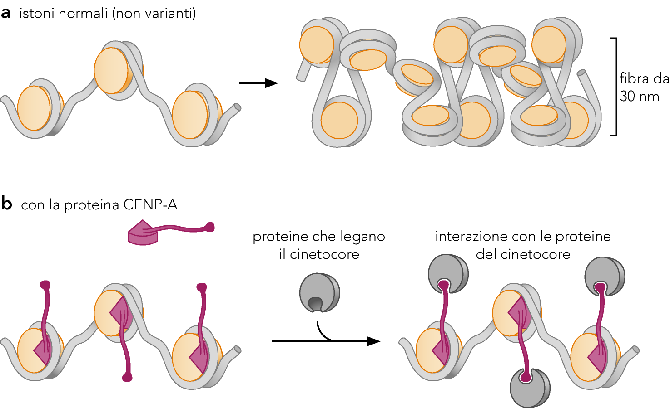

Slide 10
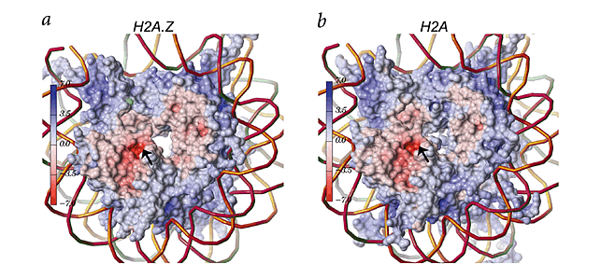
Comparison between H2A and
H2A.Z structure

Slide 11
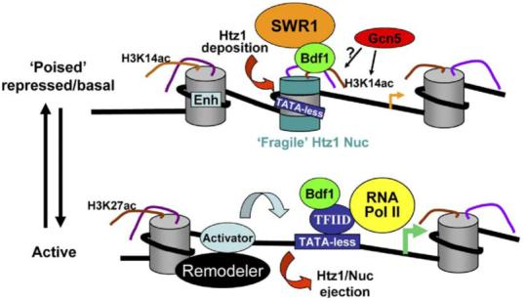
Cell. 2005 Oct 21;123(2):219-31.
Genome-wide dynamics of Htz1, a histone H2A variant that poises repressed/basal promoters for activation through histone loss.
Zhang H, Roberts DN, Cairns BR.

Slide 12
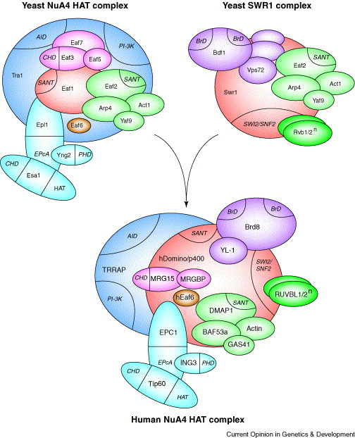
Doyon and Coté 2004

Slide 13
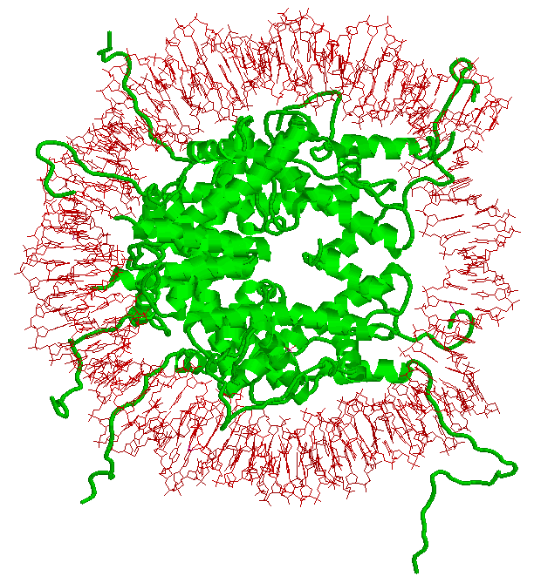
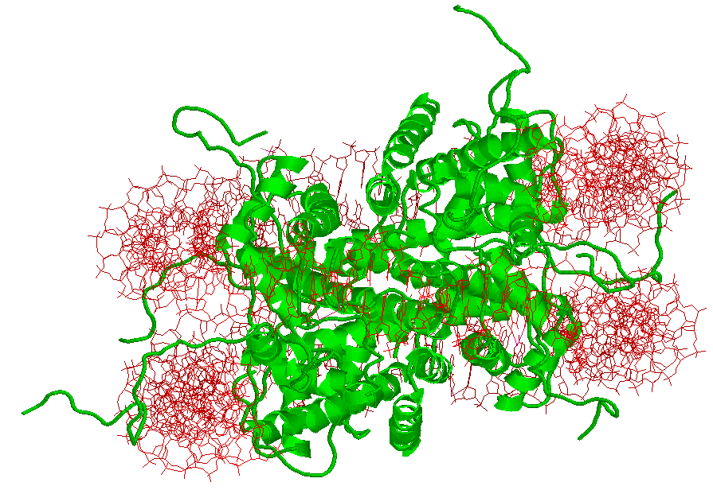
Histone tails

Slide 14
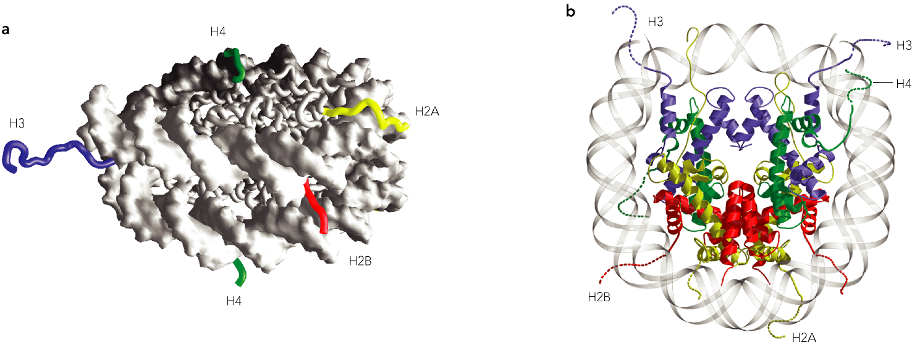

Slide 15
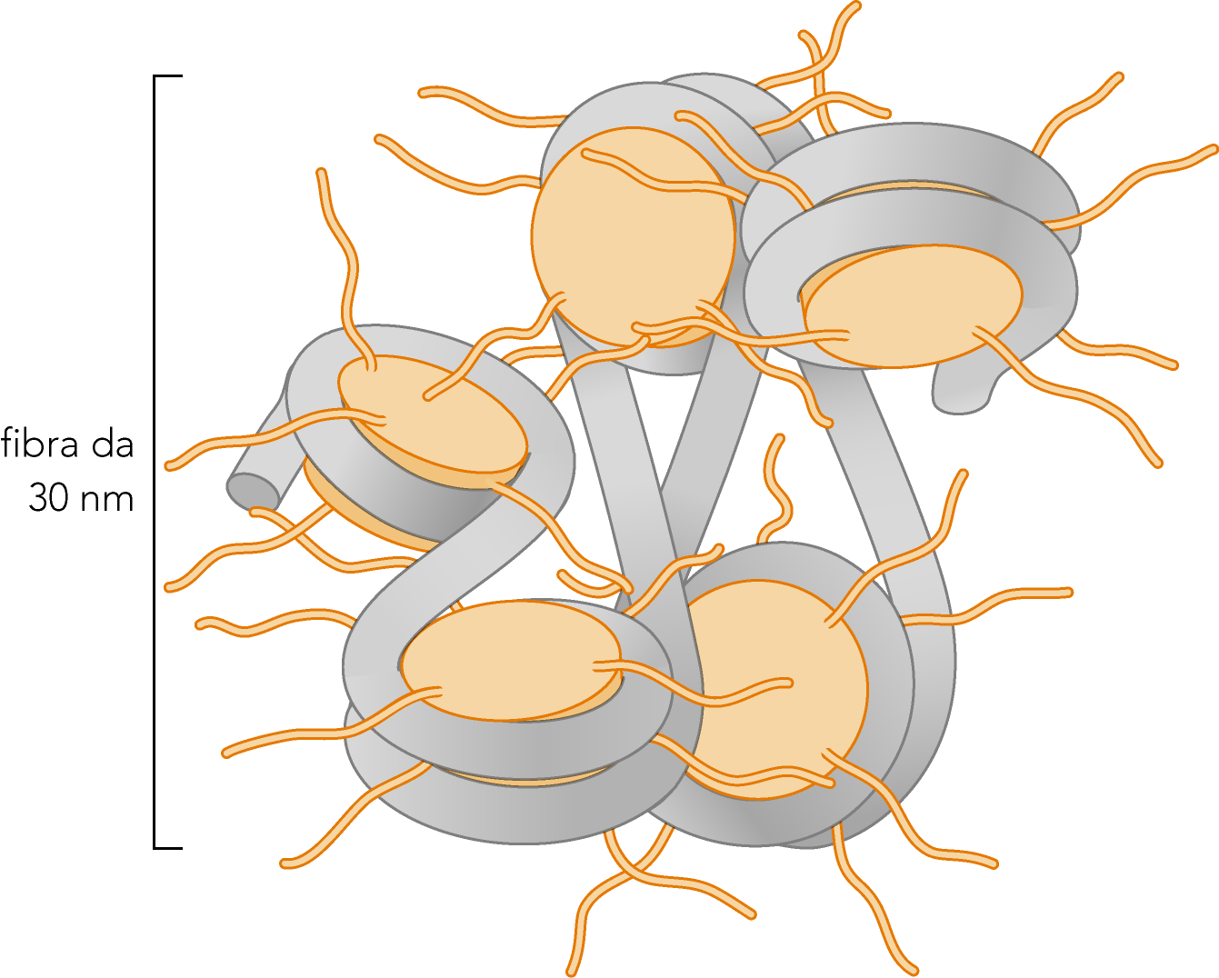

Slide 16
Histone tails
Known and well carachterized
Histone tail modifications:
methylation
acethylation
ADP ribosilation
ubiquitination
sumolilation
Phosphorylation
The contemporary occurrence and the possible mutual influence
of more than one modification at a time should be considered

Slide 17
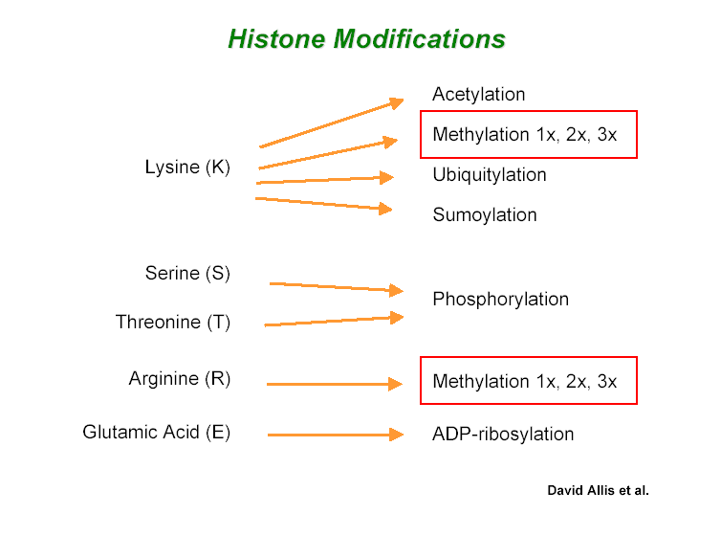
Histone modifications

Slide 18
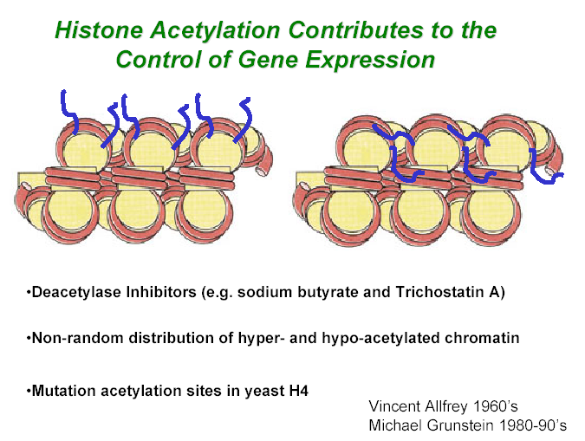
Acetilation

Slide 19
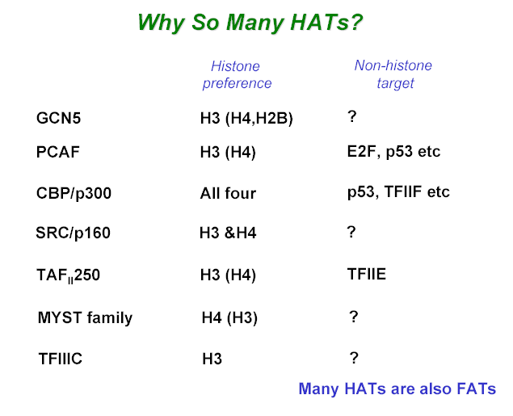
Acetilation

Slide 20
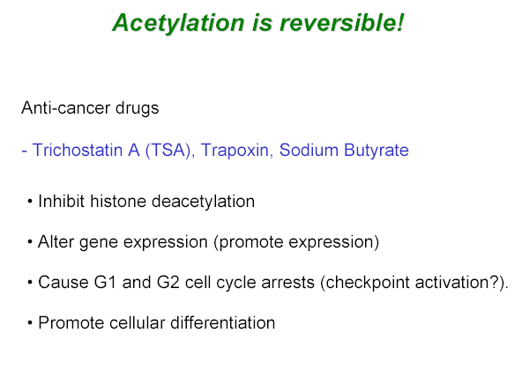
Acetilation

Slide 21
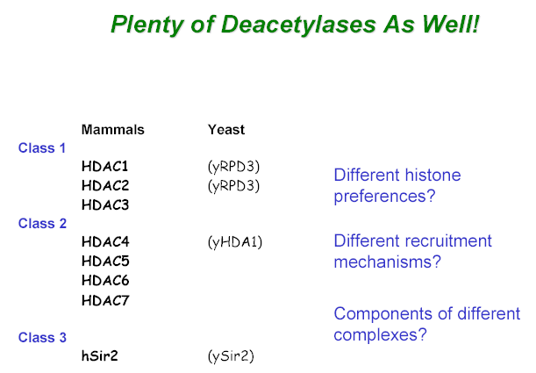
Acetilation
Deacetilasi attiva a livello globale
su tutte le code istoniche
Deacetilasi attiva a livello globale
ma solo sulle code degli istoni H3 e H2B
Deacetilasi NADH dipendente
Class 4
Hos Family
Intervengono sui promotori o ORF
di geni attivamente trascritti

Slide 22
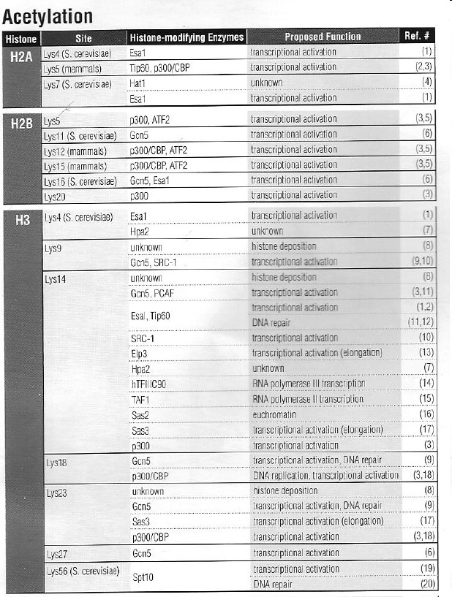

Slide 23
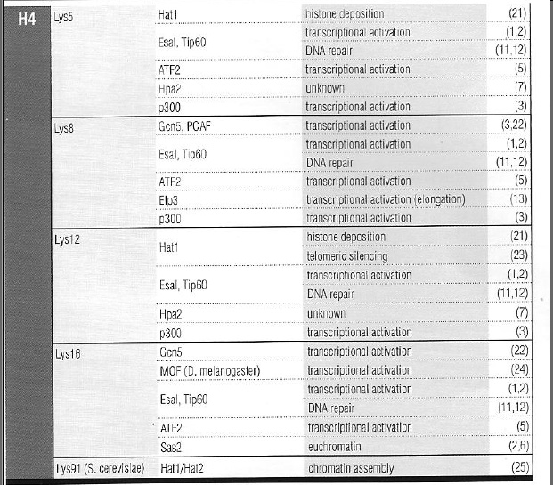

Slide 24
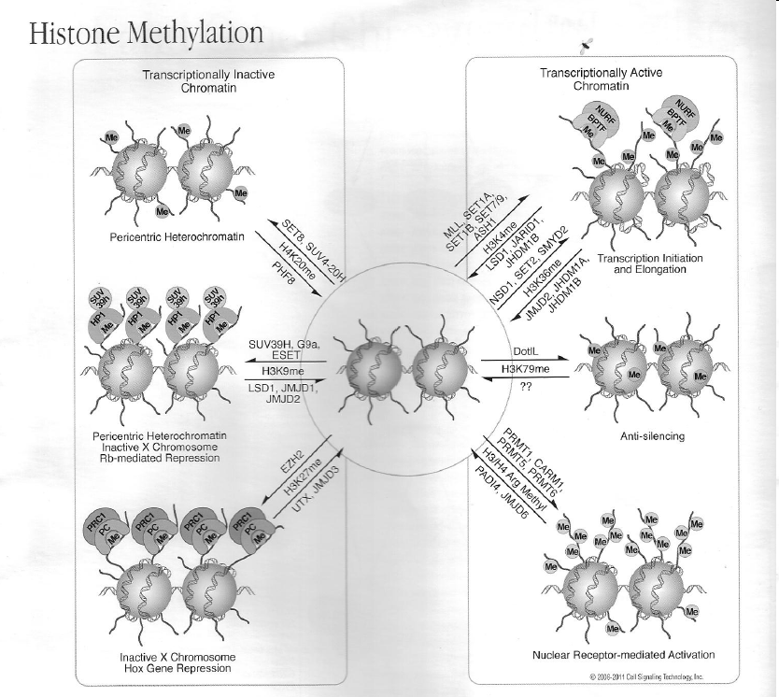

Slide 25
Metylation
Histone Methyltransferases
HMT
Histone
Sites
SET domain
Organisms
Chromatin
Set1 H3 K4 + S. cerevisiae
Set2 H3 K36 + S. cerevisiae
Clr4 H3 K9 + S. pombe
G9a H3 K9, 27 + Human Eu
Suv39h1,h2 H3 K9 + Murine He
Set9 H3 K4 + Human Eu
Dot1 H3 K79 - S. cerevisiae Eu
PR-Set7 H4 K20 + Human He
Ezh2 H3 K27 + Drosophila He
References:
Cell, Vol 9, 1201-1213, June 2002
Science. 2003 Apr 4;300(5616):131-5

Slide 26
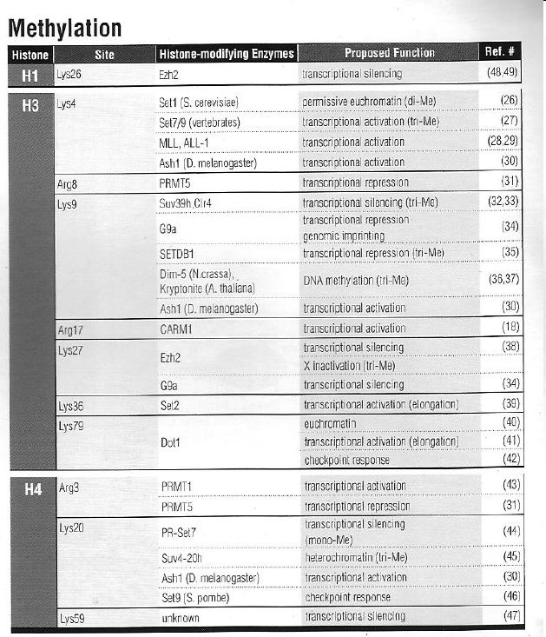

Slide 27

The first 37 amino acid of the histone H3 tail and lysine residue 79 plus neighbouring amino acids are shown. Lysine residues that undergo methylation are highlighted in green to indicate a function in active transcription, or in red to indicate involvement in transcriptional repression.
Notes:
27

Slide 28
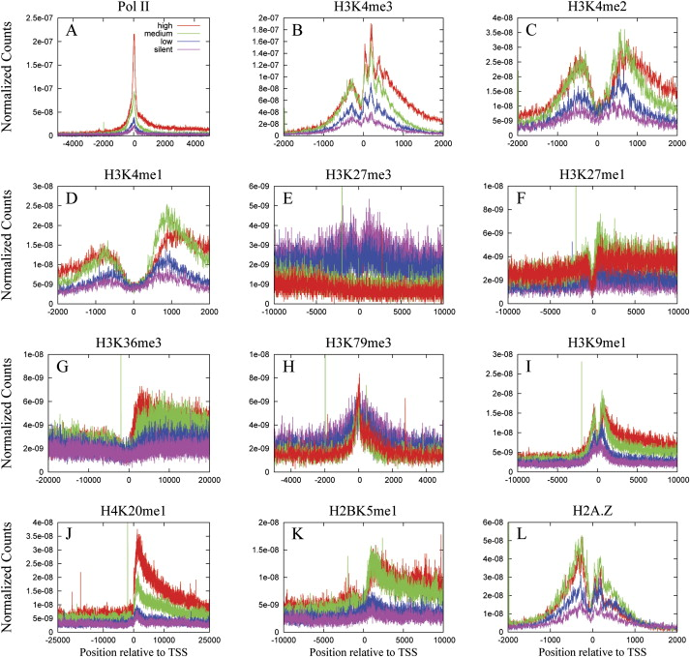
Histone PTMs around TSS region in Human genome according to transcriptional activity (red > green > blue > purple). ChIP-Seq reads highlight the diverse distribution of different PTMs according to both distance from TSS and transcriptional activity: H3K4 methylation level of active genes peaks in the immediate surroundings of the TSS, fading out in a regular fashion (me3 than me2 and finally me1) in both directions; H3K79me3 is only present in correspondence to TSSs; H3K36me3 and H4K20me1 are specifically enriched in the first region of gene bodies of transcriptionally active genes; H3K27me3 anti-correlates with transcriptional activity and its distribution spans over the whole region (up- and downstream of the TSS). From Barski et al., 2007

Slide 29
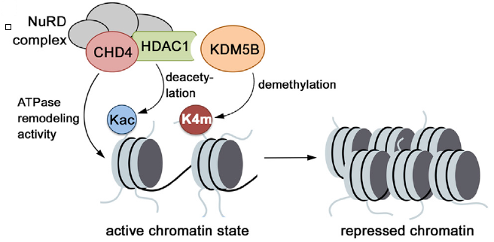
Figure JARID1B/KDM5B cooperates with NuRD complex to remove activating marks (H3K4me3) and remodel chromatin to produce a completely repressed state at the level of promoters (adapted from Klein et al., 2014)

Slide 30
Figure The model proposed by Li et al., 2014 (supplemental information): JARID1B/KDM5B is recruited to the site of damage through its parrylation by PARP1 and recognition by macro domain of macroH2A1.1. JARID1B demethylates H3K4me3 facilitating DDR proteins recruitment.

Slide 31
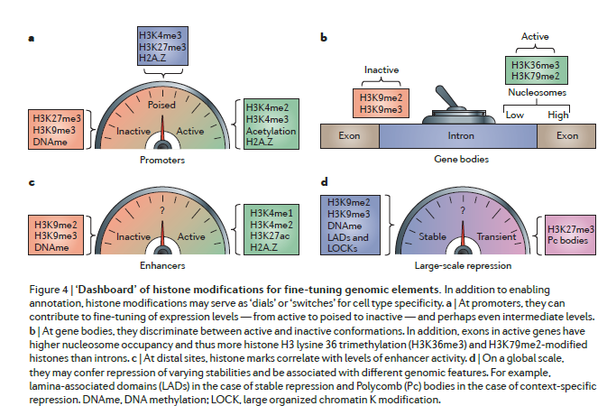
Vicky W. Zhou et al., 2011

Slide 32
Epigenetic control of neural stem/progenitor cell self-renewal and
differentiation
E. Cacci, R. Negri, S. Biagioni, G. Lupo
Current Topics in Medicinal Chemistry (CTMC) 2015 under revision
mESC
H3K27me3
H3K4me2/me3
Activation genes
Bivalent promoters
poised for activation
Methylated DNA
Not methylated H3K4
Pluripotency genes
Non-neural lineages
H3K4me2/me3
H3K27me3
NSPC
NSPC-Specific
Alternative lineages
H3K27me3
H3K4me2/me3
mESC = mouse Embrionic Stem Cell
NSPC =Neural Stem/Progenitor Cell
Neuronal Specific
Poised
Repressed
Neuronal cells
H3K4me2/me3
Active

Slide 33
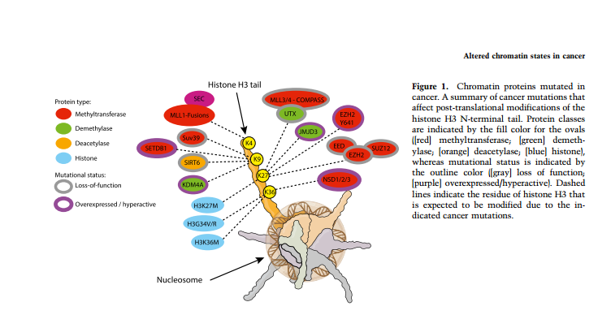
Chromatin signatures of cancer Marc A. Morgan and Ali Shilatifard, 2015

Slide 34
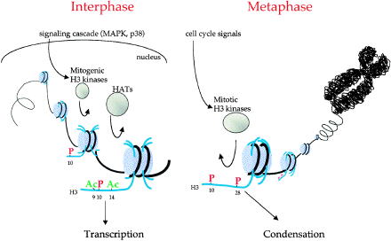
Phosphorylation
H3 phosphorylation
is important in gene activation
and mitotic chromosome condensation

Slide 35
Phosphorylation
La fosforilazione sembra essere un processo importante per la capacità di
creare un “concentramento di cariche”.
H2A.X contiene un sito
che viene fosforilato in
risposta alle DSBs
La fosforilazione delle zone positive
di H1 favorisca la dissociazione di
questo dal DNA
La variante istonica H2A.Z
è sensibile alla fosforilazione
attraverso un meccanismo
ancora poco chiaro

Slide 37
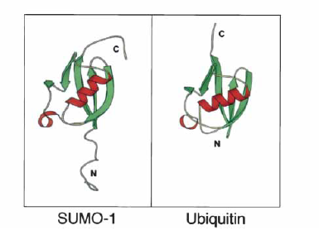
Sumolylation
Ubiquitylation
Sumo is an
ubiquitine-like protein
Histone sumolylation
is associated to:
Gene expression
Chromatin structural
changes
Signal transduction
Genome stability
Not related to degradation
Associated to:
DNA repair
Cell cycle control
Transcriptional regulation
Not related to degradation
Substrate: H4 lysine
Associated to gene repression
Substrate: H2B lysine 123
Ligase: RAD6

Slide 38
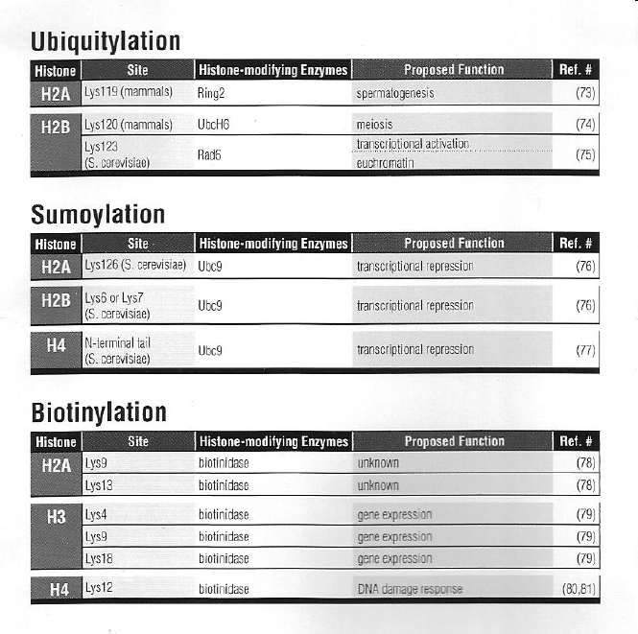

Slide 39
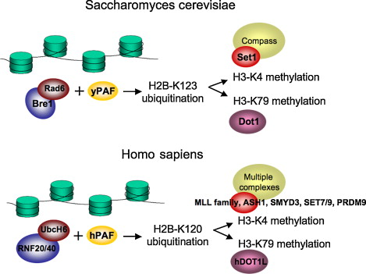
Regulative cross-talks among histone modification

Slide 40
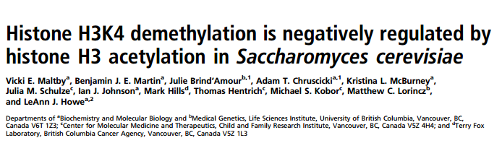
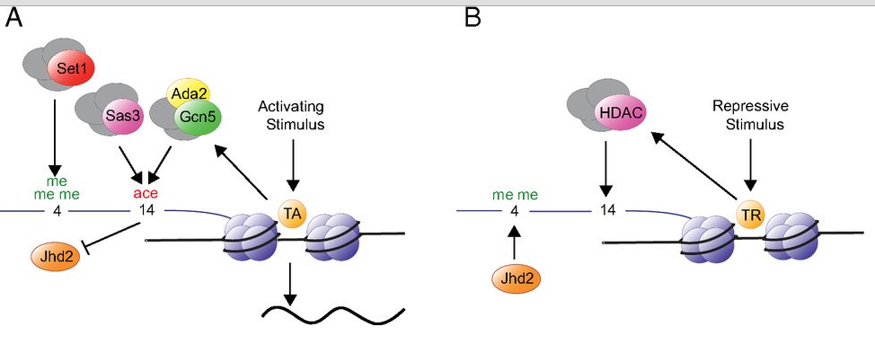

Slide 41
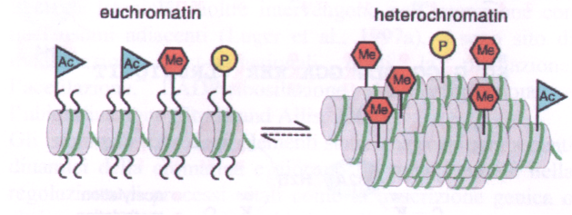
The histone code

Slide 42
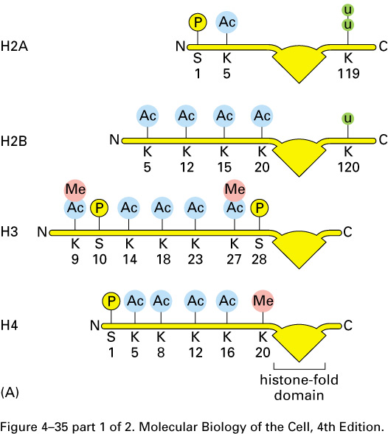
The histone code
Allis proposed that the combination of the different aminoacids modifications on the histone tails formed a real functional code

Slide 43
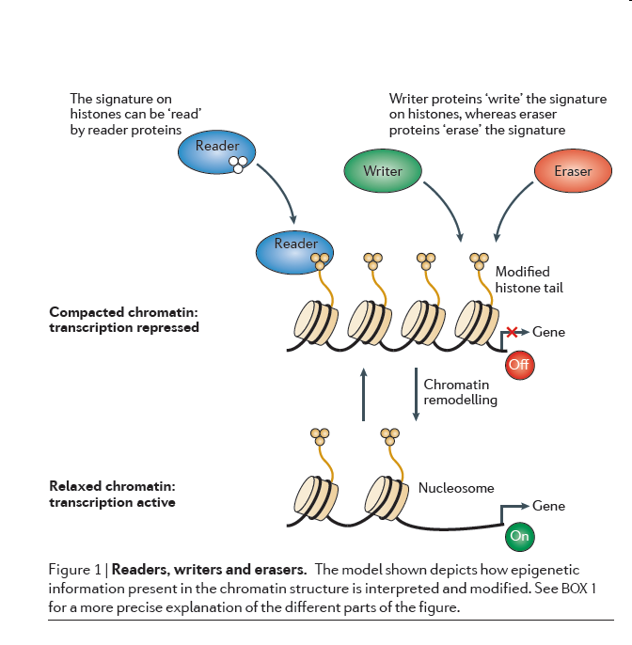
W. Højfeldt et al., 2014

Slide 44
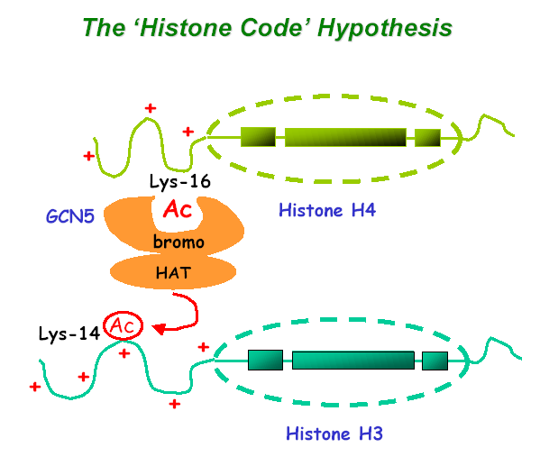
Histone code

Slide 45
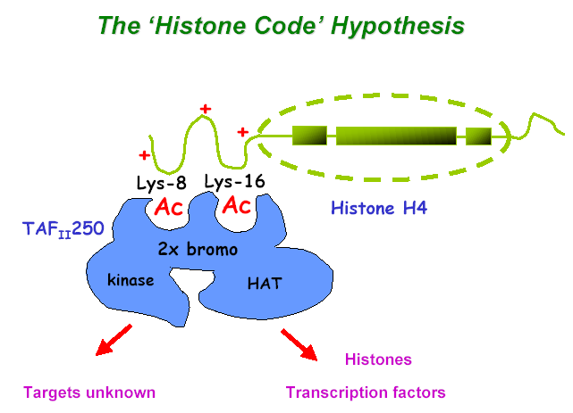
Histone code

Slide 46
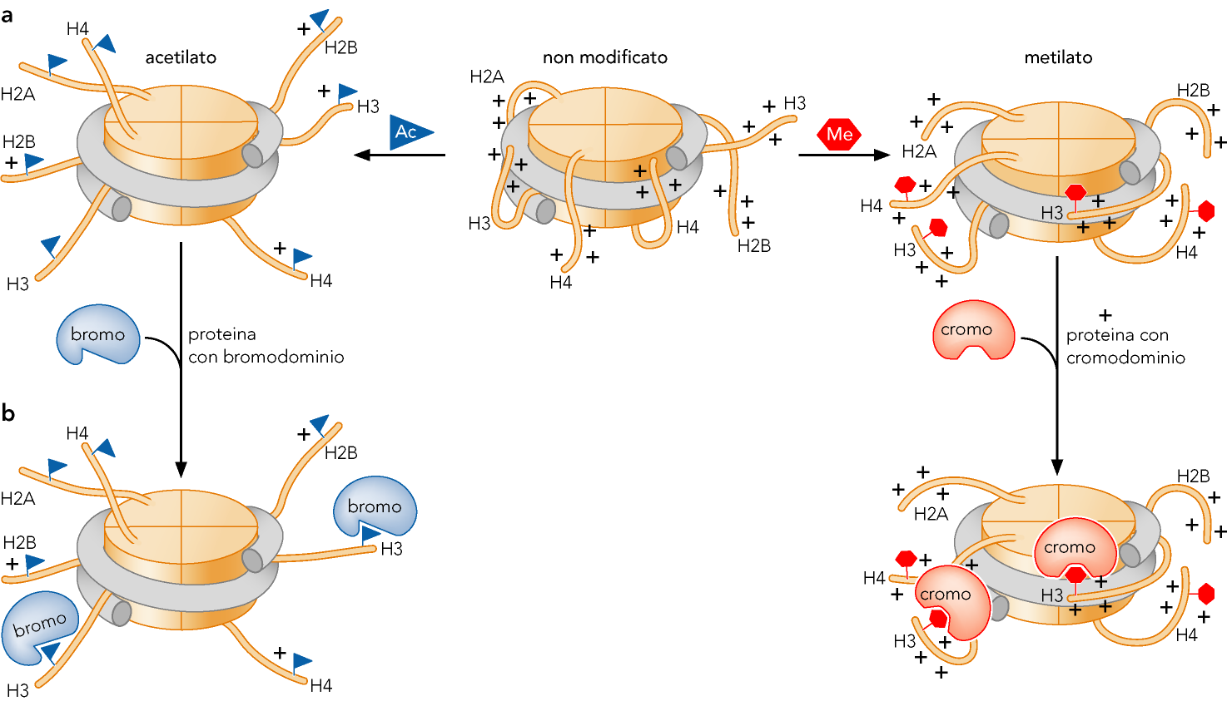

Slide 47
Nucleosome remodeling
Chromatin remodelers acquire energy through ATP hydrolysis to remodel chromatin
Numerous chromatin remodeling complexes exits
They differ in the core DNA-dependent ATPase subunit
There is some sharing of factors between complexes and homologs between species
There are 3 main classes (more could follow)
SWI/SNF
snf2
RSC
sth1
NURF
iswi

Slide 48
Nucleosome remodeling
The SWI/SNF complex
SNF2
ARP9
SWI (switch)
SNF (sucrose non fermenting)
SWI1
SNF5
11 subunits
~1 MDa
Snf2 is an ATPase
ARP7
SNF11
SWI3
SWp82
ANC1/
TGF3
SNF6
SNF12/SWP73
Subunit | Size (kDa) | Function
SWI2 / SNF2 | 194 | DNA dependent ATPase
SWI1 | 148 | AT-rich interaction domain (ARID) for non-specific binding, Zn-finger protein
SNF5 | 103 | Assembly and catalytic functions of the complex
SWI3 | 93
SWp82p | ~82
SNF12 / SWP73 | 64
ARP7 | 54 | Actin-related protein
ARP9 | 53 | Actin-related protein
SNF6 | 38
ANC1 / TFG3 | 27
SNF11 | 19 | Interacts with the N-terminal D1 region of SWI2

Slide 49
Nucleosome remodeling
The RSC (remodels the structure
of chromatin) complex
Rsc1
Rsc2
Sth1
ARP9
12+ subunits
~1 MDa
Sth1 (Snf two homolog) is an ATPase
Sfh1
Rsc30
ARP7
Rsc6
Rsc9
Rsc8
Rsc3
Rsc4
Subunits with no known homolog in Swi/Snf
Subunit | SWI/SNF homolog | Size (kDa) | Function
Sth1 | SWI2 / SNF2 | 157 | DNA dependent ATPase
Rsc1 |  | 107
Rsc2 |  | 102
Rsc3 |  | 102
Rsc30 |  | 101
Rsc4 |  | 72
Rsc8 | SWI3 | 63 | Subunit assembly, binds through C-terminal coiled coil domain
Rsc9 |  | 65
Sfh1 | SNF5 | 49 | Assembly and catalytic functions of the complex
Rsc6 | SWP73 | 54
Arp7 | ARP7 | 54 | Actin-related protein
Arp9 | ARP9 | 53 | Actin-related protein

Slide 50
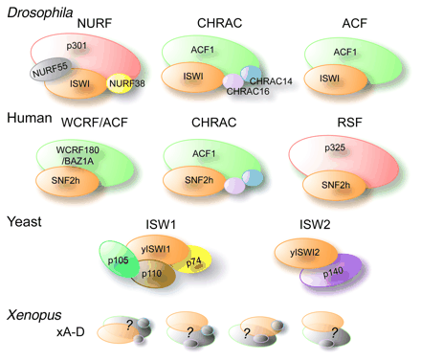
Nucleosome remodeling
Multiple types of ISWI complexes exits

Slide 51
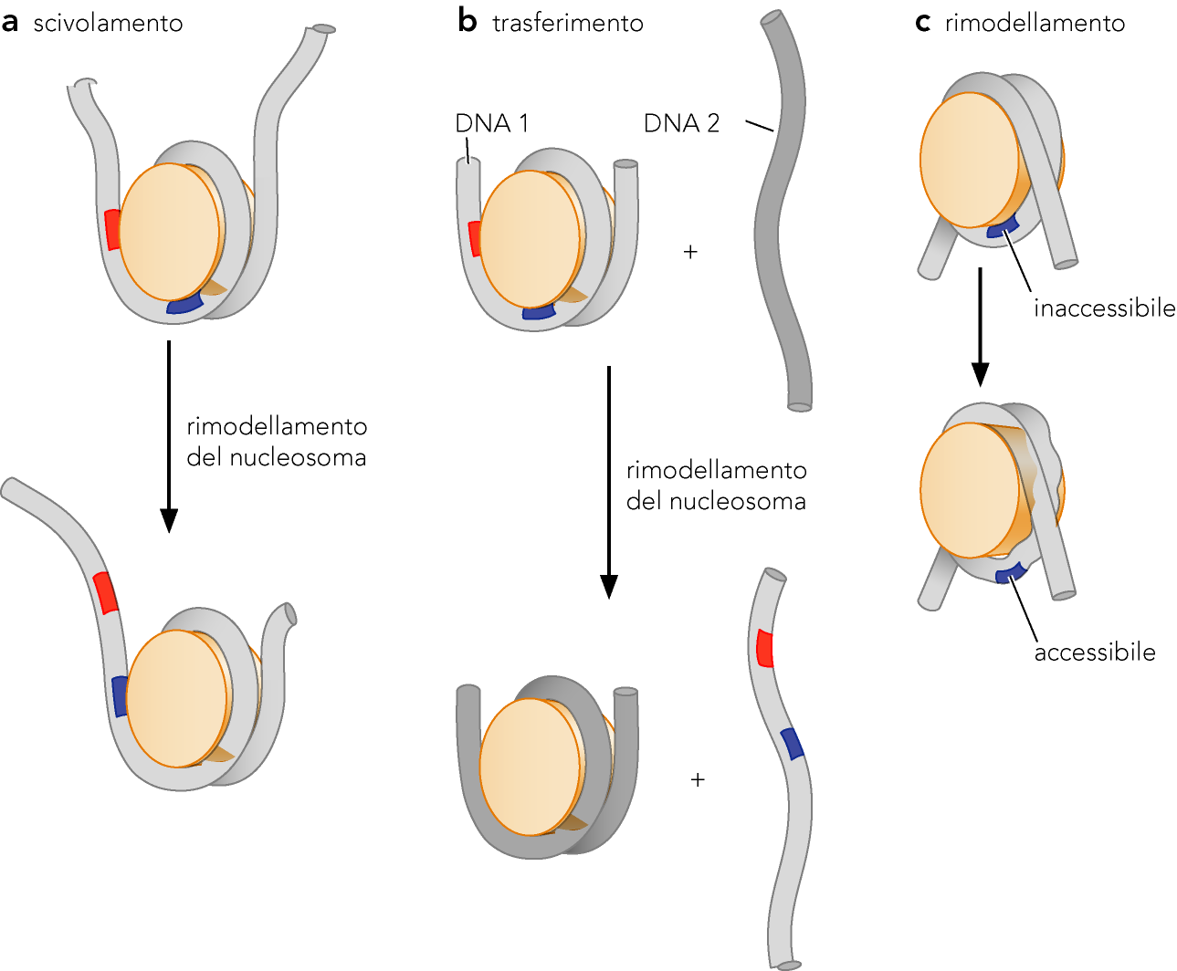
Sliding
Transfer
Remodeling

Slide 52
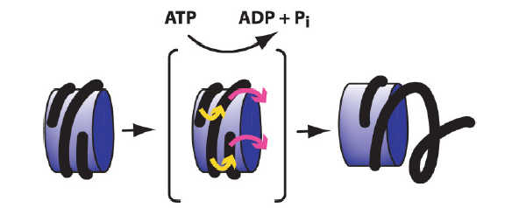
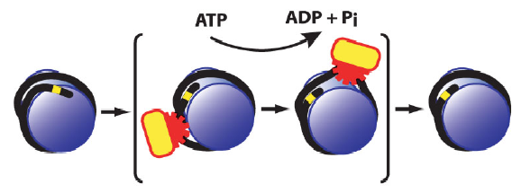
Nucleosome remodeling
SNF
ISWI
Alexandra Lusser and James T. Kadonaga 2003 Wiley Periodicals,
Notes:
A lateral cross-transfer model for nucleosome remodeling by SNF2 subfamily complexes. In this model, a SNF2 subfamily
complex catalyzes the rearrangement of one superhelical turn of nucleosomal DNA to the adjacent track on the histone octamer while the
other superhelical turn of DNA is displaced from the nucleosome.
ADNAtranslocation model for nucleosome remodeling by ISWI subfamilycomplexes. In this model, an ISWI subfamilycomplex
is anATP-driven DNA-translocating enzyme that disrupts contacts between histones and DNA. After passage of the enzyme, histone–DNA
contacts are reestablished to give a canonical nucleosome that is located at a different position relative to the DNA template.

Slide 53
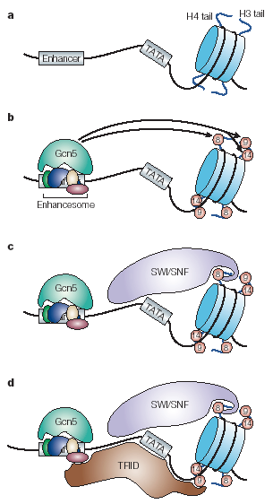
Control of chromatin structure.
Histone modifications
Nucleosome remodeling

Slide 54
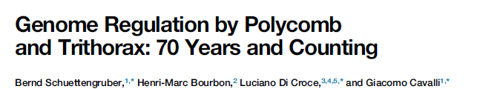

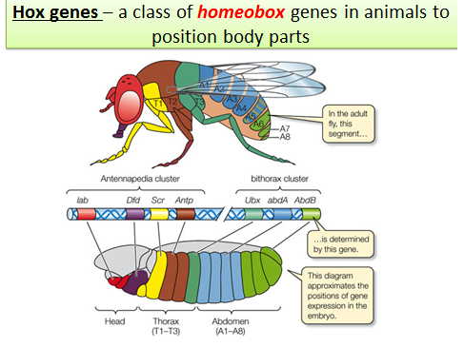

Slide 55
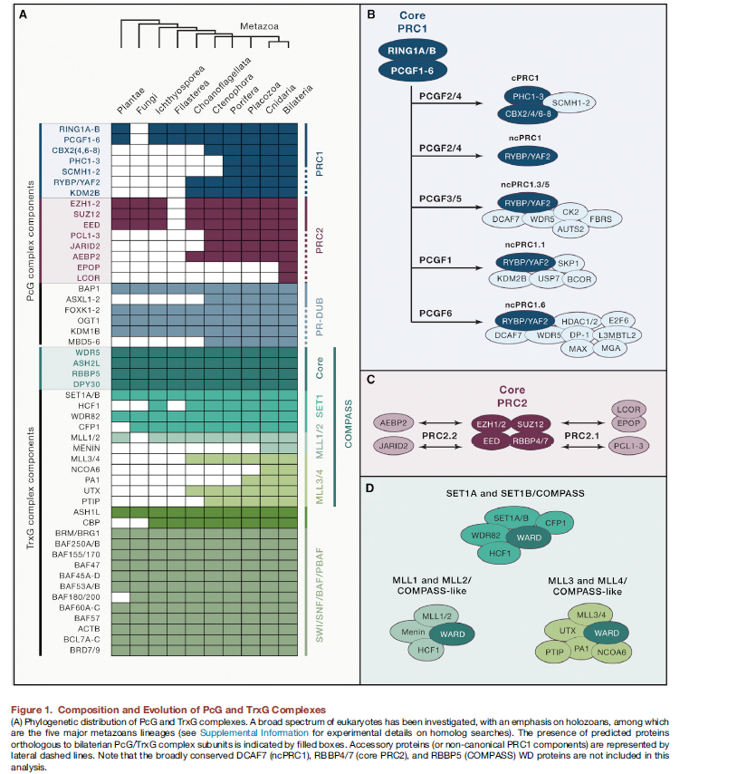

Slide 56
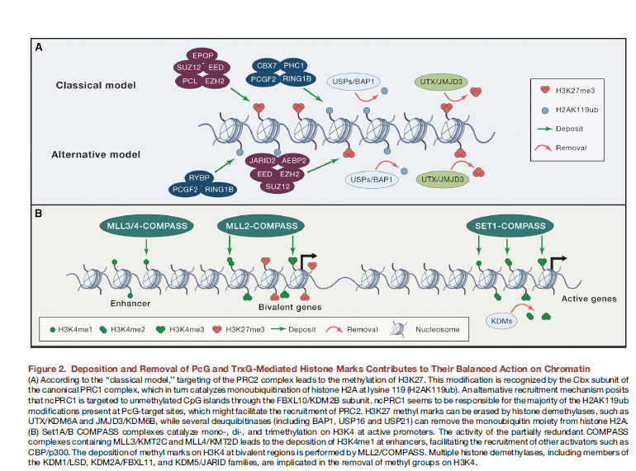

Slide 57
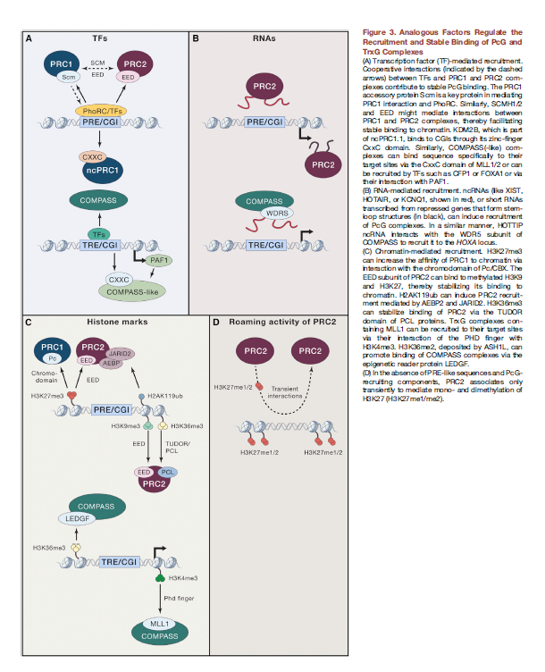

Slide 58


Slide 59


Slide 60


Slide 61


Slide 62
THE HISTONE SONG
(Sulla musica dei "Flintstones")
Histones!
Meet the Histones!
They're a basic protein family.
There are
Just four subtypes.
They're conserved evolutionarily.
Two each
Of each histone
Do their thing.
Forming
Just like beads upon a string.
H1
Binds the complex.
And it inhibits new transcription
And the creation
Of new mRNA.

