Slide 1
Sistemi di analisi delle interazioni genetiche e fisiche tra i geni
Parte II

Slide 3
Interaction of genetic background & environment
Investigating the impact that intra-specific and inter-specific variation have on the phenotypes and fitness
Genetic redundancy
Mutations
Phenotype
Environment
Genetic background
Cross all Yeast Deletion Collection with different yeast strain and species.
Study of the haploisufficiency profile in different environments
Dowell R.D. Ryan O., et al.,…& Boone C. (2010), Science 328: 469

Slide 4
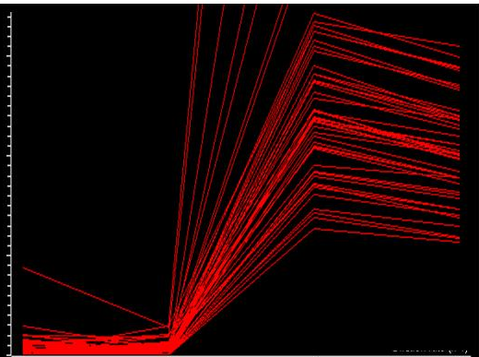
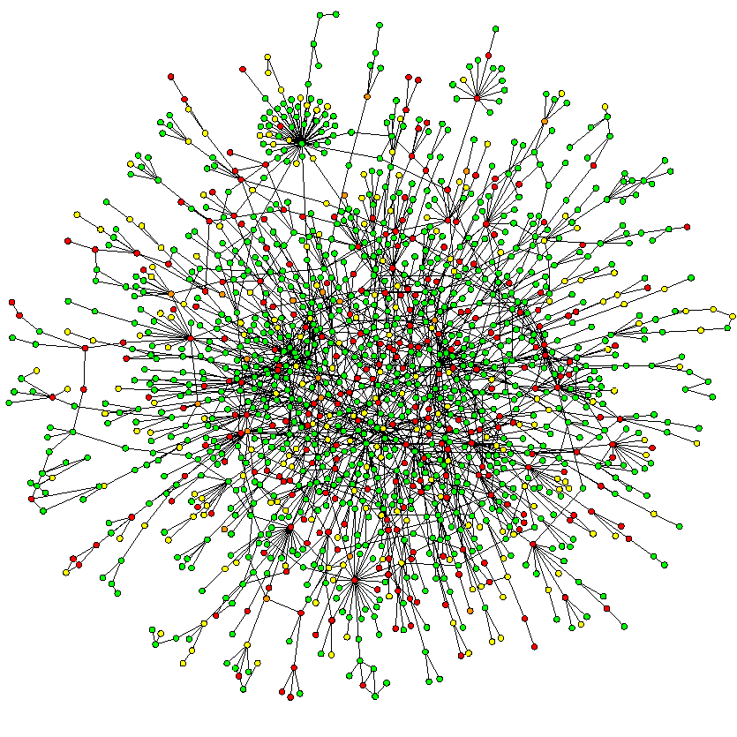
Functional analysis from single gene to gene network
Env1
Genomic level
Single/multiple gene knockout
Phenotypic assays
Env2
Env3
Env4
Transcriptome
Study of the expression profile of the cell under different physiological conditions.
Cluster analysis
Proteome
Study of the proteins produced by a cell under different physiological conditions. Protein-protein interaction.

Slide 5
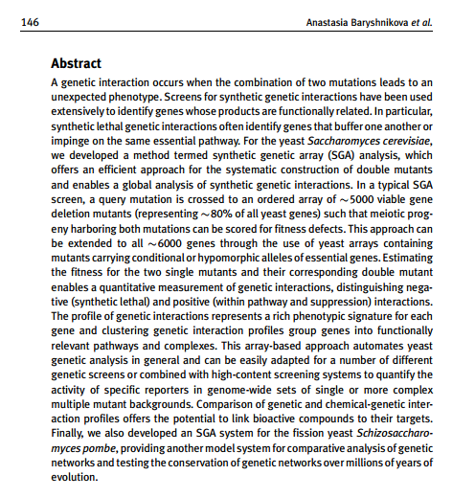

Slide 6
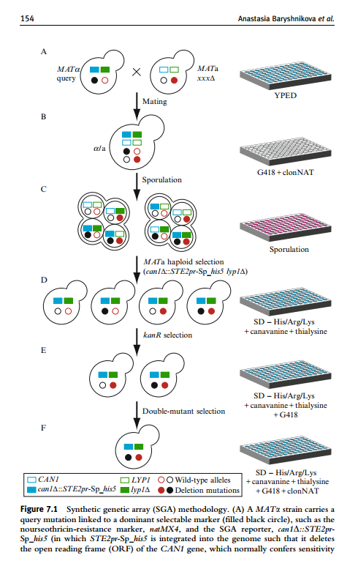

Slide 7
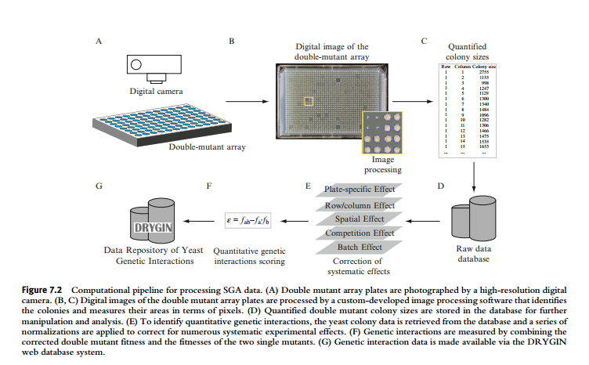

Slide 9
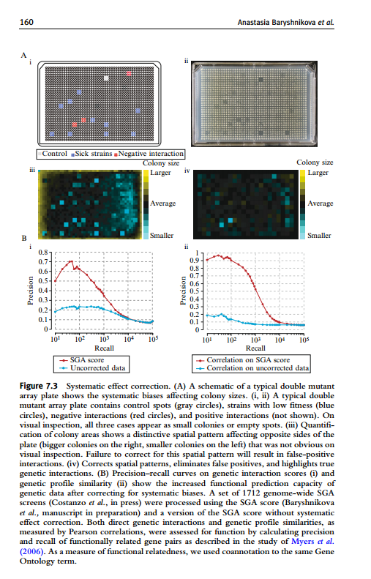

Slide 10
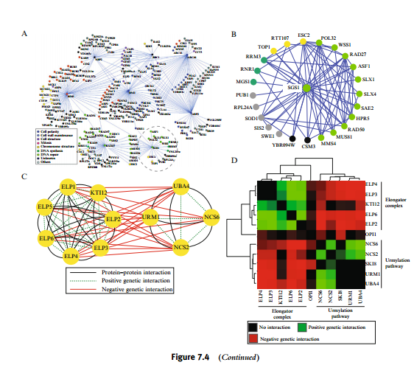

Slide 11
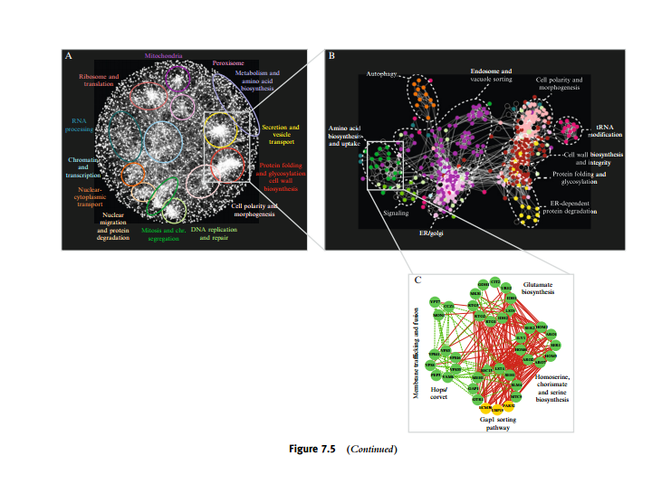

Slide 12
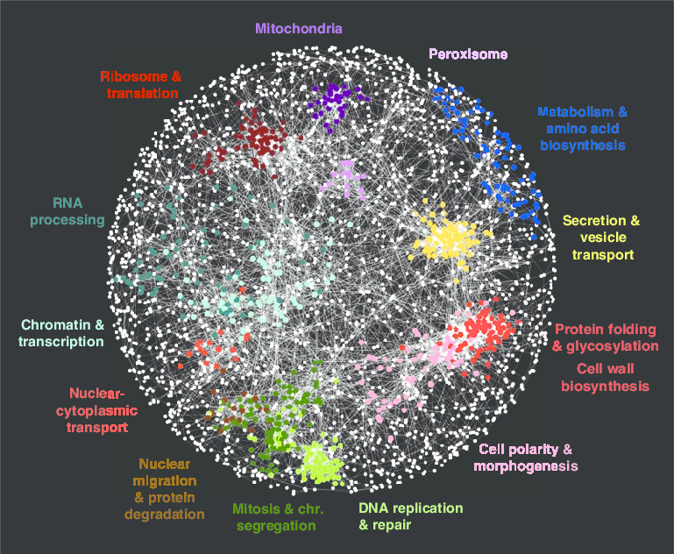

Slide 13
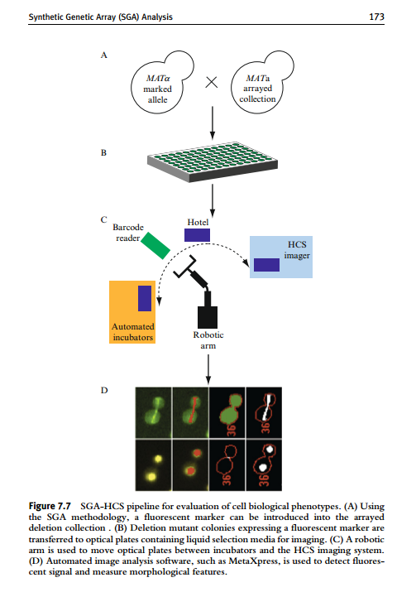

Slide 14
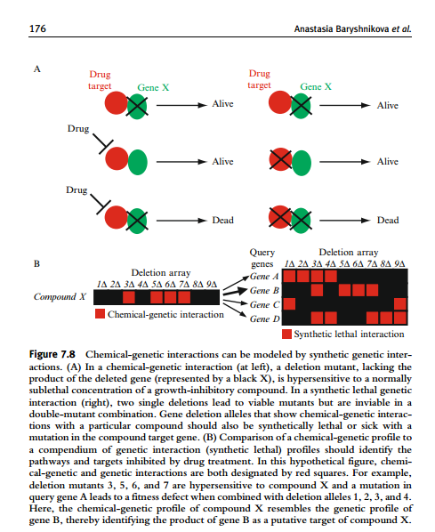

Slide 16
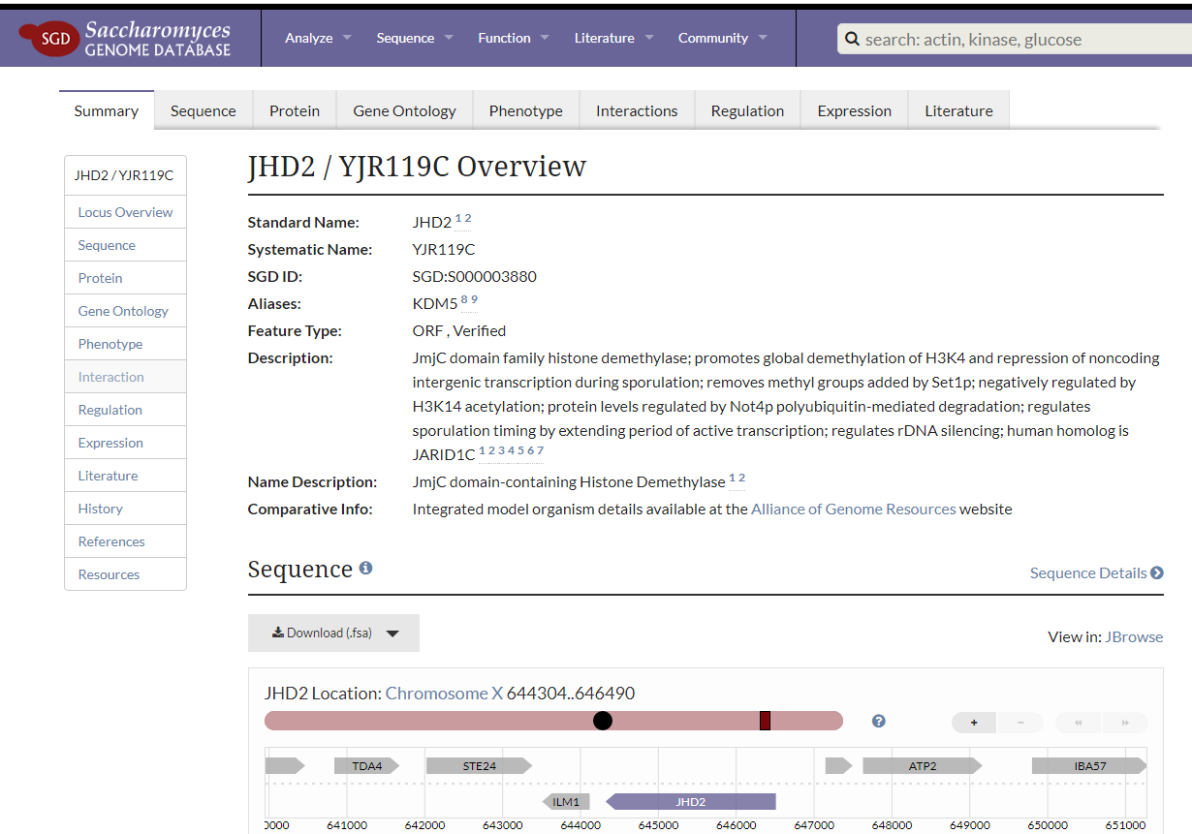

Slide 17
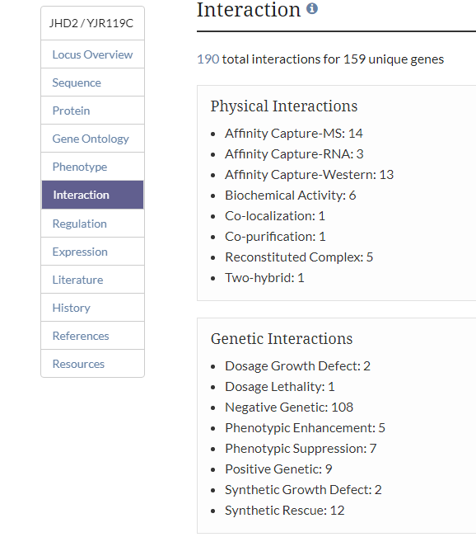

Slide 18
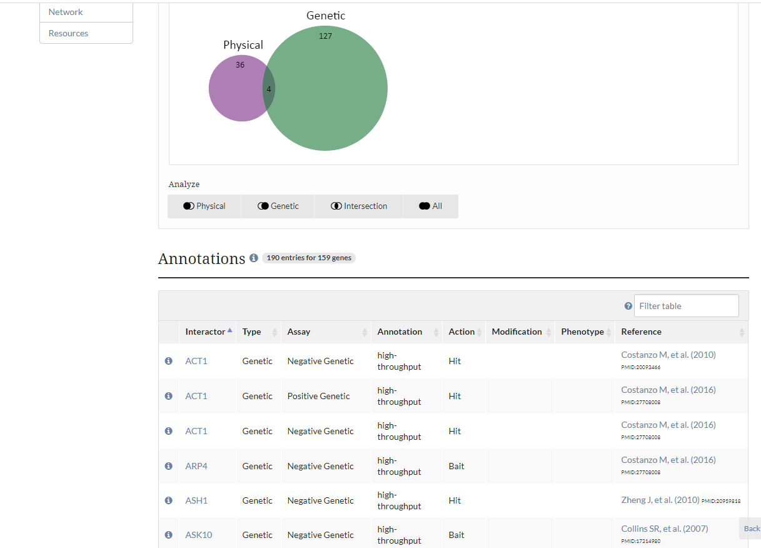

Slide 19
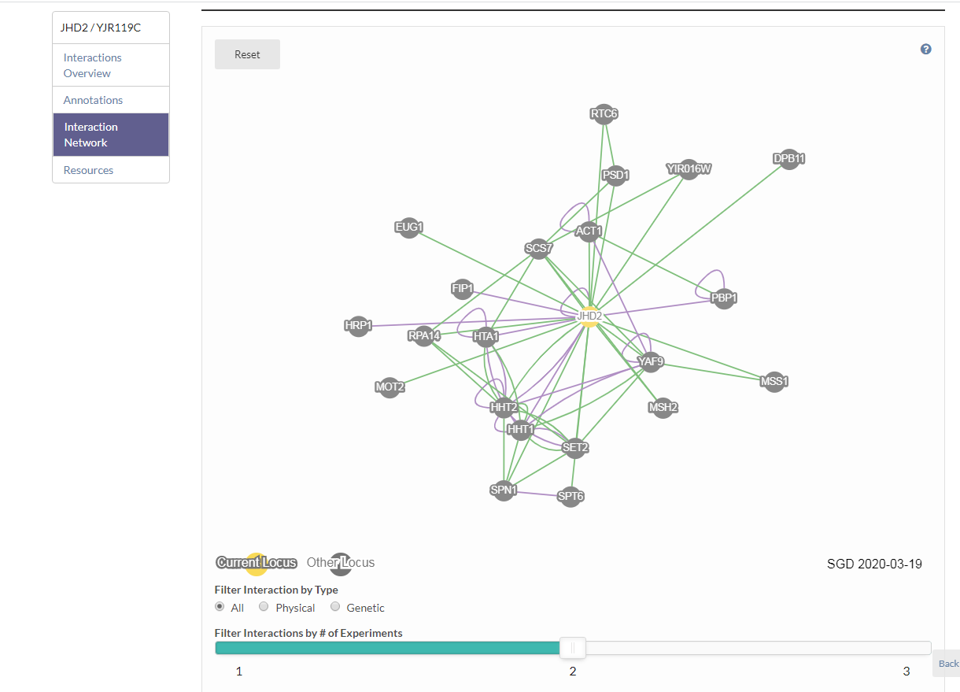

Slide 21
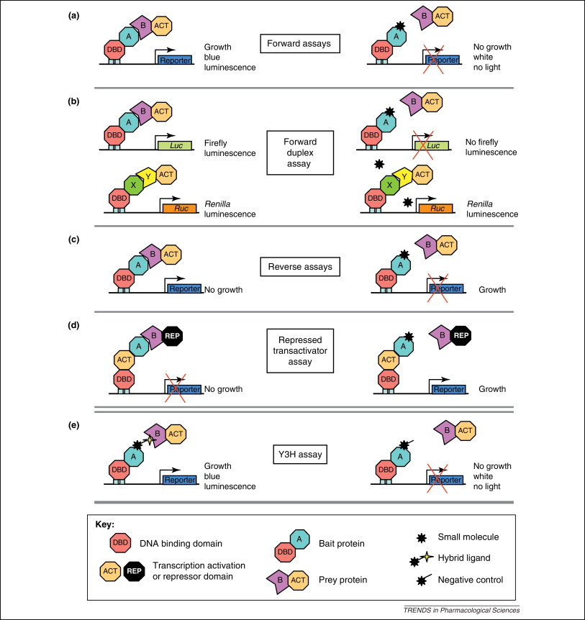

Slide 22
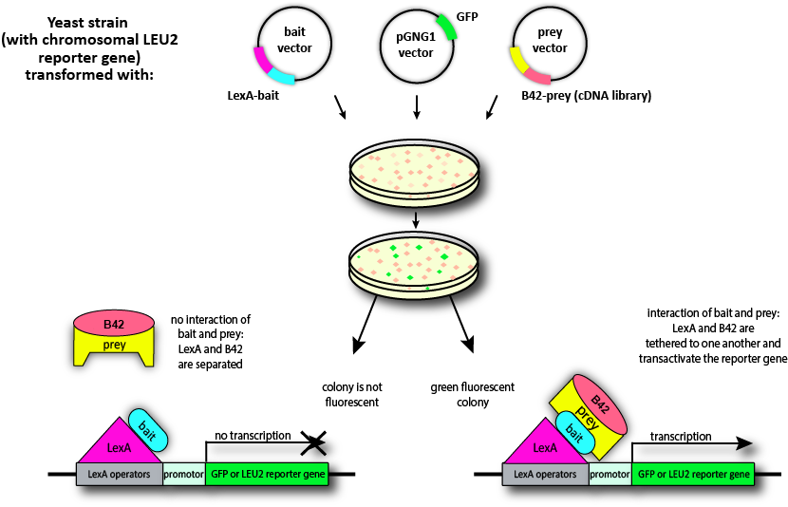

Slide 23
