Slide 1
Clinical management of cardiovascular risk
Maria Del Ben

Slide 3
Strategies for cardiovascular disease prevention are based on the evaluation of CVD global risk rather than on the level of individual risk factors

Slide 4
LDL cholesterol
LDL cholesterol reduction should be the first target of any intervention aimed at the reduction of cardiovascular risk.

Slide 5
LDL CHOLESTEROL =
TOT COL – HDL COL – (TG/5)
Friedwald Formula

Slide 6
Global cardiovascular risk
Usually, it calculates the probability to have a fatal or non fatal CVD event in the following 10 years.
Tools
Algorithms for the
calculation of Risk
Charts for the calculatin of risk
Notes:
Per stimare il rischio assoluto del soggetto sono stati elaborati degli algoritmi, che permettano al medico di calcolare velocemente il rischio assoluto
Per valutare il rischio di sviluppo delle malattie cardiovascolari sono stati sviluppati diversi modelli di rischio multifattoriale.
La Task Force raccomada l’utilizzo del modello SCORE e di carte del rischio
Il rischio viene ora definito come probabilità assoluta di sviluppare un evento cardiovascolare fatale a 10 anni
Pazienti con coronaropati conclamata, arteriopatia periferica e cerebrovasculopatia aterosclerotica sono di pe se’ ad alto rischio cardiovascolare. Ma le carte servono per individuare tra i soggetti sani quelli ad alto rischio, su cui concentrare sforzi di prevenzione.
La II Task Force dell’ES raccomandava il calcolo del rischio in funzione dei fattori più comuni e convalidati (sesso, età, fumo, ipertensione, colesterolo), utilizzando “scale” o “carte” del rischio CV globale.
In base a questo criterio, anche pazienti senza precedenti manifestazioni cliniche di processi aterosclerotici, potevano rientrare nella categoria dei pazienti ad alto rischio e quindi da privilegiare nell’indirizzo delle risorse terapeutiche.
Abbiamo a disposizione uno strumento che ci consente di inquadrare il “mio” paziente al quale devo garantire un trattamento adeguato al “suo” profilo di rischio di nuovi eventi coronarici.

Slide 7



Global cardiovascular risk
1) Subjects with:
• cardiovascular disease
• type 1 and 2 diabetes and microalbuminuria
• very high levels of a single risk factor
• cronic renal dysfunction
are, by definition, at high or very high risk
2) For the remaining subjects, risk evaluation using risk charts is necessary
Subjects with multiple risk factors may have a very high risk.

Slide 8
CHD RISK CALCULATOR From The Framingham Heart Study |  | Enter Values Here
CHD(MI and Coronary Death) Risk Prediction
Risk Factor | Units
Gender | M or F | F
Age | years | 70
Total Cholesterol | mg/dL | 180
HDL | mg/dL | 60
Systolic Blood Pressure | mmHg | 119
Treatment for Hypertension {Only if SBP>120} | yes (y) or no (n) | n
Current Smoker | yes (y) or no (n) | y
Time Frame for Risk Estimate | 10 years | 12

Slide 9
The SCORE system for the estimate of global risk
There are two charts:
low risk to be used in Belgium, France, Italy, Spain, Switzerland e Portugal;
high risk to be used in the other European countries

Slide 10
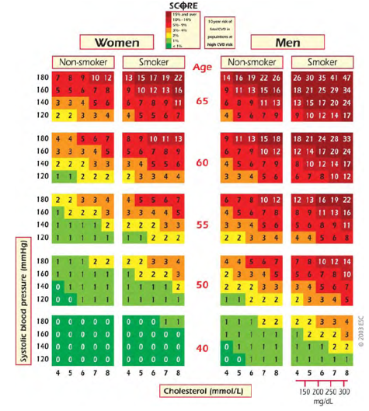
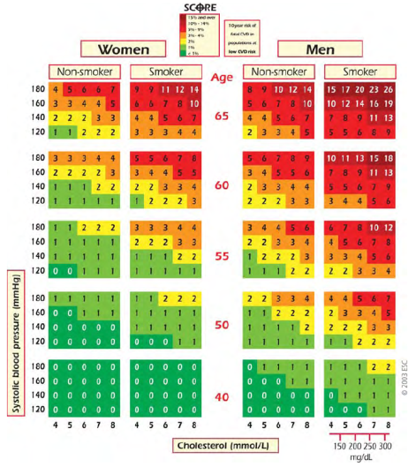
The SCORE Project
High CVD Risk
Low CVD Risk
10-year risk of fatal cardiovascular disease (CVD) in populations at high(left) or low (right) CVD risk based on the following risk factors: age, gender, smoking, systolic blood pressure, and total cholesterol.
Notes:
Low Risk Regions: Belgio, Francia, Lussemburgo, Grecia, Italia, Spagna, Svizzera, Portogallo
10

Slide 11

Risk classes
SCORE ≥10%
CHD; stroke; PVD; aorto-coronaric by-pass; diabetes with one or more risk factors and/or markers of organ damage; severe renal failure with GF 15-29 ml(min
TARGET: C-LDL < 70 mg/dl (at least, 50% reduction)
Very high
SCORE ≥5% e <10%
Familial hypercholesterolemia,; Severe hypertension;diabetes without organ damage; moderate renal failure with GF 30-59 ml/min
TARGET: C-LDL < 100 mg/dl
High
SCORE ≥1% e <5%
Family history of CHD, abdominal obesity, sedentary habits, HDL-C, TG, hs-CRP, Lp(a), fibrinogen, homocysteine, apo B,
TARGET: C-LDL < 115 mg/dl
Moderate
SCORE <1%
TARGET: C-LDL < 130 mg/dl
Medium

Slide 12
CLASSES OF RISK |  | LDL-C TARGETS
VERY HIGH | Coronary artery disease or equivalents. Type 1 or 2 diabetes with organ damage. moderate/severe CRI SCORE >10% | <70
HIGH | Very high level of a single risk factor SCORE >5% | <100
MODERATE | SCORE >1% a <5% | <115

Slide 13
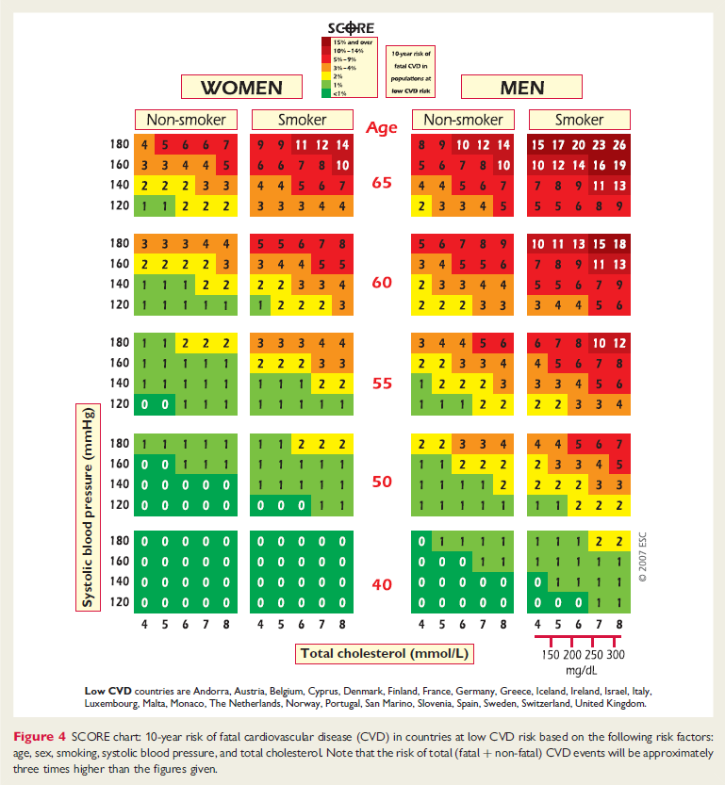

Slide 14

The new US guideline recommendations for CV prevention
Obesity should be managed and treated like a disease
The best strategy to lose weight and keep it off requires a three-pronged approach: Eat fewer calories than your body needs, exercise more and change unhealthy behaviors.
Statin therapy is recommended for the following groups:
People without cardiovascular disease who are 40 to 75 years old and have a 7.5 percent or higher risk for heart attack or stroke within 10 years.
People with a history of heart attack, stroke, stable or unstable angina, peripheral artery disease, transient ischemic attack, or coronary or other arterial revascularization.
People 21 and older who have a very high level of bad cholesterol (190 mg/dL or higher).
People with Type 1 or Type 2 diabetes who are 40 to 75 years old.
http://blog.heart.org/new-heart-disease-and-stroke-prevention-guidelines-released/#sthash.CLMocICS.dpuf

Slide 15
The lower, the better
The lower the LDL cholesterol, the lower the chances of having a cardiovascular event
The higher the risk, the greater the need to lower LDL cholesterol and to make treatment more aggressive

Slide 18
Therapeutic equivalence of statins
Low power
High power
M. Bucci, A. Mezzetti. Ateroma 2007,anno VI suppl.1
Dati da Law; BMJ 2003; 326: 1423
Notes:
18

Slide 19
IMProved Reduction of Outcomes: Vytorin Efficacy International Trial
IMPROVE-IT
A Multicenter, Double-Blind, Randomized Study to Establish the Clinical Benefit and Safety of Vytorin (Ezetimibe/Simvastatin Tablet) vs Simvastatin Monotherapy in High-Risk Subjects Presenting
With Acute Coronary Syndrome

Slide 20
Goals
IMPROVE-IT: First large trial evaluating clinical efficacy of combination EZ/Simva vs. simvastatin
(i.e., the addition of ezetimibe to statin therapy):
  Does lowering LDL-C with the non-statin agent ezetimibe reduce cardiac events?
  “Is (Even) Lower (Even) Better?”
  (estimated mean LDL-C ~50 vs. 65mg/dL)
  Safety of ezetimibe
Cannon CP AHJ 2008;156:826-32;
Califf RM NEJM 2009;361:712-7; Blazing MA AHJ 2014;168:205-12

Slide 21
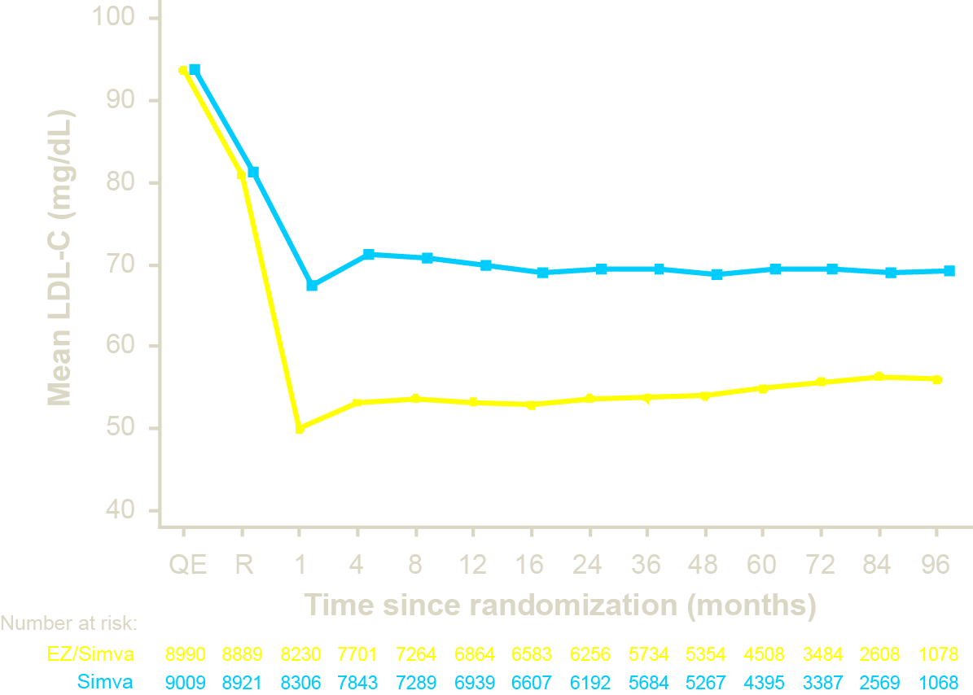
LDL-C reduction
Median Time avg
69.5 vs. 53.7 mg/dL
-17 mg/dL

Slide 22
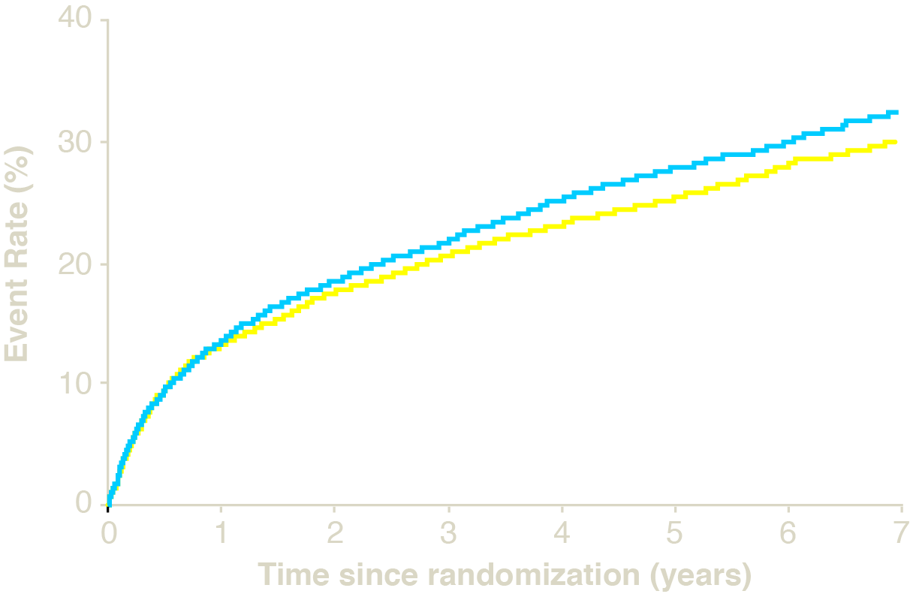
Primary endpoint
7 year event rates
HR 0.924 CI (0.868, 0.983)
p=0.012
Simvastatin 34.7%
2,742 events
Ezetimibe/Simvastatin 32.7%
2,572 events
Endpoint primari: morte CV, IMA, ricovero per angina,
Rivascolarizzazione coronarica (≥ 30 gg dopo randomizzazione), o stroke
Notes:
3 part build slide with table, lg graph, insert

Slide 23
Main results
IMPROVE-IT: First trial demonstrating incremental clinical benefit when adding a non-statin agent (ezetimibe) to statin therapy:
  Non-statin lowering LDL-C with ezetimibe
  reduces cardiovascular events
  Even Lower is Even Better
  (achieved mean LDL-C 53 vs. 70 mg/dL at 1 year)
  Confirms ezetimibe safety profile
Reaffirms the LDL hypothesis, that reducing LDL-C prevents cardiovascular events

Slide 24
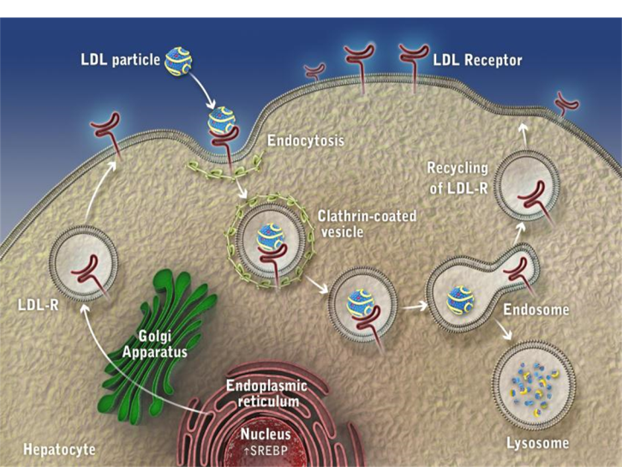
Goldstein&Brown 1985
Lambert G et al. J Lipid Res. 2012. 53: 2515–2524.

Slide 25
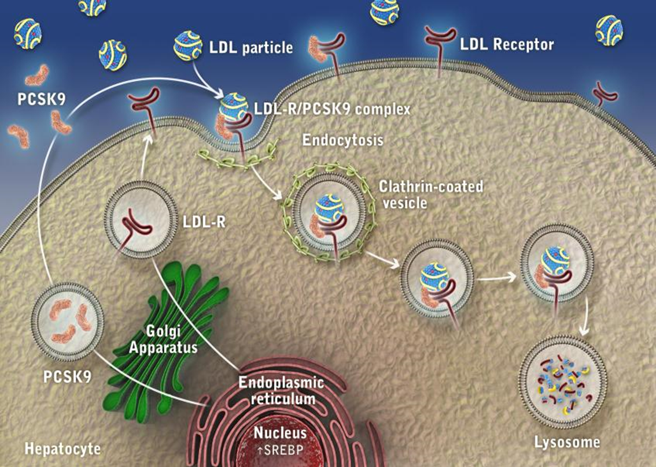
PCSK-9 Physiology
2004
Lambert G et al. J Lipid Res. 2012. 53: 2515–2524.

Slide 26
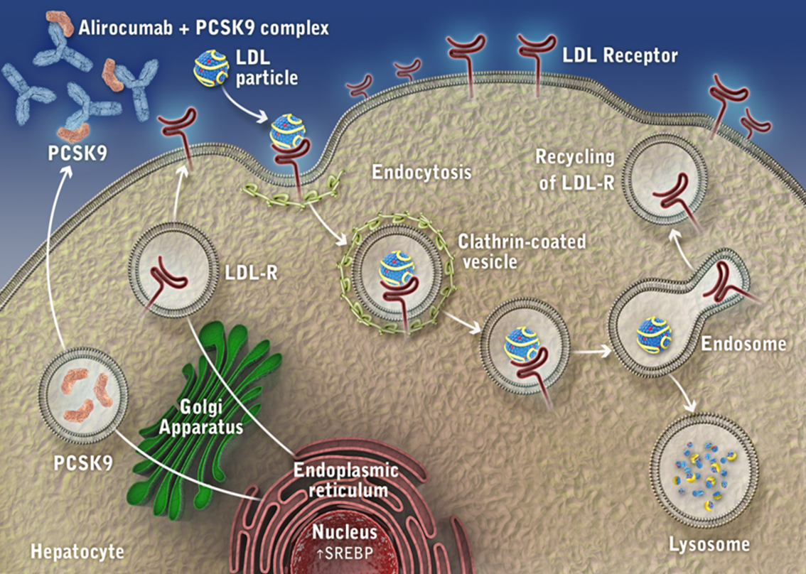
FDA Approval 2015
PCSK-9 Inhibitors
Lambert G et al. J Lipid Res. 2012. 53: 2515–2524.

Slide 27
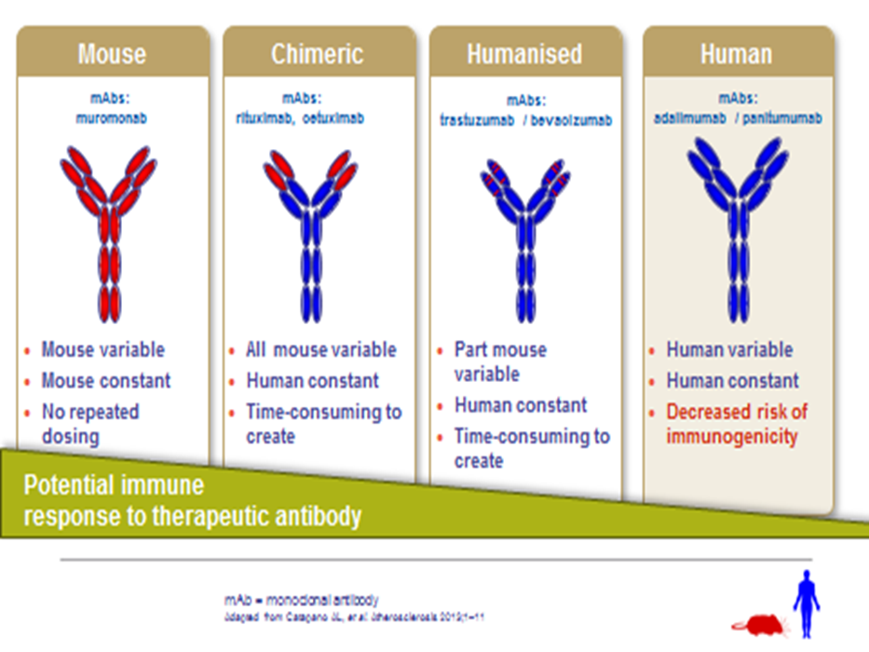

PCSK-9 Inhibitors
Alirocumab
Evolocumab

Slide 28
Design feature | ODYSSEY Outcomes | FOURIER
Patient population | Post ACS, 2-4-52 weeks from index event (median 2,6 months) | Stable ASCVD, i.e. MI, stroke or PAD (median ~3 years from index event)
No. of patients | 18,924 | 27,564
Age, years | 58 (median) | 63 (mean)
Women | 25% | 25%
LDL-C entry criteria mg/dl (mmol/L) | ≥70 (1.8) | ≥70 (1.8)
Baseline LDL-C mg/dl (mmol/L) | 87 (2.3) | 92 (2.4)
High intensity statin | 89% | 69%
Ezetimibe | 3% | 5%
PCSK9 inhibitor dose regimen | Alirocumab 75 or 150 mg every 2 weeks, titrated to target LDL-C (25-50 mg/dl) | Evolocumab 140 mg every 2 weeks or 420 mg every 4 weeks
Duration of follow-up, yr | 2.8 (44% with ≥3 years) | 2.2
Primary endpoint | CHD death, MI, ischaemic stroke, unstable angina requiring hospitalisation | CV death, MI, stroke, unstable angina, coronary revascularisation

Slide 31
LDL-C: On-Treatment Analysis
Placebo
101.4
∆ 48.1
mg/dL
105
90
75
60
45
30
15
0
96.4
93.3
∆ 55.7
mg/dL
Mean LDL-C (mg/dL)
∆ 54.1
mg/dL
–54.7%
–62.7%
–61.0%
53.3
Alirocumab
42.3
37.6
0 4 8 12 16 20 24 28 32 36 40
Months Since Randomization
Excludes LDL-C values after premature treatment discontinuation or blinded switch to placebo
44 48
Approximately 75% of months of active treatment were at the 75 mg dose

Slide 32
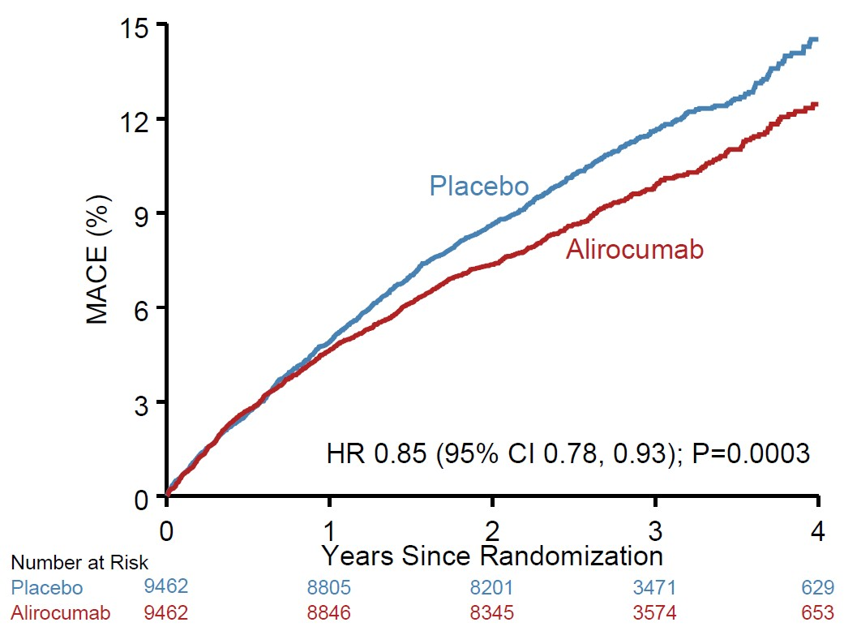
Primary Efficacy Endpoint: MACE
ARR* 1.6%
HR 0.85
(95% CI 0.78, 0.93) P=0.0003
MACE: CHD death, non-fatal MI, ischemic stroke, or
unstable angina requiring hospitalization
*Based on cumulative
incidence
31

Slide 33
Design feature | ODYSSEY Outcomes | FOURIER
Absolute change in LDL-C (mg/dl) | 54 at 12 months, 48 at 4 years | 56
% change in LDL-C | 61% | 59%
Relative reduction in primary endpoint | 15% (0.85, 0.78-0.93) | 15% (0.85, 079-0.92)
MI | 14% | 27%
Stroke | 27% | 21%
Unstable angina | 39% | 1%
CVD death | 12% (NS) | 5% increase (NS)
All-cause death | 15% (*P=0.026) | 4% increase (NS)

Slide 34
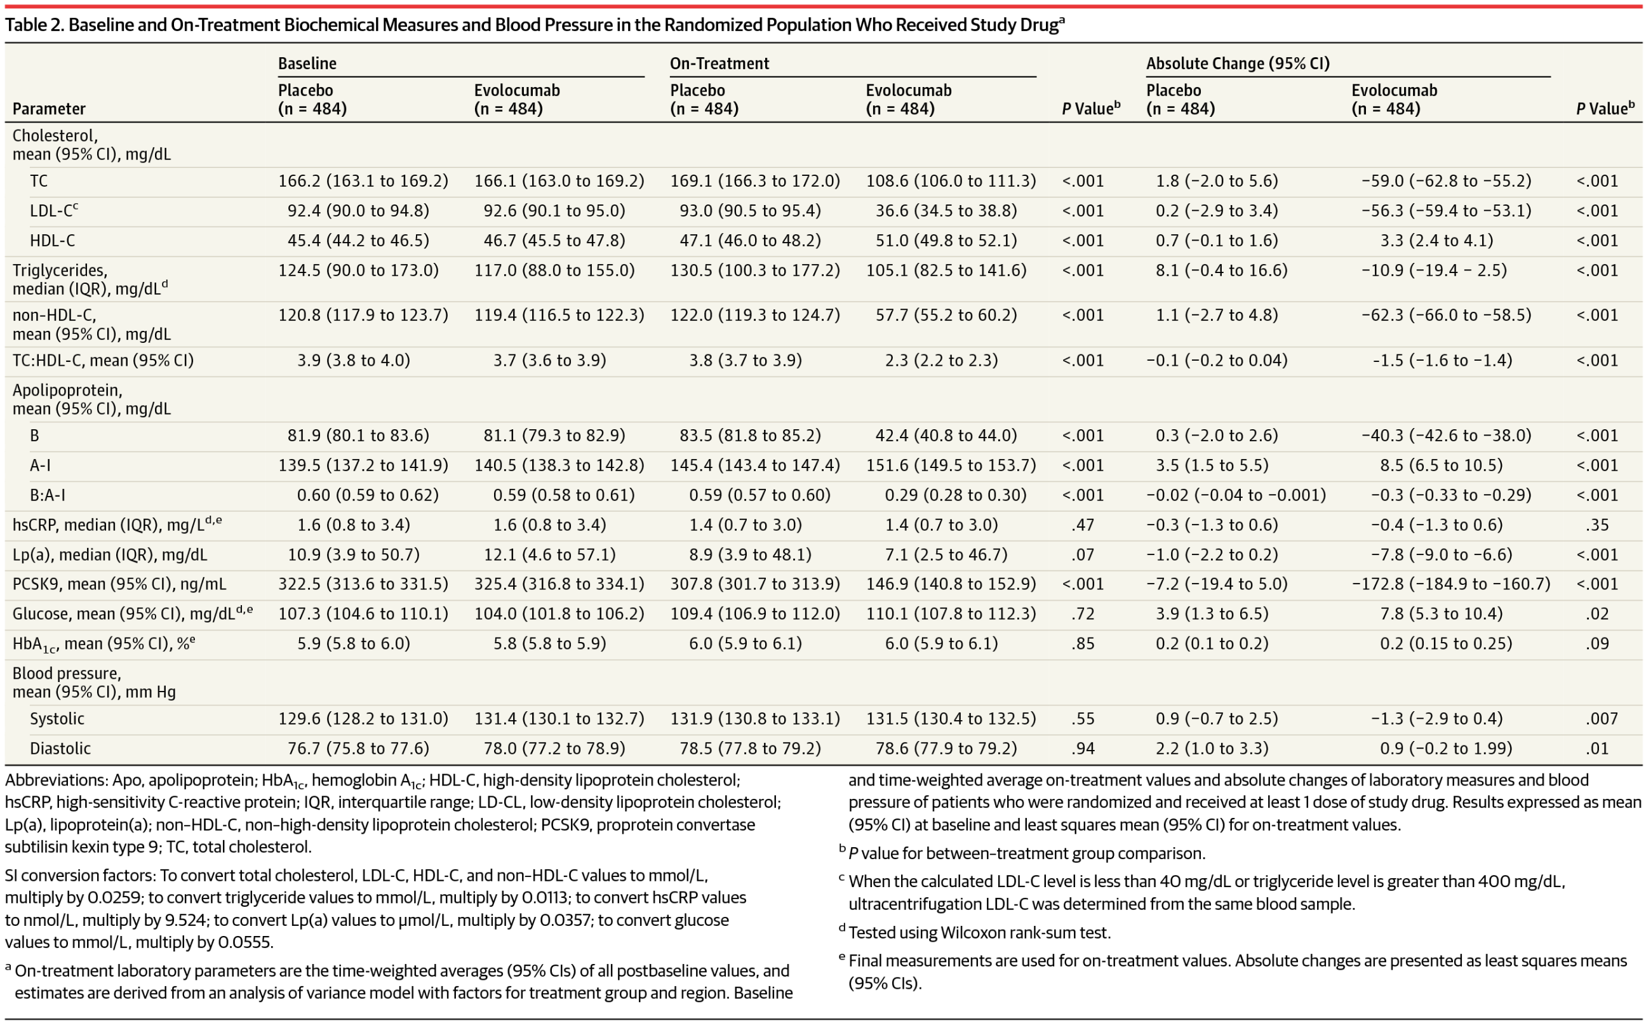

Slide 35
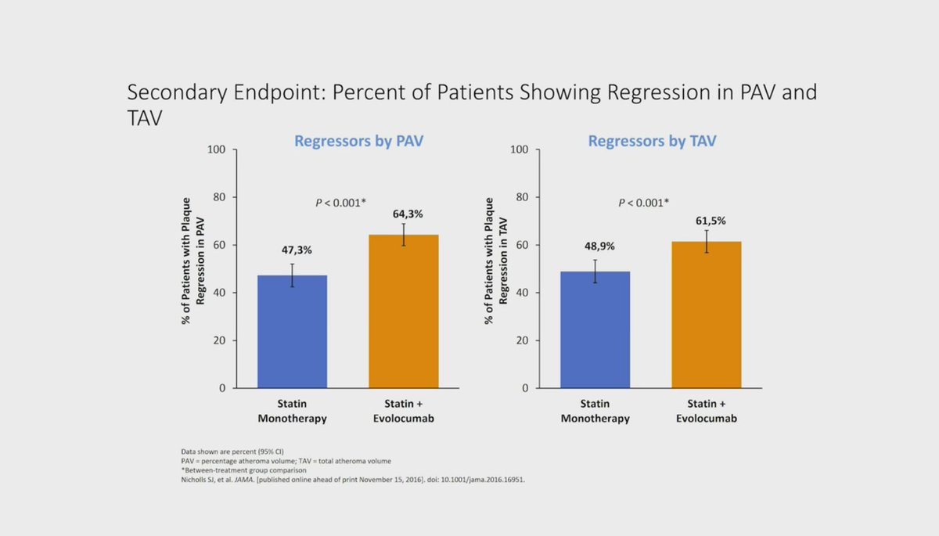
Percent variation of coronary atheroma after 78 weeks
P < 0.001*
P = NS*
Change in % atheroma volume (%)
Group differences: -1.0% (-1.8 to -0.64); P < 0.001
Nicholls SJ, et al. JAMA. [published online ahead of print November 15, 2016]. doi: 10.1001/jama.2016.16951.
Notes:
Nicholls SJ, et al. JAMA. 2016:
E7-A-1 (Table 3)

Slide 36
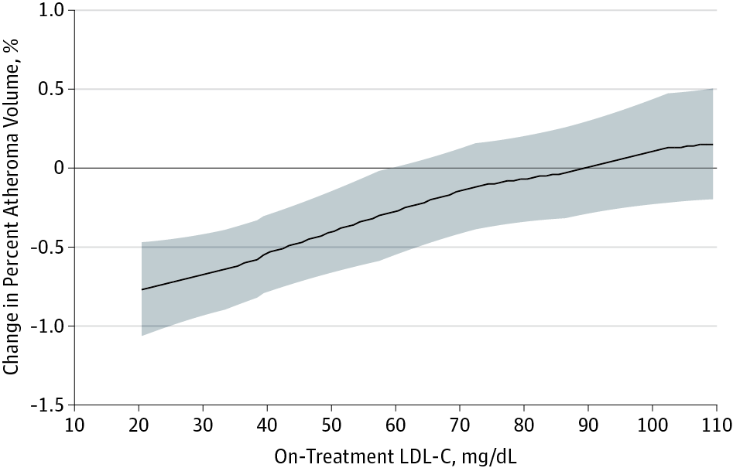
Which are the optimal LDL cholesterol levels for CV prevention?

Slide 37
What does GLAGOV tell us about optimal LDL levels?
LDL cholesterol is now universally accepted as the major driver of atherosclerosis, however, the question of how far to reduce lipid levels has remained a moving target. This study adds to evidence that optimal LDL levels for patients with coronary disease may be much lower than commonly achieved.

