Slide 1
approfondimenti
I Virus e l’RNAi

Slide 2
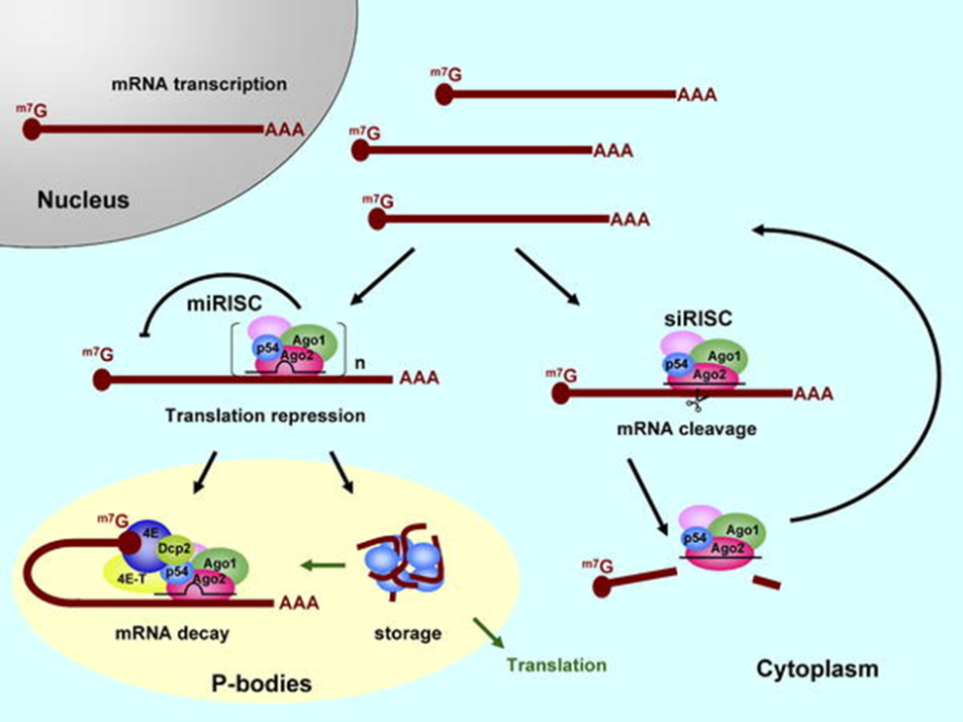
Antiviral RNA-induced silencing complexes
The Arabidopsis genome contains ten AGO proteins, AGO1 to AGO10, and they are the catalytic components of RNA silencing effector complexes.
They interact with small RNAs to effect gene silencing in all RNAi-related pathways known so far
In fact, dicing per se is not sufficient for defense against virus infection, and additional effector complex action is required
AGO1 recruits miRNAs, tasiRNAs, transgene-derived siRNAs and that AGO1-sRNA complex had slicer activity in vitro .
AGO1 also recruits vsiRNAs and the AGO1–vsiRNA complex is a major player in antiviral defense.

Slide 3
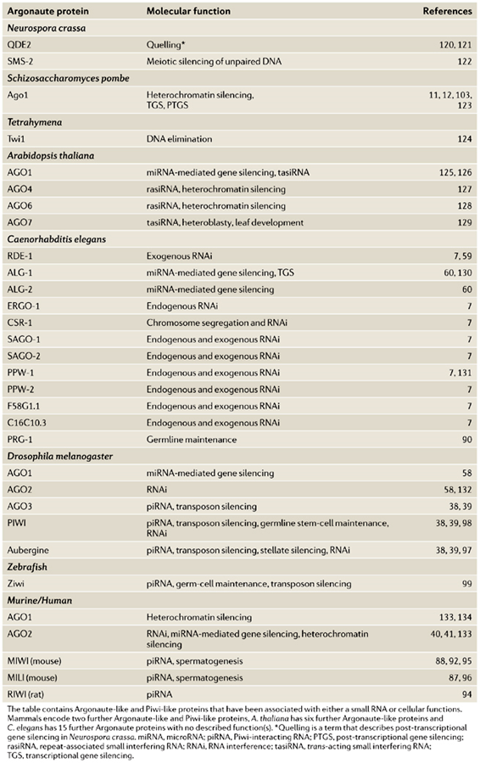
Argonauts
Argonaute proteins can be divided into two subclasses.
One resembles Arabidopsis AGO1 and is referred to as the Ago subfamily; the other is related to the Drosophila PIWI protein and is referred to as the Piwi subfamily.
Argonaute proteins typically have a molecular weight of ~100 kDa and are characterized by a Piwi-Argonaute-Zwille (PAZ) domain and a PIWI domain.
PAZ domain, which is also common to Dicer enzymes, forms a specific binding pocket for the 3’-protruding end of the small RNA with which it associates (Jinek and Doudna, 2009). The structure of the PIWI domain resembles that of bacterial RNAse H, which has been shown to cleave the RNA strand of an RNA-DNA hybrid

Slide 4
Diverse sources of small RNA molecules
Endogenous siRNAs originate from bidirectional transcription of specific chromosomal regions (centromeres and mating type locus) or aberrant production of dsRNA from repetitive regions once cleaved by Dicer. In plants and nematodes, a significant portion of siRNAs is also produced from the activity of RNA-dependent RNA polymerases
The Argonaute-3 (AGO3) protein binds mainly to piRNAs that are derived from the sense strand of retrotransposons, whereas piRNAs derived from the antisense strand are associated with Aubergine (AUB) protein.

Slide 5
HEN1
The biogenesis of sRNA in plants requires an additional step apart from DCL-mediated processing. This is a methylation reaction catalyzed by HUA ENHANCER 1 (HEN1) methyltransferase, which links a methyl group to the ribose of the 3’ last nucleotide of the sRNA duplex in a sequence-independent manner
The 2’-O-methylation of 3’ end appears to protect sRNA molecules against uridylation (and against the exoribonuclease activity of small RNA degrading nucleases (SDN1-3)
Hen1 mutant plants accumulate less vsiRNAs from both RNA and DNA viruses and exhibit reduced levels of silencing

Slide 6
RDR6
The third family of proteins involved in silencing in plants is the RDR family. In plants there are six RDR paralogs: RDR1, RDR2, RDR3a (RDR3), RDR3b (RDR4), RDR3c (RDR5) and RDR6 (SDE1/SGS-2). The putative catalytic domain is the DLDGD motif, which is highly conserved among all RDRs identified
In the silencing pathways RDRs synthesize cRNA from the 3’- terminal nucleotides of the template RNA. Then the template and the cRNA remain bound forming a perfectly base-paired dsRNA molecule, which is later processed by DCLs into siRNAs.
In the priming-dependent mechanism, viral or transgene-derived primary siRNAs recruit RDRs to the cognate ssRNA, which is converted to dsRNA through synthesis of complementary RNA. This dsRNA is then processed to secondary siRNA by DCLs
Plant RDRs can also amplify the silencing response in a primer-independent manner, in which RDRs detect the somehow aberrant (different from normal cellular and viral RNAs) RNA molecules deriving from viruses, transgenes or transposons, convert it into dsRNA which becomes the substrate for DCLs, and produce secondary siRNAs.

Slide 7
RNAi-Mediated Targeting of Heterochromatin by the RITS Complex
RNAi effector complex termed RITS (RNA-induced initiation of transcriptional gene silencing) that is required for heterochromatin assembly in fission yeast (Schizosaccharomyces pombe)
The RITS complex contains Ago1 (the fission yeast Argonaute homolog), Chp1 (a heterochromatin-associated chromodomain protein), and Tas3 (a novel protein).
In addition, the complex contains small RNAs that require the Dicer ribonuclease for their production. These small RNAs are homologous to centromeric repeats and are required for the localization of RITS to heterochromatic domains.

Slide 8
RITS
RITS contains Ago1, the S. pombe homolog of the Argonaute family of proteins, which form the common subunit of RISC complexes purified from different organisms and are thought to be directly responsible for target recognition
RITS is associated with siRNAs that require Dcr1 for their formation and originate from heterochromatin repeat regions. Thus, this complex contains the expected specificity determinants, i.e., siRNAs, which in other systems have been shown to direct target recognition
at least two subunits of the RITS complex, Chp1 and Tas3, are specifically associated with the expected heterochromatic DNA regions, which suggests that the complex localizes directly to its target DNA.
in addition to Ago1, RITS contains a chromodomain protein, Chp1, which is localized throughout heterochromatic DNA regions and requires the methyltransferase Clr4 and histone H3-K9 methylation for localization to chromatin

Slide 9
RITS model
The RITS complex is programmed by Dcr1-produced siRNAs to target specific chromosome regions by sequence-specific interactions involving either siRNA-DNA or siRNA-nascent transcript (blue arrows) base pairing. Nuc, nucleosome; red triangle, K9-methylation on the amino terminus of histone H3.
RITS contains both a subunit (Ago1) that binds to siRNAs and can function in RNA or DNA targeting by sequence-specific pairing interaction and a subunit (Chp1) that associates with specifically modified histones and may be involved in further stabilizing its association with chromatin

