Slide 1
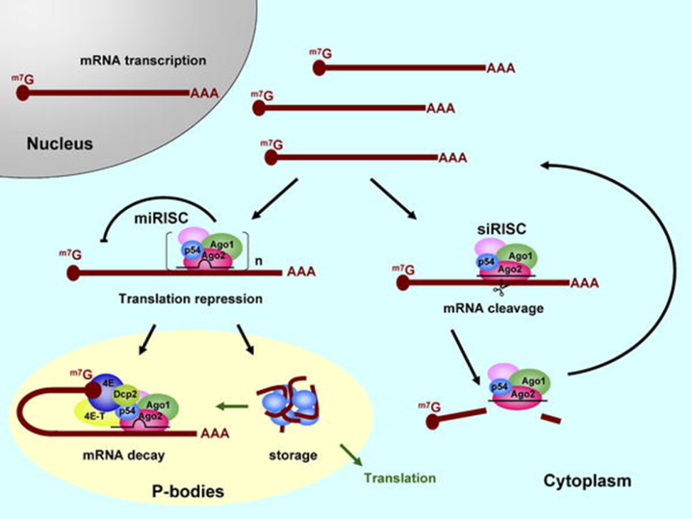
Antiviral RNA-induced silencing complexes
The Arabidopsis genome contains ten AGO proteins, AGO1 to AGO10, and they are the catalytic components of RNA silencing effector complexes.
They interact with small RNAs to effect gene silencing in all RNAi-related pathways known so far
In fact, dicing per se is not sufficient for defense against virus infection, and additional effector complex action is required
AGO1 recruits miRNAs, tasiRNAs, transgene-derived siRNAs and that AGO1-sRNA complex had slicer activity in vitro .
AGO1 also recruits vsiRNAs and the AGO1–vsiRNA complex is a major player in antiviral defense.

