Slide 1
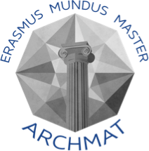
Cinnabar in prehistoric funerary practices in the Iberian Peninsula
The case study of Valencina de la Concepción
Rogerio-Candelera et al. (2013) Journal of Archaeological Science, 40: 279-290
Mafalda Costa

Slide 2
Valencina de la Concepción
Settlement from the 3rd millennium B.C.
≈120 excavations in the area since the discovery of La Pastora in 1868.
Extent: 40 Ha
Large range of megalithic structures present and density and diversity of the contexts recorded

Slide 3
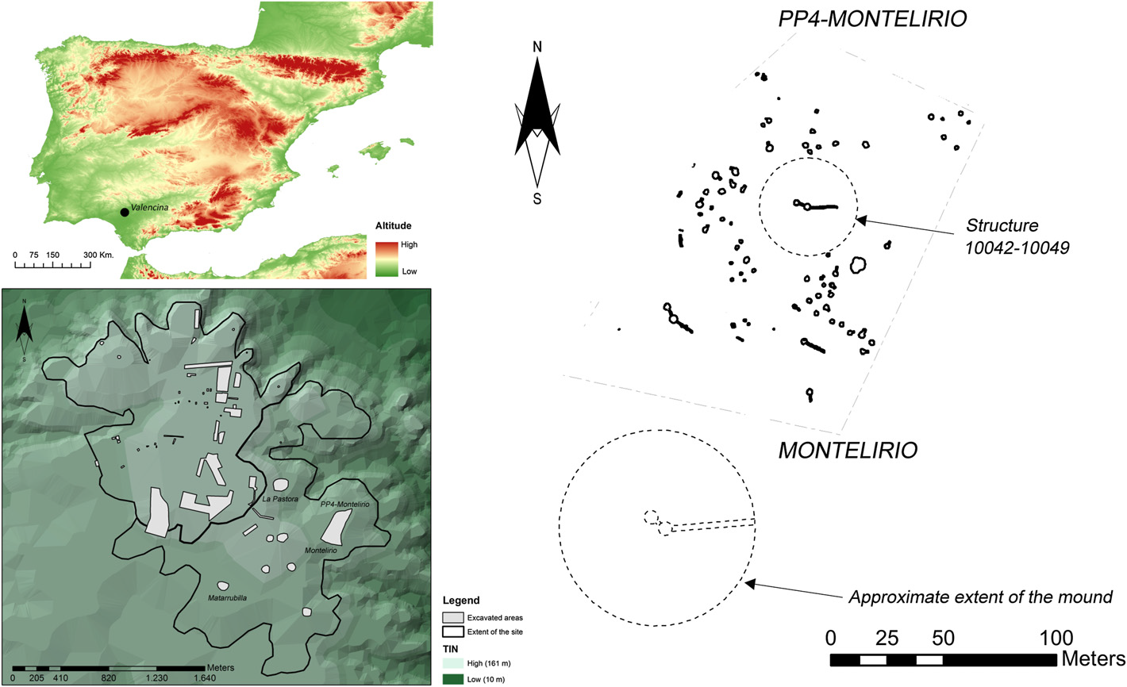
The PP4-Montelirio sector
Excavated between 2007 and 2008.
134 Chalcolithic structures found (61 funerary and 73 non-funerary).
At least 10 structures identified as Chalcolithic but not excavated.
Variability of burial structures.
Notes:
The excavation of this sector allowed the analysis of the variability of burial structures built and used by the prehistoric inhabitants of Valencina.

Slide 4
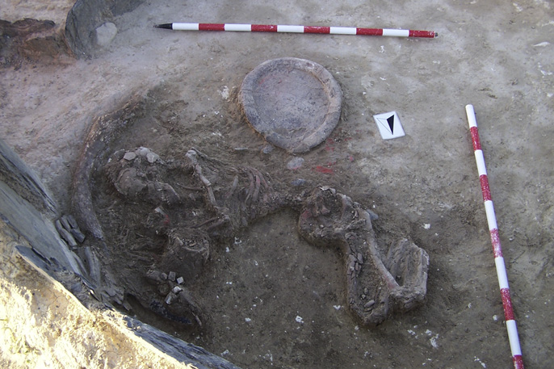
The PP4-Montelirio 10042-10049 structure
Two-chambered megalithic structure
Grave goods:
> 50 objects in the first chamber and passage;
> 30 objects in the first depositional layer of the second chamber;
> 70 objects in the second depositional layer of the second chamber
Notes:
Objects recovered include pottery, beads, lithic objects, such as arrowheads and blades, numerous ivory objects and an ostrich egg.
It is important to note that the second depositional level of the second chamber has been attributed to a single individual, which suggests that this person has a high social position.

Slide 5
Red pigments in funerary contexts
First known use of ochre in funerary contexts dates to the first evidence for anatomically modern Homo sapiens in Euroasia.
First evidences for the use of cinnabar, in Europe, are related to the Vinča culture.
In the Iberian Peninsula, the presence of cinnabar has been detected in several Neolithic archaeological sites.
In megalithic monuments in the Iberian Peninsula, red pigments can be found:
Associated with human remains;
Covering orthostats and slabs.

Slide 6
Identification of cinnabar
Sample | Analytical techniques
 | XRD | SEM/FEG-EDS | μEDXRF | μRaman | FTIR
O1-H1 (ivory) | X |  | X | X
O1-H2 (ivory) | X |  | X | X | X
O1-C1 (pottery) | X | X | X
O1-C2 (pottery) |  |  | X
O5-O (soil) |  |  | X
O3-C1 (pottery) |  |  | X
O3-C2 (pottery) |  |  | X | X
O2-H1 (bone) |  |  | X
O2-H2 (bone) | X | X | X
O4-C1 (pottery) |  |  | X
ML02 (ivory) |  |  |  | X
ML05 (ivory) | X |  |  | X | X
Notes:
Twelve samples were taken from different elements present in the structure in order to characterize the red pigment covering human bones, grave goods, and even the floor surface.
The analytical techniques used provide elemental and mineralogical (chemical compound) information.

Slide 7
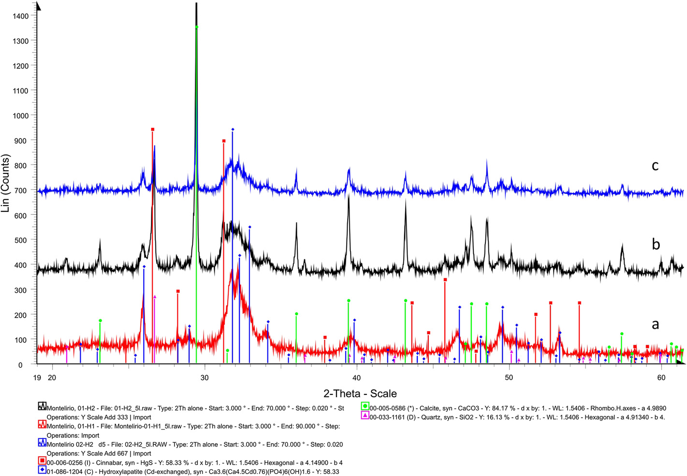
Identification of cinnabar – XRD
Notes:
Fig. 1.: Pottery and ivory; presence of cinnabar, qz and calcite.
Fig. 2.: Ivory and bone; presence of cinnabar, hydroxylapatite, calcite and qz.
Qz and calcite not explained in ivory and bone context. Possible soil encrustations (?).

Slide 8
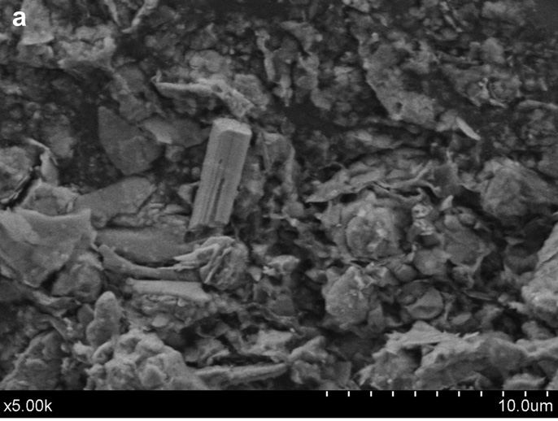
Identification of cinnabar – SEM/FEG-EDS
O1-C1
O1-H2
Notes:
Analysis of sample O1-C1 (pottery) indicated the presence of Al, Si, Ca, C, Fe, Mn, as well as Hg and S. Al, Si, Ca, C and possibly Mn said to belong to the clay matrix. Fe sometimes associated with what was interpreted as cinnabar particles.
[Methodology does not indicate that the samples were carbon coated, but given the instrument used, this is very likely and thus C can be explained by this procedure.]
Analysis of sample O1-H2 (ivory) indicated the presence of Si, Al, C, P and Ca, as well as Hg and S. Al and Si related to clay sediments, while P and Ca are related to the hydroxylapatite of ivory. Growth of microorganisms detected. Rutile crystal found (this Ti mineral was attributed to iron oxide impurities after XRD analysis of soils found in a pot from the same stratigraphic layer and soil collected directly showed the absence of Ti minerals in the soil – only kaolinite and illite were identified).
Micrometric and occasionally nanometric size of cinnabar particles suggests prolonged grounding using hard stones - possibility of use of a red-stained spilite tool described by Polvorinos del Río et al. (2001).

Slide 9
Identification of cinnabar – μEDXRF
Notes:
Presence of Hg and S, as well as Fe in all the samples suggests that the red pigment is a mix of cinnabar and iron oxides.

Slide 10
Identification of cinnabar – μRaman
Cinnabar bands: 253, 283, 343 cm⁻¹.
Free ${PO}_{4}^{3−}$ bands: 402, 420, 643 and 872 cm⁻¹.
Notes:
Circled bands not explained in the article.

Slide 11
Identification of cinnabar – FTIR
Clay minerals
Si–O and Al–O deformation band
Hematite
Quartz
Si–O stretching band
Calcite

Slide 12
Identification of cinnabar – FTIR
Phosphate in apatite
Carbonate in apatite
Amide II band (1540 cm⁻¹)
Amide I band

Slide 13
Why did prehistoric people use cinnabar in funerary context?
Possible explanations for the appearance of cinnabar in burial contexts:
Use of cinnabar as a dye for clothing;
Possible secondary deposition of pigmented bones;
Use for preservation purposes.
Association of cinnabar with other exotic materials, such as ivory and gold elements, can be an indication of established trade routes.
Cinnabar associated with wealth and/or high social status.

Slide 14
Where is the cinnabar coming from?
Use of lead or sulfur isotopes to determine cinnabar provenance:
Lead: ²⁰⁶Pb/²⁰⁴Pb, ²⁰⁷Pb/²⁰⁶Pb and ²⁰⁸Pb/²⁰⁶Pb ratios
Sulfur: ³⁴S/³²S ratio
$$δ=\frac{R_{sample}−R_{standard}}{R_{standard}}×1000$$
Notes:
Lead is present as an impurity in cinnabar, while sulfur is a main constituent.
Sulfur has 3 stable isotopes but 34S and 32S are the most abundant. All four Pb stable isotopes are used.
Isotopic characterization of geological provenances with cinnabar ores, is important to determine aqueological cinnabar provenance.

Slide 15
Conclusions
Cinnabar can be identified by a wide range of analytical methods used to characterize a material’s chemical and mineralogical composition.
Lead and sulfur isotopes can be used to determine the provenance of cinnabar.
Use of cinnabar, an exotic material, can be linked to social inequality.
A wide range of analytical techniques allow the identification of the red pigment found in the PP4-Montellirio 10042-10049 megalithic structure as cinnabar, with small amounts of iron oxides.

Slide 16
References
Gajić-Kvaščev, M.; Stojanović, M.M.; Šmit, Z.; Kantarelou, V.; Karydas, A.G.; Šljivar, S.; Milovanović, D. & Andrić, V. (2012). New evidence for the use of cinnabar as a colouring pigment in the Vinča culture. Journal of Archaeological Science, 39: 1025-1033.
Hunt Ortiz, M.A. & Hurtado Pérez, V.M. (2010). Pigmentos de Sulfuro de Mercurio – Cinabrio – en Contextos Funerarios de Época Calcolítica en el Sur de la Península Ibérica: Investigaciones Sobre el Uso, Depósitos Minerales Explotados y Redes de Distribución a Través de la Caracterización Composicional e Isotópica, in Sáiz Carrasco, M.E.; López Romero, R.; Cano Díaz-Tendero, M.A. & Calvo García, J.C. (Eds.), VIII Congreso Ibérico de Arqueometría. Actas. Seminario de Arqueología y Etnología Turolense, Teruel, pp. 123-131.
Mazzocchin, G.A.; Baraldi, P. & Barbante, C. (2008). Isotopic analysis of lead present in the cinnabar of Roman wall paintings from the Xth Regio “(Venetia et Histria)” by ICP-MS. Talanta, 74: 690–693.
Polvorinos del Río, A.; García Sanjuán, L.; Hernández, M.J. & Almarza, J. (2001). Análisis arqueométrico de objetos cultuales prehistóricos hallados en Almadén de la Plata (Sevilla), in Roldán, C. (Ed.), Actas del IV Congreso Nacional de Arqueometría. Universidad de Valencia, Valencia, pp. 321e327.
Rogerio-Candelera, M.A.; Herrera, L.K.: Miller, A.Z.; García Sanjuán, L.; Molina, C.M.; Wheatley, D.W.; Justo, A. & Saiz-Jimenez. C. (2013). Allochthonous red pigments used in burial practices at the Copper Age site of Valencina de la Concepción (Sevilla, Spain): characterisation and social dimension. Journal of Archaeological Science, 40: 279-290.
Shoval, S. & Beck, P. (2005). Thermo-FTIR Spectroscopy Analysis as a Method Characterizing Ancient Ceramic Technology. Journal of Thermal Analysis and Calorimetry, 82: 609–616.
Spangenberg, J.E.; Lavrič, J.V.; Meisser, N. & Serneels, V. (2010). Rapid Communications in Mass Spectrometry, 24 (19): 2815-2816.

