Slide 1
Internal Medicine and General Surgery II
Cognitive impairment

Slide 2
Effect of normal aging in intellectual functioning
 | Preserved cognitve functions | Functions showing decline
General intellectual functioning | Crystallized, verbal intelligence | Fluid, nonverbal intelligence, speed of information processing
Attention | Sustained attention, primary attention span | Divided attention
Executive functions | “real world” executive function | Novel executive tasks
Memory | Remote memory, procedural memory, semantic recall | Learning and recall of new informantion
Language | Comprehension, vocabulary, syntactic ablities | Spontaneous words finding, verbal fluency
Visuospatial skill | Construction, simple copy | Mental rotation, complex copy, mental assembly
Psychomotor functions |  | Reaction time

Slide 3
“A man is as old as his arteries” Thomas Sydenham 1624-1689
Many common age-related medical conditions could affect cognitive status

Slide 4
Cardiac surgery
! AD, VaD
Course: symptom onset immediate after surgery, improvement noted in first year, then further decline possible in some patients
Memory: verbal and visual memory deficits possible several years after surgery
Attention: reduced attention
Executive functions: variable
Language: -
Visual spatial fucntion: may leas to impaired visual organization and construction
Psychomotor function: reduced reaction time, general slowing
Behaviour: depression common after surgery

Slide 5
Hypertension
! AD, VaD
Course: may improve with antihypertensive treatment
Memory: verbal and visual recall and recognition deficits in some patients
Attention: reduced attension and vigilance
Executive function: impairment in working memory and other executive functions
Language: riduced verbal fluency
Visuospatial function: impaired visual organitazion and construction; more likely with comorbid diabetes
Psychomotor function: reduced riaction time, general slowing
Behaviour: variable

Slide 6
Diabetes
! AD, VaD, PD
Course: may improve with insulin or insulin-sensitizing agents
Memory: verbal memory impairment related to deficits in encoding new information
Attention: reduced complex attention, simple attention variable
Executive function: impairments in abstract reasoning and concept formation
Language: -
Visuospatial function: variable, more likely with comorbid hypertension
Psychomotor functions: -
Diabetes: depression common

Slide 7
COPD
! AD, VaD
Course: may improve with oxygen therapy
Memory: verbal and visual memory deficits
Attention: reduced attention
Executive functions: impairment in abstract thinking
Language: -
Visuospatial function:-
Psychomotor function: reduced riaction time, general slowing
Behaviour: depression common

Slide 8
Sleep apnea
Course: may improve with CPAP
Memory: verbal and visual memory deficits
Attention: reduced attention
Executive functions: impairment in general executive function; esp. working memory
Language: -
Visuospatial function: -
Psychomotor function: reduced reaction time, general slowing
Behaviour: depression and irritability related to sleed disruption

Slide 9
Nutrition deficiency
! Wernicke-Korsakoff S.
Course: may improve with supplementation, although effect of low vitamin B12 may persist
Memory: recall deficit
Attention: reduced attention
Executive function: impaurment in abstract thinking
Language: -
Visuospatial function: non verbal pattern abstraction, construction impaired in high homocysteine
Psychomotor function: reduced processing speed in patient with high hinicystseine
Behaviour: variable

Slide 10
Hypothyroidism
! AD
Course: may improve with thyroid treatment, although some patients do not return to baseline
Memory: recall deficit, intact recognition
Attention: variable
Executive function: variable
Language: -
Visuospatial function: reduced visuospatial function
Psychomotor function: reduced reaction time, general slowing;
Behavior: depression

Slide 11
Other common disease
Depression
Medications/Drugs
Delirium without complete restoration

Slide 12
Neurodegenerative Diseases

Slide 13
Alzheimer Disease
Probability!! The diagnosis is certain only after authopsy!
Diagnostic criteria (DSMV):
1)Dementia as noted on clinical examination and established by neuropsychological testing;
2)Significant impairment in two or more areas of cognition;
3)Progressive memory decline;
4)Absence of other medical or psychiatric conditions, including delirium, as the cause for memory impairment.

Slide 14
Alzheimer Disease
Potential diagnostic tools:
Cerebrospinal fluid markers (beta amyloid or tau proteins)
Structural and functional changes on brain scan
Genetic factors.

Slide 15
Alzheimer Disease
Neuropsychological assessment:
Cognitive functions:
Mini Mental State Examination (MMSE)
Severe Impairment Battery (SIB)
Milan Overall Dementia Assessment (MODA)
Alzheimer's Disease Assessment Scale- (ADAS-Cog)
Functional status:
Barthel Index
Basic Activity of Daily Living (BADL)
Instrumental Activity of Daily Living (IADL)
Bedford Alzheimer Nursing Severity Scale (BANSS)
Tinetti test
Physical Performance Test (PPT)
Cognitive symptoms:
UCLA Neuropsychiatric Inventory
Geriatric Depression Scale (GDS)
Cornell Depression Scale
Comorbidities:
Cumulative Illness Rating Scale (CIRS)
Caregivers burn out:
Caregiver burden Inventory (CBI)
Severity evaluation:
Clinical Dementia Rating Scale

Slide 16
Clinical presentation
With progression:
Behavioural disorders (aggressiveness, incontinence)
Affective disorders
Pyramidal signs (rigidity, dyskinesia, lethargy)
Difficulties in ADL and IADL
Final presentation:
Total foreignness to the environment and complete dependence
Wasting
Dysphagia
General decline
High susceptibility to infections and sepsis

Slide 17
Genetic risck factors
•Mutations of chromosomes 1, 14, 21
•Rare early-onset (before age 60) familial forms of dementia
•Down syndrome
•Apolipoprotein E4 on chromosome 19
•Late-onset AD
•APOE*4 allele ↑risk & ↓onset age in dose-related fashion
•APOE*2 allele may have protective effect

Slide 18
Pathology
•There are 3 consistent neuropathological hallmarks:
–Amyloid-rich senile plaques
–Neurofibrillary tangles
–Neuronal degeneration
•These changes eventually lead to clinical symptoms, but they begin years before the onset of symptoms

Slide 19
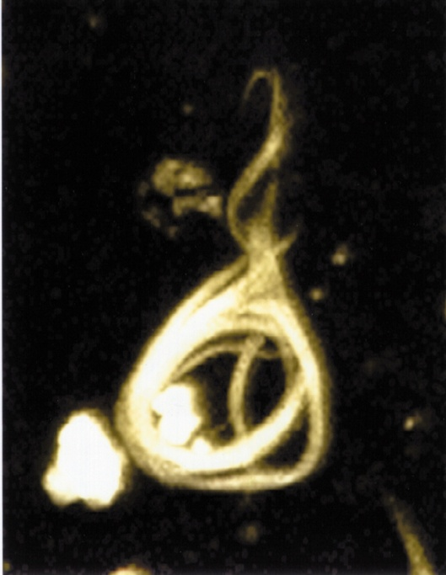
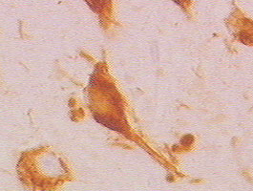
NeurofibrillaryTangles
Immunocytochemical staining of neurofibrillary tangles in the isocortex of the brain of a human with AD (anti-tau antibody)

Slide 20
AD
Alzheimer's disease is characterised by loss of neurons and synapses in the cerebral cortex and certain subcortical regions. This loss results in gross atrophy of the affected regions, including degeneration in the temporal lobe and parietal lobe, and parts of the frontal cortex and cingulate gyrus.
Both amyloid plaques and neurofibrillary tangles are clearly visible by microscopy in brains of those afflicted by AD.
Plaques are dense, mostly insoluble deposits of amyloid – beta peptides and cellular material outside and around neurons.
Tangles (neurofibrillary tangles) are aggregates of the microtubule-associated protein tau which has become hyperphosphorylated and accumulate inside the cells themselves.
Although many older individuals develop some plaques and tangles as a consequence of ageing, the brains of AD patients have a greater number of them in specific brain regions such as the temporal lobe.

Slide 21
Enzymes act on the APP (amyloid precursor protein) and cut it into fragments. The beta-amyloid fragment is crucial in the formation of senile plaques in AD.

Slide 22
Cholinergic Hypothesis
Acetylcholine (ACh) is an important neurotransmitter in areas of the brain involved in memory formation
•Loss of Ach activity correlates with the severity of AD

Slide 23
ASSESSMENT: LABORATORY
Laboratory tests should include:
Complete blood cell count
Blood chemistries
Liver function tests
>Serologic tests for:
Syphilis, TSH, Vitamin B12 level

Slide 24
ASSESSMENT: BRAIN IMAGING
Use imaging when:
•Onset occurs at age < 65 years
•Symptoms have occurred for < 2 years
•Neurologic signs are asymmetric
•Clinical picture suggests normal-pressure hydrocephalus
Consider:
•Noncontrast computed topography head scan
•Magnetic resonance imaging
•Positron emission tomography

Slide 25
TREATMENT & MANAGEMENT
•Primary goals: to enhance quality of life & maximize functional performance by improving cognition, mood, and behavior
–Nonpharmacologic
–Pharmacologic
–Specific symptom management
–Resources

Slide 26
NONPHARMACOLOGIC
•Cognitive enhancement
•Individual and group therapy
•Regular appointments
•Communication with family, caregivers
•Environmental modification
•Attention to safety

Slide 27
PHARMACOLOGIC
•Cholinesterase inhibitors: donepezil, rivastigmine, galantamine
•Other cognitive enhancers: estrogen, NSAIDs, ginkgo biloba, vitamin E
•Antidepressants
•Antipsychotics

Slide 28
Mild/Moderate AD:
Cholinesterase inhibitors increase the levels of acetylcholine in the brain, which plays a key role in memory and learning. This kind of drug postpones the worsening of symptoms for 6 to 12 months in about half of the people who take it. Cholinesterase inhibitors most commonly prescribed for mild to moderate Alzheimer's disease include Aricept (donezepil HCL), Exelon (rivastigmine), and Razadyne (galantamine).

Slide 29
Exelon (Rivastigmine)
Exelon is FDA approved for mild and moderate stages of the disease; it is also approved for the treatment of mild to moderate dementia due to Parkinson's disease.
Exelon is available as a capsule, liquid, and patch.

Slide 30
Exelon is a cholinesterase inhibitor that prevents the breakdown of acetylcholine and butyrylcholine in the brain by blocking the activity of two different enzymes. Acetylcholine and butyrylcholine play a key role in memory and learning.
When given orally, bioavailability is about 40% in the 3 mg dose. The compound can cross the blood-brain barrier.

Slide 31
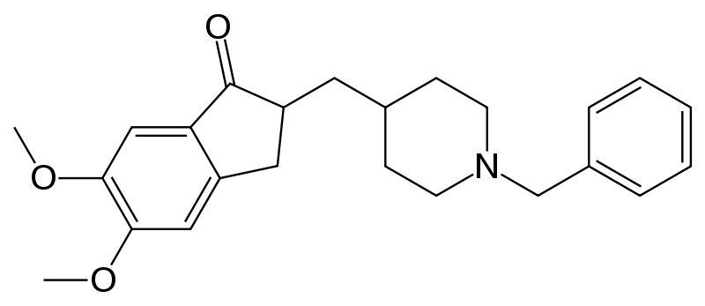
Aricept (Donepizel)
One of the most widely used drugs to treat the symptoms of Alzheimer's disease. Aricept is FDA-approved for mild, moderate, and severe stages of the disease.
Aricept is available in tablet form or an orally disintegrating tablet form, and is commonly started at 5 mg a day.
Can cross the blood-brain barrier.

Slide 32
Moderate/Severe AD:
Ebixa(memantine) regulates glutamate in the brain, which plays a key role in processing information. This drug is used to treat moderate to severe Alzheimer's disease and may delay the worsening of symptoms in some people. It may allow patients to maintain certain daily functions a little longer than they would without the medication.

Slide 33
Drugs in AD
Aricept Used to delay or slow the symptoms of AD Donepezil • Loses its effect over time • Used for mild, moderate and severe AD • Does not prevent or cure AD
Citalopram Used to reduce depression and anxiety • May take 4 to 6 weeks to work • Sometimes used to help people get to sleep
Depakin Used to treat severe aggression Sodium Valproate • Also used to treat depression and anxiety
Exelon Used to delay or slow the symptoms of AD Rivastigmine • Loses its effect over time • Used for mild to moderate AD • Can get in pill form or as a skin patch • Does not prevent or cure AD

Slide 34
Ebixa Used to delay or slow the symptoms of AD Memantine • Loses its effect over time • Used for moderate to severe AD • Sometimes given with Aricept®, Exelon® • Does not prevent or cure AD
Reminyl Used to prevent or slow the symptoms of AD Galantamine • Loses its effect over time • Used for mild to moderate AD • Can get in pill form or as a skin patch • Does not prevent or cure AD
Zoloft Used to reduce depression and anxiety Sertraline • May take 4 to 6 weeks to work • Sometimes used to help people get to sleep
Trileptal Used to treat severe aggression Oxcarbazepine • Also used to treat depression and anxiety
Tegretol Used to treat severe aggression Carbamazepine • Also used to treat depression and anxiety
Remeron Used to reduce depression and anxiety Mirtazepine • May take 4 to 6 weeks to work • Sometimes used to help people get to sleep

Slide 35
Future Trends
•Alzheimer’s as a multifactorial syndrome
•Pendulum of history
•Vaccine
•Genetic therapy

Slide 36
D
E
M
E
N
T
I
A
DRUGS
EMOTIONAL
METABOLIC
EYES & EARS
NUTRITIONAL
TUMOR-TOSSIC-TRAUMA
INFECTIONS
ATHEROSCLEROSIS

Slide 38
Vascular Dementia
-Generally clinicians look for
Stepwise progression, prolonged plateaus or fluctuating course
Focal cognitive deficits but not necessarily memory impairment
Impaired executive function (difficulty problem solving, difficulty with judgement)
-Diagnosis strengthened by
Focal neurological signs (weakness on one side, difficulty with speech)
Neuroimaging (CT or MRI) consistent with ischemia
CV risk factors, concurrent peripheral vascular disease, coronary artery disease etc

Slide 39
Large Vessel Vascular Dementia
Small Vessel Vascular Dementia
Ischemic-Hypoxic Vascular Dementia
Hemorrhagic dementia

Slide 40
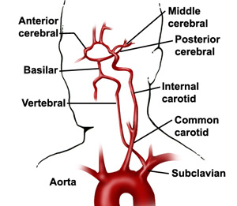

Slide 41
EPIDEMIOLOGY
-Incidence estimates (3 months post CVA) vary: 25-41%
-Clinical features will depend largely on what part of the brain was damaged
-Depression common
-Location of vascular lesion is likely more important than how much tissue died

Slide 43
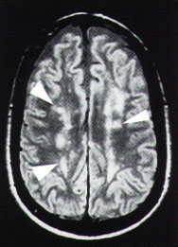
Magnetic resonance image of the brain, T2 axial view without contrast enhancement. Note the areas of increased signal bilaterally, known as periventricular hyperintensity (arrows).

Slide 44
Mixed Dementia
Vascular lesions may have synergistic effect with AD pathology
If evidence of cerebrovascular disease present, the density of plaques and tangles needed to cause dementia is lower than that needed for “pure AD”

Slide 45
Diagnosis
MMSE not adequate because of lack sensitivity in VCI, as it isn’t a sensitive test for executive function, inattention, mood or personality changes
Montreal Cognitive Assessment (MoCA)
Increasingly popular
Designed for vascular dementia
http://mocatest.org/

Slide 46
Treatment
Primary prevention:
Treatment of HTN, DM, hypercholestrolemia
Secondary prevention:
More aggressive control of HTN, DM and hypercholestrolemia
Anti-platelet agents like Aspirin and Plavix
Warfarin/NOAC in patients with Atrial fibrillation
Possible surgery in patients with documented carotid artery stenosis

Slide 47
Secondary prevention
STOP SMOKING!!!
Avoid orthostatic hypotension
Good control of congestive heart failure and obstructive sleep apnea

Slide 48
Pharmacological treatment
Acetyl cholinesterase inhibitors (AChEI) – may have mild - moderate benefit, patients with VaD are more likely to experience side effects with AChEI than AD patients and so may be more likely to discontinue the drug
Memantine – may be useful as an adjunct to AChEI in patients with moderate to severe dementia, not covered by Pharmacare
Anti depressants (specifically SSRIs)
Atypical antipsychotics

Slide 49
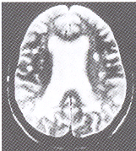
Lewy Body disease
Eosinophilic inclusions in Cortex, Ippocampus e Basal nuclei
Cognitive disorders: fluctuating state of consciousness
HALLUCINATIONS: visual ones
extrapyramidal signs (Parkinsonism)
urinary incontinence
Falls
Syncope
Atrofia corticale
aspecifica
alla TC o RM

Slide 50
Pathology
Degeneration of substantia nigra
Degeneration of the cortical areas of the brain with many or all of the features seen in Alzheimer's disease
Remaining nerve cells contain abnormal structures called ‘Lewy bodies’

Slide 51
Body Lewy
Abnormal aggregation of proteins, including
alpha-synuclein, neurofilament and ubiquitin
PD
Dementia with Lewy bodies
MSA
Amyotrophic lateral sclerosis
Hallervorden-Spatz syndrome
Core, body, halo
Variations in shape
Synucleopathies

Slide 52
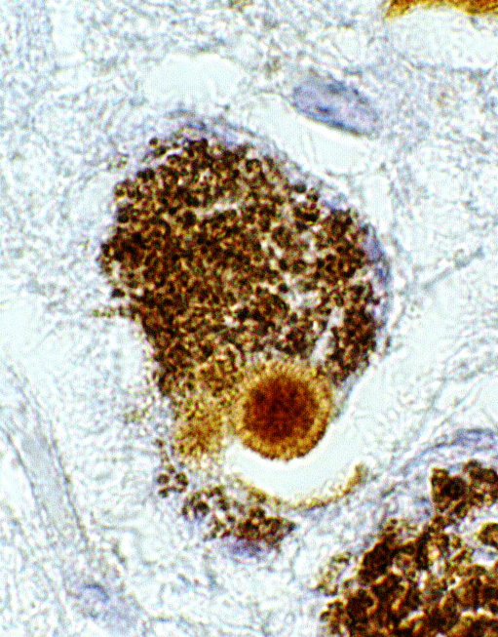

Slide 53
Alpha sinuclein
Abundant CNS protein
Composed of 140 amino acids
Alpha form of synuclein is the only form capable of aggregating into fibrillar structures in vitro
Beta-synuclein is not localized in Lewy bodies, it may have a role in regulating alpha-synuclein metabolism or aggregation

Slide 54
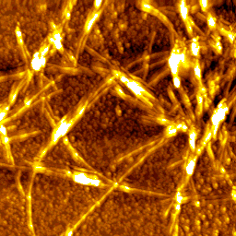

Slide 55
Role of alpha sinuclein
Synaptic plasticity
Negative regulation of dopamine neurotransmission
Protection at nerve terminals during injury
Trafficking of cargo in the ER/Golgi complex

Slide 56
In disease
‘Ubiquitinated’ with no loss of proteasome function, suggesting there is an excessive accumulation of alpha-synuclein that overwhelms the proteolytic machinery (Tofaris, et al. 2003). This may promote the formation of Lewy bodies

Slide 57
Clinical features
Dementia normally presenting feature
Minority present with parkinsonism
Some with psychiatric disorder without dementia
Others with orthostatic hypotension, falls or transient disturbances of consciousness
Sporadic (rarely familial)
Fluctuation in cognitive performance and functional ability
Variations in attention and level of consciousness
Visual hallucinations in two-thirds
Notes:
Dementia is usually, but not always, the presenting feature; a minority of patients present with parkinsonism alone, some with psychiatric disorder in the absence of dementia, and others with orthostatic hypotension, falls, or transient disturbances of consciousness. Fluctuation in cognitive performance and functional ability, which is based in variations in attention and level of consciousness, is the most characteristic feature of DLB It is usually evident on a day-to-day basis, and often apparent within much shorter periods. The marked amplitude between best and worst performance distinguishes it from the minor day-to-day variations that commonly occur in dementia of any aetiology. Repeated visual hallucinations are present in about two-thirds of patients. They take the form of vivid, colourful, and sometimes fragmented figures of people and animals,

Slide 58
TREATMENT
No cure
Cognitive symptoms → acetylcholinesterase inhibitors, such as donepezil and rivastigmine
May reduce psychiatric and motor symptoms
Rigidity → levodopa

Slide 59
Frontotemporal dementia
Definition: clinicopathologic condition consisting of deterioration of personality and cognition assoc. with prominent frontal and temporal lobe atrophy
Accounts for up to 3-20% of dementias
Third behind AD and Lewy Body Dementia in neurodegenerative dementing illnesses

Slide 60
Epidemiology
Mean age of onset 52.8
Male preponderance 14:3 in one study and M=F in others
Dementia prevalence of 81 per 100,000 (95% CI, 62.8 to 104.5) in the 45-64 year age group
Prevalence of AD and FTD in 45-64 age group same at 15 per 100,000 (8.4-27.0)

Slide 61
Core features
Insidious onset and slow progression
Early decline of
-Social interpersonal conduct
-Regulation of personal conduct
-Insight
Early emotional blunting

Slide 62
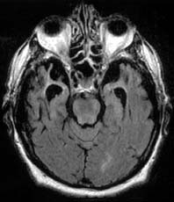
MRI

Slide 63
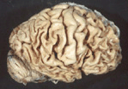
Prominent frontal and temporal lobar atrophy
Atrophy may be associated with Pick’s bodies, tauopathy, nonspecific superficial cortical neuron loss

Slide 64
Differential diagnosis
Differs from the other codes including AD, frontal dementia, Pick’s disease
Use of these codes inappropriate as not capture the age of onset, duration of illness, genetic factors, and impact on caregiver, society, and economics
AD → older, different duration, less clear genetics
Frontal dementia → no temporal lobe involvement, genetics differ
Pick’s disease → not capture spectrum of FTD

Slide 65
Implications for FTD different from other dementias/AD:
Greater caregiver burden and increased dependency and health care costs
Patients see codes and think they have some other disease

Slide 66
Treatments
No FDA‐ approved tx
• Neurochemical basis for FTD is unknown
• Abnormalities in serotonin and dopamine
– not cholinergic
• SSRI’s
– disinhibition; impulsivity; repetitive behavior; eating
disorders; sexual disinhibition
• Trazodone
– agitation; aggression; depression; eating disorder

Slide 67
Treatments
Atypical antipsychotics ( olanzapine, quetiapine,
aripiprazole )
– agitation
– particularly vulnerable to EPS; use as last resort
– quetiapine with less D2 antagonism
• Stimulants (Methylphenidate,dextroamphetamine)
– apathy; disinhibition
– may cause delirium

