Slide 1
Advanced Drug Delivery Reviews
53 (2001) 321–339
Environment-sensitive hydrogels for drug delivery
Yong Qiu, Kinam Park

Slide 2
Structures of some temperature-sensitive polymers

Slide 3
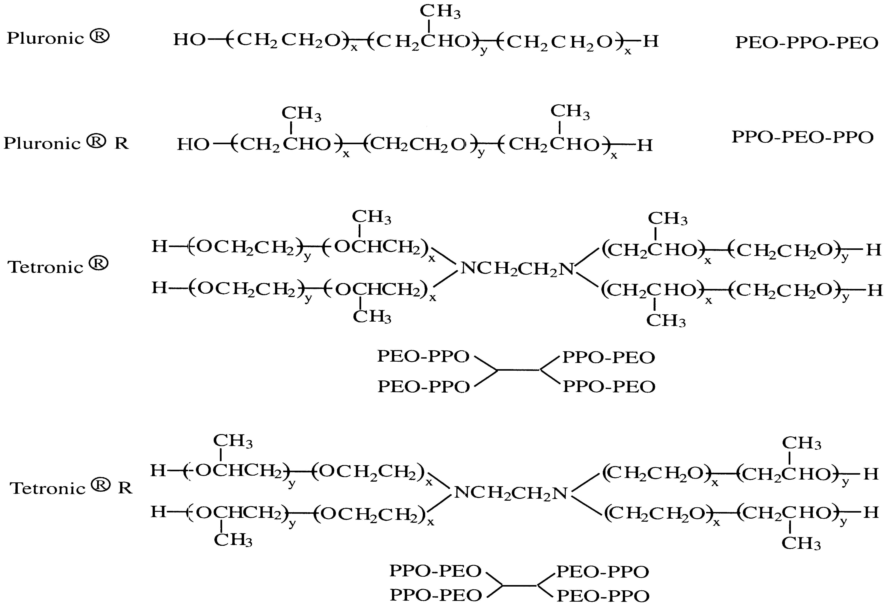
Polymer structures of Pluronic and Tetronic.

Slide 4
Schematic illustration of on–off release from a squeezing hydrogel device for drug delivery

Slide 5
pH-dependent ionization of polyelectrolytes. Poly(acrylic acid) (top) and poly(N,N-diethylaminoethyl methacrylate) (bottom)

Slide 6
Schematic illustration of oral colon-specific drug delivery acrylate using biodegradable and pH-sensitive hydrogels. The azoaromatic moieties in the cross-links are designated by –N=N–

Slide 7
Sol–gel phase-transition of a phenylborate polymer. At alkaline pH, phenylborate polymer interacts with poly(vinyl alcohol) (PVA) to form a gel. Glucose replaces PVA to induce a transition from the gel to the sol phase.

Slide 8
Structure of leuco derivative molecule bis(4-(dimethylamino)phenyl)(4-vinylphenyl)methylleucocyanide

Slide 9
Swelling of an antigen–antibody semi-IPN hydrogel in response to free antigen

Slide 10
Crosslinked ionic polysaccharides for stimuli-sensitive drug delivery
Carmen Alvarez-Lorenzo, Barbara Blanco-Fernandez, Ana M. Puga, Angel Concheiro
Advanced Drug Delivery Reviews 65 (2013) 1148–1171

Slide 11
Polysaccharide
Network
Cross-linker
neutral
neutral
neutral
Substutution
grafting
Ionic
monofunctional
ionic
Ionic bi/multi-functionalized
ionic

Slide 12
