Slide 1





Scientific approach in the conservation of cultural heritage
Giovanni E. Gigante
Department of Pure and Applied Sciences
(http://w3.uniroma1.it/gegigante/homepage.html)

Slide 2

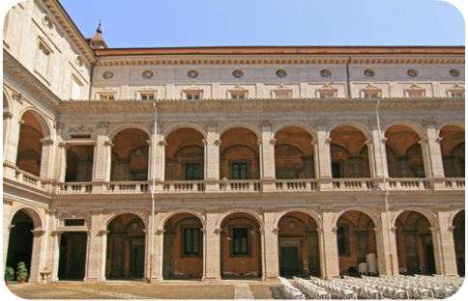
Sapienza University of Rome
A BRIEF HISTORY
Sapienza University of Rome was founded on 20 April 1303 by Pope Bonifacio VIII as “Studium Urbis”.
In 1431 Pope Eugene IV reorganized the Studium including four faculties (Law, Medicine, Philosophy and Theology) and buying a palace which later, in 1959, housed the Sant'Ivo alla Sapienza church, a Borromini’s baroque masterpiece.
In 1808, the Faculties were Sacred Sciences, Law, Philosophy, Medicine and Surgery, Philology.
In 1904 the Policlinico Umberto I was opened next to Stazione Termini, as an University hospital and headquarter of the Faculty of Medicine and Surgery.
In 1935 the new university campus planned by Marcello Piacentini, close to Stazione Termini and Policlinico Umberto I, was completed

Slide 3
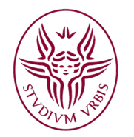
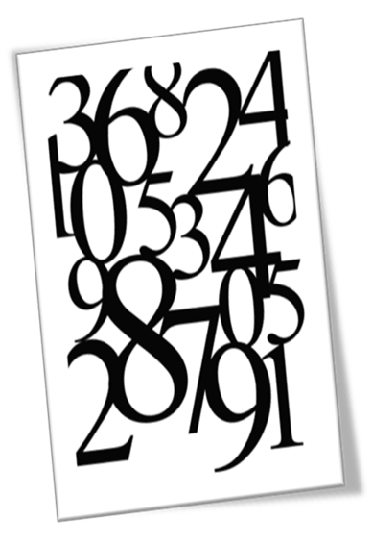
Sapienza University of Rome…Today
122.782 Enrolled students a.y. 2012/13
8.011 International students a.y. 2012/13
935 Professors and 1160 Associate Professors
1.794 Researchers
776 Research Grants
4.210 Administrative Staff
153 First Cycle (Bachelor) a.y. 2013/14
109 Second Cycle (Master) a.y. 2013/14
12 Single Cycle University Degrees a.y. 2013/14
6 Programmes Totally Taught in English
76 PhD Courses - XXIX Cycle a.y. 2013/14 (5 of them international)
100 Specialization Schools a.y. 2012/13
28 Training and Higher Education Courses a.y. 2013/14
245 Professional Master Degrees a.y. 2013/14

Slide 4
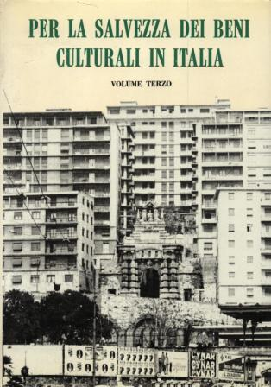
Giovanni Urbani (1925-1994)
“not to lose, in the Italian artistic heritage, the condition, unique in the world, of a system inseparable from the territory on which it had layered over millennia”
Intorno al Restauro 1976
Report of
Franceschini Commission 1966
Notes:
4

Slide 5
Conservation as a Science Based practice
As Medicine become a science based practice in the mid of XIX century the Conservation of Cultural Heritage gradually experience this transition starting from the mid of XX century. This is a conceptual transition that change from the beginning the framework in which the conservative decisions are taken.
Before was practically an Aesthetic decision based on the evidence of ‘beauty’ (that can not be easily measured) now is an experience based decision (that follow the result obtained in previous attempts).

Slide 6
Evidence Based Practice (EBP)
EBP the integration of best research evidence with expertise and analysis of obtained results.
EBP ensures the use of current best available evidence to aid in decision making about the conservation of works of art and its environment to provide better outcomes for it.

Slide 7
Evidence –based chart
This chart outlines the components of evidence-based education. Professional wisdom includes individual experience and consensus. Empirical evidence includes scientifically-based research and empirical information.

Slide 8
Modern Sciences and Practices
Science and Evidence based approaches are joint together in a common logical framework. Today it is very common to refer to ‘guidelines’ and/or ‘protocols’ in order to drive a complex process. The concept itself to develop a protocol is based on the optimised management of the Evidence.

Slide 9
Can conservation do like medicine?
The great development of modern medicine started with the that of Biochemistry before an Molecular Biology and Genetics more recently.
Can conservation science experience the same development using Material and Environmental sciences?
Those Sciences seems too generic and hedonistic now to assure a continuous support to this difficult transitions.

Slide 10
Aesthetic principles or constrains
The modern conservation renoun-ce to traditional Aesthetic founda-tions, but still remain the constrain to have results that are suitable from an aesthetic point of view.
Also the historical meaning (or heritage) is more a constrain then the principal stimulus to the conservative action.

Slide 11
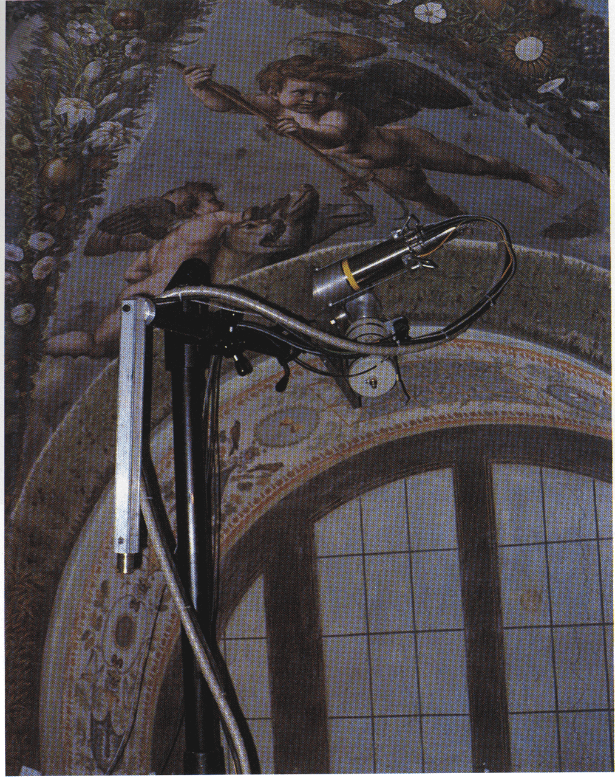
The Evolution of Conservation Theory
Monuments as Memorials (ancient times to present)
Stylistic Restoration (late eighteenth century to present)
Modern Conservation (nineteenth century to present)
Traditional Continuity (twentieth century to present)
Psyche lodge by Raffaello

Slide 12
“Anti-Scrape Society”
Ruskin, William Morris (architect and artist) and many other prominent artisans and theorists founded the Society for the Protection of Ancient Buildings (SPAB) in 1877. The society issued an important manifesto in which it denounced the restoring, copying and moving of heritage structures as inauthentic. Rather, it called for conservative repair and regular maintenance and respect for all alterations and additions created throughout a building’s life-cycle. These beliefs earned it the nickname

Slide 13
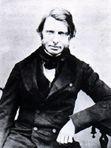
Modern Conservation
Modern conservation theory was conceived as a backlash against restoration. Its chief proponent was the art critic and theorist, John Ruskin.
The theory emphasised preserving those elements that were genuine and original (and thus authentic) and respecting all layers that had been added over time, as well as the patina
John Ruskin (1819 - 1900)

Slide 14
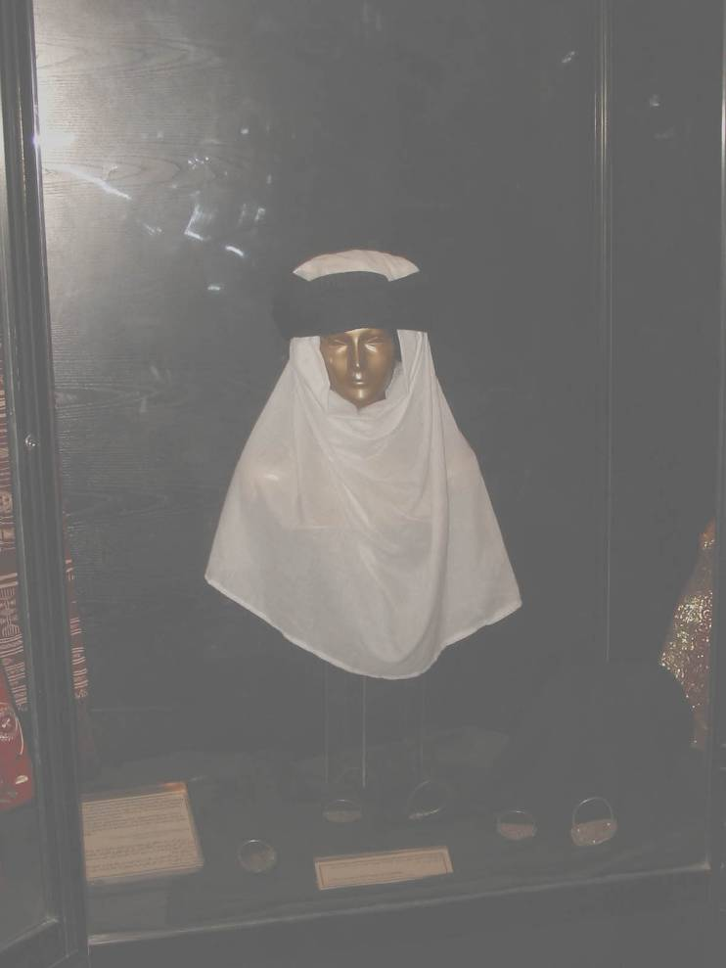
Cultural Heritage or Traditional Continuity
The ideas of traditional continuity developed in parallel to those of modern conservation. The maintenance of living cultures and traditions and the principles of sustaina-bility are emphasised.

Slide 15
International Restoration Charter, Venice Charter
This charter launch the foundation in 1965 of the International Council on Monuments and Sites (ICOMOS), an organisation that would bring together architects, restoration specialists, archaeologists and town planners. The Venice Charter remains the principal document of the organisation.

Slide 16
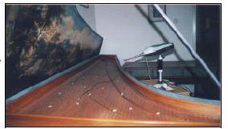
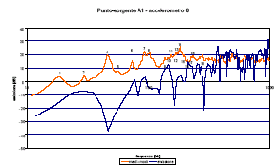
Charter of Venice: Article 2
The conservation and restoration of monu-ments must have recourse to all the sciences and techni-ques which can con-tribute to the study and safe-guarding of the architectural heri-tage
Comparison between the graph of transfer function (orange) and acoustical radiation blue

Slide 17
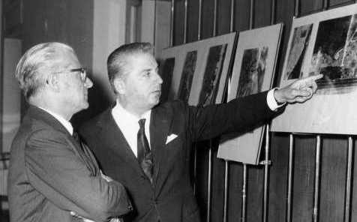
Science and Conservation
The development of a scientific approach to the restoration is a quite recent achieve-ment, mostly due to the cultural action of Cesare Brandi, first director of the Italian Istituto Centrale del Restauro.

Slide 18
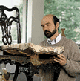
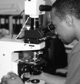
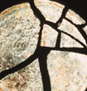
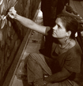
Conservation is a new science
The influence of Idealistic philosophy on the humani-ties delayed, in the past years, the development of a rationa-listic approach to restoration, which ascer-tains the need of recognis-ing the work of art in its material consistency and of defining the actions (resto-ration) assuring its survival.

Slide 19
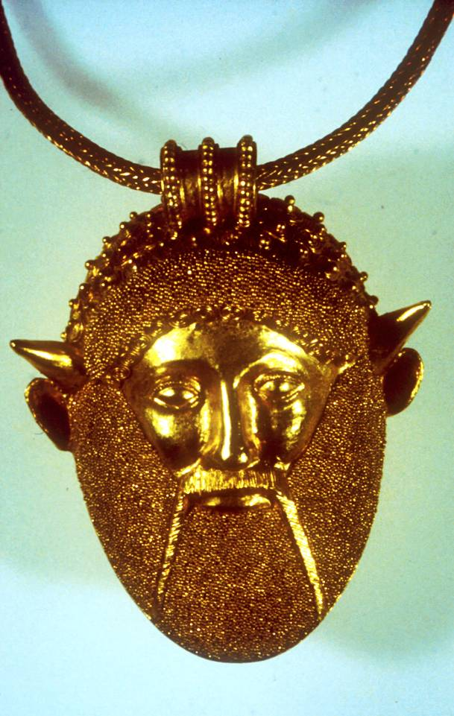
Conservation start with the identification
conservation of cultural heritage in all its forms and historical periods is rooted in the values attributed to the heritage. Our ability to understand these values depends, in part, on the degree to which information sources about these values may be understood as credible or truthful. Knowledge and understanding of these sources of information, in relation to original and subsequent characteristics of the cultural heritage, and their meaning, is a requisite basis for assessing all aspects of authenticity.
1994 Nara Document on Authenticity
Achelo – Villa Giulia

Slide 20
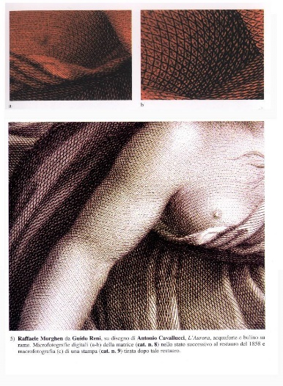
Theory of Restoration 1963
It is the methodological moment of the recognition of the work (heritage resource) in its physical consistency and its significance (aesthetic and historic), in view of its transmission to the future. The focus in restoration is the material object, and the aim is to re-establish the potential unity of the work so far as this is possible without committing an historic or artistic fake, and without cancelling traces of its passage in time.
Copper matrix restored at the Calcografia pontificia

Slide 21
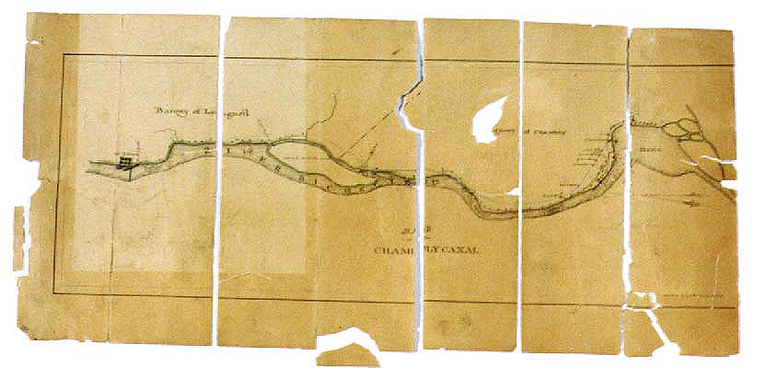
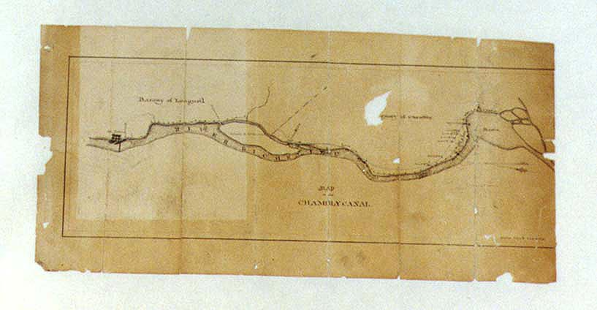
Unity of work of art (Brandi 1963)
Re-establish the poten-tial unity of the work of art, as long as this is possible without produ-cing an artistic or histo-rical forgery and with-out erasing every trace of the passage of time left on the work of art.

Slide 22
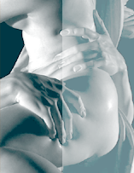
Visual processes and mechanisms
… re-establishing the unity of the image means intervening on the image itself. This ought to be done, therefore, taking into account the visual processes and mechanisms of the human eye/brain interaction. Brandi started from this basic insight when formulating his theory,
From a Bernini marble

Slide 23
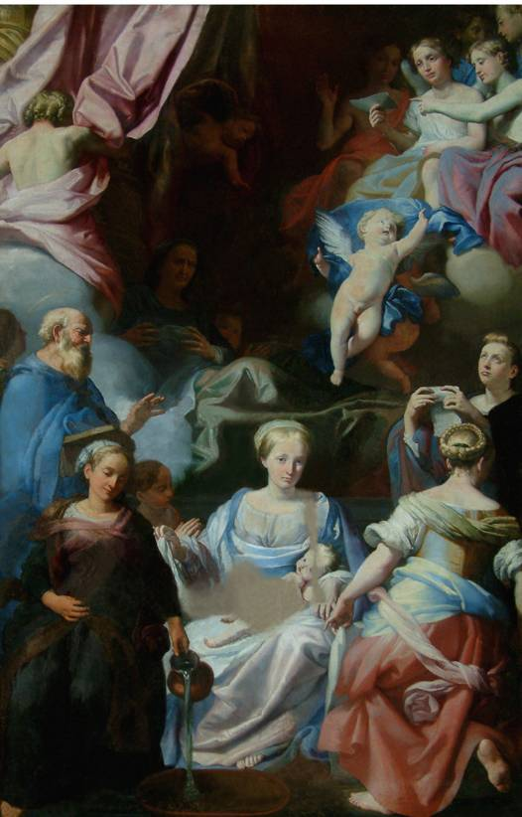
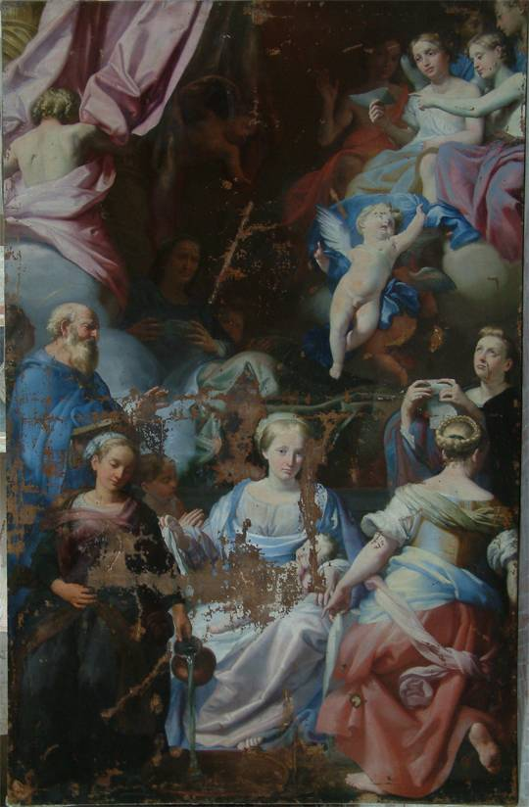
The Autonomy of Restoration: Ethical Considerations in Relation to Artistic Concepts
It is based on the a priori, all too often confirmed by experience, that conserva-tion-restoration is always an interpretation of the object concerned and therefore implies the risk of being a mistaken ana-chronistic interpretation.
Lady of Gualdo Tadino

Slide 24
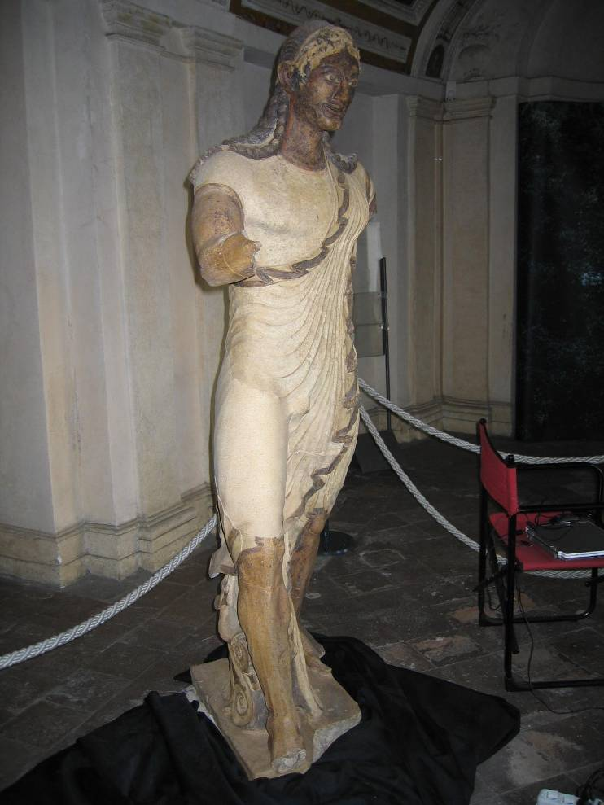
The Emergence of Modern Conservation Theory
is that it may be possible to recognize the museum, or at least the country, from which a painting in an exhibition originated by the manner in which the painting was treated.
Apollo of Veio recently restored

Slide 25
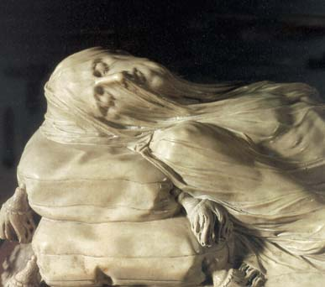
Restoration principles
Any reintegration should be easily recognizable at close distance but, at the same time, it should not offend the unity that is being restored.
The part of material that directly results in the images is irreplaceable so far as it forms the aspect and not the structure.
Any restoration should be so made that it will not be an obstacle for necessary future interventions. Indeed, these should be facilitated .

Slide 26
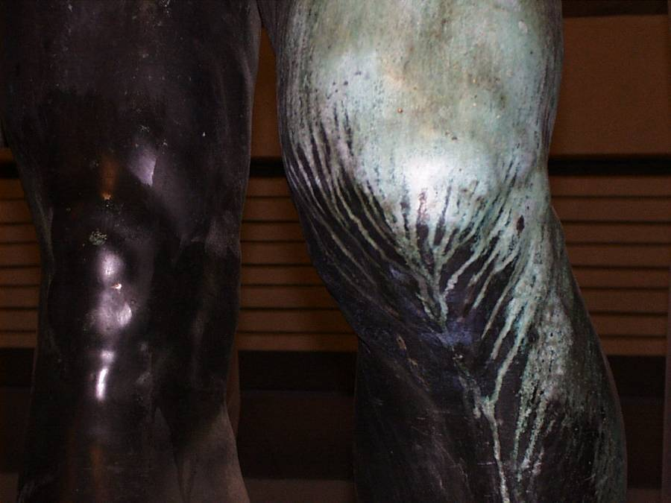
The Idea of Patina
Thus the traces of time, and human interventions designed to counteract the more disfiguring effects of time, are concentrated in the material of the work of art, especially on its surface. Scientific analysis and critical interpretation are often in conflict over the few microns of a layer under discussion.
Perseo legs by Cellini

Slide 27
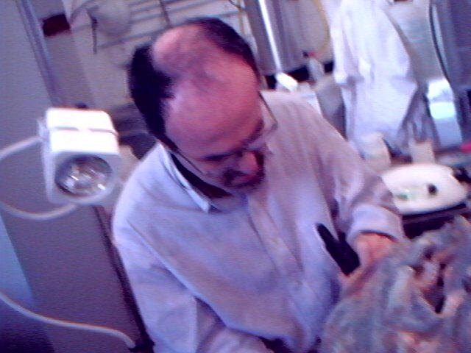
Conservation and restoration
It is very difficult to move from general principles to the criteria and precepts that ought to ensure that these principles are put into practice. Many apparent points of agreement fail to make this transition. It appears to be just as difficult to clarify the relationship between the terms conservation and restoration.
A restorer at work

Slide 28
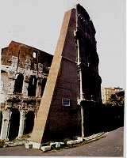
The principle of minimum intervention
With rare exceptions, only one wise course of action remains: to leave works of art alone, or, where, necessary, to free them of restorations, whether old or recent, bad or not too bad.
by Camillo Boito

Slide 29
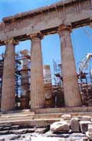
Principle of reversibility
The scepticism on the anastylosis methods and the possibility of a necessity of a new intervention in the future, due to a possible misbehavior of a restored part, leads to the acceptance of the principle of reversibility, in addition to the rest conservation ethics
Parthenon

Slide 30
What are the descriptors on the base of international experience
we can refer to following documents:
  University Postgraduate Curricula for conservation Scientists (CURRIC), April 2000
  Clarification of Conservation/Restoration Edu-cation at University Level … (ENCoRE) fol-lowed by the join declaration ENCoRE-ECCO, 2002 and La Venaria Reale document, 2005
  The Professional Accreditation of Conservator-Restorers (PACR, UK), April 2001
  Becoming a Conservator, Conservation Training in the United States - The American Institute for Conservation of Historic & Artistic Works

Slide 31
CURRIC -University Postgraduate Curricula for Conservation Scientists
A Conservation Scientist today can be defined as a scientist owing a good scientific background and further knowledge in conservation (ethics, history, cultural values, historical technologies, past and present conservation technologies and practice, specific scientific aspects, etc.) which enables him/her to contribute to the study and conservation of Cultural Heritage within an interdisciplinary team.

Slide 32
The skills of a conservation scientist are:
  to be conversant with the phenome-nological approach to problem solving
  ability to formulate and carry out research
  ability to formulate practical solutions
  ability to work in an interdisciplinary way
  ability to communicate effectively
  Additional skills might include the ability to teach and manage human and economical resources

Slide 33
The competence are:
Study, investigate and monitor Cultural Heritage and its environment with respect to conservation and preservation.
Define, develop and evaluate conservation concepts, materials, measures, methods and techniques and develop standards and guidelines
Provide diagnosis before, during and after conservation interventions
Conduct research on causes and mechanisms of deterioration and interpret scientific results for the benefit of the conservation of Cultural Heritage
Communicate the scientific principles of conservation and promote scientific research in conservation

Slide 34
Code of the Cultural Heritage and the Landscape, law 22 January 2004, n. 42
Art. 29 Conservation
All the actions necessary in the conservation and restoration are define in this articles
The diagnosis is clearly defined as a necessary step in the conservation procedure
We are waiting for a straightforward regulation of all activity, giving to each professionals a specific role in the different phases of conservation

Slide 35

Education and Training in Conservation in Sapienza

Slide 36
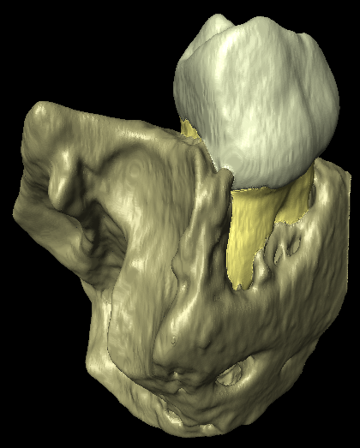
Educational objectives
To train scientific experts that, starting from a sound understanding of materials and techniques of investigation, both in the laboratory and in the field, are able to perform:
diagnostic tests and monitoring of the cultural heritage for conservation and restoration purposes
archaeometrical and scientific research on the material constitution and on the causes and mechanisms of deterioration of the cultural heritage
environmental surveys for conservation and safety purposes
Micro-tomographic techniques in paleoanthropology: segmentation and 3D visualization of hidden anatomical structures
Technologies for the Conservation and Restoration of the Cultural Heritage – Sapienza University of Rome
Notes:
36

Slide 37
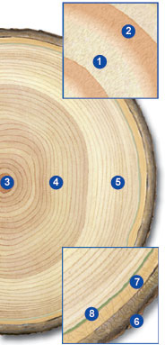
Structure of the course
The course is structured as follows:
in the first year basic teaching in mathematics, physics, chemistry and materials are taught
in the second year various laboratory activities are carried out with an interdisciplinary approach, in addition to law and economics teaching
in the third year the training is complemented by some humanities, choice courses, internship and a final short dissertation.
Dendrochronological survey on the pile foundations of buildings on the Giudecca island in Venice
Technologies for the Conservation and Restoration of the Cultural Heritage – Sapienza University of Rome
Notes:
37

Slide 38
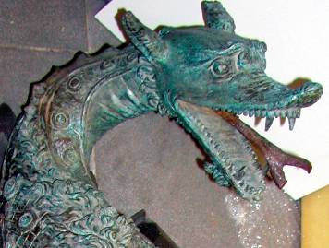
Professional outcomes
Protection of the cultural heritage and environmental recovery in specific institutions, such as offices, museums, libraries, archives
Evaluation of environmental parameters and microclimate control in museum
Technical knowledges
Conservation of books and paper, paintings on various supports, wooden sculptures, stone material and mosaics, metals, textiles, pottery and other materials
Non-destructive testing of metal items, such as St Michael Archangel in the Orvieto Cathedral
Notes:
38

Slide 39
Internships
Internships involve all major superintendences of the Region, Central Institutes of the Ministry of the Cultural Heritage and Activities, as well as private companies operating in the field of conservation and restoration
Excellence programs
Deserving students may be included in “excellence programs” of Sapienza University of Roma
Protection of the cultural heritage and environmental recovery in specific institutions, such as offices, museums, libraries, archives
Evaluation of environmental parameters and microclimate control in museum
Technical knowledges
Conservation of books and paper, paintings on various supports, wooden sculptures, stone material and mosaics, metals, textiles, pottery and other materials
Diagnostics applied to the study of Chinese paintings of the Ming Dynasty
Technologies for the Conservation and Restoration of the Cultural Heritage – Sapienza University of Rome
Notes:
39

Slide 40
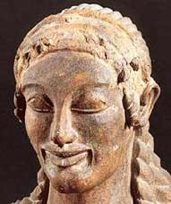
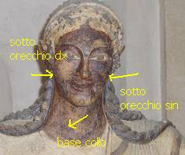
Training program
scientific disciplines in science and technology for the conservation and restoration
scientific disciplines of earth science and nature
humanities
optional courses
internship and final dissertation
Colorimetry applied to the acroterial statues of the Veii temple
Science and Technology for the Conservation of the Cultural Heritage – Sapienza University of Rome
Notes:
40

Slide 41
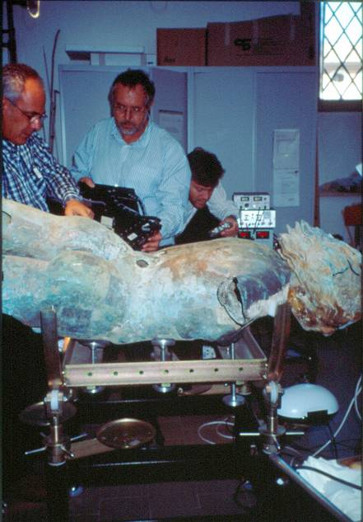
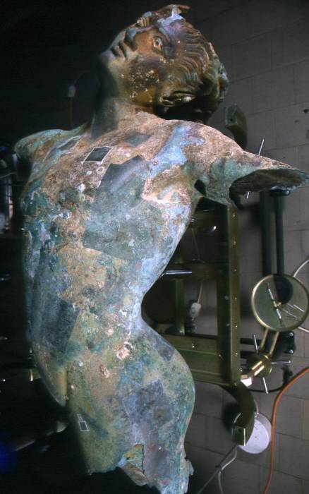
Internationalization
The Erasmus Mundus Master Course in ARCHaeological MATerials Sciences (ARCHMAT) includes training in:
University of Evora (Portugal)
Aristotle University of Thessaloniki (Greece)
Sapienza University of Rome
(http://www.erasmusmundus-archmat.uevora.pt/)
Erasmus students exchange :
Valencia University (Spain)
Queen’s University of Belfast (UK)
Grants for internship abroad
Satiro in Estasi (Mazara del Vallo)
Science and Technology for the Conservation of the Cultural Heritage – Sapienza University of Rome
Notes:
41

Slide 42
Bologna process
The purpose of the Bologna process (or Bologna accords) is to create the European higher education area by making academic degree standards and quality assurance standards more comparable and compatible throughout Europe, in particular under the Lisbon Recognition Convention. The Ministers of Education from 29 European countries signed it 1999, the process end is scheduled in the 2010.
The Council of Europe together with the members of the Europe Region of UNESCO have jointly prepared the Lisbon recognition convention on recognition of academic qualifications as part of the process, which has been ratified by the majority of the countries party to the Bologna process.

Slide 43
Country A
Country B
EQF Level 8
Q
NQF/
NQS
EQF Level 7
NQF/ NQS
Q
EQF Level 6
Q
NQF/
NQS
EQF Level 5
NQF/ NQS
Q
Q
NQF/
NQS
EQF Level 4
EQF Level 3
Q
NQF/
NQS
NQF/ NQS
Q
EQF Level 2
EQF Level 1
Notes:
43

Slide 44
National Qualification Framework
In it have been discussed the problem of insertion of conservation scientists and restorers in the EQF
This forum help the development of the discussion on the transfer to the Higher Education Area of the training of conservation and restoration professionals
Our national council has been the forum for the discussion on the development of a higher education system in the conservation and restoration area in Italy

Slide 45
A tradition of education outside the university
Traditionally, most higher education institutions not included in the university sector in Europe have offered bachelor degrees, and only recently have they introduced master degrees in some countries. This happen also in the restoration (and not in conservation). This serves the purpose of diversification of higher education, which is called for by European labour market needs and the increasingly heterogeneous student population.

Slide 46
The university works on last three levels:
Level 6 - Bachelor (180 ECTS)
Level 7 - Master (90-120 ECTS)
Level 8 - Doctorate

Slide 47
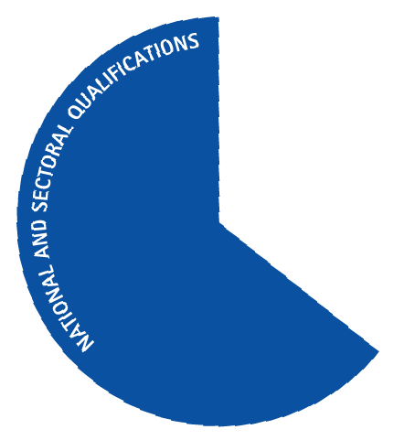

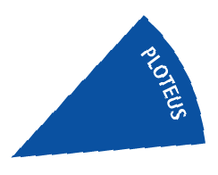
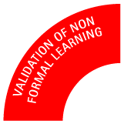




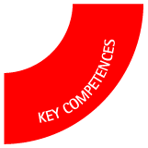
The Main
elements
of the
EQF

Slide 48
The Eight EQF Levels
Knowledge
Each
EQF
Reference
Level
Skills
Competences

Slide 49
EQF concepts
Skills are cognitive and practical
Competence is about responsibility and autonomy
The descriptors are ‘read across’
Each level assumes learning at the lower levels
Each new higher level introduces a new dimension of learning
Higher levels draw directly on EHEA descriptors

