Slide 1
Overview of the Assignment
Career Expectations Survey – Group Exercise
Course: Statistics for Business and Decision Making
A.Y. 2025/2026
43 group submissions
Each group analyzed one thematic area using R
Tasks: descriptive statistics, correlation/association tests, short written report

Slide 2
Main Topics Covered
Most popular themes:
Mobility and International Aspirations
Job Preferences and Sectors
Demographics and Study Background
Career Confidence in finding a job
Job Search and Preparation Behavior
Students were particularly interested in international mobility, salary expectations, and job satisfaction.

Slide 3
Analytical Approaches Used
use of position indicators with summary command: mean, median, and frequency tables
Application of Chi-square and Pearson correlations
Visualizations: bar charts, boxplots, histograms
Some groups used tests not yet covered in class (e.g., t-tests, ANOVA, regression) – showing curiosity but also confusion.
Sometimes the interpretation of the result is missing (in some report I found R codes + graphs without any interpretation)

Slide 4
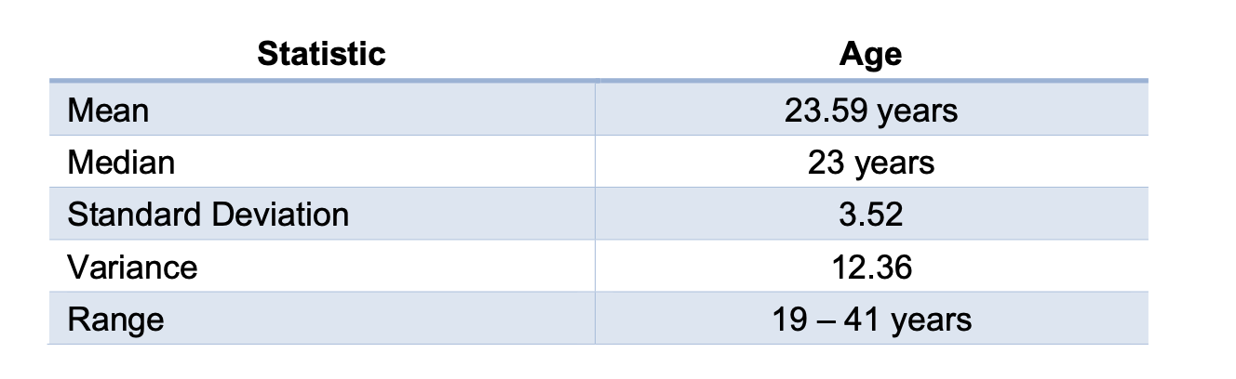
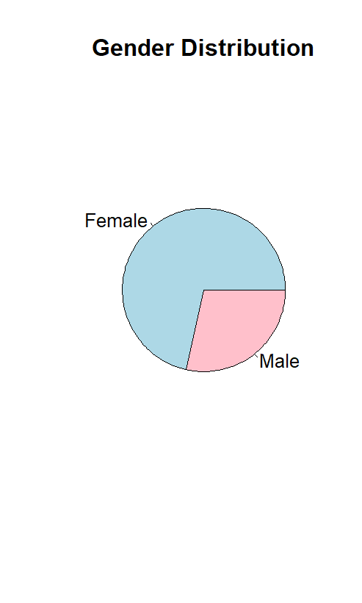
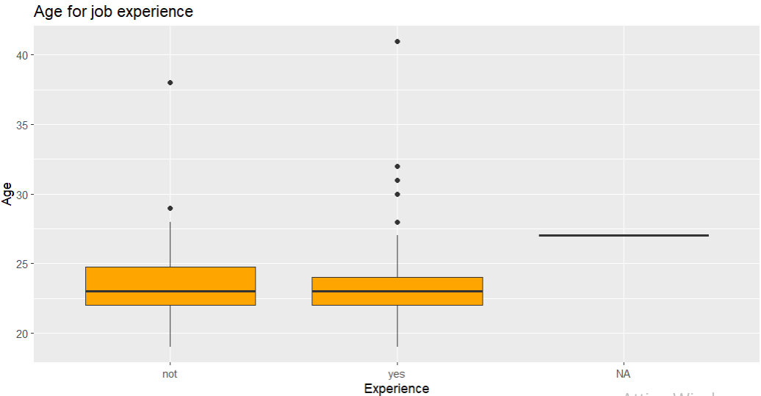
Examples of Students Work
Demographic analysis: gender, enrolment year
Do you observe differences?

Slide 5
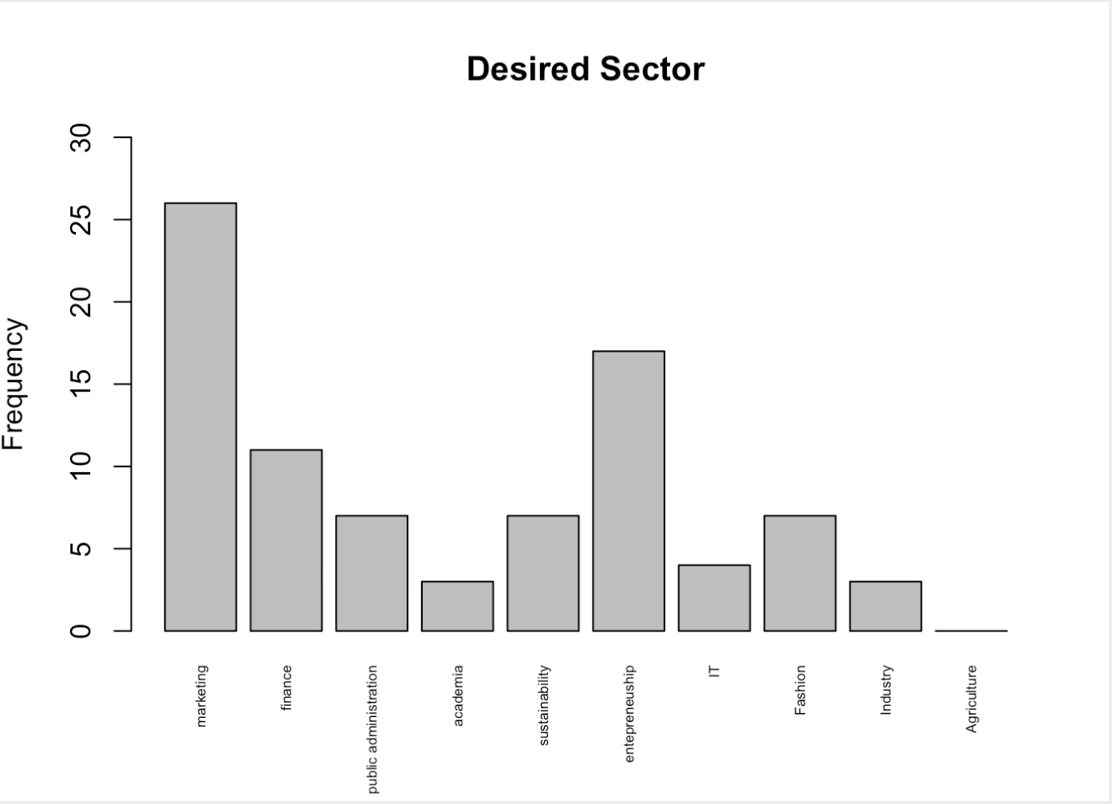
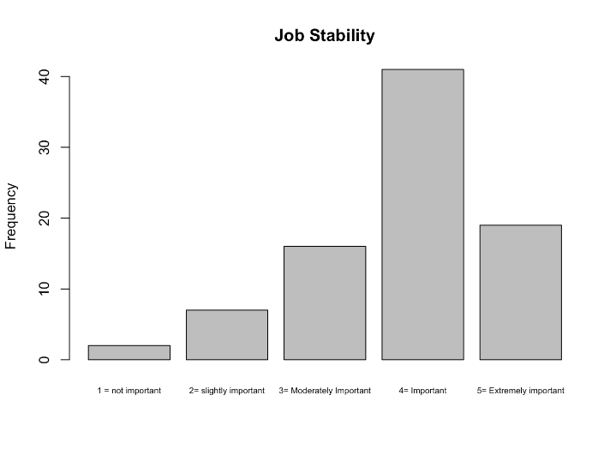
Examples of Students Work
Job Preferences and Sectors

Slide 6
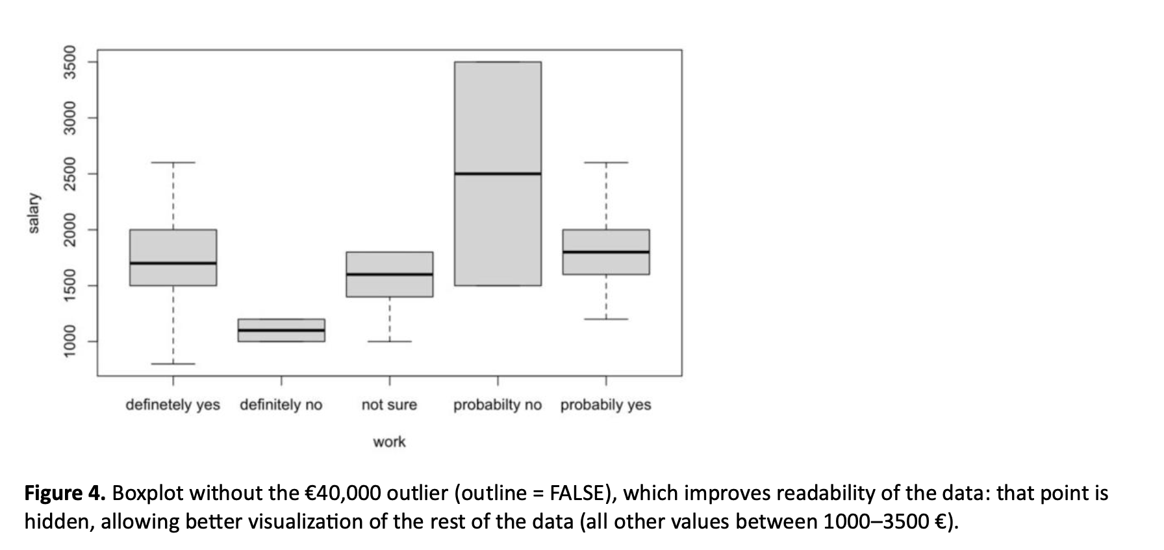
Examples of Students Work
Comparison of Expected Salaries and Willingness to Move Abroad

Slide 7
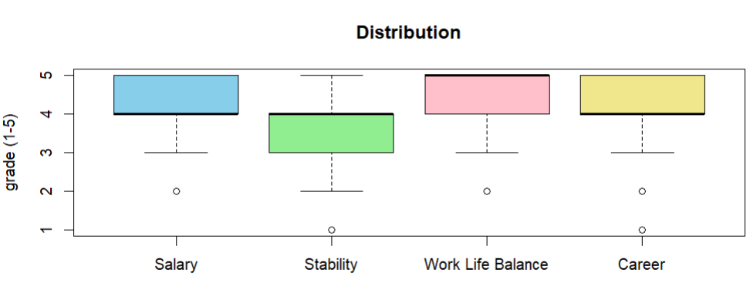
Examples of Students Work
Importance in the following statements
Importance (scale with 5 modalities)
Pearson's correlation matrix revealed positive and significant correlations between the importance attributed to salary, job stability, and career opportunities, suggesting that students who value one of these aspects tend to value the others as well.
Here it would be better to use CHi2

Slide 8
Examples of Students Work

Slide 9
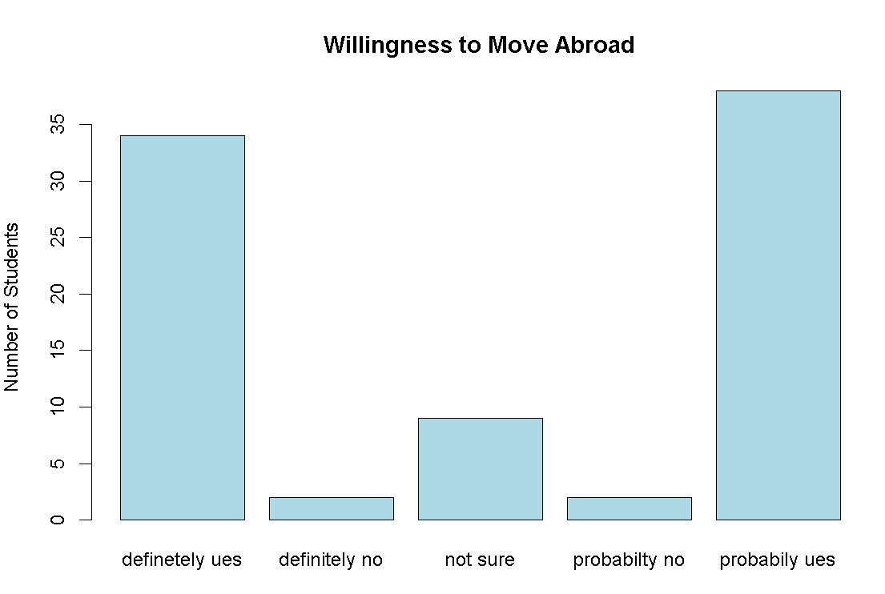
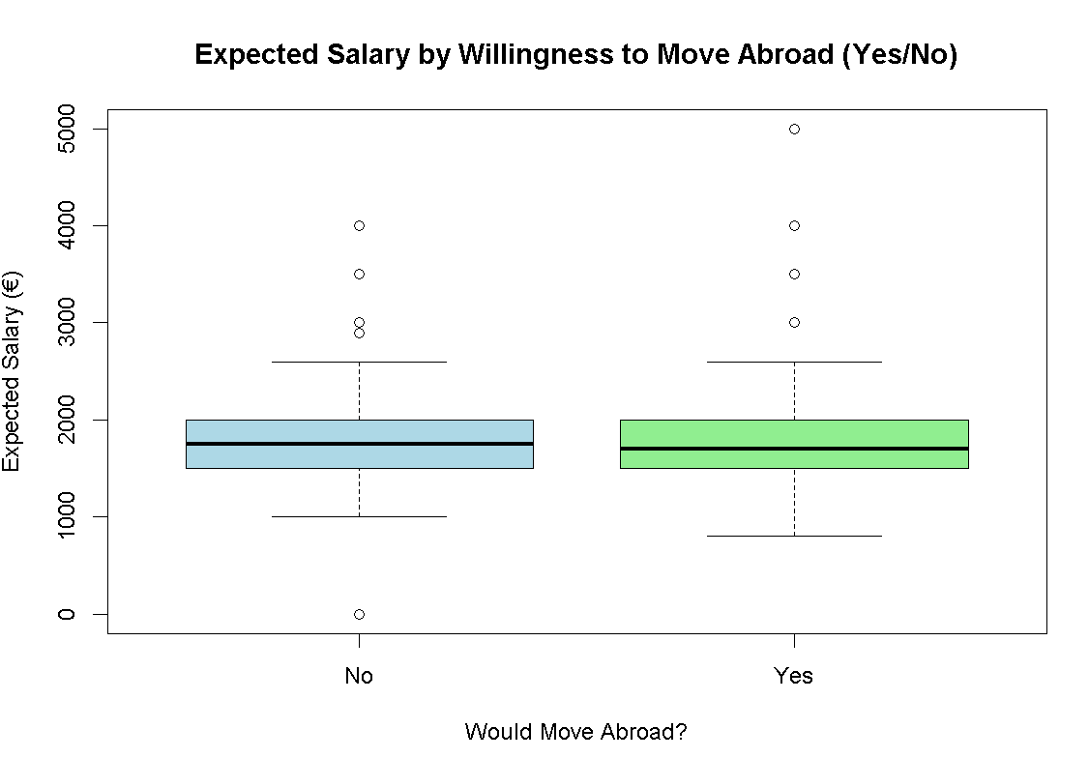
Examples of Students Work
Interpretation:
Key Findings:
Most of the students are willing to move abroad for better job opportunities (definitely yes + probably yes)
Only 5% are unwilling to move abroad (definitely no + probably no)
About 10% are undecided
This shows a very strong international mobility aspiration among the students, with the vast majority being open to working abroad for better career opportunities.
Willingness to move abroad
Do students who want to move expect different salaries than those who don't?
Students willing to move abroad expect €1,986 on average
Students unwilling to move abroad expect €1,858 on average
Difference: €128 higher expectations for mobile students

Slide 10
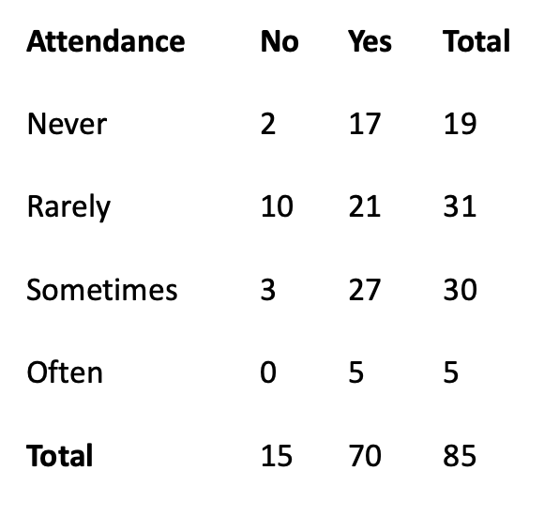
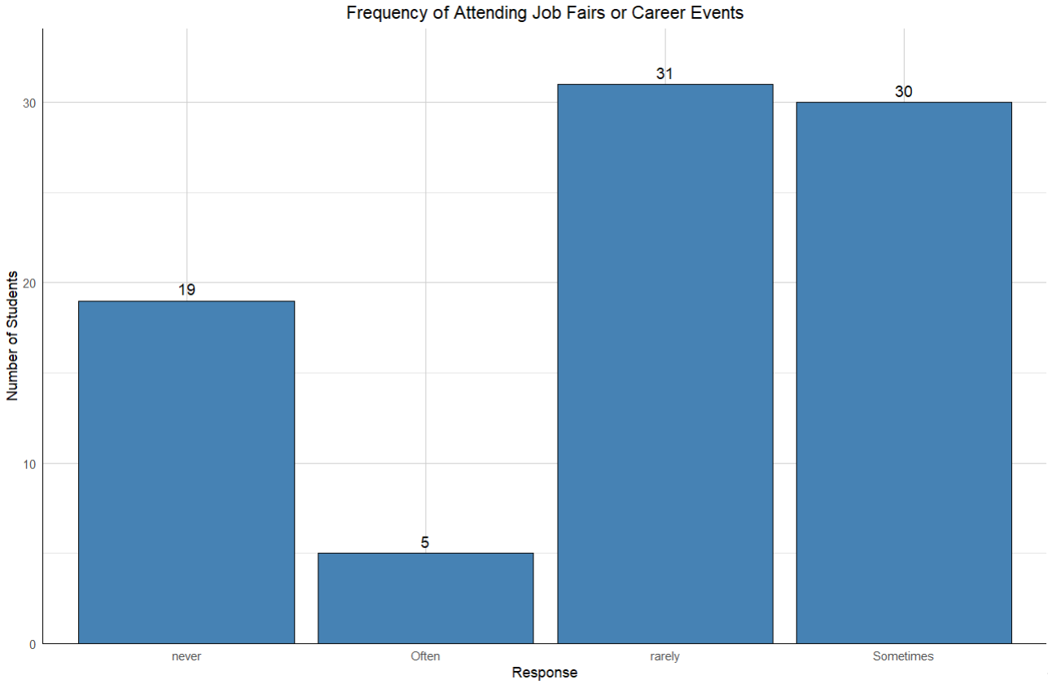
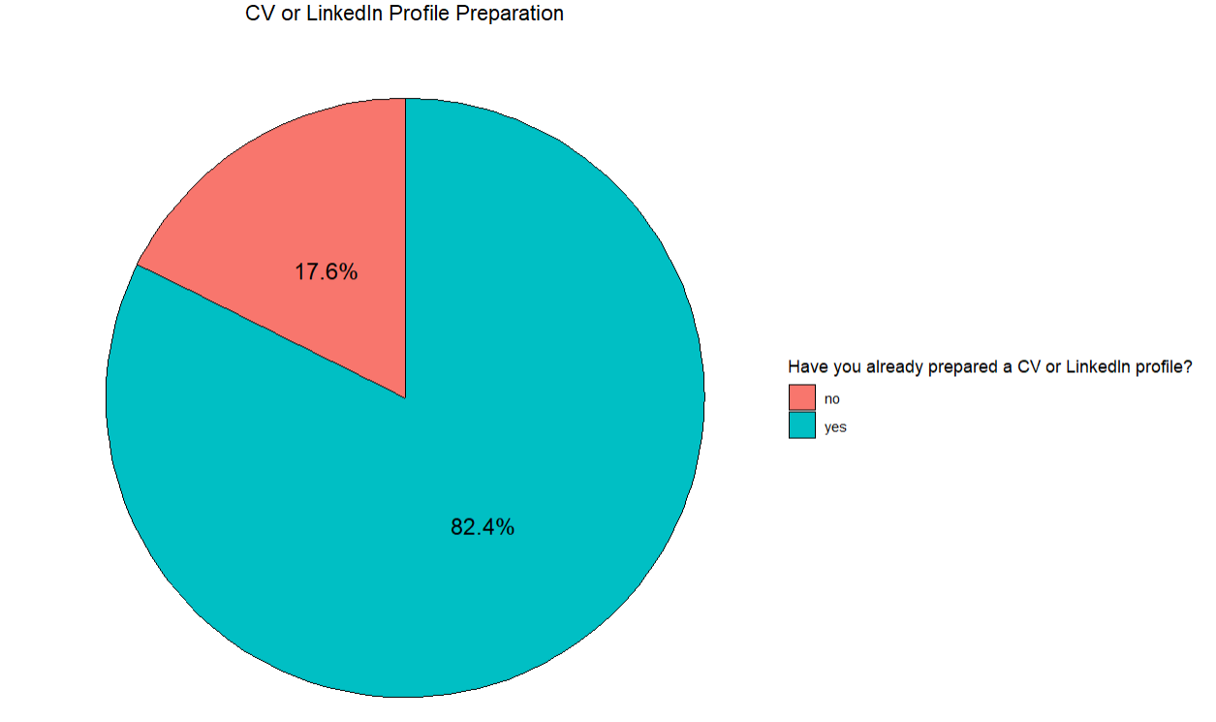
Examples of Students Work
Job fair attendance x CV/LinkedIn preparation
Good Description of the results and interpretation, also using Chi2
Maybe a graphical representation here could be useful!

Slide 11
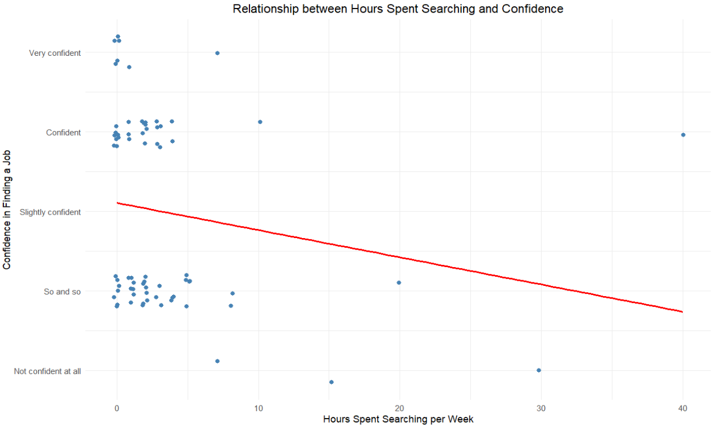
Examples of Student Work
Association between:
Job Search Hours (quantitive)
confidence to find a job (qualitative)

Slide 12
Unexplored Areas of the Survey
Interestingly, no group focused on the sections related to: Main worries or Perception of university skills.
These aspects could have offered valuable insights into students’ concerns and self-assessment of preparedness. Their absence may reflect either a lower perceived relevance of these questions or a greater interest in more tangible topics such as mobility and salary expectations

Slide 13
Evaluation Summary
Overall good understanding of descriptive and inferential analysis.
Reports well structured and data-driven.
Most groups produced clear and meaningful visualizations, successfully applying the plotting codes learned in class and, in some cases, experimenting with additional R functions.
Some groups likely used ChatGPT or other AI tools: fluent English, similar phrasing, lack of numerical details.
AI likely used for editing.

Slide 14
Key Takeaways from Your Analyses
Strong interest in international mobility — most groups highlighted students’ openness to working abroad, showing that global opportunities remain a major driver of career expectations.
Salary remains central, but many of you also recognized the growing value of work–life balance and job satisfaction — a sign of mature, multidimensional reasoning.
Good use of descriptive and correlation analyses, often supported by clear graphs. In several cases, results were correctly interpreted in light of the questions asked.
Some overreliance on numerical output without commentary — a reminder that data only become meaningful through your explanation.
Creativity and curiosity emerged
Unexplored variables such as Main worries and Perception of university skills suggest room to deepen the human side of the data — fears, self-perception, and expectations often explain as much as numerical indicators.

Slide 15
Suggestions for improvement
1. Interpretation matters
Avoid stopping at the code or the graph — explain what the results mean in relation to your question.
2. Choose the right tools
Before using statistical tools(e.g., Chi², Pearson,), check if the variables and assumptions match the method.
3. Support every chart with context
A good graph answers a question — include labels, titles, and short comments that make your findings clear.
4. Be consistent with units and categories
When comparing groups (e.g., salary, confidence), make sure values are on the same scale and categories are well defined.
5. Keep curiosity, add precision
Exploring beyond what we covered in class is excellent — just ensure you understand what each function actually tests.
6. Write as a team, think as analysts
Balance the workload but align on interpretation — the best reports read as one voice, not several pasted parts.

