Slide 1
THE TORTURE AND DEATH PENALTY REGULATION
Trade in specific goods. In this case, TRADE BAN ON GOODS THAT CAN BE USED FOR THE DEATH PENALTY AND FOR TORTURE

Slide 2
OBJECTIVES
Act against torture
Contribute to the abolition of the death penalty worldwide
Avoiding complicity in executions in third countries

Slide 3
Torture and the death penalty in international and EU Law
Evolution of international law about the death penalty.
Convention on the rights of the child
Protocols 6 (1983) and 13(2002) to the ECHR
Interpretation of human rights treaties (right to life and right to human dignity: Schabas)
Article 2(1) ECHR and the Ocalan case
EU Charter of fundamental rights, Article 2(2)
UN moratorium on the death penalty 2007

Slide 4
Torture
Strictly prohibited under a norm of international customary law with peremptory character (ius cogens)
Article 5 Universal Declaration on Human Rights
United Nations Convention against Torture and Other Inhuman or Degrading Treatment or Punishment 1984
UN General Assembly Resolution 3452(XXX) of 1975
Article 3 ECHR
Article 4 EU Charter

Slide 5
The EU’s action in third countries against torture and the death penalty
Guidelines to EU policy towards third countries on the death penalty, 1998
Guidelines to EU policy towards third countries on torture and other cruel inhuman or degrading treatment or punishment, 2001
Right to international protection: Qualification Directive of 2004-2011 (notion of serious harm under Article 2(f)
Refusal of extradition. Article 19 (2) EU Charter Agreements with US and Japan

Slide 6
The Torture Regulation and the WTO
Public morals of the international community.
Recital 7 of the Regulation, Commission’s comments and Article XX of the GATT

Slide 7
The EU Regulation No 1236/2005, as amended in 2016. Definitions
Articles 2 (a) and (b) of the Regulation.
Definition of torture is taken from the 1984 CAT.
In addition: «capital punishment is not deemed a lawful penalty under any circumstances» (letter b).
Public officials or also private parties? Article 6(2) includes «any natural or legal person in a third country»

Slide 8
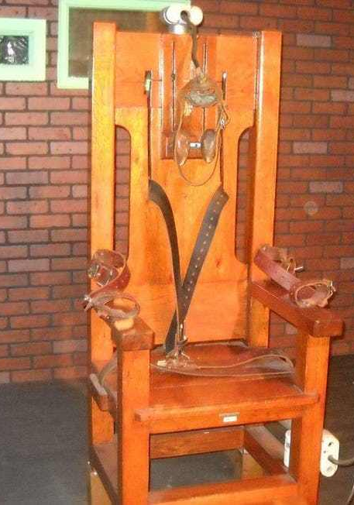
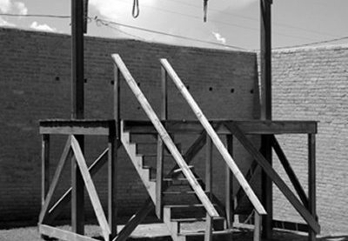
TRADE REGIME FOR GOODS USED SOLELY FOR DEATH PENALTY OR TORTURE: COMPLETE BAN
The ban includes export, technical assistance, brokering services, transit, training, advertising

Slide 9
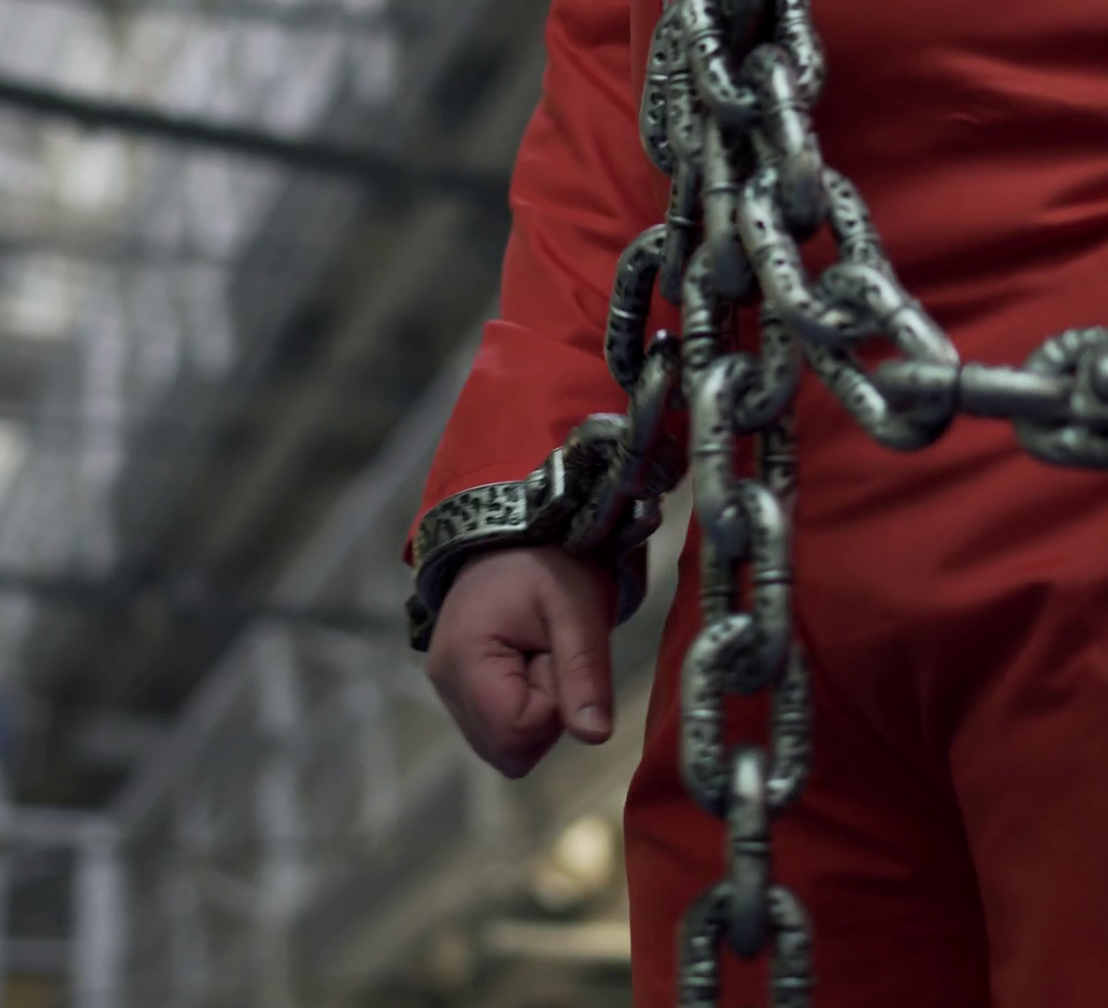
GOODS THAT CAN BE USED ALSO FOR LEGITIMATE PURPOSES
Law enforcement items
Medicinal goods
System of national authorization

Slide 10
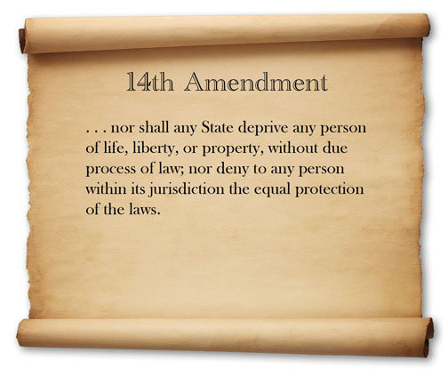
THE DEATH PENALTY IN THE US AND THE CONSTITUTION

Slide 11
Death penalty in the US

Slide 12
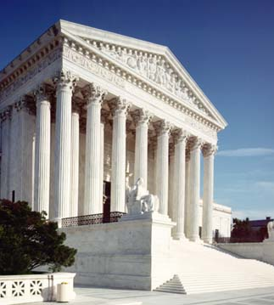
The EU ban impact and the Supreme Court
Glossip v. Gross, 29 June 2015
Arthur v. Dunn, 2017 (Sotomayor, J. Dissenting Opinion.

