Slide 1
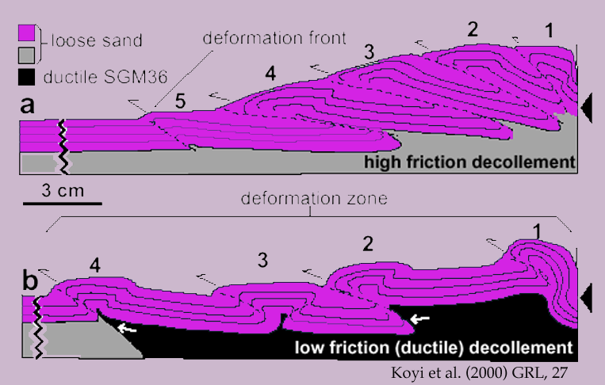

Slide 2
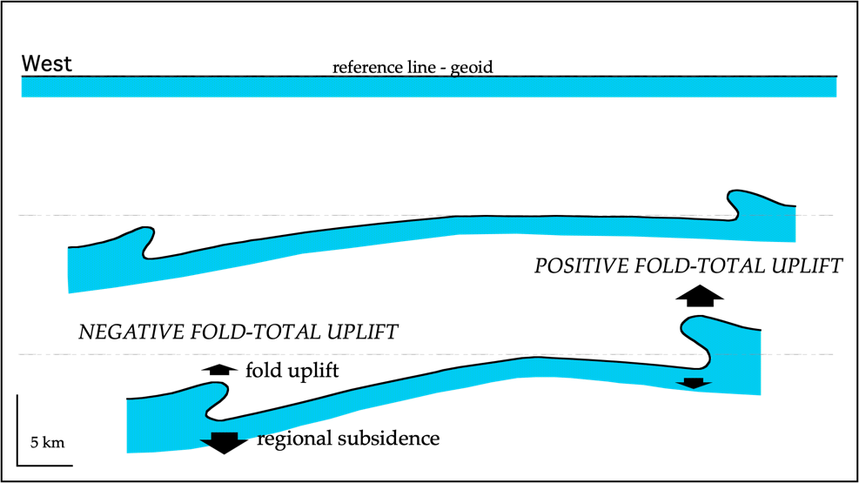
positive fold
total uplift
SW
Canale d'Otranto
HELLENIDES
E-NE
APENNINES
S-Adriatic - Ionian seas
FRONT
0
negative fold
FRONT
1
.
total uplift
0
Plio-Pleistocene
2
.
deeper
M
0
foredeep
3
.
Pleistocene
Apulian carbonate platform
Sec TWT
0
0
1
0
k
m
5
.
Subsidence rate > 1 mm/yr
5
Subsidence rate < 0.3 mm/yr
0
C
R
O
P
M
5
regional subsidence > fold uplift
regional subsidence < fold uplift
SUBDUCTIONS DIRECTION
Calabria
M
5
M
3
8
I
o
n
i
a
n
S
e
a
1
0
0
k
m

Slide 3
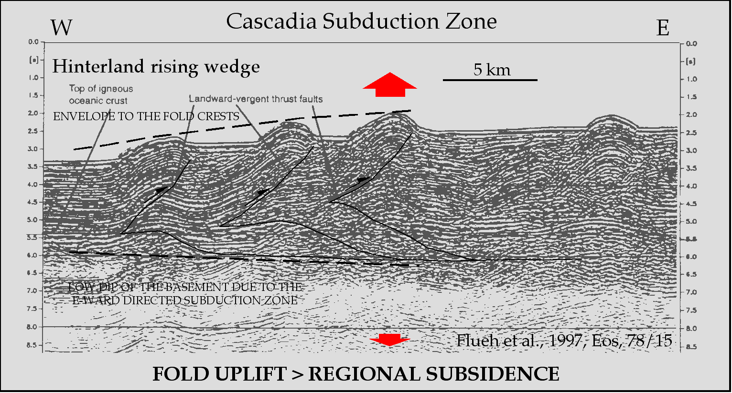
Apennines -W Adriatic Sea

Slide 4
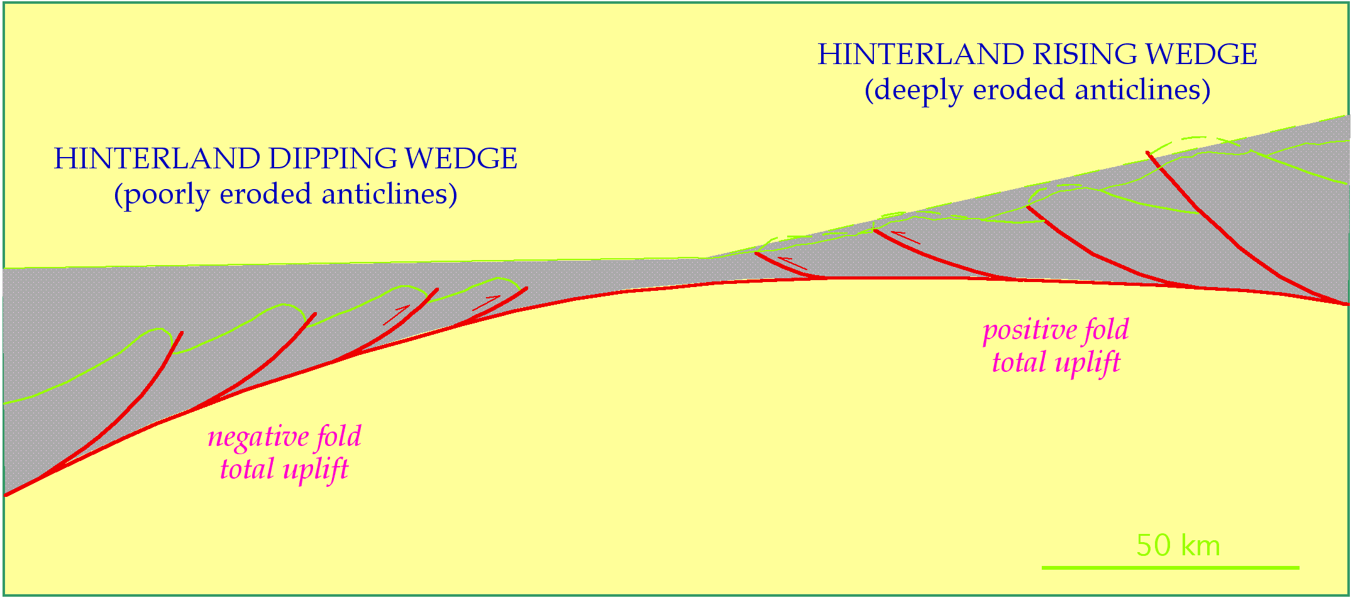
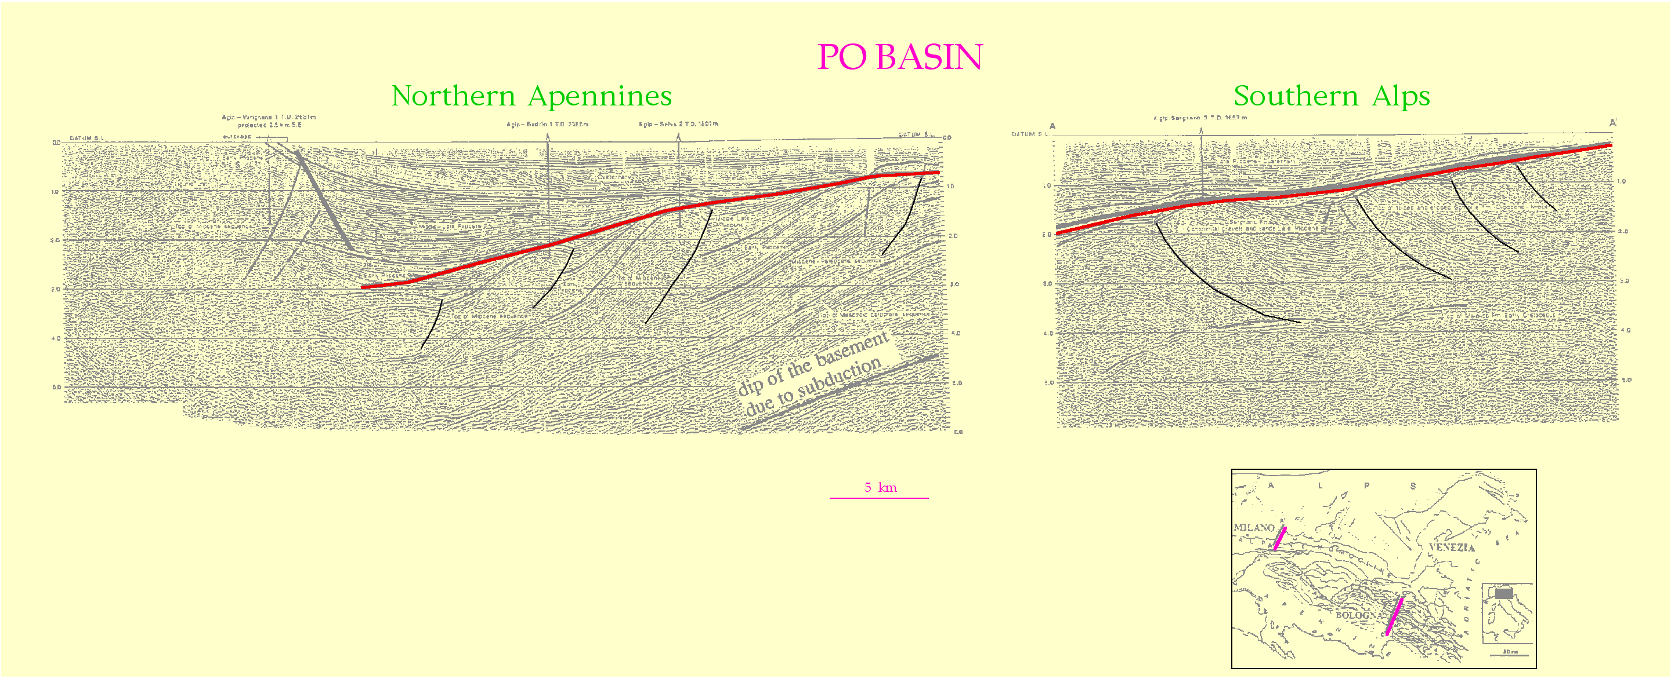
5 km

Slide 5
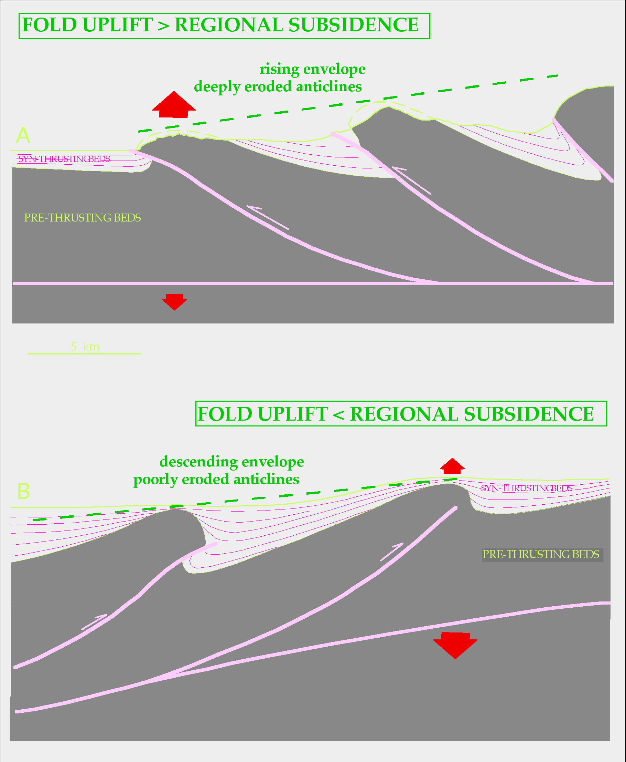
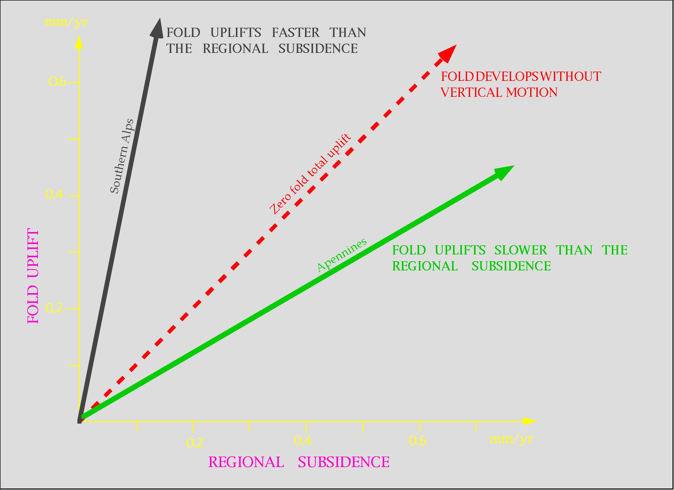

Slide 6
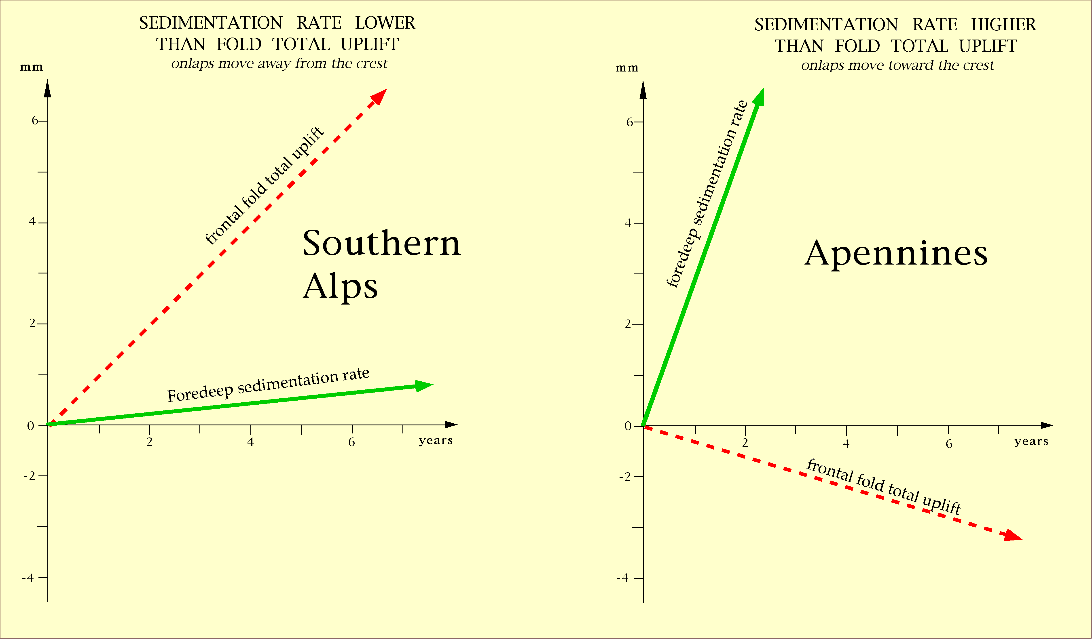

Slide 7
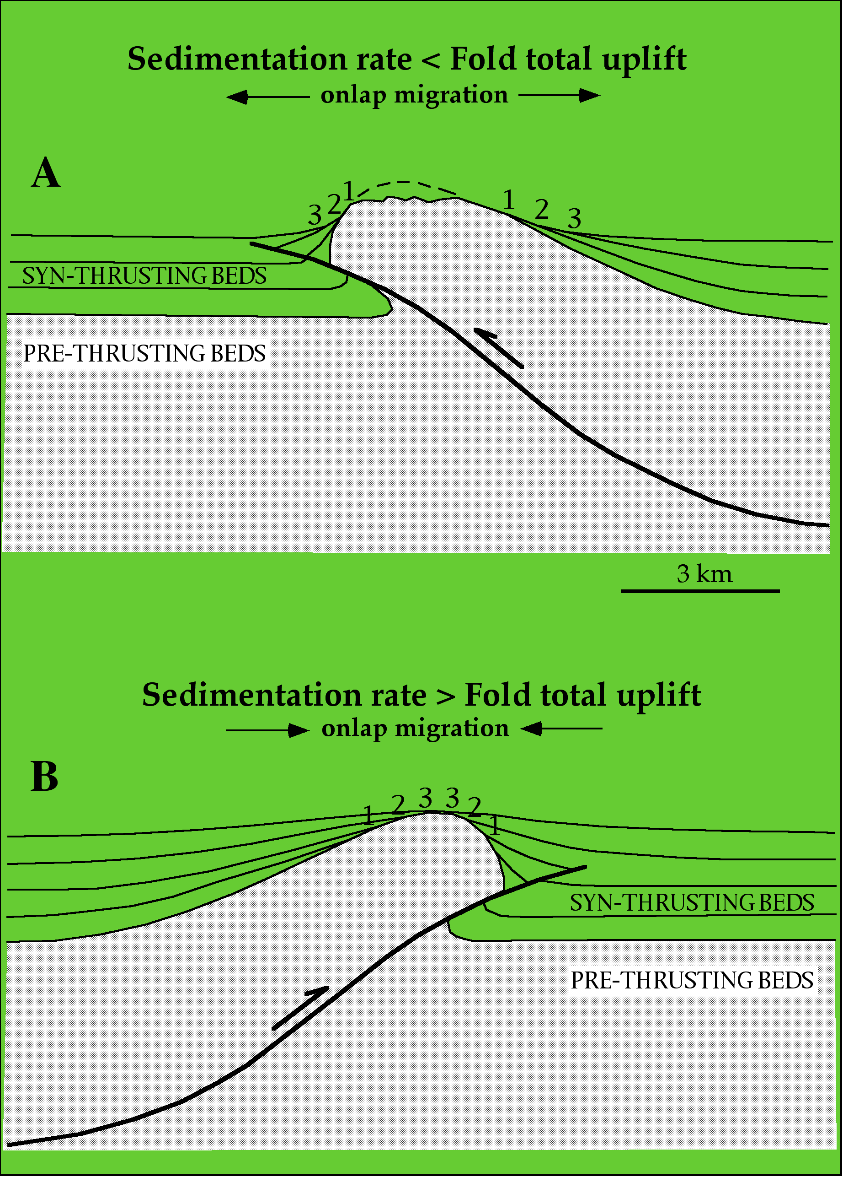

Slide 8
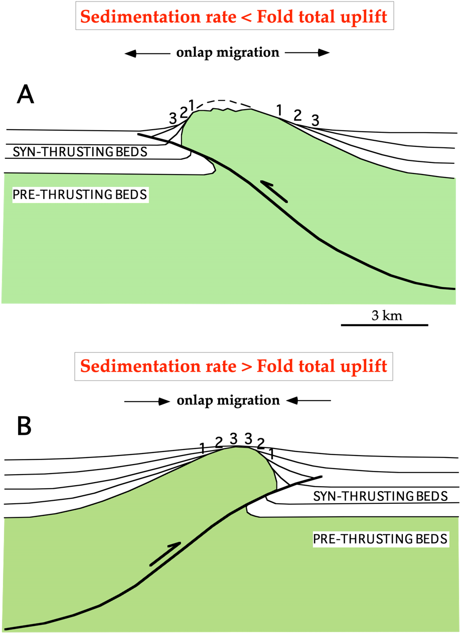
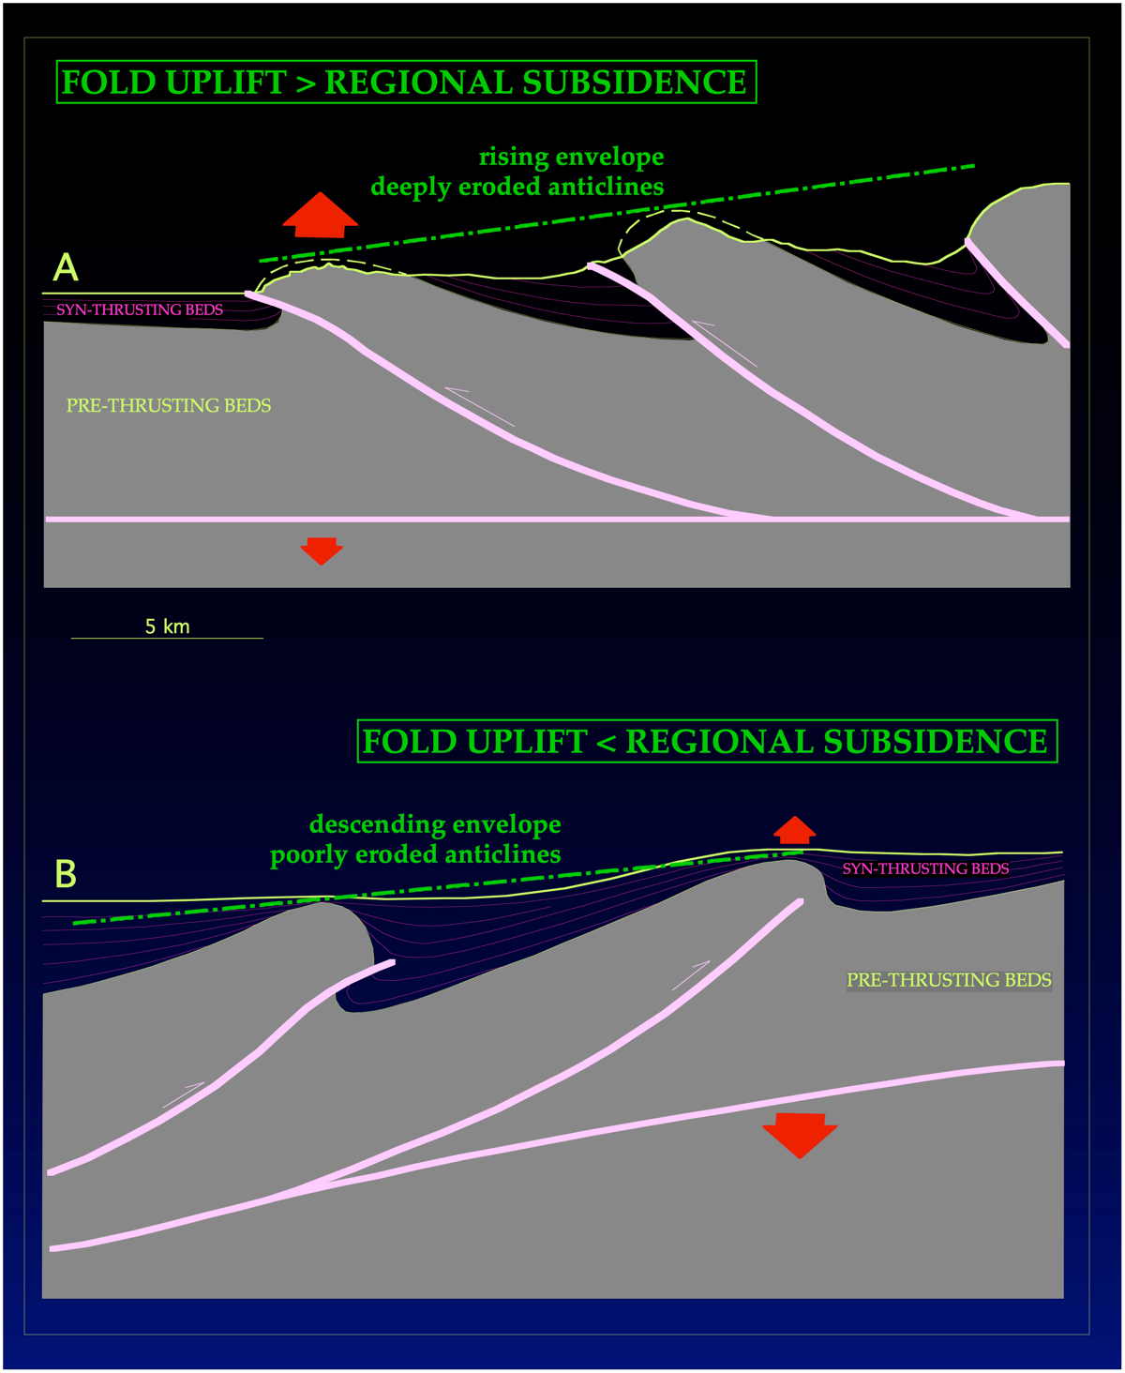

Slide 9
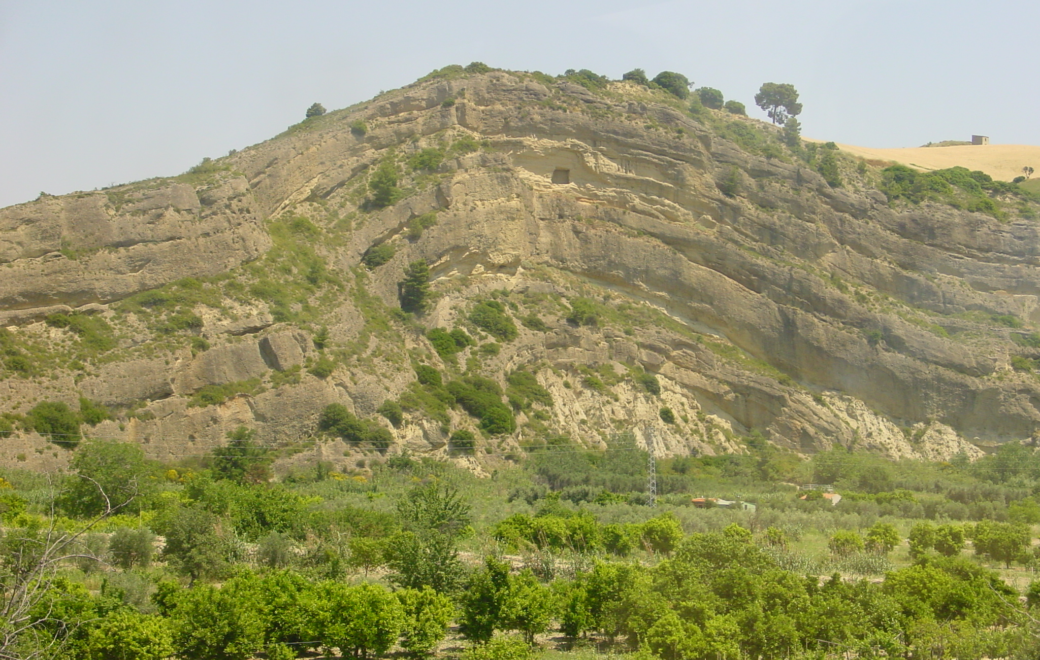
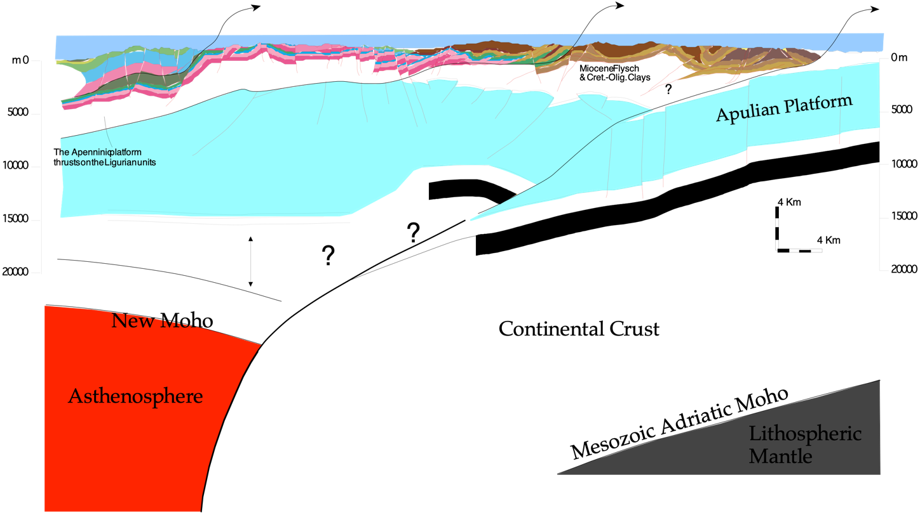
Growth fold in Lower Pleistocene conglomerates
W
Sant’Arcangelo Basin

Slide 10
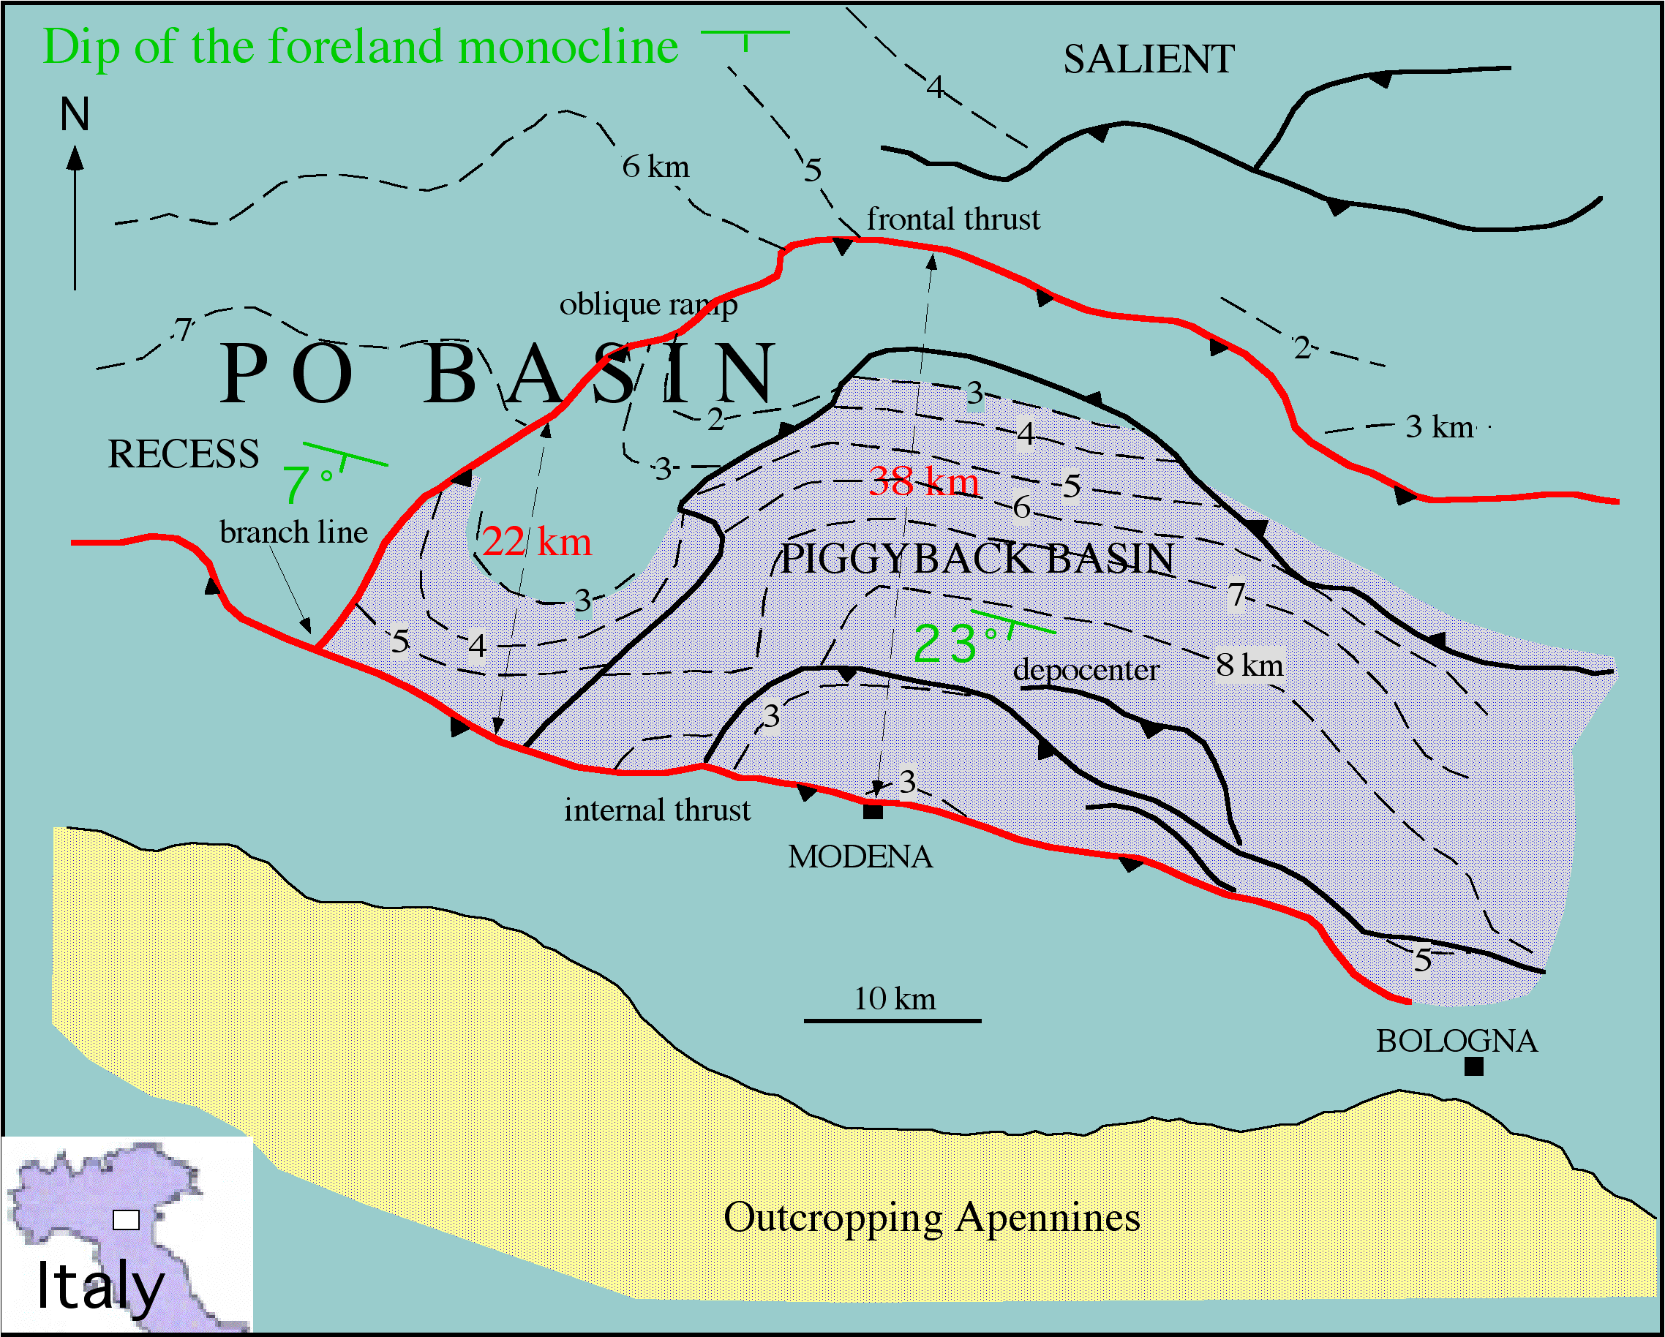

Slide 11
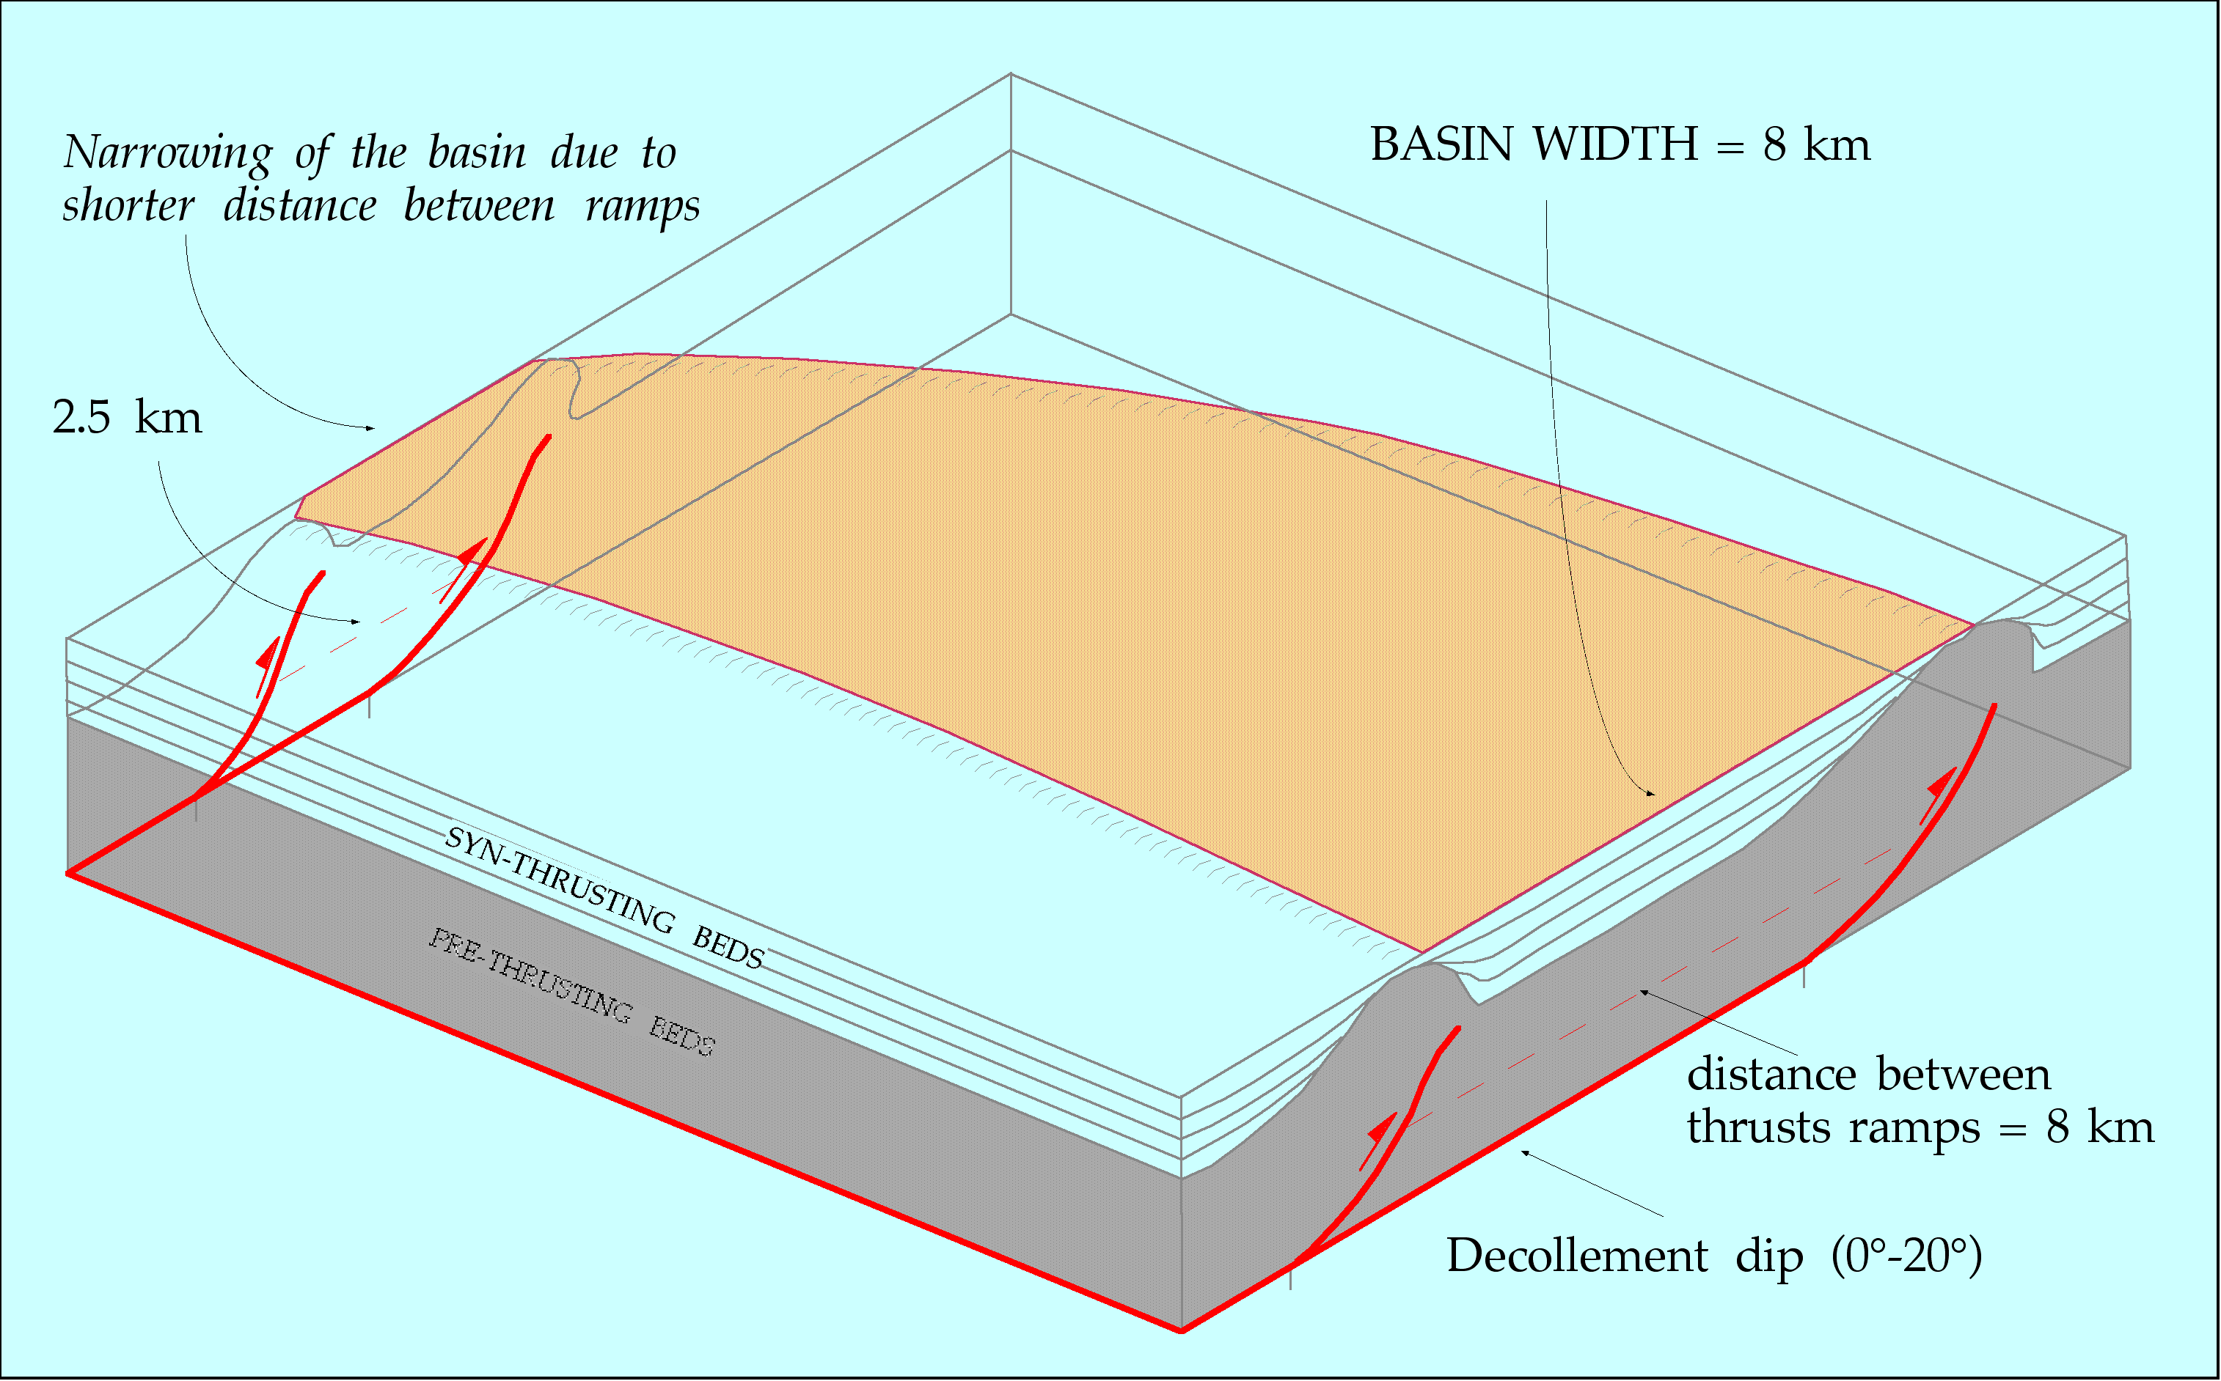

Slide 12
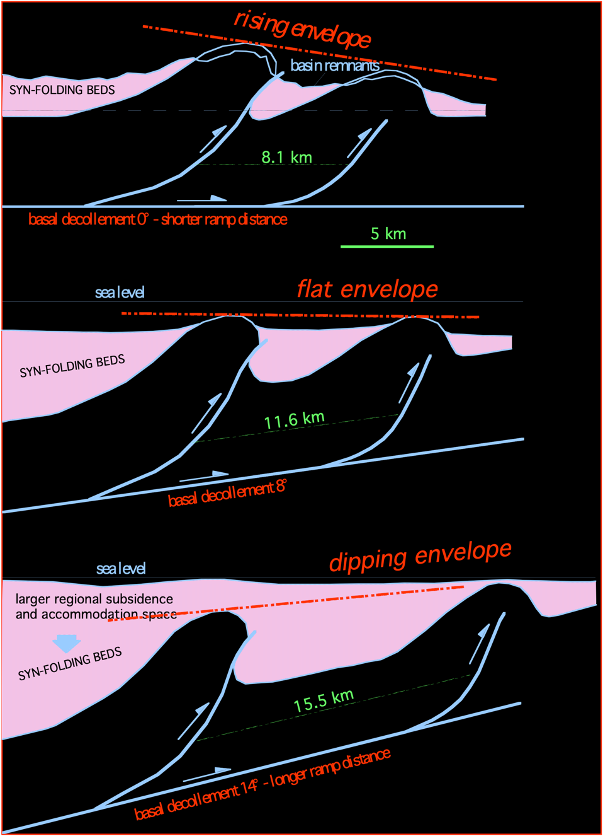

Slide 13
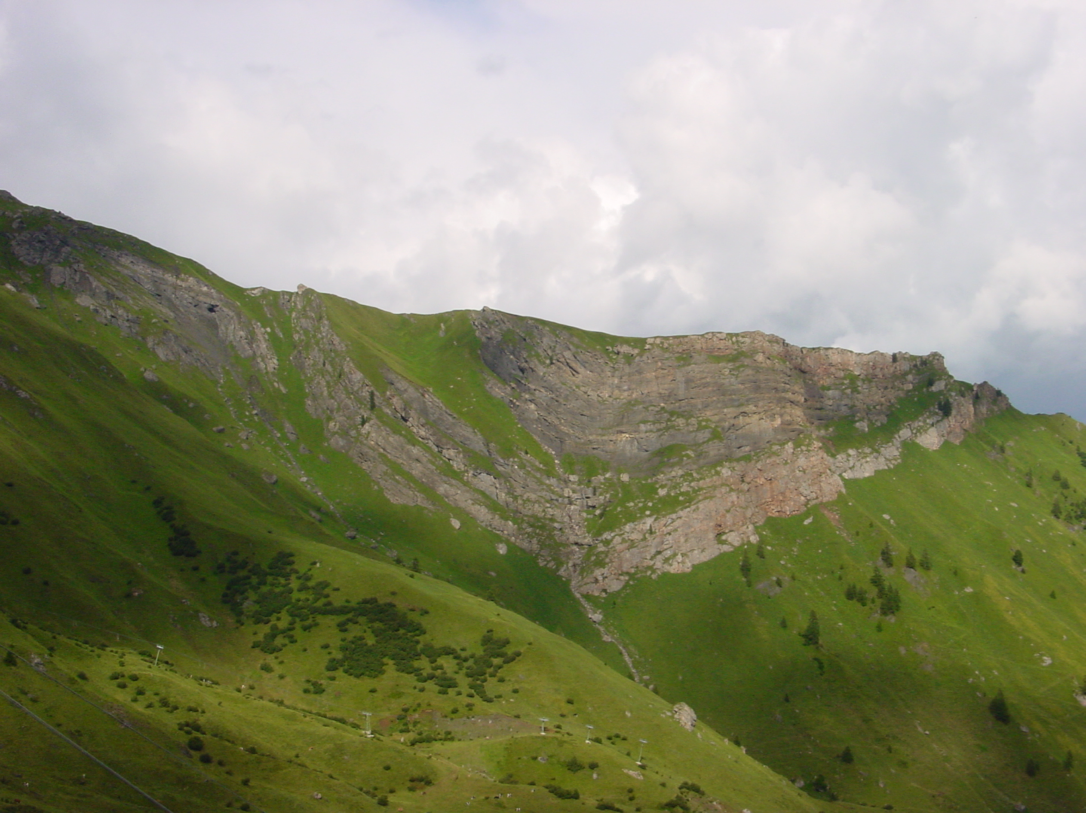
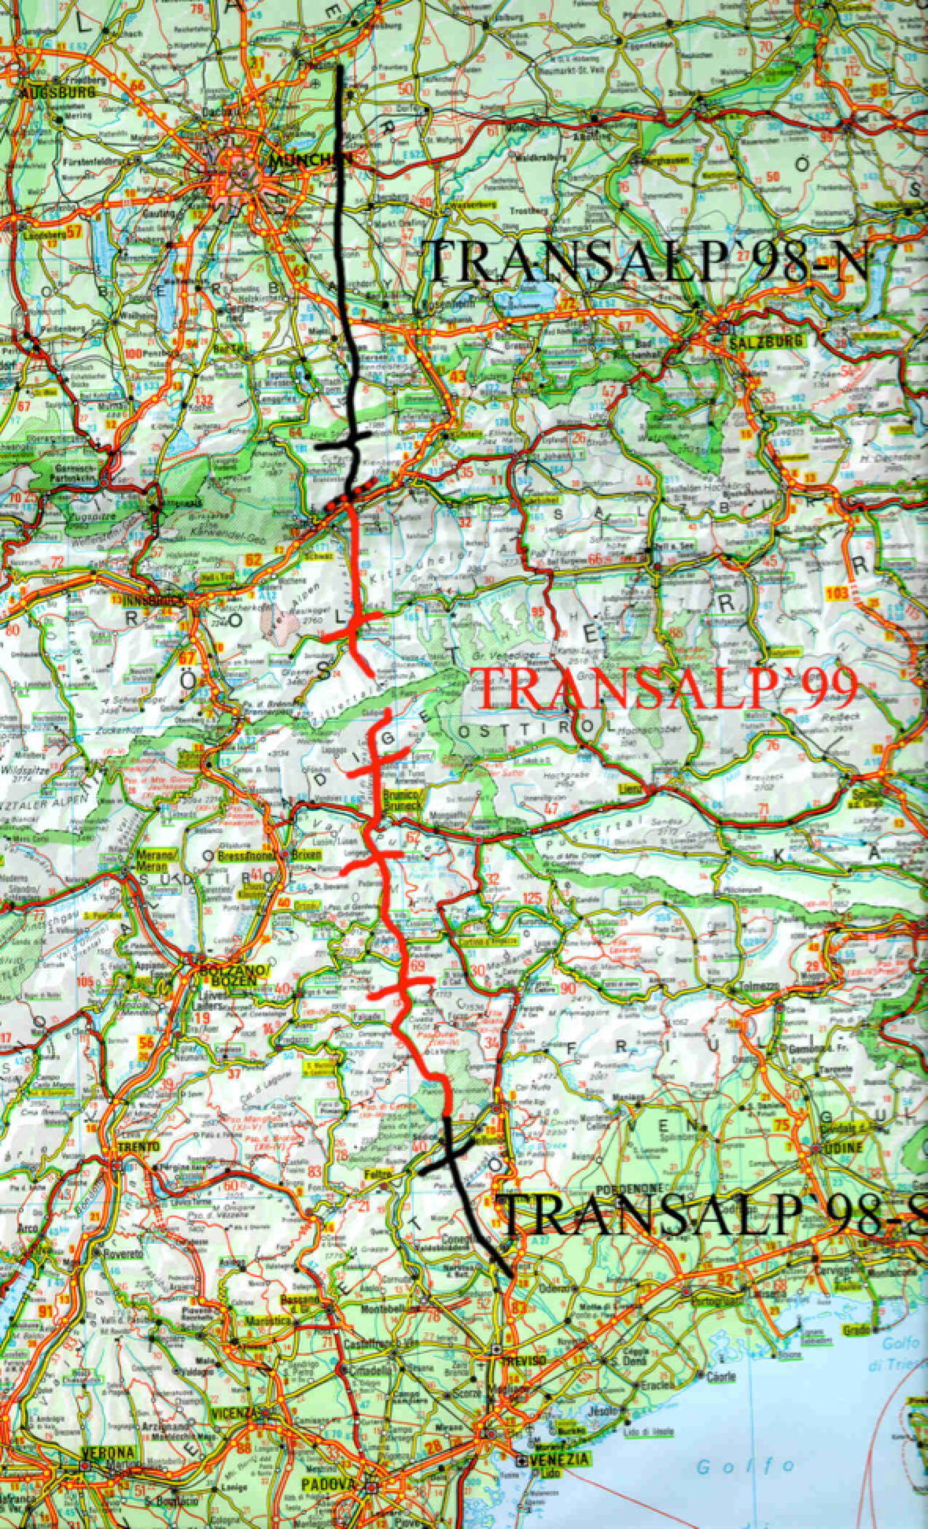

Slide 14
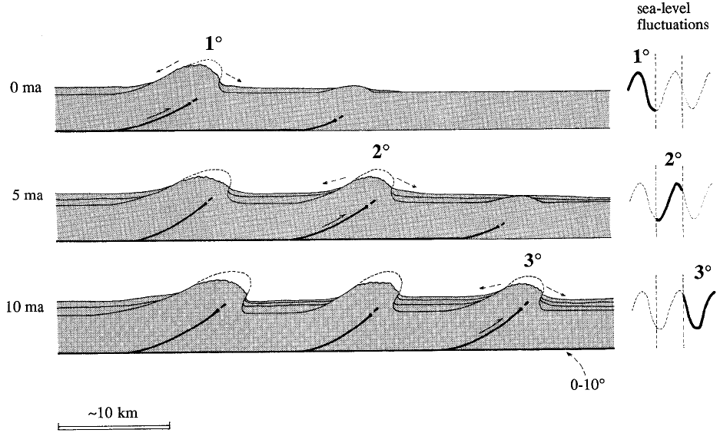

Slide 15
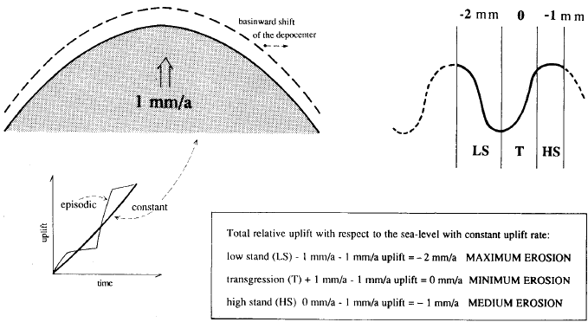
Growth anticline

Slide 16
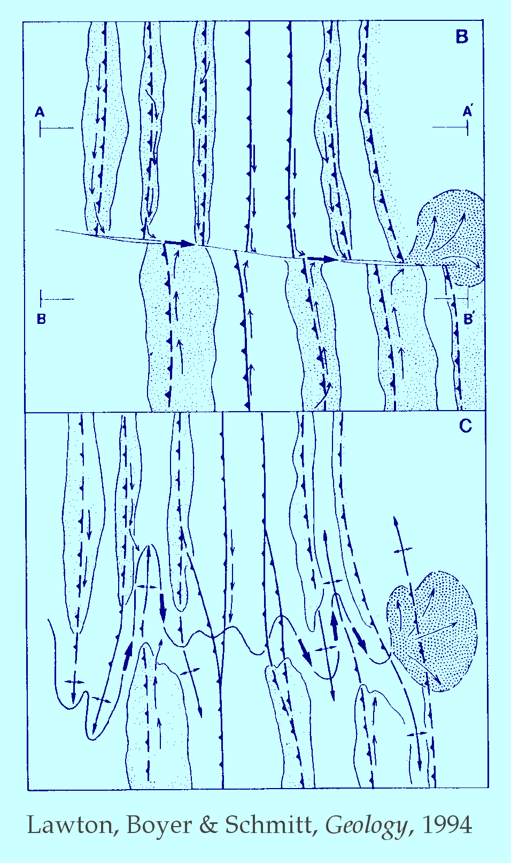

Slide 19
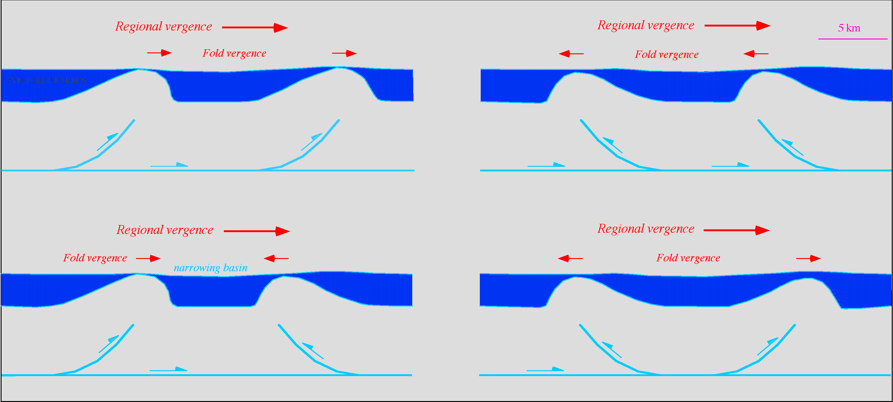

Slide 21
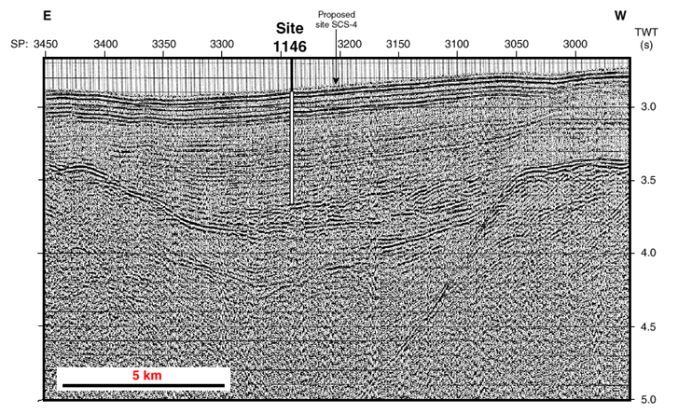
S China sea

Slide 23
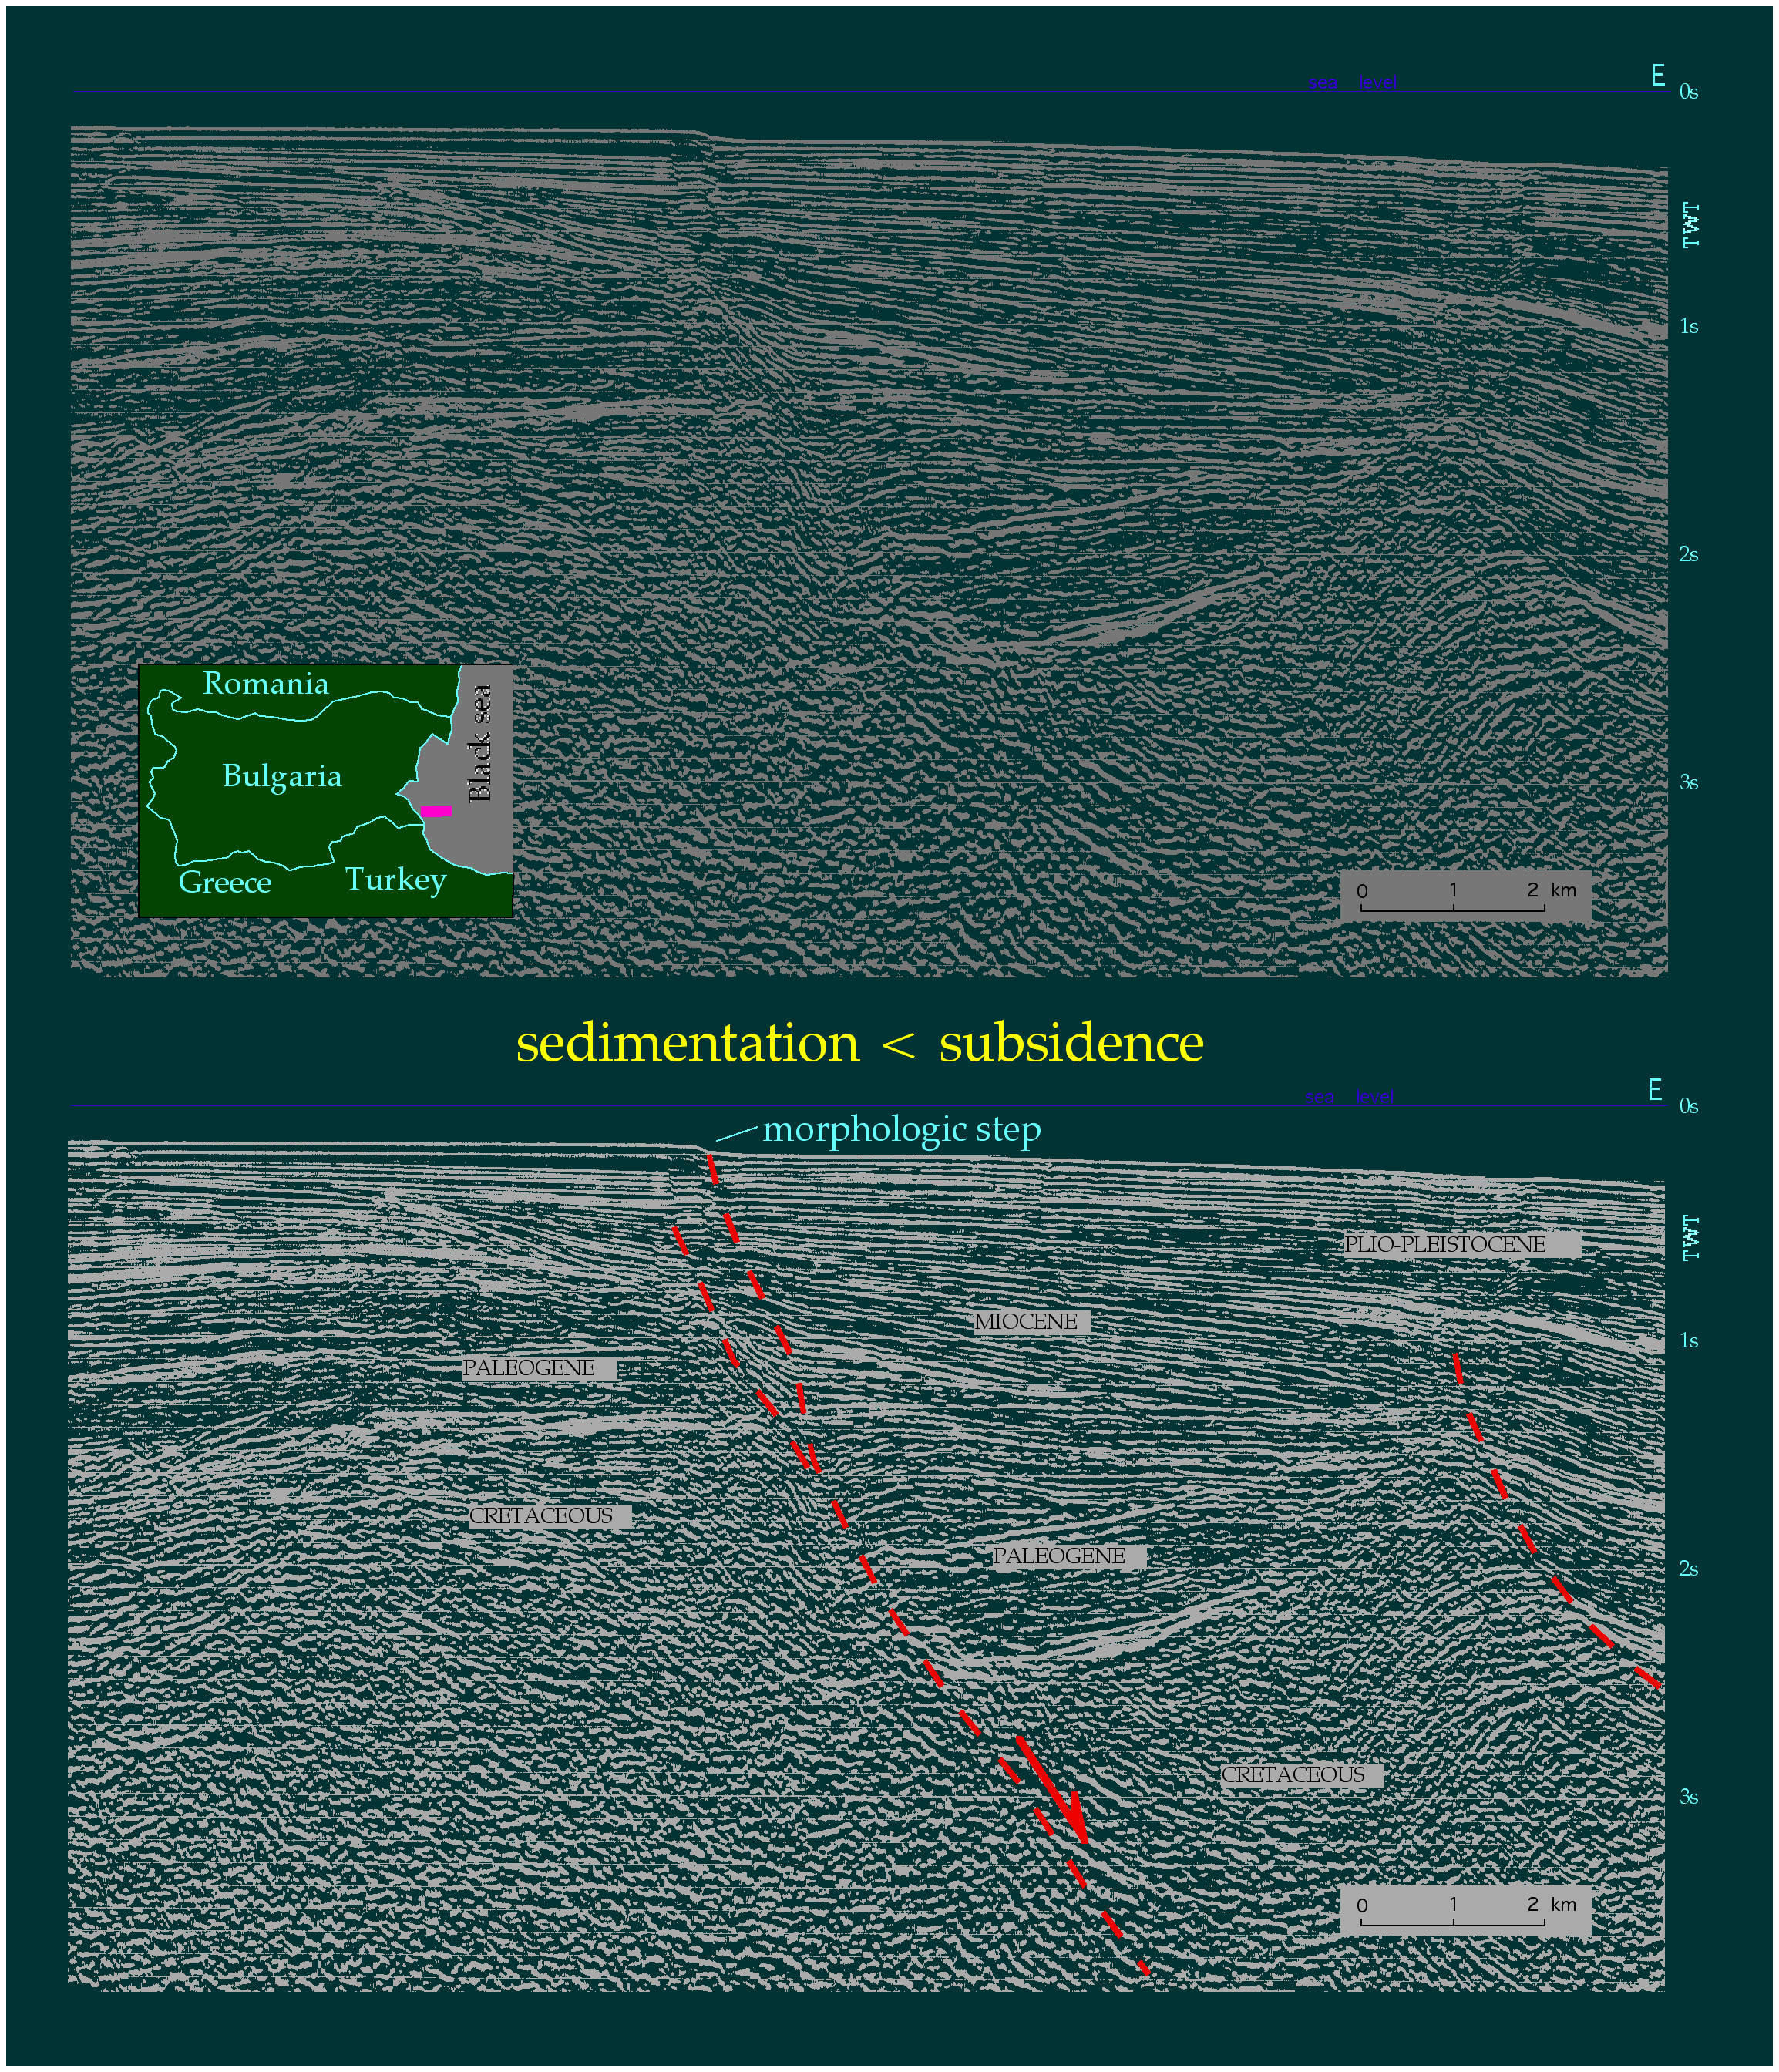
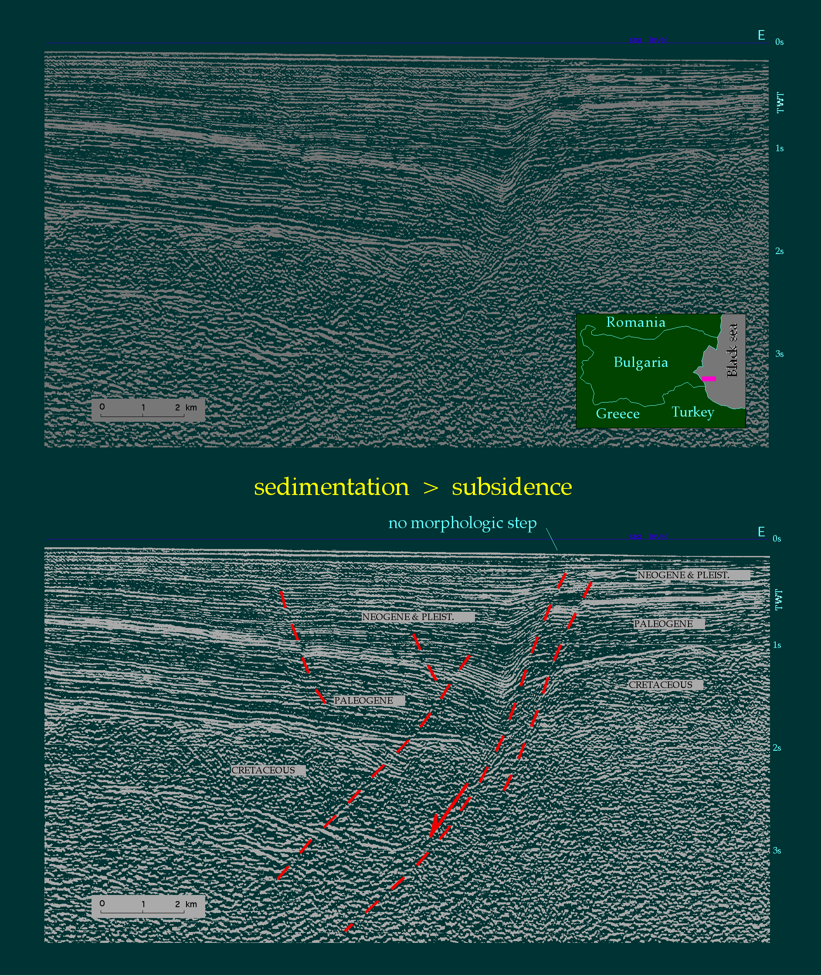

Slide 26
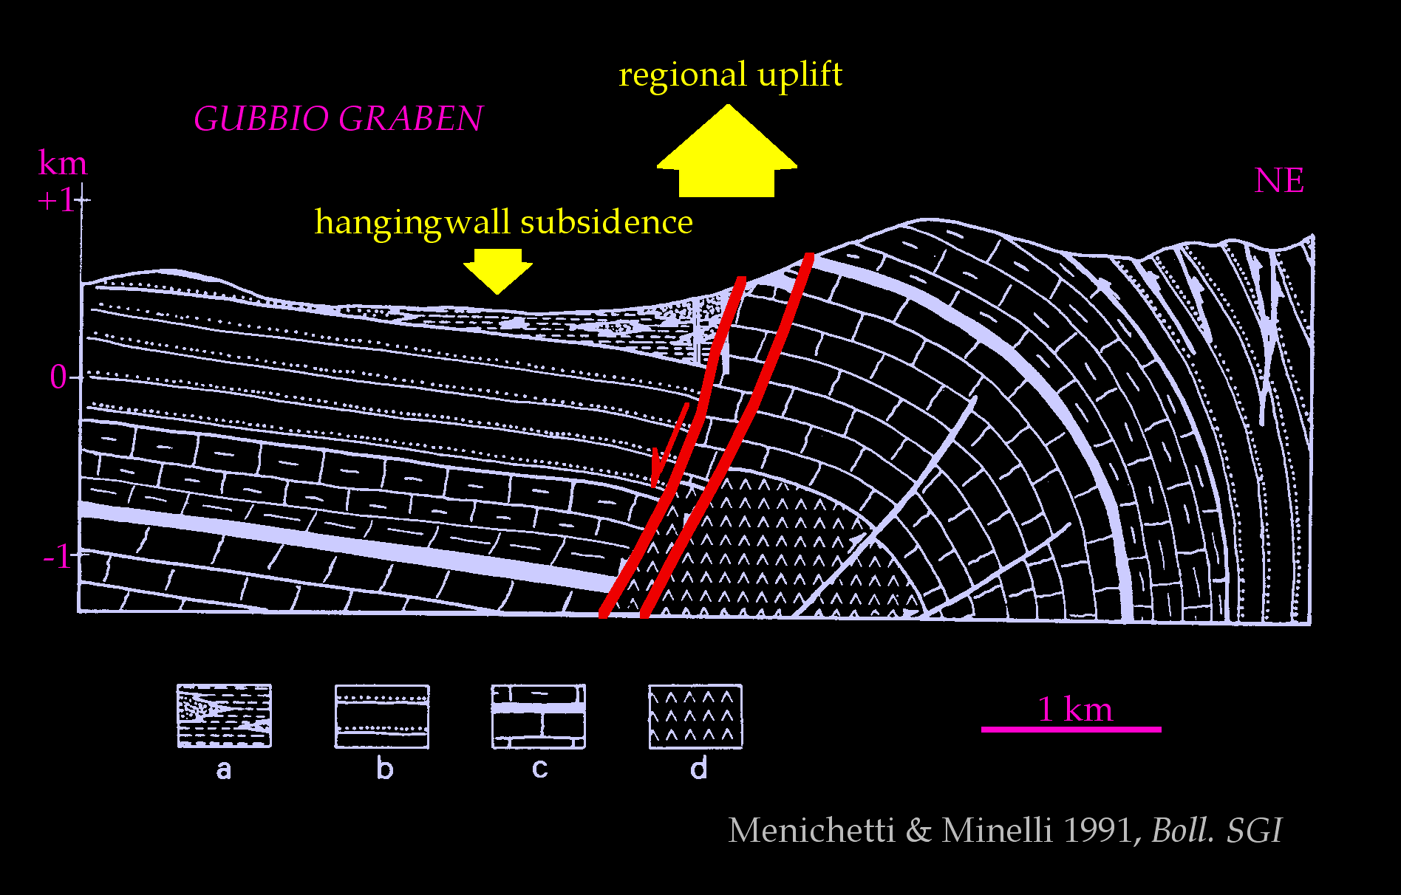
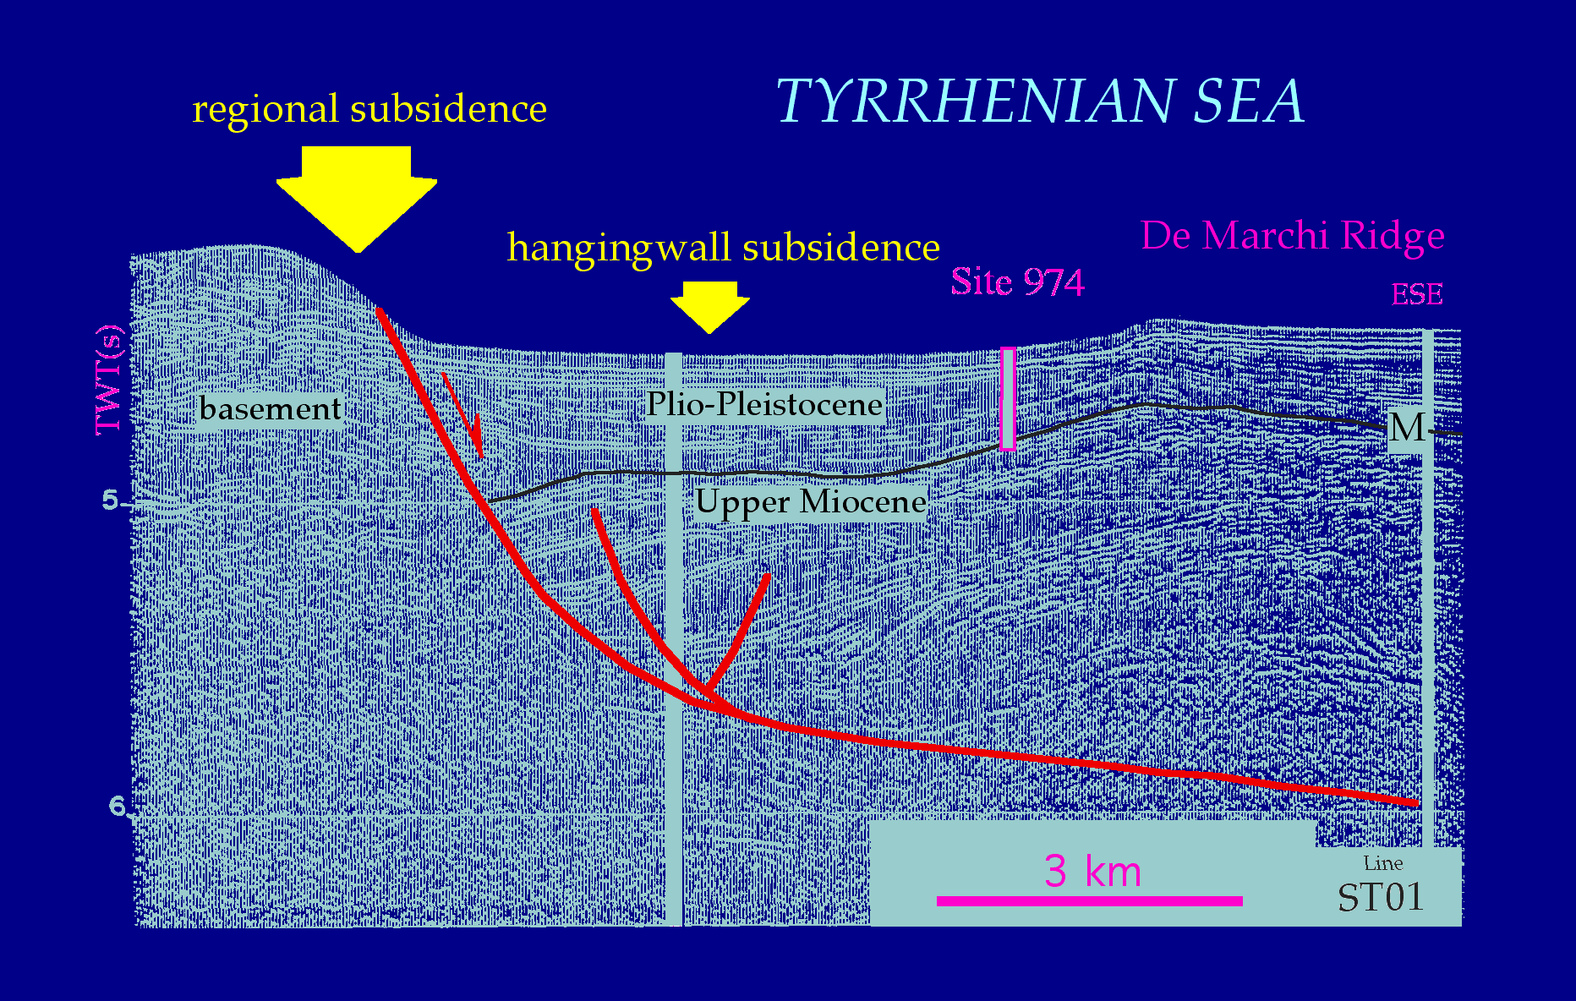

Slide 28
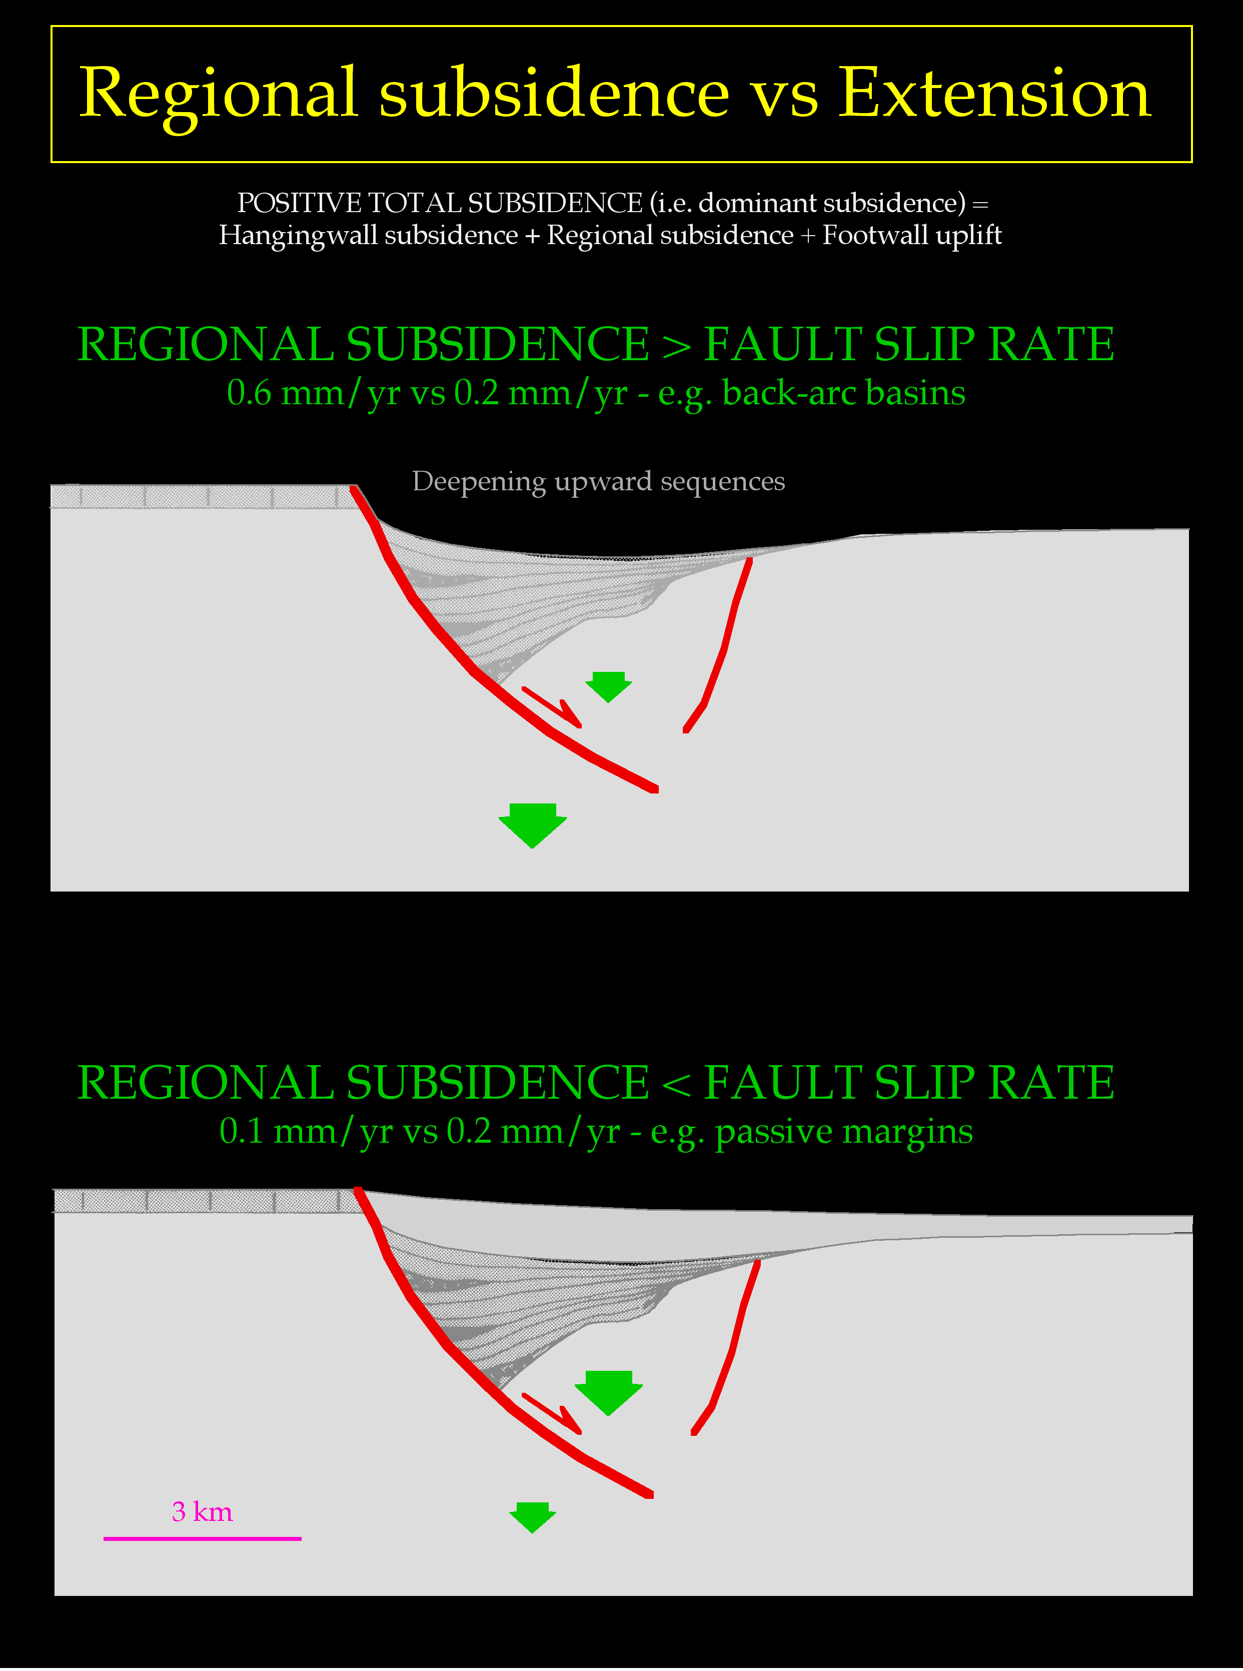
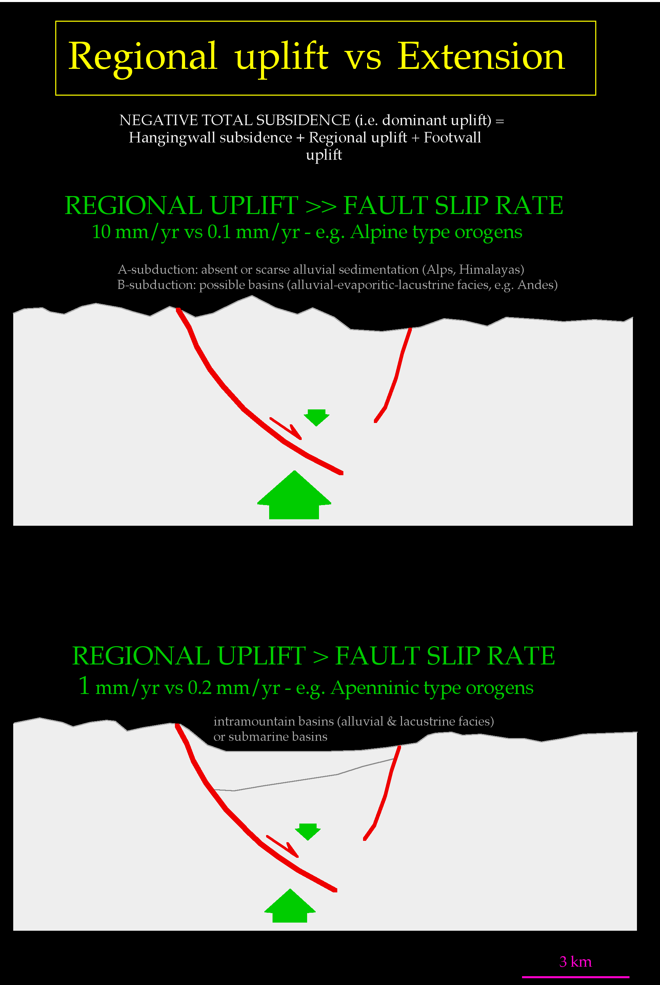

Slide 30
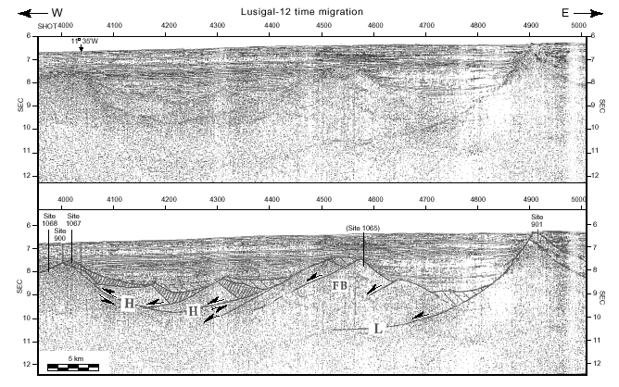
Iberia margin

Slide 31
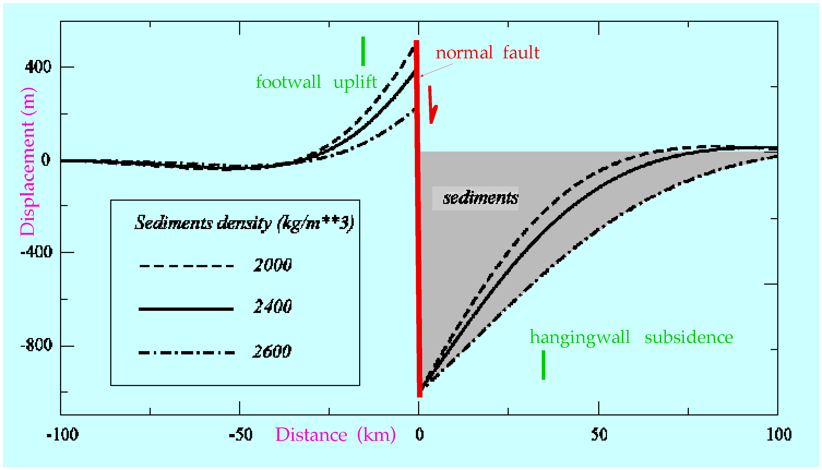

Slide 32
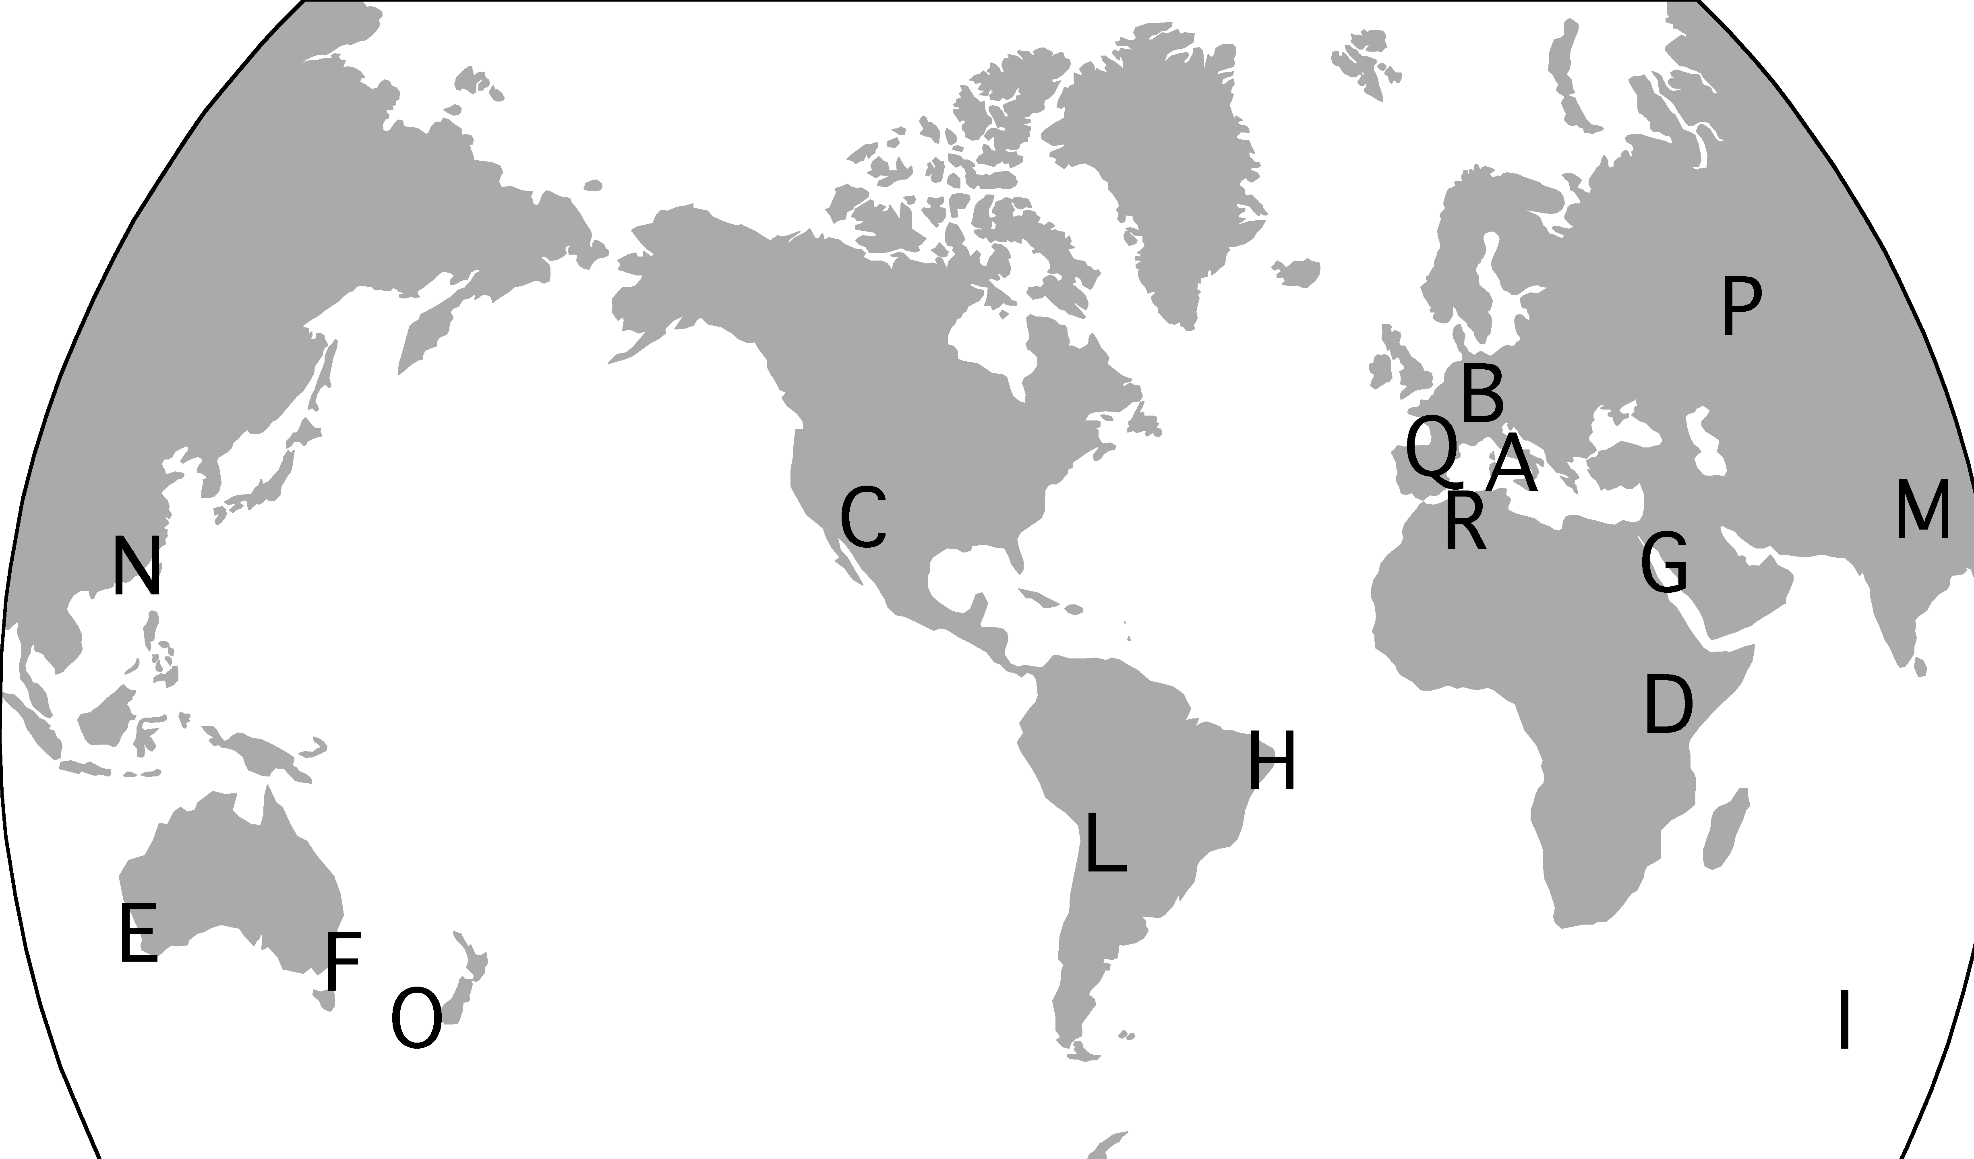
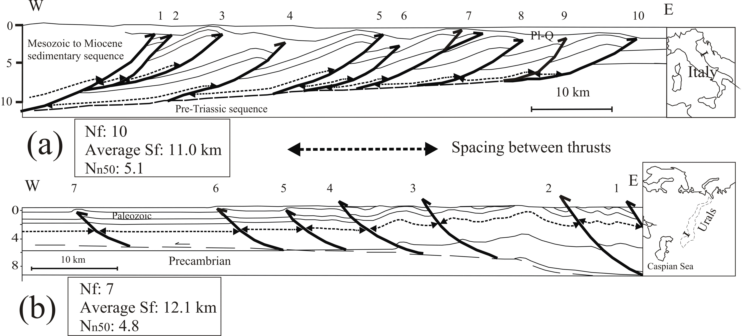
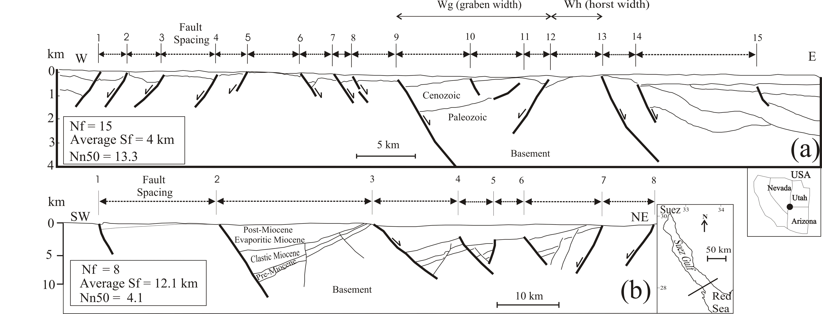

Slide 33
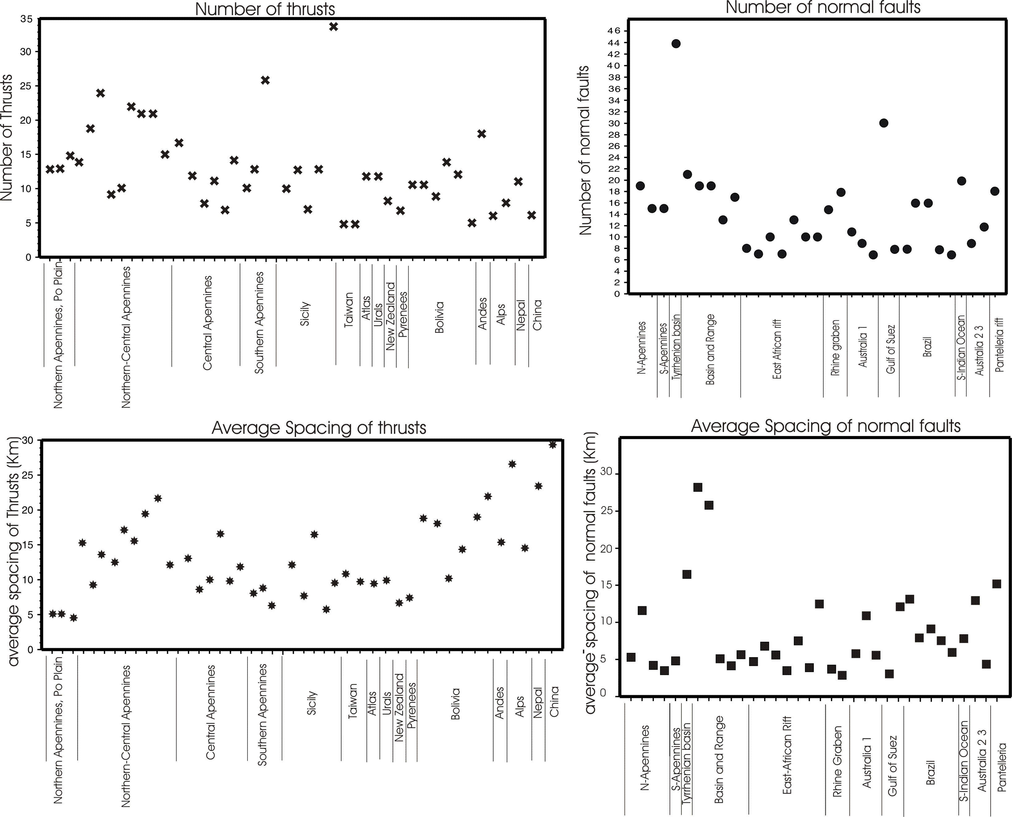

Slide 52
