Slide 1
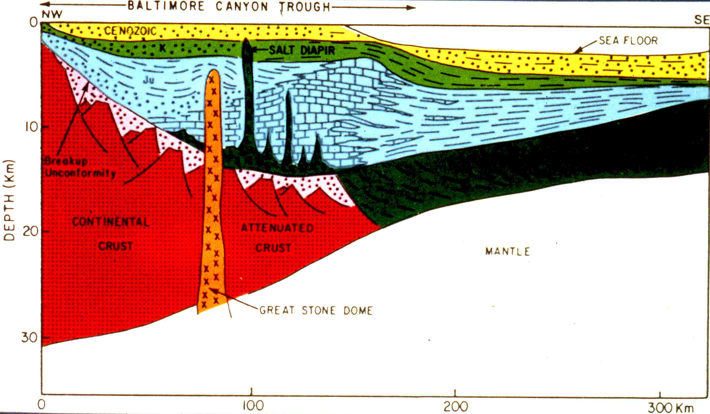
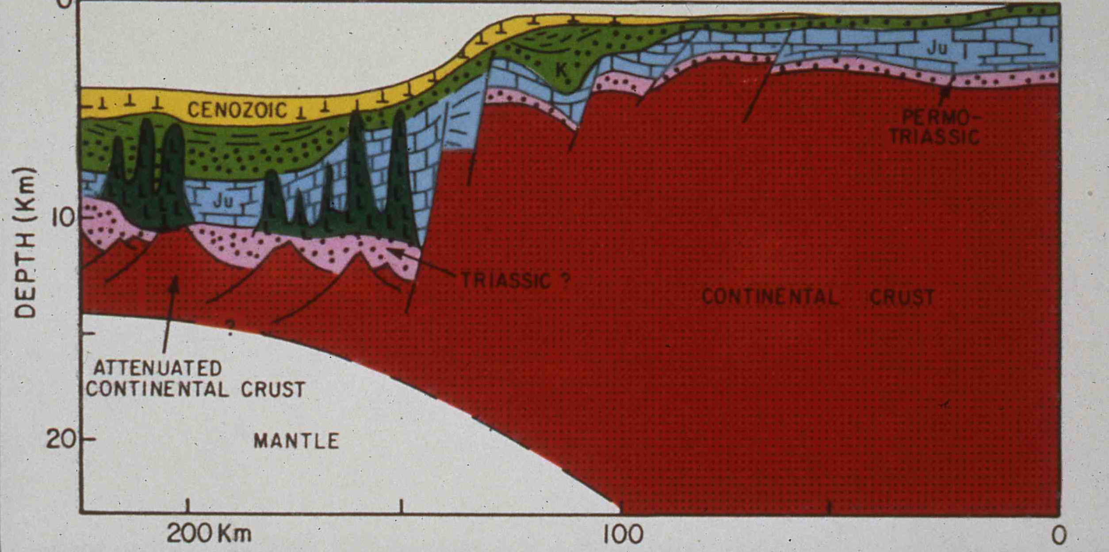
US-West Atlantic
Morocco-East Atlantic
Manspeizer, 1985

Slide 2





Triade sedimentaria

Slide 3
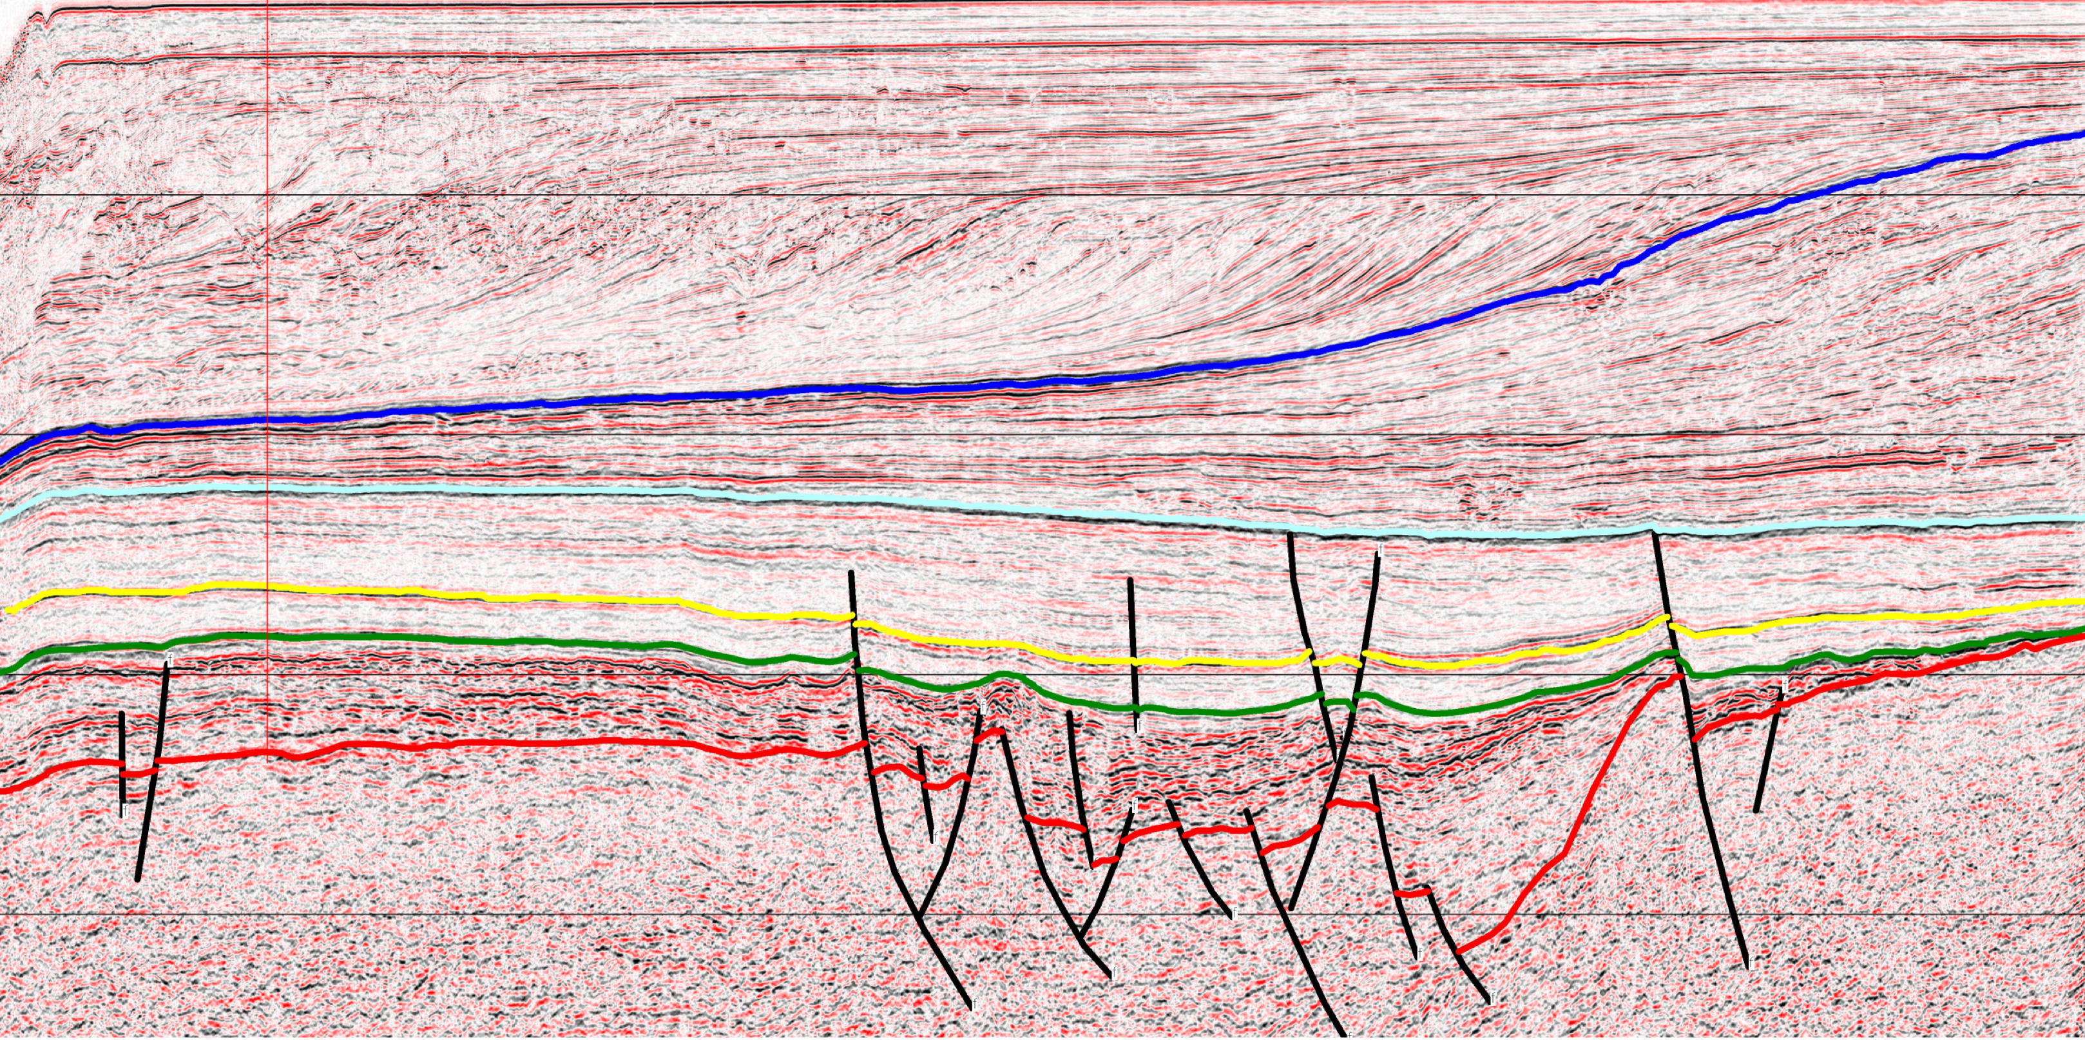

Slide 4
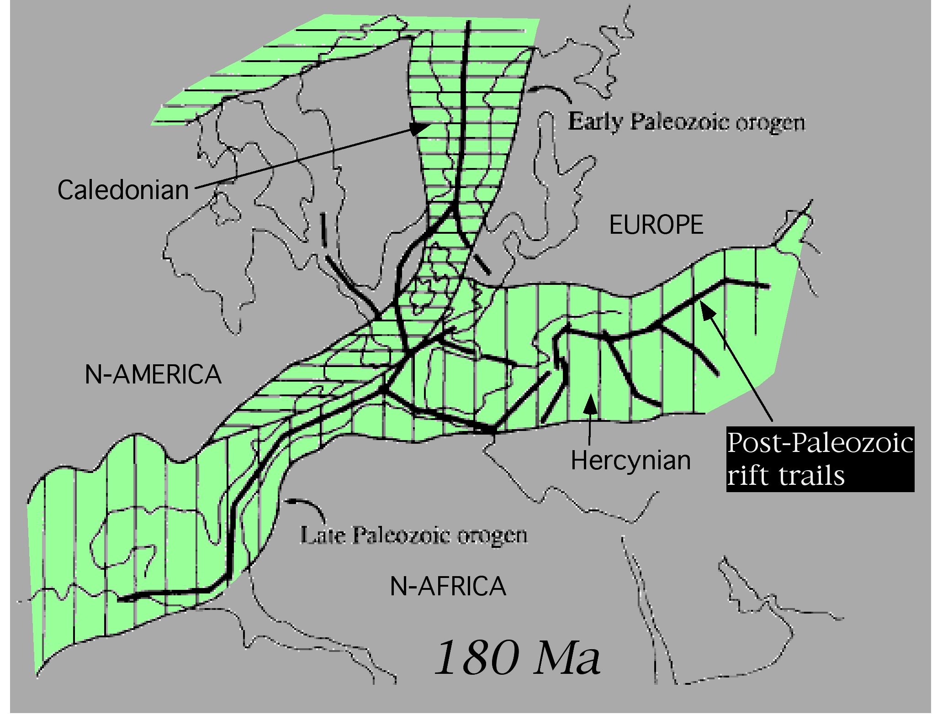






Slide 6






Slide 7




Slide 8
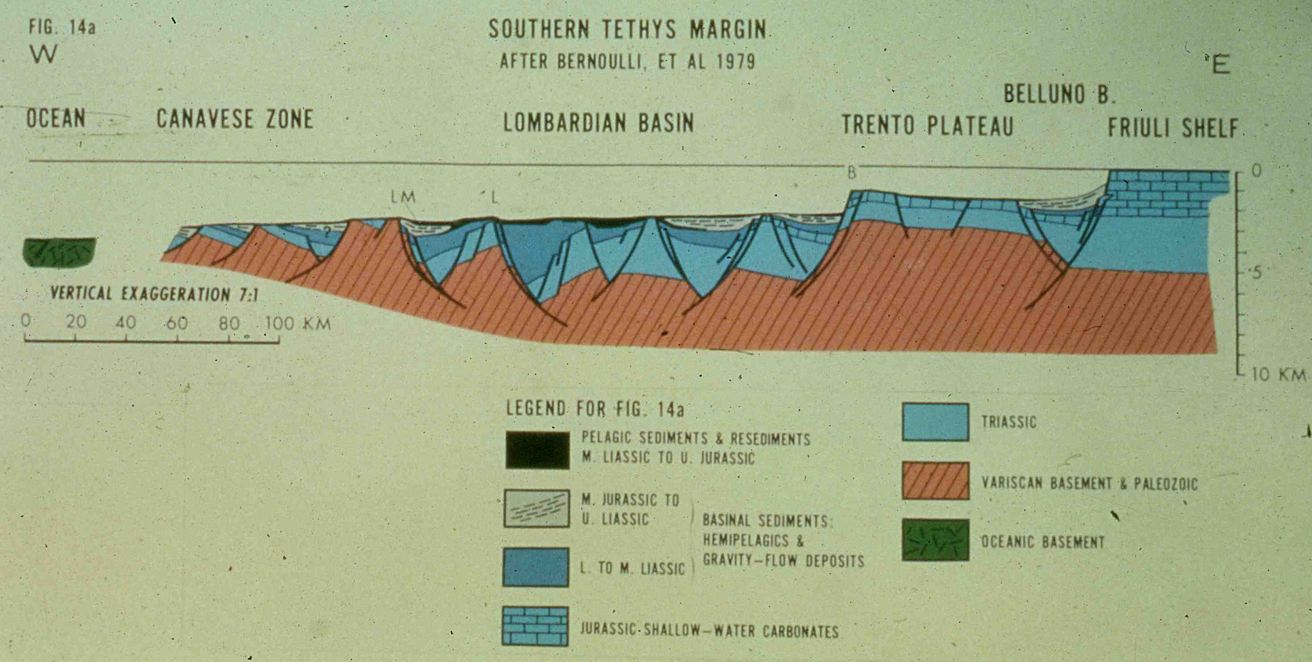

Slide 9
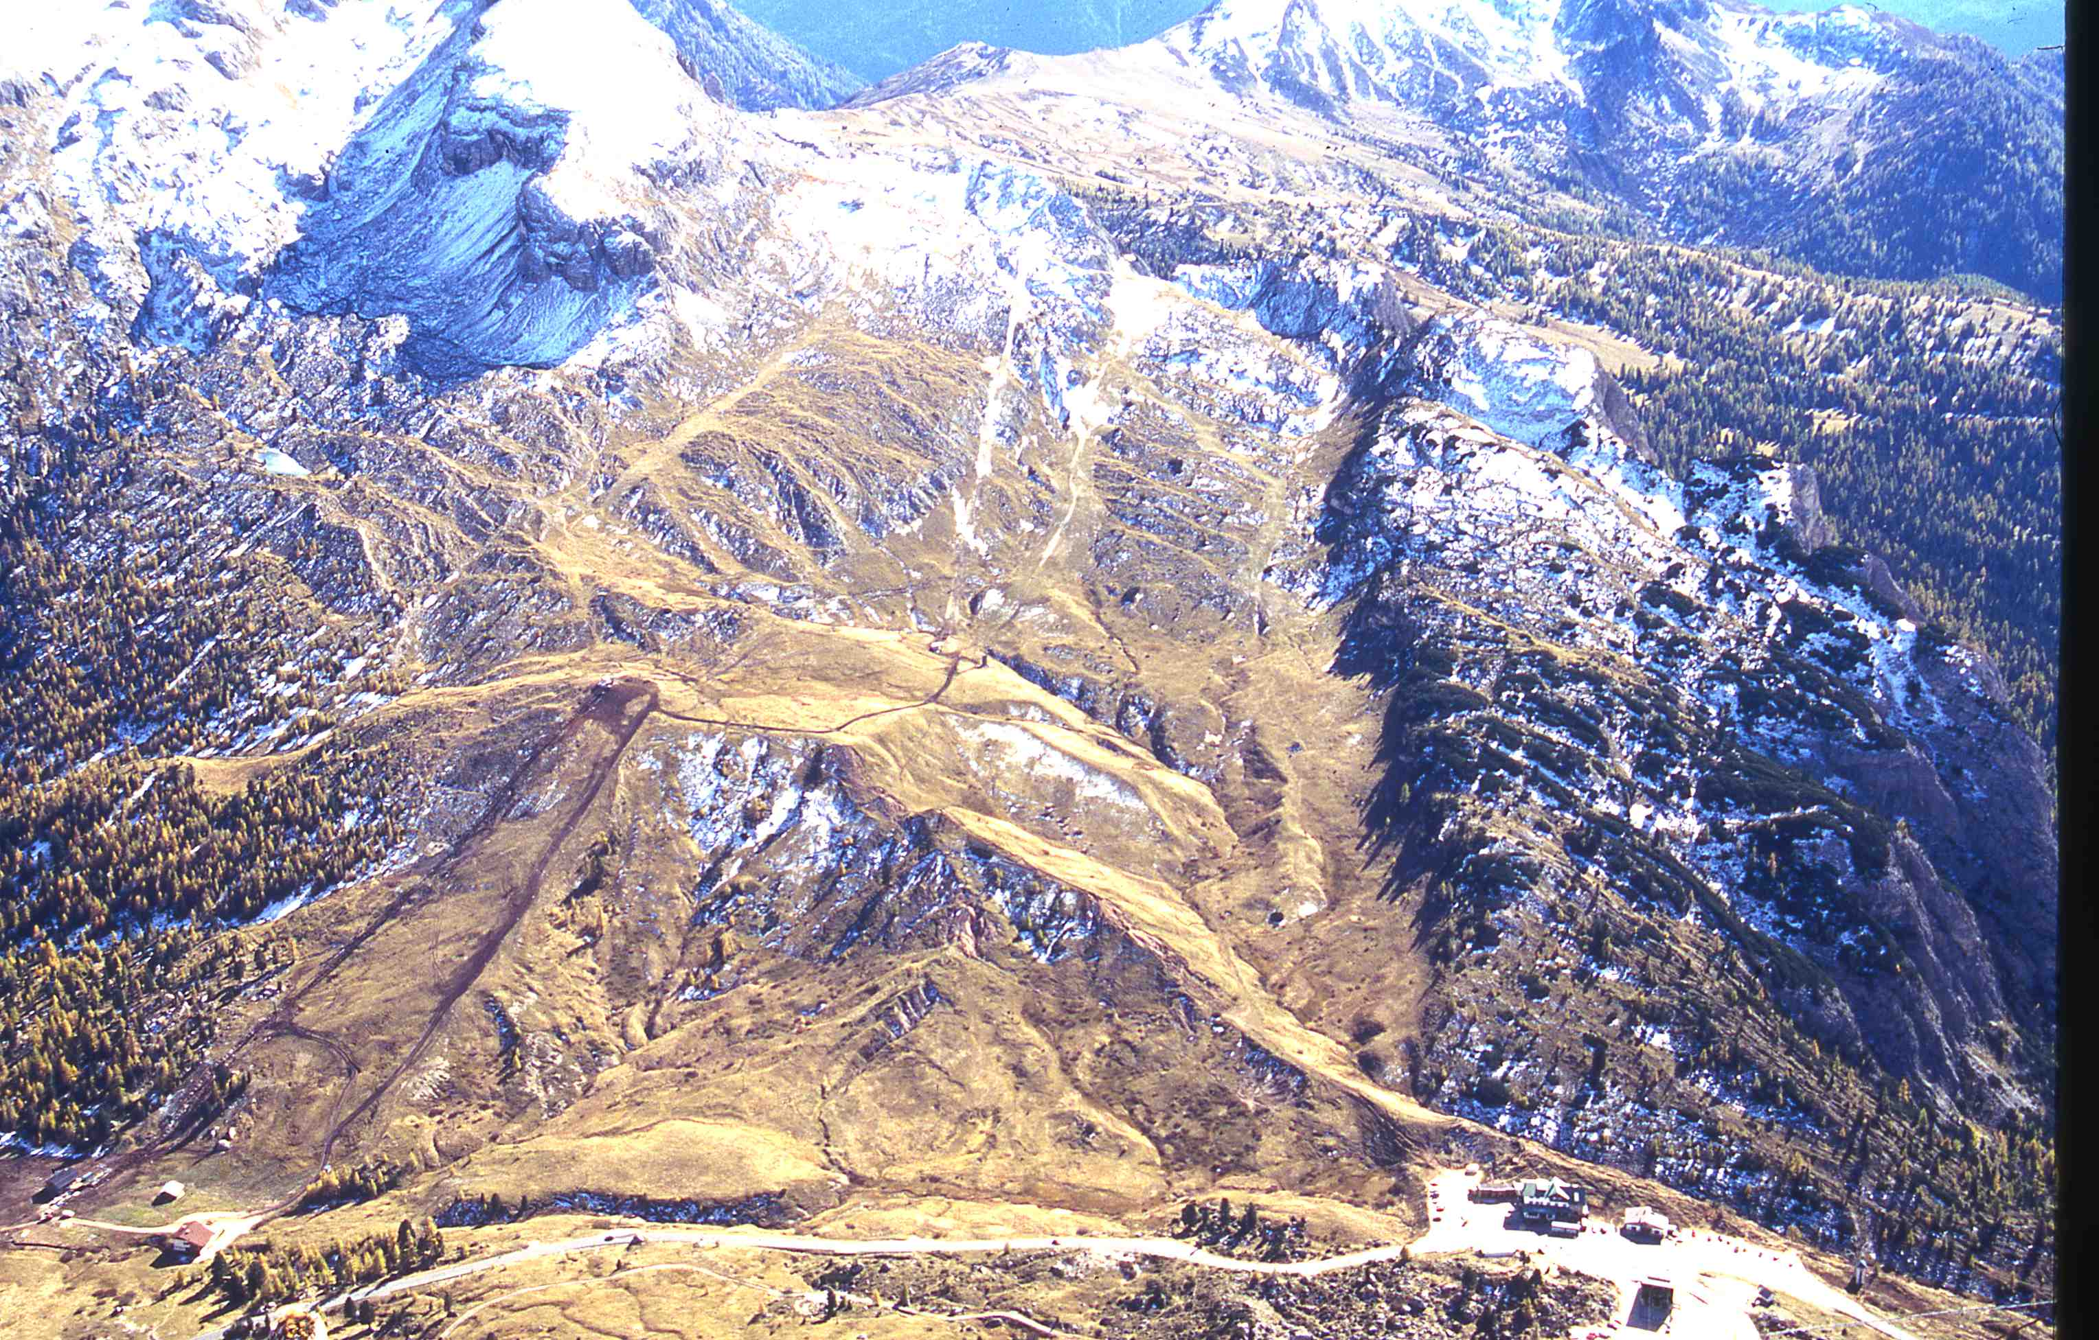


Slide 10
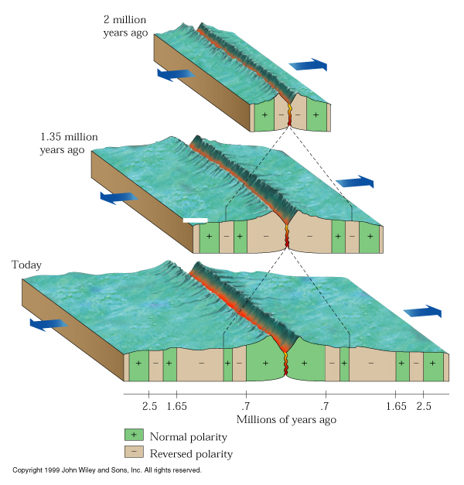




Slide 11
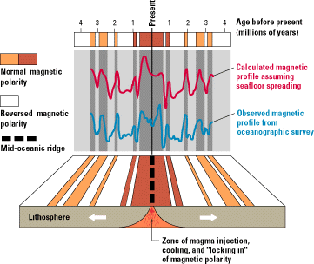
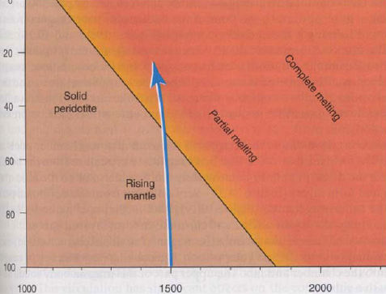
fusione del mantello per decompressione
km
T °C

Slide 12
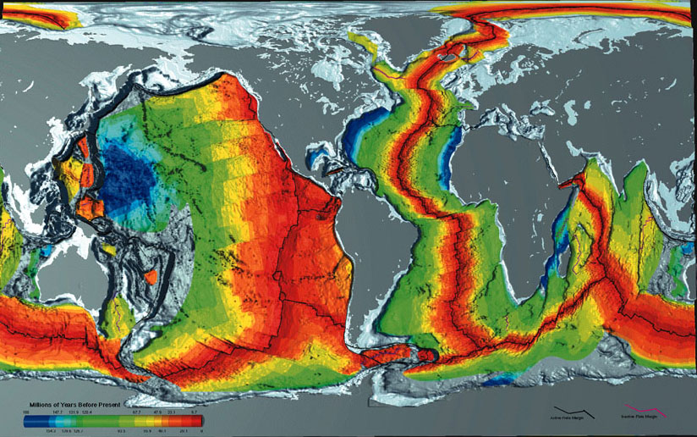



Slide 13
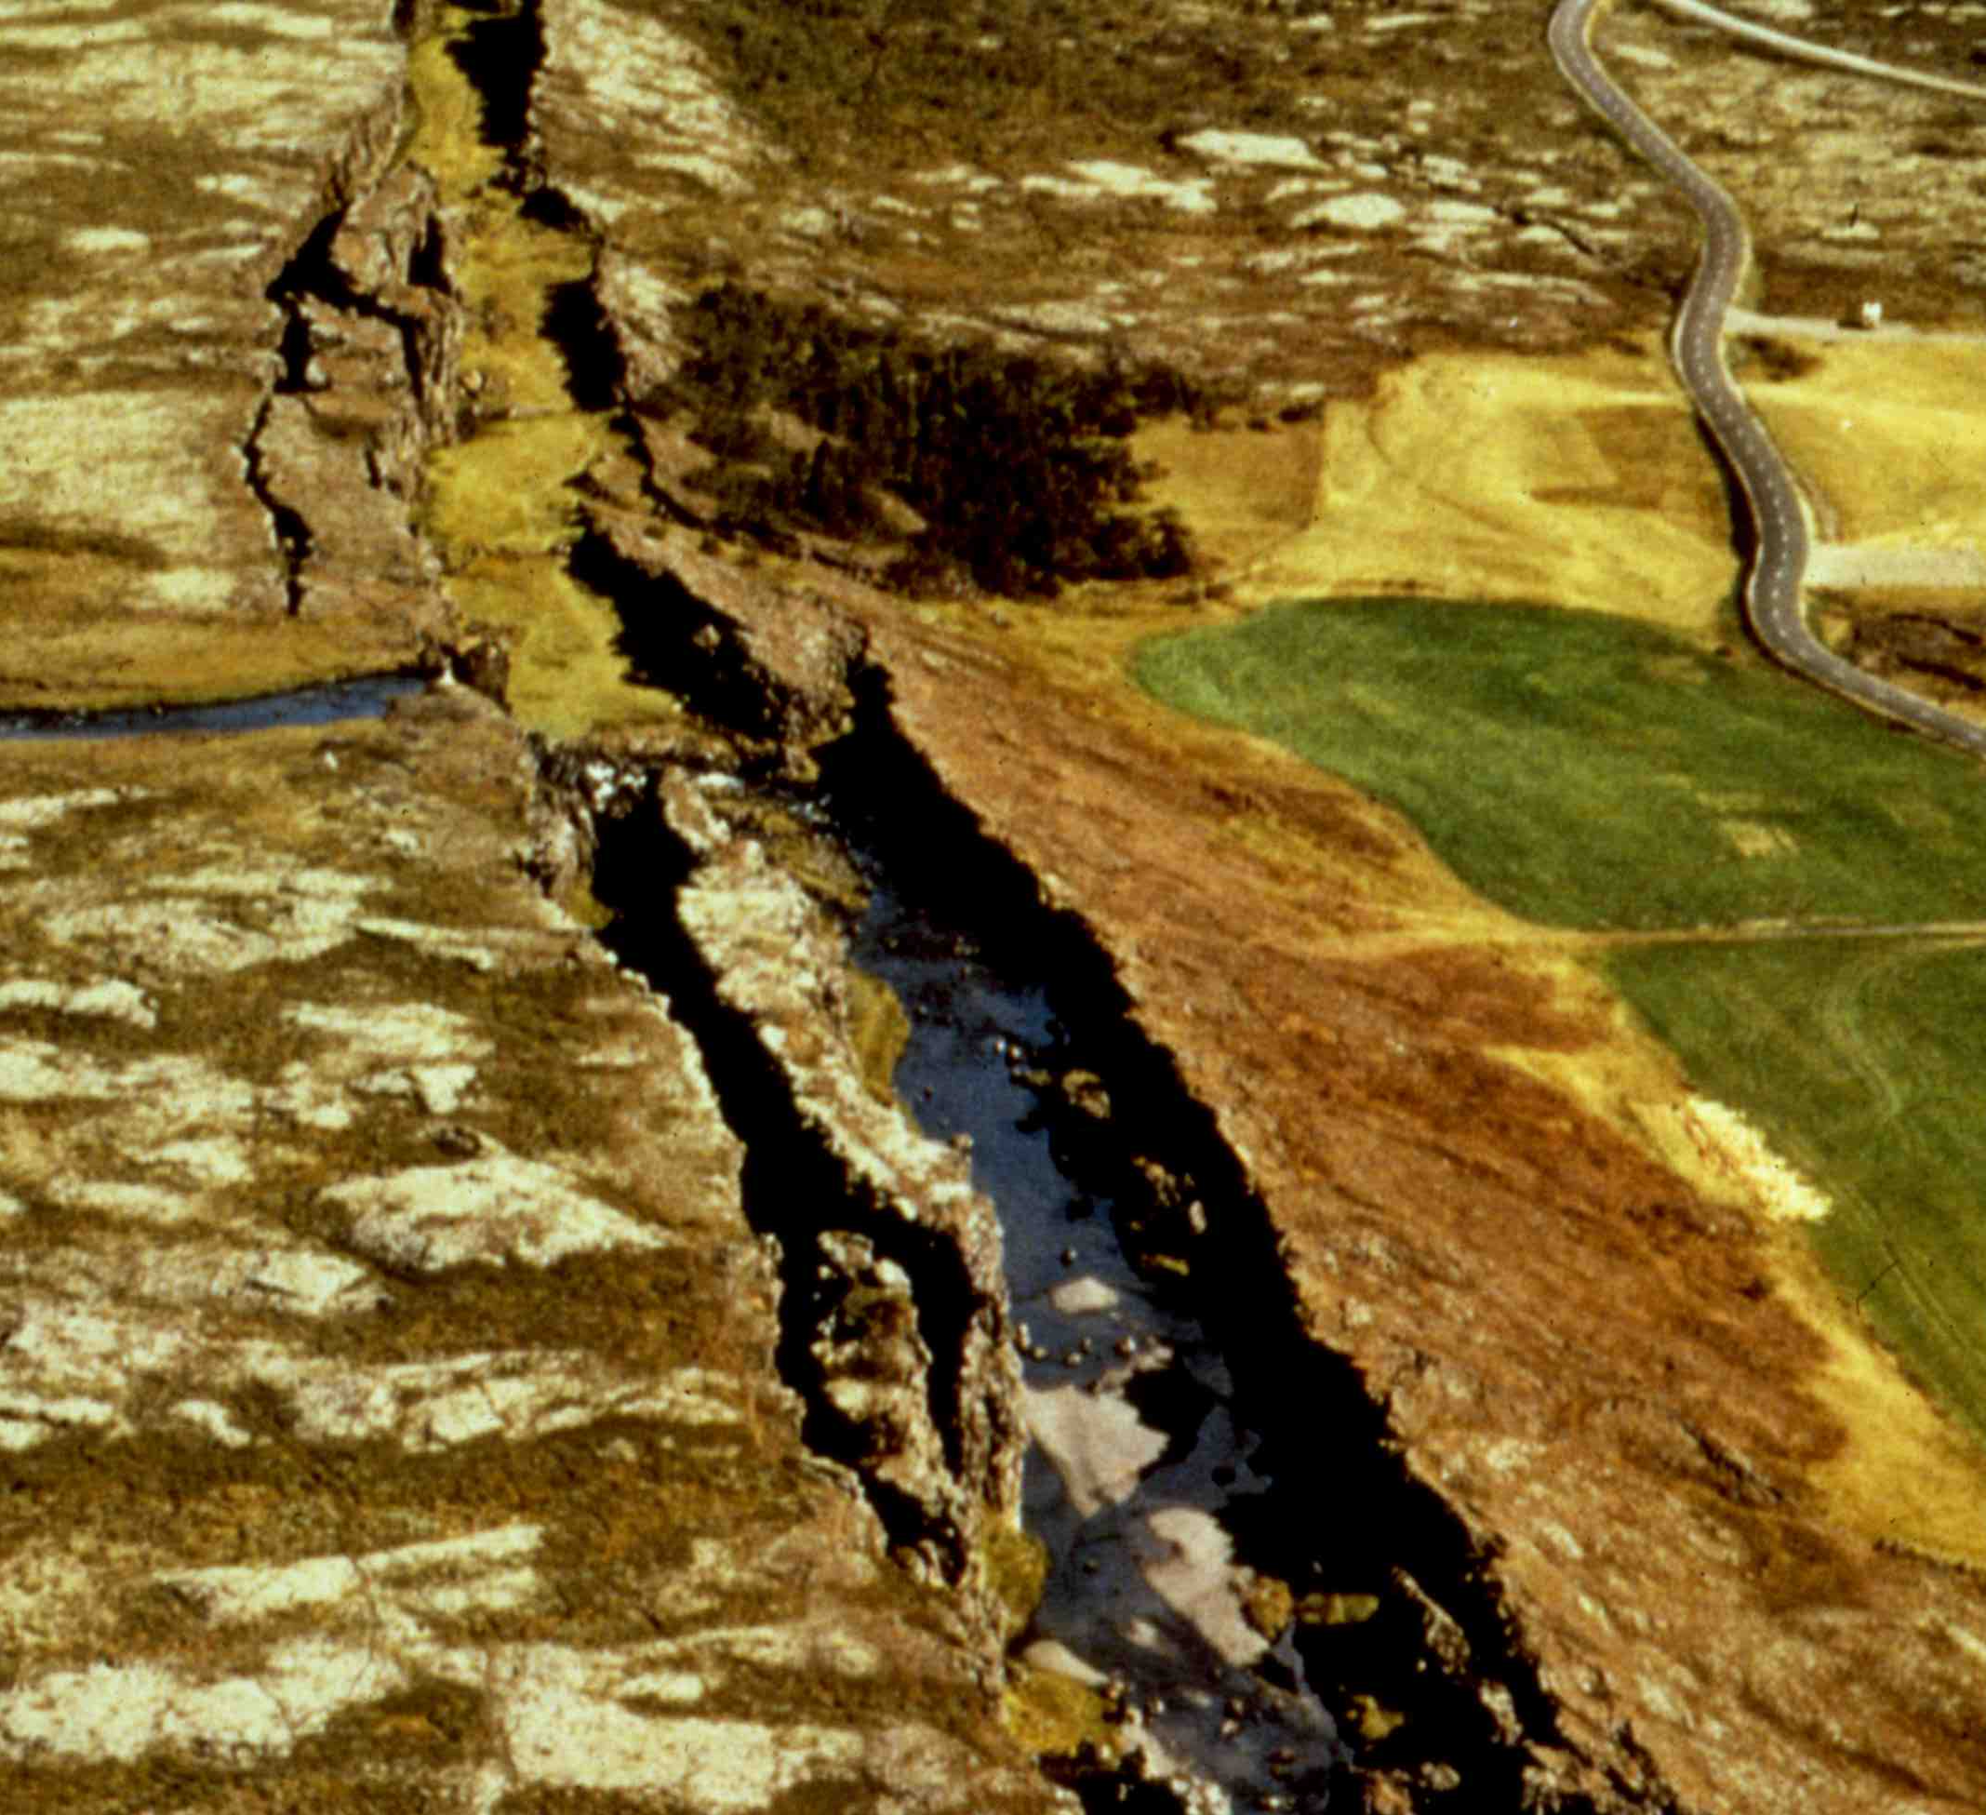

Slide 14
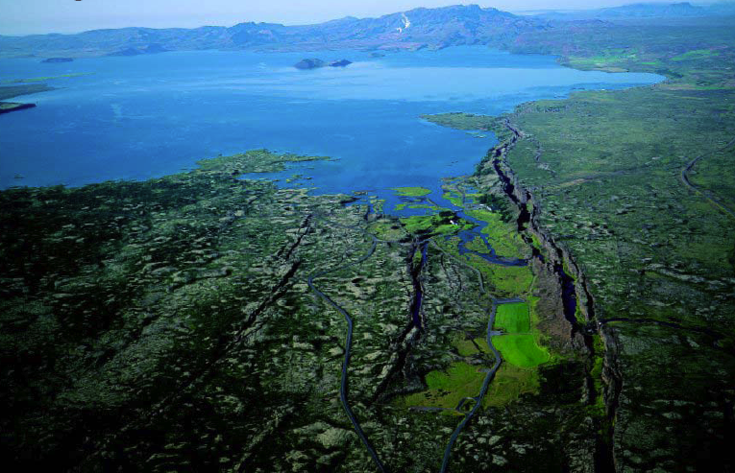
Middle Atlantic Ridge
Iceland

Slide 15


Slide 16
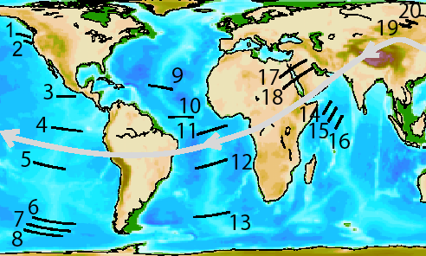

Slide 17
BATHYMETRY vs DISTANCE

Slide 18
BATHYMETRY vs AGE SQUARE ROOT

Slide 19
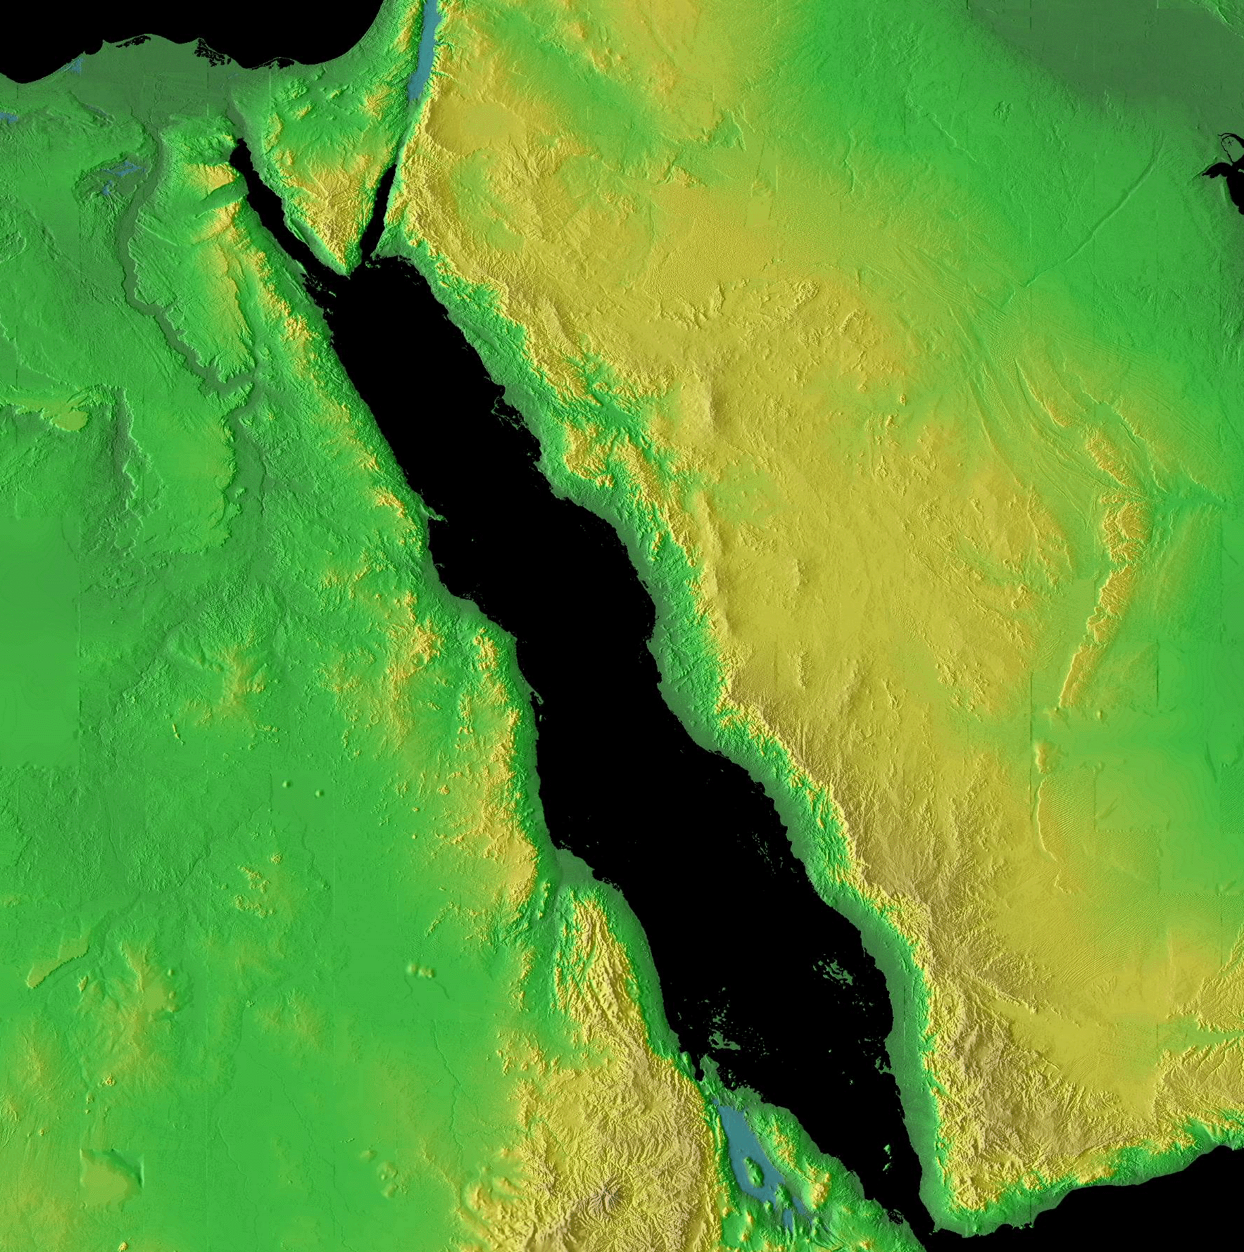
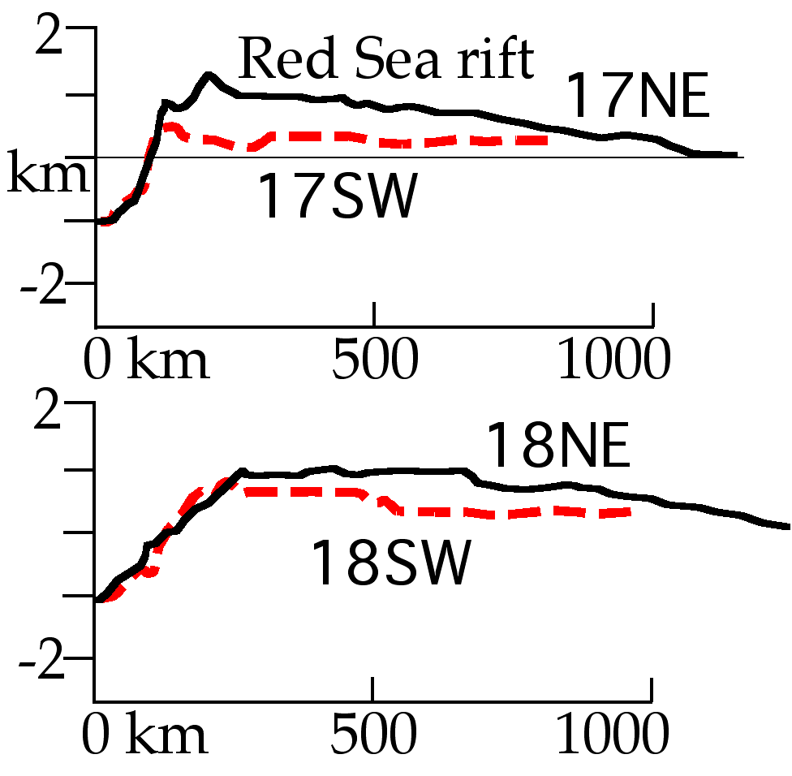
17
18

Slide 20
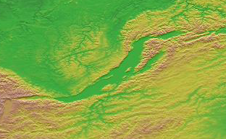
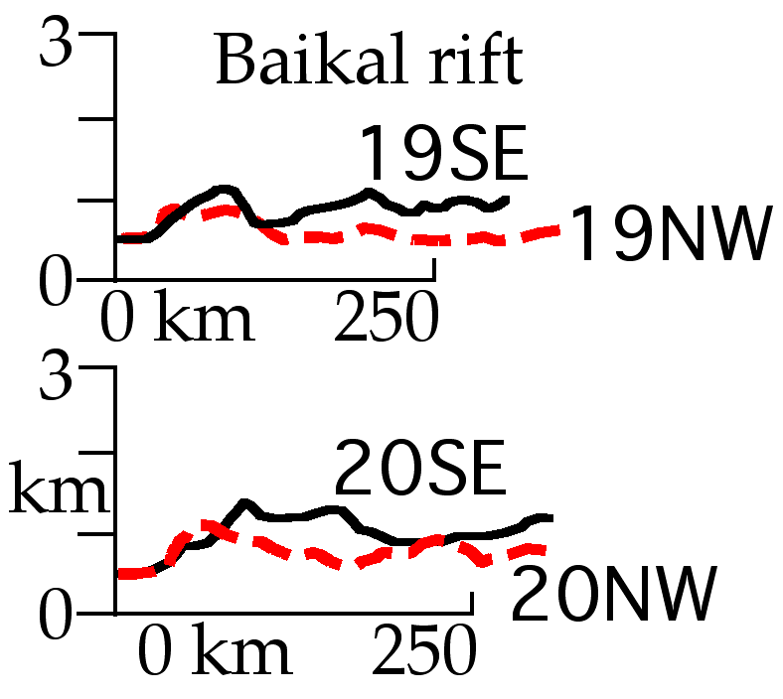
20
19

Slide 21

Turcotte & Schubert, 1982
W = water depth
ρm = asthenosphere density
ρw = water density
Tm = mantle temperature
T0 = surface temperature
αv = volumetric coefficient
of thermal expansion
k = mantle thermal diffusivity
x = distance from the ridge
u = half spreading rate

Slide 22
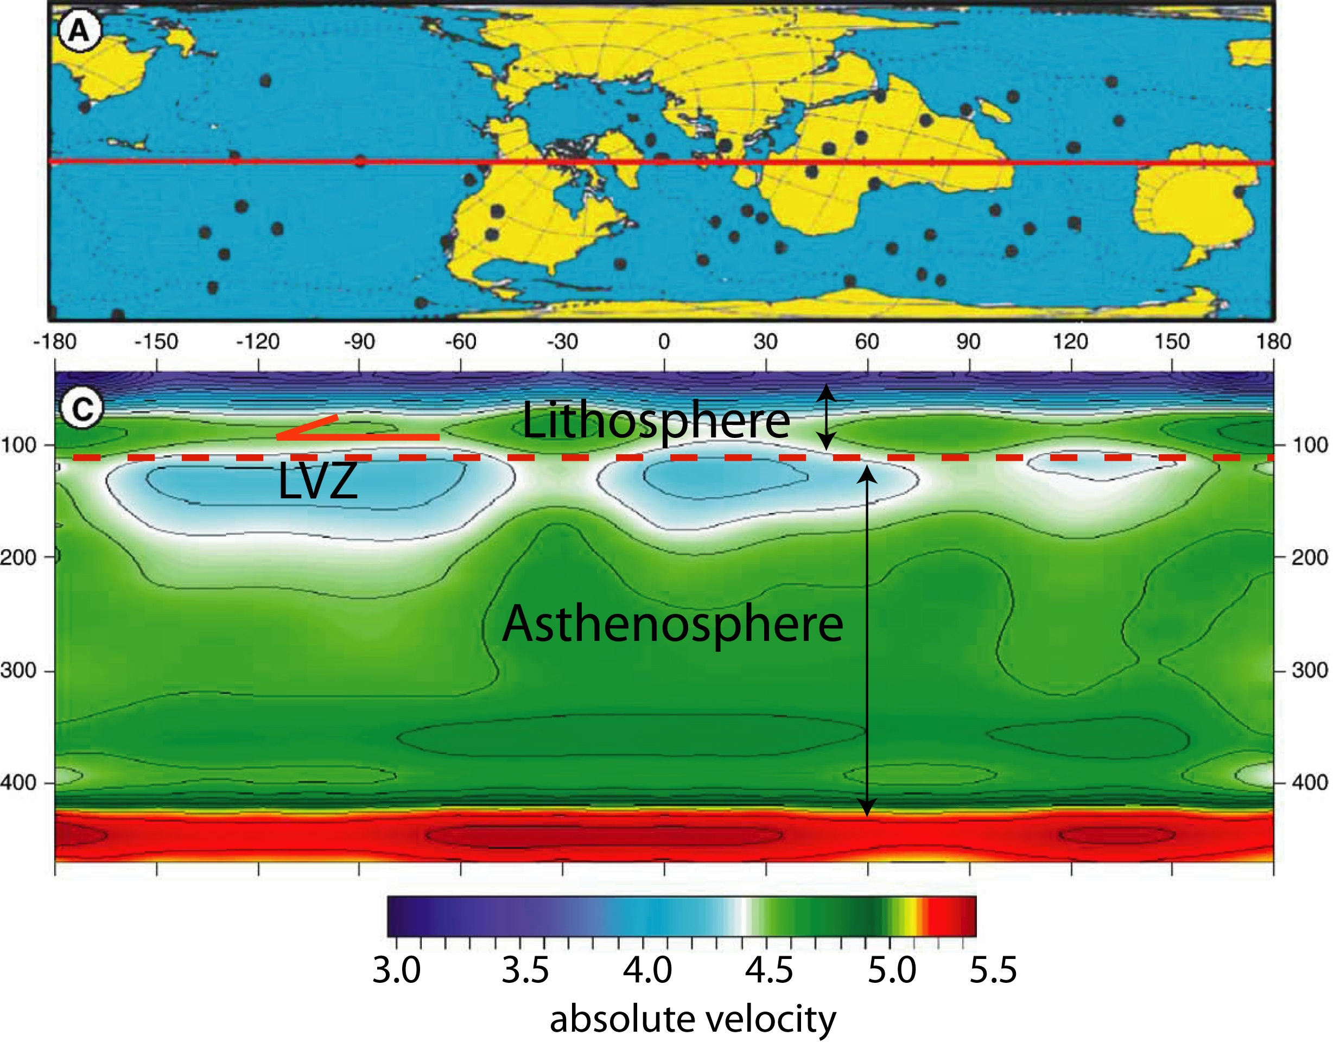

Slide 24
rifting model
Ridge speed = (V_{A}+V_{B})/2
A
B
The ridge is moving relative to the mantle
Ridge-centered hotspots are also moving relative to the mantle

Slide 25
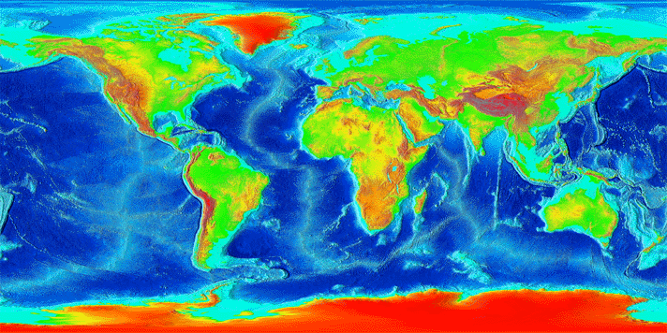
AFRICA
S-AMERICA

Slide 27
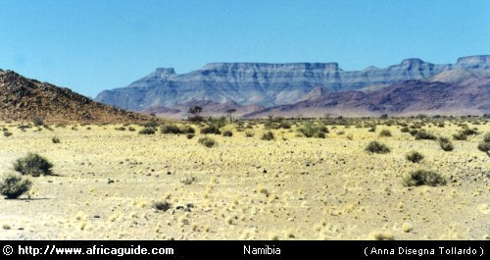
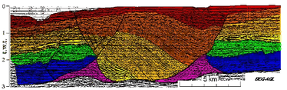
- Different isostatic answer due to lateral variation in composition and temperature of the lithosphere
- Coherent system: no independent mantle plume confined underneath the continent

Slide 28
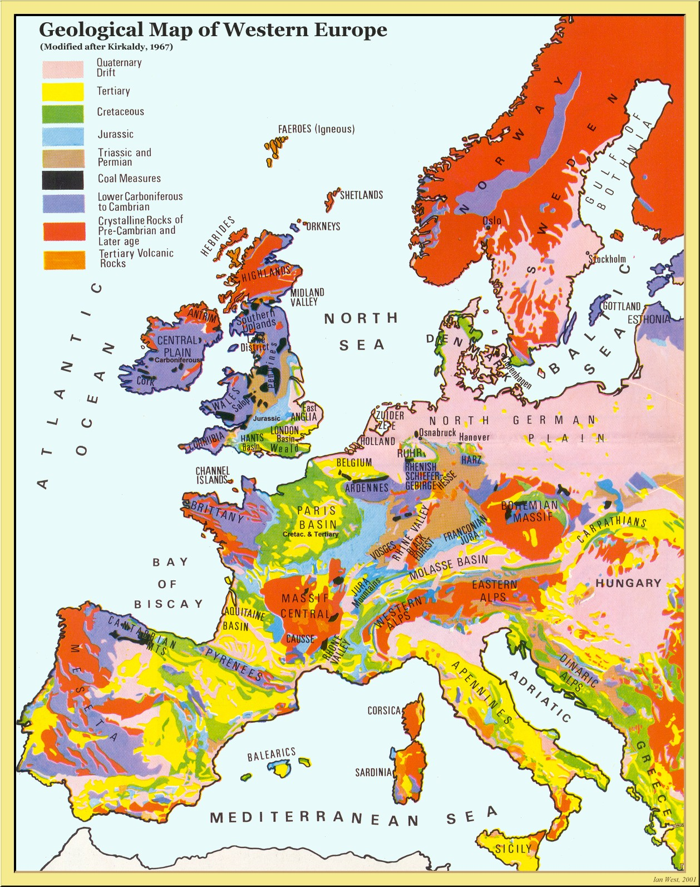
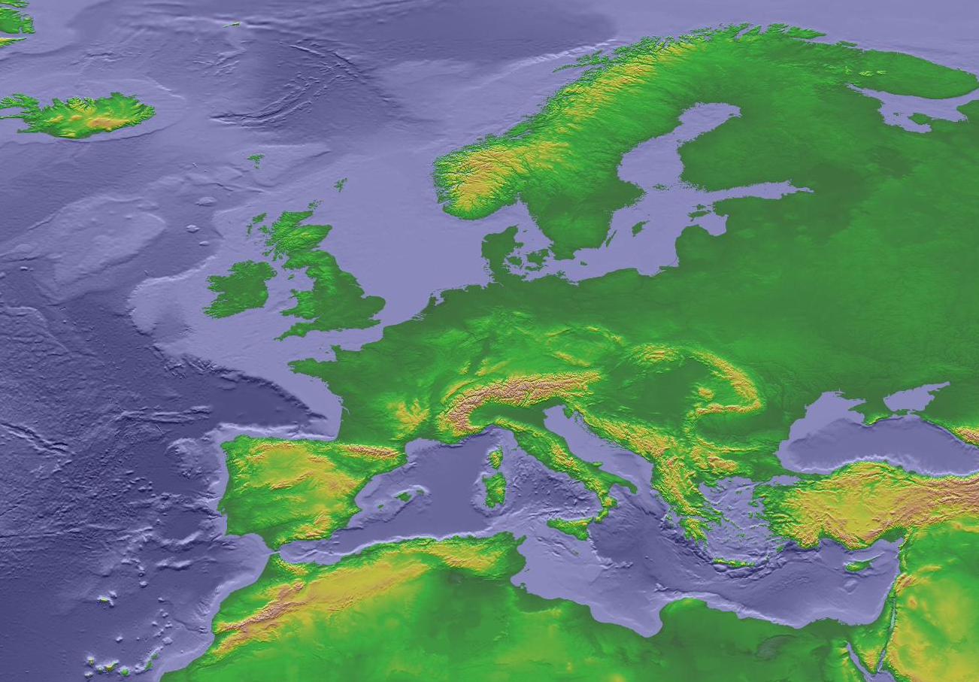
…and Europe?

Slide 29
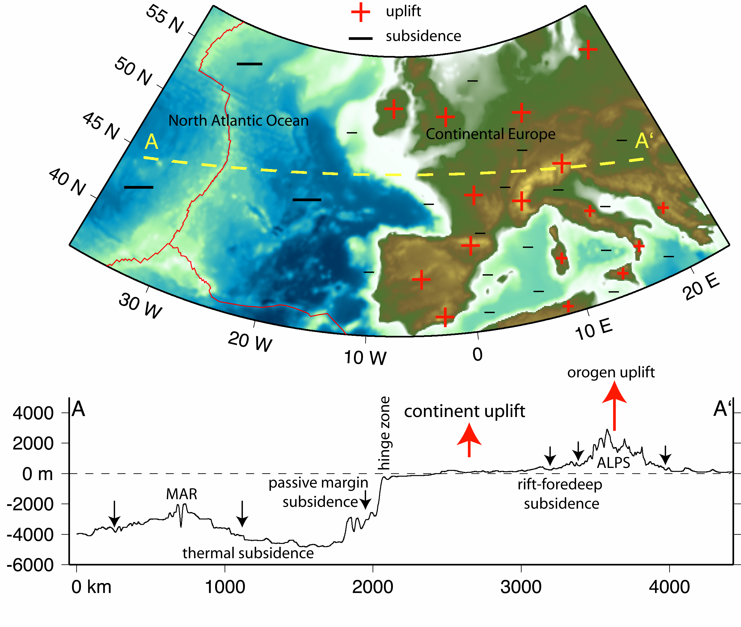

Slide 30
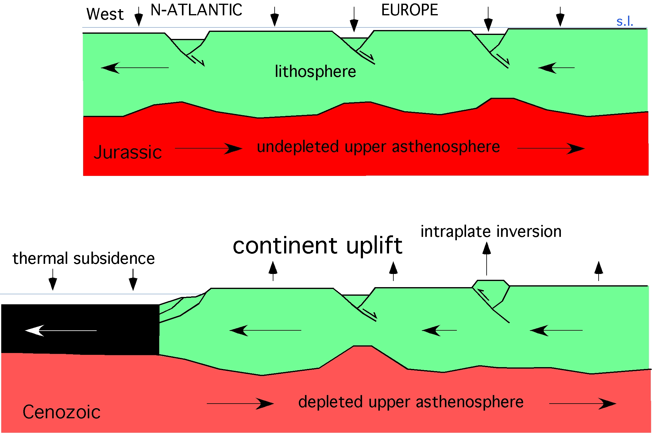

Slide 31
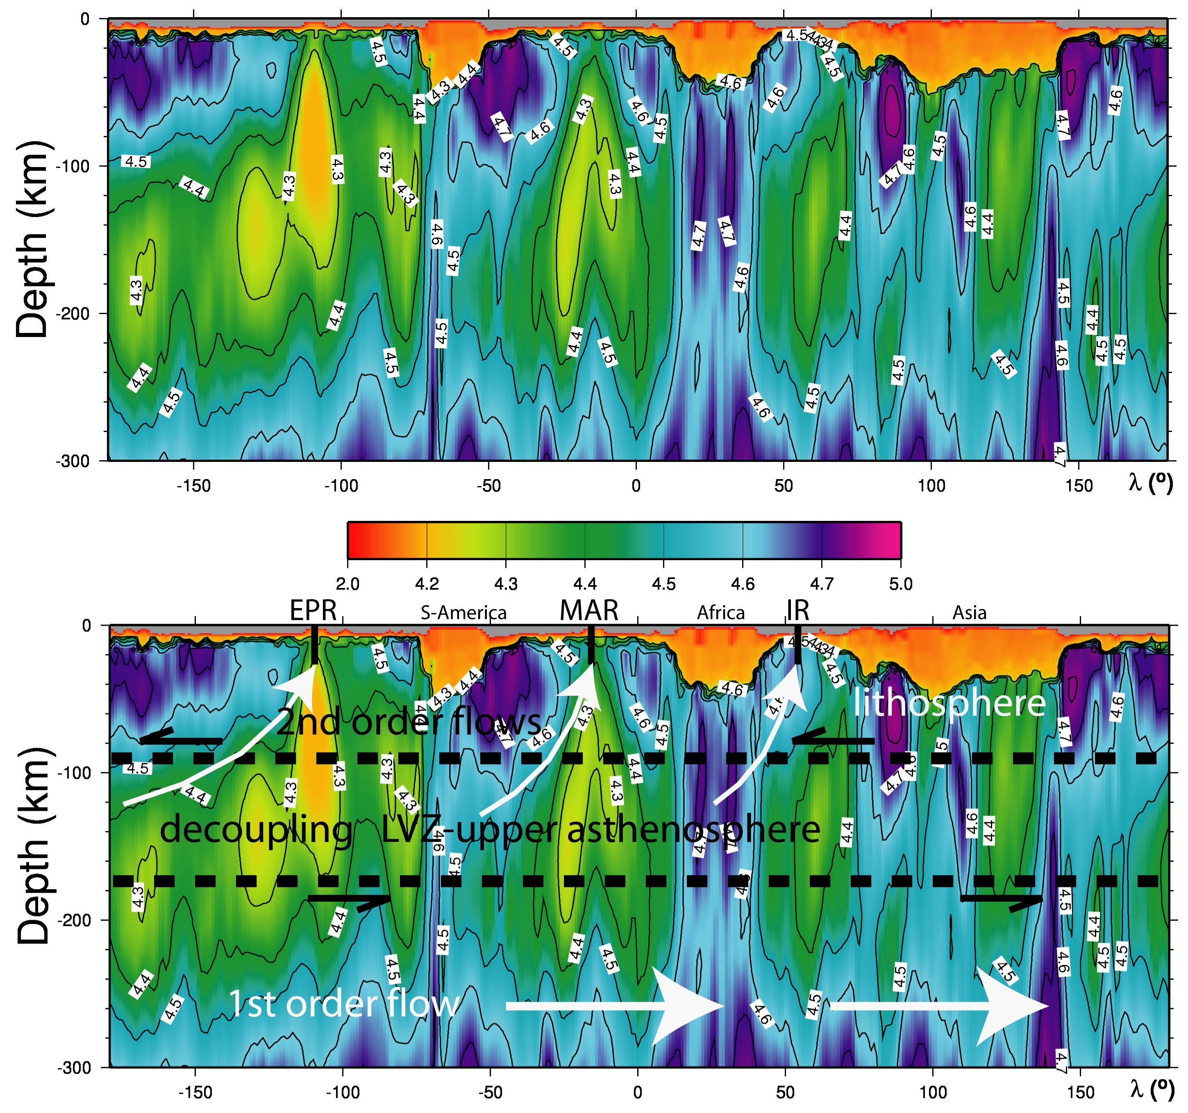

Slide 32
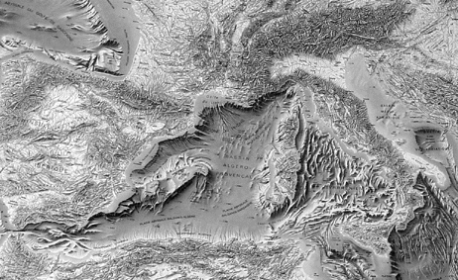
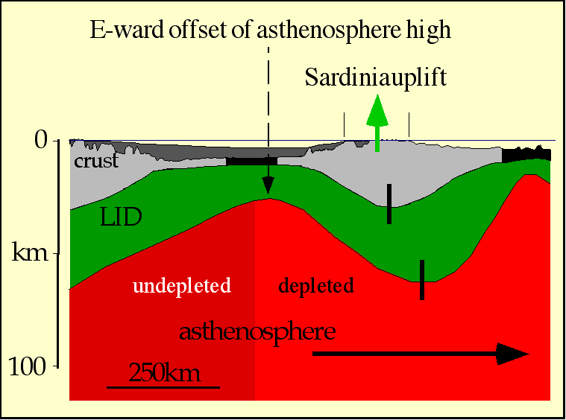
km

Slide 33
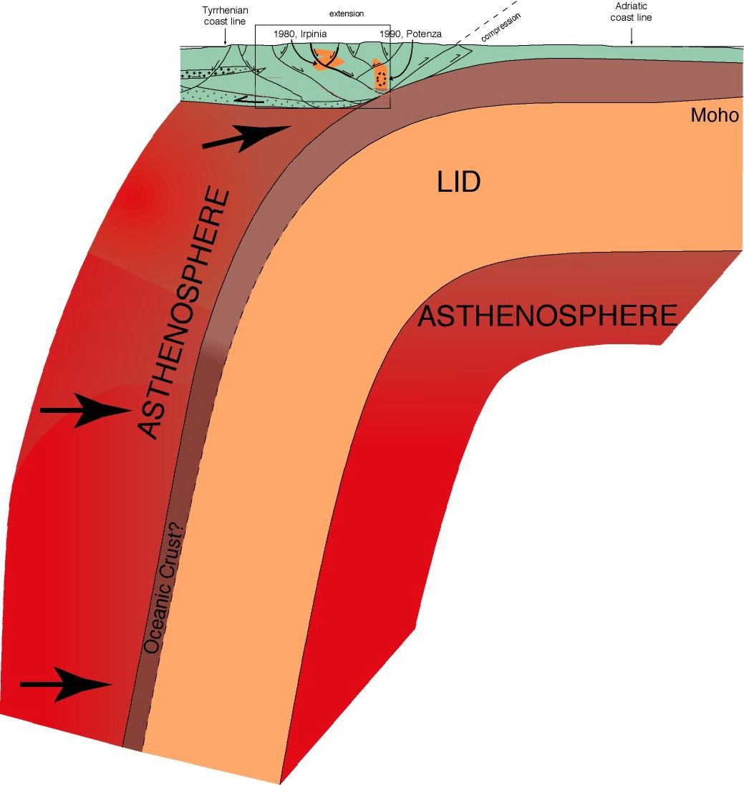
Mantle -ρ deficit
extension
Mantle
wedging

Slide 34
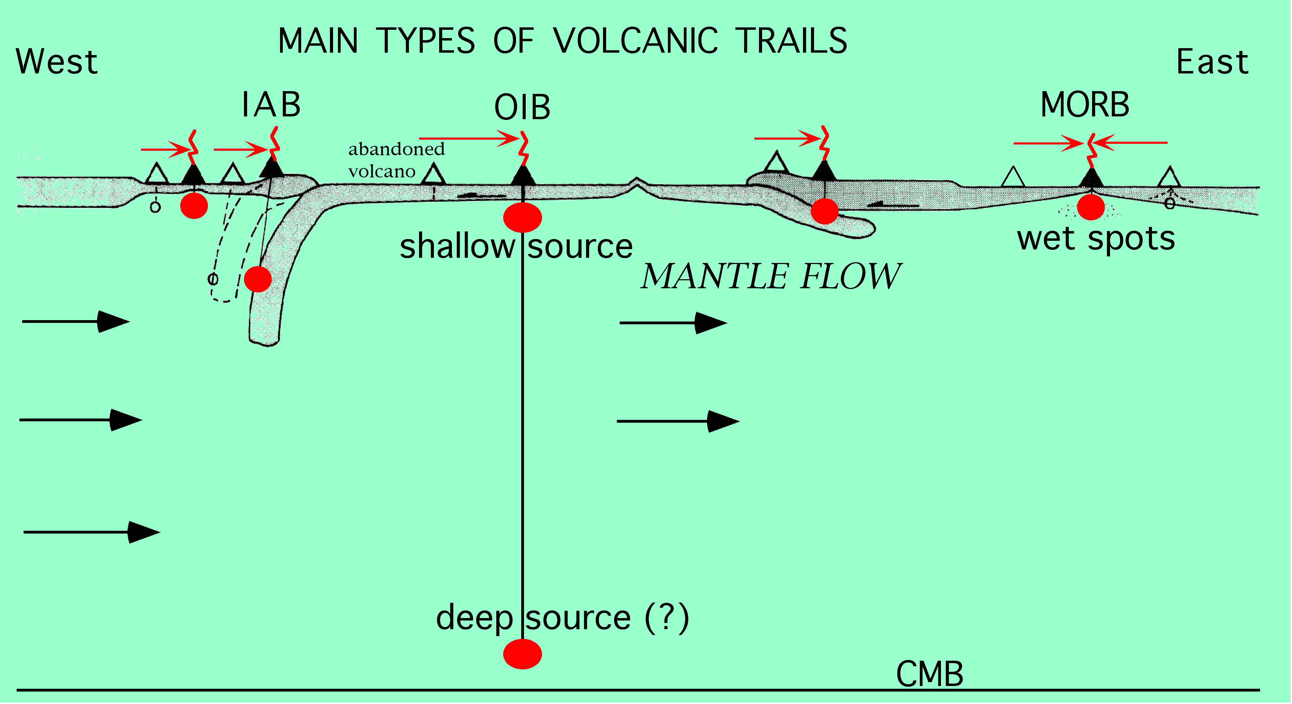
- Different depths of the magmatic sources
- Most of them in the asthenosphere or in the lithospheric mantle
- Most of them along moving and mantle-detached plate margins
Without “hotspots” located along plate margins & shallow plumes
Westward drift = 90 mm . yr ⁻¹

Slide 35
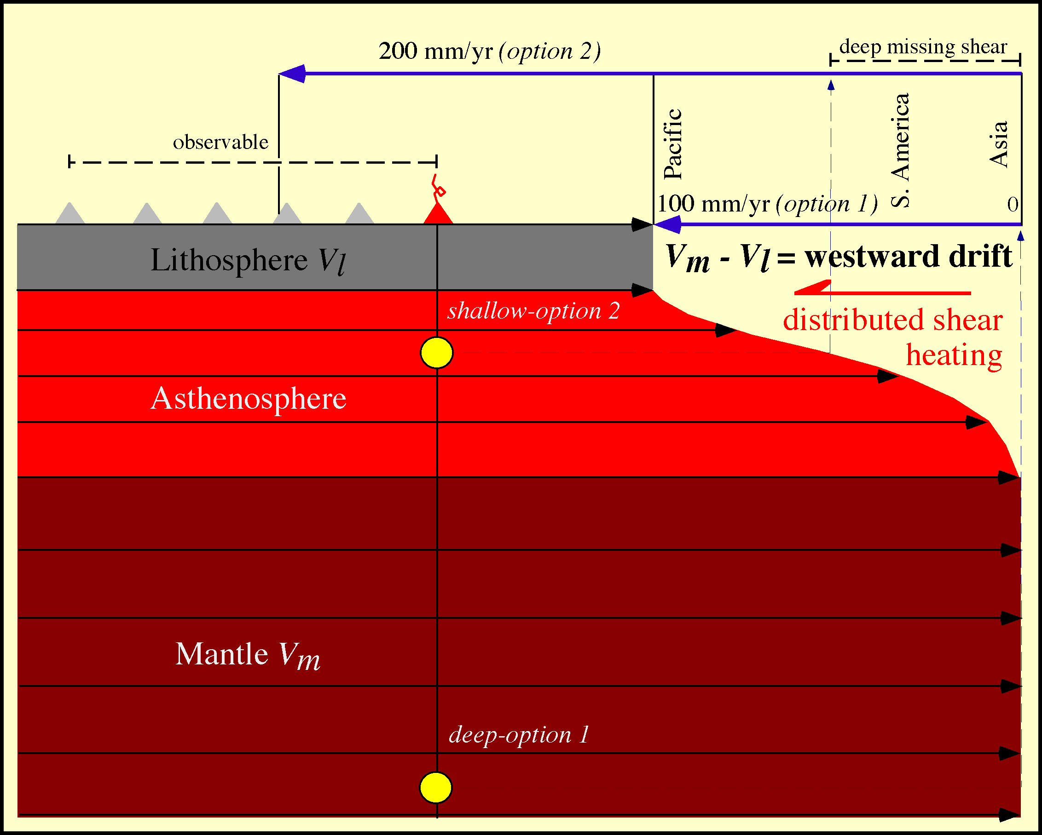
Shallower source (Hawaii?) = Larger the westward drift
Faster W-ward lithospheric delay = Larger shear heating
= Larger intraplate asthenospheric sourced magmatism?
Larger decoupling above undepleted fluid-rich & less viscous asthenosphere

Slide 36
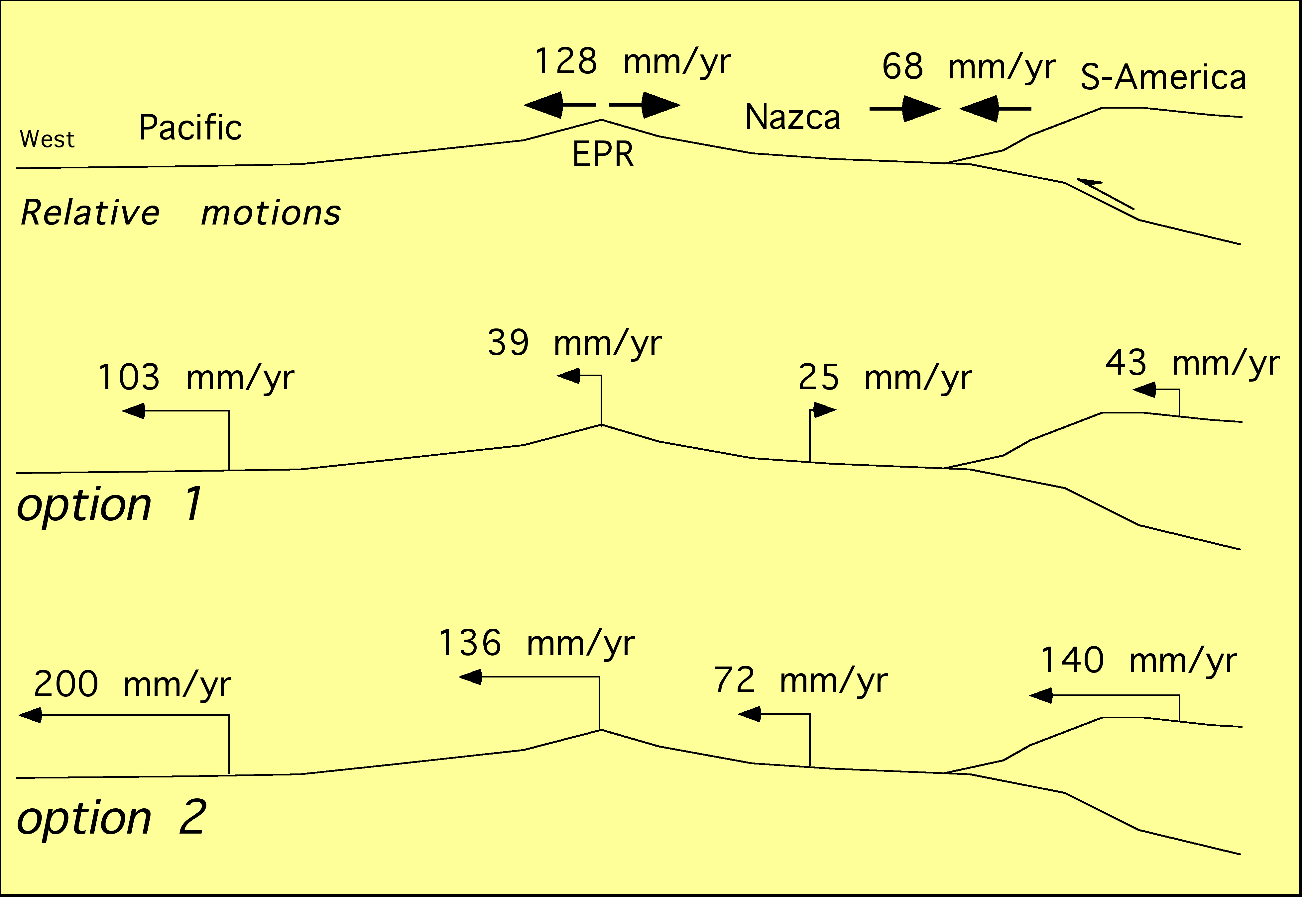
- DEEP HOTSPOTS
- SHALLOW HOTSPOTS

Slide 37
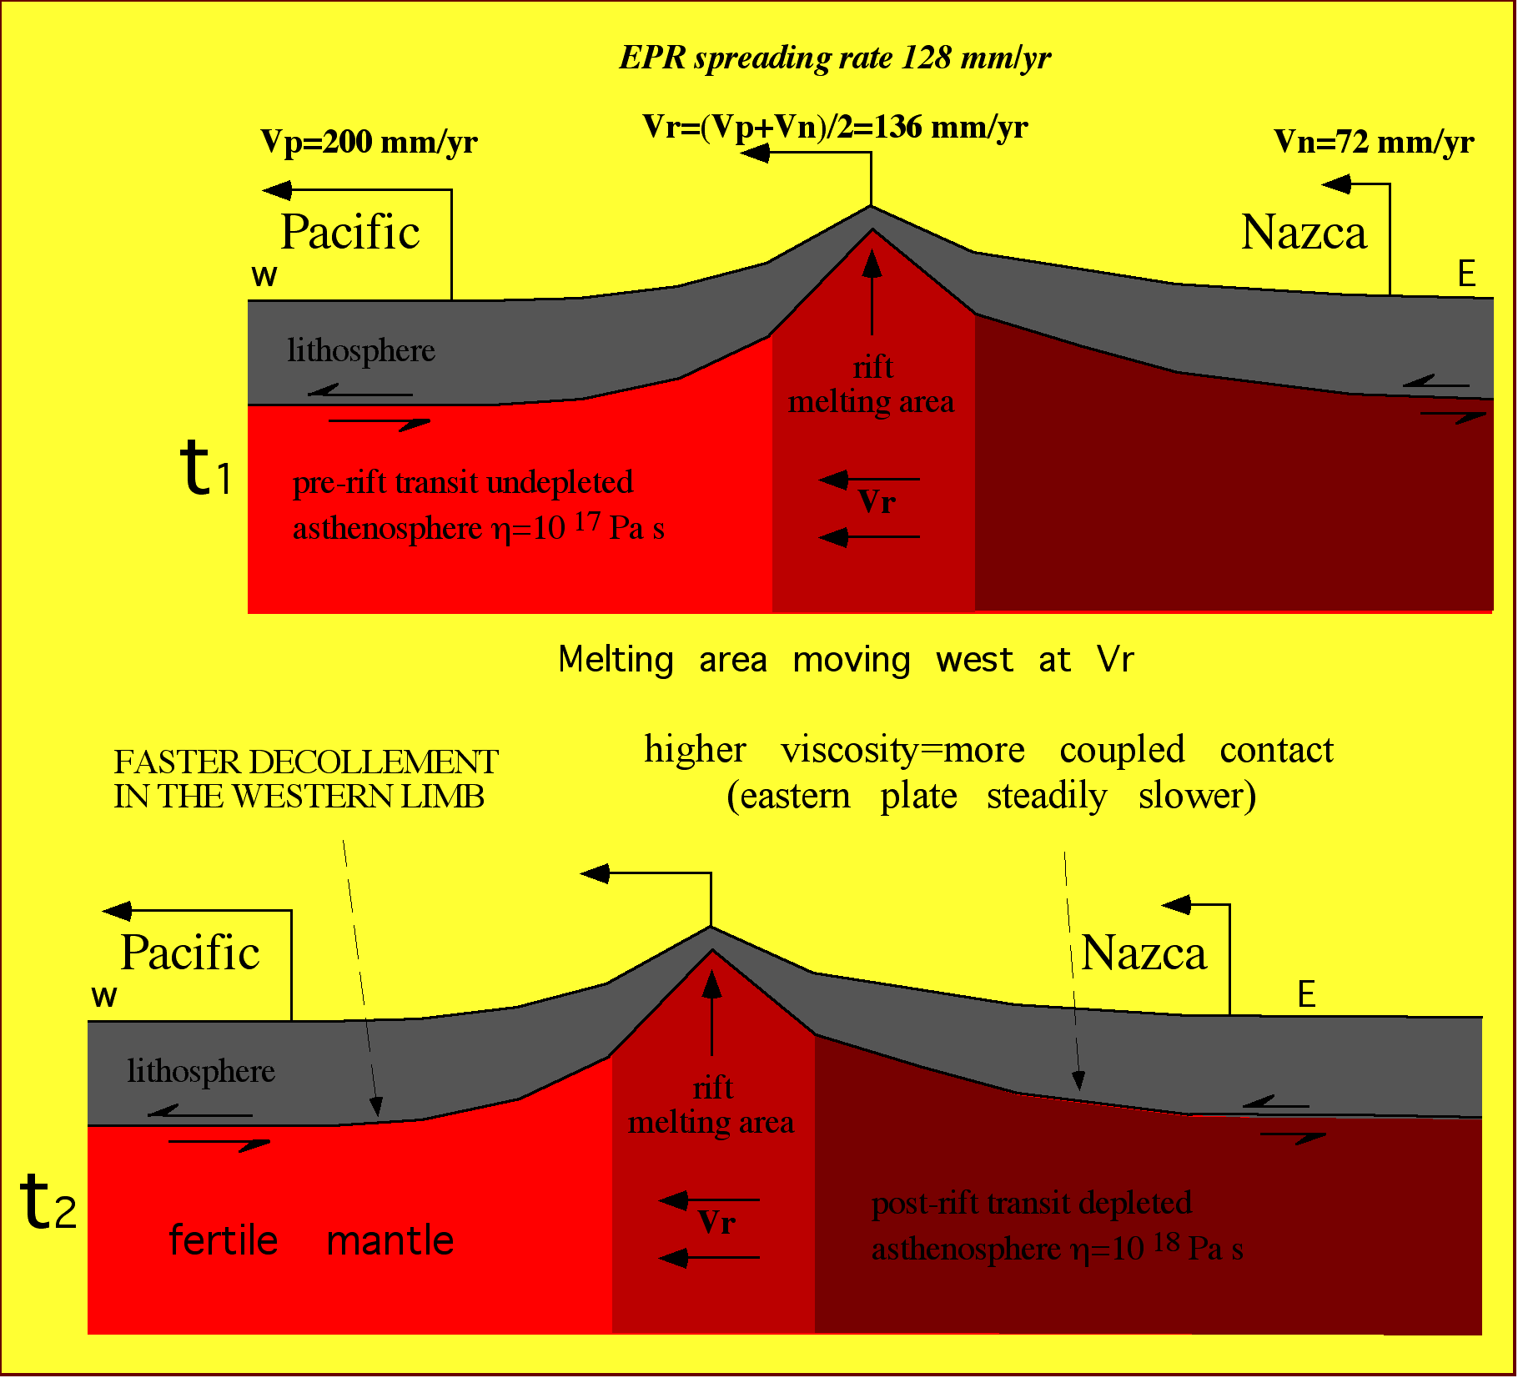
Let’s assume the
mantle fixed
Extraction of water
during melting
increases residual
mantle viscosity of
1-2 orders of
magnitude
(Braun et al.,
EPSL, 2000)

Slide 38
Let’s assume the
mantle fixed
20-60 kg/m³ lighter
1-2 orders > viscous
SubsW>SubsE
SubsW
SubsE

Slide 40
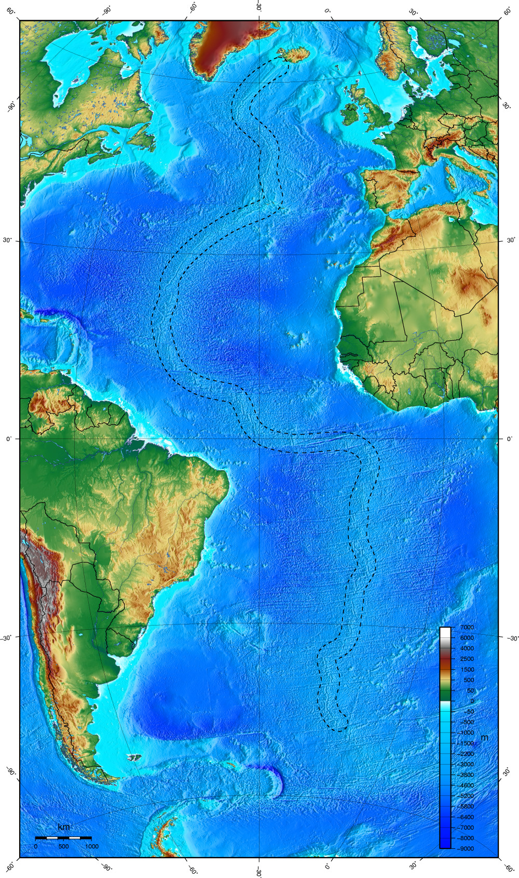
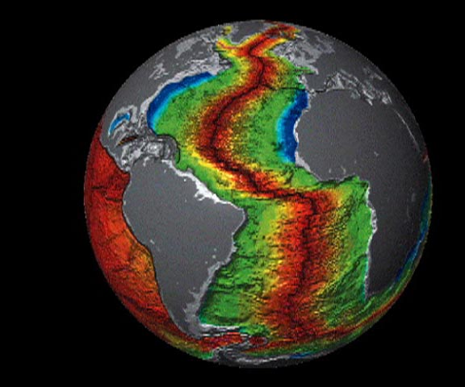
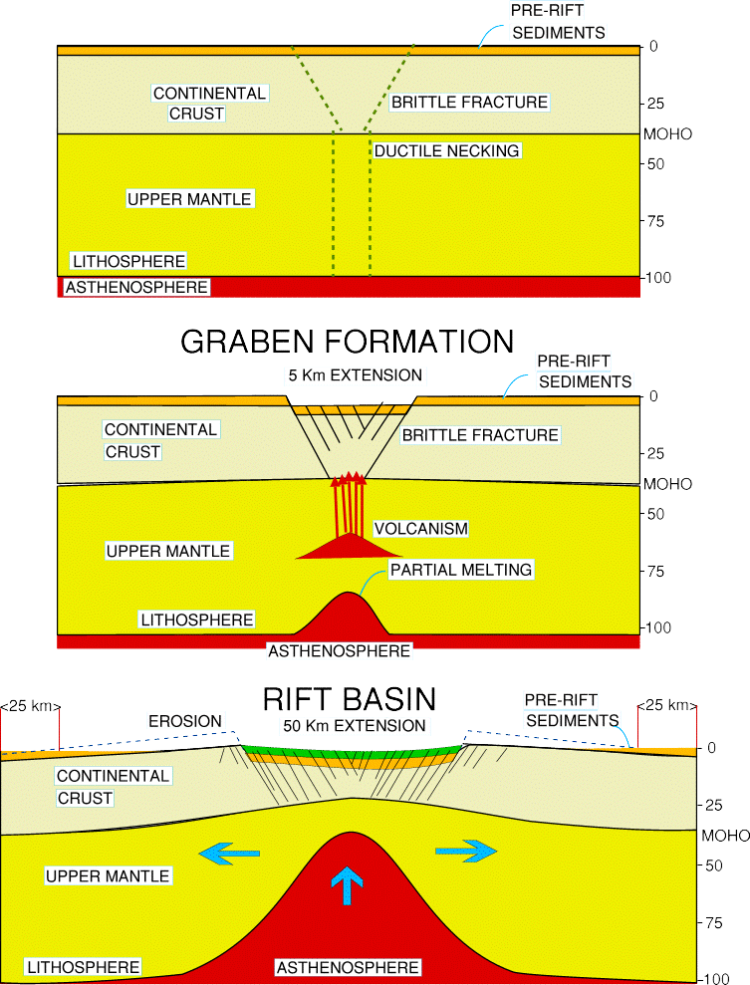

Slide 44
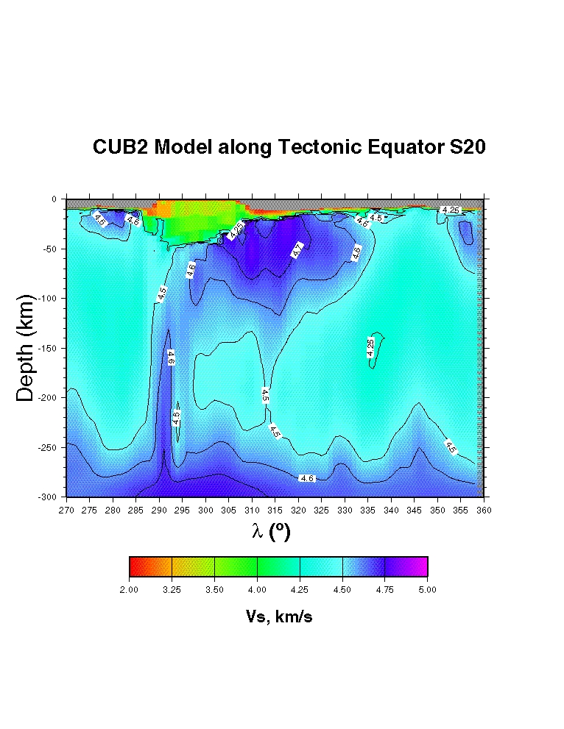
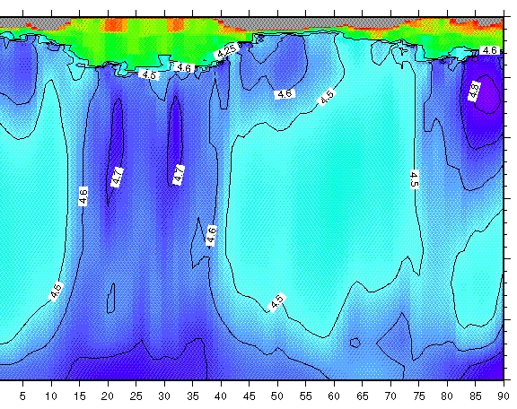
S-America
MAR
Africa
IR
India

Slide 45
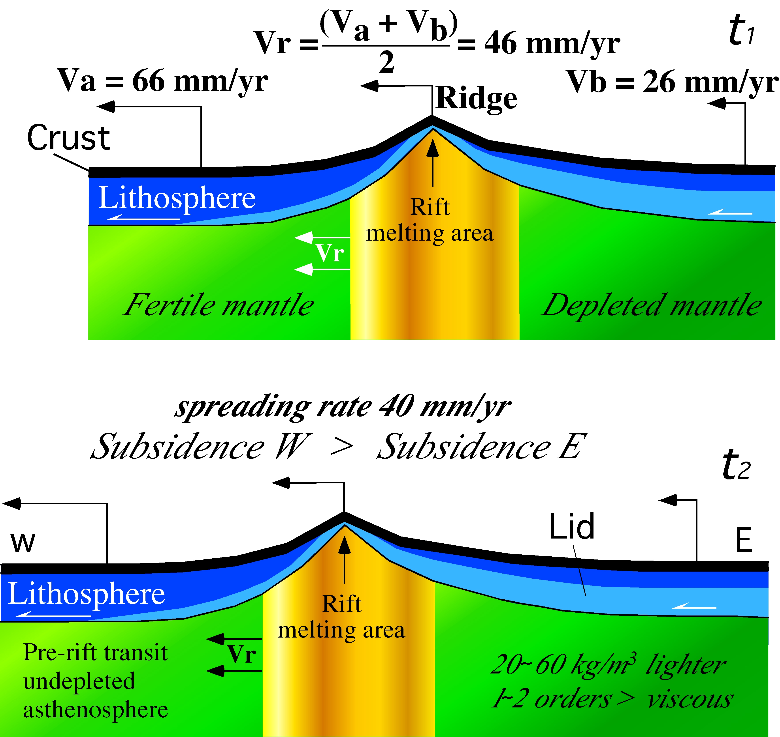

Slide 46
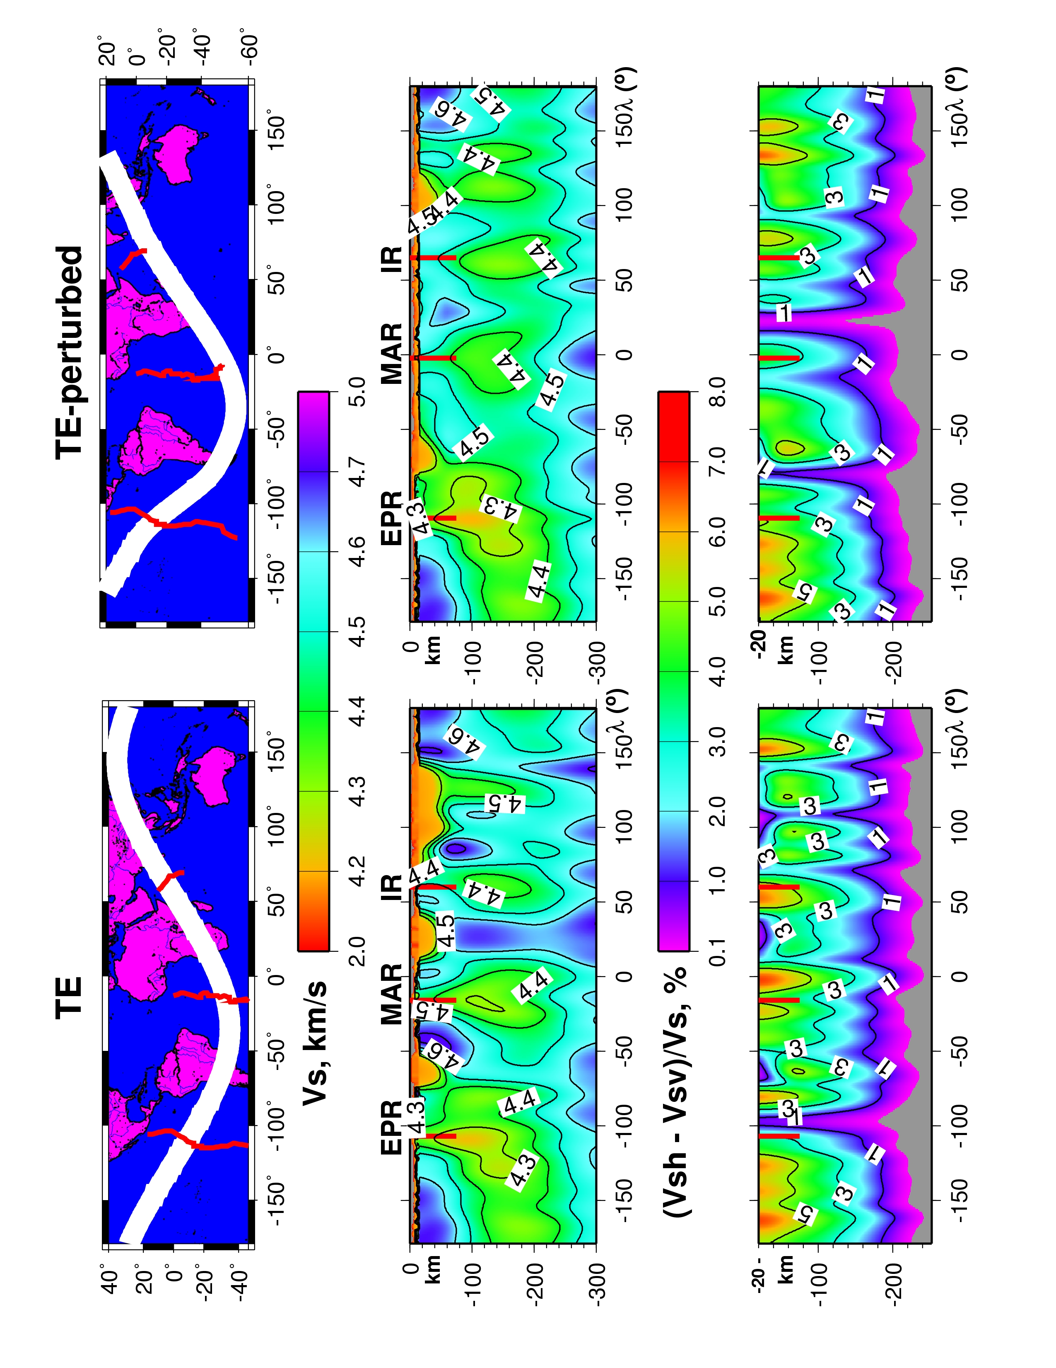
Panza et al. Geology 2010

Slide 47
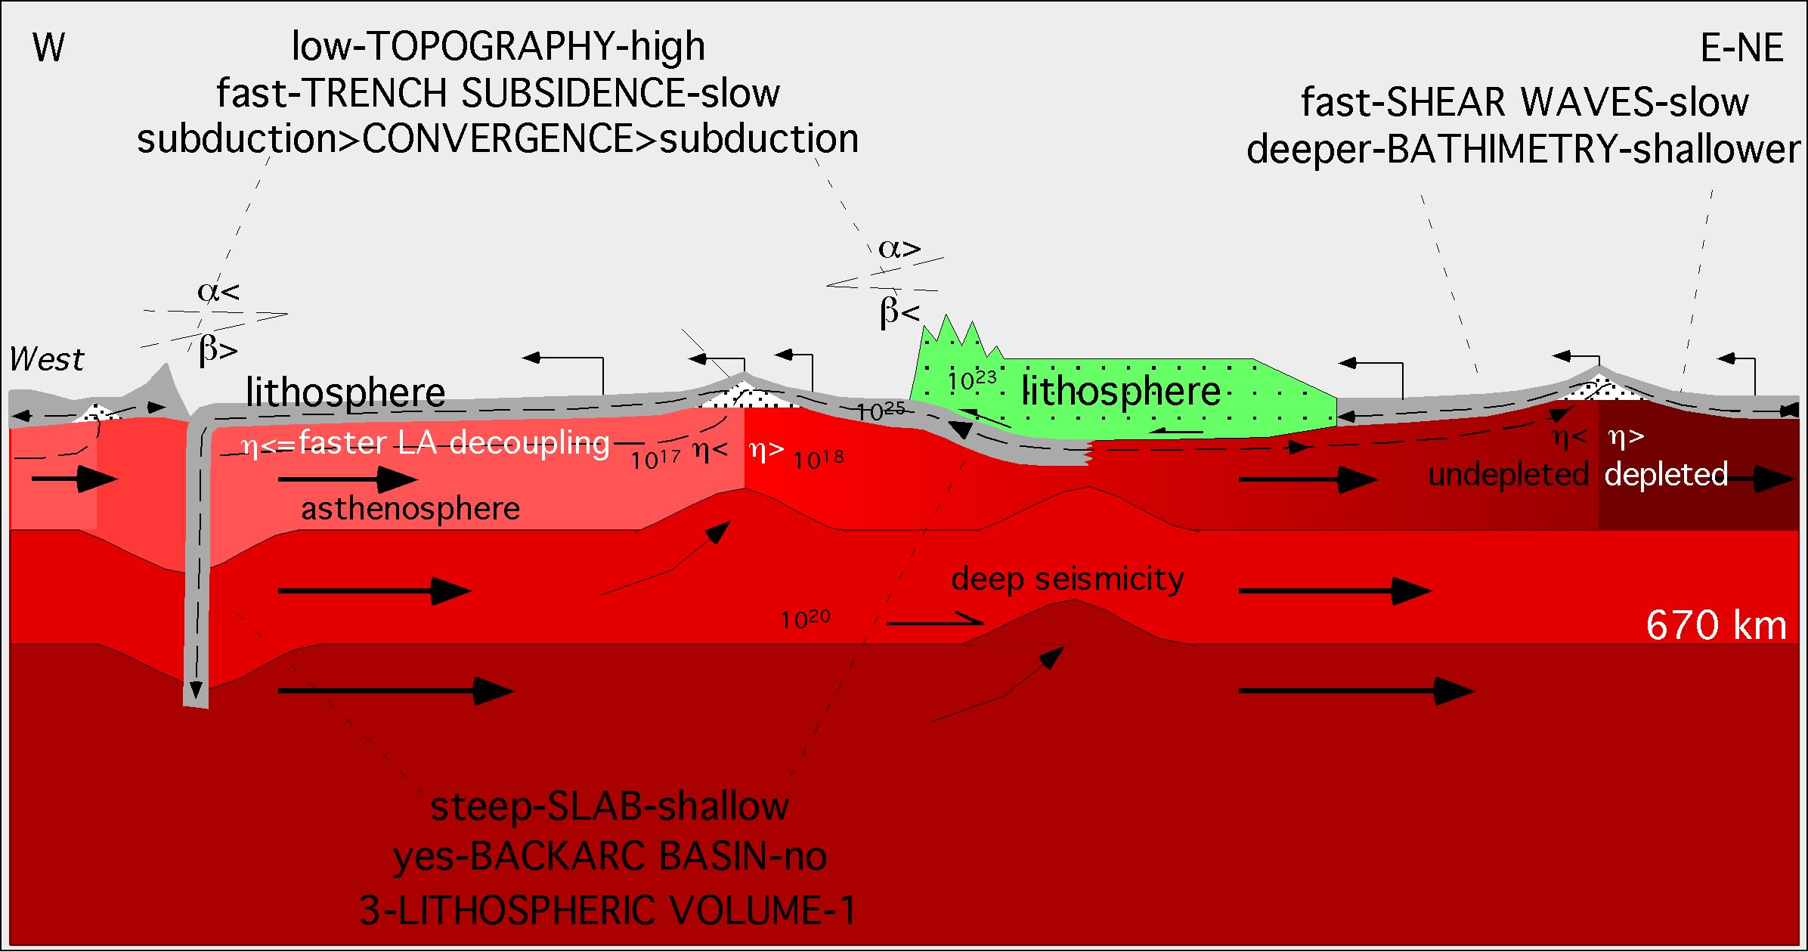

Slide 48
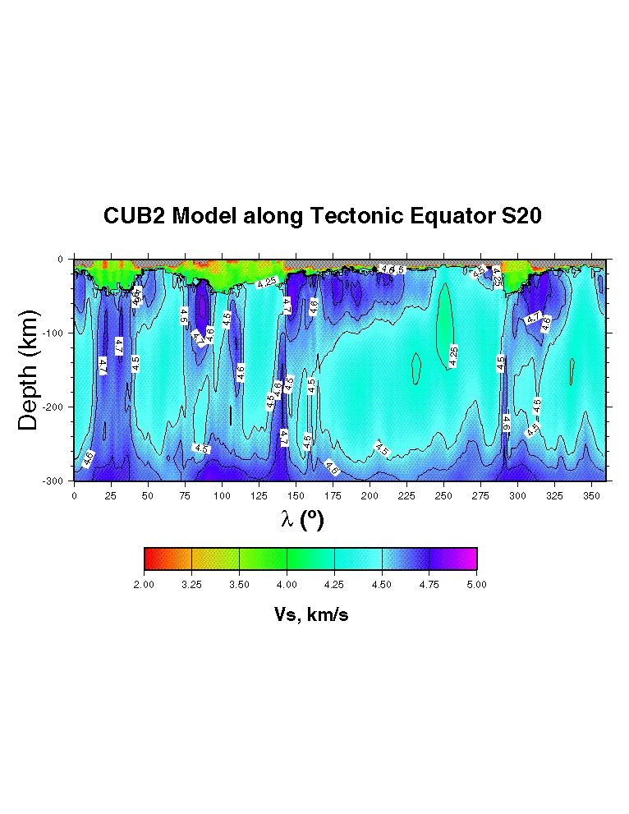
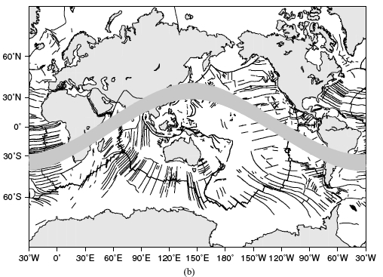
Africa
IR
India-Asia
Pacific
EPR
S-Am
Atlantic
2nd order flows
1st order flow
Panza et al. submitted

Slide 49
rifting model
Ridge speed = (V_{A}+V_{B})/2
A
B

Slide 52
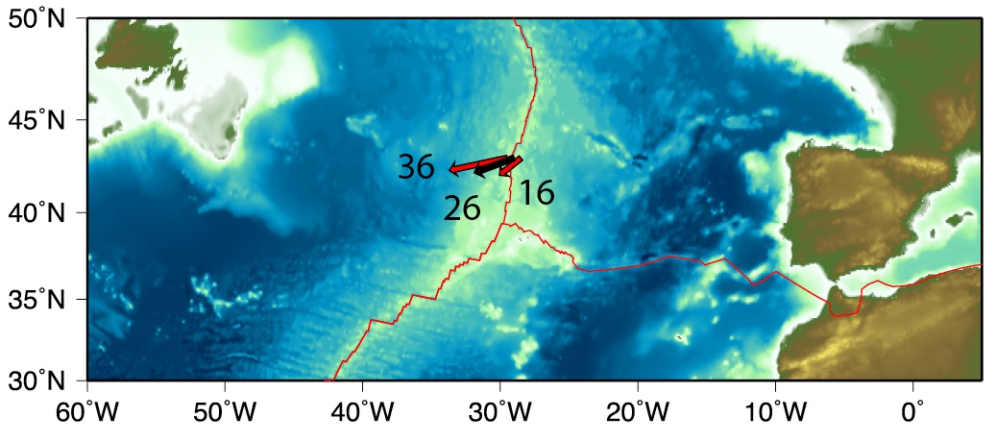
NA
EU
Mantle
MAR

Slide 53
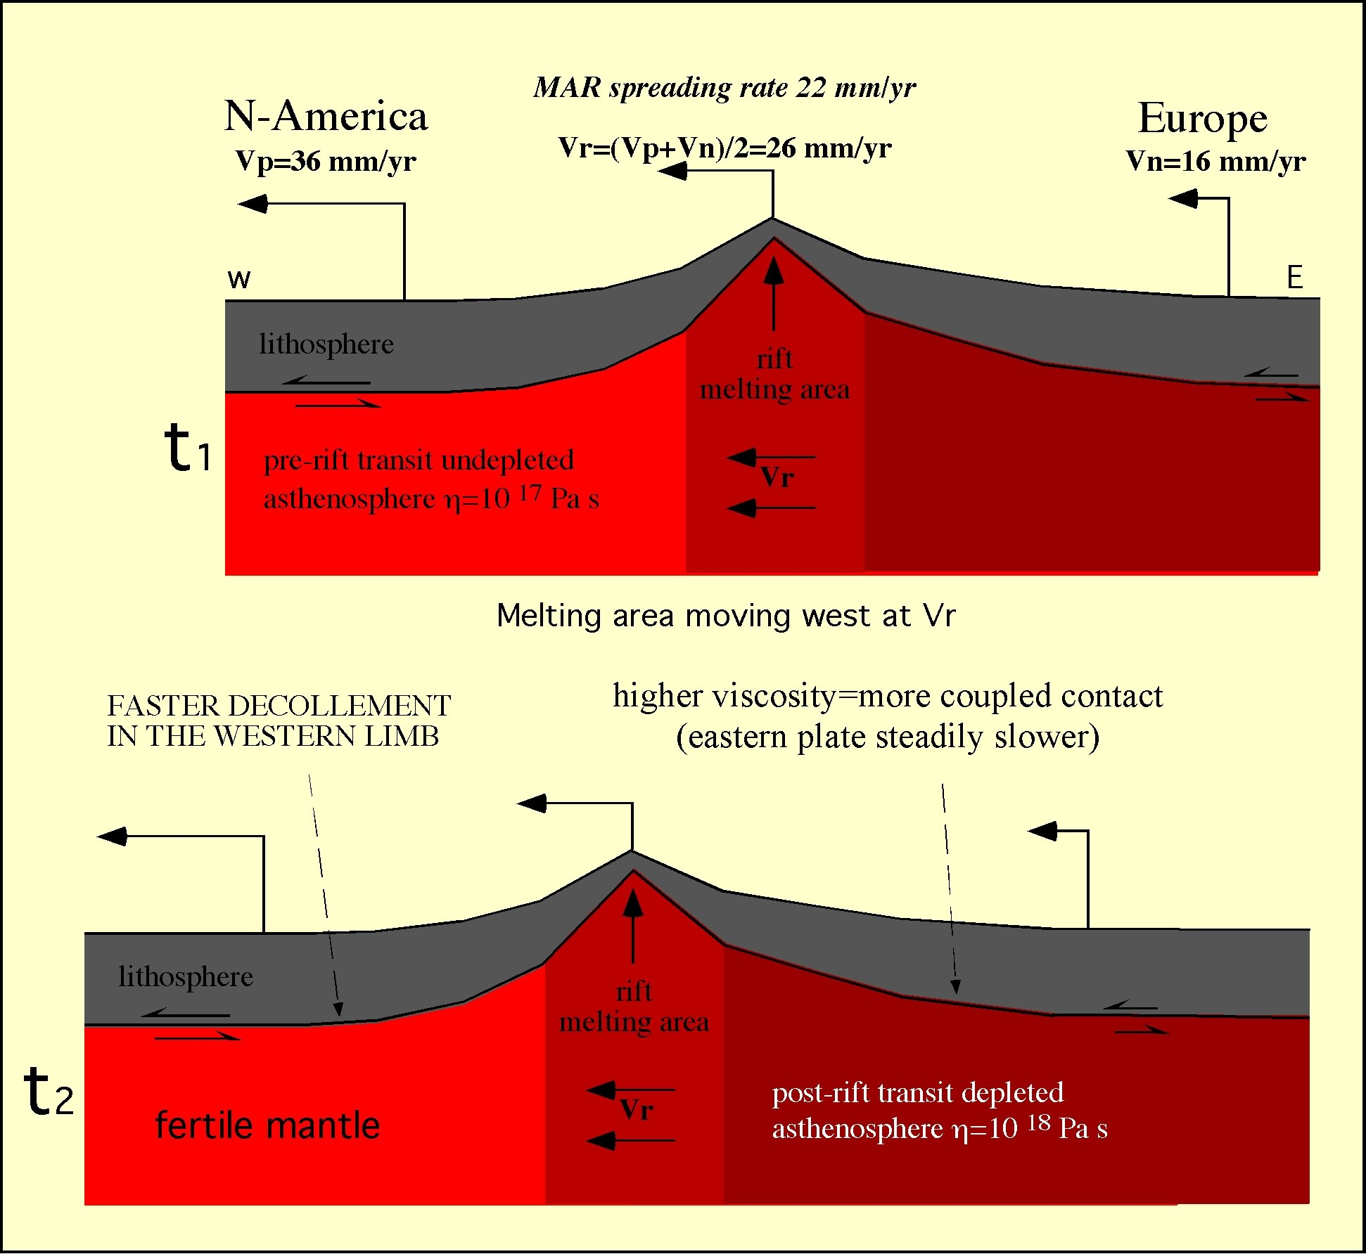
Let’s assume the
mantle fixed
20-60 kg/m³ lighter
1-2 orders > viscous
SubsW>SubsE
SubsW
SubsE

Slide 54
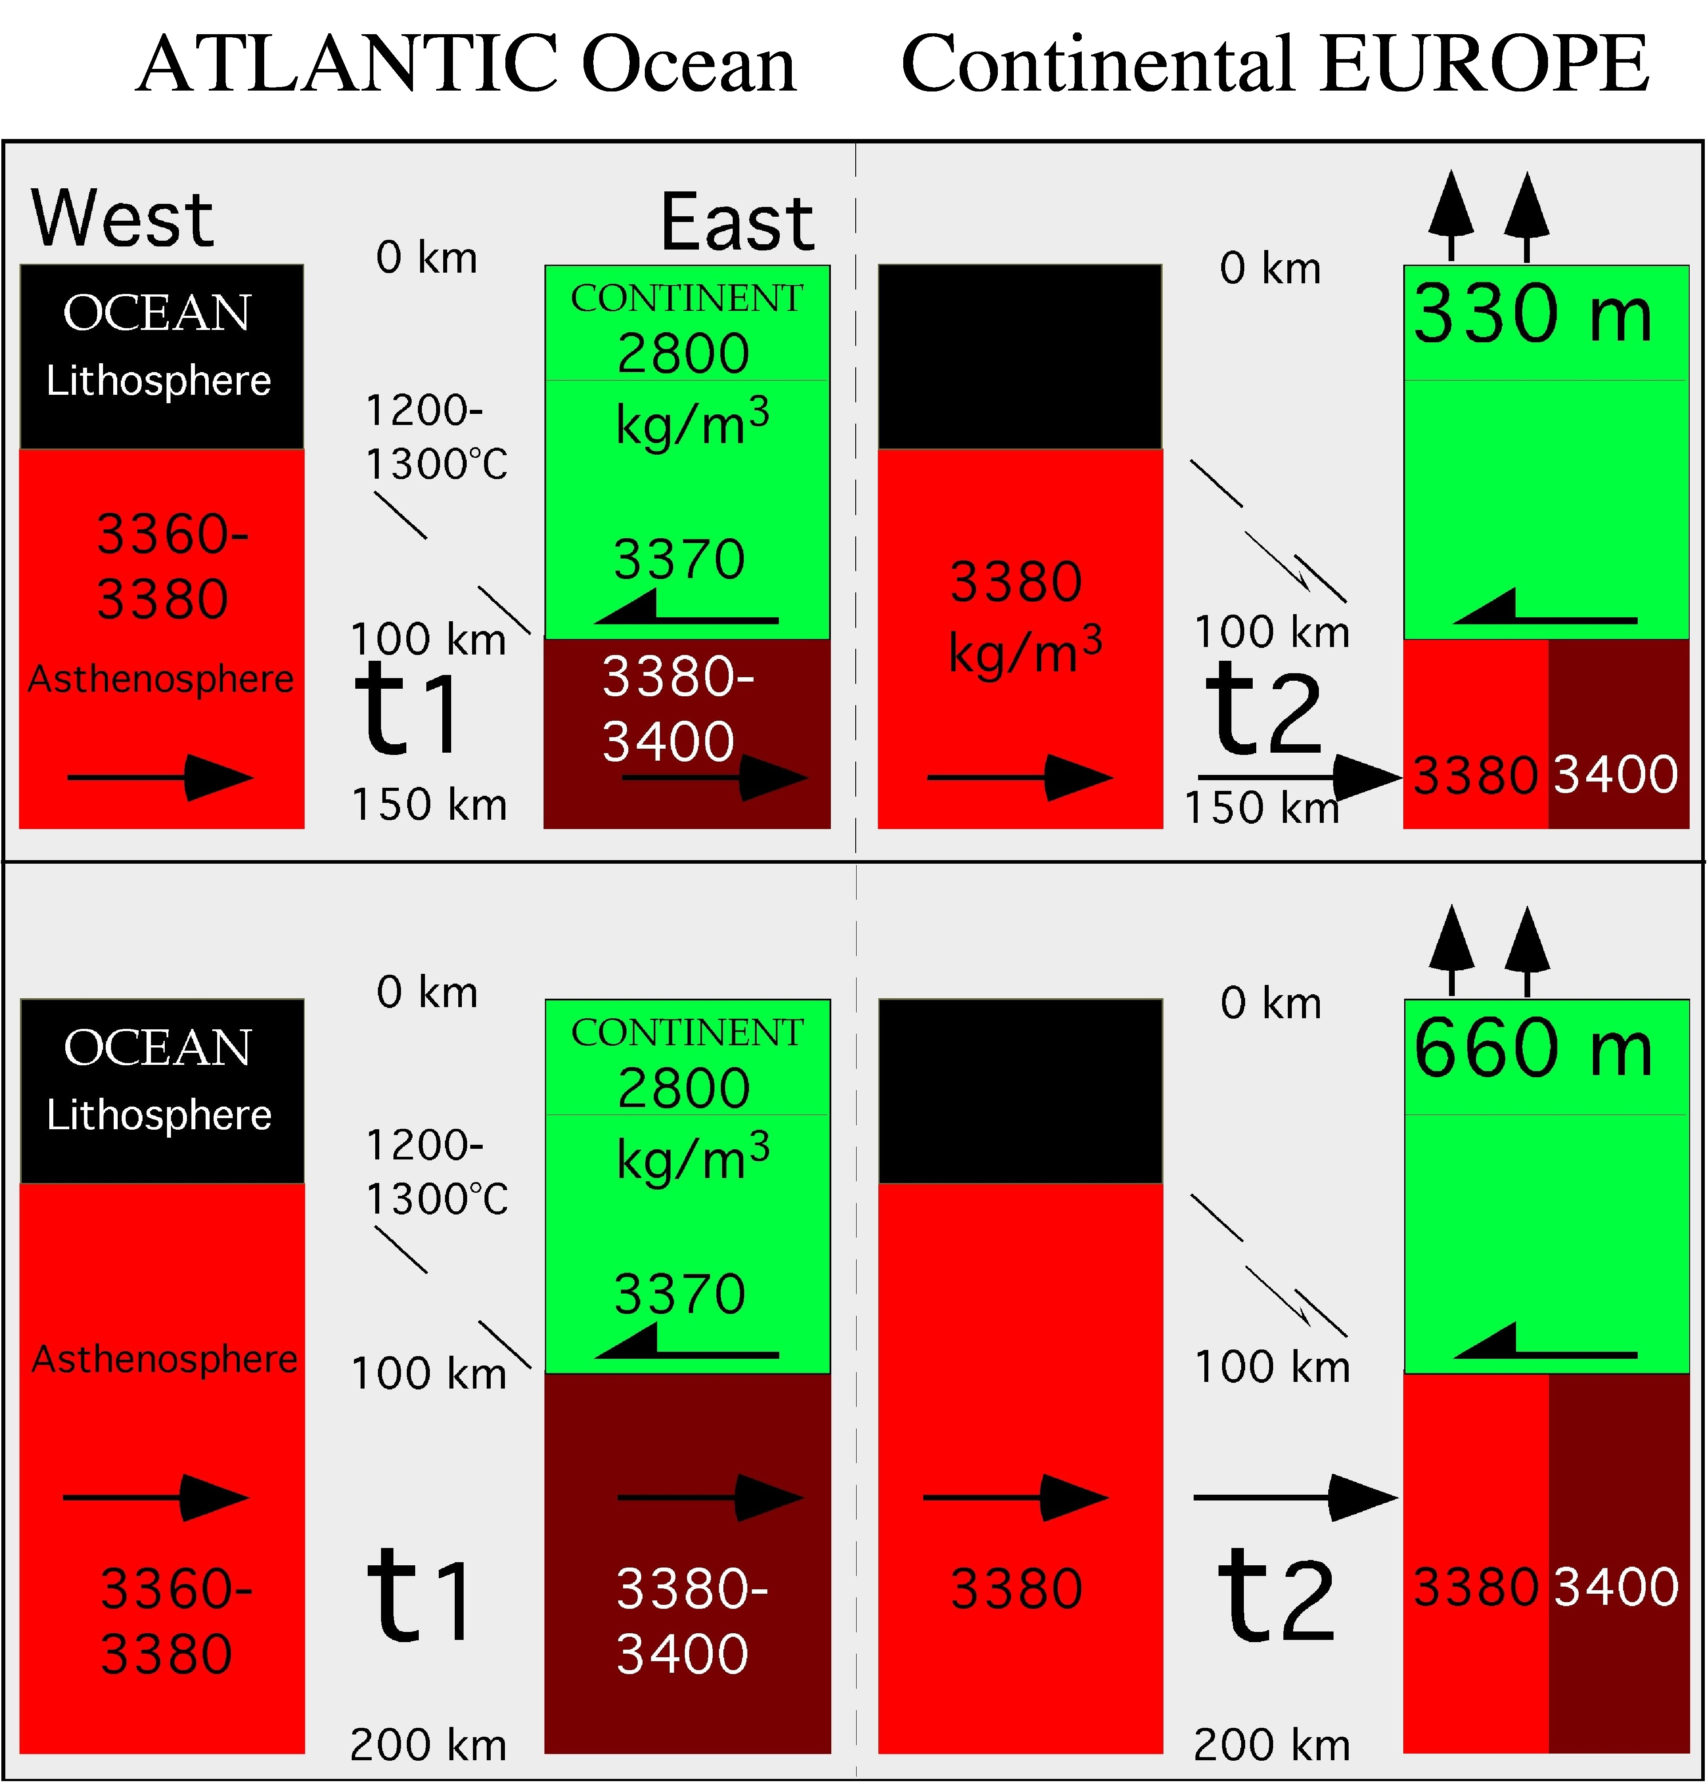

Slide 55
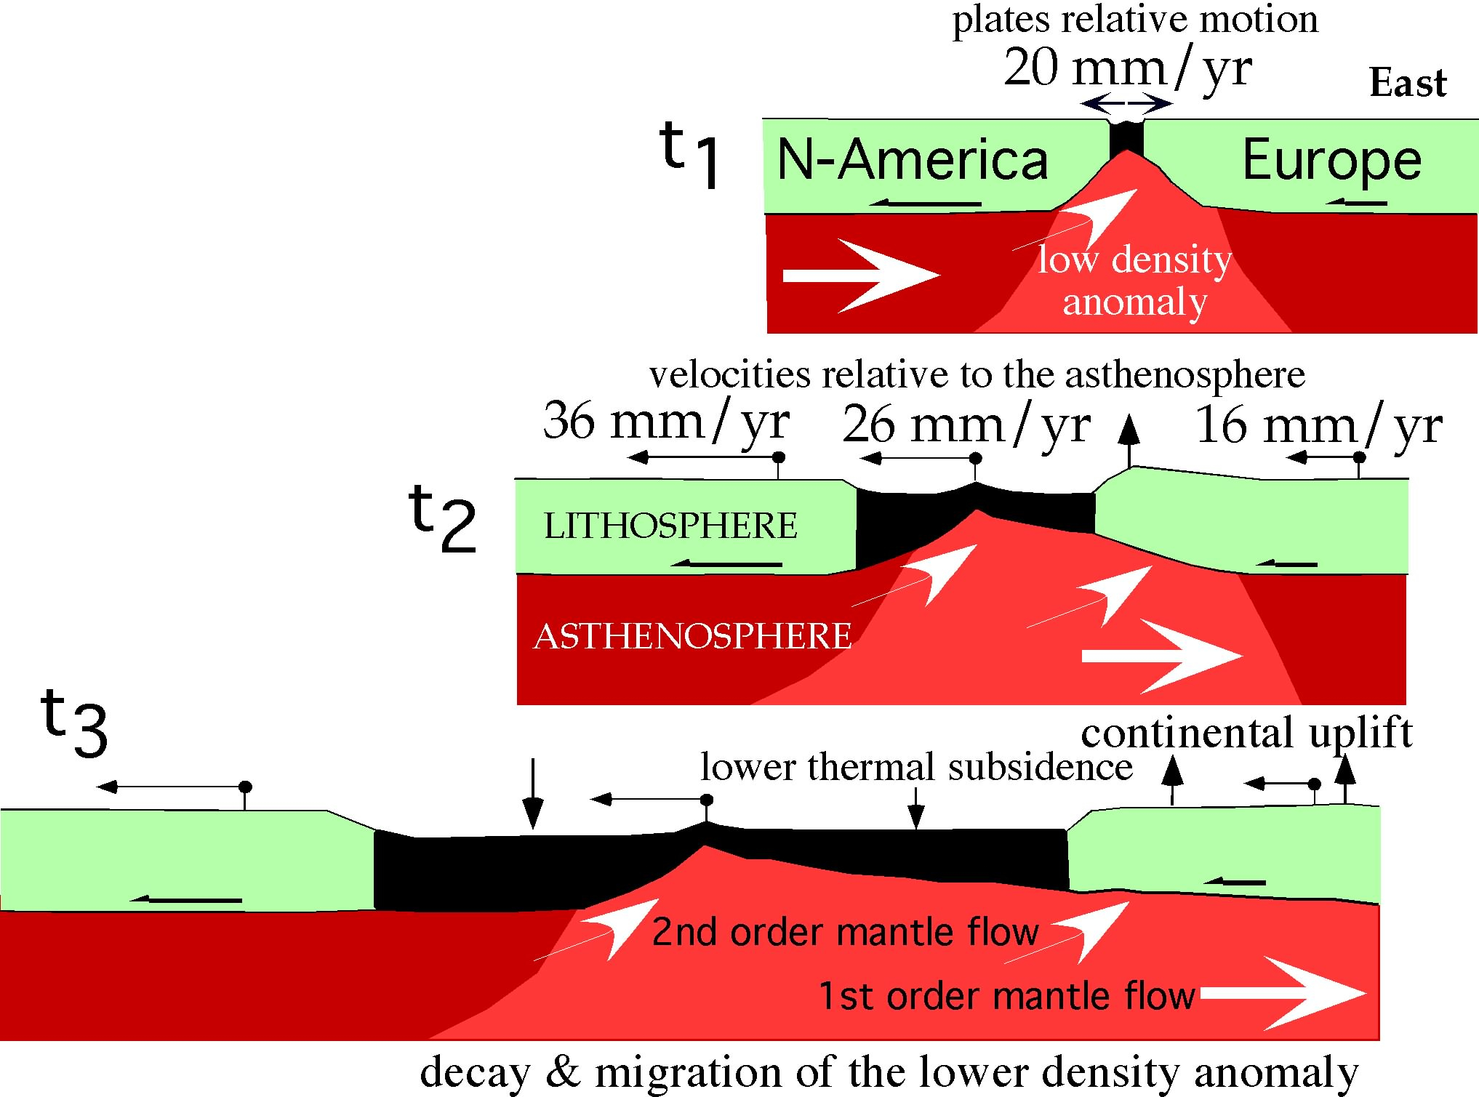

Slide 56
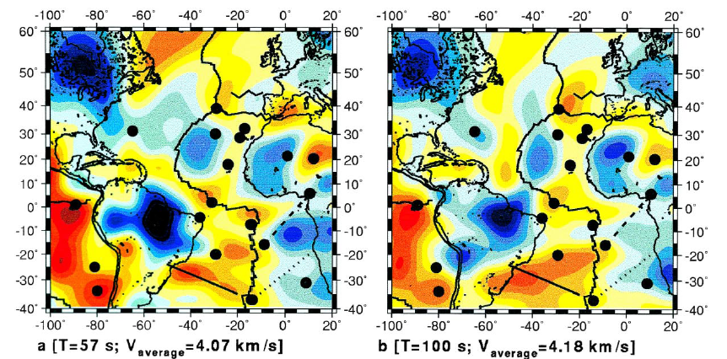
Silveira et al., 1998, PEPI

