Slide 1
Metamorphism and Metamorphic Rocks

Slide 3
Rock Cycle Revisited
And
Pressure
Cementation
Sedimentary
Rocks
Erosion
Sediment
Heat
Erosion
Pressure
Erosion
Metamorphic
Rocks
Heat and Pressure
Igneous
Rocks
Heat
Cooling
Magma

Slide 4
Definitions
Metamorphism – mineralogical, chemical, and physical changes that occur in solid rocks.
Occurs at depths greater than that of lithification (Diagenesis).
Solid state recrystallization – changes that occur without the rock melting (rocks that melt are igneous).

Slide 5
Sedimentary
Surface
15º C
5 km
200º C
Metamorphic
30 km
Magma
600º C

Slide 6
Factors influencing Metamorphism
Temperature
Pressure
Pore Fluid
Time

Slide 7
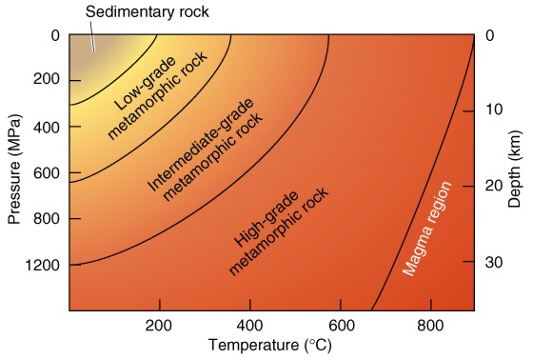
Temperature, Pressure and Rock Type

Slide 8
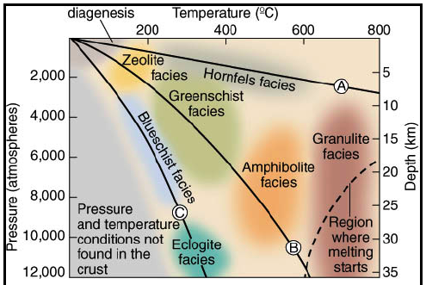

Slide 9
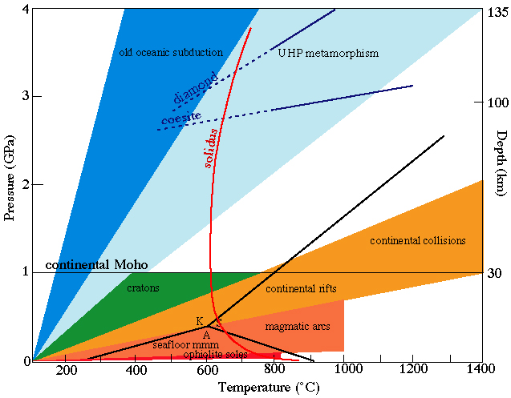

Slide 10
Factors influencing Metamorphism
Temperature
  below about 200ºC, most minerals are stable (little or no metamorphism)
  above 200ºC, reaction rate increases as temperature increases, new minerals begin to form
  above 600ºC, some minerals begin to melt (transition to igneous rocks)

Slide 11
Factors influencing Metamorphism
Pressure
  as pressure increases, pore spaces reduced and density increases, pore fluids are expelled
Differential stress
  pressure is greater in one direction than in another

Slide 12
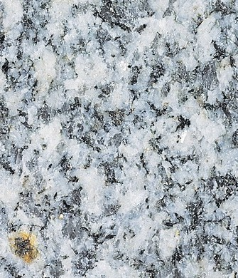
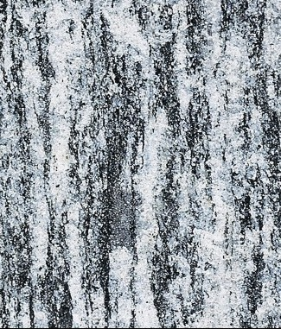
Effects of Stress
Uniform
Differential

Slide 13
Differential Stress
Foliation – a metamorphic rock texture due to alignment of minerals as a result of differential stress
Slaty cleavage – foliation that develops at low temperature and pressure (metamorphosed shale)

Slide 14
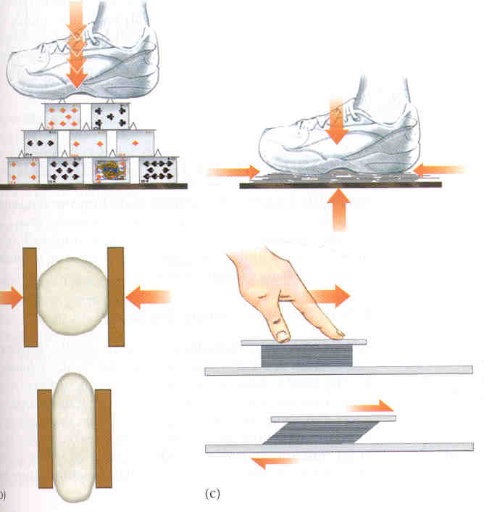






Differential
Stress

Slide 15




























Slide 16


























Slide 17




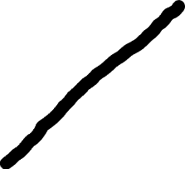









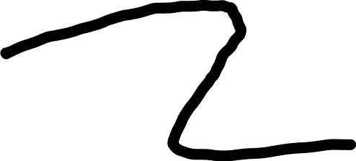





Slide 18


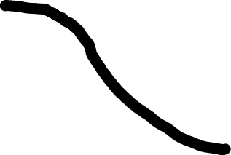
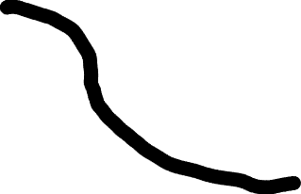







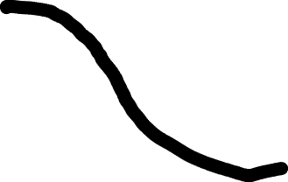


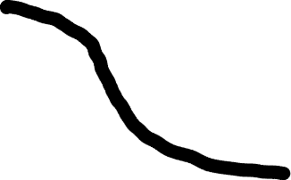







Slide 19


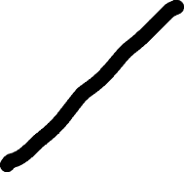



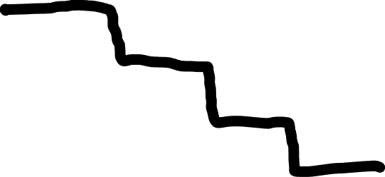



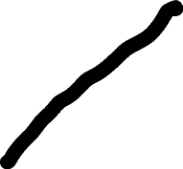



Slide 20
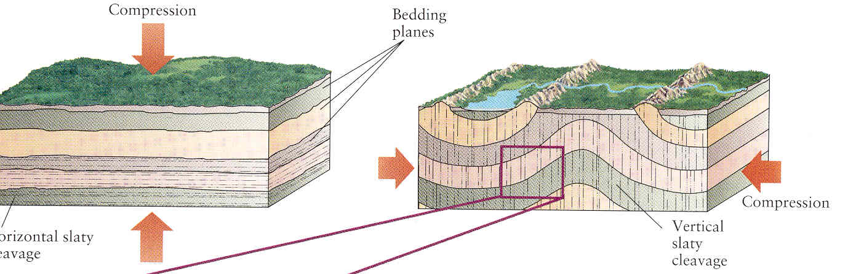
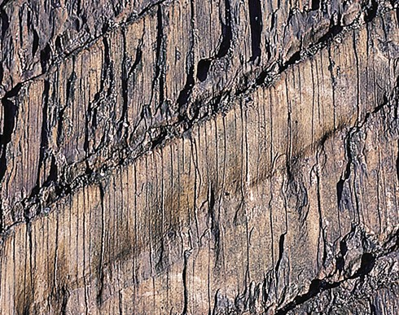
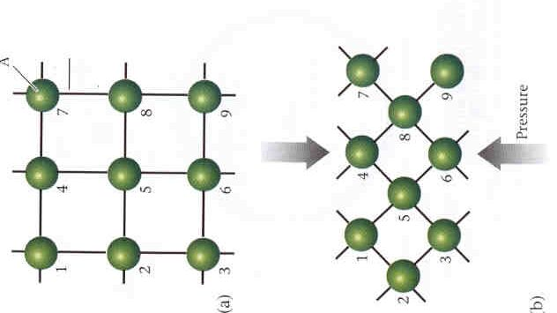
Burial
Mountain Building

Slide 21
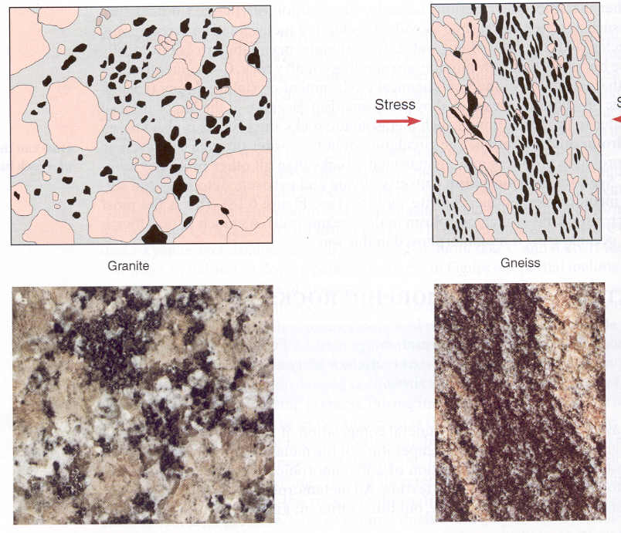

Slide 22
Factors influencing Metamorphism
Pore fluids (water and carbon dioxide)
  as pressure increases, pore fluids are expelled
Pore fluids increase the rate of metamorphic reactions by:
  storing ions involved in reactions
  moving ions from one place to another

Slide 23
Pore Fluids
Dissolution / Precipitation
Ductile Processes
Different than PRESSURE SOLUTION
Water is more important than pressure

Slide 24
Factors influencing Metamorphism
Time
  solid state recrystallization is a slow process
  in general, size of minerals increases with time

Slide 25
Preferred Mineral Orientation
Ductile (plastic) Deformation
Pressure Solution
Grain Rotation
Growth in Preferred Orientation

Slide 26
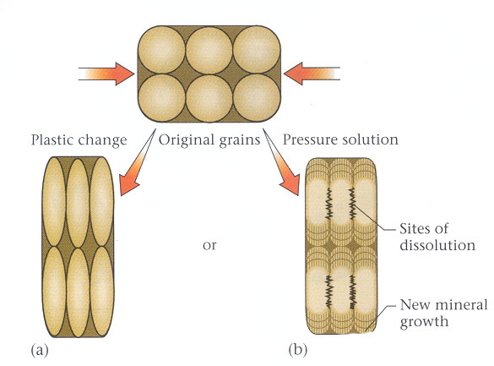
Ductile (plastic) Deformation
Pressure Solution

Slide 27
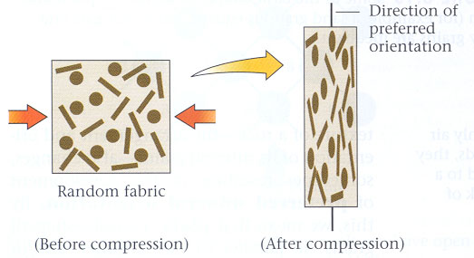
Grain Rotation

Slide 28
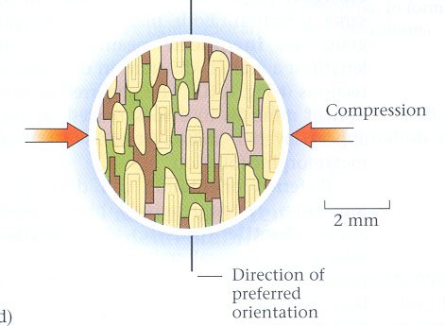
Growth in Preferred Orientation

Slide 29
Types of Metamorphism
1. Burial Metamorphism
2. Contact Metamorphism
3. Regional Metamorphism

Slide 30
Types of Metamorphism
Burial Metamorphism
  most common type, occurs where crust is greater than 5 km thick
Relatively low temperature and pressure (low grade metamorphism)
Maximum stress vertical, foliation parallel to ground surface

Slide 31
Burial Metamorphism

Slide 32
Types of Metamorphism
Contact Metamorphism
  occurs in rocks around a magma body
  high temperature (heat from magma)
  low pressure (occurs at shallow depths in the crust)

Slide 33
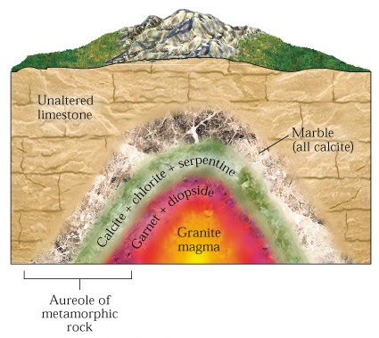
Contact Metamorphism

Slide 34
Types of Metamorphism
Regional Metamorphism
  associated with convergent plate margins
  folding and faulting increase thickness of the crust
  occurs over a range of temperatures and pressures
  low grade to high grade metamorphism

Slide 35
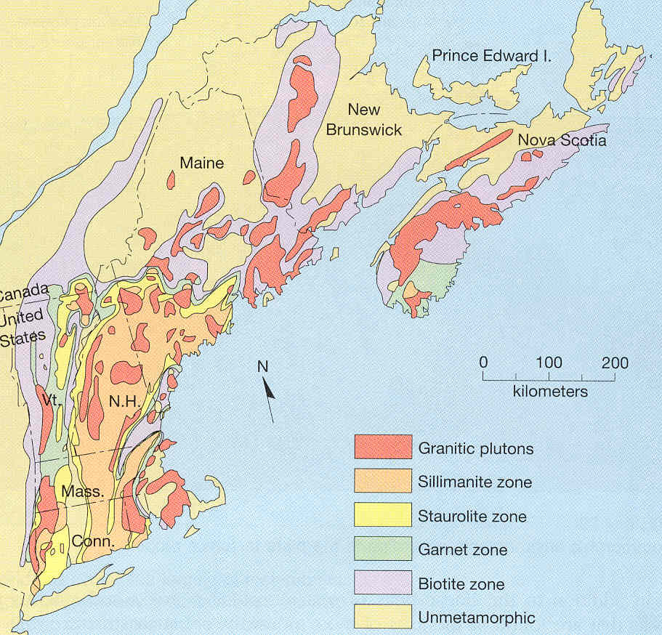

Slide 36
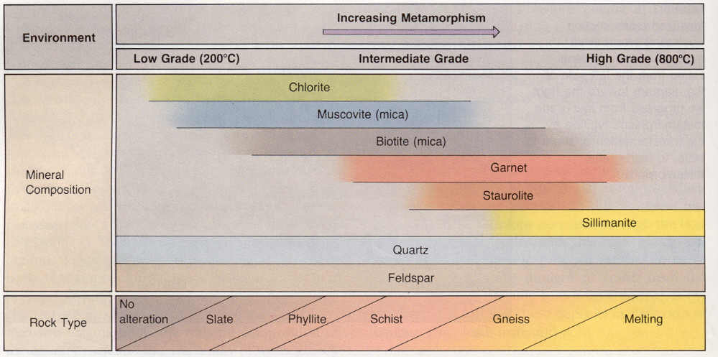
Grades of Regional Metamorphism

Slide 37
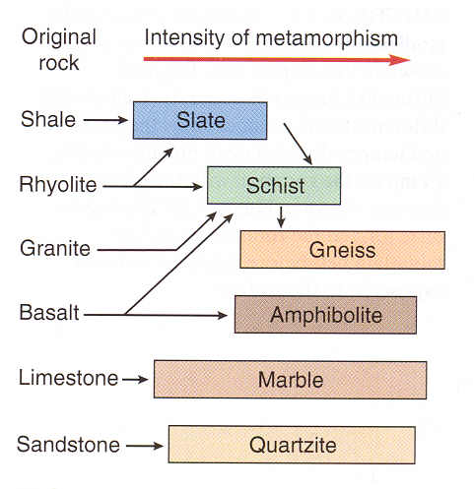
Metamorphic
Grades

Slide 38
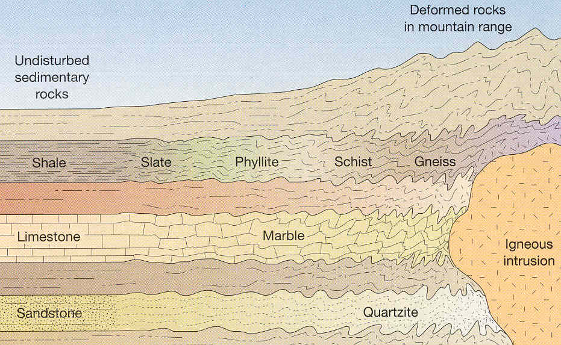
Regional Metamorphism

Slide 39
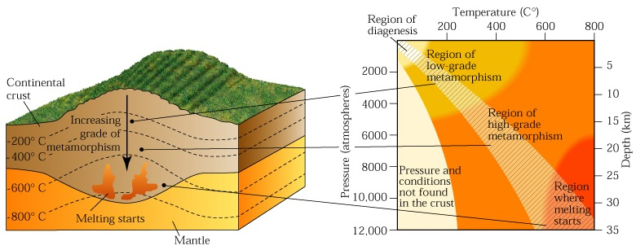
Regional Metamorphism

Slide 40
Metamorphic Grade

Slide 41
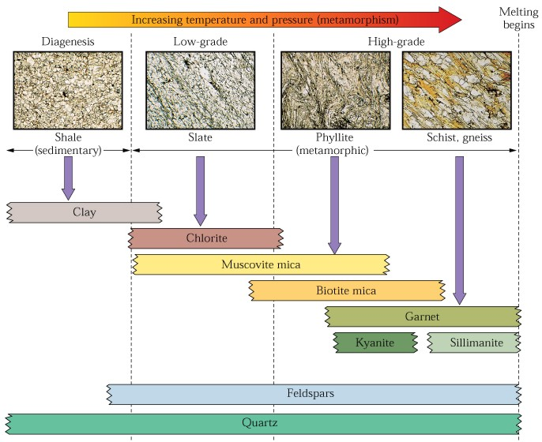
Metamorphic Grade

Slide 42
Low Grade Metamorphism
Example: Slate
  forms at low temperature and pressure
  microscopic crystals
  dull luster
  clay and mica minerals
  foliated

Slide 43
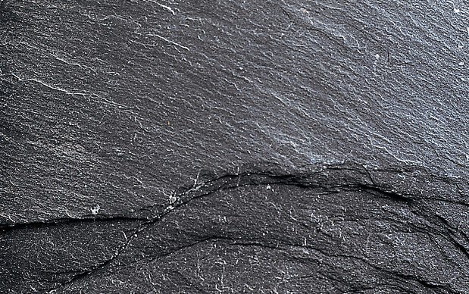
Low Grade - Slate

Slide 44
Metamorphic Grade

Slide 45
Intermediate Grade Metamorphism
Example: Phyllite
  intermediate temperature and pressure
  small crystals
  shiny luster
  mostly mica minerals
  foliated

Slide 46
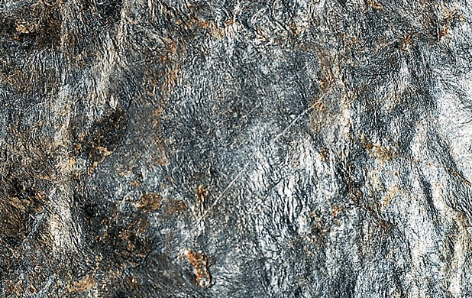
Intermediate Grade –
Phyllite

Slide 47
Metamorphic Grade

Slide 48
High Grade Metamorphism
Example: Schist
  high temperature and pressure
  large crystals
  mica-rich
  foliated

Slide 49
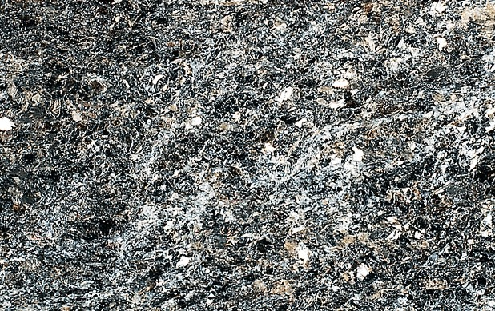
High Grade - Schist

Slide 50
Metamorphic Grade

Slide 51
High Grade Metamorphism
Example: Gneiss
  high temperature and pressure
  large crystals
  mica-poor
  foliated

Slide 52
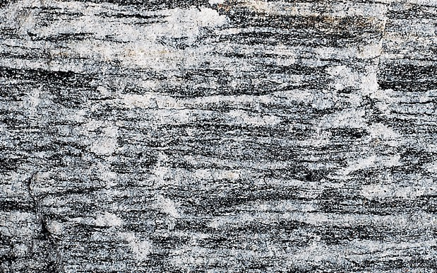
High Grade - Gneiss

Slide 53
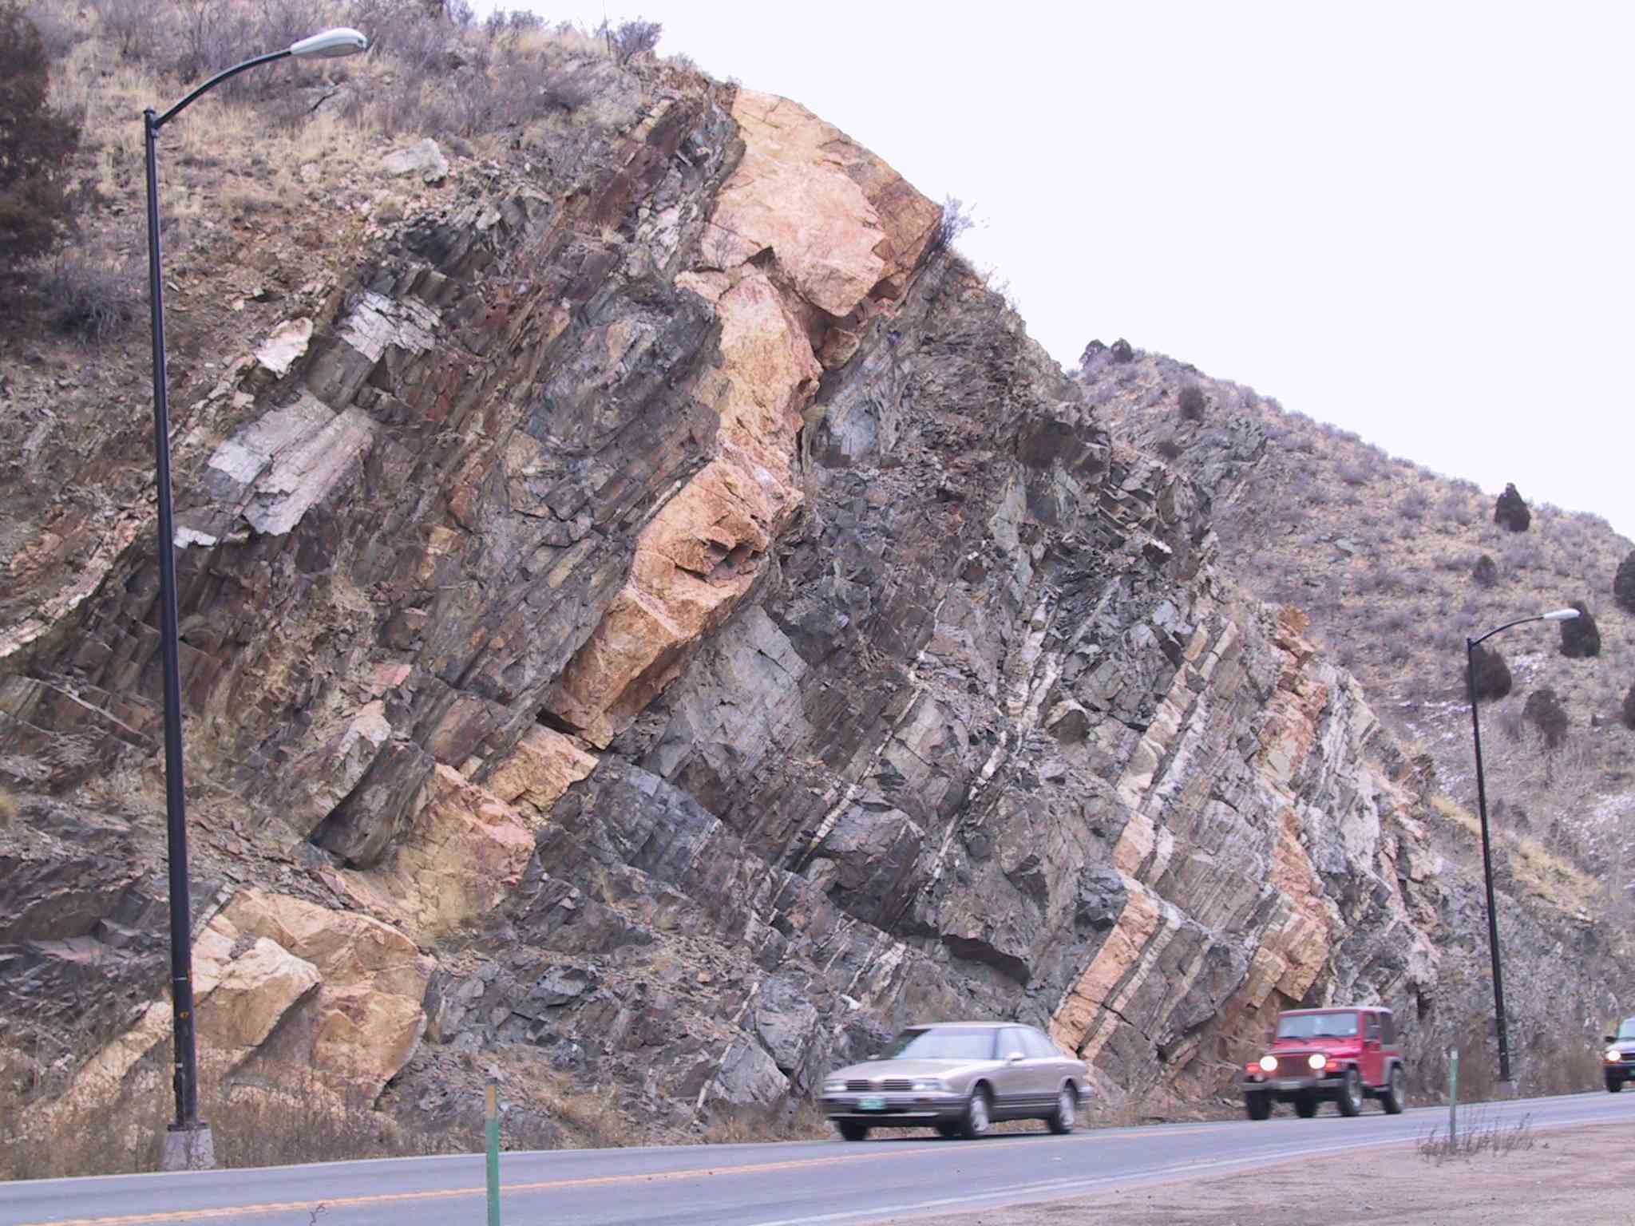

Slide 54
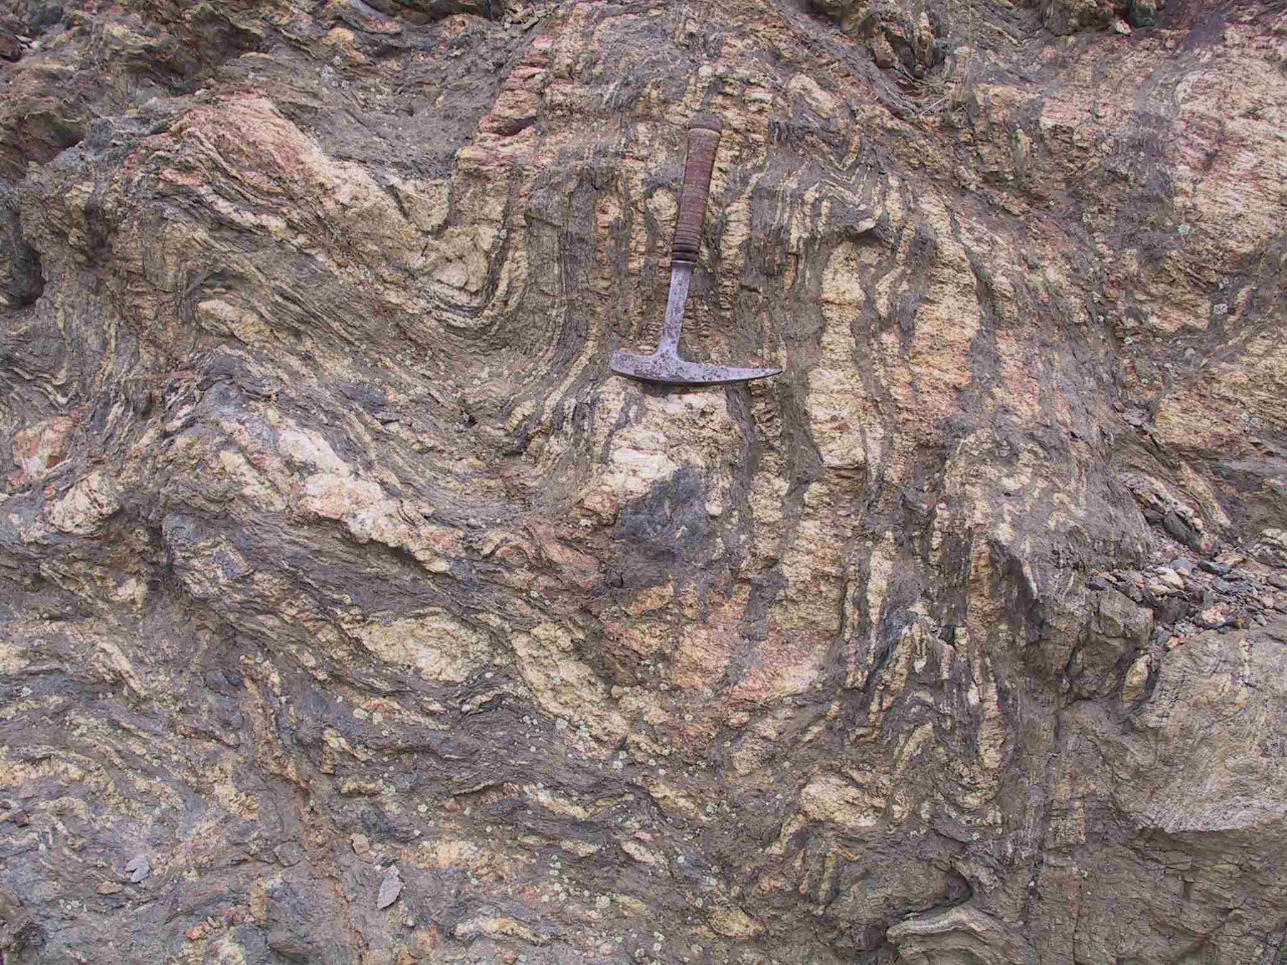

Slide 55
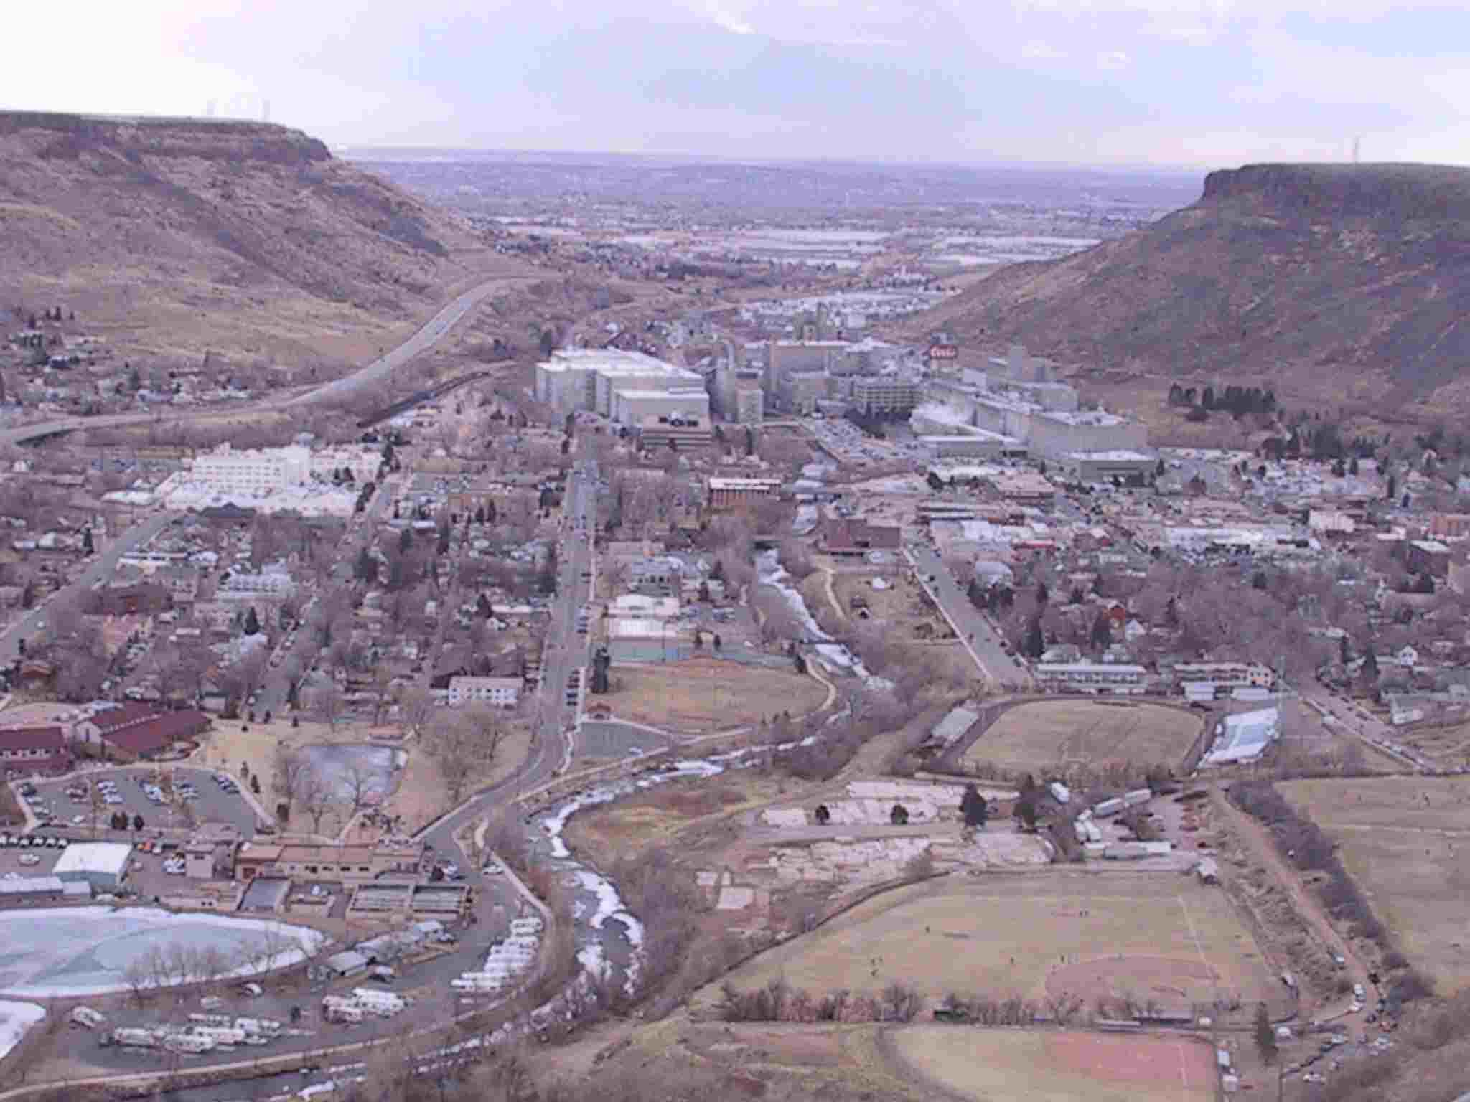

Slide 56
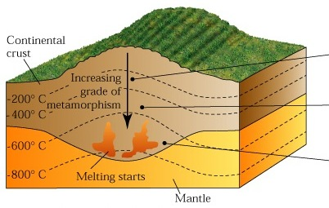
Regional Revisited
Slate
Phyllite
Schist,
Gneiss

Slide 57
Non-foliated Metamorphic Rocks
  granular texture
  interlocking grains
  composed primarily of one mineral
  uniform grain size

Slide 58
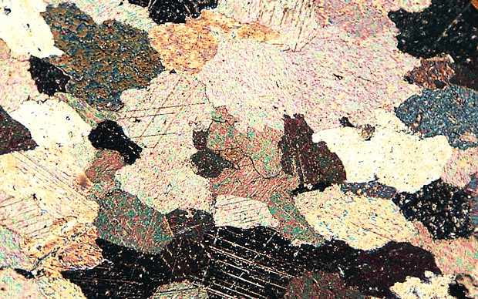
Nonfoliated - Marble
  metamorphosed limestone (CaCO₃)
  bedding and fossils obliterated

Slide 59
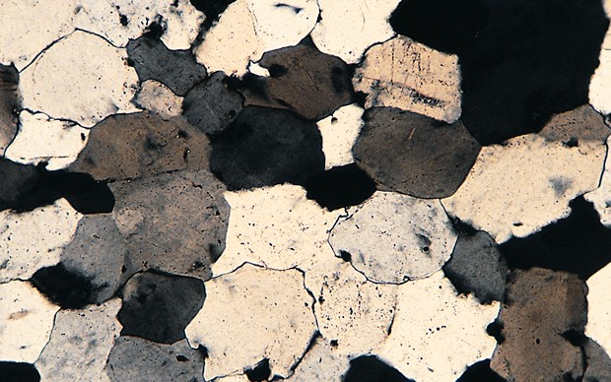
Nonfoliated - Quartzite
  metamorphosed quartz-rich sandstone
  Pore spaces filled with SiO₂

Slide 60
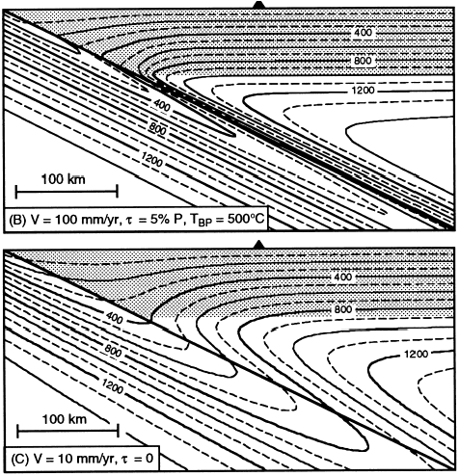
Evolution of slab and mantle wedge
The thermal environment of a subduction zone is set by the temperature structure of the oceanic lithosphere entering at the trench, by the induced convection in the overlying mantle wedge, and by heat transport and generation mechanisms within the system.
Typical models generate isotherms that are dragged far down the slab and predict moderately low temperature to great depth along the slab-wedge interface.
60

Slide 61
Evolution of slab and mantle wedge
What materials are available to contribute to magmatic activity at subduction zones?
  The downgoing slab is made of sediments, altered oceanic crust, and depleted lithospheric mantle peridotite.
  The mantle wedge between the slab and the overriding plate is made of peridotite whose composition is modified first by melt extraction in the back-arc basin, then by addition of mobile components from the slab.
  The overriding plate is made of old oceanic or continental crust and earlier products of the ongoing subduction zone processes.
We can understand the possible environments for melt generation by mapping the phase relationships of these materials onto thermal models of slab-wedge thermal convection
  If we know what is there, and in the laboratory we measure where these materials melt or dehydrate, perhaps we can develop a sensible model for the unseen processes the explains the observed products.
61

Slide 62
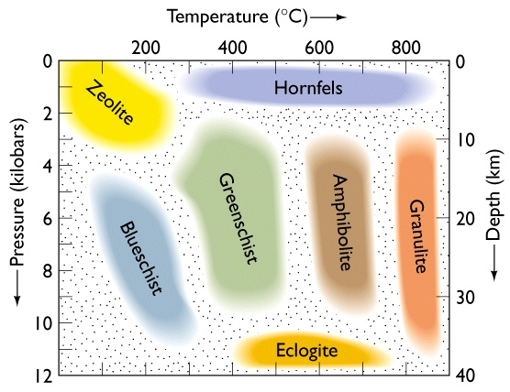
Evolution of slab and mantle wedge
62
First consider the metamorphism of hydrothermally altered basaltic rocks in the crust of the downgoing slab.
  This is our fist look at the metamorphic facies diagram.
It shows the generalized phase assemblages that occur on metamorphism of hydrated basaltic rocks at various Pressure and Temperature conditions.
The metamorphic conditions seen by rocks of any composition are named by these facies, but here it is convenient that the facies are named for hydrated basaltic rocks, since we are looking at subduction of altered oceanic crust.

Slide 63
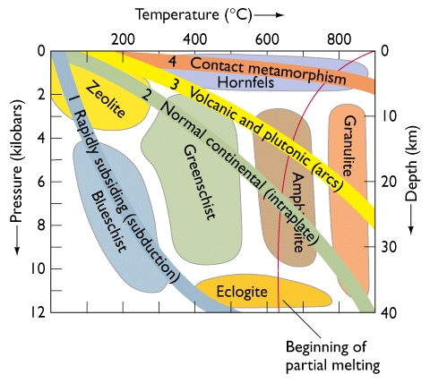
Evolution of slab and mantle wedge
63
Hydrothermal alteration of the crust creates hydrous minerals and stores water in the rock.
Mapping the P-T path of slabs on the metamorphic facies diagram shows that subducting basalt is expected to pass through blueschist into eclogite facies.
Eclogite is an anhydrous rock, showing that by ≤ 40 km we have almost total dehydration of the basalt. We follow this water to understand the melting process.
Note: the red curve is the water-saturated solidus, not relevant if water is dehydrated at lower T.

Slide 64
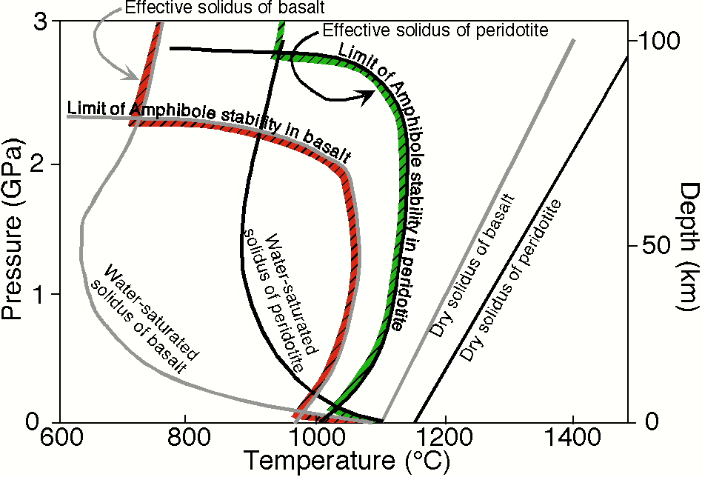
Evolution of slab and mantle wedge
Water is extremely effective at promoting the melting of rocks at high pressure, where the solubility of water in the melts becomes large (think freezing point depression).
This diagram shows the solidus curves for basalt and peridotite when dry (lines at high temperature) and with excess water (concave upwards curves at lower T).
It also shows the limit of amphibole stability, which is expected to be the primary mineral able to store water and prevent it from enhancing melting.
If the bulk water content is smaller than the amount that can be tied up by amphibole formation (~2%), the effective solidus is the envelope formed by the amphibole stability limit and the water-saturated solidus (hatched).
AmP
AmB
AP
WP
Note reversed sign on Pressure axis! (Petrologists plot pressure increasing upwards, geophysicists plot depth increasing downwards)
64

Slide 65
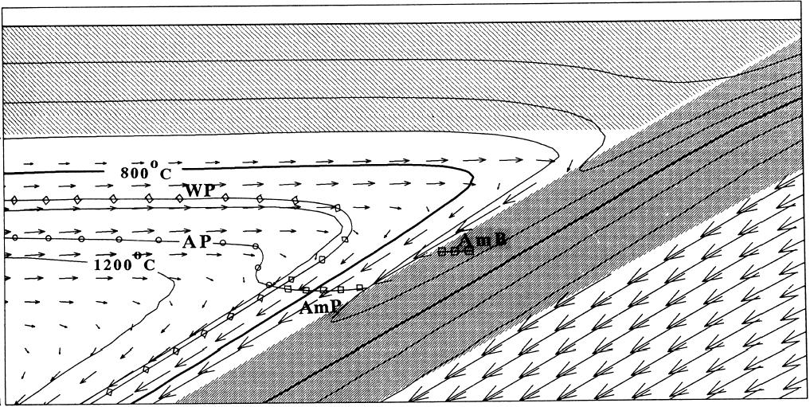
Evolution of slab and mantle wedge
The next step is to take these phase boundaries and draw them on the P-T field generated by a thermal convection model of a subduction zone, to show the likely regions of dehydration and melt generation.
In this model, the slab dehydrates (at AmB), but never melts.
Peridotite melting is restricted to this area here, at higher P and T than the intersection of amphibole stability and the wet solidus of peridotite.
65

Slide 66
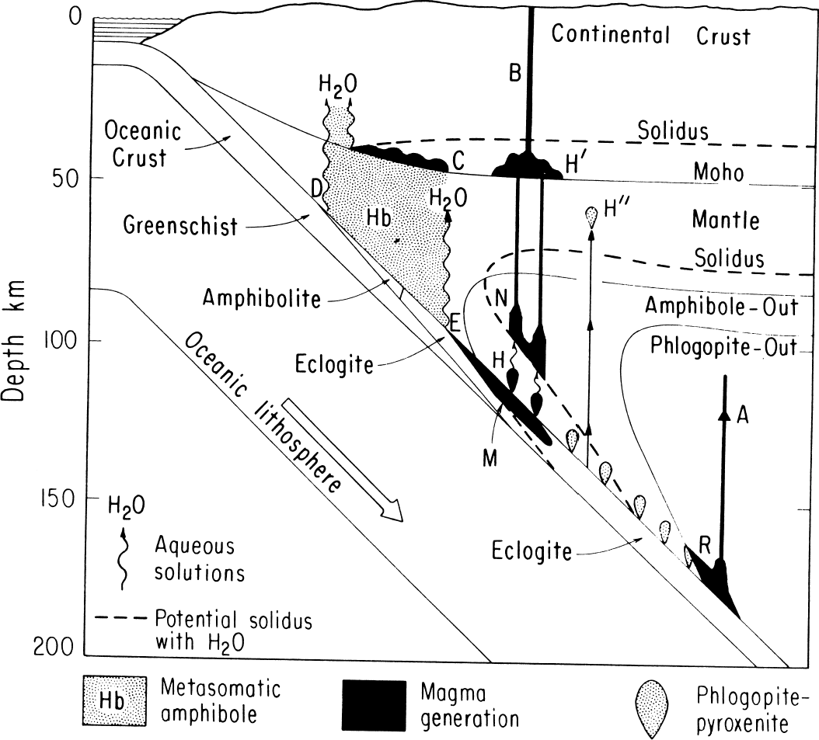
Evolution of slab and mantle wedge
66
A more general, complete and intuitive qualitative version is shown in this diagram by Prof. Wyllie
Things to note in this mess:
The key observation that the volcanic front sits 100 km above the Benioff zone could be explained by the shape of the Amphibole stability curve.
Shows possibility of slab melting if any water is retained to >100 km. Probable only in Archaean or for very young slabs.
Mantle melts likely to pond and evolve at base of low-density crust.
Sorry about the reversed sense of subduction…people draw it both ways.

Slide 67
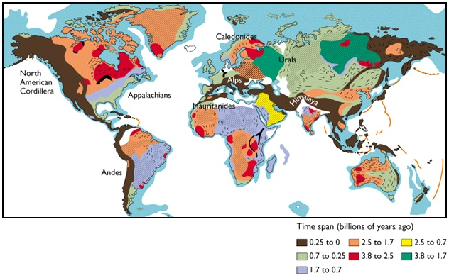
Lecture 7: Continents and Orogeny
There is a general large-scale structure of continents:
  Old stable cores surrounded by younger deformed belts
67

Slide 68
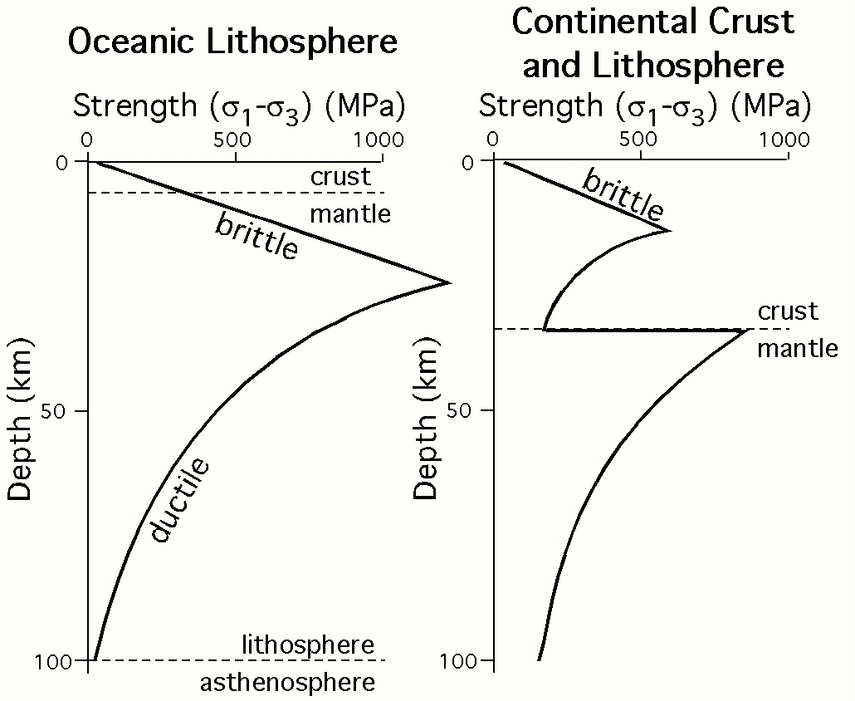
Continuum Mechanics: Overall Strength envelopes
If we map the temperature-dependent plastic strength and the pressure-dependent brittle strength of rocks onto a particular geotherm (i.e. temperature-depth curve), we have a prediction of the strength of the crust and lithosphere as a function of depth.
For the oceanic case (6 km of basaltic crust on top of olivine-rich mantle) and the continental case (30 km of quartz-rich crust on top of olivine-rich mantle), it looks like this:
68

Slide 69
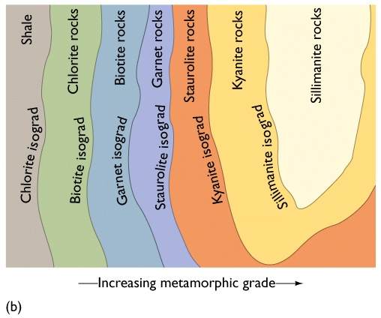
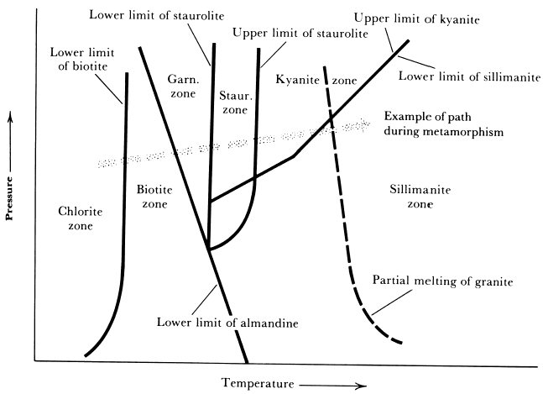
Regional Metamorphism: Facies and Zones
69
Metamorphic conditions were classified first by zones, which are defined by the appearance or disappearance of particular minerals in rocks of a given bulk composition. The surface (line in map view) where a mineral appears is called an isograd, and ideally expresses equal metamorphic grade. Thus, along a field gradient in pelitic rocks (Al-rich metasediments, from shaly protoliths), Barrow defined the following sequence of isograds, which corresponds to a particular P-T path in experiments on phase stability in pelitic compositions.

Slide 70
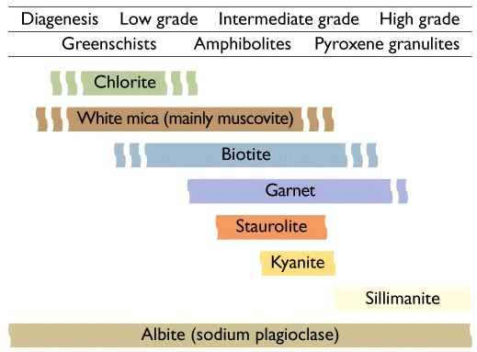

Regional Metamorphism: Facies and Zones
70
However, in different bulk compositions, the same mineral (though probably of different composition if you go to the trouble of a microprobe analysis) appears under different conditions, so zones are not very general:
  a mineral isograd recognizable in the field is not necessarily a surface of constant metamorphic grade.
Pelitic Rocks
Basaltic Rocks

Slide 71

Regional Metamorphism: Facies and Zones
71
This leads to the concept of a metamorphic facies, which is meant to express a given set of conditions independent of what rock is involved. Confusingly, however, the facies are generally named for the assemblage typical of basaltic rocks equilibrated at the relevant conditions.
Here is a more quantitative and complete facies diagram than the one from Press and Siever (Note that every metamorphic petrologist has a different version they prefer). It shows how the facies are bounded by a network of mineral reactions.

Slide 72

Mineral reactions and geothermobarometry
As an example, consider the reaction Muscovite + Quartz →
Sillimanite + Orthoclase + H₂O
In the absence of Na, the only variable phase in the system in the vapor.
The diagram shows the reaction for a pure-H₂O system, in which the partial pressure of H₂O equals the total pressure.
It also shows the location of the reaction when the vapor is 50% CO₂. If the vapor were an ideal solution of CO₂ and H₂O, the partial pressure of H₂O would then be half the total pressure and the curve would move up by a factor of two. In fact, the vapor is not quite ideal, so this is only an approximation, as shown.
72

Slide 73

Mid-Ocean Ridges

Slide 74

Subduction Zones and Island Arcs

Slide 75

Metamorphic Facies

Slide 76

Contact vs Regional Metamorphism

Slide 77

Inverted Isotherms in a Subduction Zone

Slide 78


Foliation and Lineation

Slide 79


Metamorphic Mineral Reactions
kyanite with biotite

Slide 80


Progressive Metamorphism
…the beginning
Slate

Slide 81

Crenulation Cleavage
…. new foliation grows

Slide 82

Quartzite

Slide 83

Metaconglomerate

Slide 84

Garnet mica schist

Slide 85

Orthogneiss
Derived from a granite or other igneous rock

Slide 86

Layered Gneiss

Slide 87

Metamorphic Minerals the Aluminosilicates
kyanite with muscovite, biotite

Slide 88

Aluminosilicate Polymorphs

Slide 89

Andalusite - Low P

Slide 90


Andalusite

Slide 91


Andalusite
var. chiastolite

Slide 92


Andalusite Structure
Al₂SiO₅
Andalusite, ^{VI}Al^{V}AlO[SiO₄] has Al in 6 and 5-fold coordination giving the largest molar volume (V= 51.3 cm3/mole) of the three polymorphs; It is stable at the lowest pressures. The unit cell is orthorhombic.

Slide 93


Andalusite in Thin Section

Slide 94

Kyanite - High P

Slide 95


Kyanite
METAPHYSICAL PROPERTIES
Kyanite is said to be very usefull in enhancing one's creativity, broadening one's perspective, and in reaching a better understanding with others. Kyanite is also said to bring calm and tranquility, and to facilitate meditation.
Kyanite is said to help clear sinus congestion, and to help in the treatment of muscular disorders.

Slide 96

Kyanite with Biotite

Slide 97


Kyanite Structure
Al₂SiO₅
Kyanite, ^{VI}Al₂O[SiO₄] has all of the Al in 6-fold coordination giving the most dense structure (V = 44.09 cm3/mol). Kyanite is stable at high pressure. It is triclinic.

Slide 98


Sillimanite - Highest T

Slide 99


Sillimanite Structure
Al₂SiO₅
Sillimanite, ^{VI}Al[^{IV}AlSiO₄] has the greatest entropy (S(298K) = 96.11 J/mol-K) because it has a high symmetry (orthorhombic). The molar volume is V =49.9 cm3/mole. The unit cell is orthorhombic.

Slide 100


Sillimanite

Slide 101

Gibbs Phase Rule
Gibbs phase rule
f = c - p + 2
where:
* p = number of phases
* f = the variance or number of degrees of freedom in the system
* c = number of components

Slide 102

The Al₂SiO₅ Phase Diagram

Slide 103

Note Temperature gradient
Index Minerals in metamorphic rocks
Note Quartz and Feldspar are not index minerals: Why?

Slide 104


Greenschist Hand Sample
Greenschist Thin Section
Chl-Ep

Slide 105




Mica
Schist

Slide 106

Distinct Tectonic Environments
Fig. Story 9.7d

Slide 107

Zoned Garnets
Geochemical analyses can determine composition
Fig. 9.9

Slide 108

Metamorphic Grid

Slide 109


The Grid in Color
The rock - where do you belong?
The clue is in the minerals!!

Slide 110

Prograde Path

Slide 111

Isograd Map
mapping the prograde path in the field

Slide 112

The P-T-t Loop
clockwise paths - from thrust loading
counter clockwise paths - from magma loading

Slide 113

The Retgrograde Path

Slide 114


Subduction Zones
Cold Metamorphism
retrograde of mantle periodotite to serpentinite
2Mg₂SiO₄ + 3 H₂O =
Fo
Mg₃Si₂O₅(OH)₄ + Mg(OH)₂
Serpentine Brucite

Slide 115

Serpentine Polymorphs
chrysotile
antigorite, lizardite
retrograde involves hydration!

Slide 116

Asbestos Mine, Quebec

Slide 117

Serpentine - a 1:1 Phyllosilicate

Slide 118


Phyllosilicates Review
1 : 1 Phyllosilicates: (Si₂O₅)
Dioctahedral: Kaolinite Al₂Si₂O₅(OH)₄
Trioctahedral: Serpentine (Mg,Fe)₃Si₂O₅(OH)₄
2 : 1 Phyllosilicates: (Si₄O₁₀)
Dioctahedral: Pyrophyllite Al₂Si₄O₁₀(OH)₂
Trioctahedral: Talc (Mg,Fe)₃Si₄O₁₀(OH)₂
Micas:
Dioctahedral: Muscovite KAl₂(Si₃Al)O₁₀ (OH)₂
Trioctahedral: Biotite K(Mg,Fe)₃(Si₃Al1)O₁₀(OH)₂

Slide 119

Antigorite Atomic Structure
The mismatch - the tetrahedral layers are shorter than the octahedral layers
Inversions make for corrections of the “bends”

Slide 120



The Origin of Chrysotile Fibers
they’re hollow!
mismatched layers curl!

Slide 121


Olivine to Serpentine
….just add water
“spirit of oceans past”

Slide 122


Epidote - Another Common Retrograde Mineral
Commonly replaces plagioclase and hornblende

Slide 123



Epidote
Ca₂(AlFe)Al₂O(SiO₄)(Si₂O₇)(OH)
Can also be prograde and even igneous!
Epidote from fault zone
Al octahedral chains (grey)
Single (blue) and double (not shown) tetrahedra
Brown is Fe, Al polyhedra; green is Ca

Slide 124


Prograde Path
Some reactions involve polymorph change
Aragonite = Calcite
aragonite

Slide 125

Aragonite
CaCO₃
Denser than calcite
2.95 vs 2.71
Orthorhombic
Two occurrences
1. High P metamorphism
(subduction zones)
2. Organic precipitate

Slide 126





Aragonite
marine reef
cave stalagtite
(France)

Slide 127


Jadeite - High Pressure Metamphism
… prograde reaction involving a phase change
The wonder of Jade
P-T conditions of jadeite stability - only in subduction zones

Slide 128


Jadeite
A sodic pyroxene: NaAlSi₂O₆
Carved Mayan Jade

Slide 129

Blue = Fast (cold)
Red = Slow (hot)

Slide 130


Slide 131



Slide 132


Slide 133


Slide 134


Slide 135


Slide 136


Slide 137





Slide 138




Slide 139






W. Schreyer, 1999 Geol. Soc. Lond. Sp. Publ. 150

Slide 140






Carbon system
SiO₂
SiO₂ + Al₂O₃ = Al₂SiO₅

Slide 141








SiO₂ + Al₂O₃ = Al₂SiO₅

Slide 142





SiO₂ + Al₂O₃ = Al₂SiO₅
Al₂SiO₅ + H₂O

Slide 143



SiO₂ + Al₂O₃ + H₂O

Slide 144

SiO₂ + Al₂O₃ + H₂O + MgO

Slide 145






SiO₂ + Al₂O₃ + H₂O + MgO

Slide 146

SiO₂ + Al₂O₃ + H₂O + MgO

