Slide 1
HOT SPOTS

Slide 2
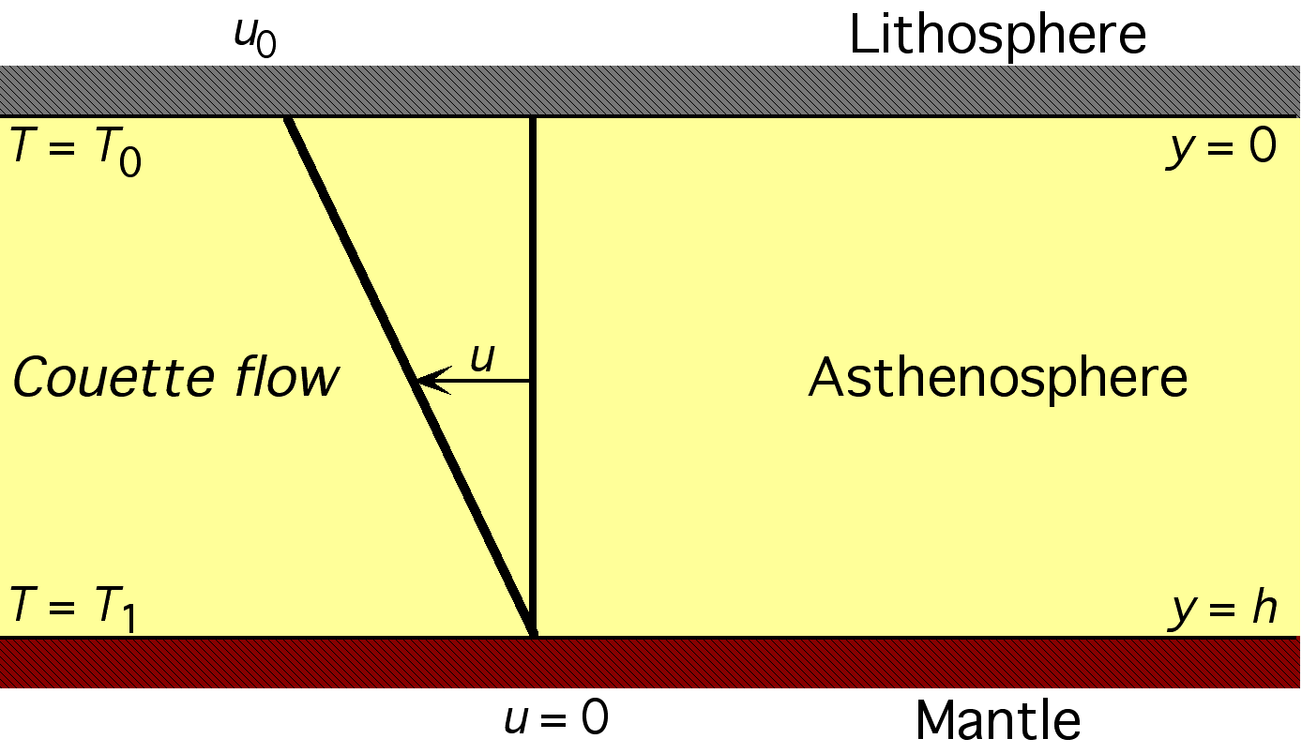

Slide 4
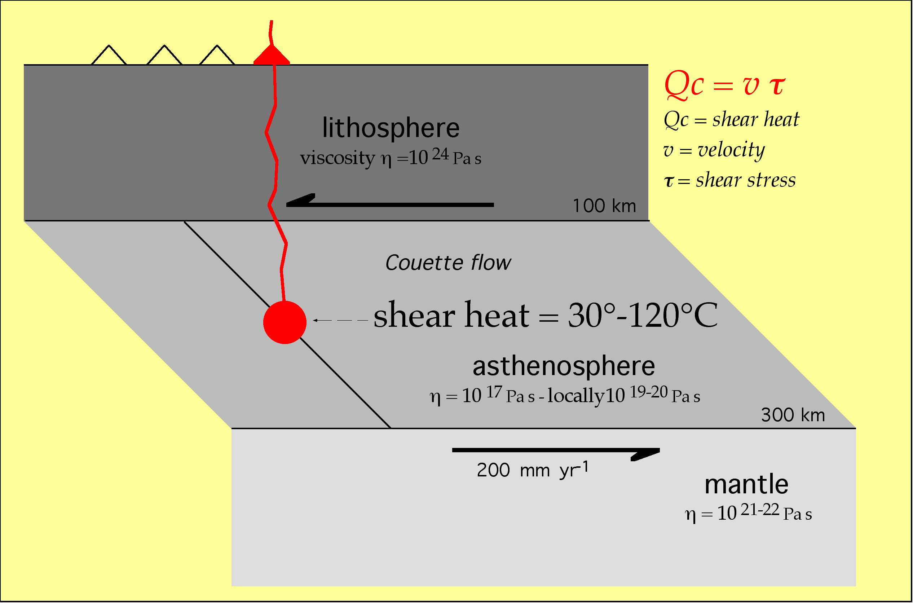

Slide 5
Local increase of the asthenospheric viscosity can generate extra T
(i.e. higher viscosity = larger amount of melting?)

Slide 6
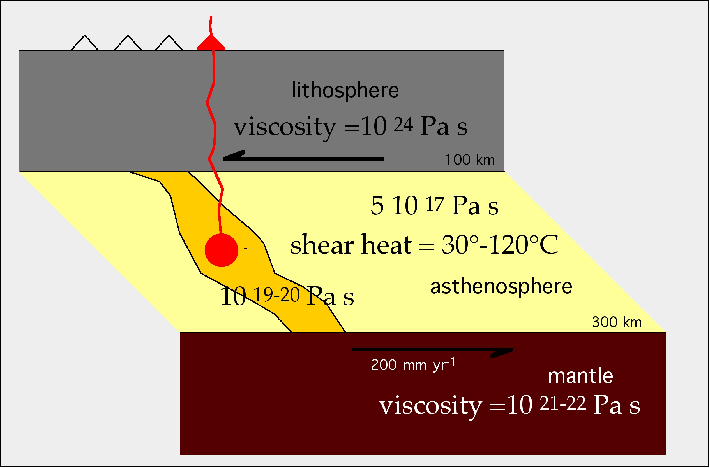
Local increase of the asthenospheric viscosity can generate extra T
(i.e. higher viscosity = larger amount of melting?)

Slide 8
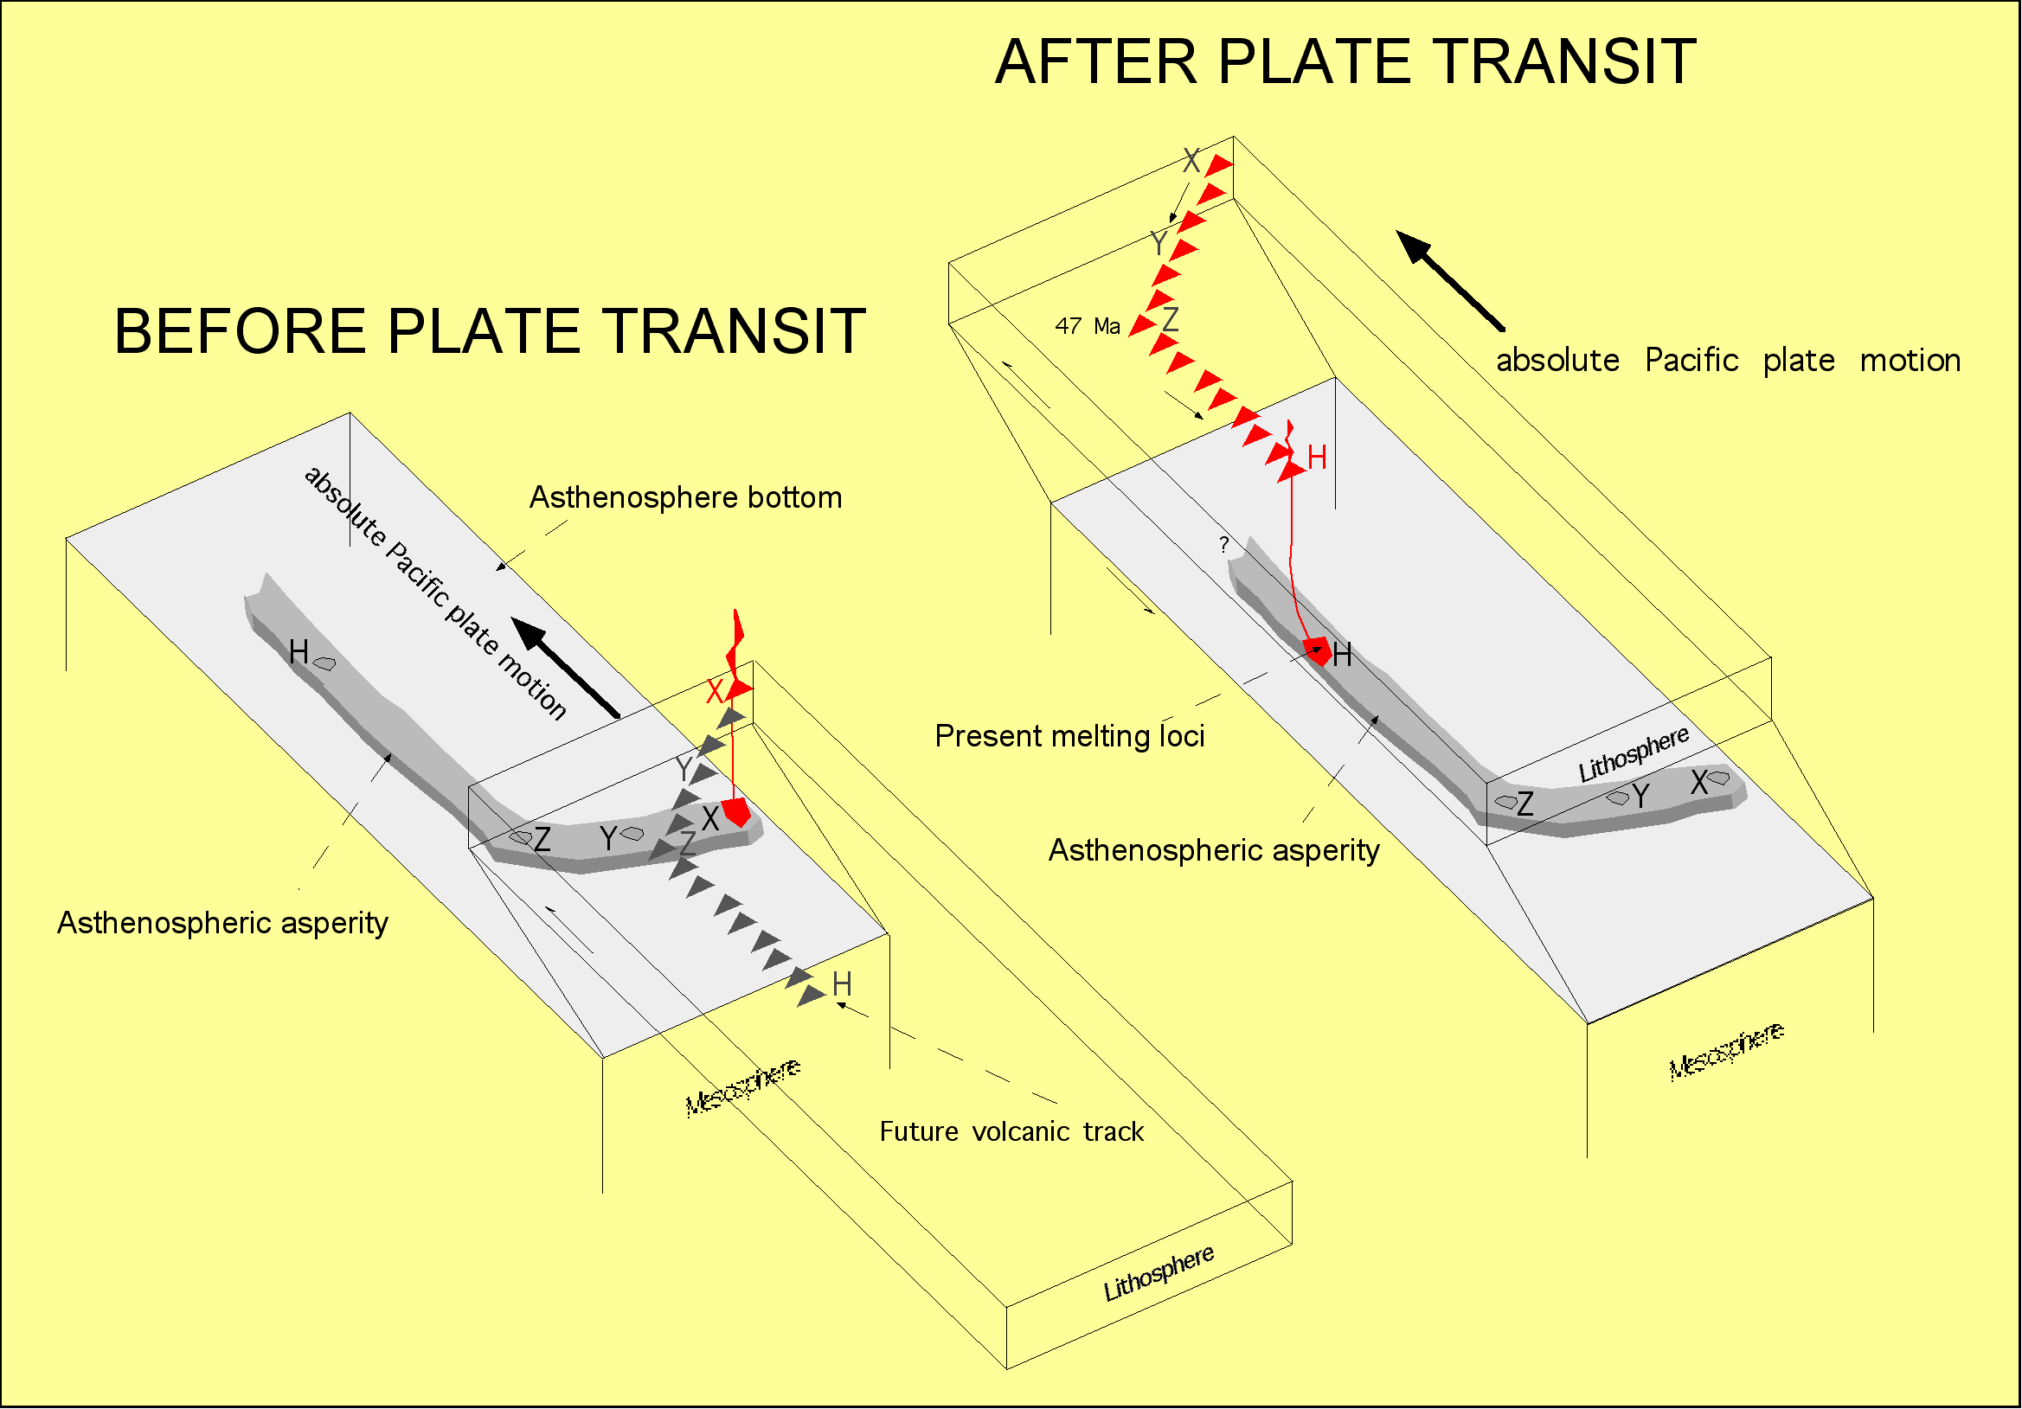

Slide 9
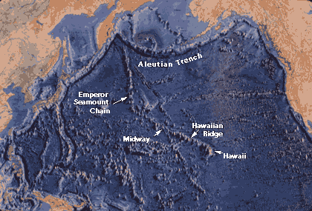
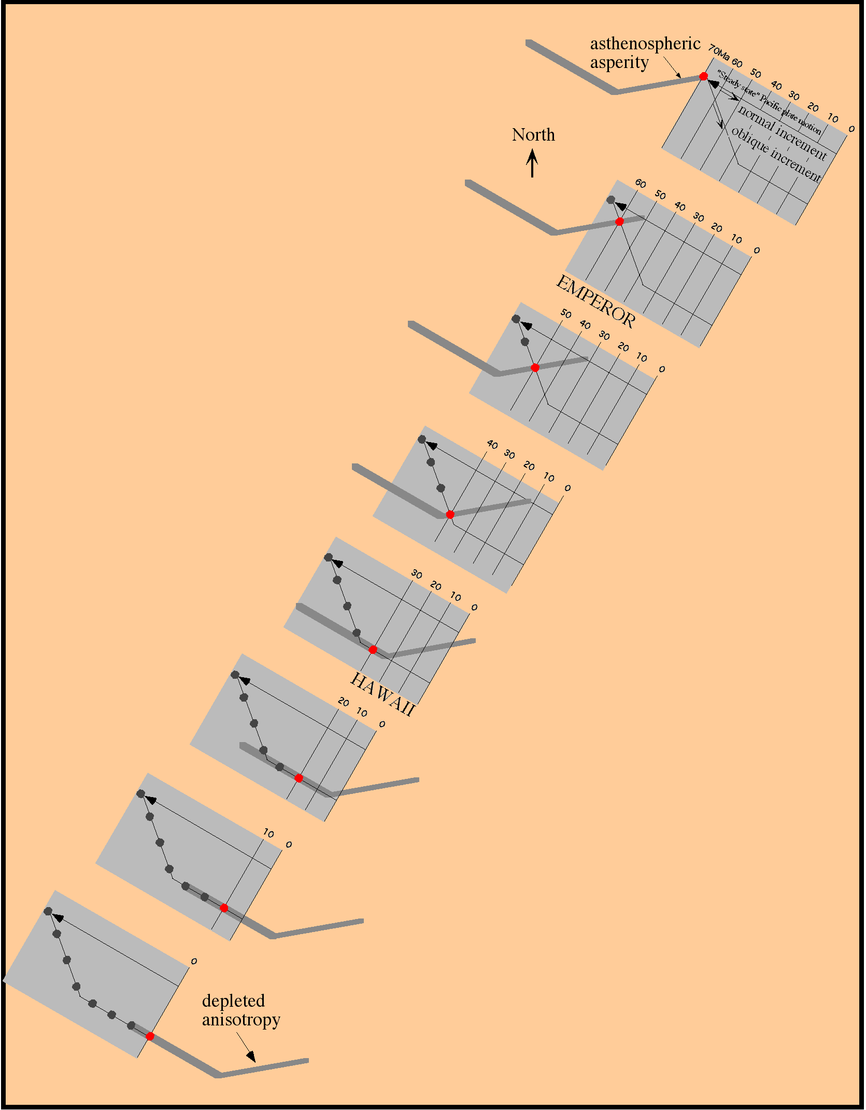
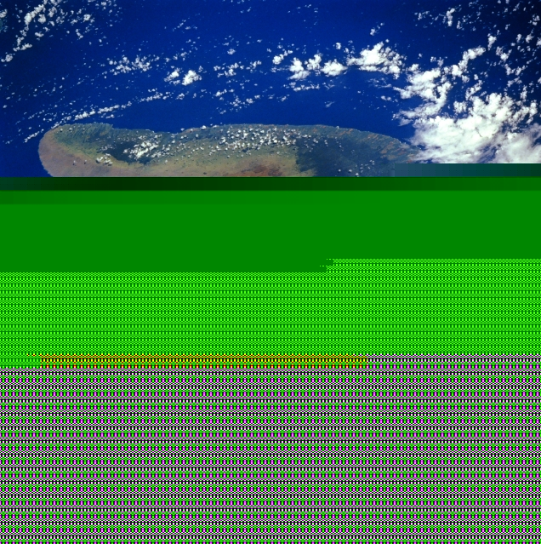

Slide 10
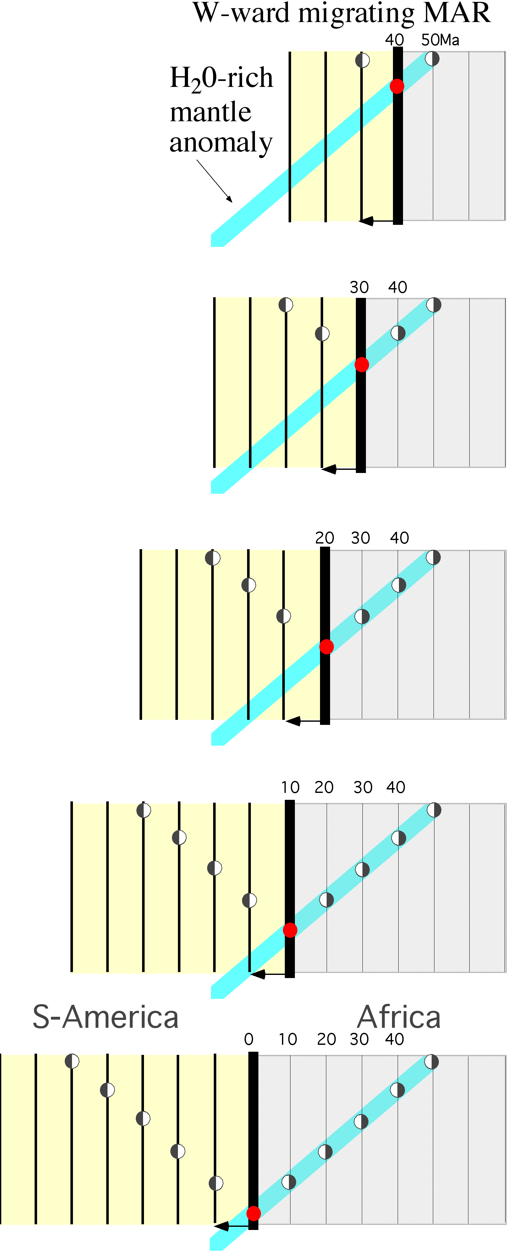
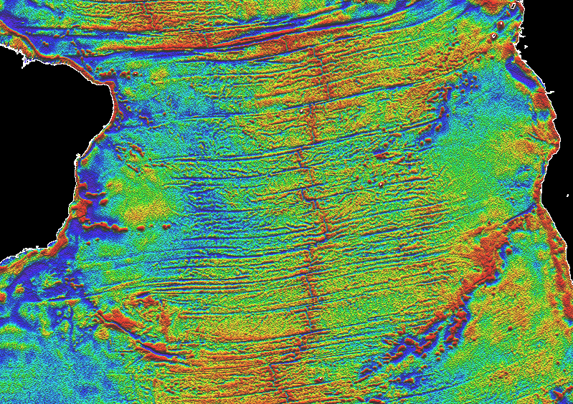


Slide 11
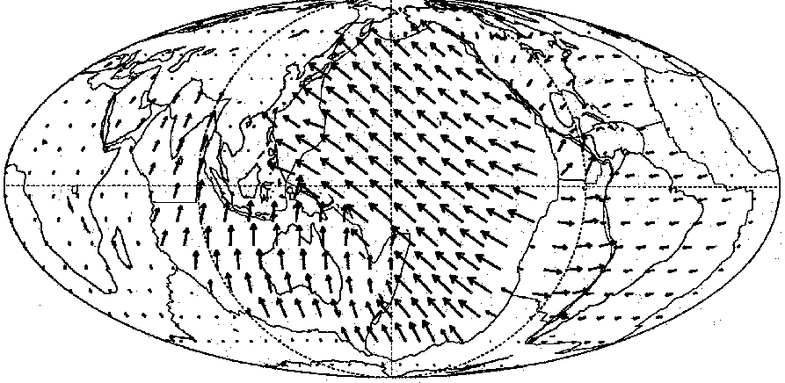
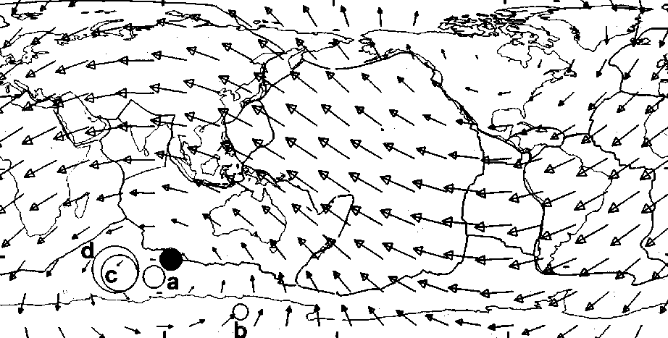





Plate motions based on the
Hotspot Reference Frame
(O’Connell, Gable & Hager, 1991)
(Ricard, Doglioni & Sabadini, JGR, 1991)
A
B
Resulting vector

Slide 12
“Westward” drift of the lithosphere
E-NE
lithosphere
low-velocity layer
mantle

Slide 13
“Westward” drift of the lithosphere
(or “eastward” mantle flow)
E-NE
lithosphere
mantle

Slide 14

“Westward” drift of the lithosphere
(or “eastward” mantle flow)
E-NE
lithosphere
crystals alignement
mantle

Slide 15
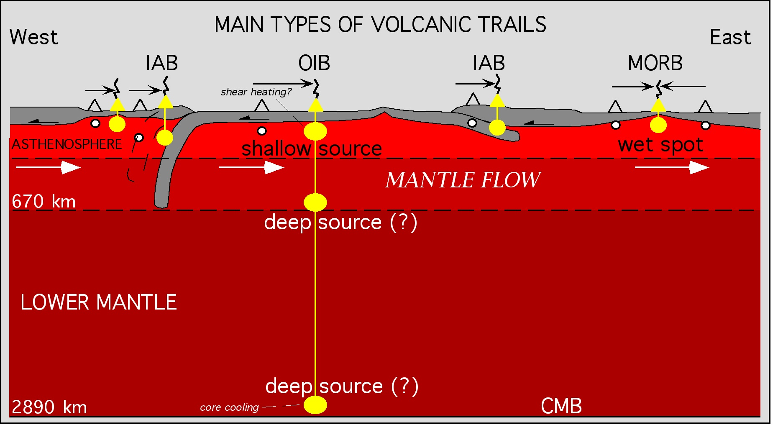

Slide 16
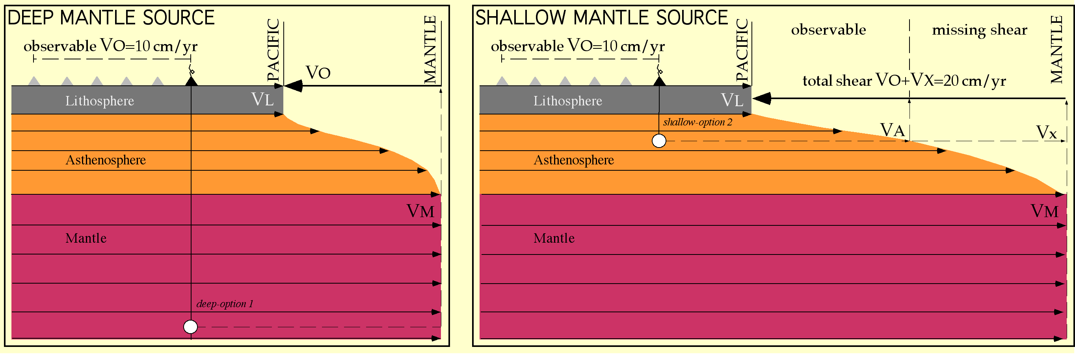
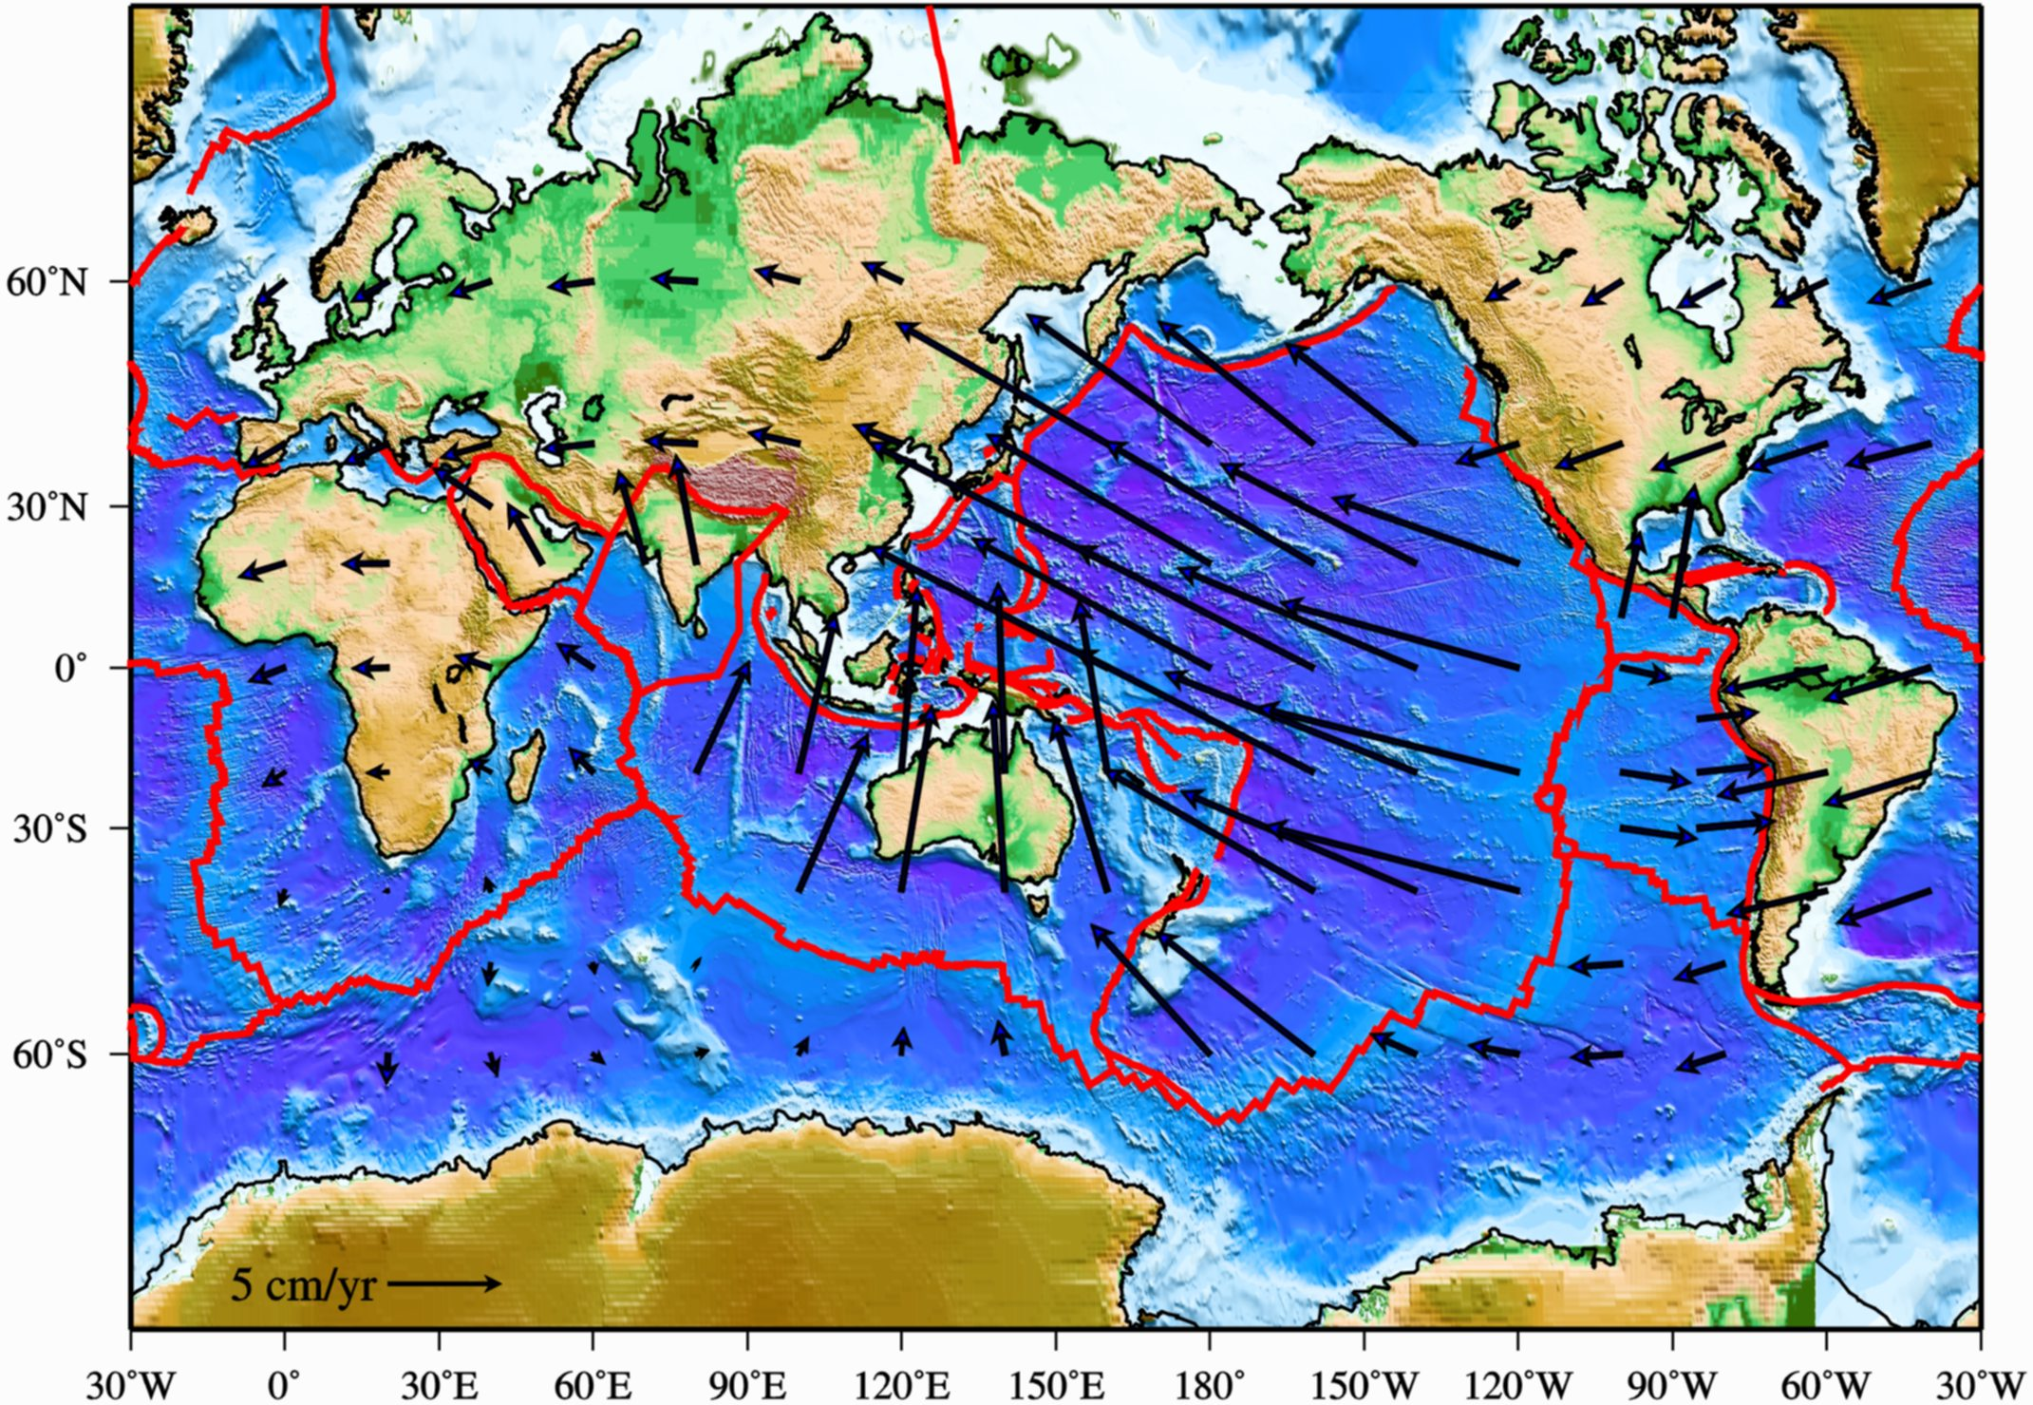
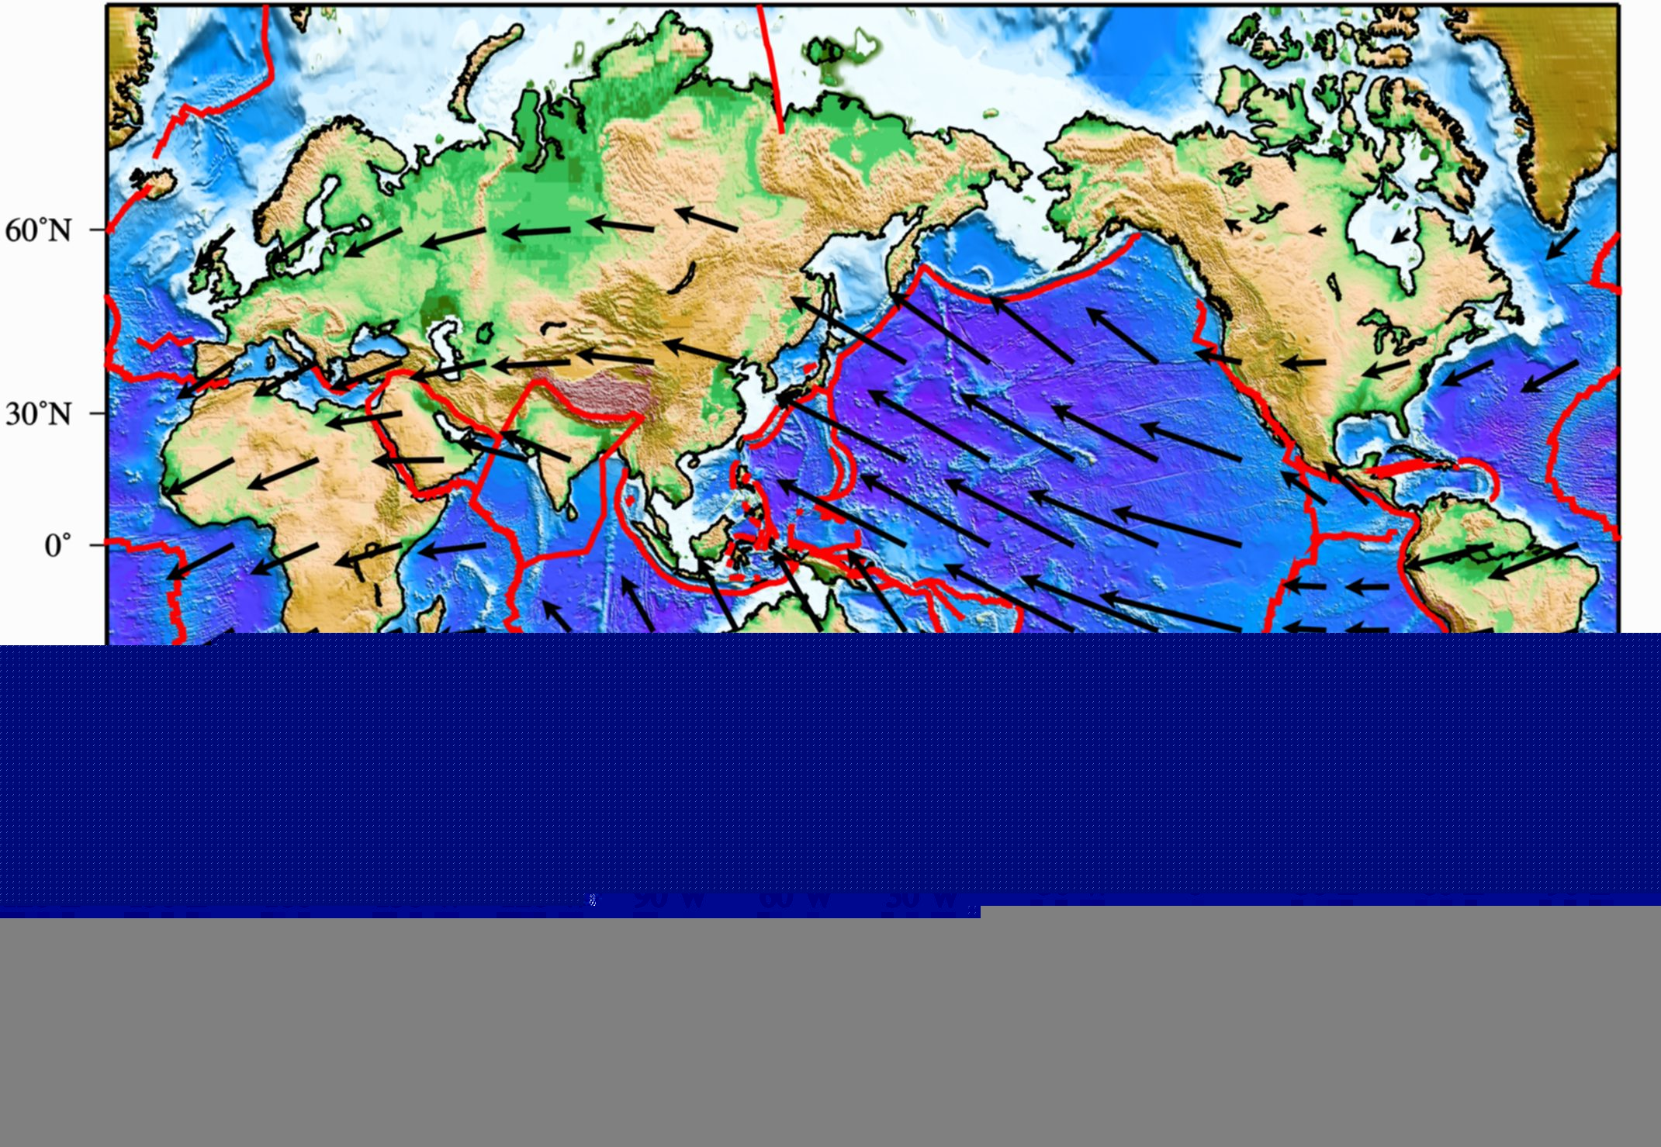
DEEP PLUMES
SHALLOW PLUMES

Slide 17
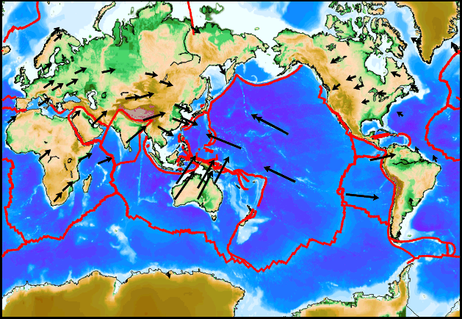
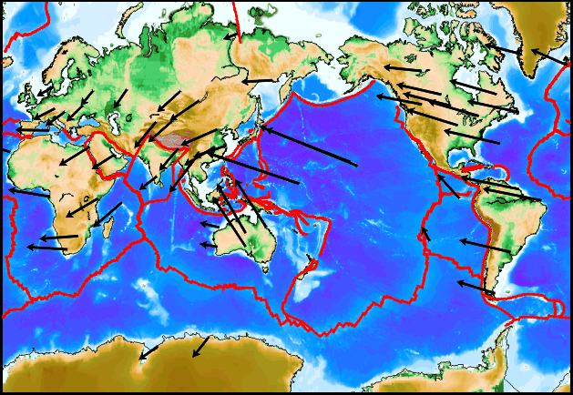
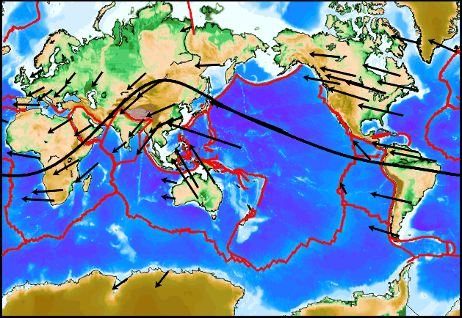
Tectonic equator
Plate motions + W-ward drift based in the HSRF
Plate motions ITRF-NNR
The sub-lithospheric mantle should move “E-ward”

Slide 18
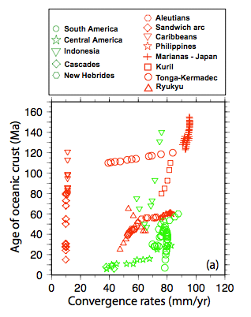

Slide 19
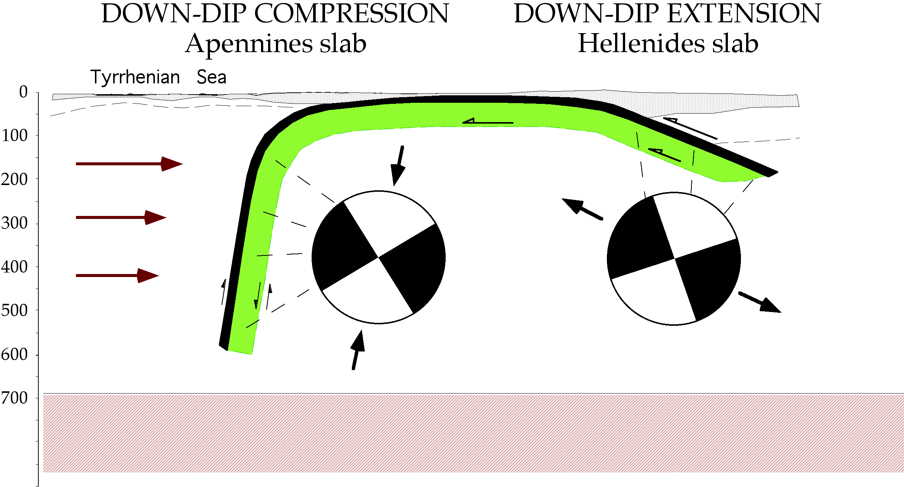

Slide 20
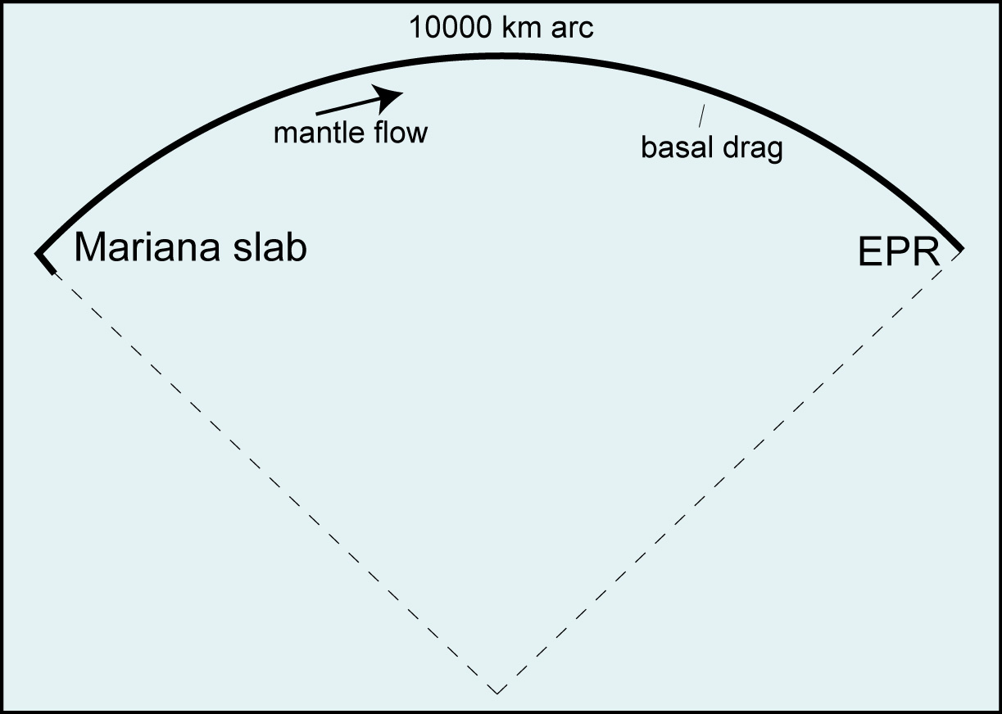
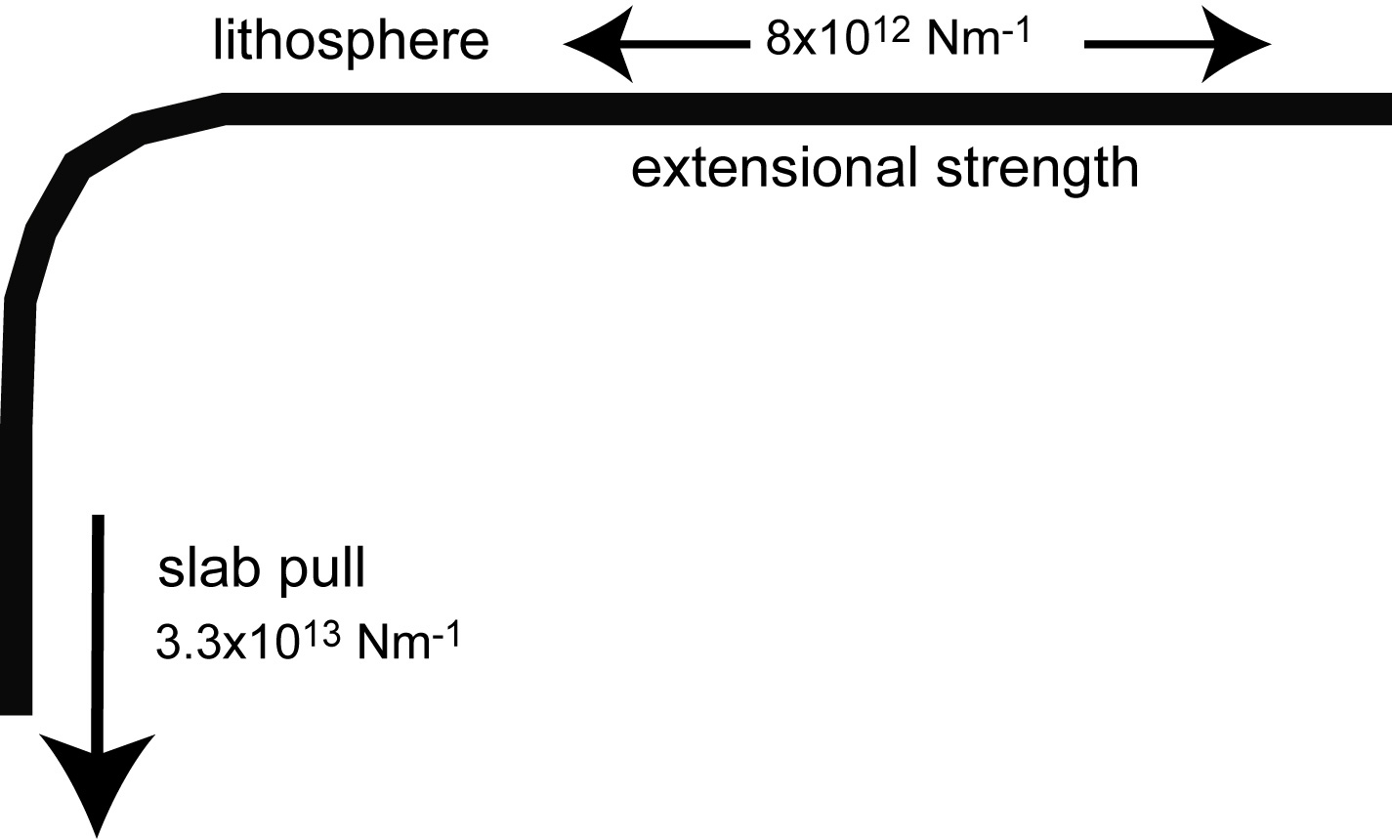

Slide 21
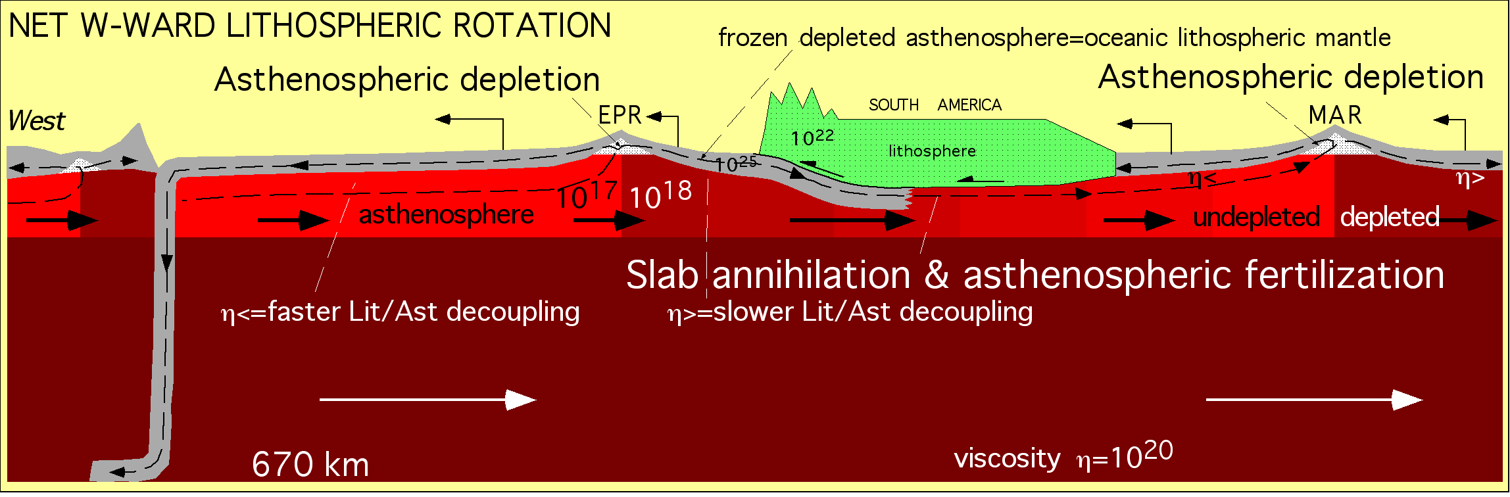

Slide 22
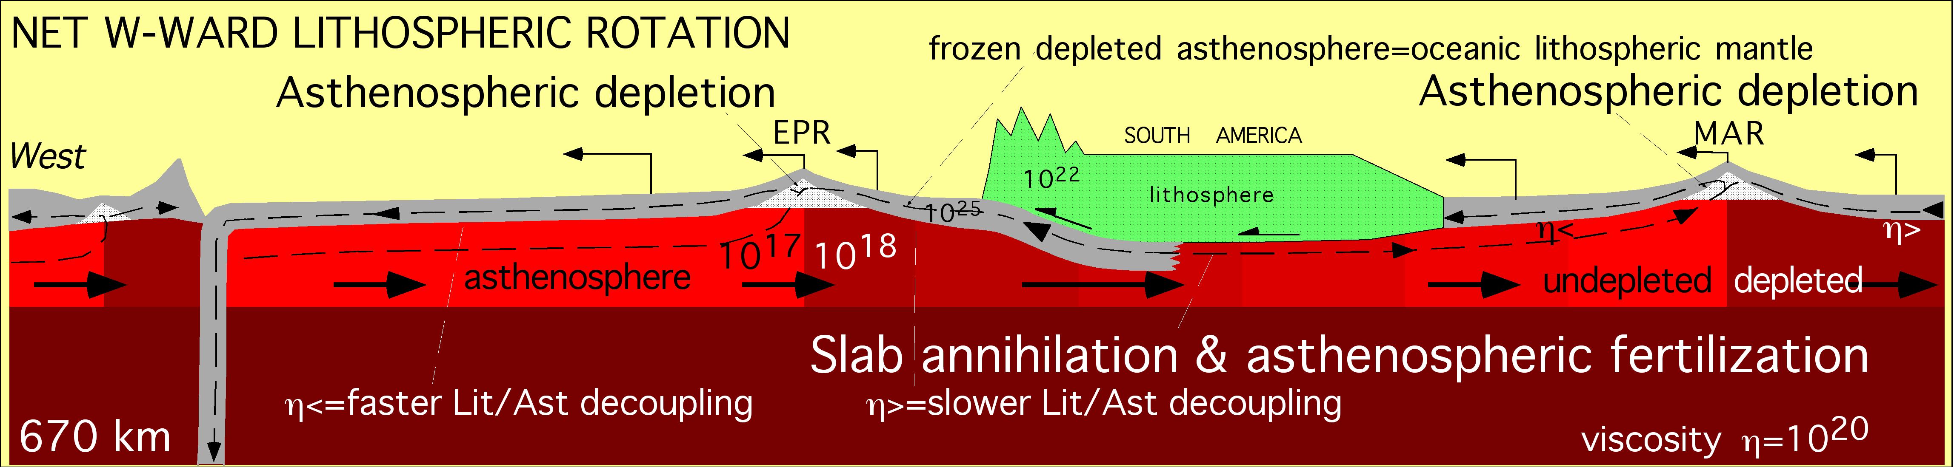
OUT
OUT
IN

Slide 23
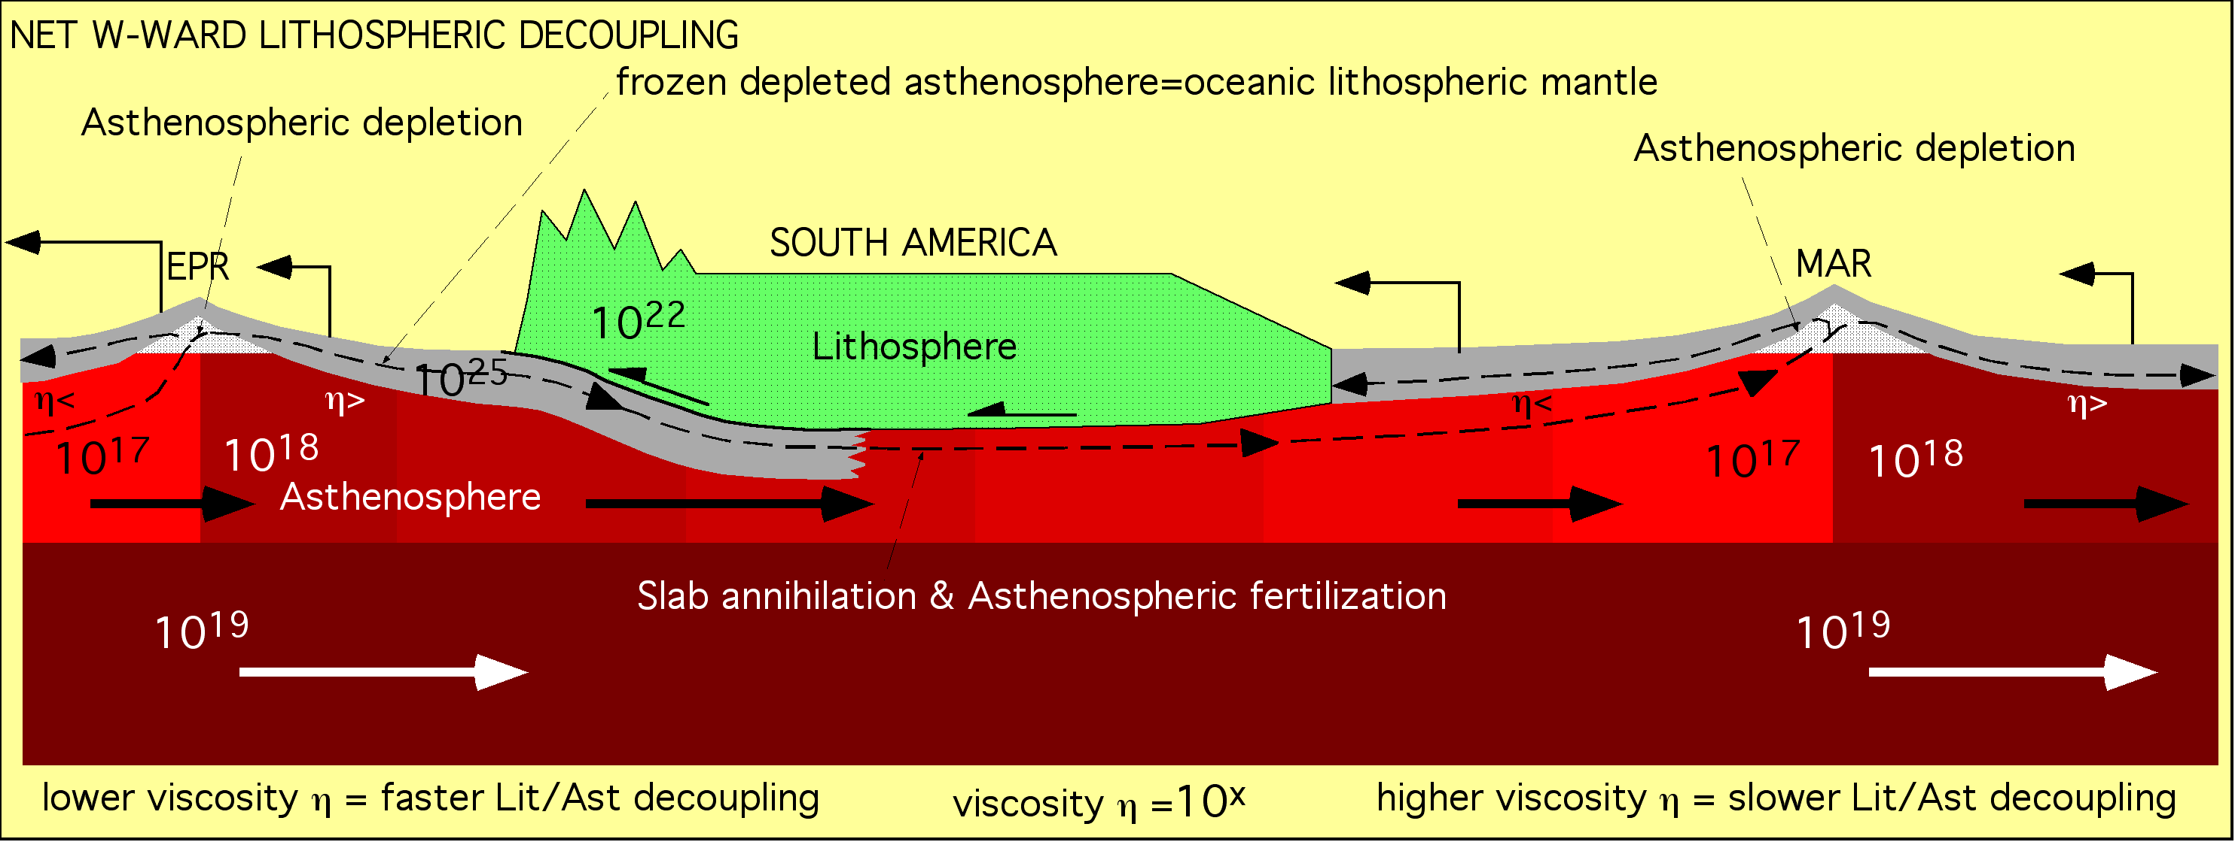

Slide 24
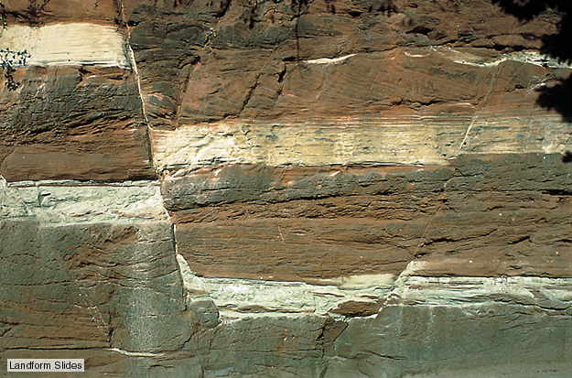

Slide 25
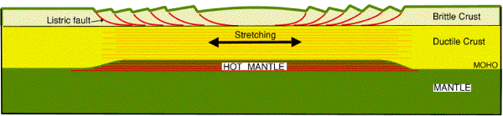
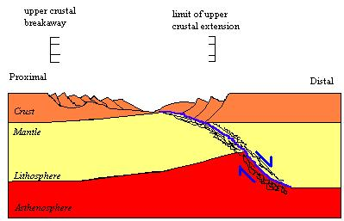

Slide 26
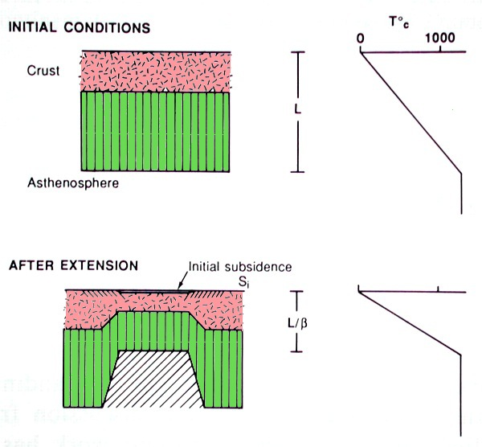


Slide 27
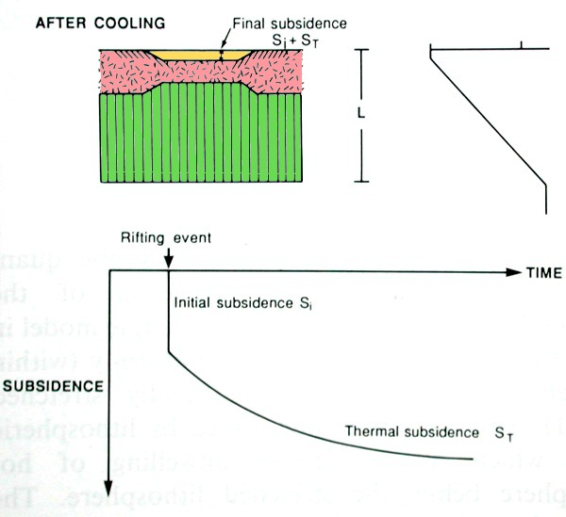



Slide 28
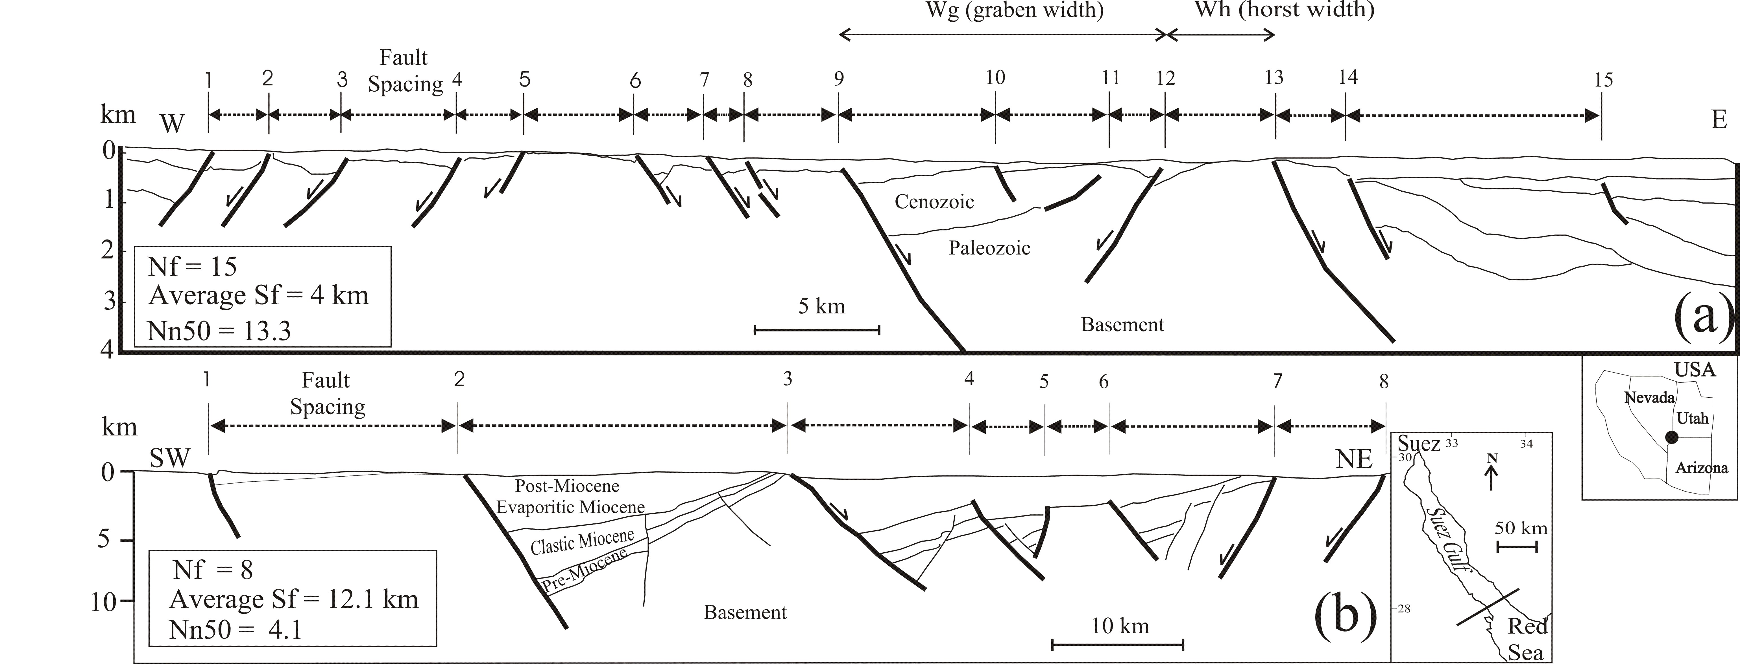
Morellato et al. 2003

Slide 29
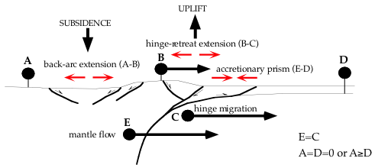
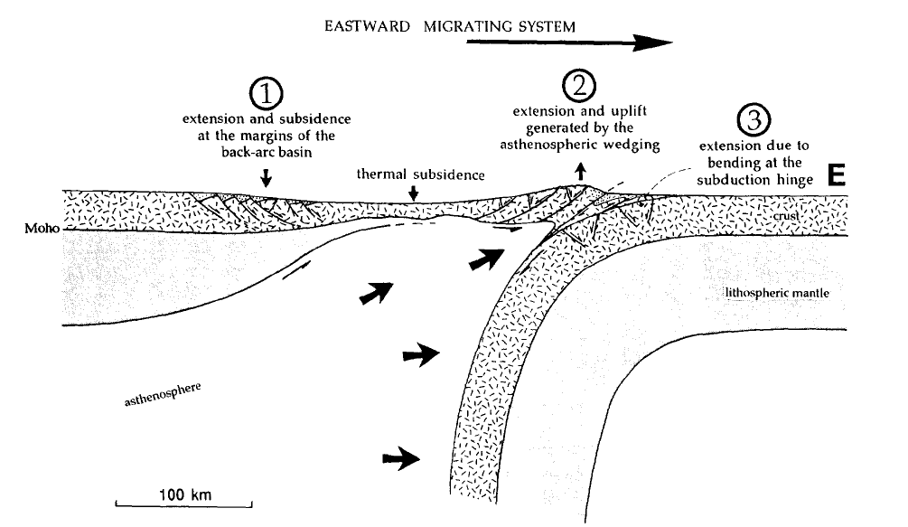

Slide 30
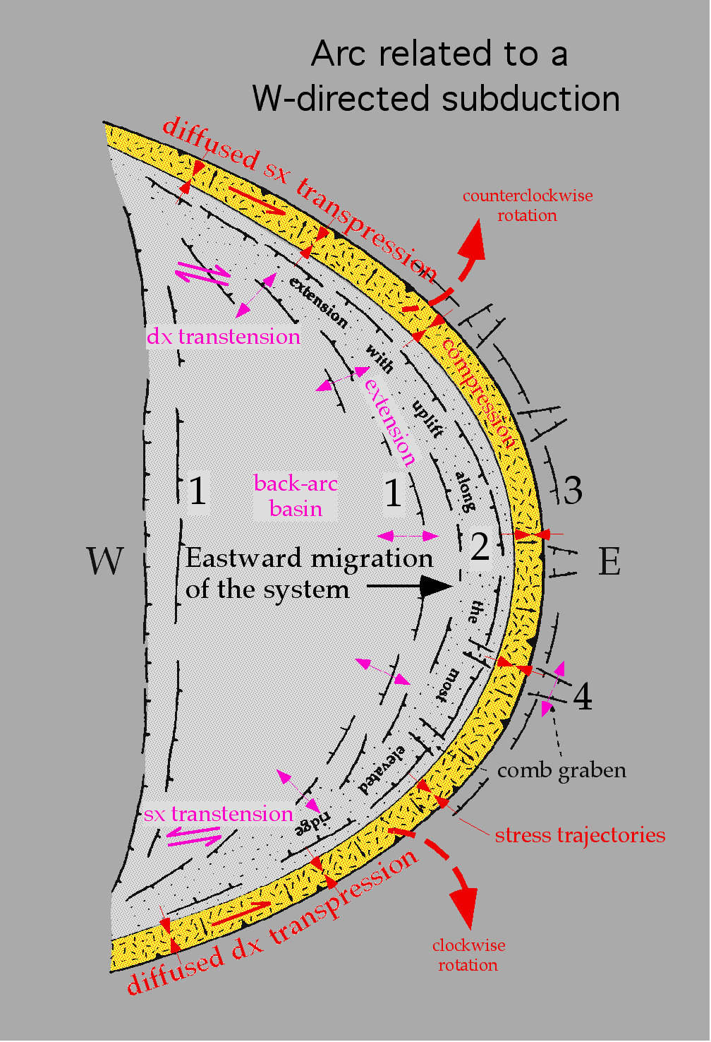
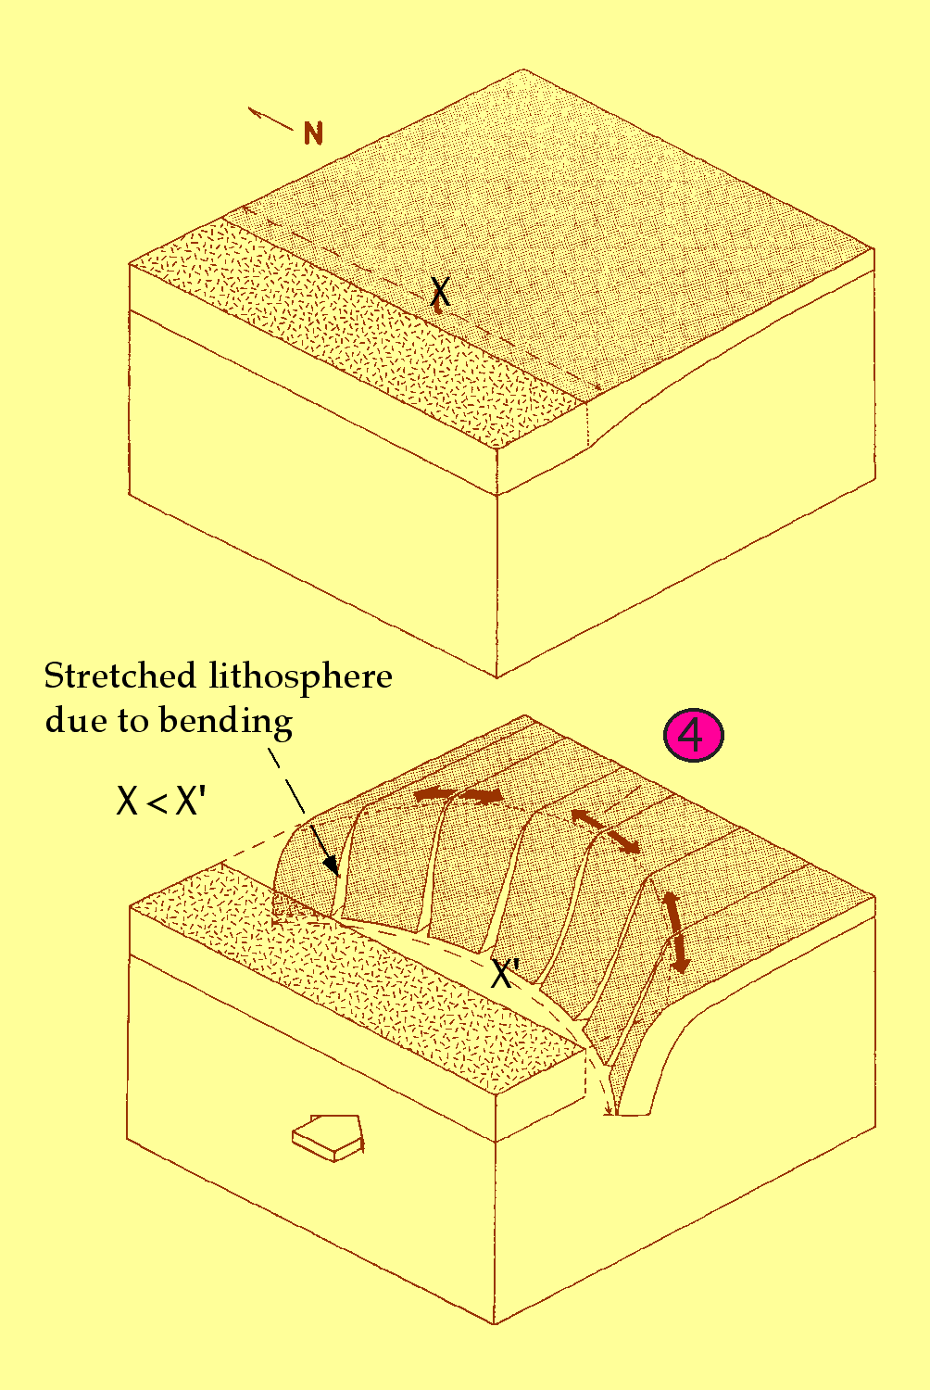

Slide 31
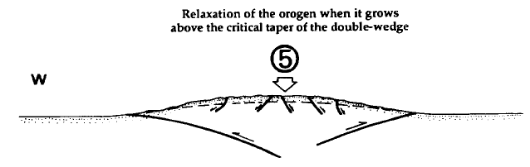

Slide 32
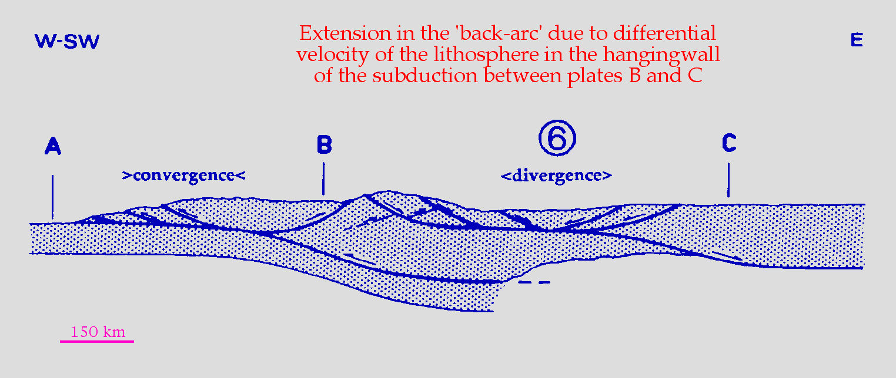
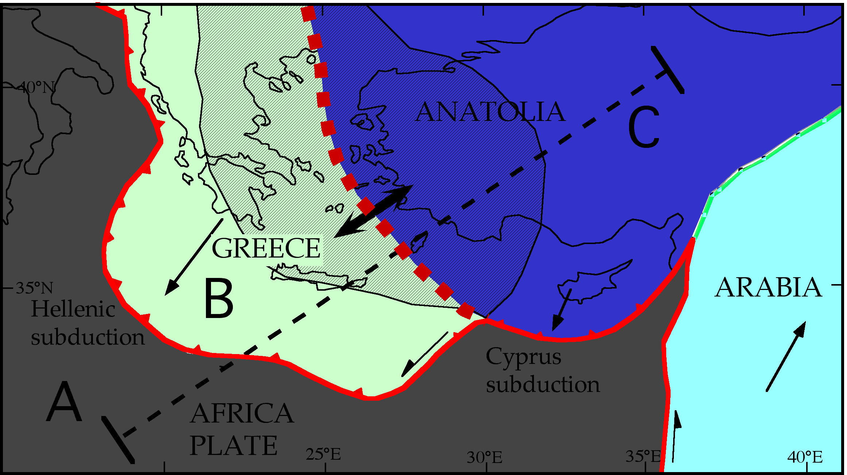

Slide 33
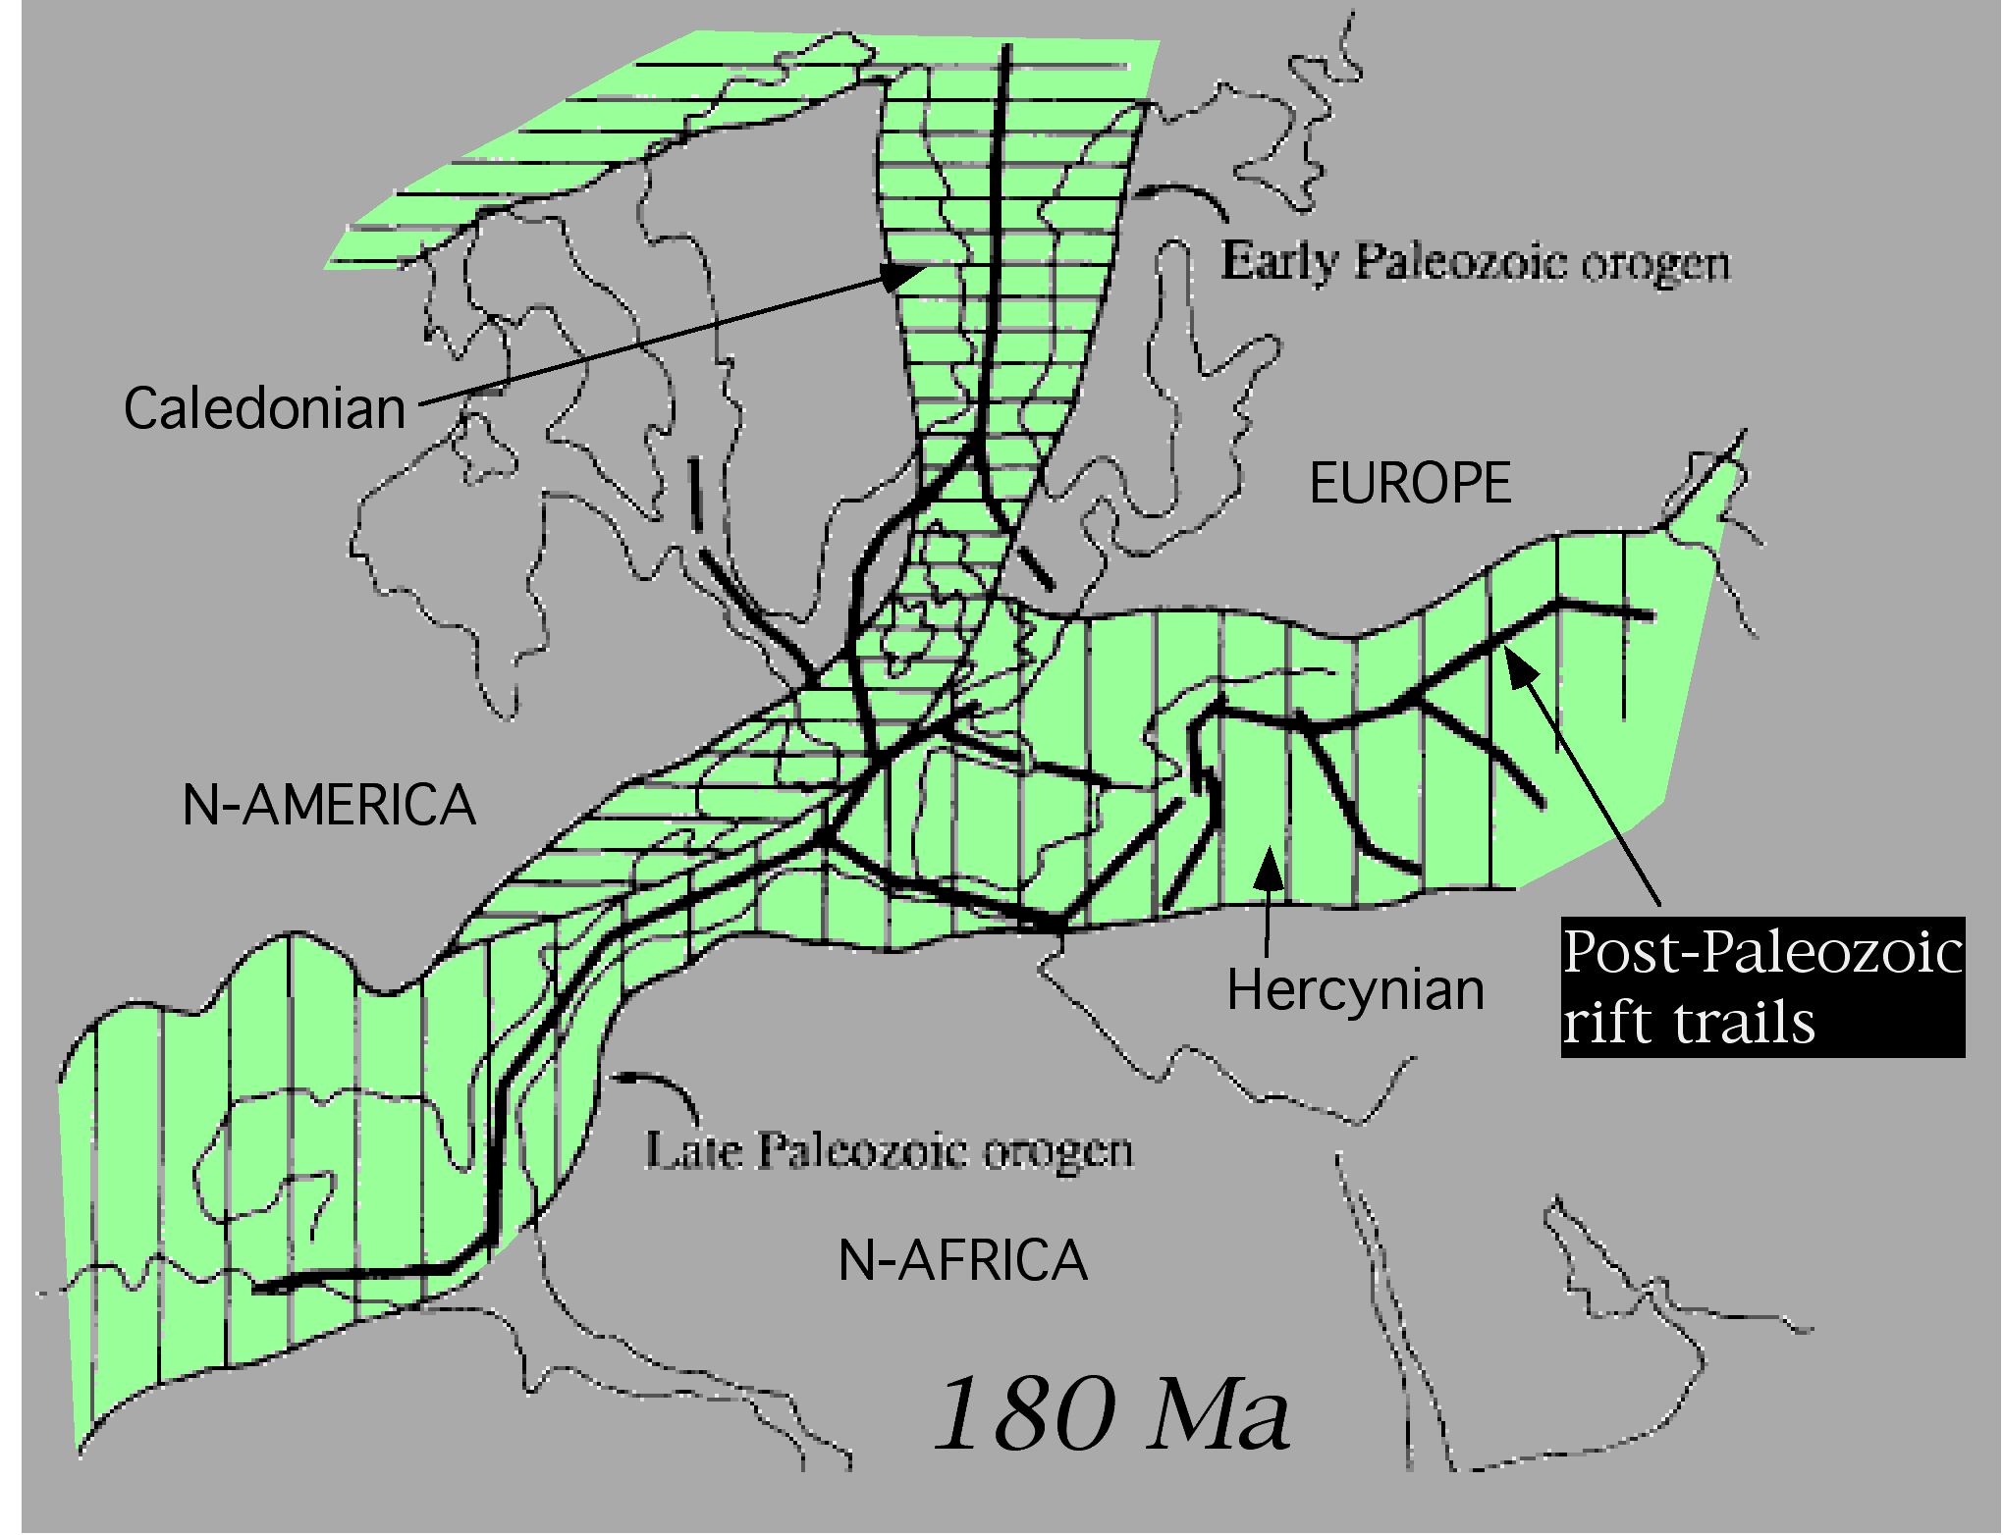
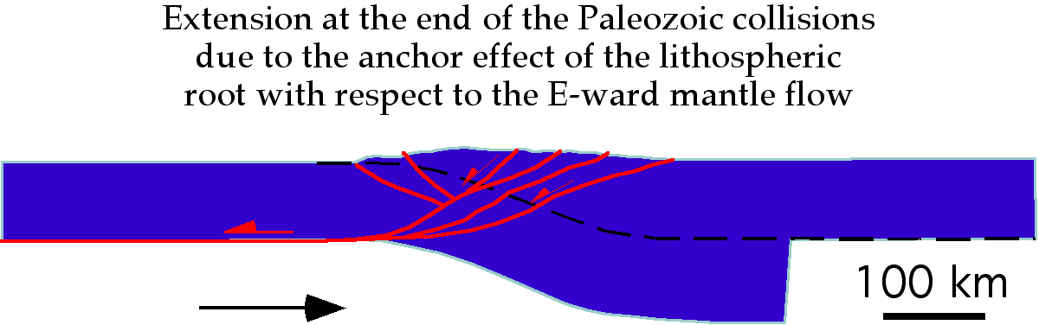
- Atlantic-Tethys rifts developed
along earlier lithospheric
continental Paleozoic thickening
Rifts are unrelated to deep mantle
plumes, but they are rather
controlled by the lithosphere

Slide 34
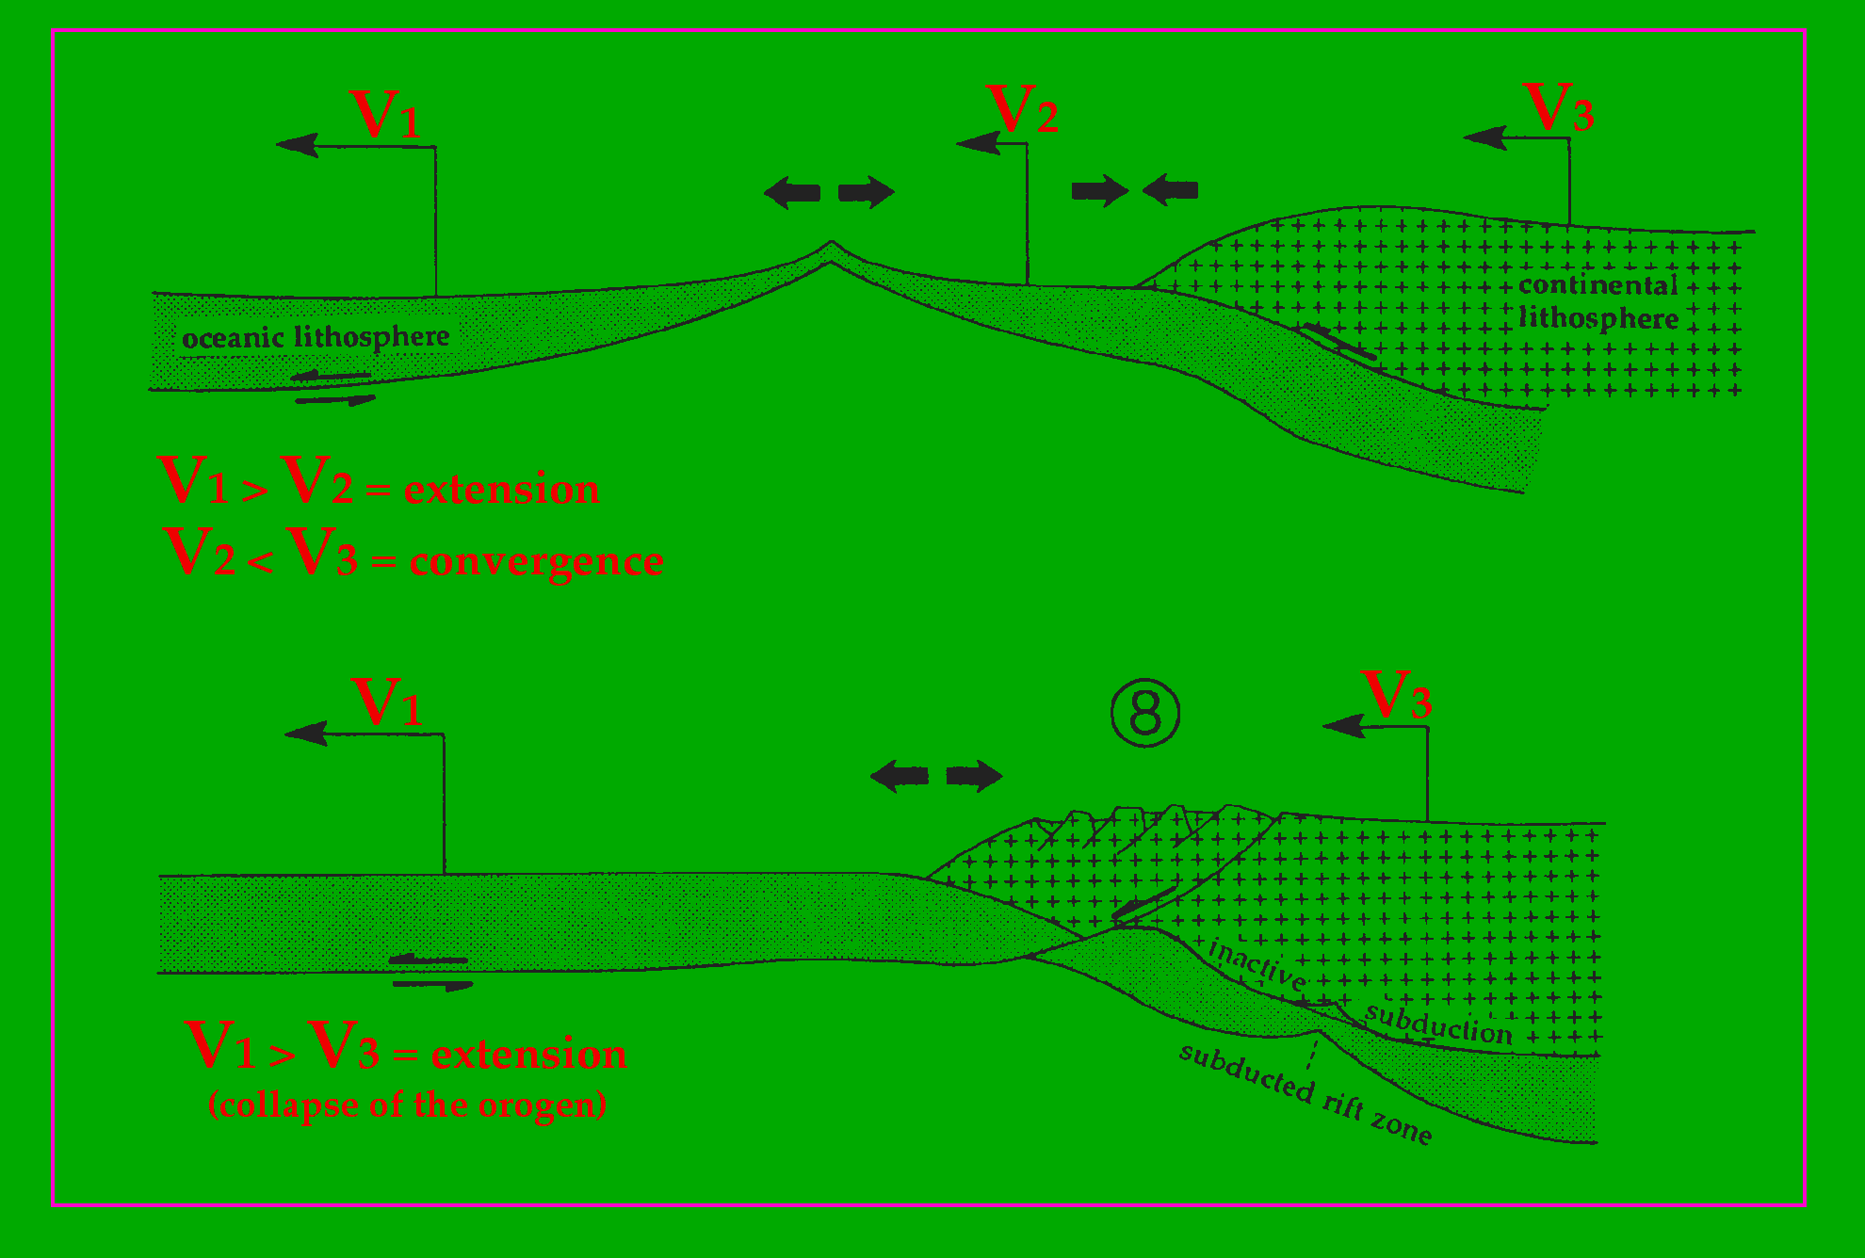
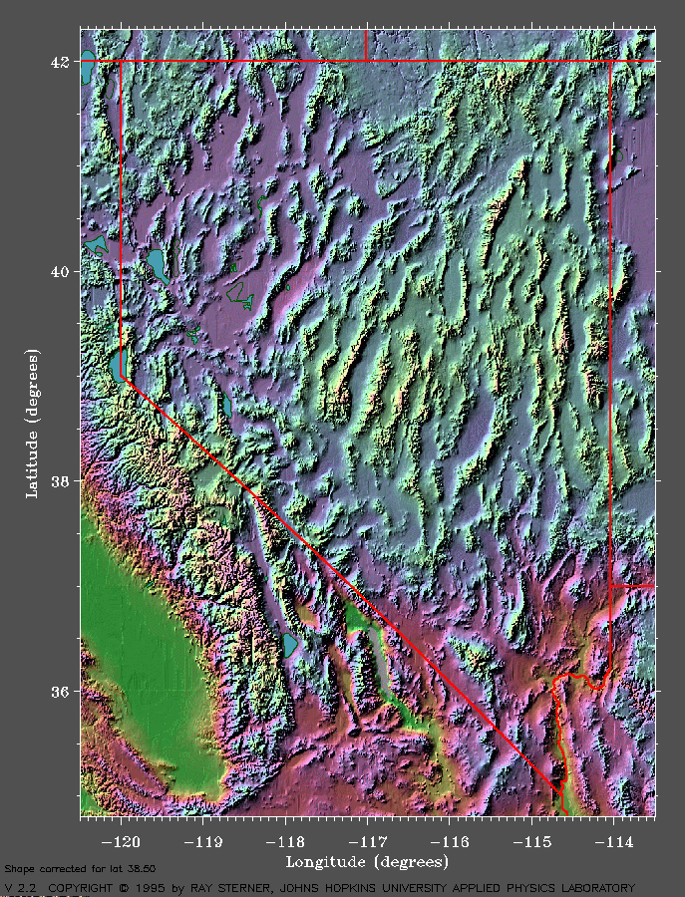

Slide 35
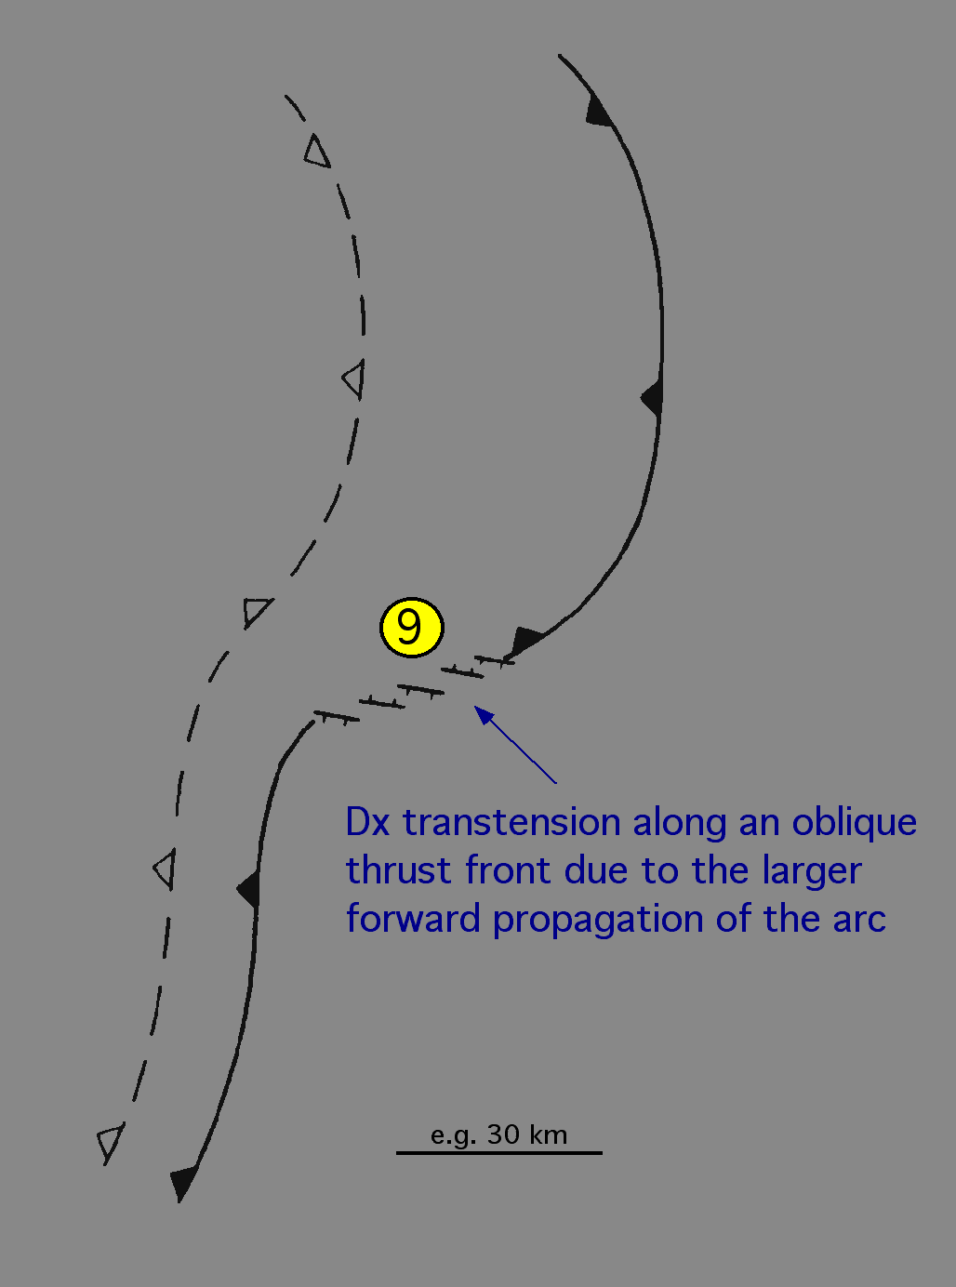
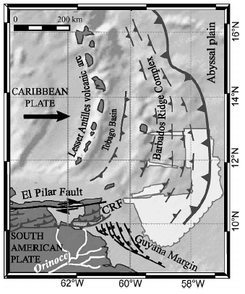

Slide 36
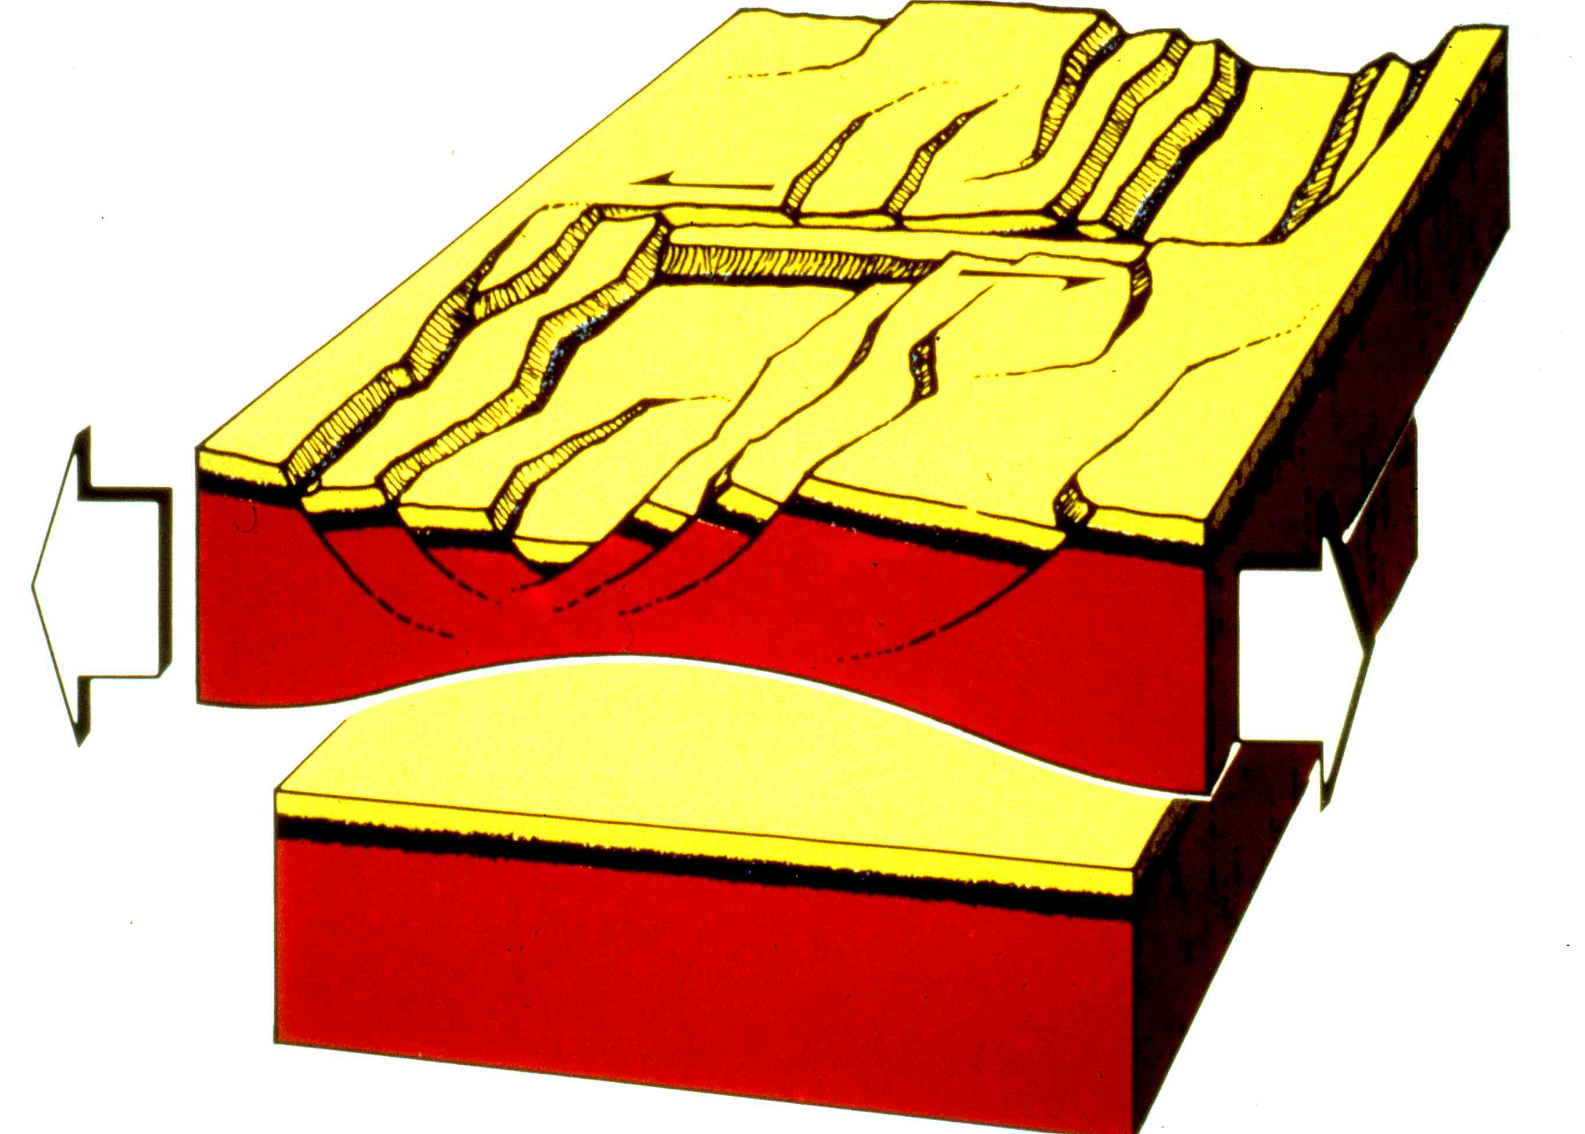

Slide 37


Slide 38
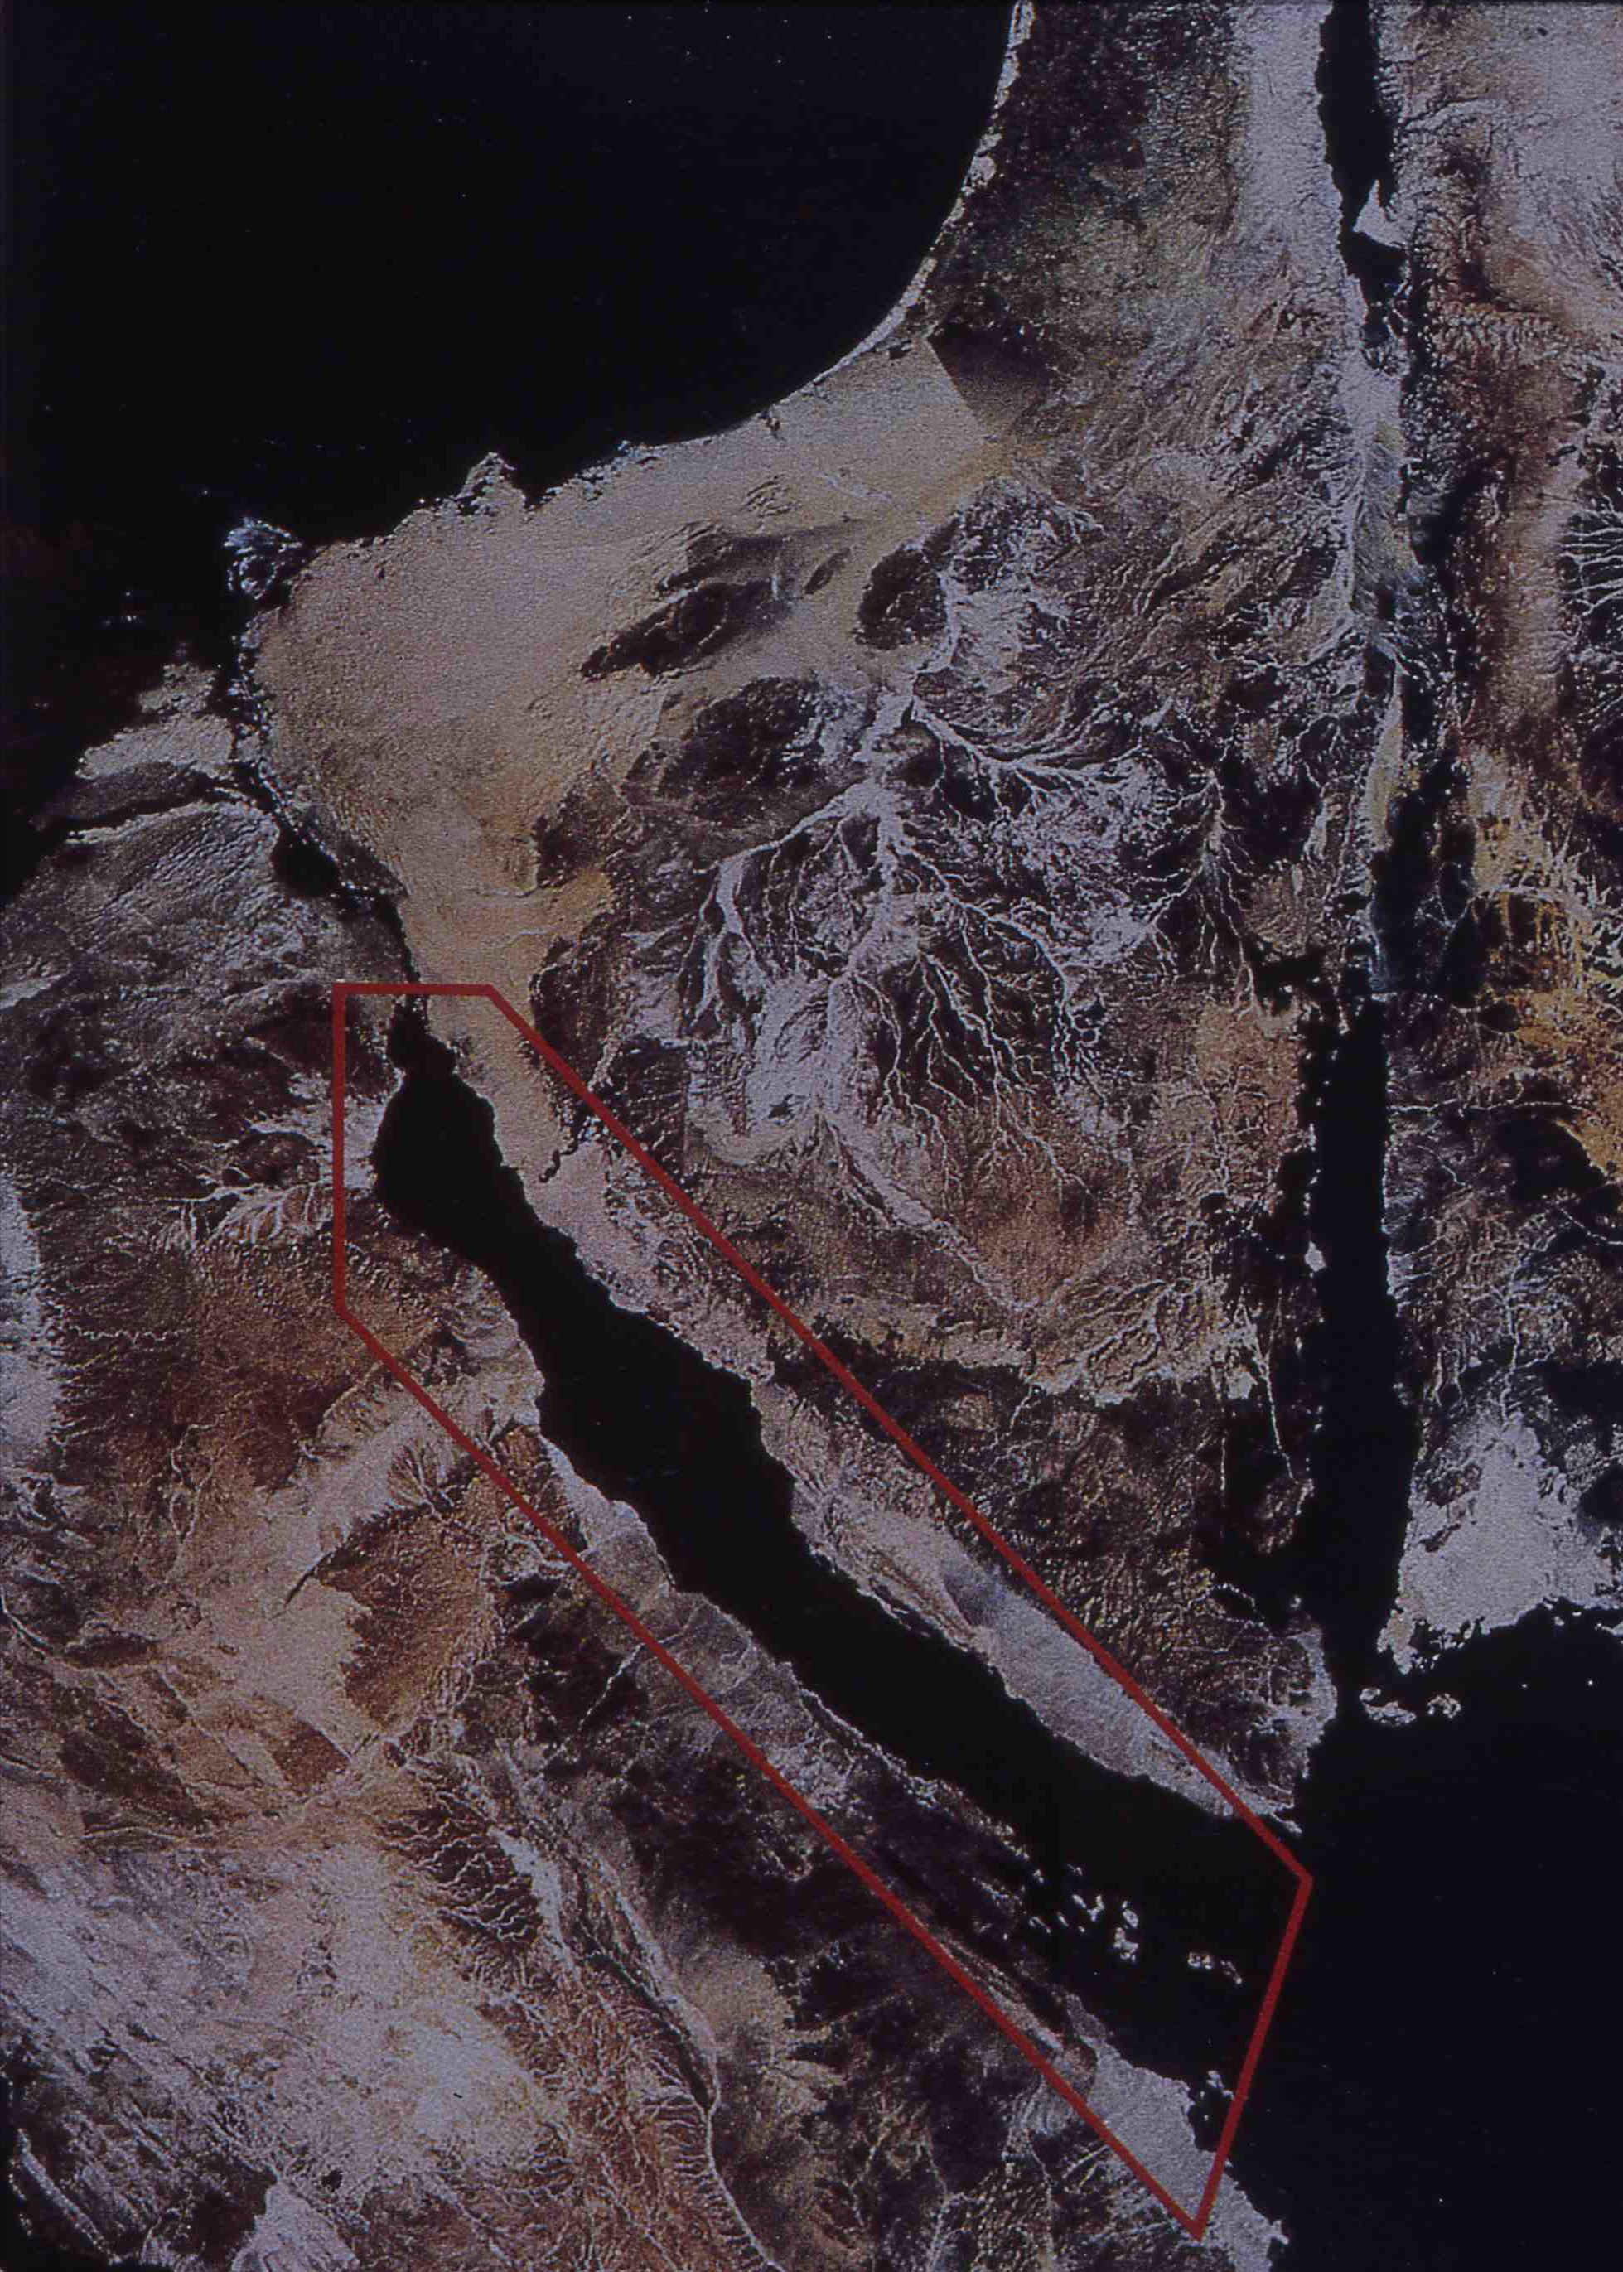

Slide 39
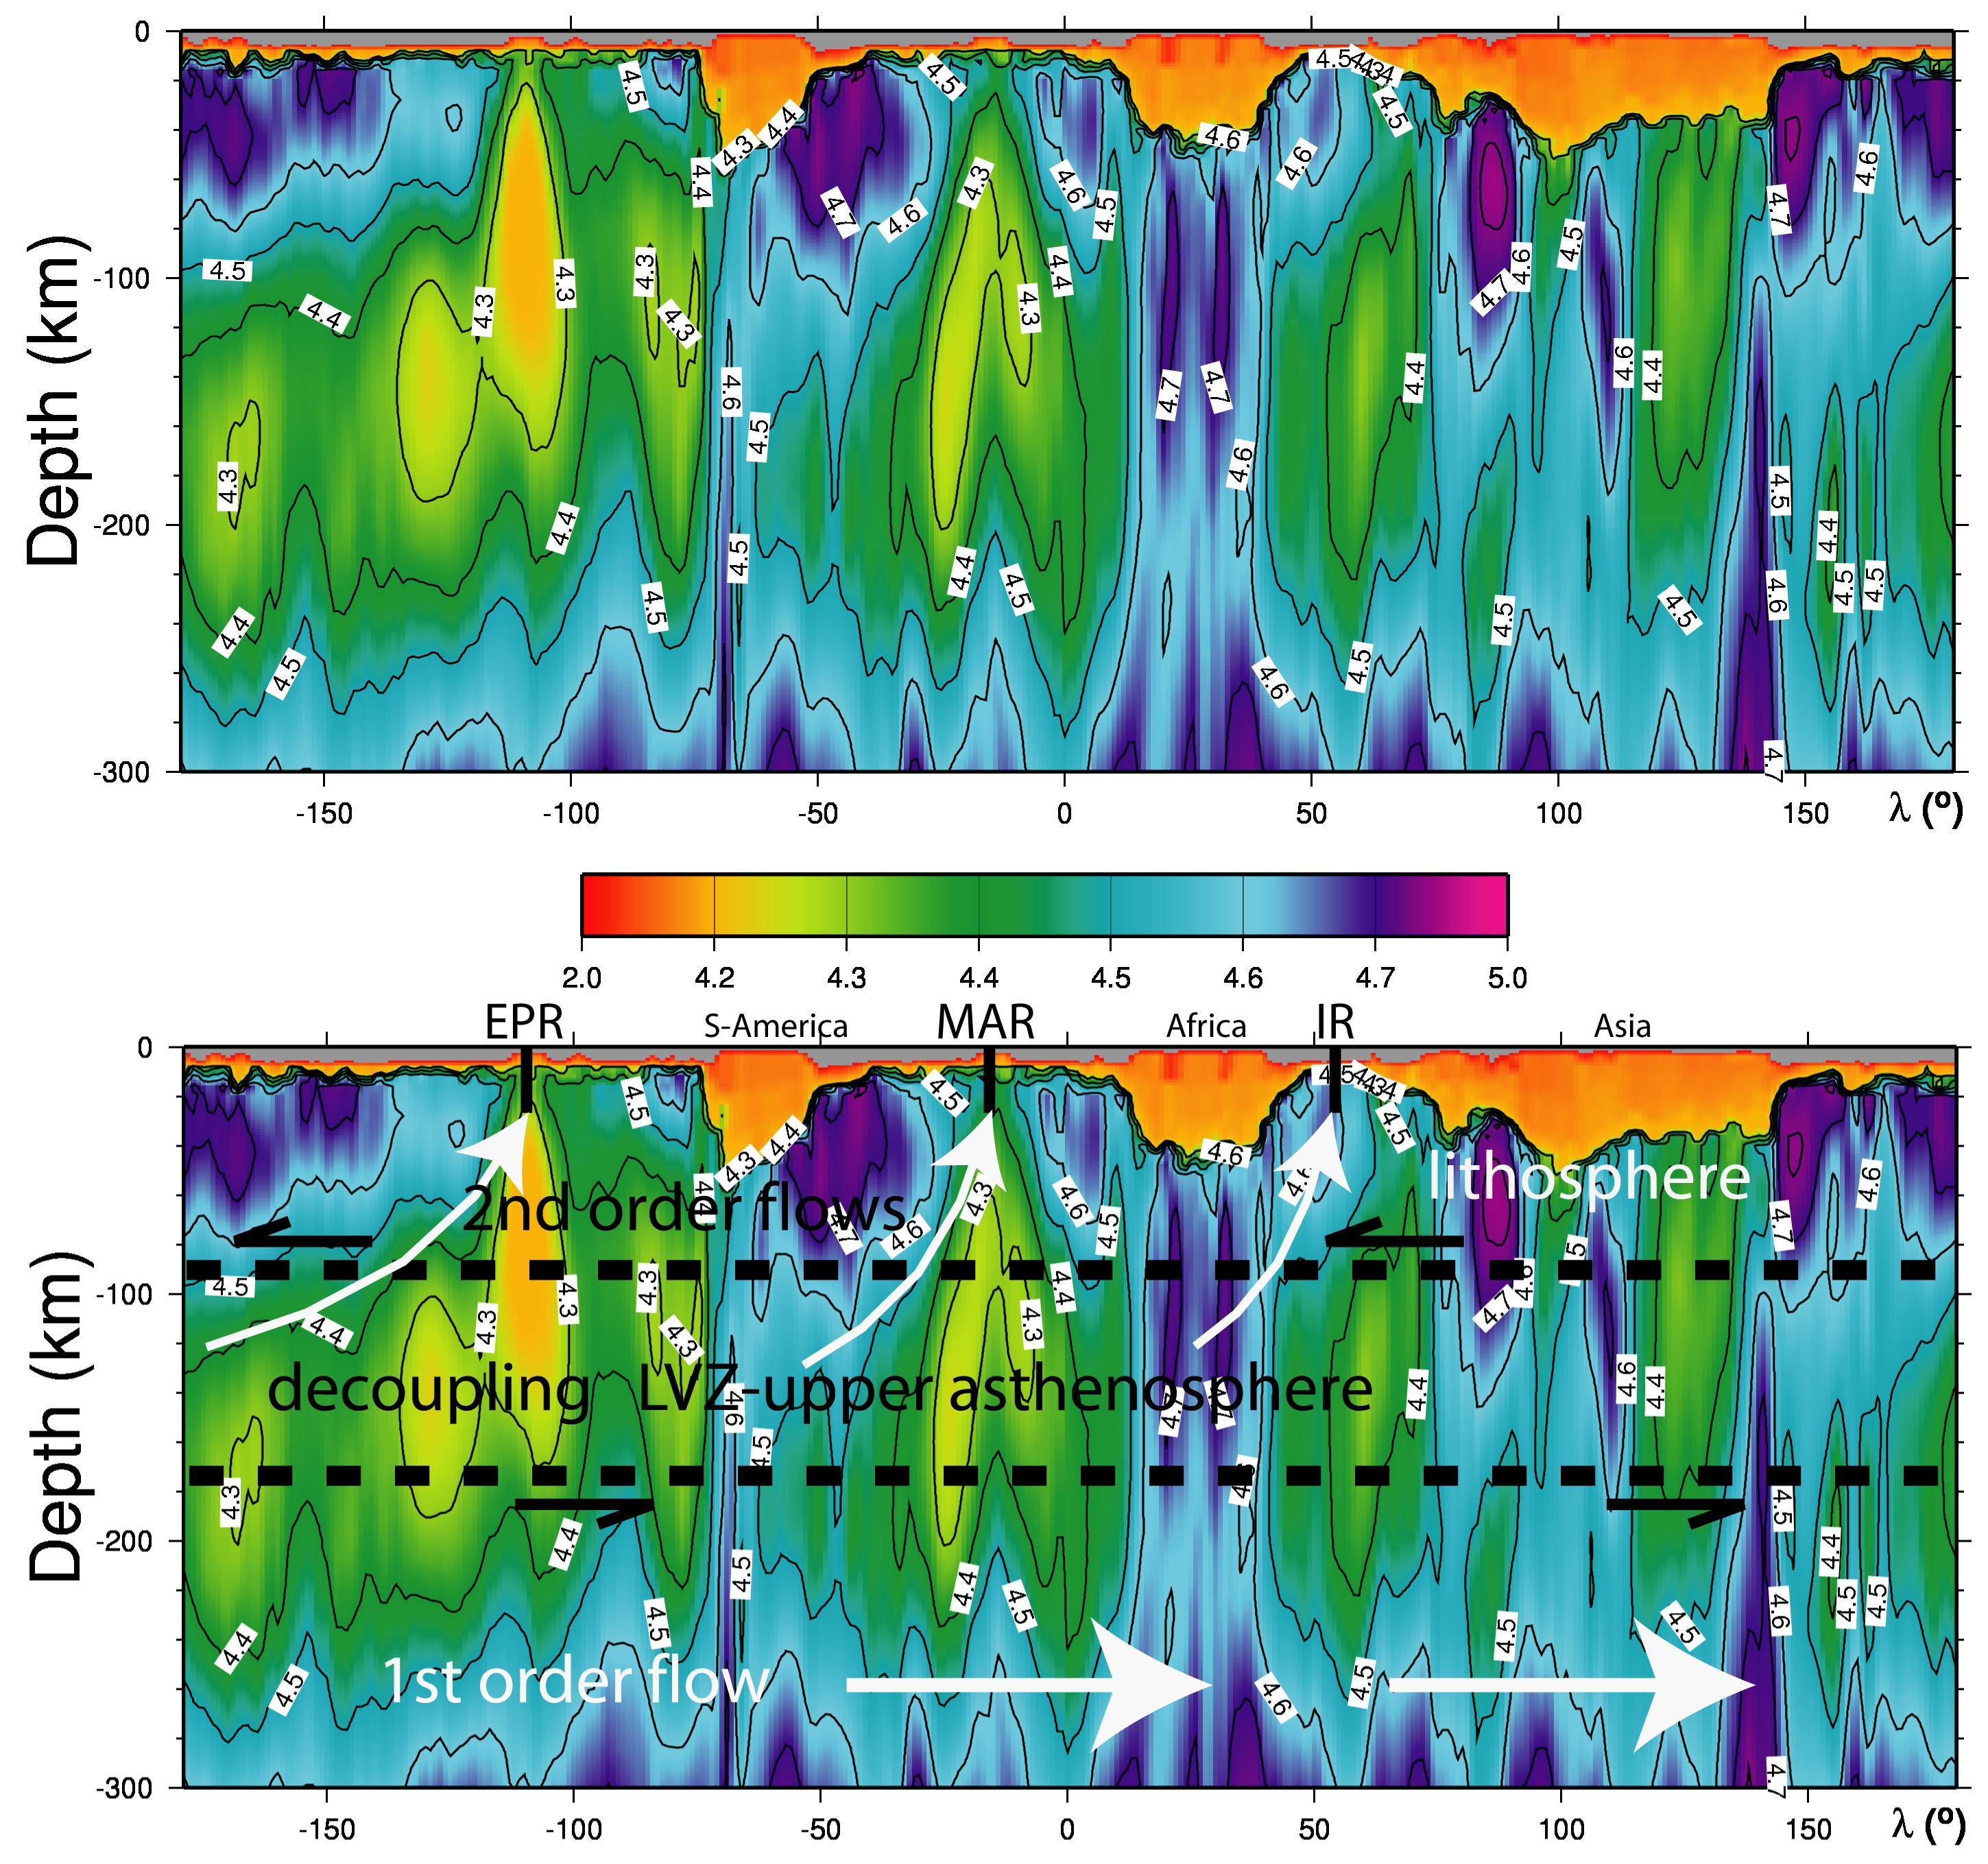

Slide 40
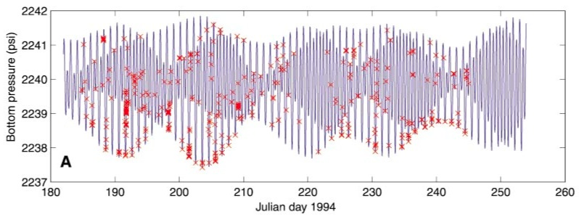
Tolstoy et al. (2002)
Normal fault earthquakes more frequent during low tide
Thrust fault earthquakes more frequent during high tide

Slide 41
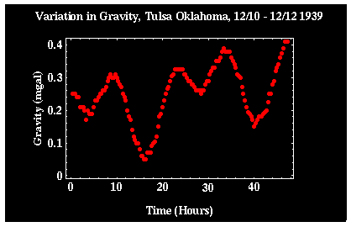

Slide 42
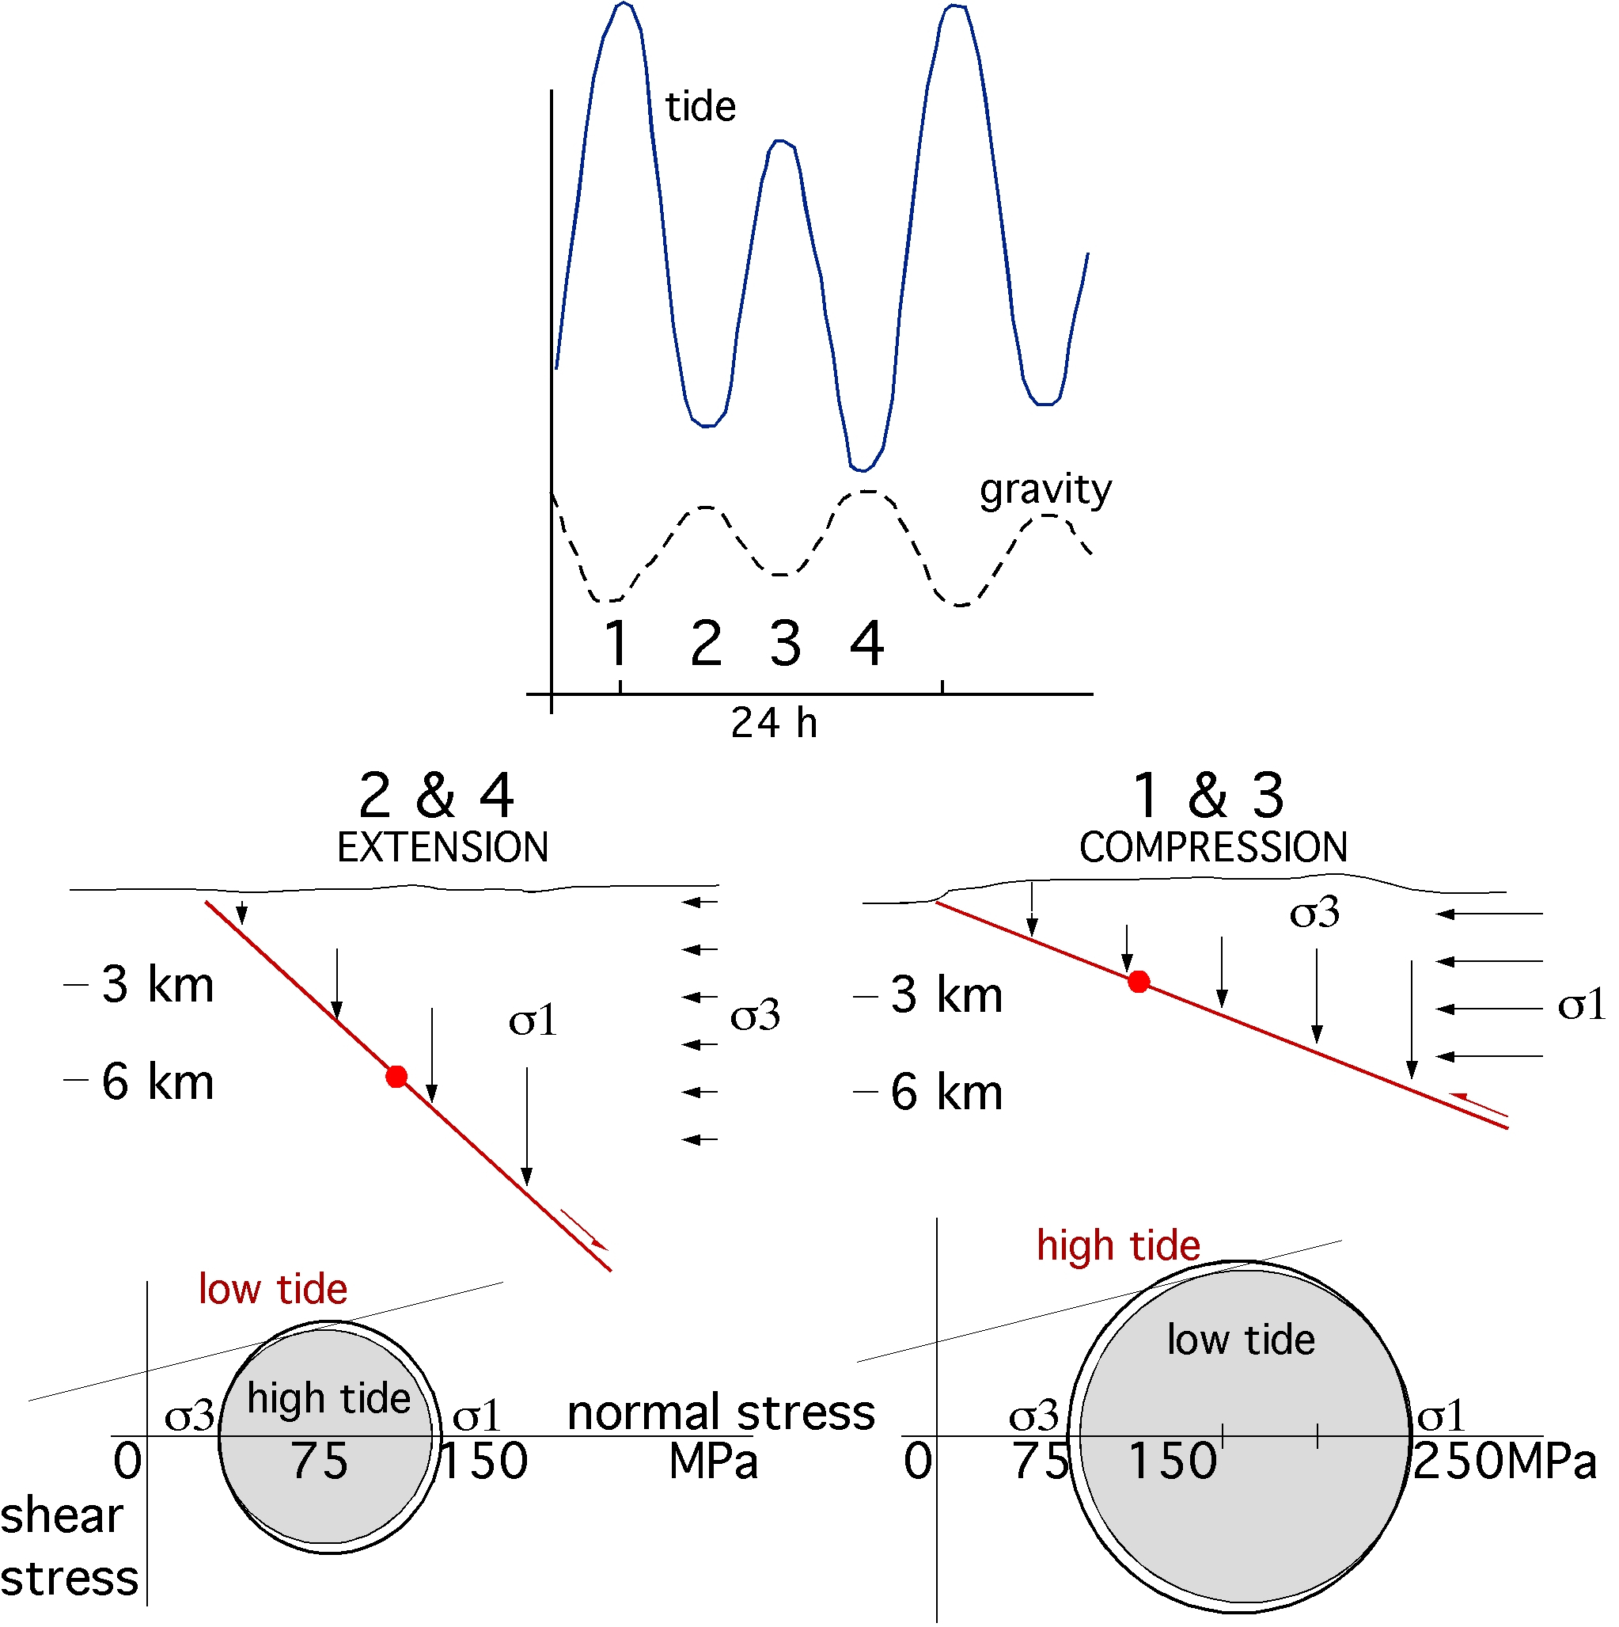
Riguzzi et al. submitted

Slide 43

Panza et al. submitted

Slide 44


Slide 45


Slide 46

4-13 cm/yr net rotation
mantle
lithosphere
Crespi et al. GJI, 2007

Slide 47


THE ALPS IN THE APENNINES
FOREBELT
FOREBELT
RETROBELT

Slide 48


Slide 49
-0.1-0.6 mm/yr
1 mm/yr
-1 mm/yr
Mantle ρ⁻+Wedge>Extension
Accretion>Slab retreat
Extension+Mantle ρ⁺ >Mantle ρ⁻
Slab retreat
Mantle ρ⁻
coast
coast
coast
Apennines
Mantle
Wedging
Mantle flow

Slide 50


S-America
MAR
Africa
IR
India
Levshin et al. in progress

Slide 51


1 mm
η horizontal << η vertical

Slide 52

Post-glacial rebound
Pacific earthquakes
Channel flow
Petrology experiment
Is the asthenosphere viscosity sufficiently low?

Slide 53


Slide 54

The vapour-saturated solidus and the
water-storage capacity of HZ1 lherzolite.
DH Green et al. Nature 467, 448-451 (2010) doi:10.1038/nature09369

Slide 56


Slide 57


Slide 59

VERTICAL MOVEMENTS - PLATE TECTONICS RELATED

Slide 60

Global lithospheric flow
mid astenosphere net rotation equator lies within the
tectonic mainstream latitude band
Crespi et al., 2007 GJI

Slide 61

lithosphere
LVZ
asthenosphere

Slide 62
model
A
B

Slide 63

Modified after Thybo, 2006

Slide 64

GEOID shape
Grace data

Slide 65

Conder et al., 2002, JGR, MELT

Slide 66

Hammond & Toomey, 2003

Slide 67

Conder et al., 2002
JGR, MELT

Slide 68



Slide 69


Slide 70


Wolfe & Solomon, 1998, Science, MELT

Slide 71
rifting model
Ridge speed = (V_{A}+V_{B})/2
A
B

