Slide 1
Wilkinson et al. 2017 SREP

Slide 2
Wilkinson et al. 2017 SREP

Slide 3
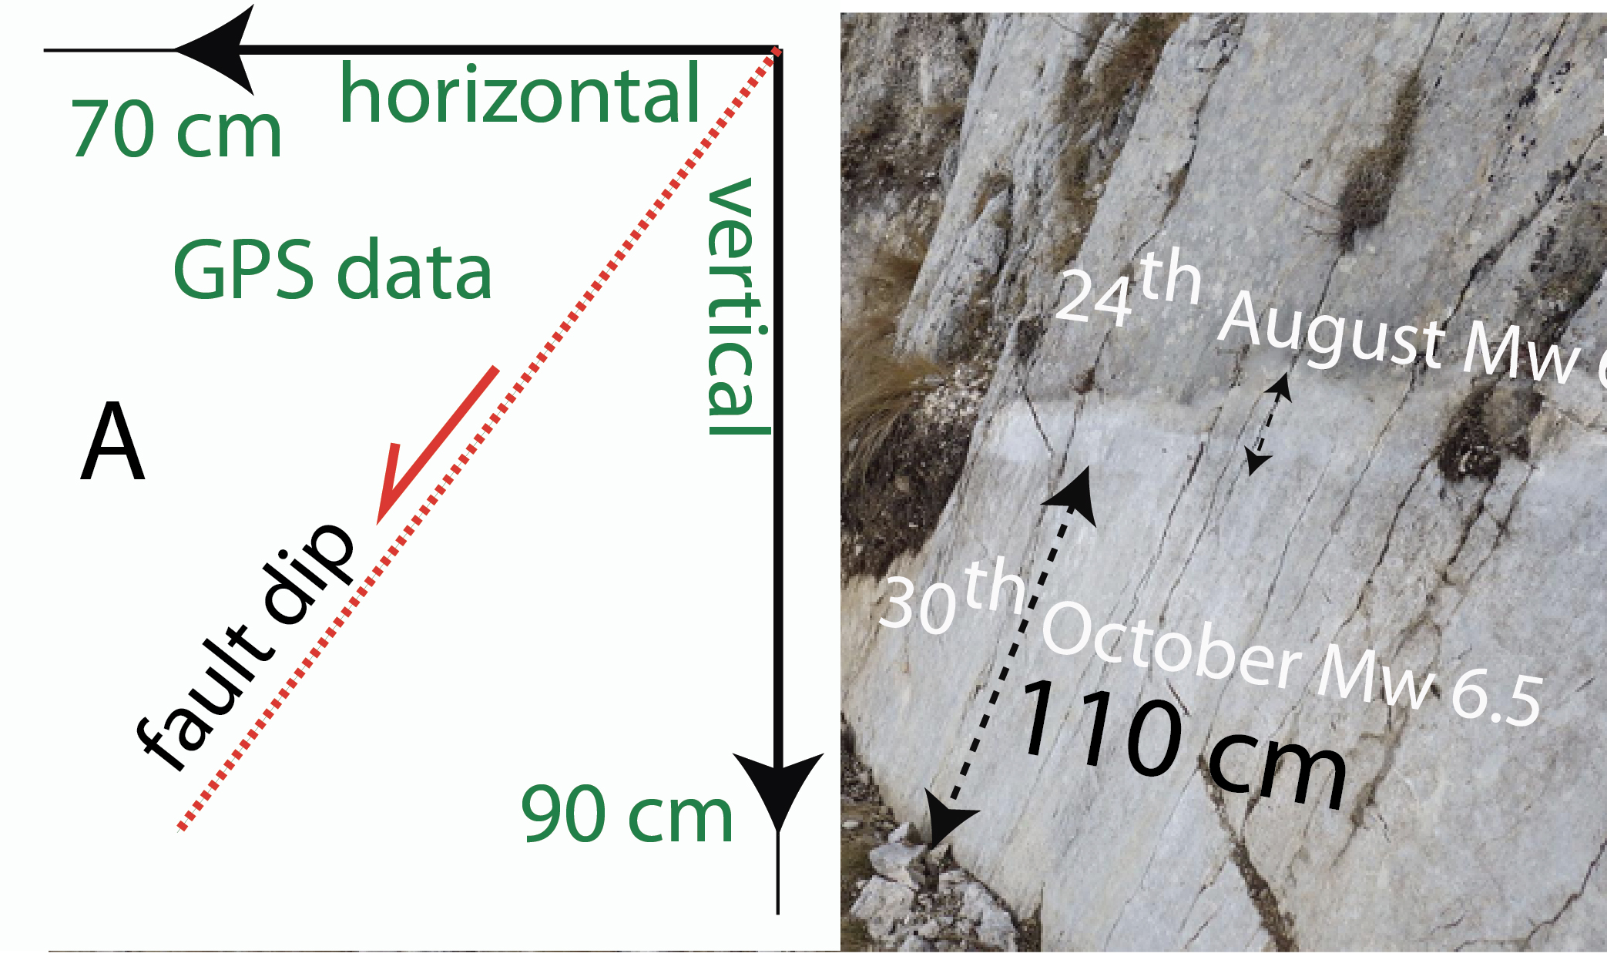
Bignami et al. 2019 Scientific Reports

Slide 4
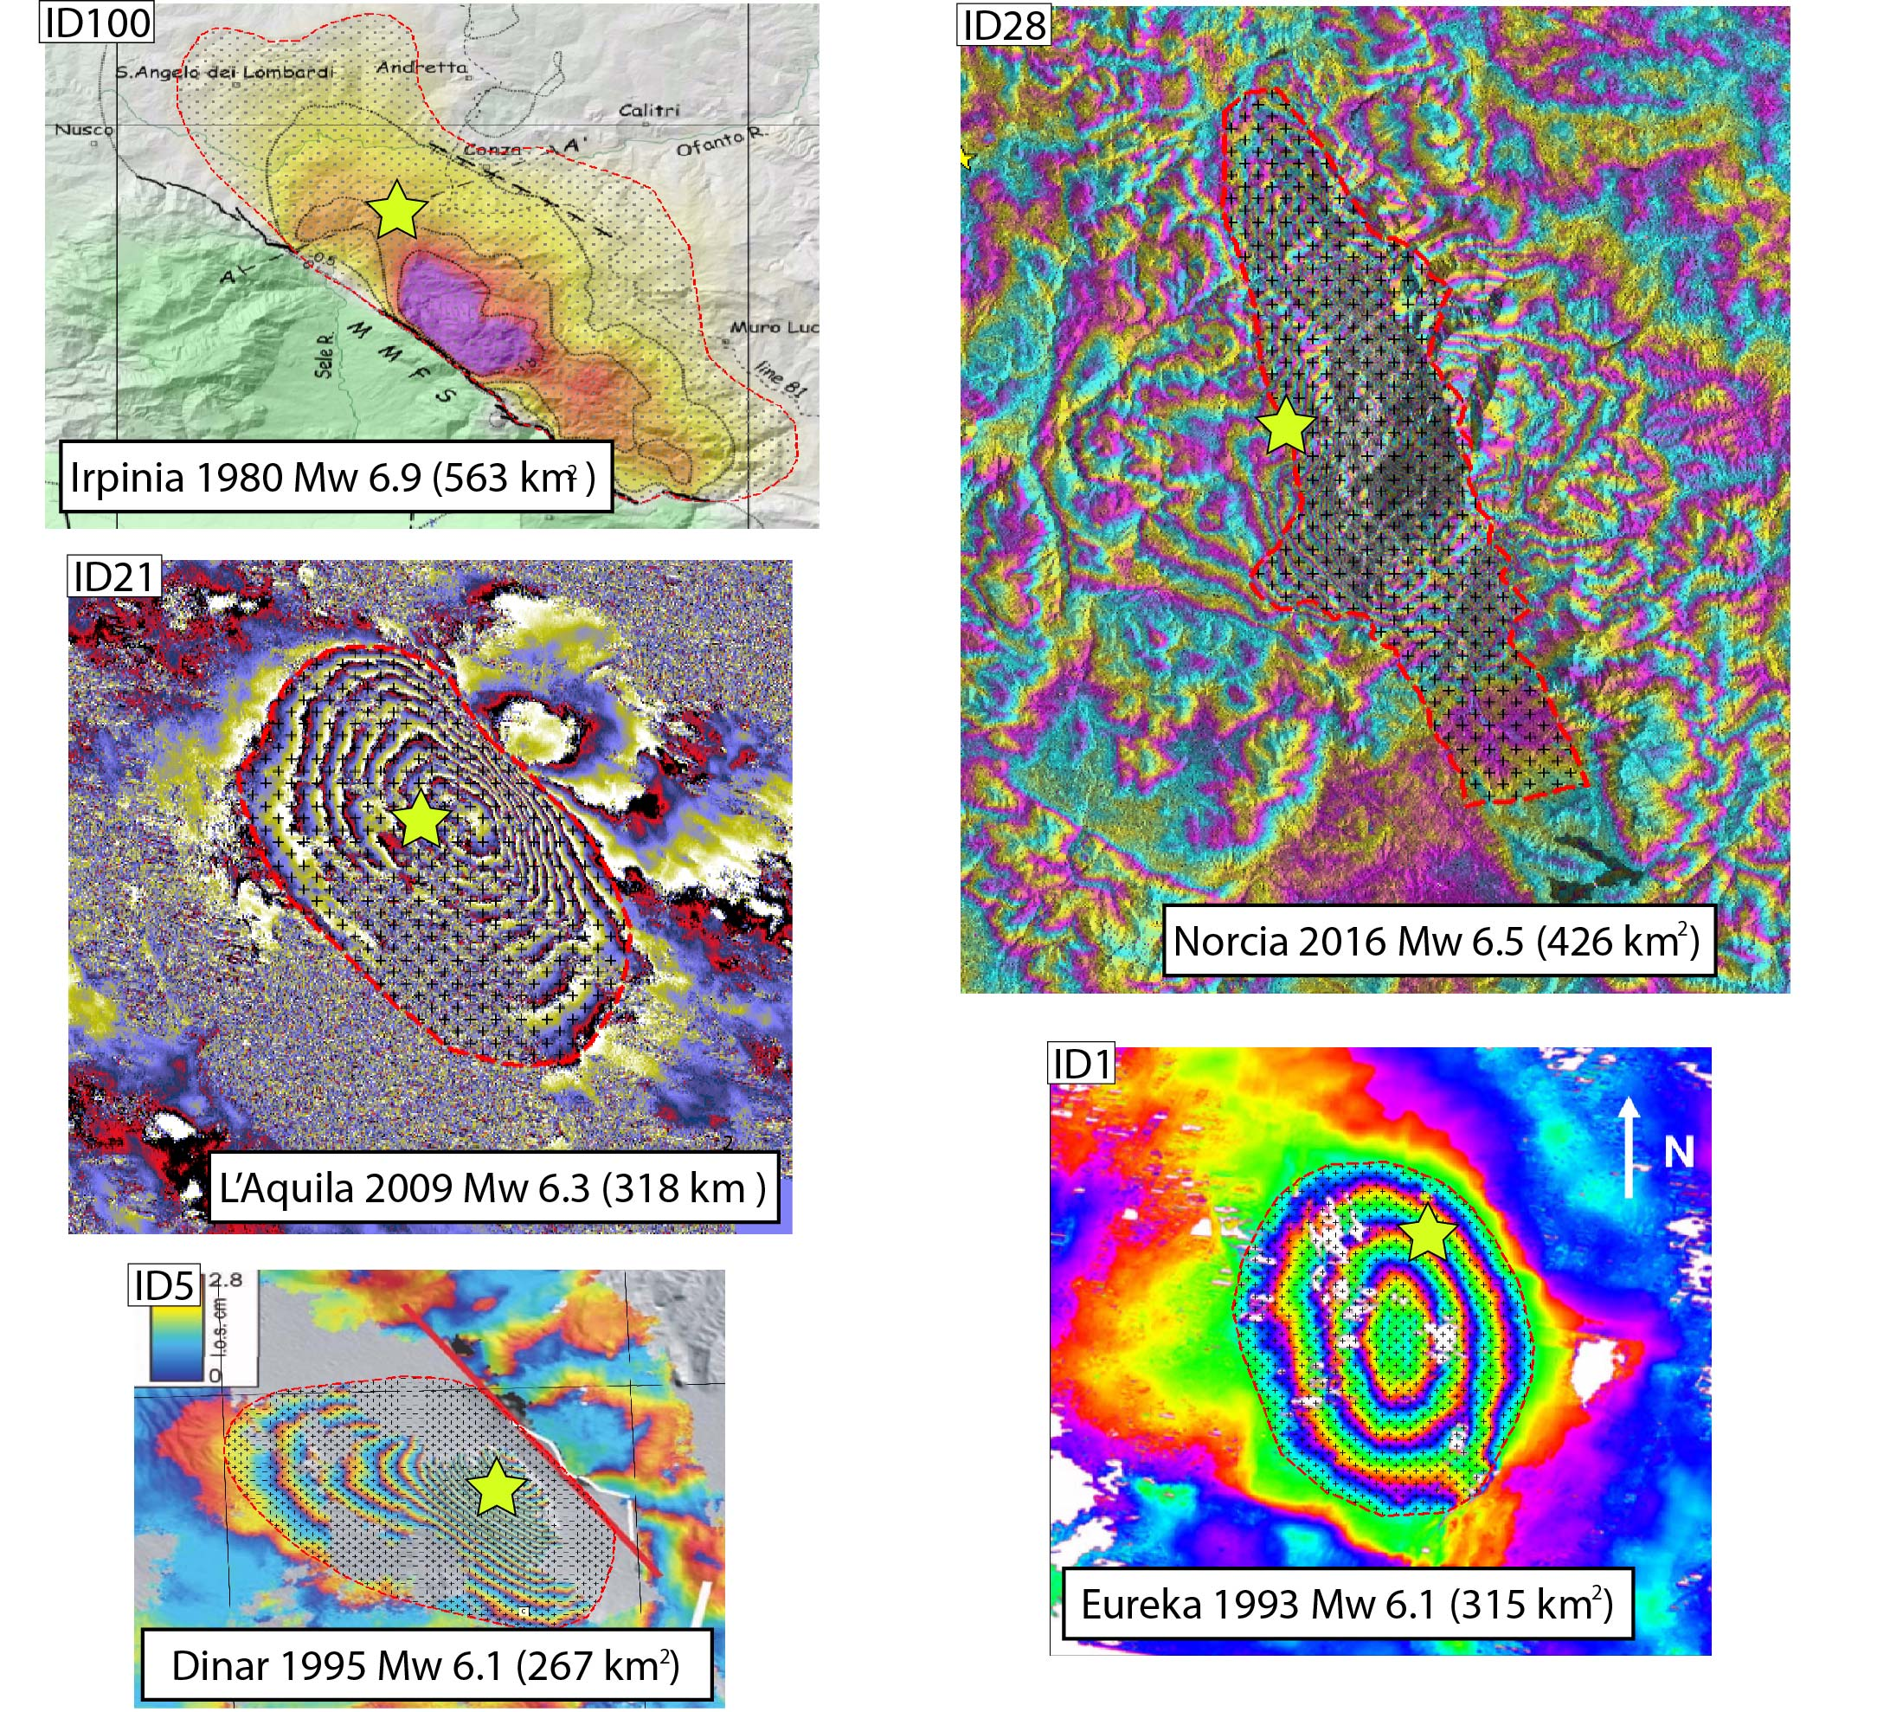
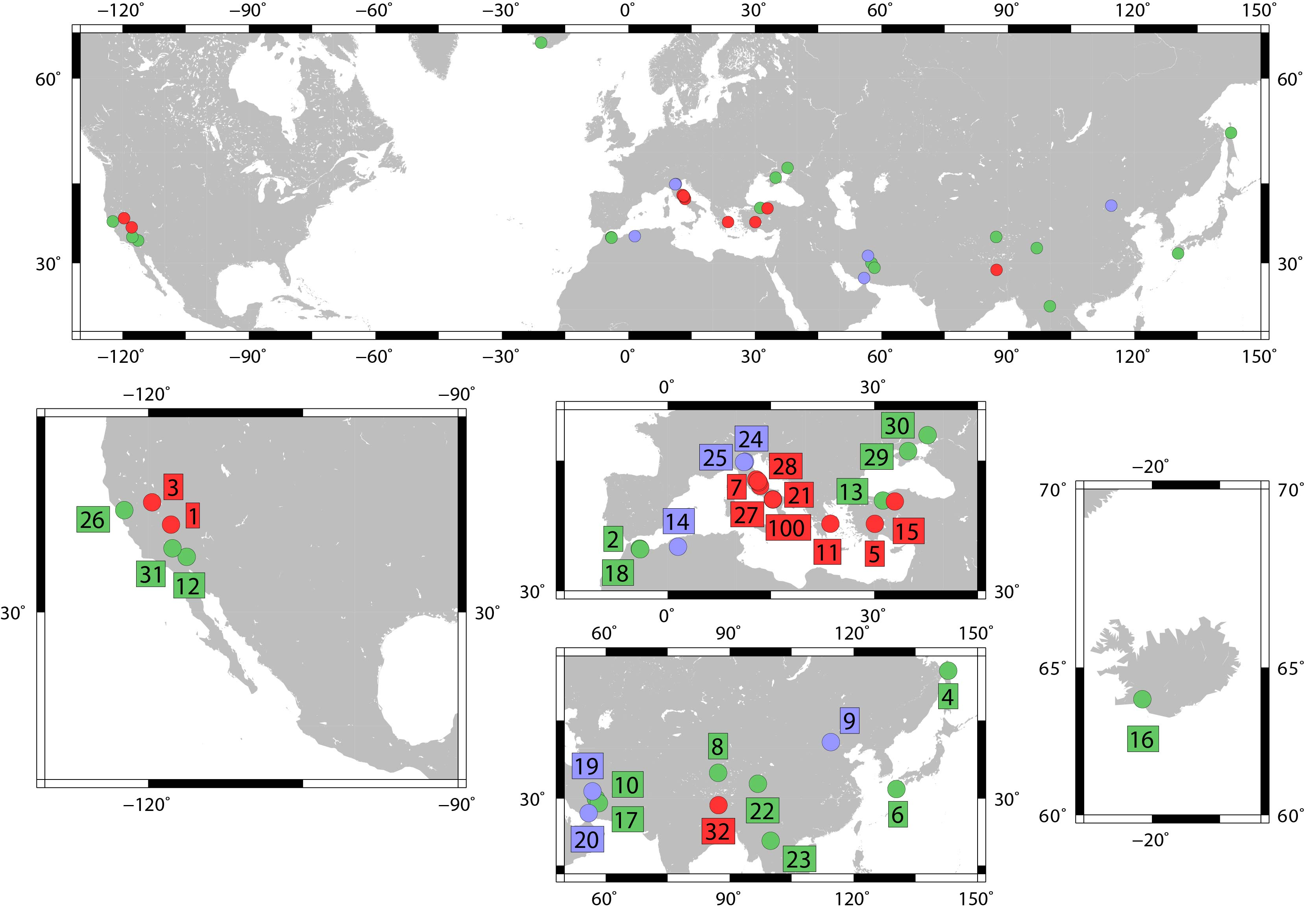
Petricca et al. 2021 ESR

Slide 5
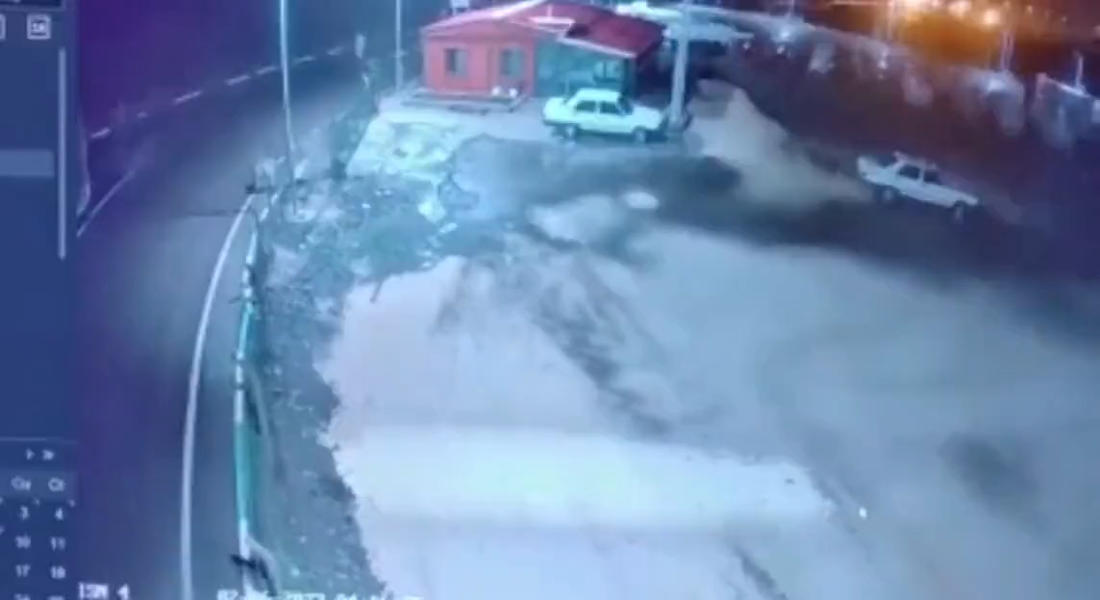

Slide 6
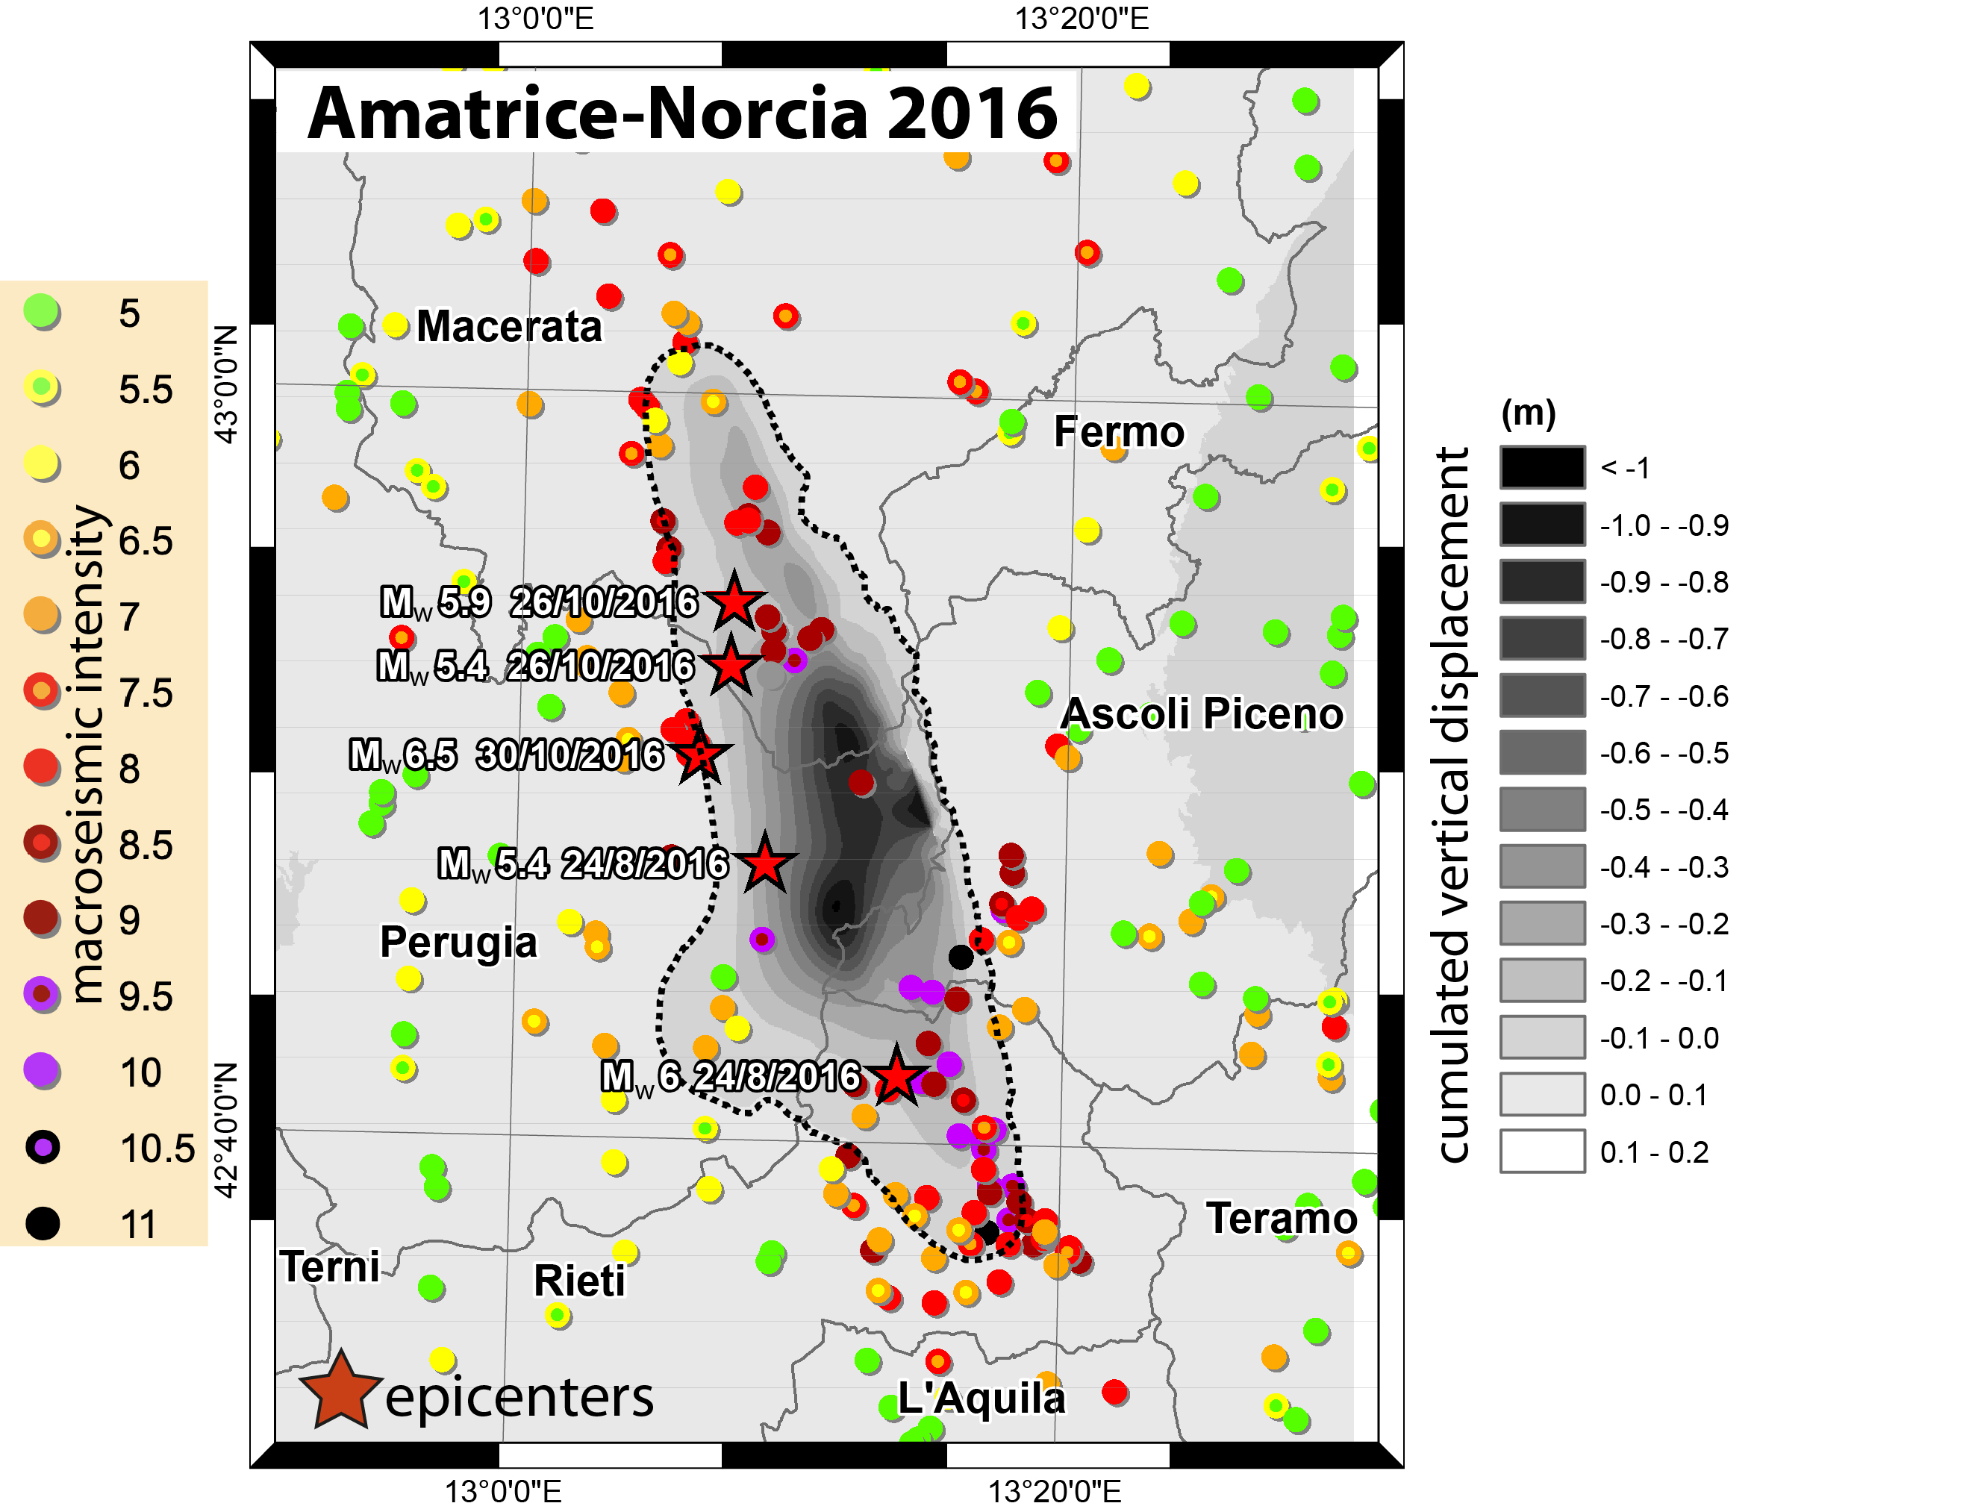
Al Shawa et al. 2021 Eng. Geol.

Slide 7
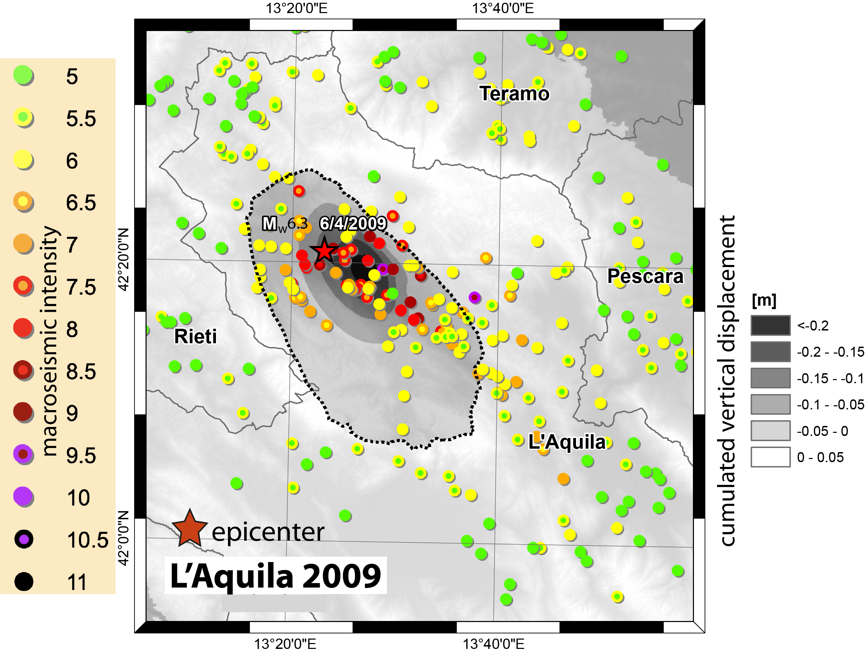
Al Shawa et al. 2021 Eng. Geol.

Slide 8
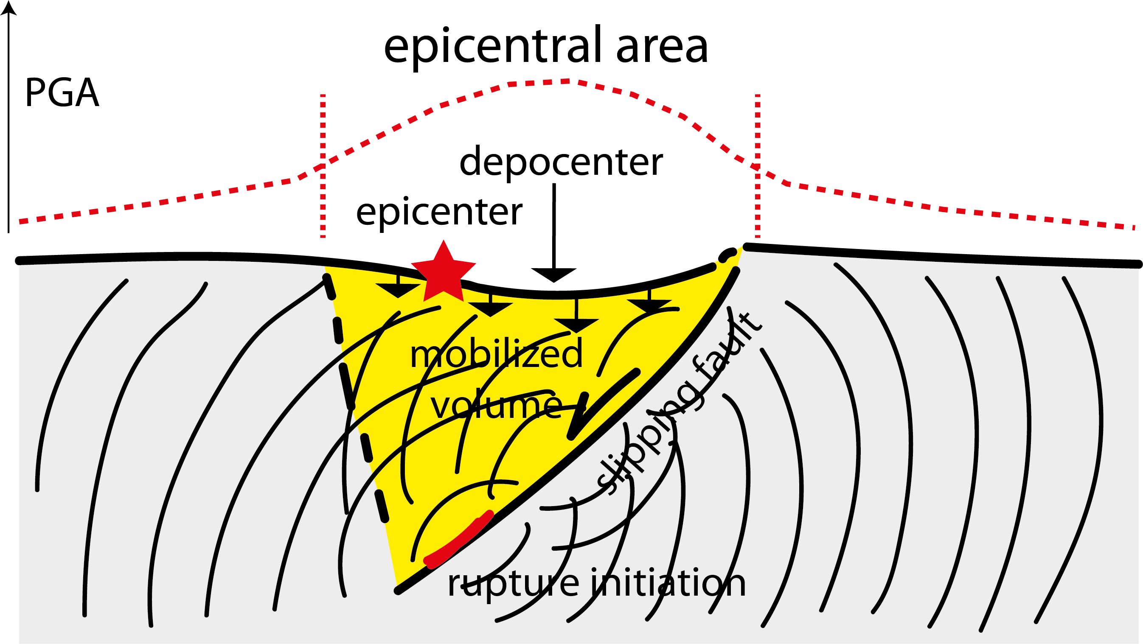
Al Shawa et al. 2021 Eng. Geol.

Slide 9
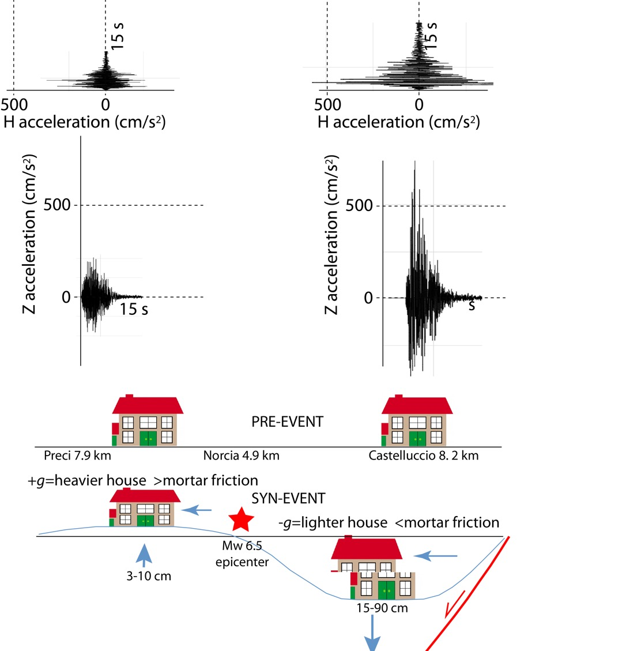
Liberatore et al. 2019

Slide 10
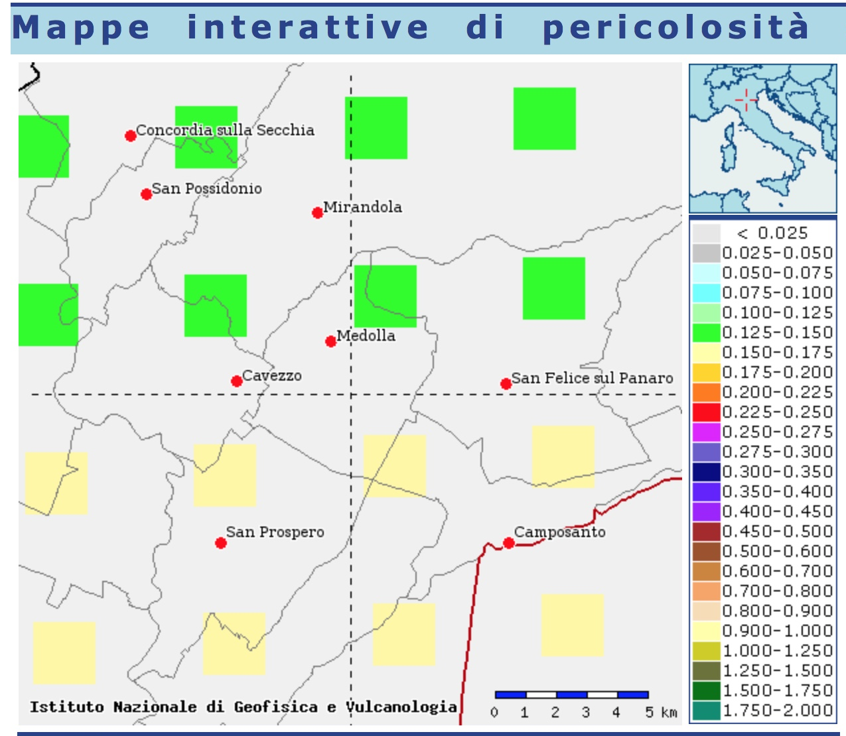

Slide 11
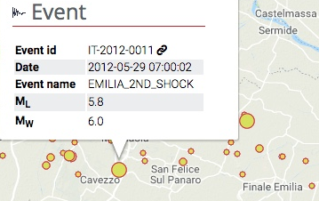
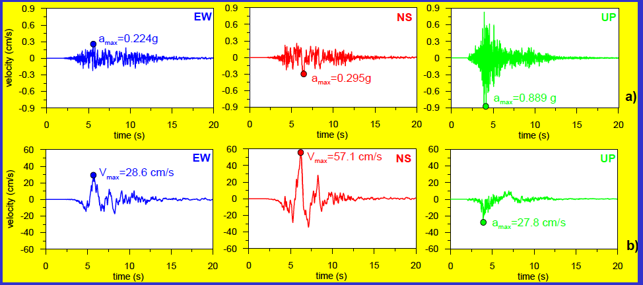
Mirandola station 29 May 2012
Station RAN - soil C
Amplification 1.125x1.5 = (0.18-0.20)
Maugeri et al.
A _{max}0.889 g

Slide 12
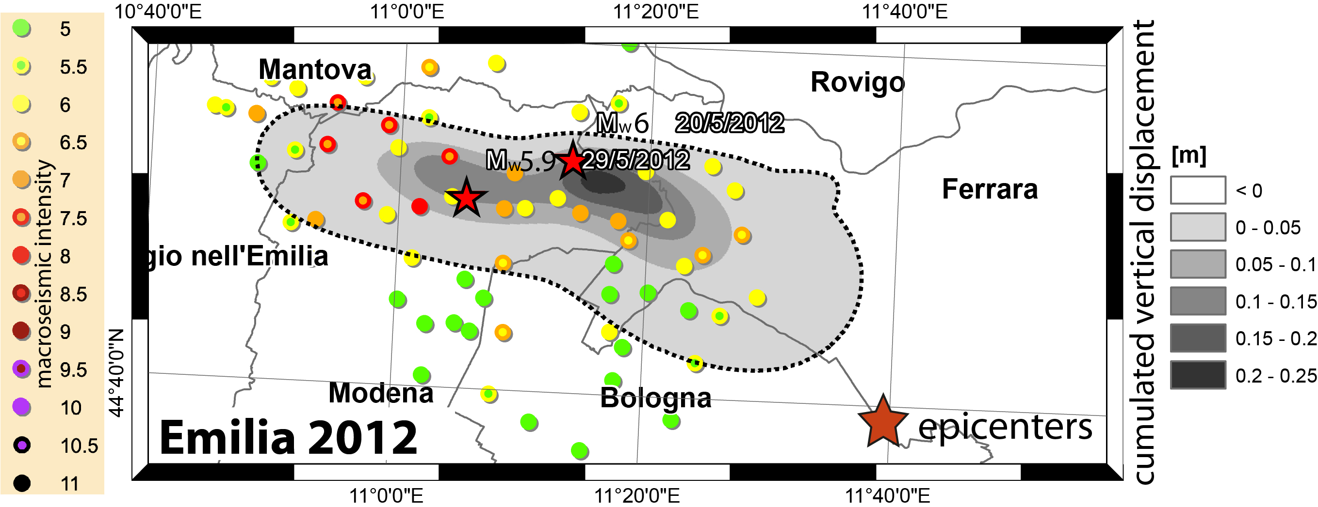
Al Shawa et al. 2021 Eng. Geol.

Slide 13
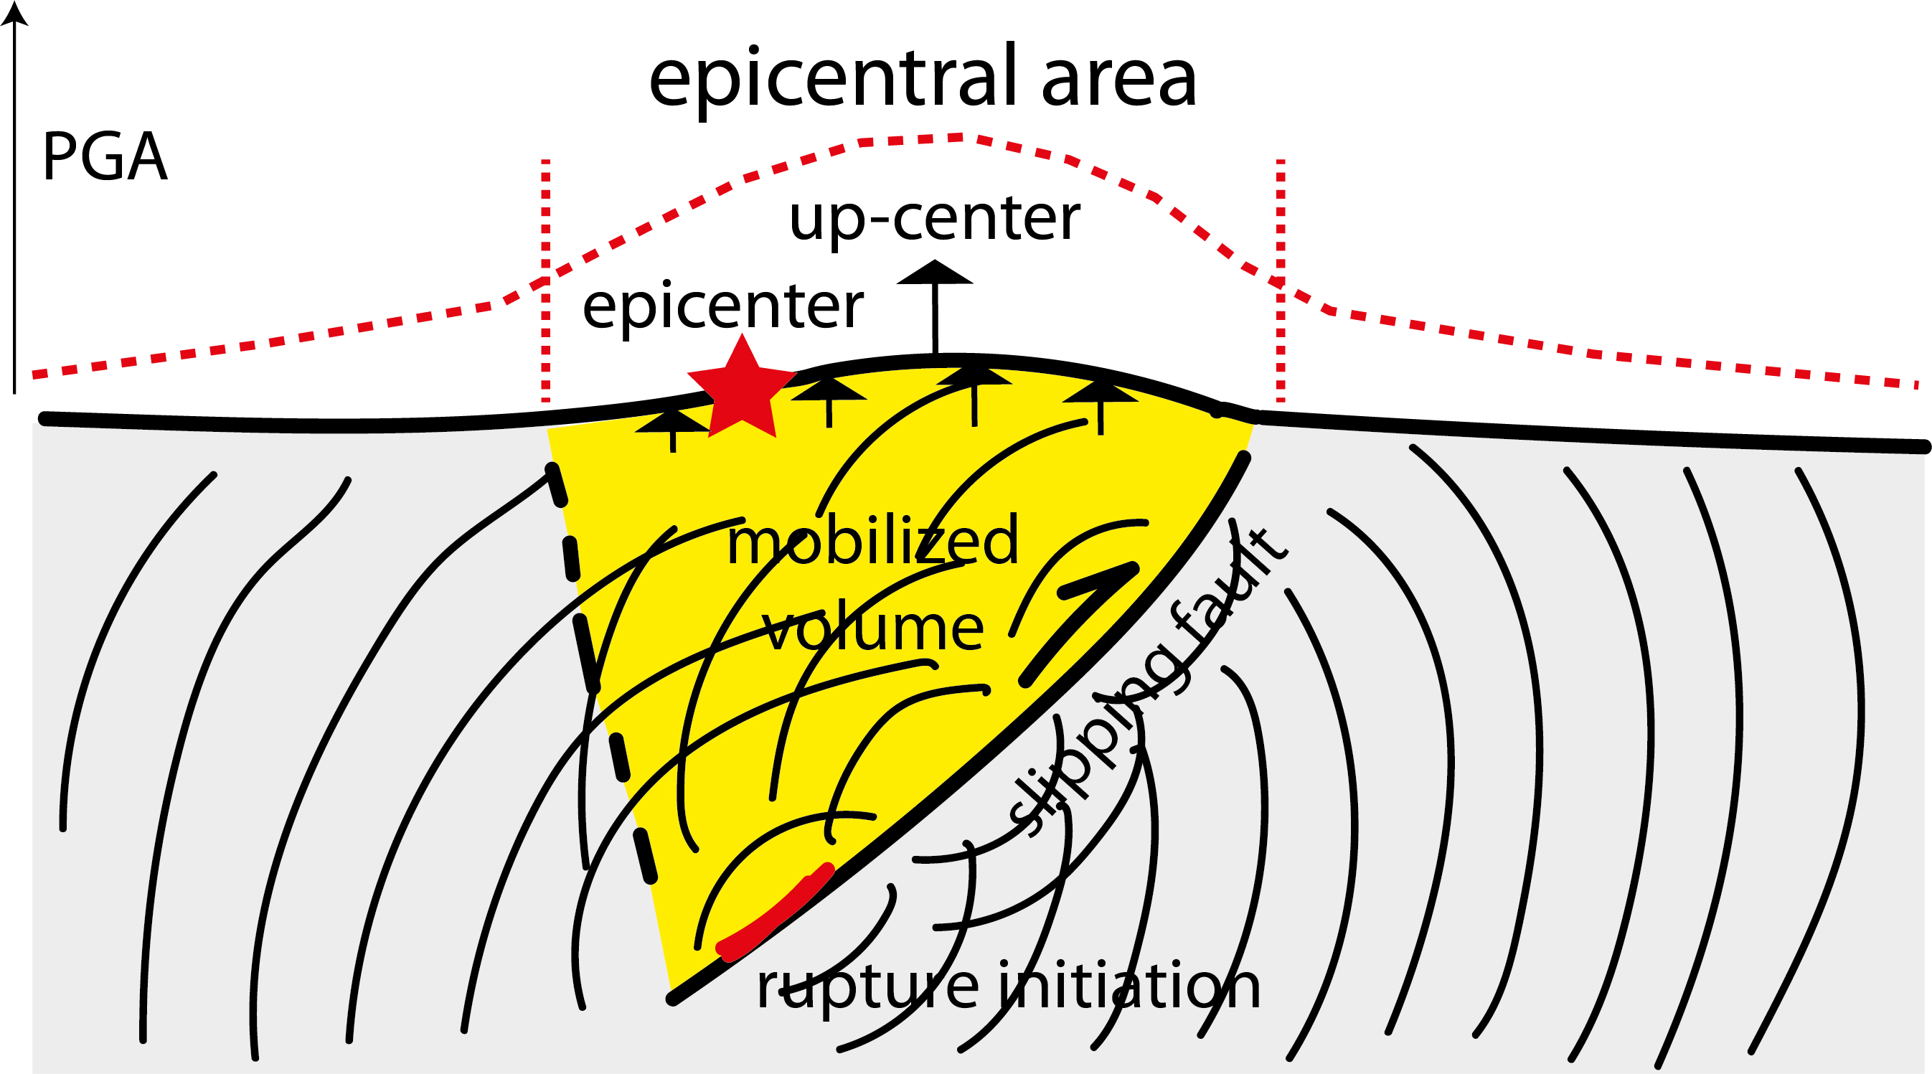
Al Shawa et al. 2021 Eng. Geol.

Slide 14
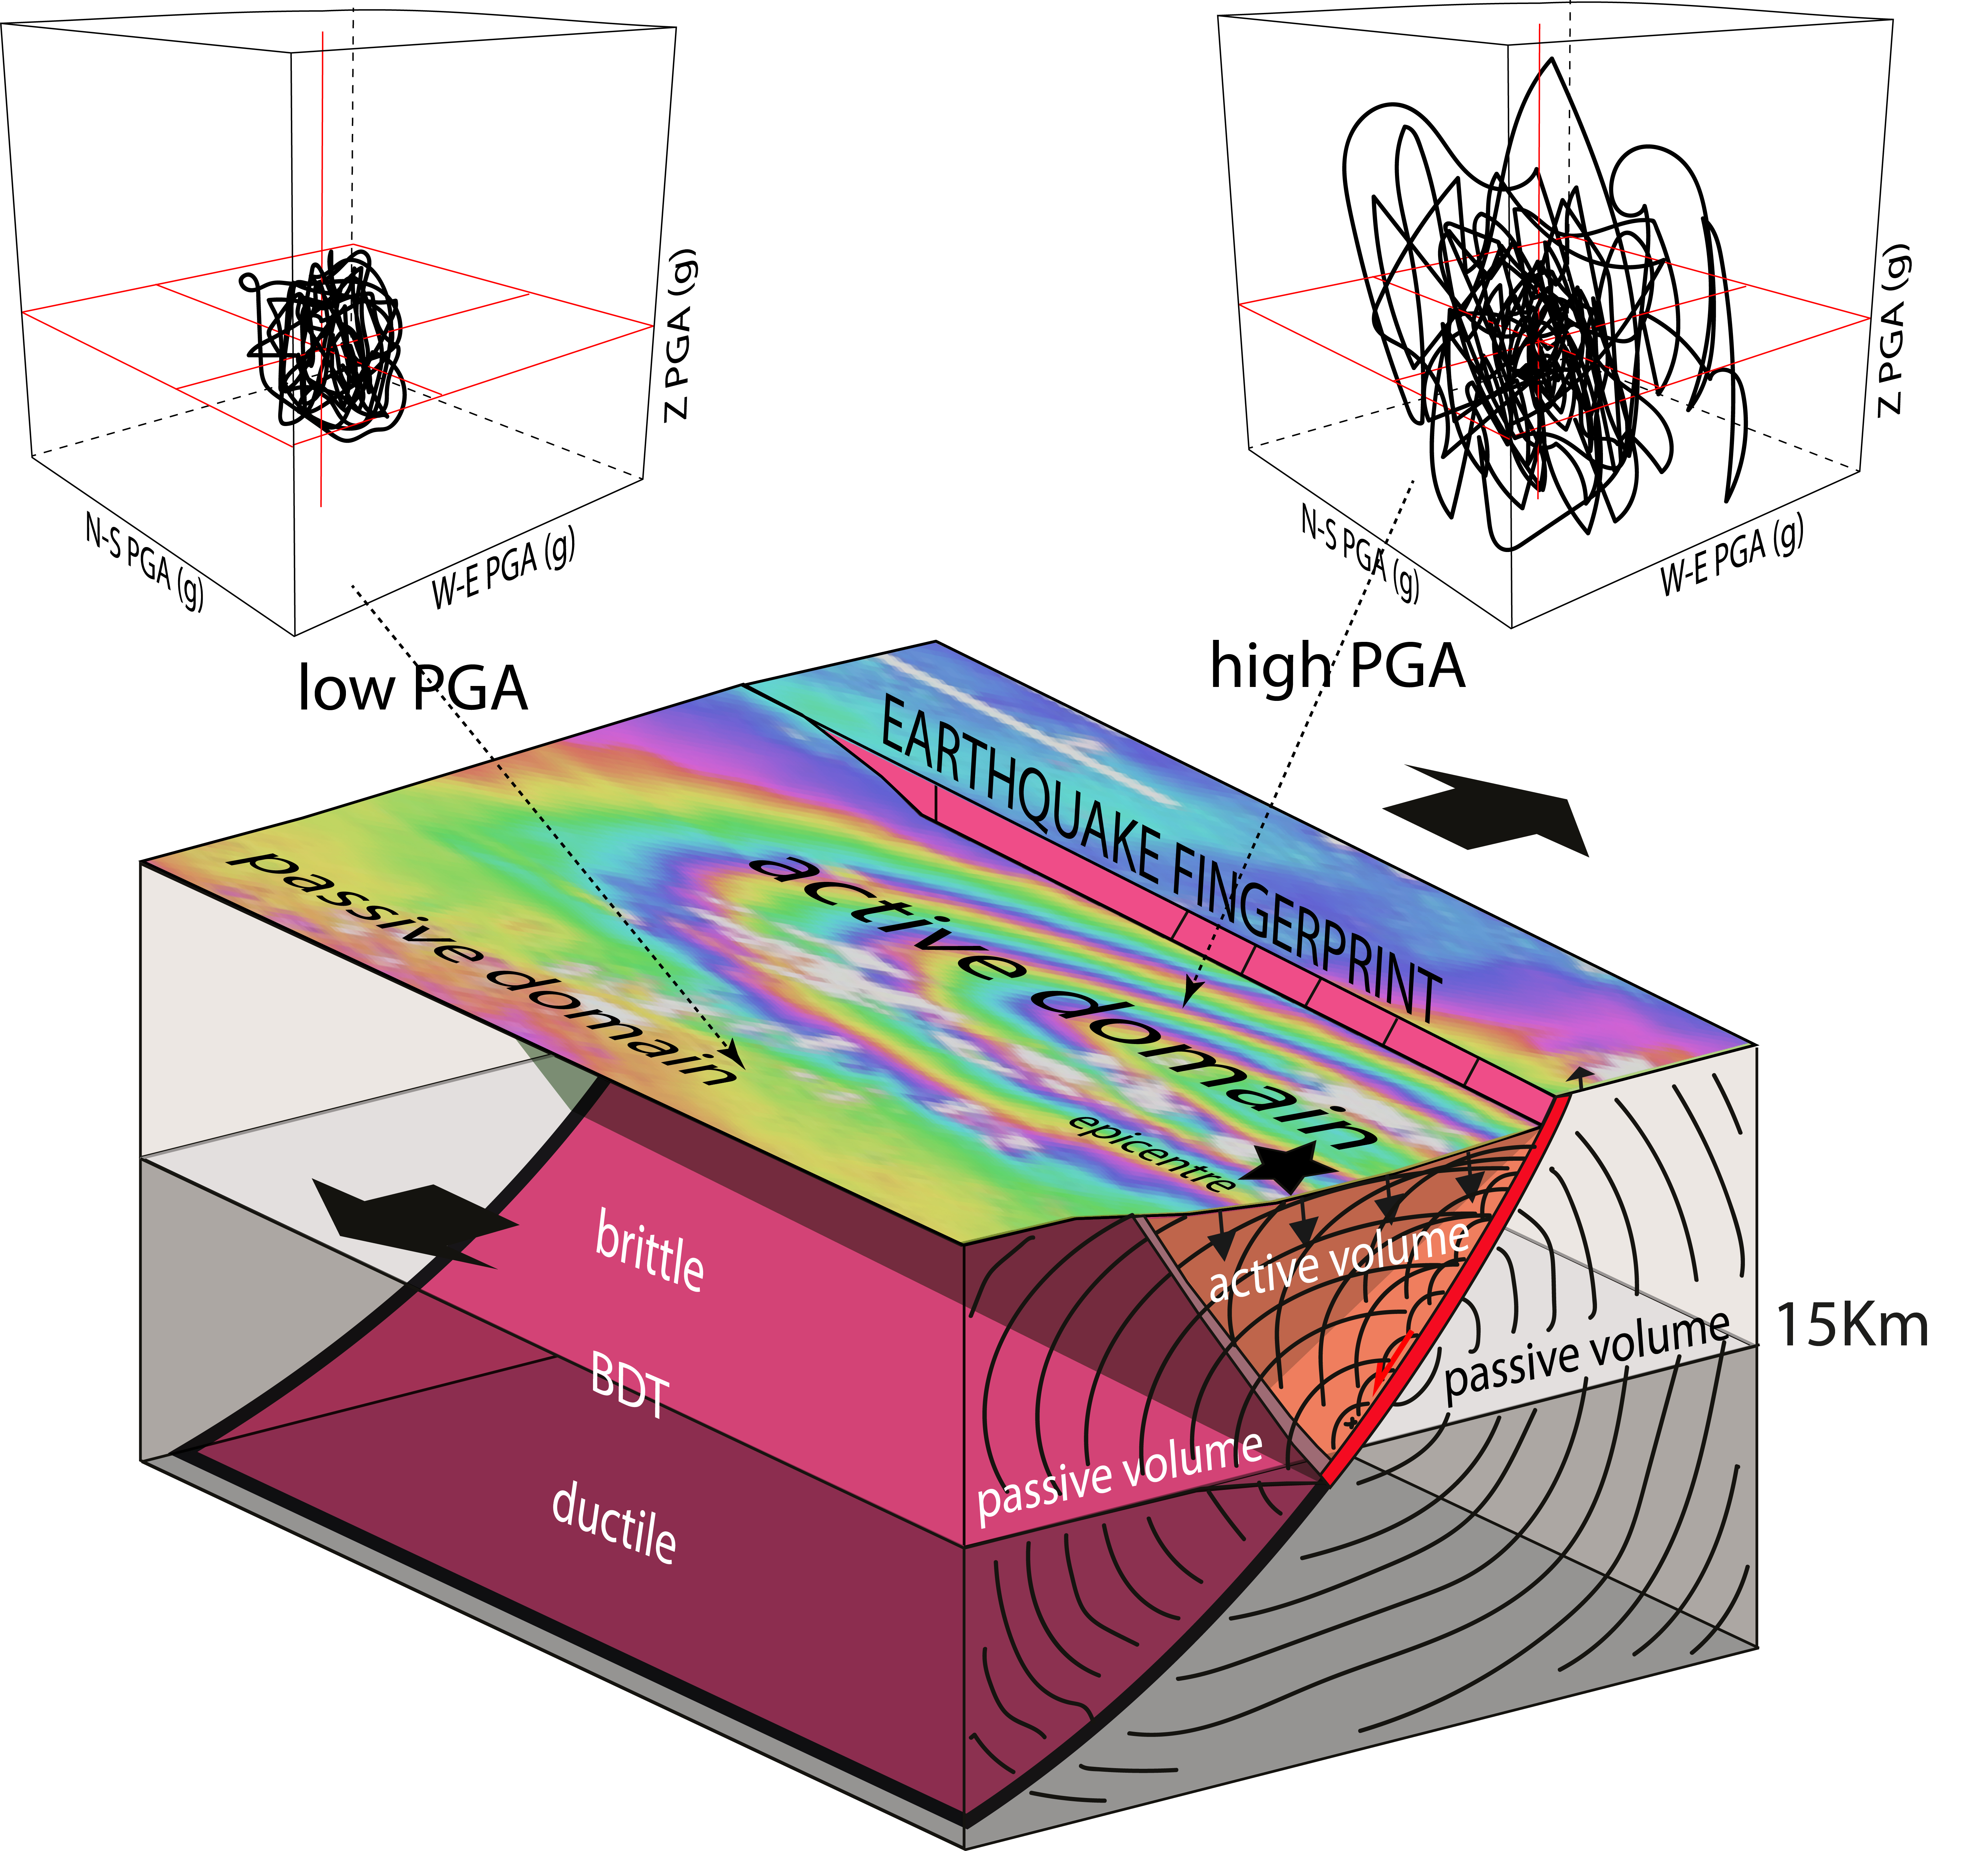
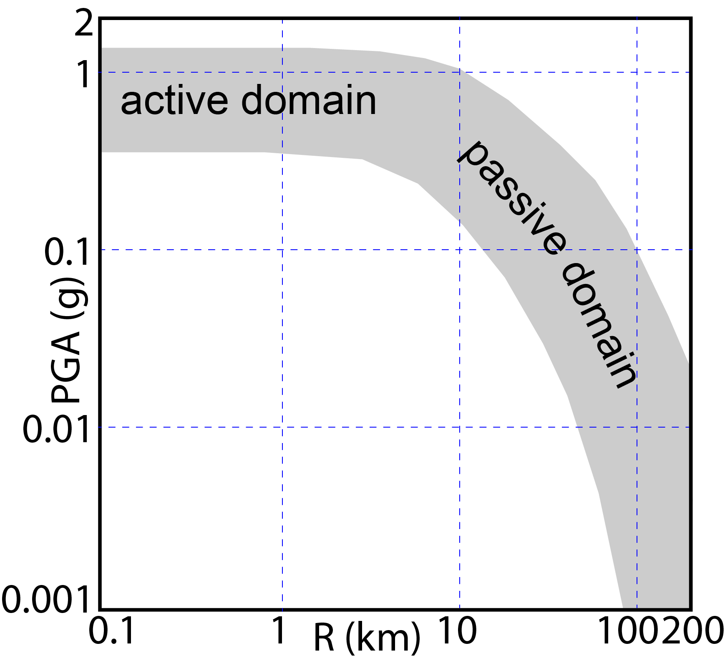
Petricca et al. 2021 ESR

Slide 15
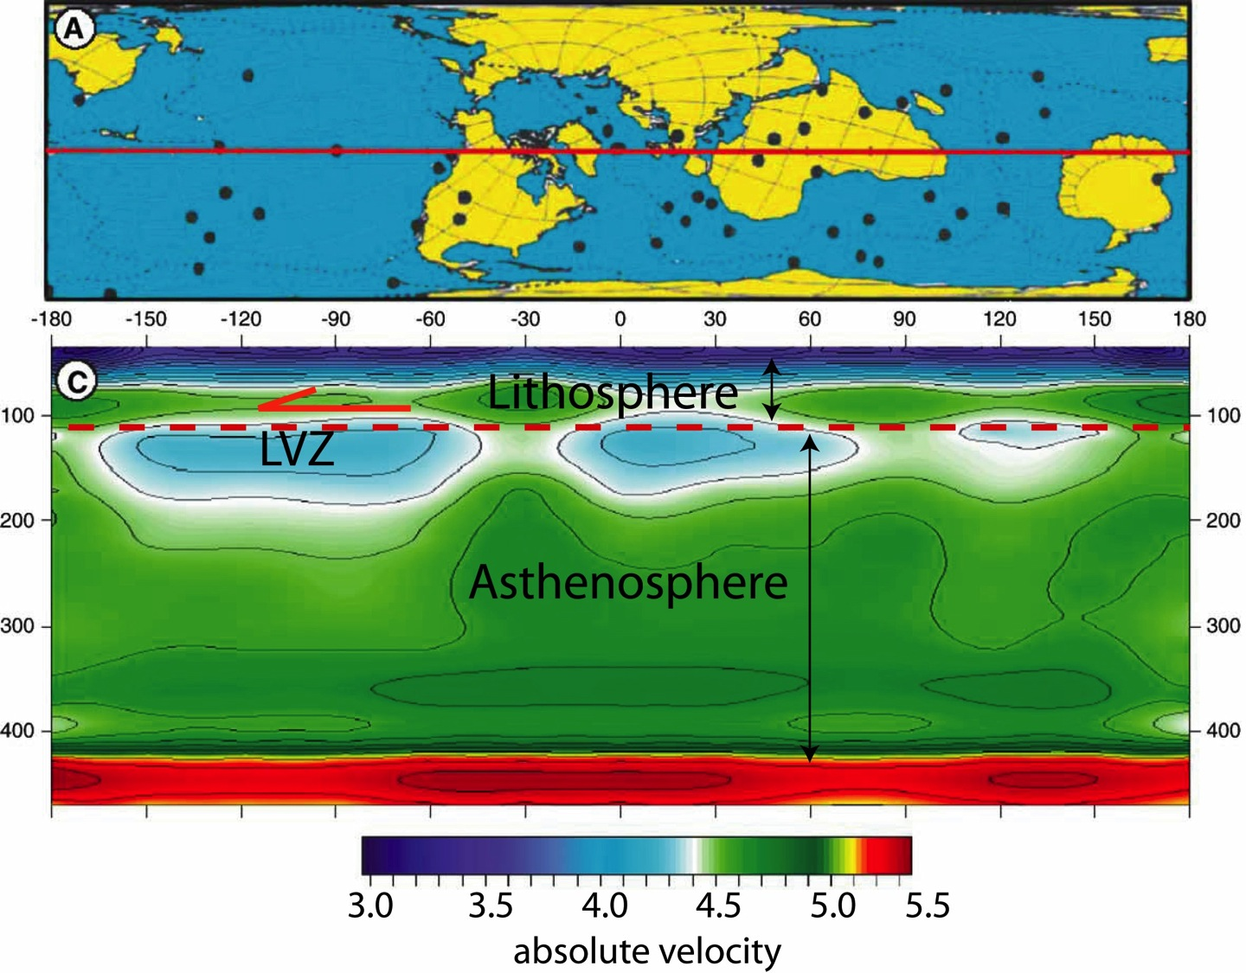
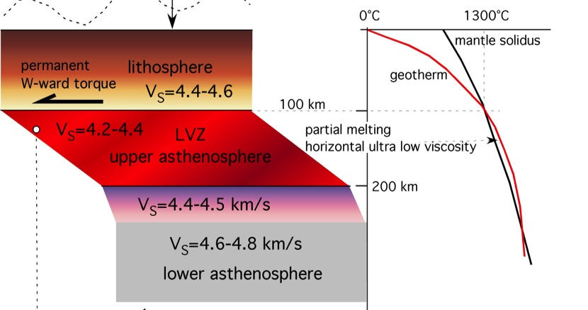
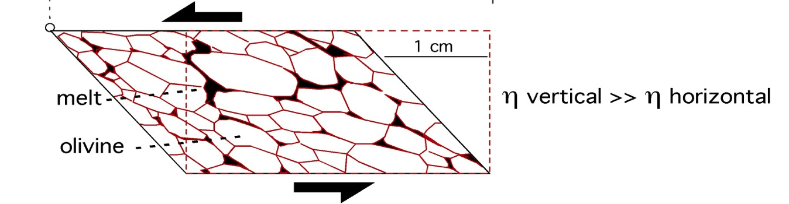
Modified after Thybo, 2006
Riguzzi et al. 2010 Tectonophysics
Riguzzi et al. 2010 Tectonophysics

Slide 16
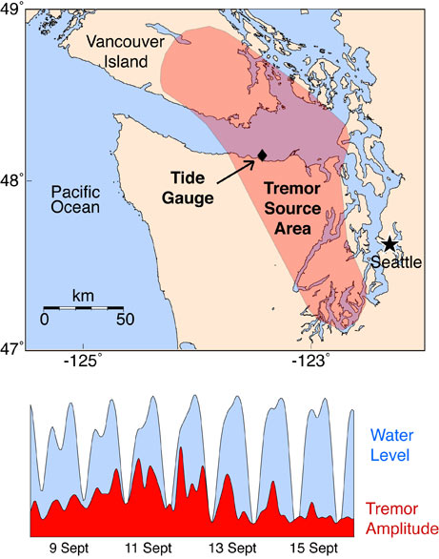
Rubinstein et al.,
2009 Science

Slide 17
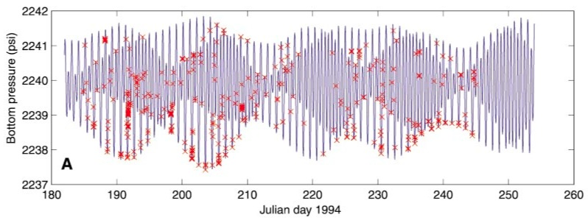
Tolstoy et al. (2002)
Normal fault earthquakes more frequent during low tide
Thrust fault earthquakes more frequent during high tide

Slide 18
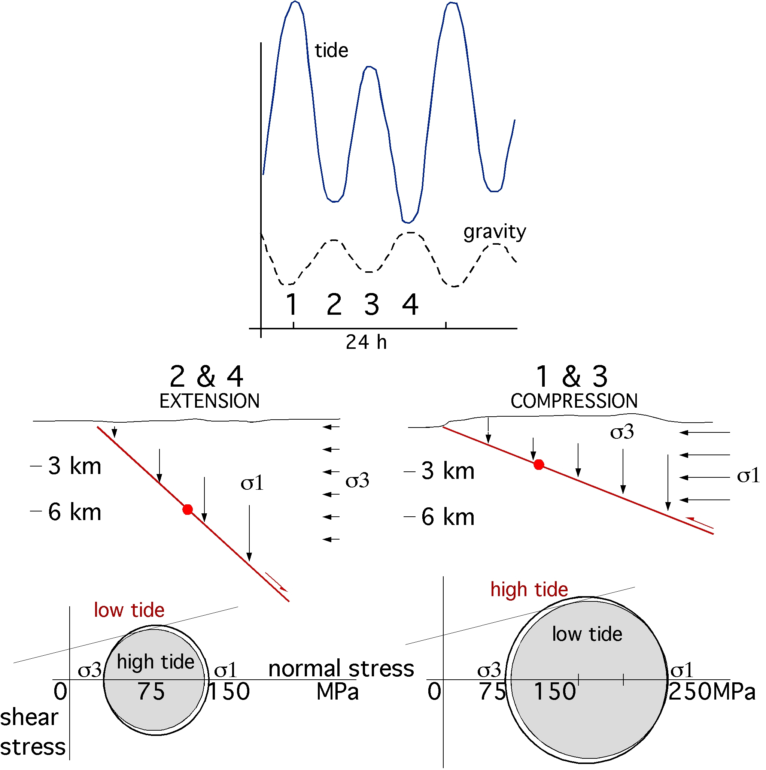
Riguzzi et al. 2010 Tectonophysics

Slide 19
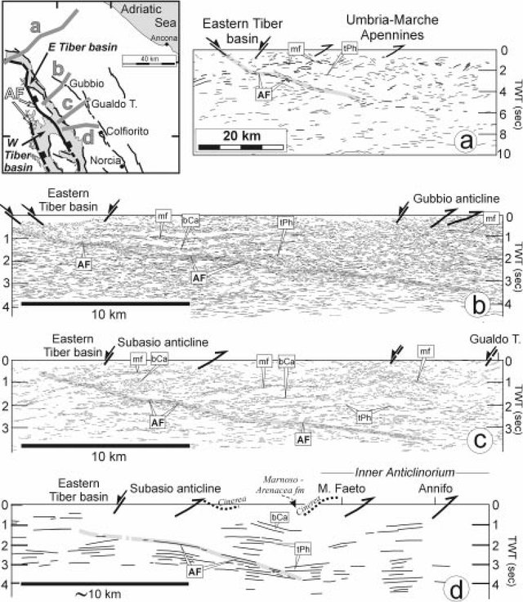


Boncio & Lavecchia 2000 JS

Slide 20
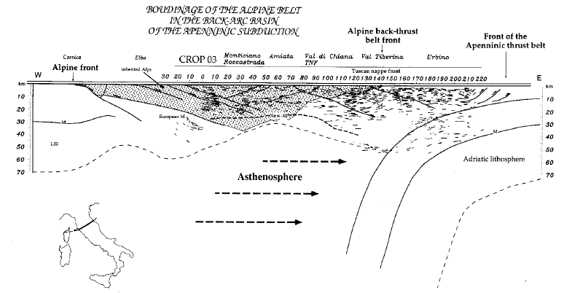

Doglioni, Mongelli, Pialli, 1996 Mem. SGI

Slide 21
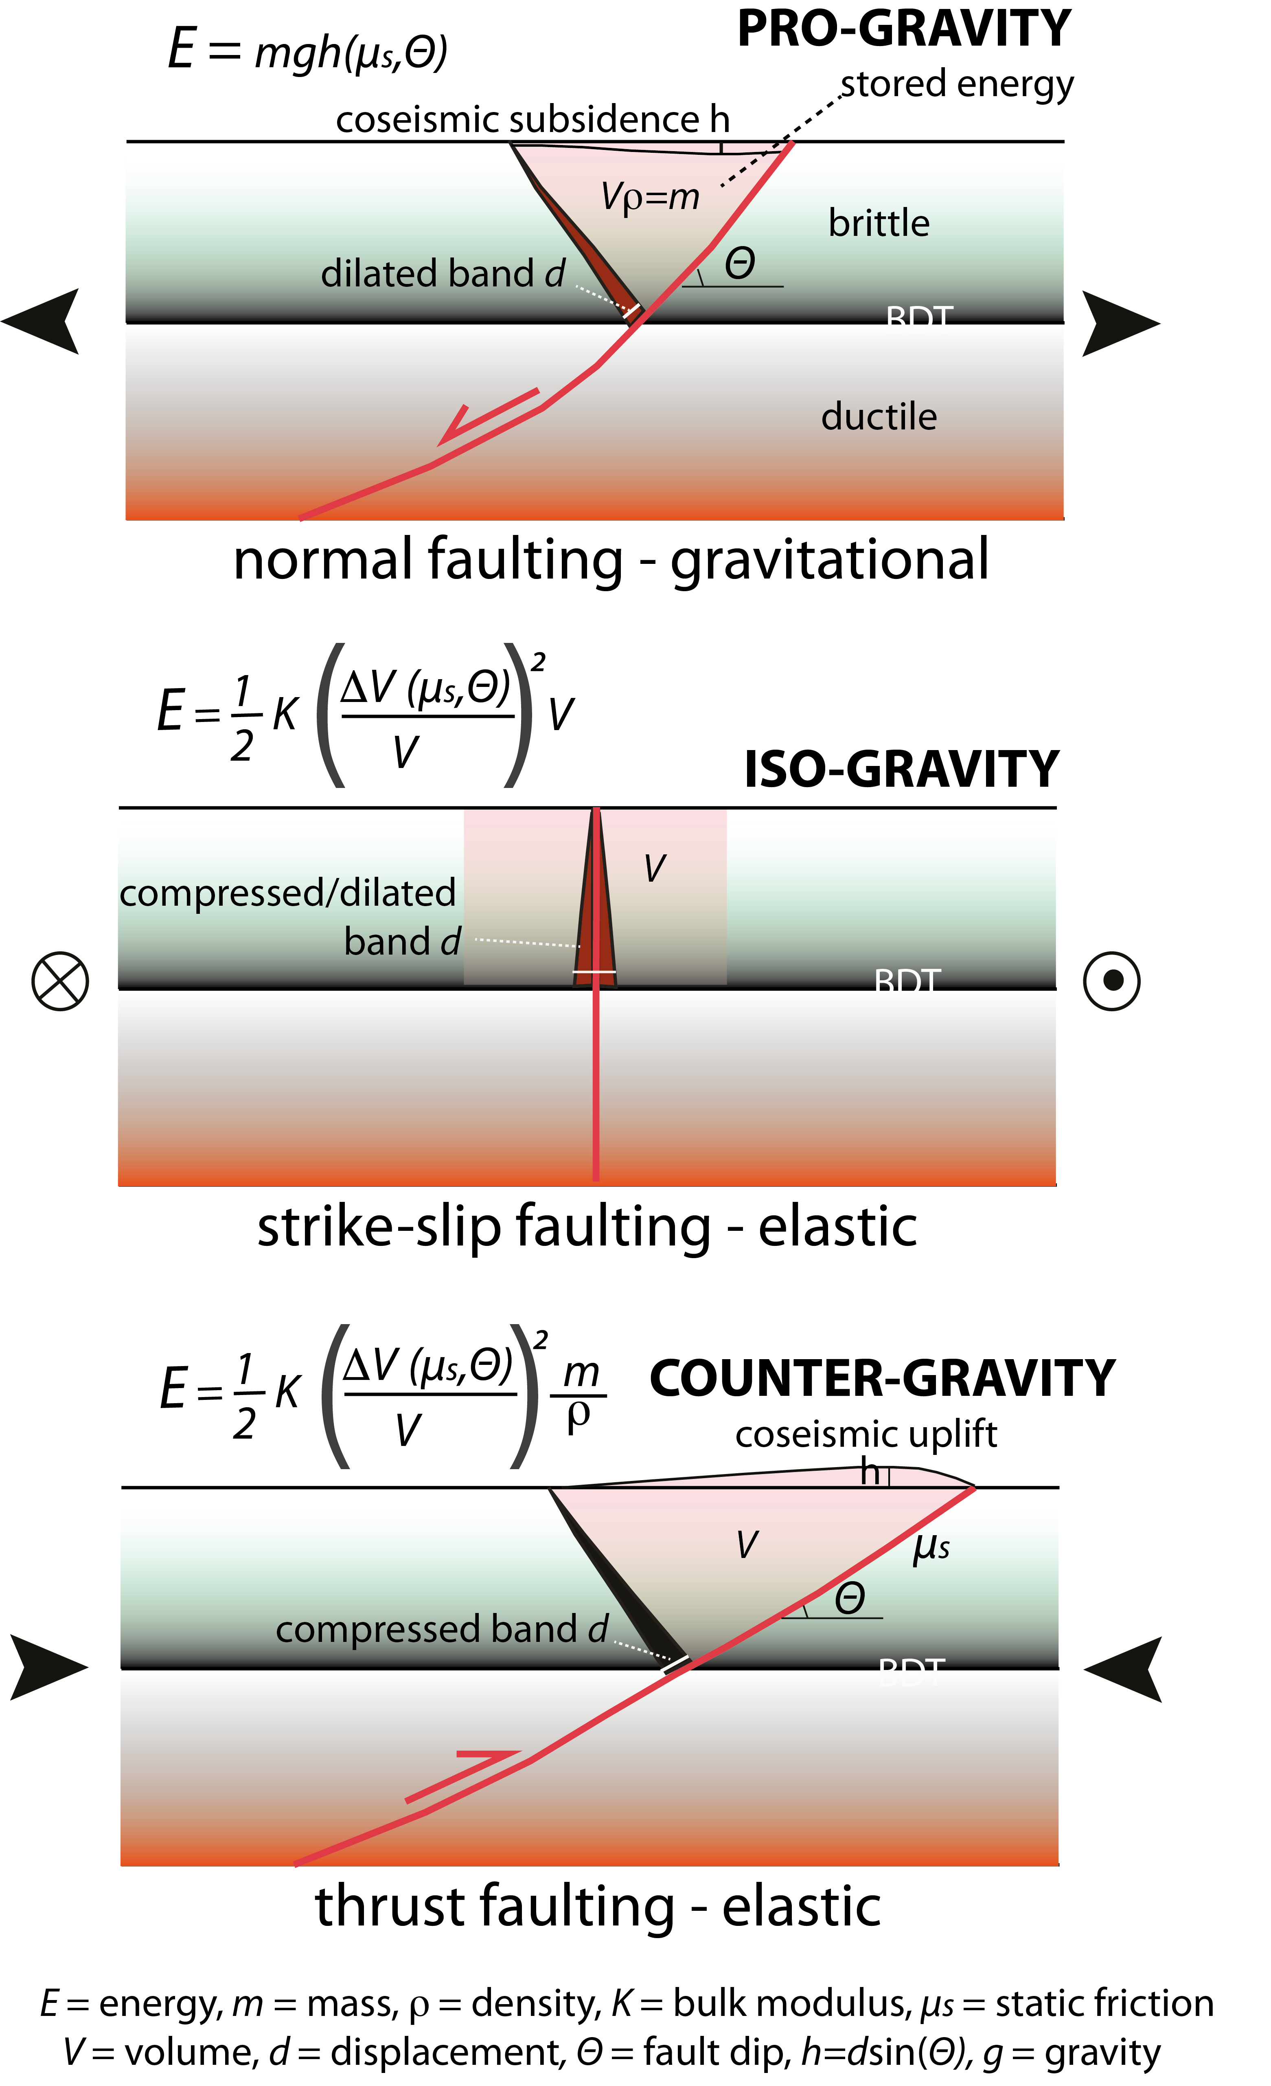
Doglioni 2024 GSF

Slide 22
Petricca et al. 2021 ESR

Slide 23
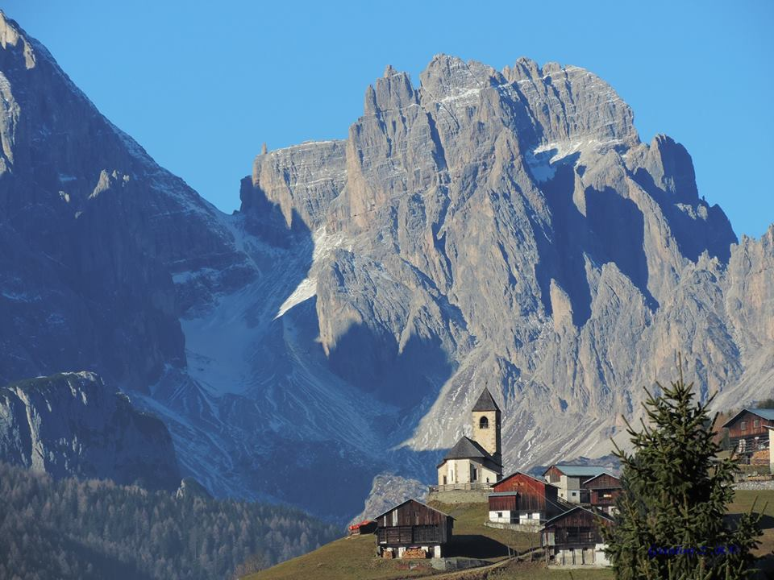
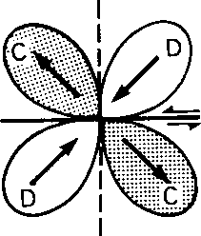

Slide 24
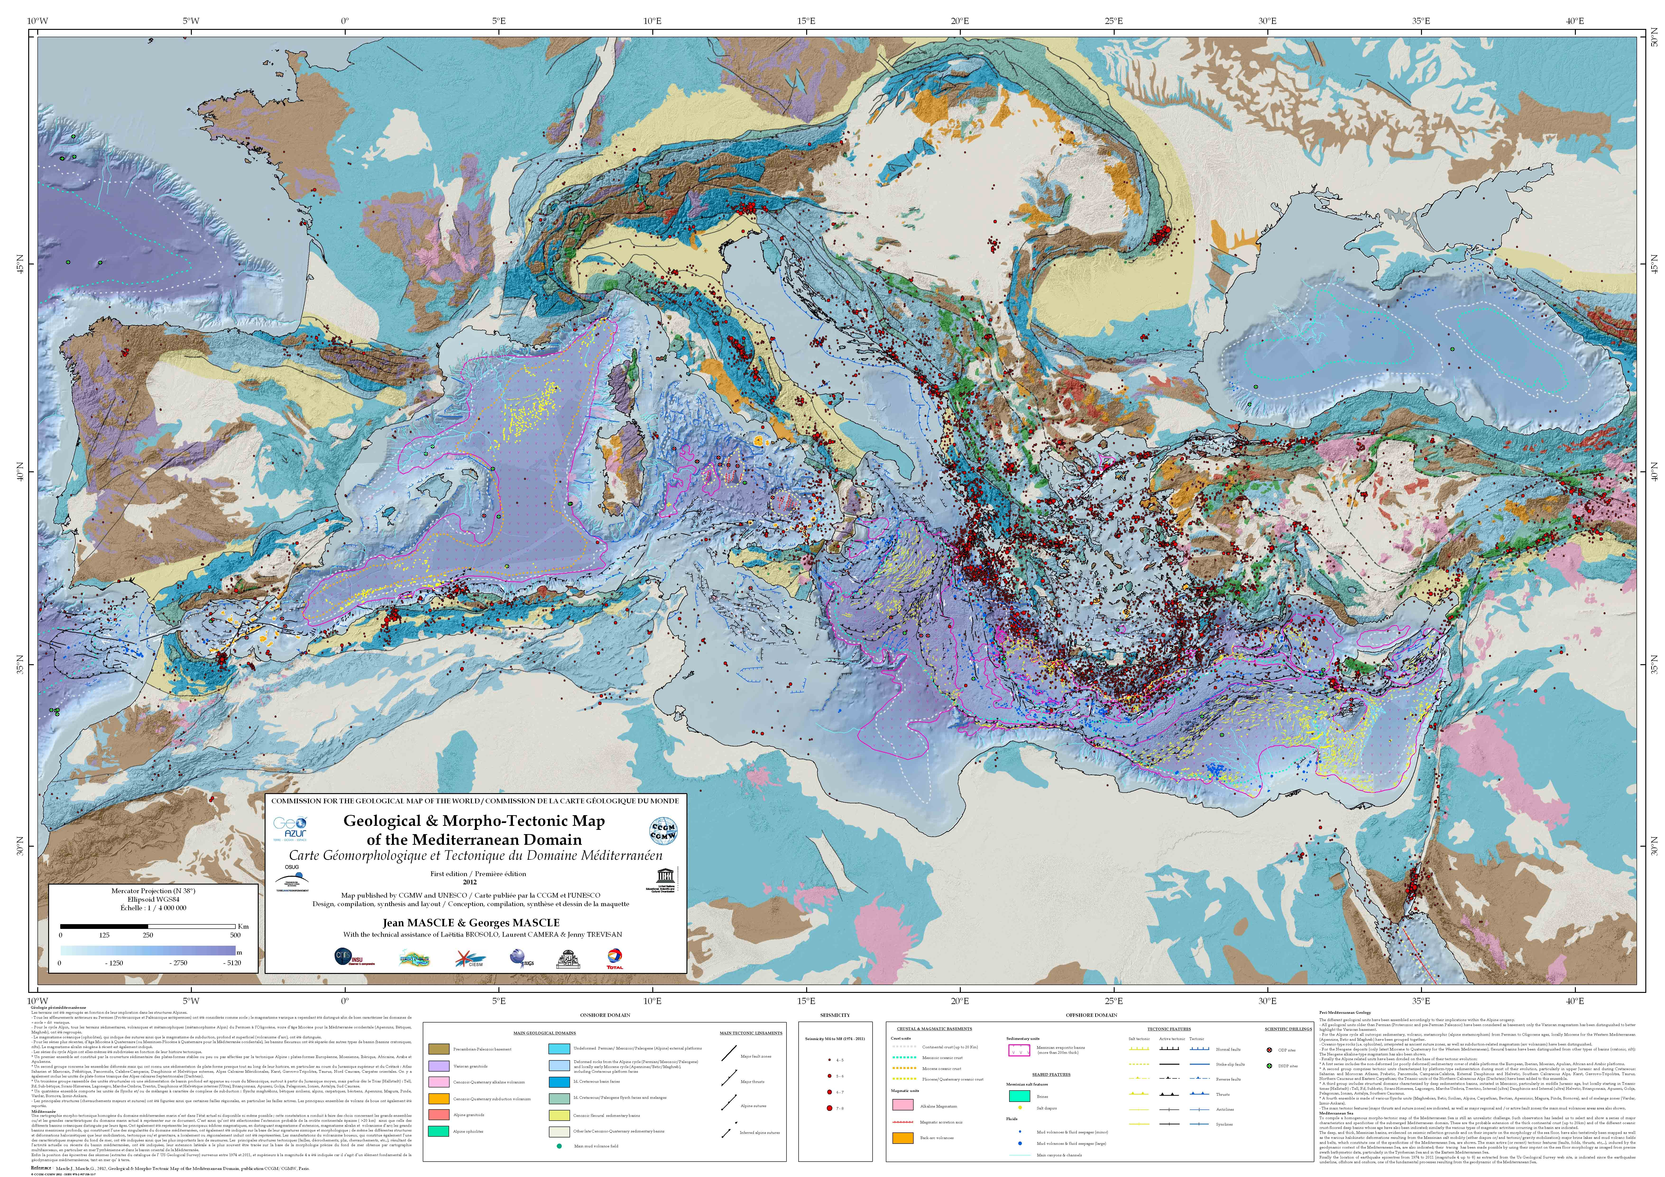
Mediterranean geodynamics:
a global laboratory of the polarized plate tectonics - Carlo Doglioni

Slide 25
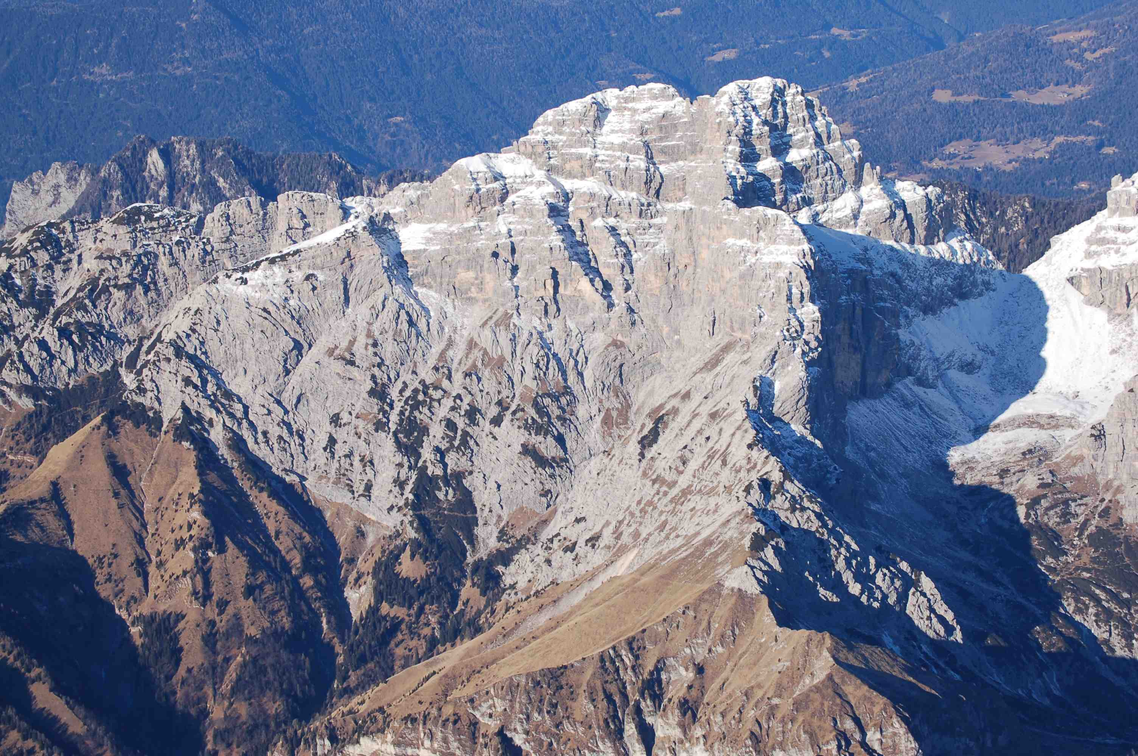
S
Sass de Mura – Vette Feltrine
DP
B
Doglioni & Carminati 2008 Mem. Descrittive Carta Geol. It.
http://www.dst.uniroma1.it/dst1/sciterra/sezioni/doglioni/Publ_download/2008DoglioniCarminatiStructuralStyles.pdf

Slide 26
ACTIVE MARGIN
PASSIVE MARGIN
Wrigley et al. 2015 JPG

Slide 27
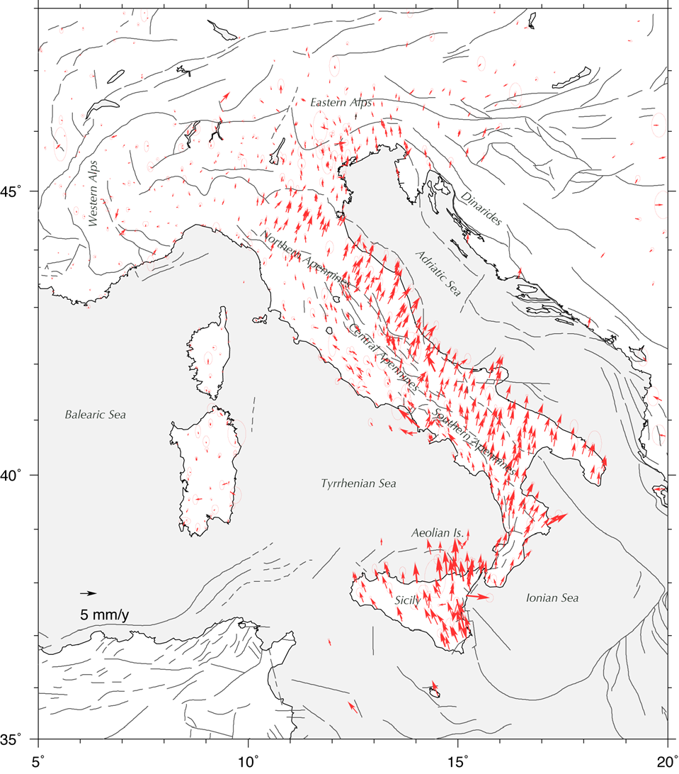

INGV
Devoti et al. 2017

Slide 28
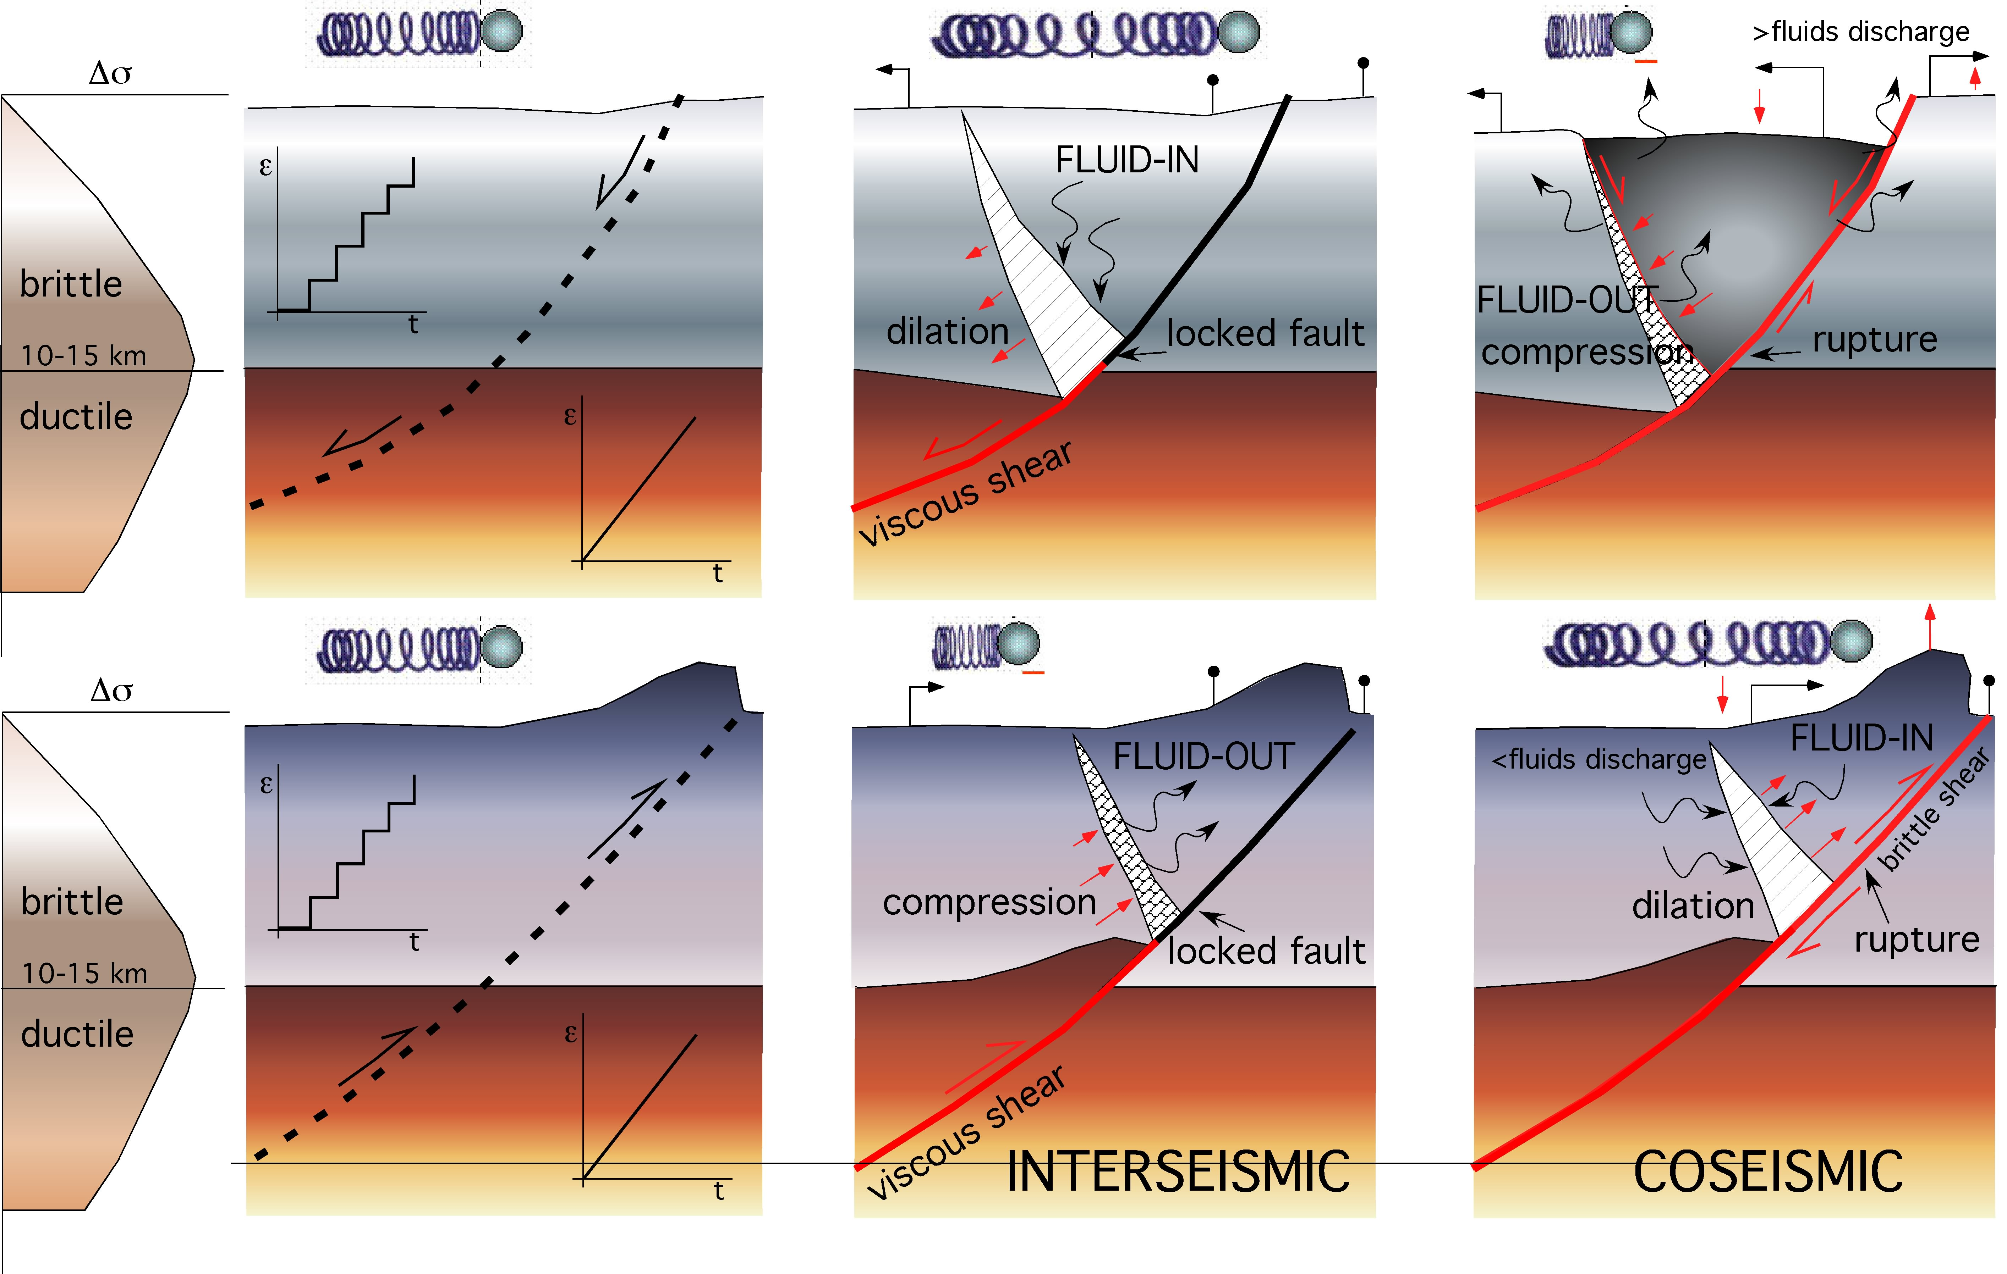
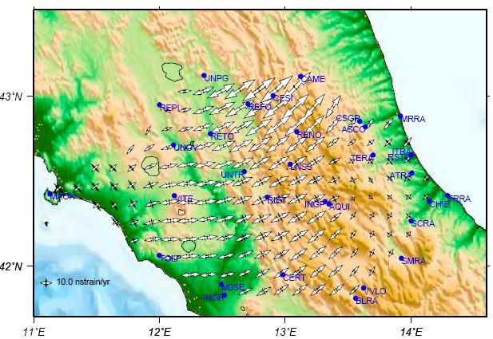
Interseismic strain rate
Doglioni et al. 2011 PEPI

Slide 30
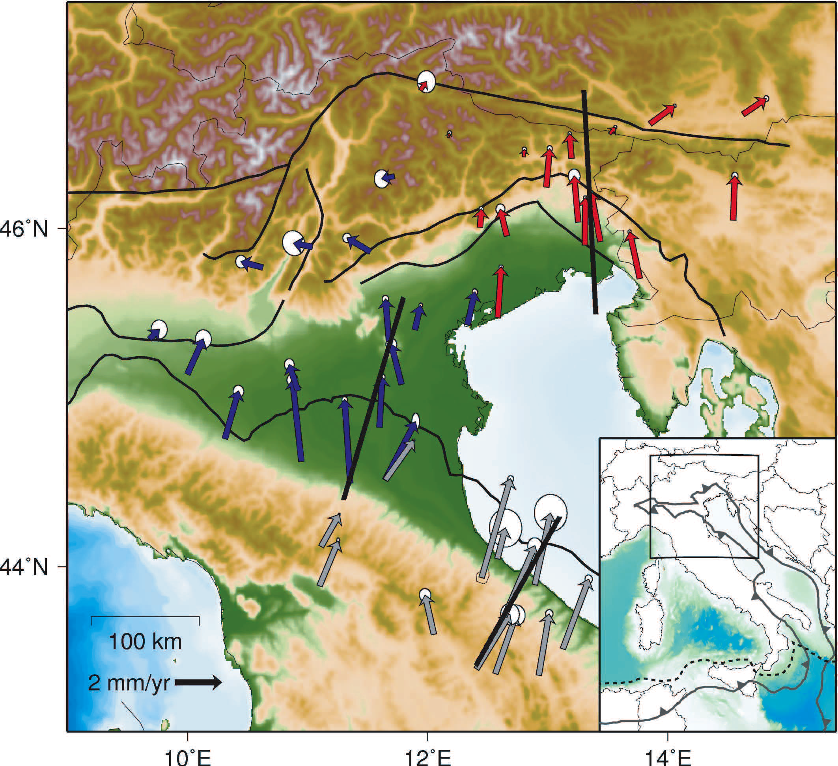
Cuffaro et al. 2010 Rend. Lincei

Slide 31
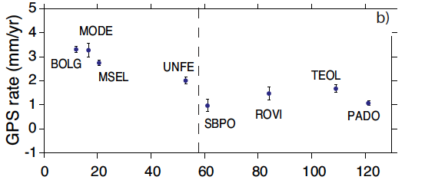
km
Cuffaro et al. 2010 Rendiconti Lincei

Slide 32
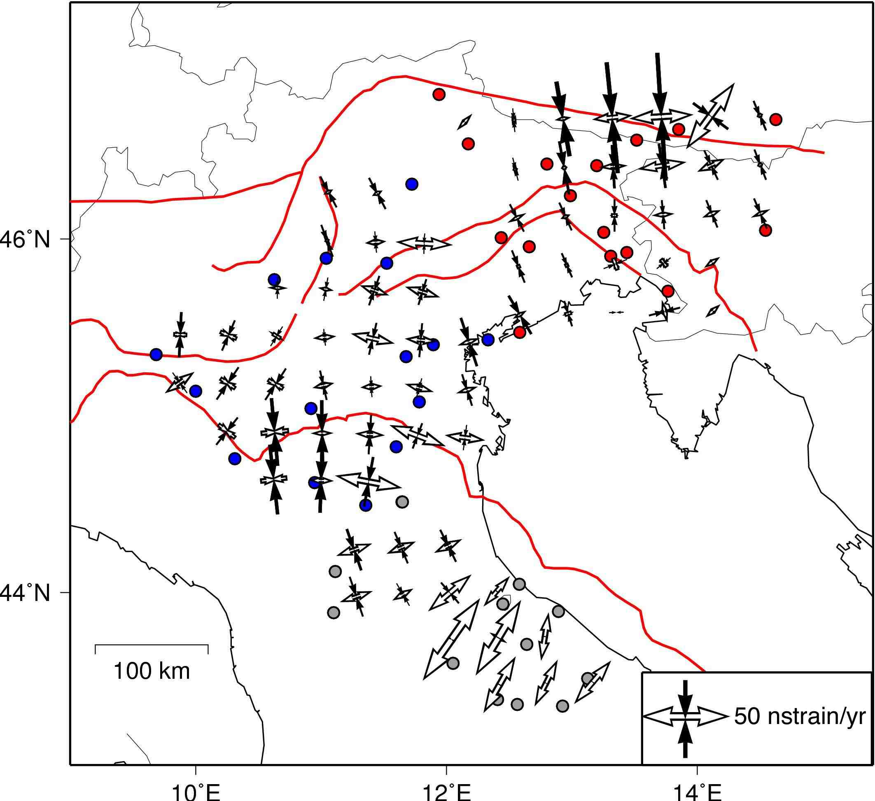
Cuffaro et al. 2010 Rend. Lincei

Slide 33
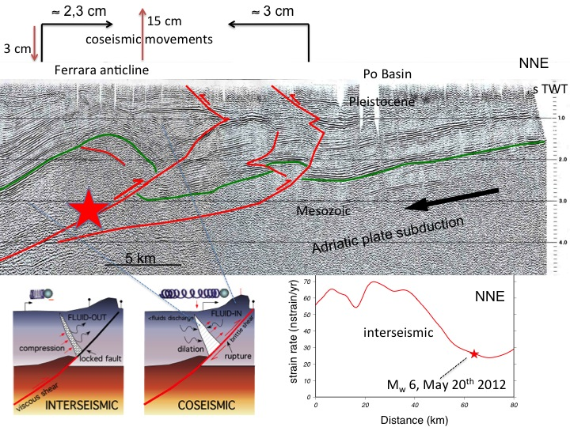

Slide 34
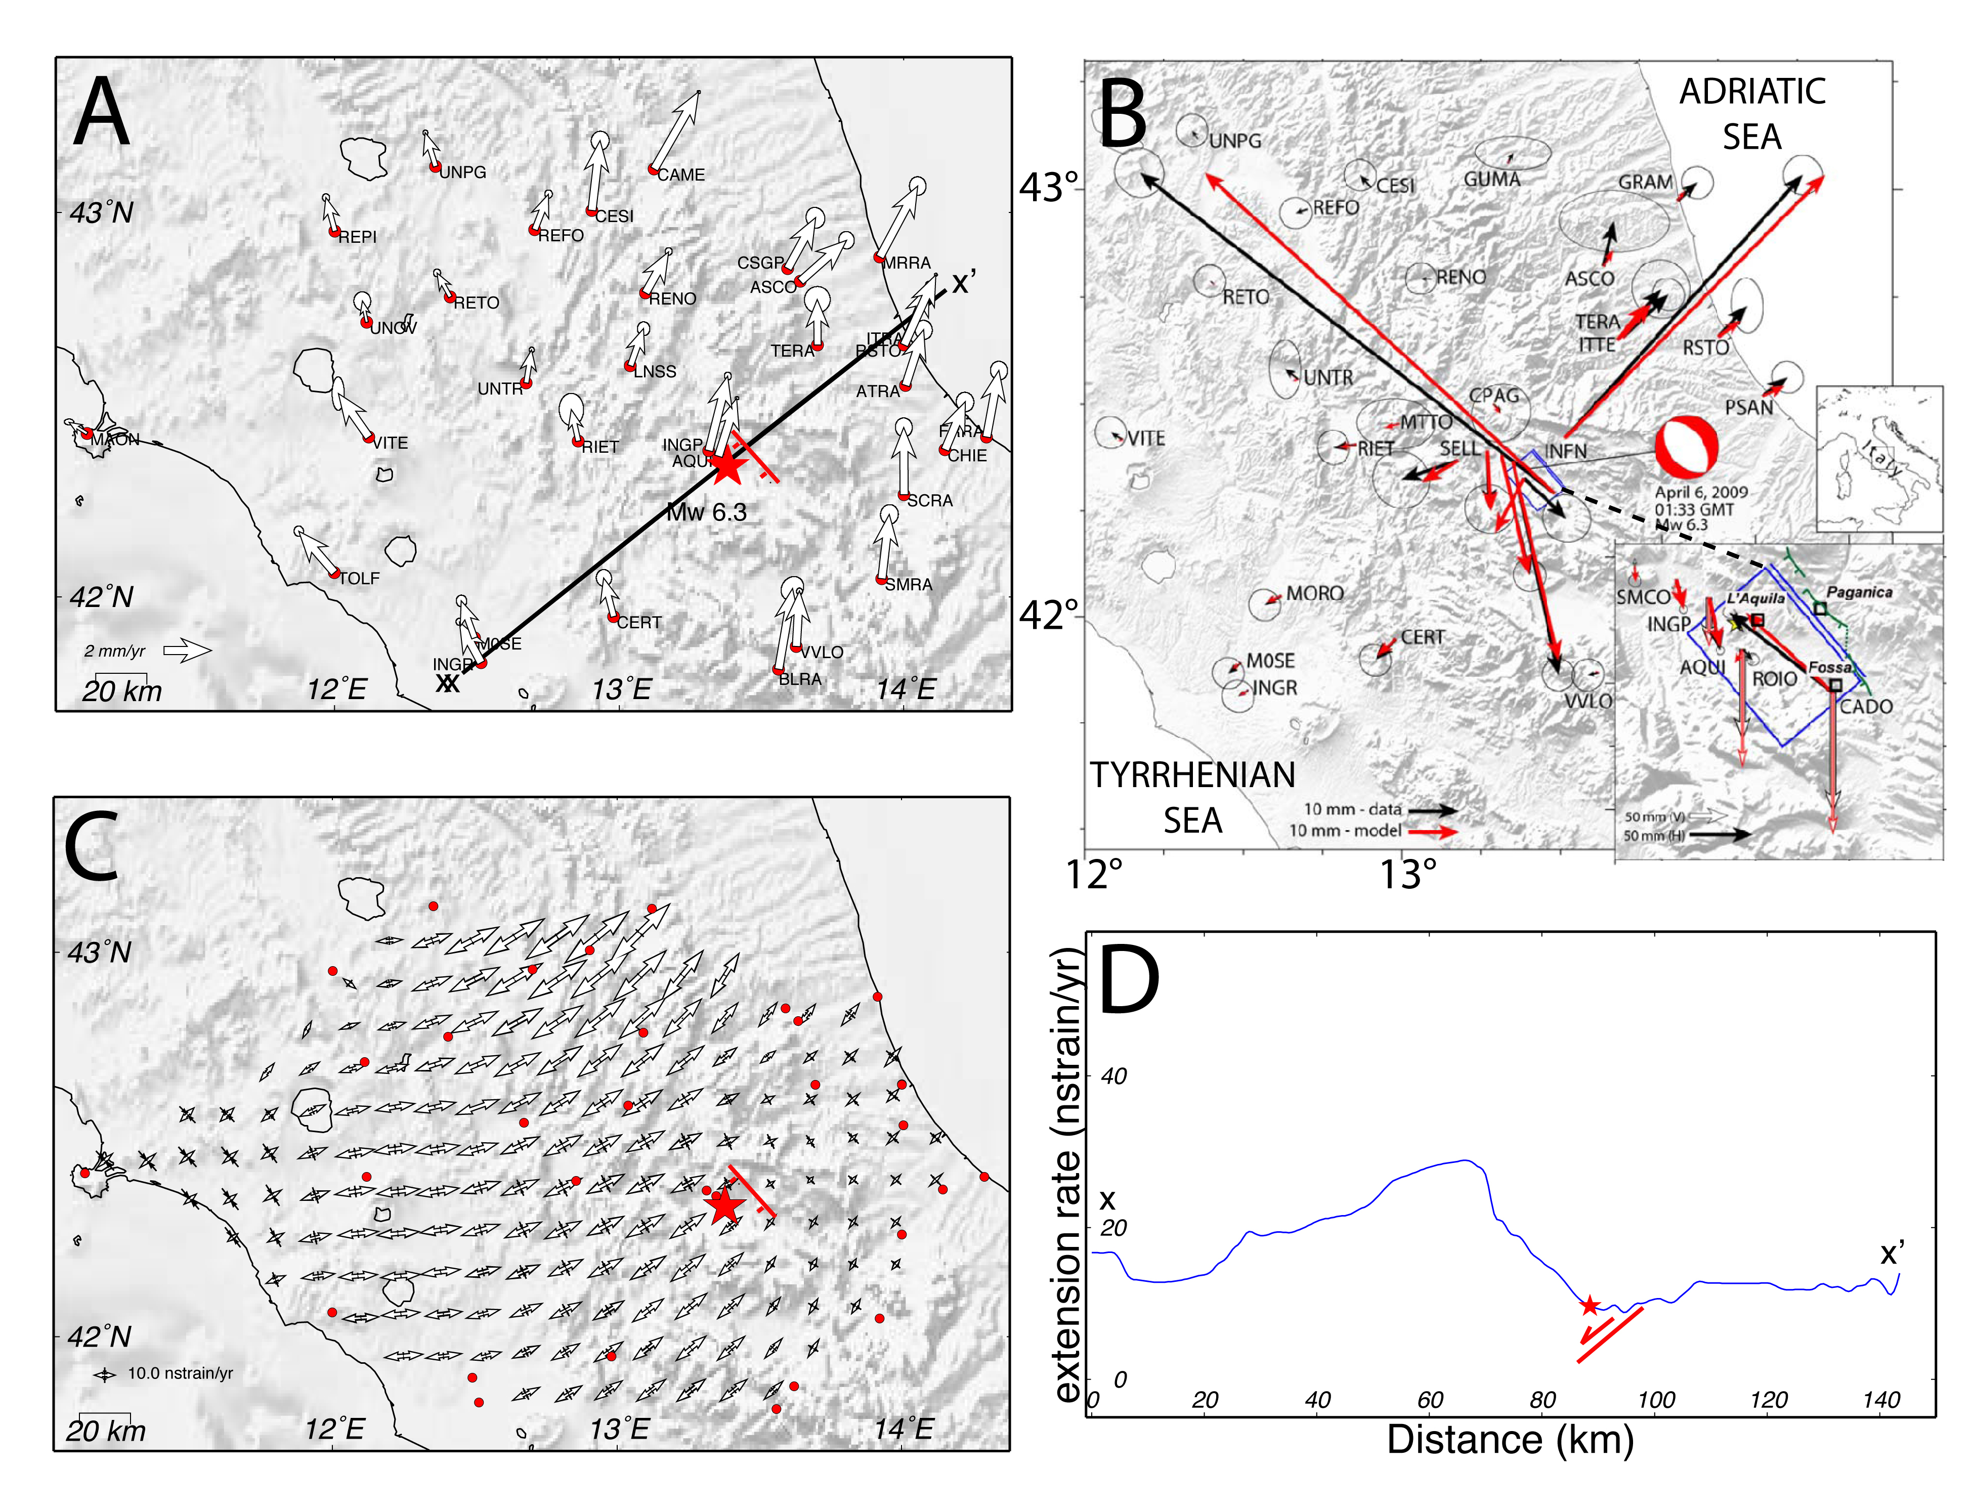

Slide 35
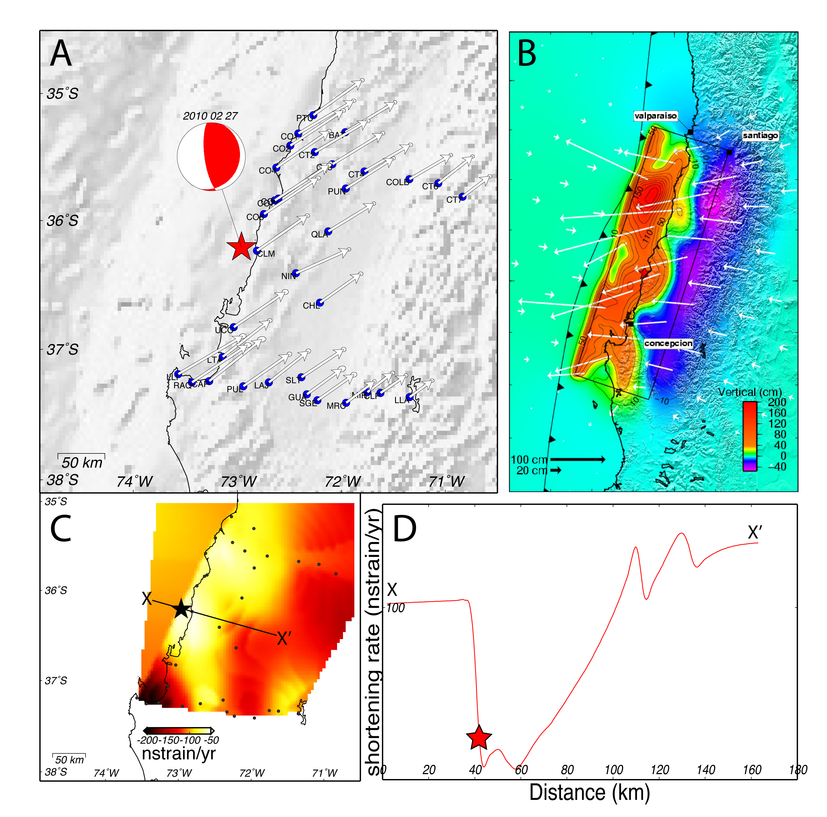
Doglioni et al. 2015 Geoscience Frontiers

Slide 36
Earthquakes >M2.2 vs SR
2007-2011
Magnitude
Riguzzi et al. 2012 PEPI

Slide 37
Seismicity (>M3) 2007-2011
same time frame >M4 vs SR>40 ns
Riguzzi et al. 2012 PEPI

Slide 38
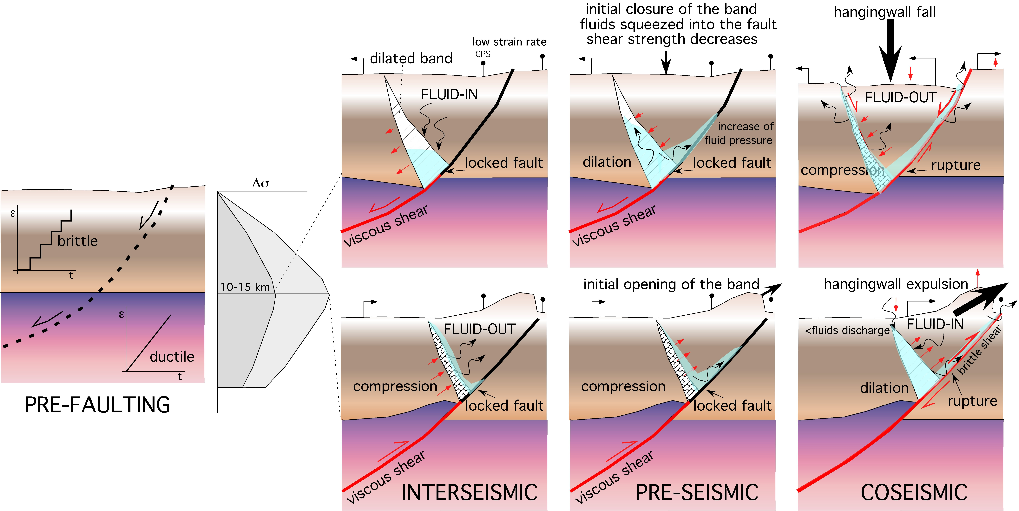
Doglioni et al. 2014 Geoscience Frontiers

Slide 39
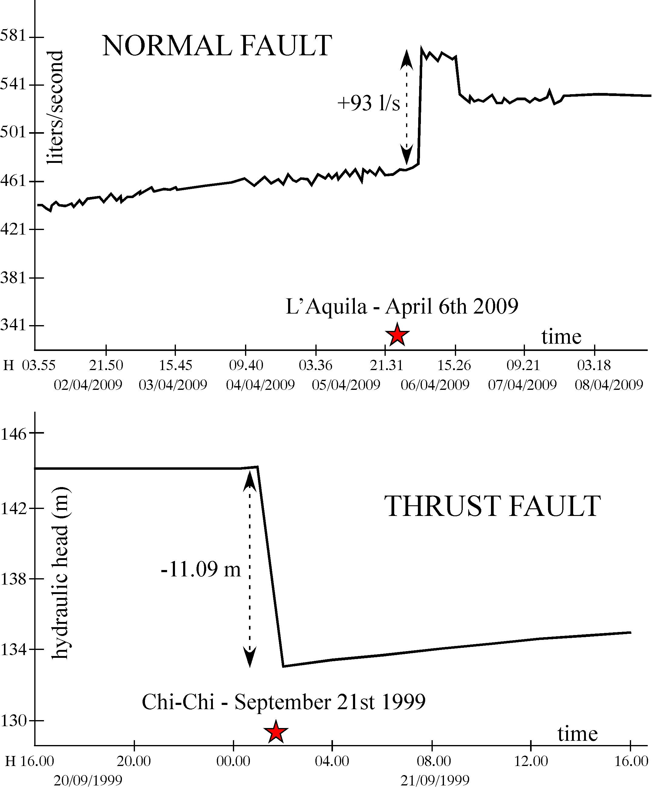
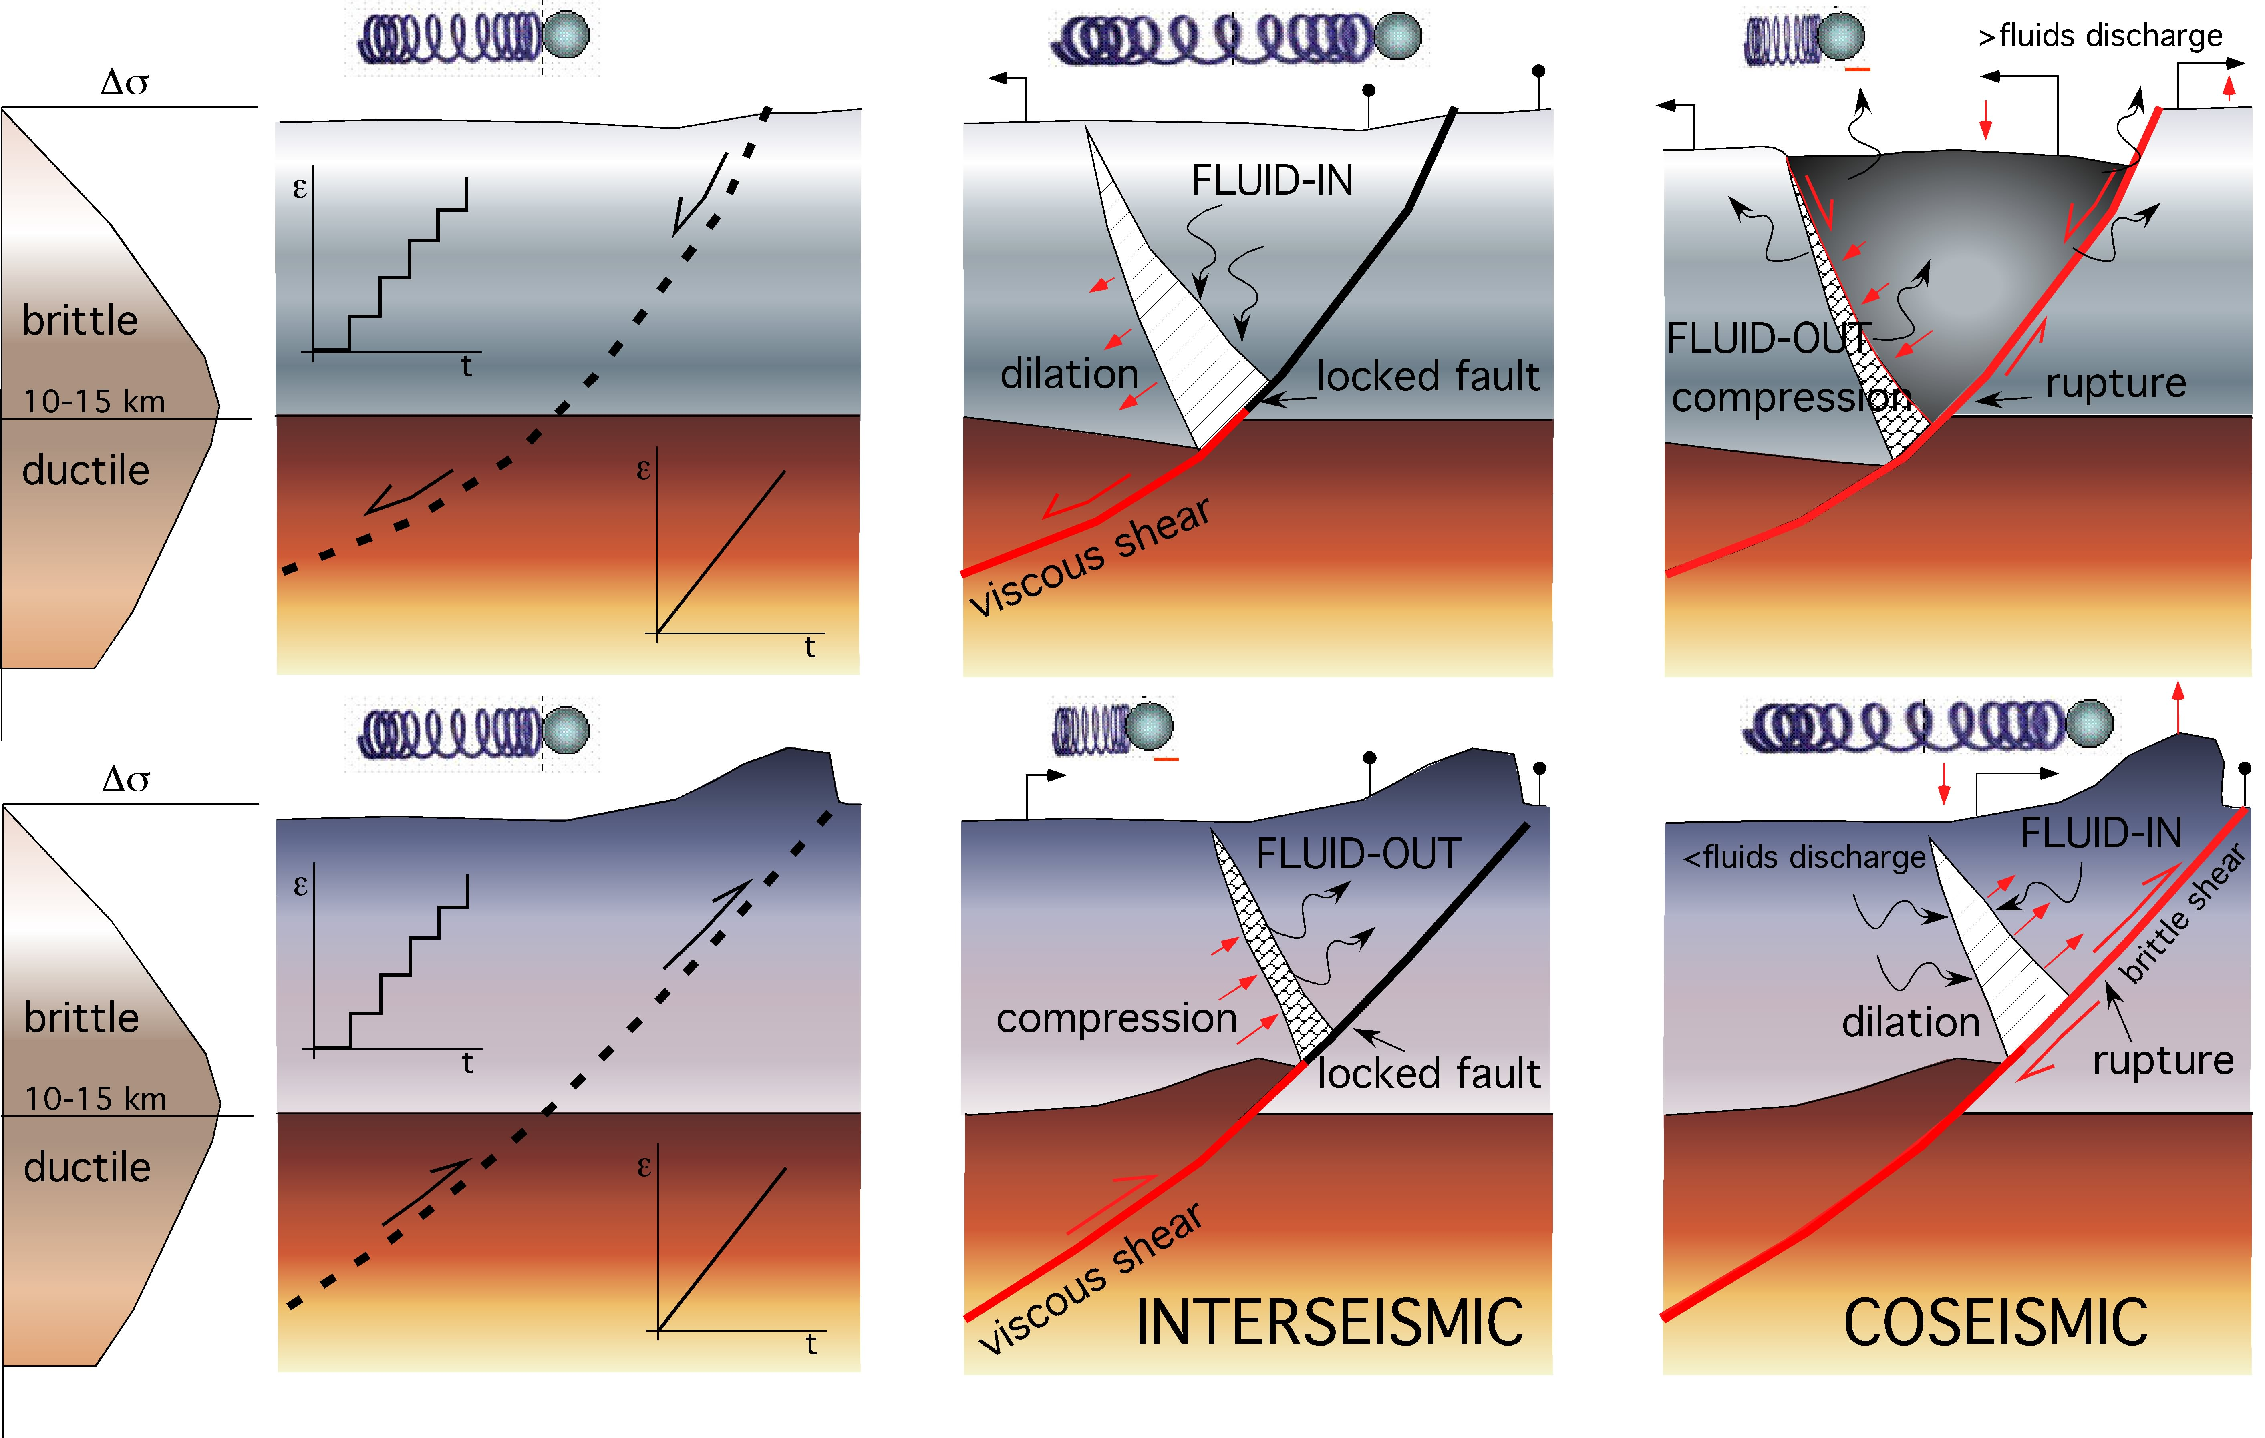

Slide 40
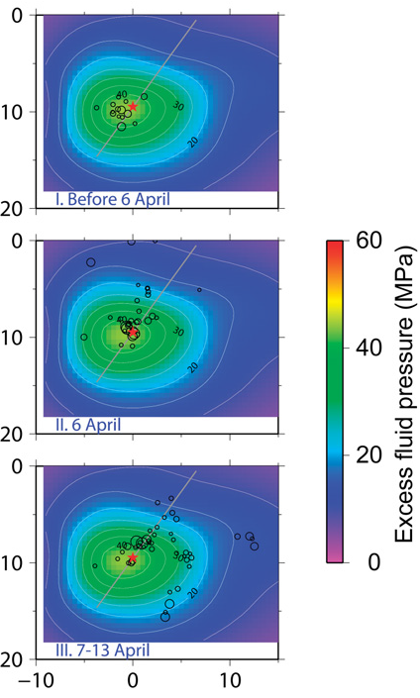
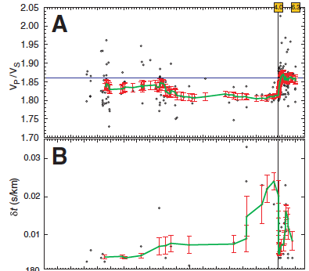
NE
km
100 days before 7 0
Lucente et al. 2010
km
Terakawa et al. 2010

Slide 41
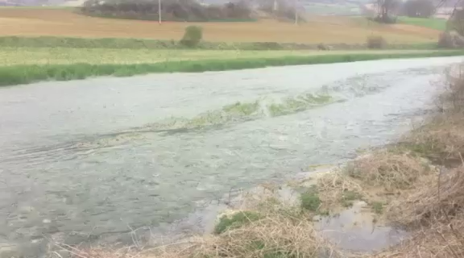

Slide 42
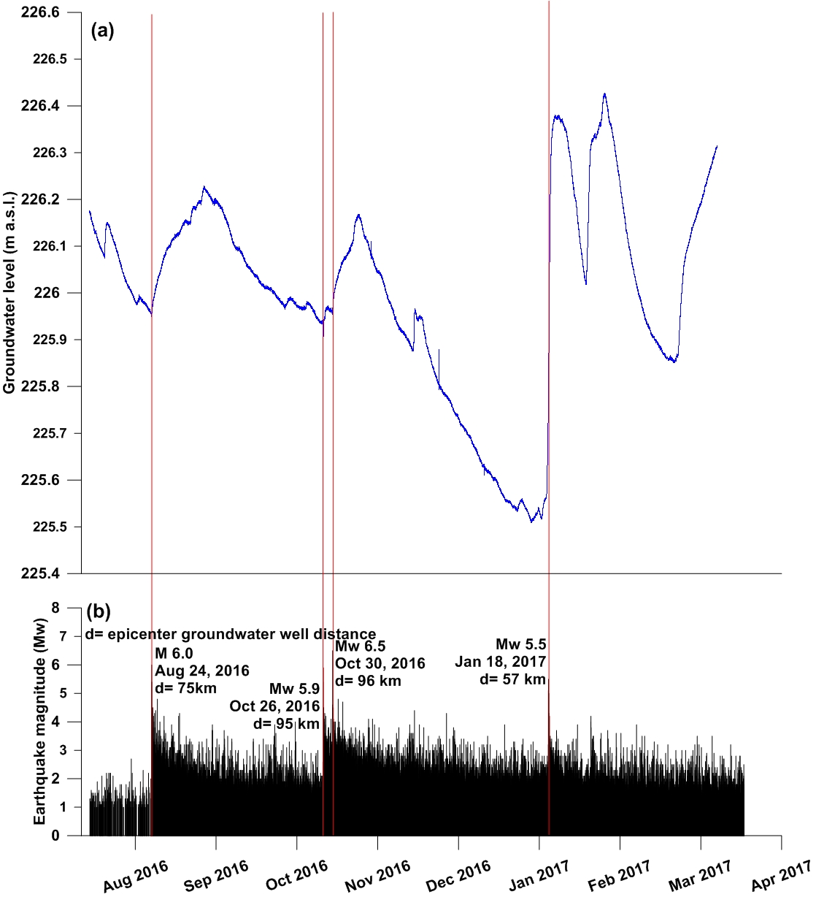
Barberio et al. 2017 SREP

Slide 43
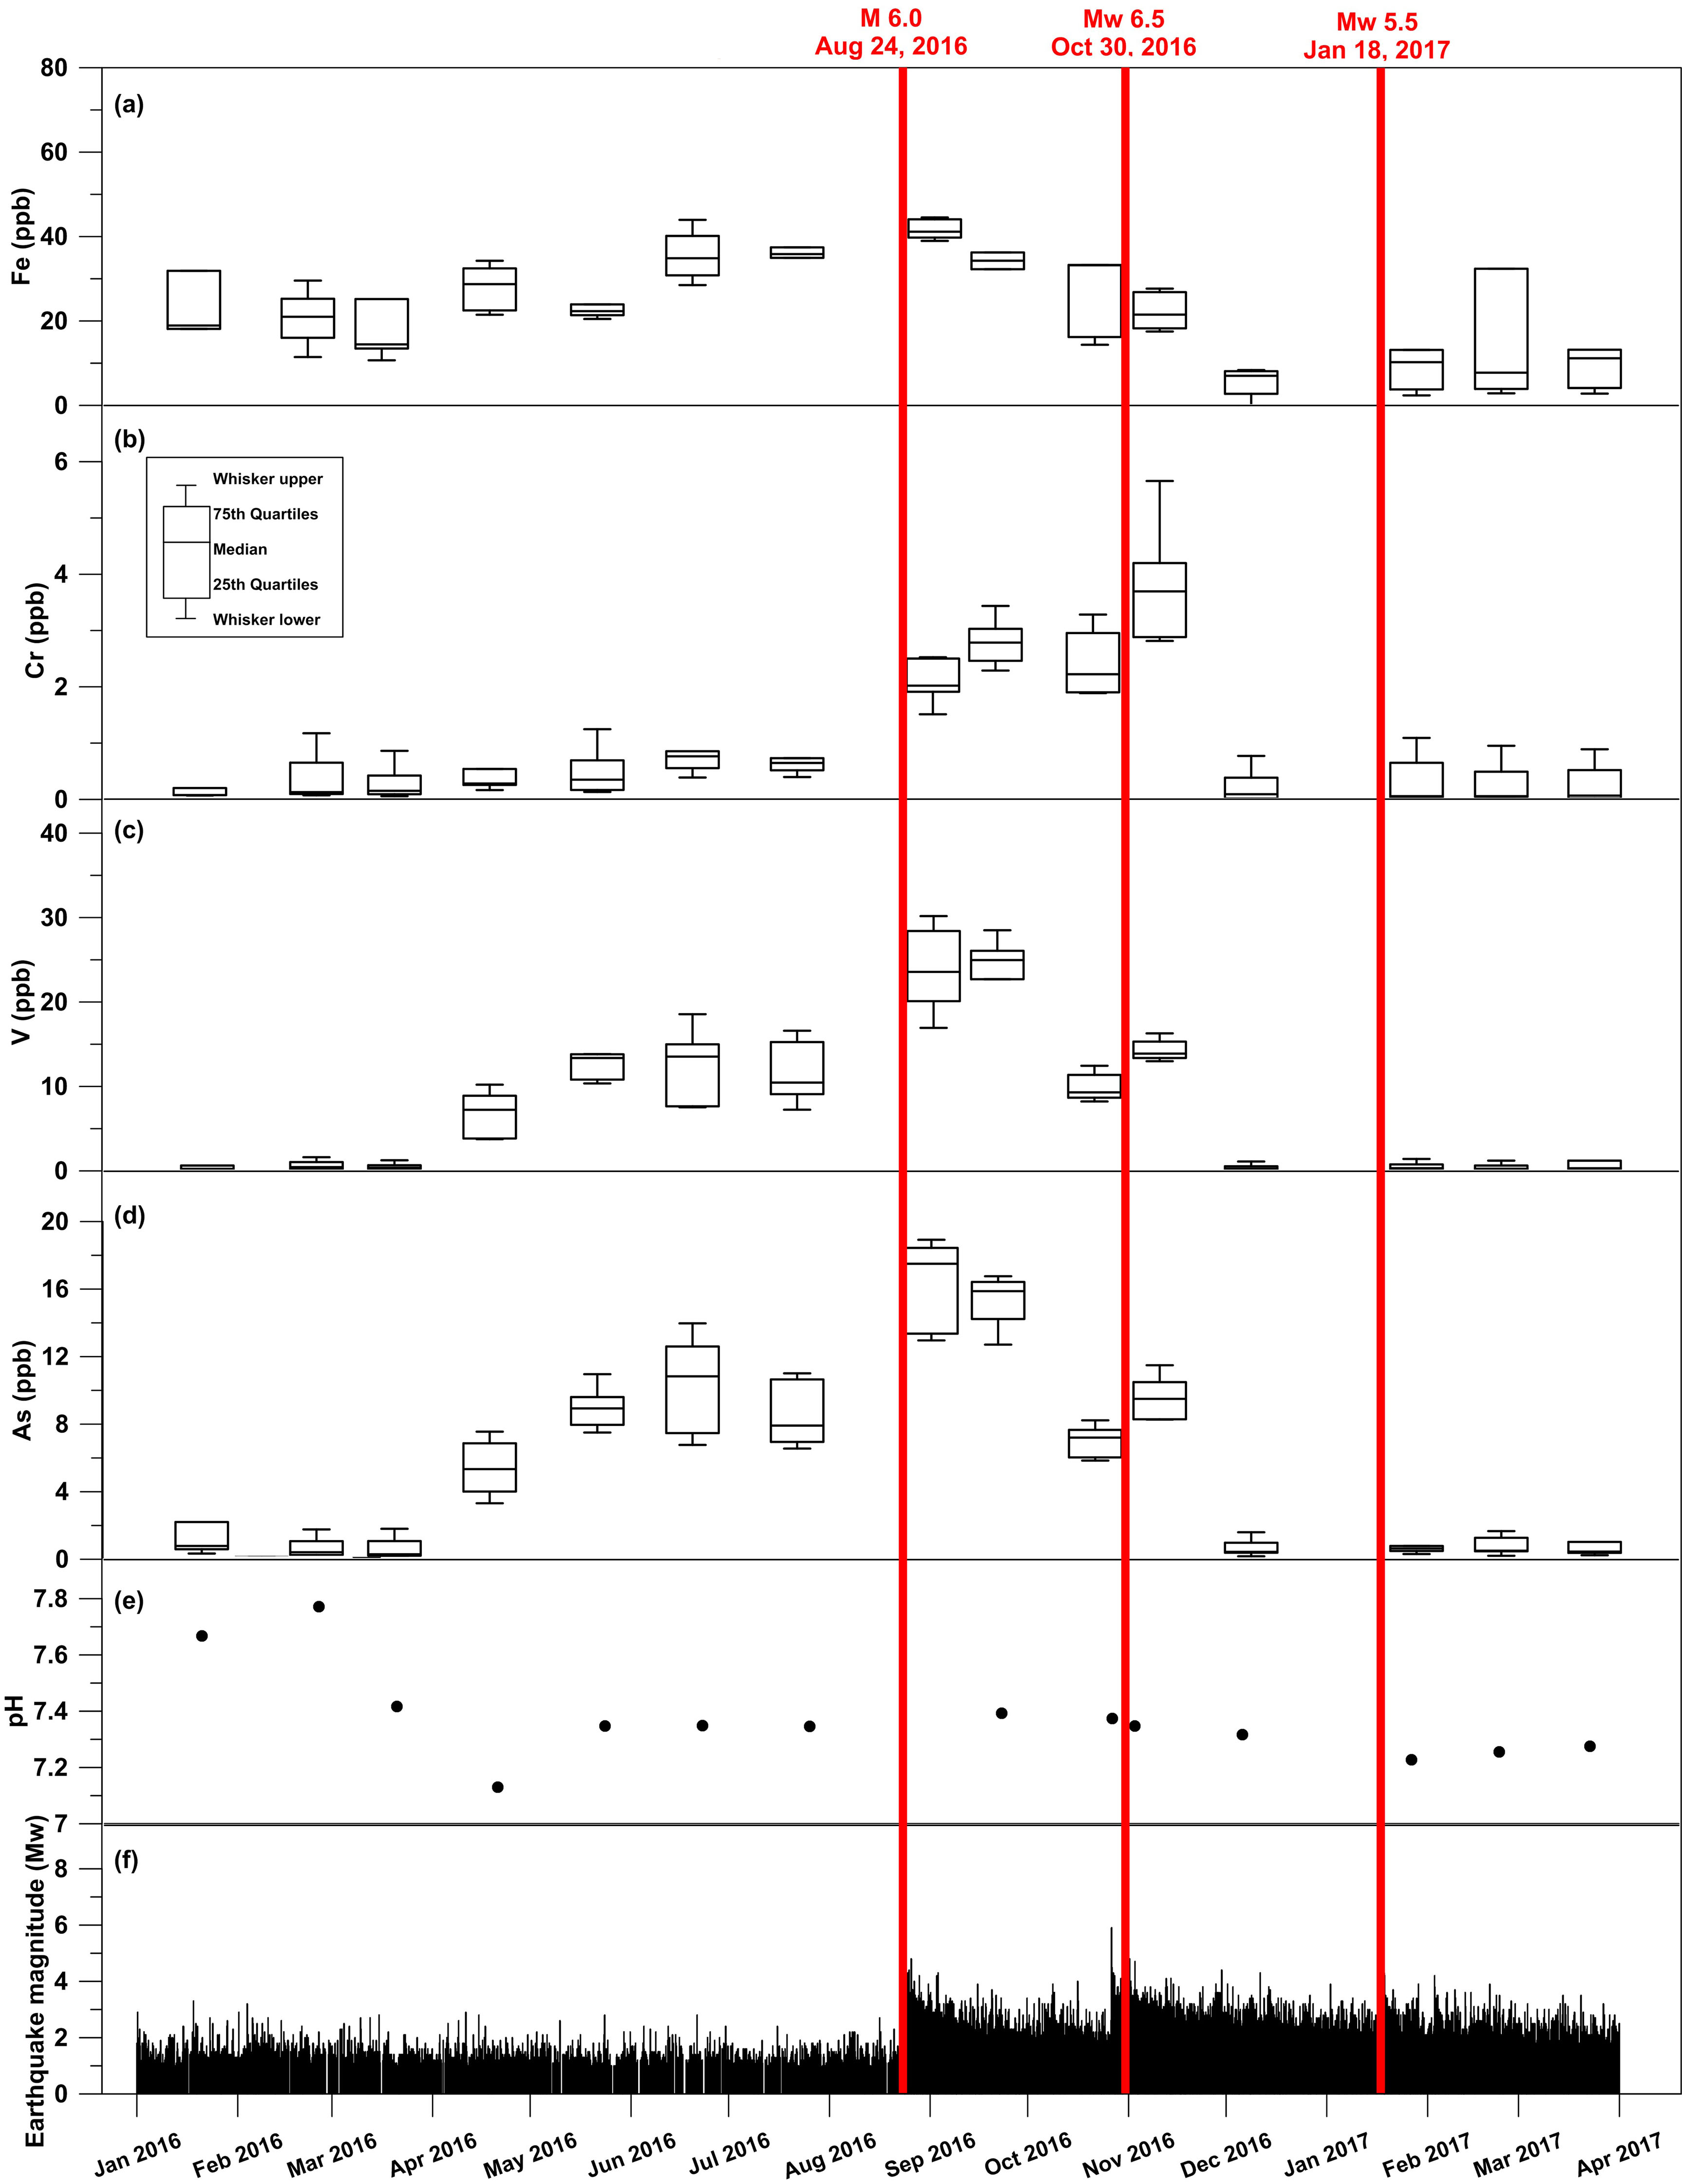
Barberio et al. 2017 SREP
ferro
cromo
vanadio
arsenico

Slide 44
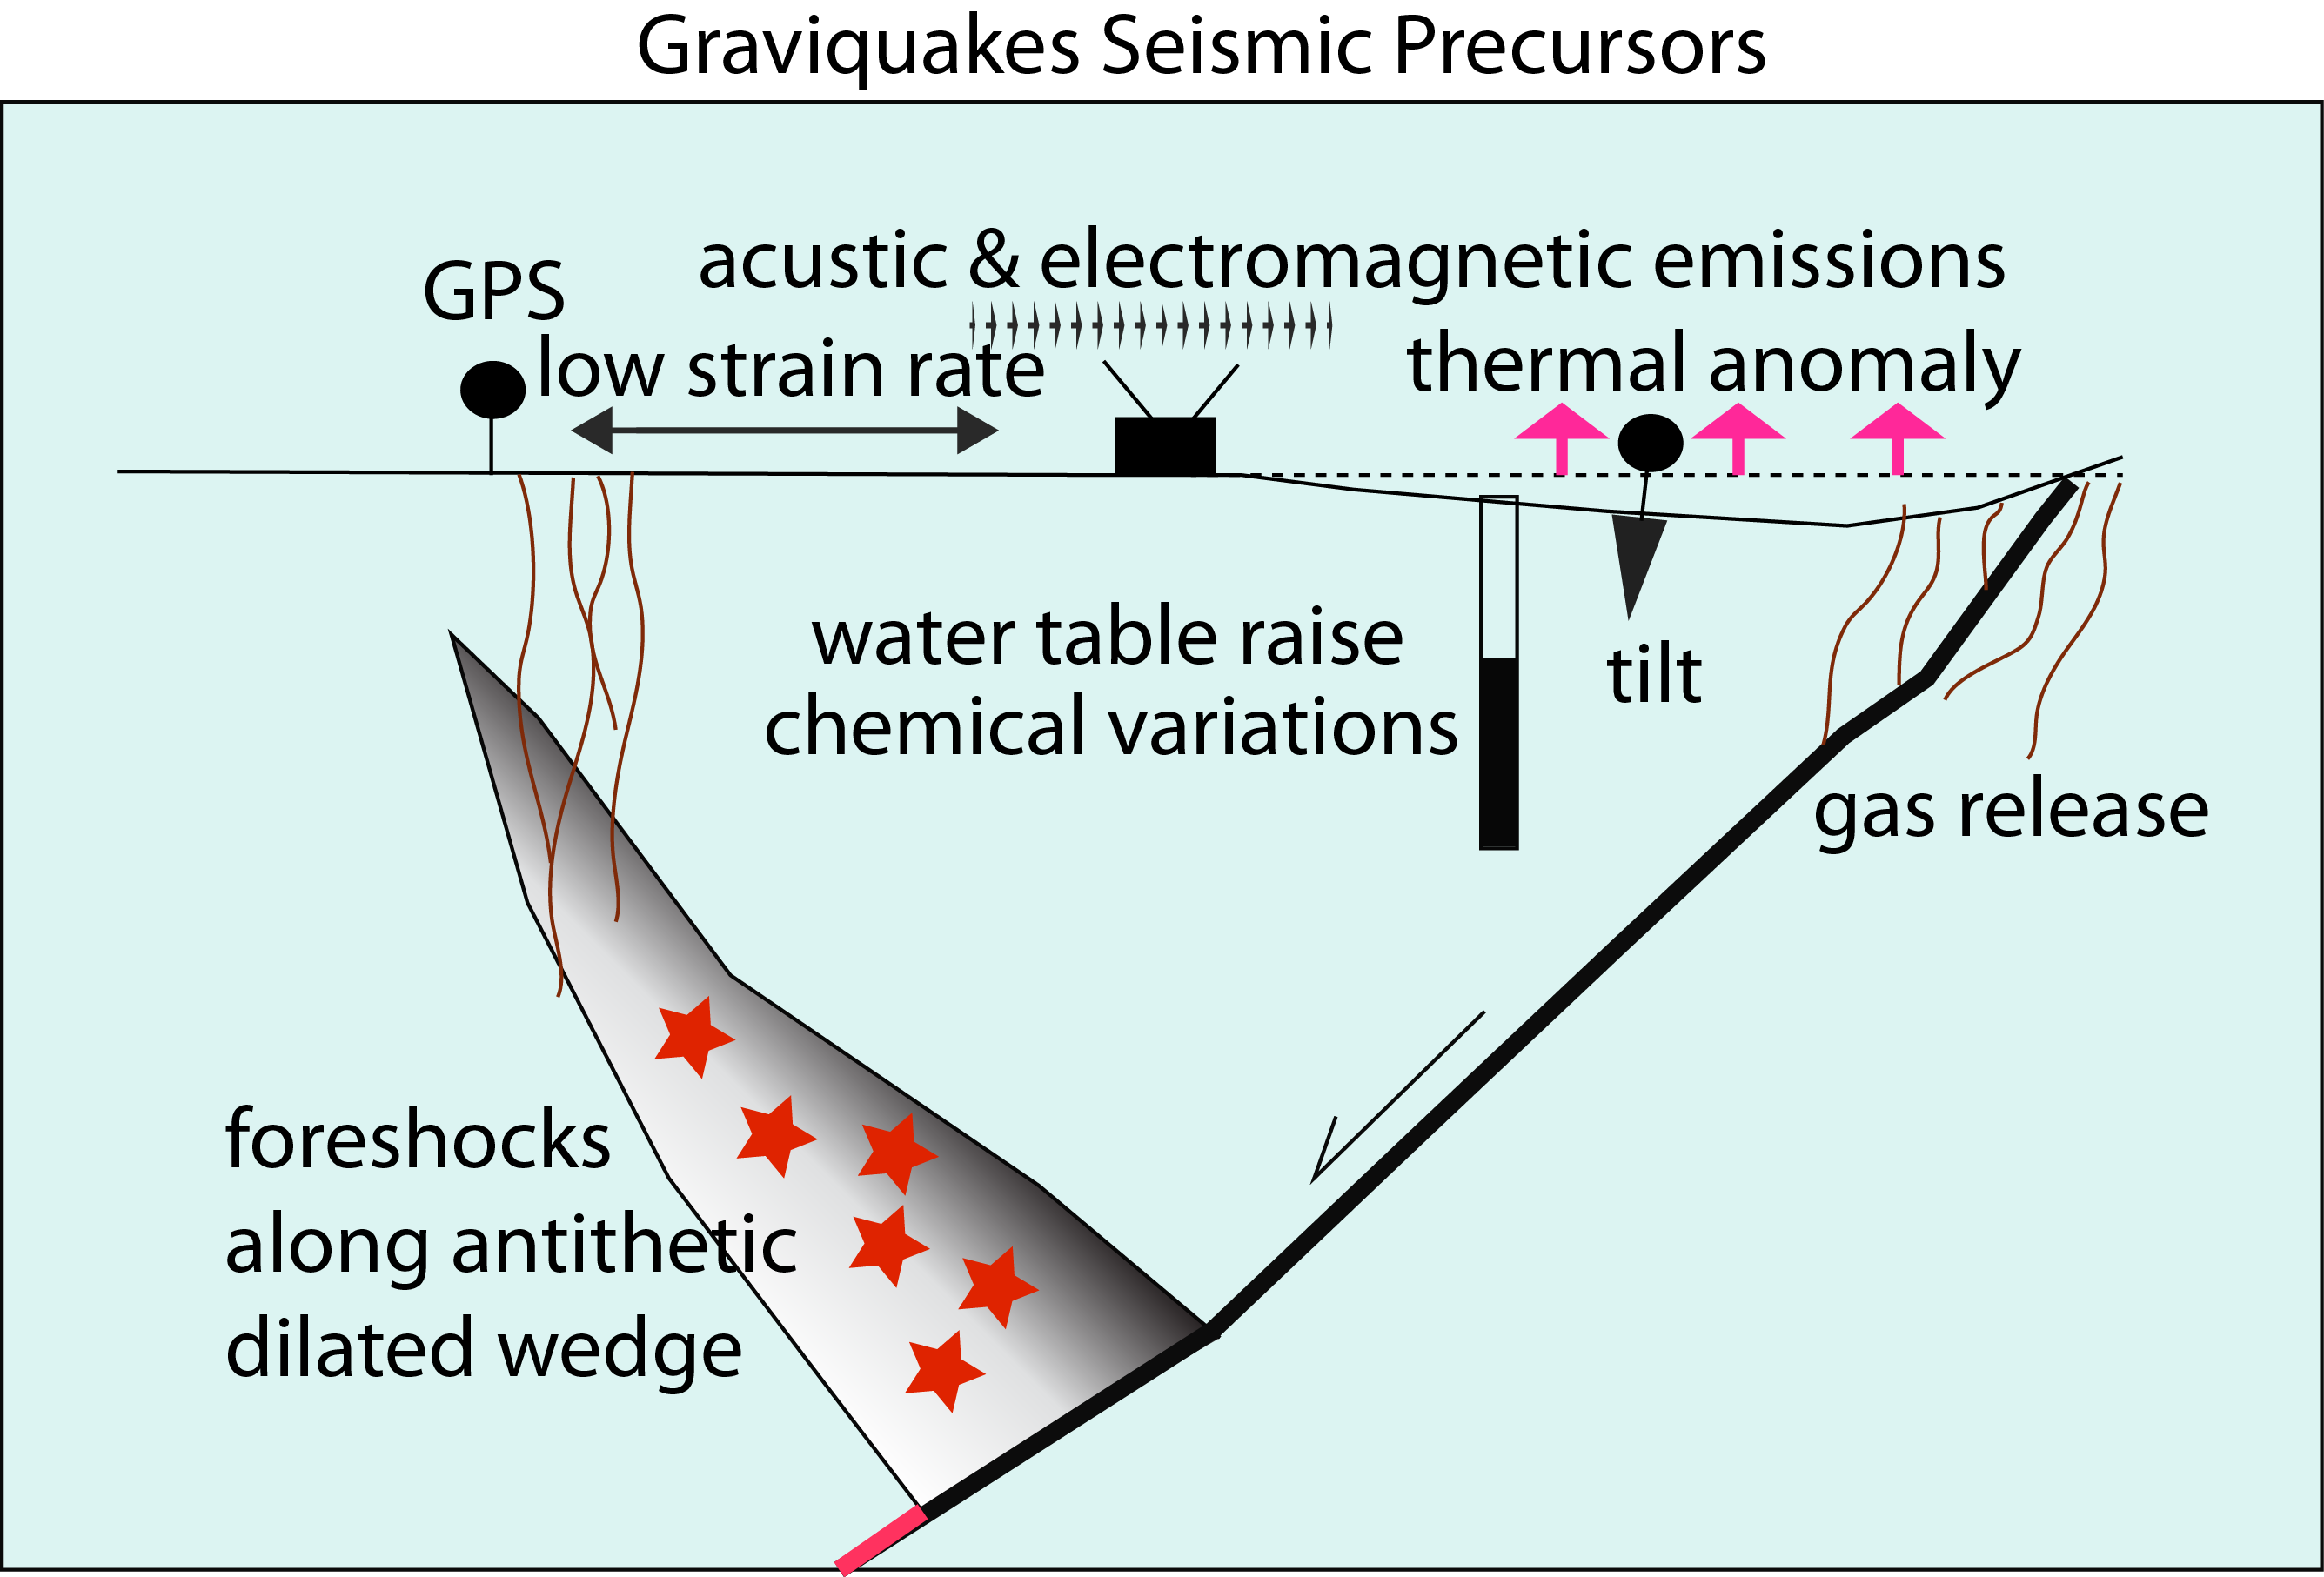

Slide 45
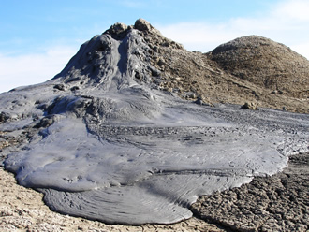

Slide 46
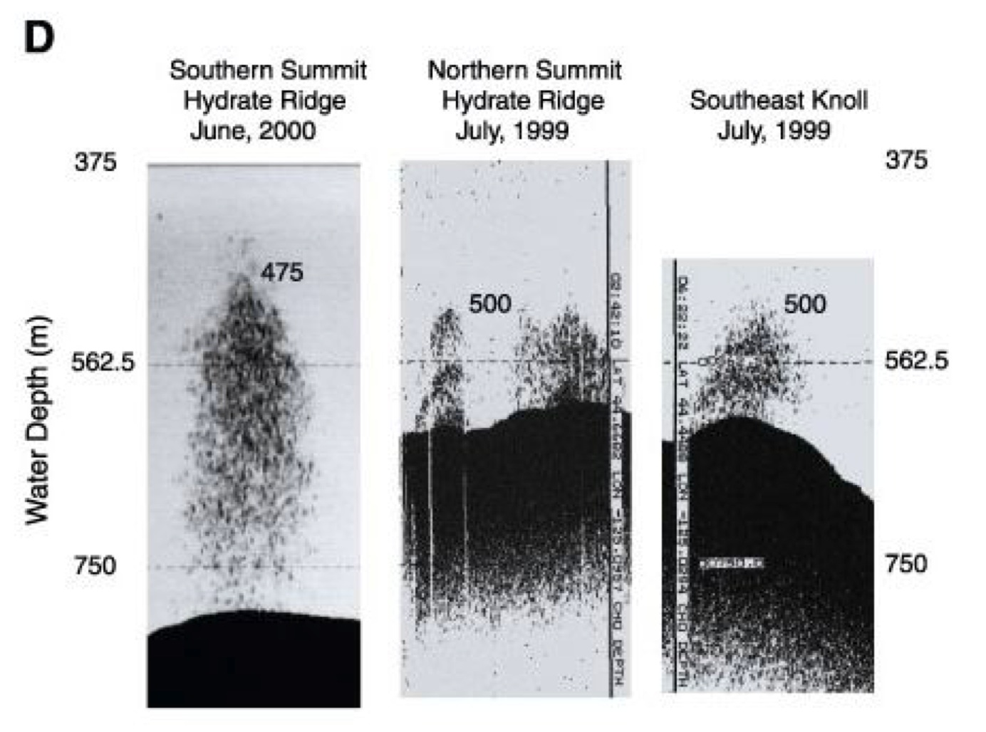

Slide 47
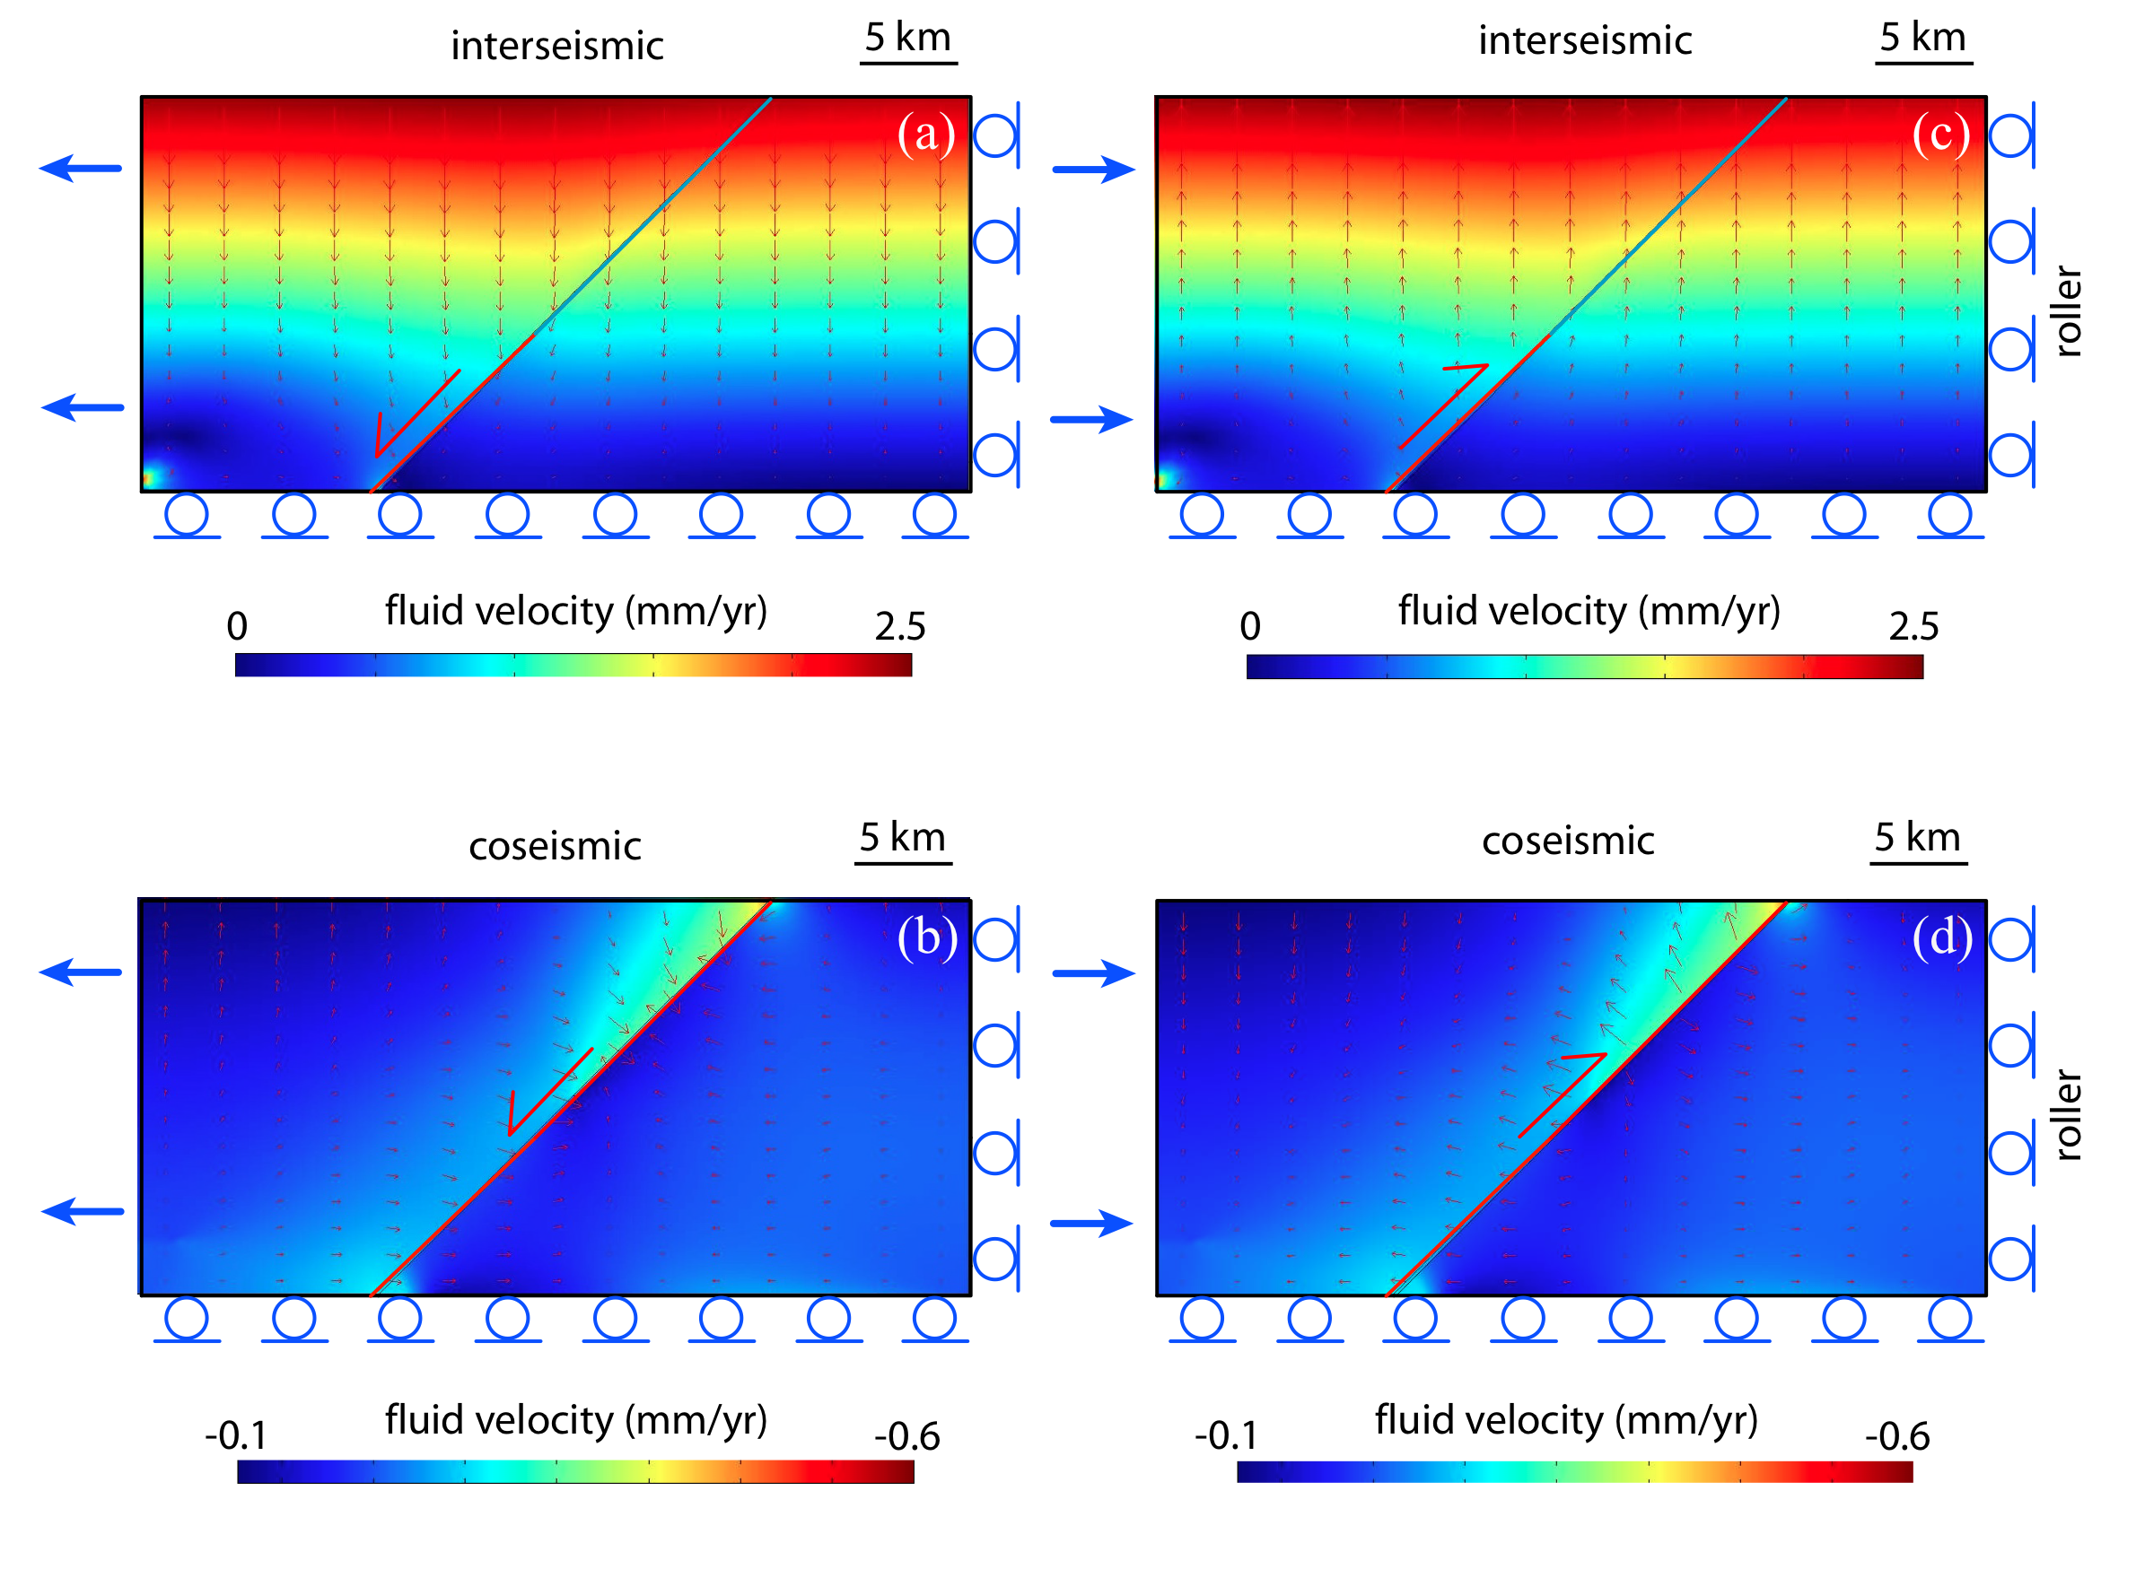
Doglioni et al. 2014 Geoscience Frontiers

Slide 48
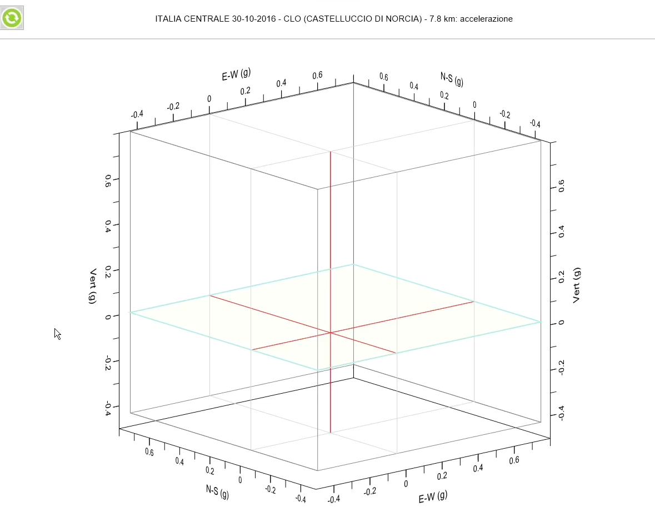
Pugi & Mariani – pers. Comm.

Slide 49

Mariani & Pugi 2019 Ingenio

