Slide 1
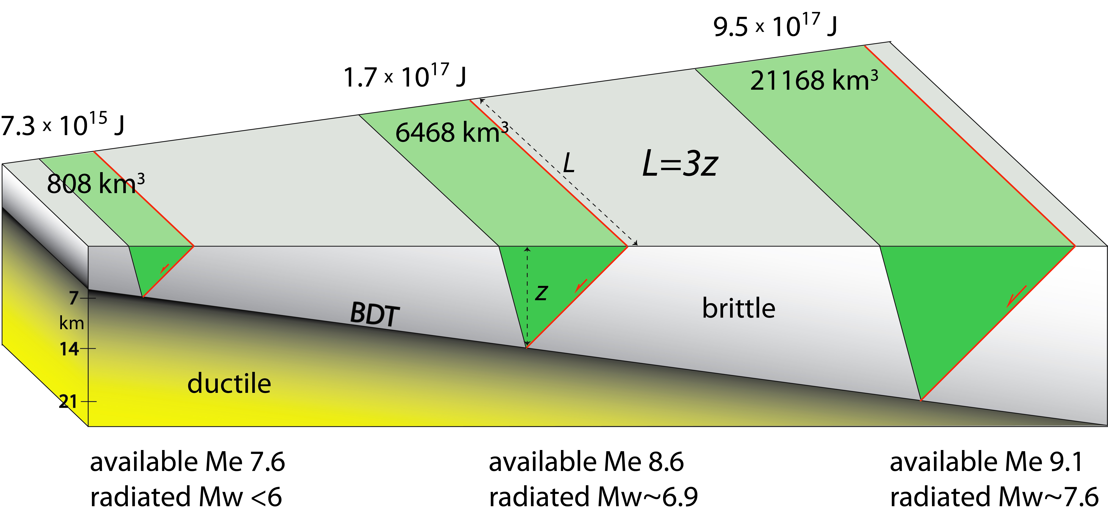
3 times BDT depth
26 times mass
>100 total energy
>1000 seismic energy
63 km
42 km
21 km
Doglioni et al. 2015 Scientific Reports

Slide 2
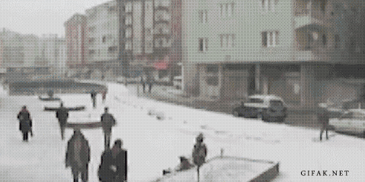

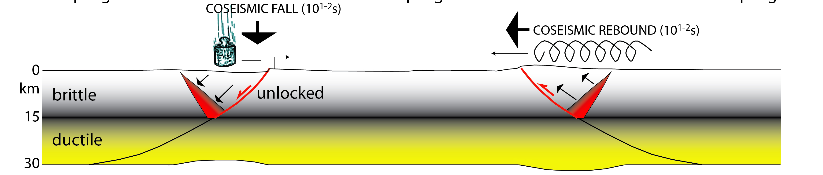
pro gravity
against gravity

Slide 3
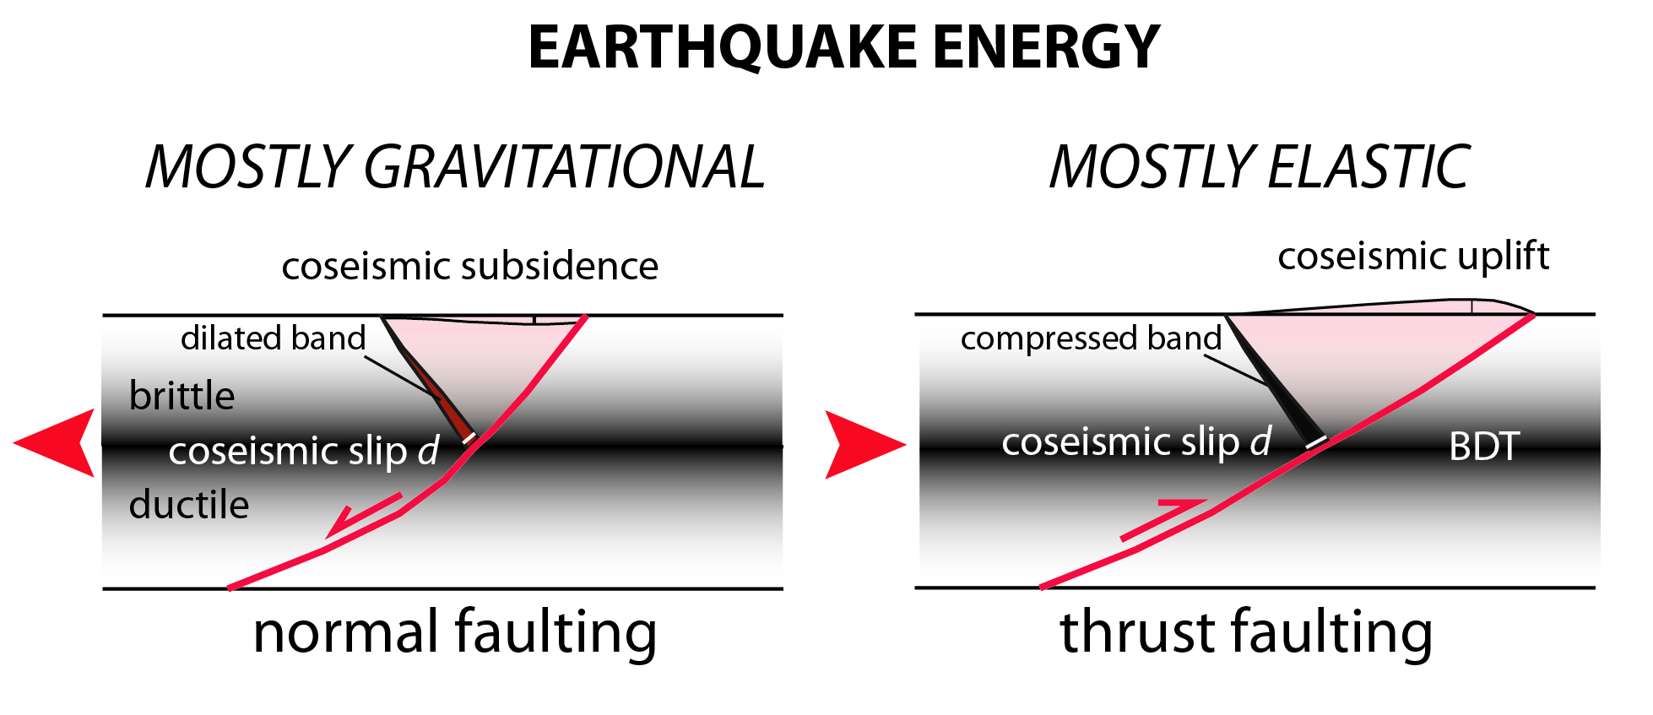
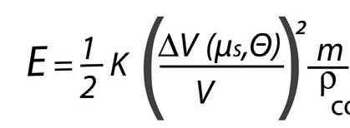

GRAVIQUAKE ELASTOQUAKE

Slide 4
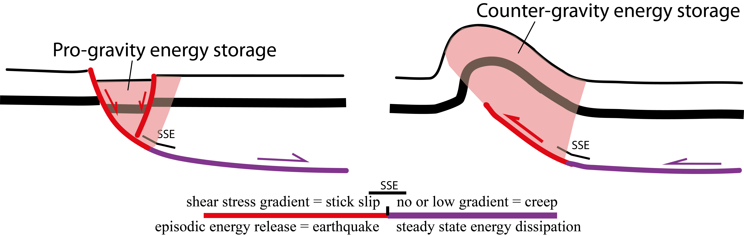
Doglioni 2024 GSF

Slide 5
up to 10⁵ km²
f : μ_{s} (0.1-0.8), θ (0-50°thrust, 70-90°SS)
f : decollement depth (2-40 km),
convergence rate (0.1-10 cm/yr)
coseismic slip speed (1mm/s-1m/s)
volume
fault size
up to 10²² J
elastic
THRUST Mw up to 9.5?
ENERGY
MAGNITUDE
STRIKE-SLIP Mw up to 8.7?
NORMAL FAULT Mw up to 7.5?
gravitational
up to 10¹⁸ J
volume
fault size
f : BDT depth (5-40 km)
coseismic slip mm/s speed (1mm/s-1m/s)
up to 10³ km²
f : μ_{s}, (0.1-0.8), θ (70-10°normal fault)

Slide 6
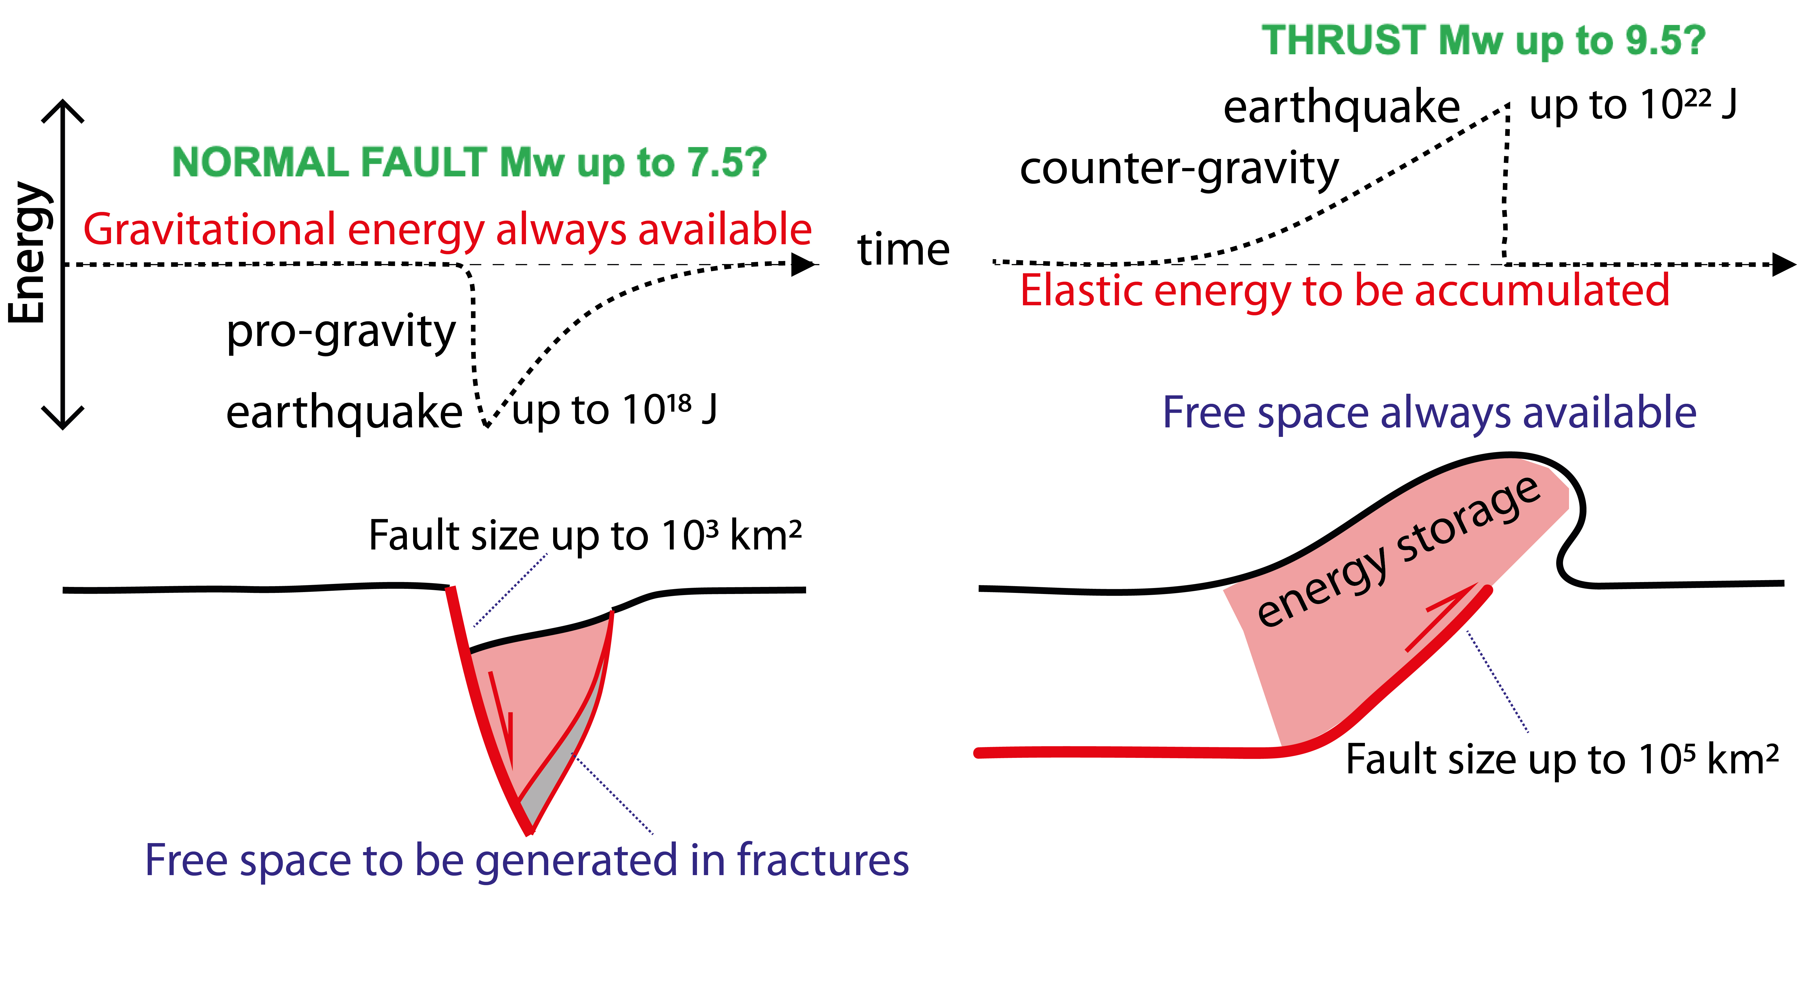
Doglioni 2024 GSF

Slide 7
Wilkinson et al. 2017 SREP

Slide 8
Wilkinson et al. 2017 SREP

Slide 9
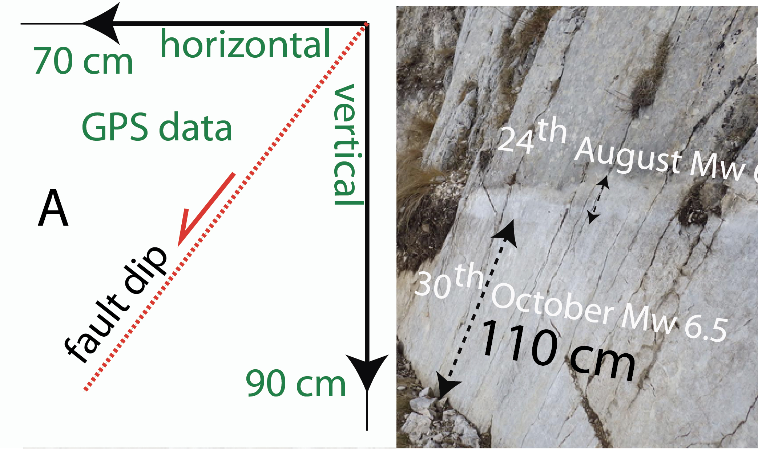
Bignami et al. 2019 Scientific Reports

Slide 10
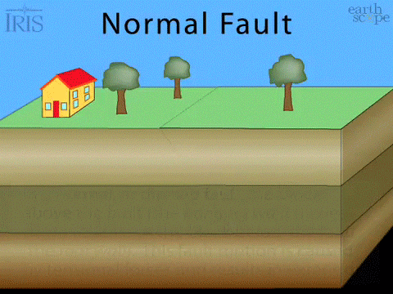
Velocities for normal fault:
- interseismic tectonic extension = 2-4 mm/yr (2-4*10⁻¹³ km/s)
- coseismic fracturing = 3-4 km/s
- coseismic slip = 30-40 cm/s (0.0003 km/s)
- coseismic slip lateral propagation = 0.5-1 km/s

Slide 11
Normal fault earthquakes M>5.2
50
Number of eq
0°
45°
90°
Normal fault dip
Jackson & White 1989 JSG

Slide 12
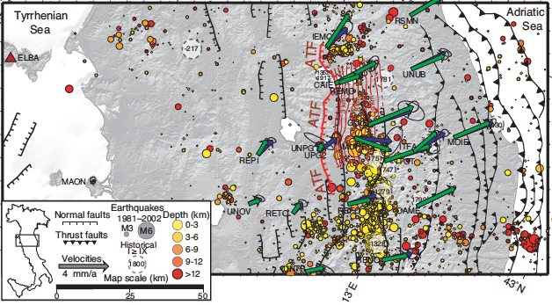
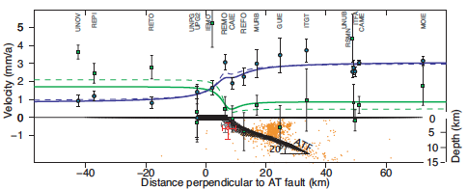
Hreinsdóttir and Bennett 2009 Geology

Slide 13
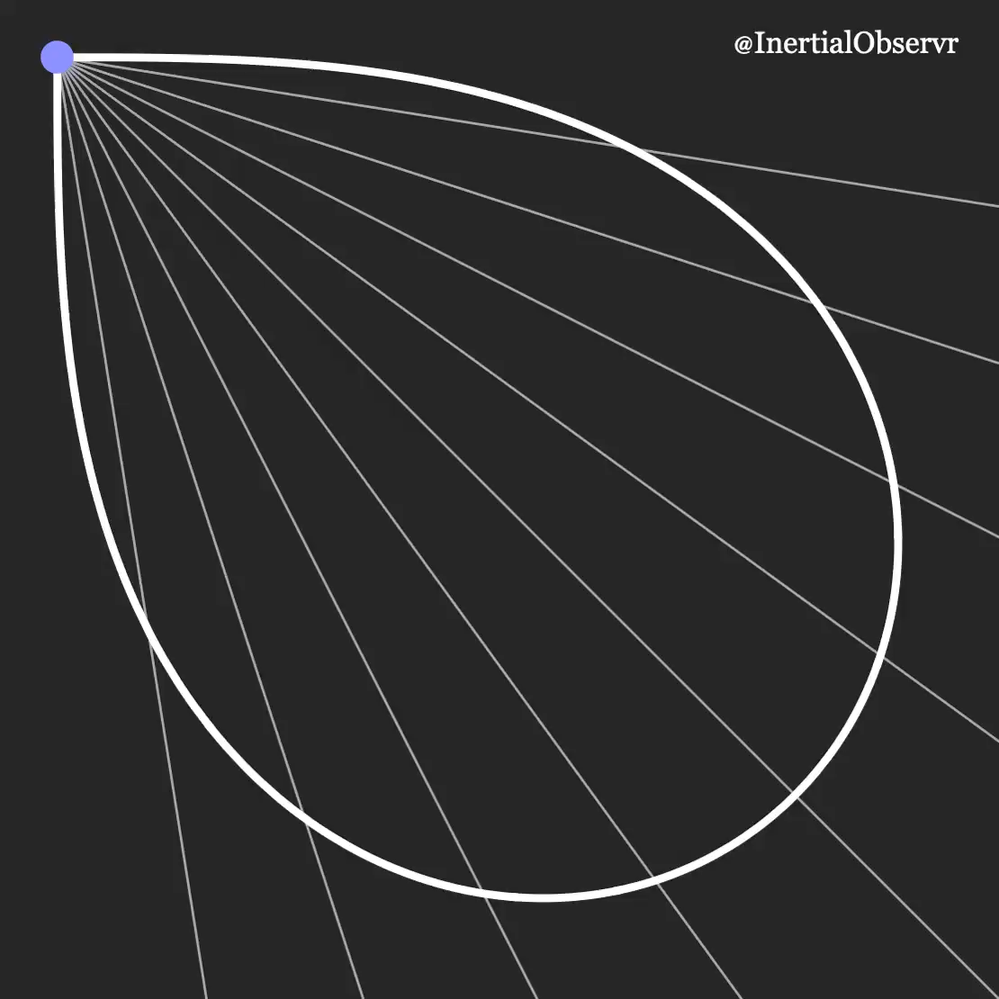

Slide 14
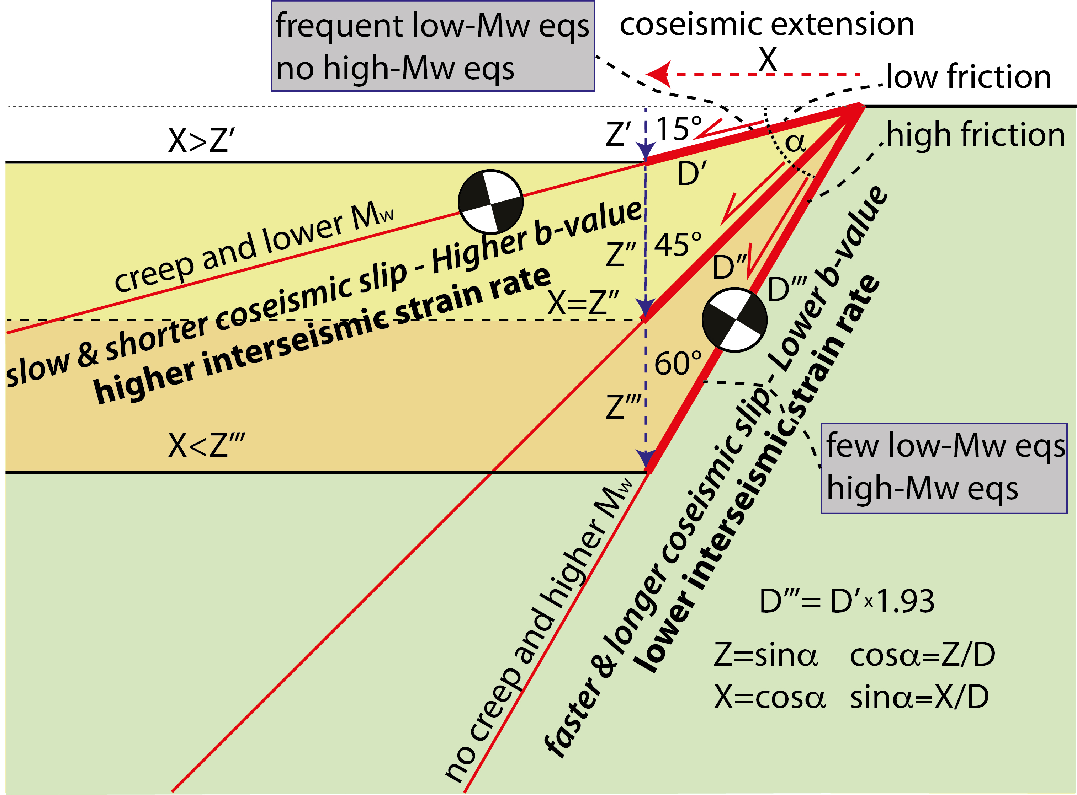
Doglioni 2024 GSF

Slide 15
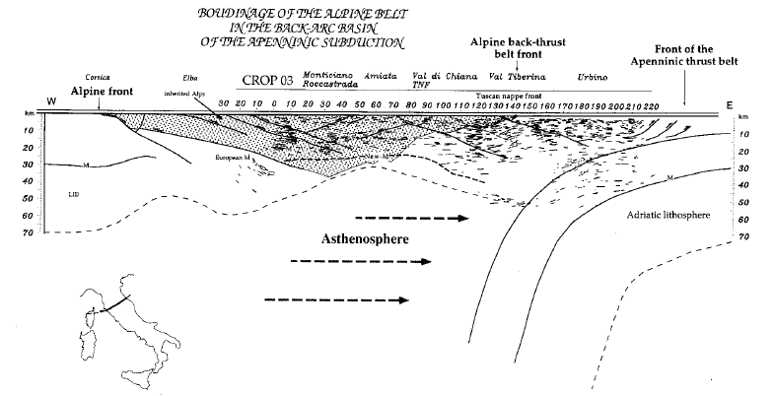
Doglioni, Mongelli, Pialli, 1996 Mem. SGI

Slide 16
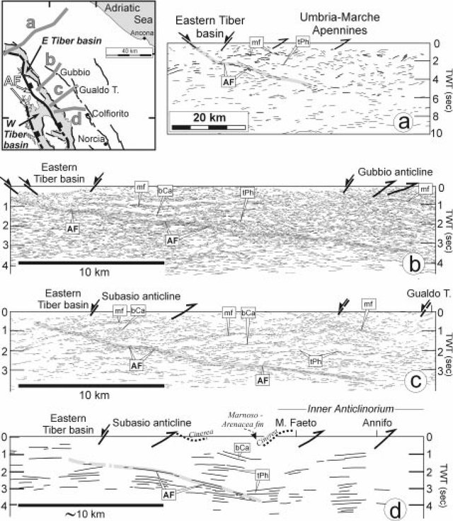
Boncio & Lavecchia 2000 JS

Slide 17
graviquake
ESTENSION
elastoquake
COMPRESSION

Slide 18
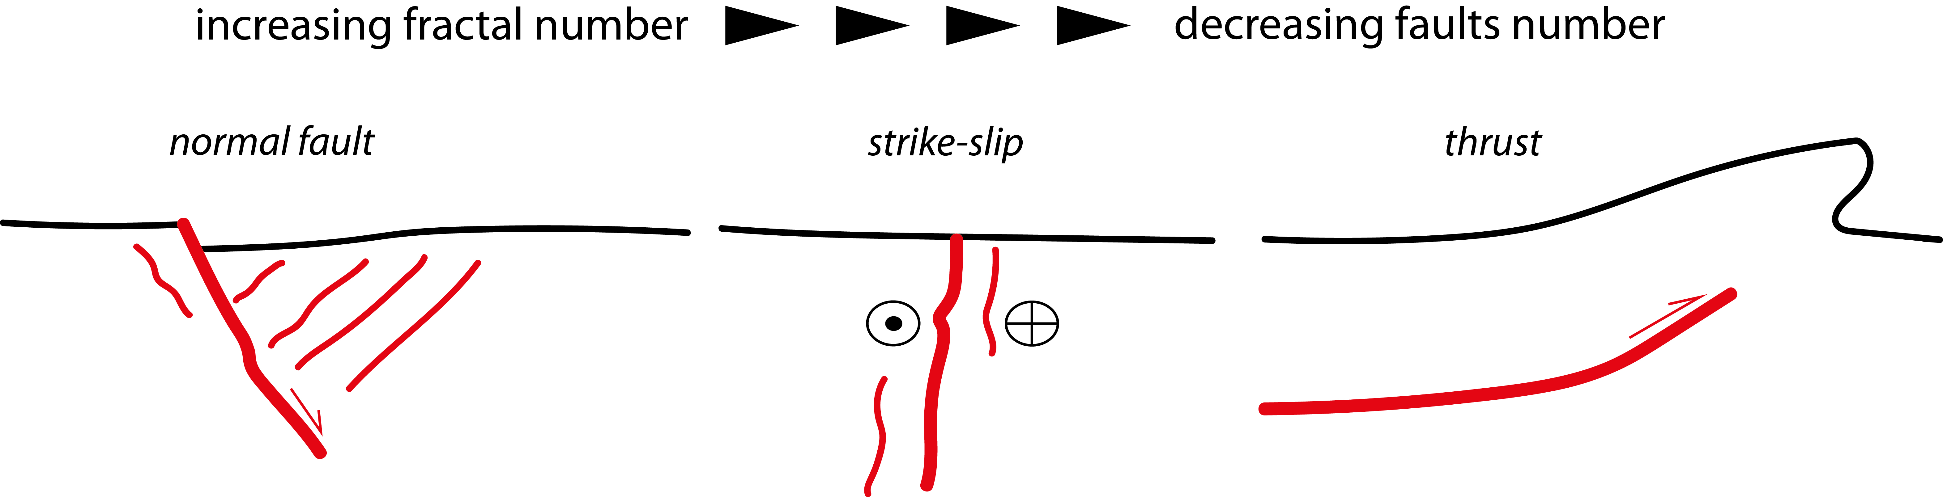
Zaccagnino & Doglioni 2022 Comm. Earth & Environment

Slide 19
Thrust
Strike-slip
Normal
Zaccagnino & Doglioni 2022 Comm. Earth & Environment

Slide 20
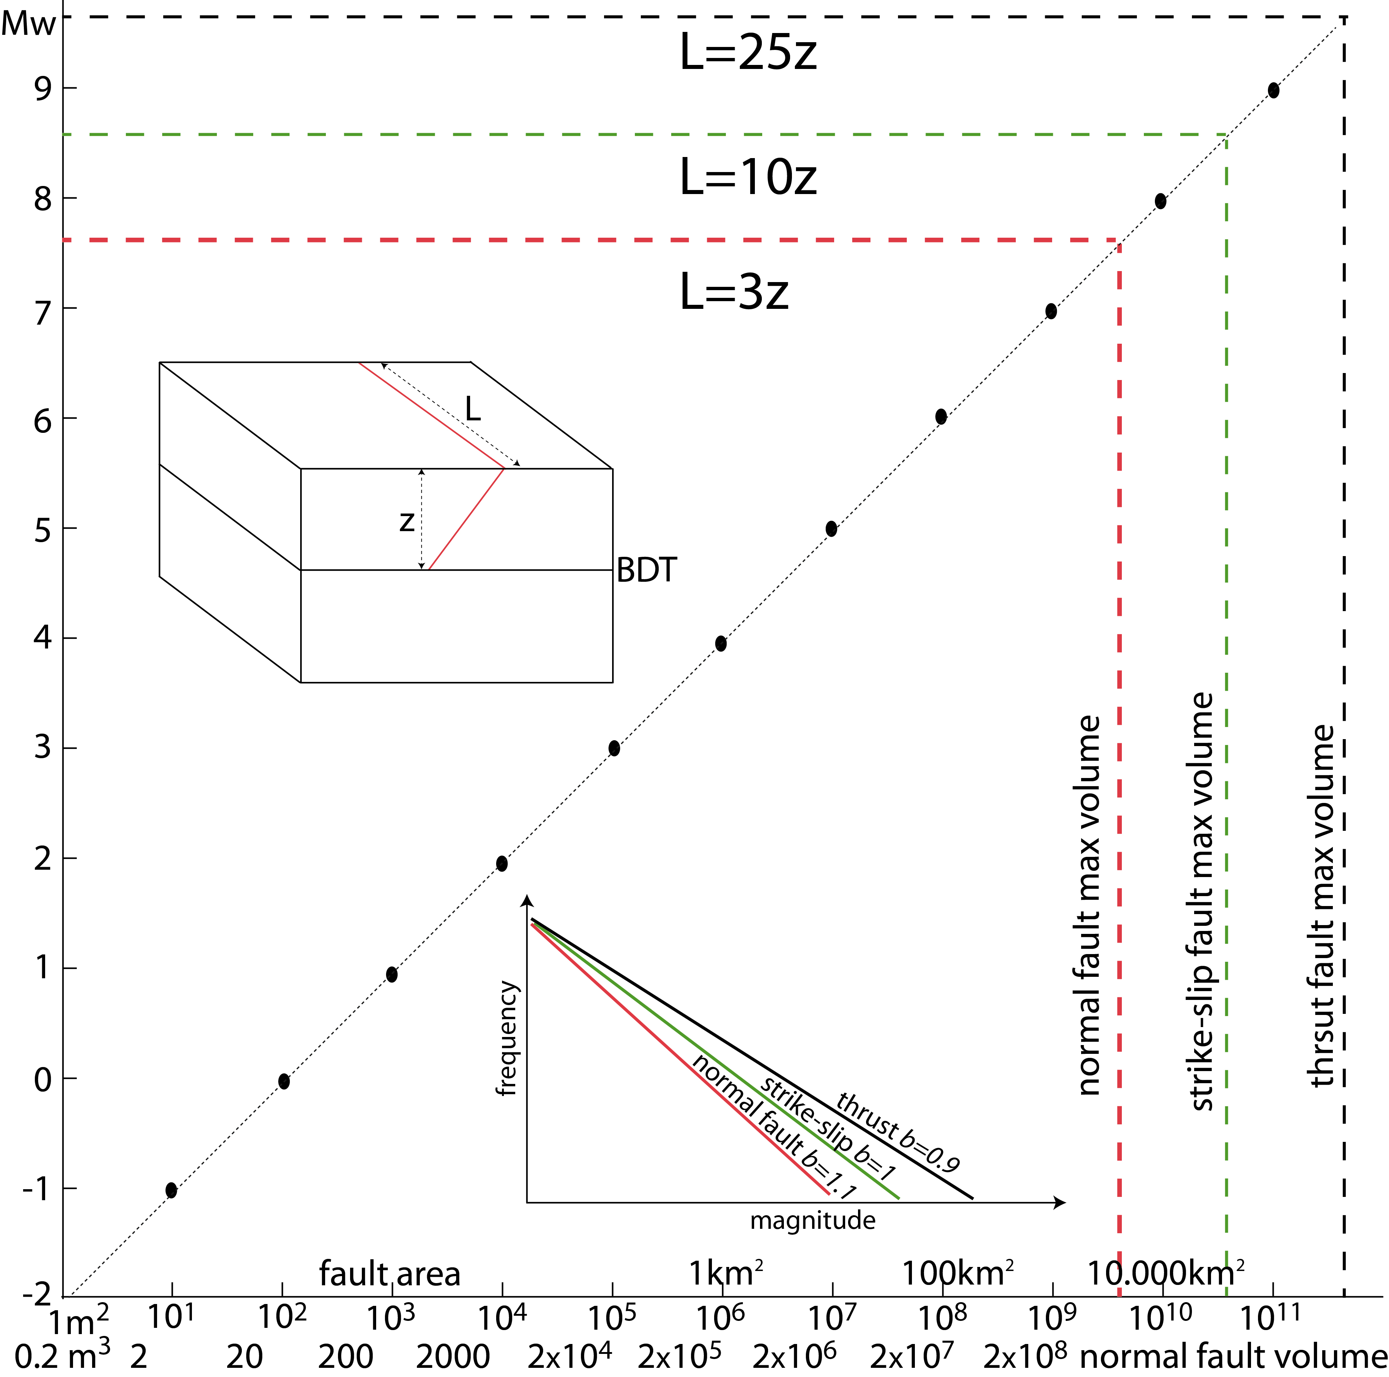
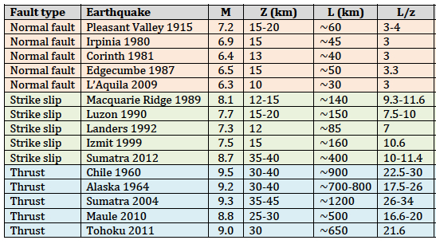
Doglioni et al. 2015 SREP
7.5
3
8.7
10
9.5
25

Slide 21
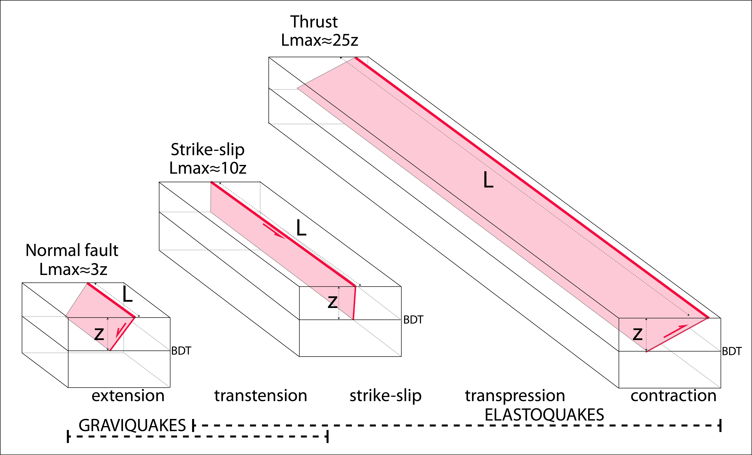
ENERGY
L /z = rupture length / depth activated volume

Slide 22
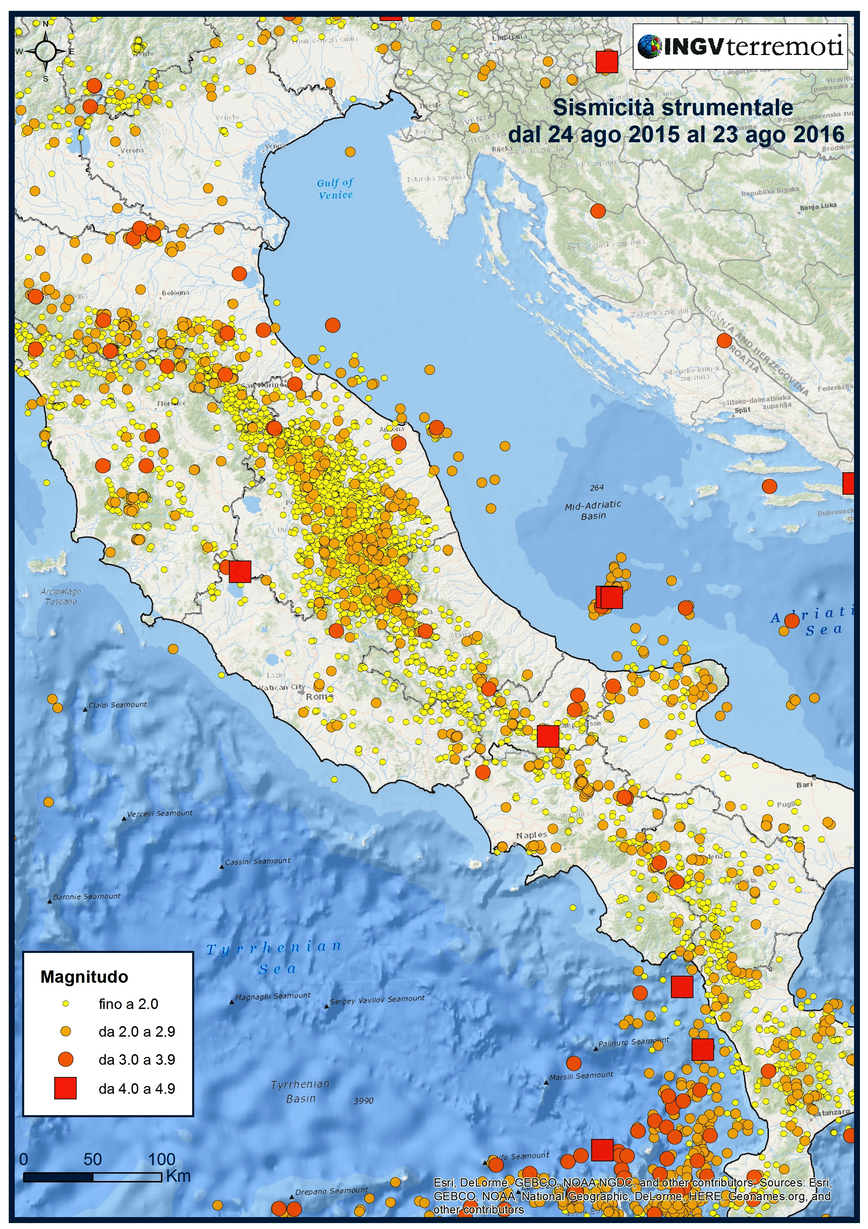

Slide 23
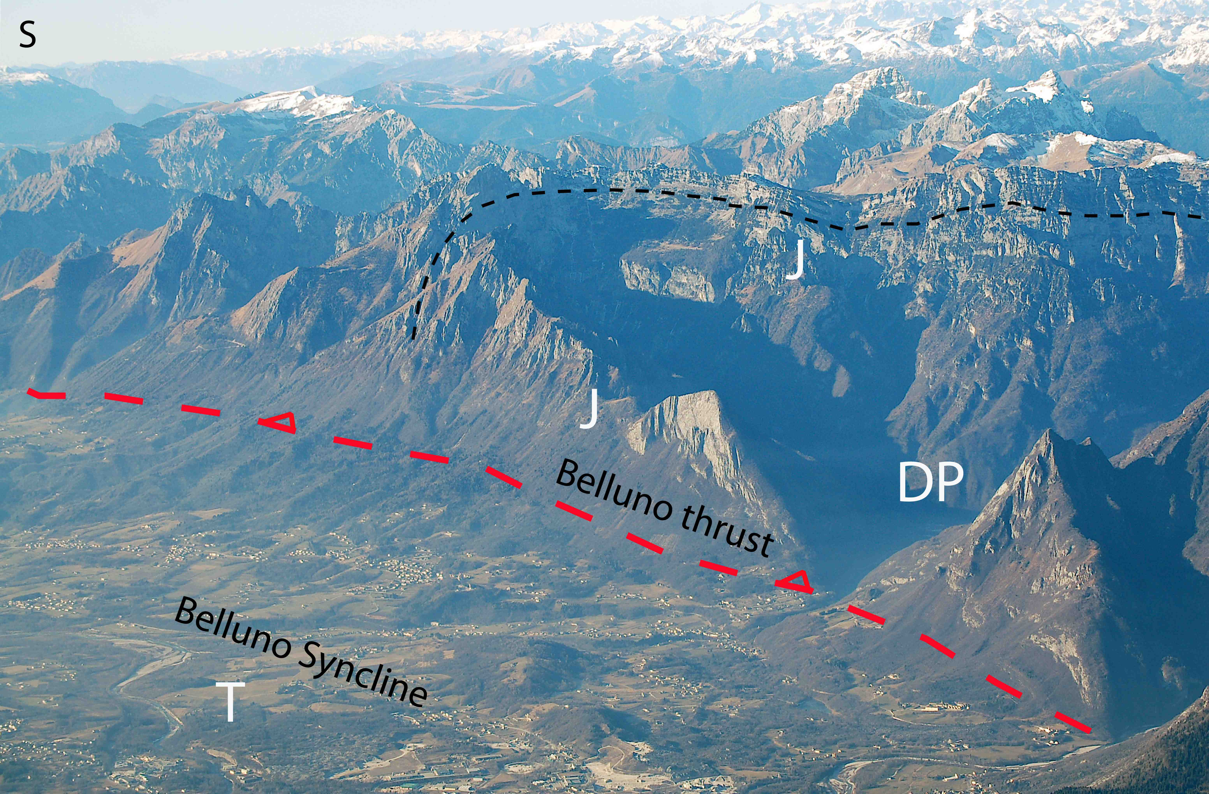
S
urassic
Dolomiti Bellunesi
ertiary
Doglioni & Carminati 2008 Mem. Descrittive Carta Geol. It.

Slide 24
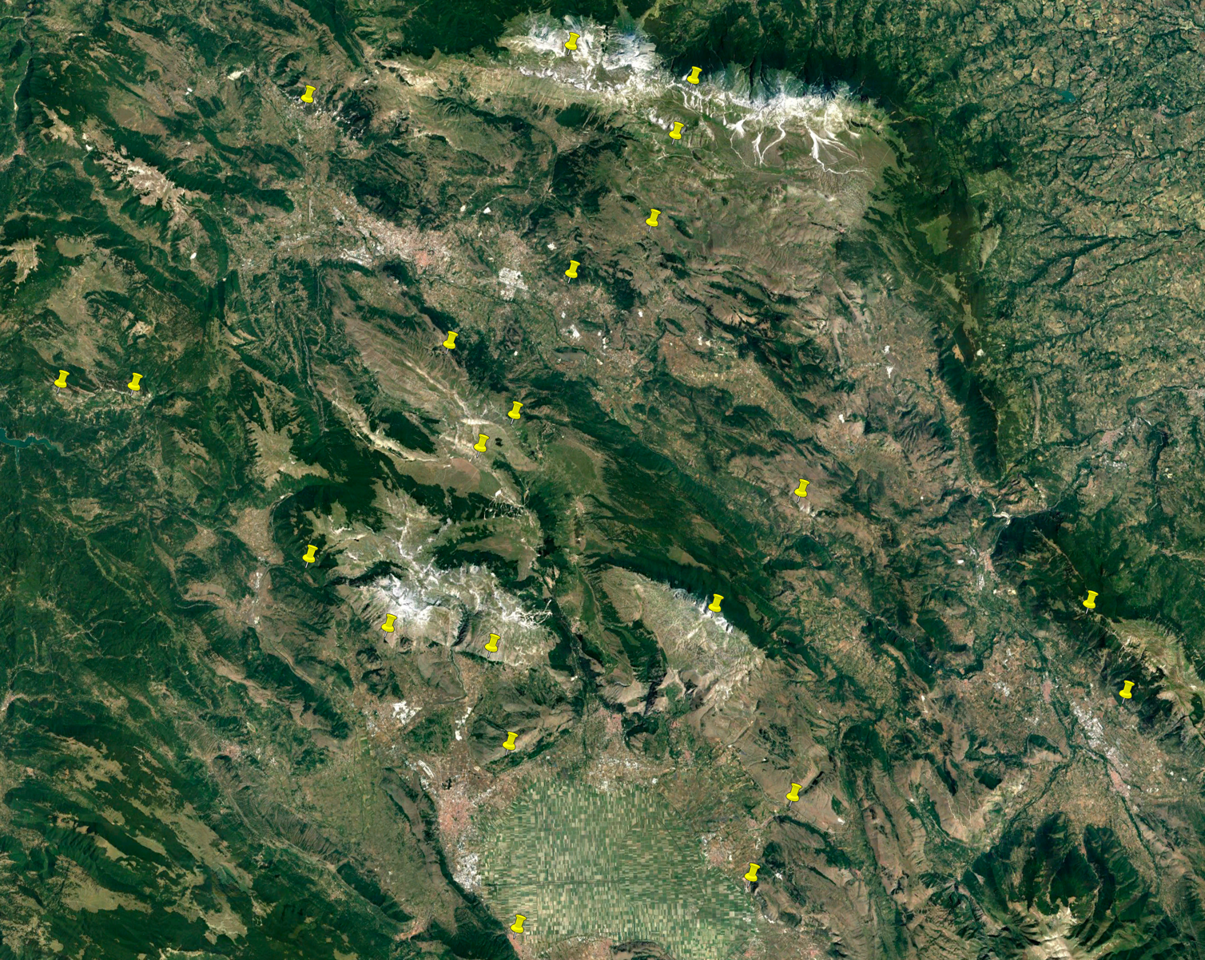
Gran Sasso
L’Aquila
10 km
Fucino

Slide 25
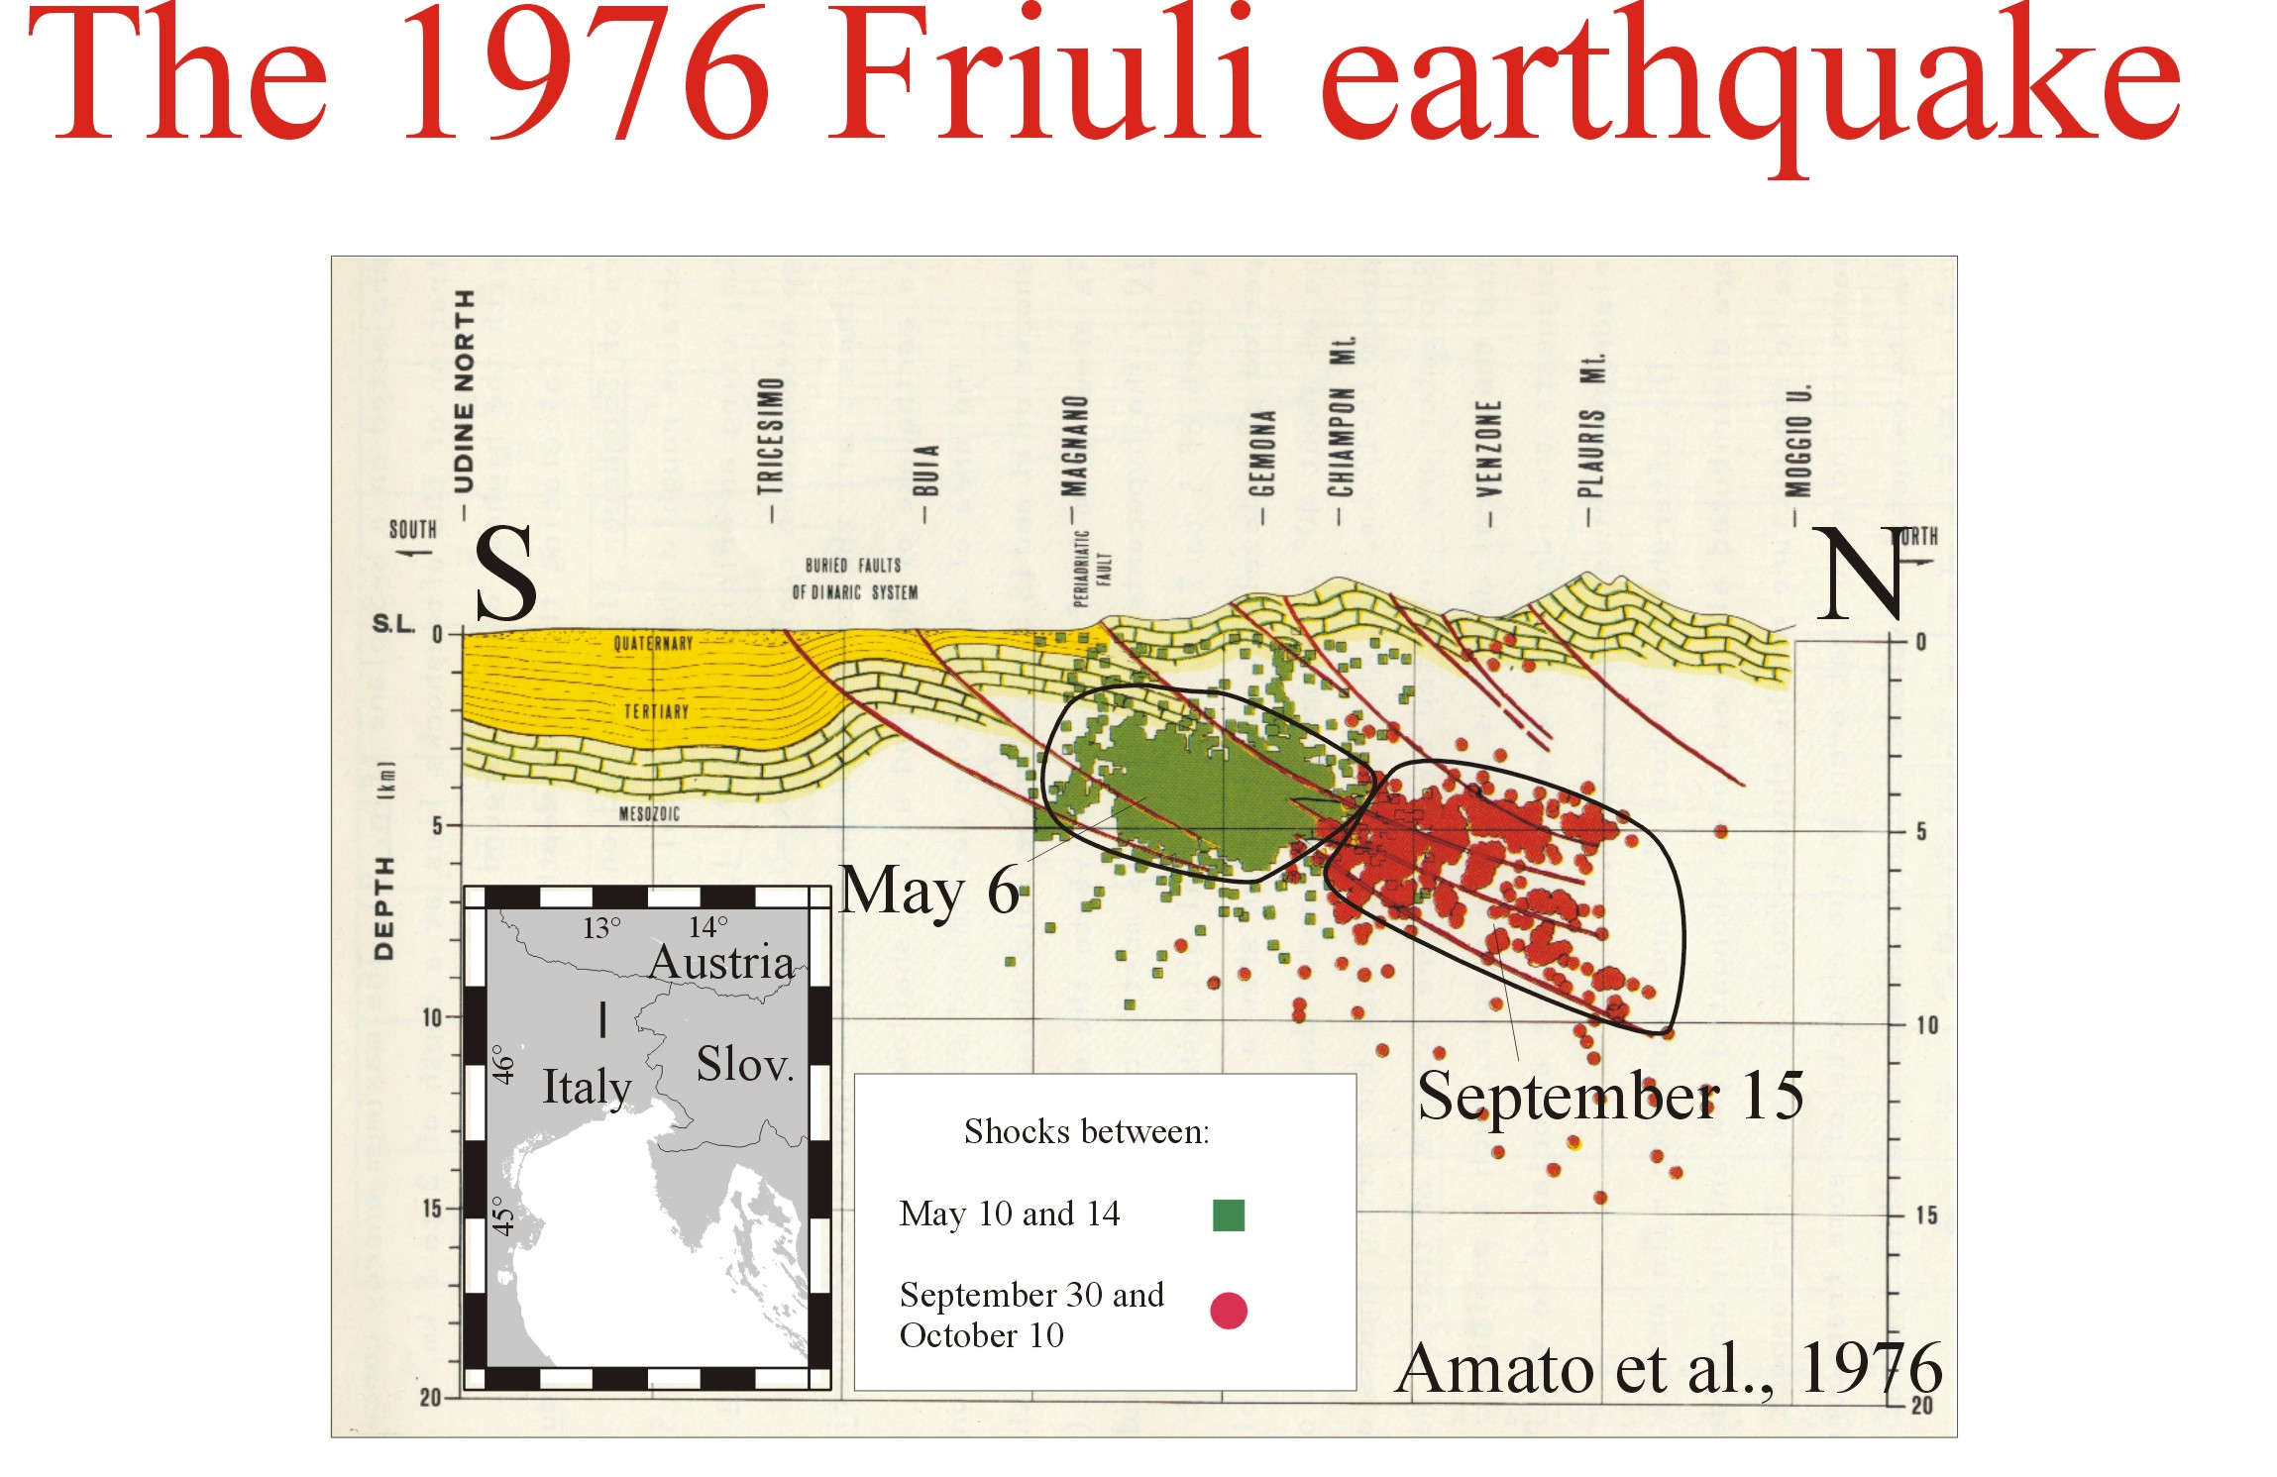
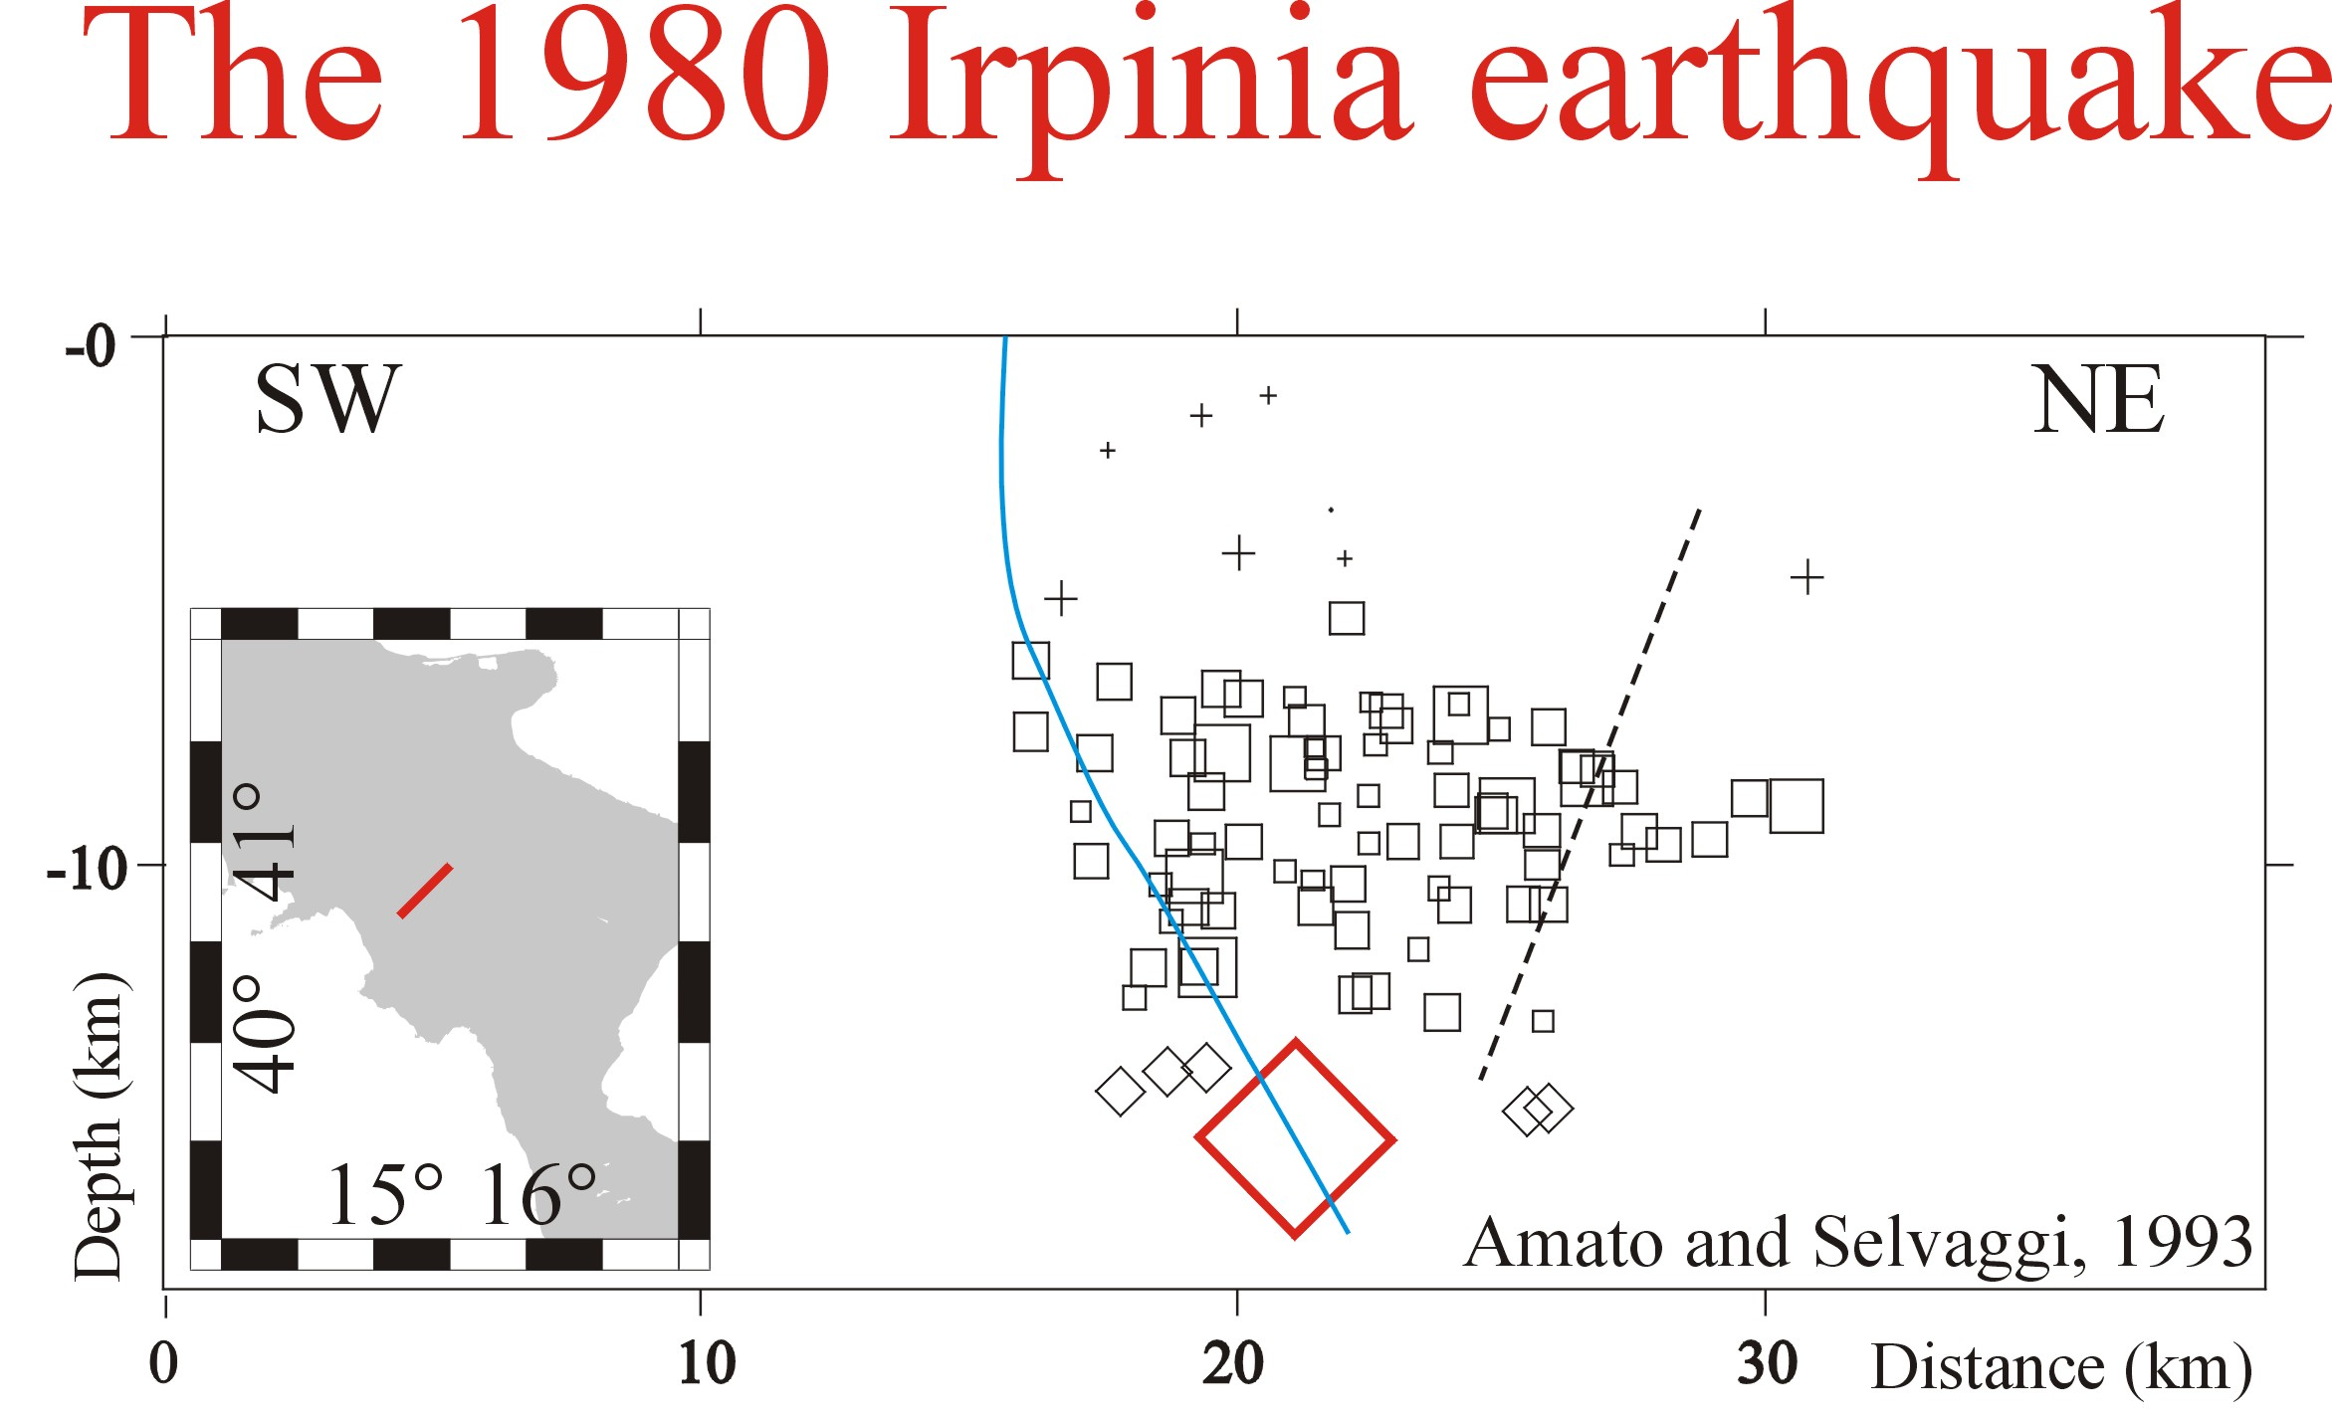

Slide 26
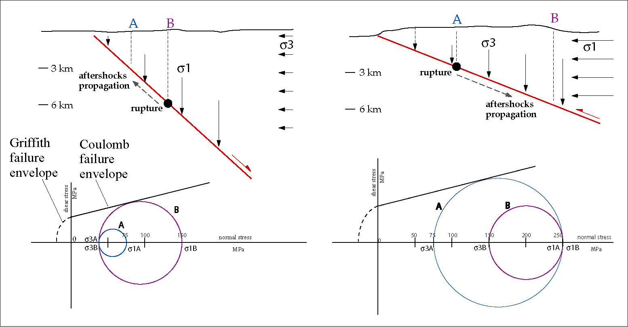
NORMAL FAULT
lithostatic load=sigma1
THRUST
lithostatic load=sigma3
Carminati et al. 2004 Earth Science Reviews
Loading favours normal faulting – Unloading favours thrust faulting

Slide 27
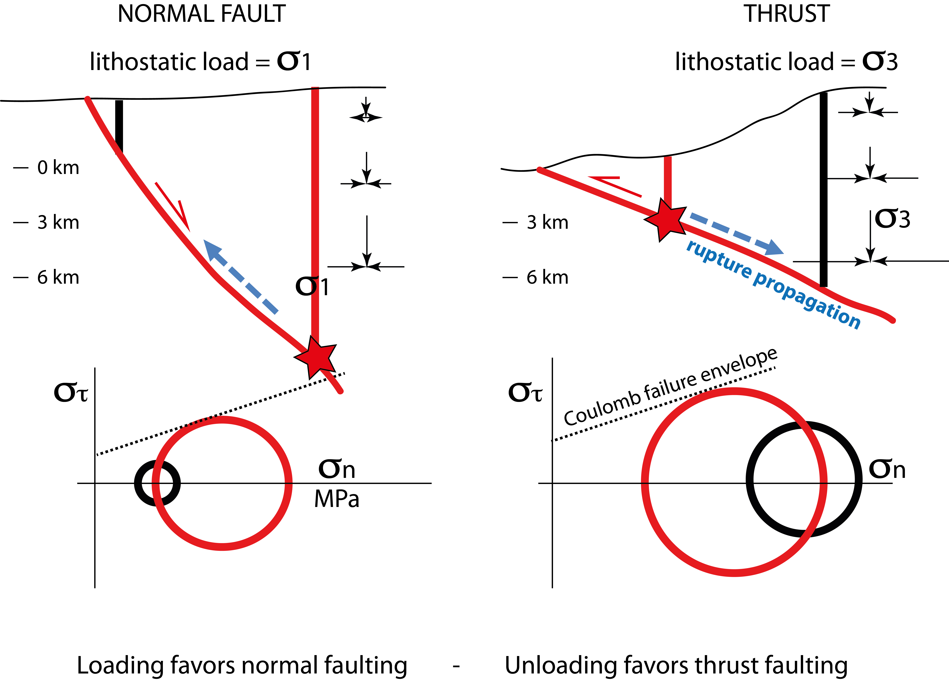
Doglioni 2024 GSF

Slide 29
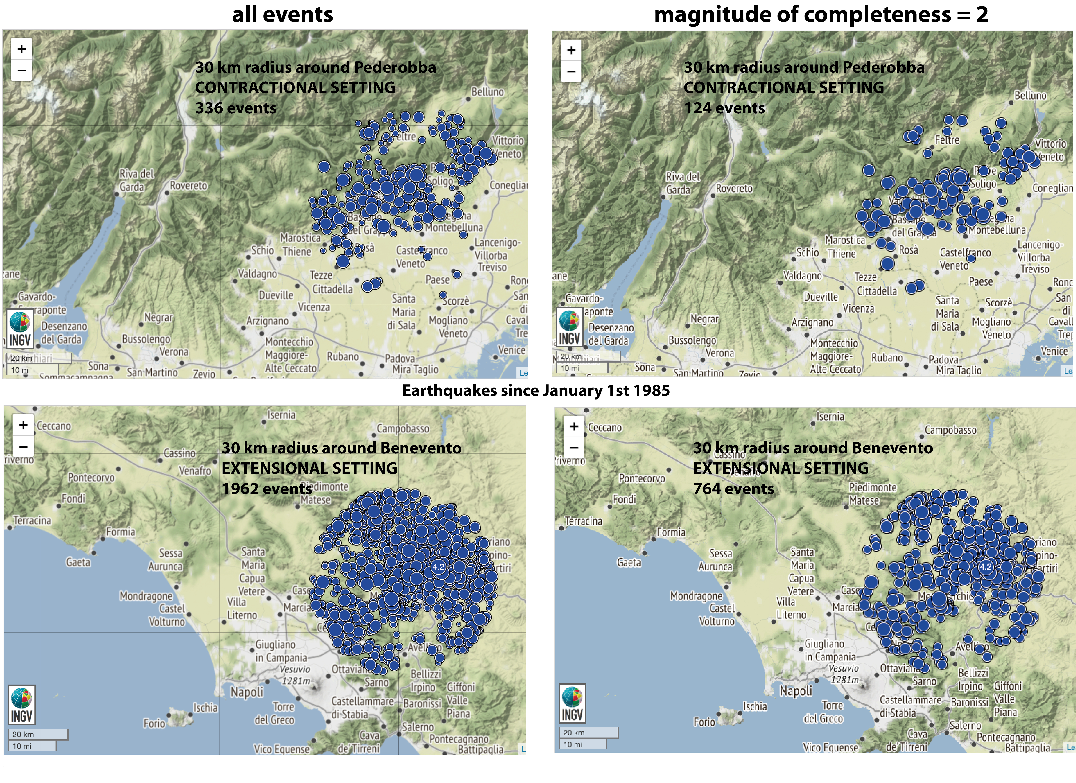
Doglioni 2024 GSF

Slide 30
Zaccagnino et al. 2022 EPSL

Slide 31
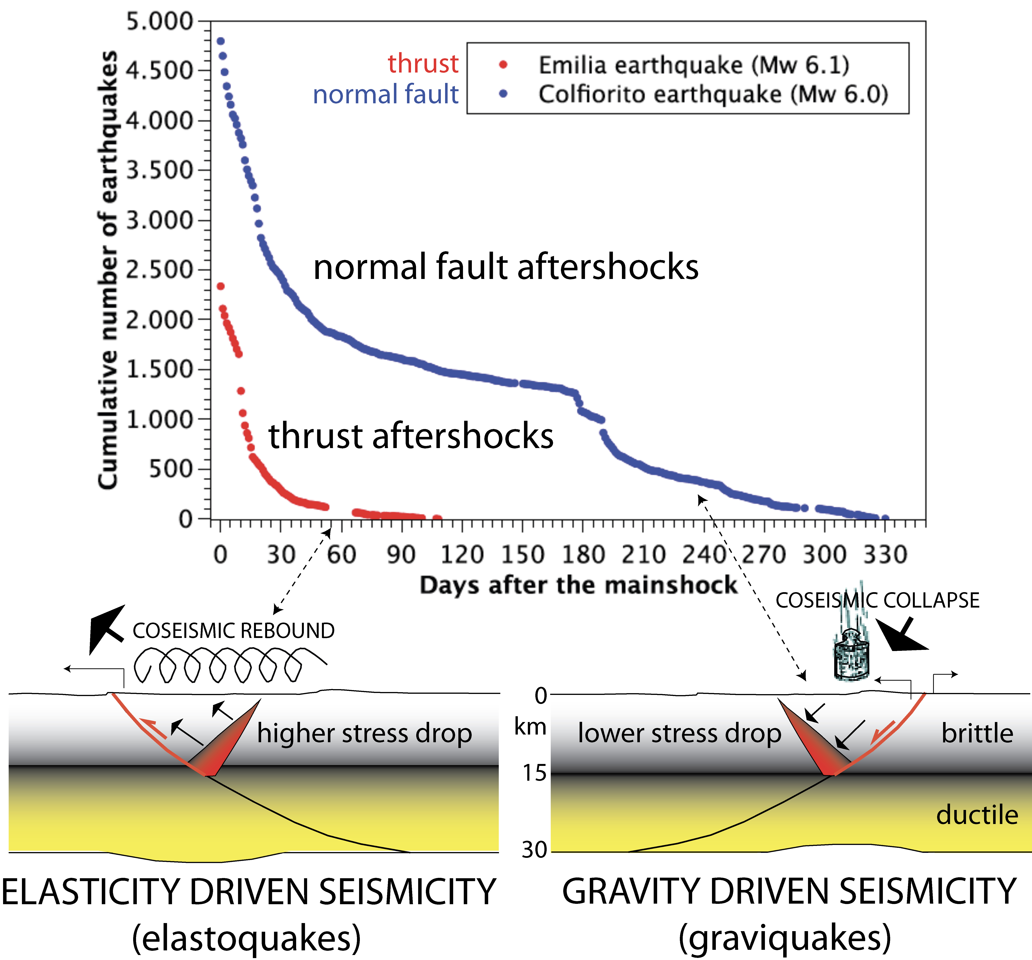

Slide 32
Doglioni 2024 GSF

Slide 33
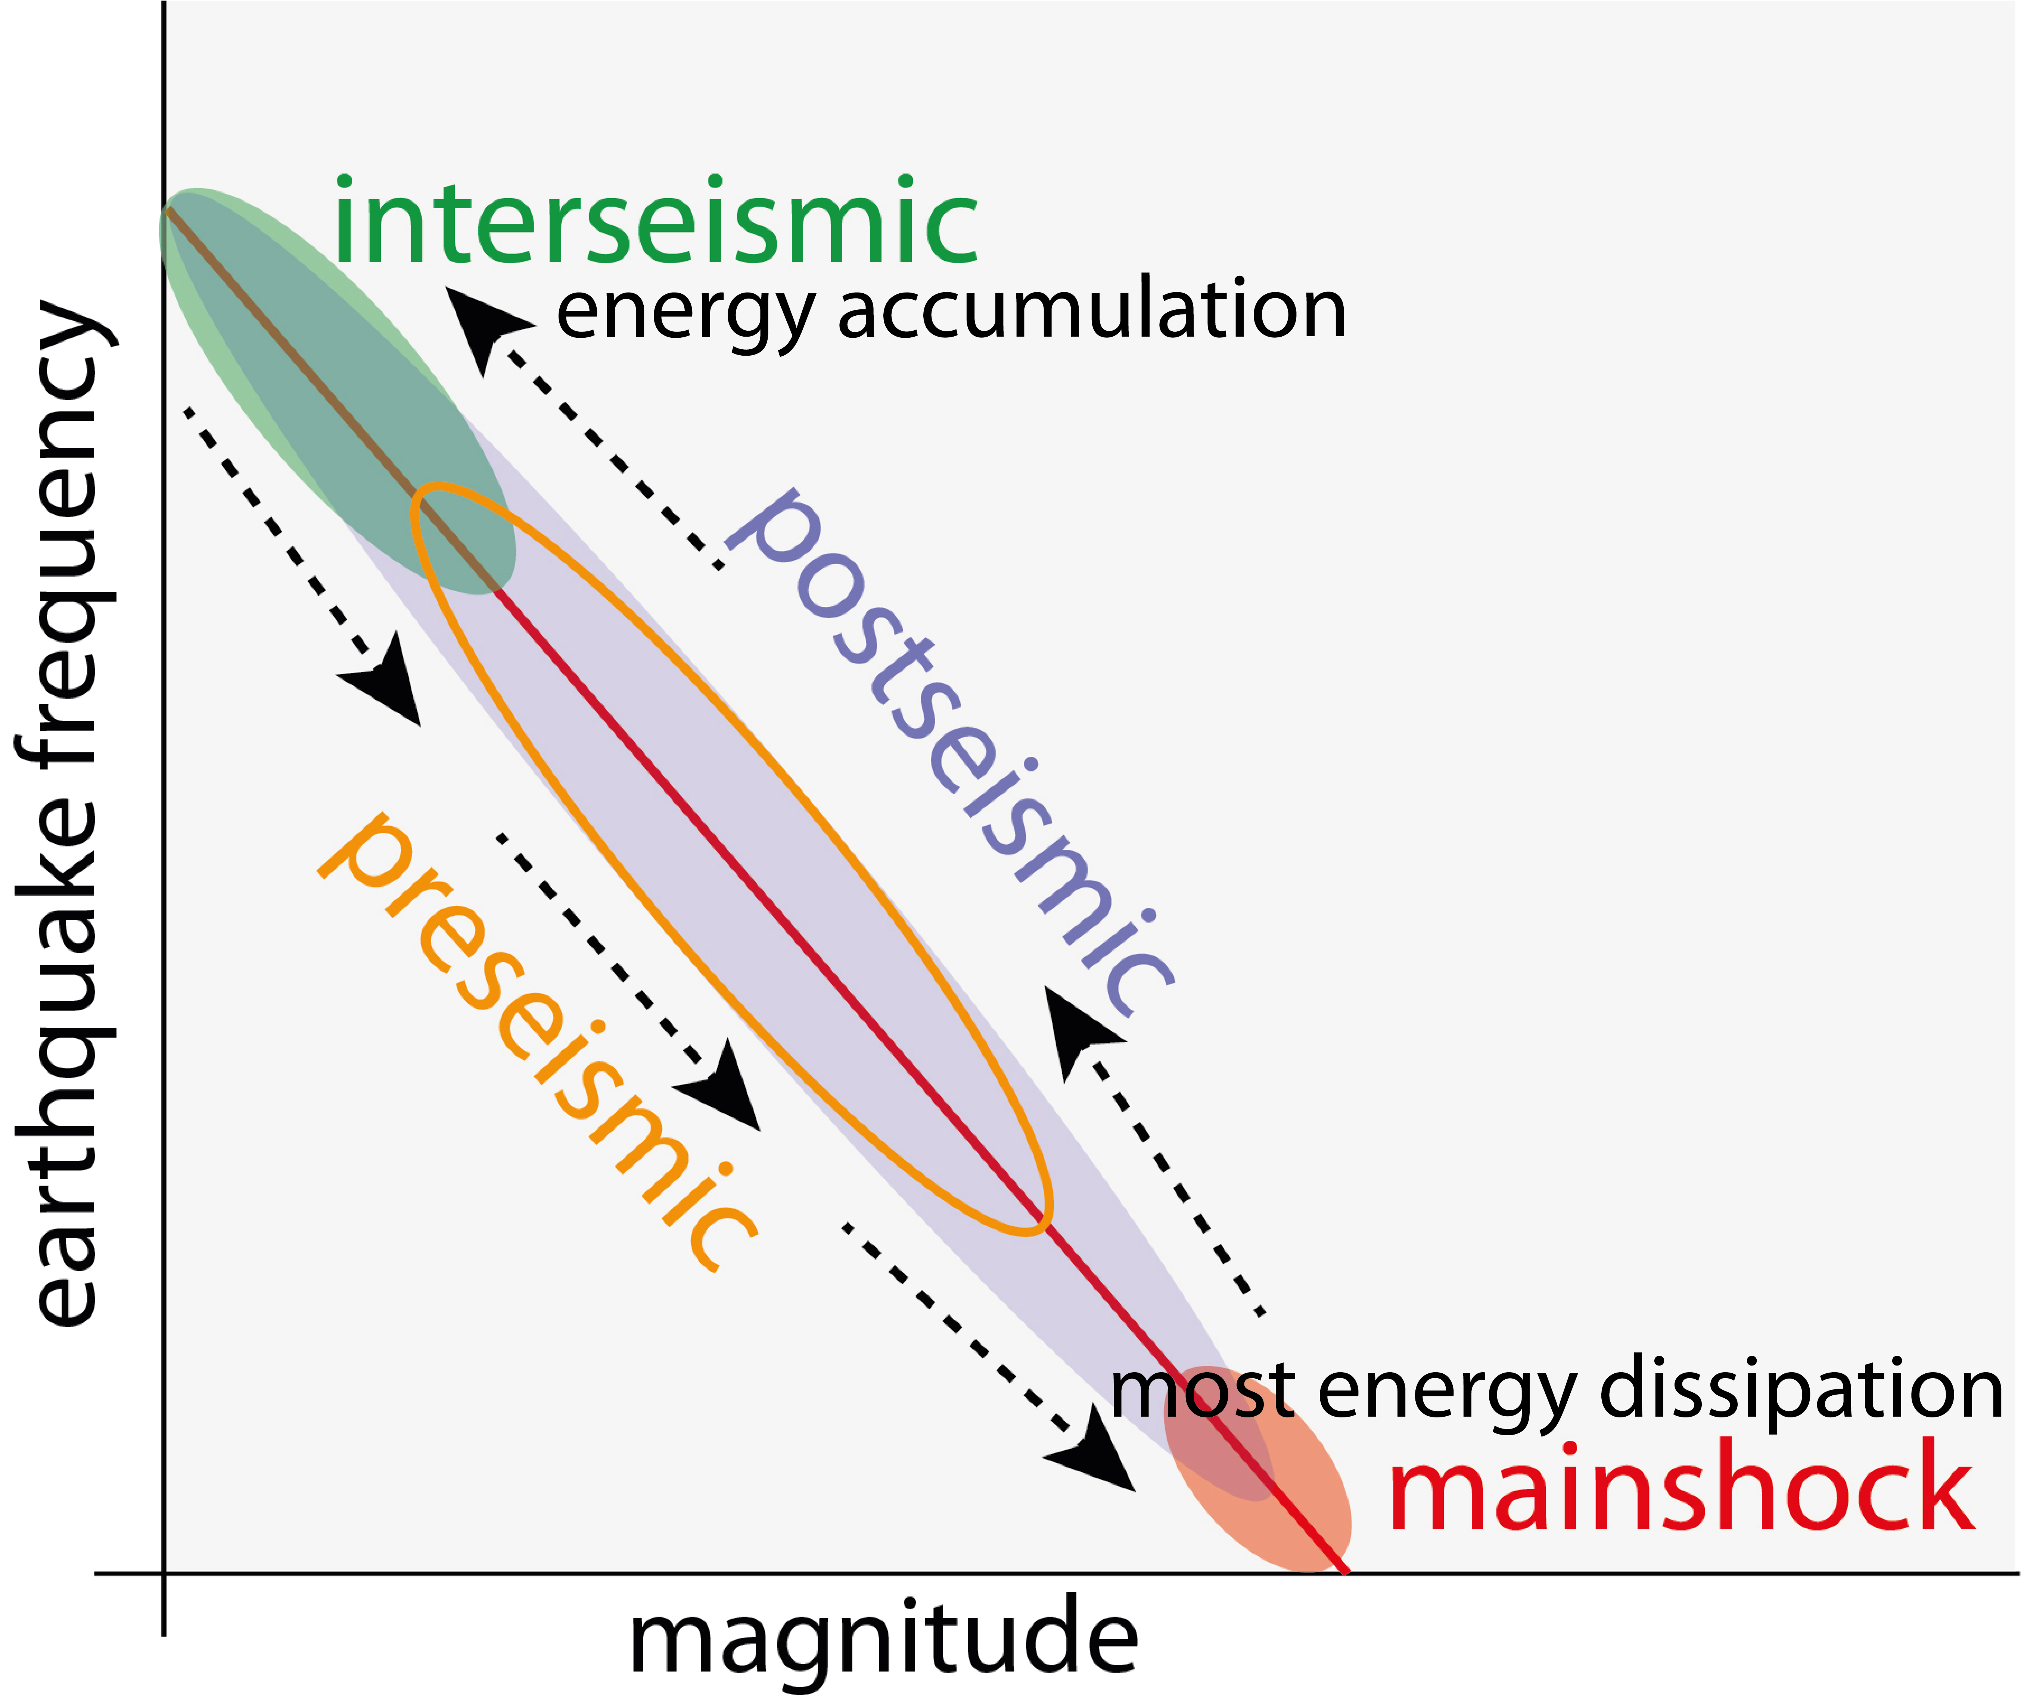
Doglioni 2024 GSF

Slide 34
Heat flow map
Della Vedova et al. 2001

Slide 35
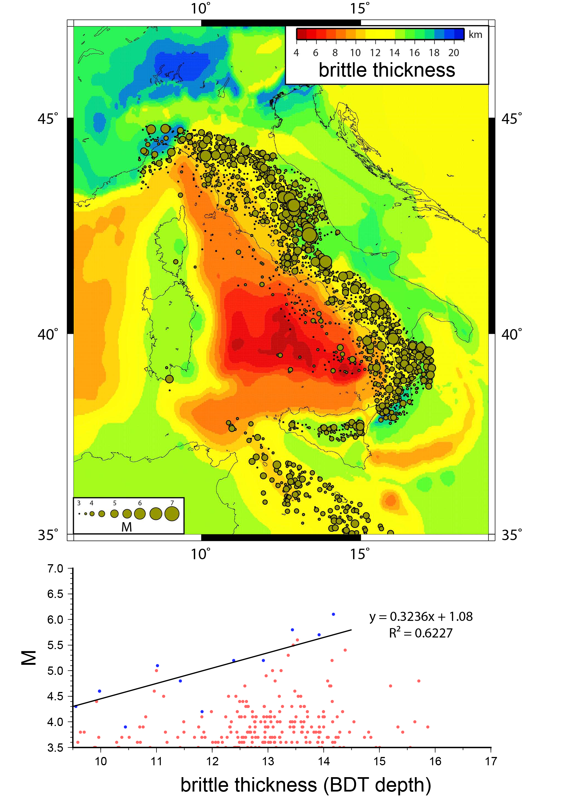
Petricca et al. 2015 Tectonophysics

Slide 36
Doglioni et al. 2015 Scientific Reports

Slide 37
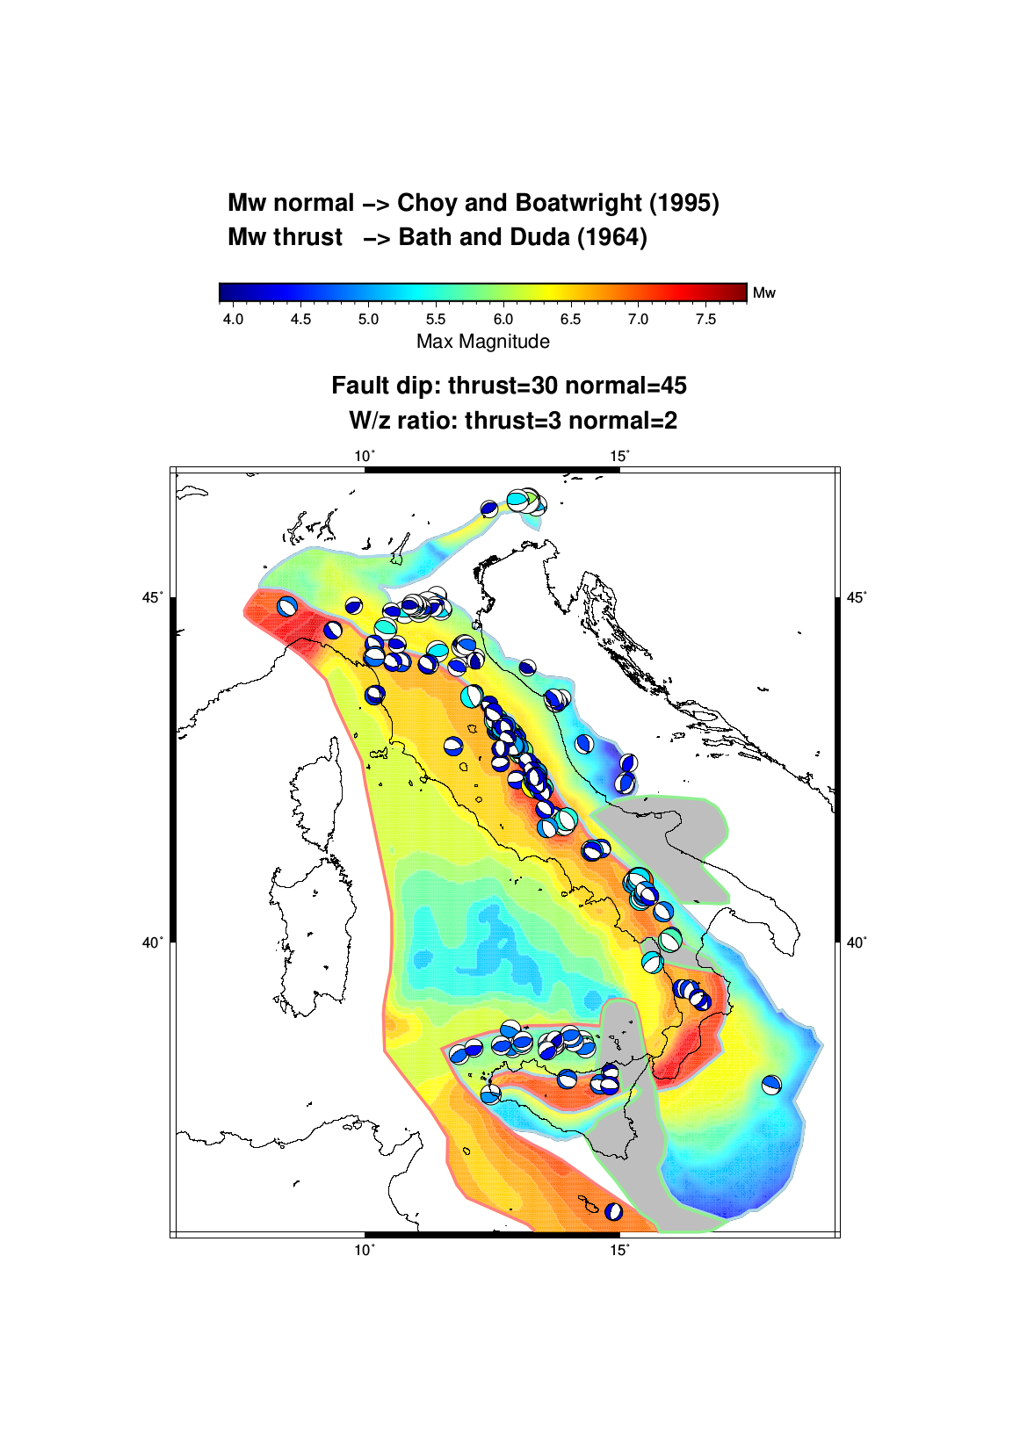

Slide 38
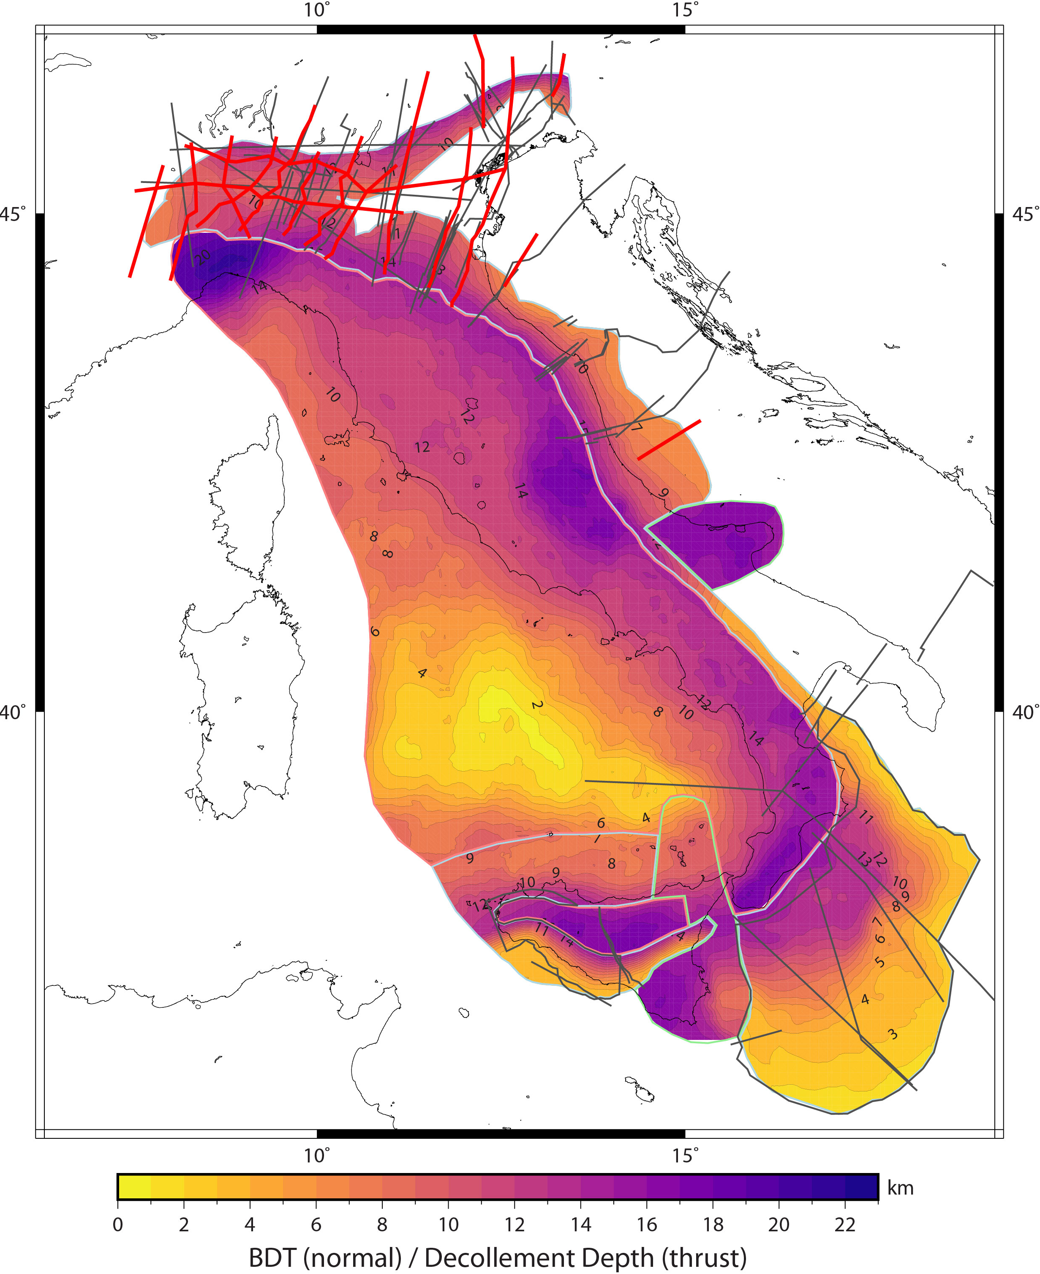
Petricca et al. 2022 Tectonophysics

Slide 39
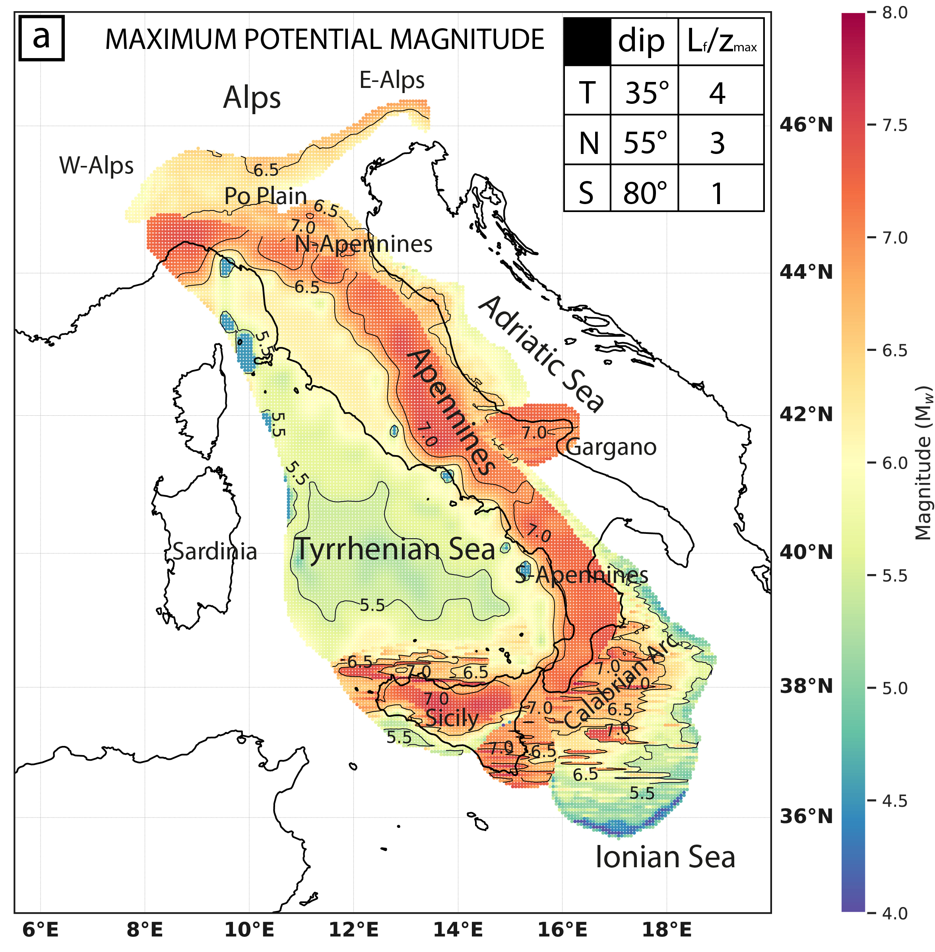
Petricca et al. 2022 Tectonophysics

Slide 40
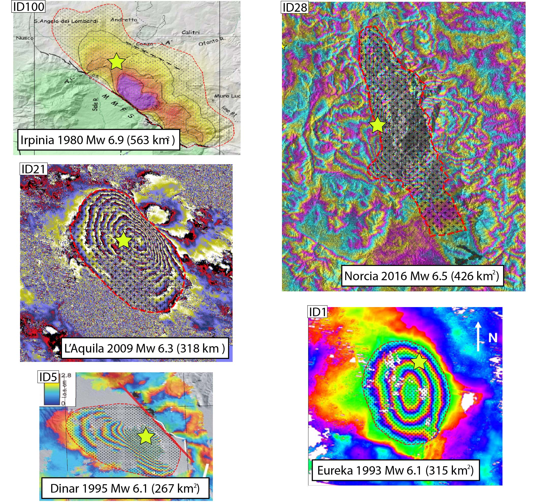
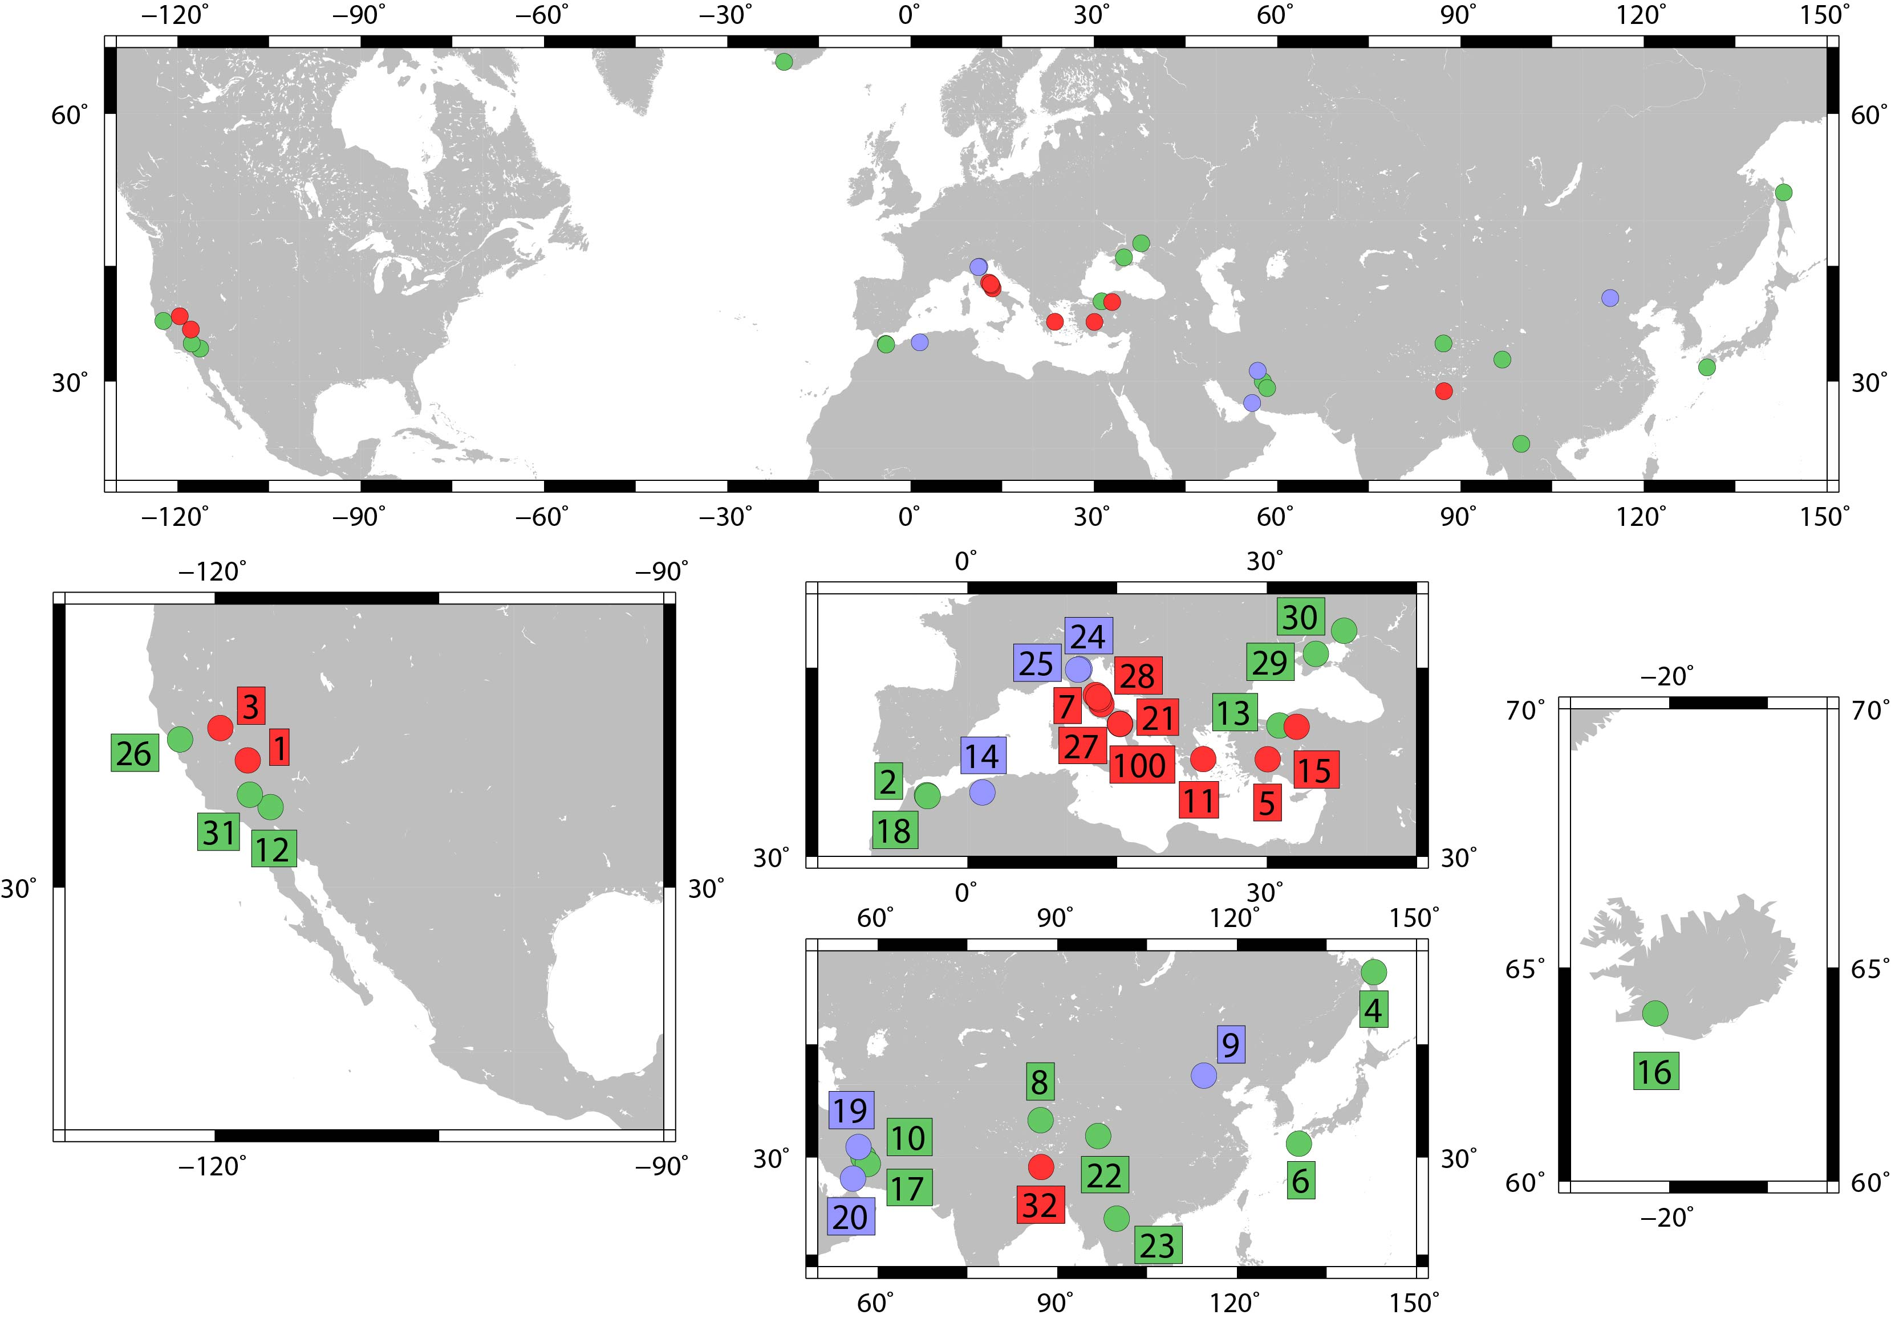
Petricca et al. 2021 ESR

Slide 41
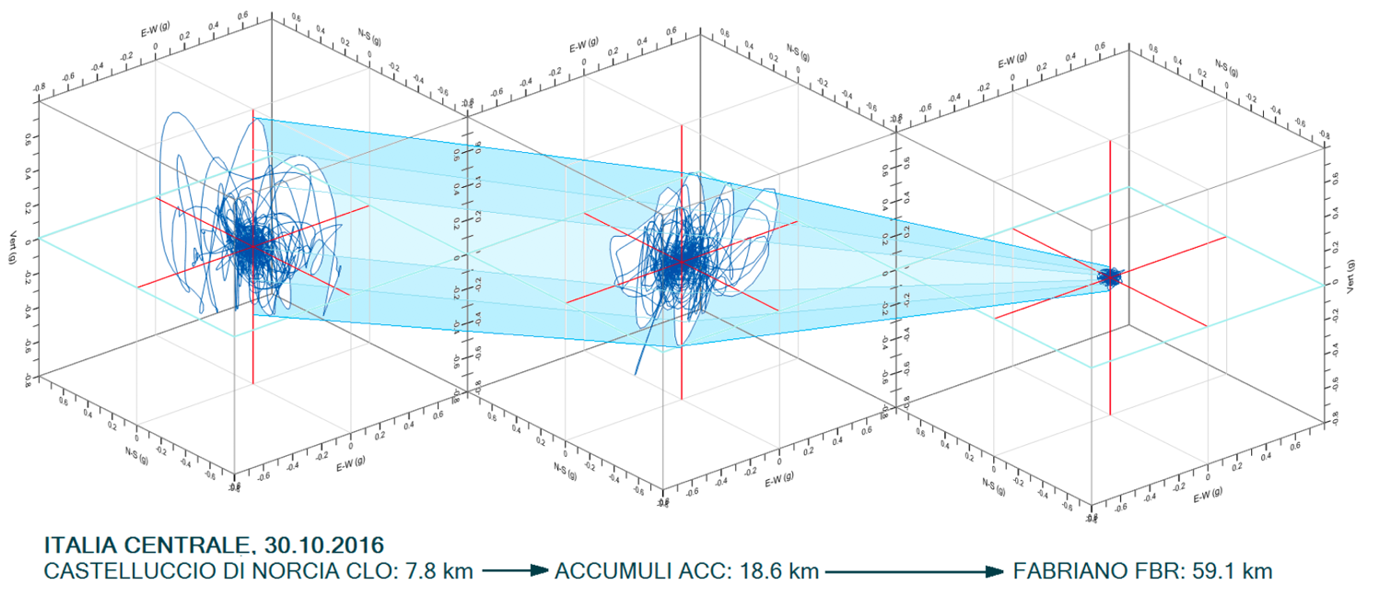
Mariani & Pugi 2019 Ingenio

Slide 42
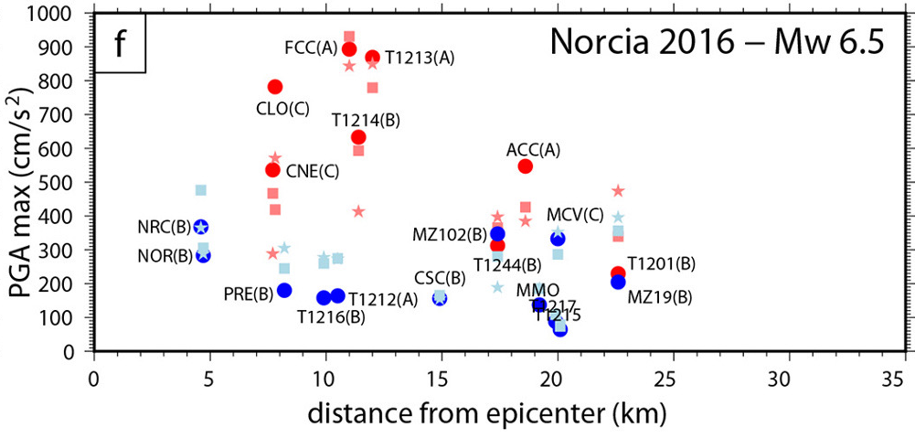
Petricca et al. 2021 ESR

Slide 43
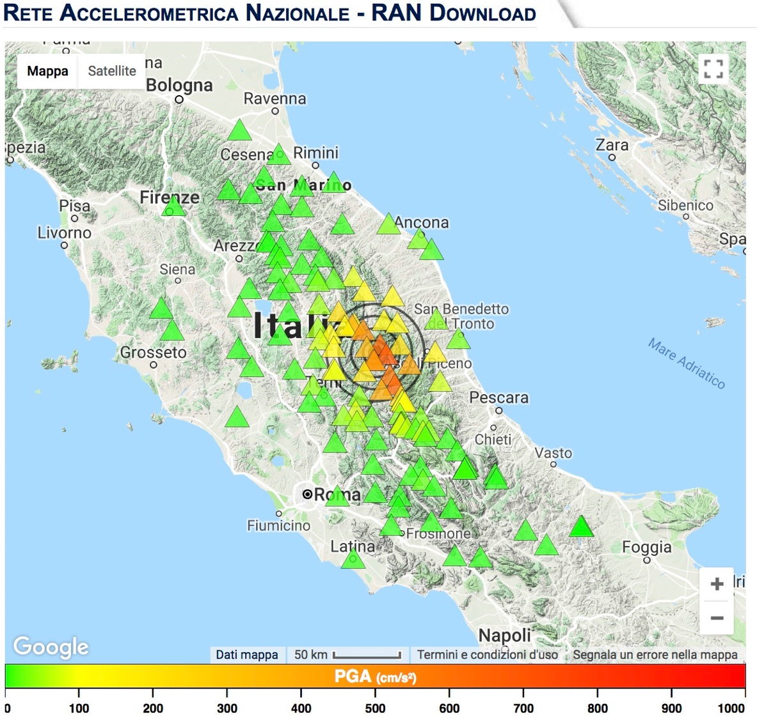

Slide 44
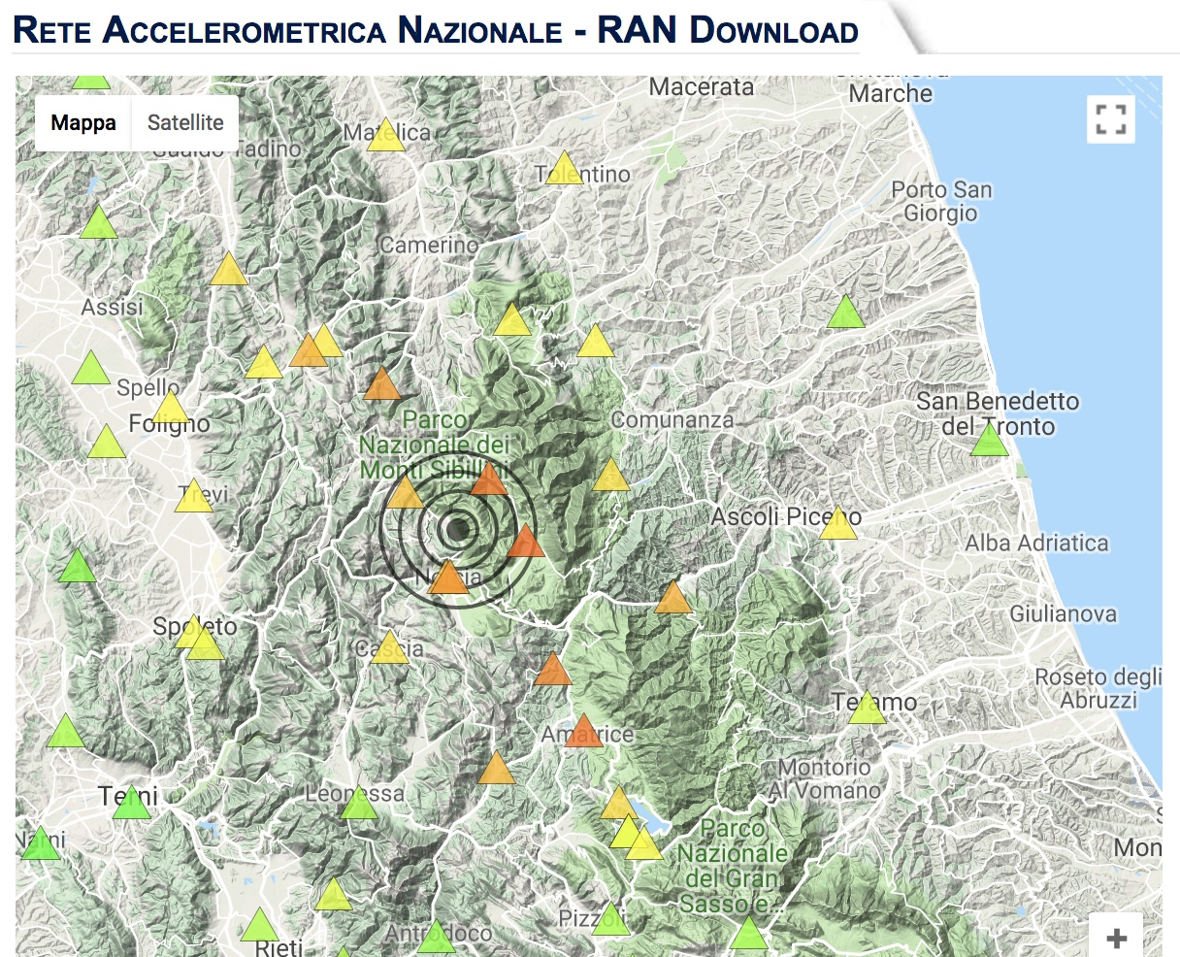
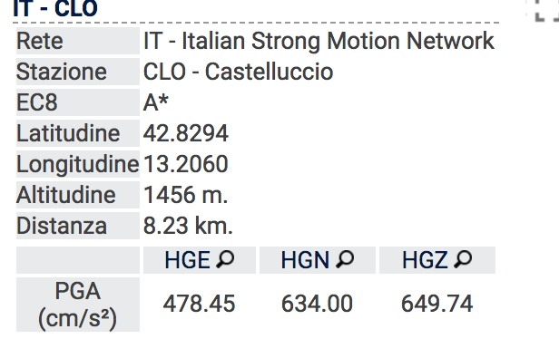
30/10/2016

Slide 45
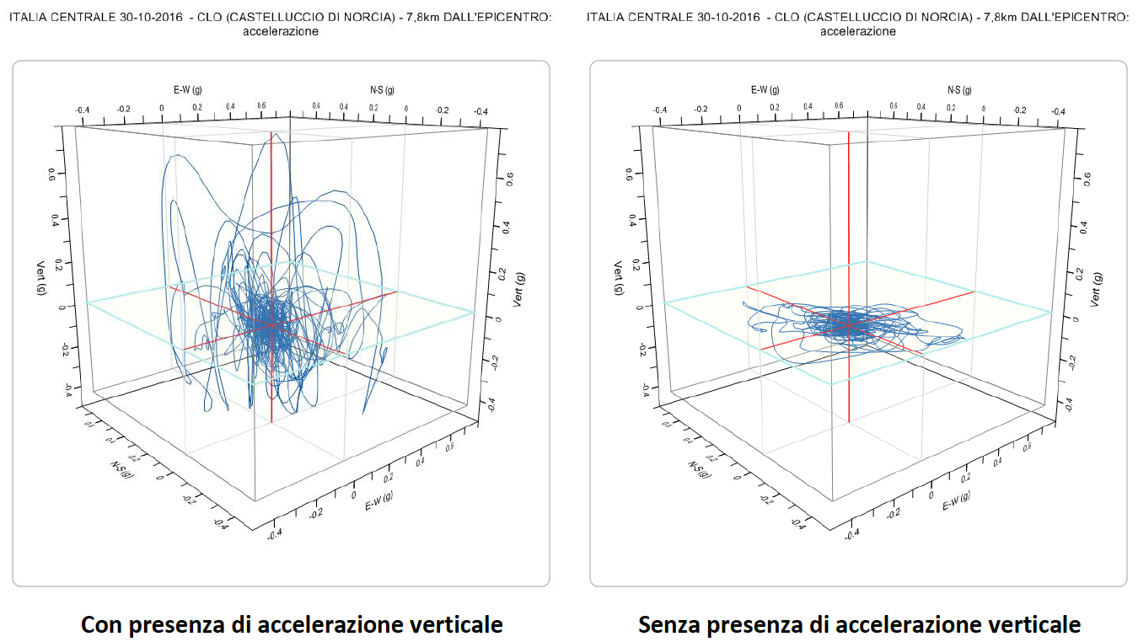
Mariani & Pugi 2019 Ingenio

