Slide 1
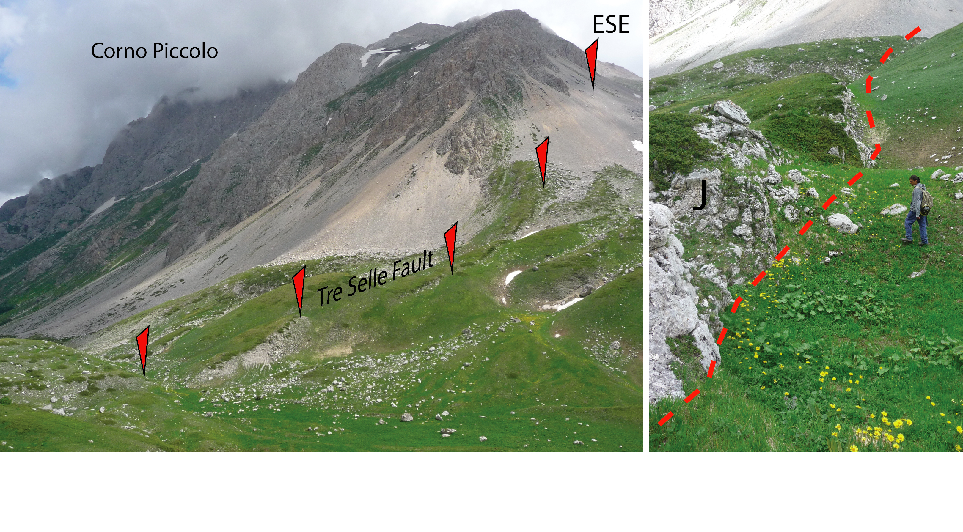
Cardello & Doglioni 2015, Gondwana Res.

Slide 2
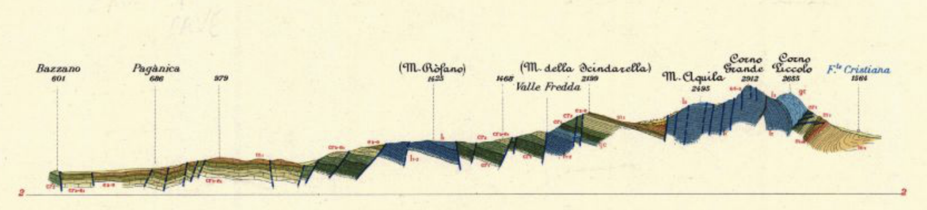

Slide 3
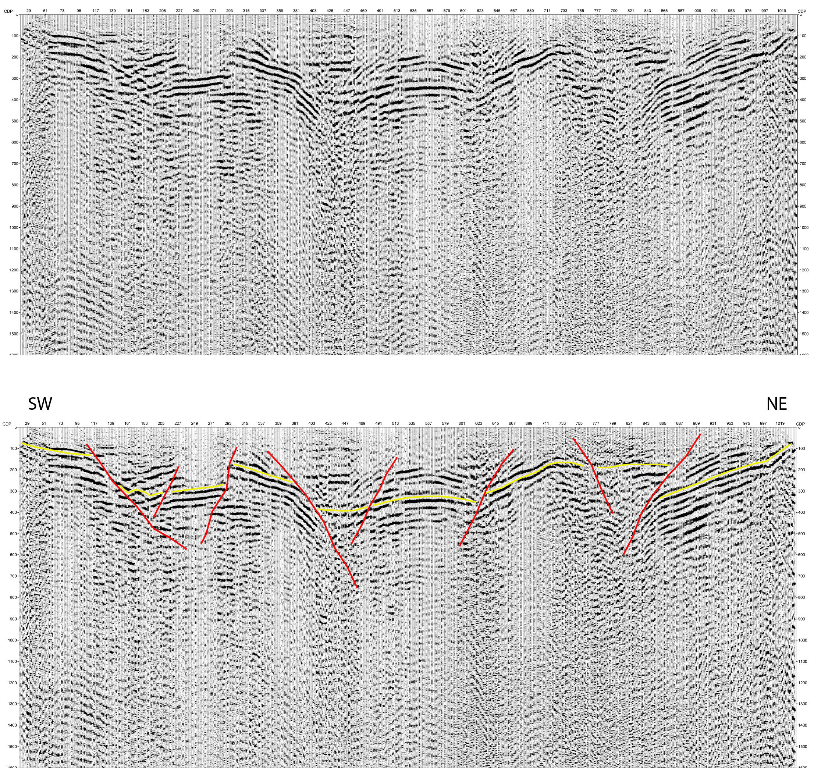
Mt. Vettore
1 km
Bruno et al. in prep.

Slide 4
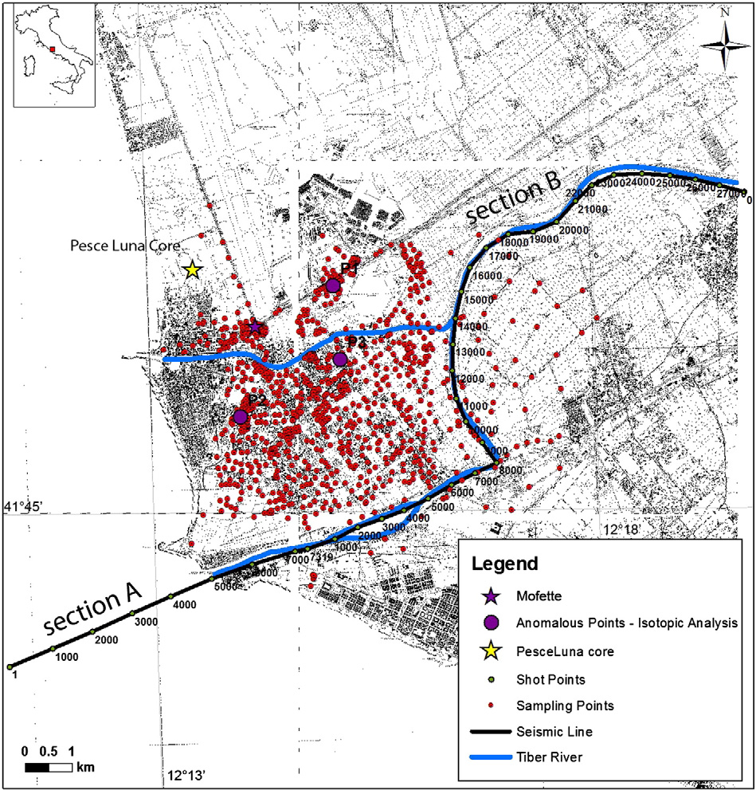
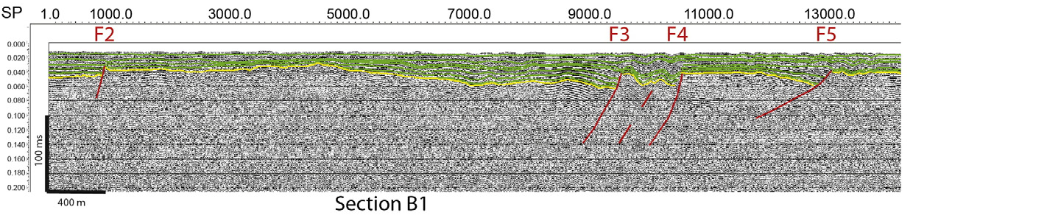

Slide 5
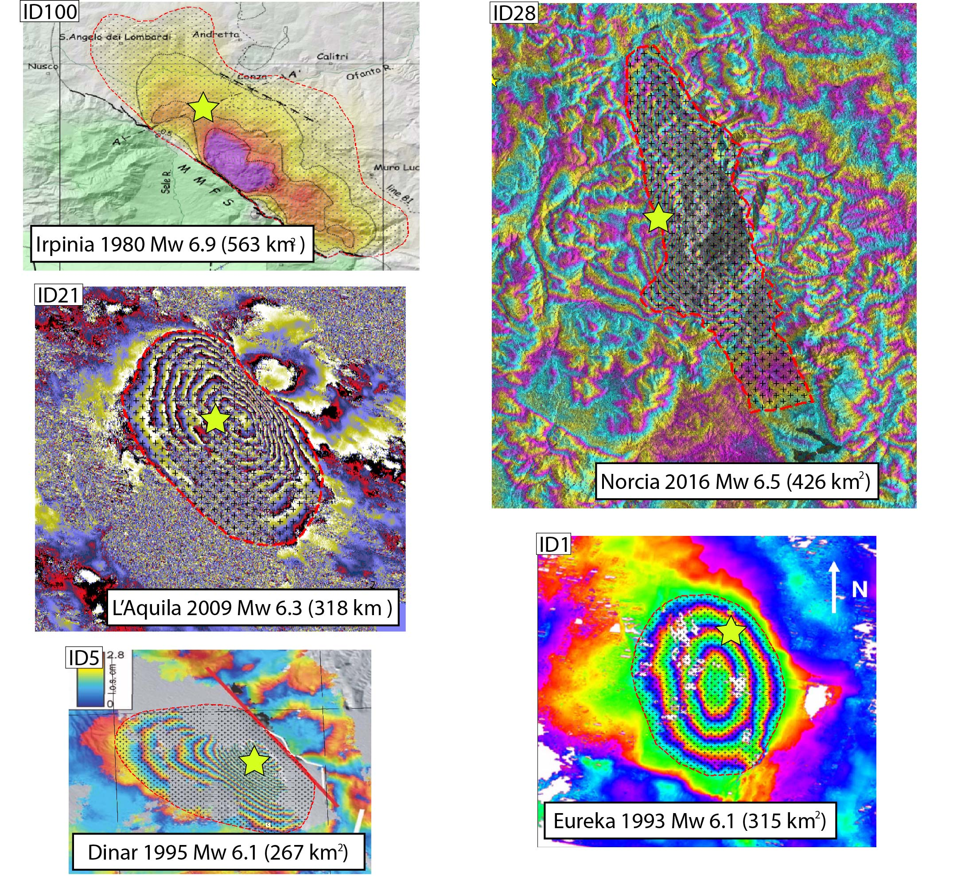
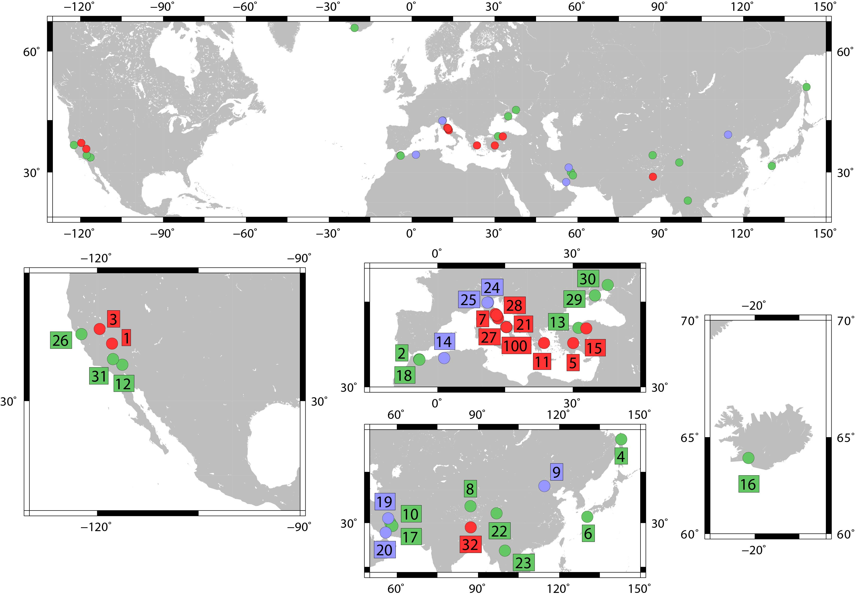
Petricca et al. 2021 ESR

Slide 6
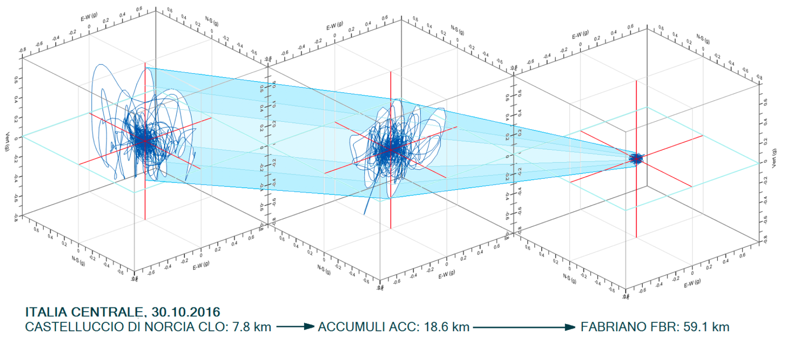
Mariani & Pugi 2019 Ingenio

Slide 7
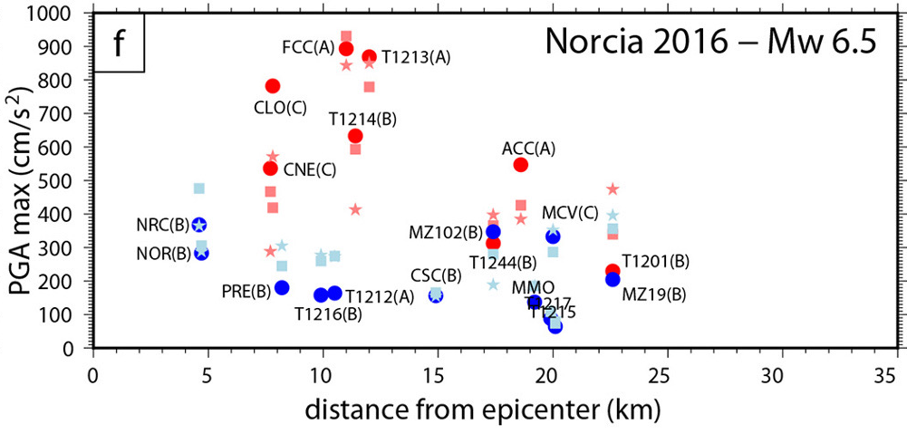
Petricca et al. 2021 ESR

Slide 8
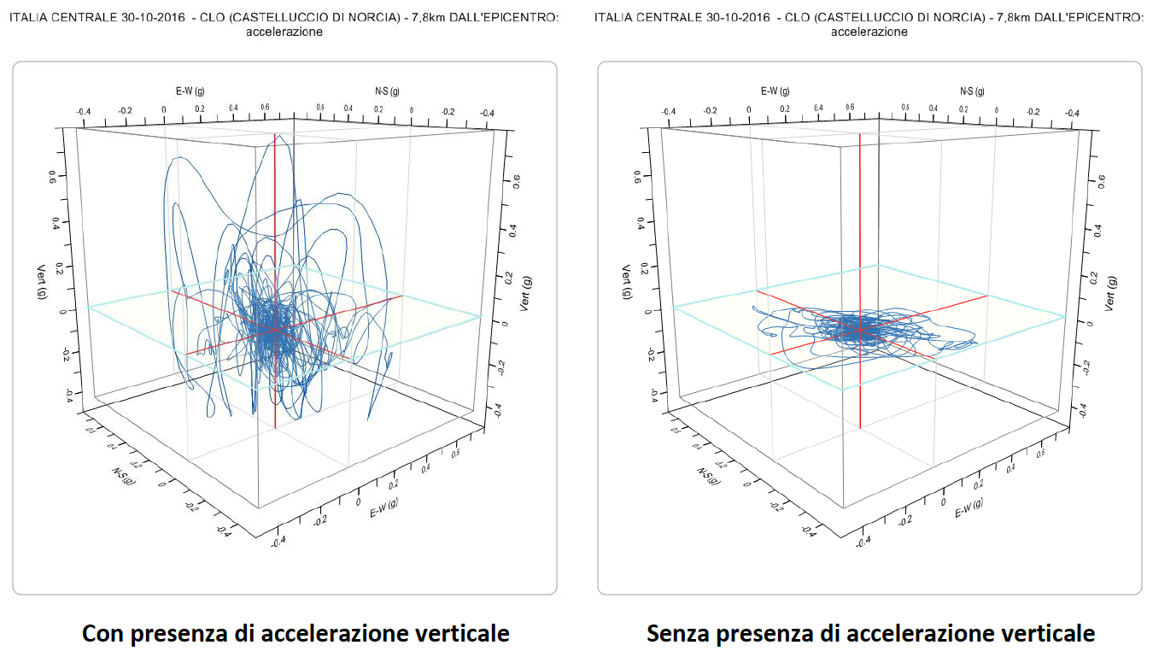
Mariani & Pugi 2019 Ingenio

Slide 9
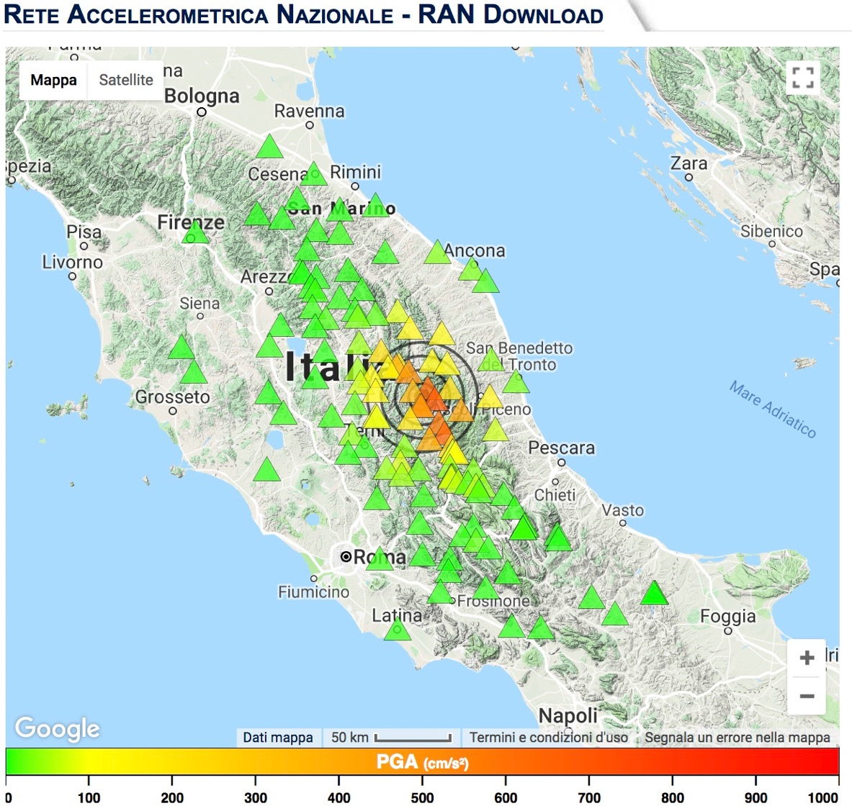
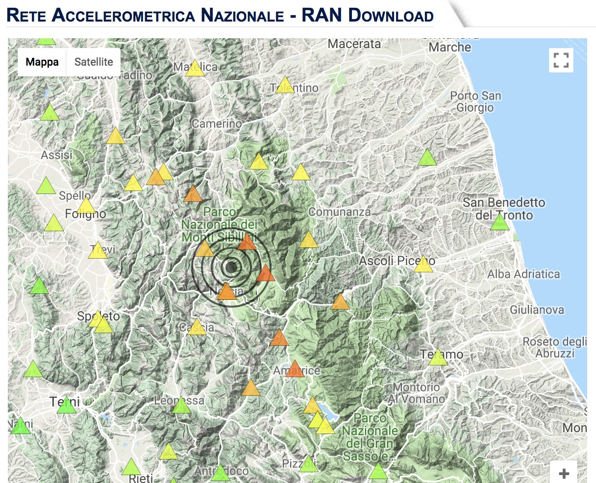
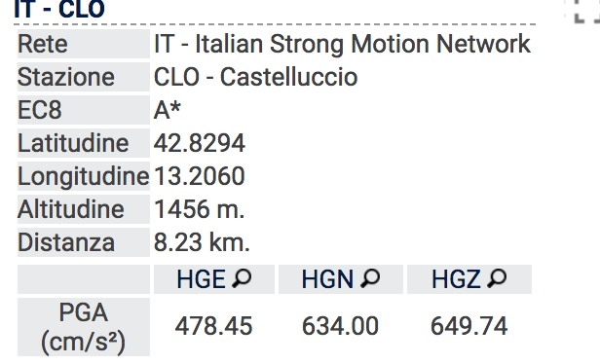
30/10/2016

Slide 10
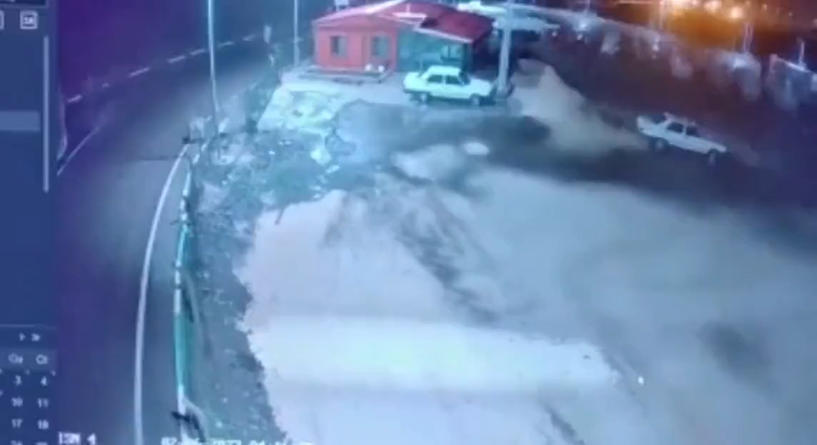

Slide 11
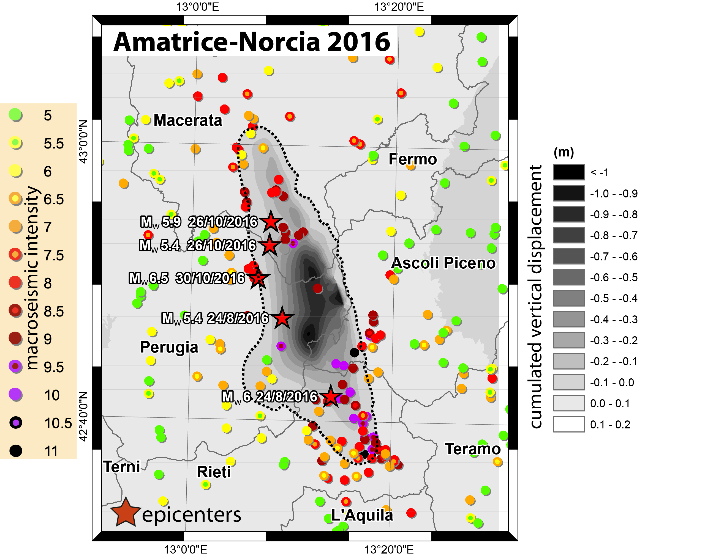
Al Shawa et al. 2021 Eng. Geol.

Slide 12
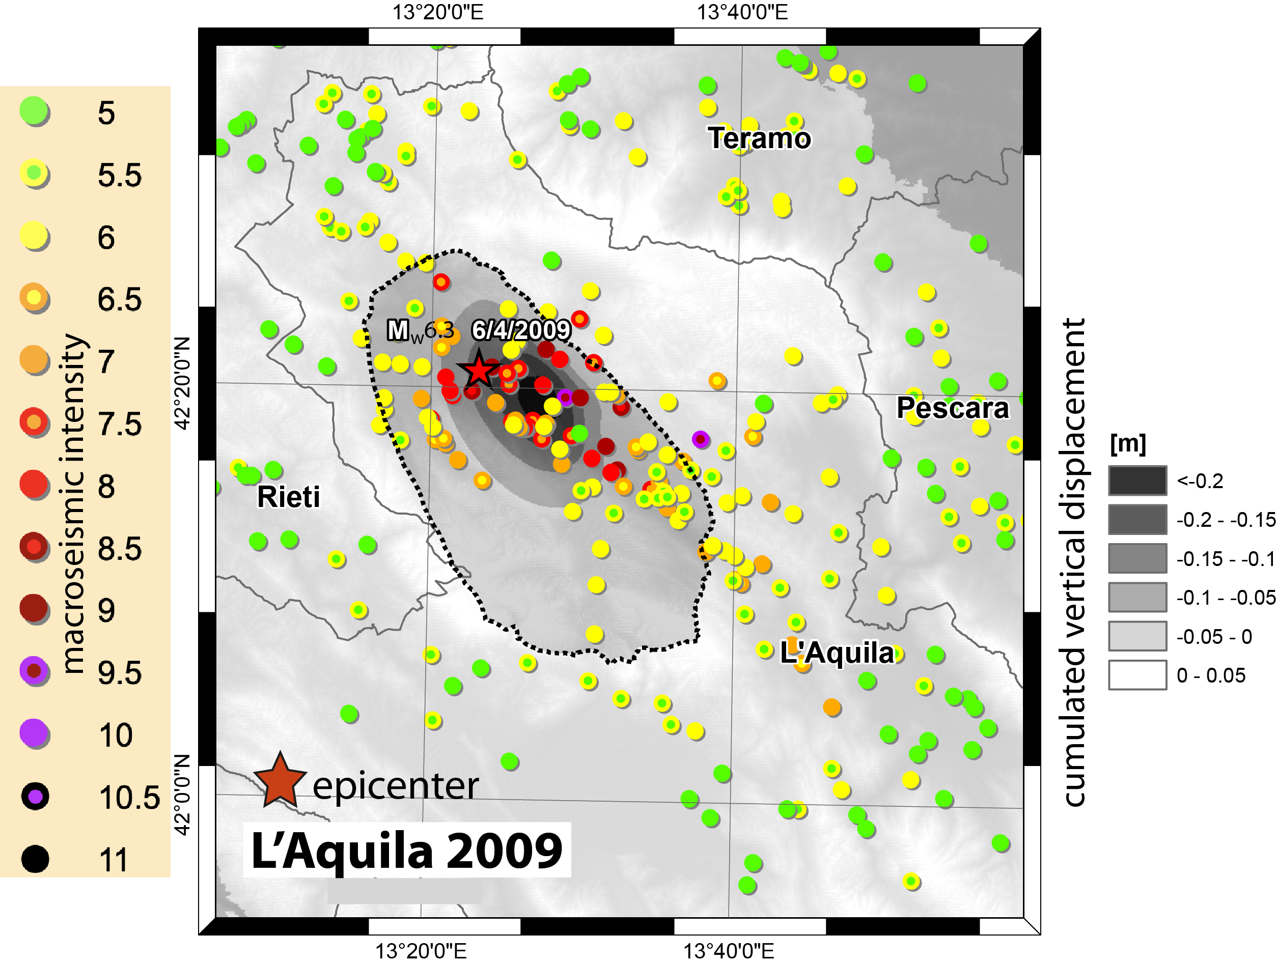
Al Shawa et al. 2021 Eng. Geol.

Slide 13
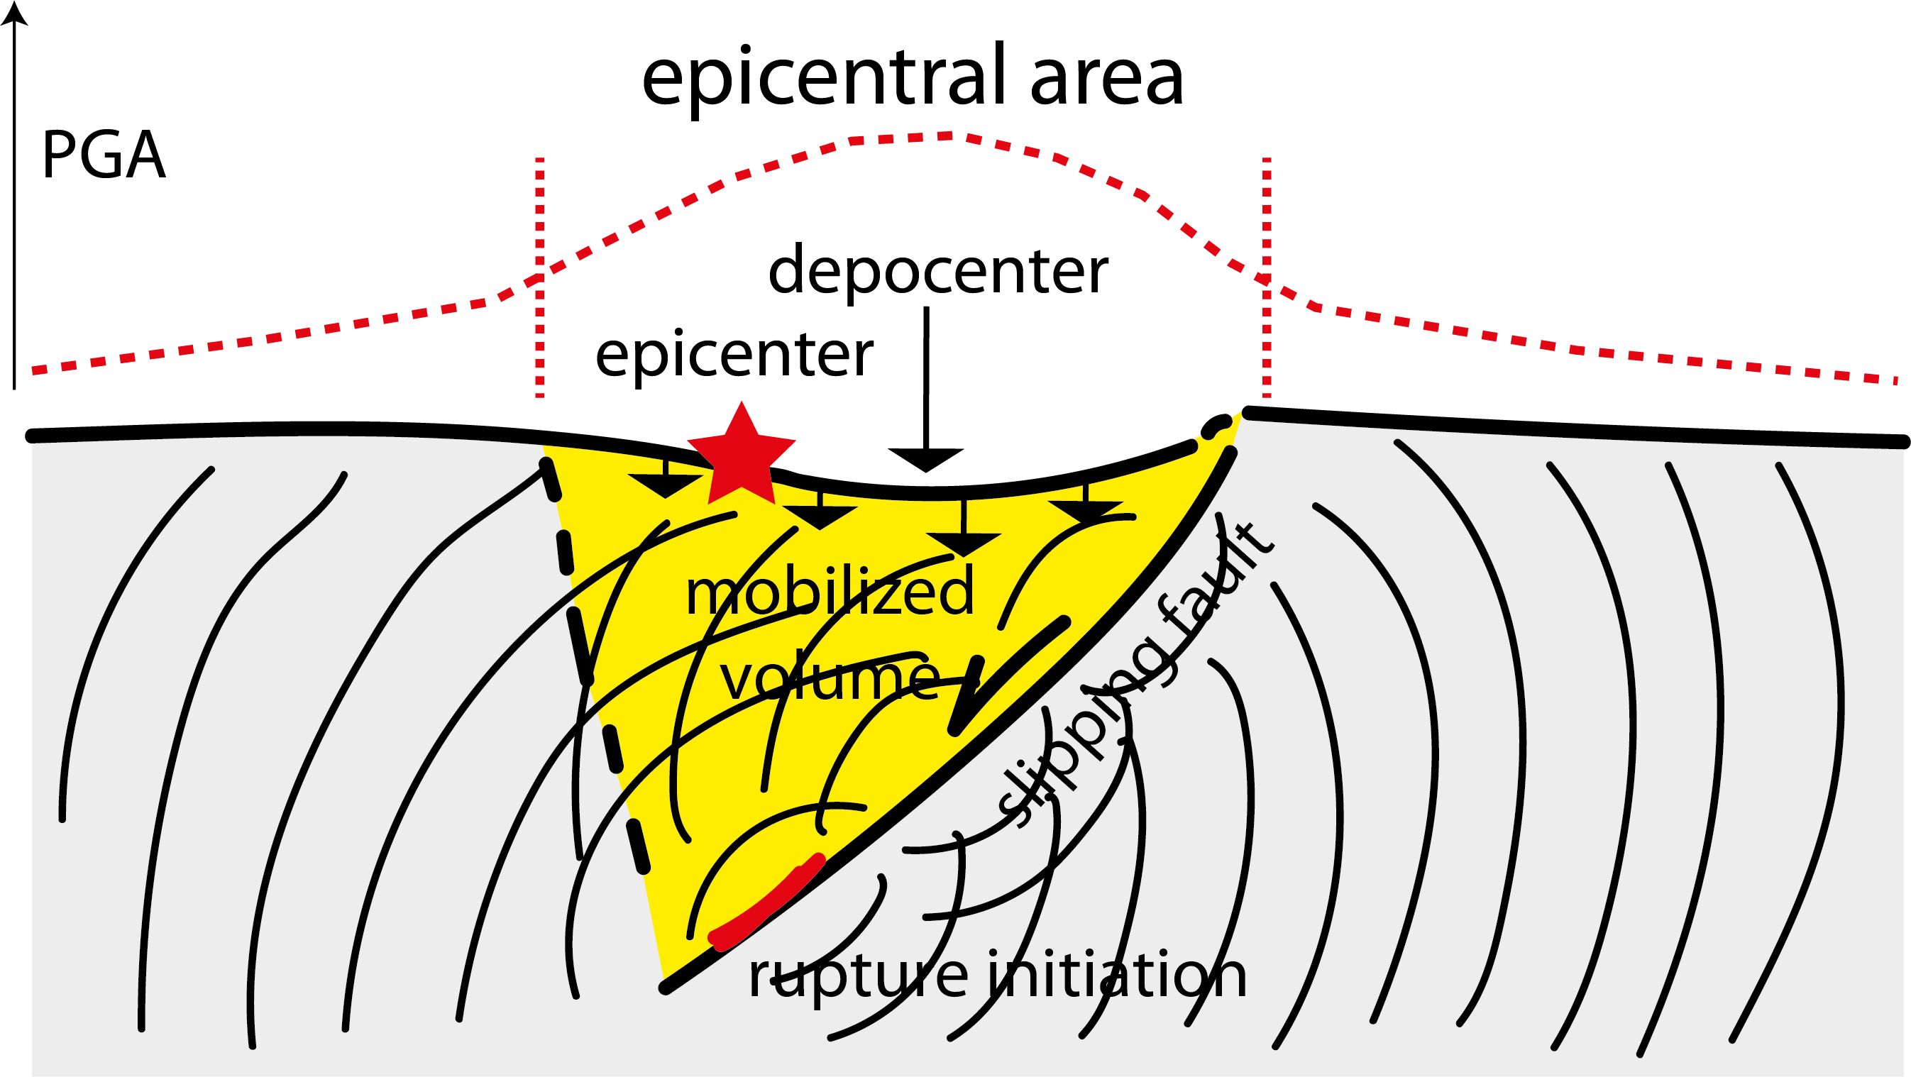
Al Shawa et al. 2021 Eng. Geol.

Slide 14
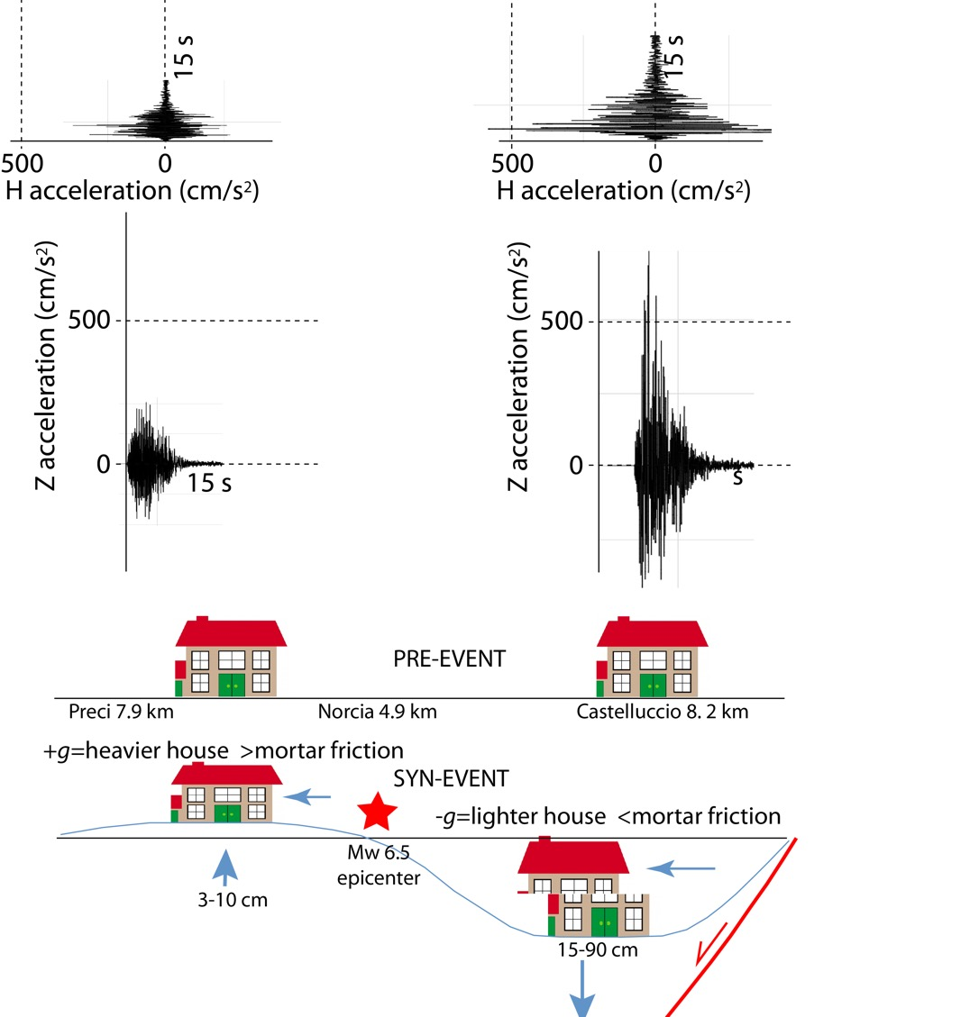
Liberatore et al. 2019

Slide 15
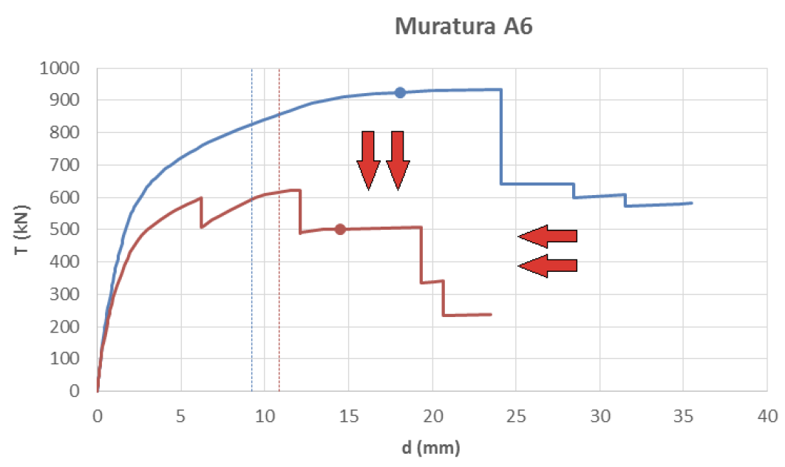
masonry
Horizontal shaking
Horizontal and Vertical shaking
Mariani et al. 2018 Ingenio

Slide 16
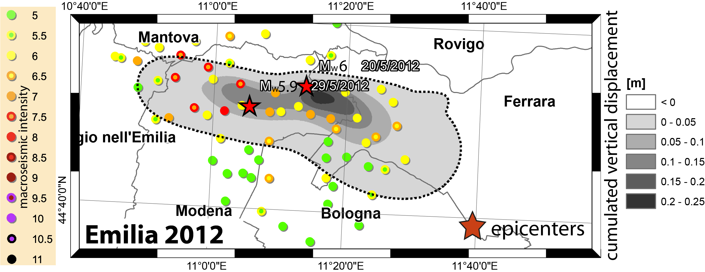
Al Shawa et al. 2021 Eng. Geol.

Slide 17
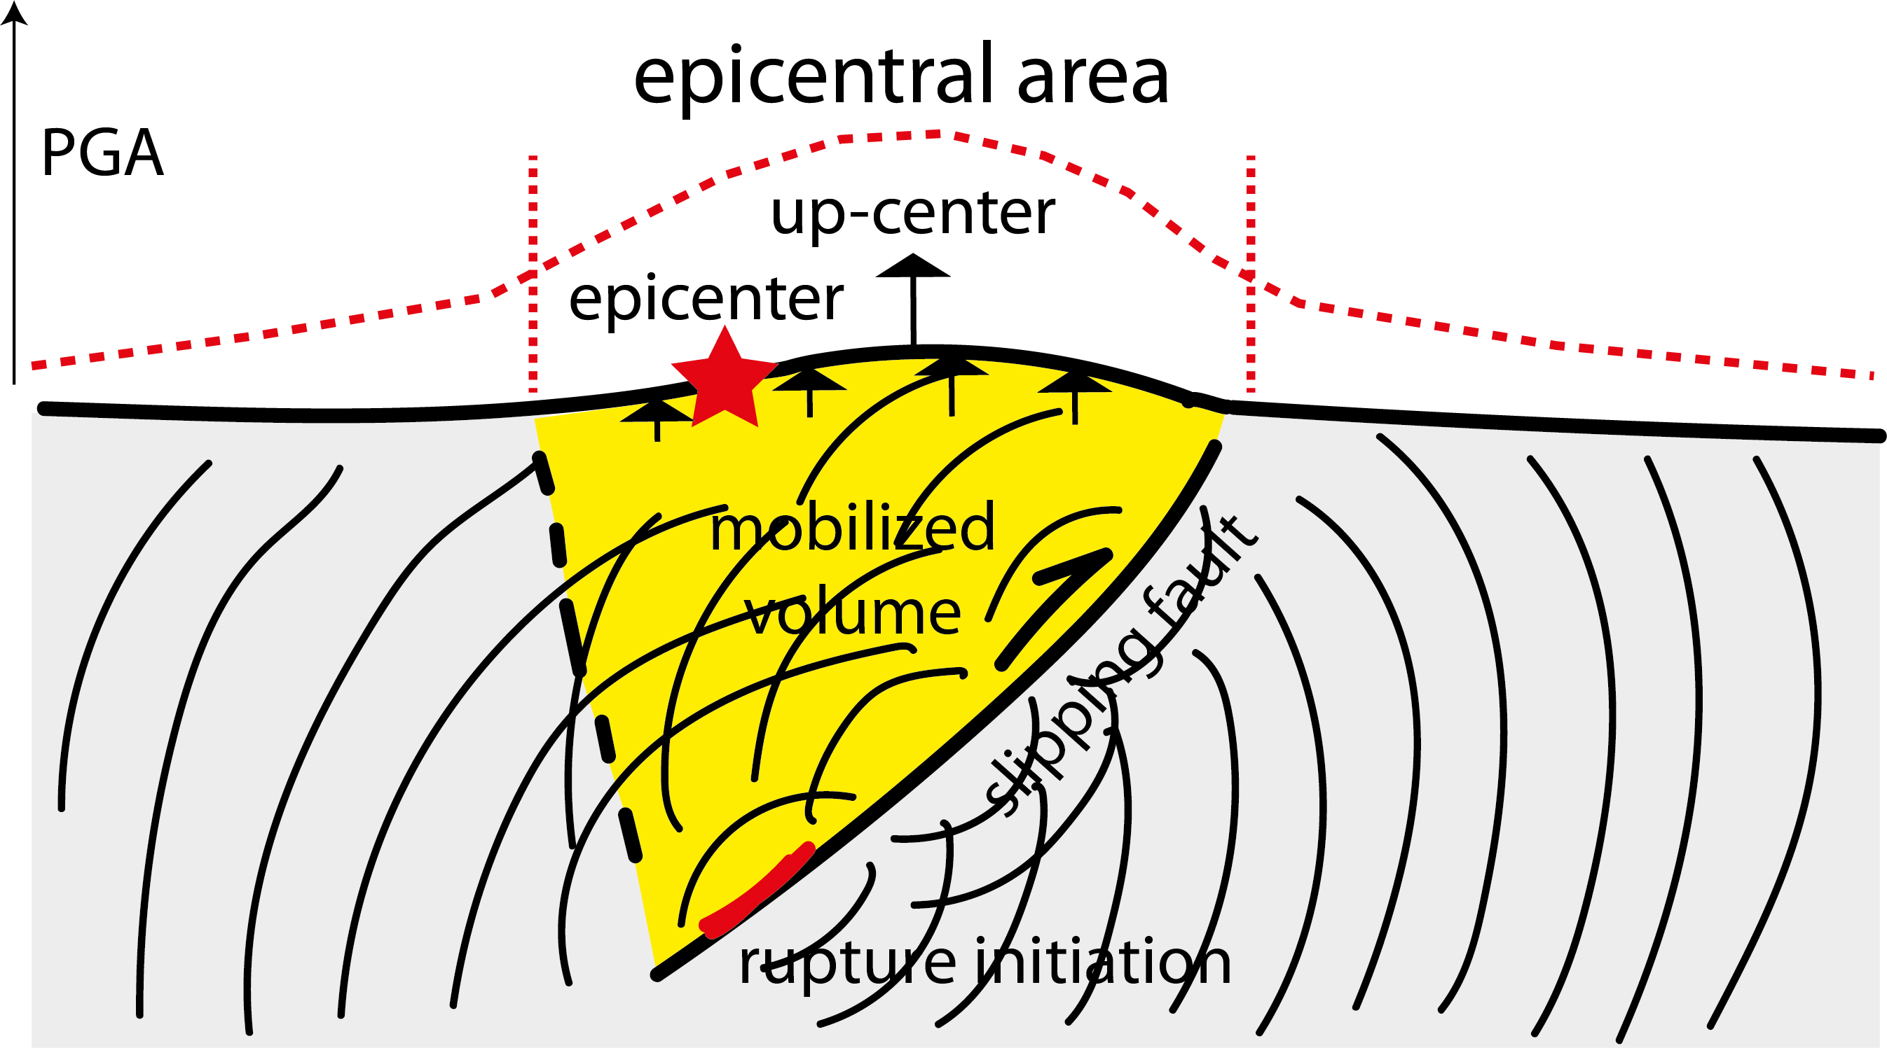
Al Shawa et al. 2021 Eng. Geol.

Slide 18
Cardello & Doglioni 2015, Gondwana Res.

Slide 19
Doglioni 2024 GSF

Slide 20
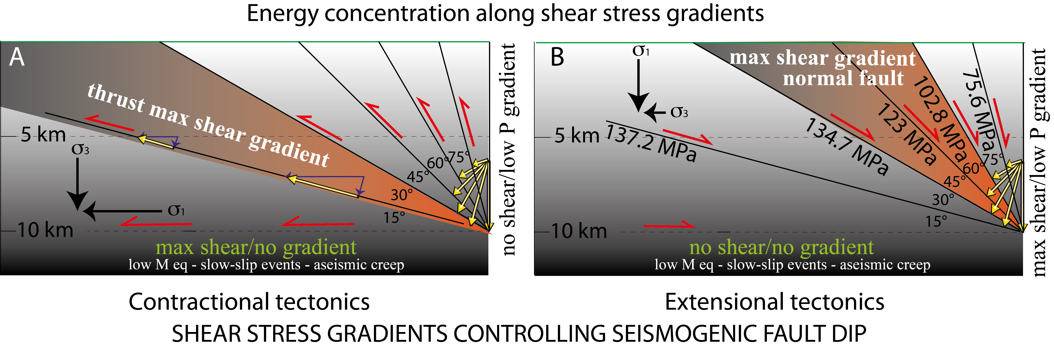
Zaccagnino & Doglioni 2023 Geosystems & Geoenv.

Slide 21
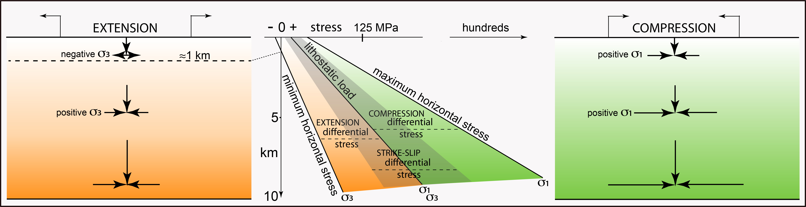
Doglioni 2024 GSF

Slide 22
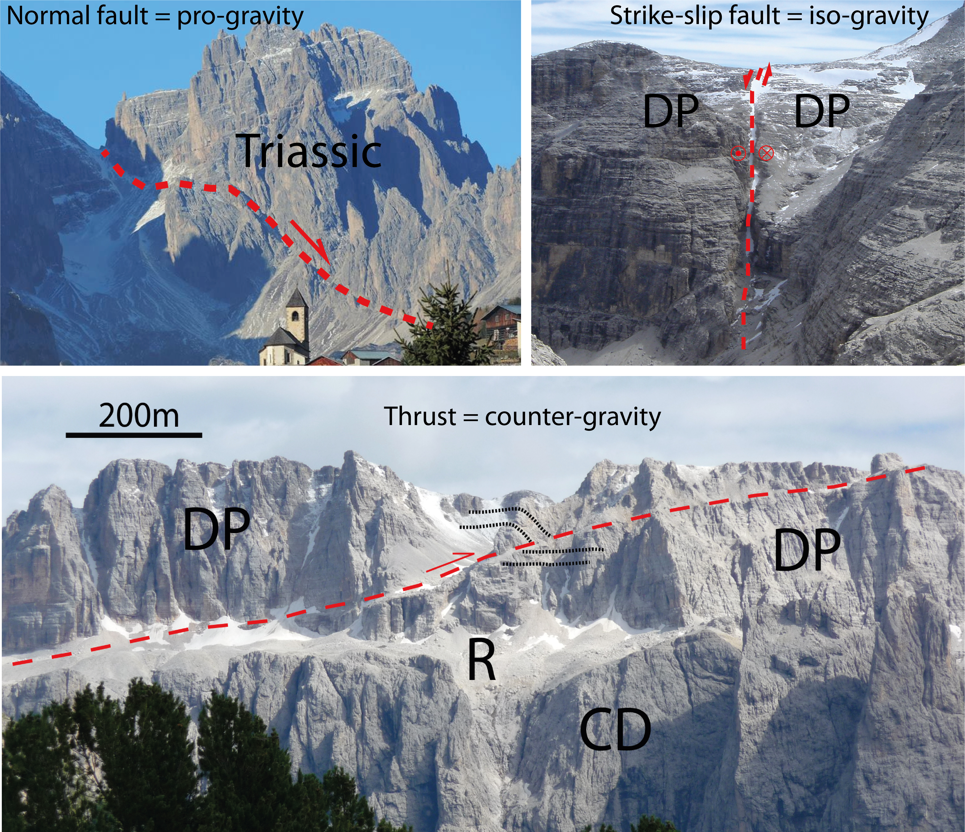
Doglioni 2024 GSF

Slide 23
Doglioni 2024 GSF

Slide 24
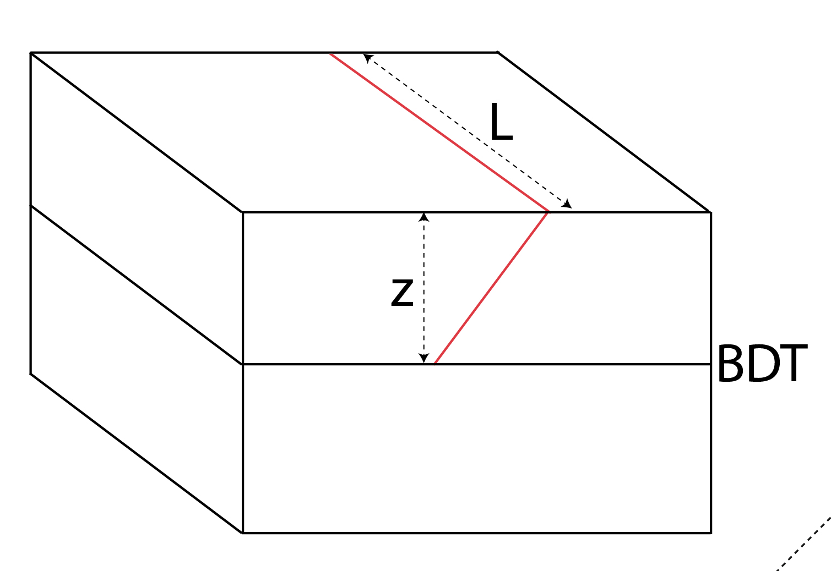
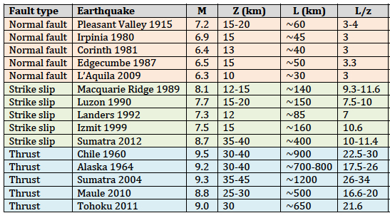
Doglioni et al. 2015 SREP
7.5
3
8.7
10
9.5
25

Slide 25
Zaccagnino et al. 2022 EPSL

Slide 26
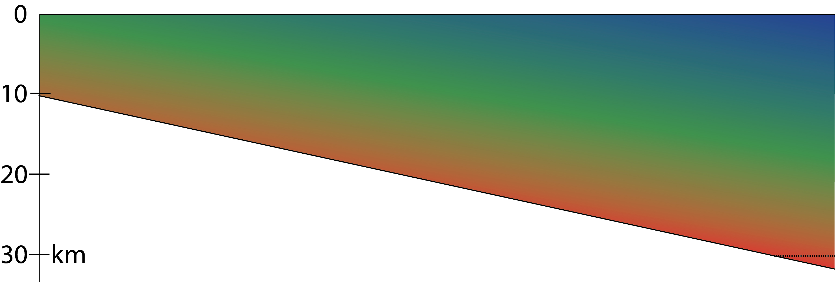
heat flow

Slide 27
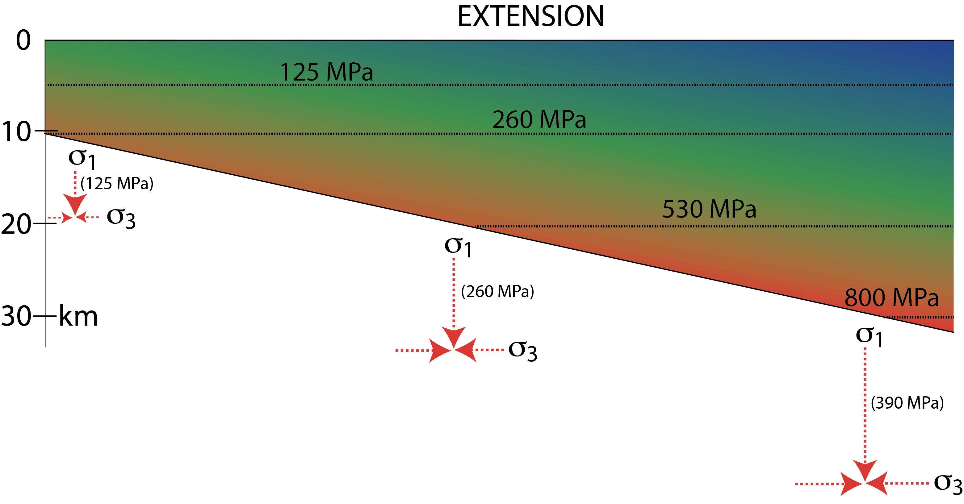

Slide 28


Slide 29
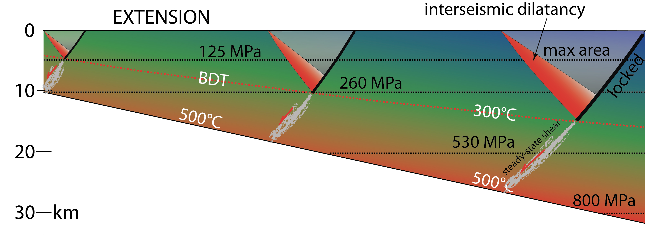

Slide 30
