Slide 1
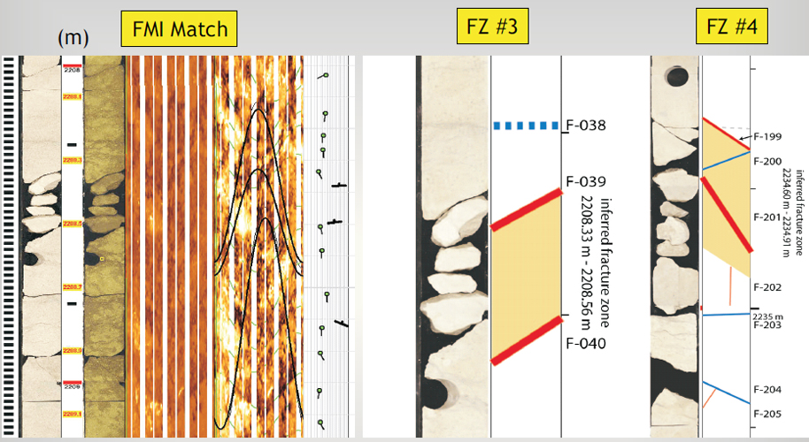

Slide 2
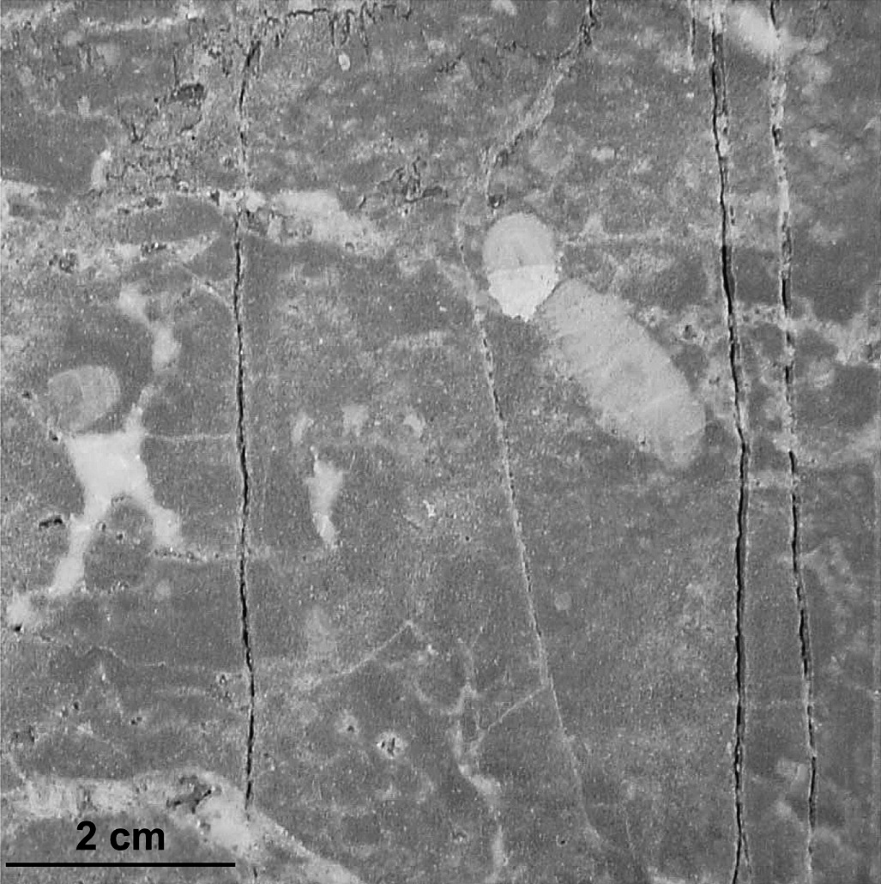
Packstone 2300 m
Pennsylvania well

Slide 3
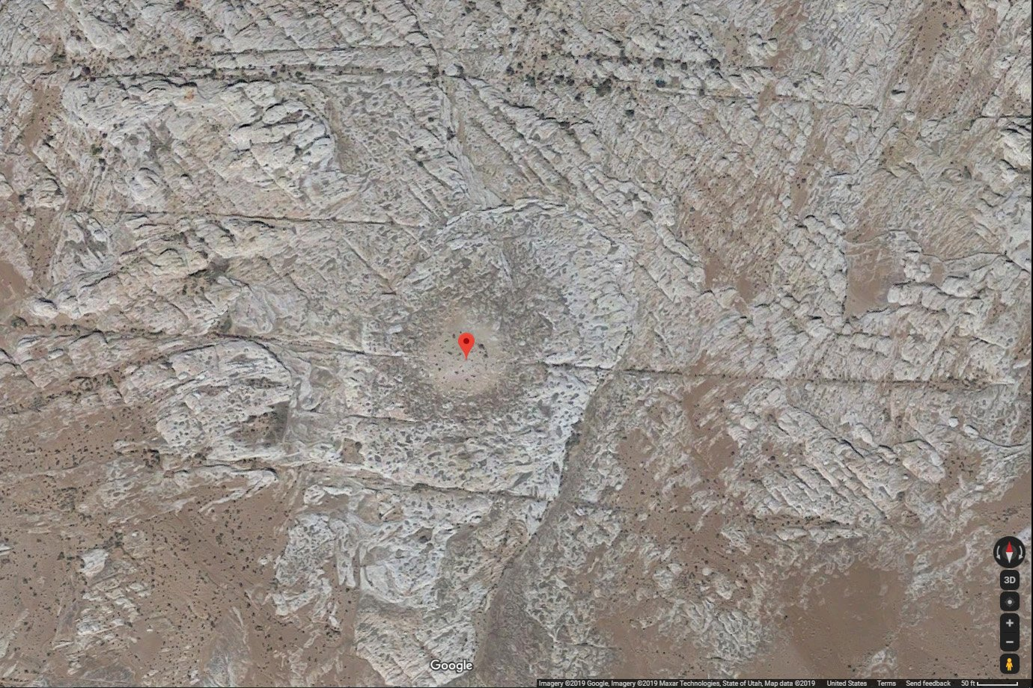

Slide 4
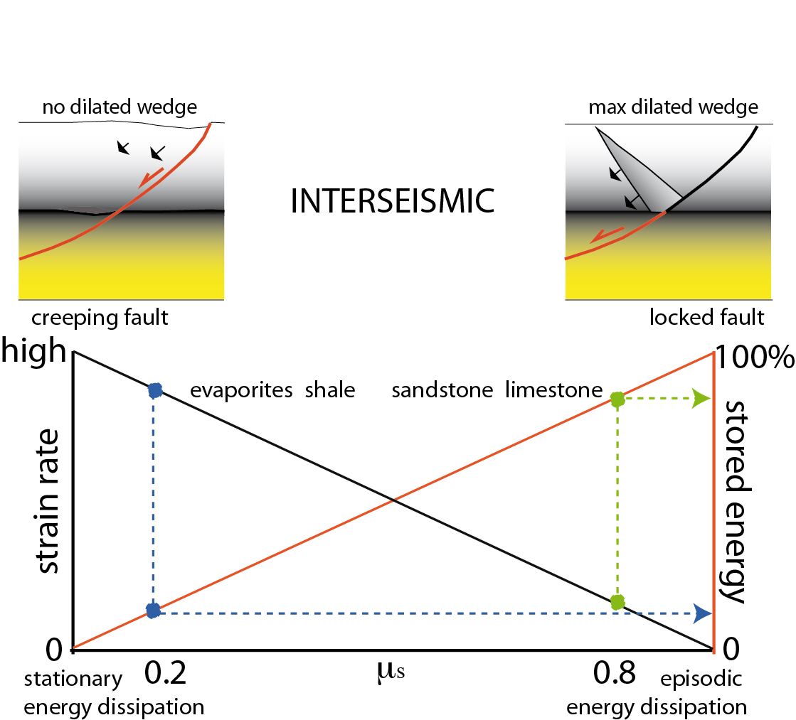

Slide 5
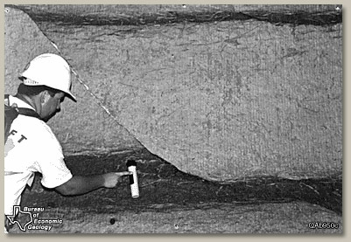

Slide 6
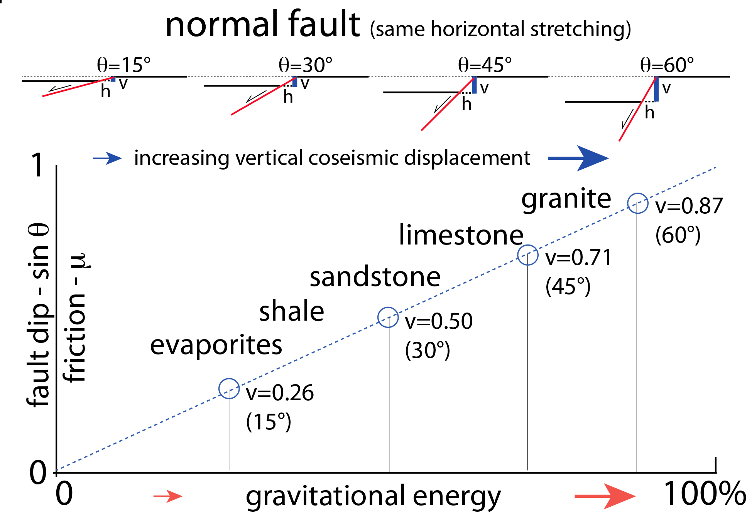
Doglioni et al. 2015 Scientific Reports

Slide 7
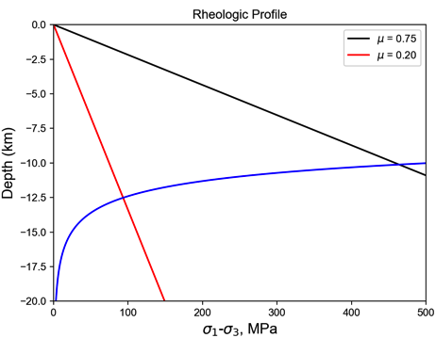
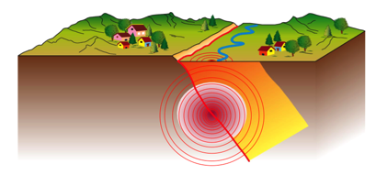
Strong vs. weak faults
Rheologic Profile
strong
weak
75 MPa
450 MPa

Slide 8
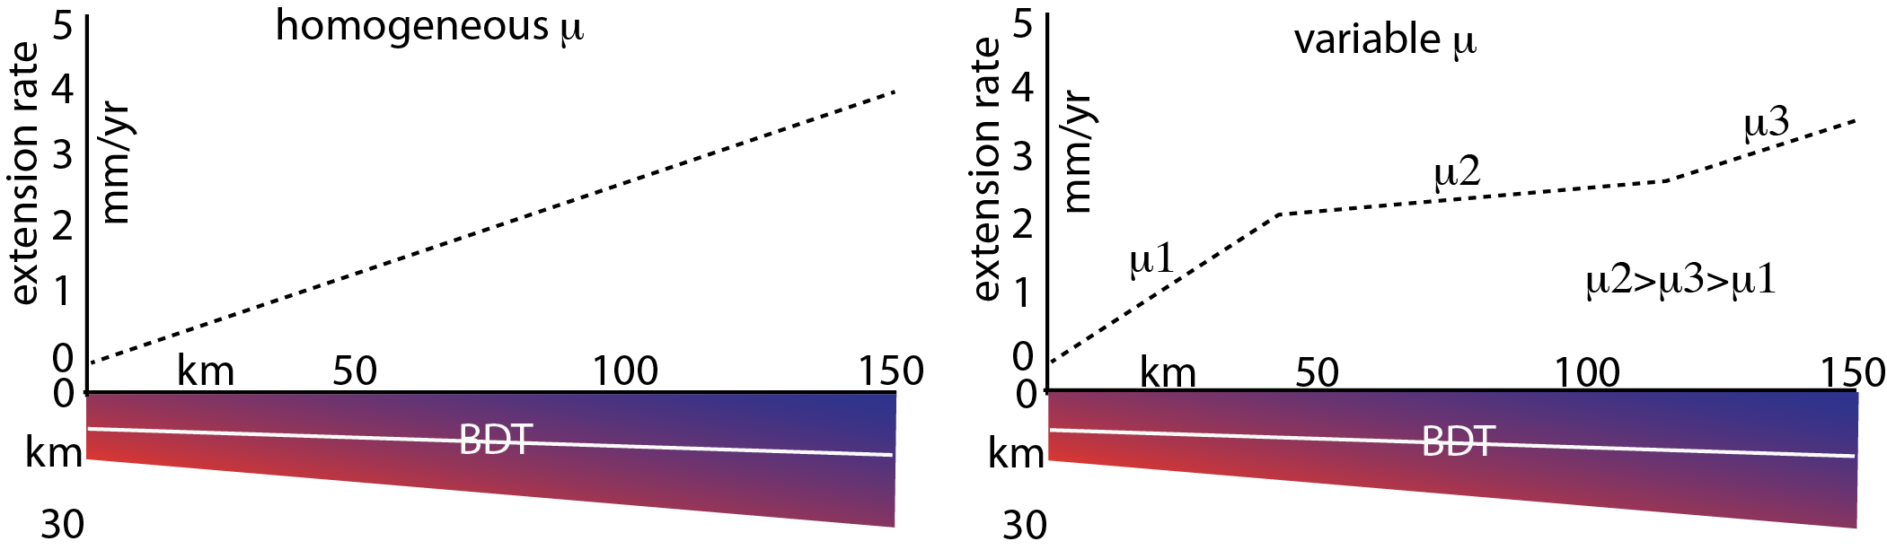
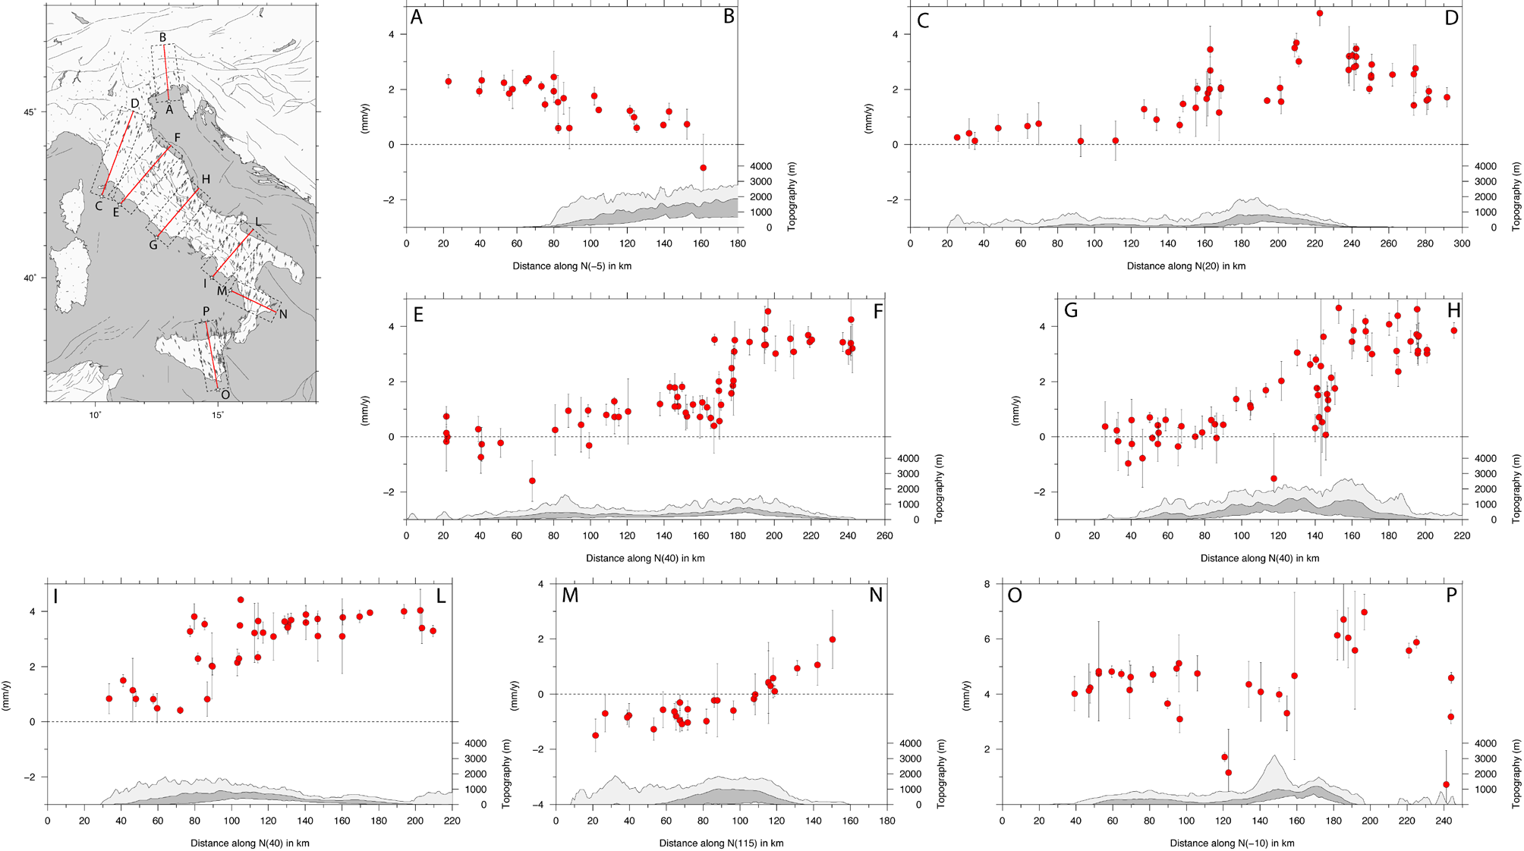
μ--
μ+
μ-

Slide 9
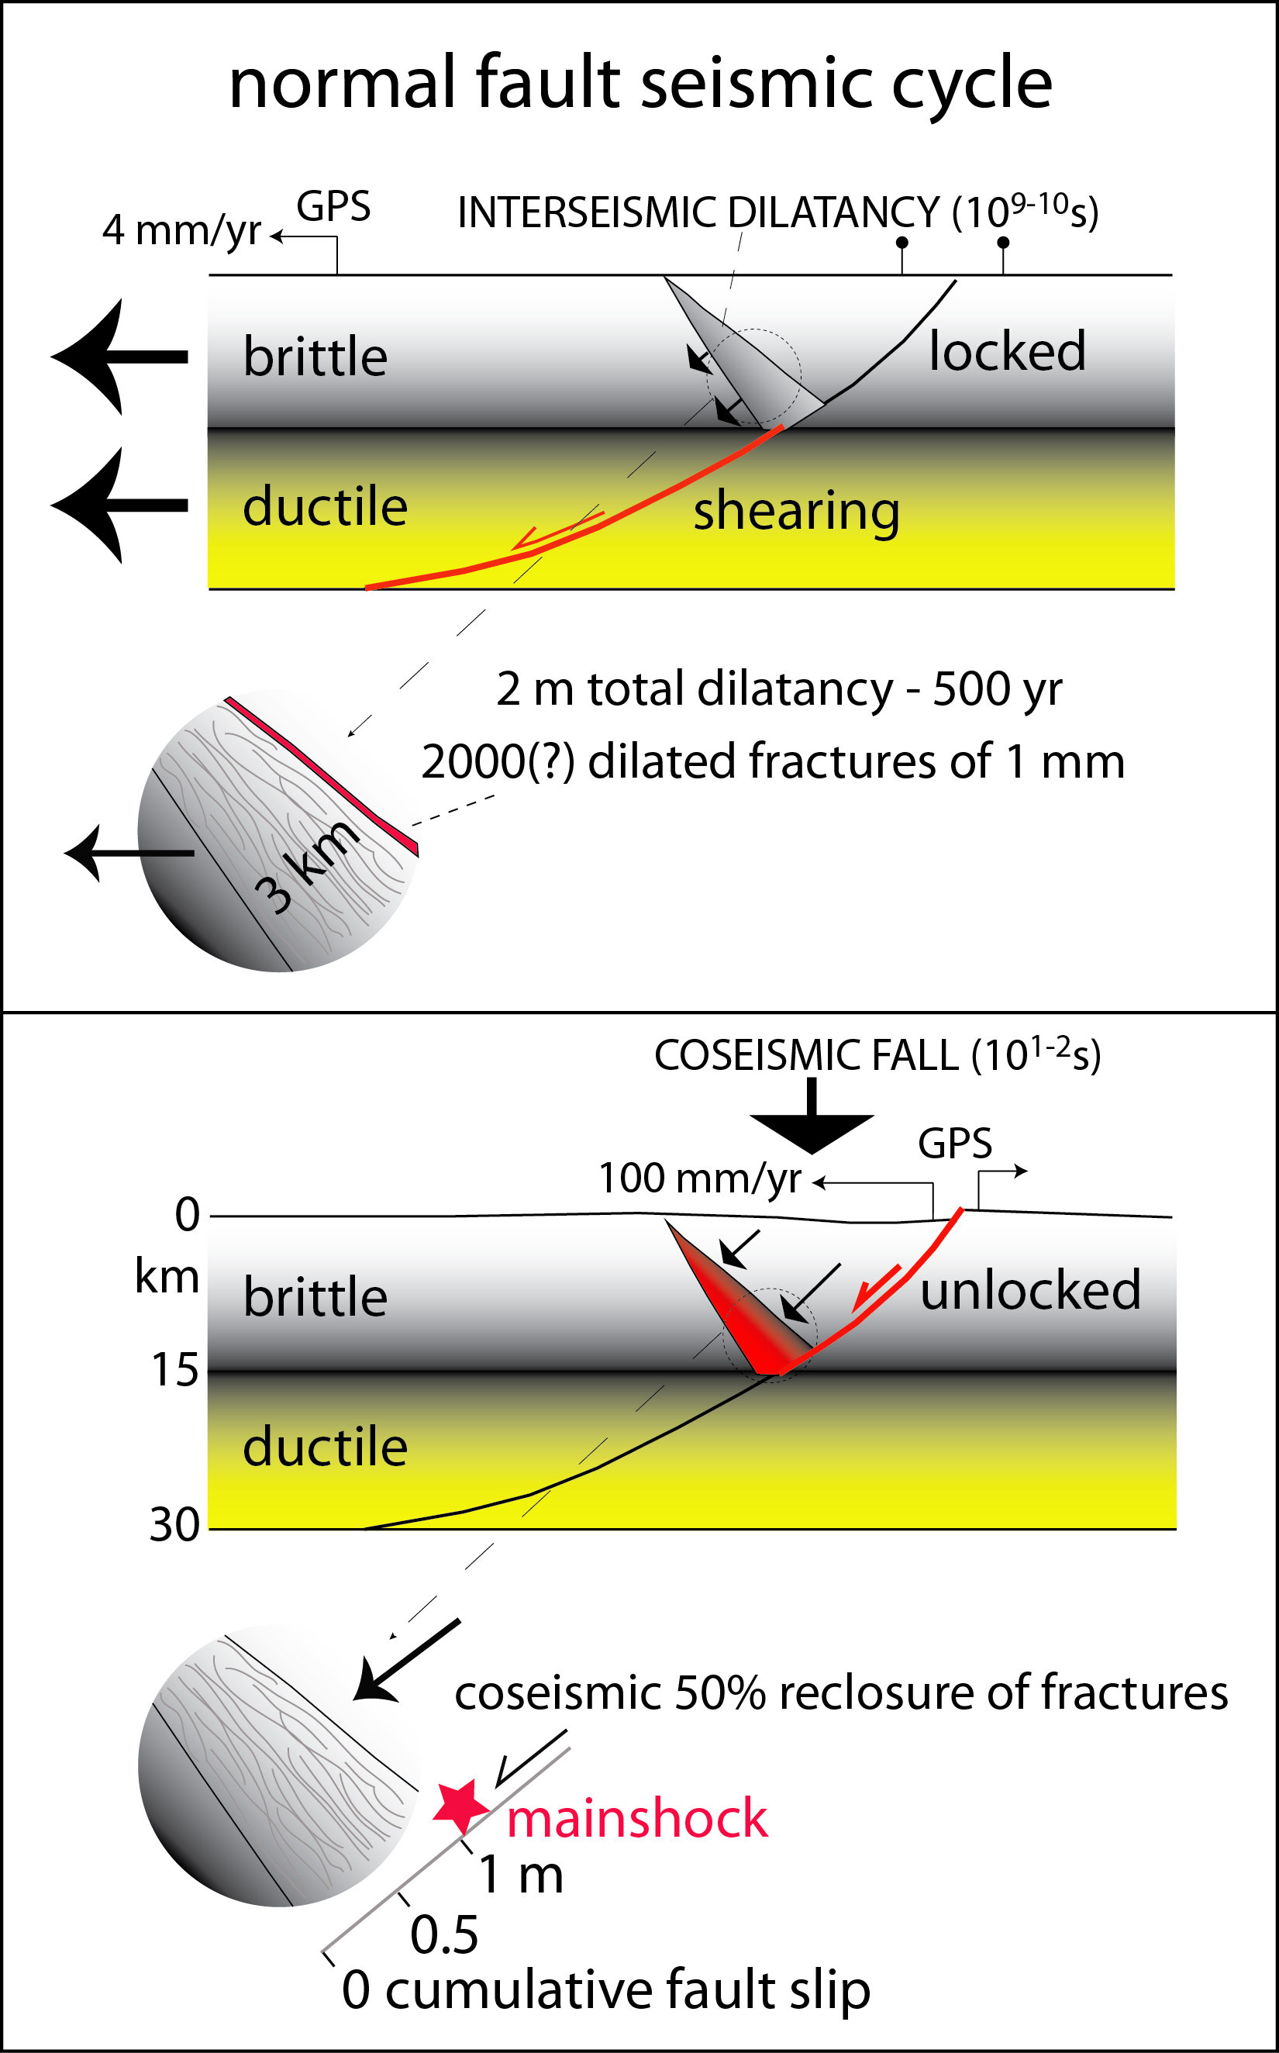

Slide 10
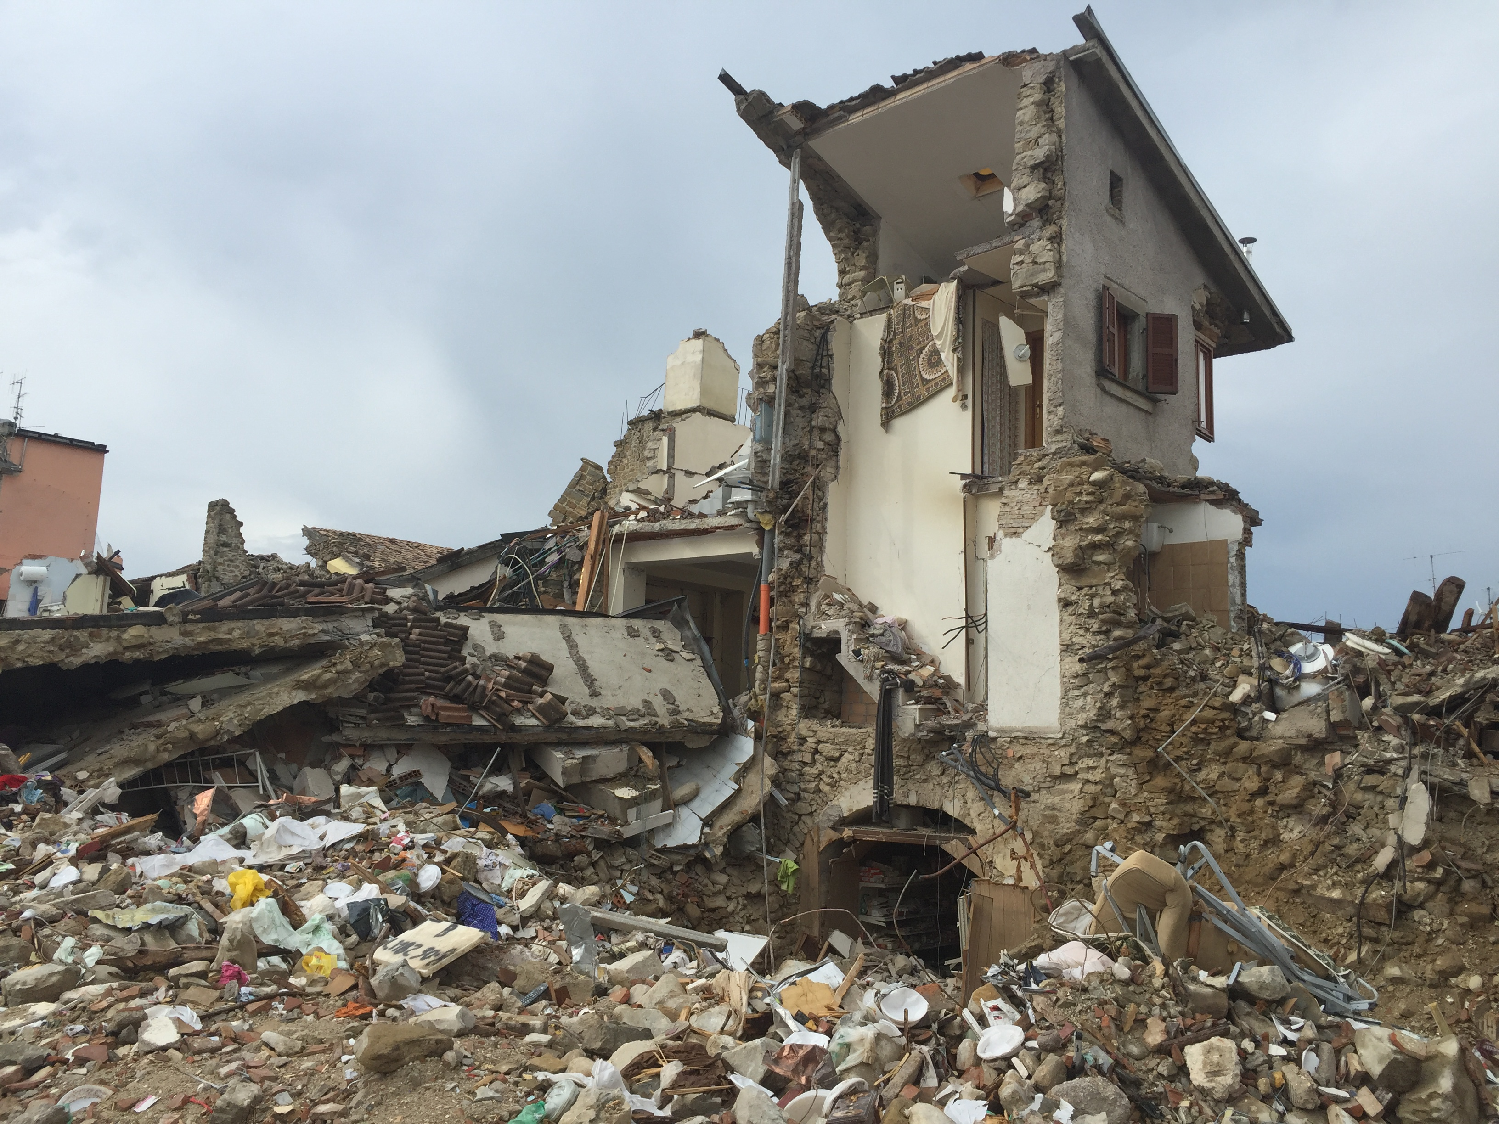
Amatrice 24 agosto 2016

Slide 11
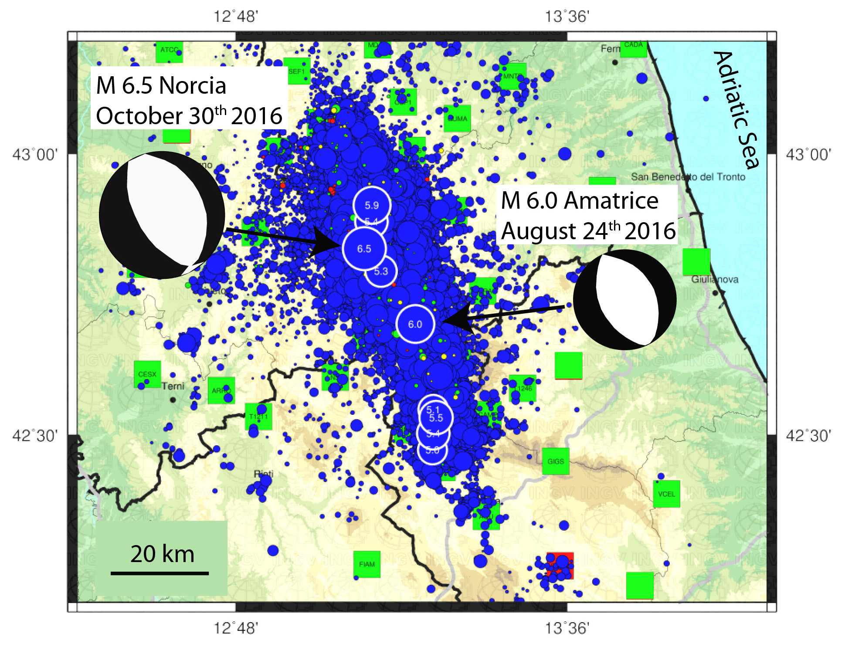

INGV
Area epicentrale della sequenza sismica iniziata il 24/8/2016 –
Dati catalogo sismico INGV

Slide 12
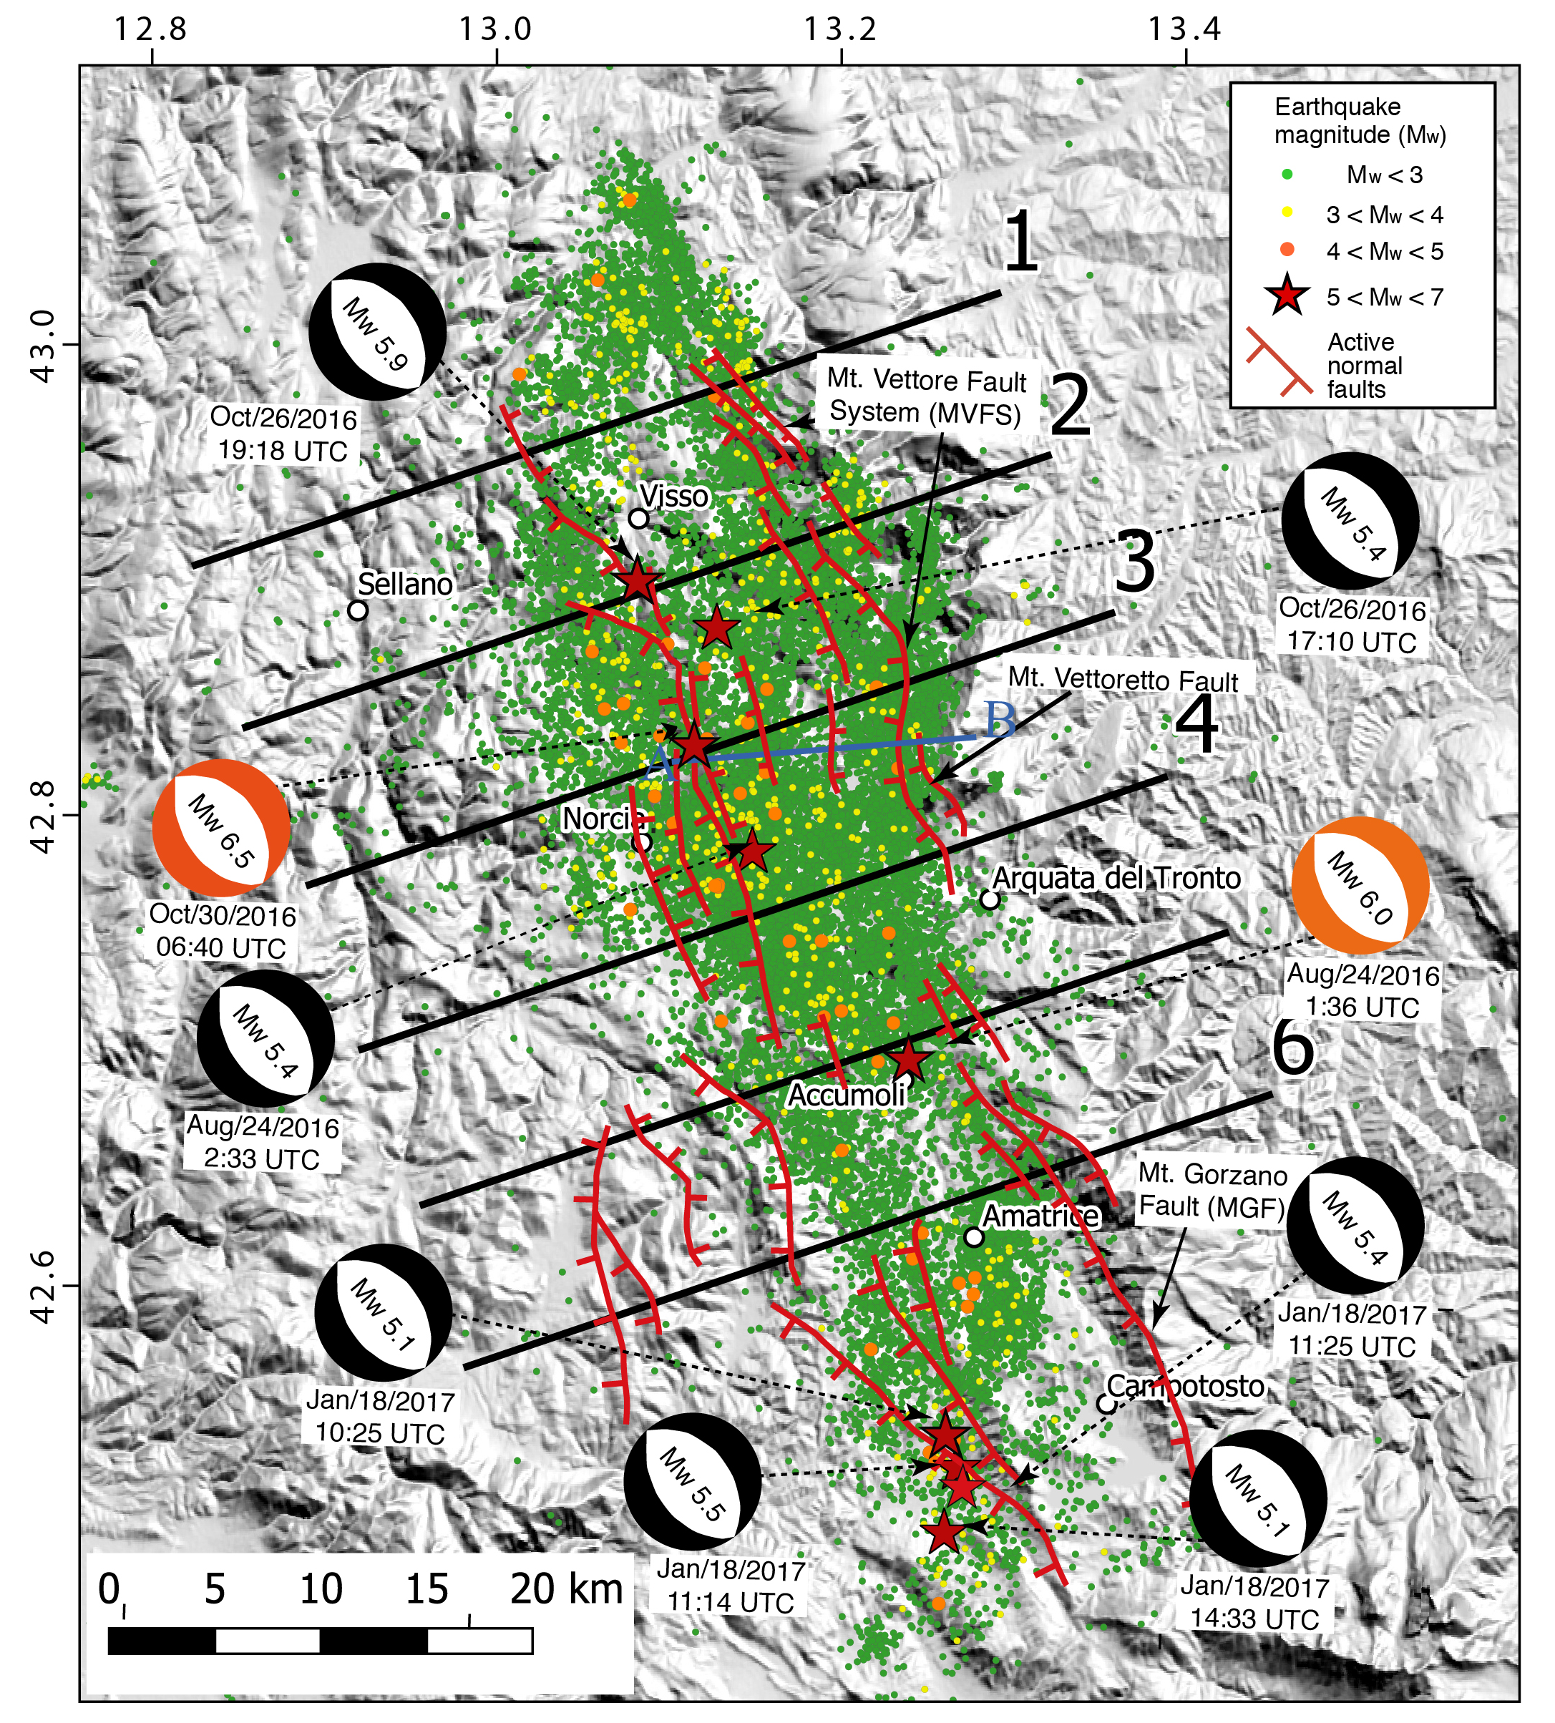

Slide 13
Bignami et al. 2019

Slide 14
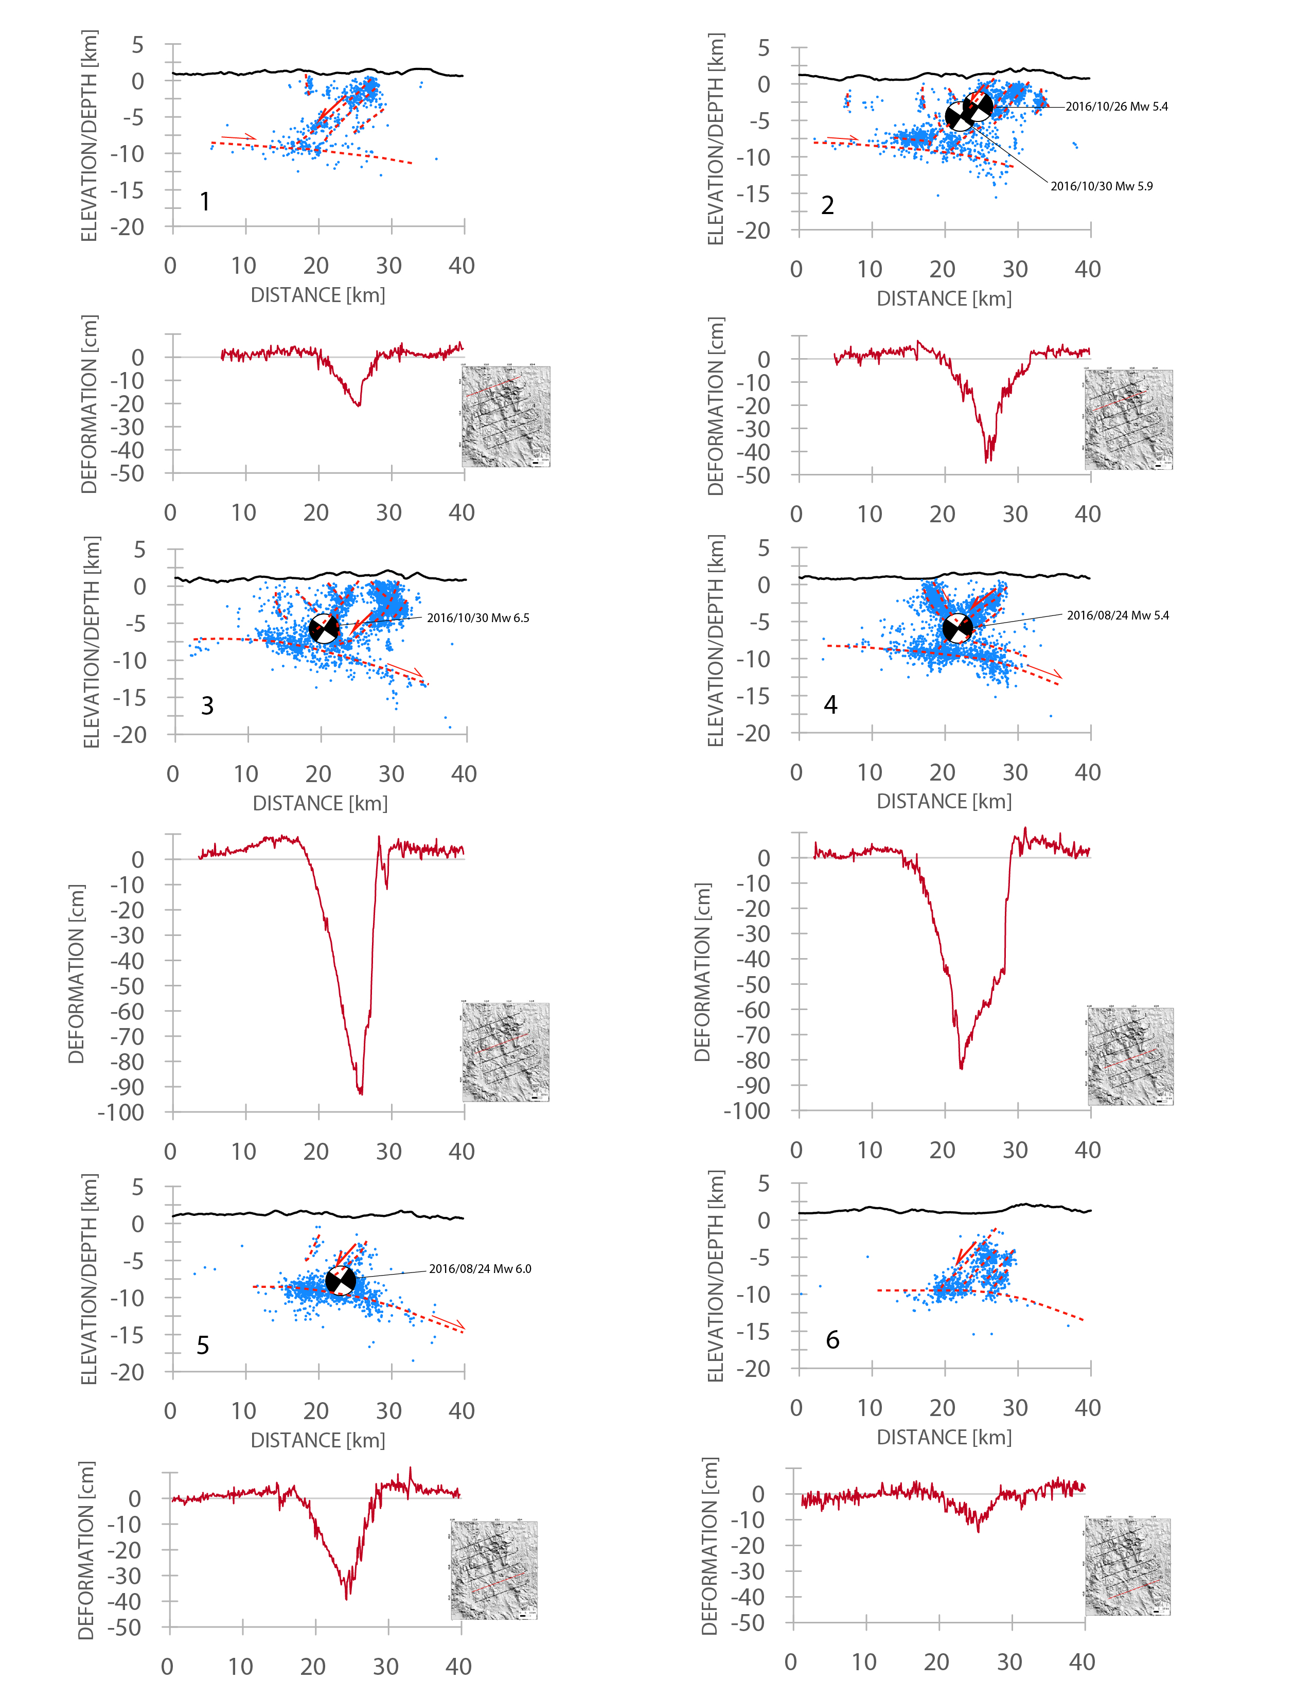

Slide 15
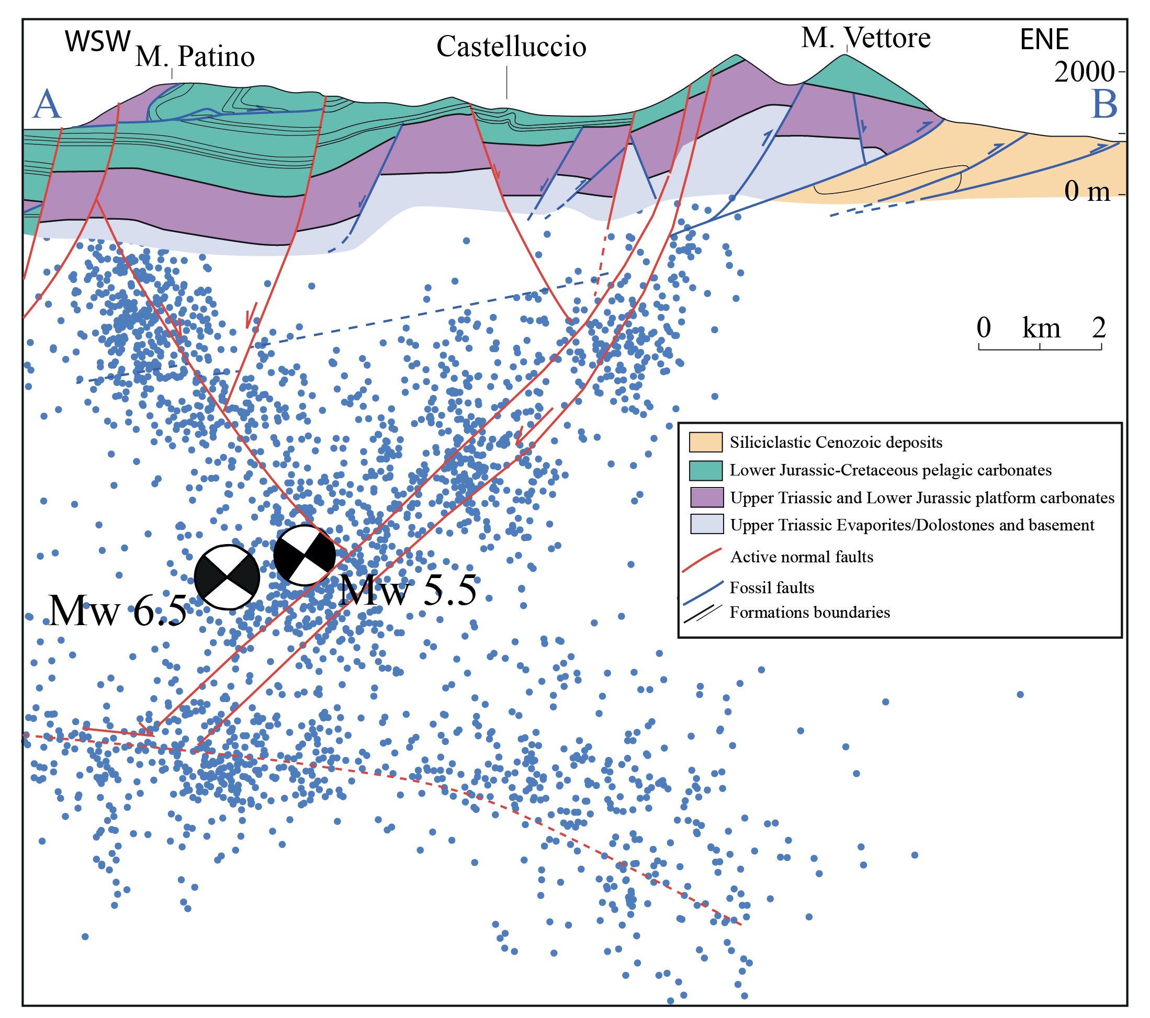

Slide 16
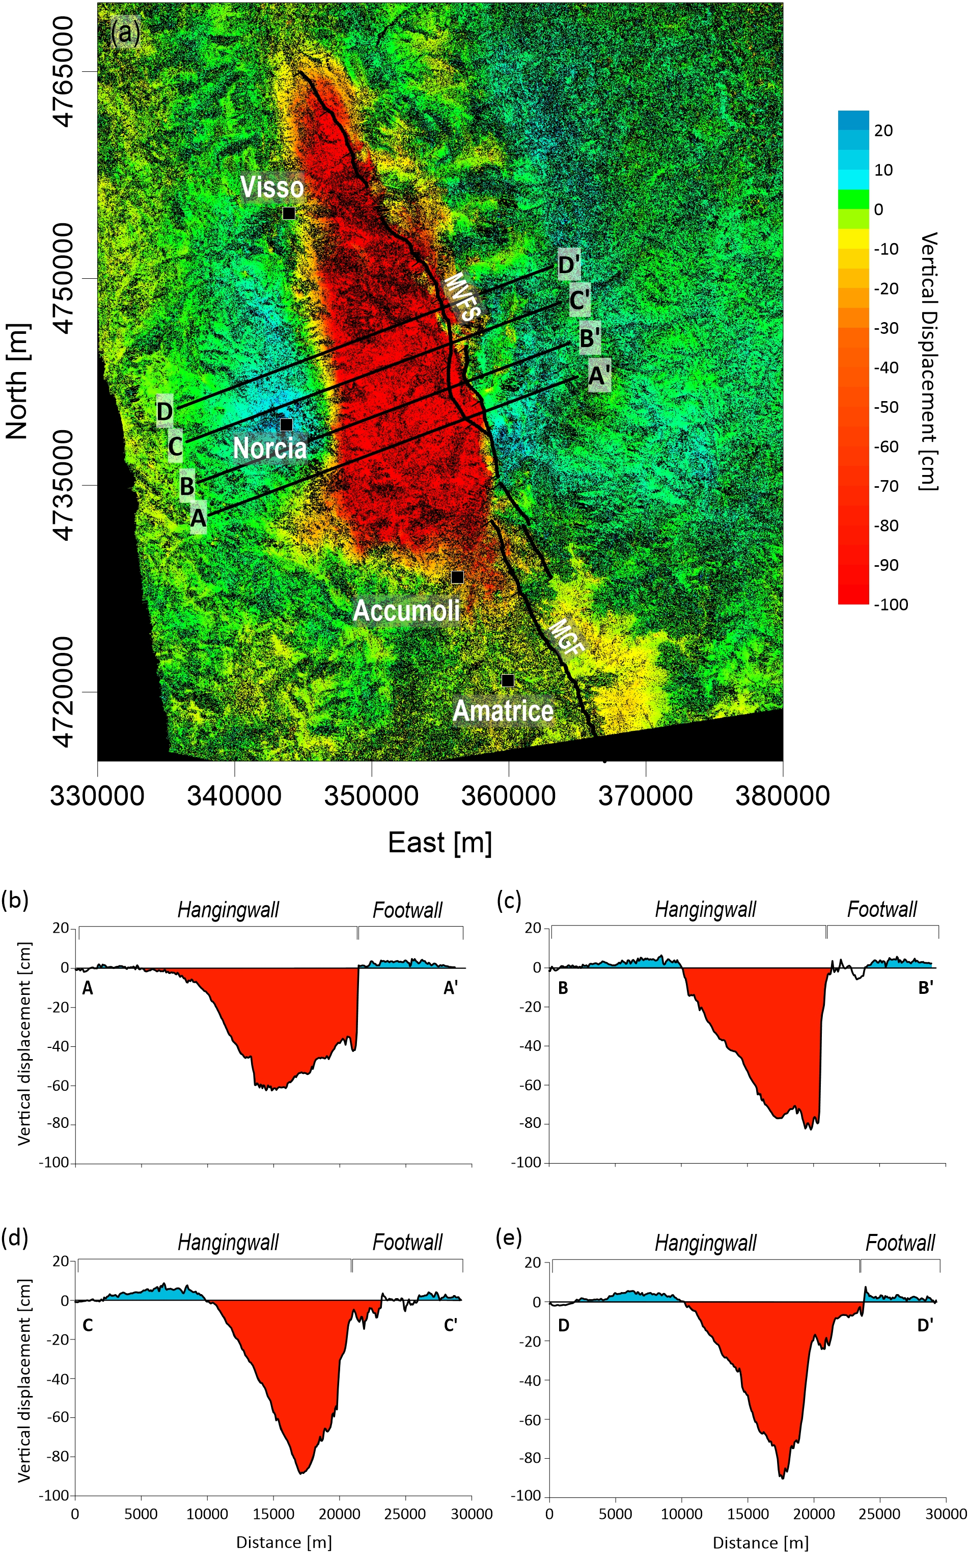
Valerio et al., 2018

Slide 17
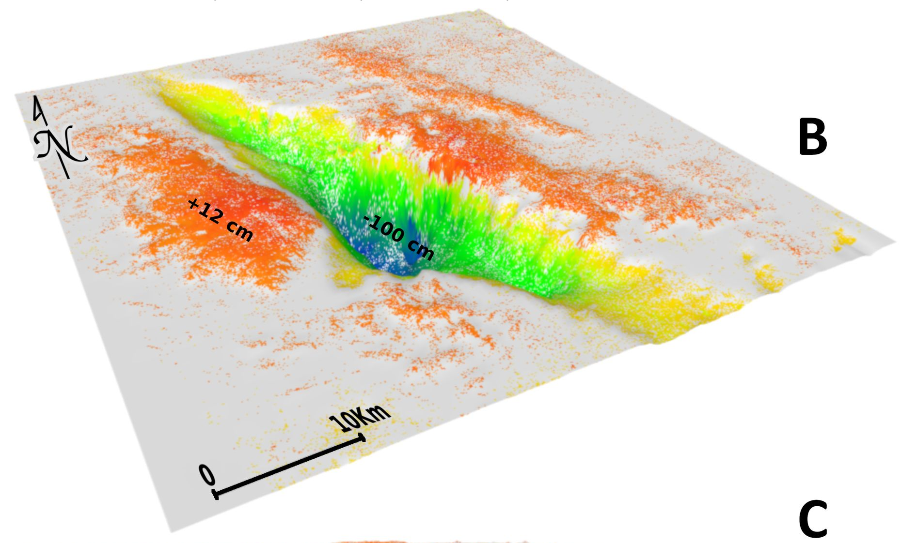
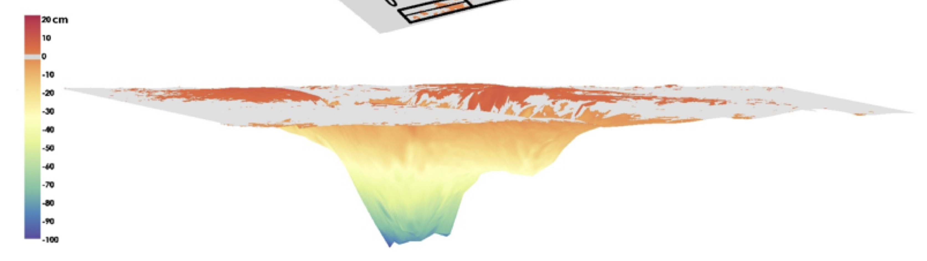
Bignami et al. 2019 Scientific Reports

Slide 18
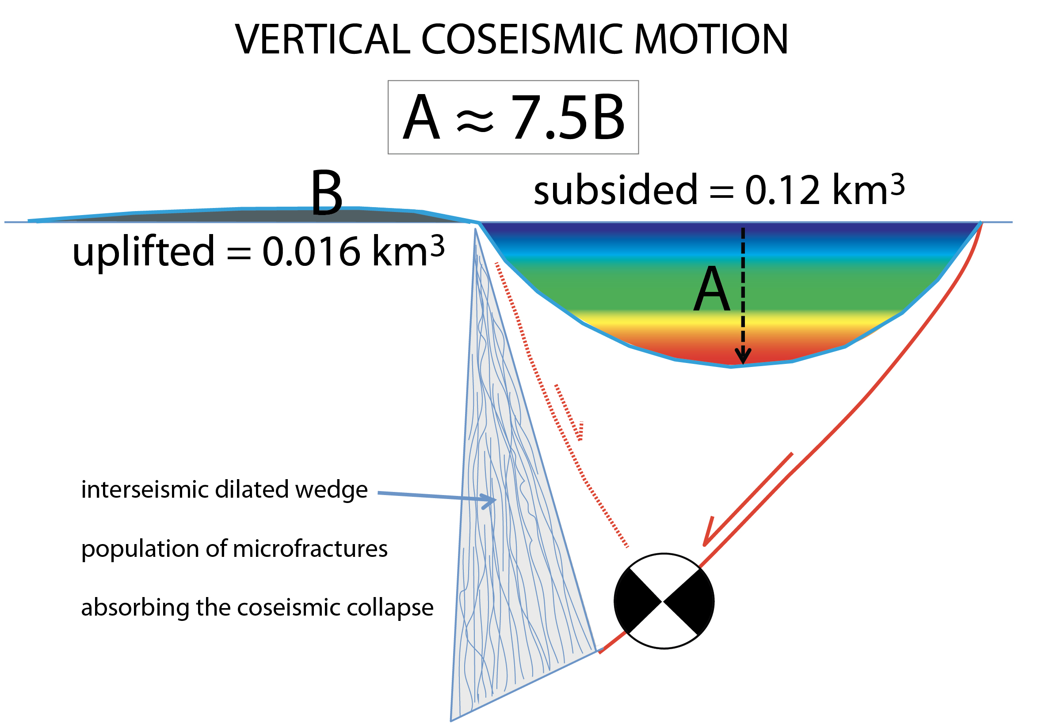
Bignami et al. 2019 Scientific Reports

Slide 19
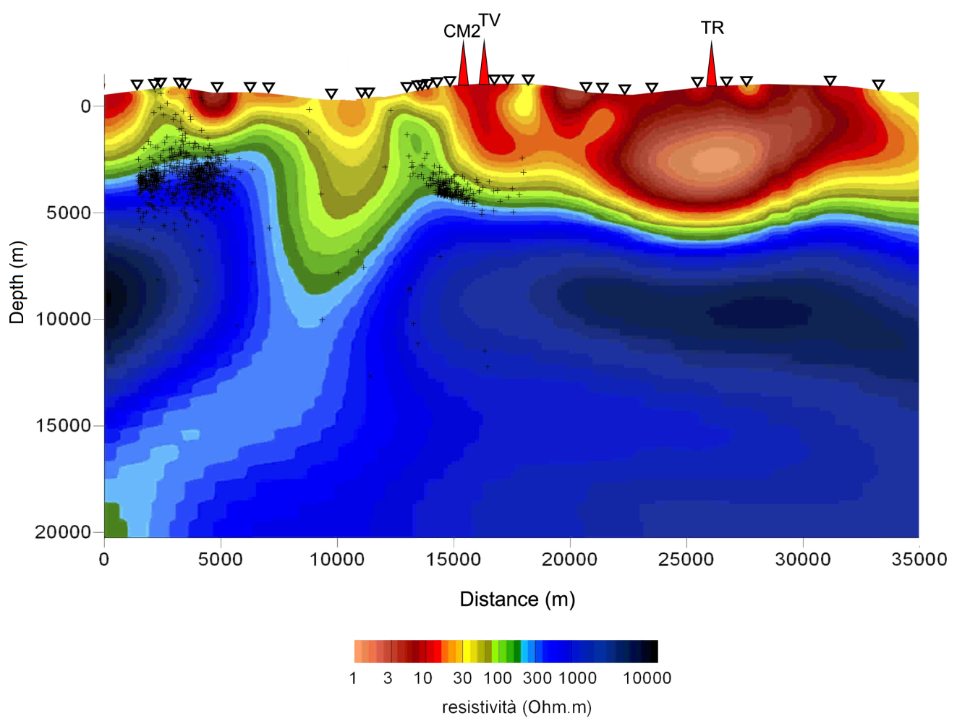
Bignami et al. 2019 Scientific Reports

Slide 20
Stramondo et al. 2011

Slide 21
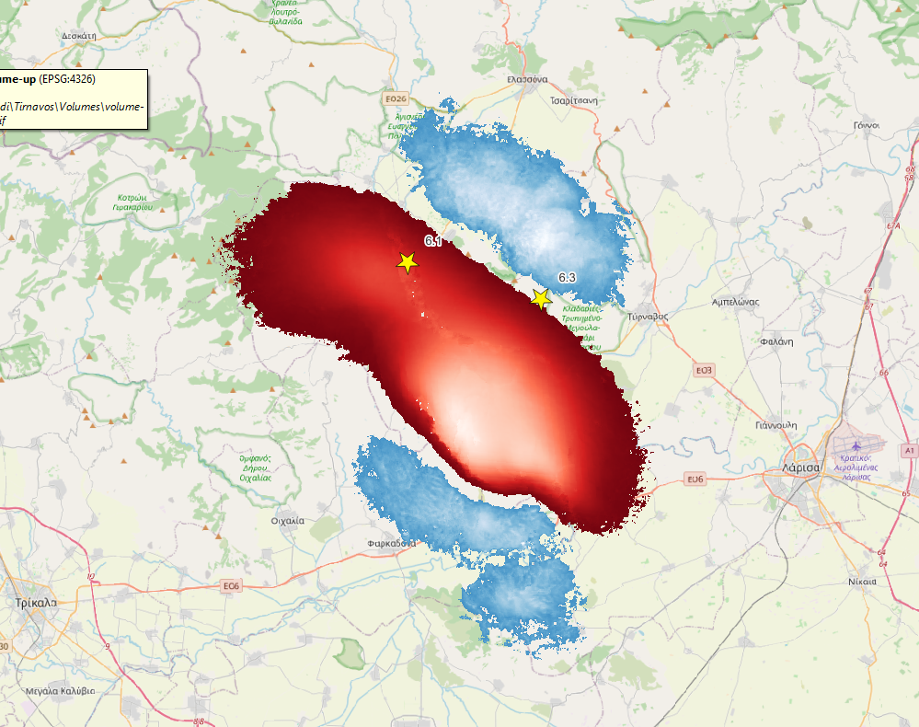
Greece - Tyrnavos Eq 2021 Mw 6.3 – 6.1
coseismic subsidence
61.7 milioni di m-cubi in basso
5.17 milioni di m-cubi in up
Bignami et al in prep

Slide 22
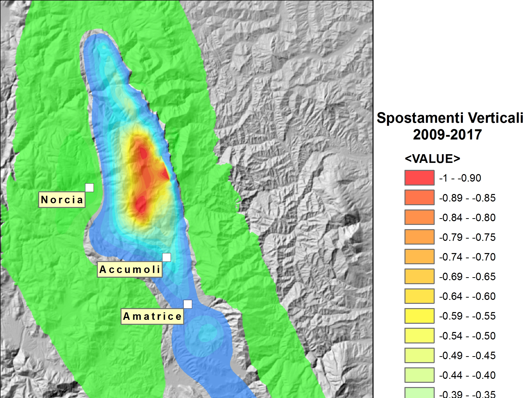
2016-2017
6000 km³
26/10/16
Mw 5.9
Vertical displacement m
30/10/16
Mw 6.5
24/8/16
Mw 6.0
18/1/17
Mw 5.5

Slide 23
Petricca et al. 2021 ESR

Slide 25
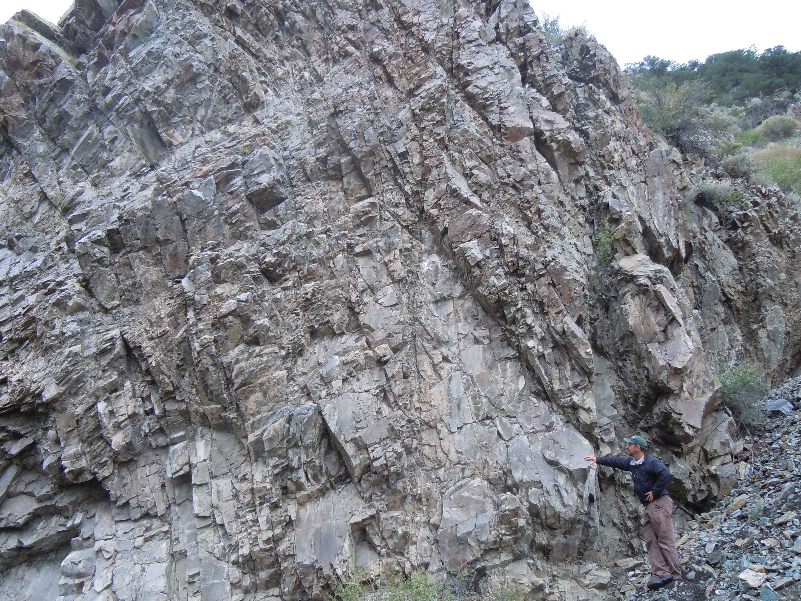
USGS
Notes:
Intensely fractured Proterozoic metamorphic basement rock that was subsequently uplifted and exposed in Poncha Canyon, CO

Slide 26
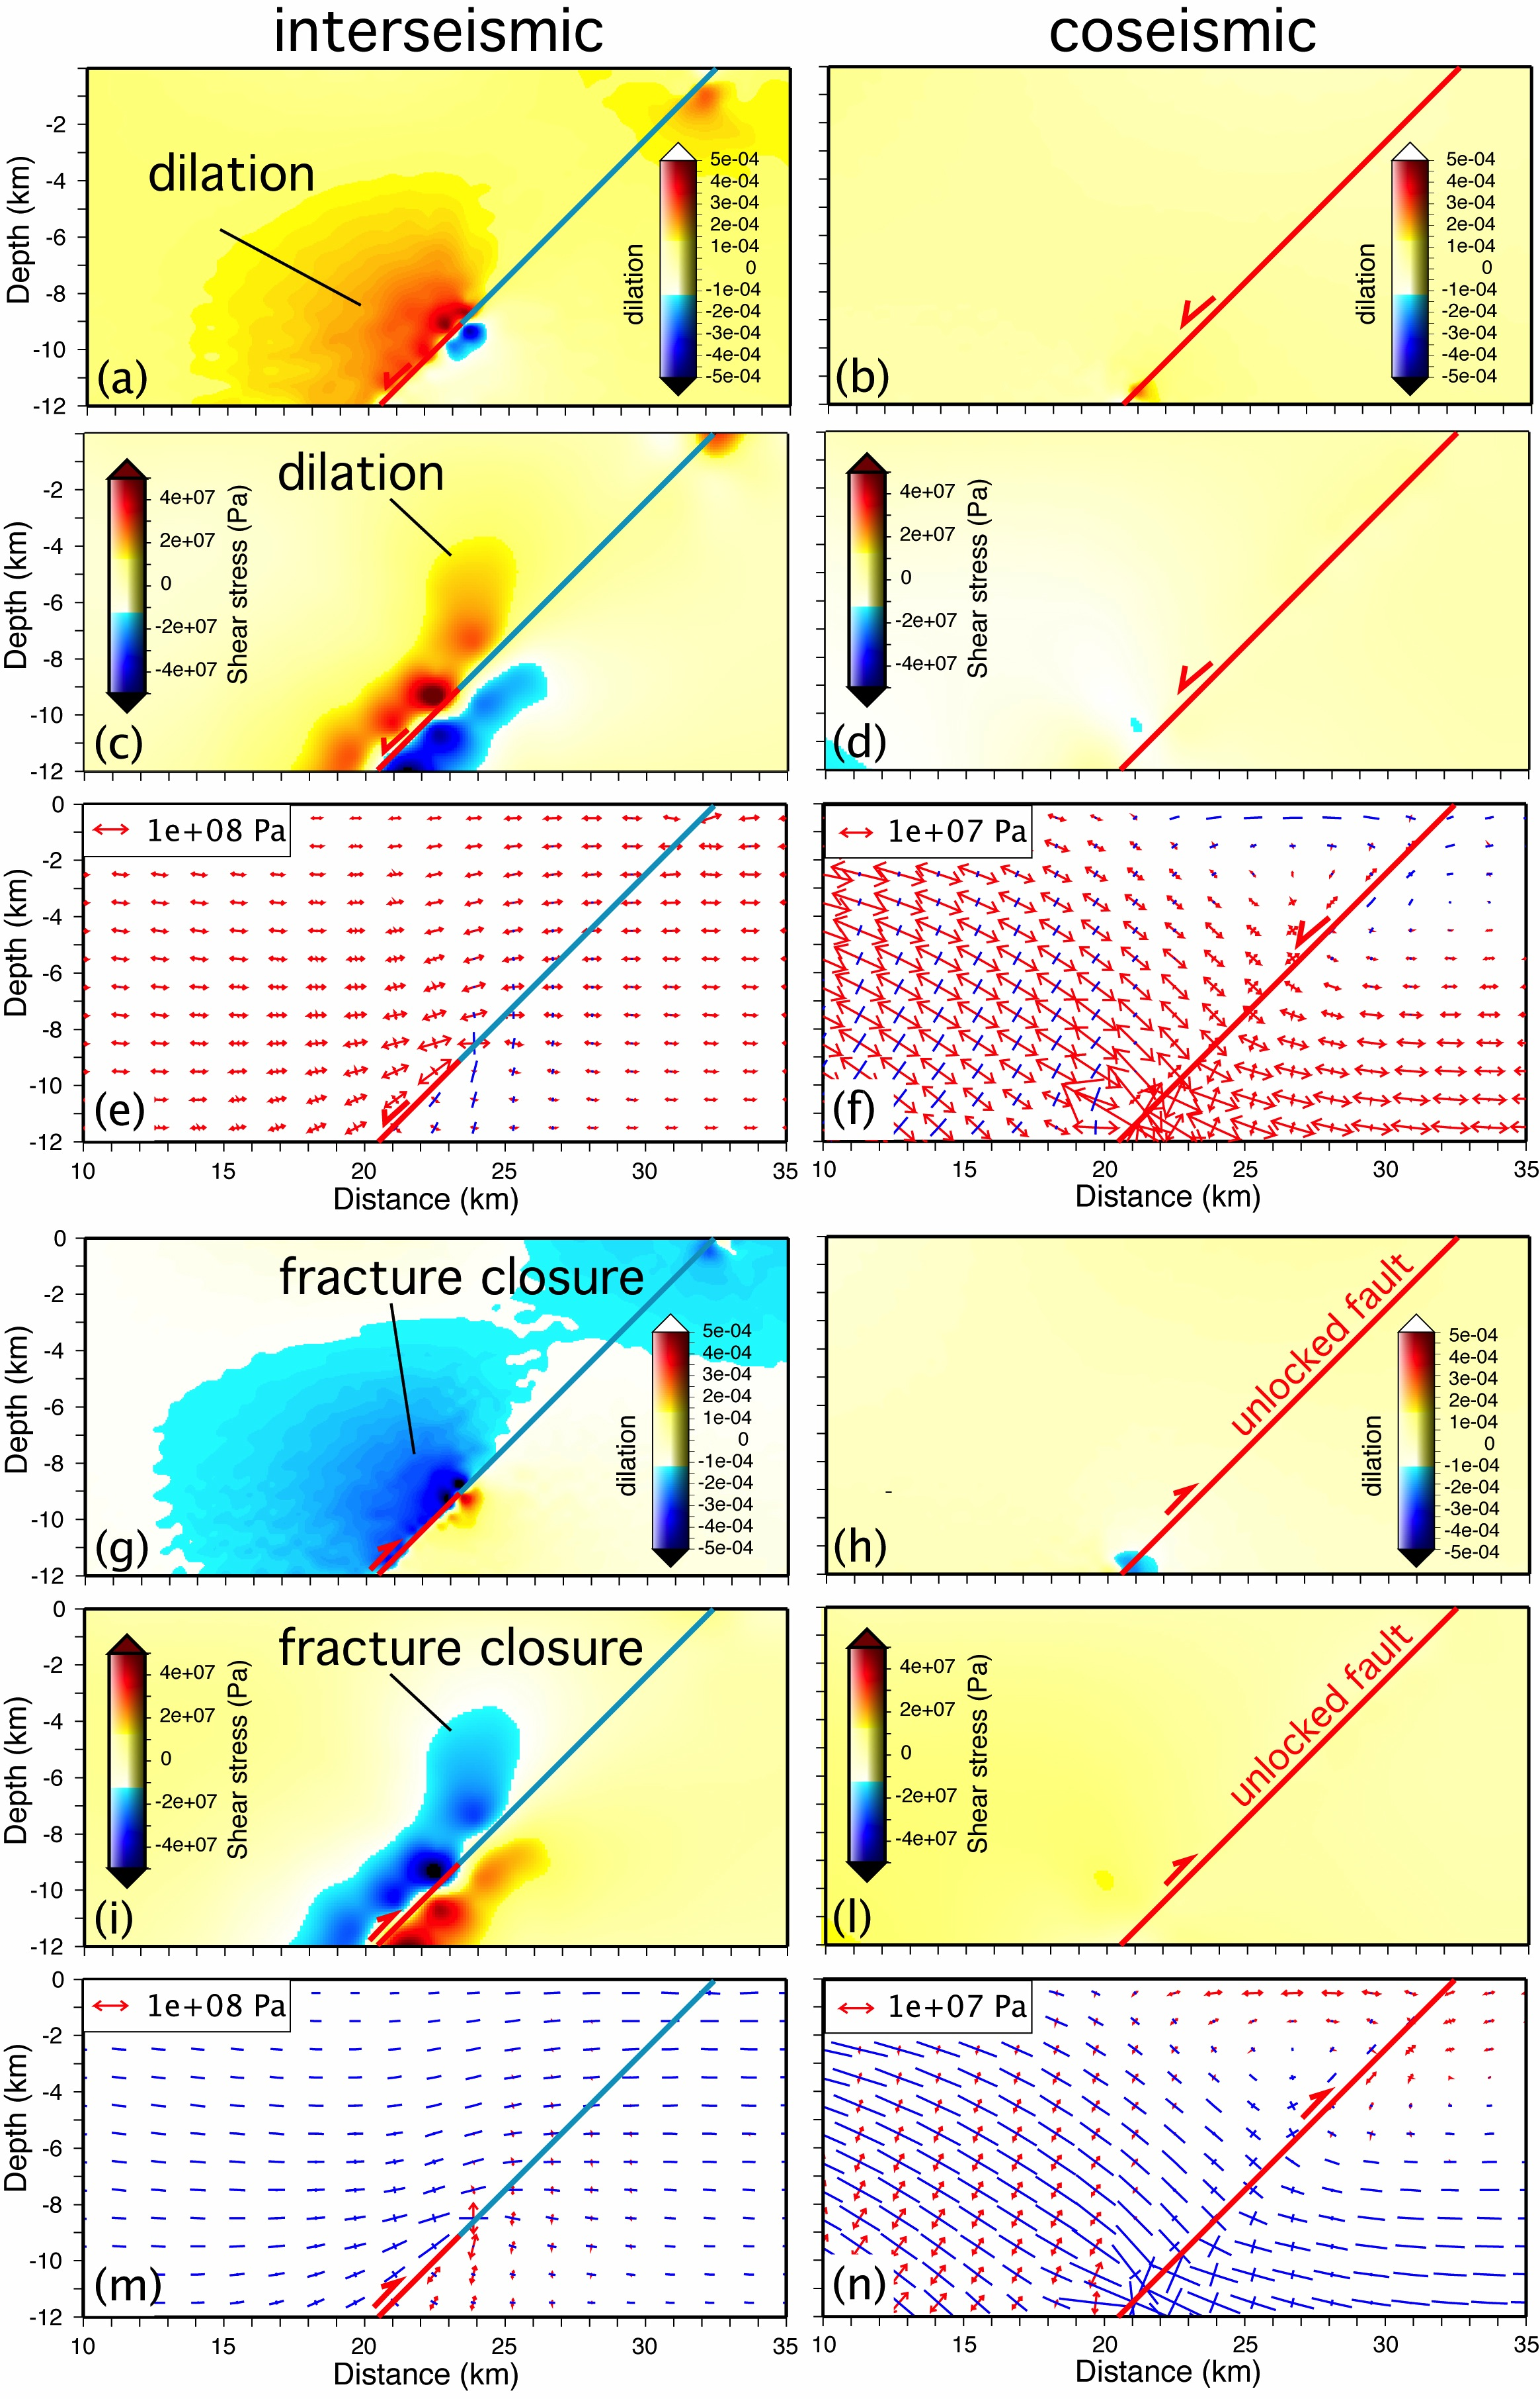
INTERSEISMIC
COSEISMIC
Normal fault
Thrust
Doglioni et al. 2011 PEPI

Slide 27
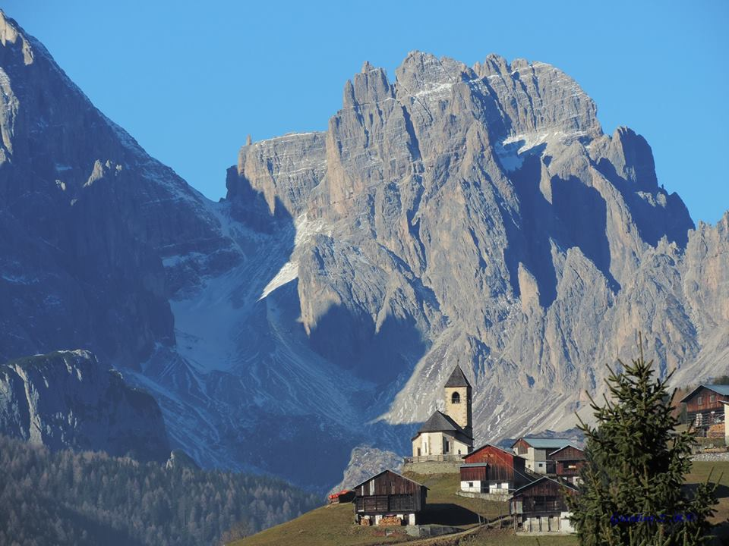
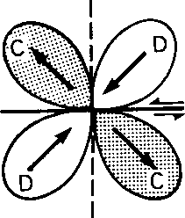

Slide 28
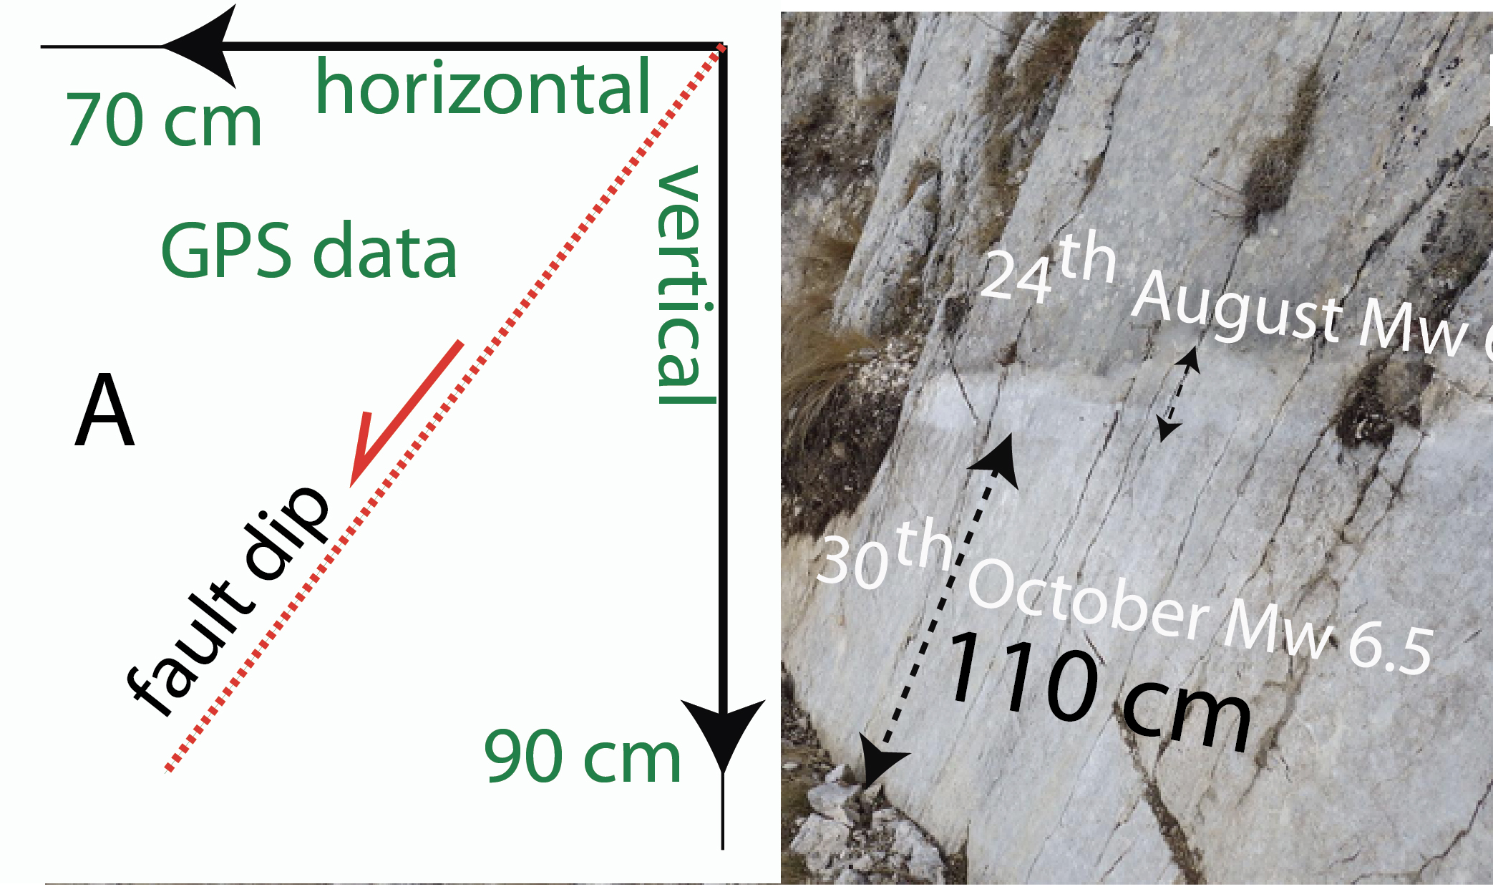

Slide 29
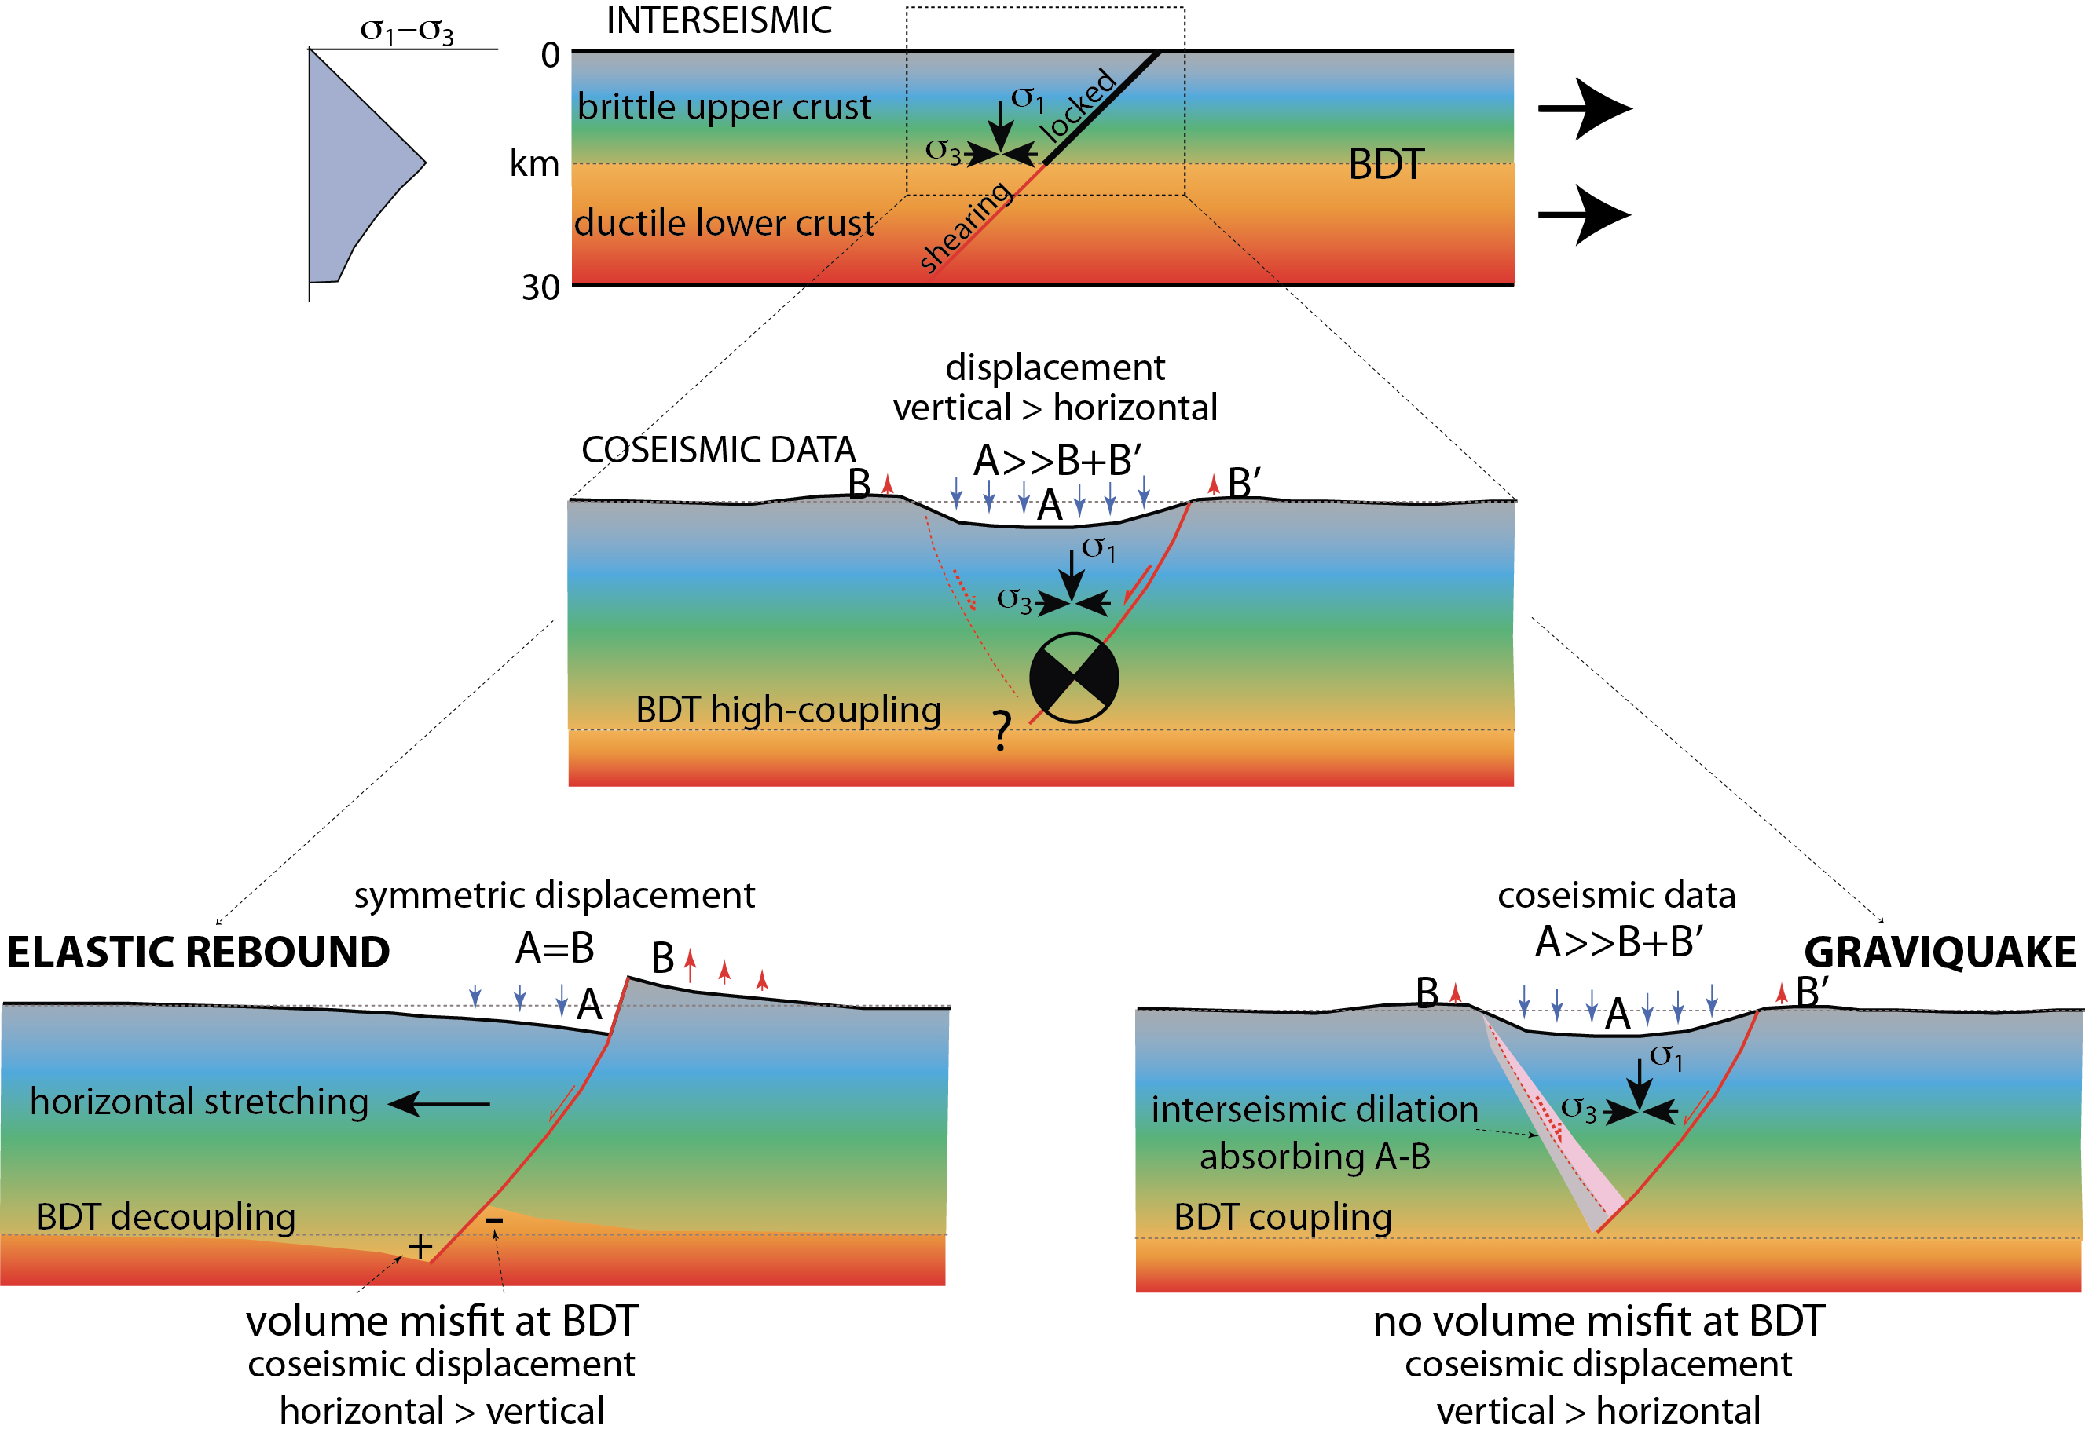

Slide 30
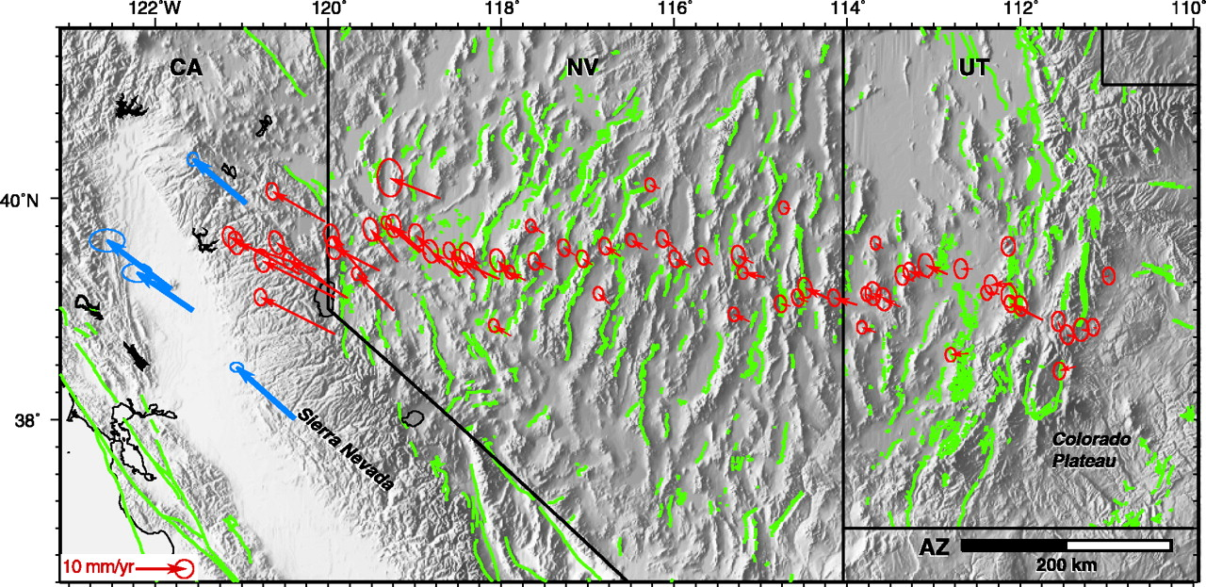
USGS

Slide 31
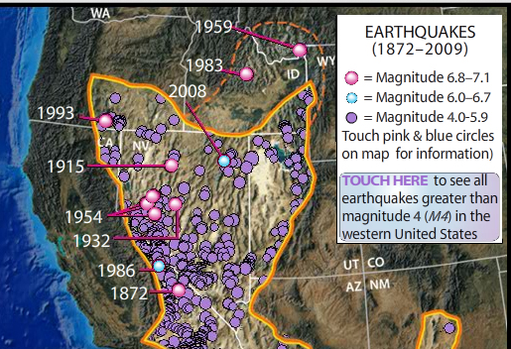
USGS

Slide 32
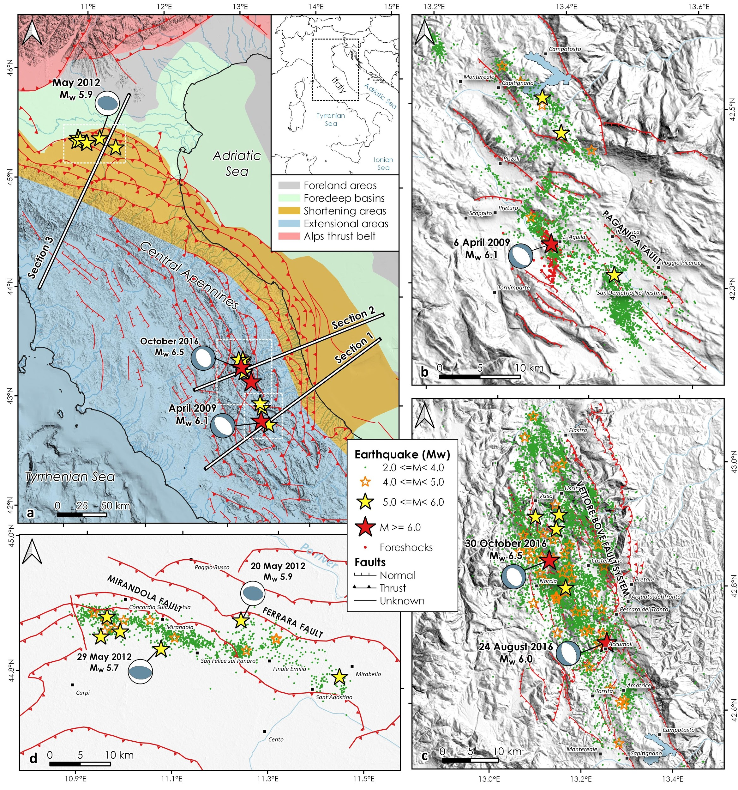
Albano et al. 2020

Slide 33
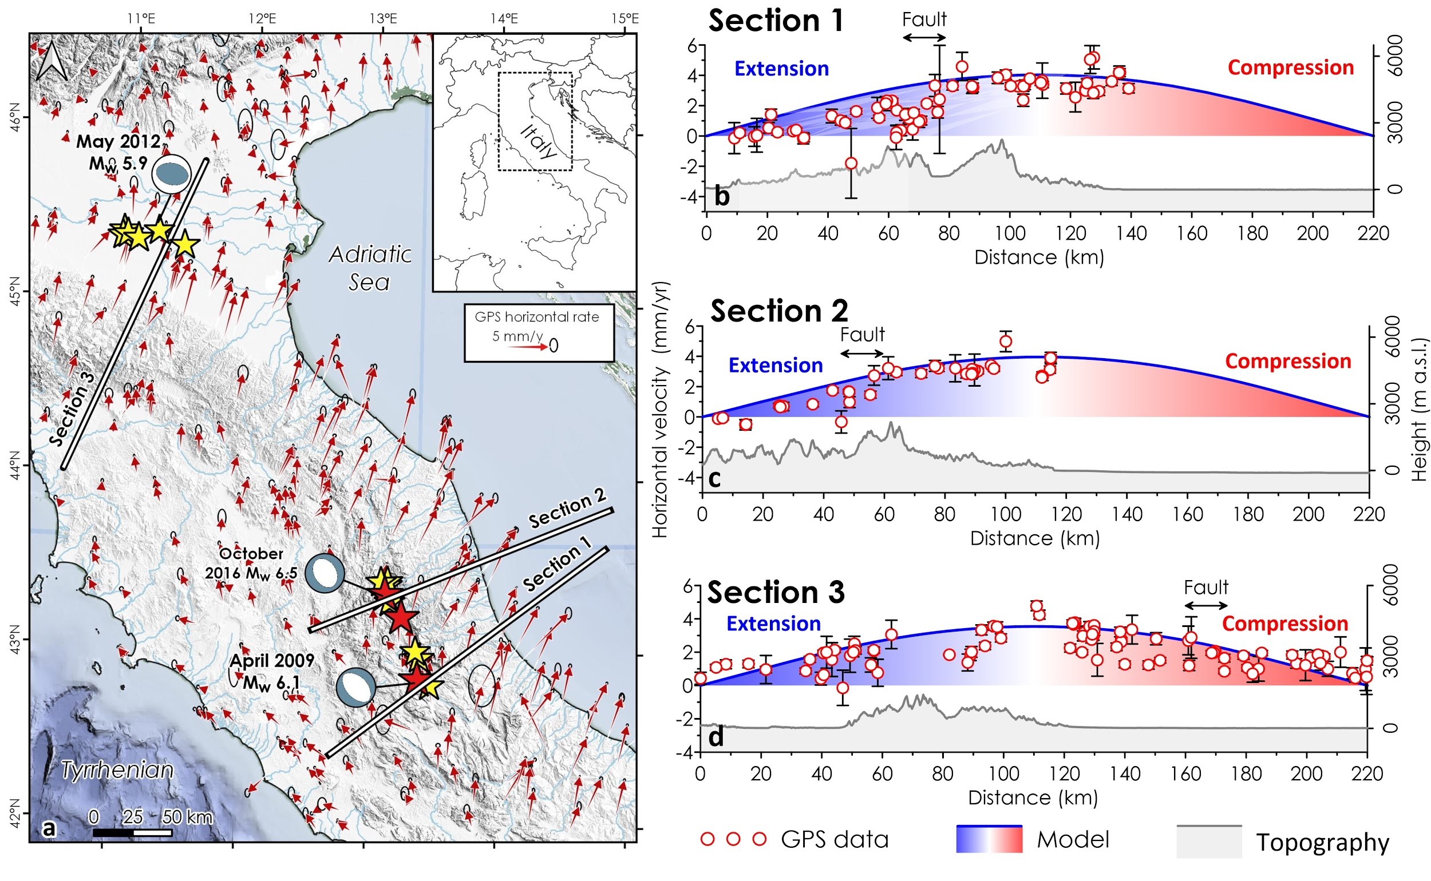
Albano et al. 2020

Slide 34
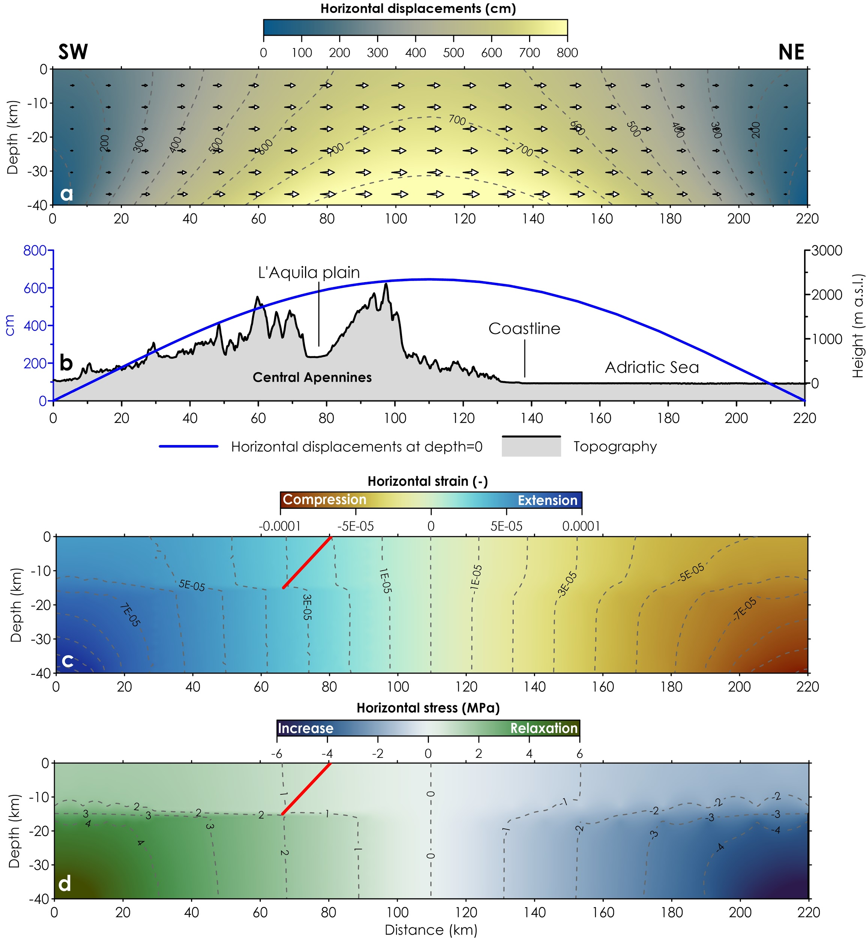
Albano et al. 2020

Slide 35
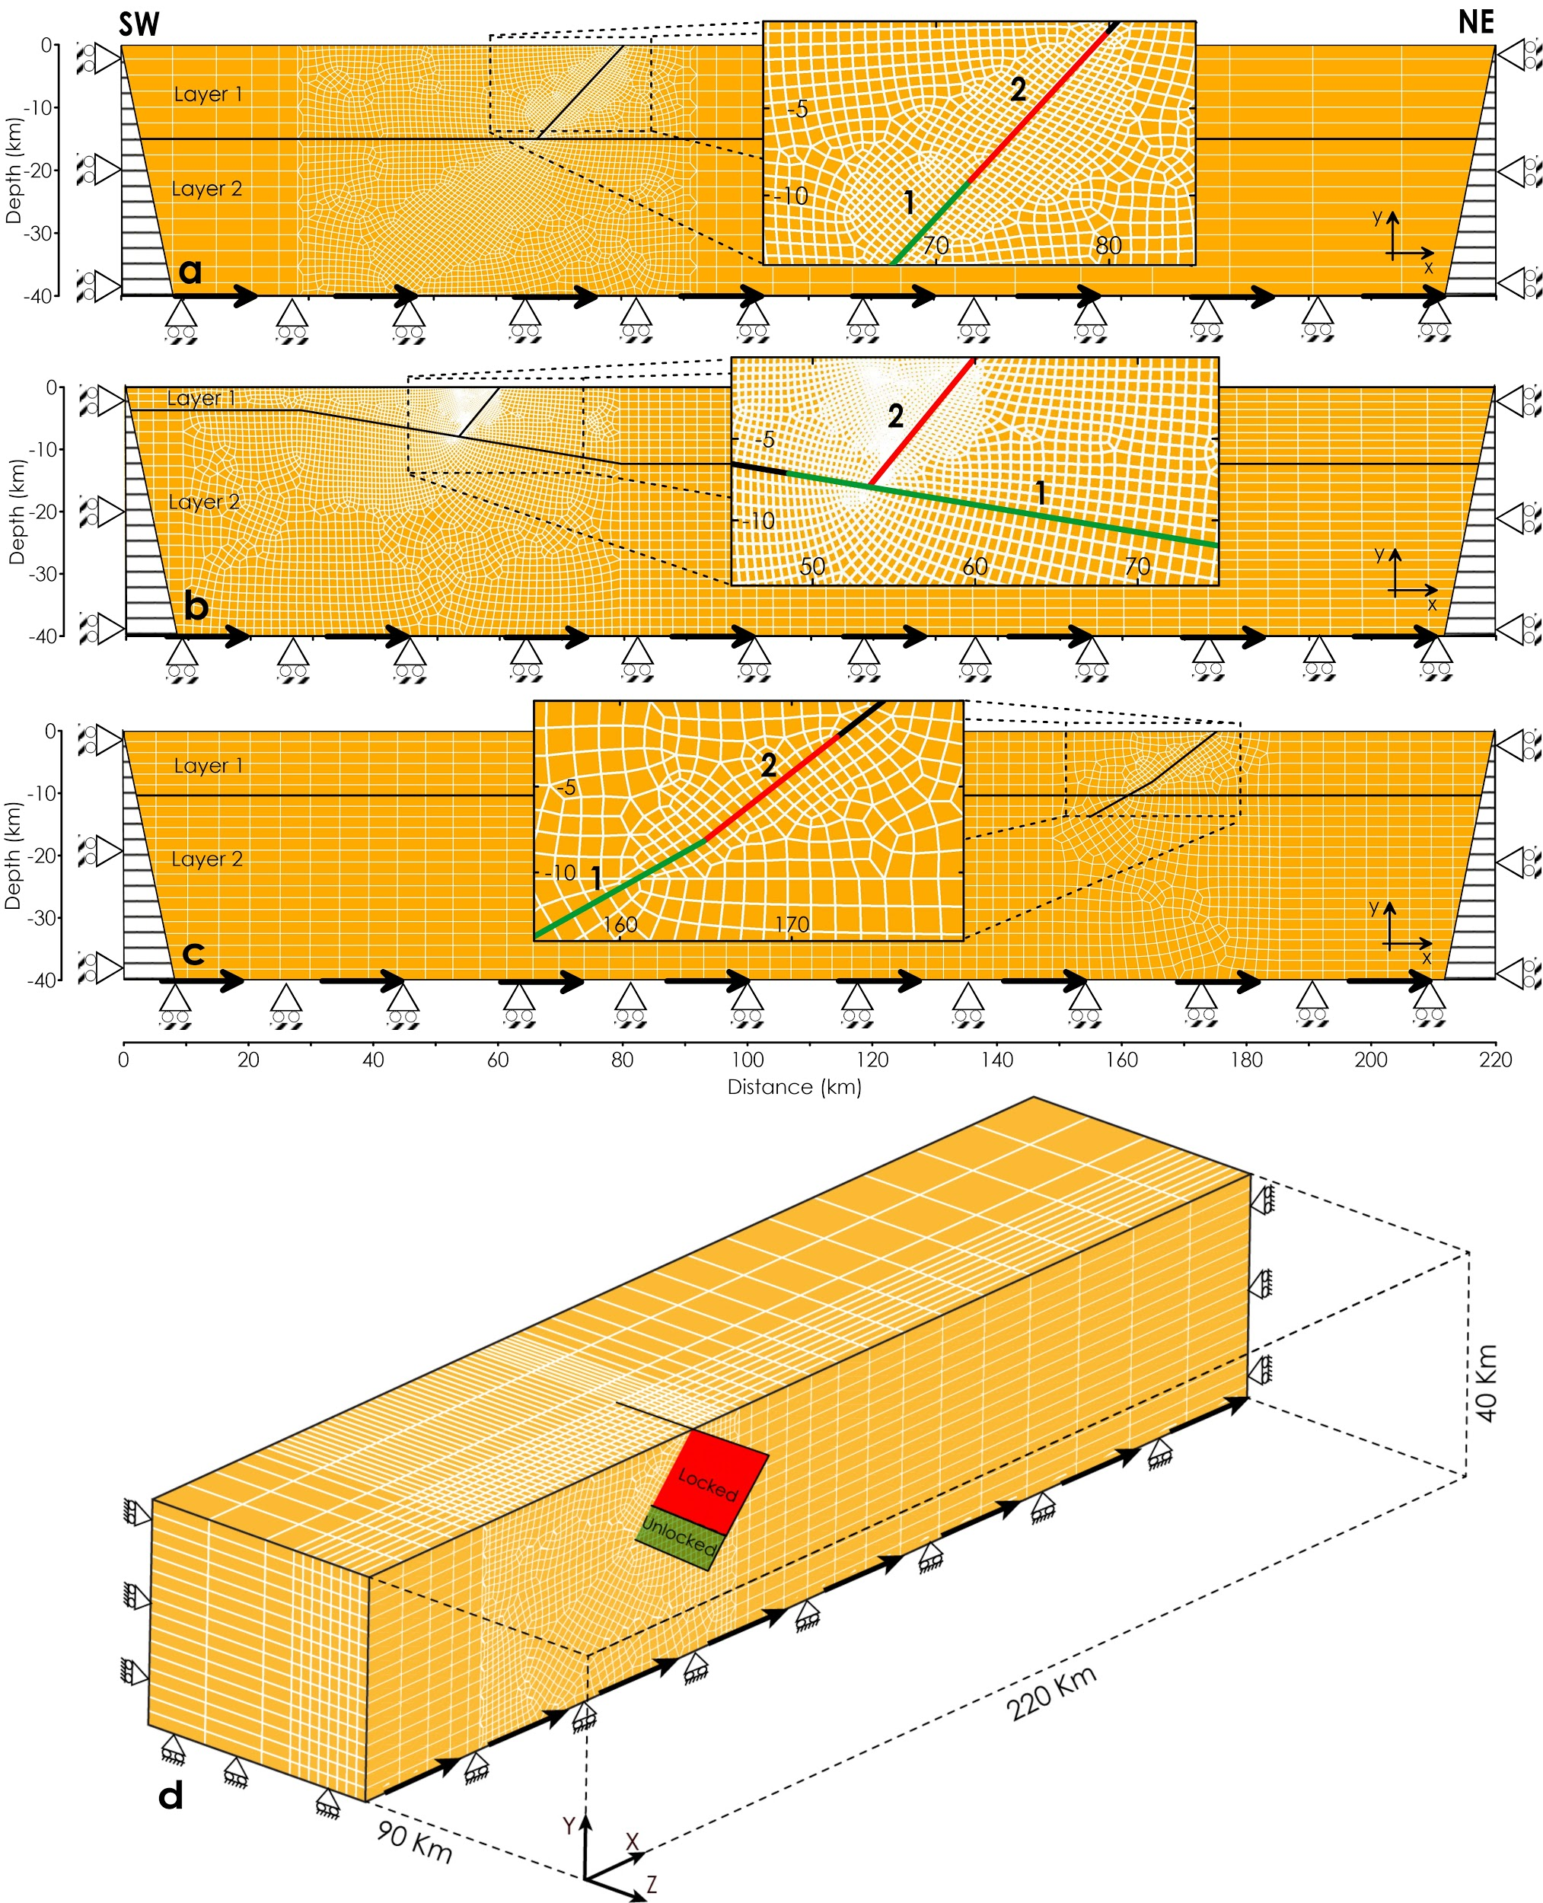
Albano et al. 2020

Slide 36
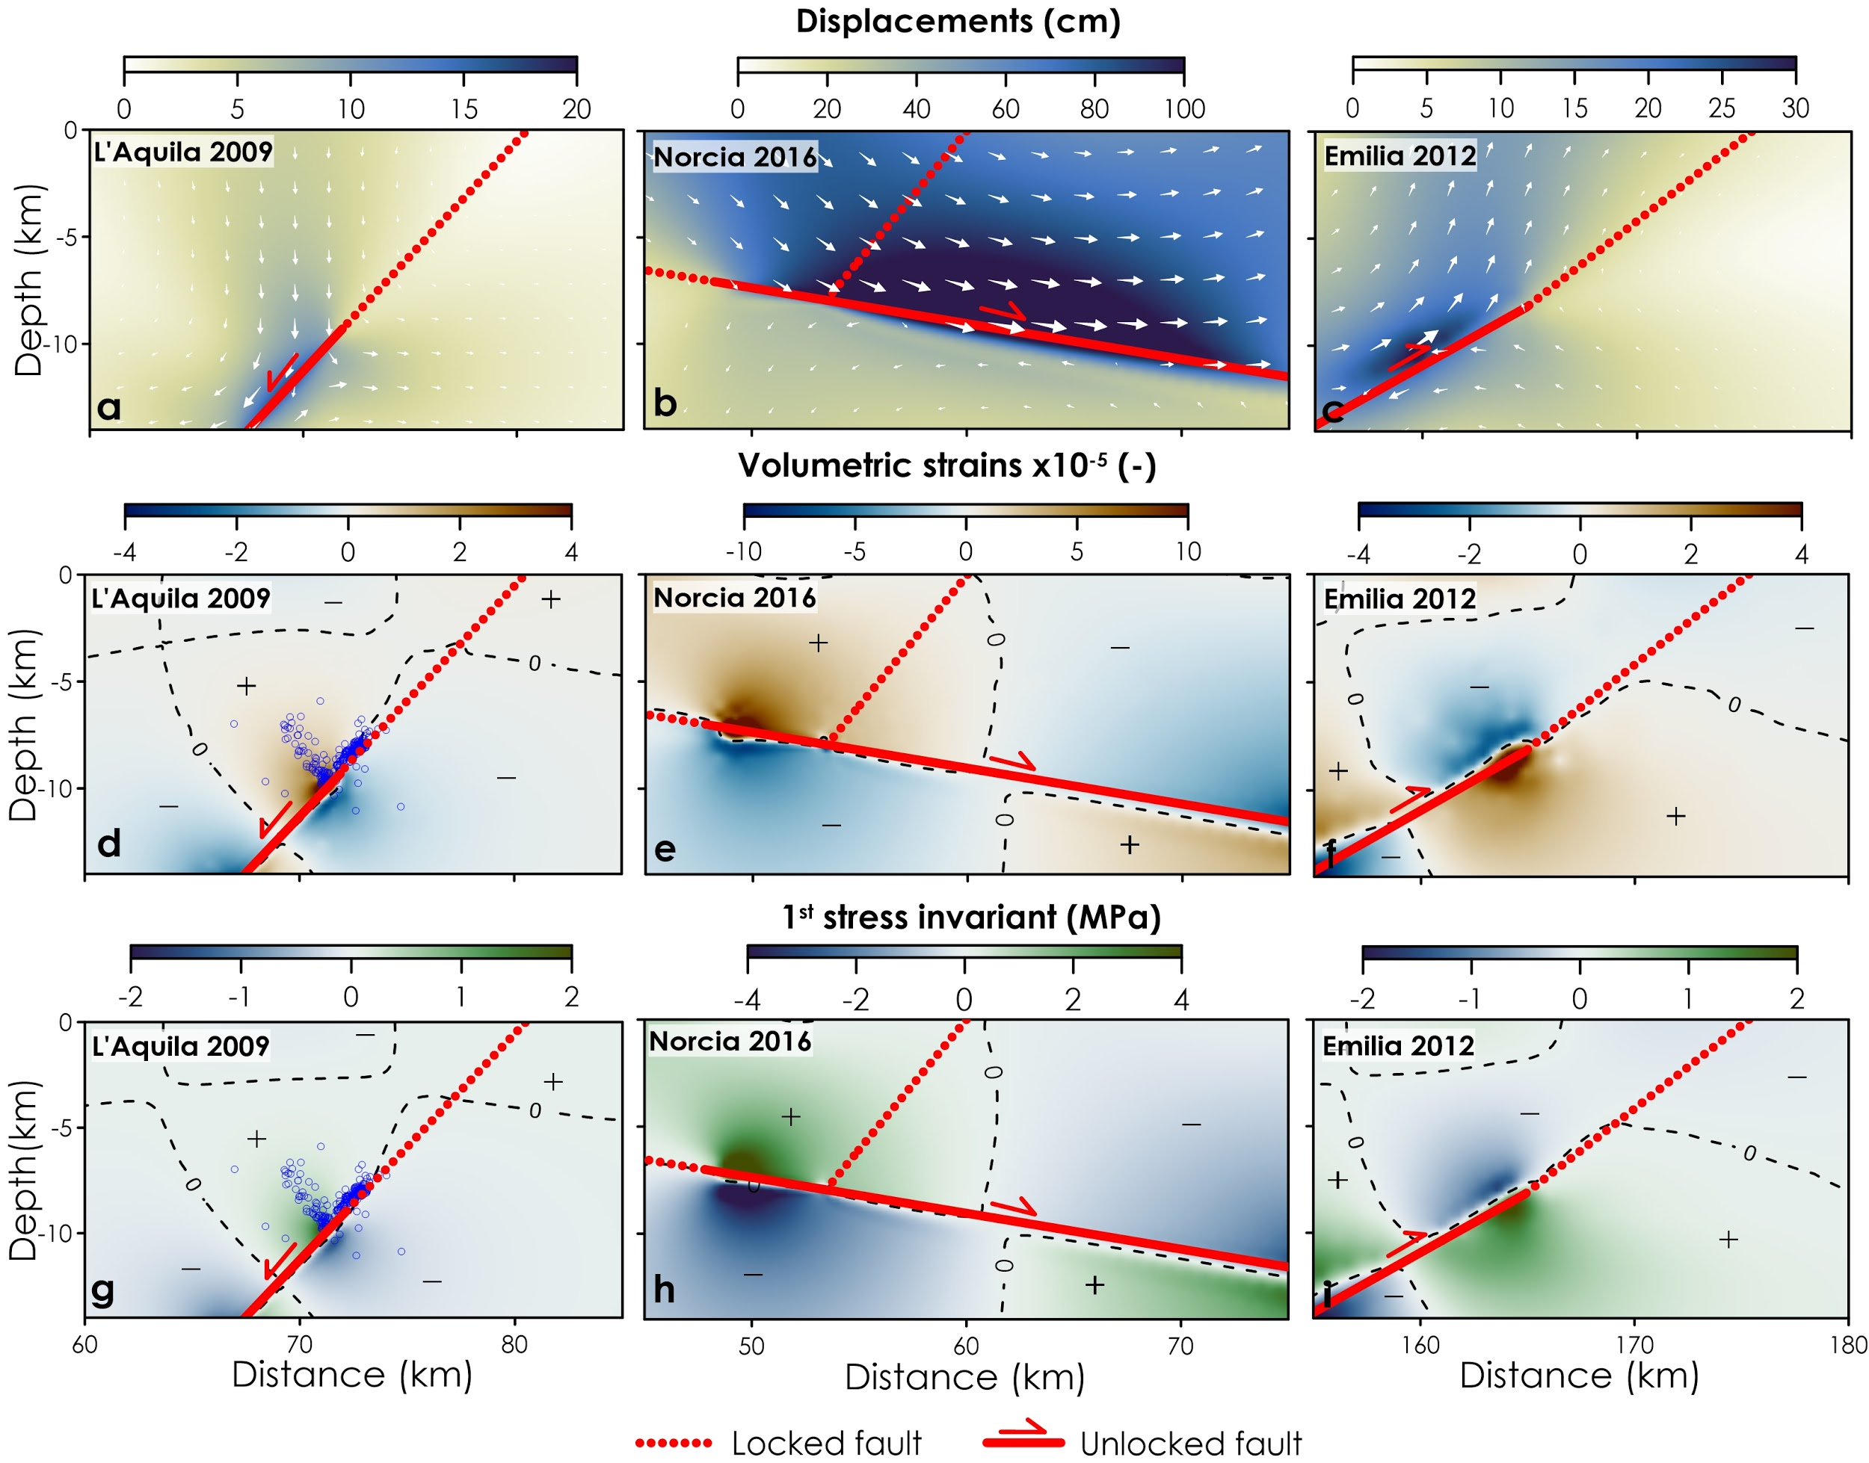
INTERSEISMIC
Albano et al. 2020

Slide 37
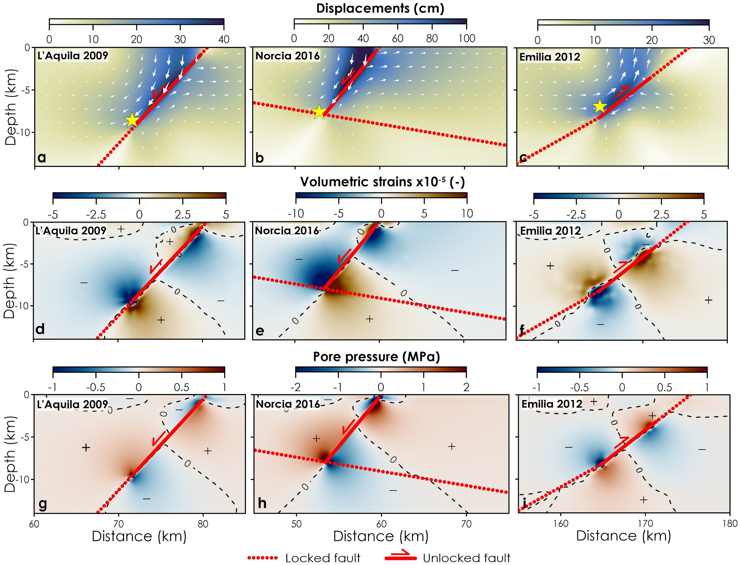
COSEISMIC
Albano et al. 2020

Slide 38
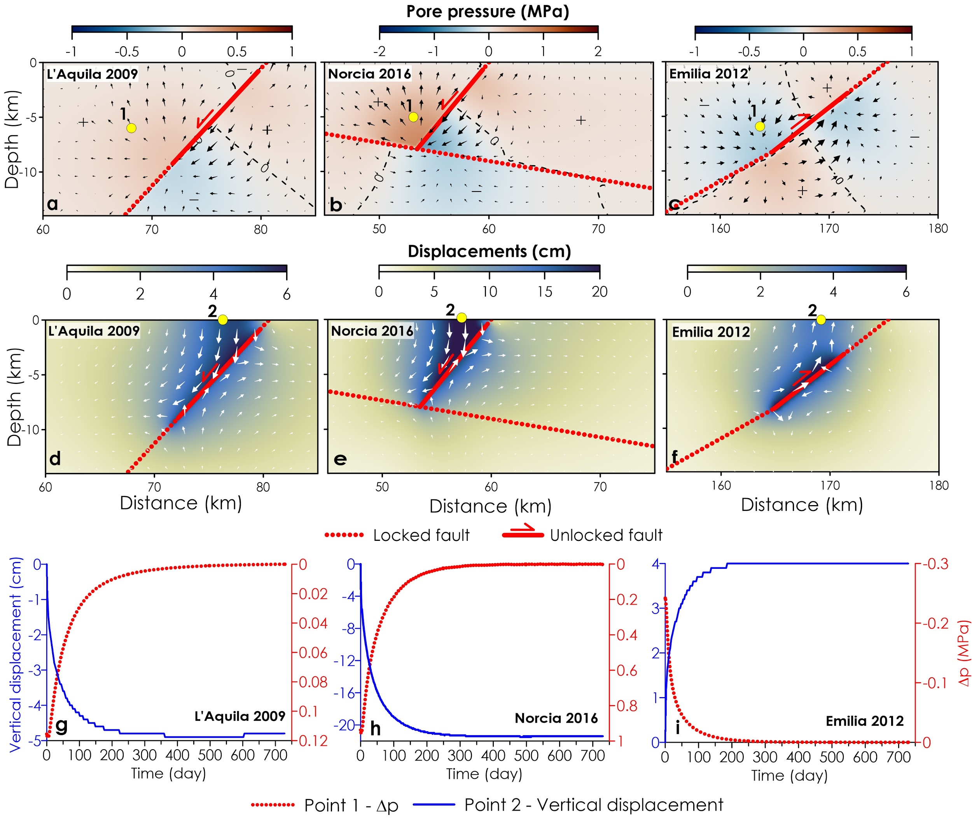
Albano et al. 2020

Slide 39
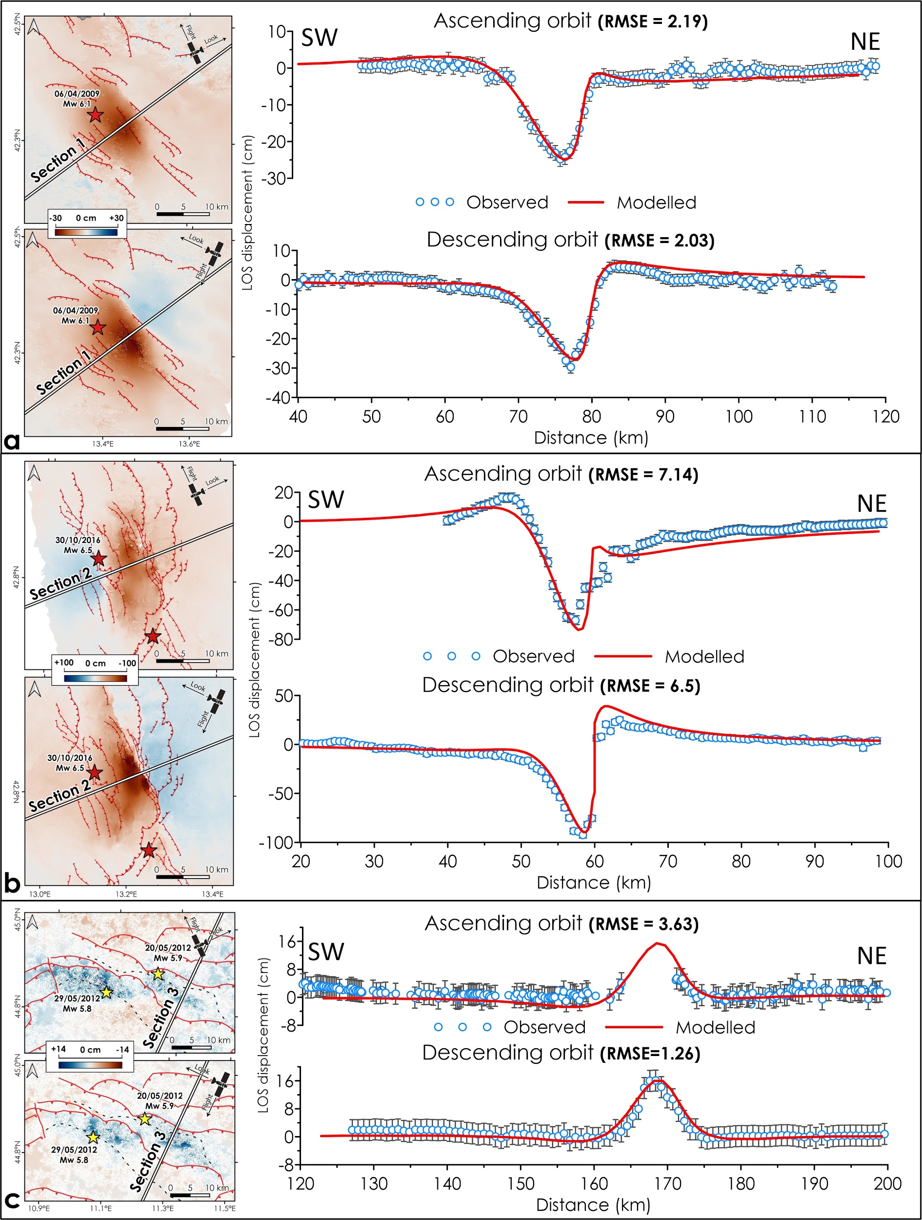
L’AQUILA 2009
NORCIA 2016
Albano et al. 2020

Slide 40
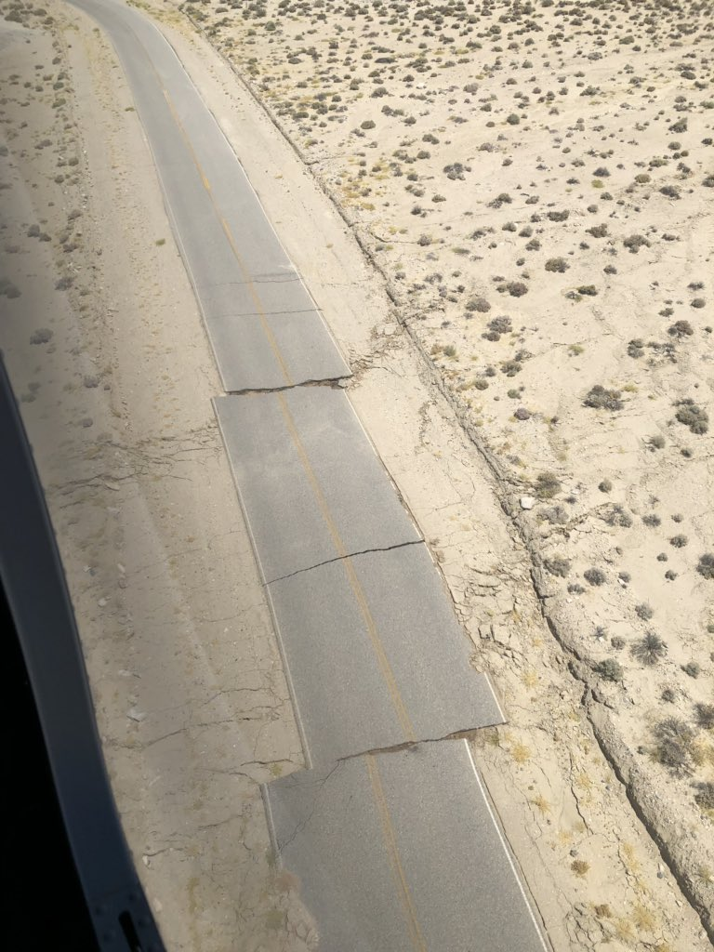

Slide 41
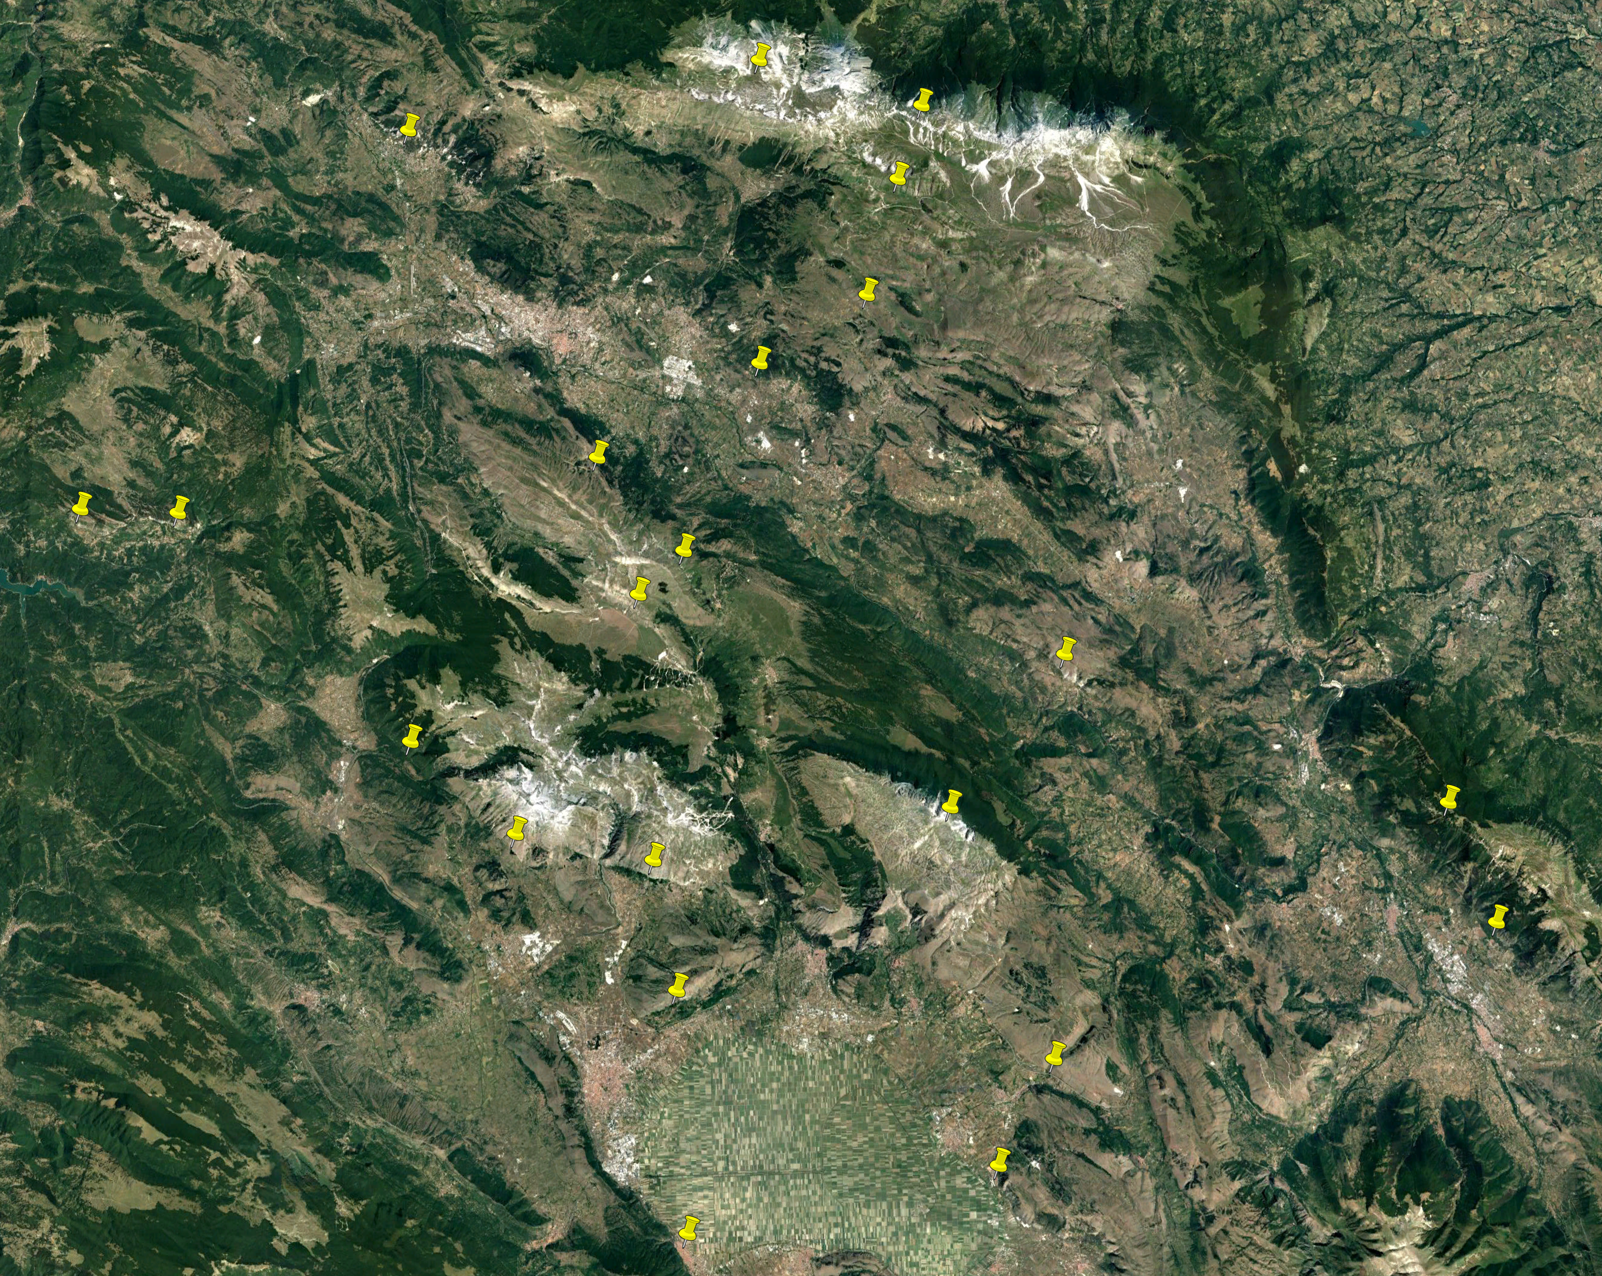

Slide 42
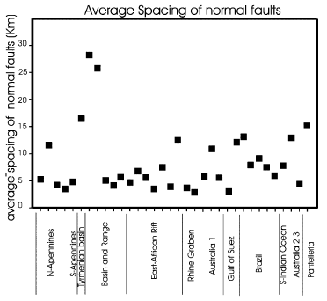
Morellato et al. 2002 Terra Nova

