Slide 1
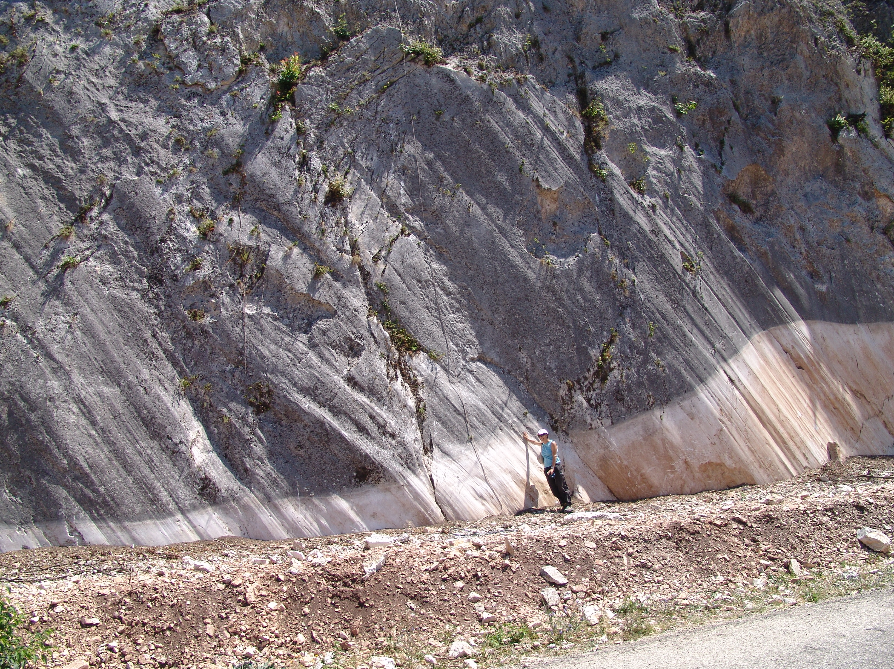

Fault activation energy
or
Crustal Energy Gradients
Carlo Doglioni INGV - UniSapienza
INGV

Slide 2
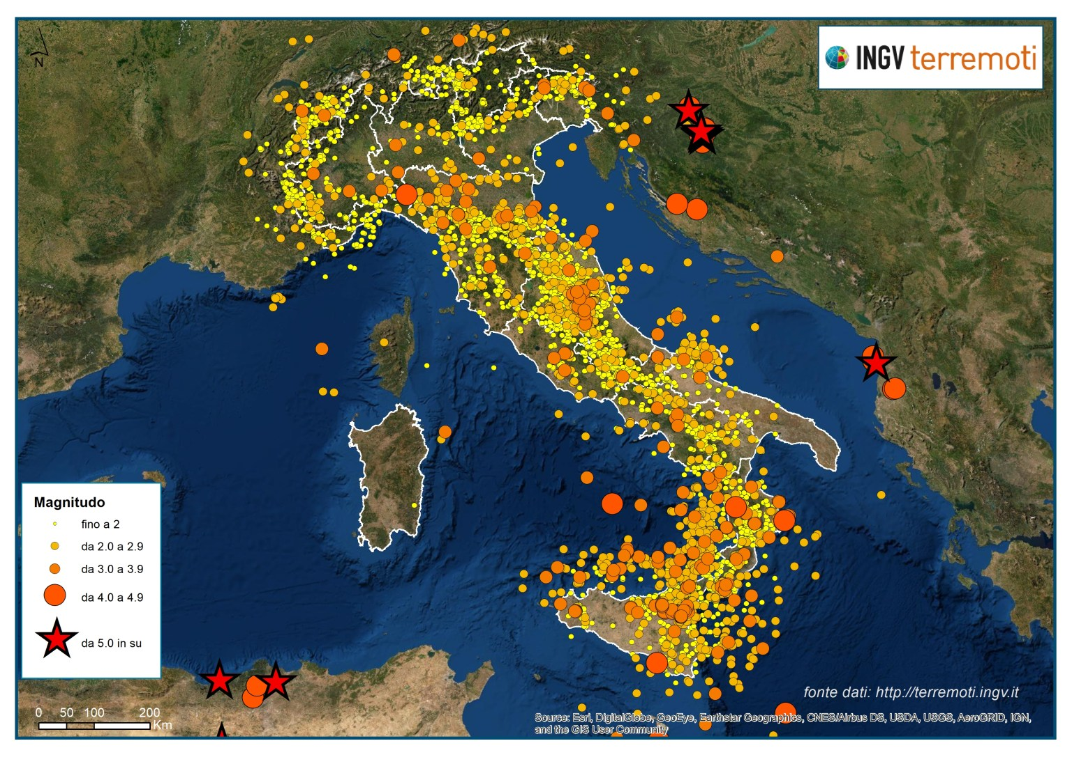

Slide 3
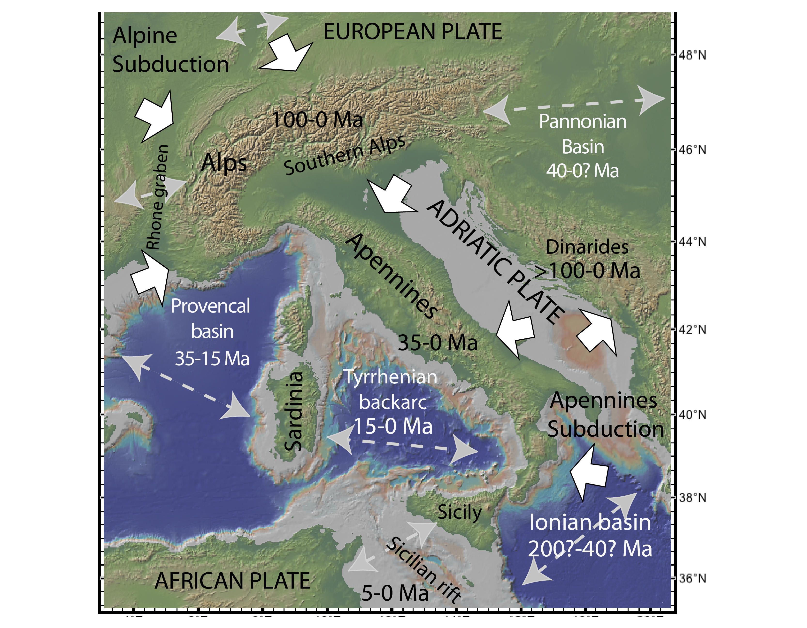

Slide 4
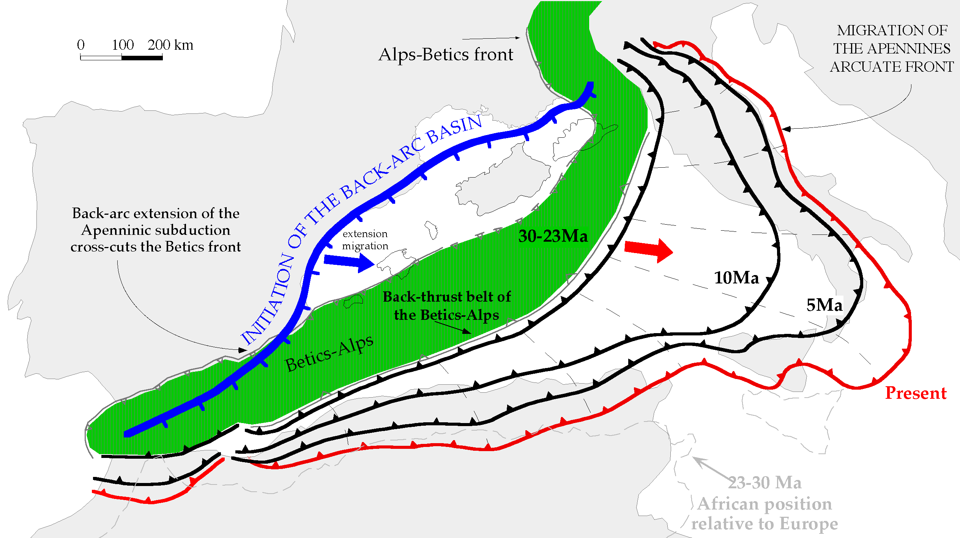
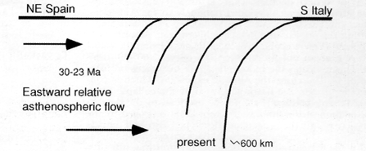
Ionian ocean
H
E-ward slab retreat
5 times faster than N-S
convergence

Slide 5
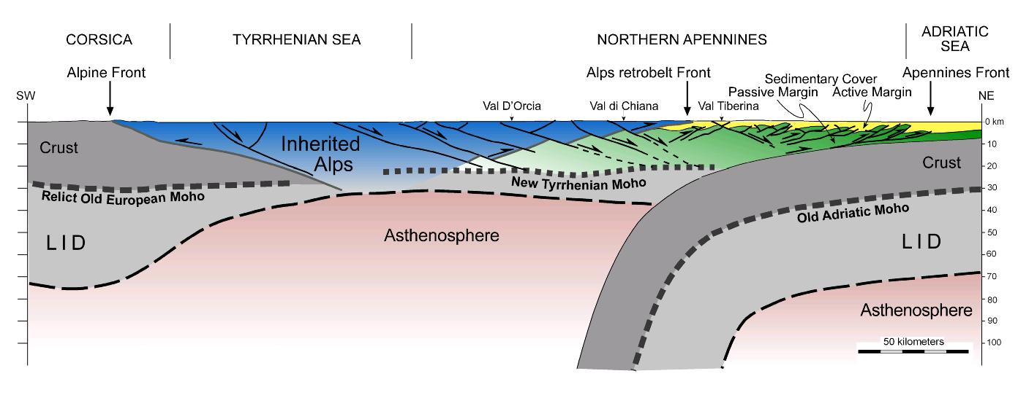
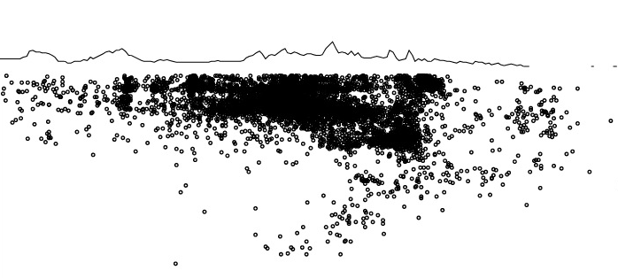
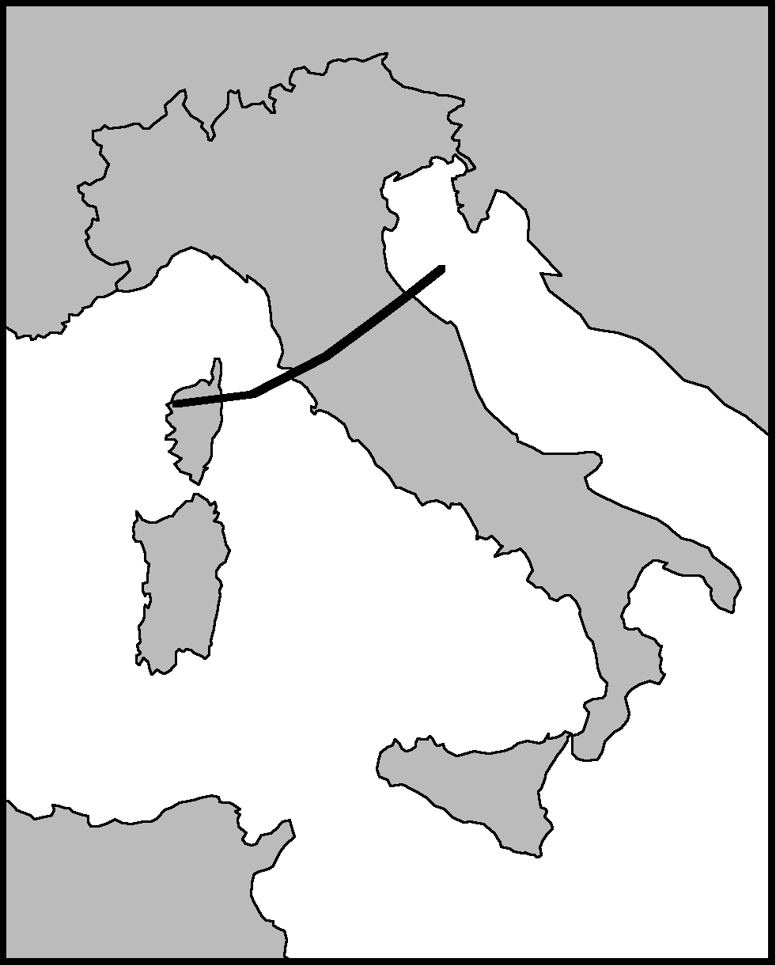
estensione
INGV
compressione
coast
Tirreno
coast
Appennini
coast
Mantle
Wedging
Mantle flow

Slide 6
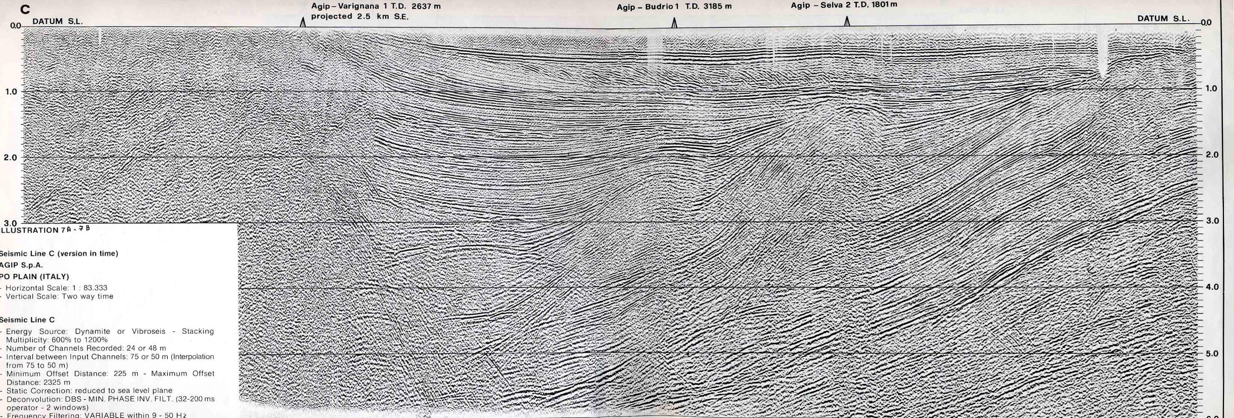
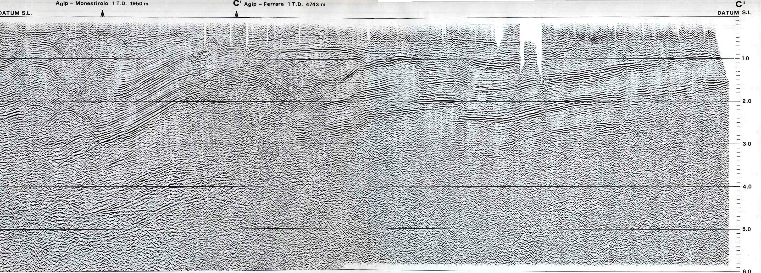
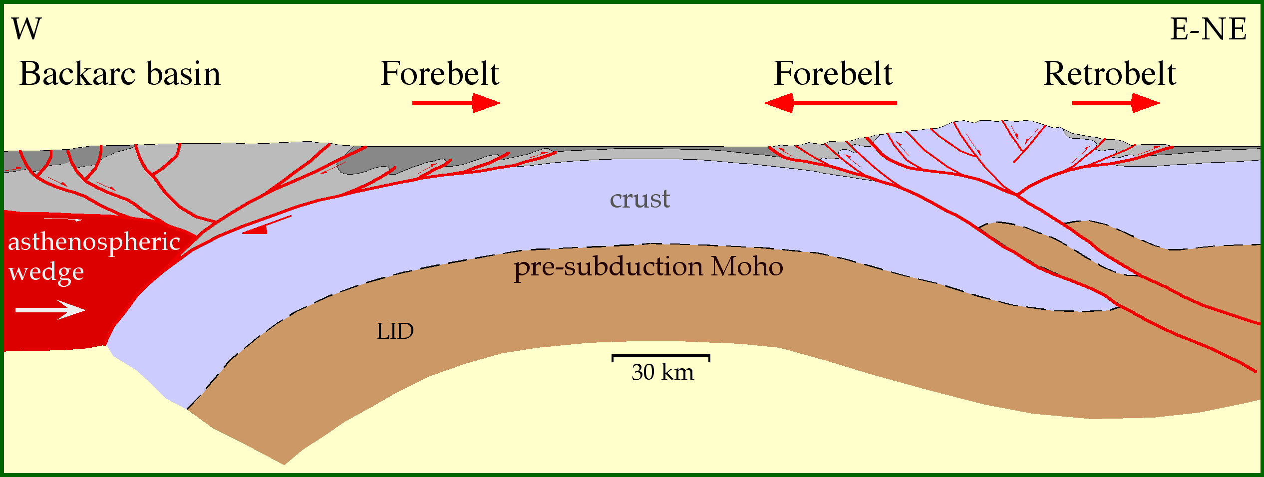
Out-of-sequence thrust
Frontal thrust
5
Present N-Apennines accretionary prism
5
Late Pleistocene-Active 5
Early Pleistocene 4
Late Pleistocene-Active 5
Late Pliocene 3
Mid-Pliocene 2
Early Pliocene 1
5 km
5
5

Slide 7
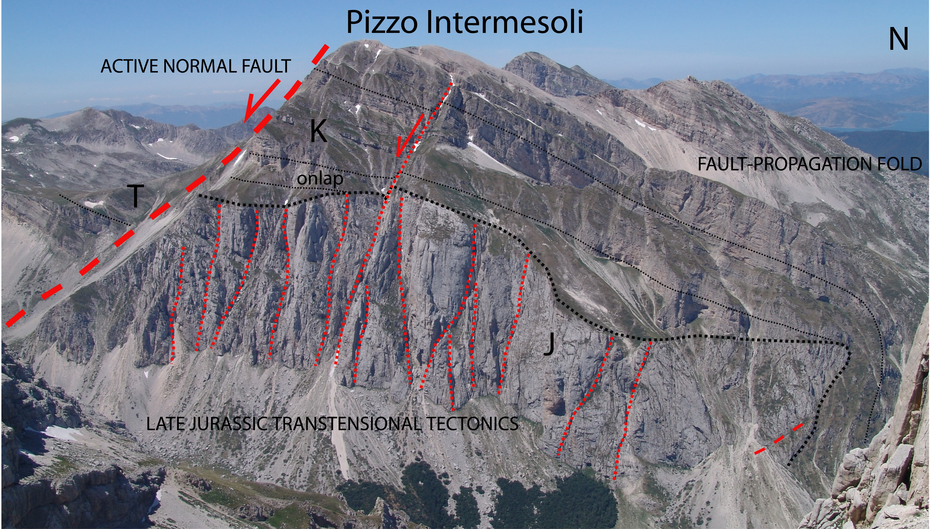
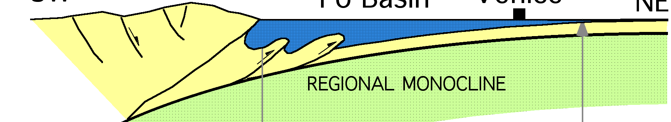
Gran Sasso Range
Quaternary
2-0 Ma
Messinian-Pl
6-2 Ma
3
2
1
Jurassic
160-150 Ma
3
2
1

Slide 8
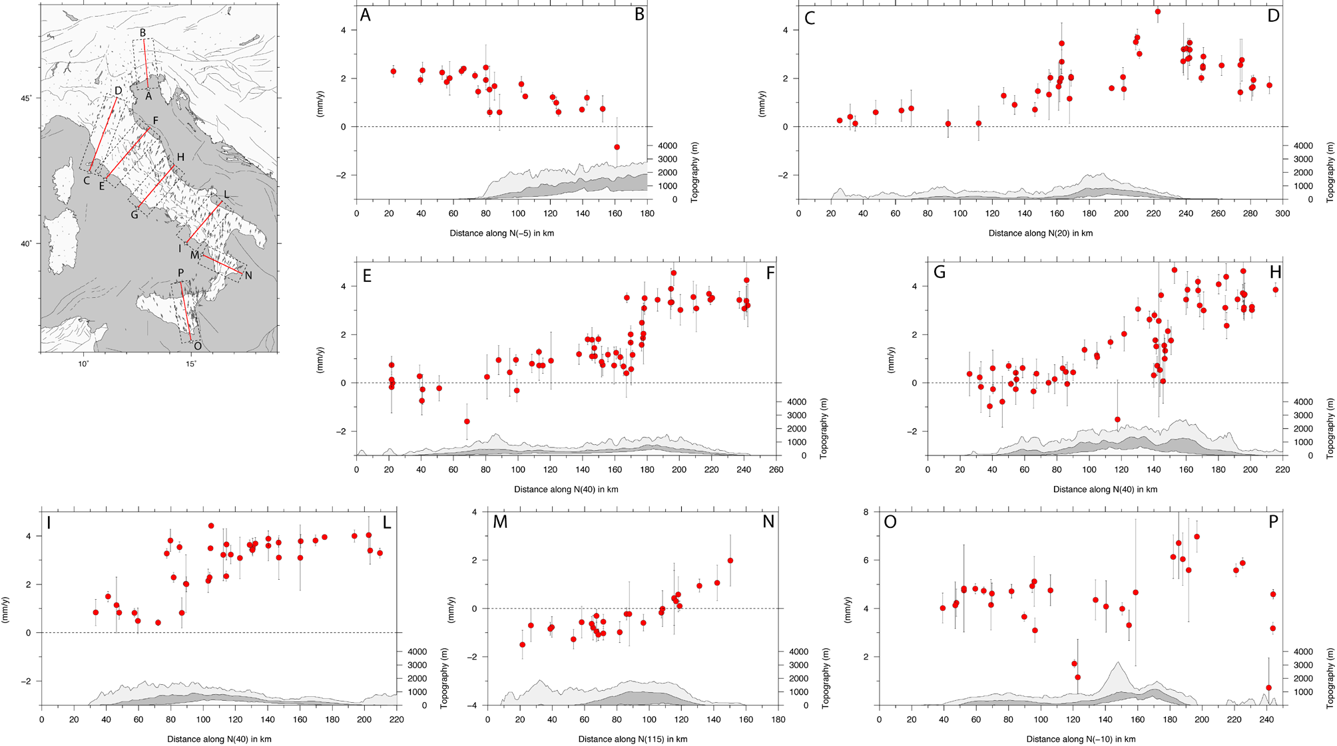
La sezione G-H evidenzia l’estensione di circa 4mm/anno responsabile della
sismicità appenninica e del terremoto del 24/8/2016
Dati geodetici rete RING-INGV
INGV
contraction
extension
Devoti et al. 2017 Annals of Geophysics

Slide 9
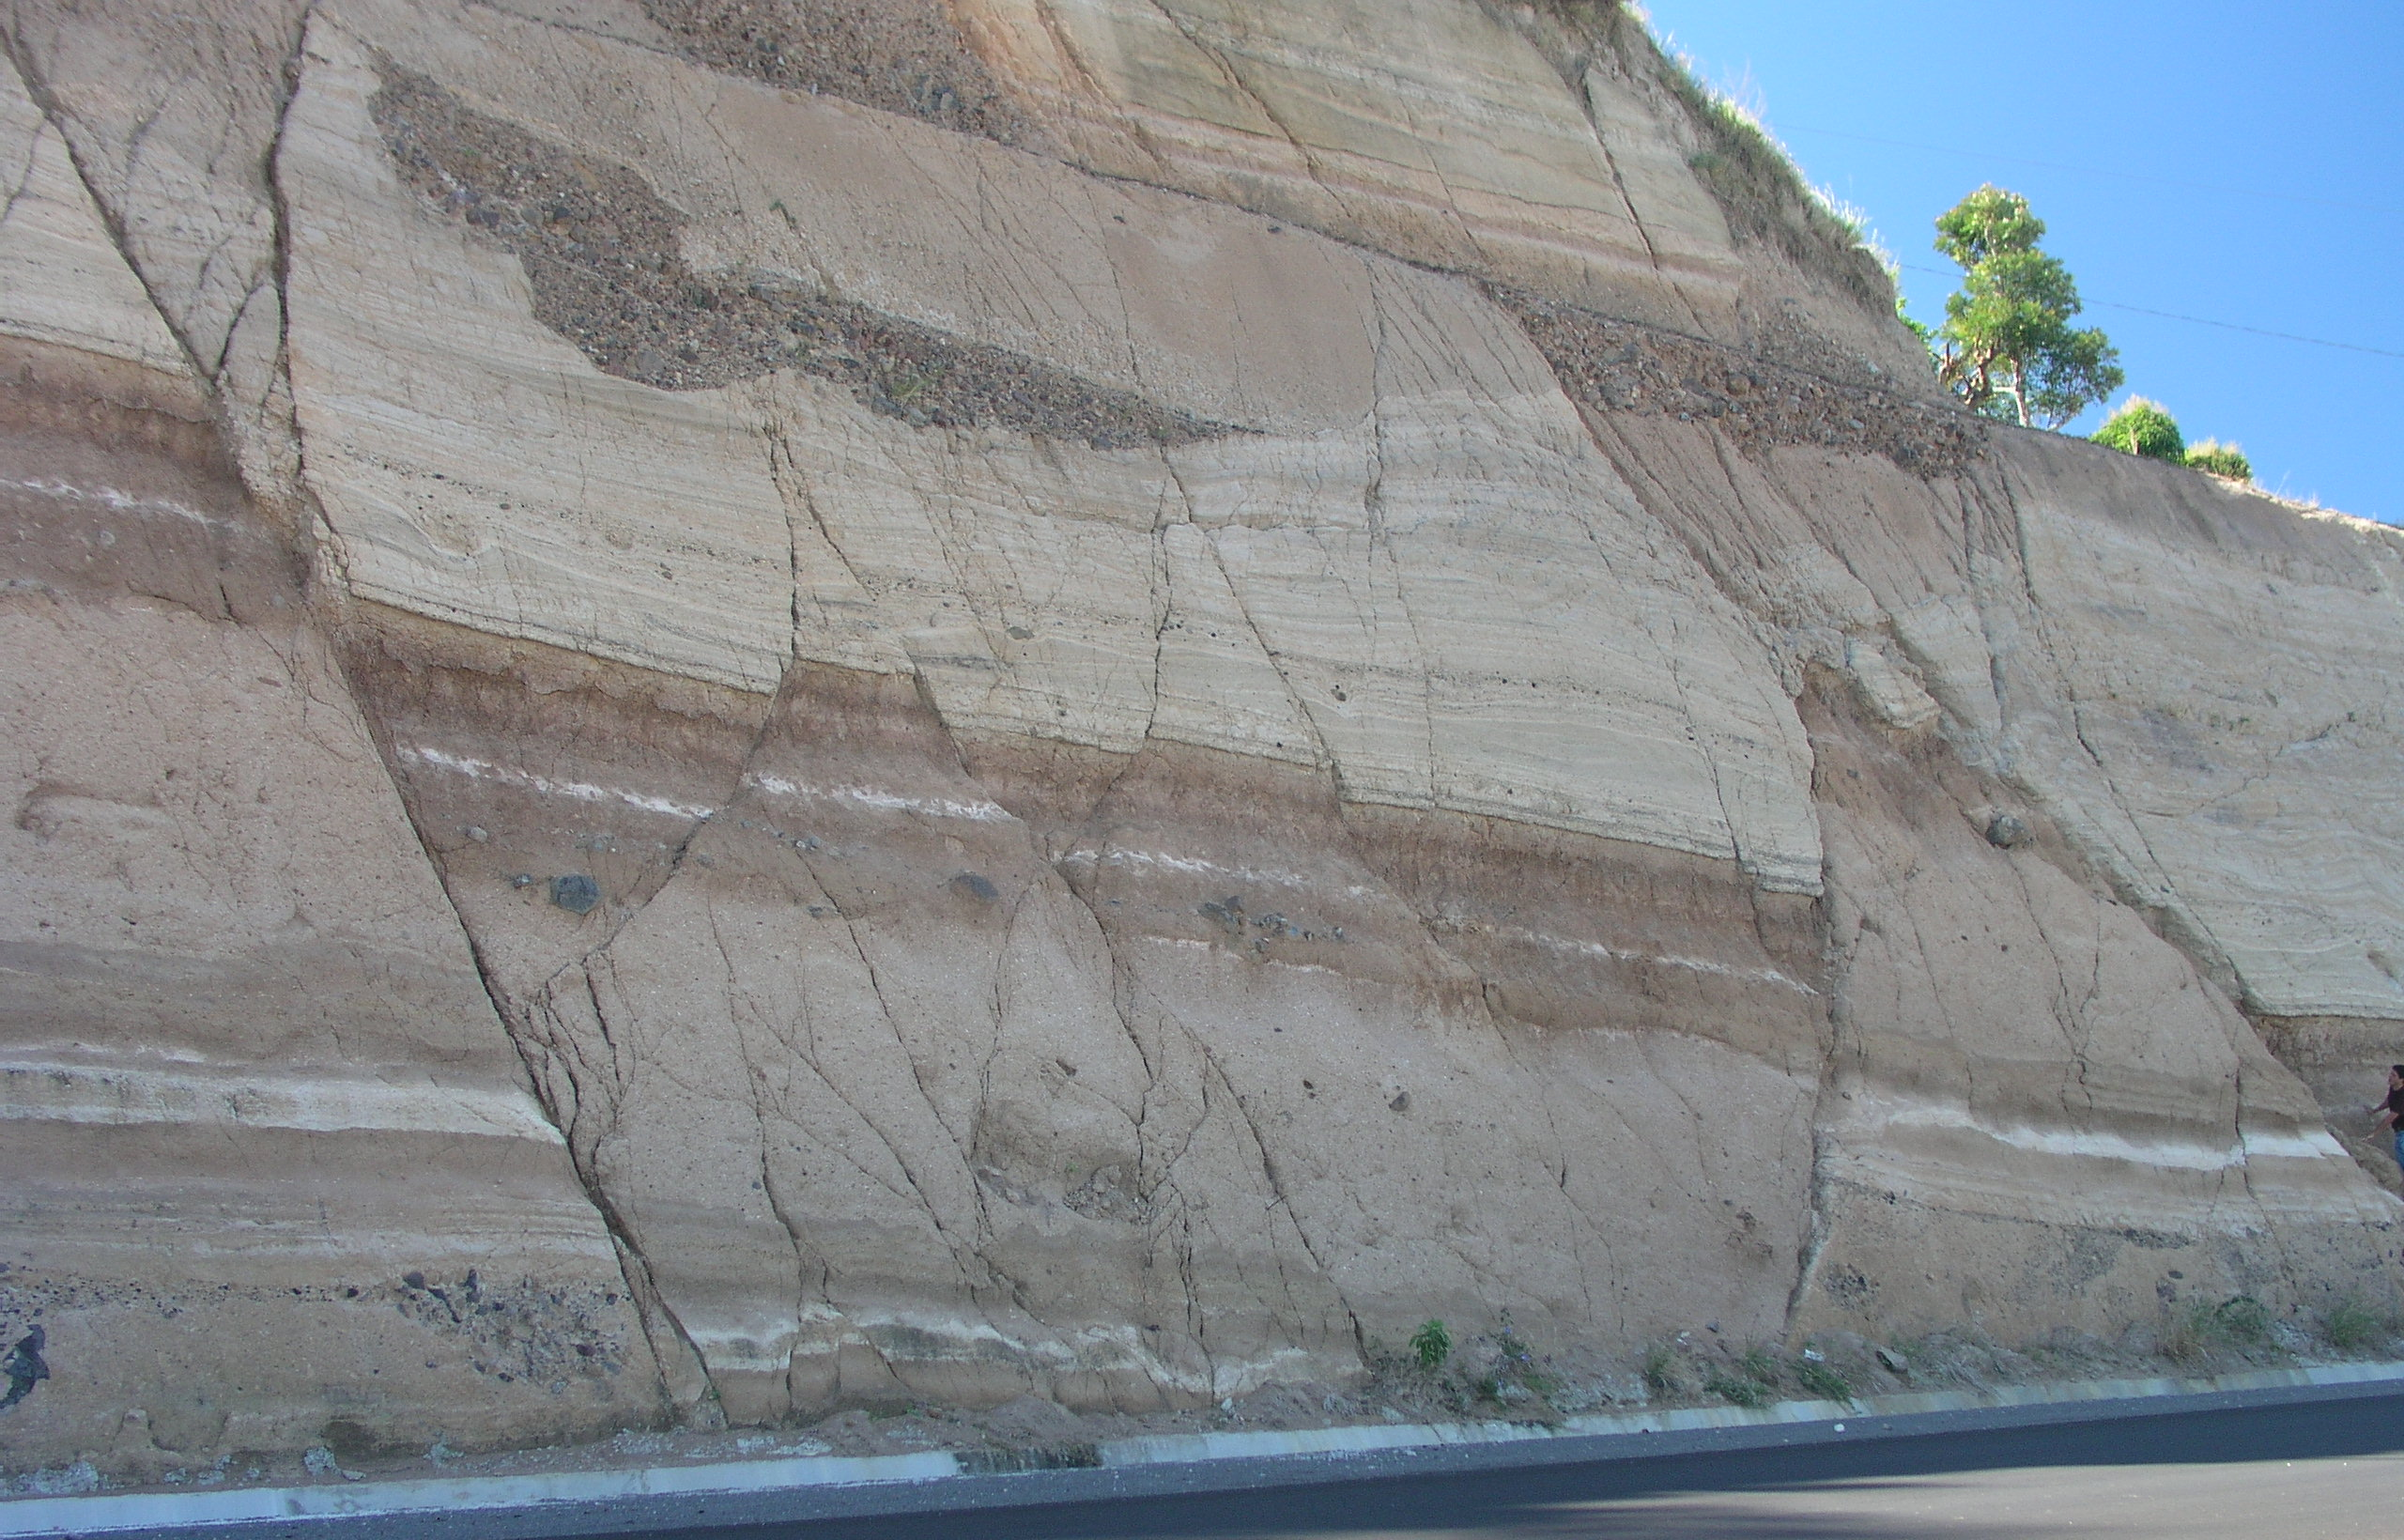
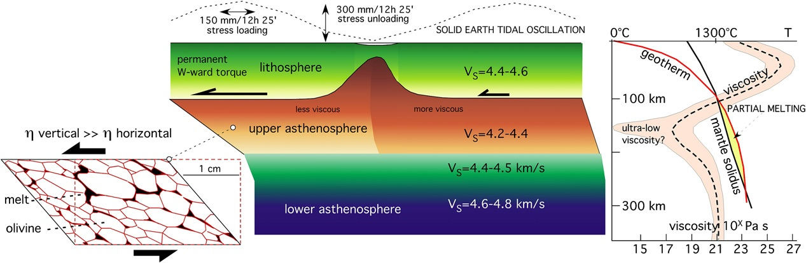

Slide 10
coseismic slip mm/s speed (1mm/s-1m/s)
NO-INTERSEISMIC slip
CRUST
BDT
interseismic slip 10⁻⁸ mm/s
NO-COSEISMIC slip

Slide 11
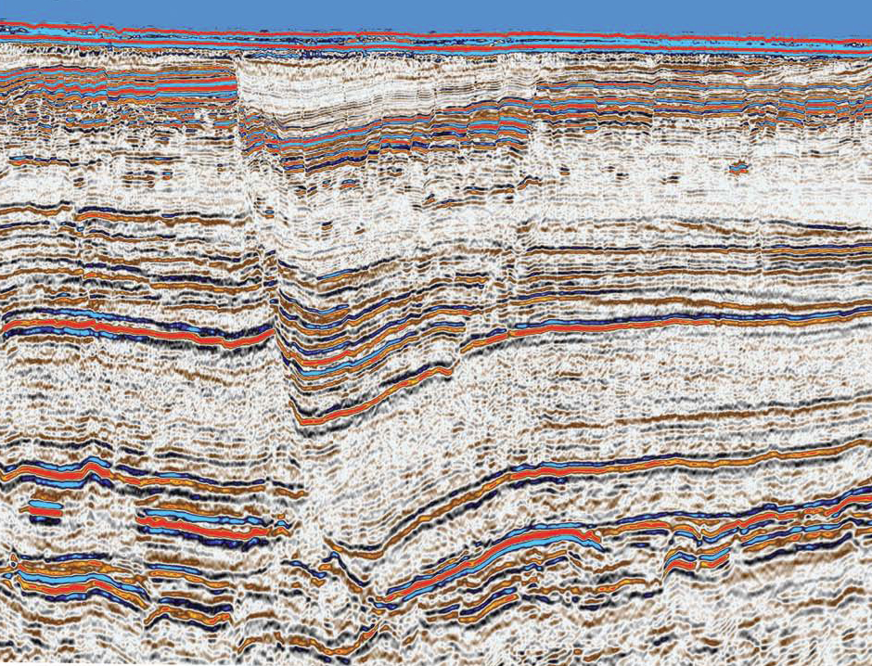
5 km

Slide 12
“Real” world: a spring stretched over a viscous-plastic layer
dilatancy
flattening

Slide 13
“Real” world: a spring stretched over a viscous-plastic layer
contracting
thickening

Slide 14
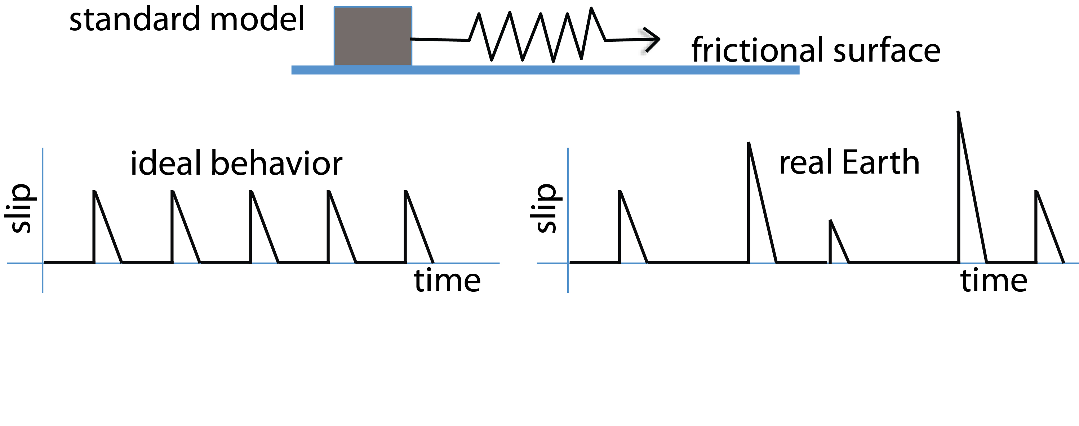
1 km

Slide 15
Twiss and Moores, 1992

Slide 16
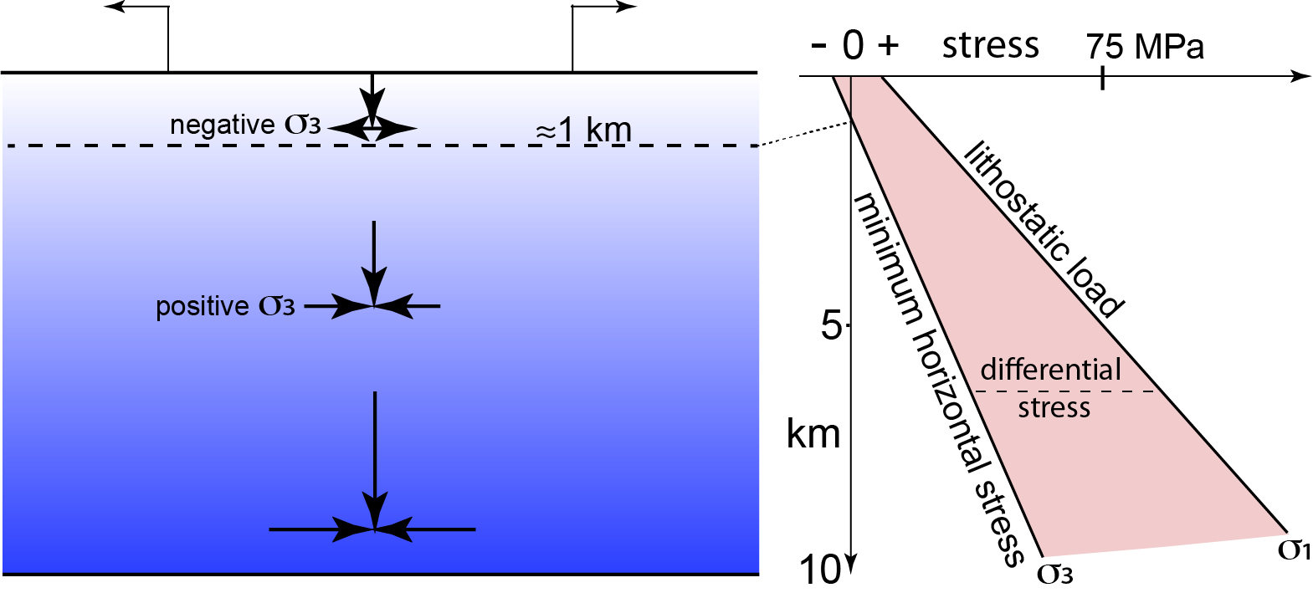

Slide 17


STRESS
0
BRITTLE
km
temperature
λ, pore fluids
β, type of fault
stability field
15
BDT
pressure
DUCTILE
30
Q, activation energy
A, viscosity coefficient
ε, effective strain
n, stress power law
β=3 thrust, 1.2 strike-slip, 0.75 normal fault
Notes:
Beta=
3 thrust
1.2 strike-slip
0.75 normal fault

Slide 18
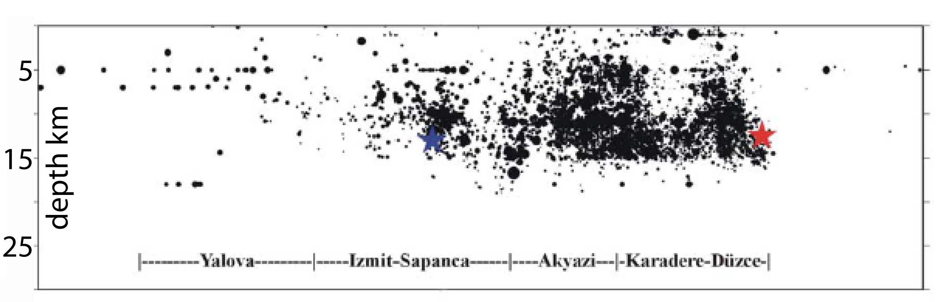

STRESS
0
Brittle deformation
km
temperature
Stable
rocks
15
pressure
Ductile deformation
30

Slide 19
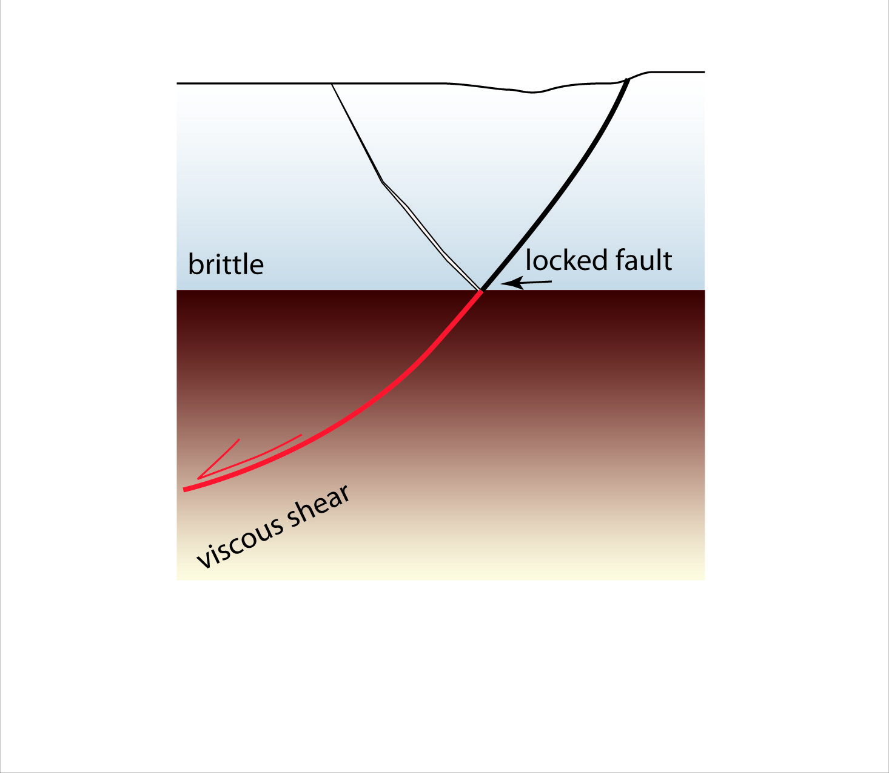
σ1
0
km
30
σ3

Slide 20
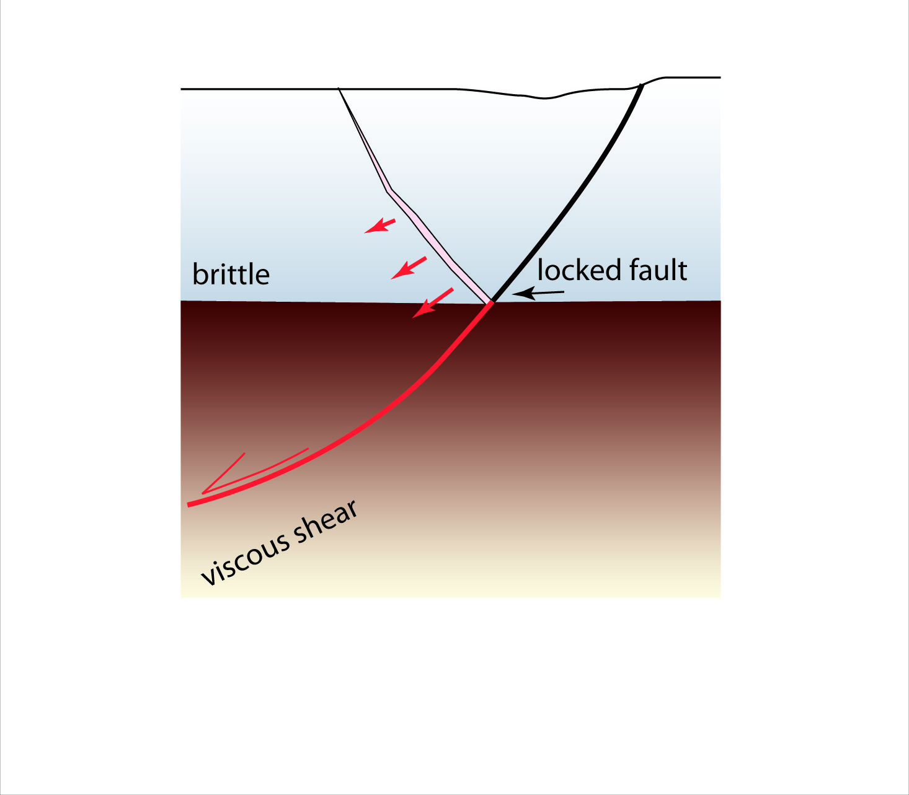
σ1
0
km
30
σ3

Slide 21
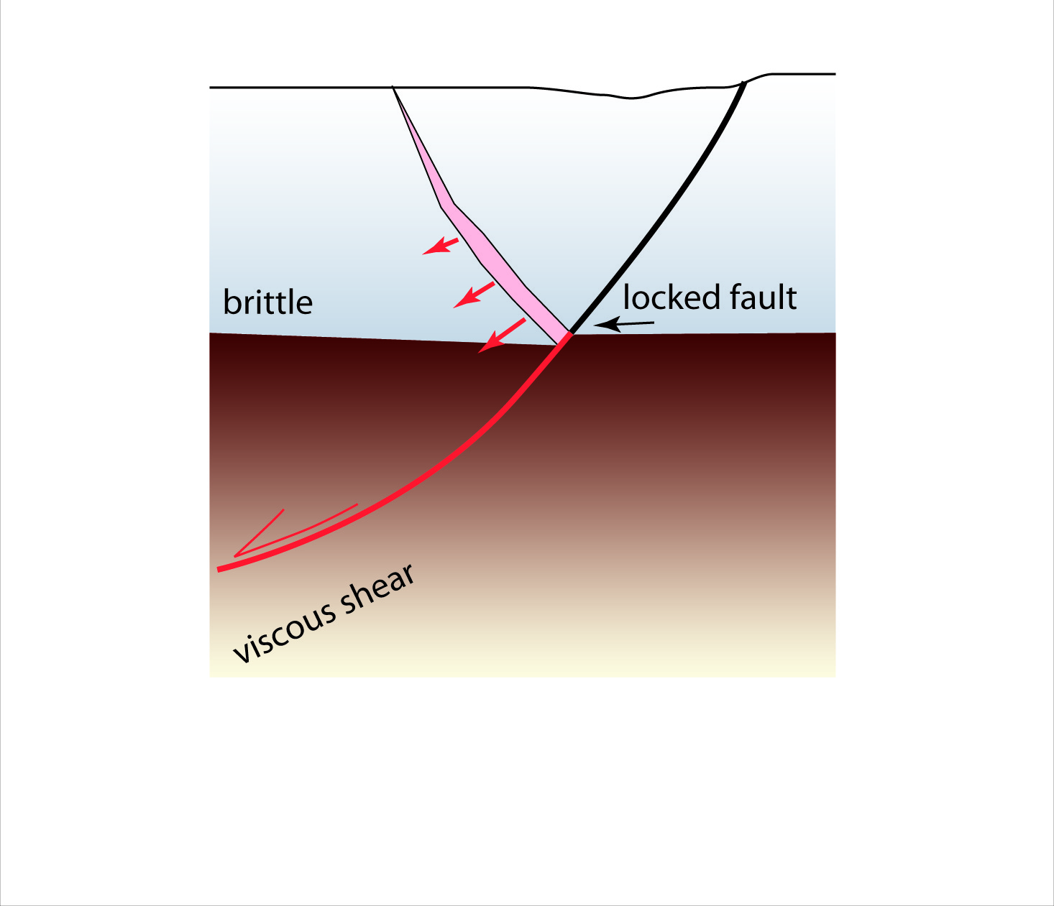
σ1
0
km
30
σ3

Slide 22

σ1
0
km
30
σ3

Slide 23
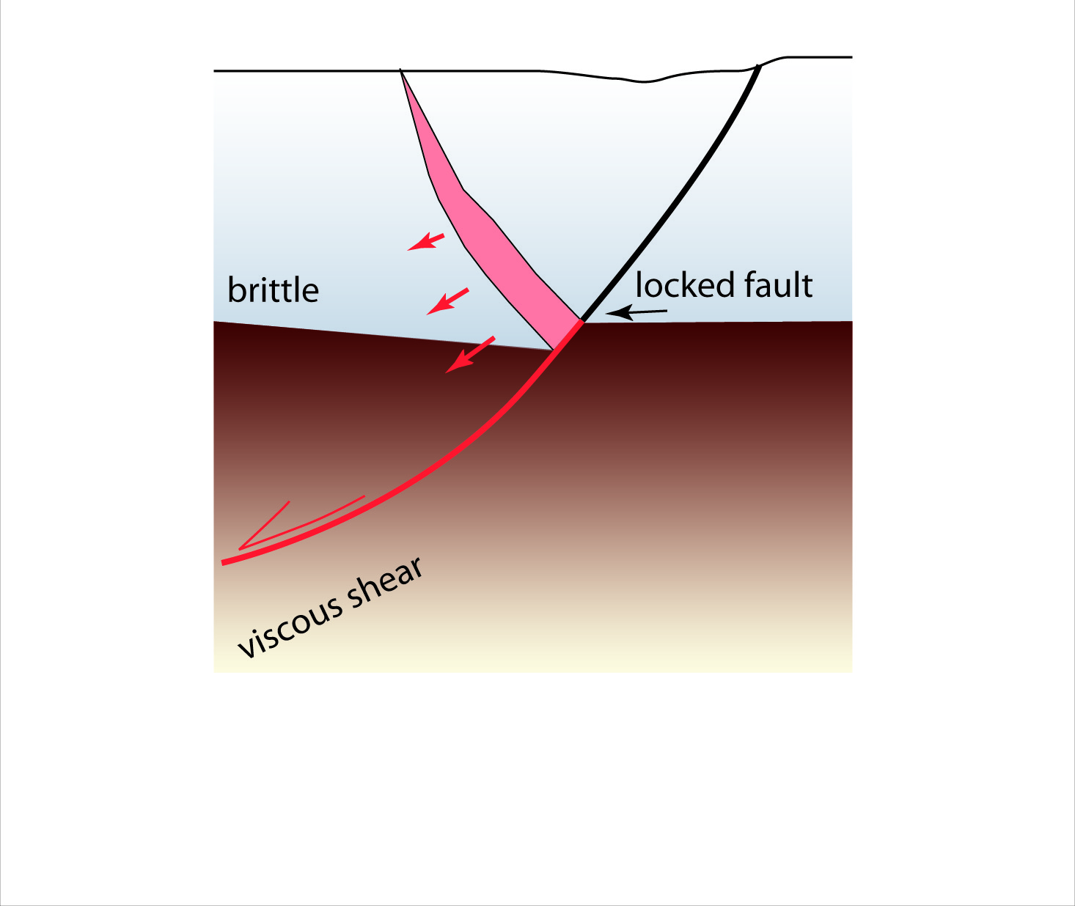
σ1
0
km
30
σ3

Slide 24
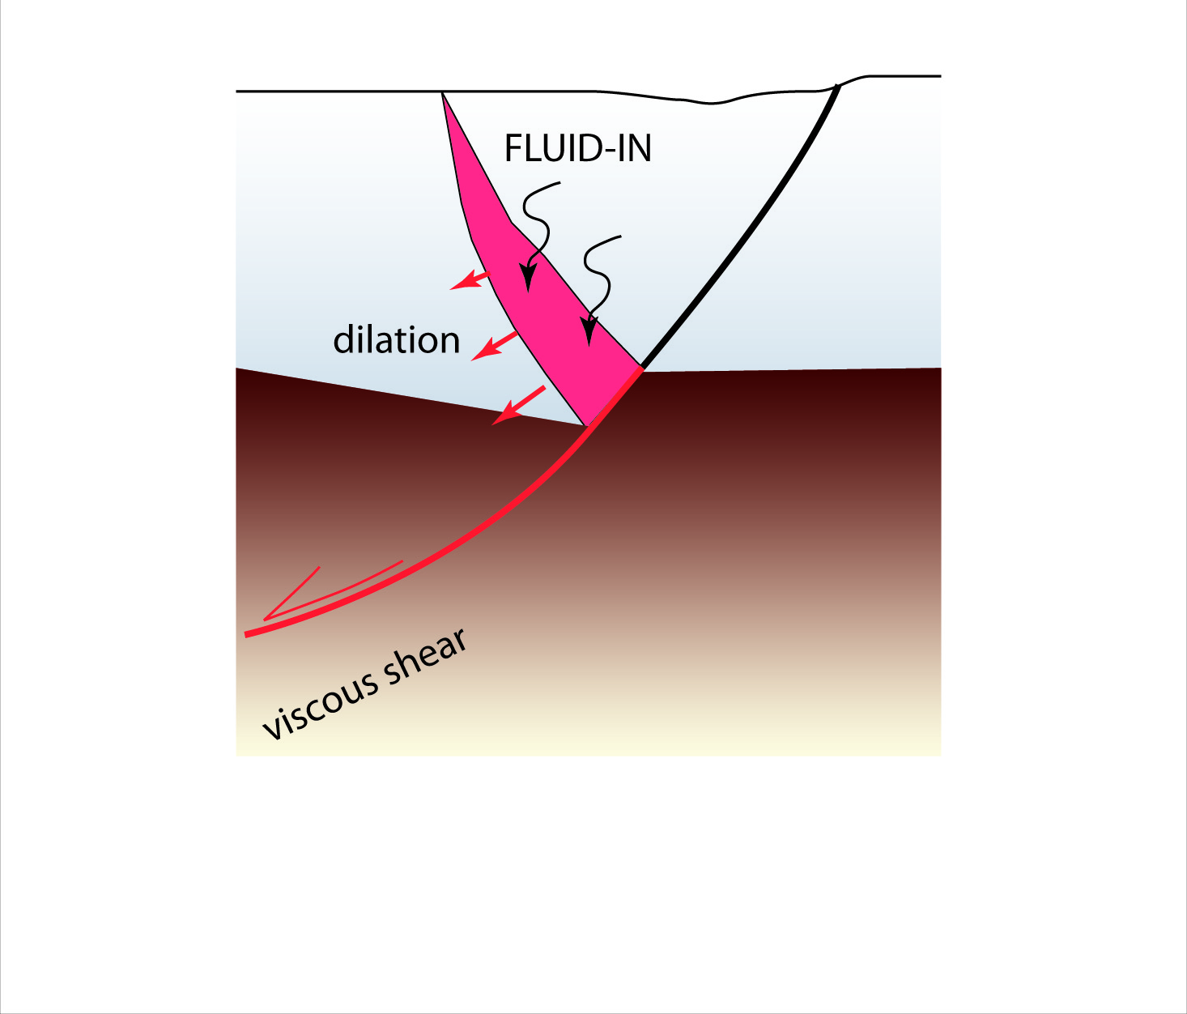
σ1
interseismic end
0
km
30
σ3

Slide 25
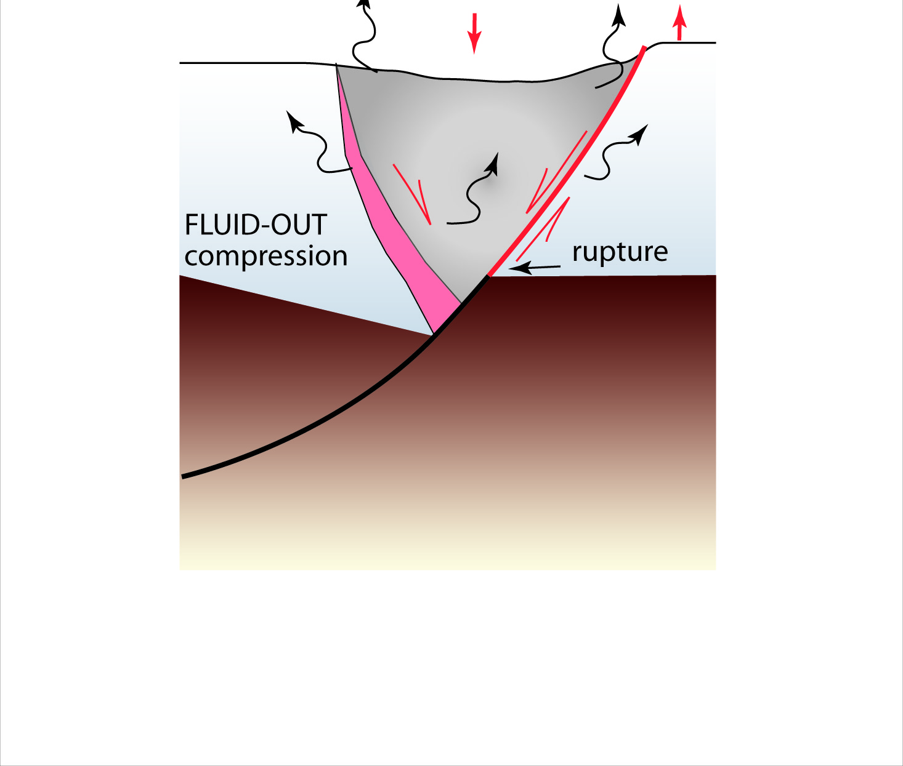
σ1
coseismic fall
0
km
30
σ3

Slide 26
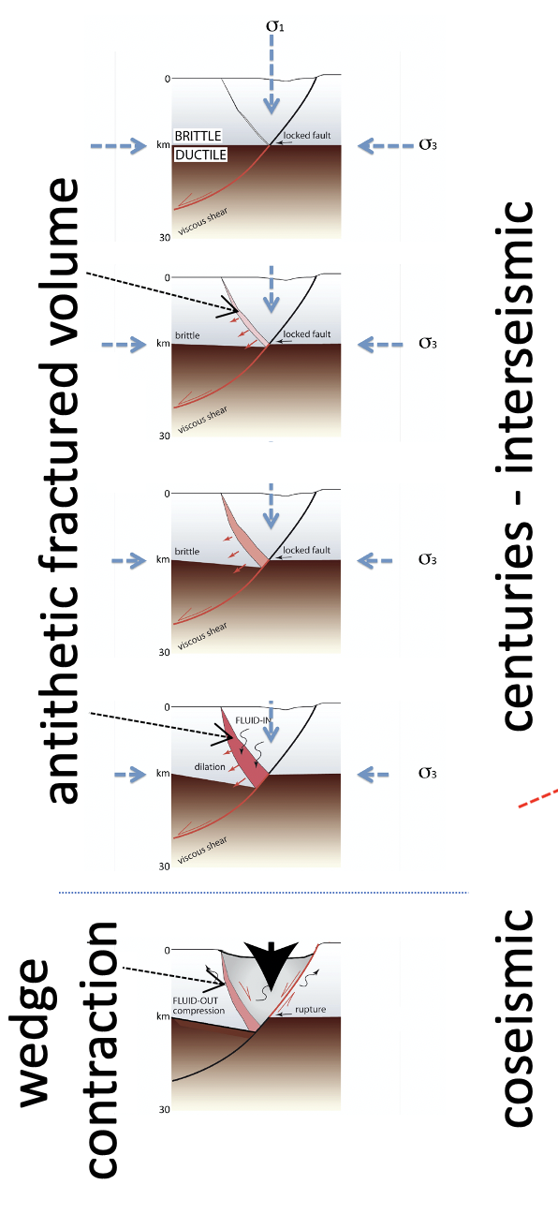
τ
σ3
σ1
σn

Slide 27
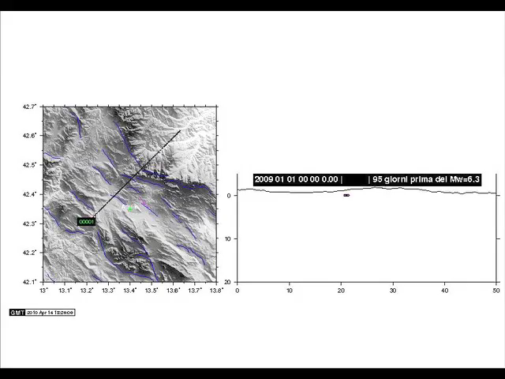
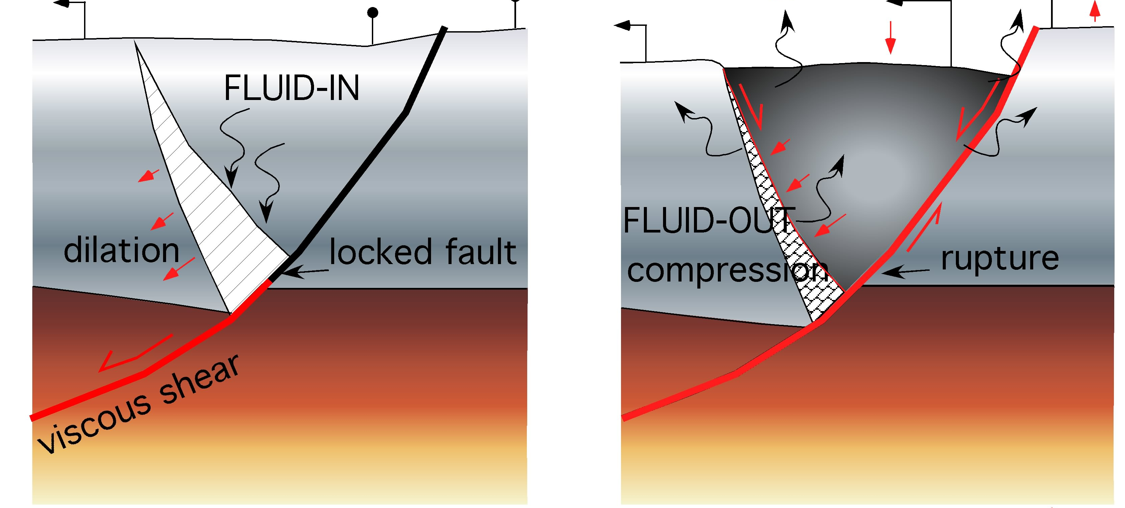
interseismic
coseismic
Courtesy R. Di Stefano

Slide 28
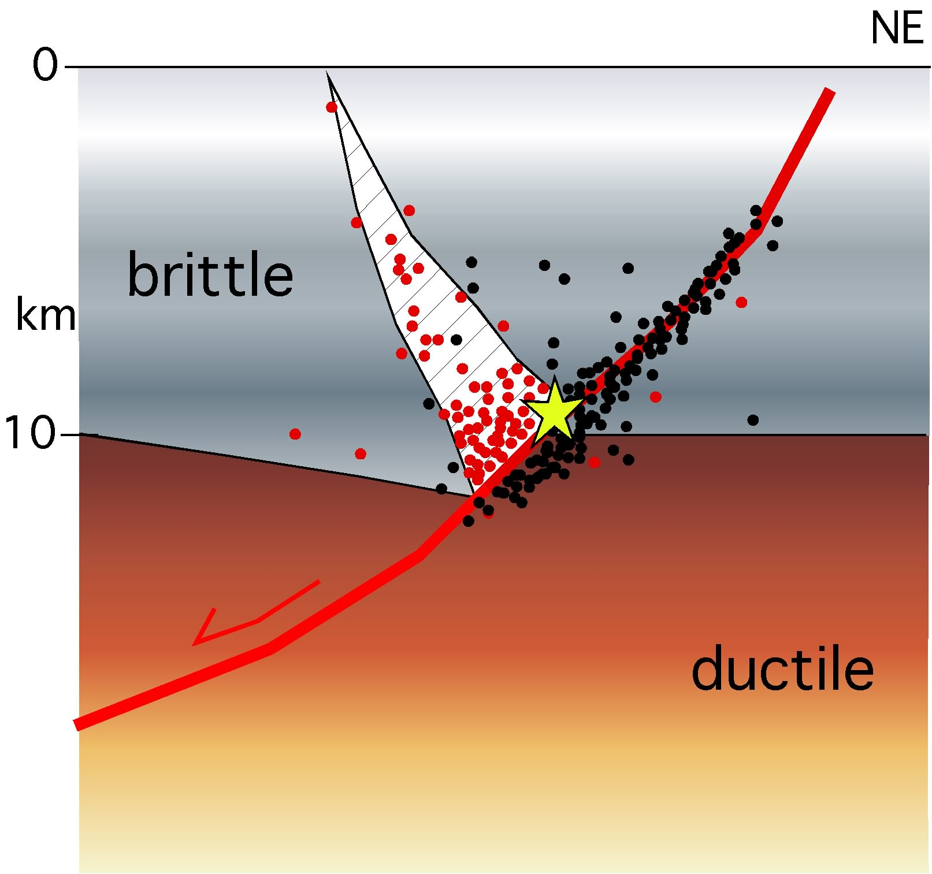

Slide 29
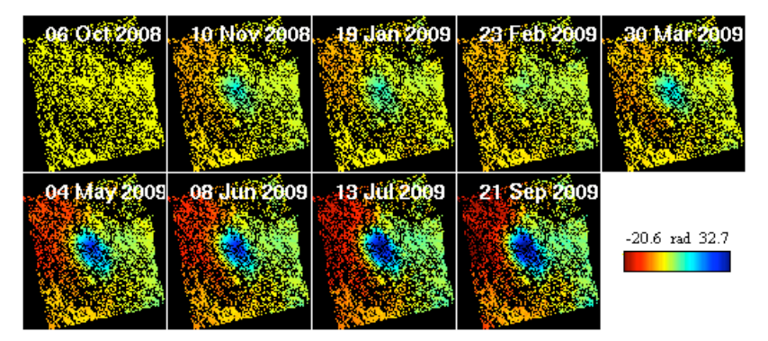
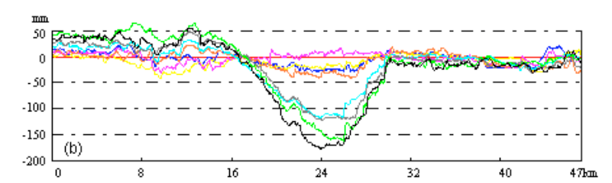
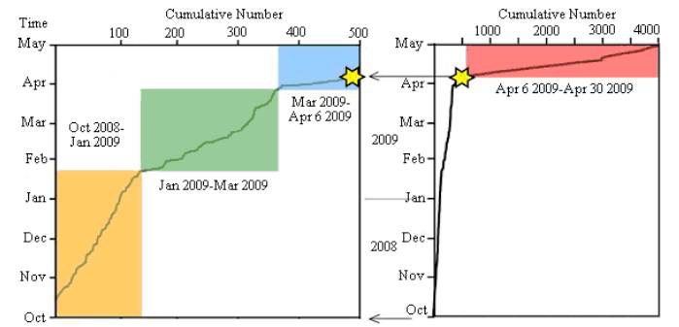
Dati DInSAR – Lou et al. 2014
Initial subsidence 5 months earlier Aquila Eq
6° April
http://www.fig.net/pub/fig2014/papers/ts10b/TS10B_luo_bo_et_al_7051.pdf
Vertical motion
earthquakes
Lou et al. 2014

Slide 30
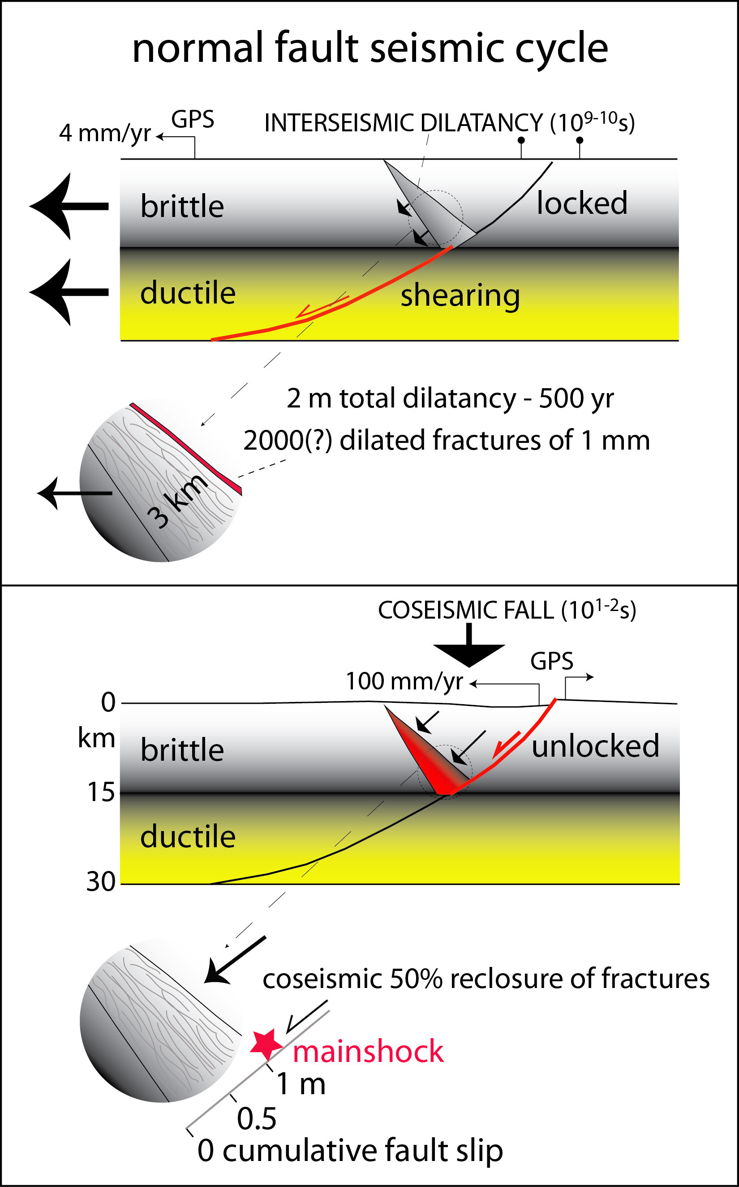

Slide 32
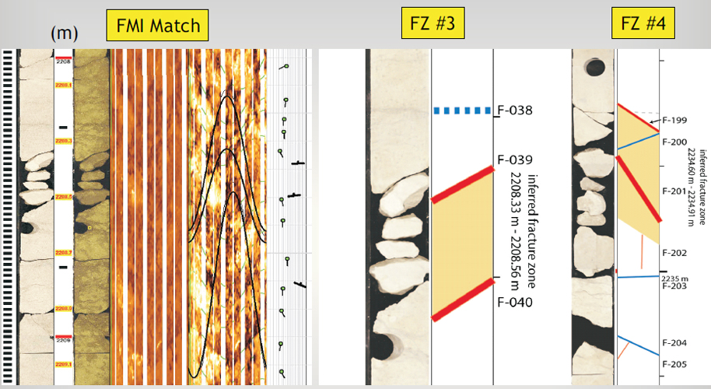

Slide 33
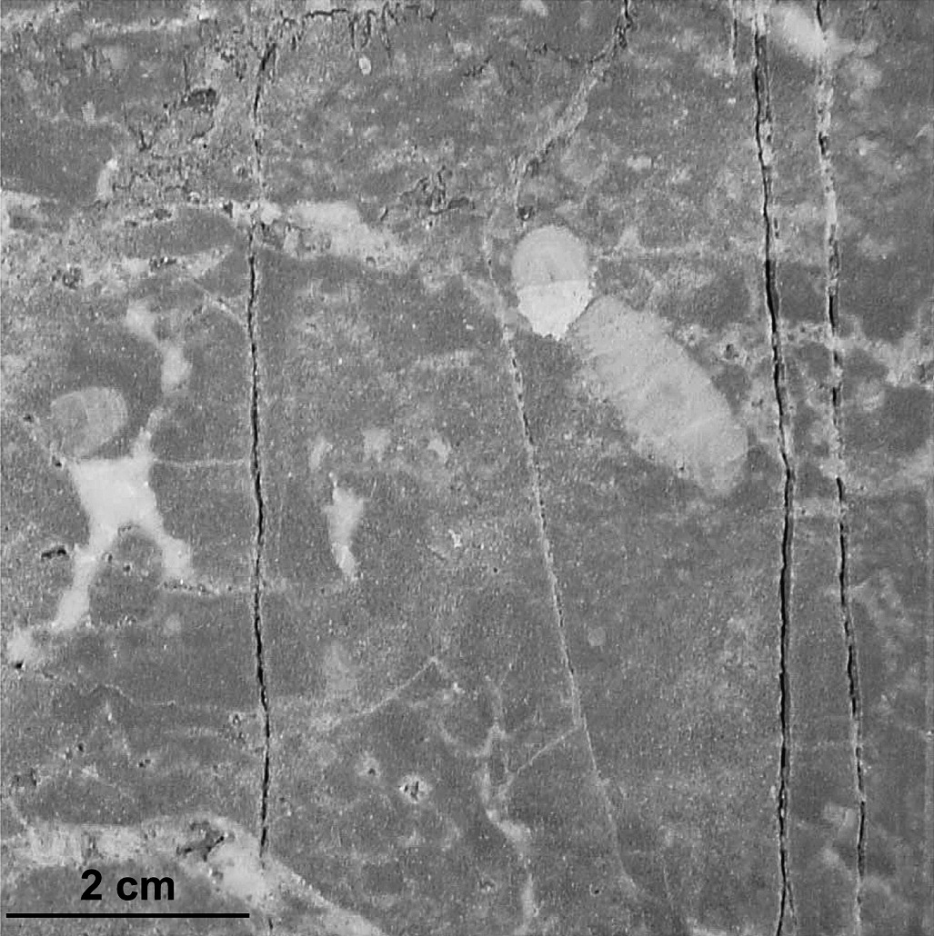
Packstone 2300 m
Pennsylvania well

Slide 34
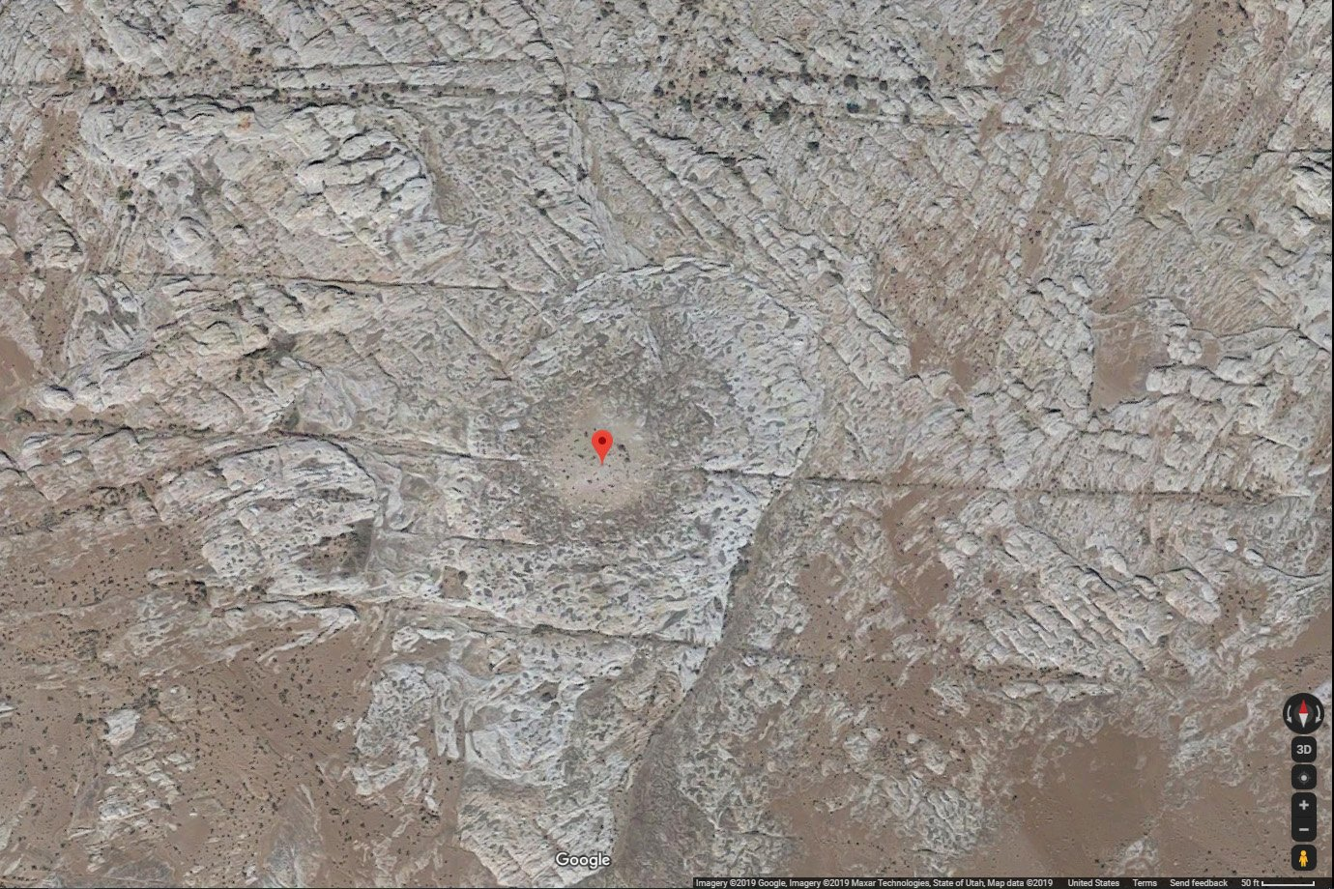

Slide 35
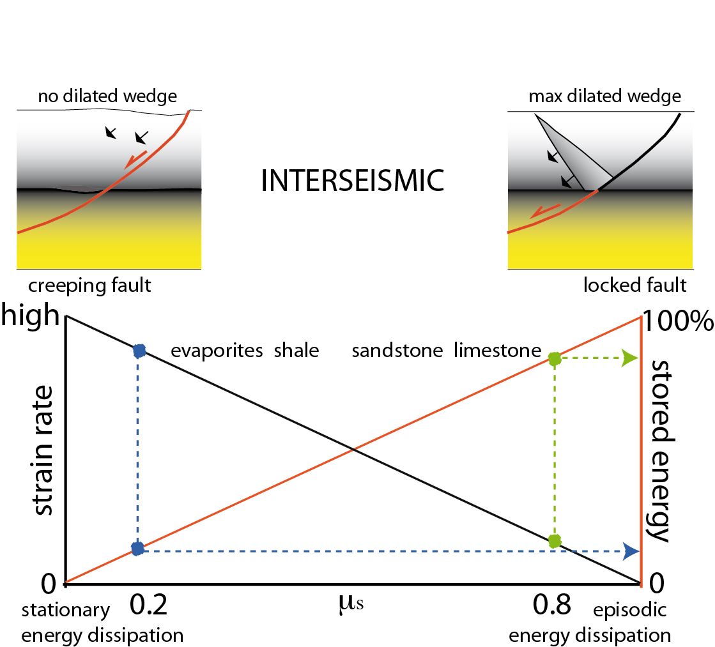

Slide 36
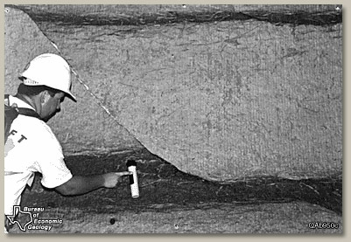

Slide 37
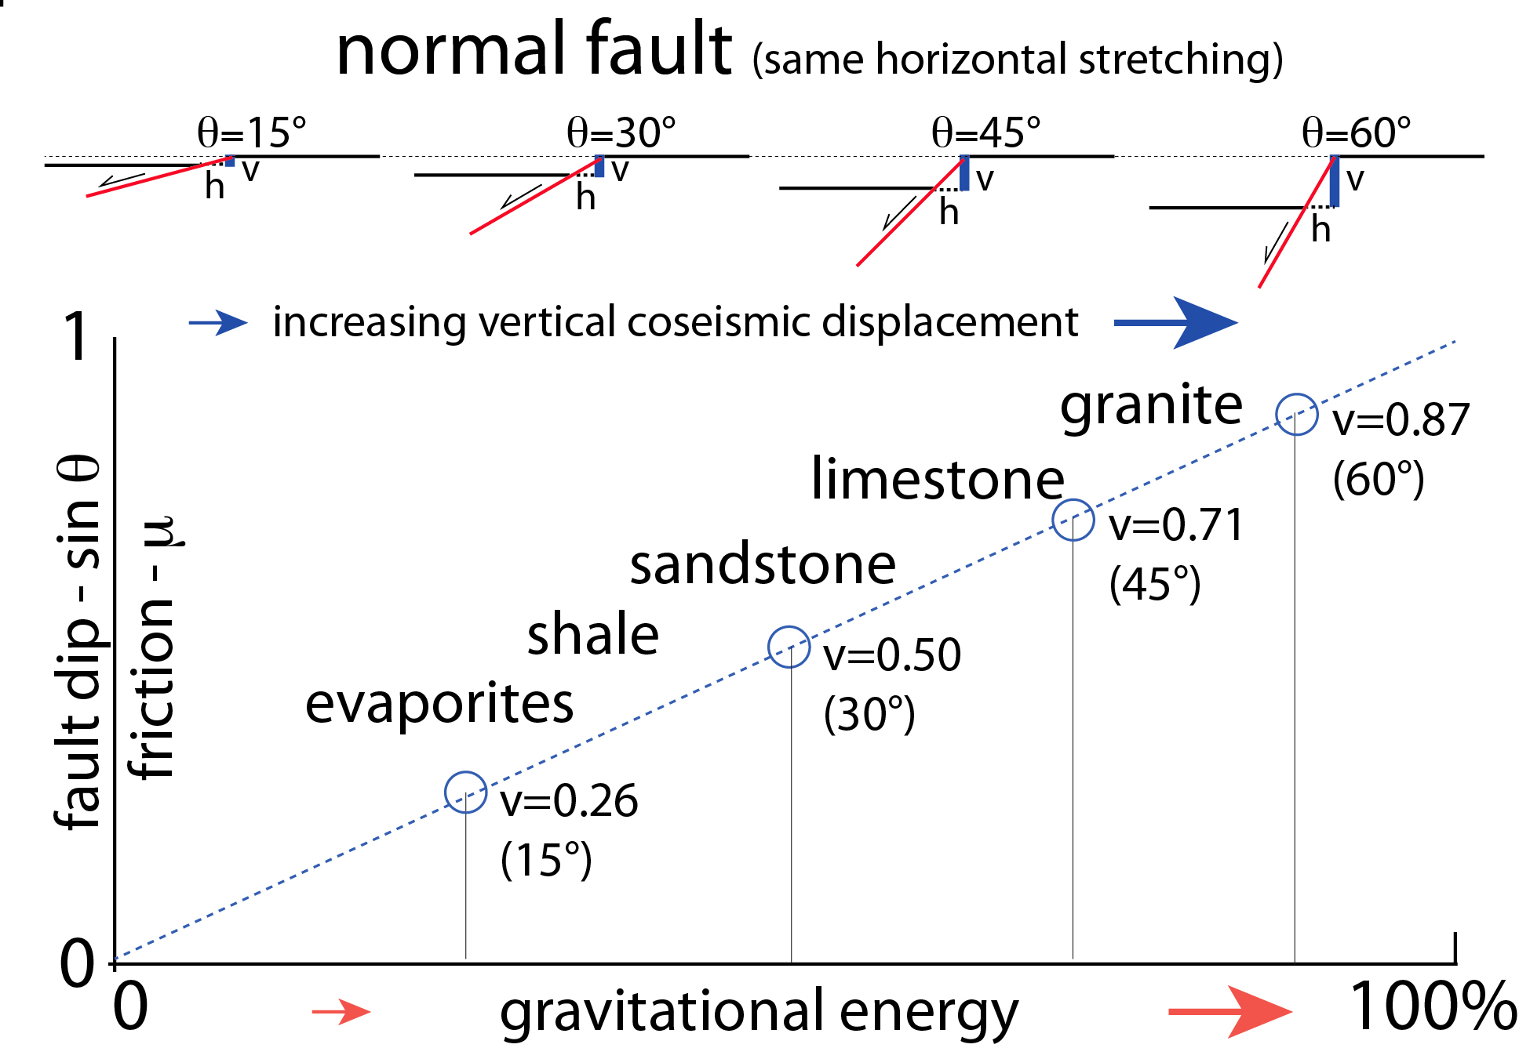
Doglioni et al. 2015 Scientific Reports

Slide 38
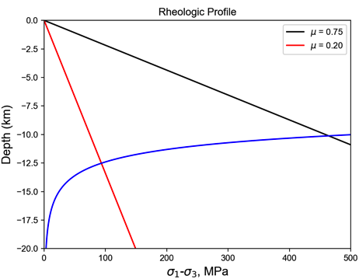
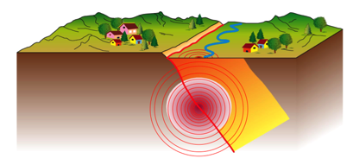
Strong vs. weak faults
Rheologic Profile
strong
weak
75 MPa
450 MPa

Slide 39
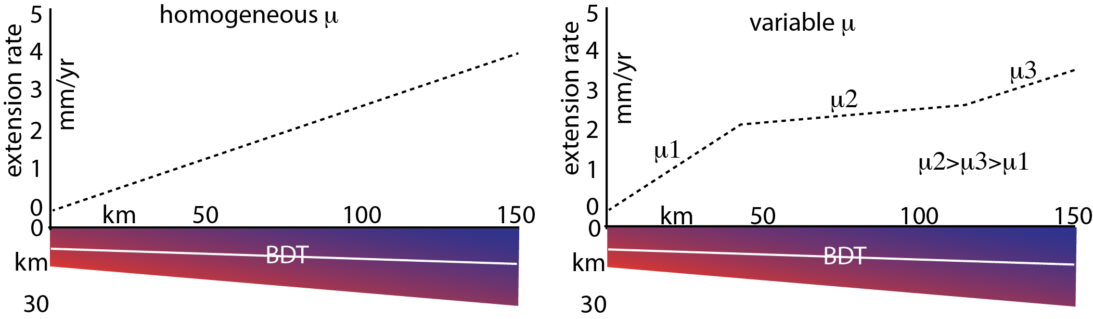
μ--
μ+
μ-

Slide 41
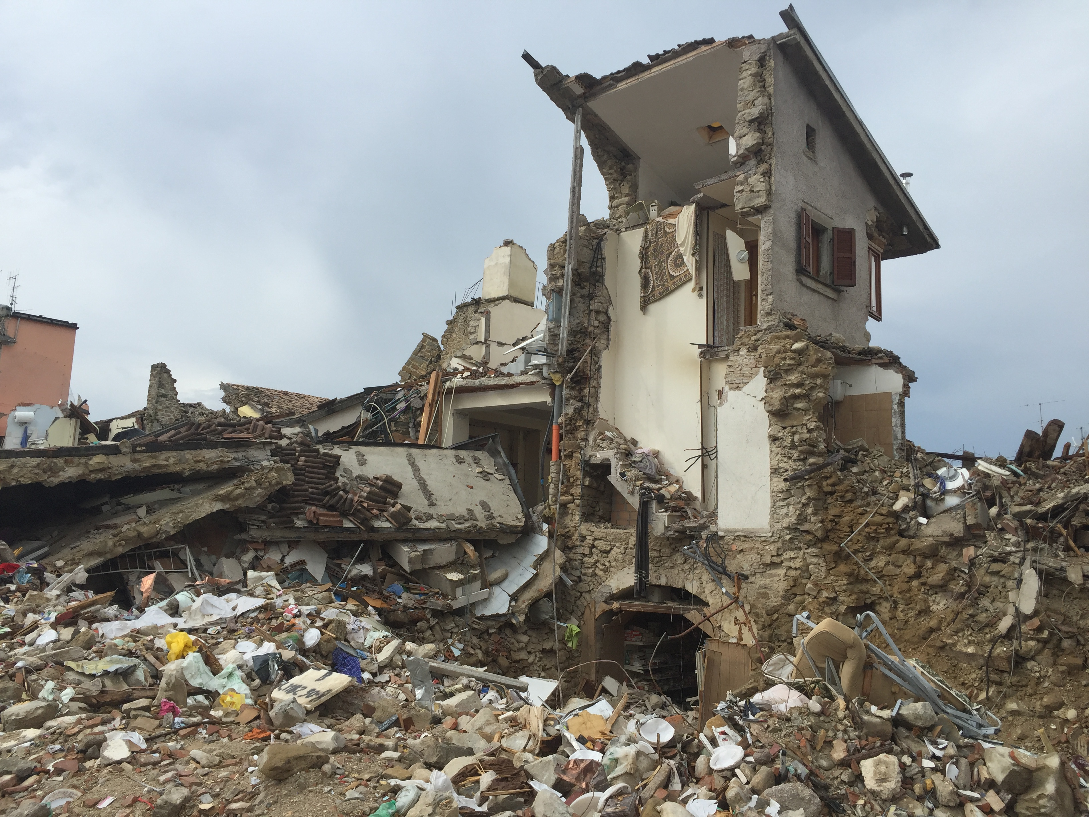
Amatrice 24 agosto 2016

Slide 42
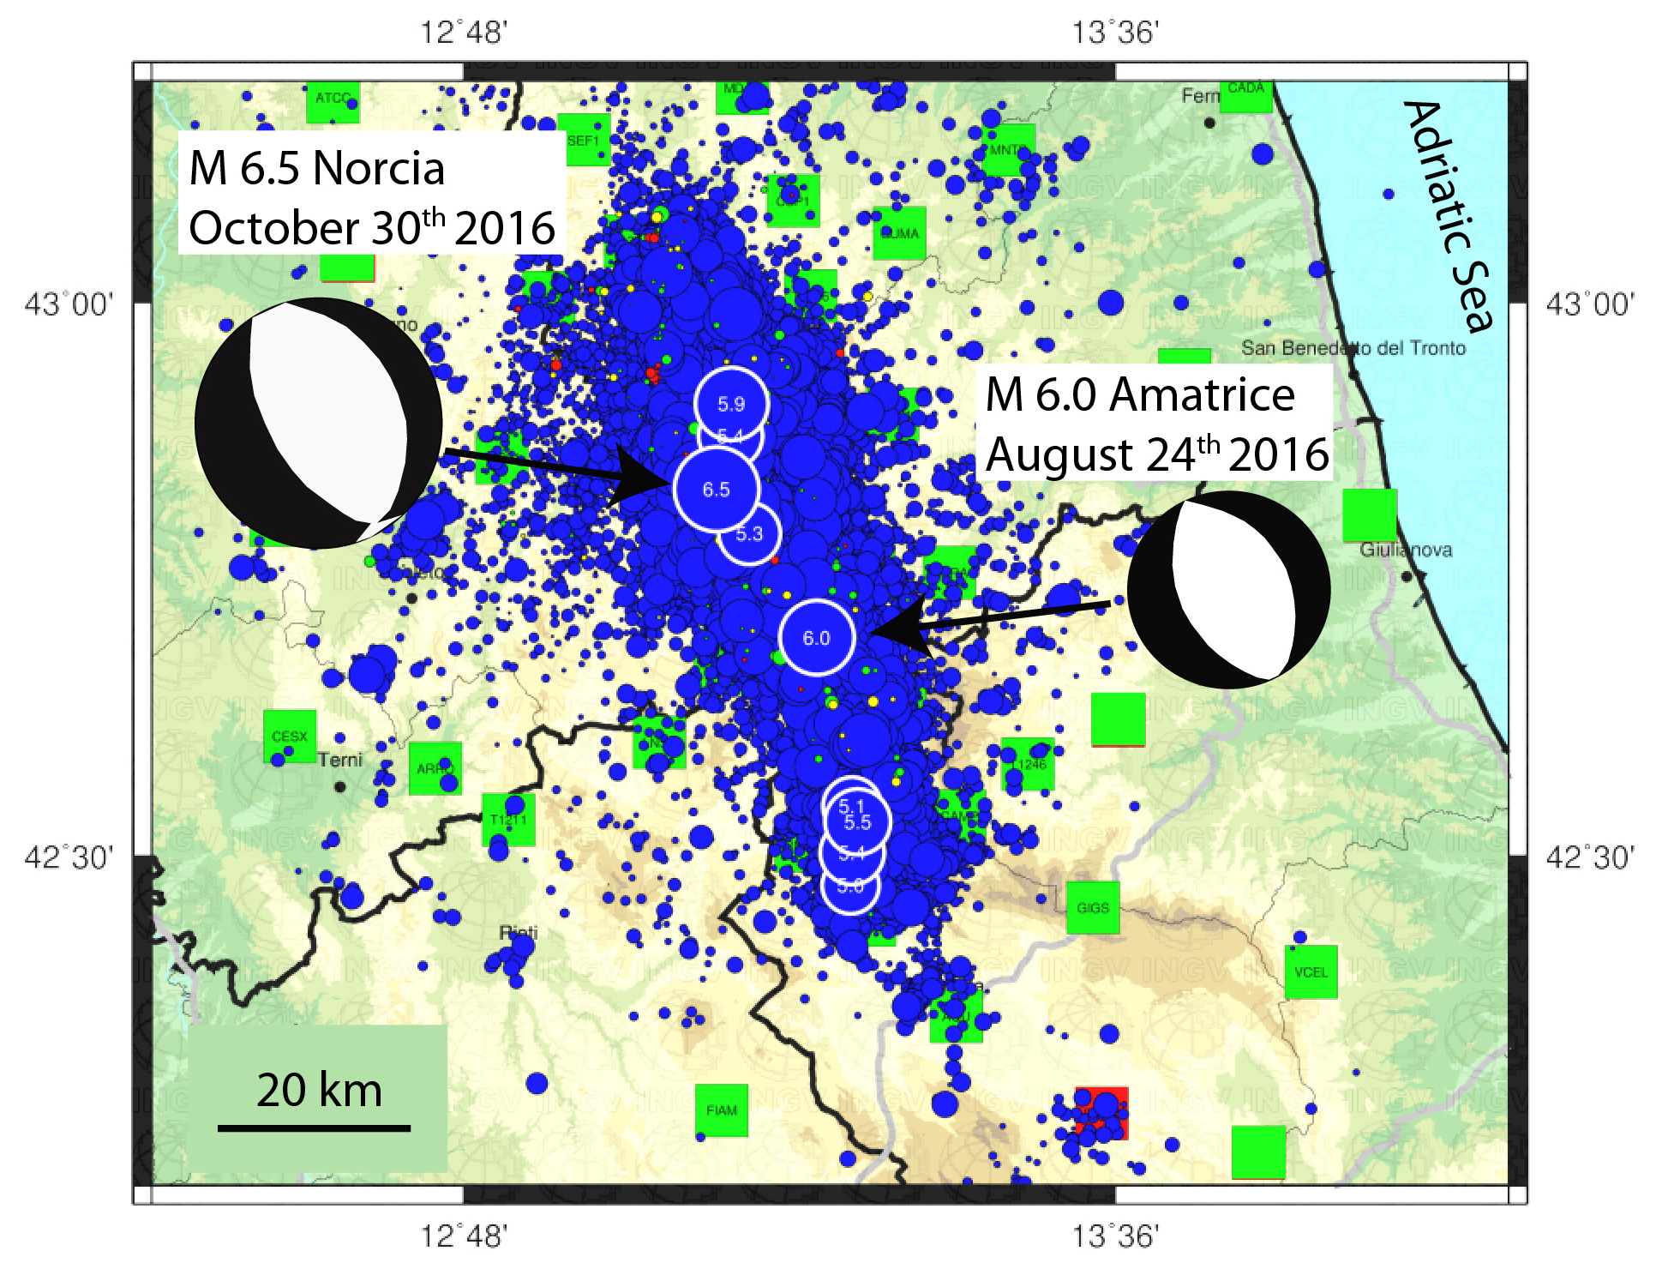
INGV
Area epicentrale della sequenza sismica iniziata il 24/8/2016 –
Dati catalogo sismico INGV

Slide 43
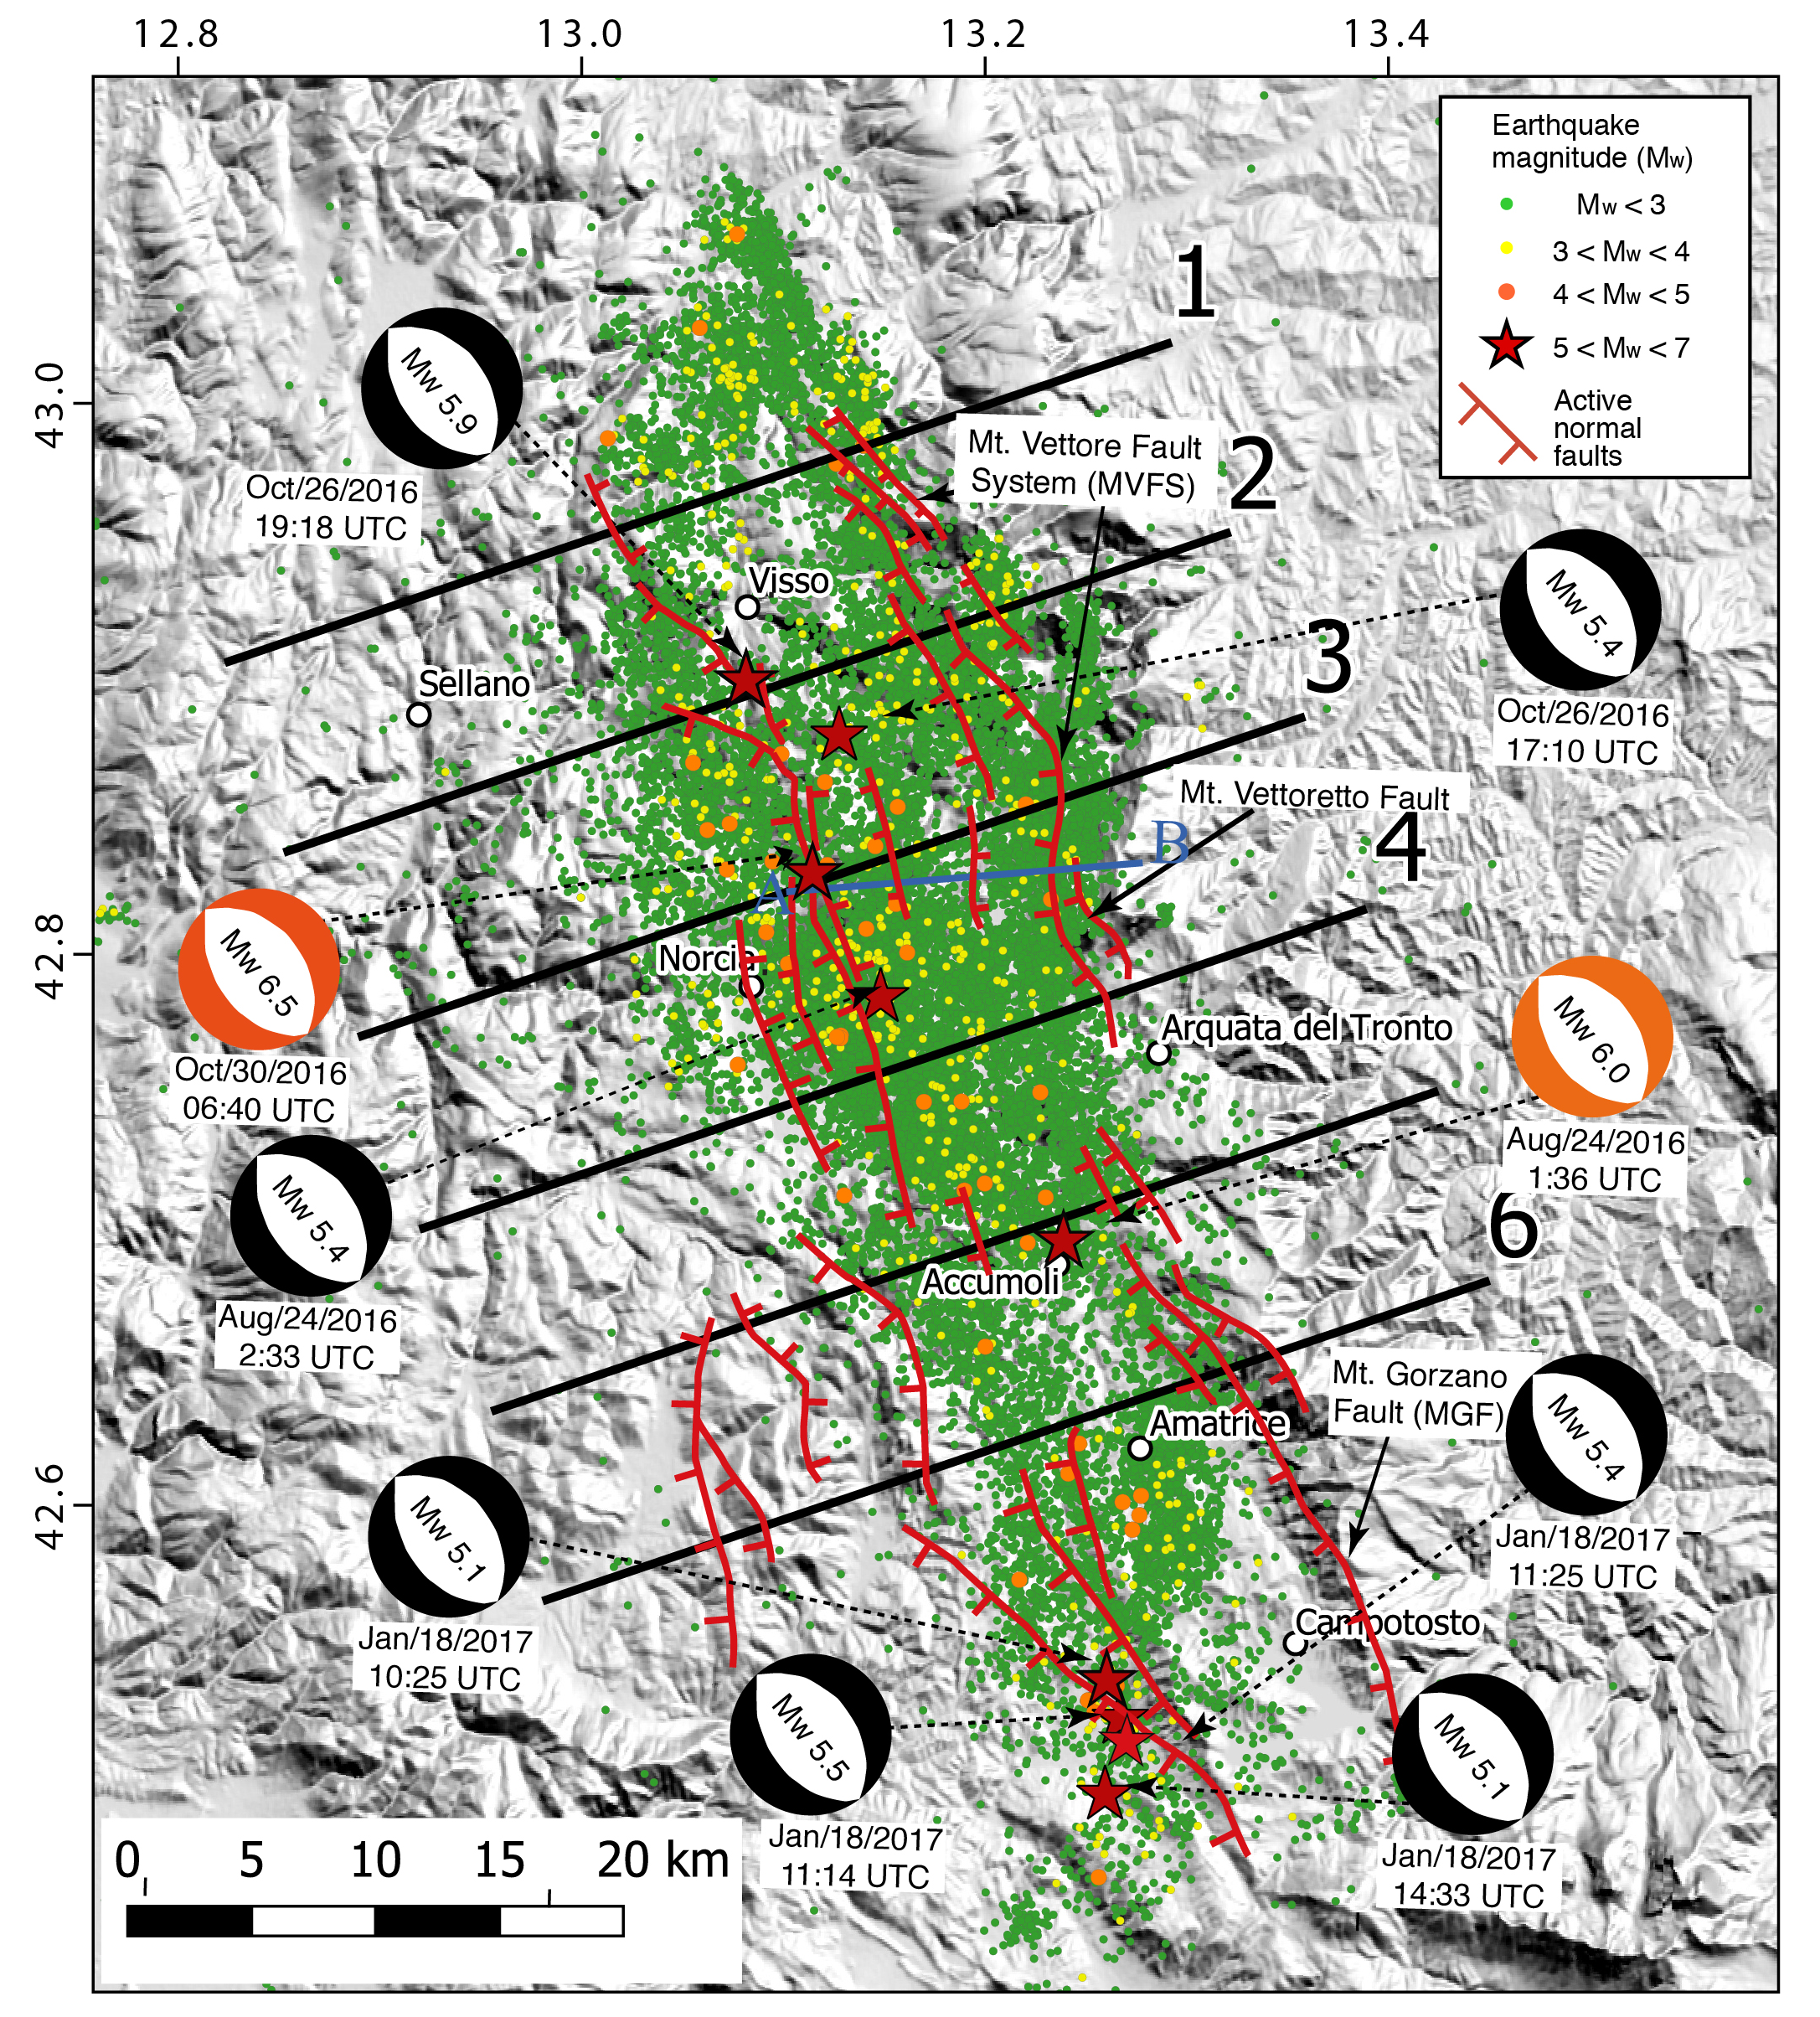

Slide 44
Bignami et al. 2019

Slide 45
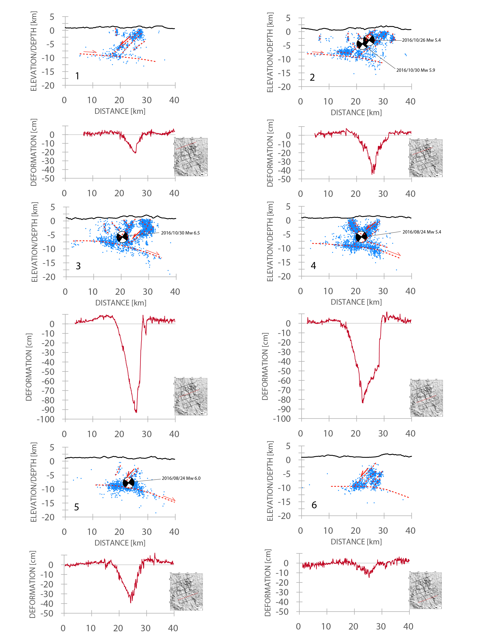

Slide 46
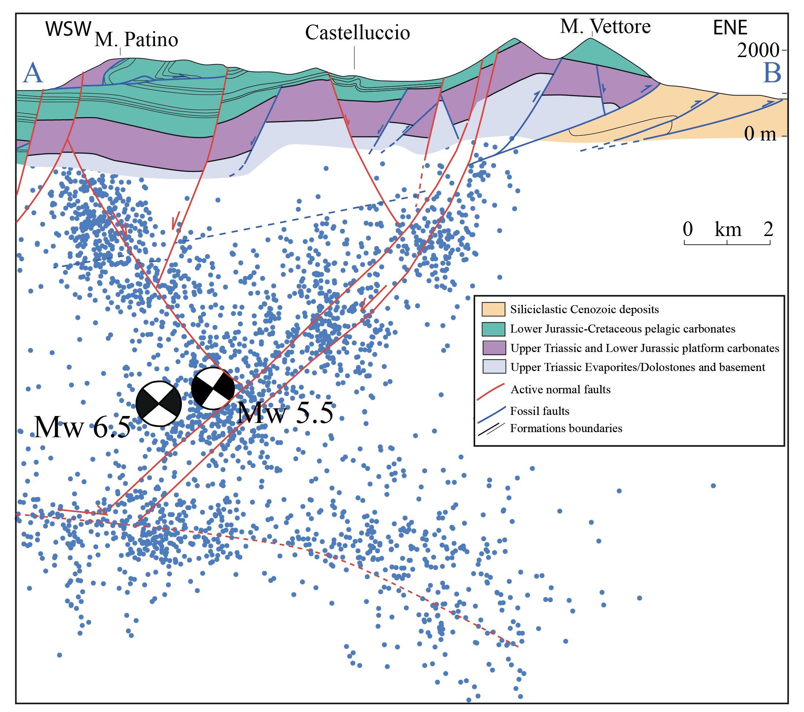

Slide 47
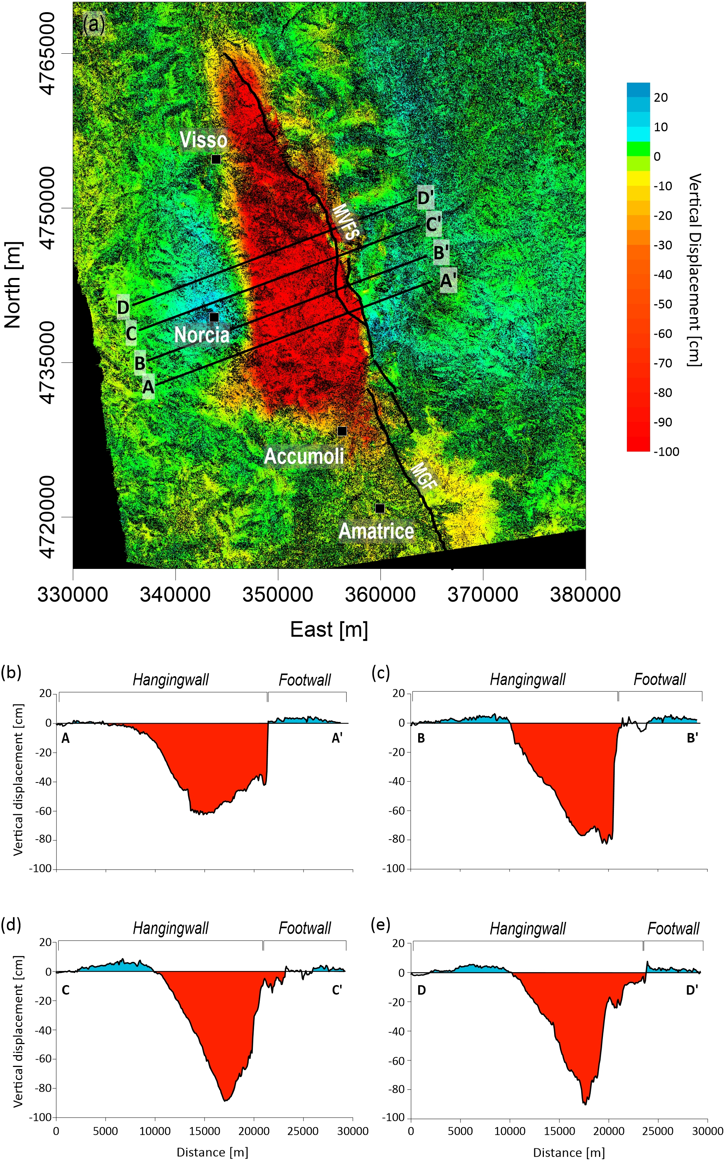
Valerio et al., 2018

Slide 48
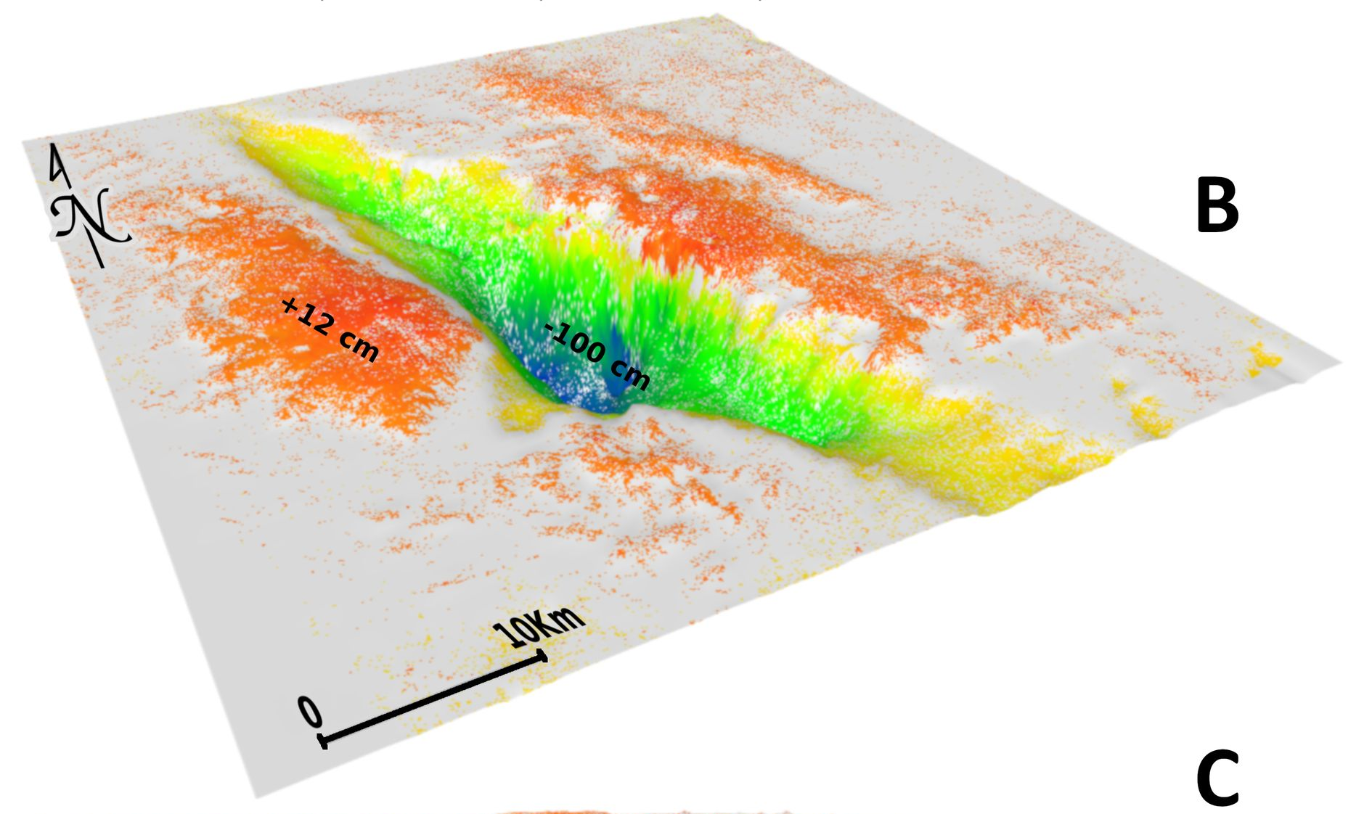

Bignami et al. 2019 Scientific Reports

Slide 49

Bignami et al. 2019 Scientific Reports

Slide 50

Bignami et al. 2019 Scientific Reports

Slide 51
Stramondo et al. 2011

Slide 52

Greece - Tyrnavos Eq 2021 Mw 6.3 – 6.1
coseismic subsidence
61.7 milioni di m-cubi in basso
5.17 milioni di m-cubi in up
Bignami et al in prep

Slide 53

2016-2017
6000 km³
26/10/16
Mw 5.9
Vertical displacement m
30/10/16
Mw 6.5
24/8/16
Mw 6.0
18/1/17
Mw 5.5

Slide 54
Petricca et al. 2021 ESR

