Slide 1
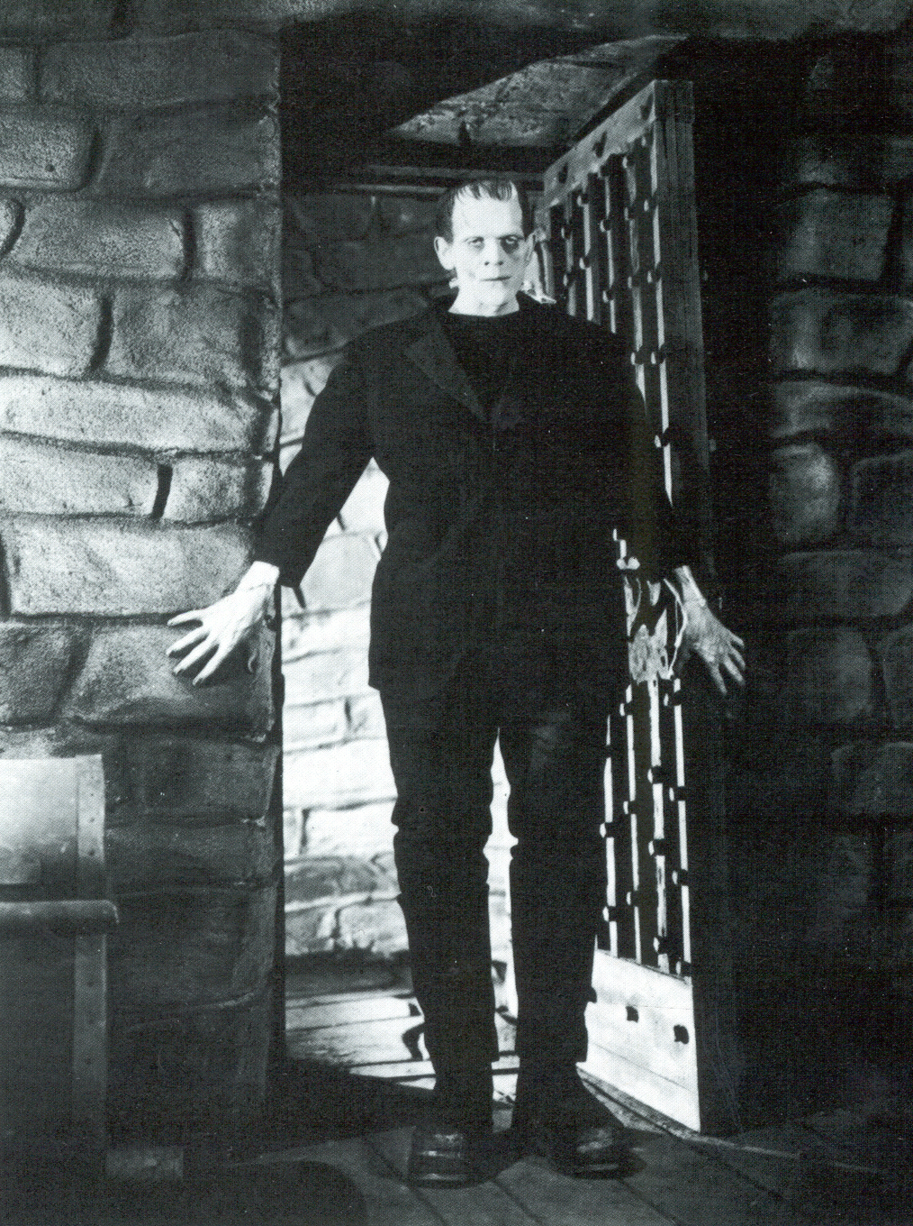
Integrated Interpretations
Integration of all data does not always result in the most likely interpretation on the first try...

Slide 2
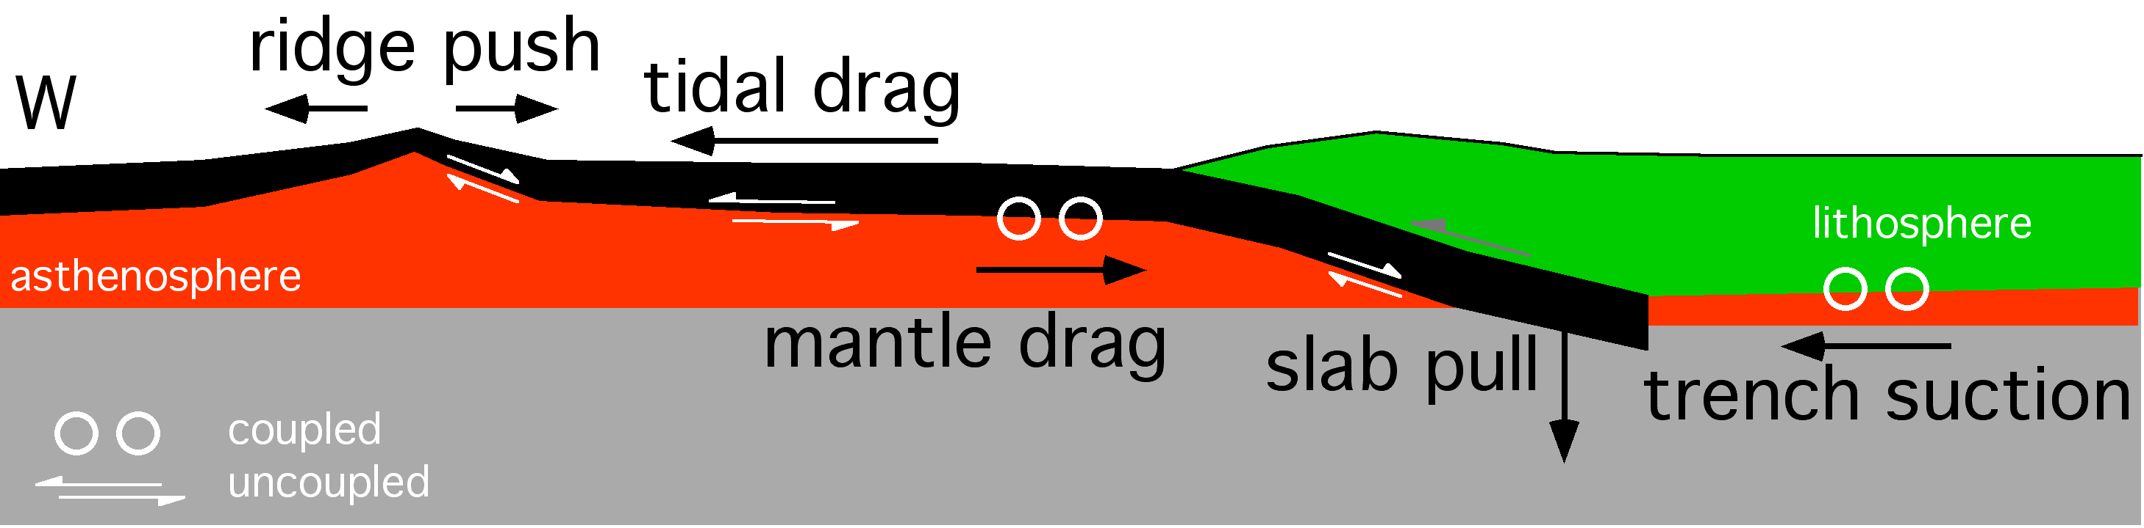
Forces acting on the lithosphere

Slide 3
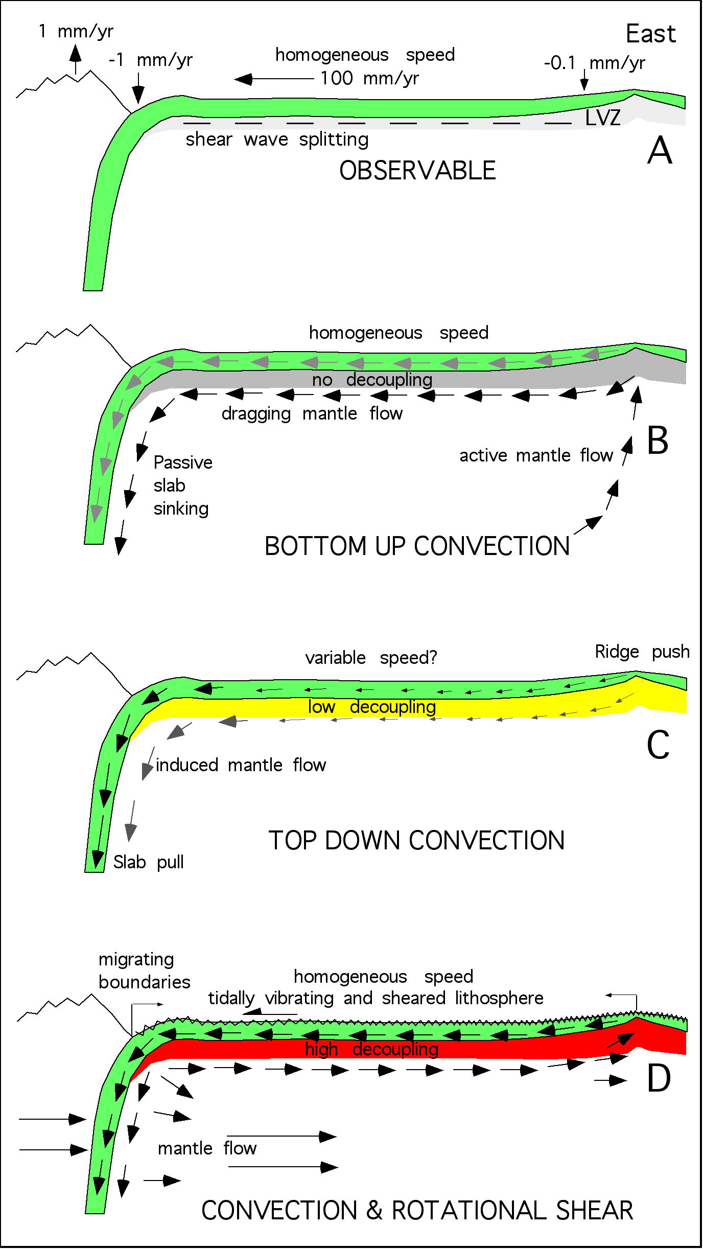


Slide 4


Slide 5
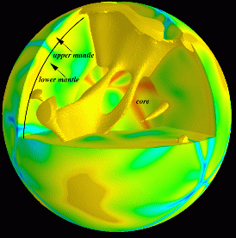
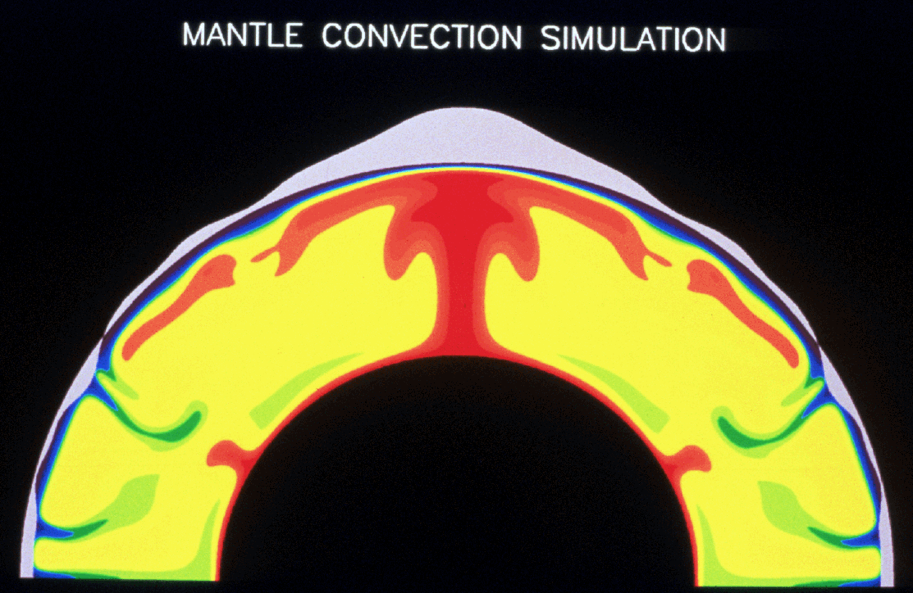
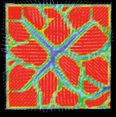
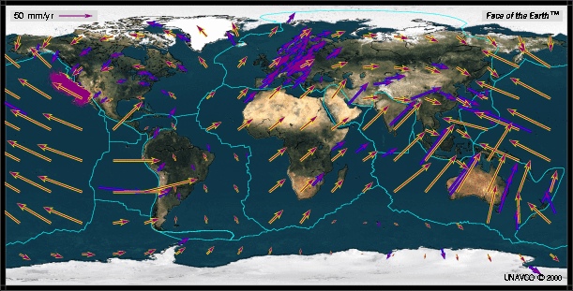
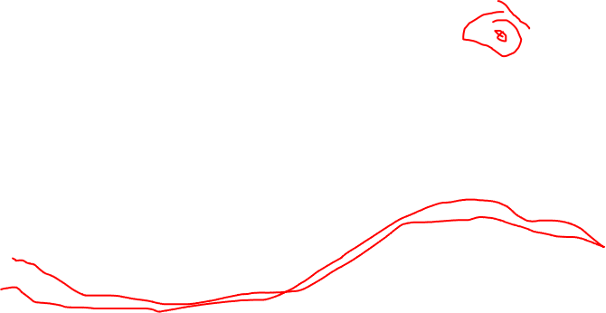

Slide 6
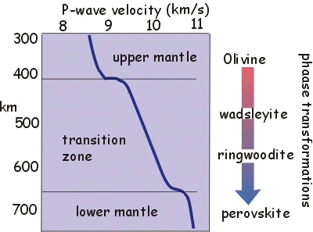
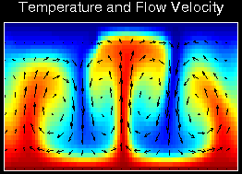
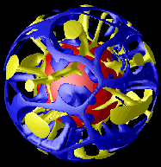
Tackley et al., 2003

Slide 7
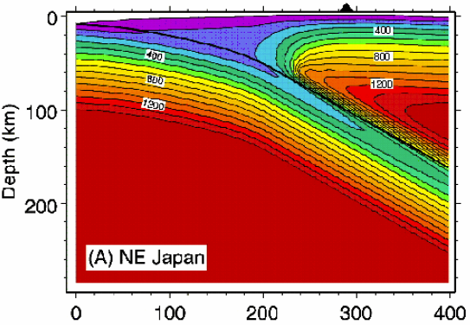
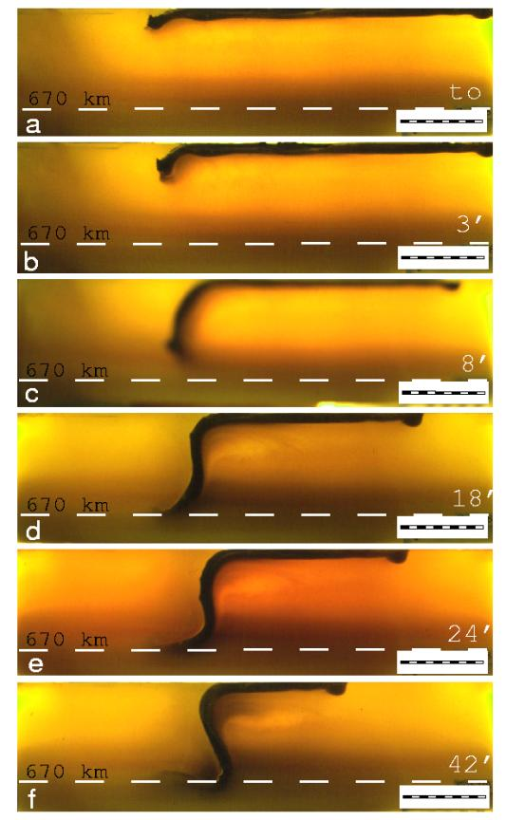
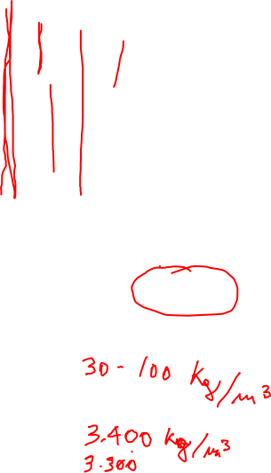
Slab pull = 10¹³ N m⁻¹

Slide 8
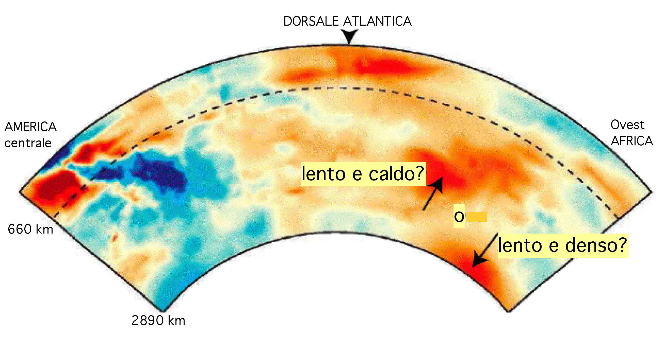
Van der Hilst, 2004

Slide 9
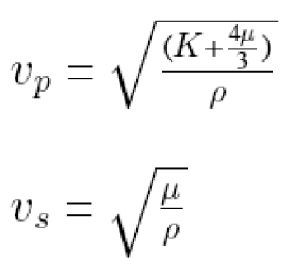


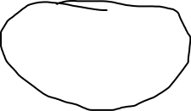
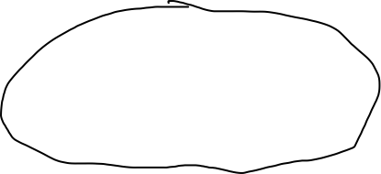
SEISMIC WAVES

Slide 10
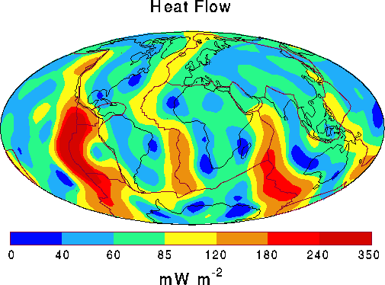
Pollack, 1996

Slide 11
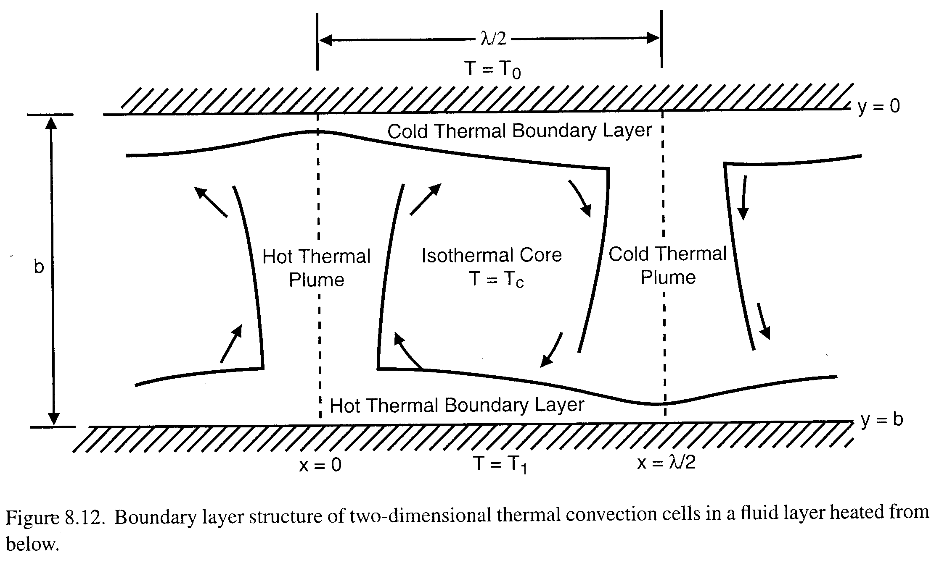
Un fluido scaldato dal basso e raffreddato dall’alto può trasferire
il calore attraverso il suo spessore tramite conduzione o convezione
T₀
h
T₁
Il numero senza dimensione di Rayleigh
misura la convettibilità del sistema
Un livello di spessore h, con temperature constanti T₀ e T₁ al tetto e alla base del
livello, ha un numero di Rayleigh (Ra) dato da:
ρ²gc_{p}α(T₁- T₀)h³
Ra =
μκ
ρ densità
g gravità
c_{p} calore specifico
α espansione termica 
μ viscosità
κ diffusività termica
pro-convezione
anti-convezione
Ra stimato per il mantello ~ 9 ·10⁶

Slide 12

SLAB PULL
lithosphere ρl
z
mantle ρm
d

Slide 13
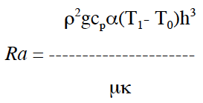
Rayleigh number Ra
CONVECTION
Ra =

Slide 14
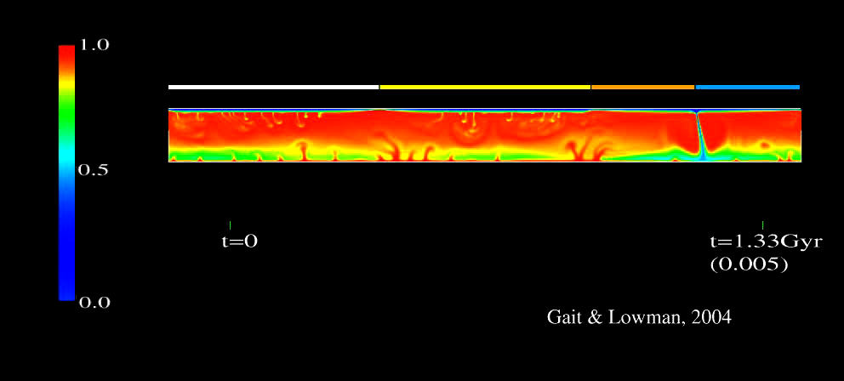

Slide 15
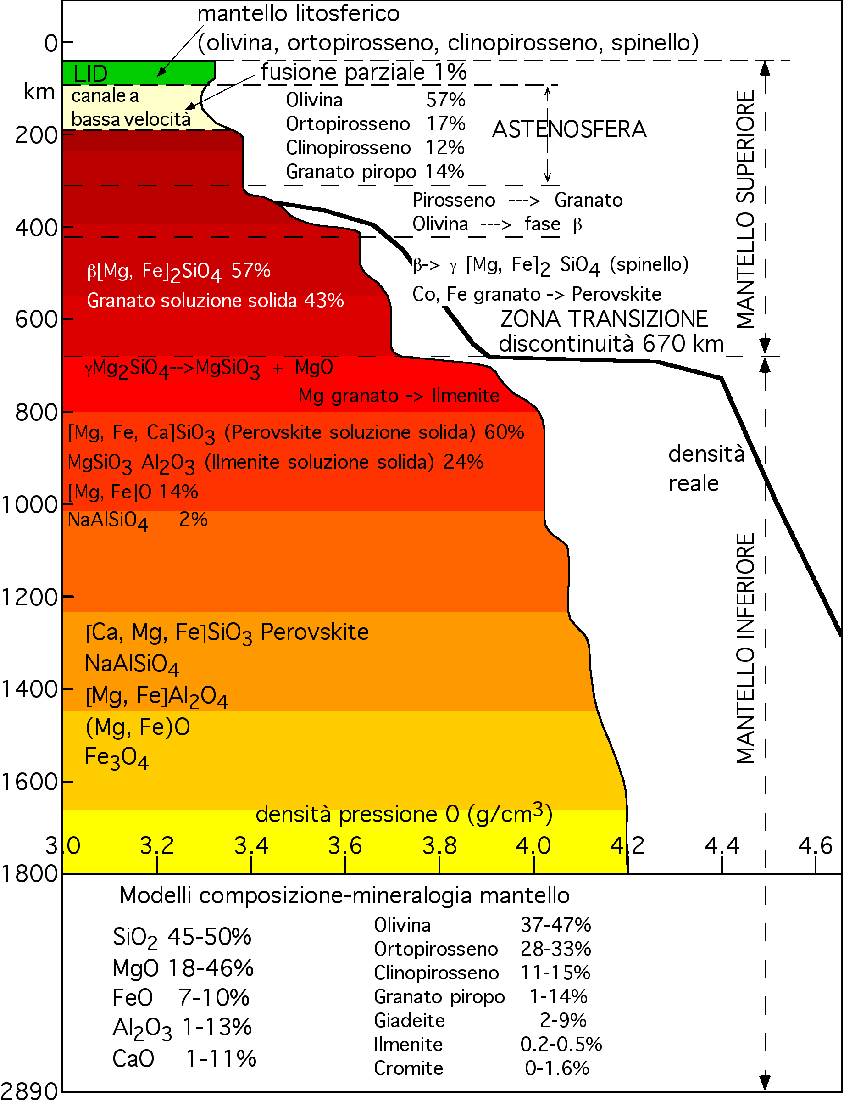
Quanto Fe
e come è
distribuito
nel mantello ?
Fe 15% della massa
Terrestre!

Slide 16
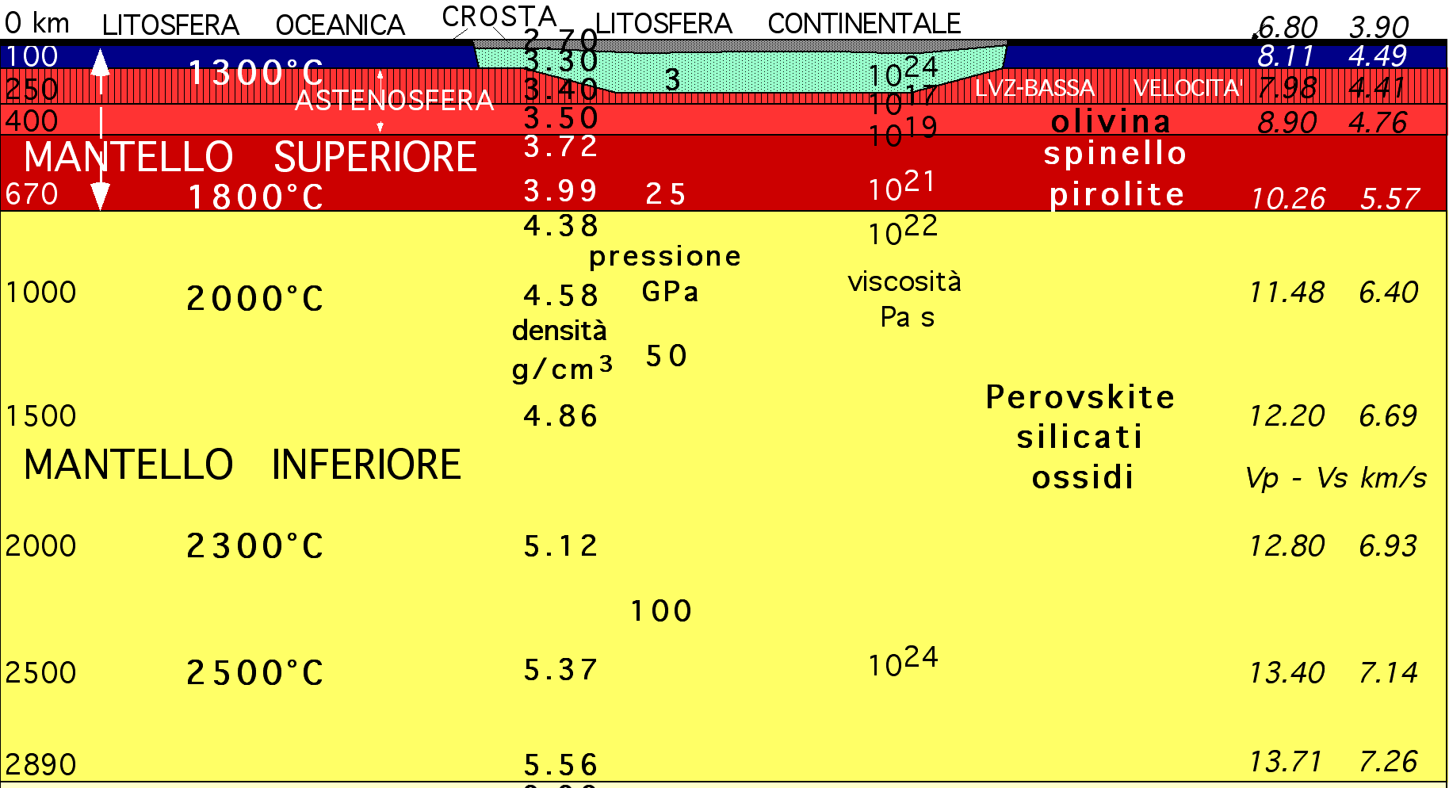
densità e viscosità aumentano colla profondità
Ra più piccolo e difficile da calcolare

Slide 17
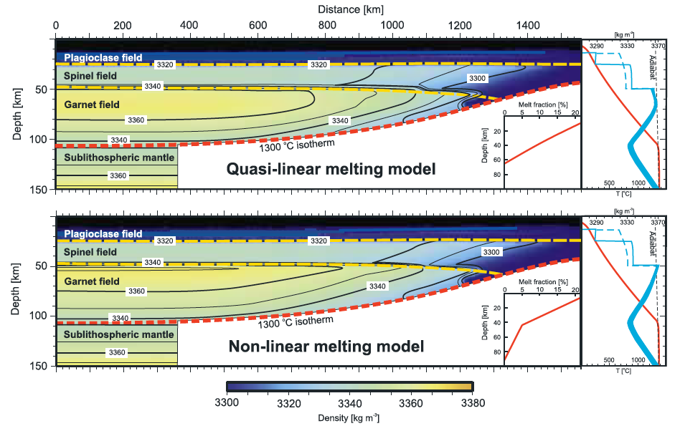
Afonso et al. 2007 GRL

Slide 18
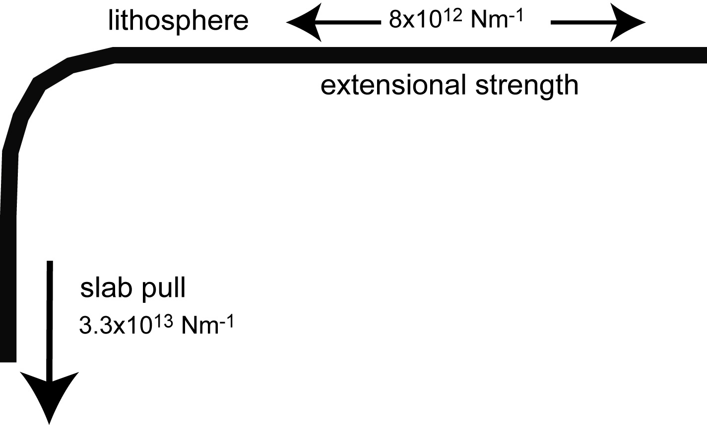
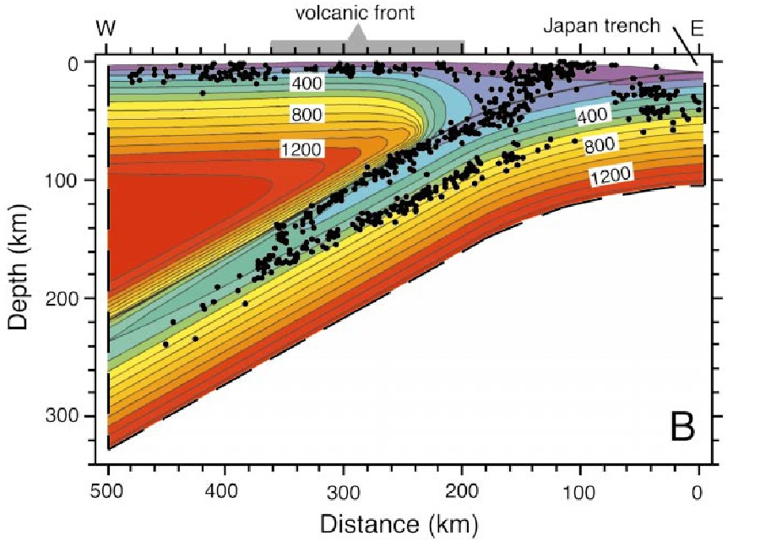

Slide 19
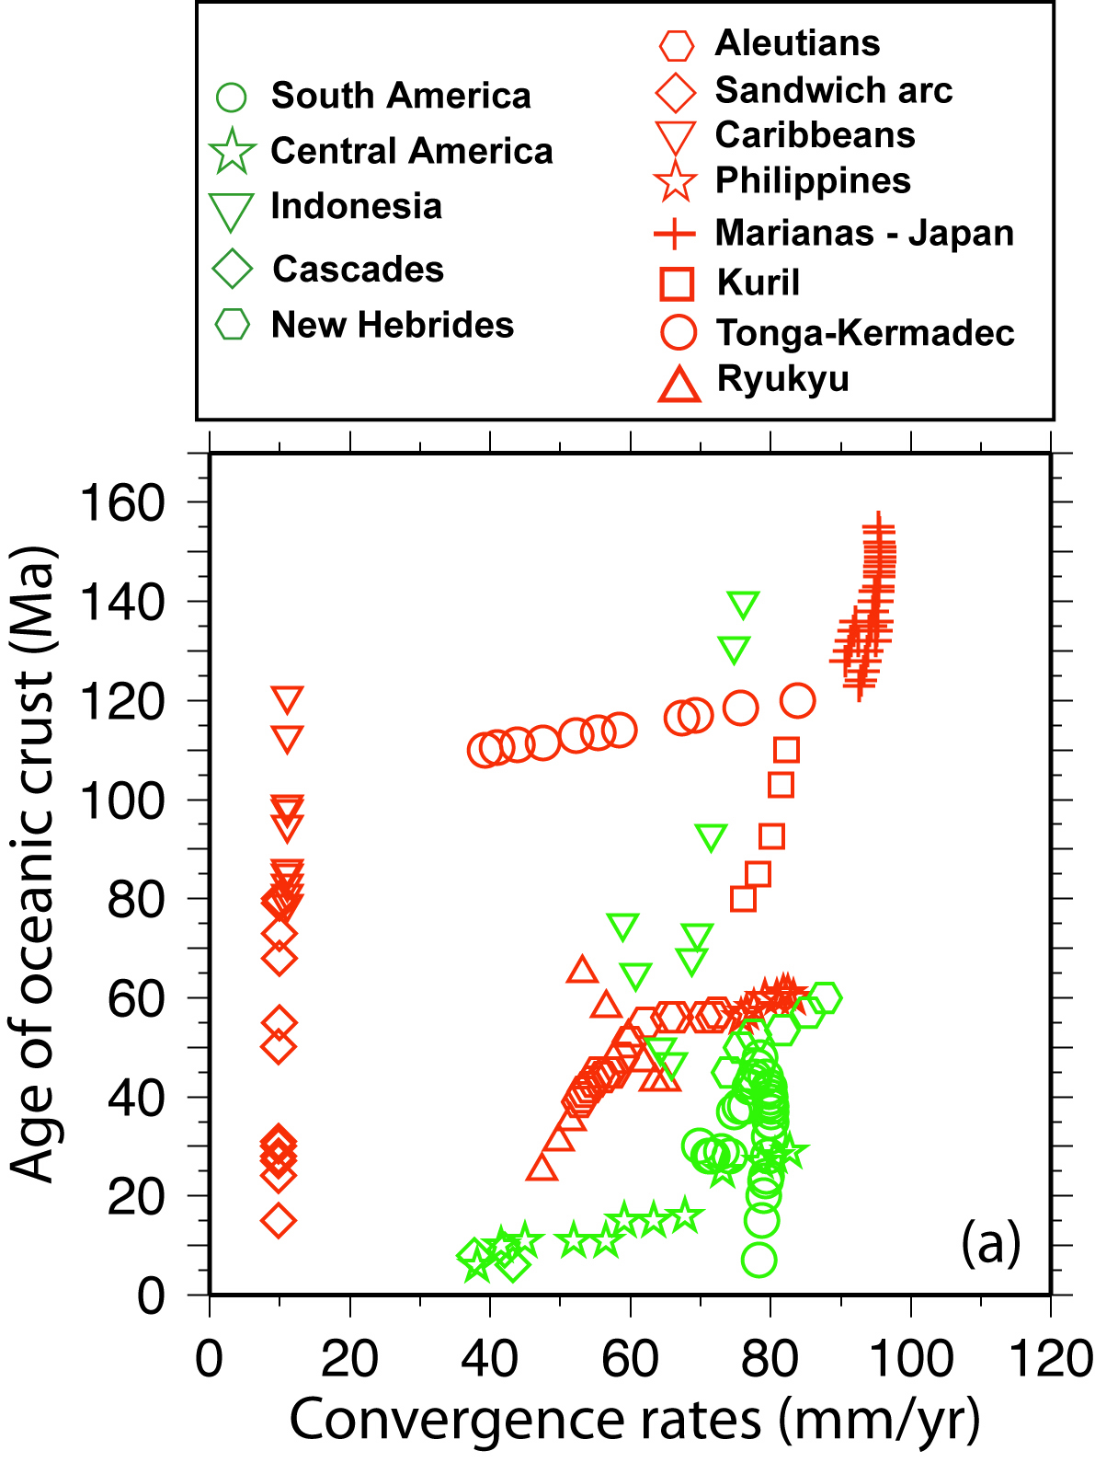

Slide 20
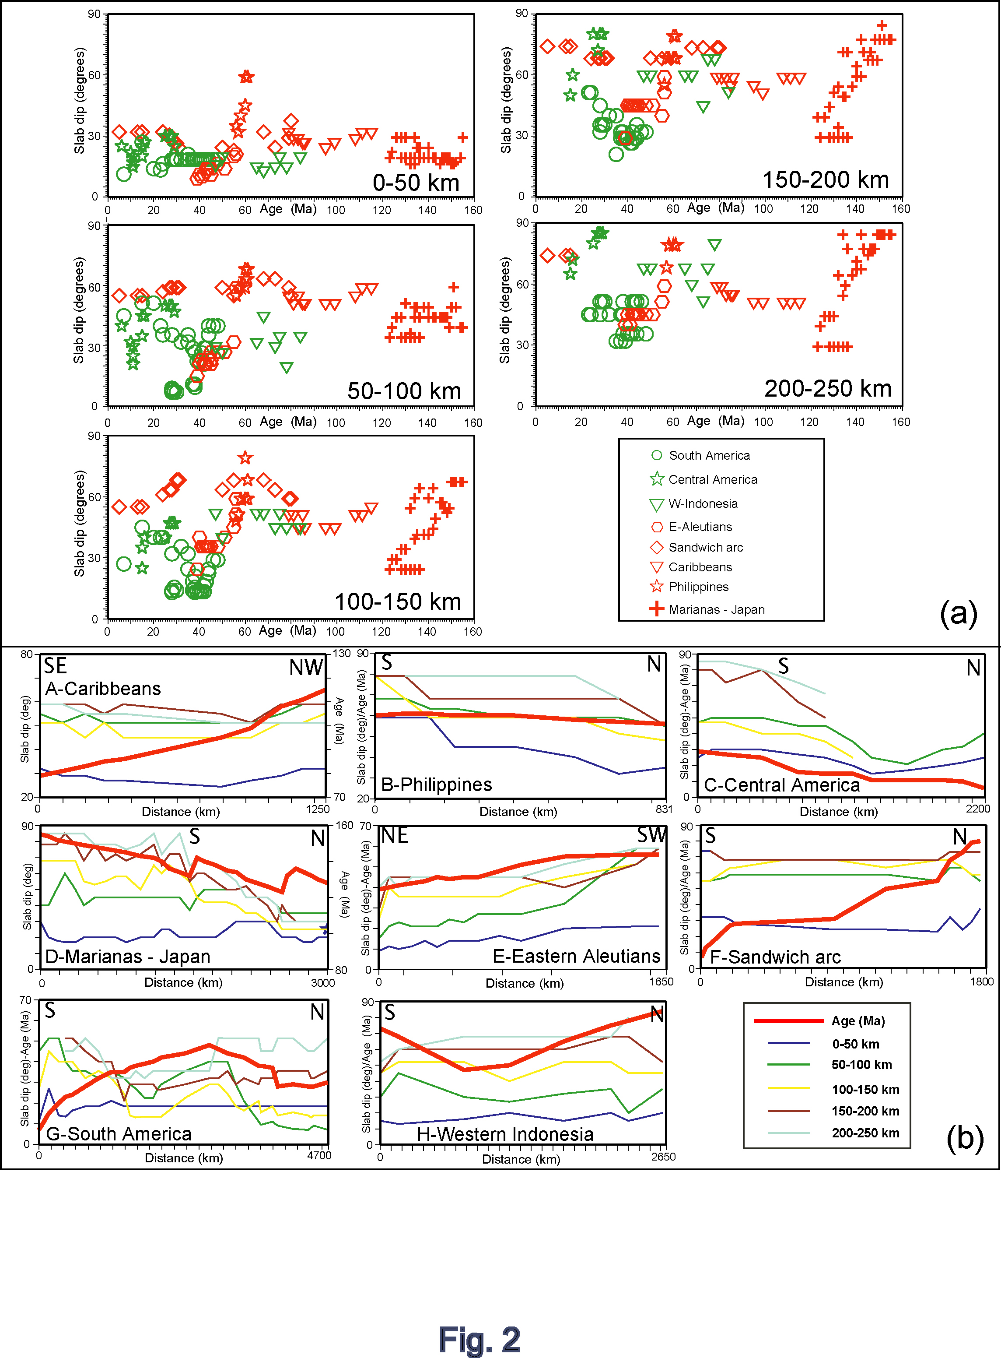
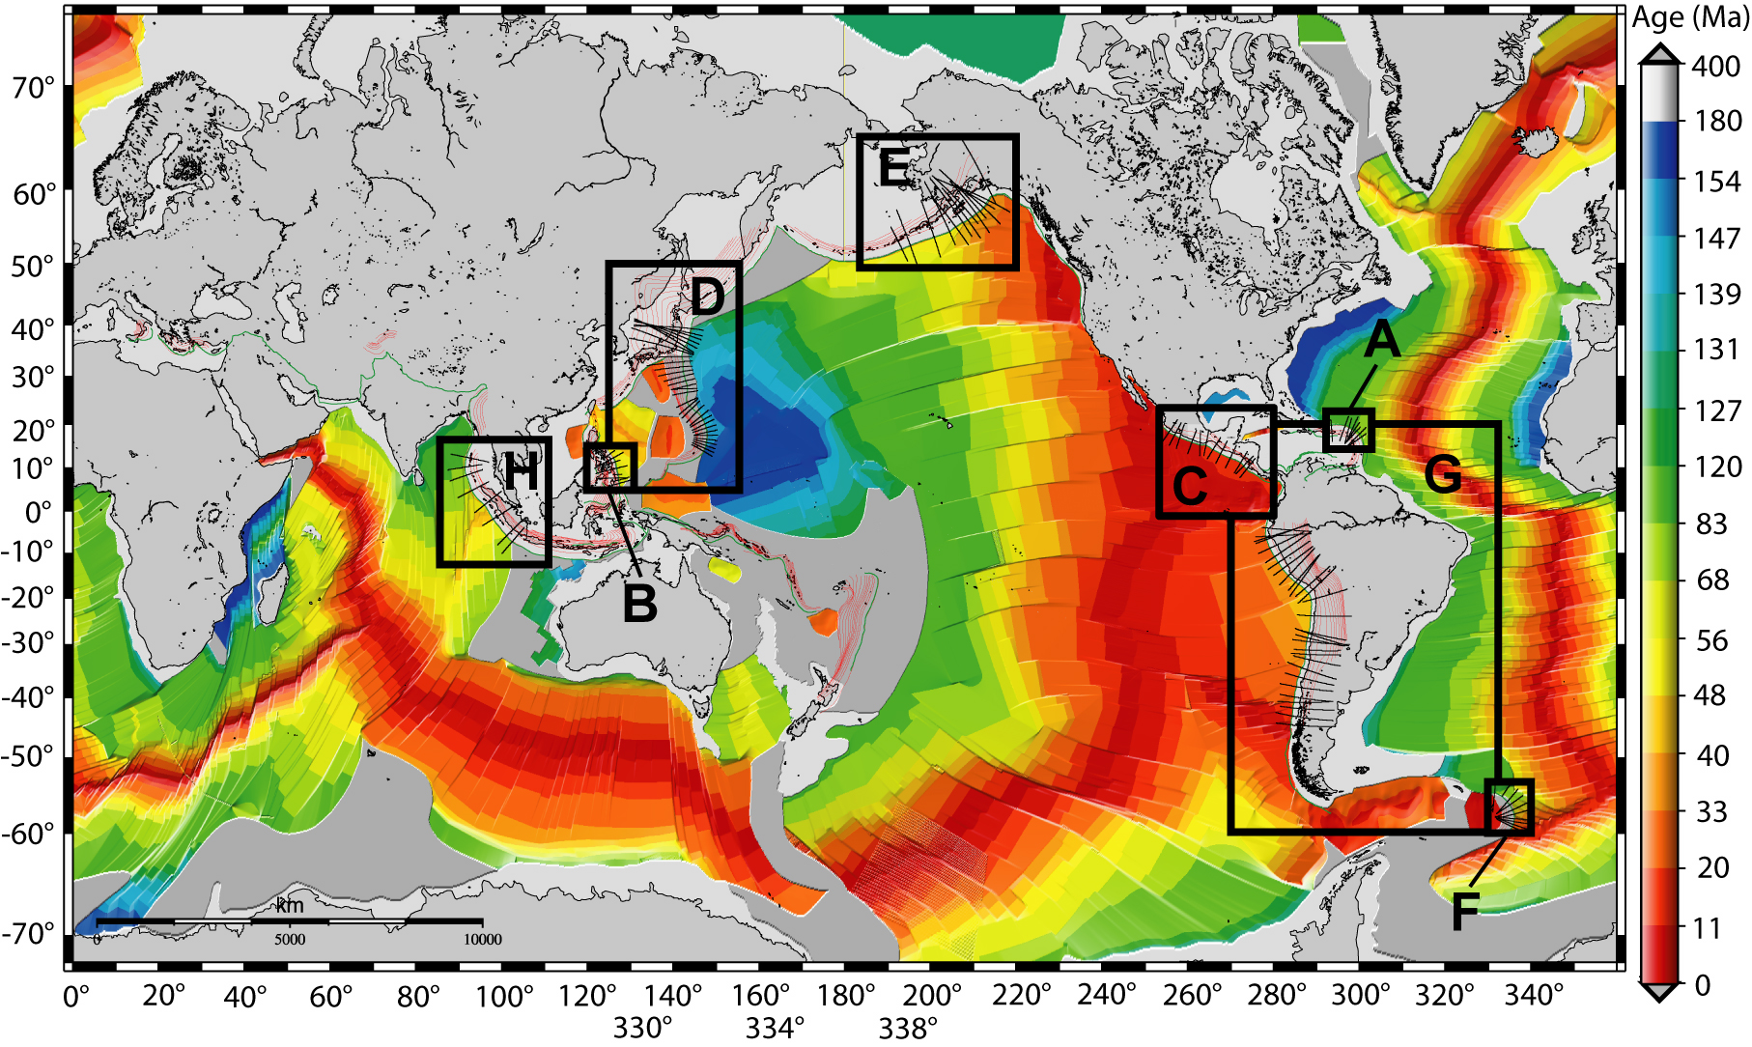
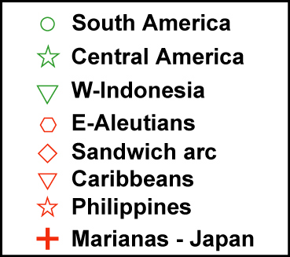
Slab dip Vs. Lithosphere age
Same dip for variable ages = no correlation

Slide 21
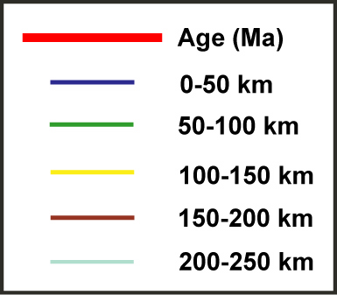
- Age increases but dip remains constant (1)
- Dip decreases but age remains constant (2)
- Dip decreases and age increases (3)
- Dip increases and age decreases (4)
= No correlation
(1)
(2)
(3)
(4)

Slide 22
Varga et al., 2012

Slide 23
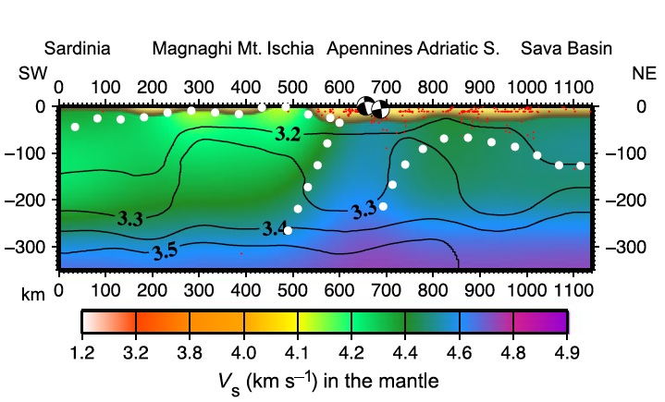
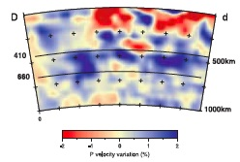
Piromallo & Morelli, 1993
Brandmayr et al., 2011

Slide 24
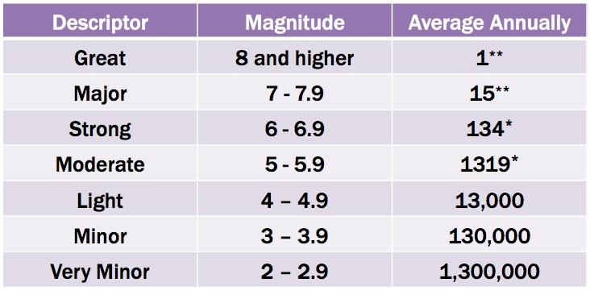
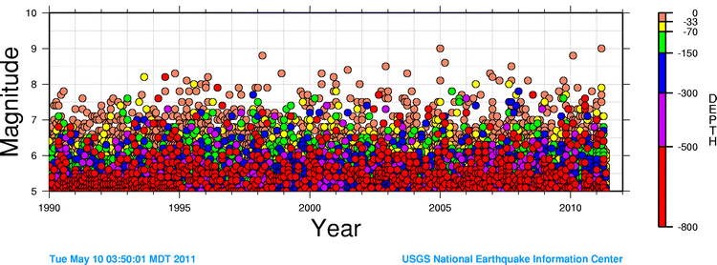

Slide 25
Varga et al., submitted

Slide 26
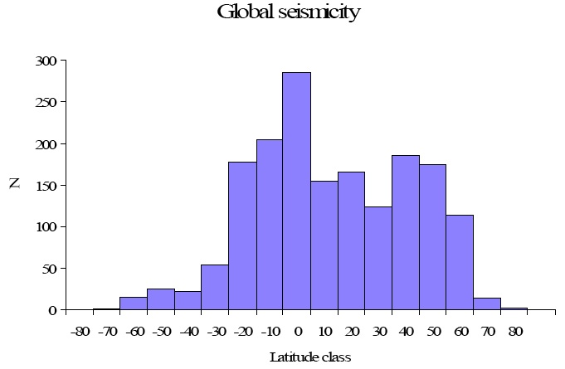
Riguzzi et al., 2010 Tectonophysics

Slide 27
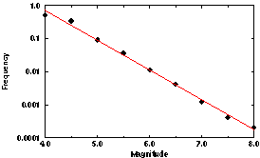
Gutenberg-Richter scale
1.0
0.1
Frequency
0.01
0.001
0.0001
4.0
5.0
6.0
7.0
8.0
Magnitude

Slide 28
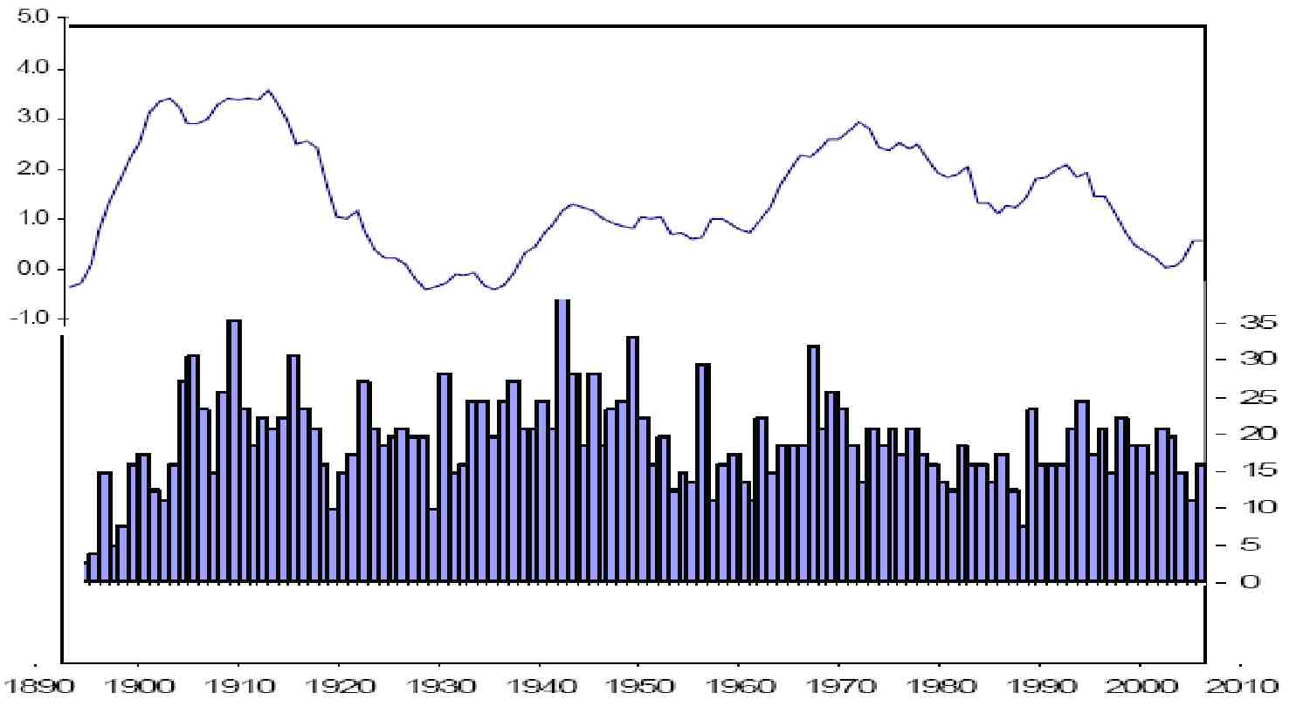
LOD - length of the day in ms
Seismicity M>6.9
Riguzzi et al., 2010 Tectonophysics

Slide 29
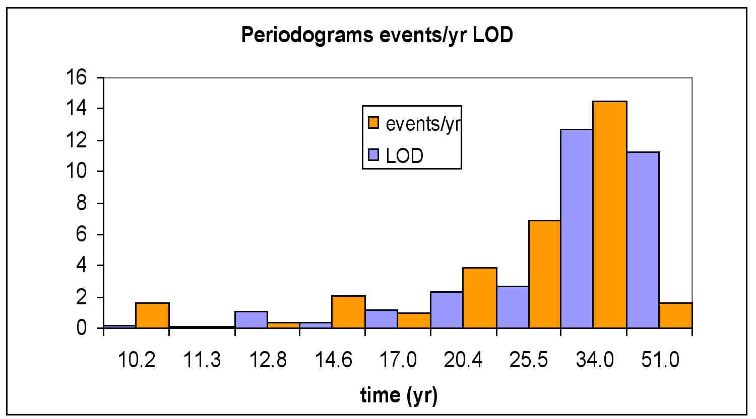

Slide 30
Knopoff, 1970
Earthquakes >7.8
1900-1950
Synodic month
Anomalistic month

Slide 31
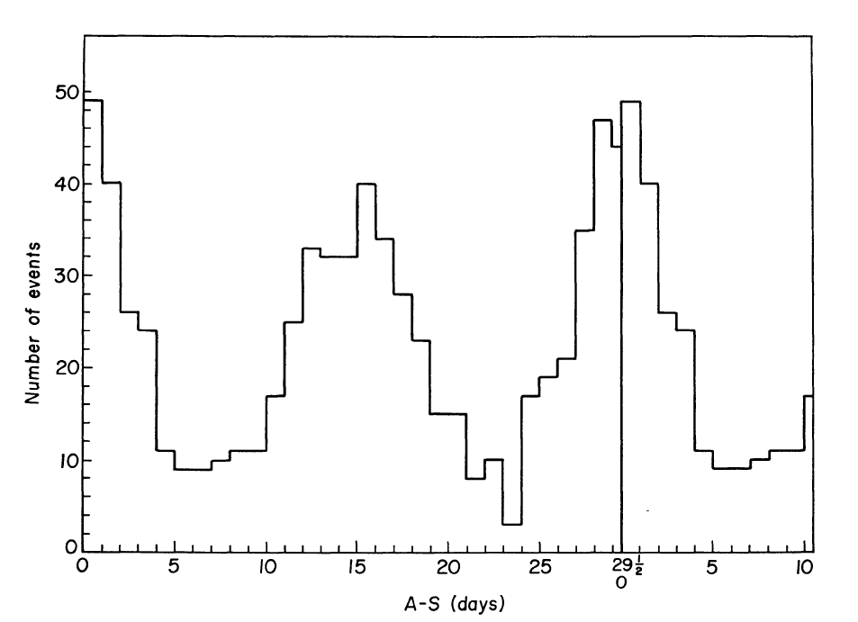
Knopoff, 1970

Slide 32
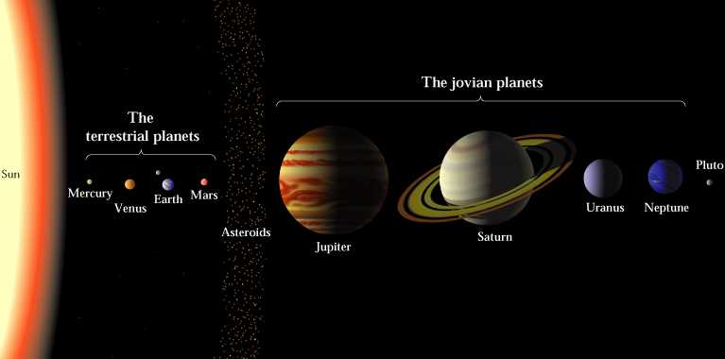

Slide 33
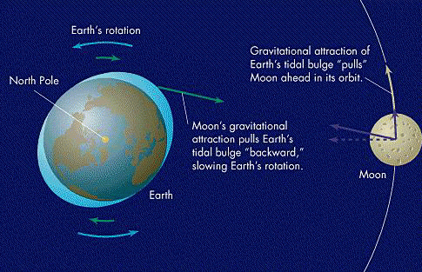
TIDAL FRICTION
  Earth’s rotation is slowing: with dinosaurs the day was of 22h
  Moon receding at 38 mm/year

Slide 34
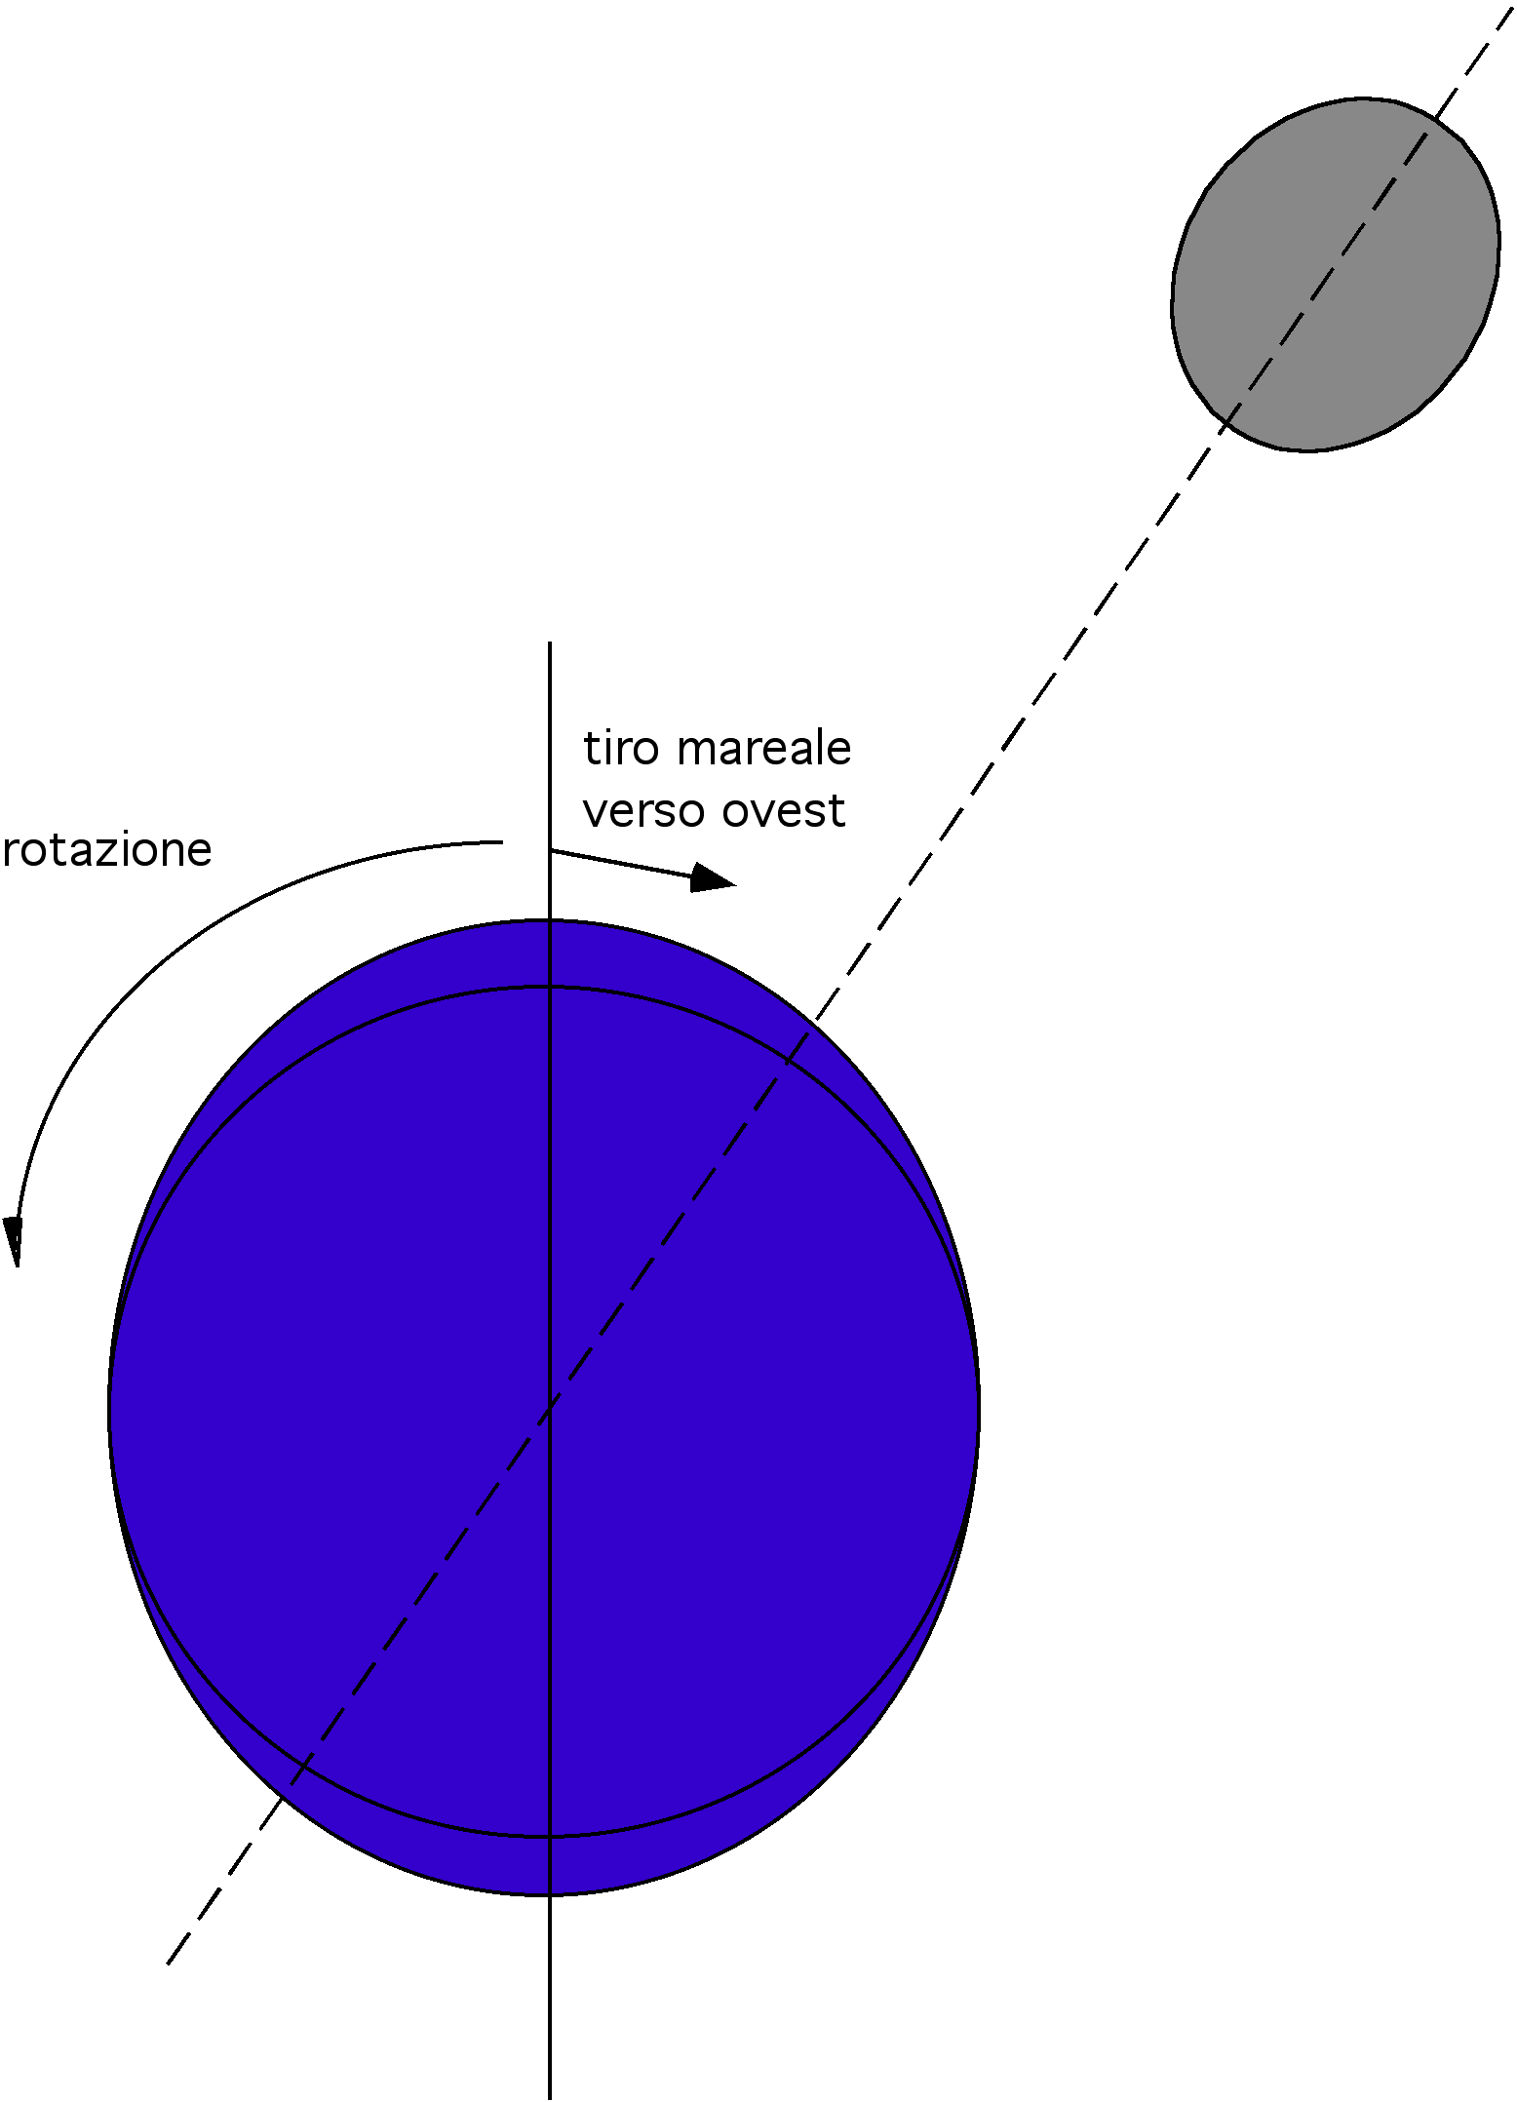
Tectonic moment 10²¹ J/yr
Tidal friction 10²⁰⁻²¹ J/yr
bulge delay
W-ward
tidal drag
rotation

Slide 35
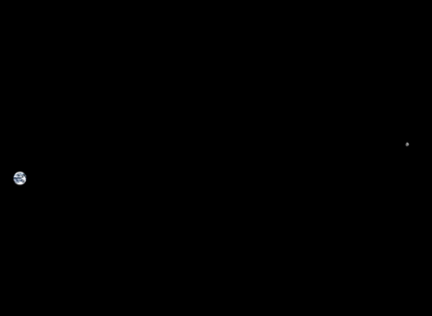
384.000 km

Slide 36
SOLID EARTH TIDE
vertical component
30-40 cm/12h25’:
stress unloading
horizontal component
15-20 cm/12h25’:
stress loading
0.15 mm

Slide 37
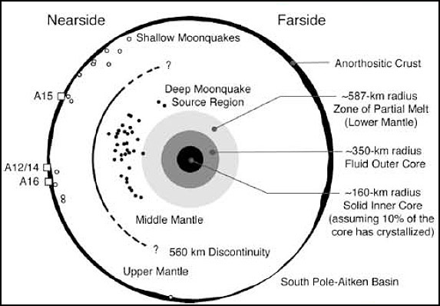

Slide 38
Adinolfi et al. in prep.
Italian seismicity 2008-2012
Andean seismicity M>6 2008-2012
new Moon
perigee

Slide 39
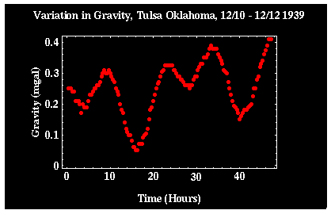

Slide 40
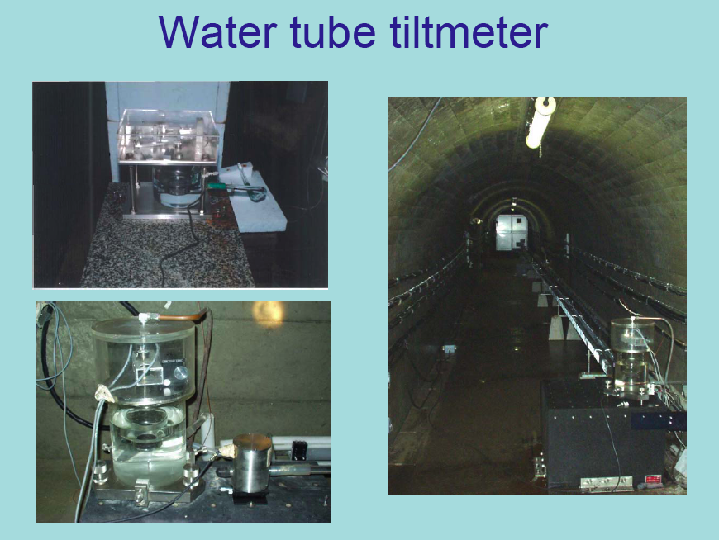
Yoshiaki TAMURA
Mizusawa VERA Observatory Japan

Slide 41
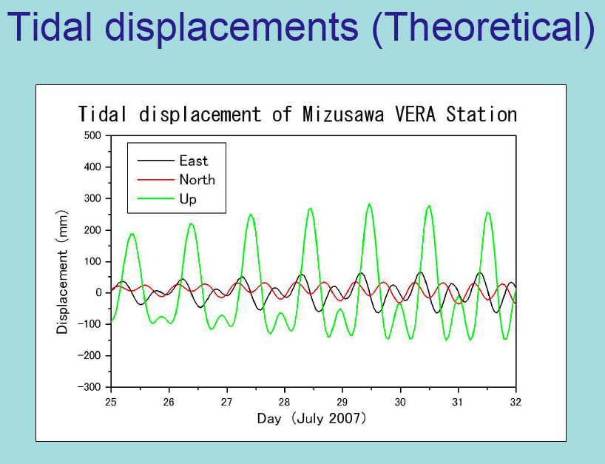

Slide 42
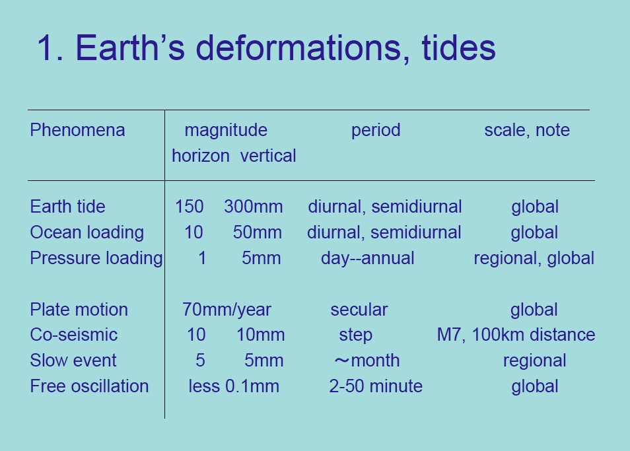
Yoshiaki TAMURA, Mizusawa VERA Observatory Japan

Slide 43


Slide 44

150 mm
300 mm

Slide 45

Tectonophysics 2010

Slide 46
Moon
depth 6 km
density 2.5 g/cm³
gravity 9.810000
lithostatic load <
high tide
- gravity anomaly
depth 6 km
density 2.5 g/cm³
gravity 9.810002
lithostatic load >
low tide
+ gravity anomaly

Slide 47

ultralow-viscosity
LVZ
GSABull 2006

Slide 48


Slide 49

Tectonic equator
Lunar revolution
Adinolfi et al. 2010

Slide 50


Slide 51


Slide 52



Slide 53


Slide 54


Is the asthenosphere viscosity sufficiently low?
Post-glacial rebound
Pacific earthquakes
Channel flow
Petrology experiment

Slide 55


1 mm
η horizontal << η vertical

Slide 56


Slide 57




Slide 58


Slide 59


Slide 60


Slide 61


Slide 62

viscosity
10²² Pa s
Maxwell relaxation time = = = 10¹¹ s
rigidity
10¹¹ Pa

Slide 64
Ficini et al. 2020 Gondwana Res.

Slide 65
log₁₀N=a-bM
1.0
0.1
GUTENBERG-RICHTER
Frequency
0.01
0.001
0.0001
4.0
5.0
6.0
7.0
8.0
Magnitude

Slide 66
Riguzzi et al., 2010 Tectonophysics

Slide 67
Varga et al. 2012 Tectonophysics

Slide 68
384.000 km

Slide 69
Tectonic equator
Lunar revolution
Adinolfi et al. in prep.

Slide 70


Slide 73


Slide 76






26,000 years precession
Rotation axis
tectonic equator
viscosity
10²³ Pa s
Maxwell relaxation time = = 10¹¹ s
=
rigidity
10¹¹ Pa

Slide 77



Zaccagnino et al. 2020

Slide 78

TIDAL FRICTION
  Earth’s rotation is slowing: with dinosaurs the day was of 22h
  Moon receding at 38 mm/year
  Tidal friction 10²⁰⁻²¹ J/yr
  Tectonic moment 10²¹ J/yr

Slide 79


Carcaterra & Doglioni 2018 Geoscience Front.

Slide 80
SOLID EARTH TIDE
vertical component
30-40 cm/12h25’:
stress unloading
horizontal component
15-20 cm/12h25’:
stress loading
0.15 mm
Doglioni & Panza 2015 Advances Geophys.

Slide 81

Zaccagnino et al. 2020

Slide 82

Zaccagnino et al. 2020

Slide 83
Zaccagnino et al. 2020

Slide 84


Slide 85


Slide 86

1 year
Zaccagnino et al. 2020

Slide 87

Zaccagnino et al. 2020

Slide 88


Zaccagnino et al. 2020

Slide 89

Zaccagnino et al. 2020

Slide 90

Zaccagnino et al. 2020

Slide 91

Zaccagnino et al. 2020

Slide 92


Slide 93
ASTRONOMICAL TUNING
THERMAL COOLING
Self Organized Chaotic System

Slide 94

1977-2013
M>6
<50 km depth
Adinolfi et al. in prep.

Slide 95
Riguzzi et al. 2010 Tectonophysics

Slide 96


Cochran et al. 2004 Science
Earthquakes >40 km
Rubinstein et al.
2009 Science

Slide 97

Tolstoy et al. (2002)
Normal fault earthquakes more frequent during low tide
Thrust fault earthquakes more frequent during high tide

Slide 98

vertical stress = lithostatic load = density x gravity x depth
Riguzzi et al. 2010

Slide 99


18000 km
1208 km
2370 km

Slide 100


Slide 101
Ficini et al. 2020 Gondwana Res.

Slide 102
log₁₀N=a-bM
1.0
0.1
GUTENBERG-RICHTER
Frequency
0.01
0.001
0.0001
4.0
5.0
6.0
7.0
8.0
Magnitude

Slide 103
Riguzzi et al., 2010 Tectonophysics

Slide 104
Varga et al. 2012 Tectonophysics

Slide 105
384.000 km

Slide 106
Tectonic equator
Lunar revolution
Adinolfi et al. in prep.

Slide 108
26,000 years precession
Rotation axis
tectonic equator
viscosity
10²³ Pa s
Maxwell relaxation time = = 10¹¹ s
=
rigidity
10¹¹ Pa

Slide 109
Zaccagnino et al. 2020

Slide 110
TIDAL FRICTION
  Earth’s rotation is slowing: with dinosaurs the day was of 22h
  Moon receding at 38 mm/year
  Tidal friction 10²⁰⁻²¹ J/yr
  Tectonic moment 10²¹ J/yr

Slide 111
Carcaterra & Doglioni 2018 Geoscience Front.

Slide 112
SOLID EARTH TIDE
vertical component
30-40 cm/12h25’:
stress unloading
horizontal component
15-20 cm/12h25’:
stress loading
0.15 mm
Doglioni & Panza 2015 Advances Geophys.

Slide 113
Zaccagnino et al. 2020

Slide 114
Zaccagnino et al. 2020

Slide 115
Zaccagnino et al. 2020

Slide 118
1 year
Zaccagnino et al. 2020

Slide 119
Zaccagnino et al. 2020

Slide 120
Zaccagnino et al. 2020

Slide 121
Zaccagnino et al. 2020

Slide 122
Zaccagnino et al. 2020

Slide 123
Zaccagnino et al. 2020

Slide 124


Slide 126
ASTRONOMICAL TUNING
THERMAL COOLING
Self Organized Chaotic System

Slide 127
1977-2013
M>6
<50 km depth
Adinolfi et al. in prep.

Slide 128
Riguzzi et al. 2010 Tectonophysics

Slide 129
Cochran et al. 2004 Science
Earthquakes >40 km
Rubinstein et al.
2009 Science

Slide 130
Tolstoy et al. (2002)
Normal fault earthquakes more frequent during low tide
Thrust fault earthquakes more frequent during high tide

Slide 131
vertical stress = lithostatic load = density x gravity x depth
Riguzzi et al. 2010

Slide 132
18000 km
1208 km
2370 km

Slide 133
ASTRONOMICAL TUNING
THERMAL COOLING
Self Organized Chaotic System
Doglioni et al. 2007, ESR

Slide 134

It is the asymmetry
that generates the phenomenon
PIERRE CURIE
Thanks to:
Eugenio Carminati, Mattia Crespi,
Marco Cuffaro, Adriana Garroni, Corrado Mascia, Enzo Nesi, Giuliano Panza & Federica Riguzzi

