Slide 1
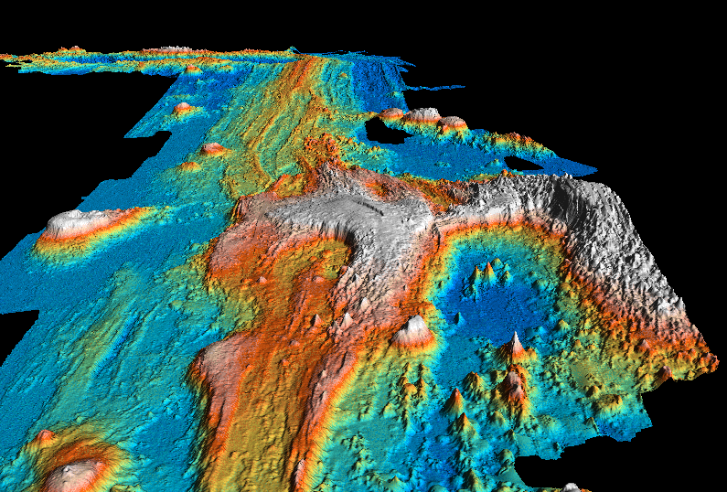
Juan de Fuca ridge
www.marine-geo.org/rmbs

Slide 2
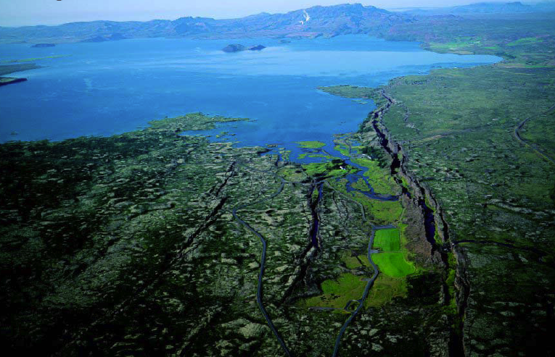
Middle Atlantic Ridge
Iceland

Slide 3
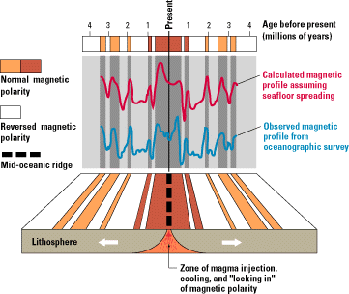
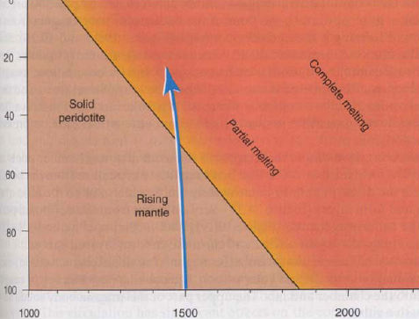
Melting of the mantle by decompression
km
T °C

Slide 5
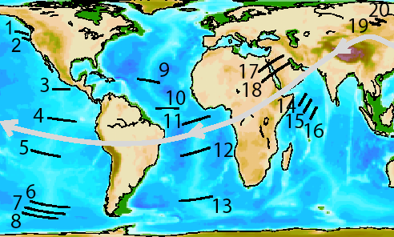

Slide 6
BATHYMETRY vs DISTANCE

Slide 7
BATHYMETRY vs AGE SQUARE ROOT

Slide 8
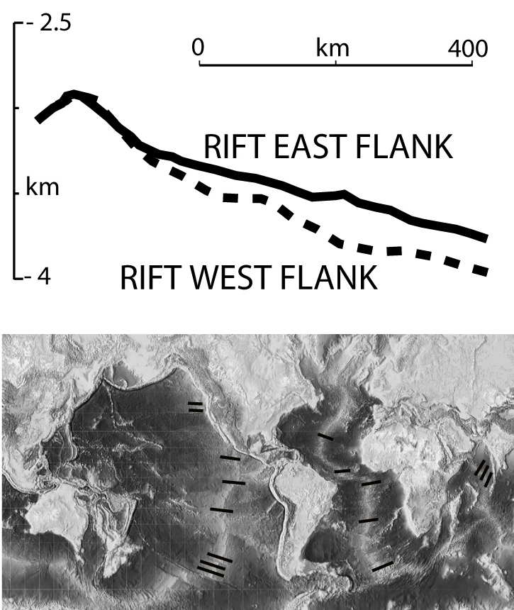

Slide 9
0
R
e
c
i
f
e
M
A
R
A
n
g
o
l
a
0
Shallower and less steep flank
3
3
6
6
V
e
r
t
i
c
a
l
e
x
a
g
g
e
r
a
t
i
o
n
x
1
0
0
5
2
7
5
k
m

Slide 10
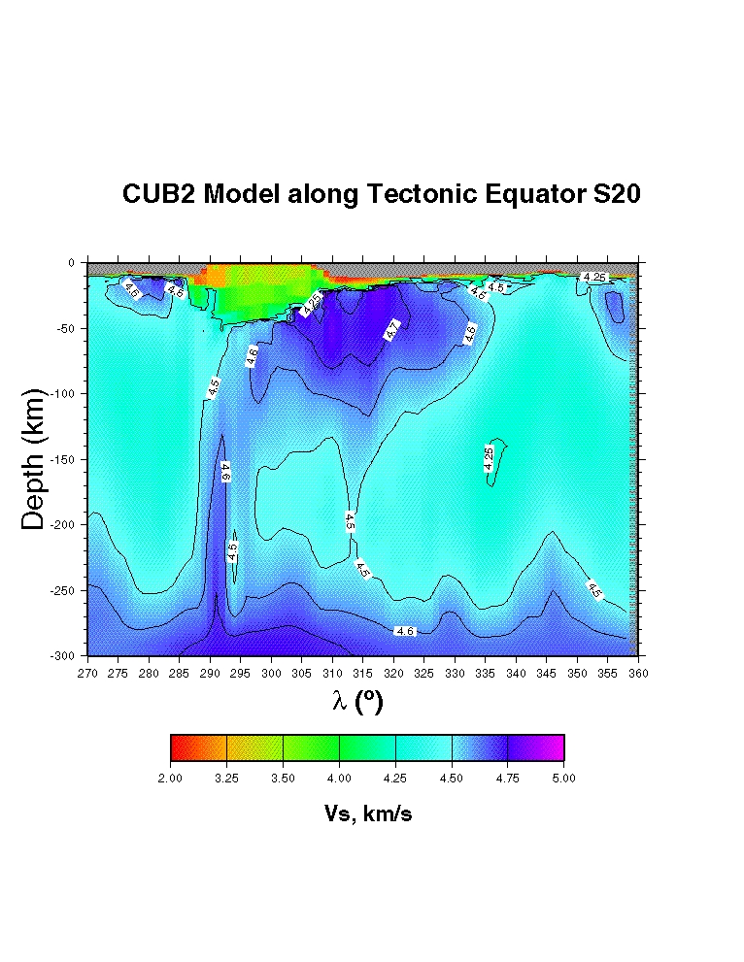
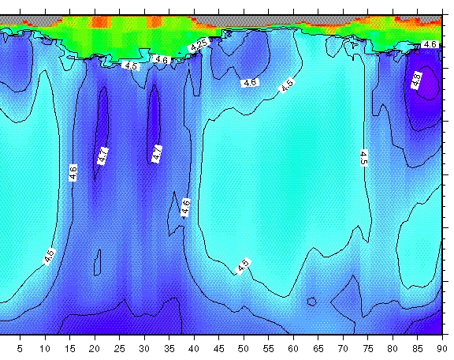
S-America
MAR
Africa
IR
India
Panza et al. 2010, Geology

Slide 11
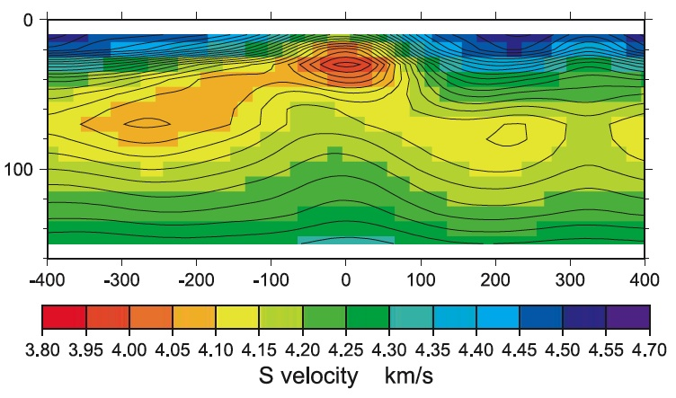
Conder et al., 2002, JGR, MELT

Slide 12
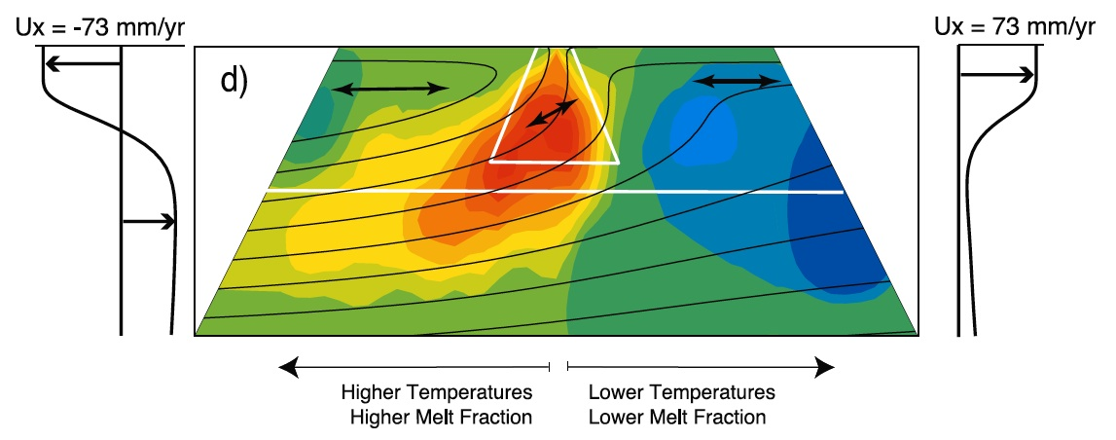
Hammond & Toomey, 2003

Slide 13
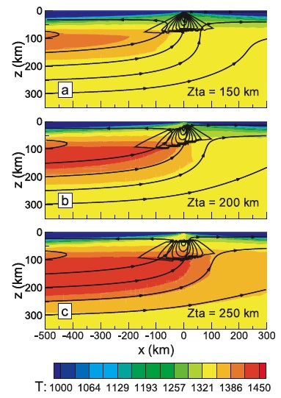
Conder et al., 2002
JGR, MELT

Slide 14
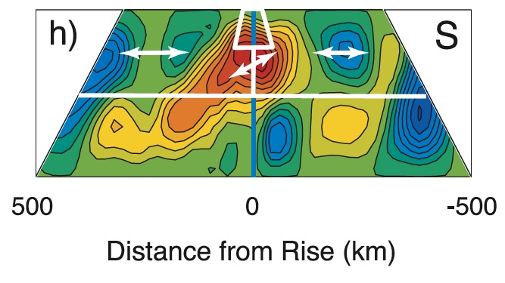
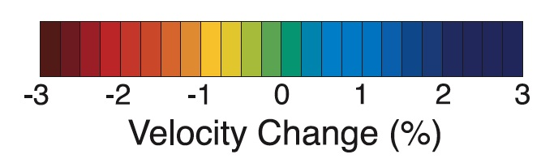

Slide 15
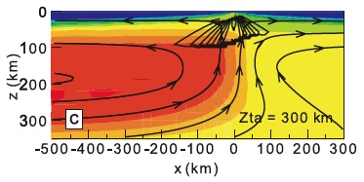

Slide 16
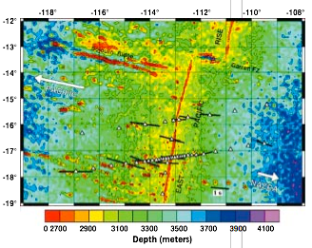
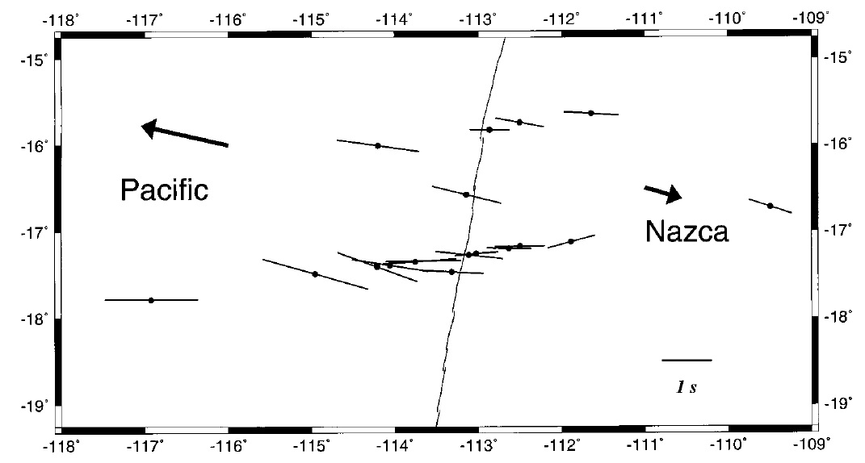


Wolfe & Solomon, 1998, Science, MELT

Slide 17
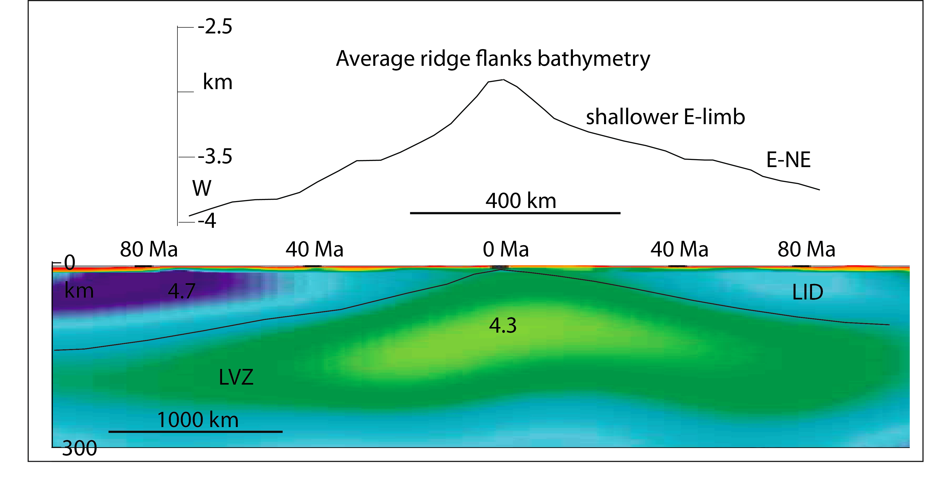
Mid Atlantic Ridge

Slide 18
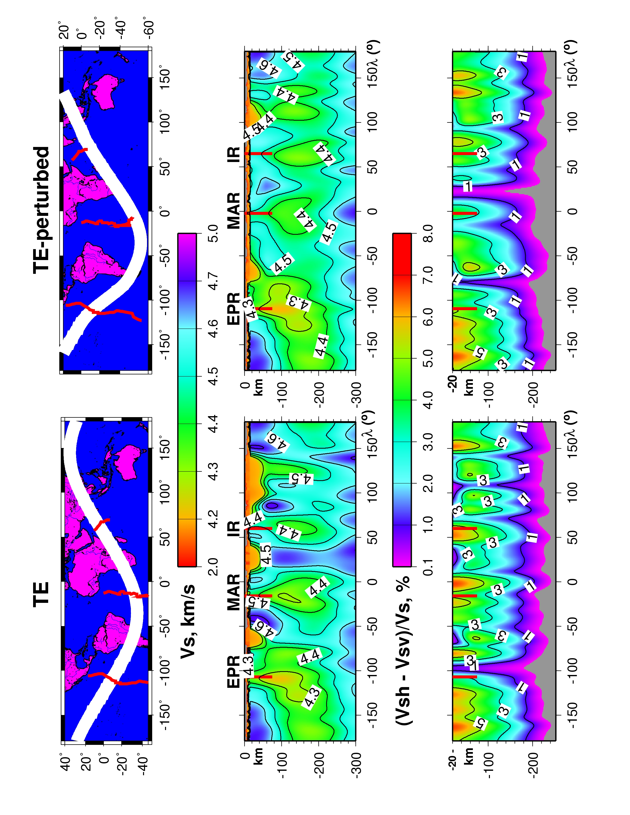
Panza et al. Geology 2010

Slide 19
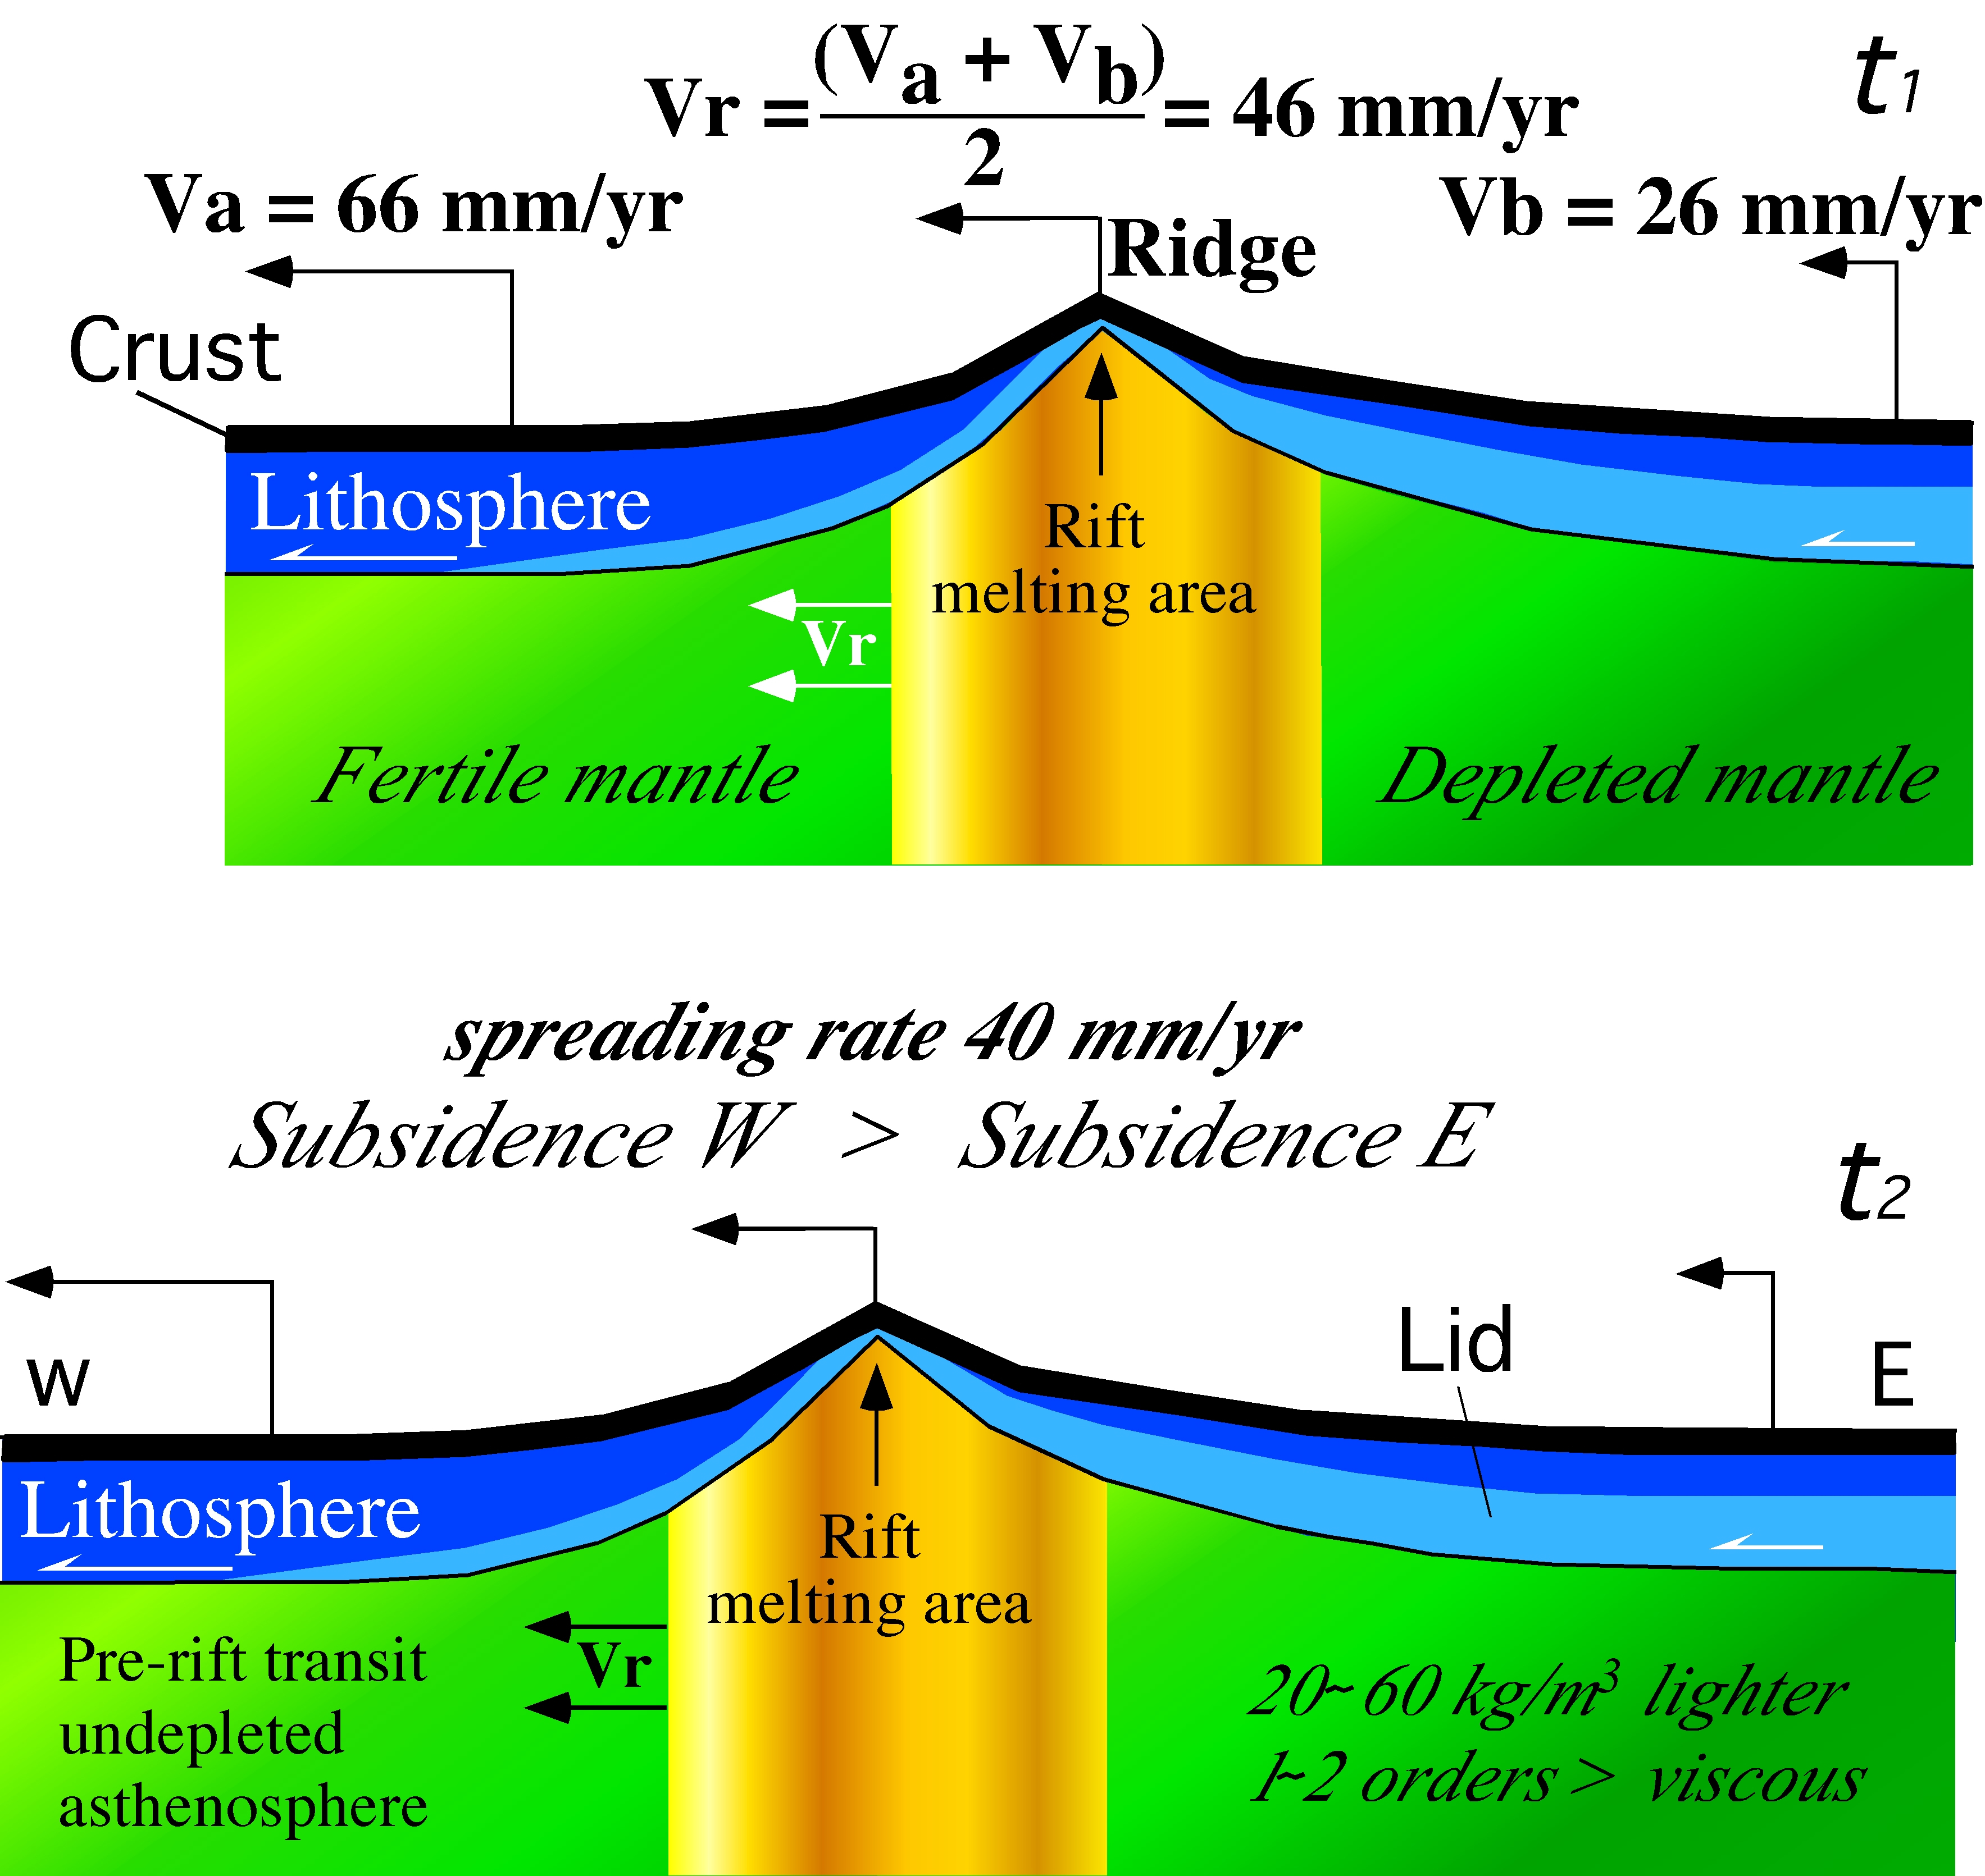




Panza et al. Geology 2010

Slide 20
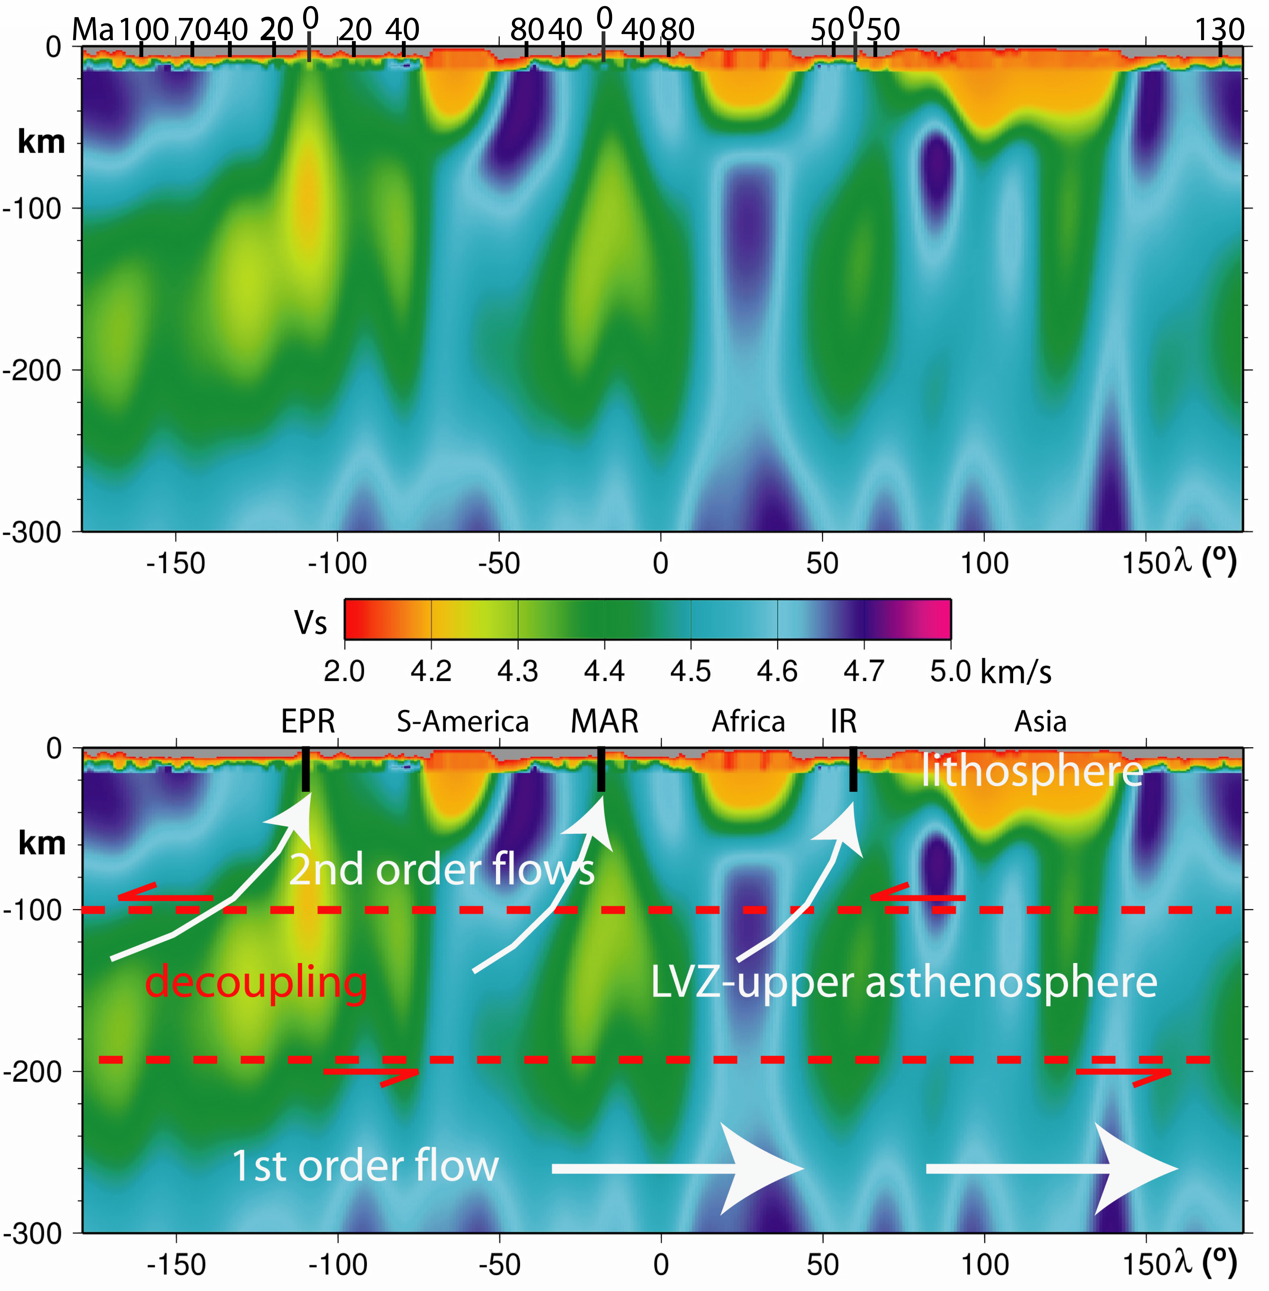
Panza et al. Geology 2010

Slide 21
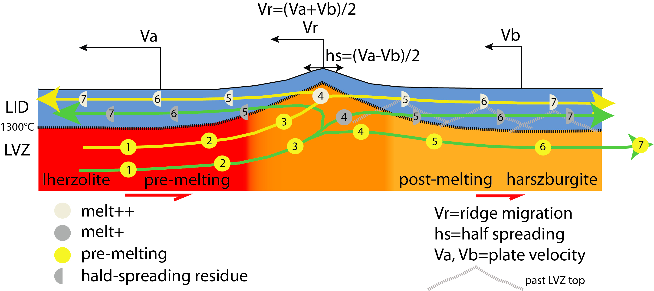







Slide 22
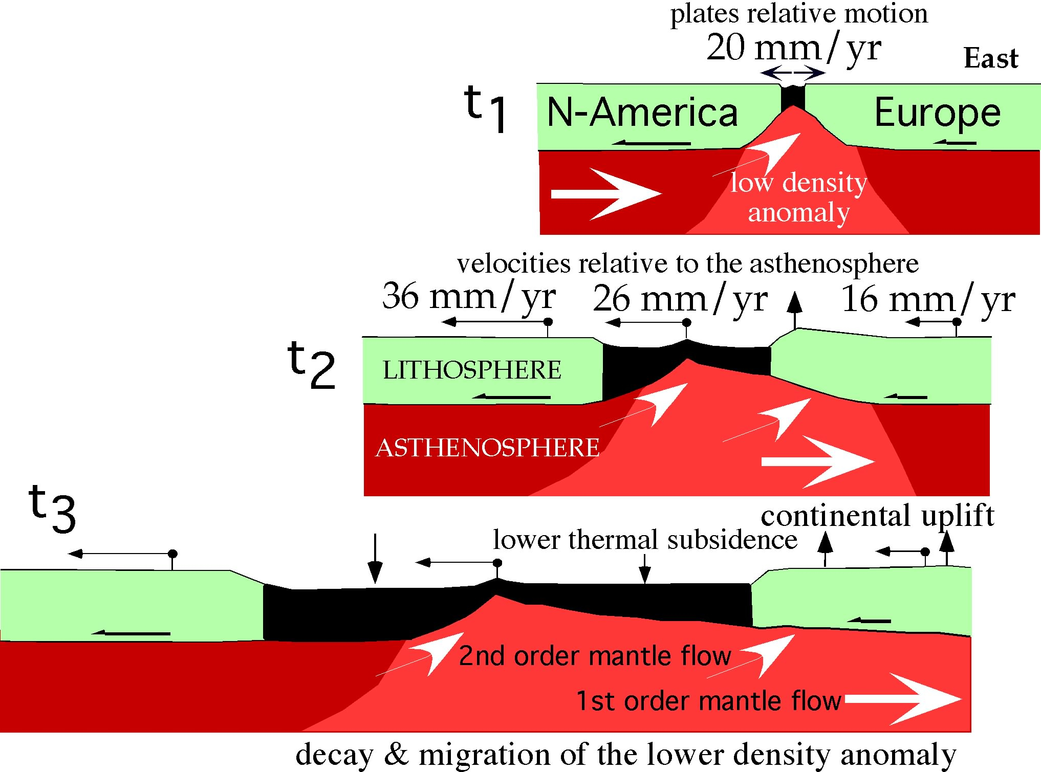




Slide 23






Slide 24
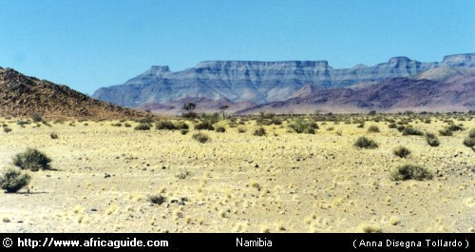
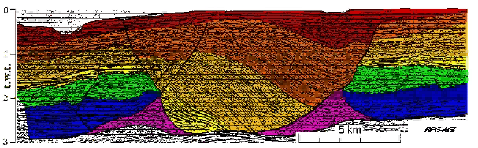





Slide 25
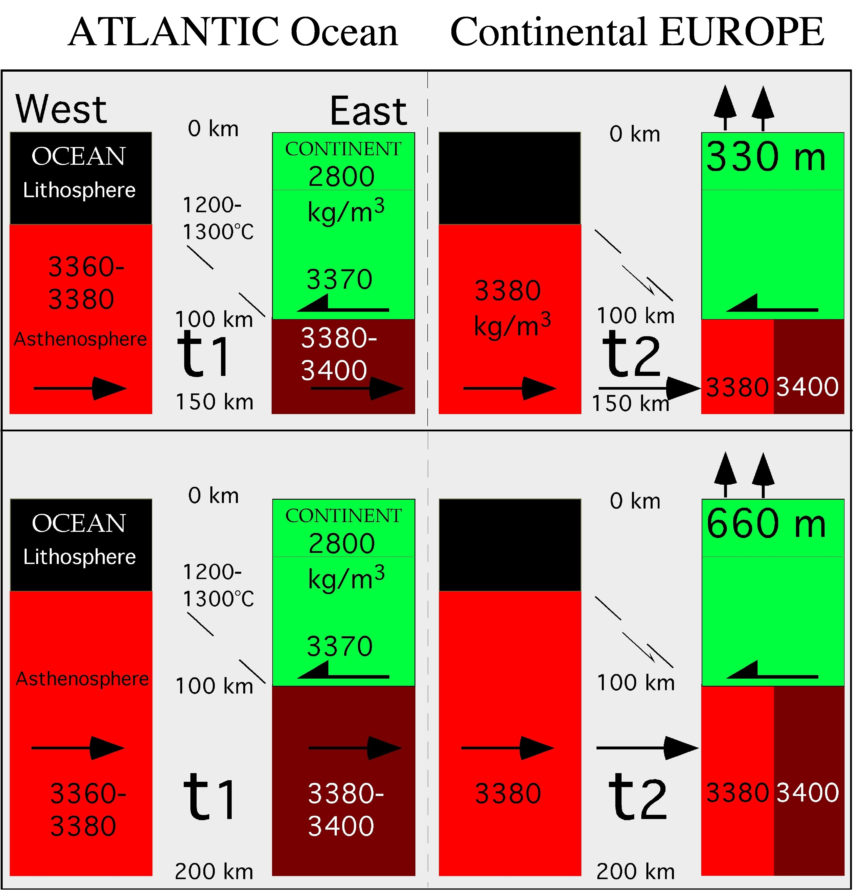

Slide 26
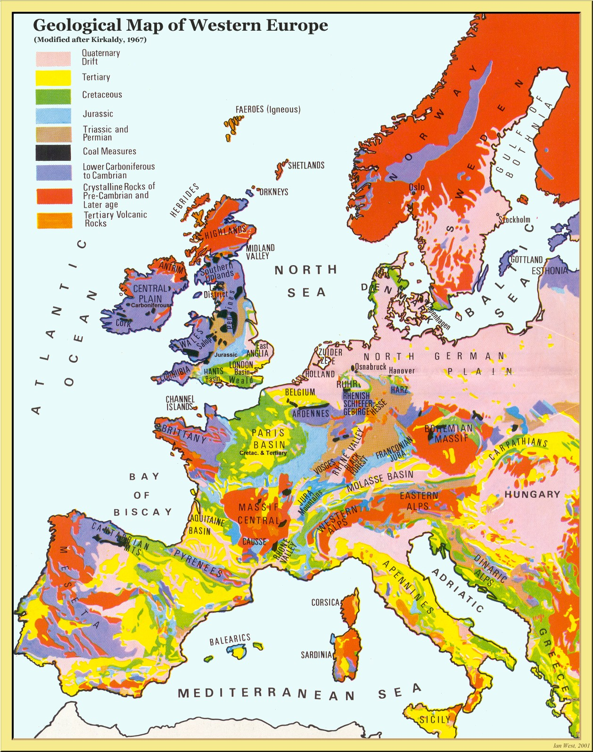
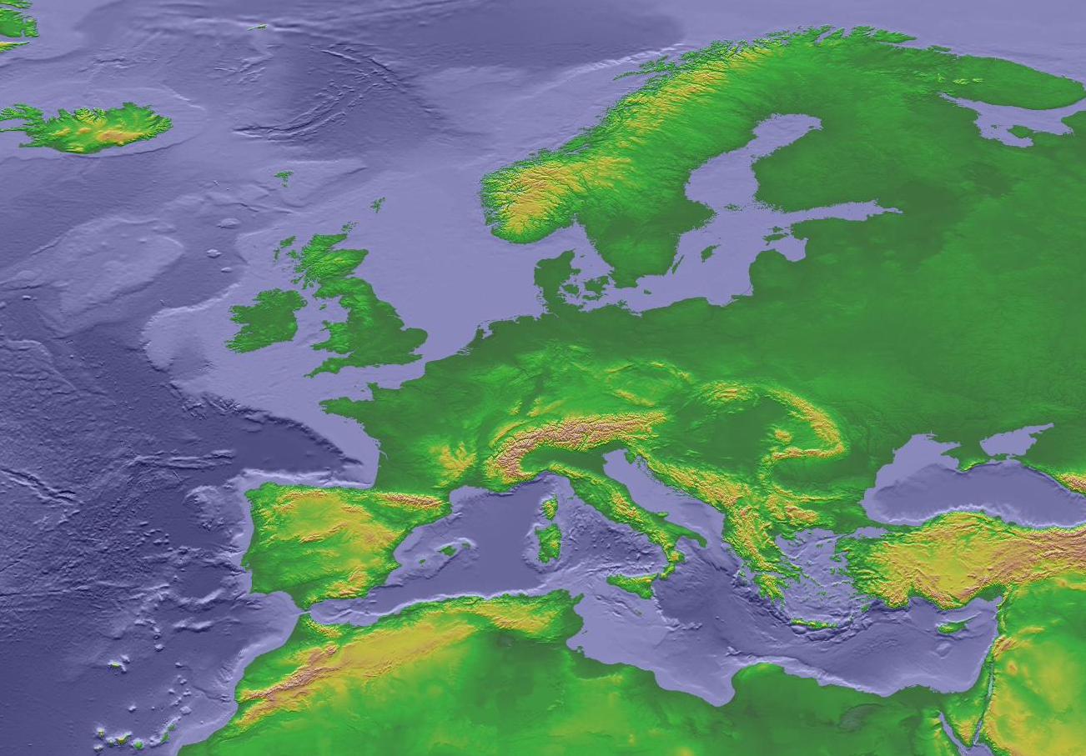



…and Europe?

Slide 27
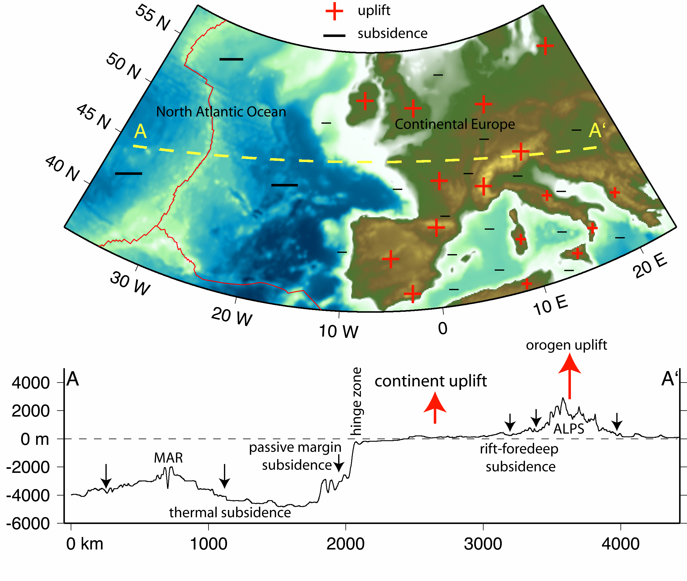

Slide 28
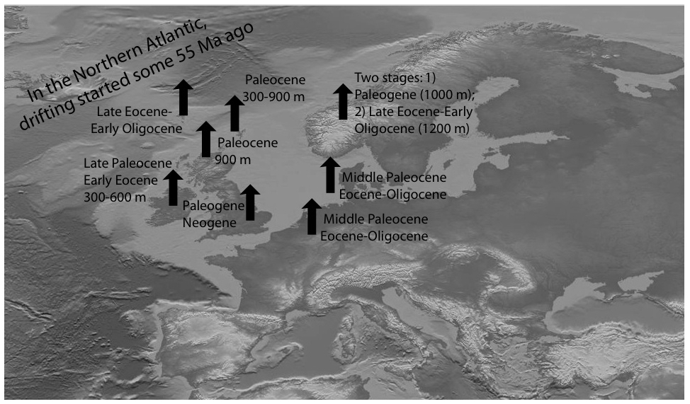

Slide 29
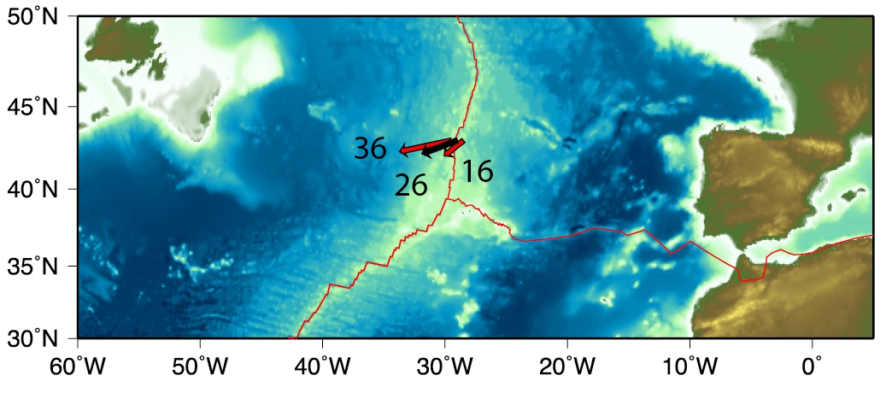

NA
EU
Mantle
MAR

Slide 30
Panza et al., Geology 2010

Slide 31
rifting model
Ridge speed = (V_{A}+V_{B})/2
A
B

Slide 32
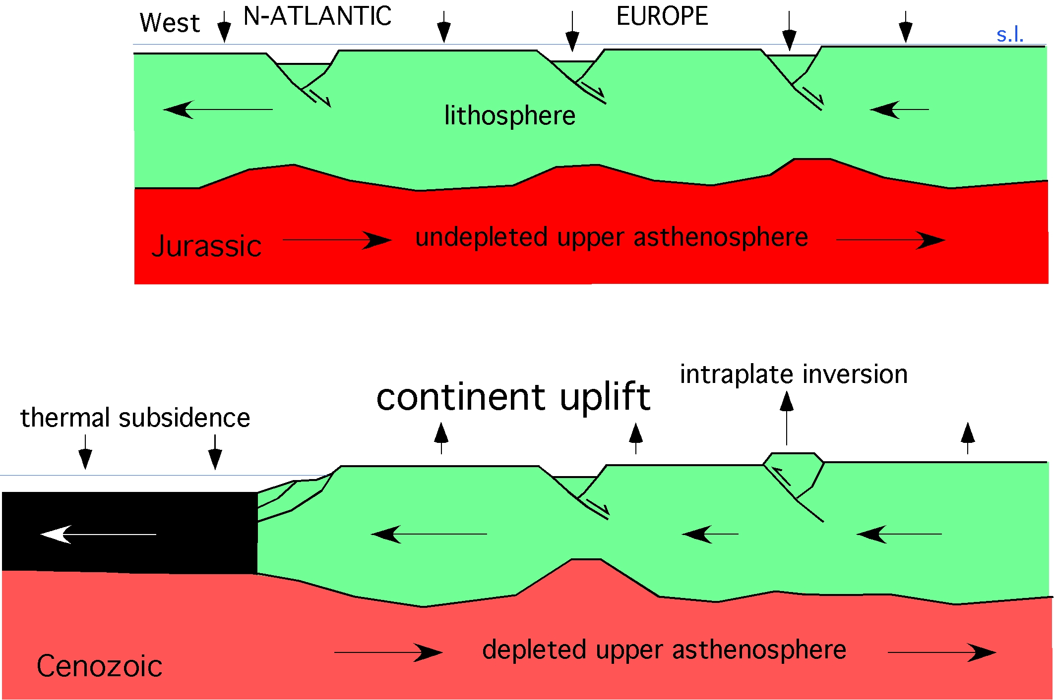

Slide 33
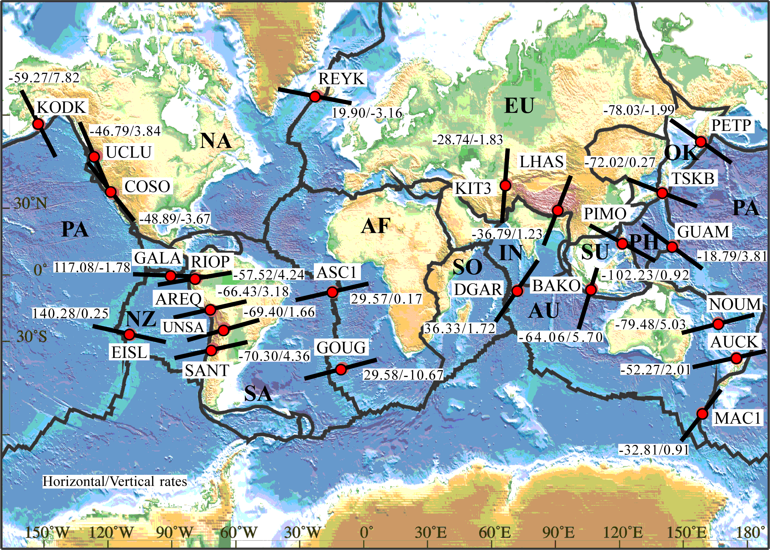
HORIZONTAL RELATIVE MOTIONS
& VERTICAL UPLIFTS AT PLATE BOUNDARIES

Slide 34
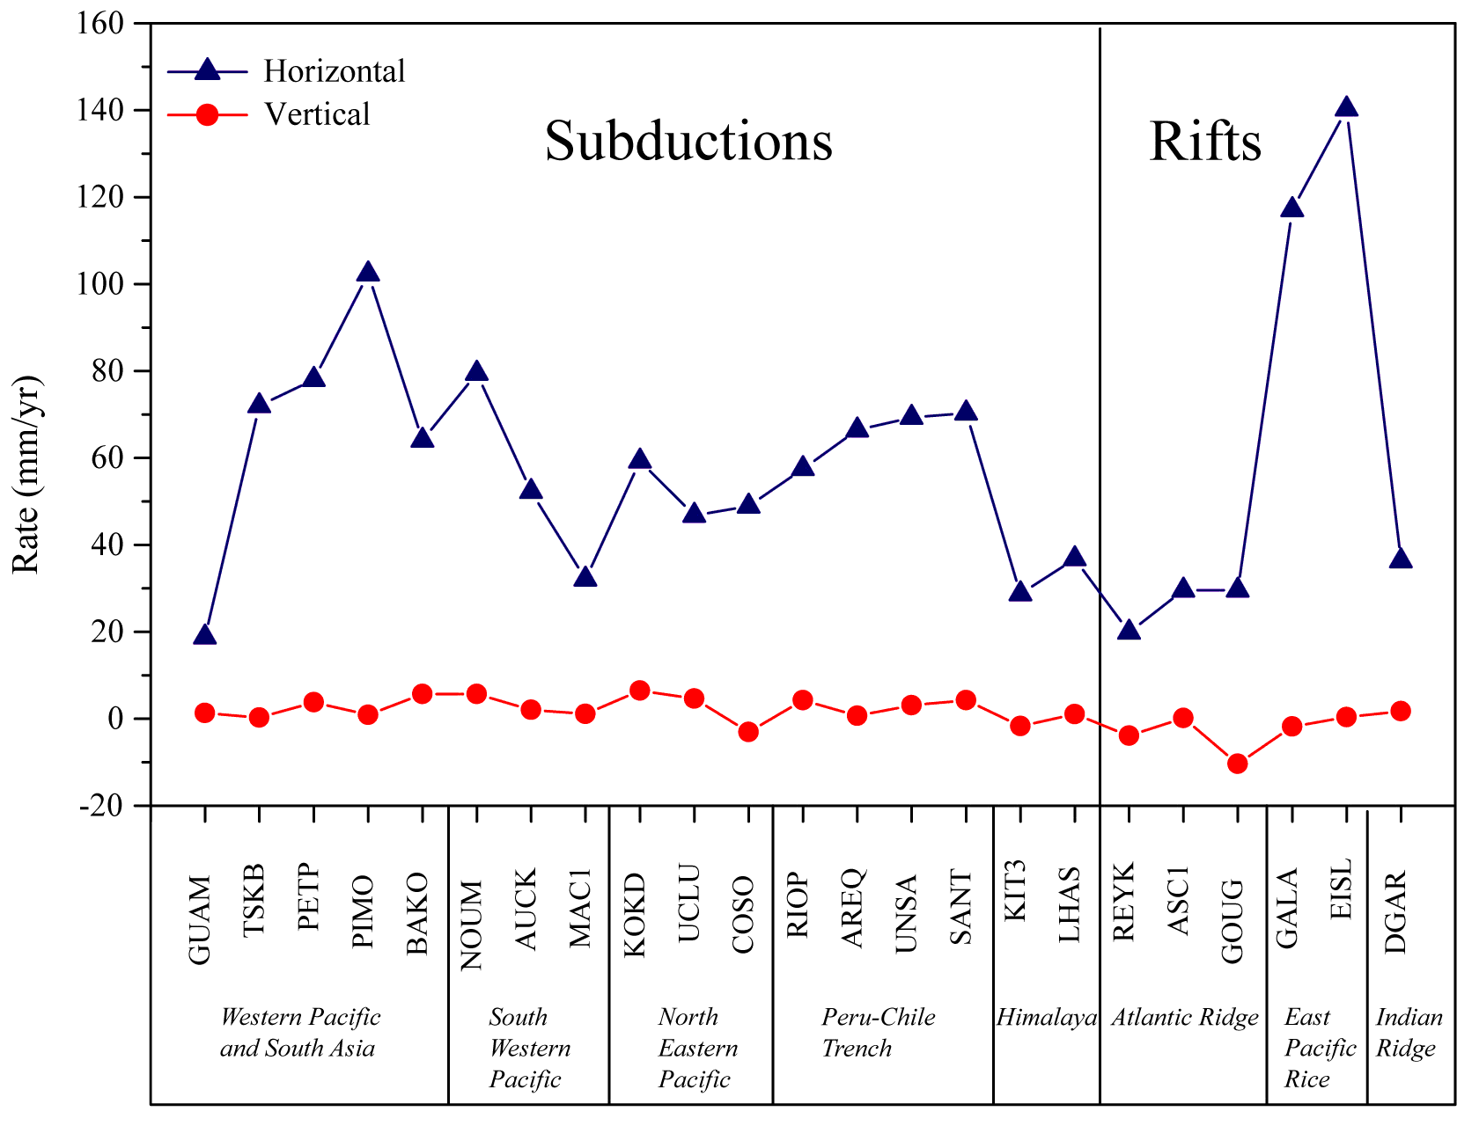

Slide 35
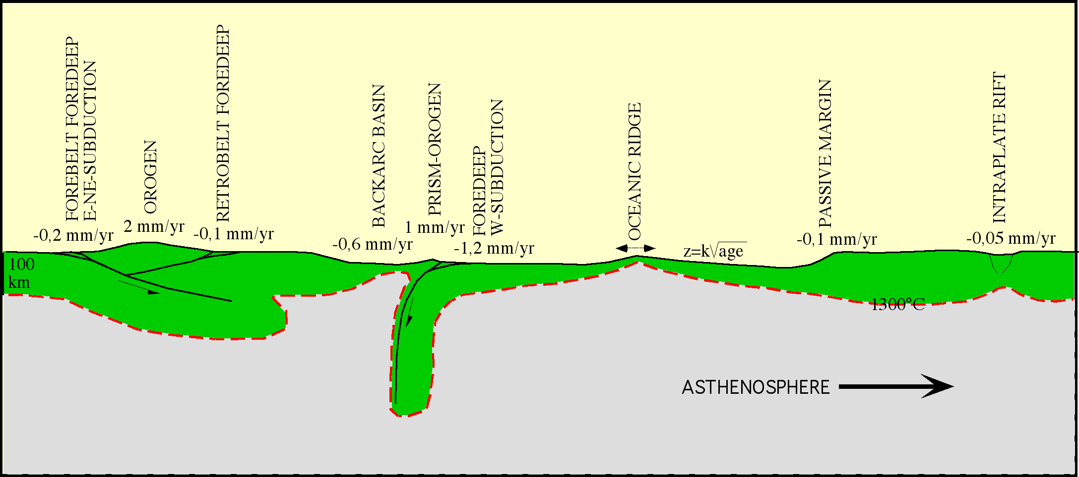
Vertical movements:
- PLATE TECTONICS RELATED
- MANTLE DENSITY RELATED

Slide 36
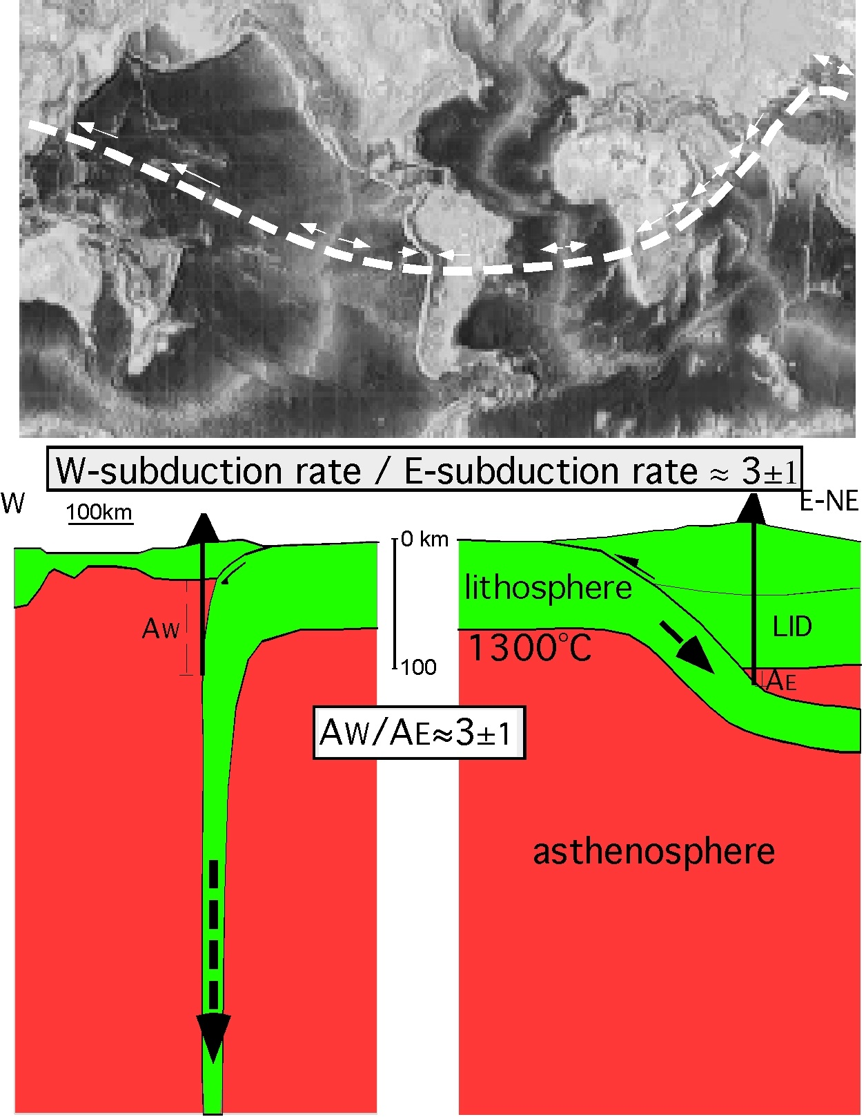

Slide 37
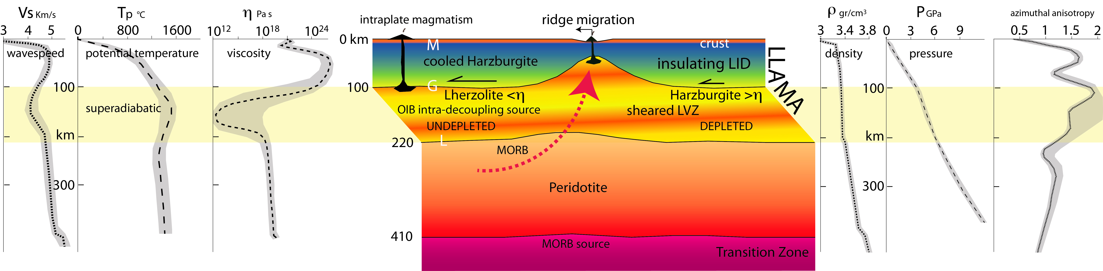

Slide 38
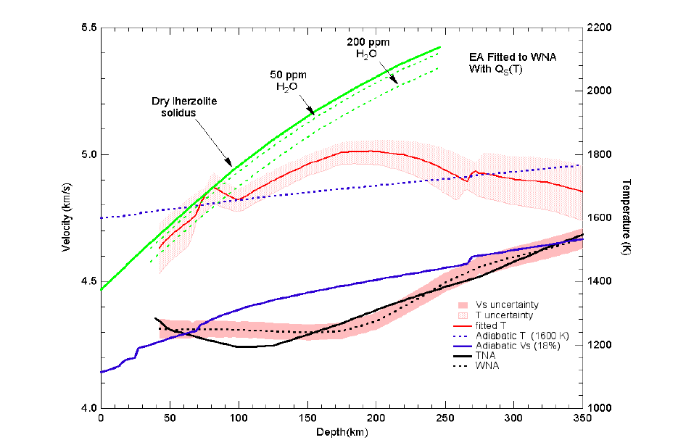
4 km/s
Vs
4.5
Tp
5.0
5.5
Vs wavespeed
CONDUCTION REGION
Dry lherzolite
solidus
100
50 ppm
H₂O
SUPERDIABATIC REGION
Depth km
Canonical 1600 K adiabat
Thermal bump region (OIB source)
Geotherm from seismic gradients
300
SUBADIABATIC REGION
T
Modified after Xu et al. 2011, GJI
1600
1800
2000 K
Notes:
9. Wavespeed gradients imply subadiabaticty below ~200 km. The average temperature increase inferred from seismic gradients across the upper 200 km of the mantle is ~1530 K. This causes the negative seismic wavespeed gradient and the Gutenberg low velocity zone, as has long been known but often ignored.
Thermodynamic inversion of seismological data show that there is at least a 200 C decrease in temperature between 200 km and the base of the transition zone…gradients of wavespeeds exceed those predicted for adiabatic self-compression of a homogeneous mantle for depths between 200 and > 350 km depth. (seismic gradients imply
subadiabaticity over most of the mantle Bullen, Birch)

Slide 39
Crust
LID
220-410
650
Lower
Mantle
Superadiabatic geotherm
LVZ
km
Tp
Upper Mantle
TZ
Subadiabatic geotherm
Deep Tp colder than LVZ
BL
Anderson, J. Petr. 2011
Notes:
15. Nomenclature of the mantle & elements of a thermodynamically consistent geotherm. A schematic potential temperature (Tp) geotherm is shown.
The adiabatic interior of canonical geotherms is replaced by an internally heated-slab cooled region with a subadiabatic gradient.
Second law of thermodynamics states that the entropy of an isolated system never decreases, because isolated systems spontaneously evolve toward thermodynamic equilibrium

Slide 40
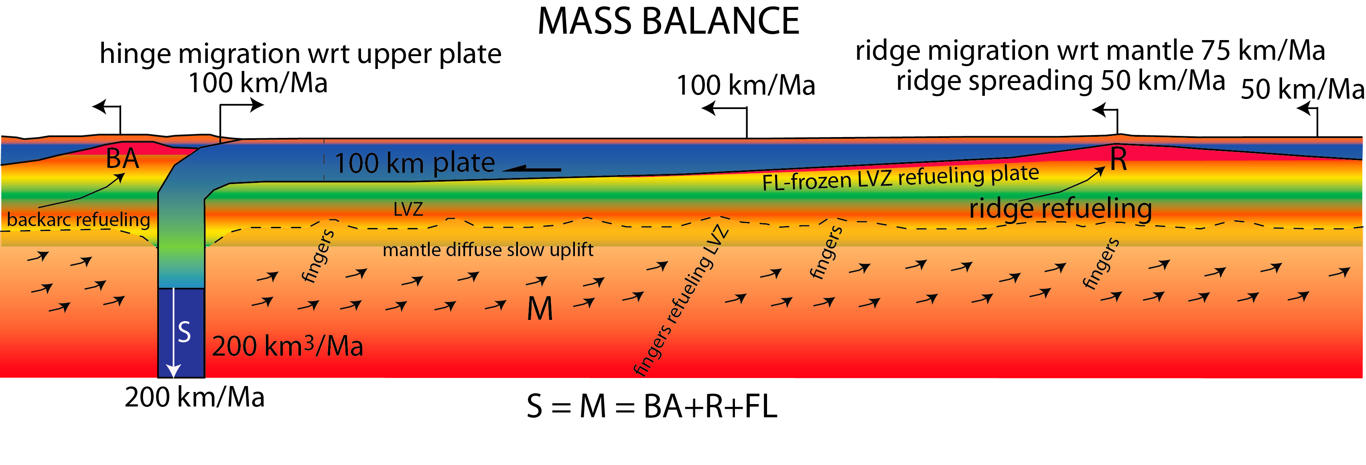

Slide 41
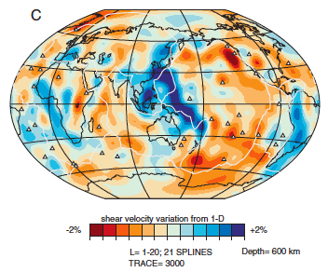
Ritsema, 2003

Slide 42
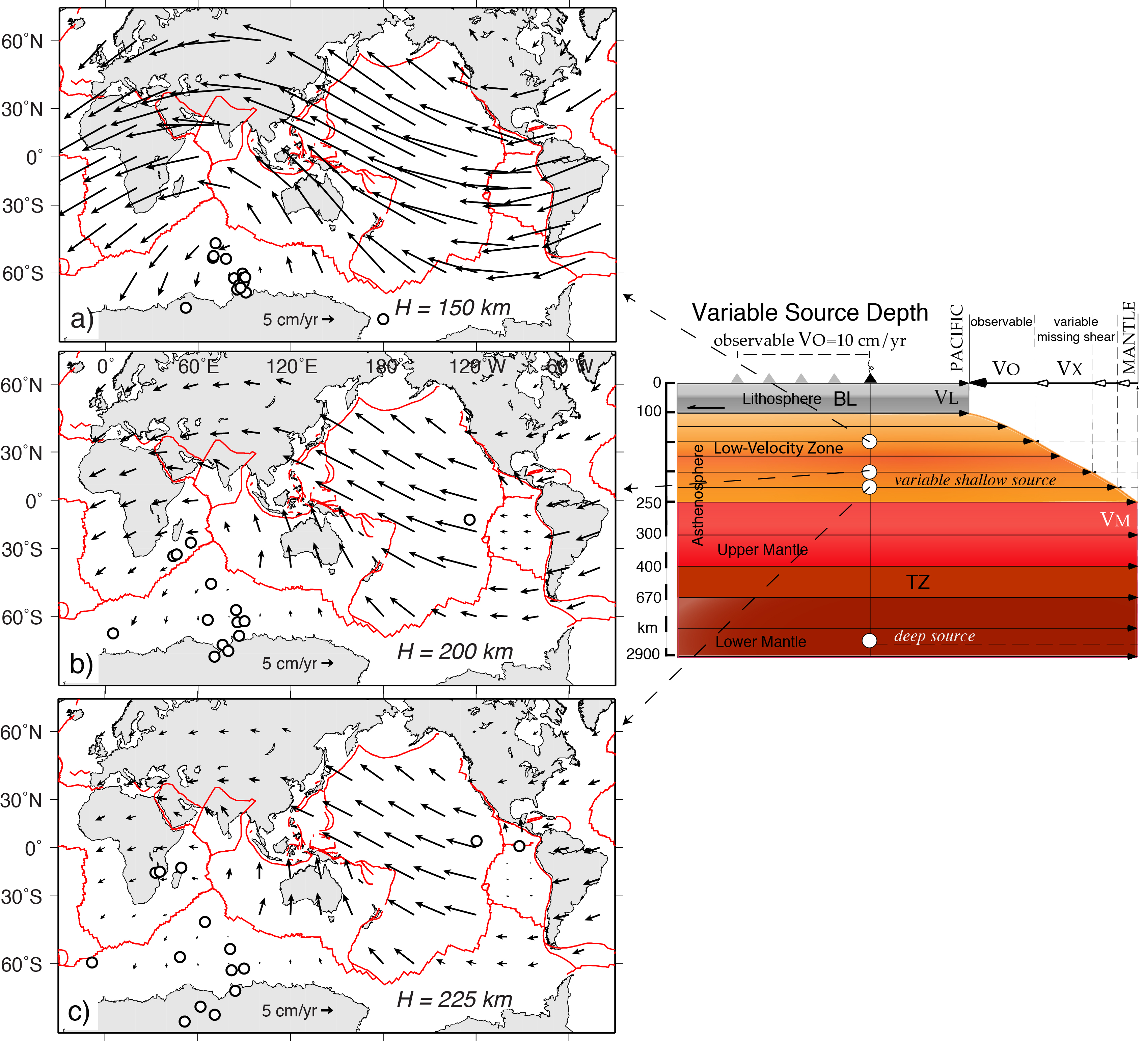

Slide 43
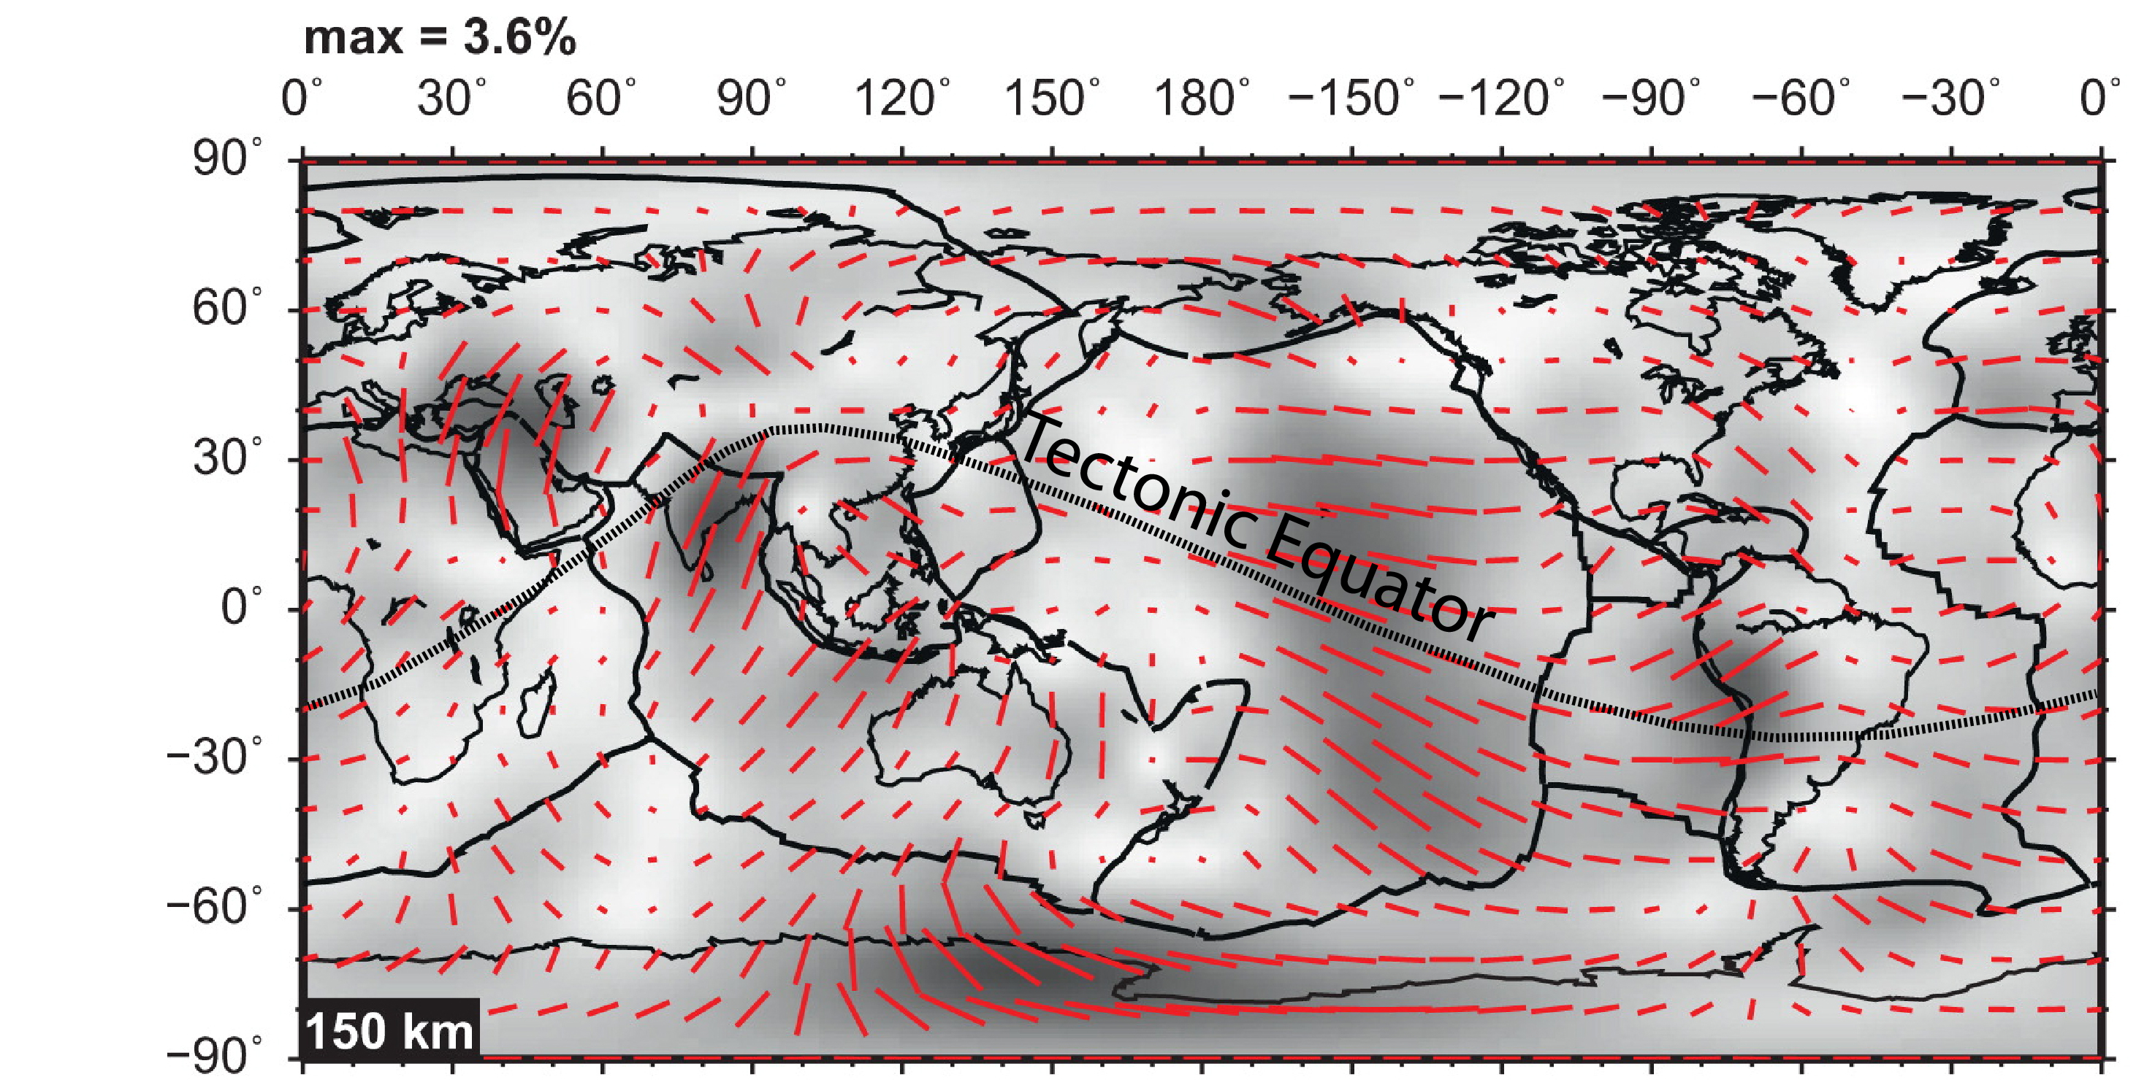

Slide 44
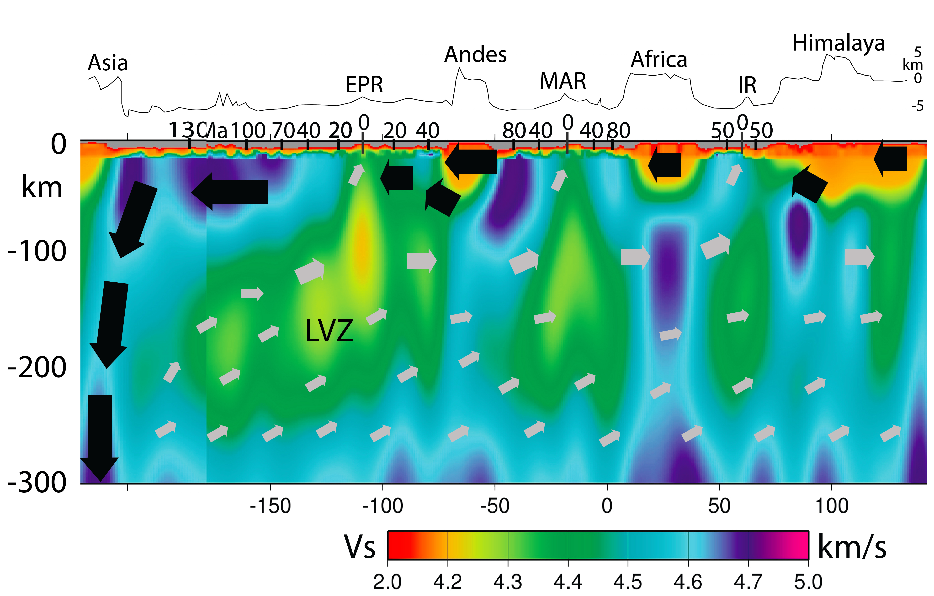

Slide 45
E-NE
W
 | E-directed | convergence | hinge wrt | subduction rate | volume rate |  | W-directed | convergence | hinge wrt | subduction rate | volume rate
 | length | mm/yr | upper plate mm/yr | mm/yr | km3/yr |  | length | mm/yr | upper plate mm/yr | mm/yr | km3/yr
N-America | 2573 | 37 | -18 | 19 | 4,9 | Barbados | 2273 | 0 | 20 | 20 | 4,5
S-America | 9900 | 66 | -35 | 31 | 30,7 | Sandwich | 1582 | 0 | 18 | 18 | 2,8
South America-Antarctica | 1641 | 22 | -14 | 12 | 1,9 | Aleutians | 3674 | 65 | 15 | 80 | 37,9
Antarctica | 1793 | 8 | -5 | 3 | 0,5 | Kurile-Kamchatka | 2141 | 80 | 14 | 66 | 13,7
Macquarie-NewZealand | 2563 | 6 | -4 | 2 | 0,5 | Carpathians | 1110 | 0 | 2 | 2 | 0,3
Papua-NewGuinea | 2511 | 5 | -3 | 2 | 0,5 | N-Japan | 1039 | 80 | -19 | 61 | 6,5
Indonesia | 5127 | 75 | -50 | 25 | 12,8 | Nankai-Ryukyu-Philippine | 4320 | 70 | 23 | 93 | 39,3
Himalaya | 2995 | 36 | -30 | 6 | 1,8 | Izu Bonin-Marianas | 4703 | 50 | 30 | 80 | 37,6
Zagros | 3539 | 24 | -14 | 10 | 3,5 | N-NewZealand-Tonga-Kermadek | 3233 | 80 | 100 | 180 | 58,2
Dinarides | 1114 | 4 | -3 | 1 | 0,1 | Bismarck-Solomon | 3457 | 60 | 20 | 80 | 27,7
Hellenides | 952 | 36 | -15 | 21 | 2 | Banda | 2555 | 0 | 10 | 10 | 2,5
Cyprus | 731 | 10 | -5 | 5 | 0,4 | Apennines | 1700 | 3 | 2 | 5 | 1
Taiwan-Borneo | 2860 | 60 | -35 | 25 | 7,1 | Total length | 31787 |  |  |  | 232
Alps | 850 | 1 | -0,5 | 0.5 | 0,04
New Hebrides | 3098 | 60 | -40 | 20 | 6,2
Caucasus | 2481 | 12 | 8 | 6 | 1,5
Total length | 44728 |  |  |  | 74,44
Slab recycling volumes in km³/yr

Slide 46
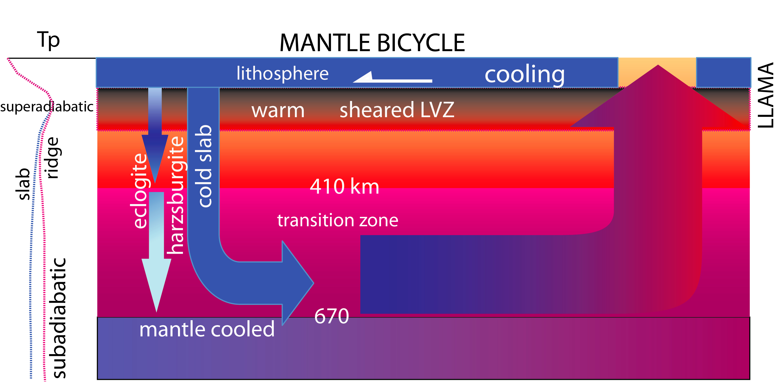

Slide 47
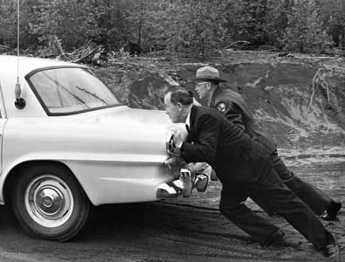
PLATES MOVE: WHO IS PUSHING THEM??!!

Slide 48
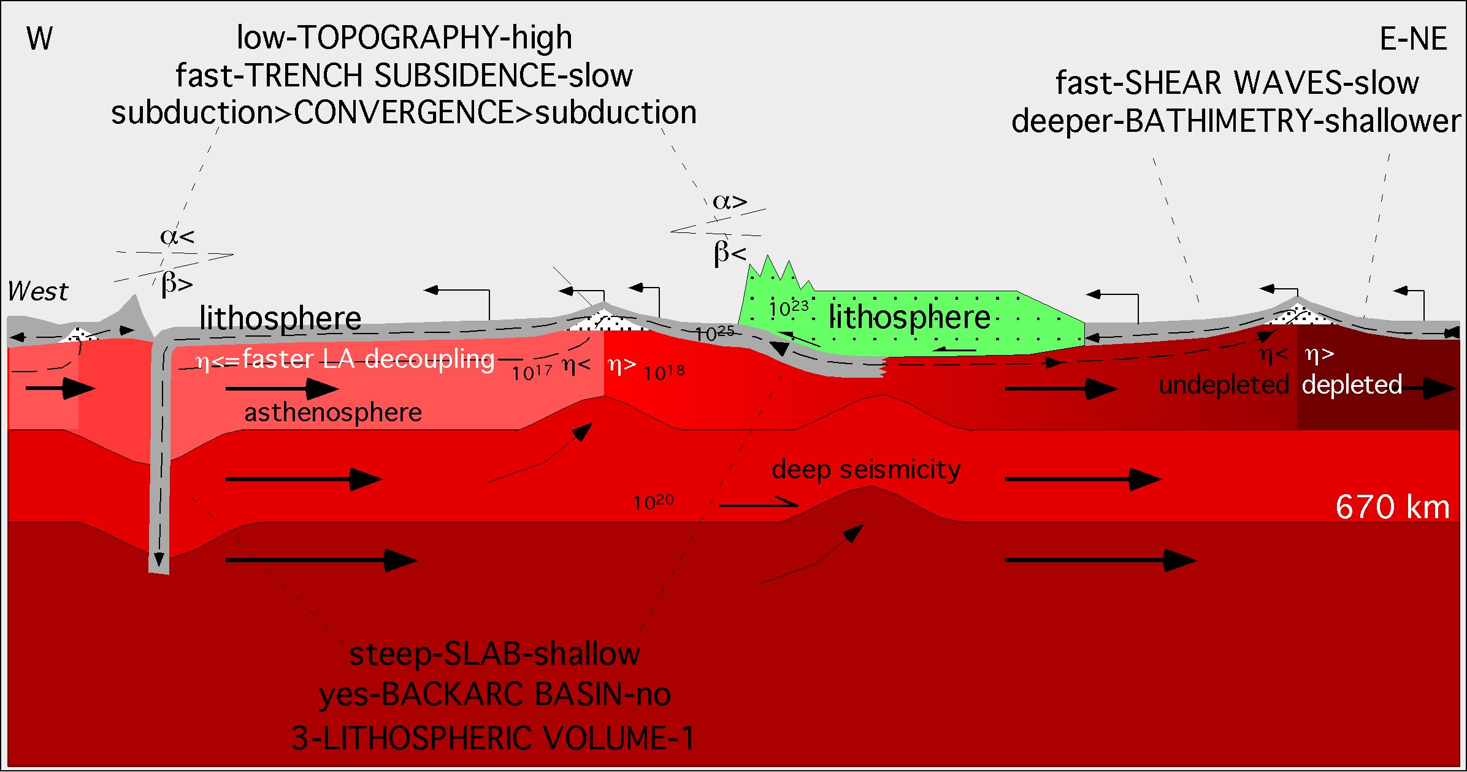

Slide 49
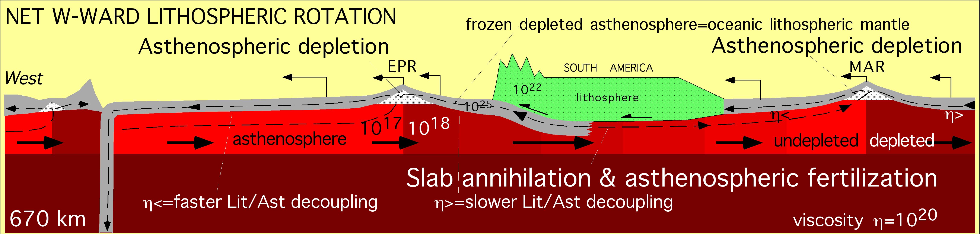
OUT
OUT
IN

Slide 50









Slide 51
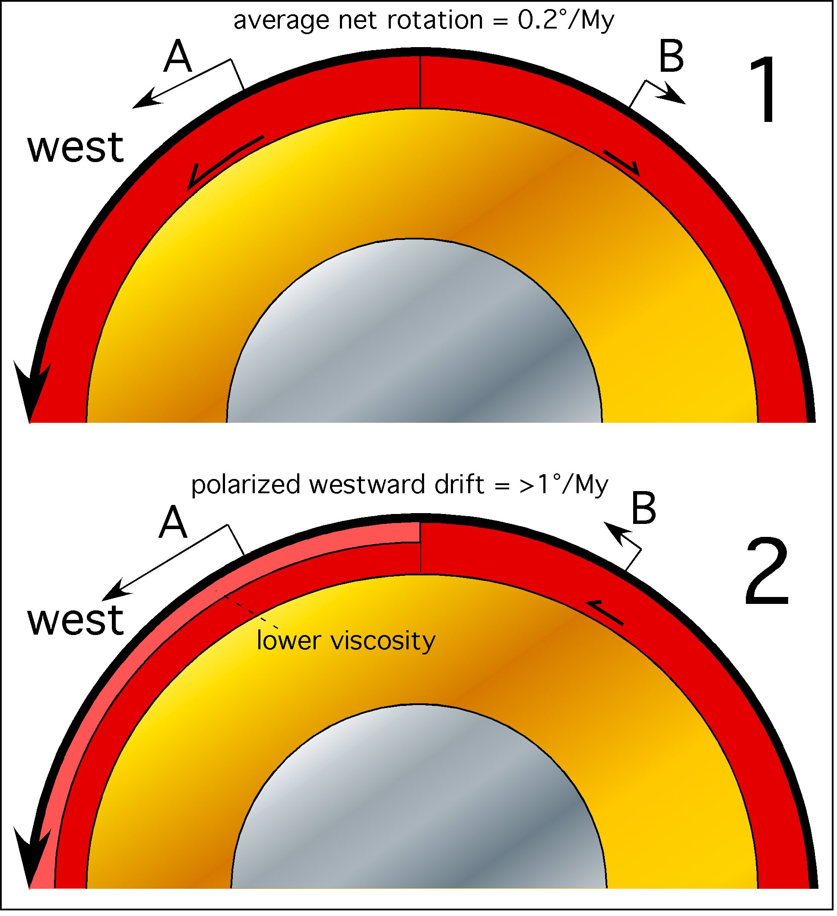

Slide 52
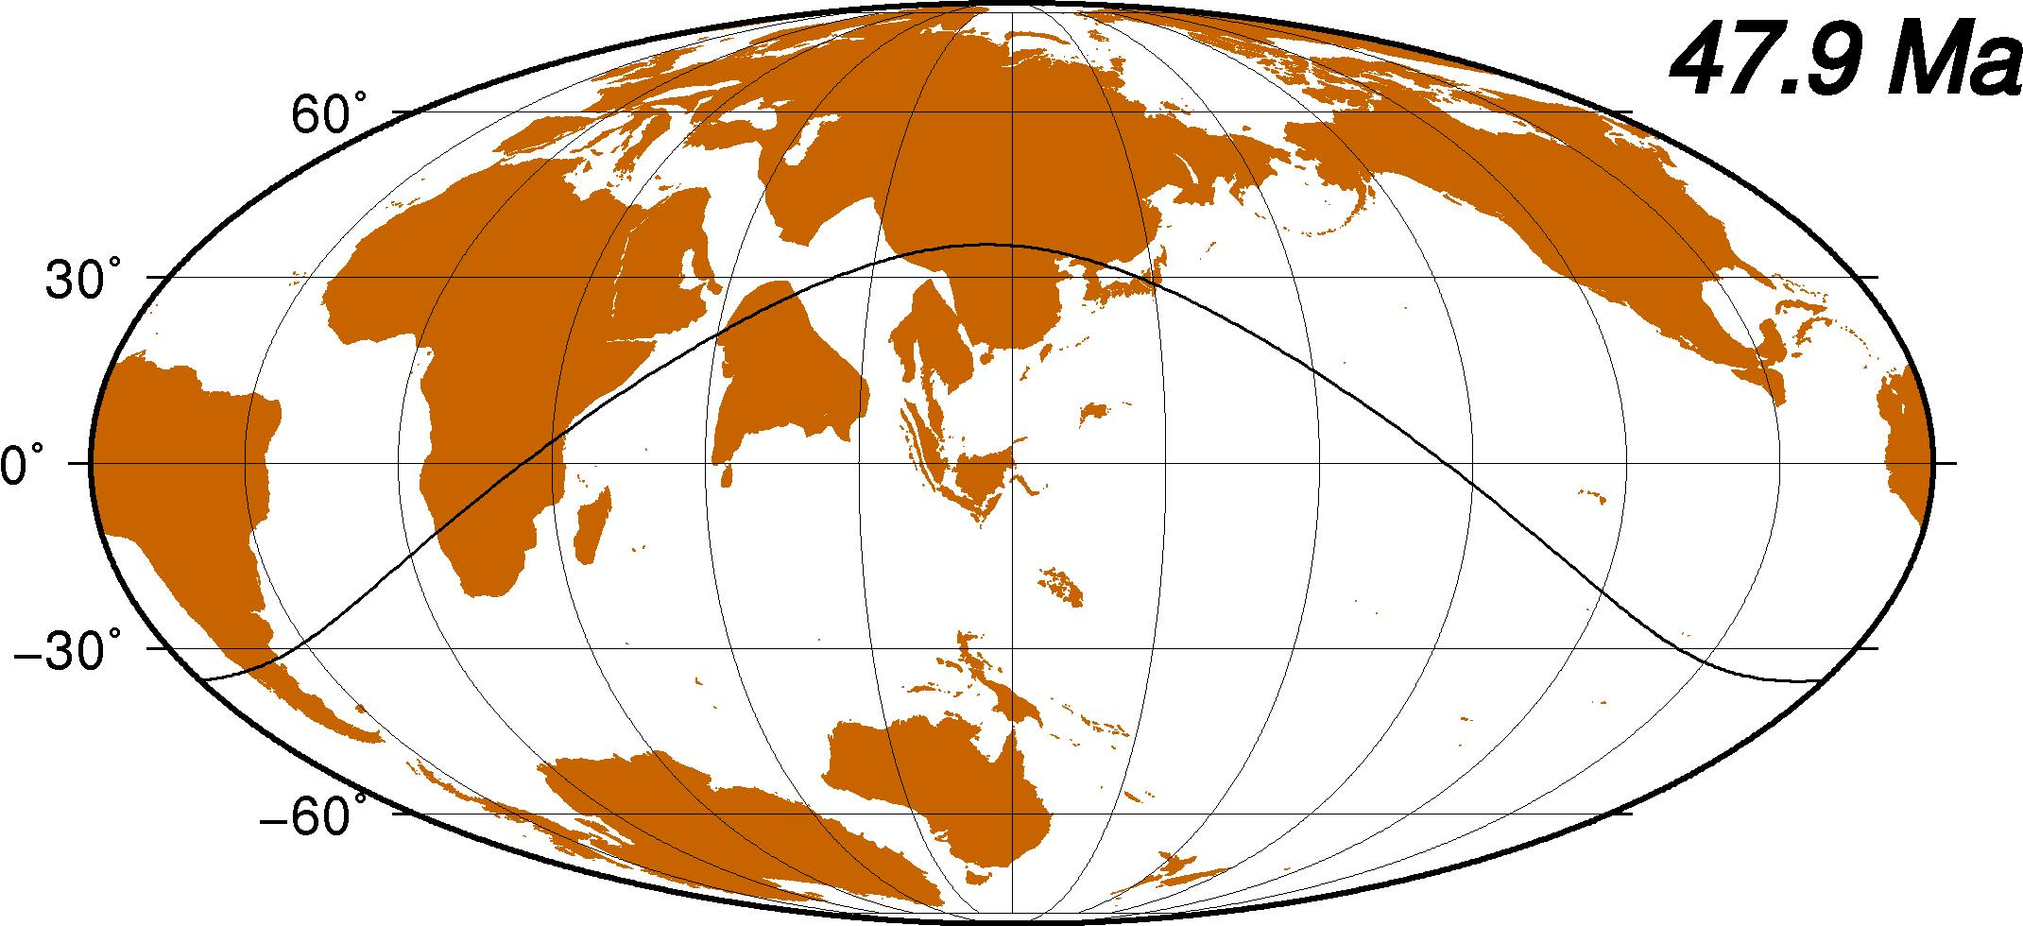

Slide 53
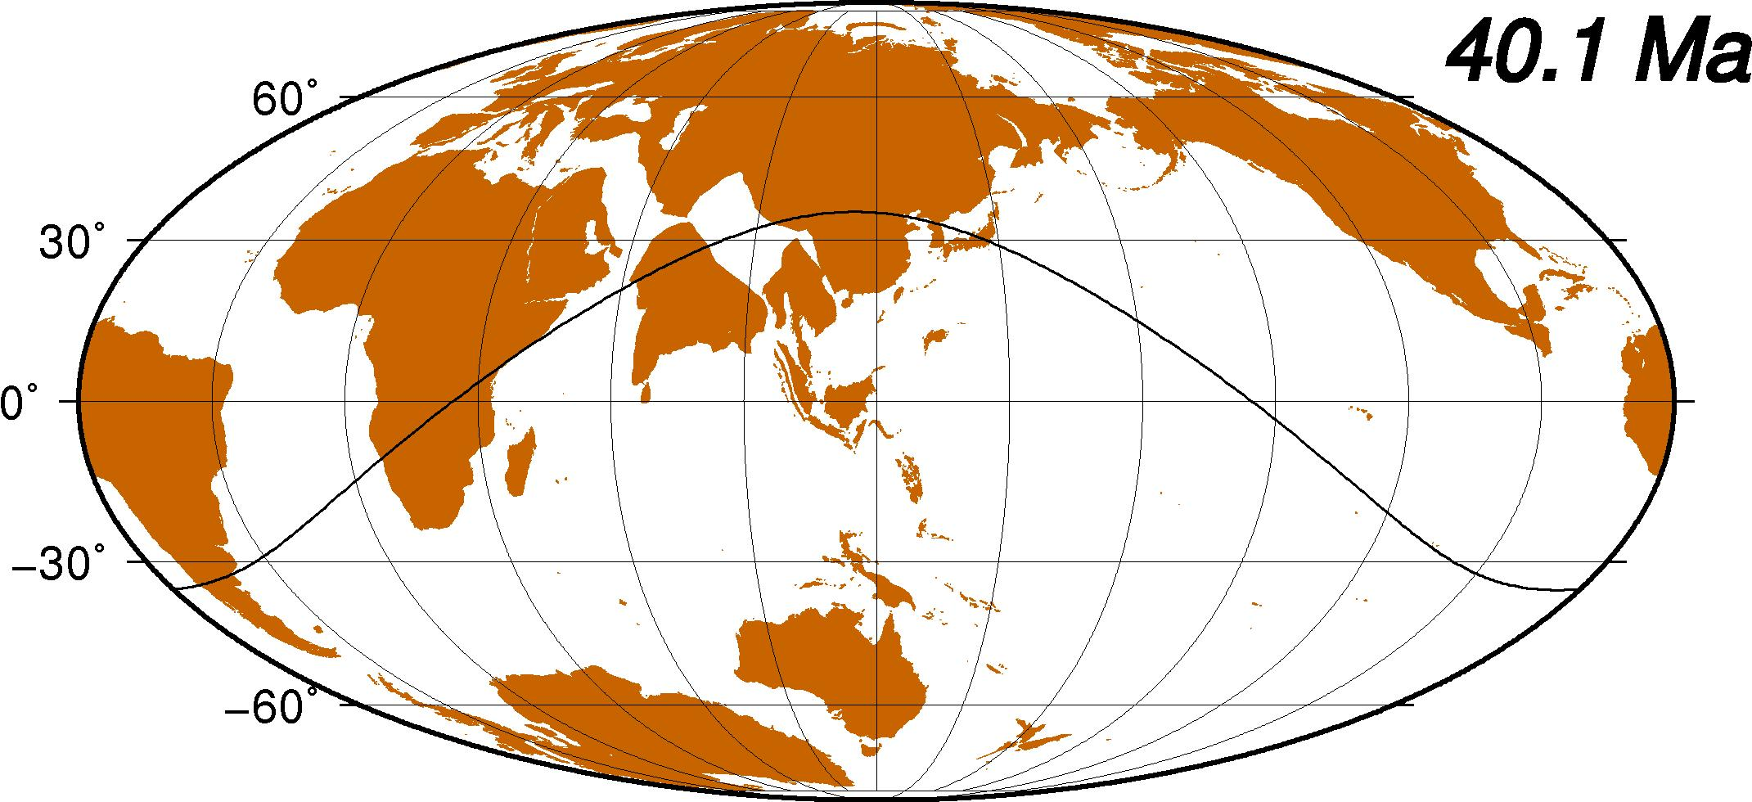

Slide 54
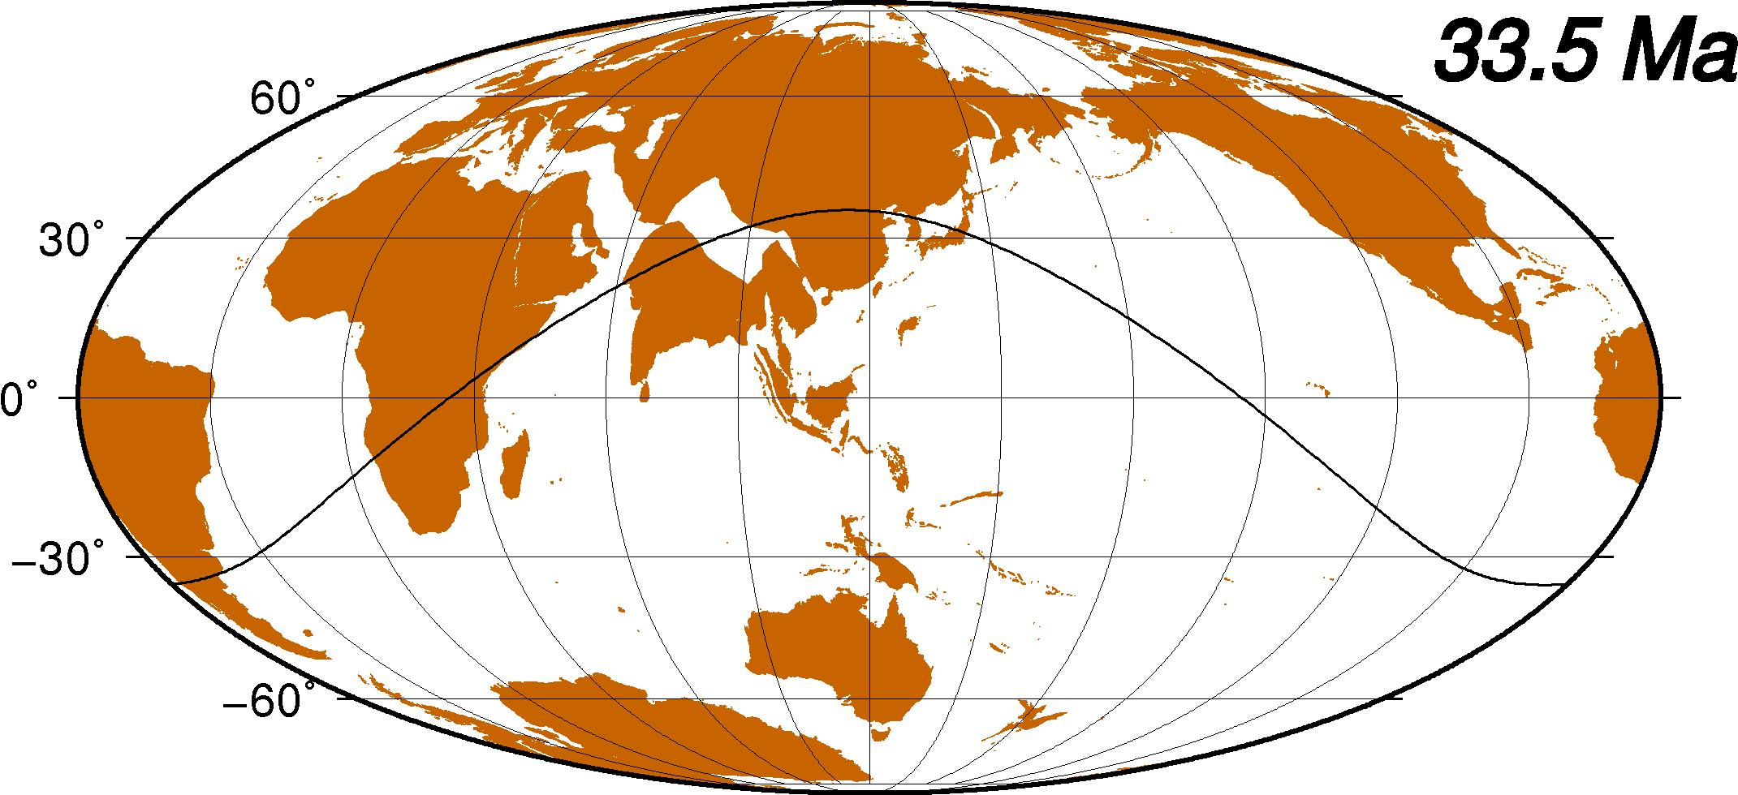

Slide 55


Slide 56


Slide 57


Slide 58


Slide 59


Slide 60


Slide 61


Slide 62


Slide 63


Slide 64


Slide 65


Slide 66

HSRF
complete NET ROTATION = ω>1°/Ma
GJI 2007

