Slide 1



WHAT CAN WE MEASURE?
uplift rate
subsidence rate
elevation
UPPER PLATE
convergence rate
envelope dip
PTt rocks
decollement depth
monocline dip
?
LOWER PLATE
subduction hinge migration
upper & lower plate thickness
thermal state
gravity anomaly
slab seismicity (depth, dip, stress orientation)
backarc spreading ?
subduction rate

Slide 2
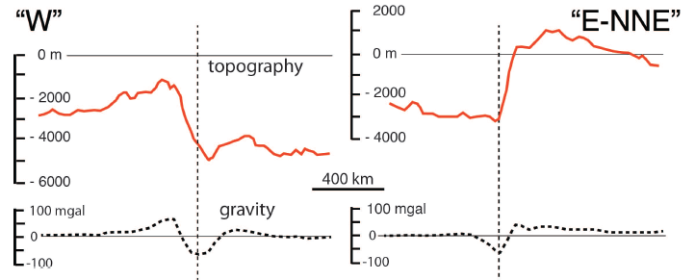
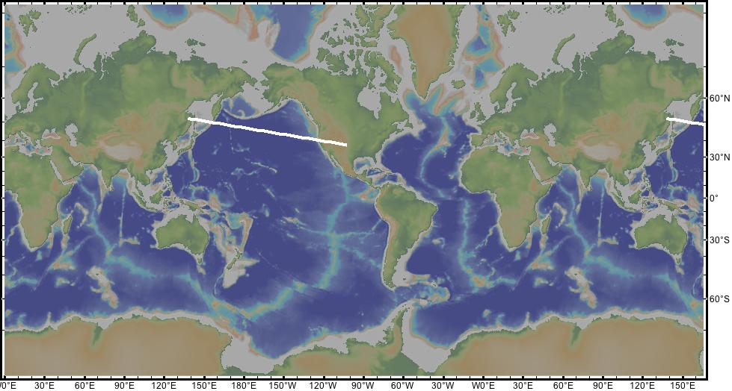
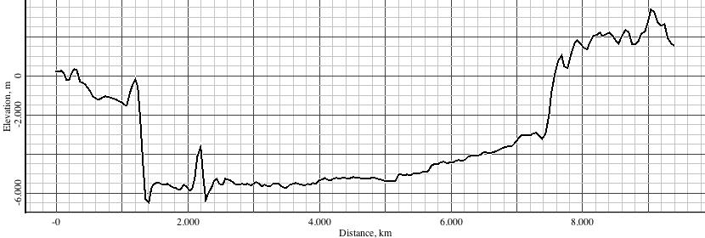
N-CORDILLERA
KURILI

Slide 3
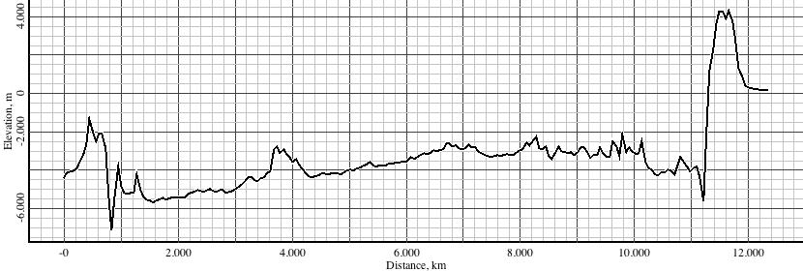
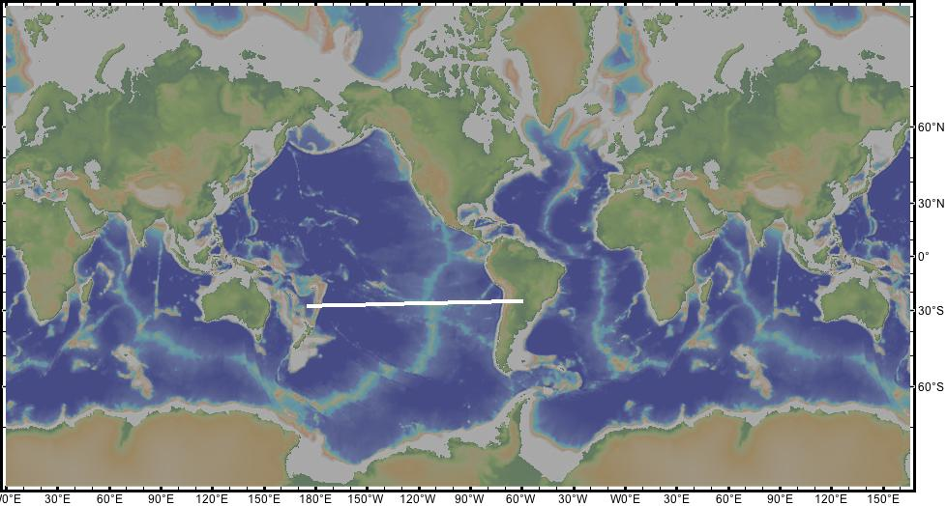
ANDES
TONGA

Slide 4
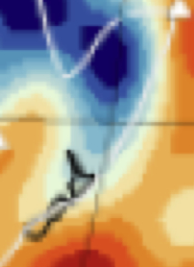
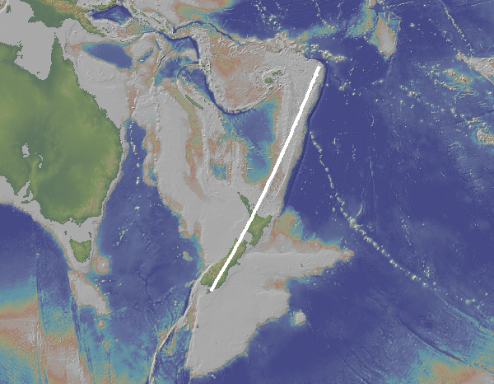
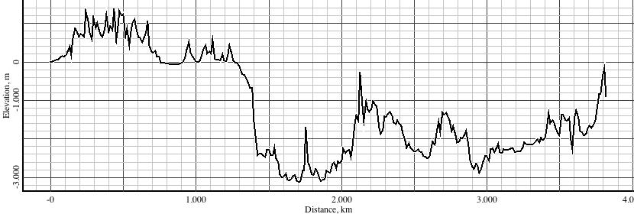
E-directed
New Zealand
W-directed
Tonga-Kermadec

Slide 5
MORPHOLOGIC RELIEF
STRUCTURAL RELIEF
E-NE-directed subductions
20 km
10 km
W-directed subductions
5 km
300 km

Slide 6
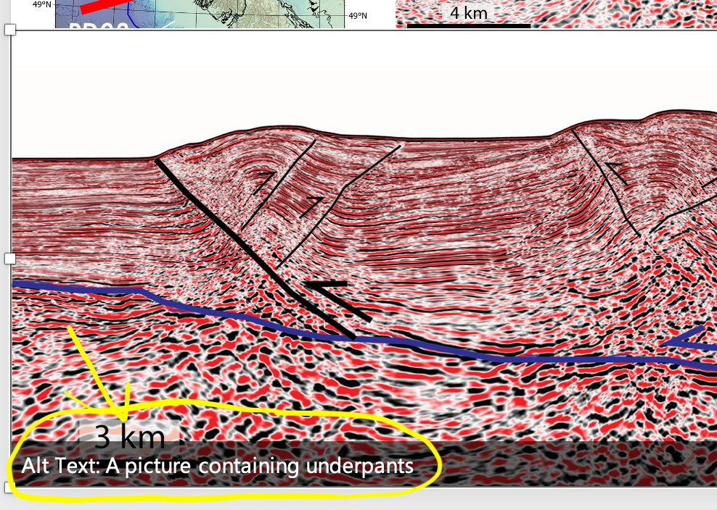

Slide 7
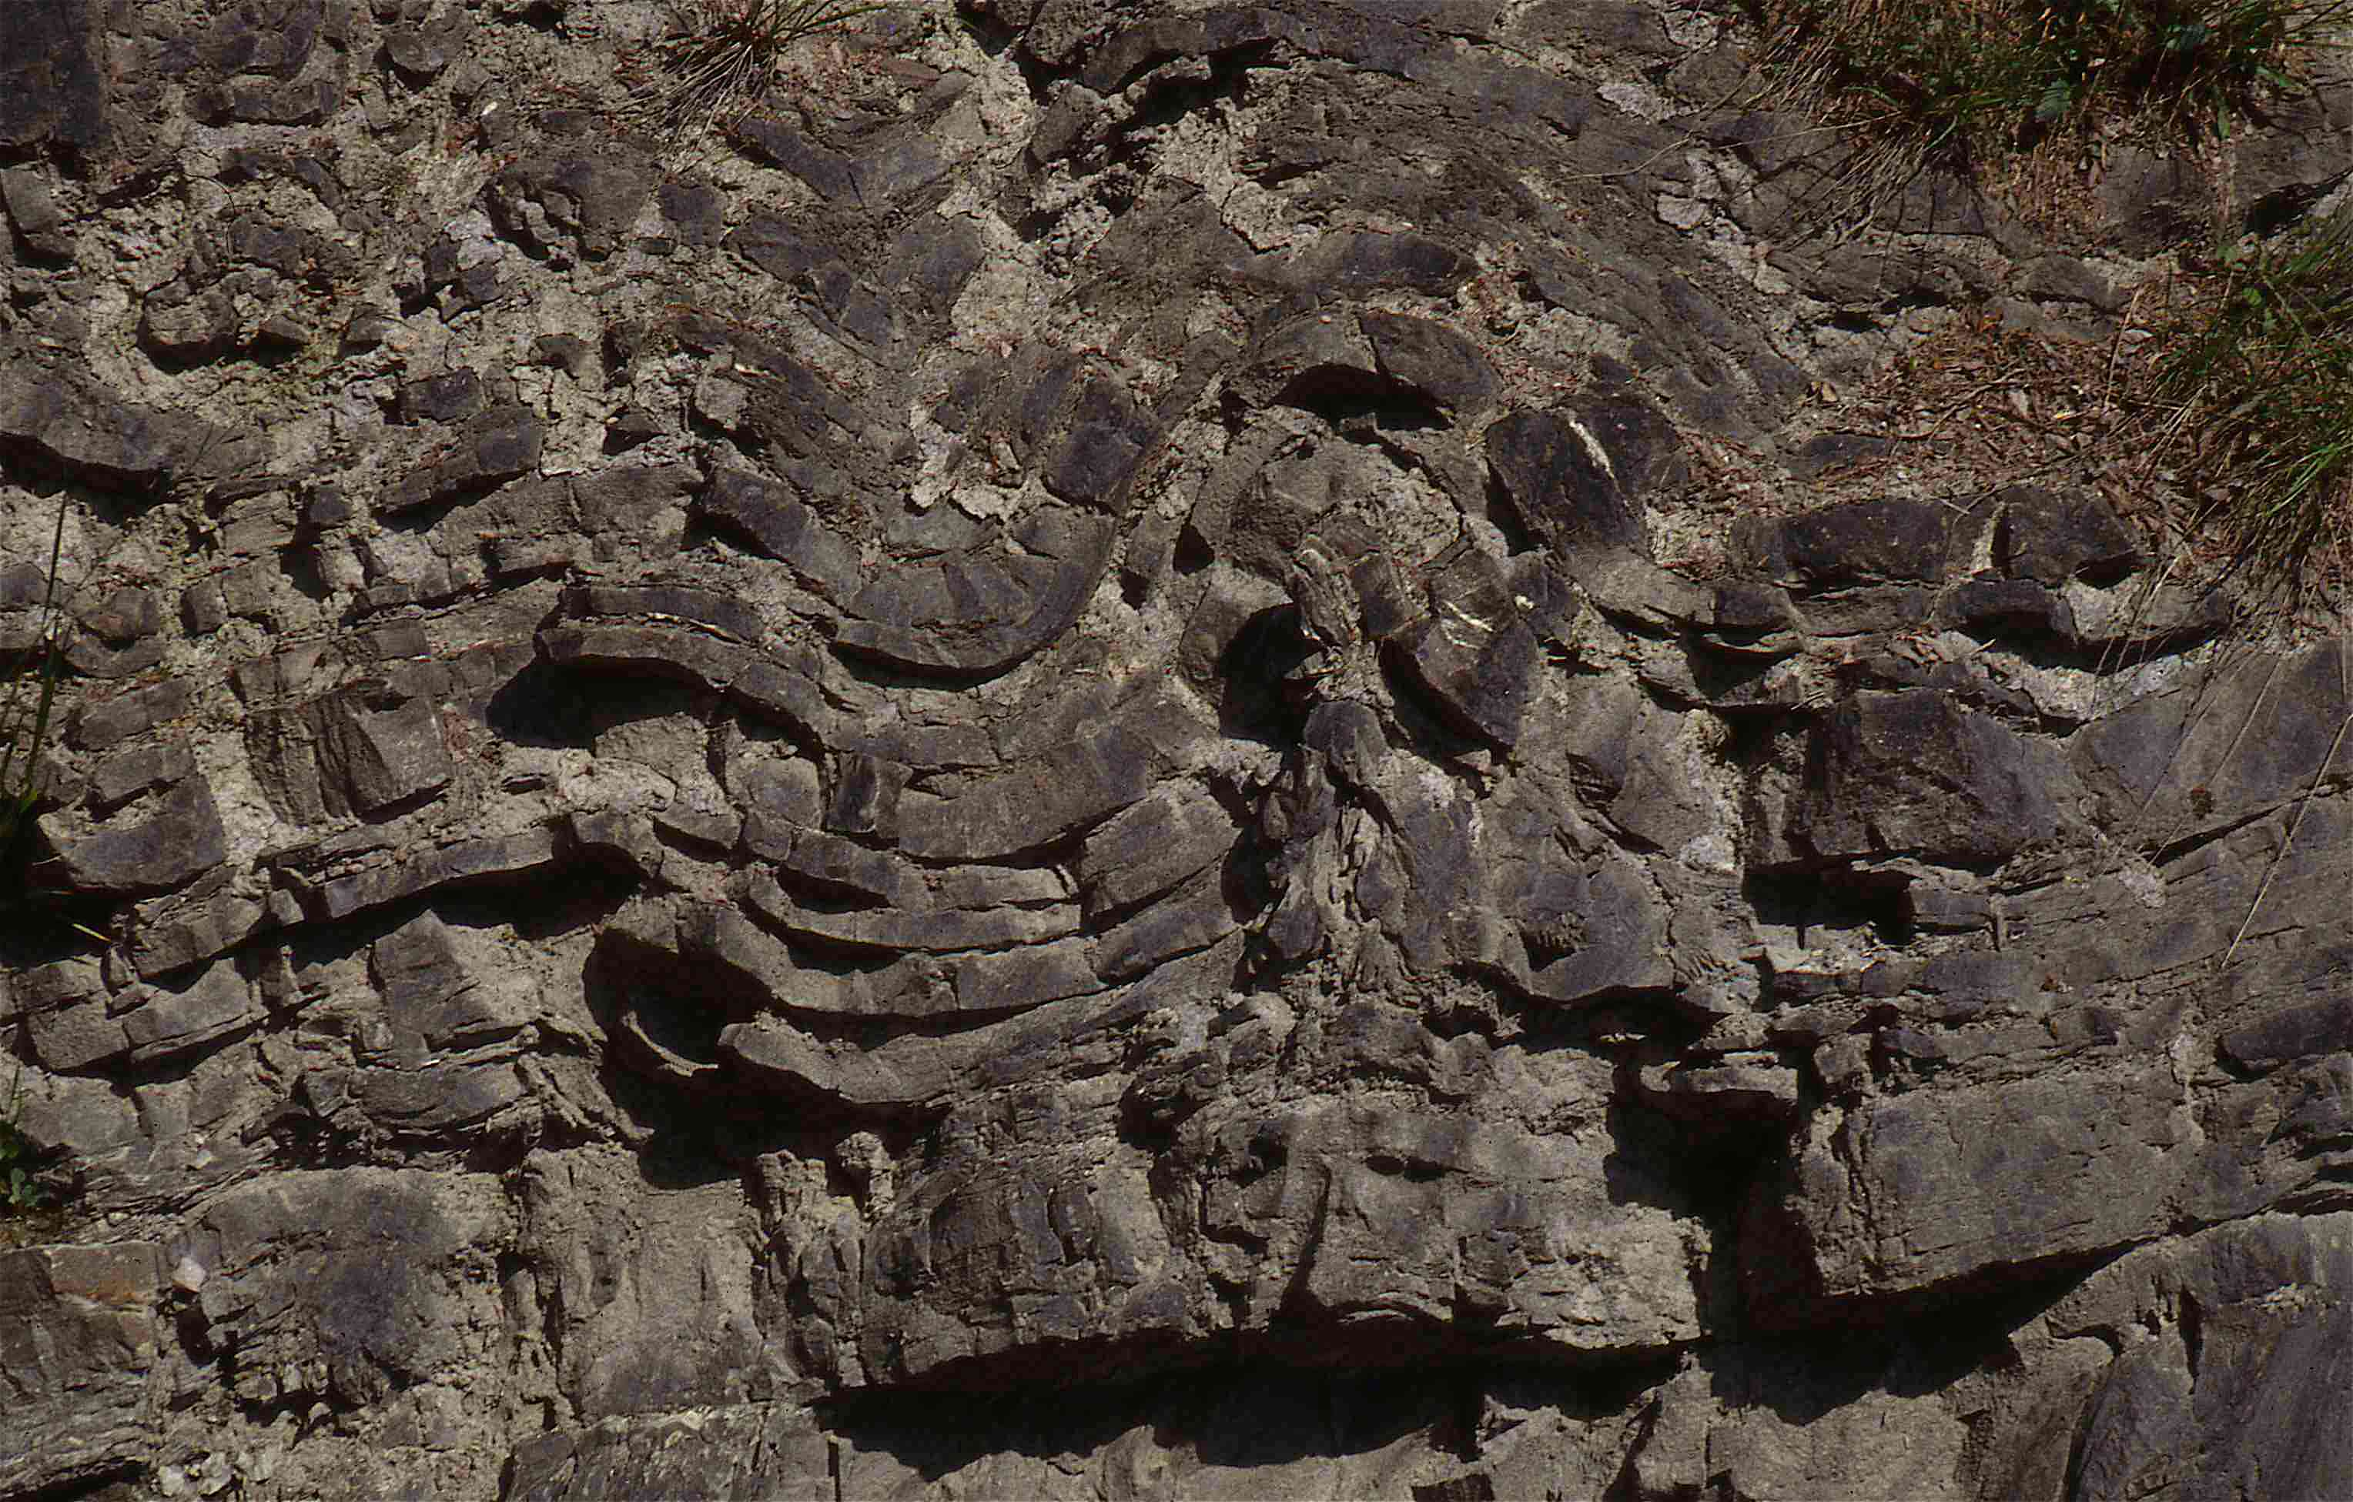
Piega da buckling o buckle fold

Slide 8
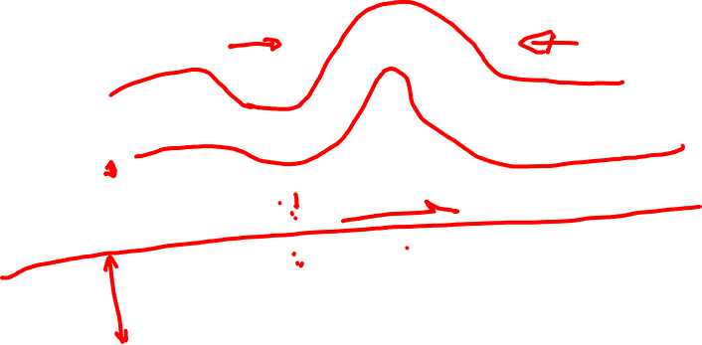
Piega da buckling o buckle fold

Slide 9
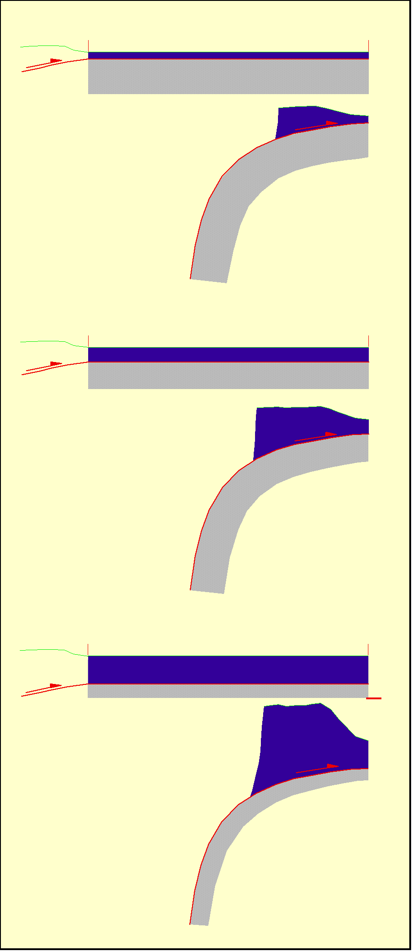
Deeper Decollement = Thicker Prism

Slide 10
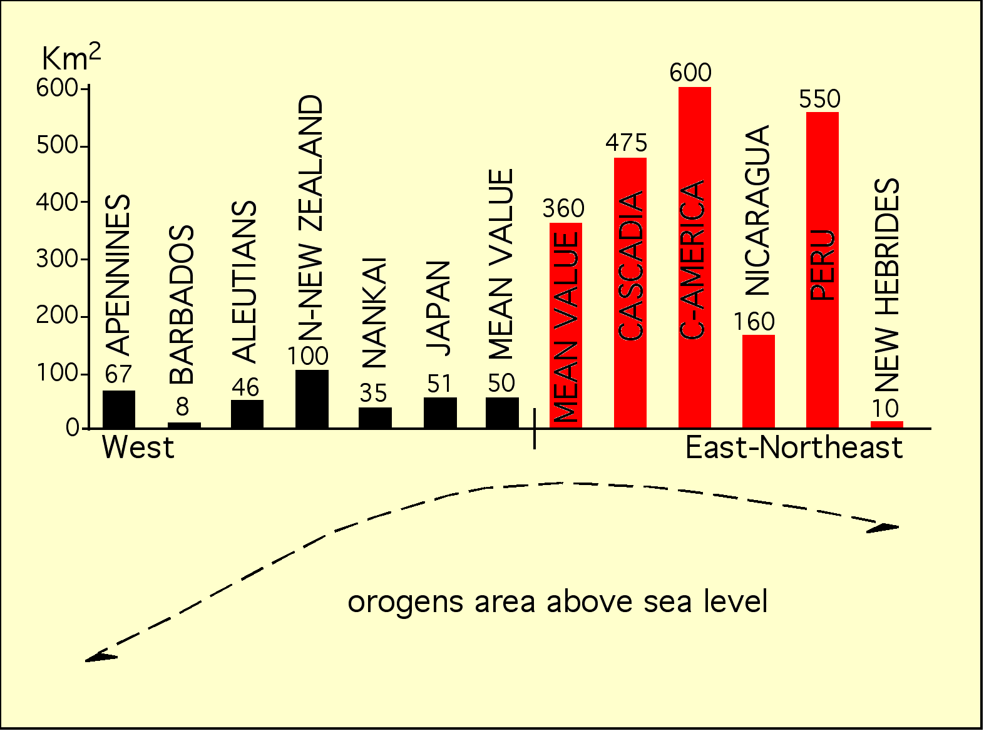

Slide 11
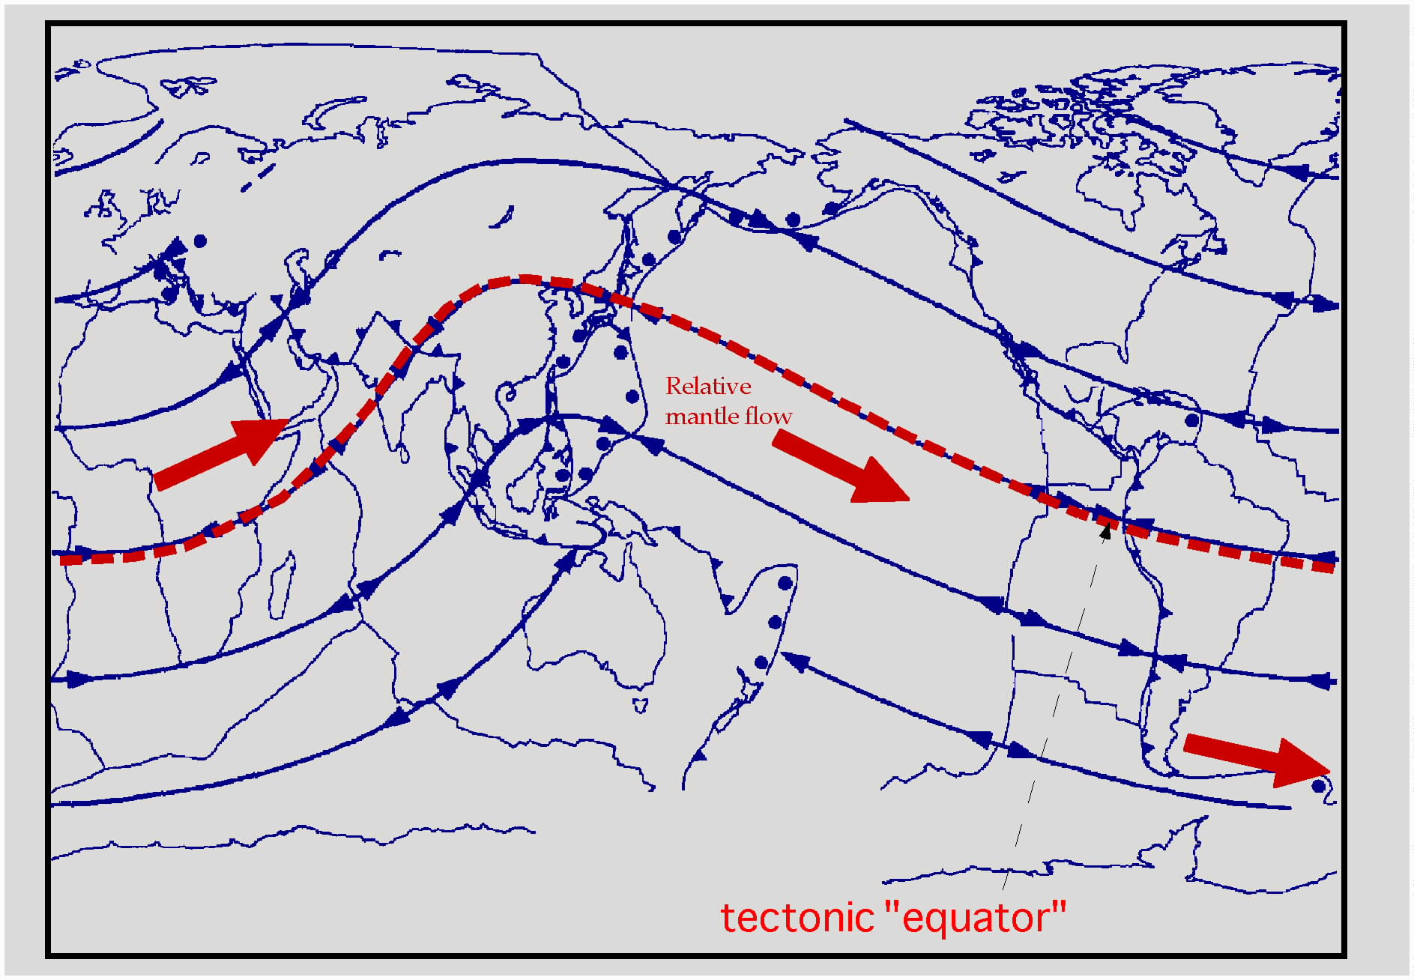
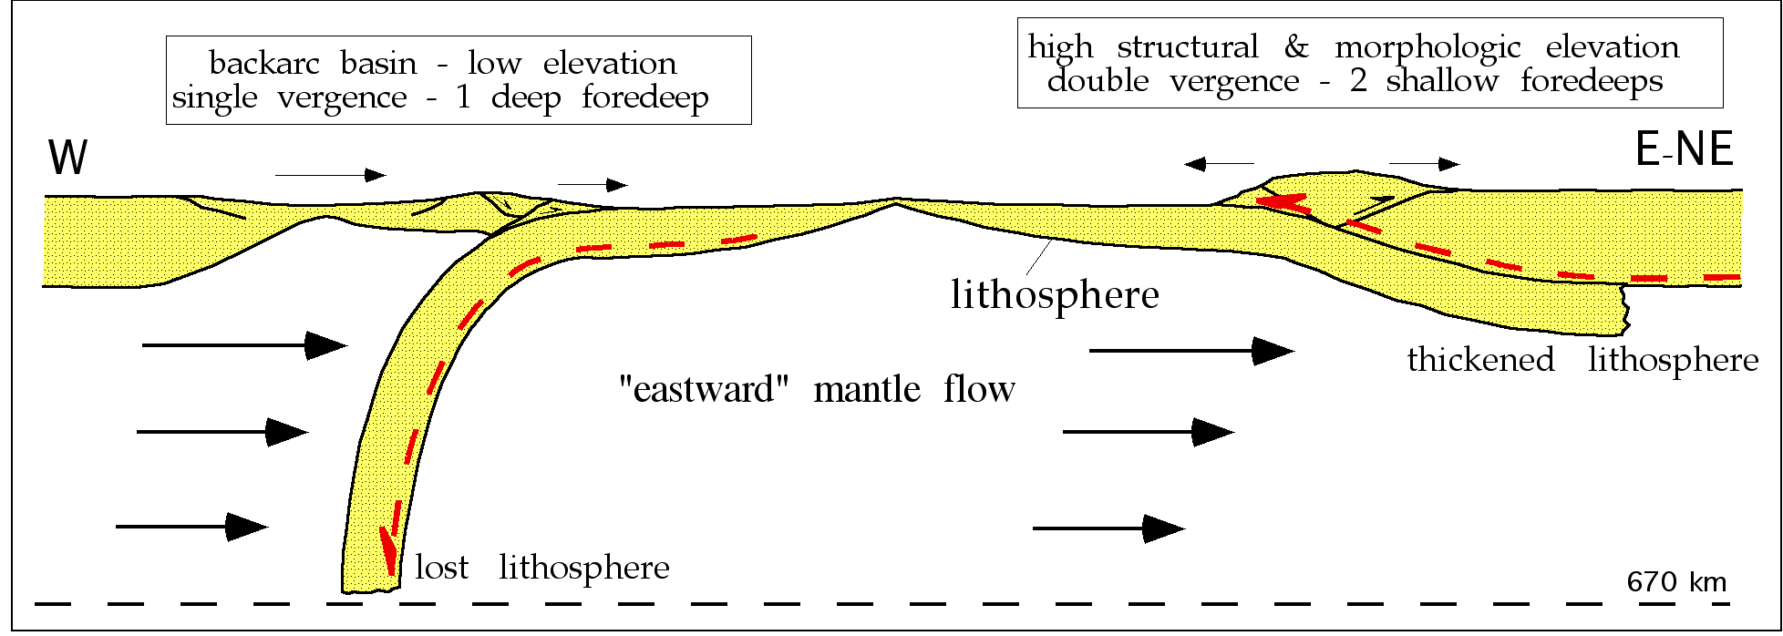
U
H
H
U
L
L
H=slab hinge
L=Lower plate
U=Upper plate
Mainstream of plate motions based on tectonic features

Slide 12
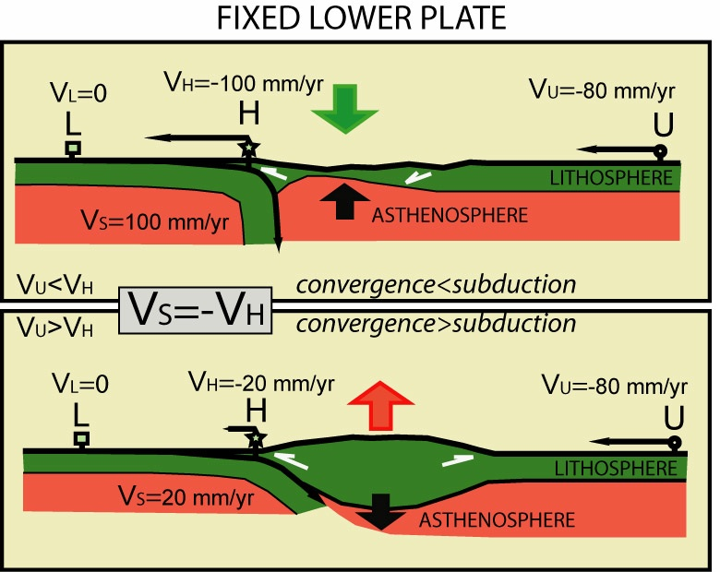

Slide 13
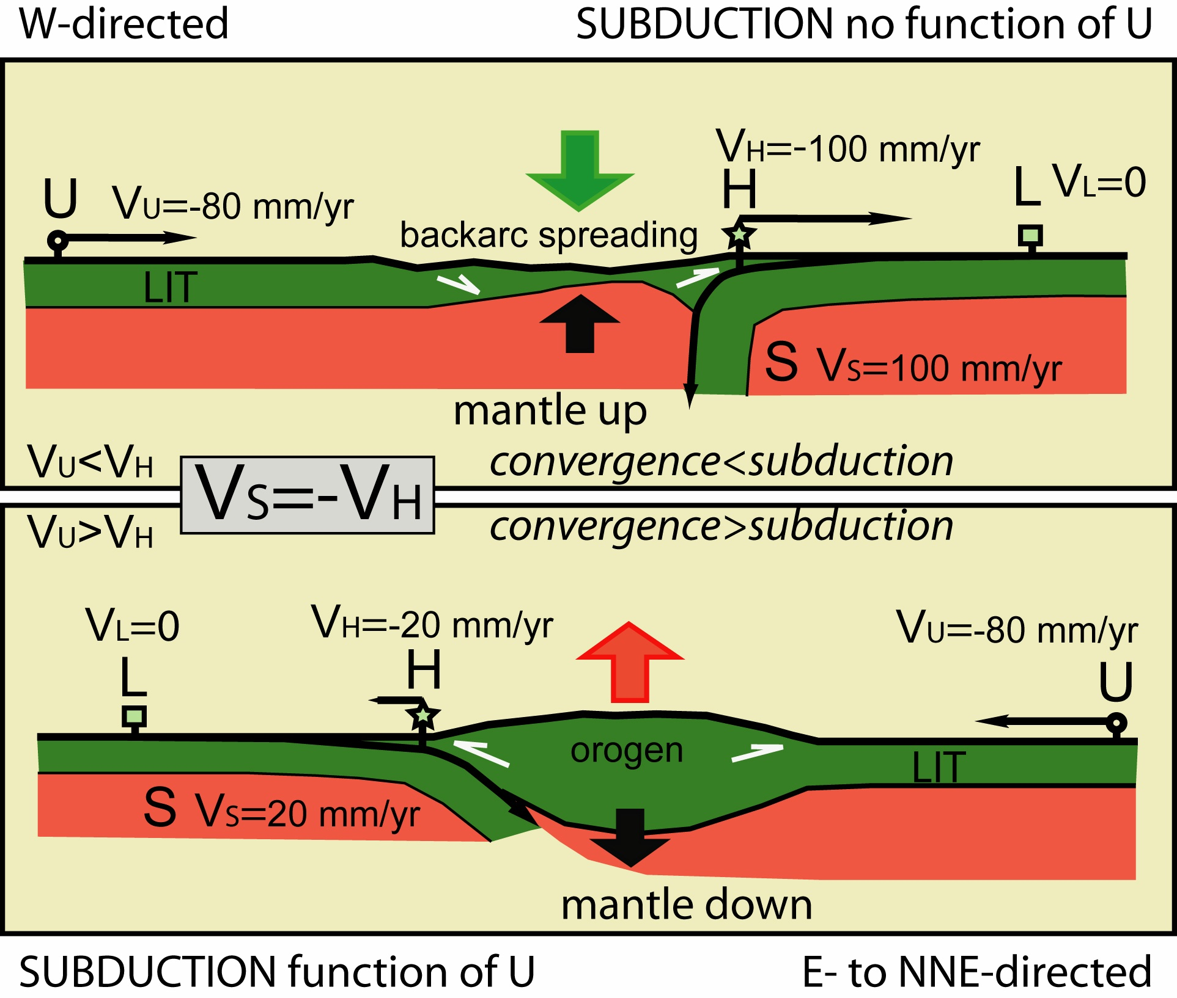

Slide 14
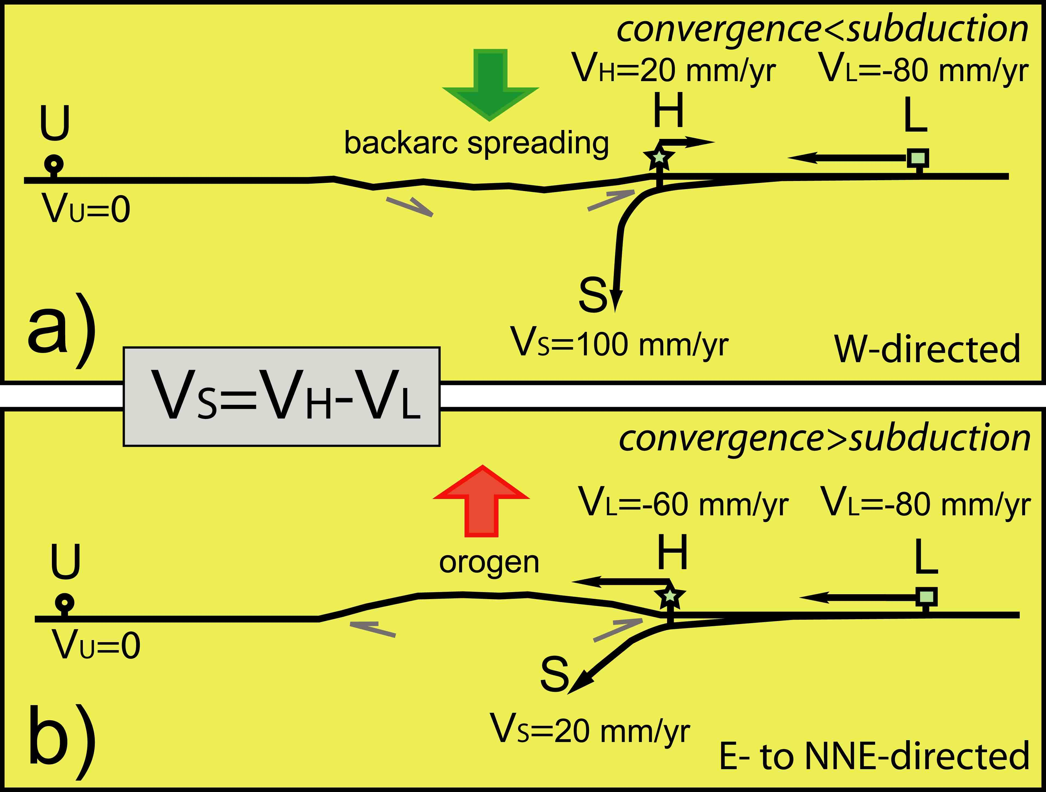

Slide 15


Slide 16



















Slide 17
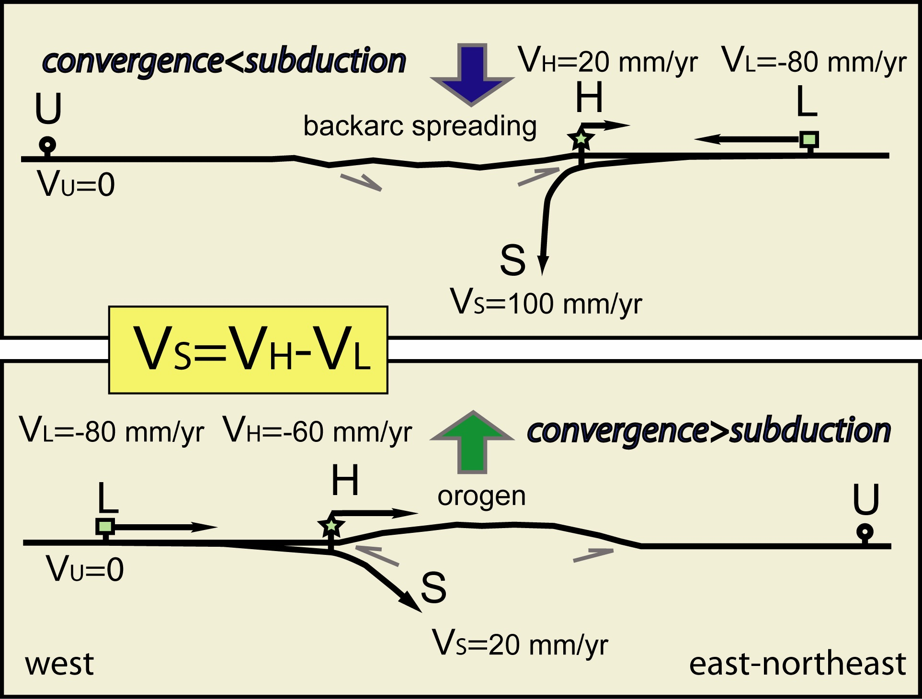








ESR 2007

Slide 18
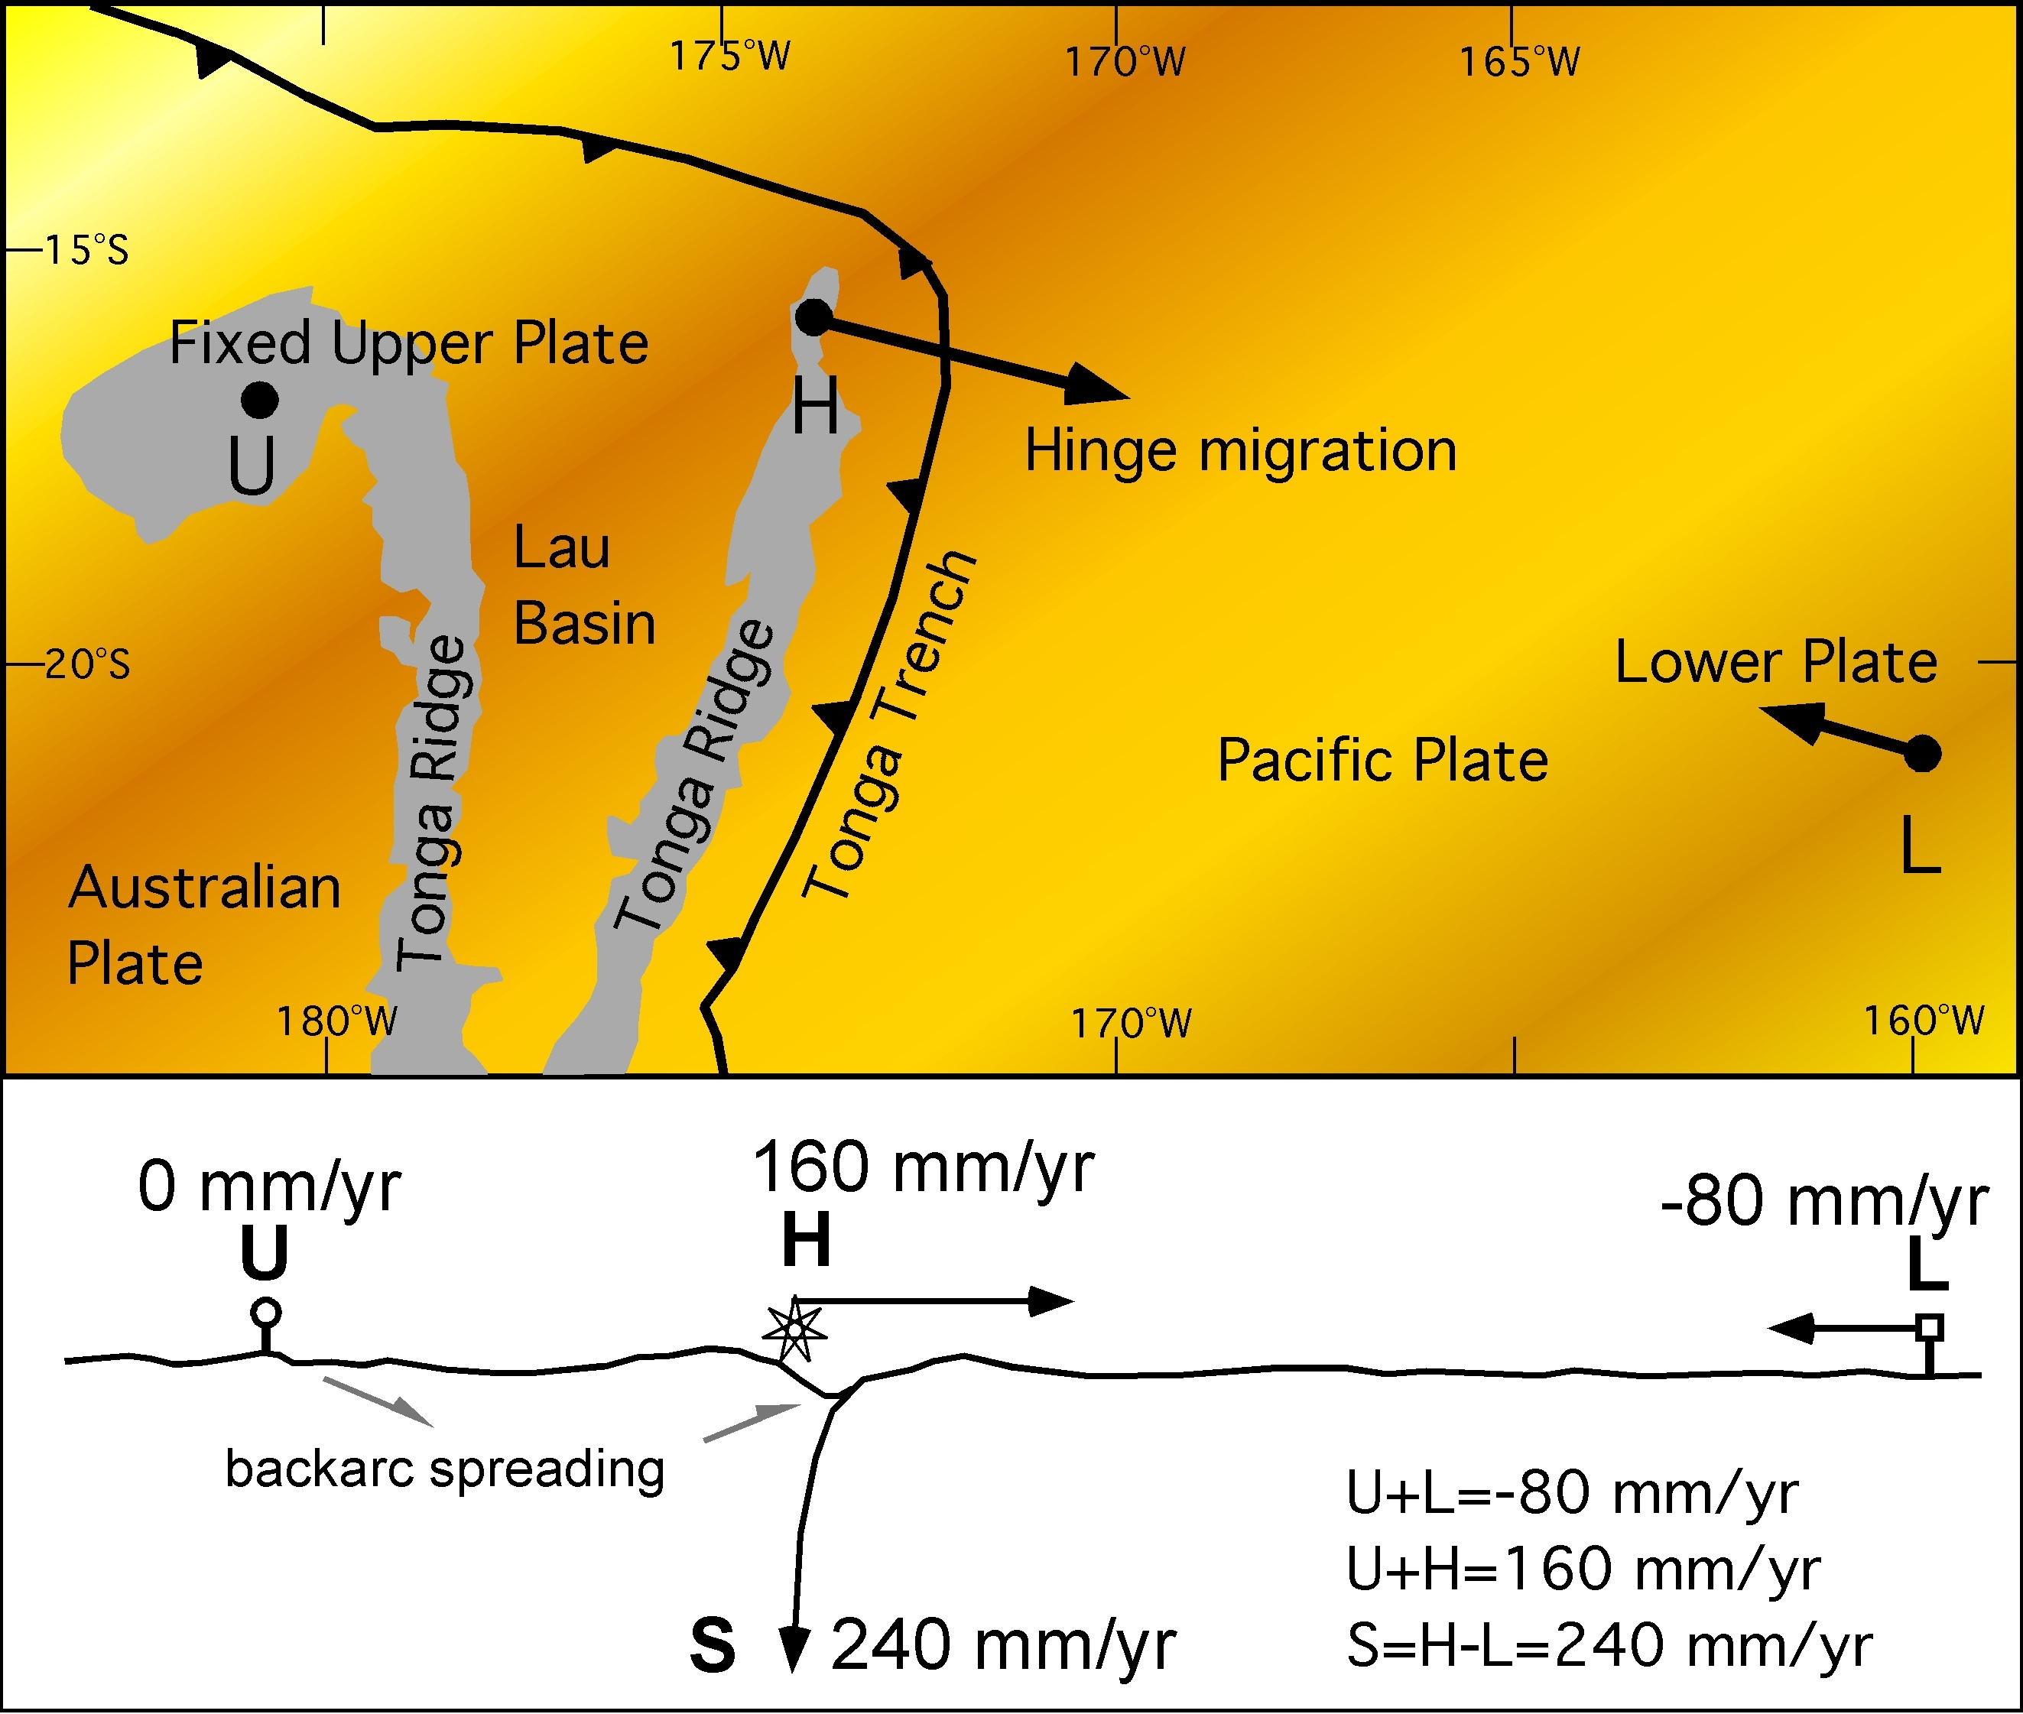










Slide 19


Slide 20
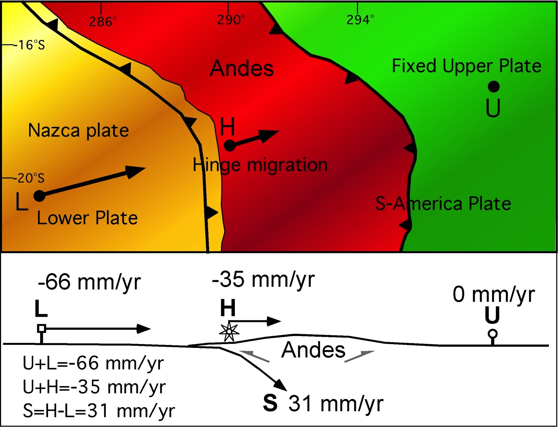


Slide 21


Slide 22






Slide 23
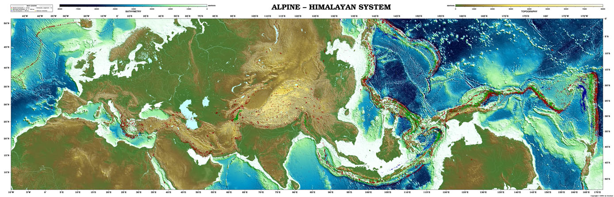

Slide 24
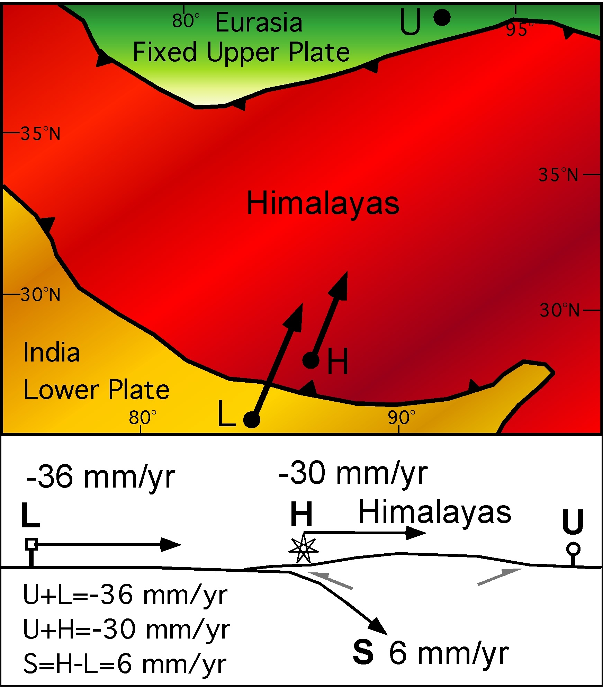

Slide 25
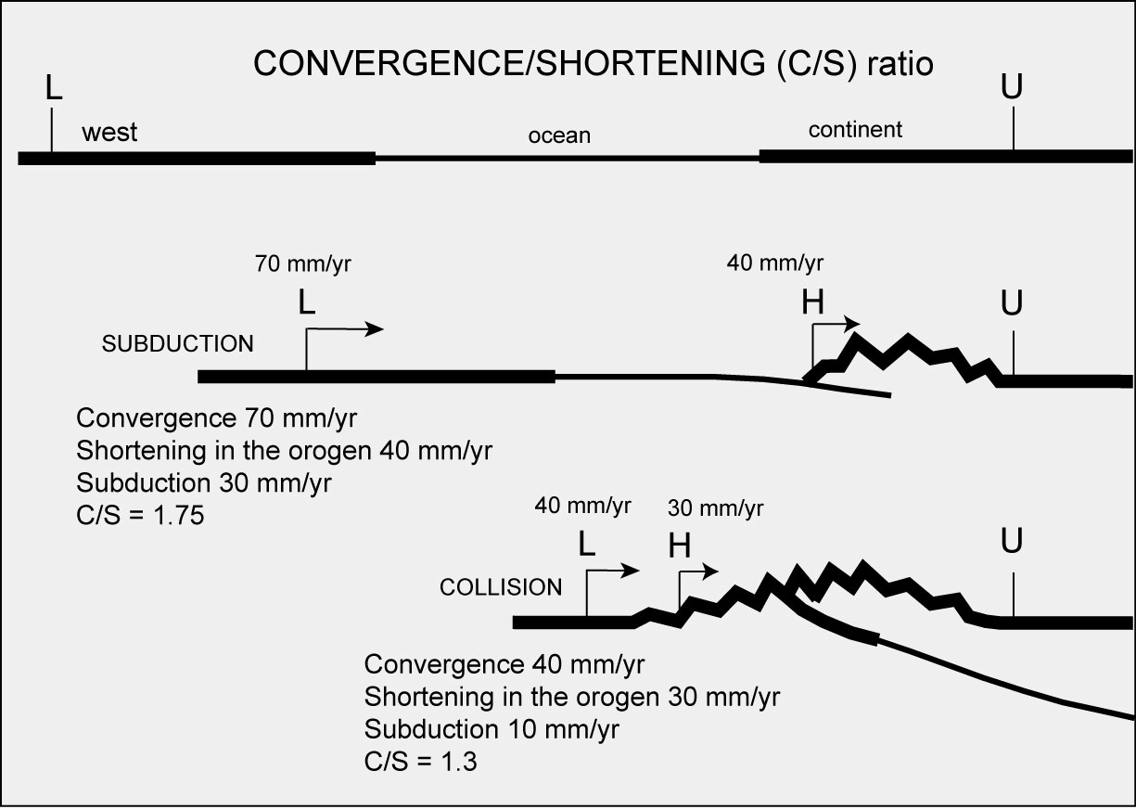

Slide 26











Slide 27












Slide 28













Slide 30







Slide 31



















Slide 32
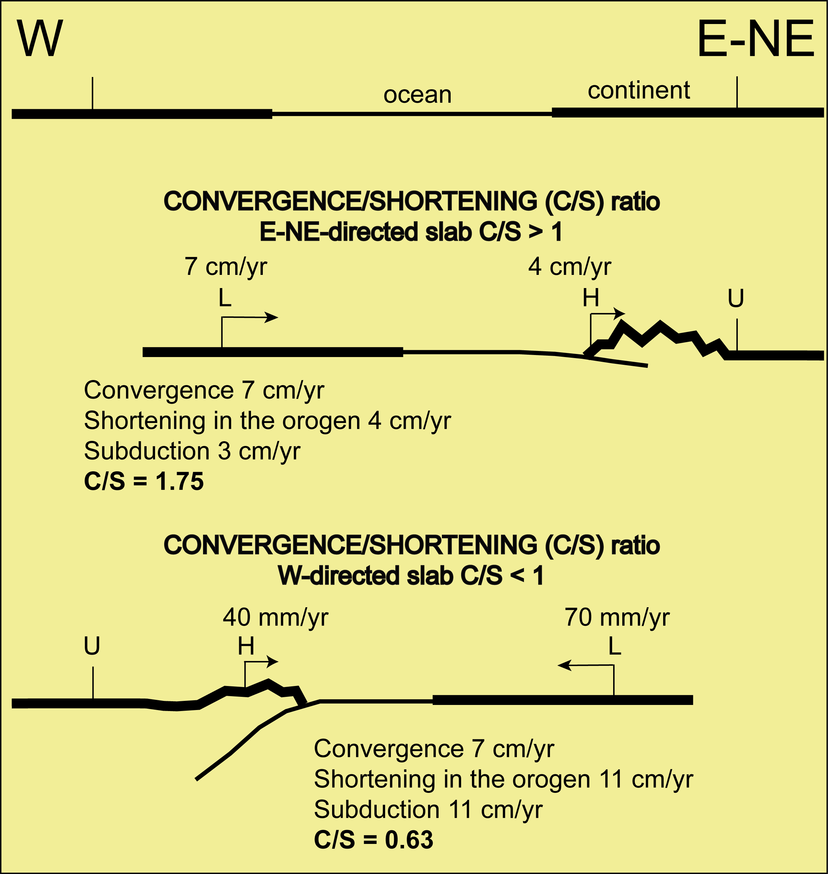

Slide 33
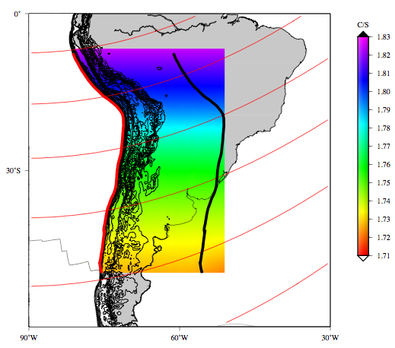
Higher convergence/shortening ratio, higher lithosphere viscosity

Slide 34
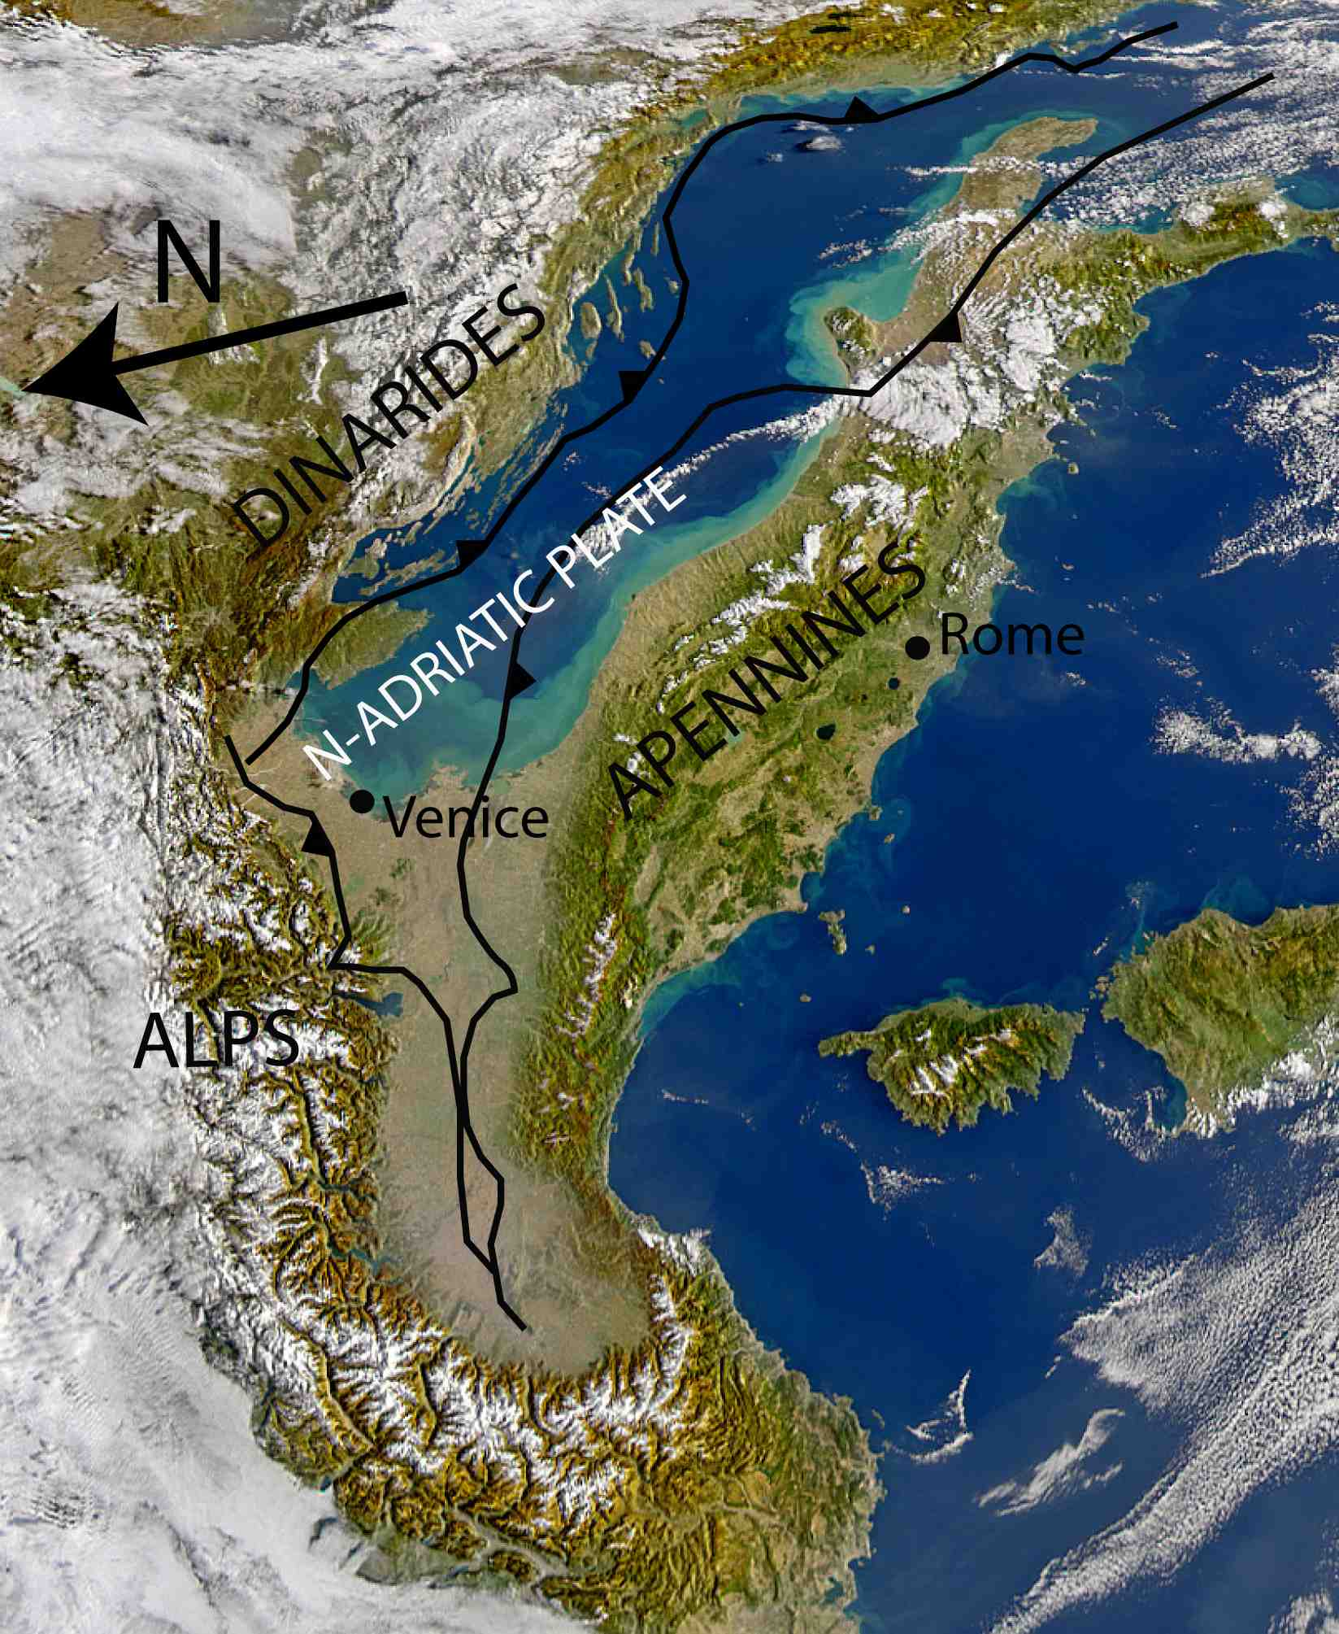




Slide 35
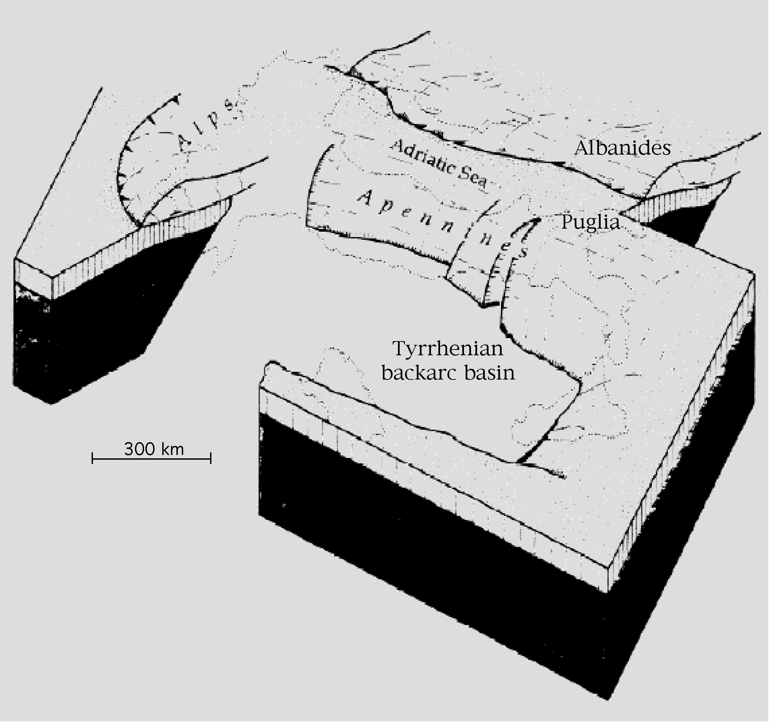


Slide 36
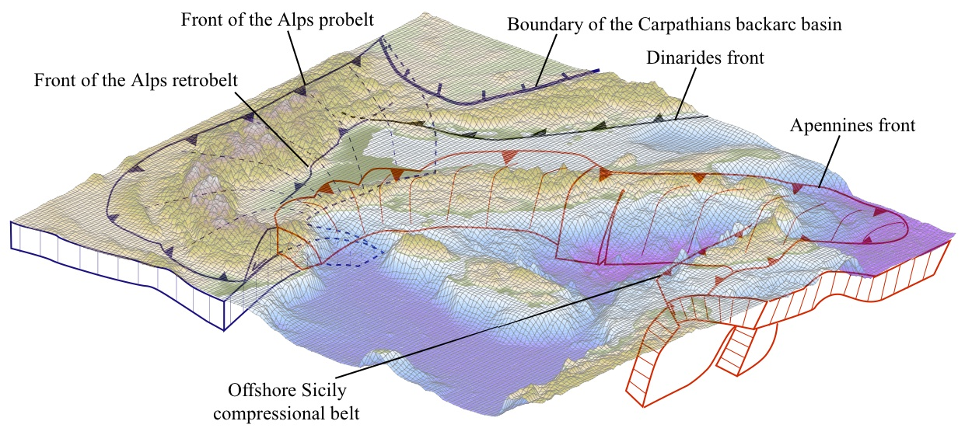

The subductions in the Central Mediterranean
Carminati and Doglioni, ESR 2012

Slide 37
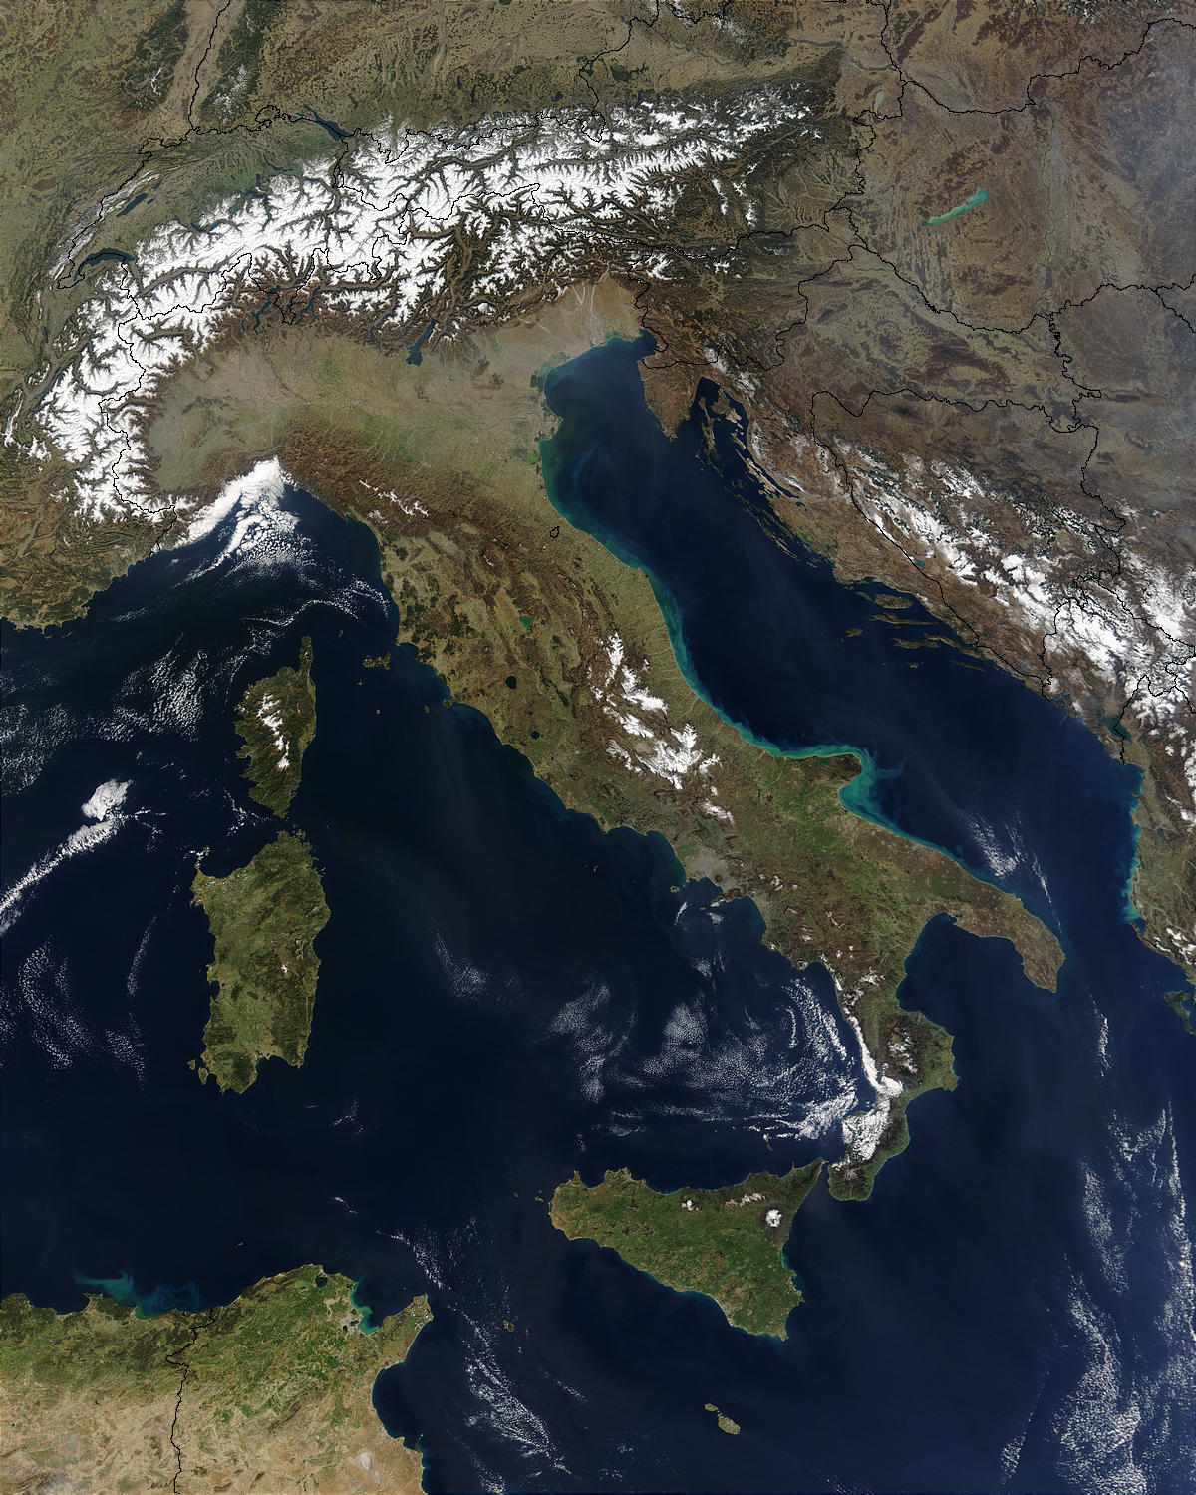
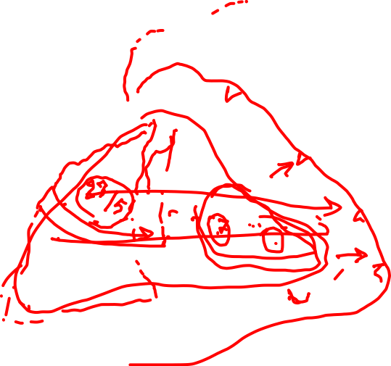
Subduzione
Alpi
Subduzione
Appennino

Slide 40
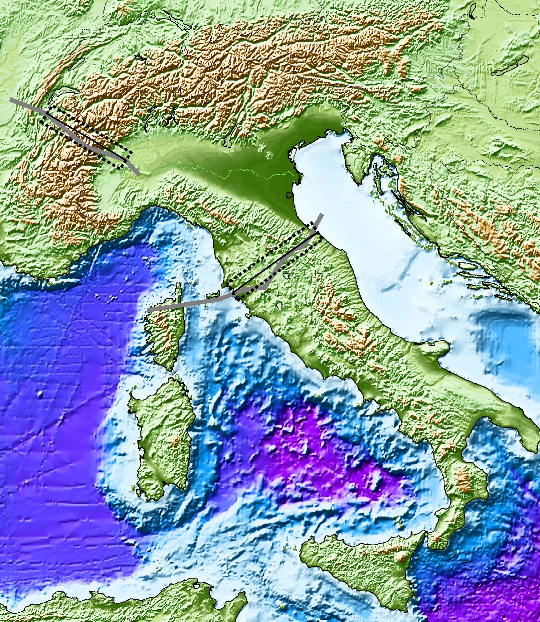
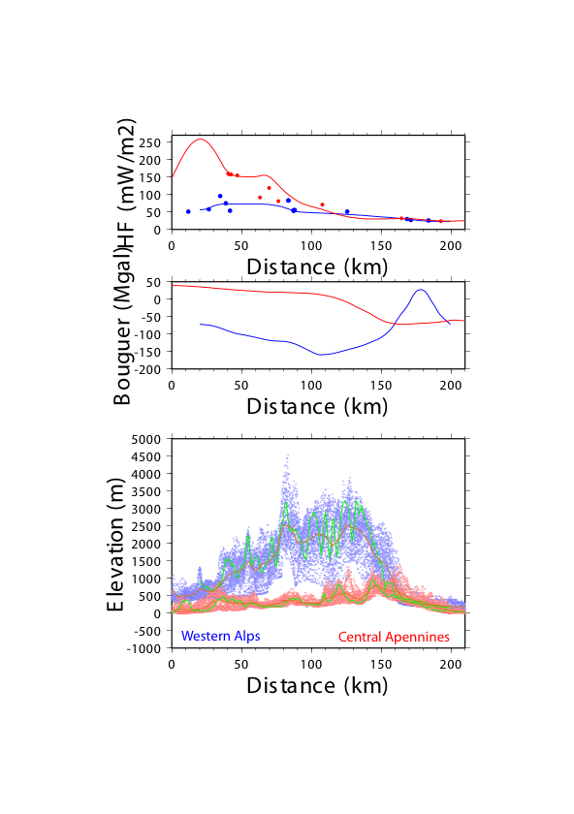
TOPOGRAPHY
Alpine subduction
Alps
Apennines
subduction
Apennines
Carminati et al., 2004 SGI

Slide 41
BOUGER ANOMALY & HEAT FLOW
Alpine subduction
Apennines
Alps
Apennines
subduction
Apennines
Alps
Carminati et al., 2004 SGI

Slide 42
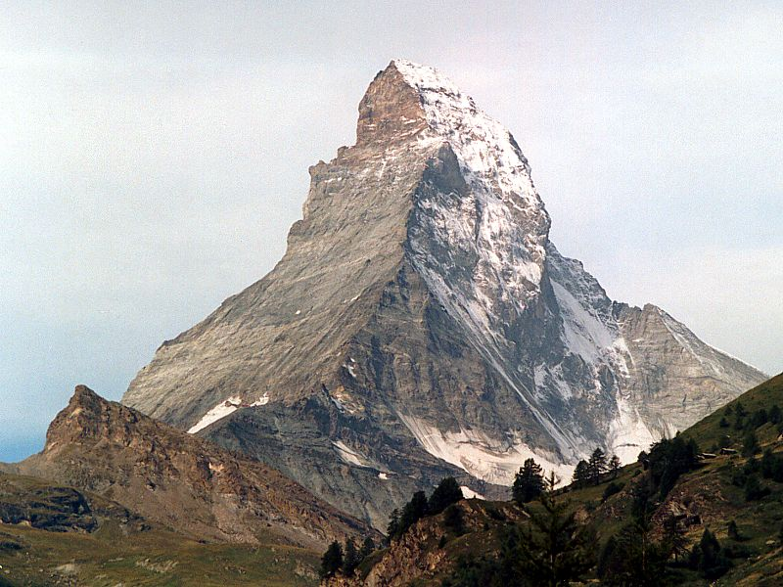
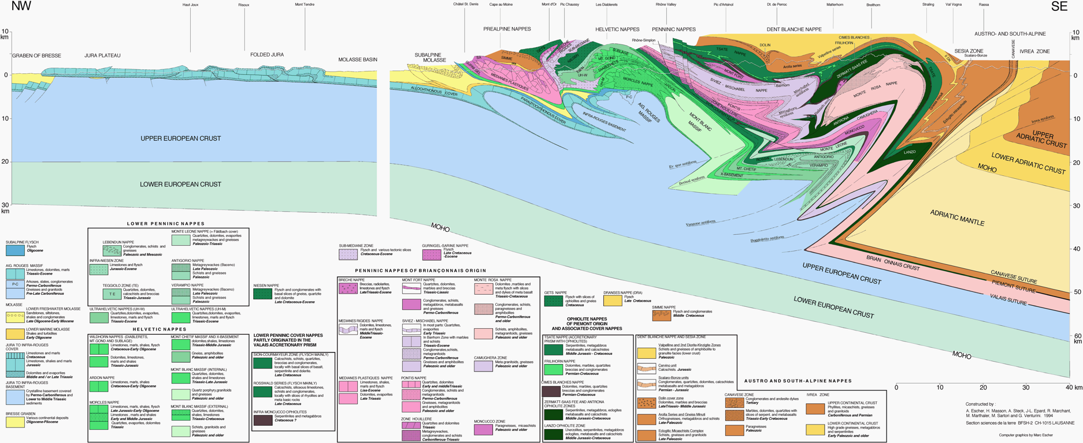

Adriatic plate basement
Tethys ophiolites
3
European plate
gneiss
2
1
2
1
3
Escher et al., 1997 NFP20

Slide 43
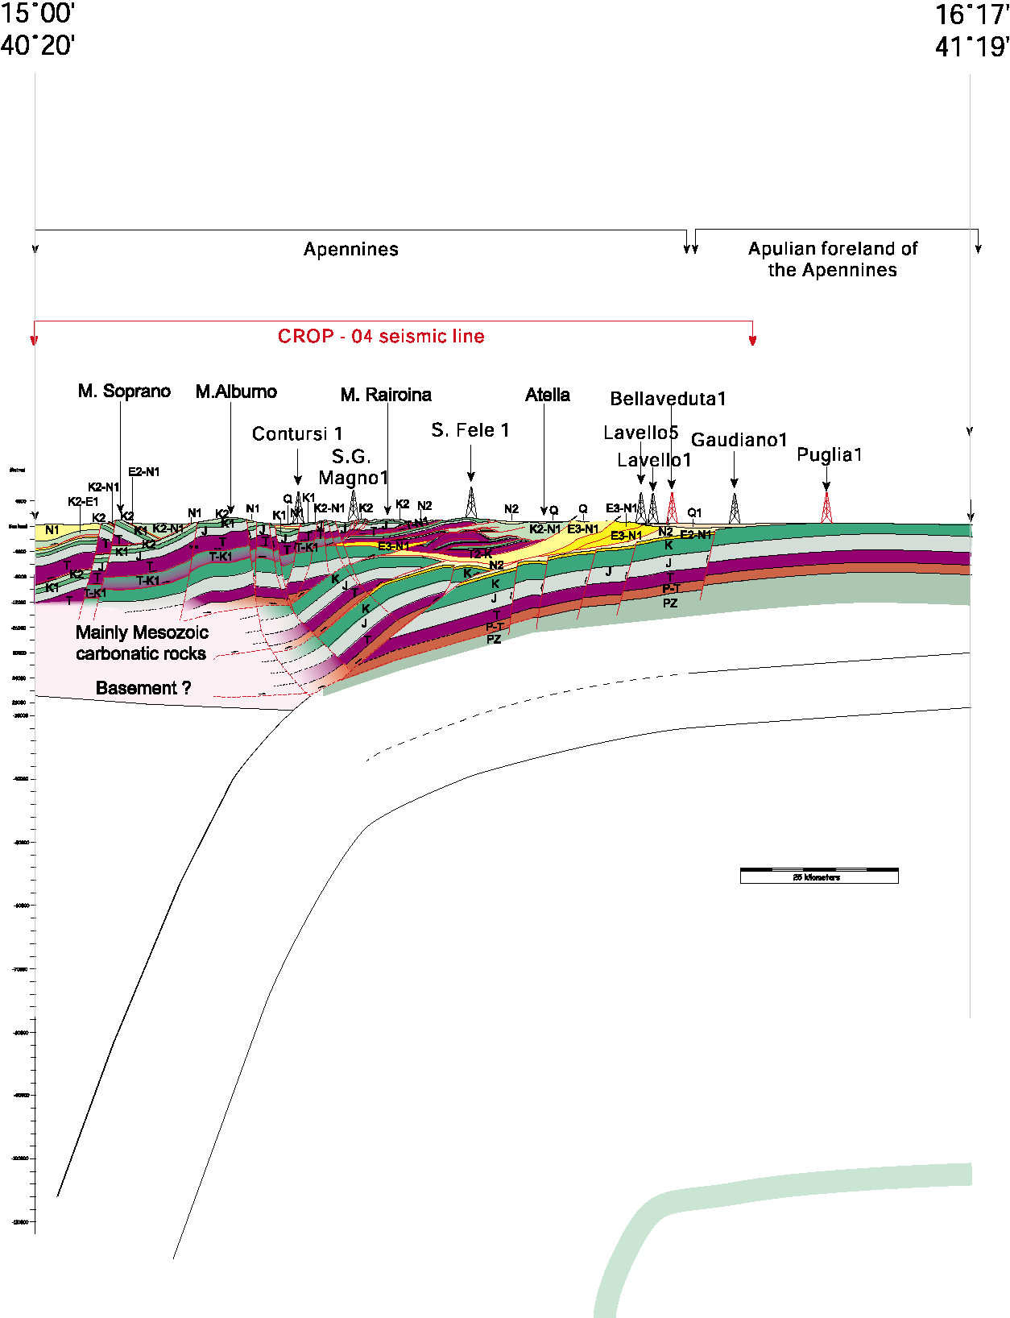
New Moho
Old Moho

Slide 44
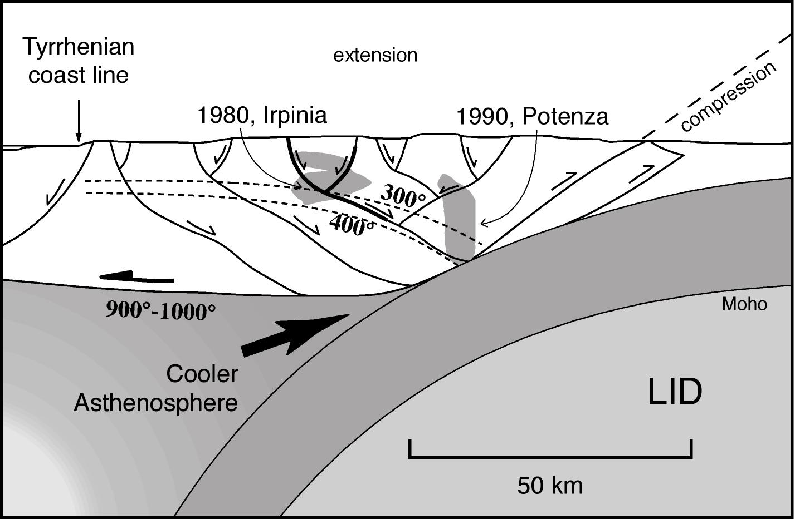
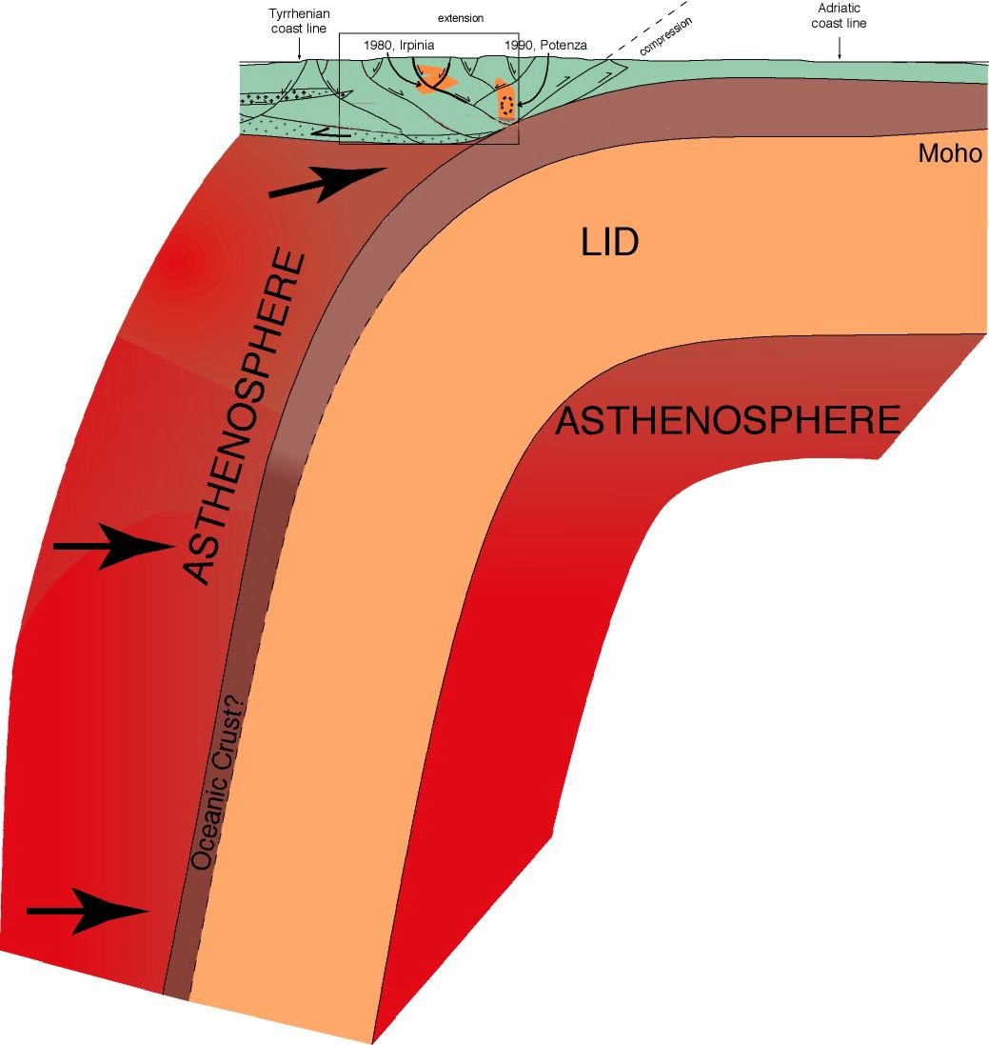

Mantle -ρ deficit
OVER-
COOKED
L.OIL
H.OIL
GAS
extension
Mantle
wedging

Slide 45
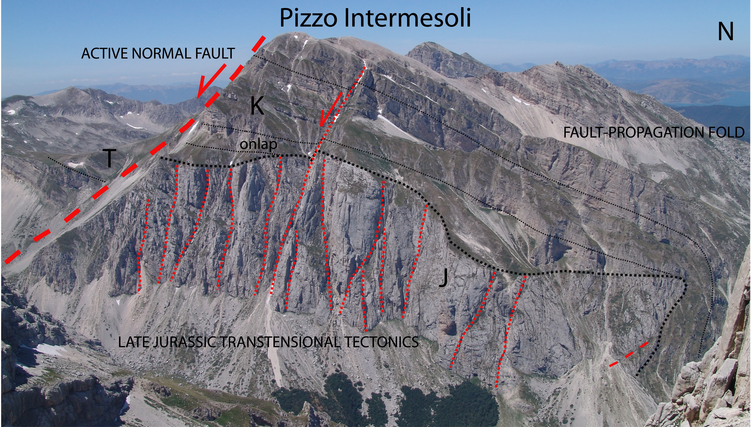
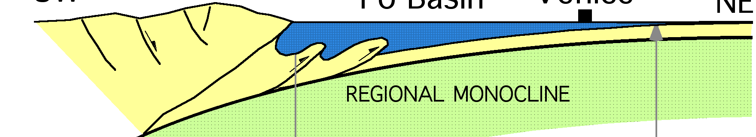
Gran Sasso Range
Quaternary
2-0 Ma
Messinian-Pl
6-2 Ma
3
2
1
Jurassic
160-150 Ma
3
2
1

Slide 46
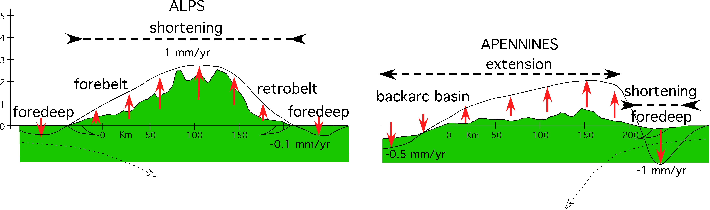
Carminati & Doglioni 2012, ESR

Slide 47


Slide 48
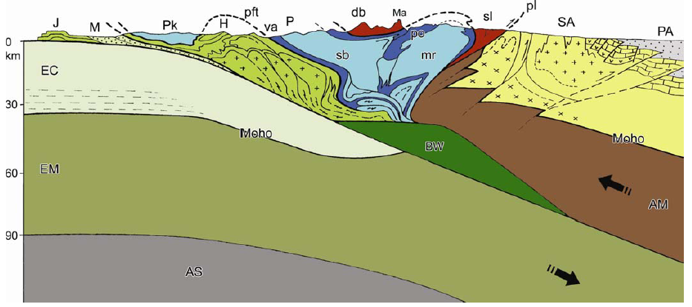
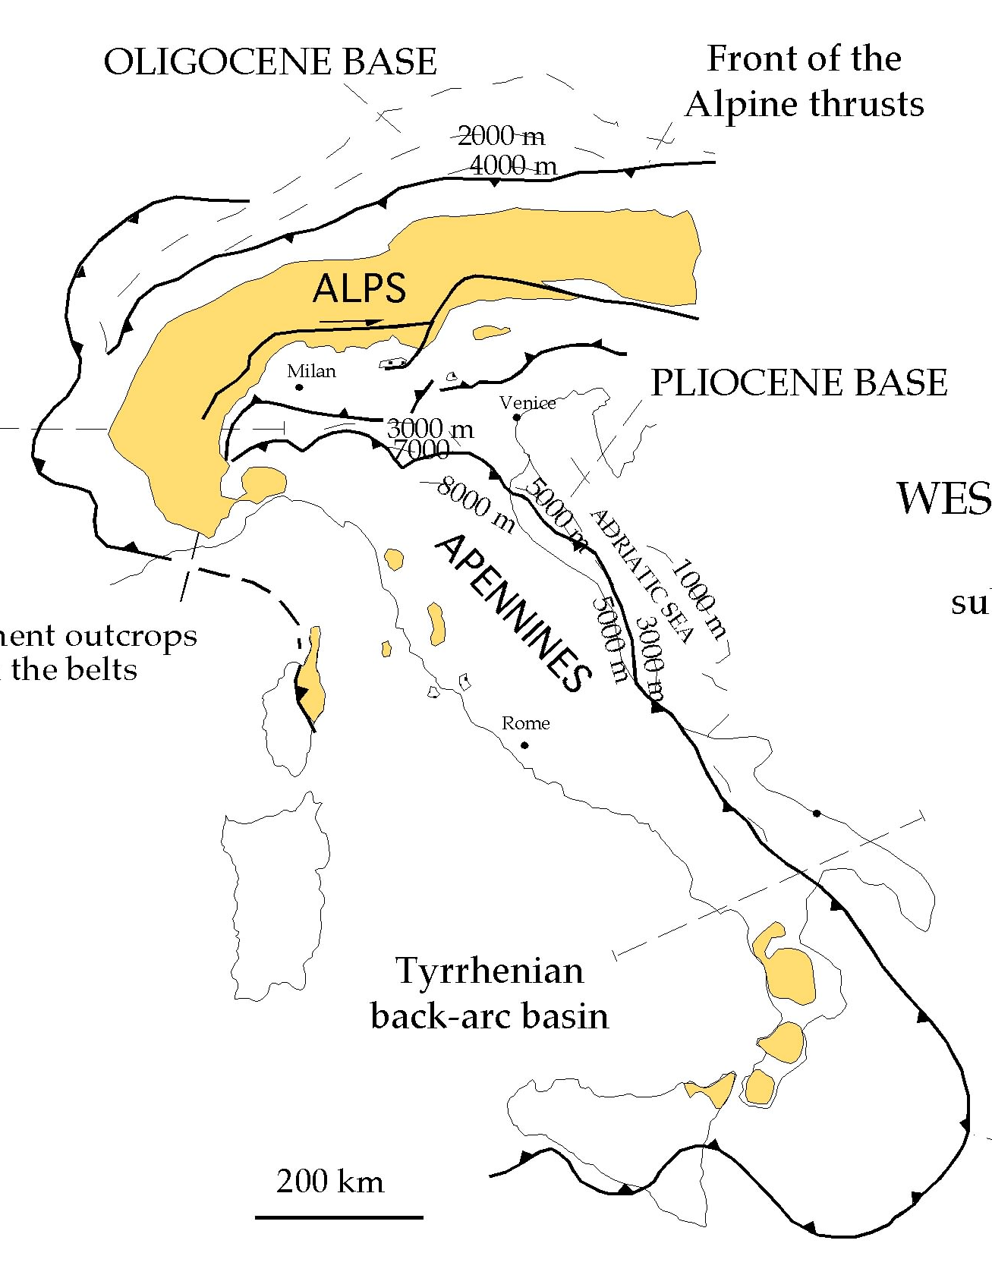
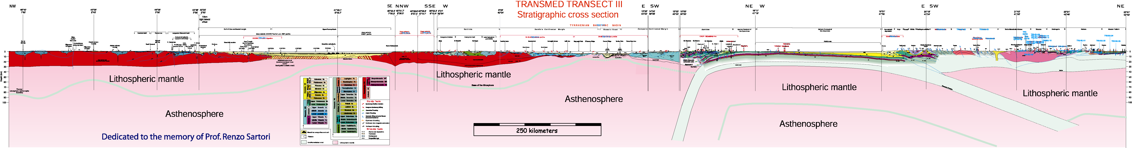
A
2 vergences
NW
0
km
30
60
90
1300°C
Dal Piaz, 1997
1 vergence
basement
B
0
km
NE
30
60
90
1300°C
Scrocca et al., 2005

Slide 49
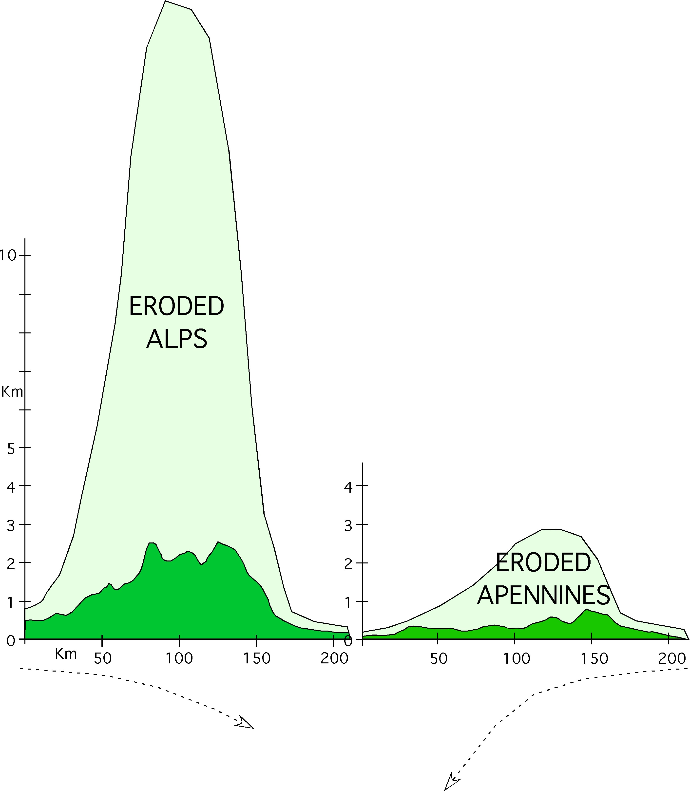
Carminati & Doglioni 2012, ESR

Slide 50
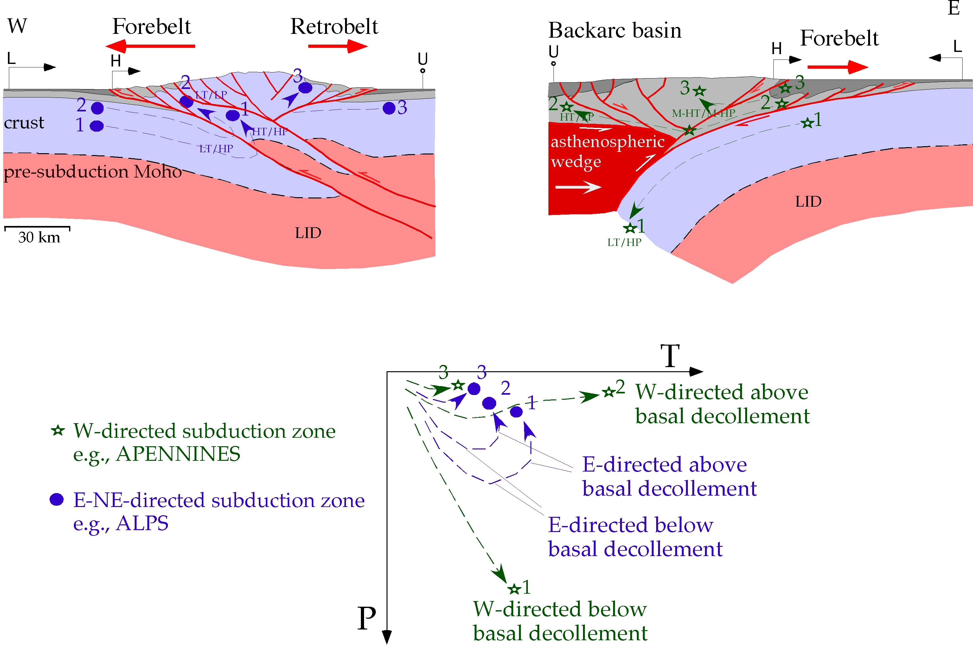

Slide 51
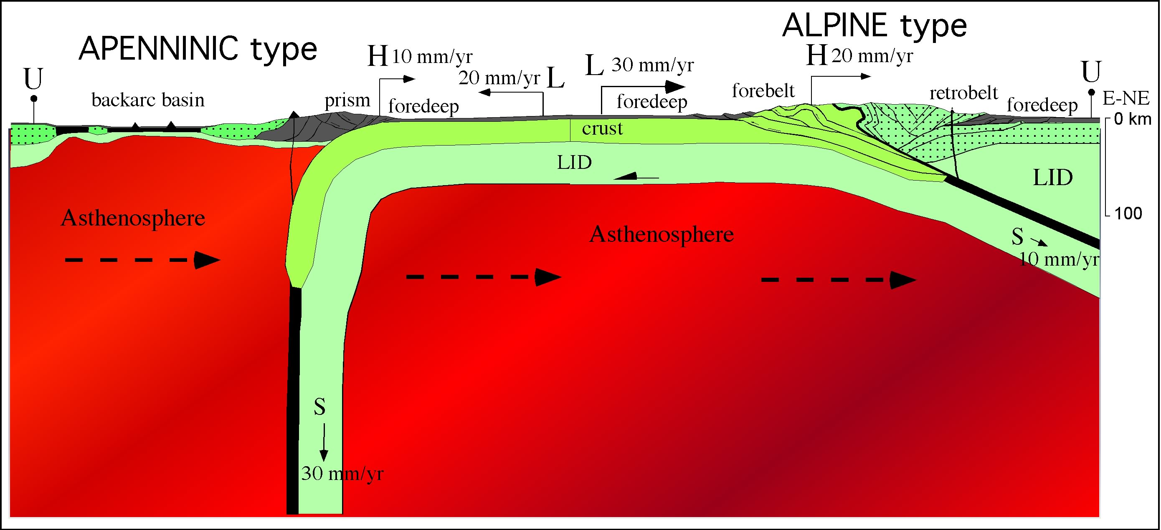








heat flow
VS=VH-VL
S=H-L
convergence<subduction
convergence>subduction

