Slide 1
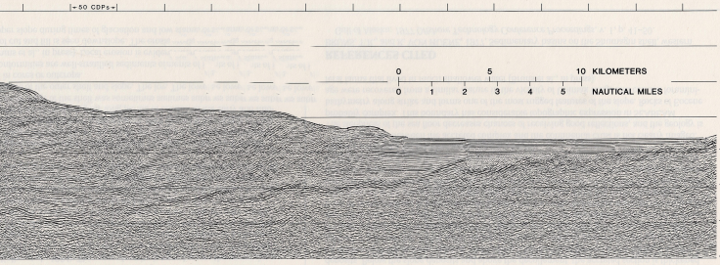
accretionary prism front
topographic envelope
Protodecollement
α
2
α
1
Accretionary prism
Decollement layer
Topographic envelope
β
0
km
20
1
dα2
β
Regional monocline
α₂
2
dα1
α₁
Front
Depth of the
Basal
decollement
βavp
β1
dβavp
β2
dβ1
Regional monocline
dβ2
Front
Front
4
foreland
prism
Distance from the front (km)
Vertical distance
from the front (km)
0
5
10
15
20
25
30
2
α
0
1
Basal decollement
-20
0
20
40
60
80
100
2
Distance from the front (km)
Depth (km)
-2
β
3
-4
4

Slide 2
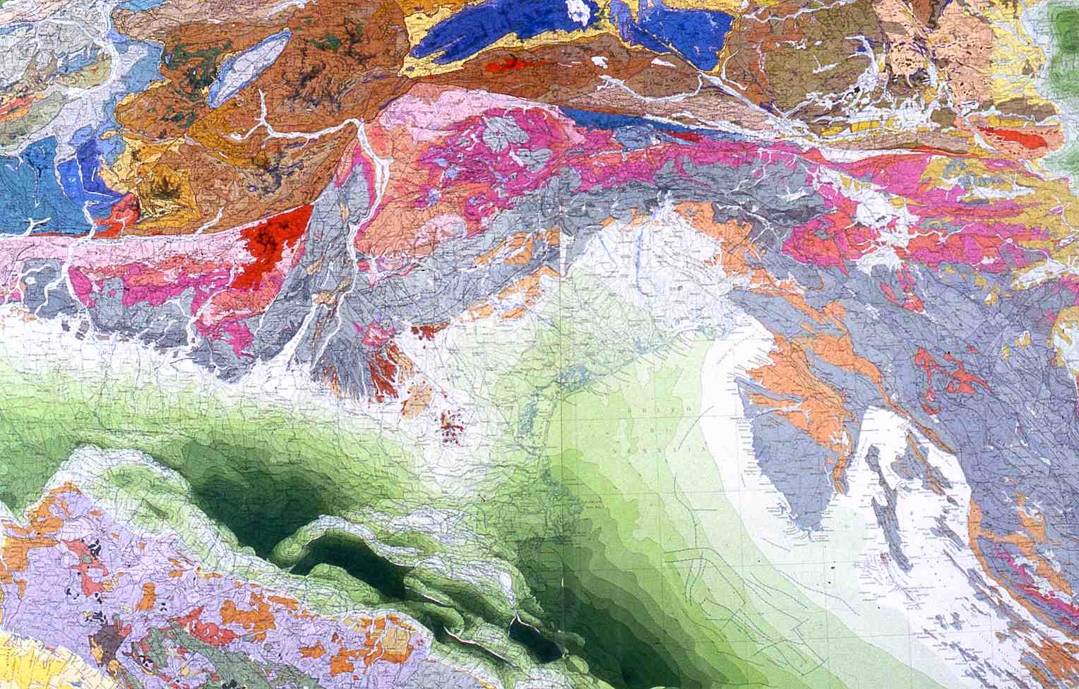

Slide 3
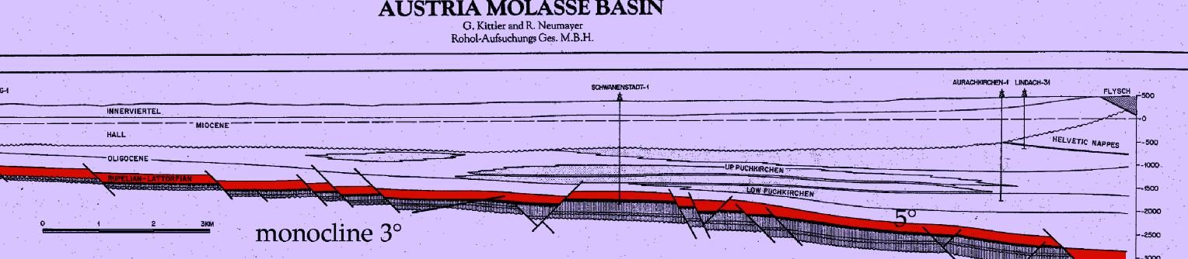
REGIONAL MONOCLINE
α
β
ALPS
Kittler & Neumayer (1983)

Slide 4
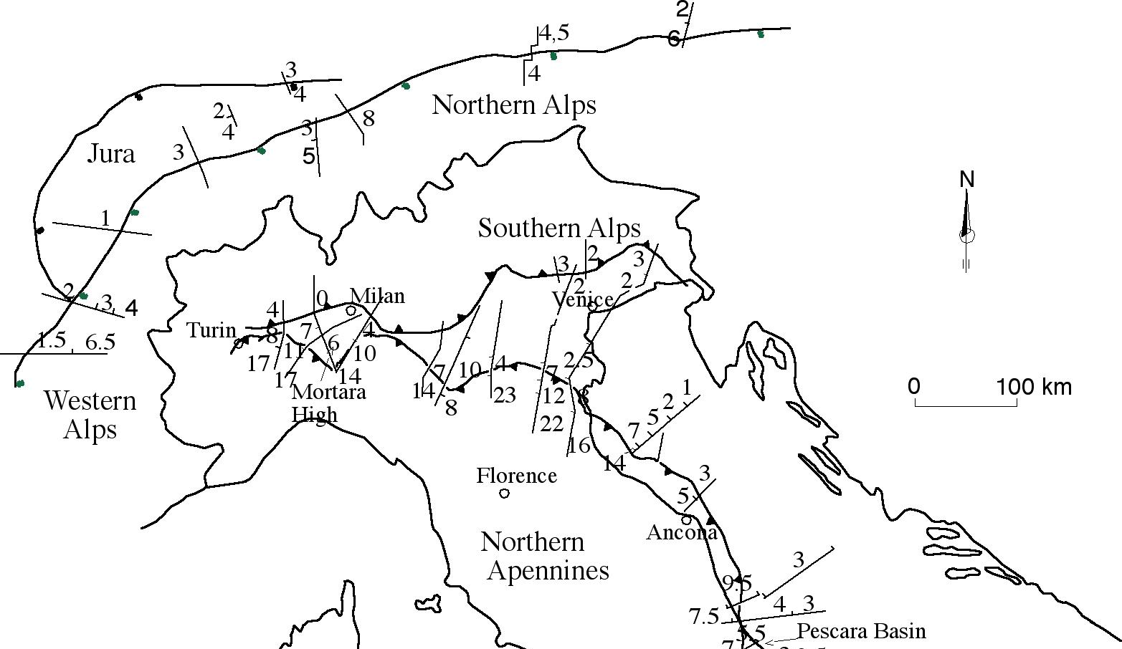
REGIONAL MONOCLINE
α
β

Slide 5
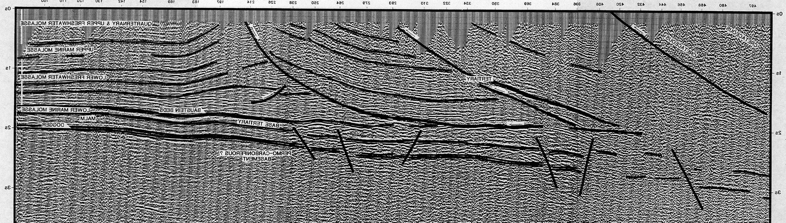
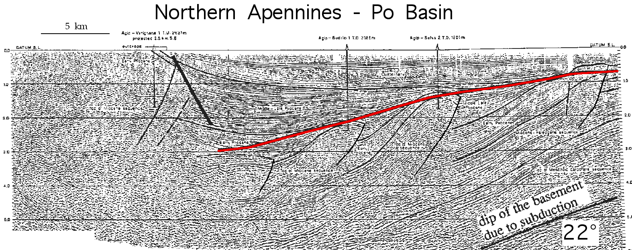
α
ALPINE FRONT - AUSTRIA
S
Foreland monocline 3,5°
β
Bachmann & Koch, 1983
α
β
Pieri, 1983

Slide 6
α
β
α
β
7°

Slide 7
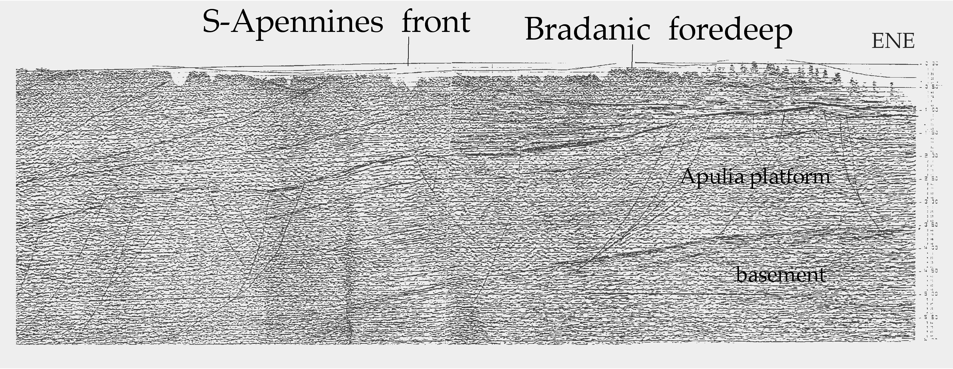
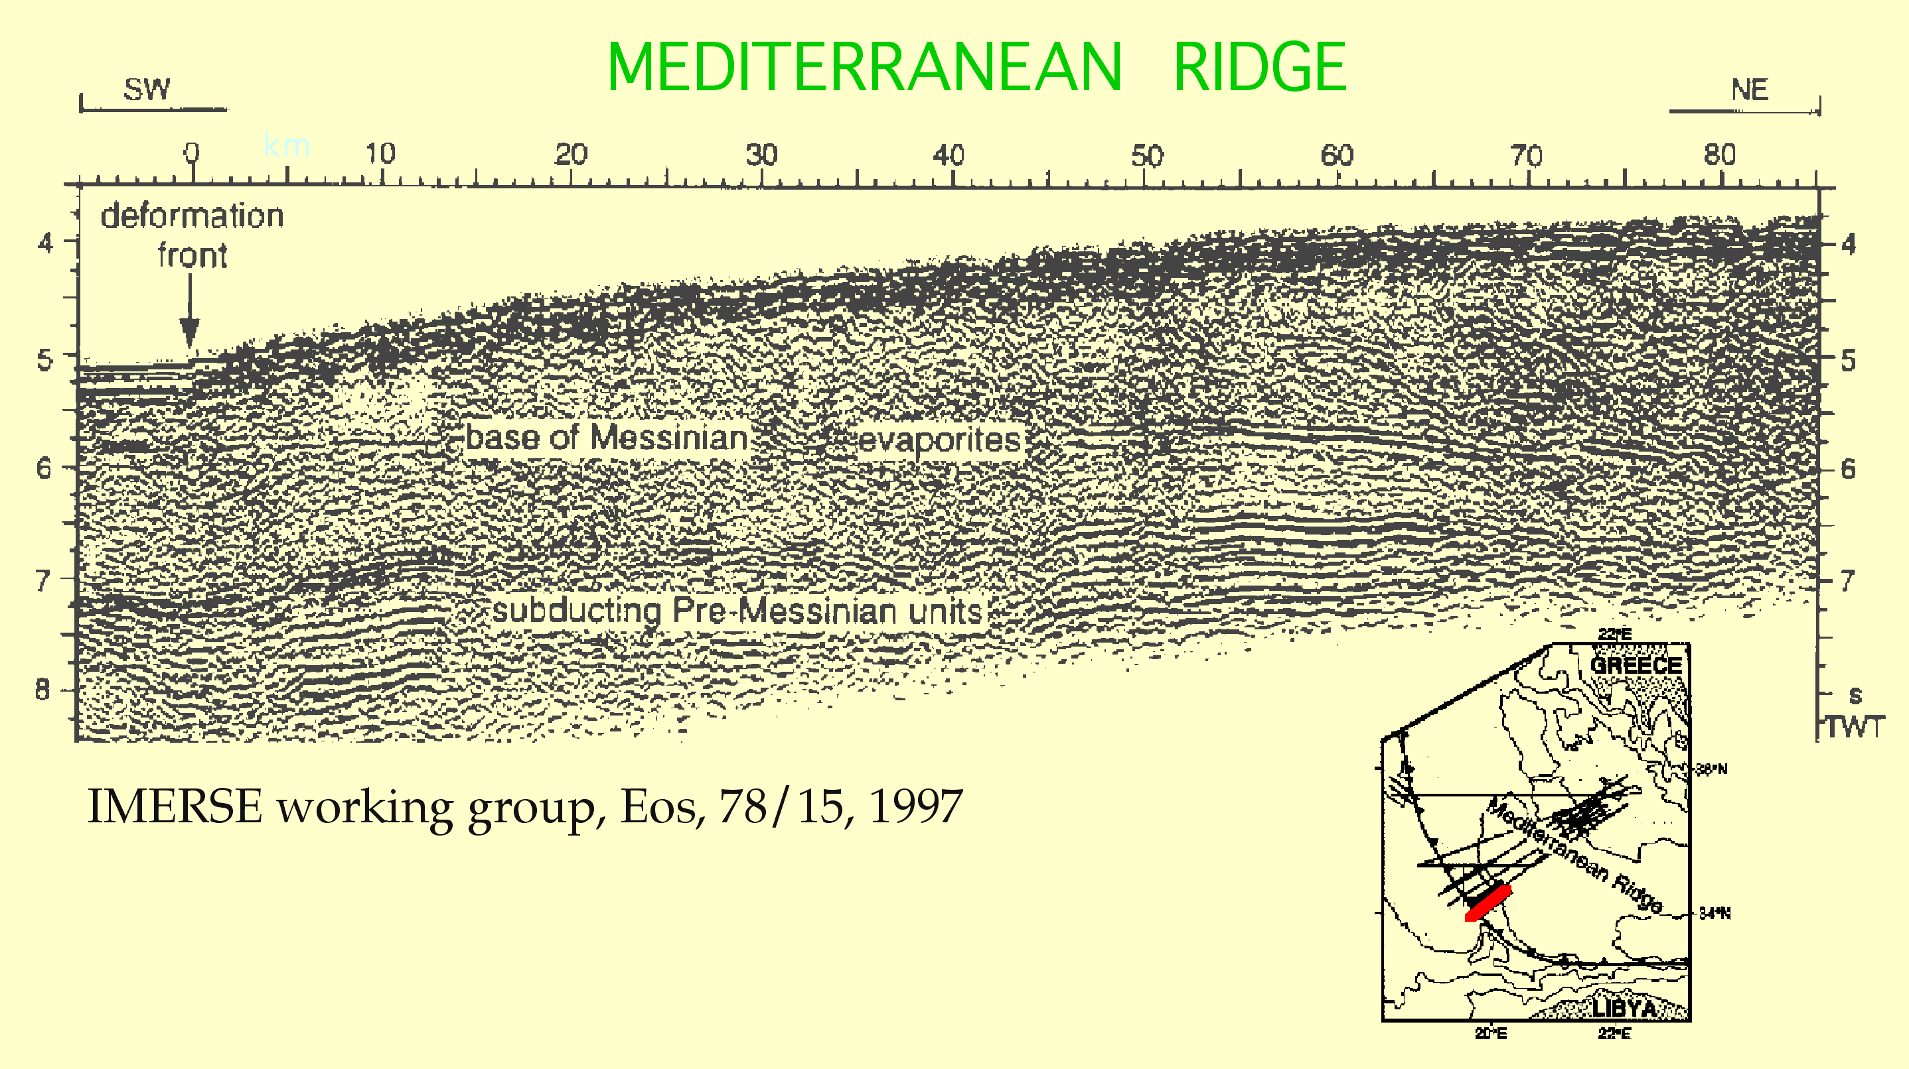
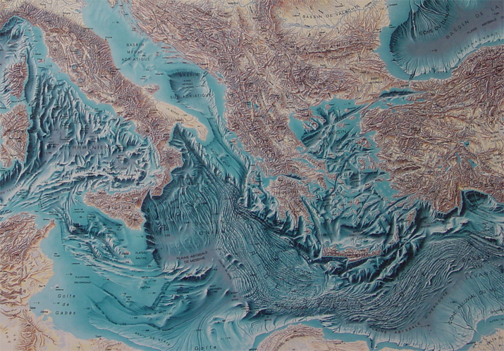
α
β
8-10°
α
β
0-2°

Slide 9
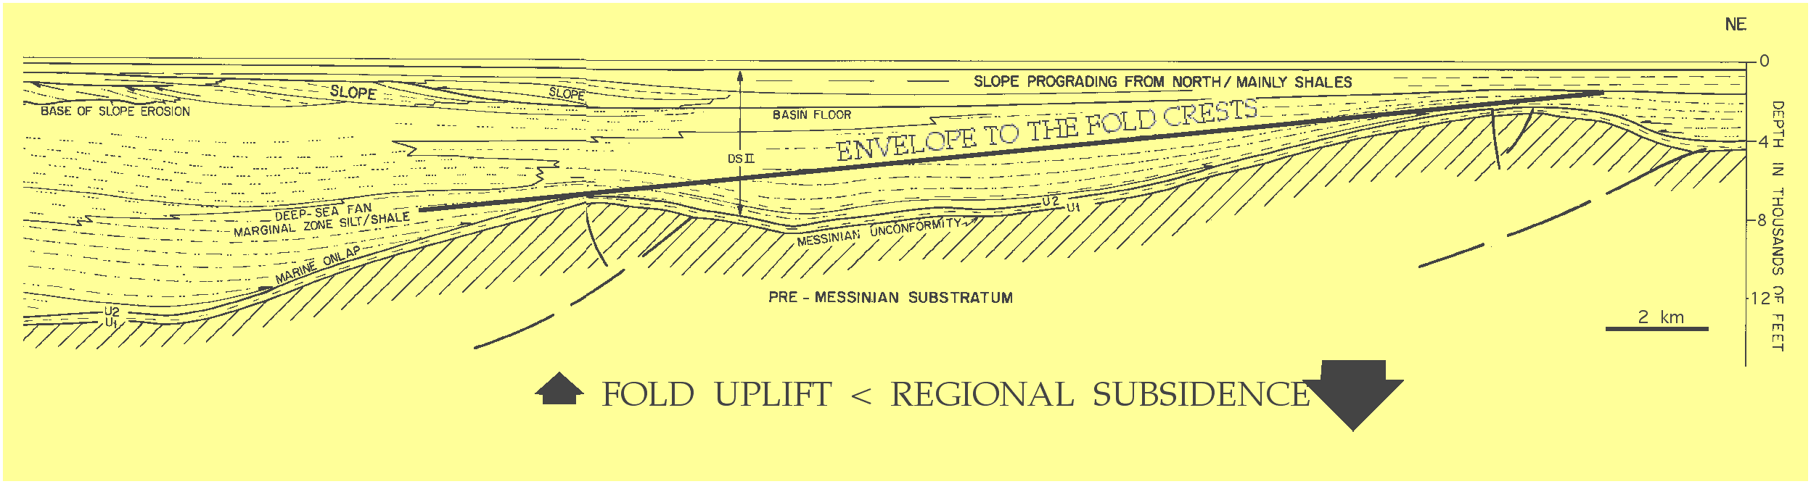
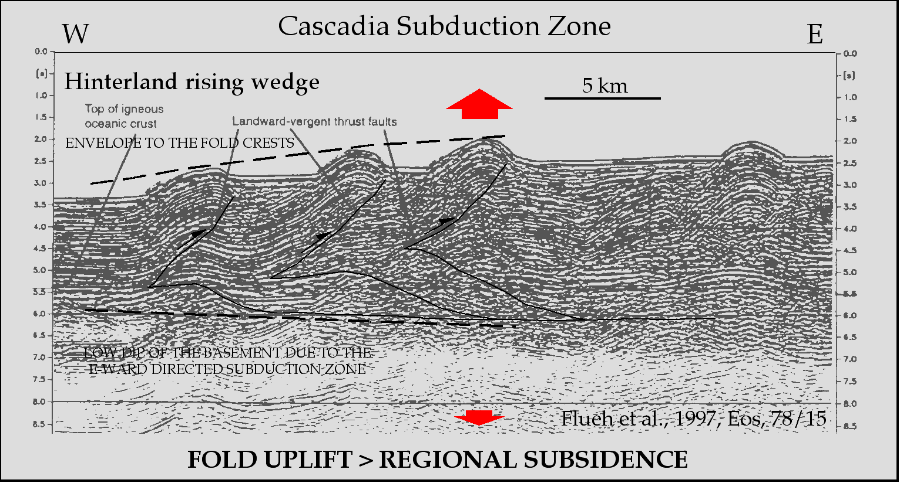
Apennines -W Adriatic Sea
α
β
α
β

Slide 10
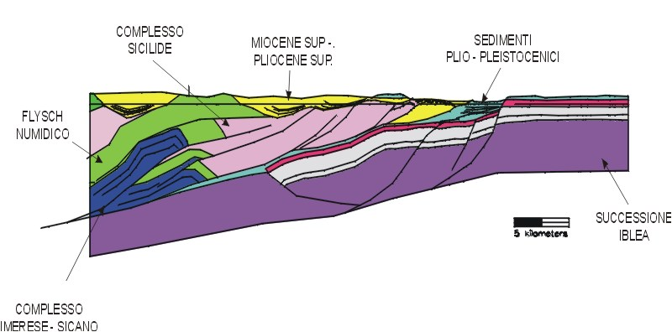
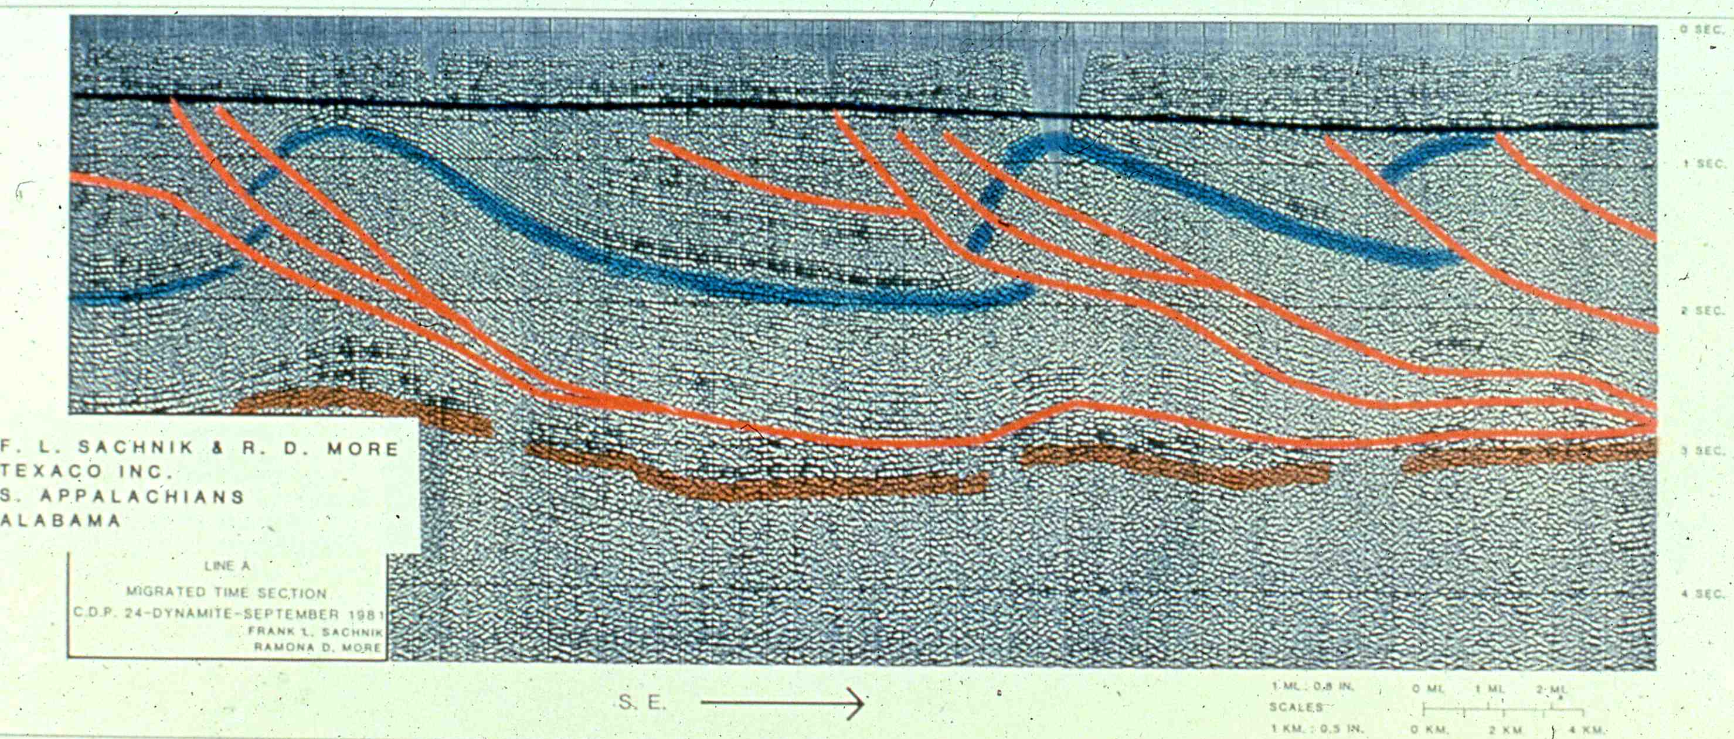
α
β
α
β

Slide 11
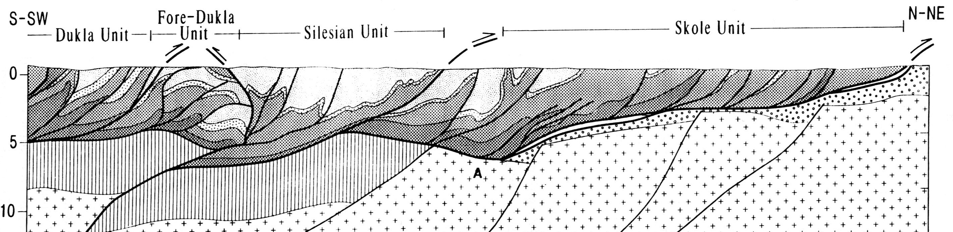
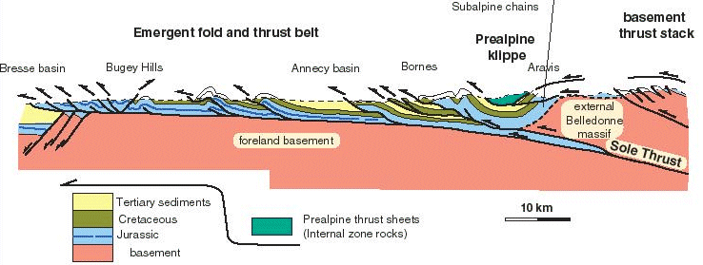
Carpathians - W-directed subduction
α
β
8°
Roure et al., 1993
Alps - E-directed subduction
WNW
α
1°
β
3°

Slide 12
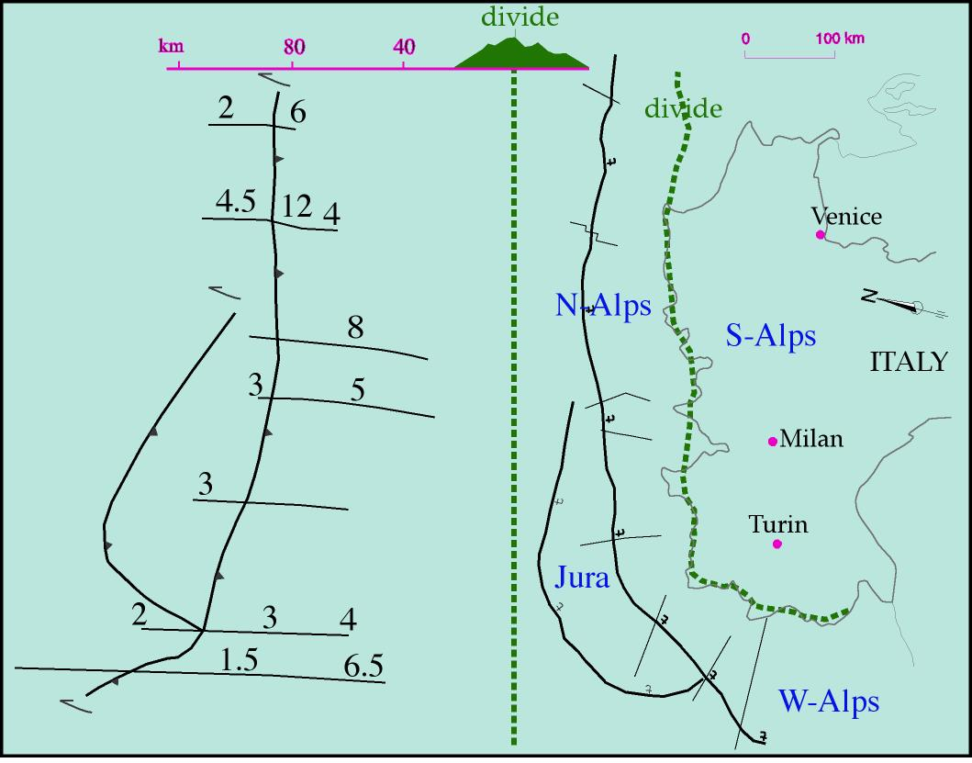

Slide 13
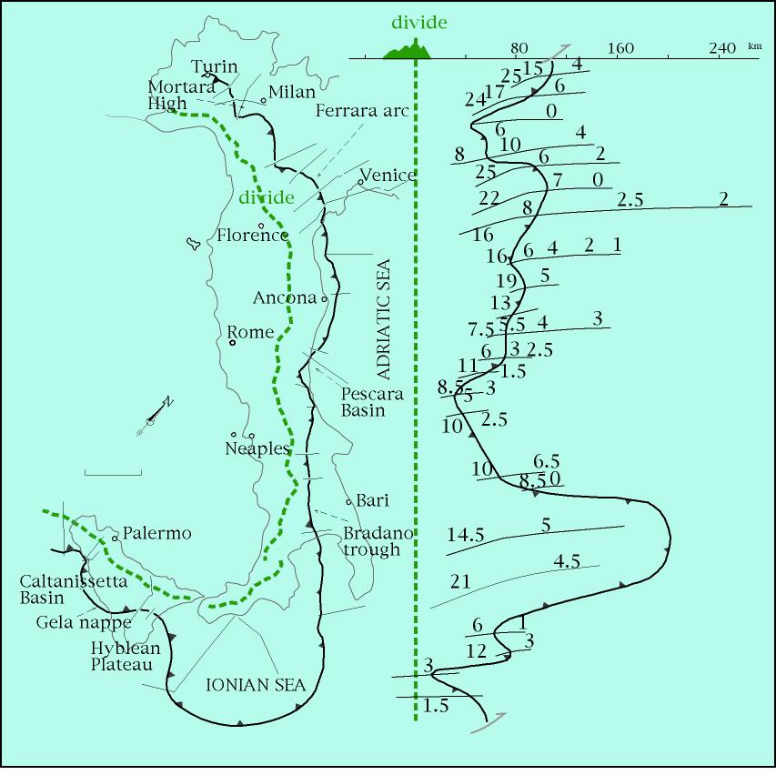
Lombard B.
Trento H.
Belluno B.
Umbro-M. B.
Apulian
Platform
RECESS
Ionian
Basin
SALIENT
Mariotti & Doglioni, 2000

Slide 14
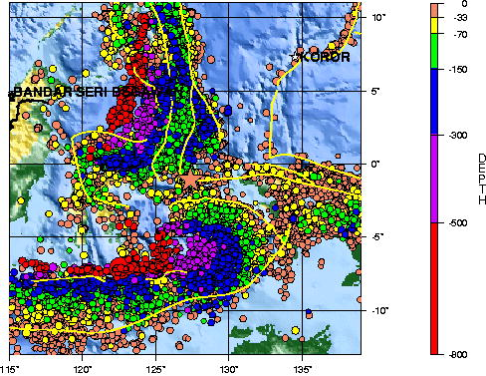
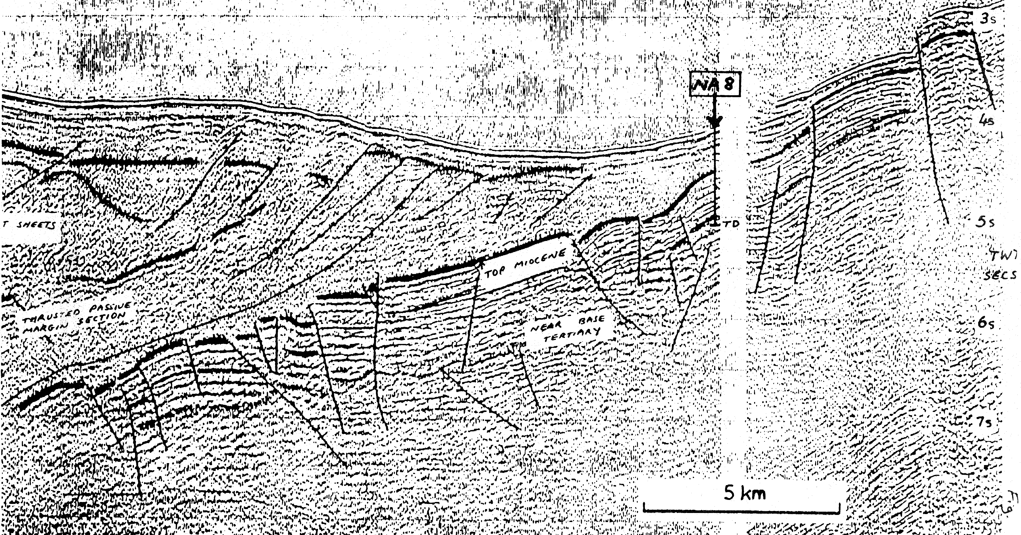
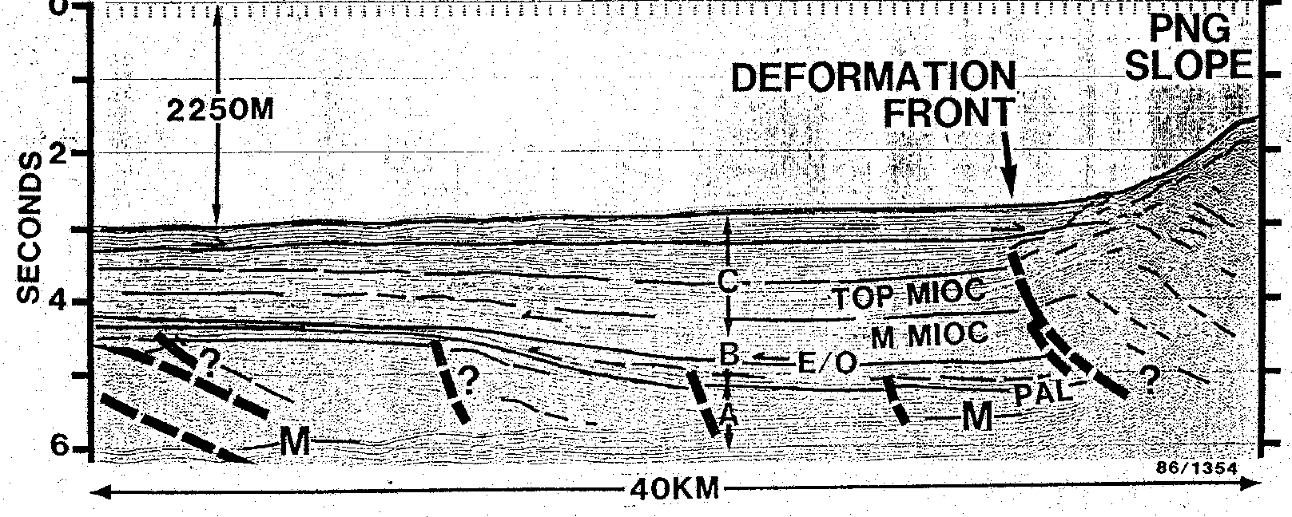
W
Banda arc
W-directed subduction
α
β
15°
SW
Papua-New Guinea
NE-directed subduction
α
α
β
3°

Slide 15
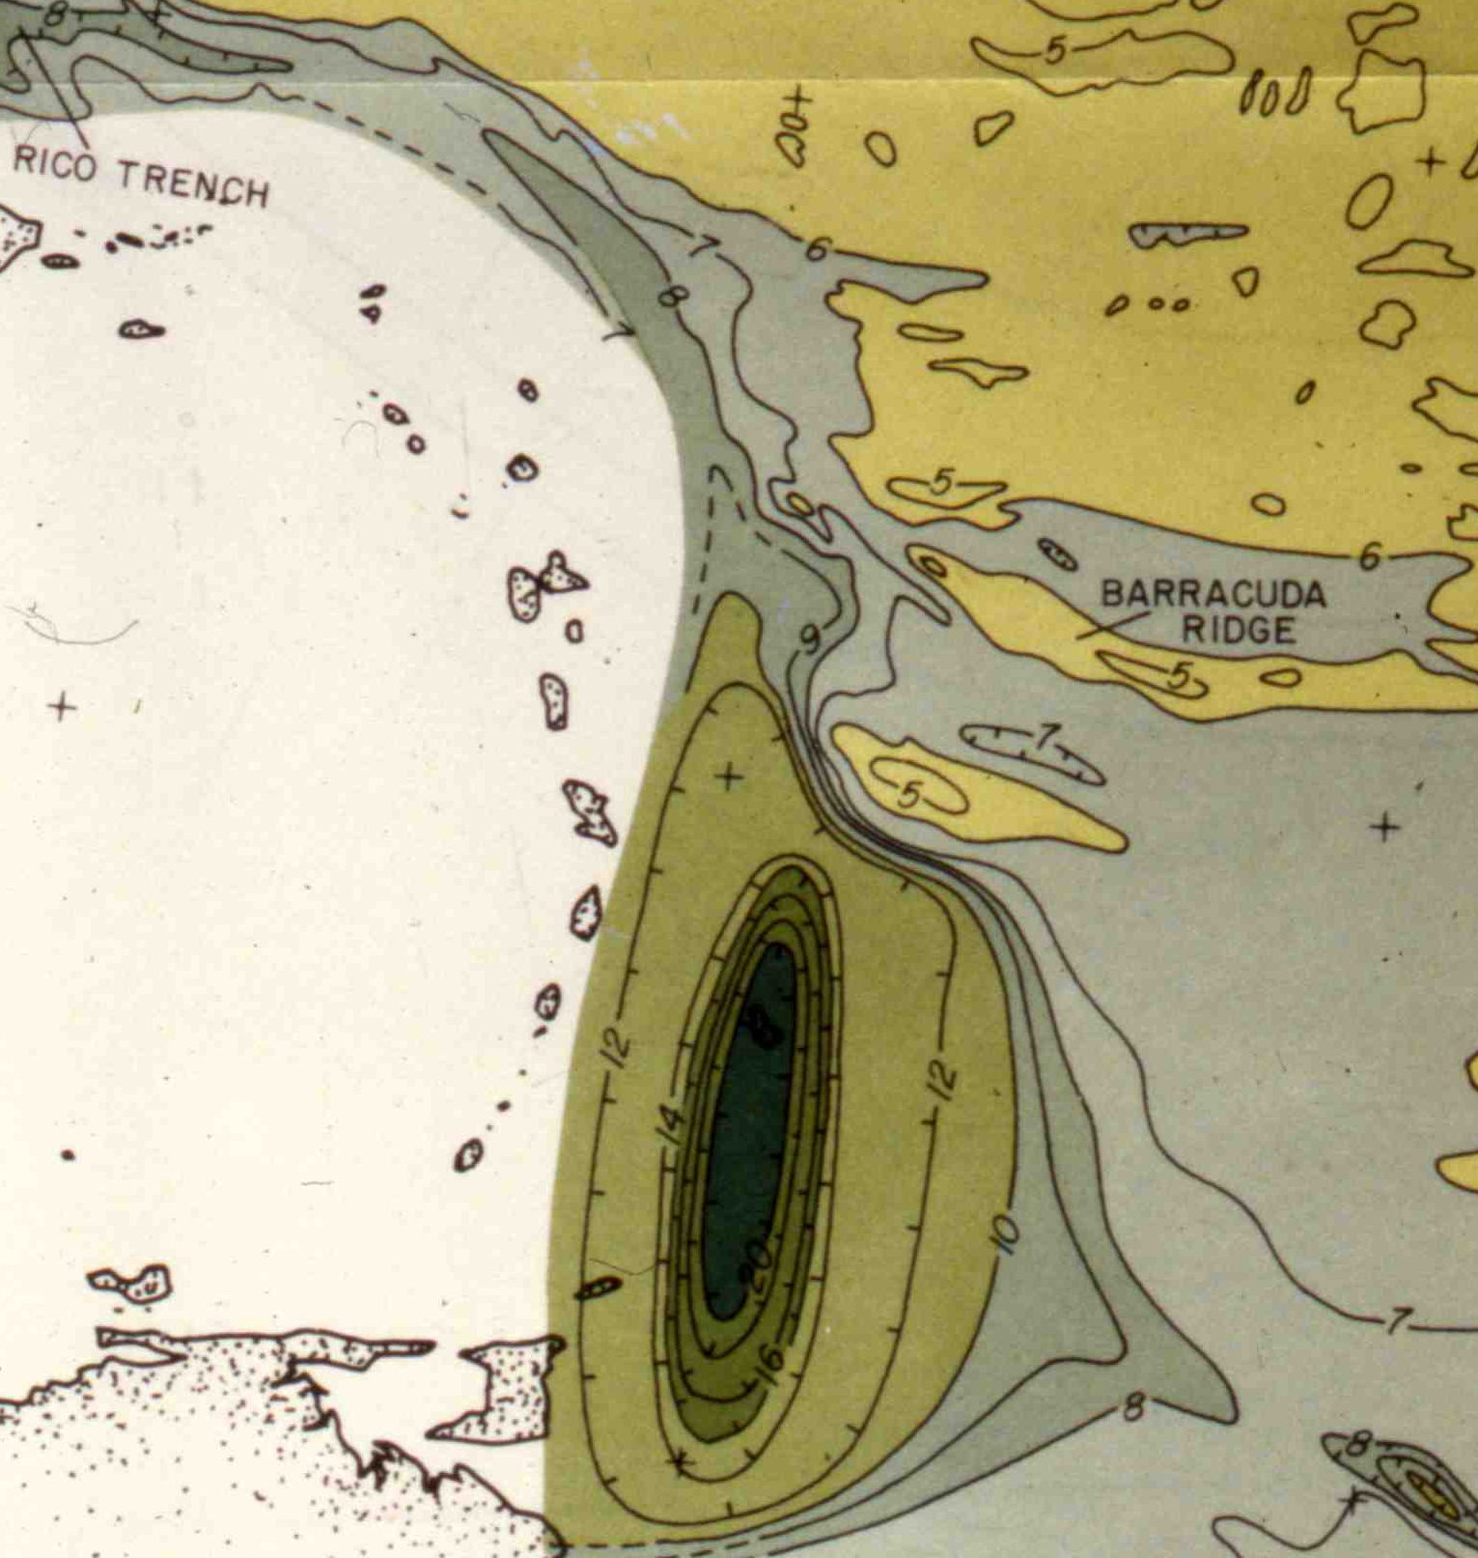
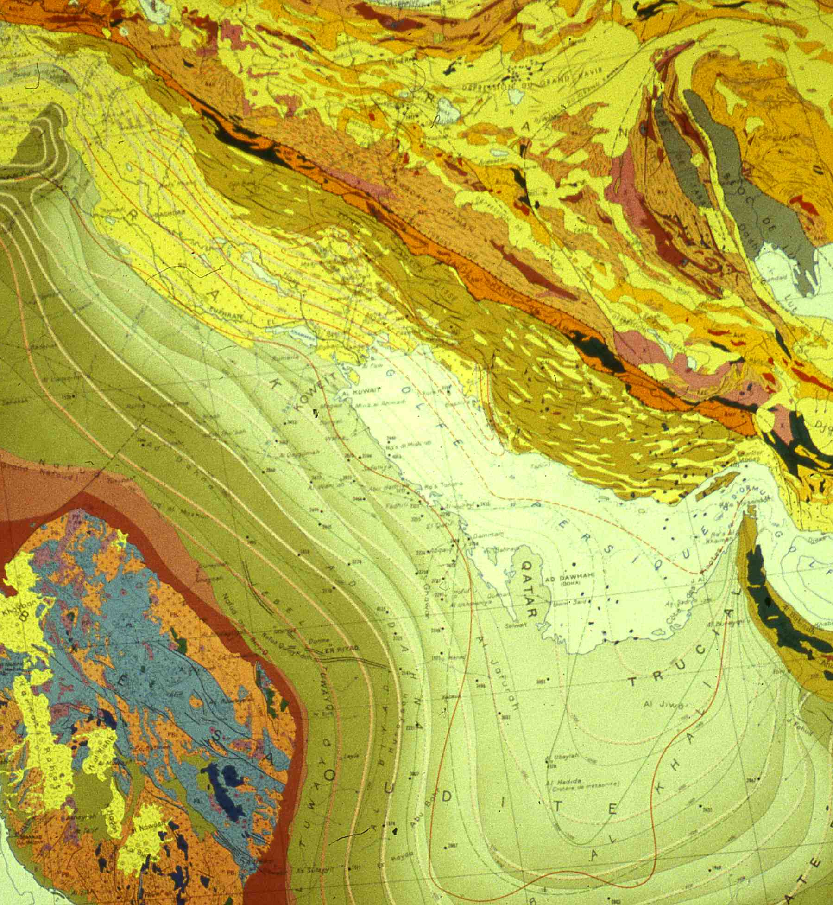
Atlantic
Arabia
Barbados W-subduction Zagros NE-subduction

Slide 16
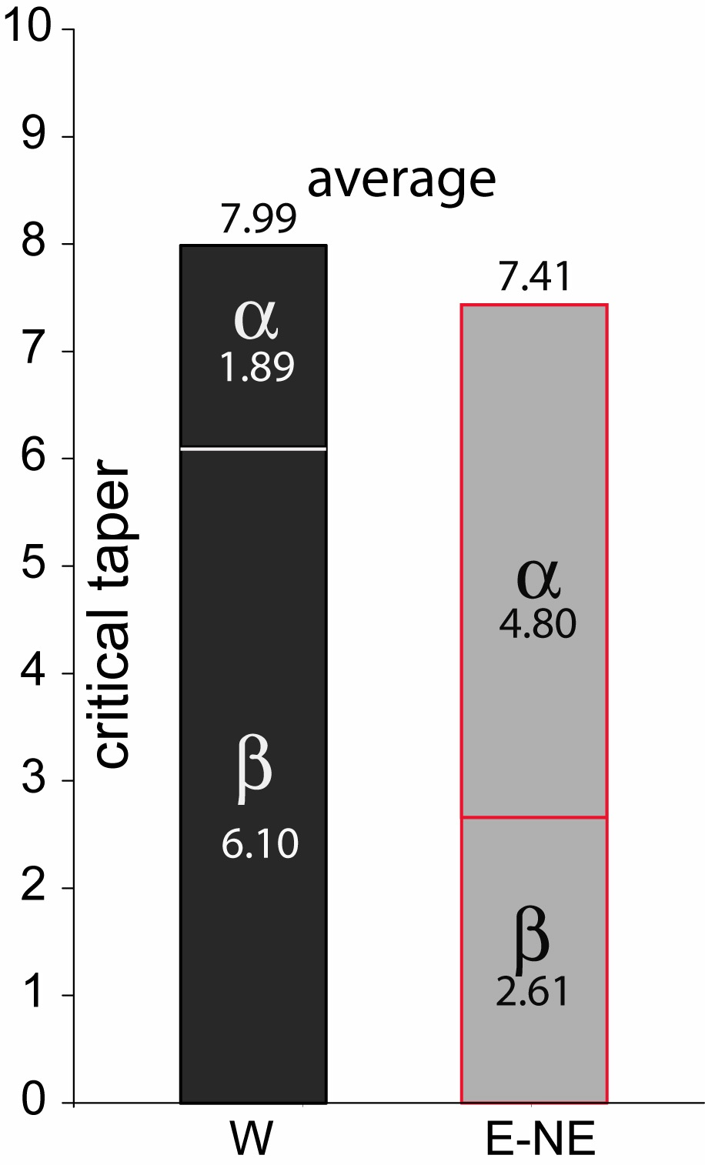
Lenci & Doglioni, 2007

Slide 17
positive fold
total uplift
SW
Canale d'Otranto
HELLENIDES
E-NE
APENNINES
S-Adriatic - Ionian seas
FRONT
0
negative fold
FRONT
1
.
total uplift
0
Plio-Pleistocene
2
.
deeper
M
0
foredeep
3
.
Pleistocene
Apulian carbonate platform
Sec TWT
0
0
1
0
k
m
5
.
Subsidence rate > 1 mm/yr
5
Subsidence rate < 0.3 mm/yr
0
C
R
O
P
M
5
regional subsidence > fold uplift
regional subsidence < fold uplift
SUBDUCTIONS DIRECTION
Calabria
M
M
5
3
8
I
o
n
i
a
n
S
e
a
1
0
0
k
m

Slide 18
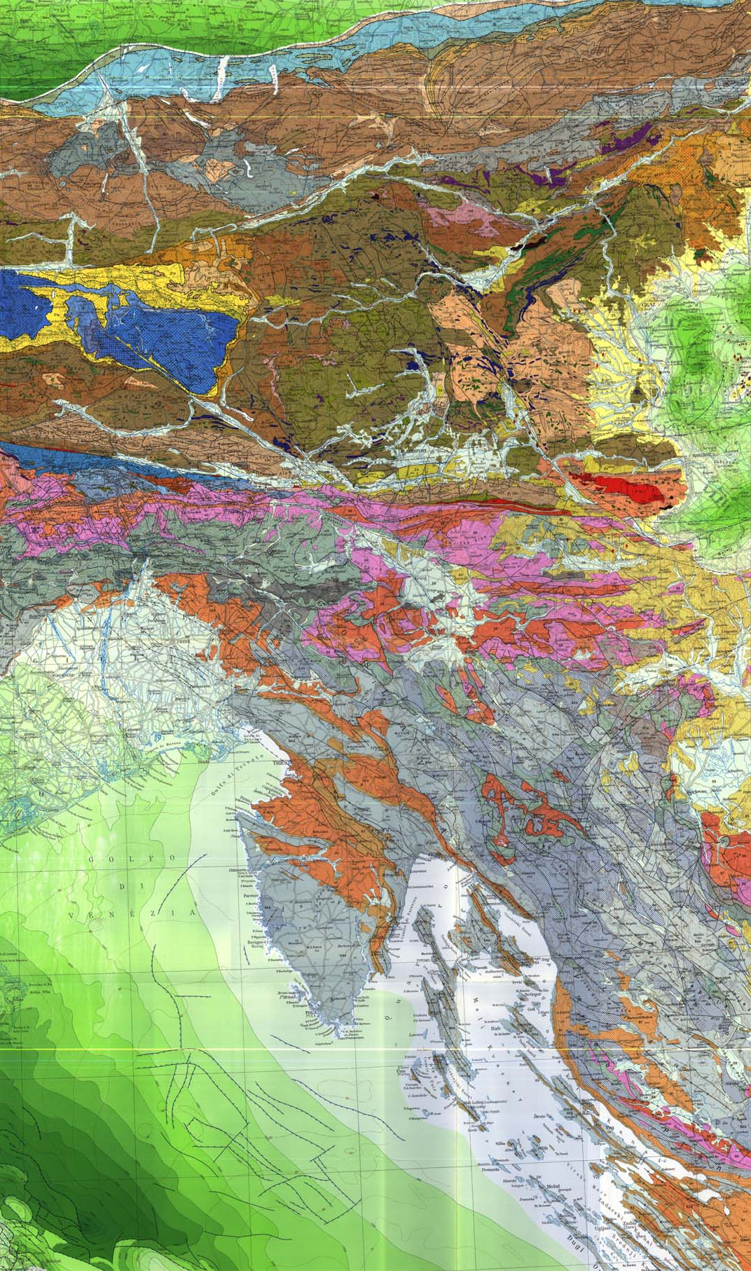
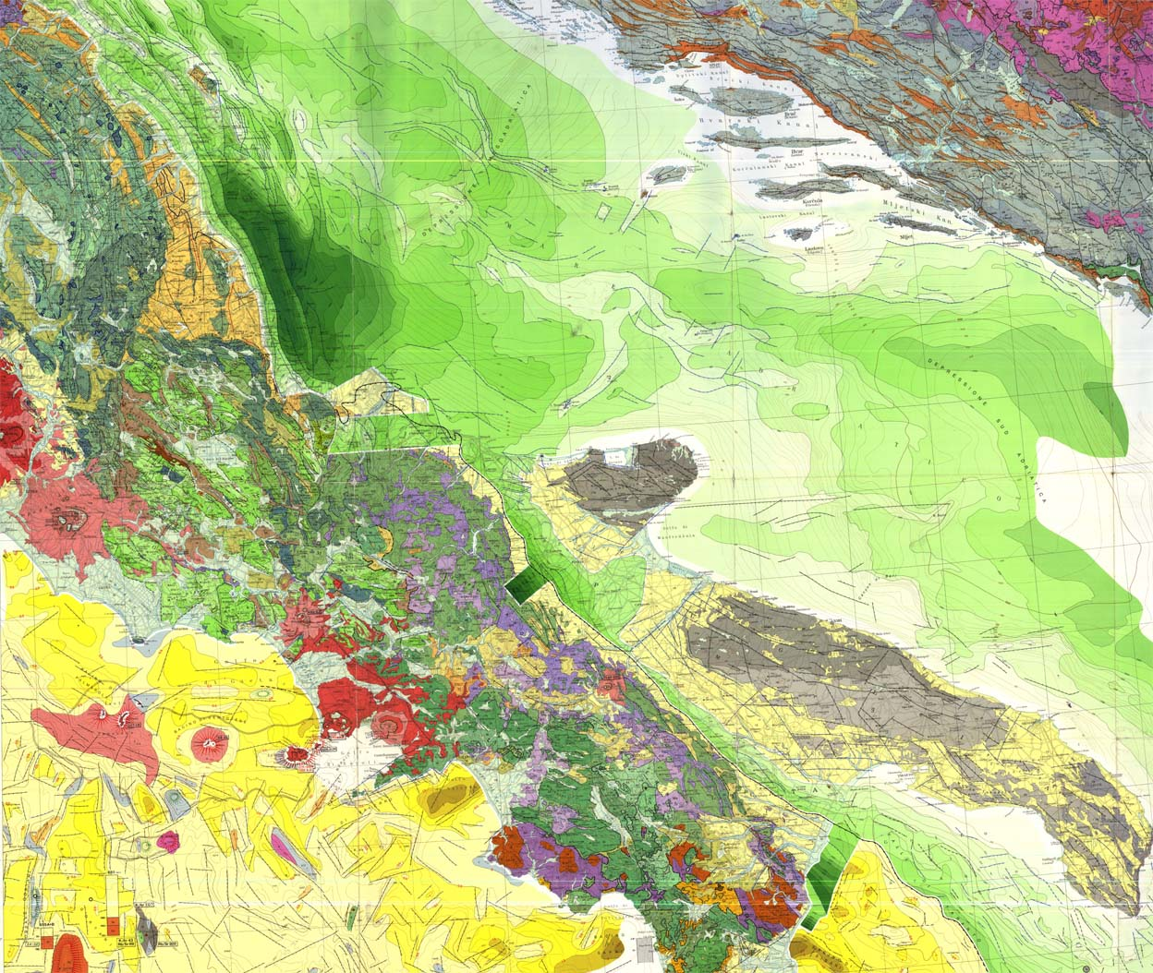
Dinarides
α
β
α
β
Apennines

Slide 19

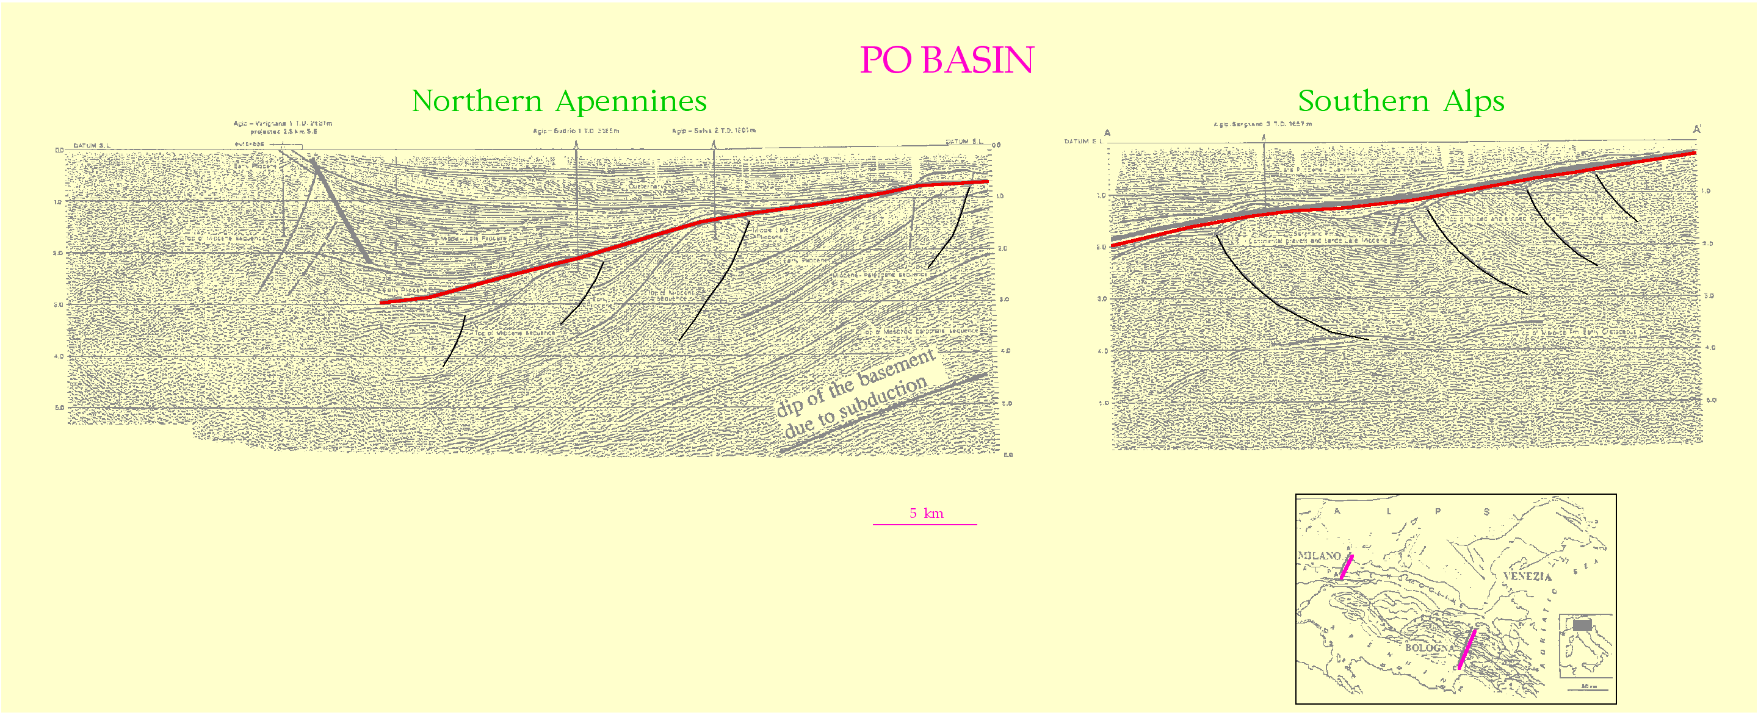
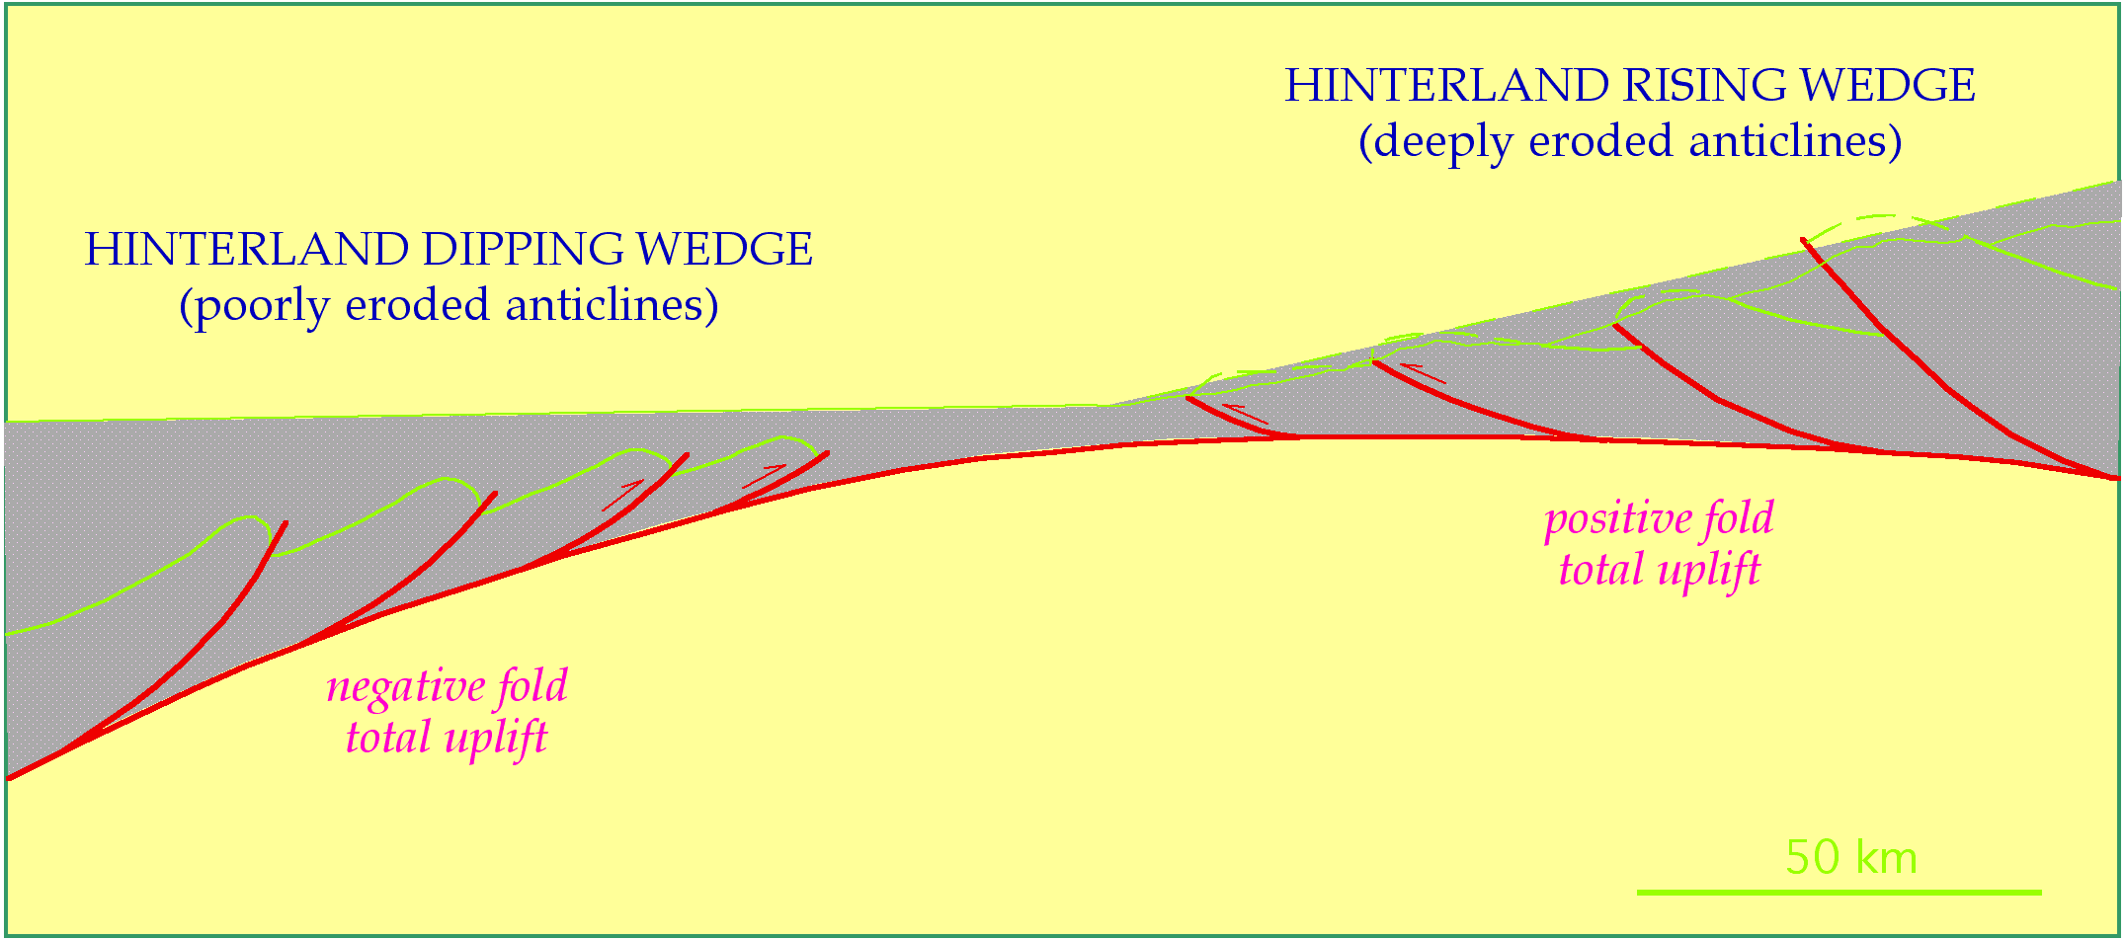
α
5 km
α
α
α
β
β
β
β

Slide 21
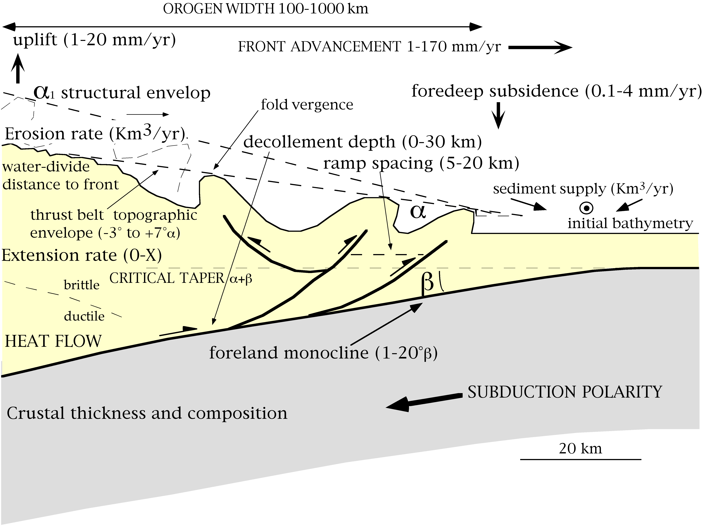

Slide 22
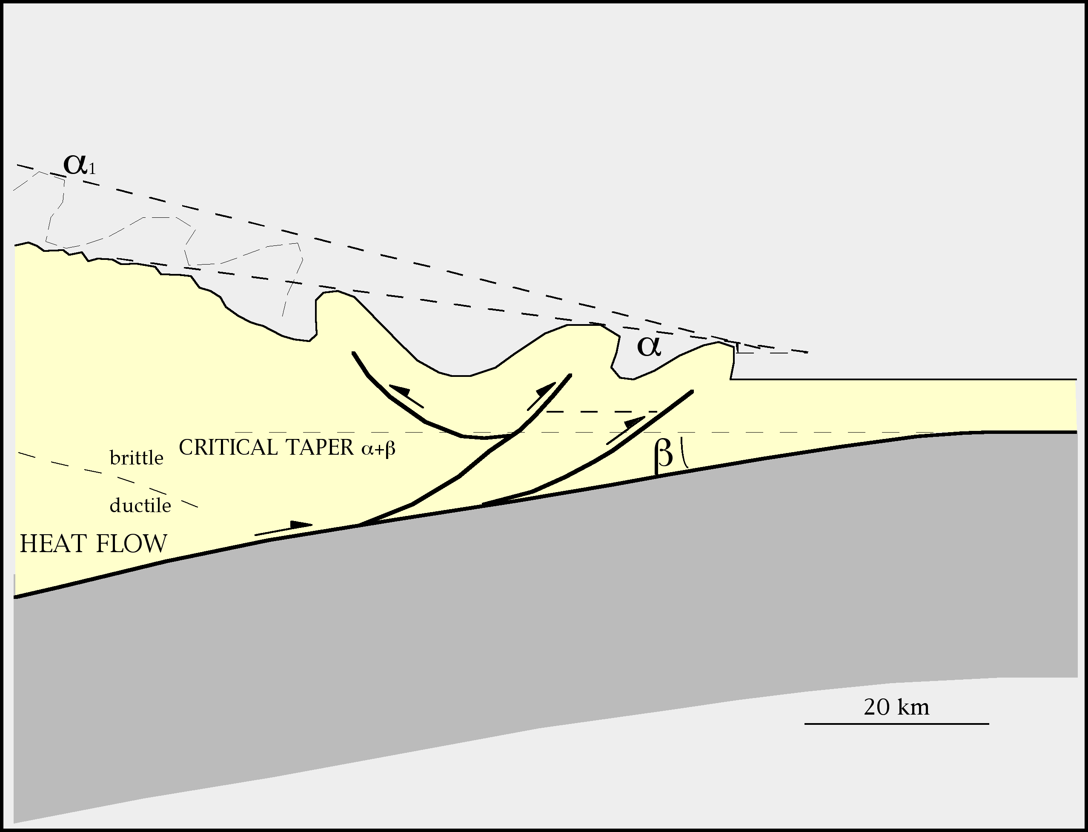
MAIN PARAMETERS
- lithosphere thickness-composition
- uplift rate
- convergence rate
- foredeep subsidence
- shortening rate
- erosion rate
DECOLLEMENT DEPTH
ramp spacing & vergence
SUBDUCTION POLARITY
HINGE MIGRATION

Slide 23

β vs. age of the subducting lithosphere
β°
0
1
2
3
4
5
6
7
8
9
Middle Amer. Trench
Nicaragua
Costa Rica
Costa Rica
Peru-Chile Trench
Lithosphere age
Peru-Chile Trench
Cascadia
Cascadia
Aleutians
Aleutians
Aleutians
Japan
Appennino Barbados Aleutine
N. Zelanda Nankai Giappone
km
Cascadia Nicaragua-CostaRica
N. Ebridi America centr.
Perù
α
α
8
"W"
6
"E-NE"
β
4
2
ϑ°
β
0
α
-60
-40
-20
0
20
40
60
km
-2
α
-4
β
β
-6
Notes:
ETA’ PLACCA: FATTORE LOCALE DIREZIONE: FATTORE REGIONALE

Slide 24
AREA OF THE OROGENS ABOVE SEA-LEVEL
Vs subduction direction
km²
600
600
550
500
475
400
360
300
200
160
67
100
100
46
35
51
50
8
0
W
E-NE
Apennines Barbados Aleutians
N. Zealand Nankai
Japan
Mean value
W-directed
Mean value
Cascadia America centr.
Nicaragua-CostaRica
Perù
N. Ebridi
E-NE-directed
Mean values
Notes:
MECCANISMO: GEOMETRIE ED ELEVAZIONE

Slide 25
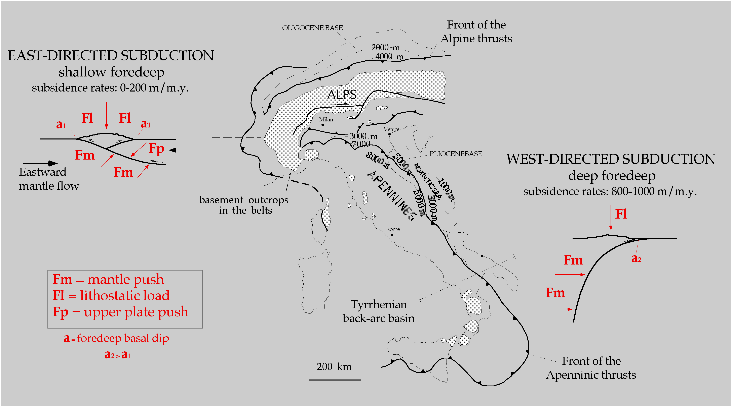

Slide 27
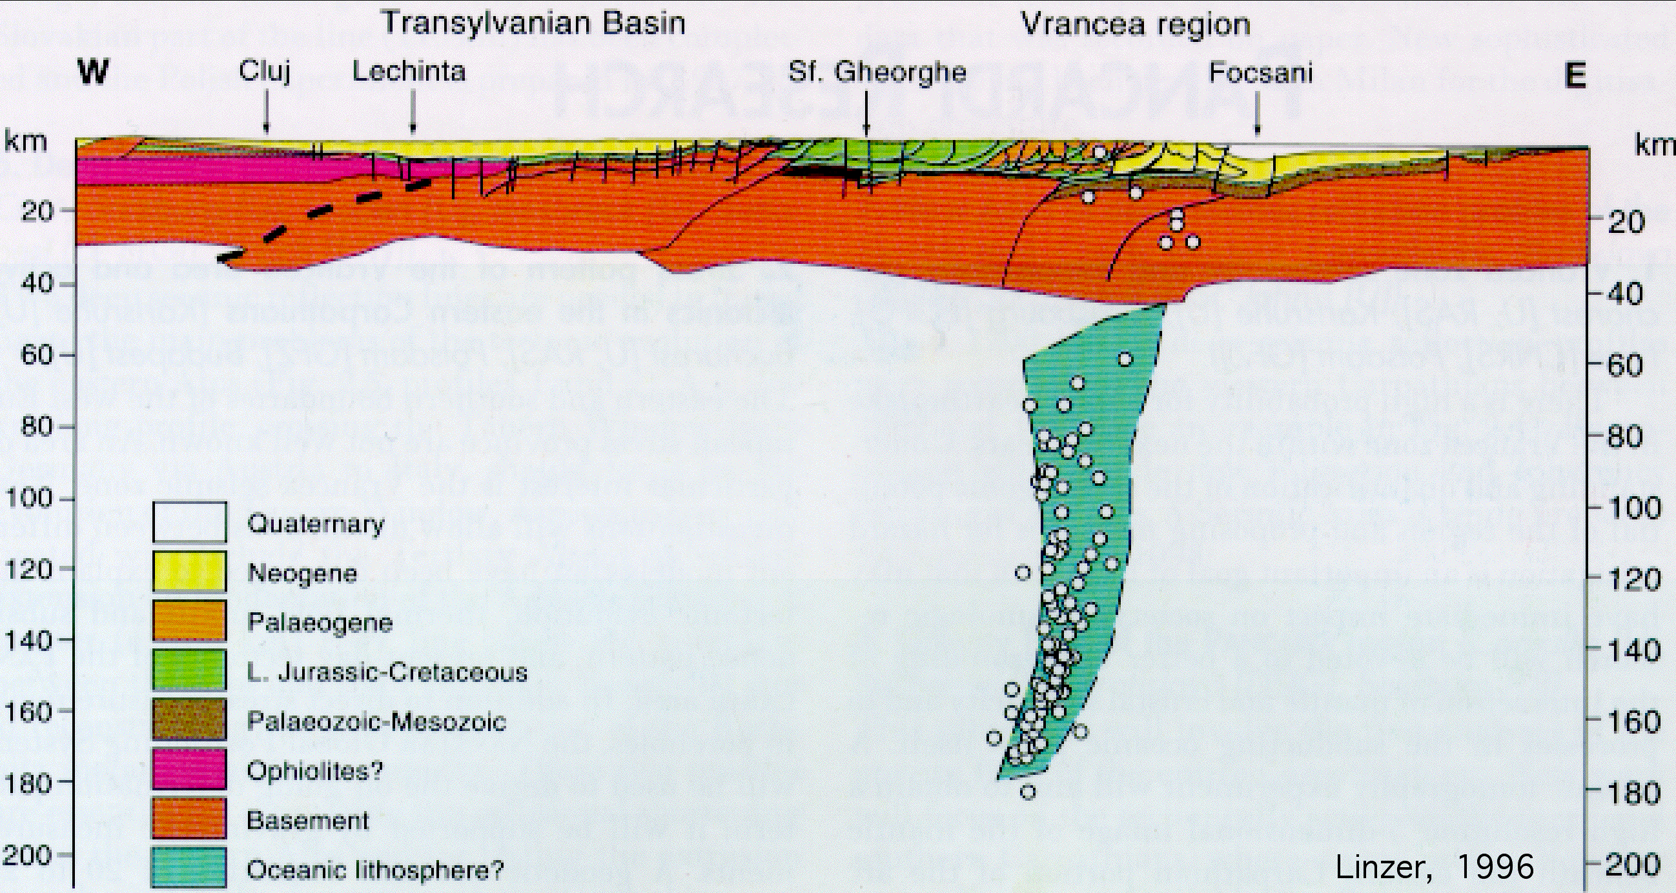
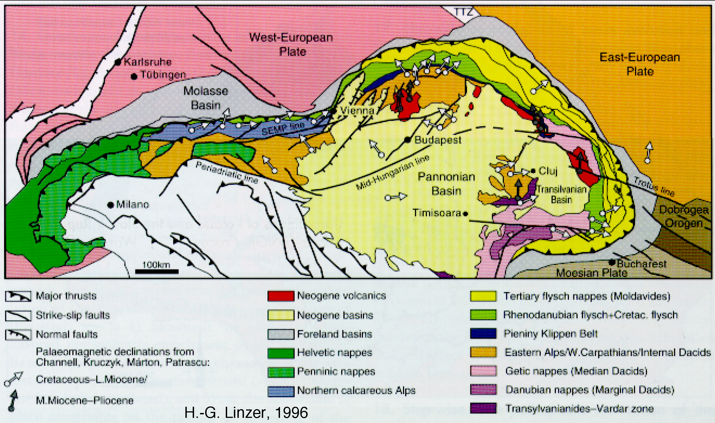

Slide 28
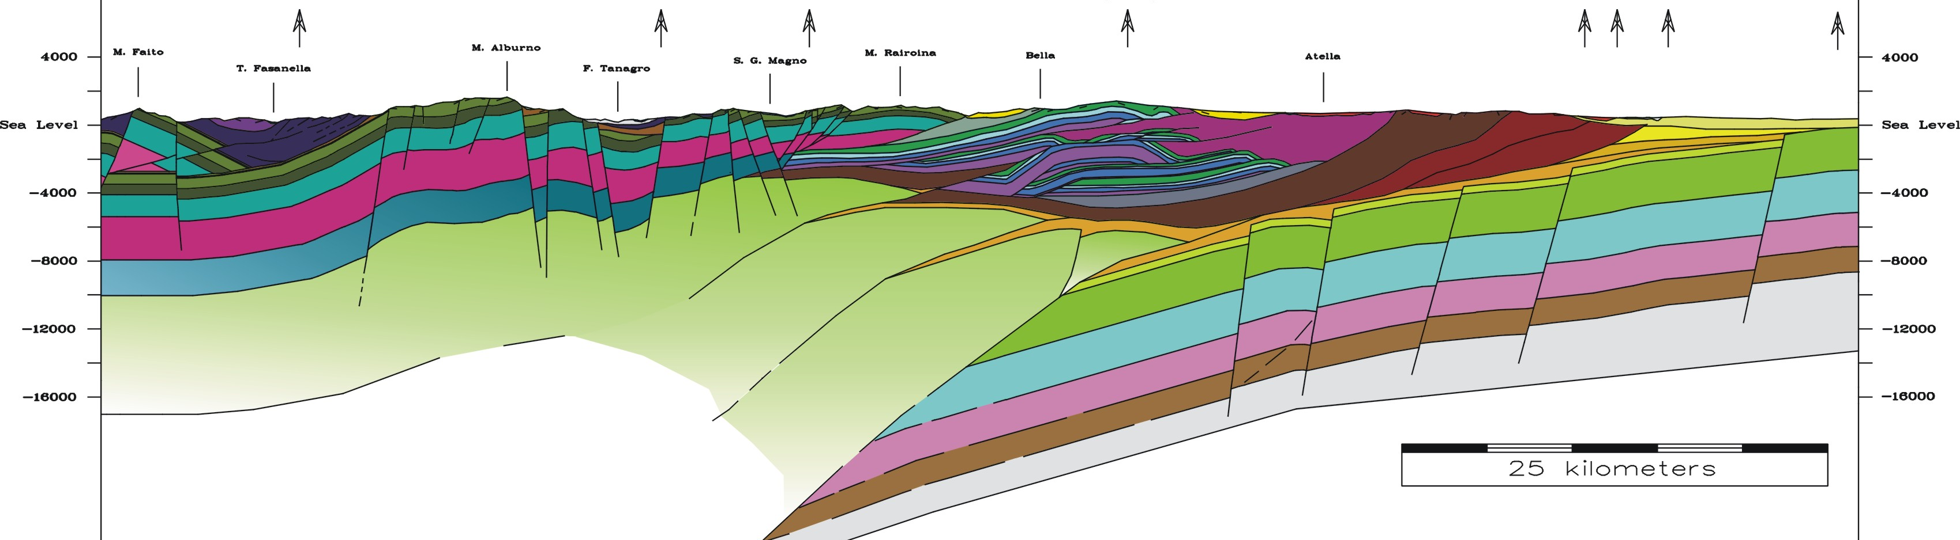
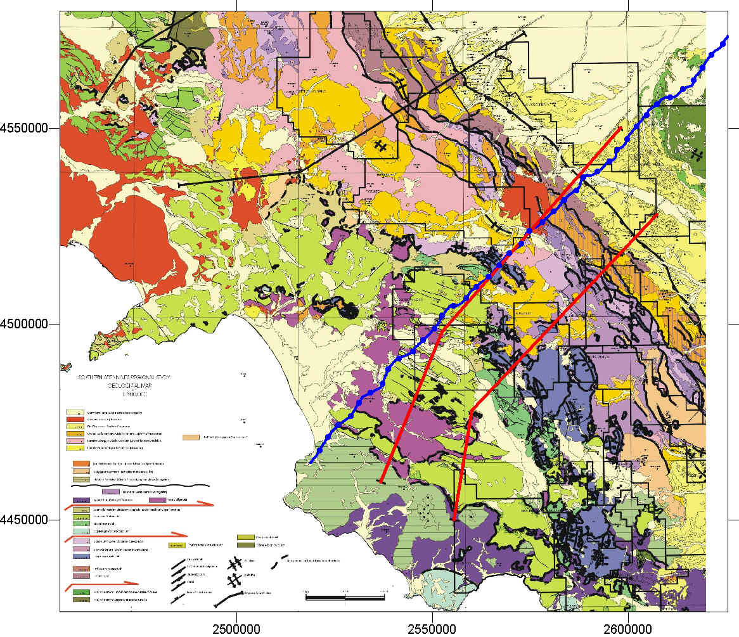
Scrocca et al. 2003

Slide 29
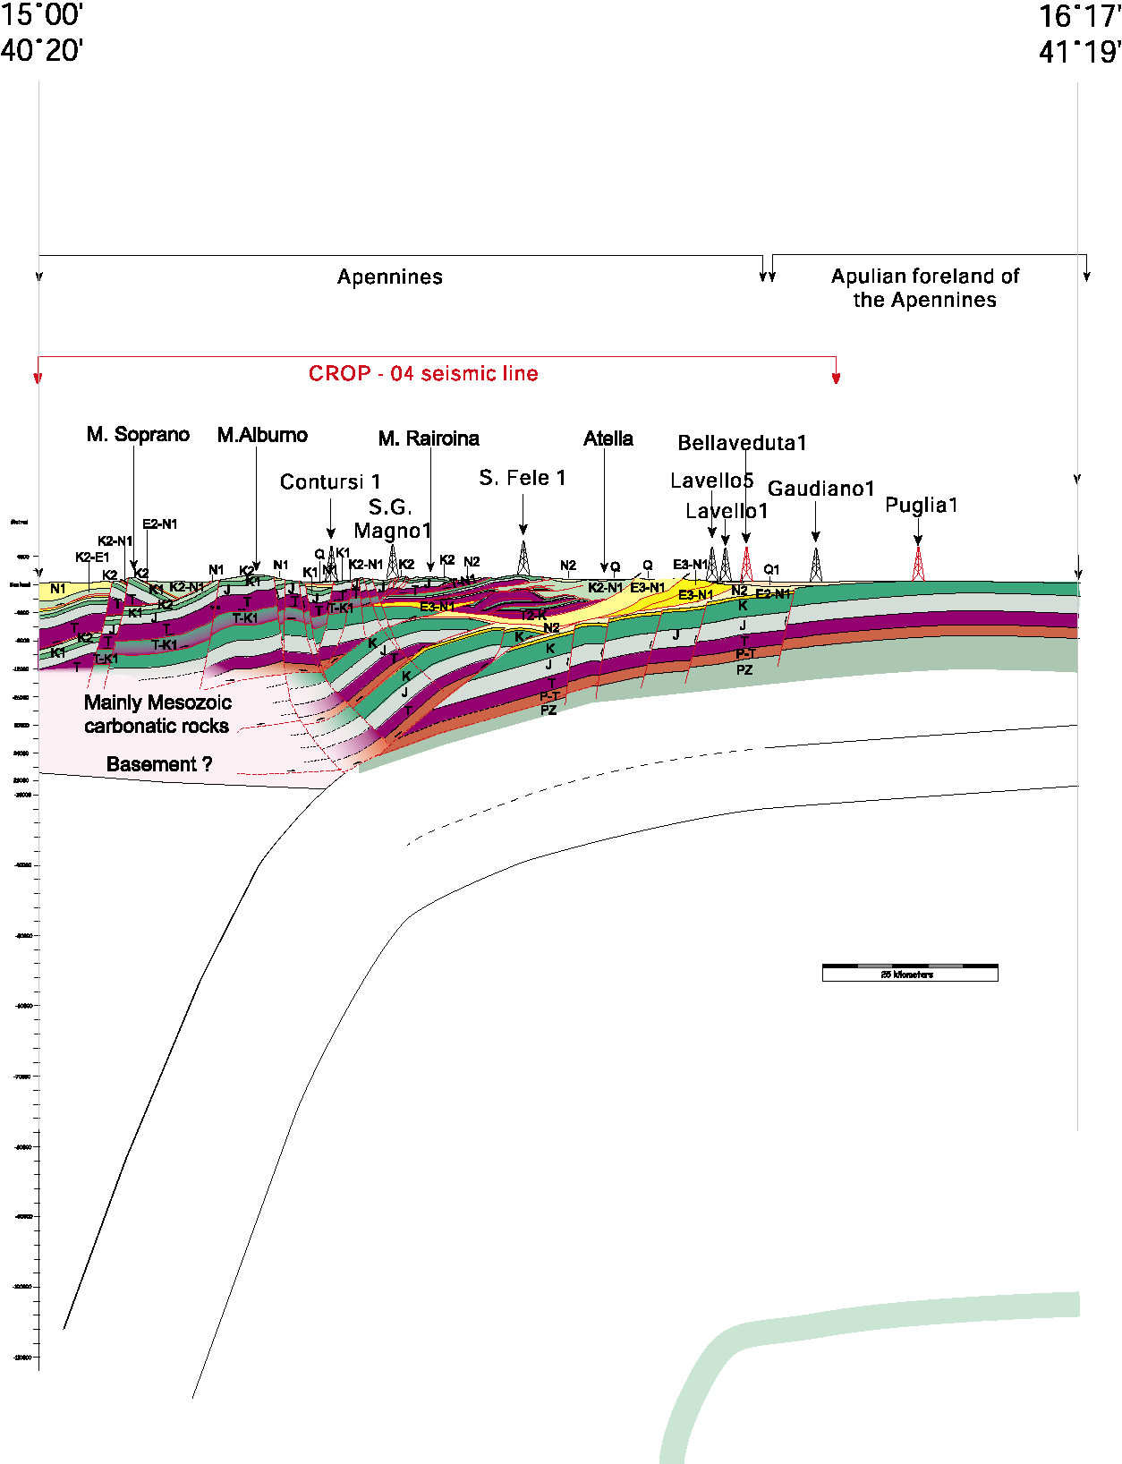
New Moho
Old Moho

Slide 30
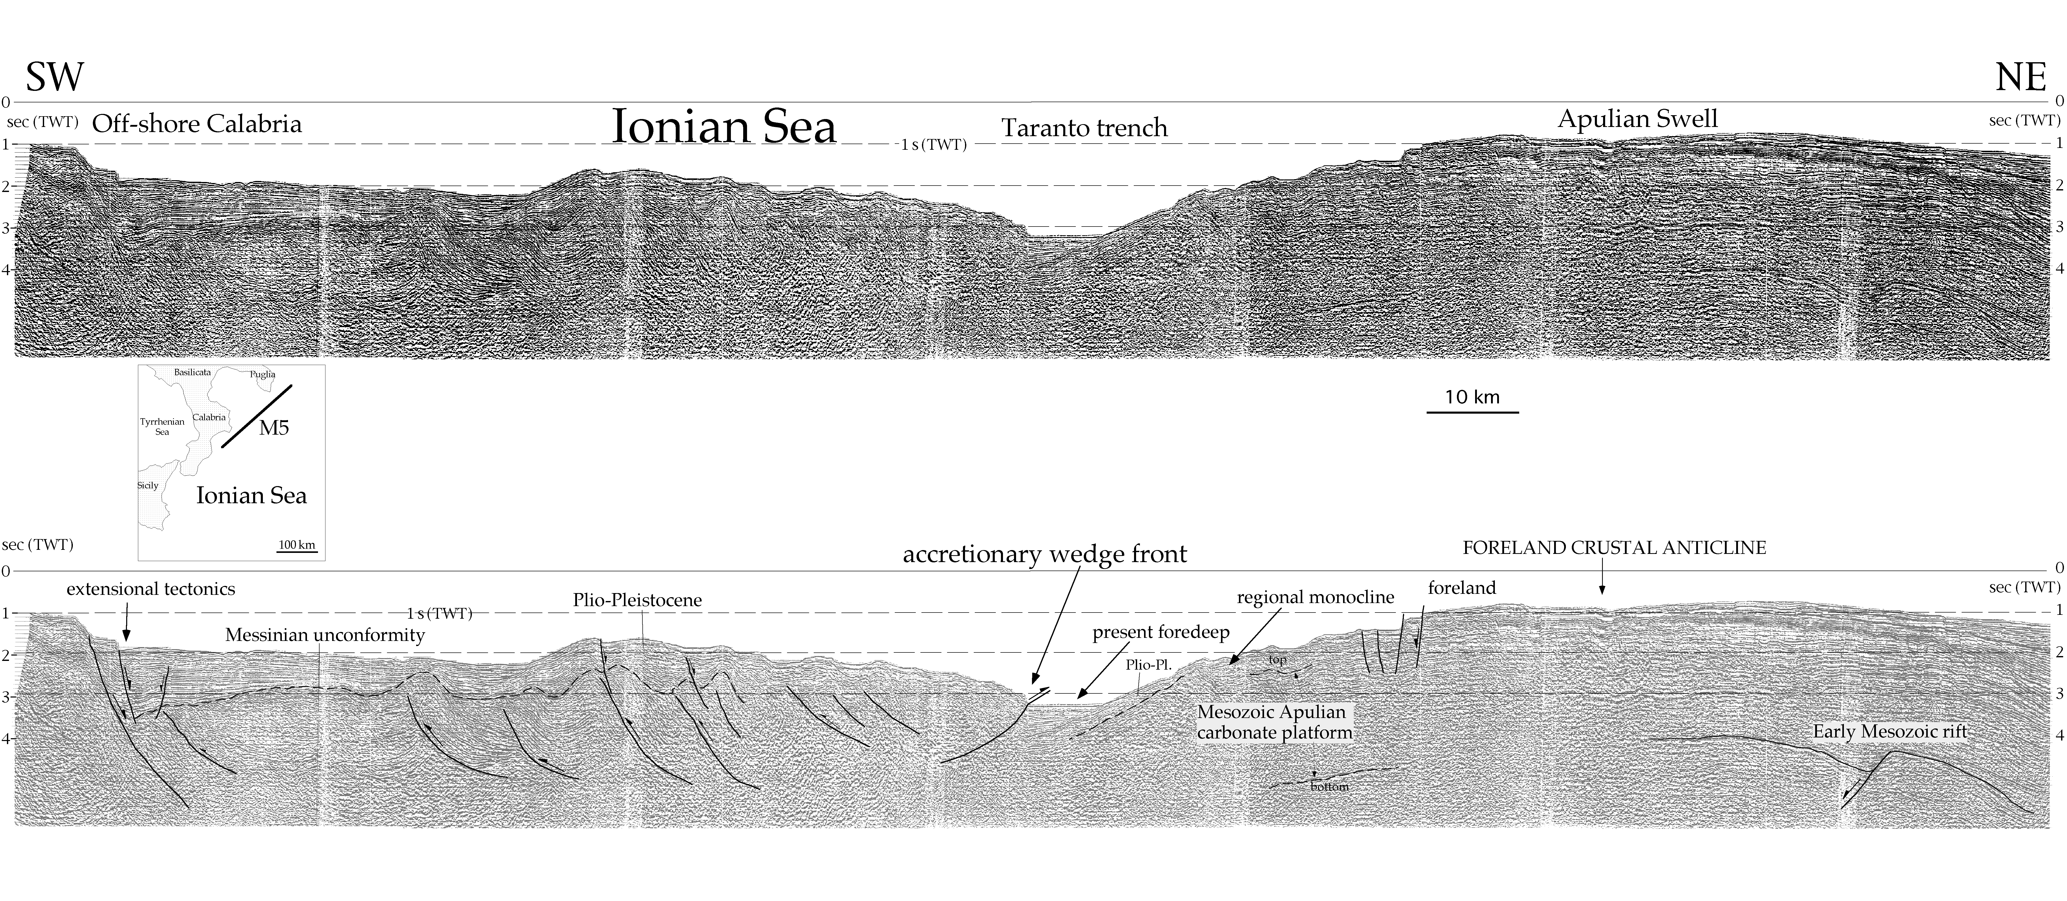
OFF-SHORE SEISMIC: AN EXAMPLE

Slide 31
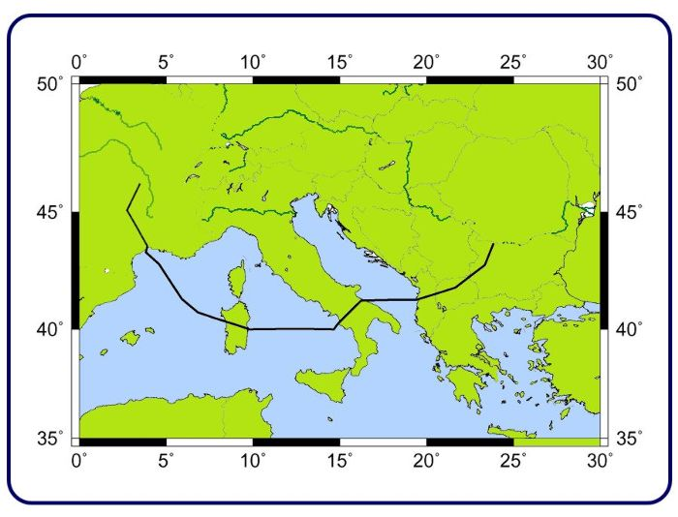
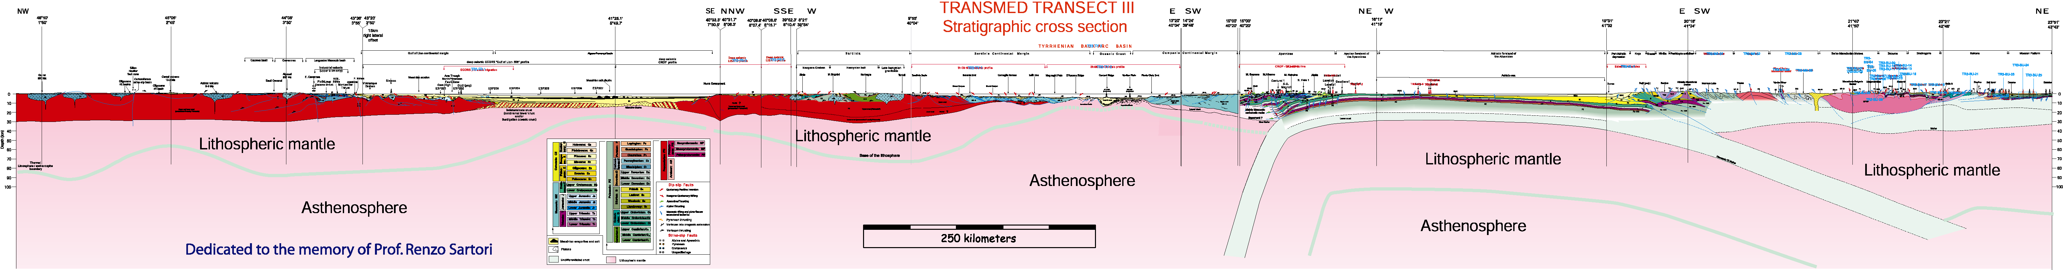

Slide 32
Southern Apennines
Albanides
Adriatic Sea

Slide 33
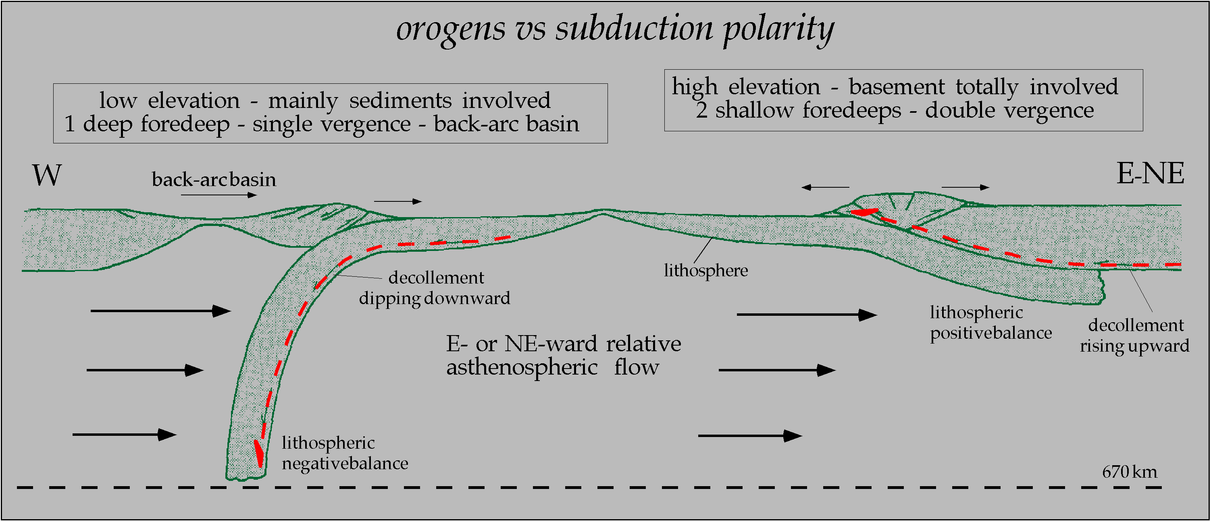
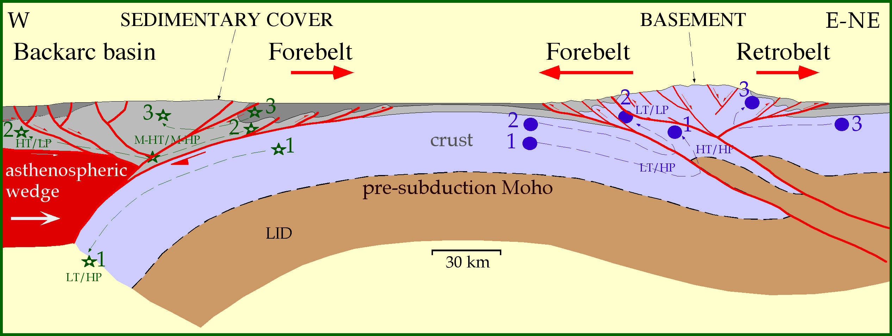

Slide 34
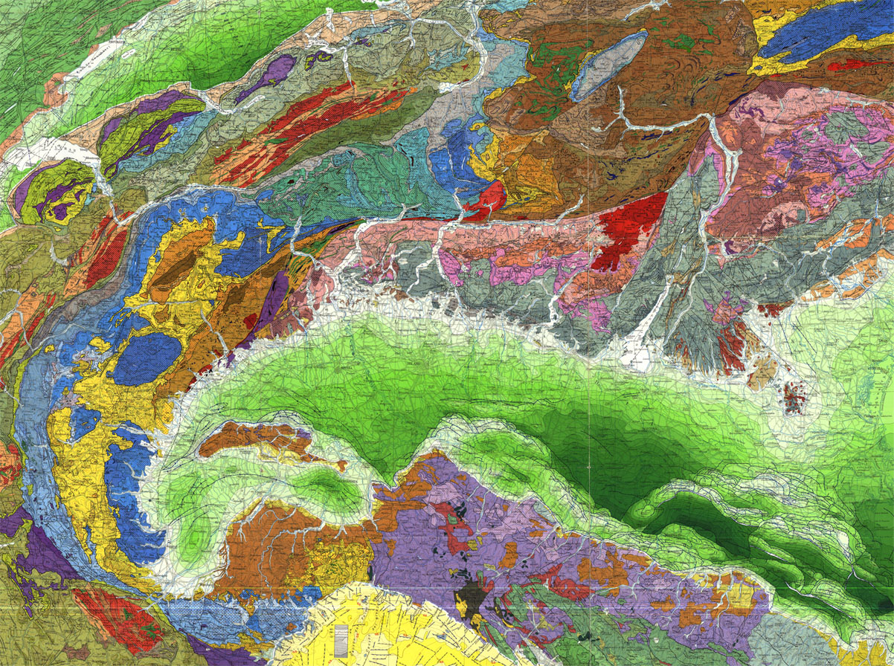

Slide 35
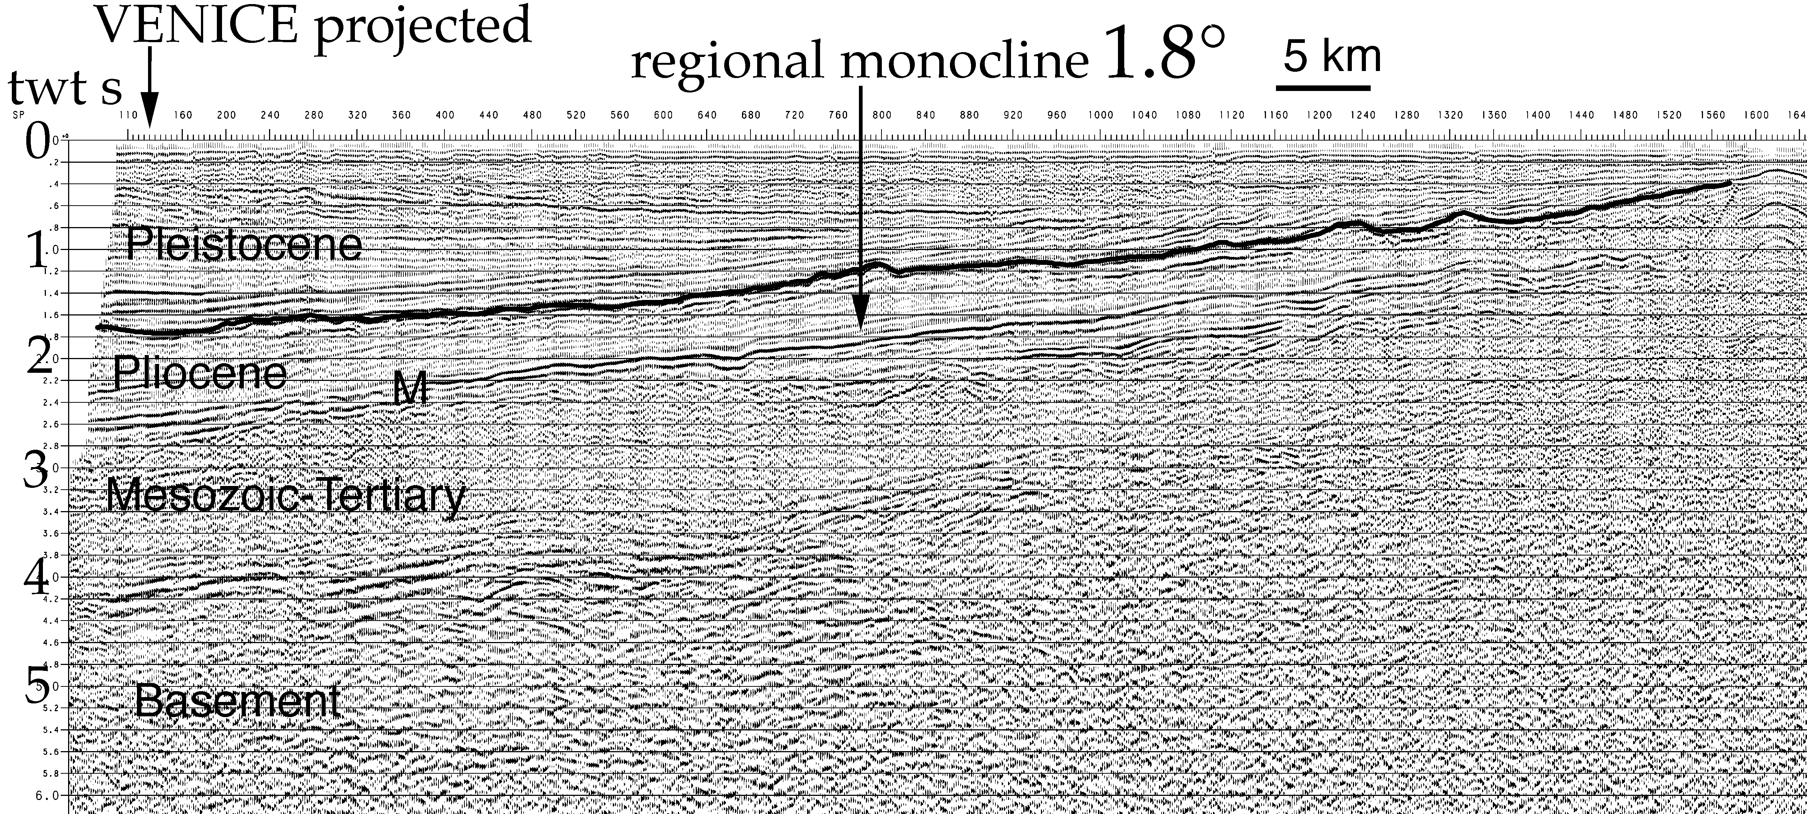
NE

Slide 36
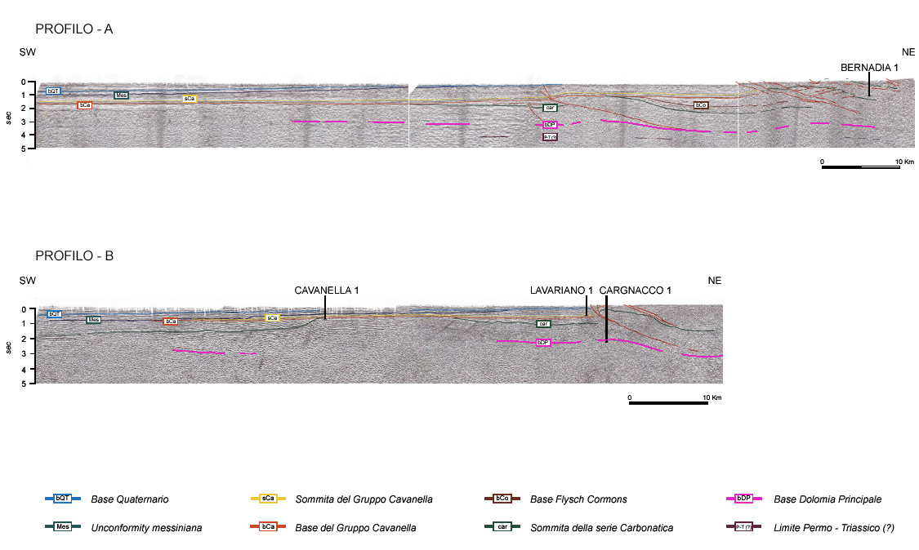
Merlini et al., 2002 Mem. SGI

Slide 37
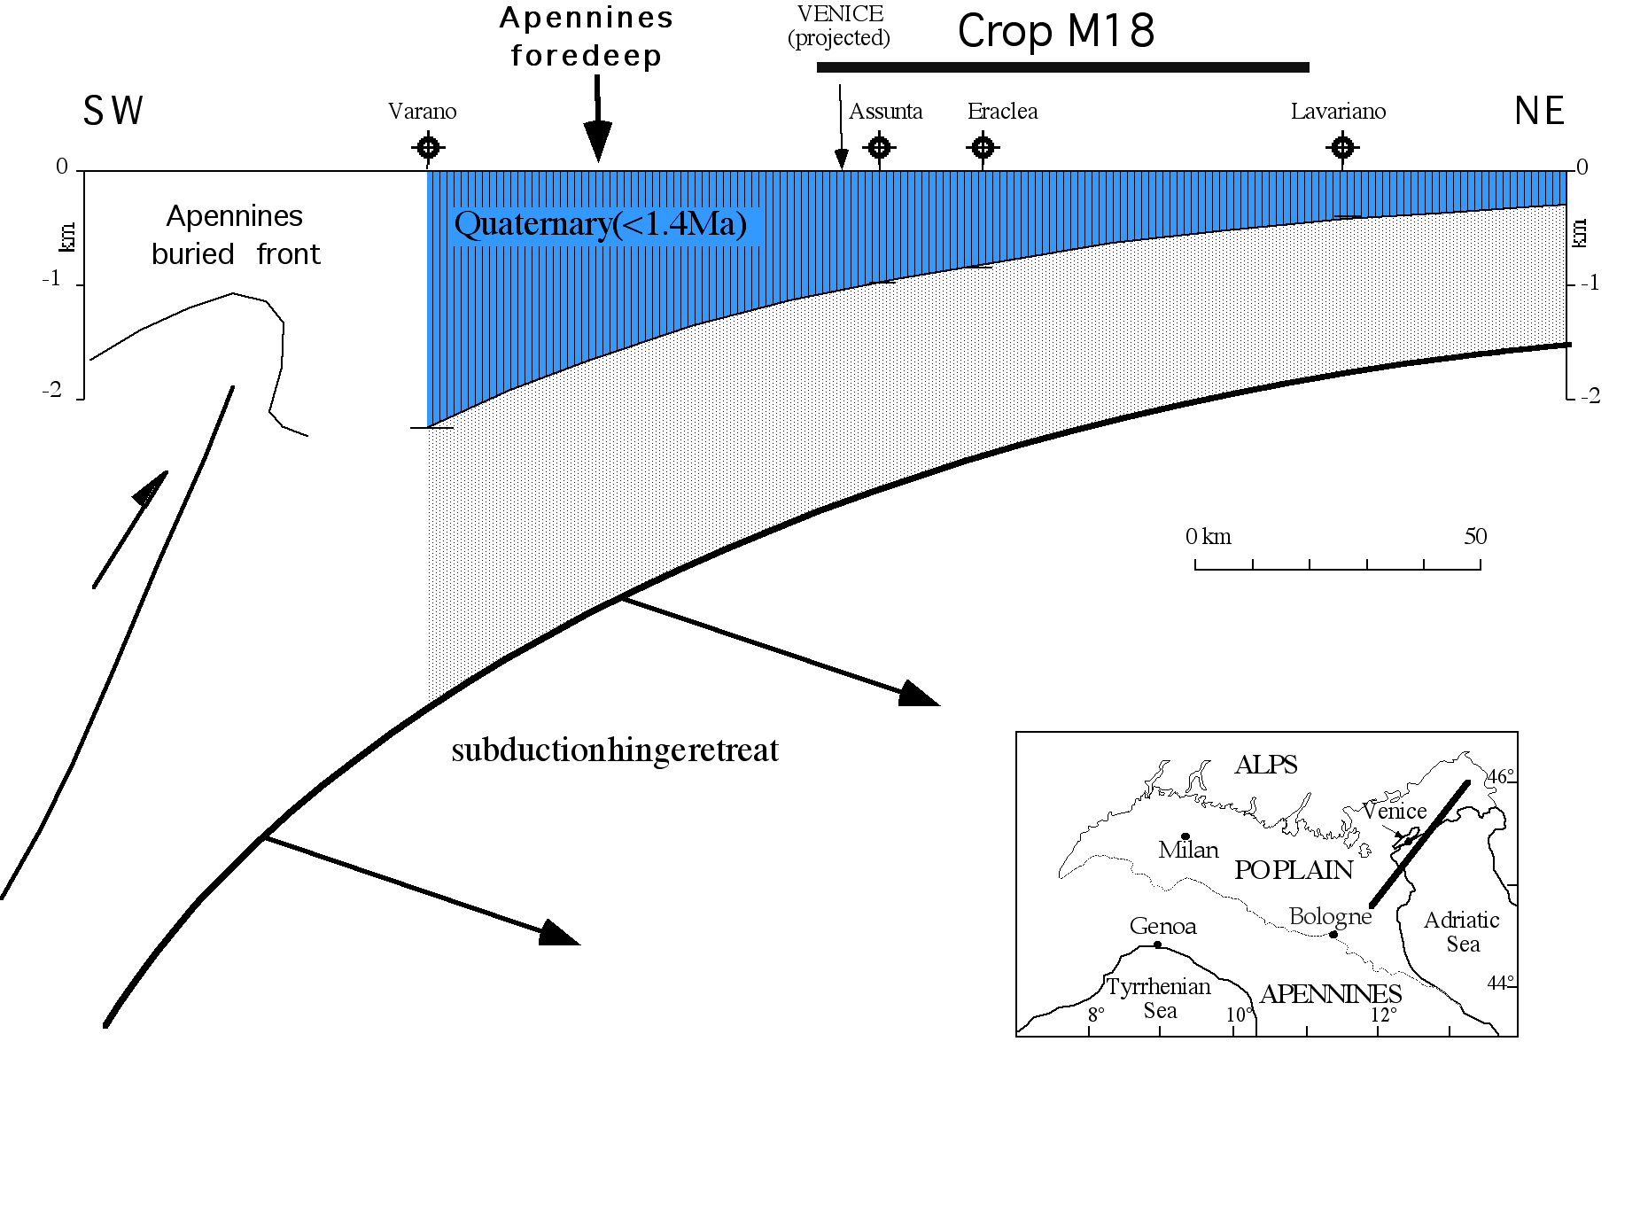

Slide 38
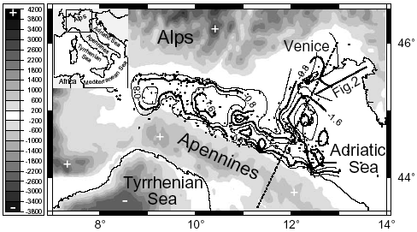
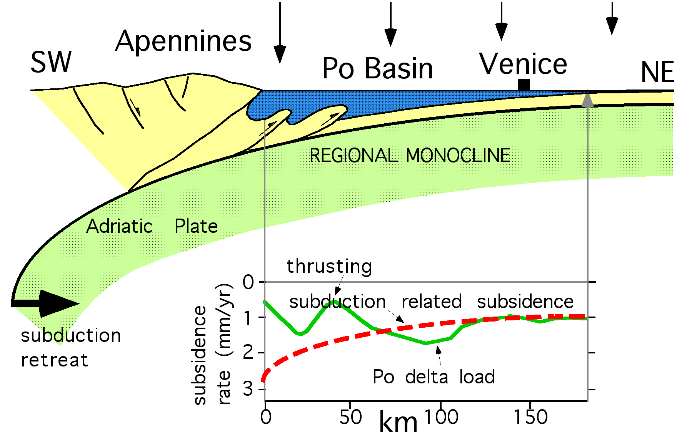

Slide 40
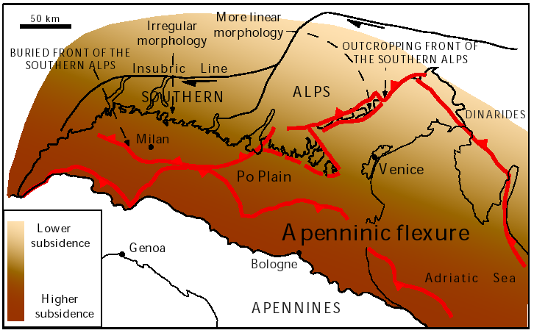
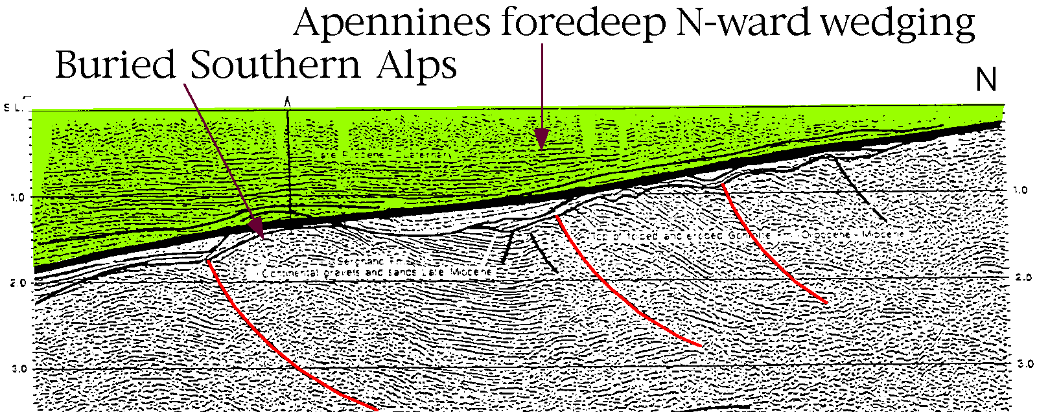

Slide 41
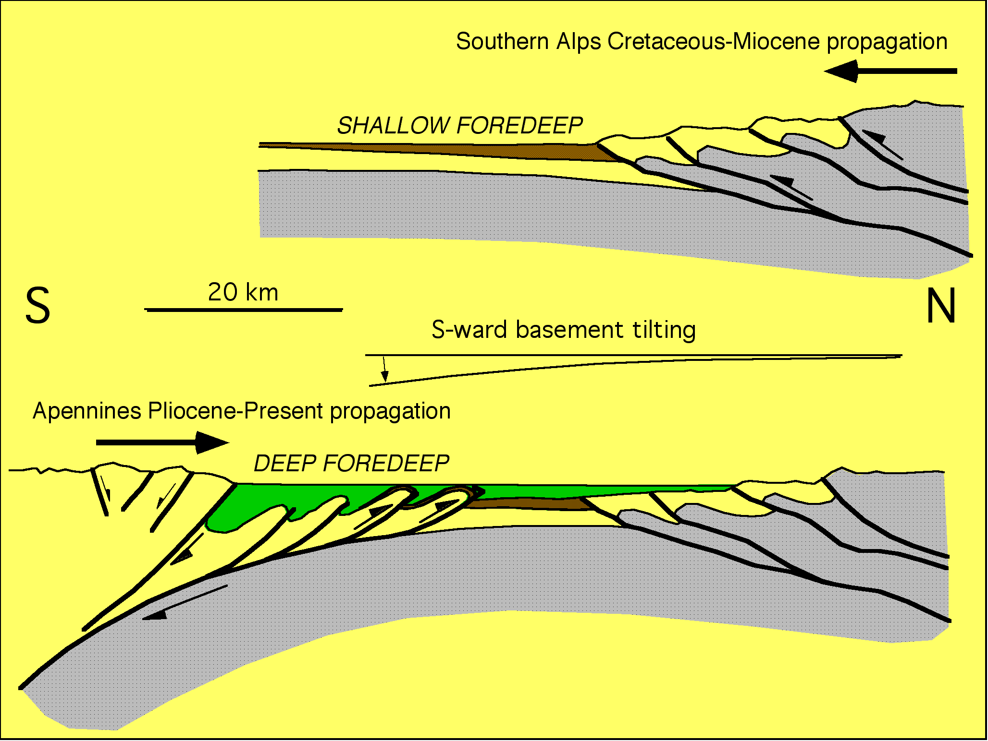

Slide 42
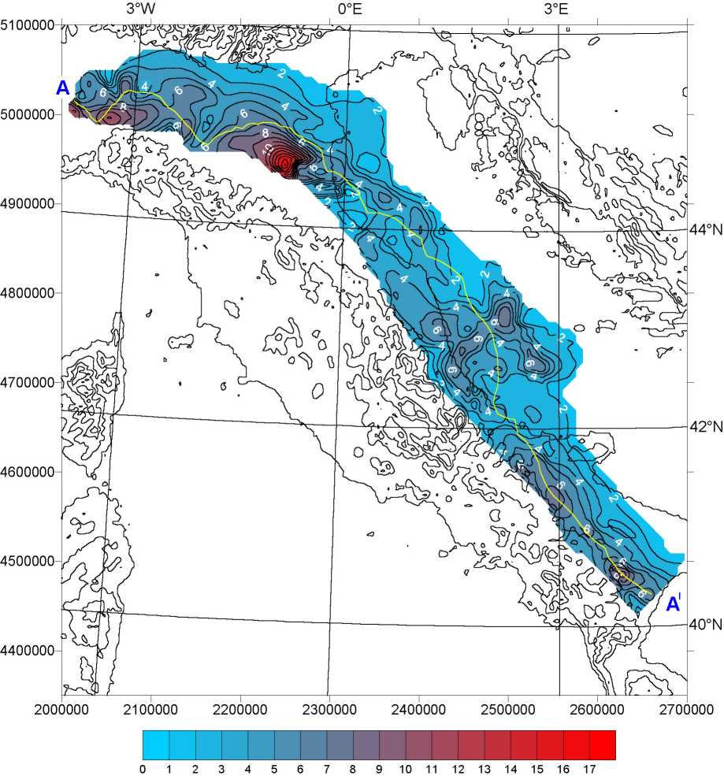

MONOCLINALE REGIONALE ADRIATICA
A
A^{I}
β
Cassano et al., 1986
Bally et al., 1986
Sella et al., 1988

Slide 43


Slide 44
IL PRISMA D’ACCREZIONE DELL’APPENNINO CENTRO-SETTENTRIONALE
E LA MONOCLINALE REGIONALE ADRIATICA
LEGENDA
sovrascorrimenti attivi:
fuori-sequenza più interno
fronte s.s.
traccia delle sezioni utilizzate
1°
isolinee di pendenza della monoclinale regionale: intervallo 1°
A-A^{I} traccia dei profili
18°
Notes:
Ampiezza prisma, inclinazione monoclinale, area prisma, elevazione catena

Slide 45




Out-of-sequence thrust
Frontal thrust
5
Present N-Apennines accretionary prism
5
Late Pleistocene-Active 5
Early Pleistocene 4
Late Pleistocene-Active 5
Late Pliocene 3
Mid-Pliocene 2
Early Pliocene 1
5 km
Po Basin - seismics after Pieri, 1983
5
5

Slide 48

0.5 km
4 km

Slide 49
MAIN vertical motion (+/-) PARAMETERS of orogens
- lithosphere thickness/composition+asth
- critical taper
- convergence rate
- regional monocline dip
- shortening rate
- erosion rate
DECOLLEMENT DEPTH
ramp spacing & vergence
SUBDUCTION POLARITY
HINGE MIGRATION

Slide 50

VERTICAL MOVEMENTS - PLATE TECTONICS RELATED

Slide 51
α
β
0.5 km
4 km

Slide 52

Deeper Decollement = Thicker Prism

Slide 53


Slide 54
REGIONAL MONOCLINE
α
100 km
β
subduction
α
β
8-10°

Slide 55
α
ALPINE FRONT - AUSTRIA
S
Foreland monocline 3,5°
β
200m/Ma
Bachmann & Koch, 1983
1600m/Ma
α
β
Pieri, 1983

Slide 56
W
Banda arc
W-directed subduction
α
β
15°
1500m/Ma
200m/Ma
SW
Papua-New Guinea
NE-directed subduction
α
α
β
3°

Slide 57
Alps - Dinarides
α
β
α
β
Apennines

Slide 58

Scrocca, 2006
REGIONAL SUBSIDENCE > FOLD UPLIFT

Slide 59
positive fold
total uplift
SW
Canale d'Otranto
HELLENIDES
E-NE
APENNINES
S-Adriatic - Ionian seas
FRONT
0
negative fold
FRONT
1
.
total uplift
0
Plio-Pleistocene
2
.
deeper
M
0
foredeep
3
.
Pleistocene
Apulian carbonate platform
Sec TWT
0
0
1
0
k
m
5
.
Subsidence rate > 1 mm/yr
5
Subsidence rate < 0.3 mm/yr
0
C
R
O
P
M
5
regional subsidence > fold uplift
regional subsidence < fold uplift
SUBDUCTIONS DIRECTION
Calabria
M
M
5
3
8
I
o
n
i
a
n
S
e
a
1
0
0
k
m

Slide 61
Lombard B.
Trento H.
Belluno B.
Umbro-M. B.
Apulian
Platform
RECESS
Ionian
Basin
SALIENT
Mariotti & Doglioni, 2000

Slide 62
FOREDEEPS
4 km Oligocene base
8 km Pliocene base

Slide 63
1600m/Ma
200m/Ma
200m/Ma

Slide 64

MORPHOLOGIC RELIEF
STRUCTURAL RELIEF

Slide 66
Lombard B.
Trento H.
Belluno B.
Umbro-M. B.
Apulian
Platform
RECESS
Ionian
Basin
SALIENT
Mariotti & Doglioni, 2000

Slide 67
Scrocca, 2006
REGIONAL SUBSIDENCE > FOLD UPLIFT

Slide 68
positive fold
total uplift
SW
Canale d'Otranto
HELLENIDES
E-NE
APENNINES
S-Adriatic - Ionian seas
FRONT
0
negative fold
FRONT
1
.
total uplift
0
Plio-Pleistocene
2
.
deeper
M
0
foredeep
3
.
Pleistocene
Apulian carbonate platform
Sec TWT
0
0
1
0
k
m
5
.
Subsidence rate > 1 mm/yr
5
Subsidence rate < 0.3 mm/yr
0
C
R
O
P
M
5
regional subsidence > fold uplift
regional subsidence < fold uplift
SUBDUCTIONS DIRECTION
Calabria
M
M
5
3
8
I
o
n
i
a
n
S
e
a
1
0
0
k
m

Slide 69
FOREDEEPS
4 km Oligocene base
8 km Pliocene base

Slide 70
Dinarides
α
β
α
β
Apennines

Slide 71
REGIONAL SUBSIDENCE > FOLD UPLIFT

Slide 72
α
5 km
α
α
α
β
β
β
β

Slide 73
Atlantic
Arabia
Barbados W-subduction Zagros NE-subduction

Slide 75

Pleistocene subsidence ≈ 1 mm/yr
CROP M18

Slide 79


Slide 80


Slide 81
H

Slide 82
Out-of-sequence thrust
Frontal thrust
5
Present N-Apennines accretionary prism
5
Late Pleistocene-Active 5
Early Pleistocene 4
Late Pleistocene-Active 5
Late Pliocene 3
Mid-Pliocene 2
Early Pliocene 1
5 km
Po Basin - seismics after Pieri, 1983
5
5

Slide 84


