Slide 1
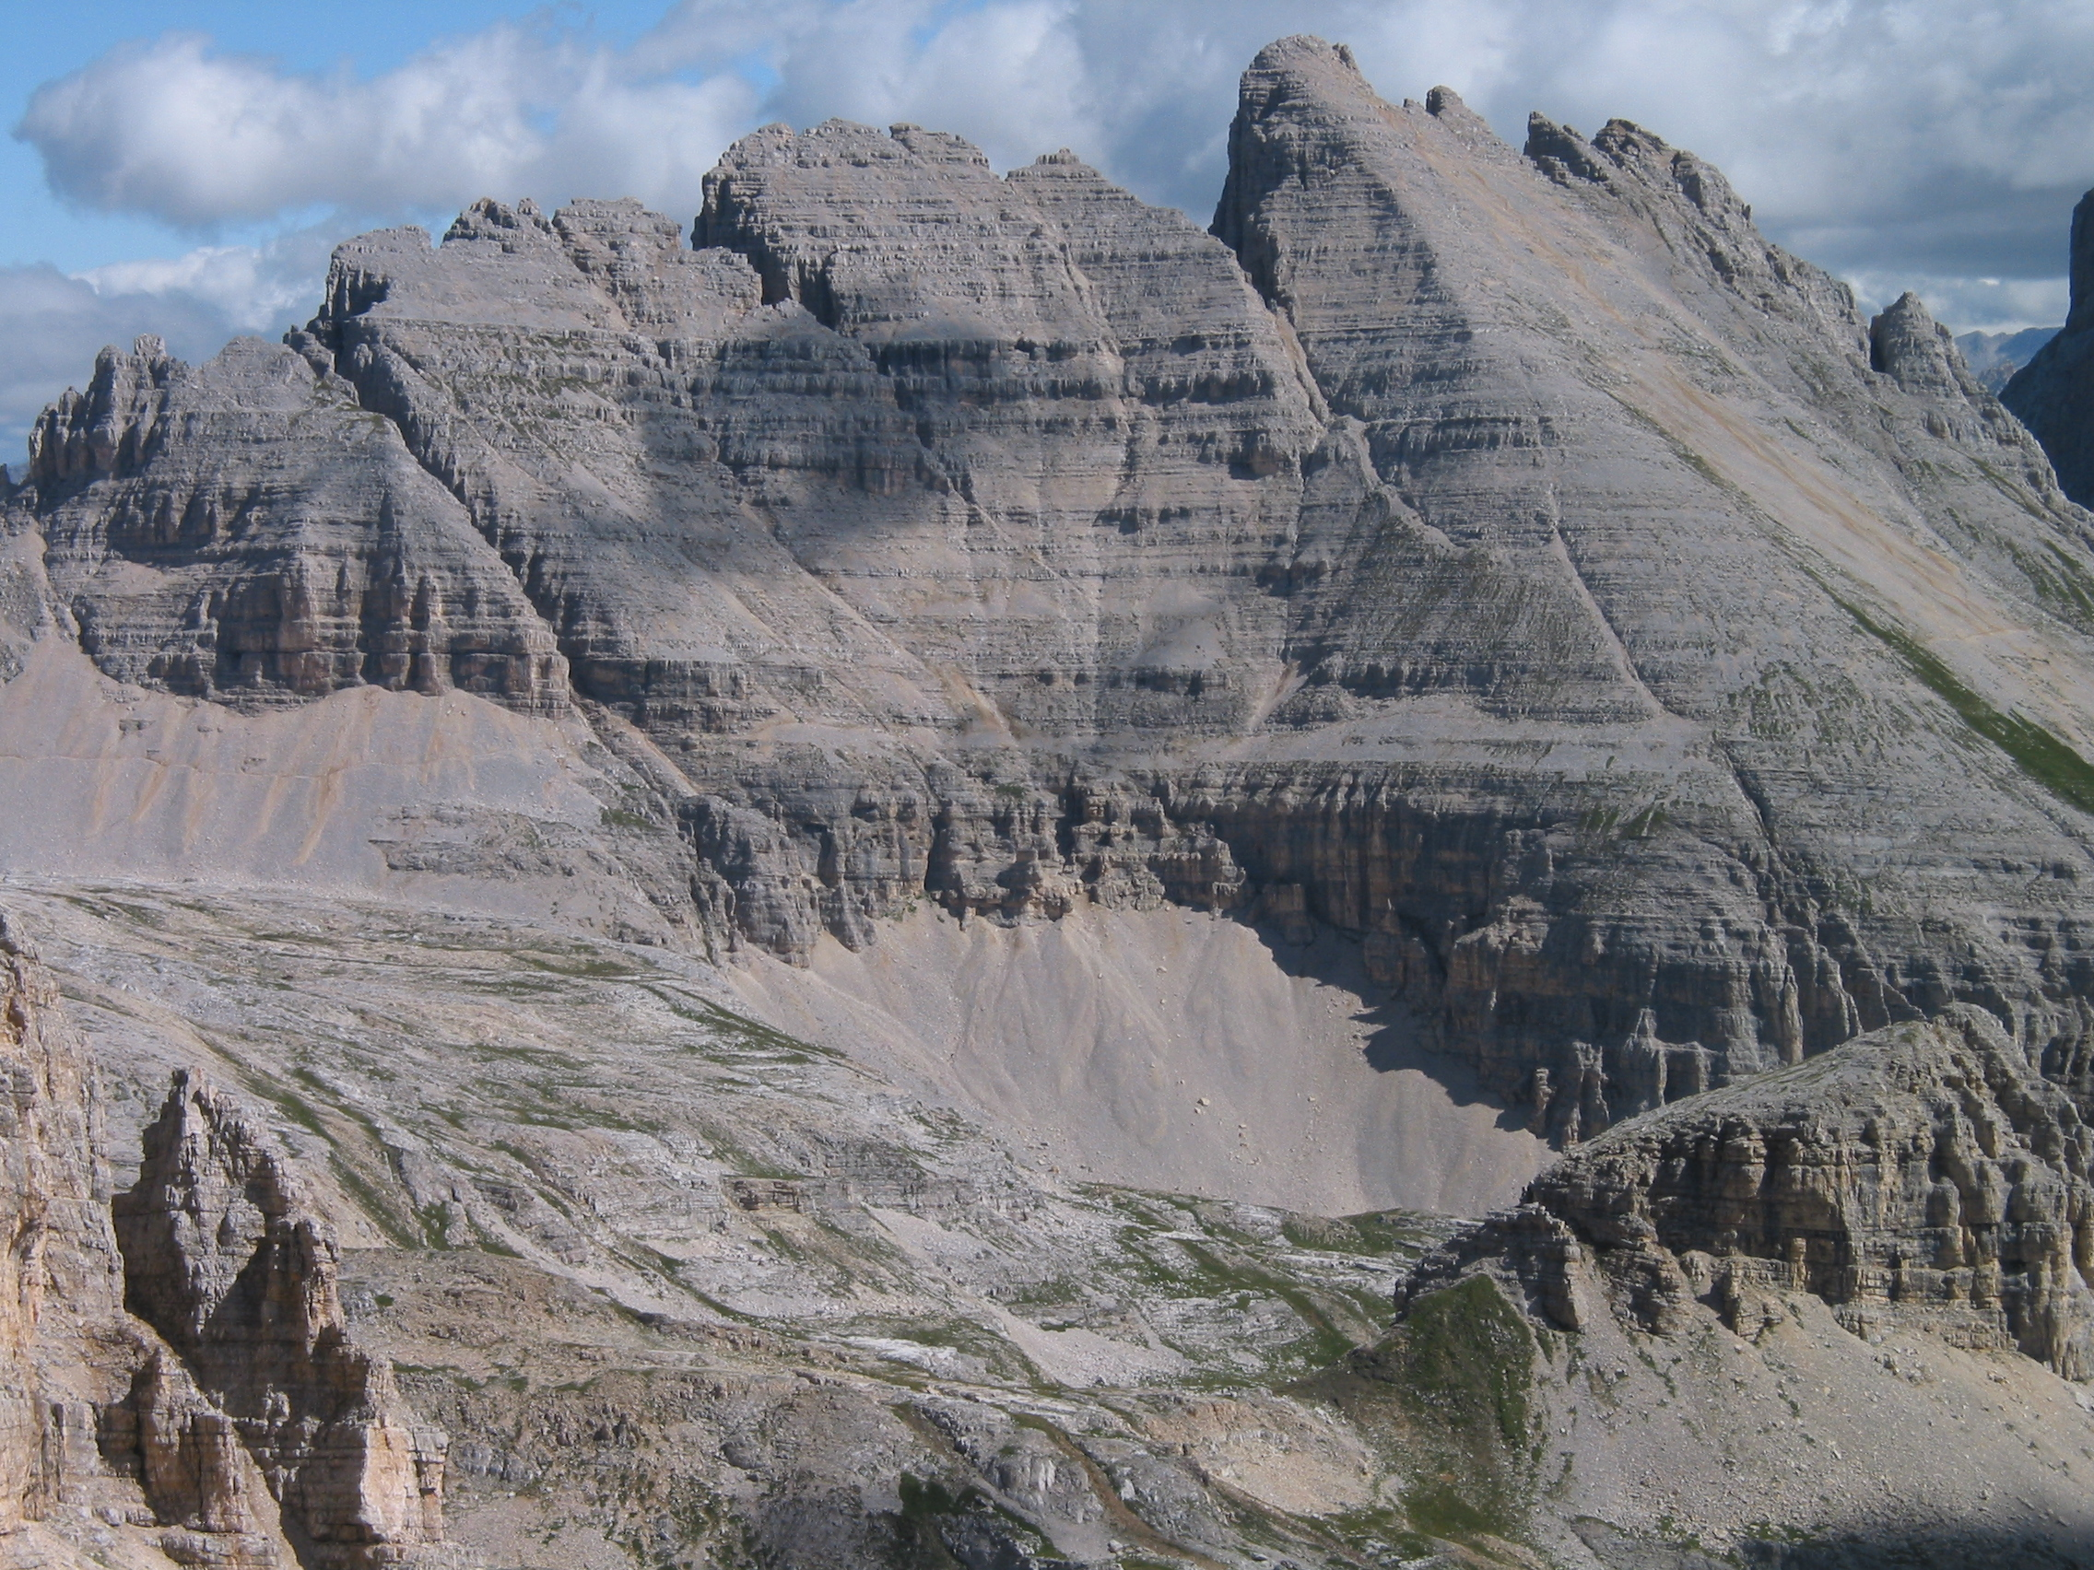
Resurrection of the Allocyclic Interpretation of the Latemar Cycles (M. Triassic, the Dolomites) : View from a Coeval Platform
RK Goldhammer (UT Austin), LA Hinnov (Johns Hopkins Univ.), LA Hardie (Johns Hopkins Univ.) and R. Forkner (UT Austin)

Slide 2
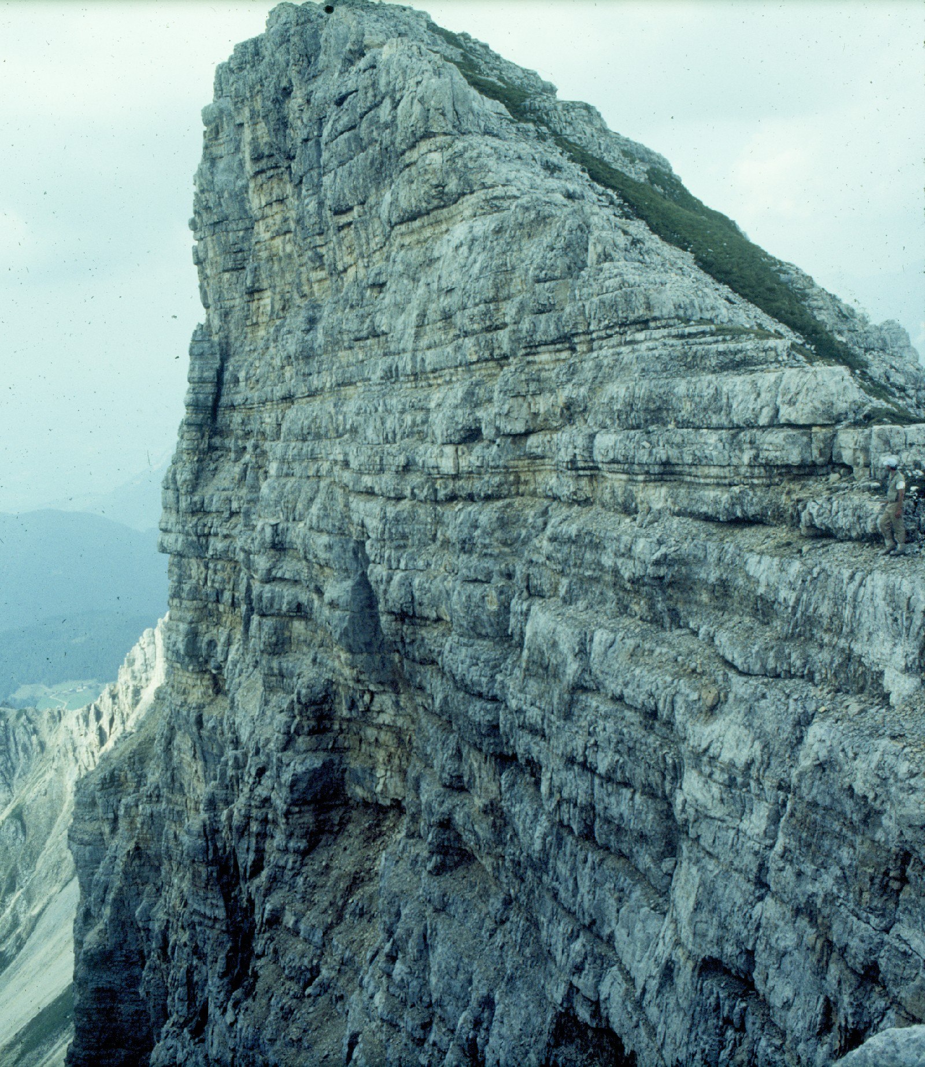
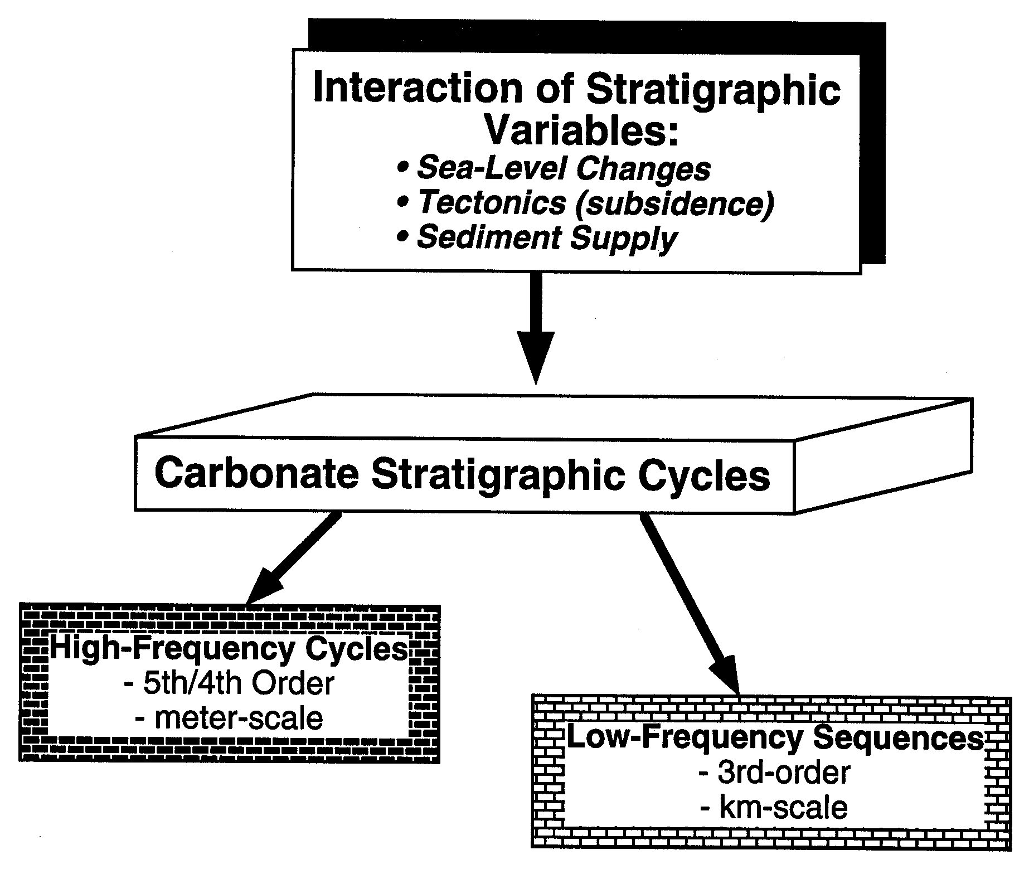

Slide 3
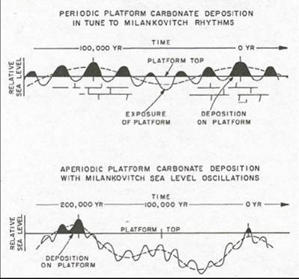
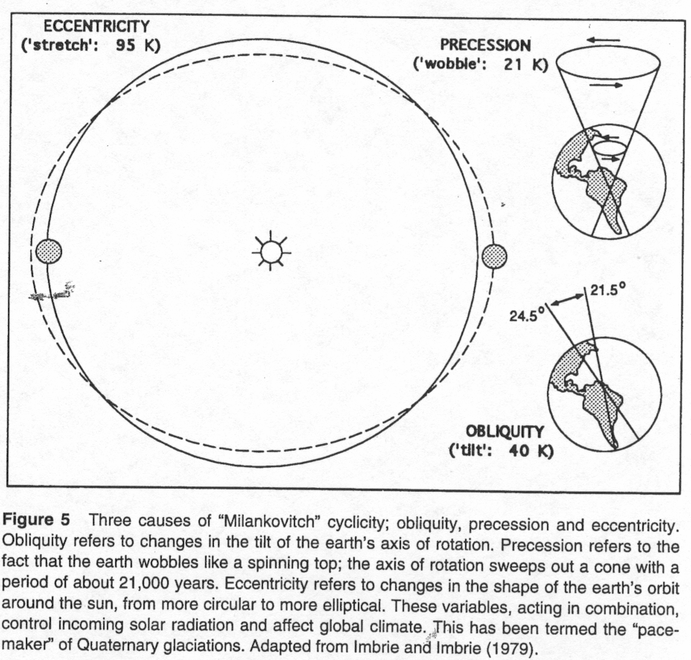
ALLOCYCLIC:
Process(es) external to the depositional system which impart a net effect on stratigraphic accumulation….example: Milankovitchian glacio-eustasy
Orbital Forcing - Milankovitch

Slide 4
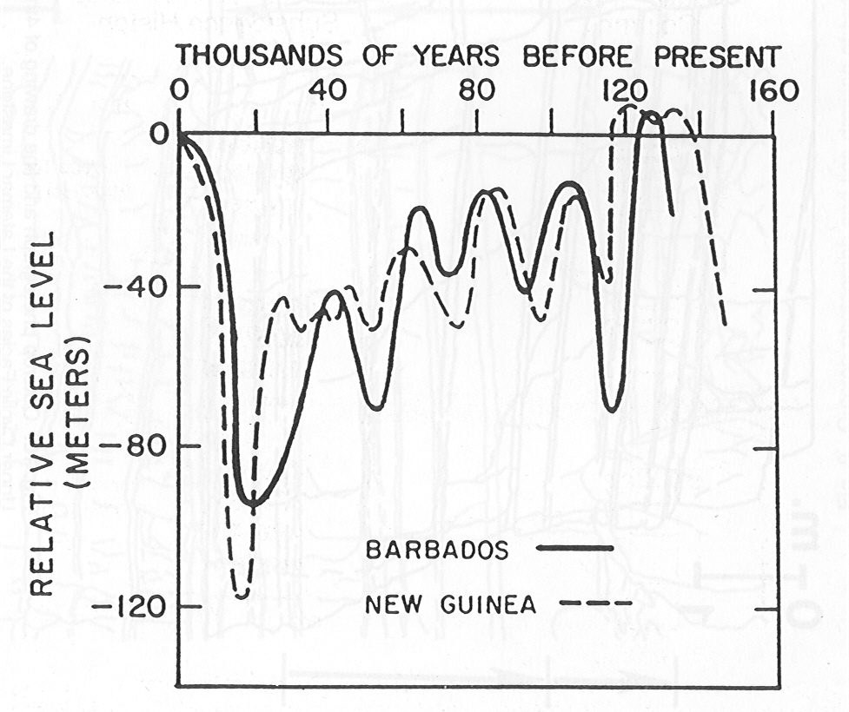
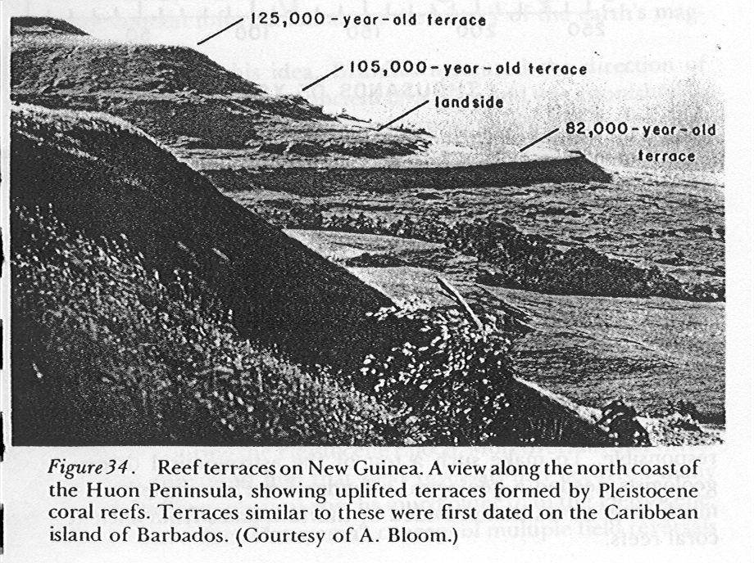
Allocyclicity and High-Frequency Carbonate Cycles
The Pleistocene Record

Slide 5
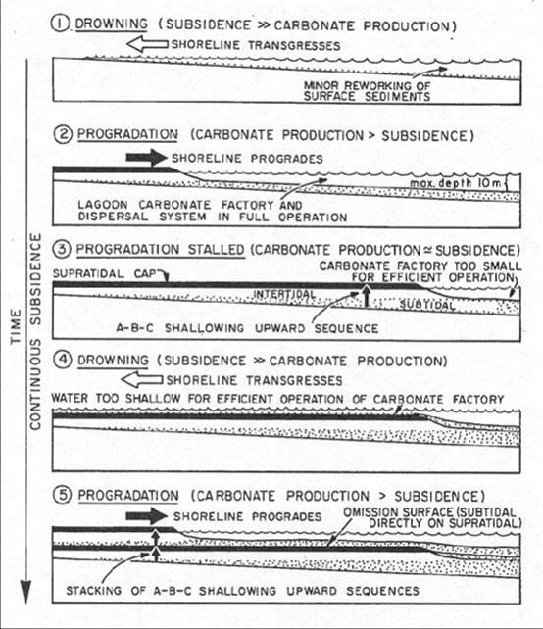
AUTOCYCLIC:
Process(es) that are internal to a sedimentary system, totally devoid of external influences. To develop cyclic deposits, these processes have to be self-regulating and include a built-in feedback mechanism…..example: Delta lobe abandonment; fluvial avulsion
Ginsburg
Autocycles

Slide 6
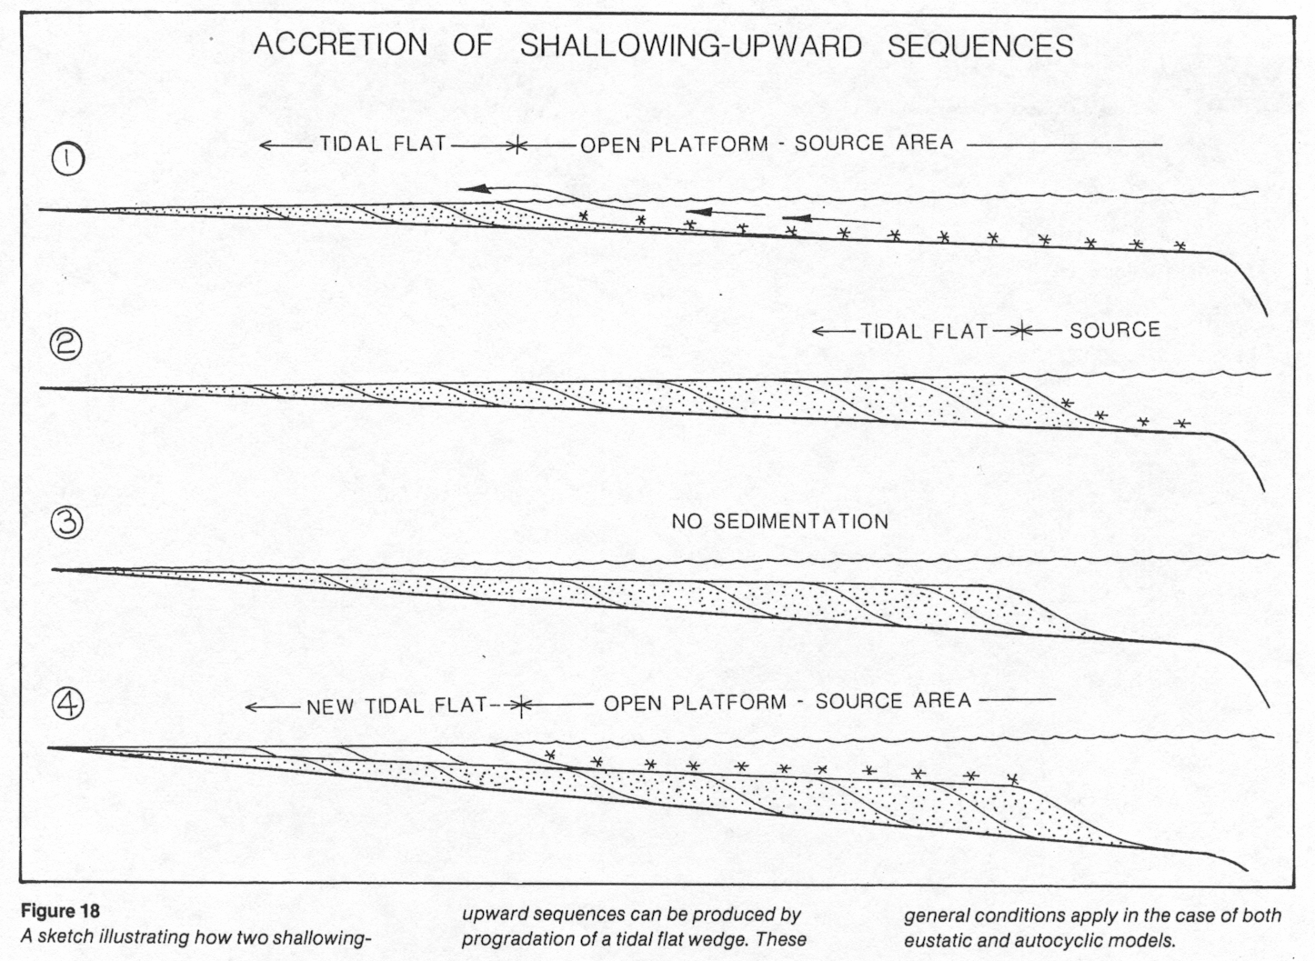
Cycle Problem:
(a) approx. 10,000 – 100,000 yr duration
(b) vertical A-B-C asymmetric facies pattern

Slide 7
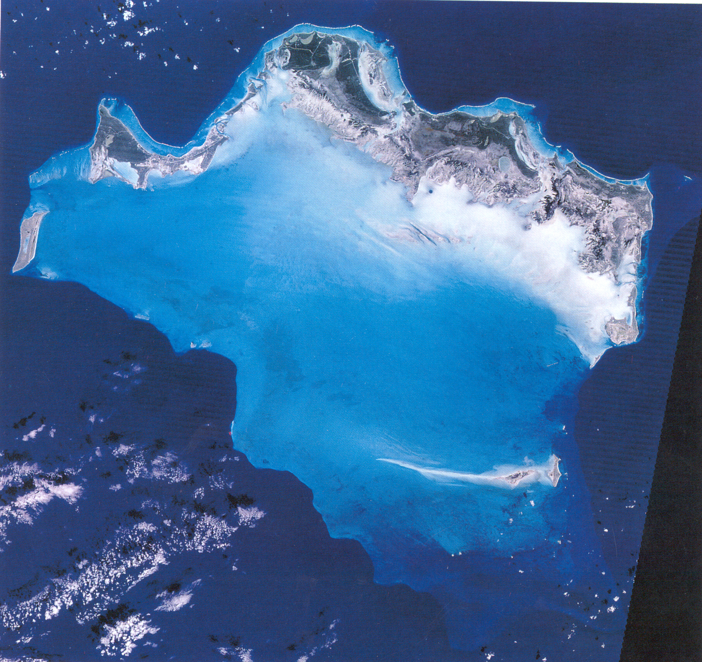
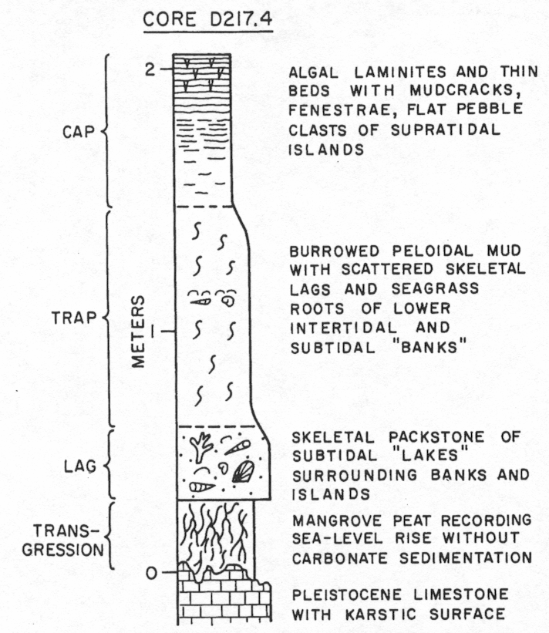
Holocene Tidal Flats of Caicos:
In approx. 6,000 yrs:
(a) 2.5 m ‘upward-shallowing cycle’
(b) 4-5 km of ‘downdip’ progradation of tidal flats

Slide 8
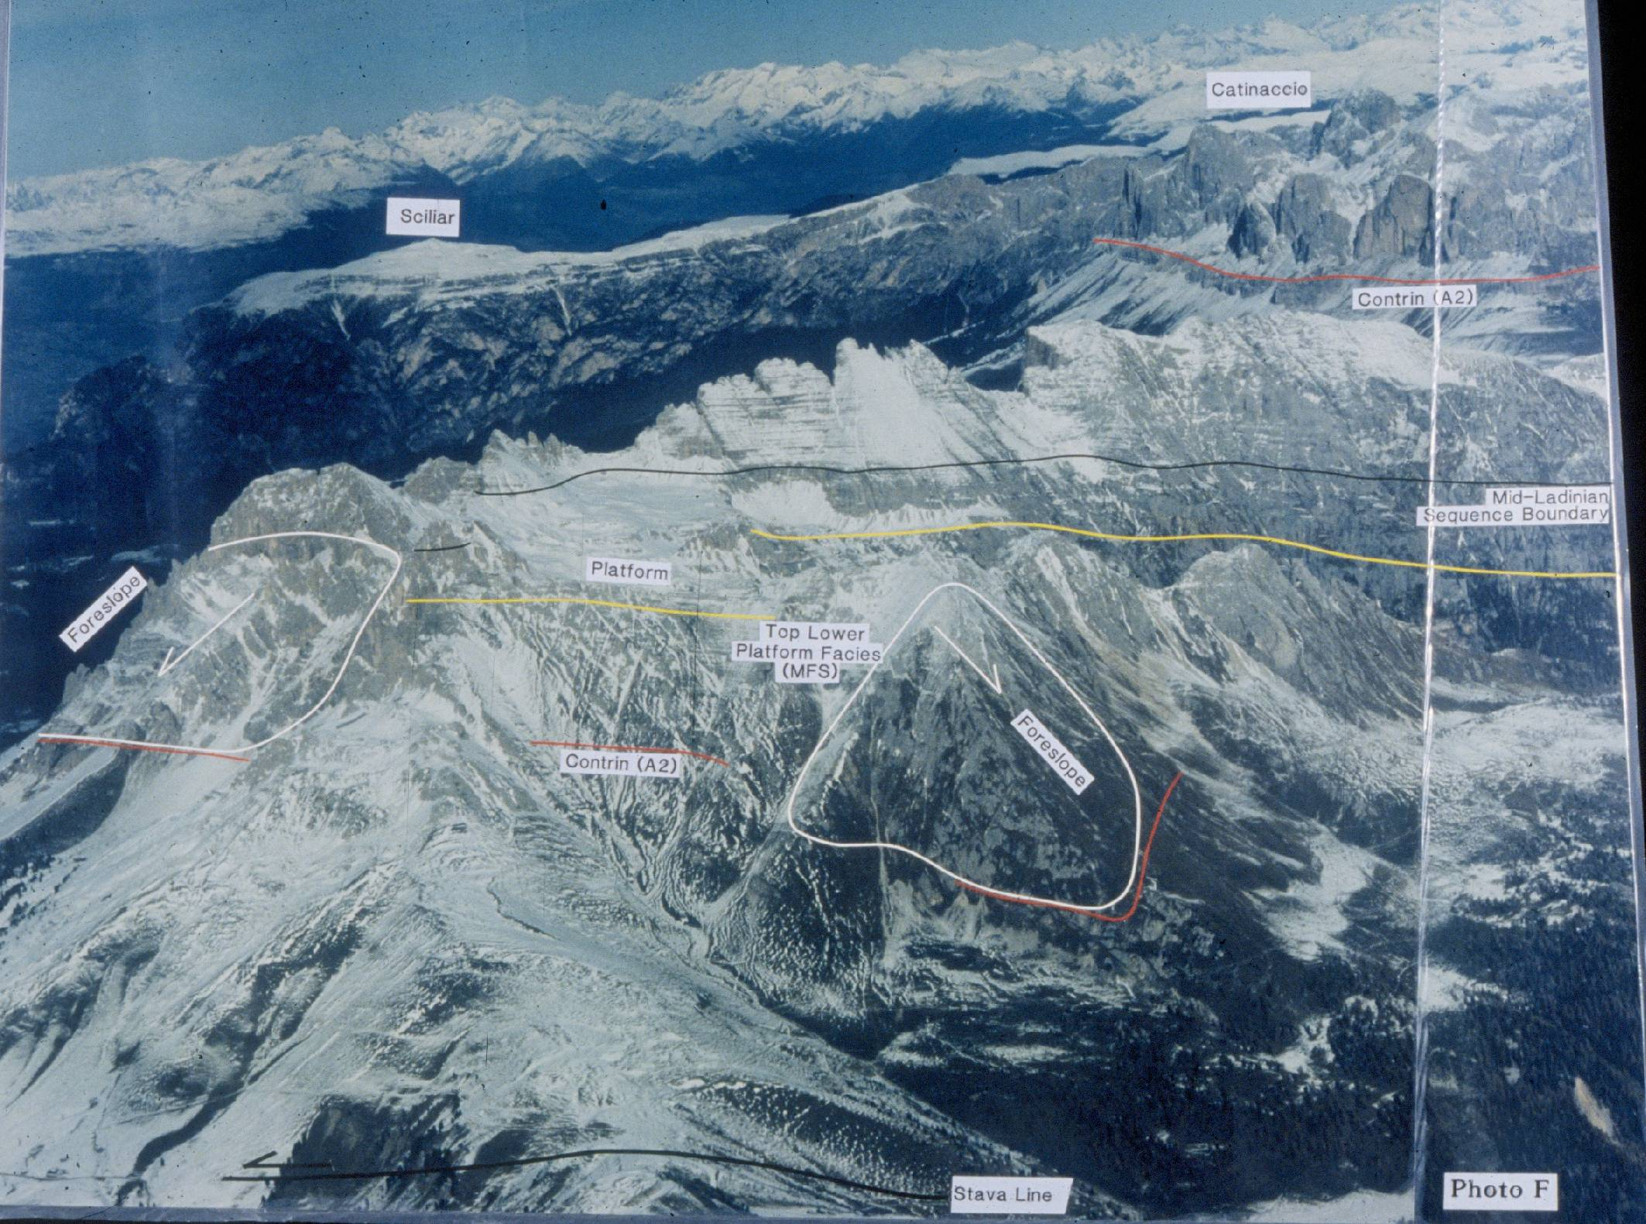
The Latemar : Isolated Platform (Middle Triassic of the Dolomites)

Slide 9
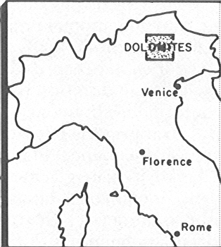
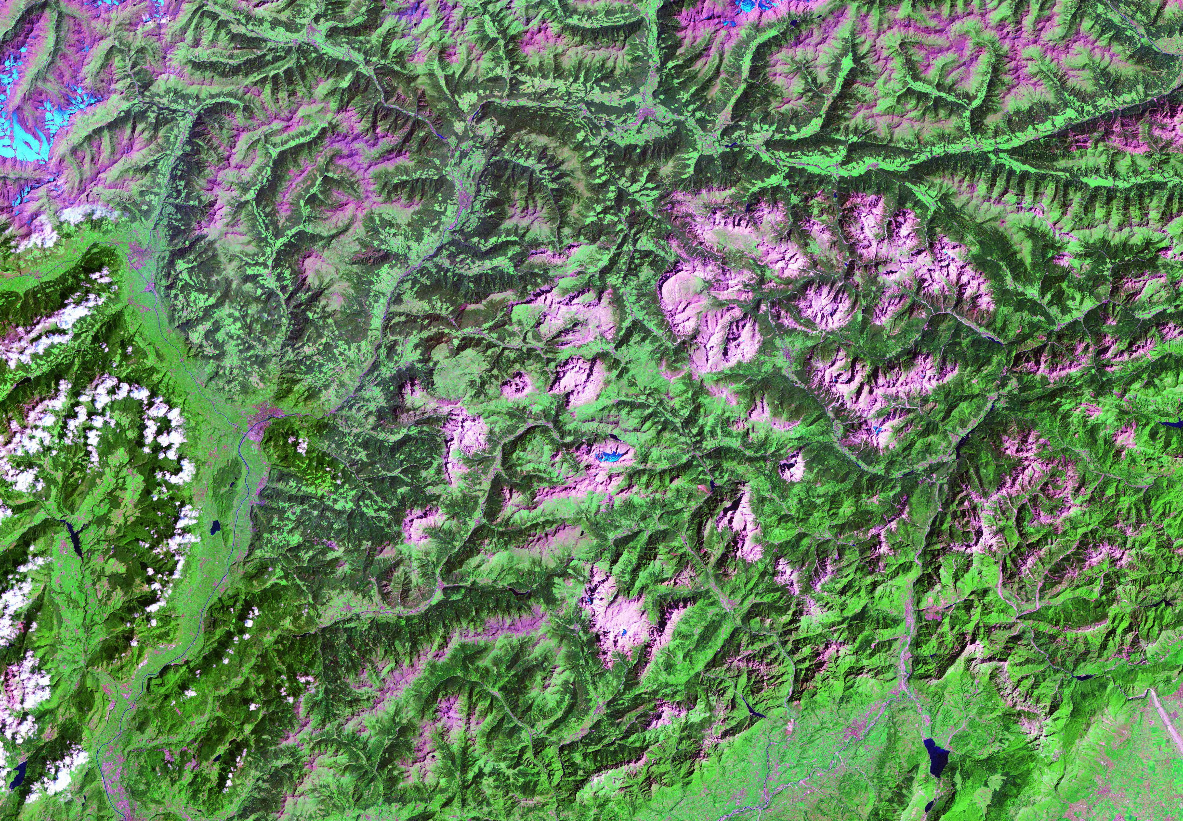
Landsat Image of the Dolomites

Slide 10
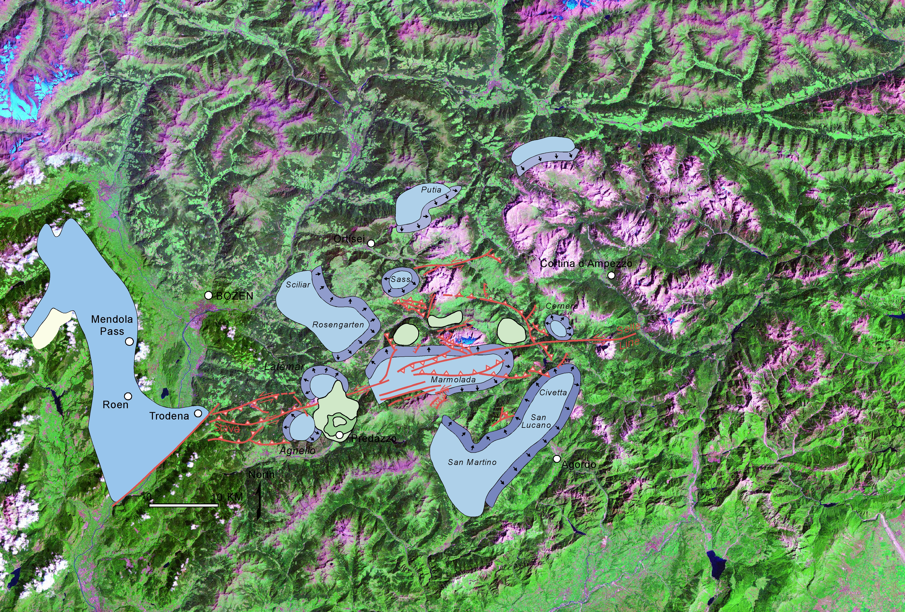
Middle Triassic Paleogeography
Mendola Escarpment
Latemar

Slide 11
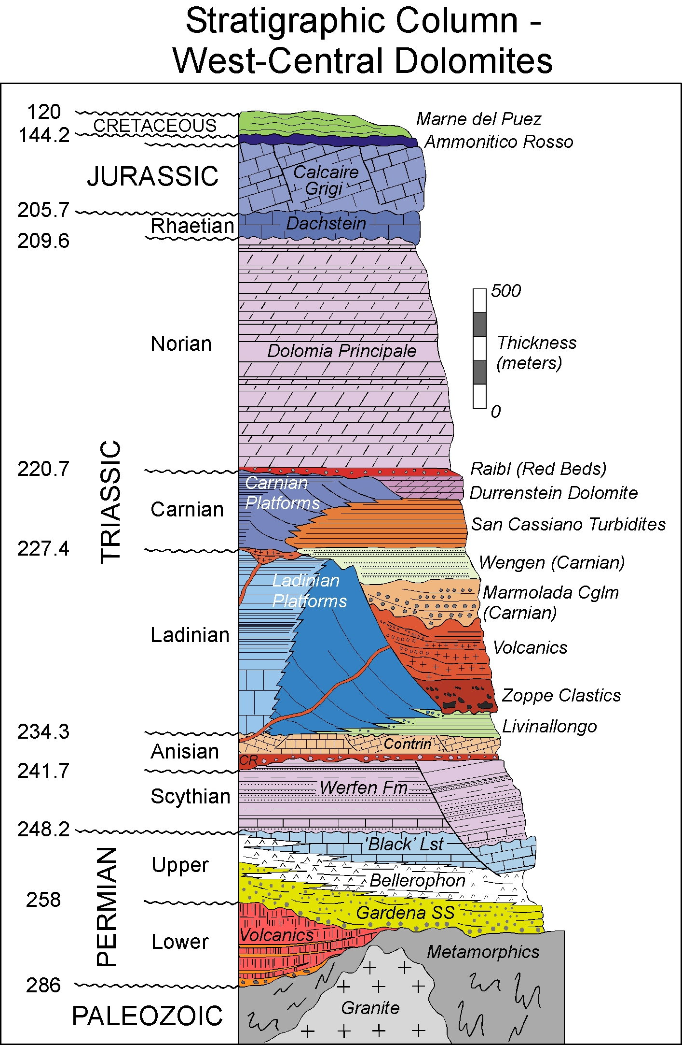
Regional Stratigraphy

Slide 12
The Latemar Cycles:
(the Johns Hopkins Group – Goldhammer, Dunn, Harris, Hinnov, Hardie – 1986-1993)

Slide 13
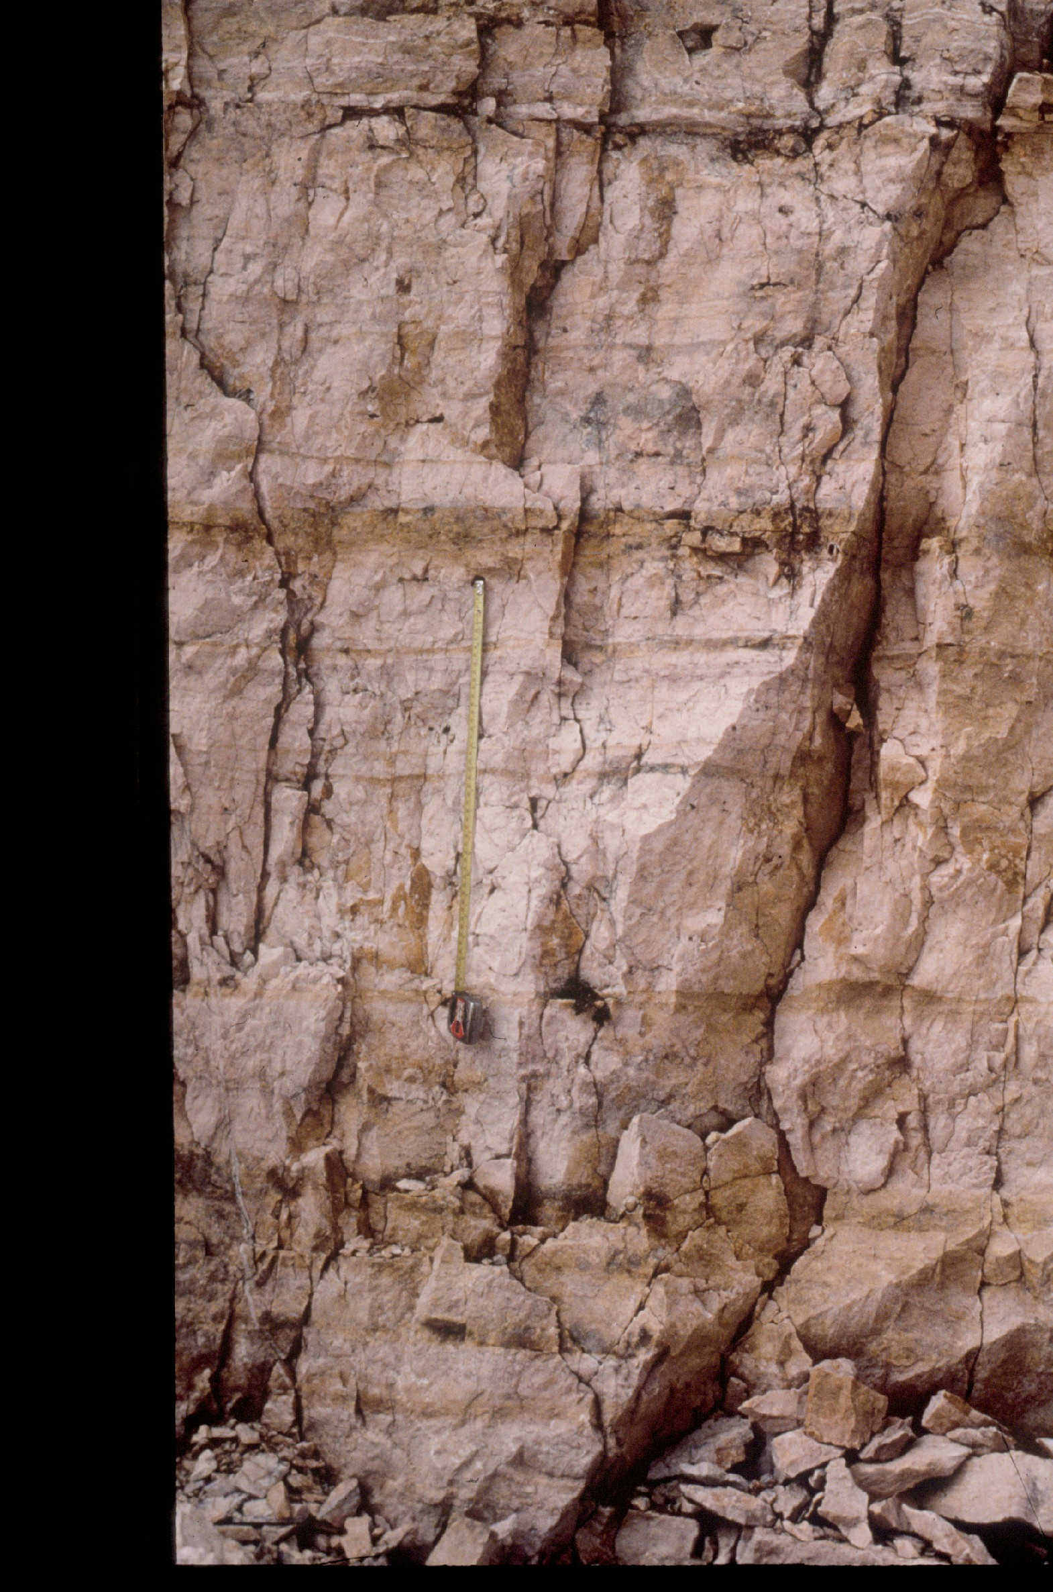
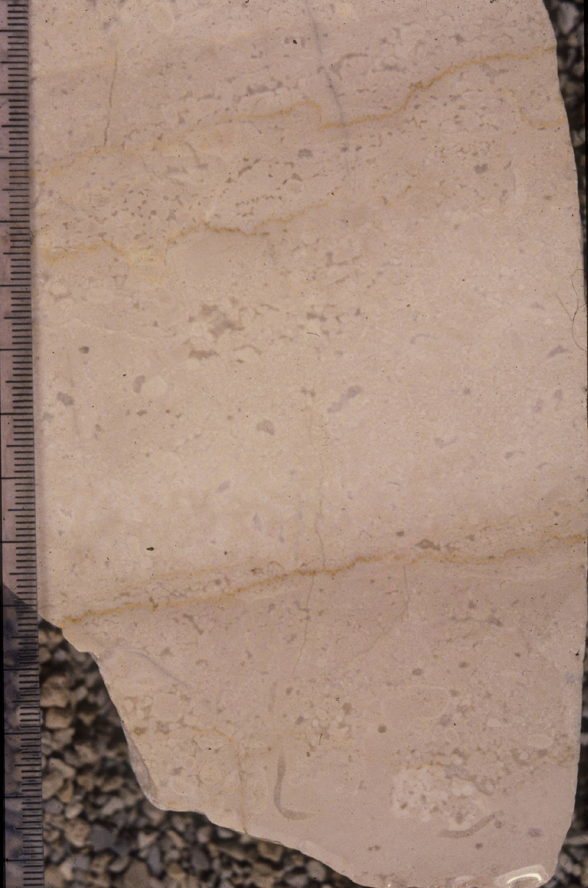
The Latemar Cycles:
(the Johns Hopkins Group – 1986-1993)
2 m
Subtidal Member

Slide 14
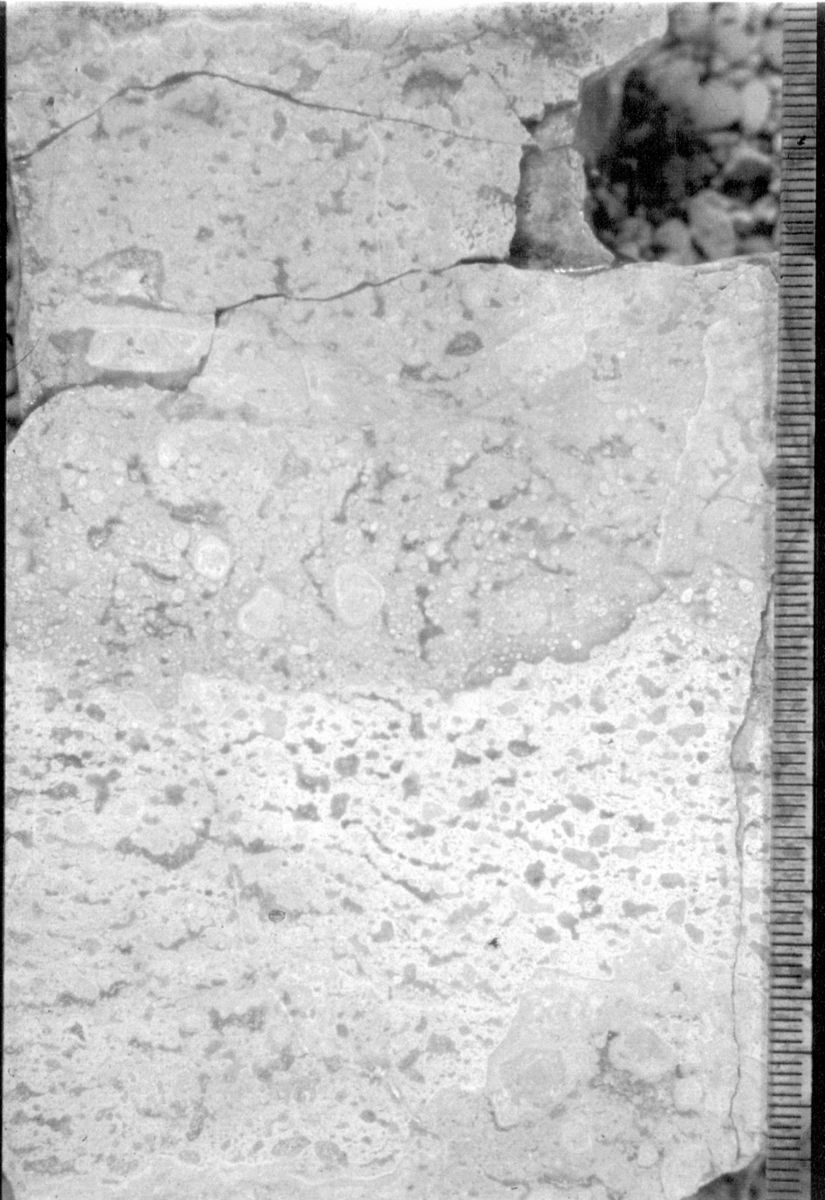
The Latemar Cycles:
(the Johns Hopkins Group – 1986-1993)
2 m
Subtidal Member
Subaerial Exposure Cap

Slide 15
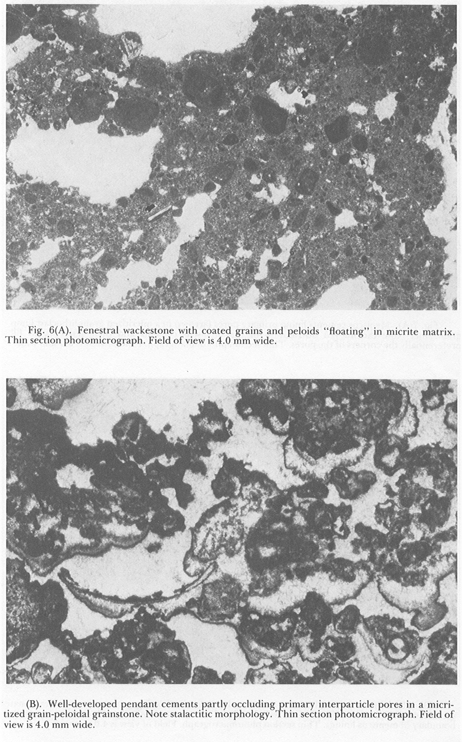
The Latemar Cycles:
(the Johns Hopkins Group – 1986-1993)
Cap Petrography

Slide 16
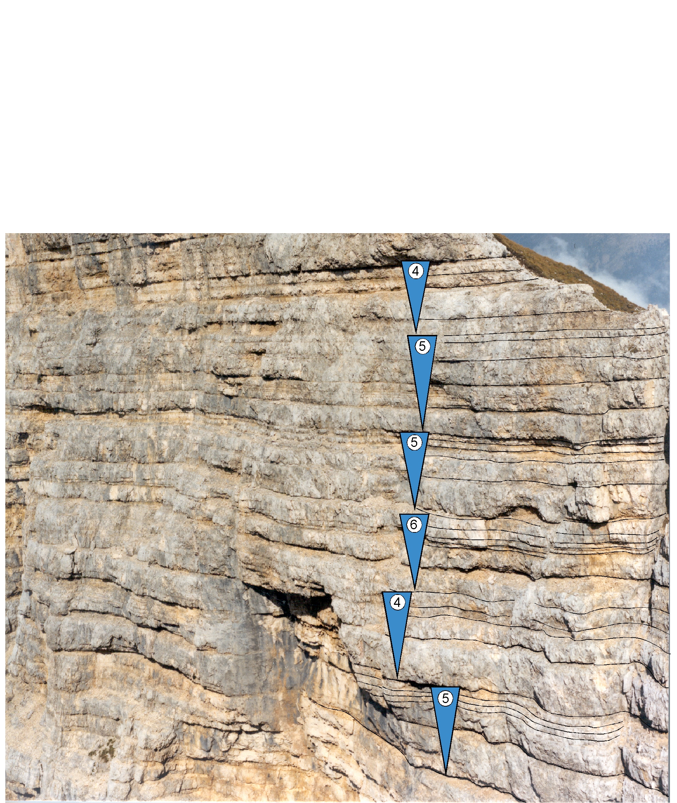
The Latemar Cycles:
(the Johns Hopkins Group – 1986-1993)
Cycle Stacking Patterns – “5:1” bundling

Slide 17
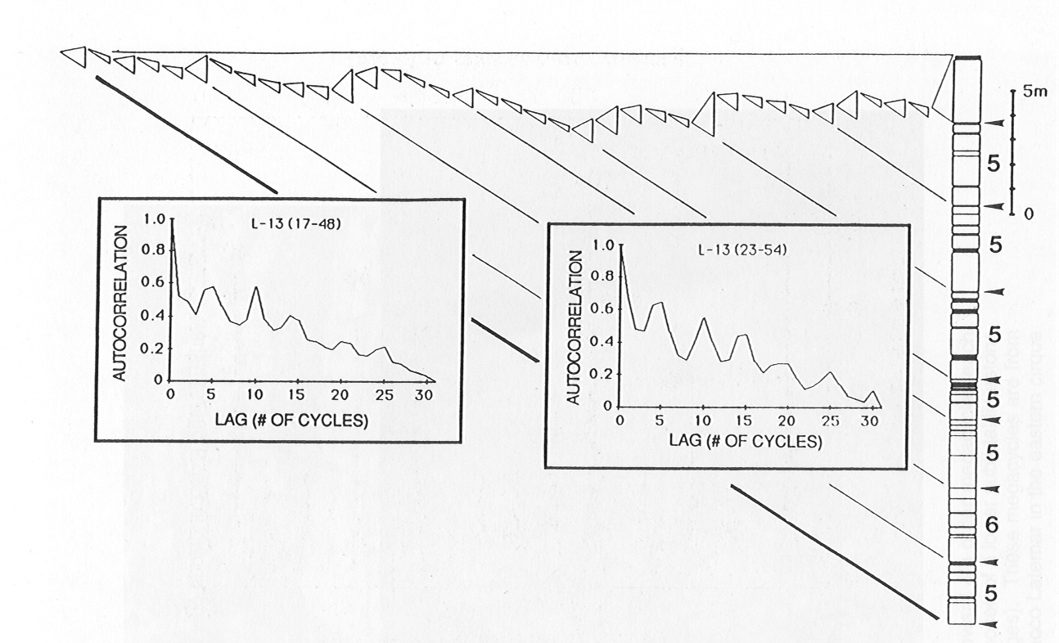
The Latemar Cycles:
(the Johns Hopkins Group – 1986-1993)
Cycle Stacking Patterns –
“Fischer Plot” and Relative Time Series
(a) 5:1 bundling
(b) asymmetry of mega-cycles

Slide 18
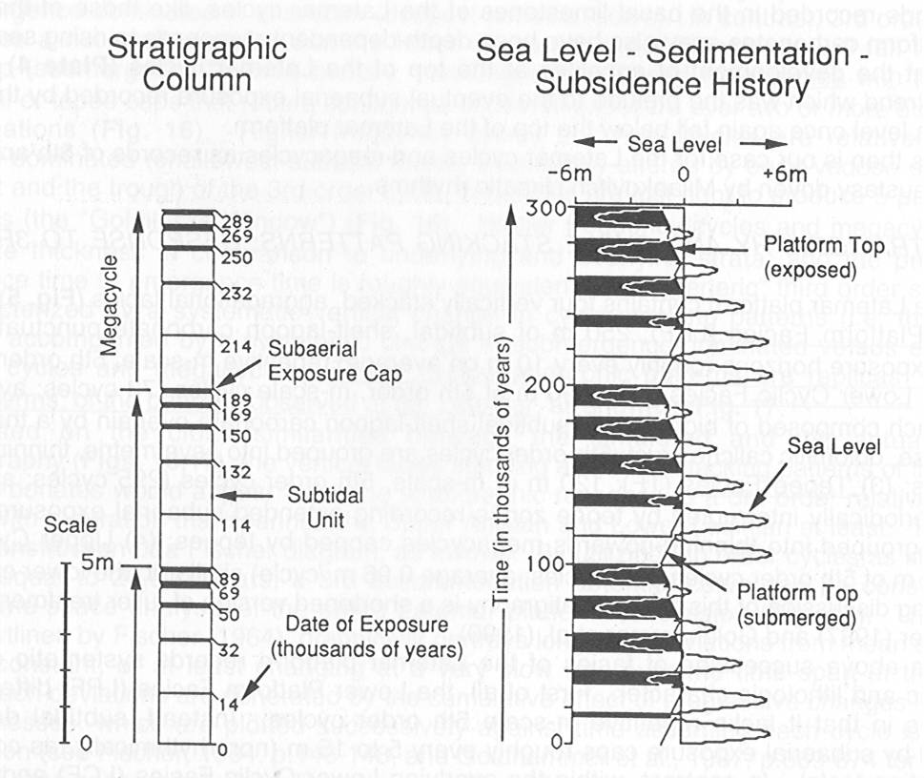
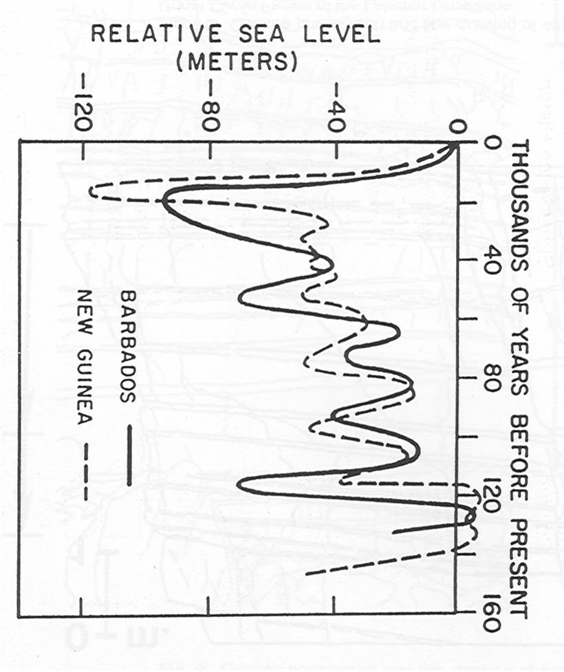
The Latemar Cycles:
(the Johns Hopkins Group – 1986-1993)
Mr. Sediment:
- Milankovitch-driven
composite eustasy
- replicates essential
aspects of Latemar
cycles (thickness,
stacking; inferred
duration)

Slide 19
The Latemar Cycles:
(the Johns Hopkins Group – 1986-1993)
Implications:
- Latemar cycles are high-frequency allocycles depicting alternating marine submergence and subaerial exposure
- Latemar composite cyclicity may be interpreted as the result of glacio-eustasy driven by orbital forcing (20 kyr and 100 kyr composite eustasy)

Slide 20
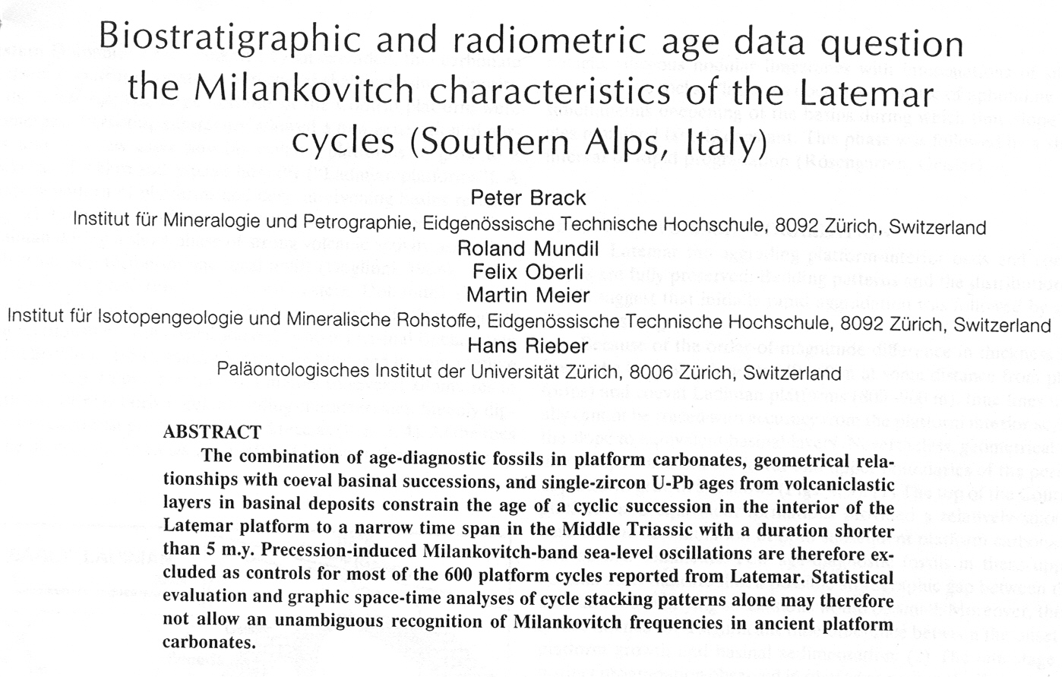
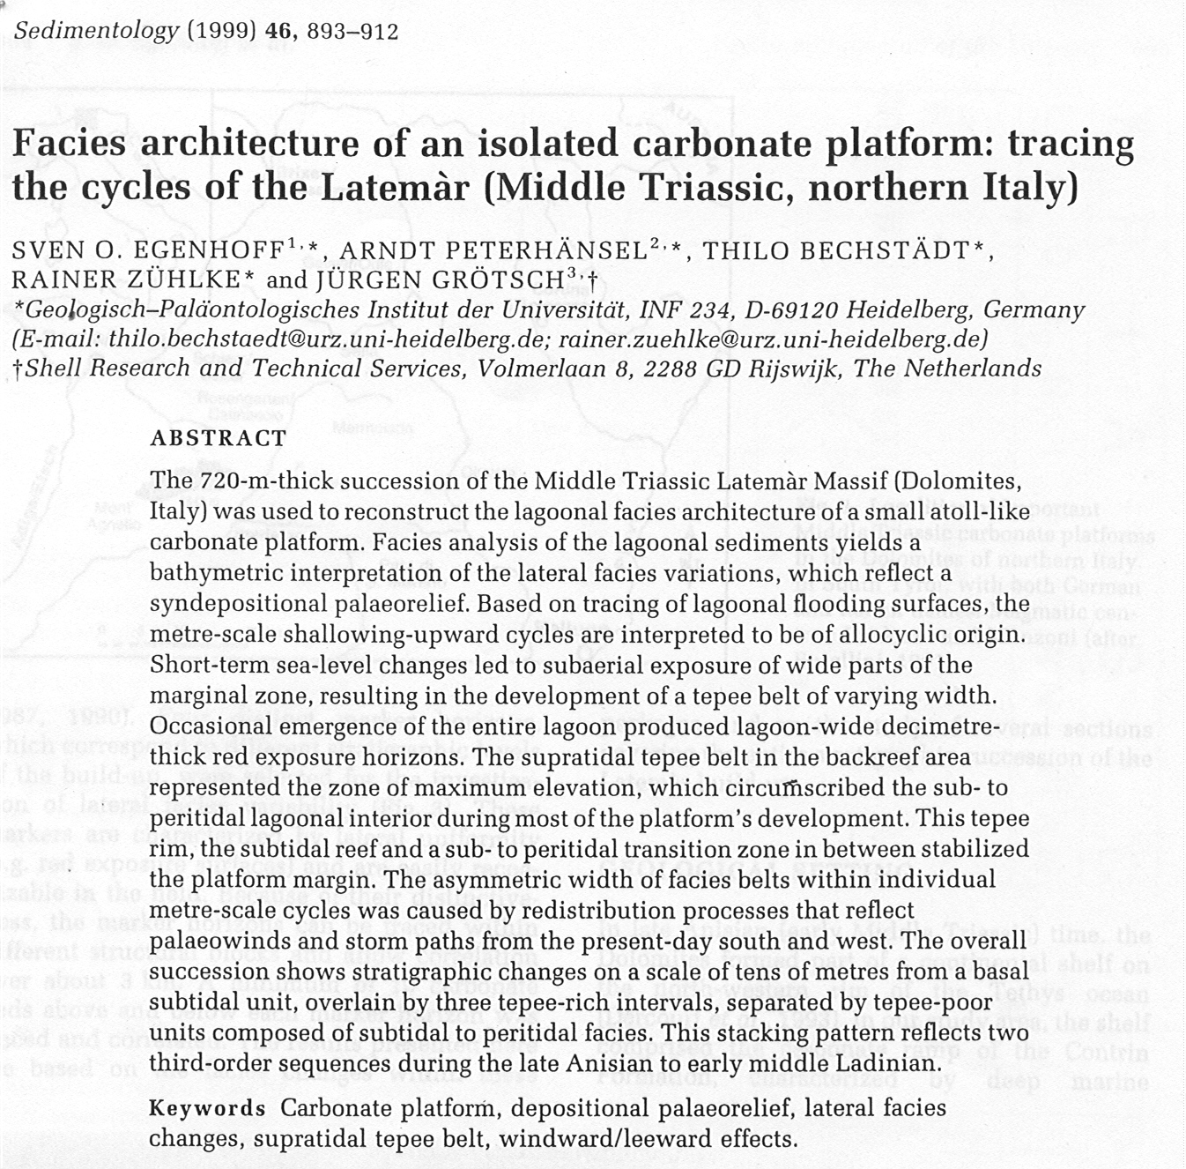
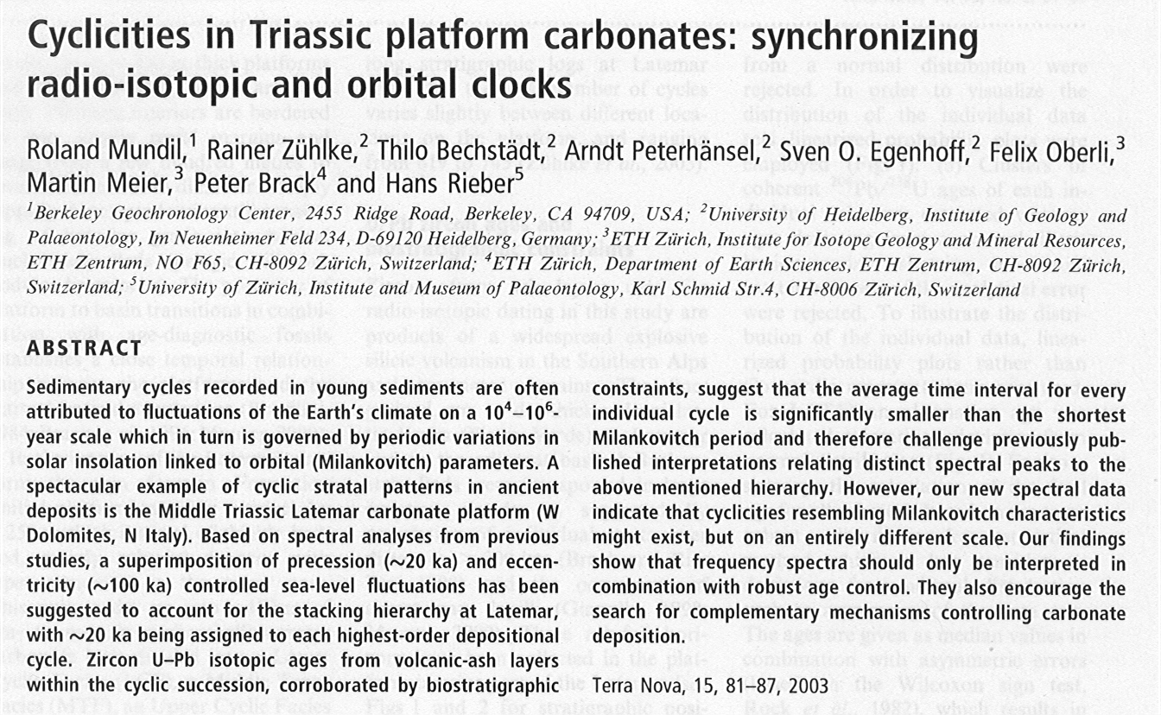
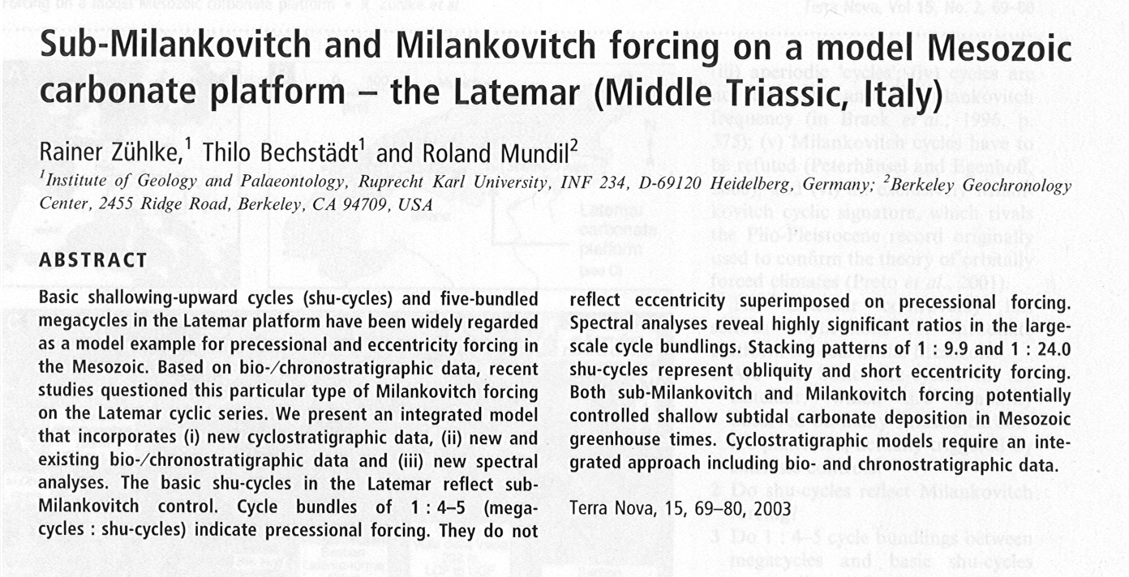
The Latemar Cycles:
(ETH Zurich, Heideldberg, Berkeley, Shell Research – 1993-2003)

Slide 21
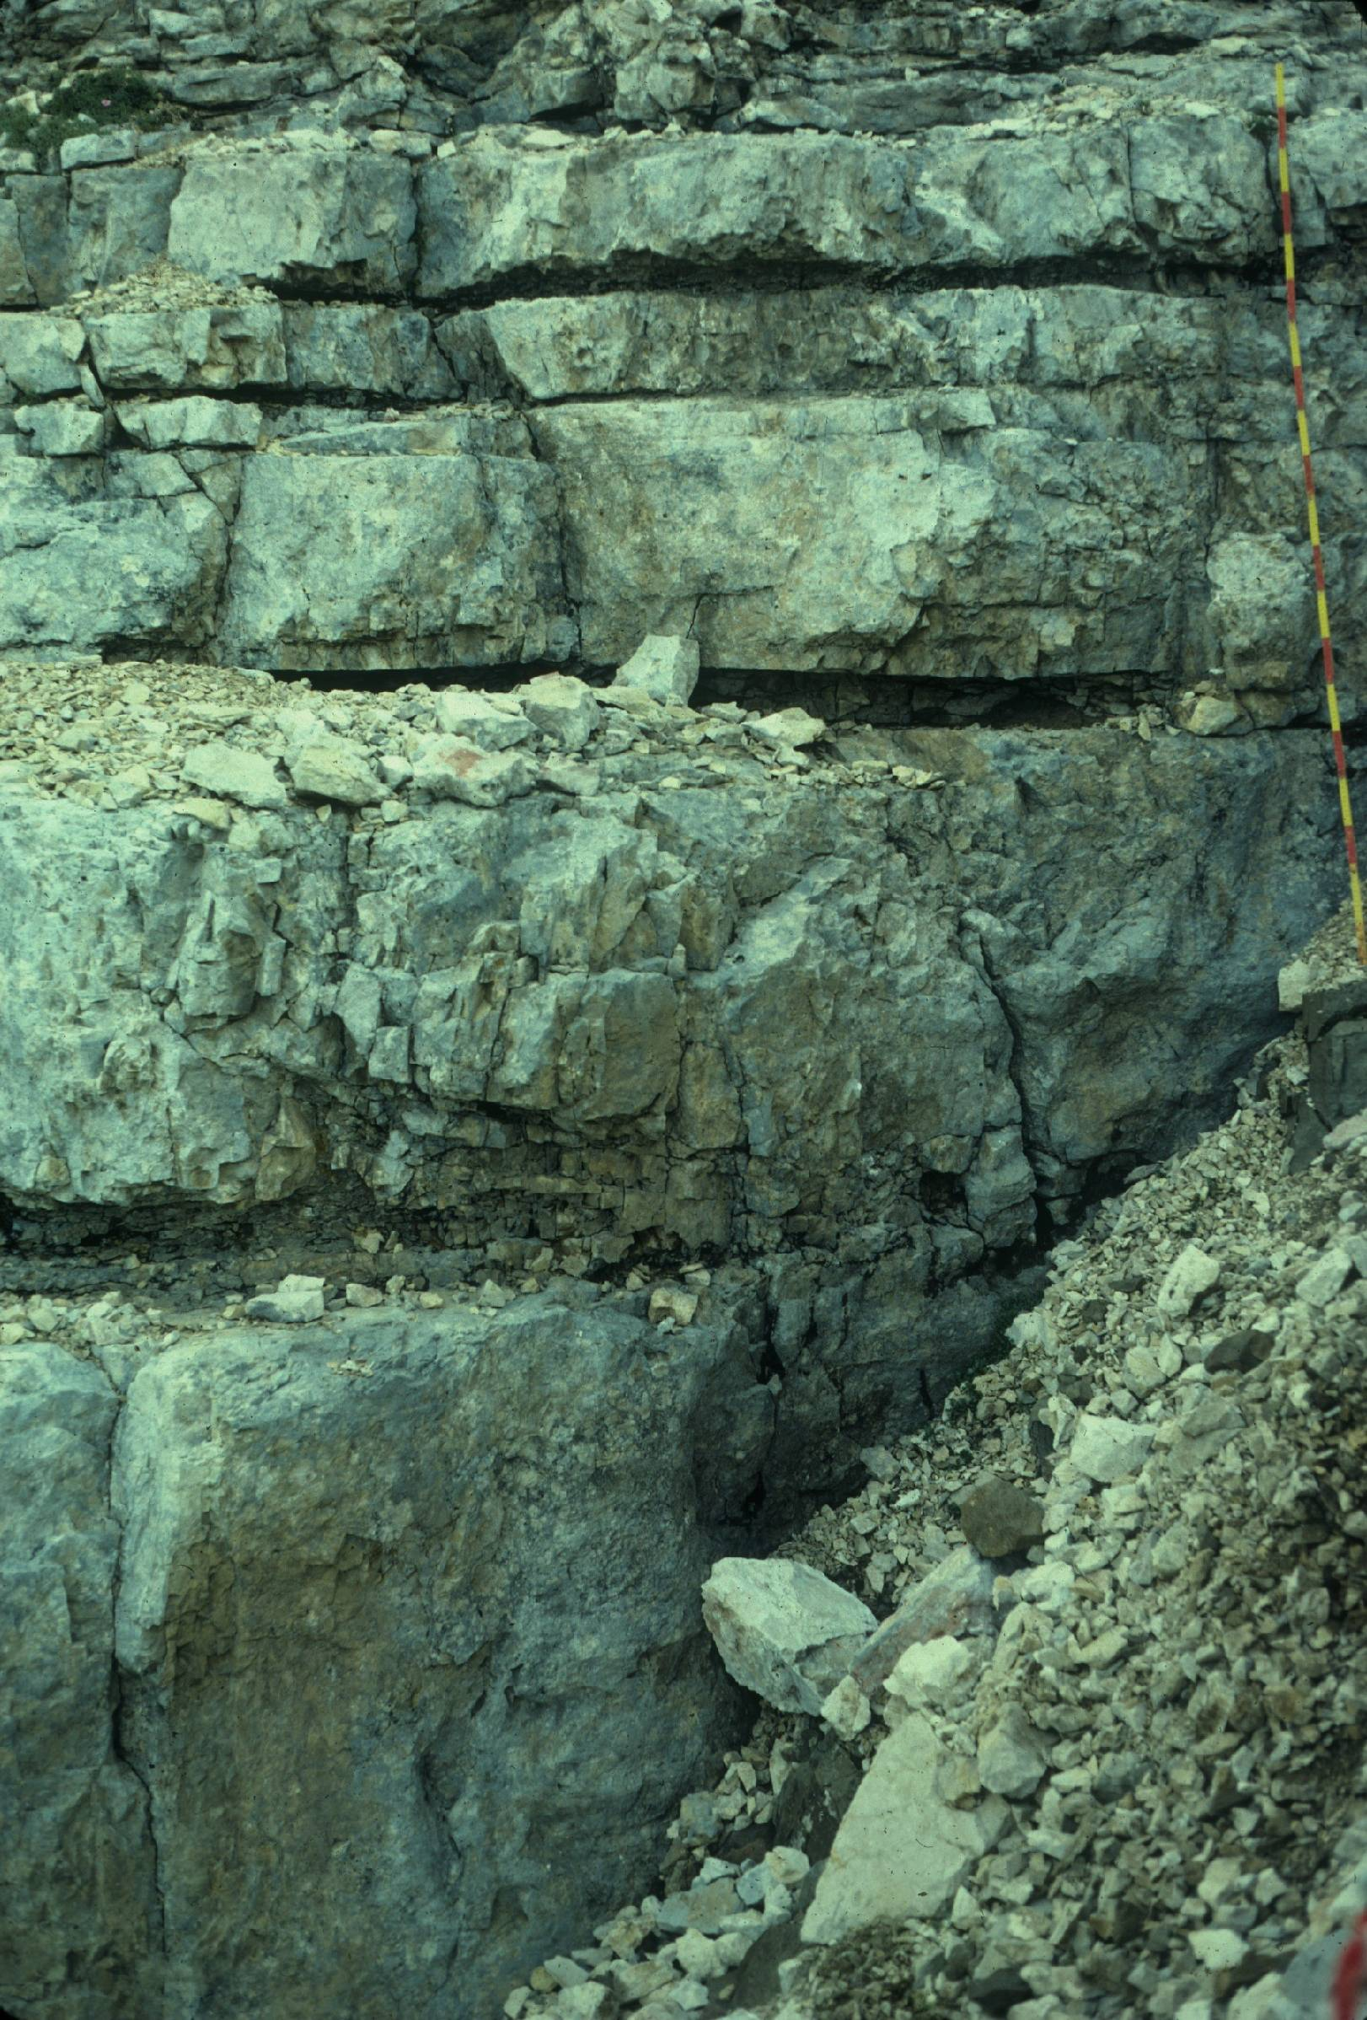
The Latemar Cycles:
(ETH Zurich, Heideldberg, Berkeley, Shell Research – 1993-2003)
Combination of:
(a) age-diagnostic macro-fossils
(b) zircon U-Pb age dates from ash beds intercalated within the Latemar succession
(c) geometric relationships with co-eval basinal succession
Conclusion:
(a) fundamental cycle is “sub-Milankovitch” in duration (approx. 4 kyr)
(b) 4-5 : 1 cycle bundling depicts 20 kyr
precession
(c) approx. 750 m depicted by the Latemar platform interior, and 650 cycles depictabout 2.2 myr of time

Slide 22
Middle Triassic Paleogeography
Mendola Escarpment
Latemar

Slide 23
View from Mendola Escarpment Looking EAST

Slide 27
Middle Triassic Paleogeography
Mendola Escarpment
Latemar

Slide 28
View from Base of Latemar Looking WEST

Slide 32
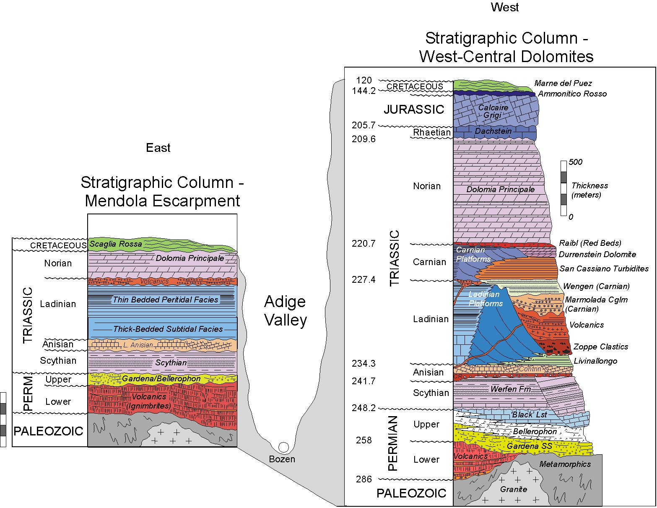
Stratigraphy

Slide 33
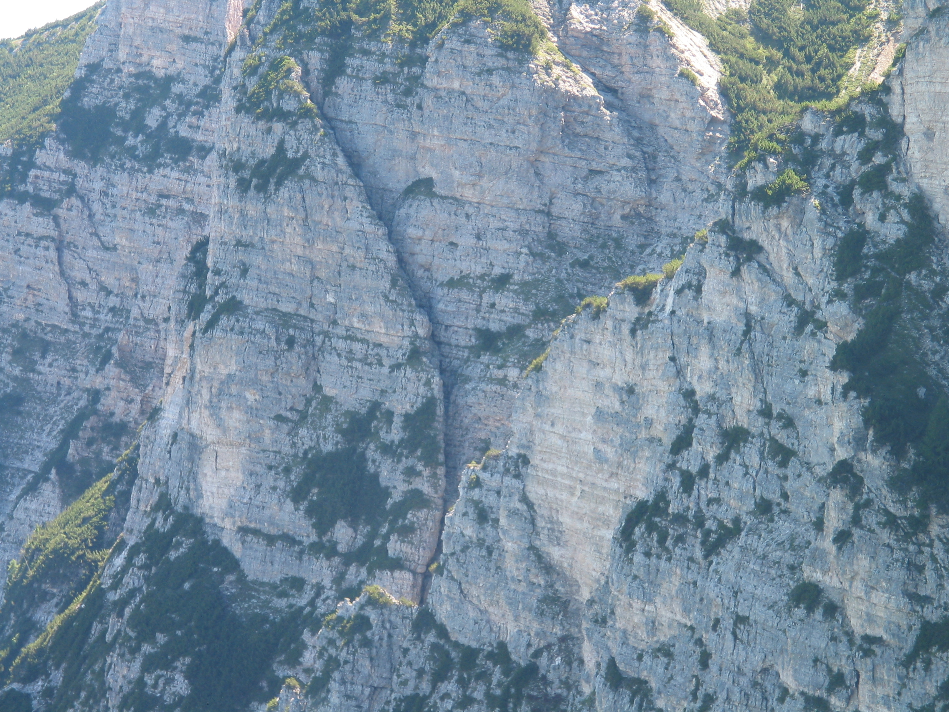
Cyclic Succession at Mendola Escarpment

Slide 34
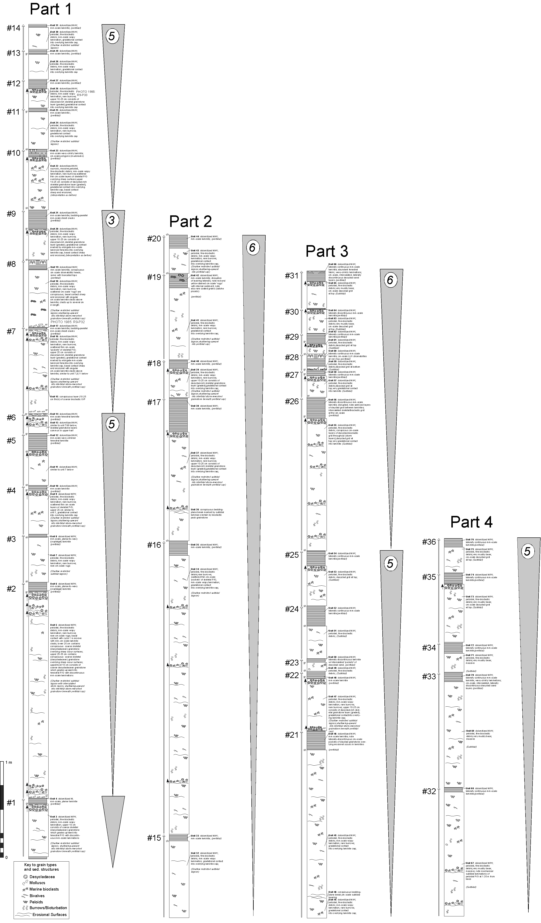
Measured Section:
- 36 cycles in 27 meters
- 0.75 m/cycle

Slide 35
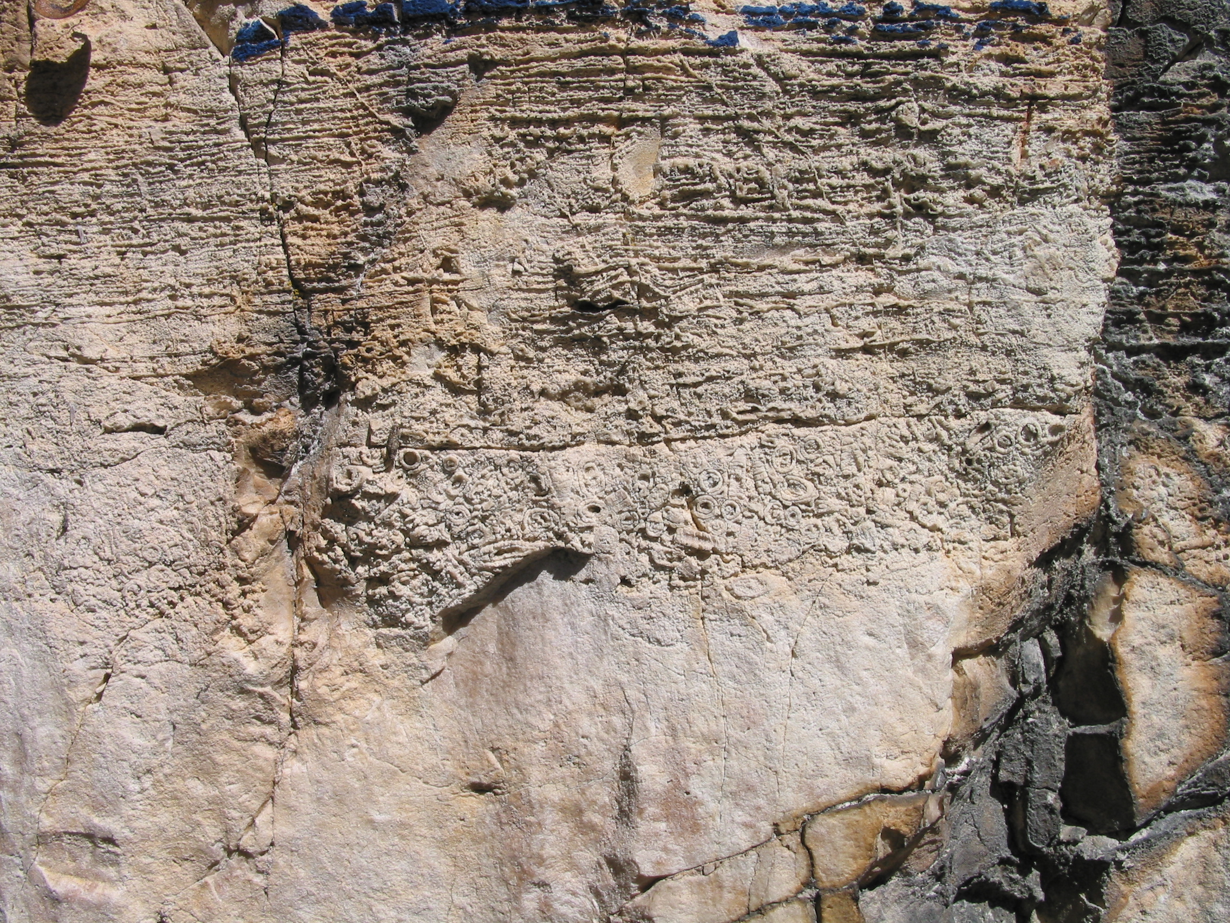
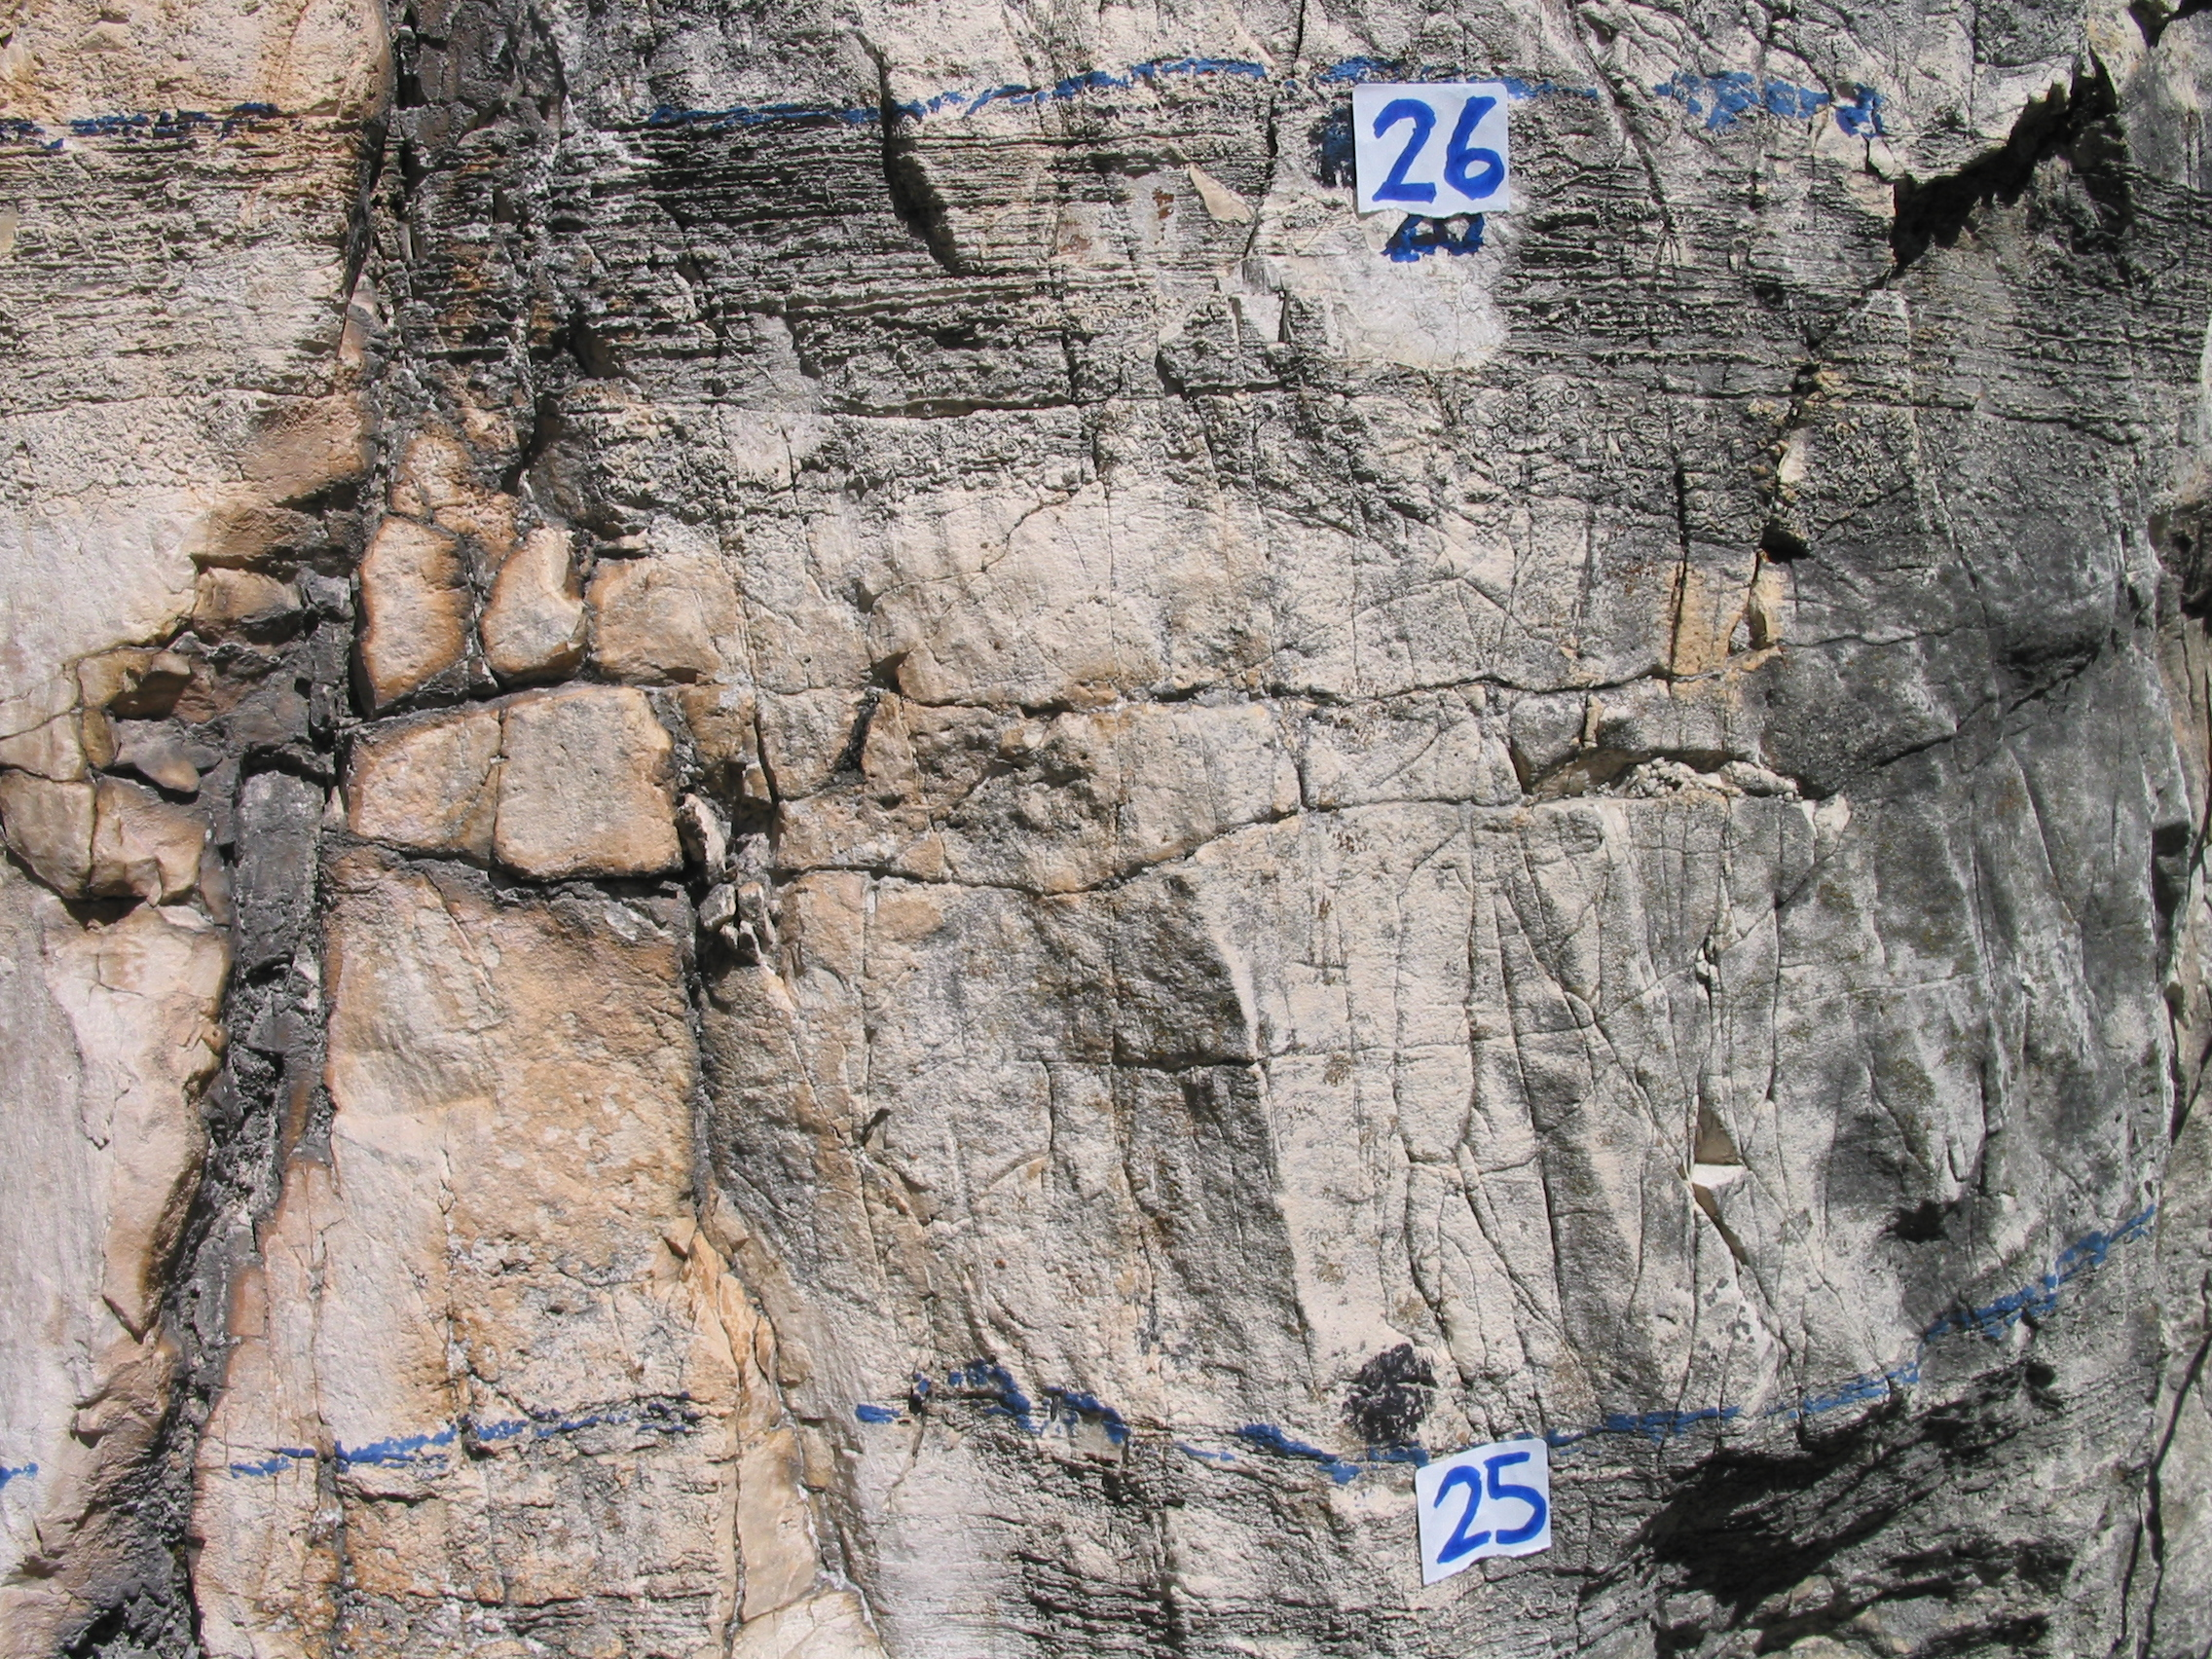
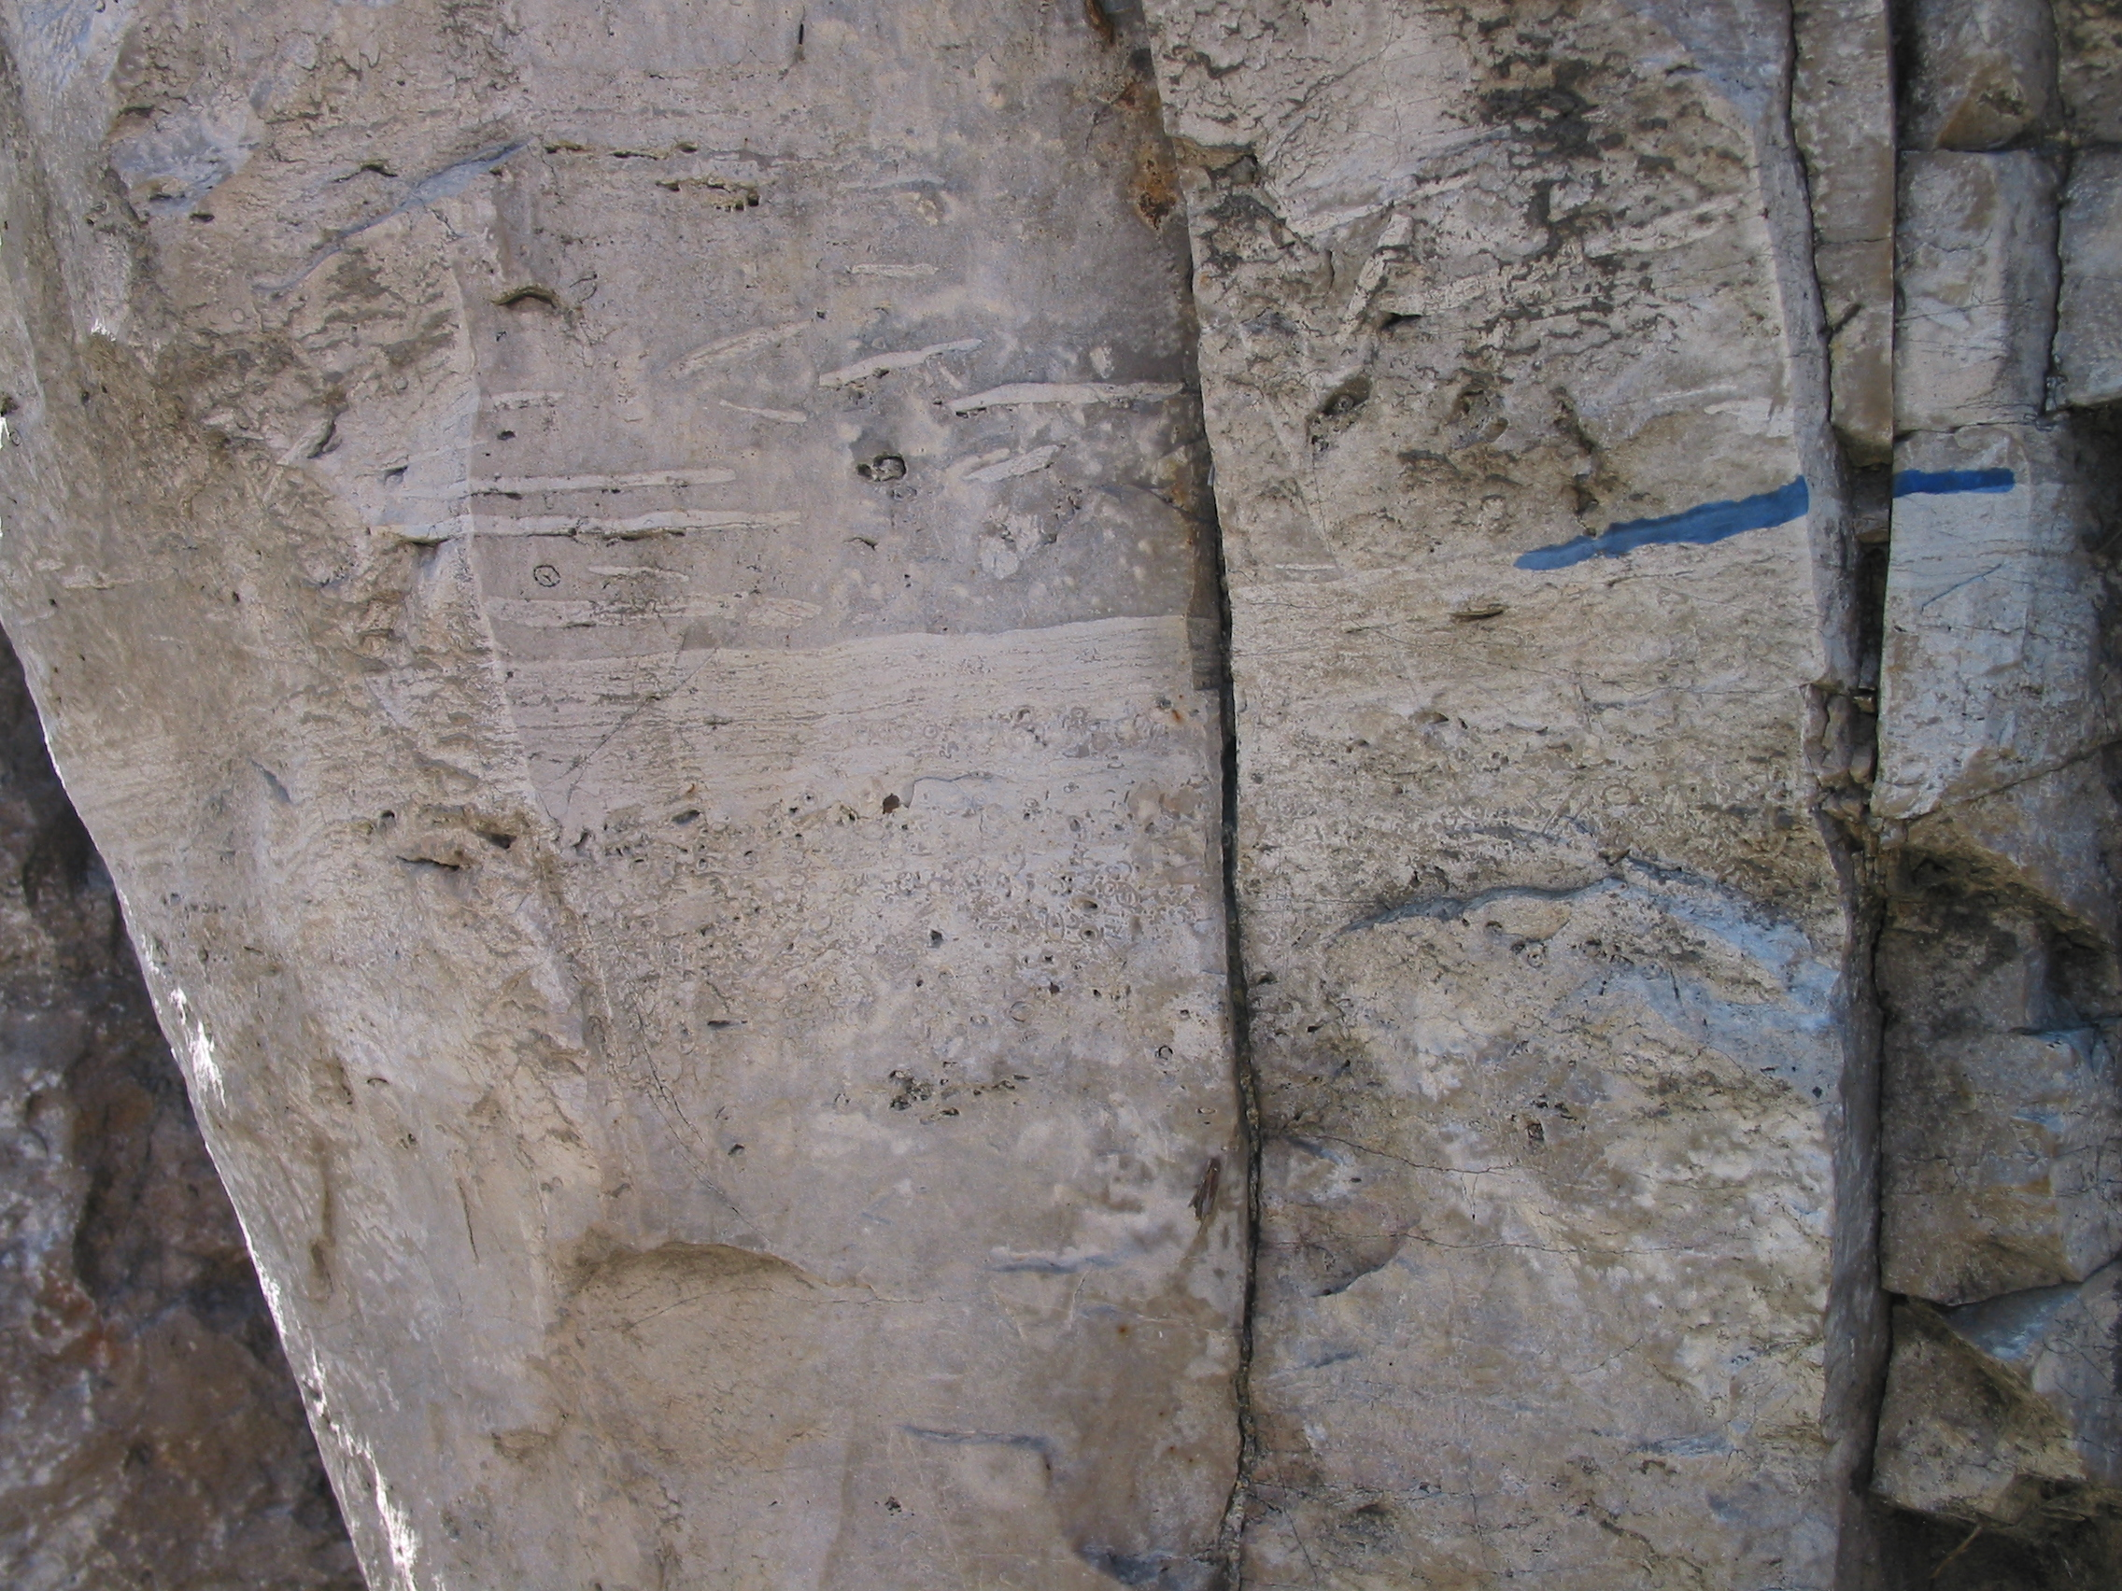

Slide 36
Mendola Cycles Produced by Tidal Flat Progradation

Slide 37
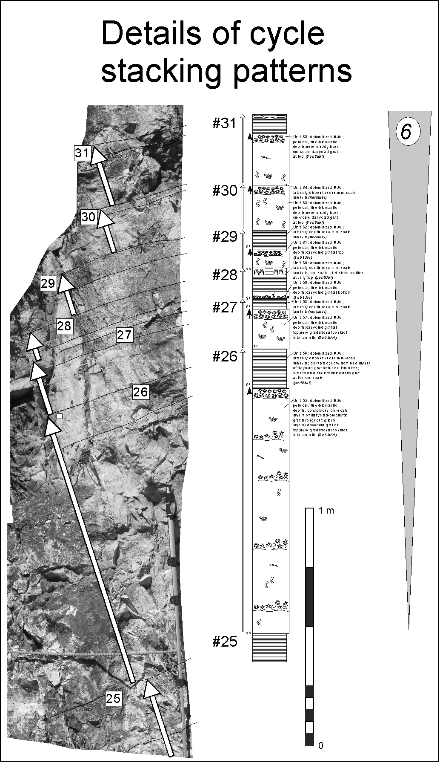
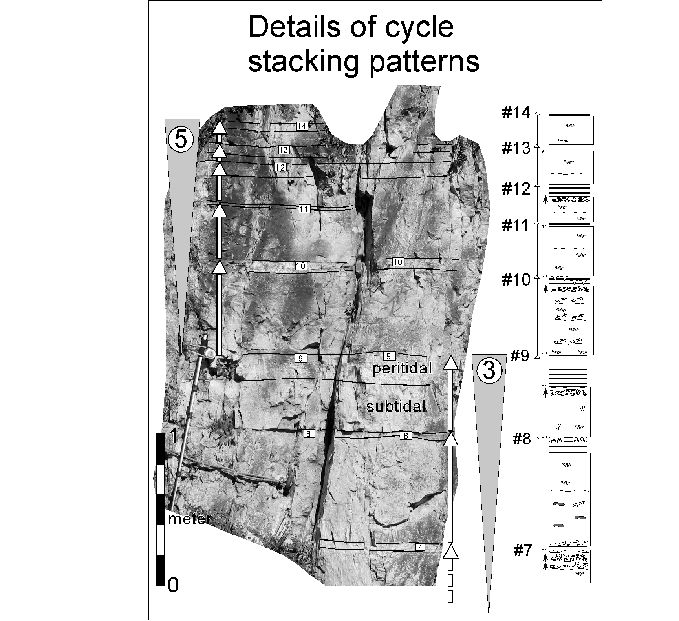

Slide 38
Fischer Plot and Relative Time Series Analysis

Slide 39
Middle Triassic Paleogeography
Mendola Escarpment
Latemar

Slide 40
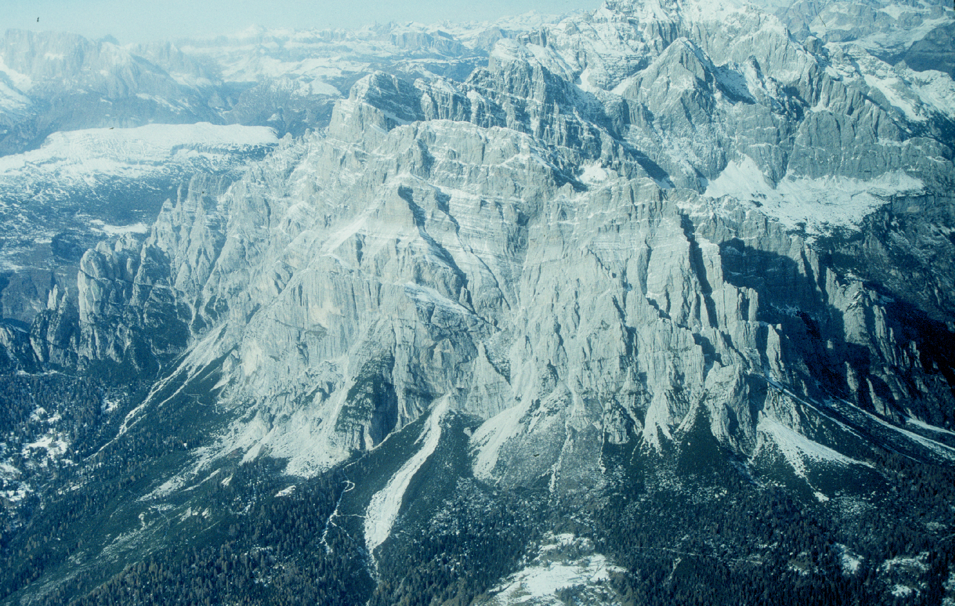
Conclusions:
(a) Fundamental m-scale cycles at both the Latemar and the platform interior of the Mendola Escarpment are most likely allocyclic in origin based on: (i) similarity in cycle thickness; (ii) distinctive cycle stacking patterns (‘5:1’ bundles)
(b) If one assumes that the Mendola platform interior was originally linked to the platform margin defined by the Sciliar-Rosengarten complex, then 40 km of cycle progradation is implied
(c) Holocene tidal flat progradation rates of 2-5 km/1000 yrs over a distance of 40 km would yield cycle durations of between 8,000 and 20,000 yrs

