Slide 1
Methods in building and analysing biological networks.
Livia Perfetto, PhD
Assistant Professor, rtdB and SIGNOR database coordinator
livia.perfetto@uniroma1.it

Slide 2
Summary
PART 2:
Intro to Cytoscape
Molecular Interaction Databases
Protein-protein interaction (PPI) resources: IMEx/IntAct DB
Signaling Interaction Resources: SIGNOR

Slide 3
what’s next…
PART3:
practical: retrieving PPI from IMEx/IntAct DB
practical: Signaling Interactions from SIGNOR

Slide 4
Network part 3

Slide 5
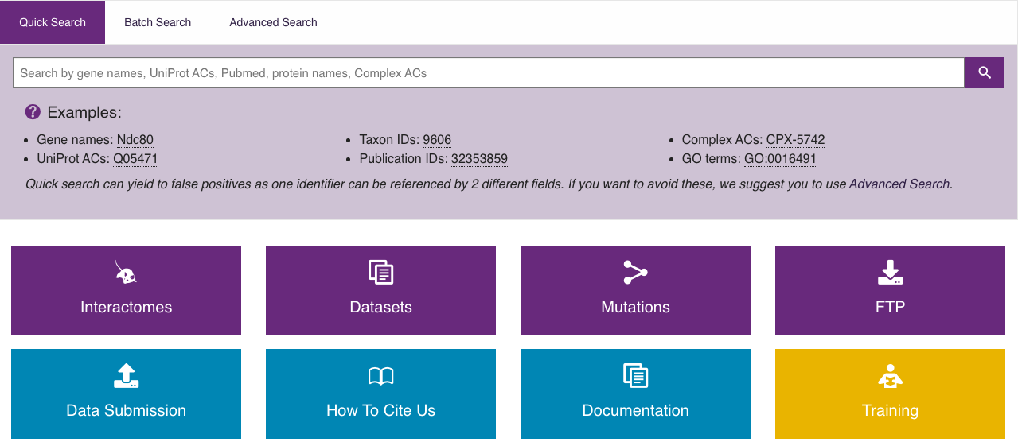
Demonstration Snapshots

Slide 6
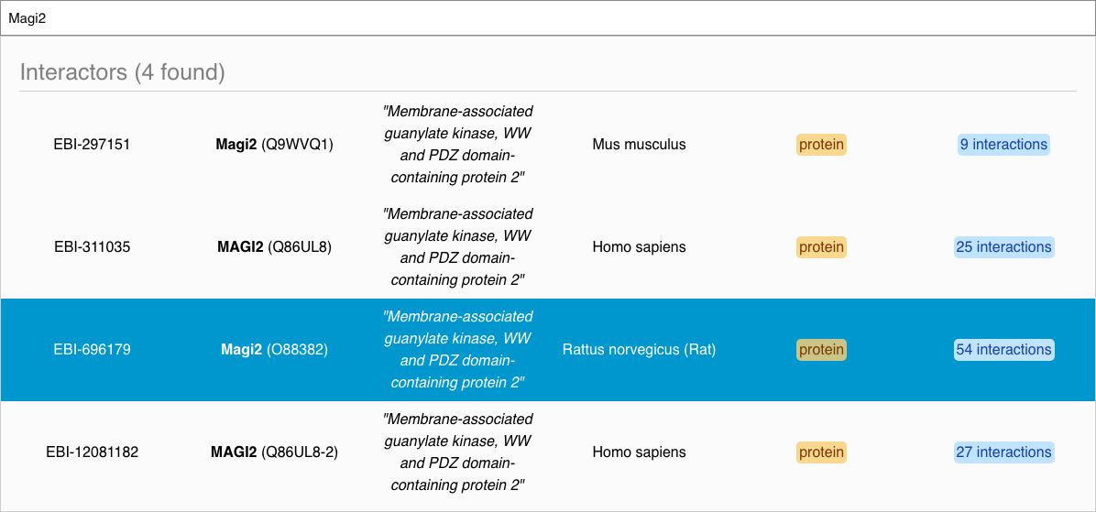
Demonstration Snapshots

Slide 7
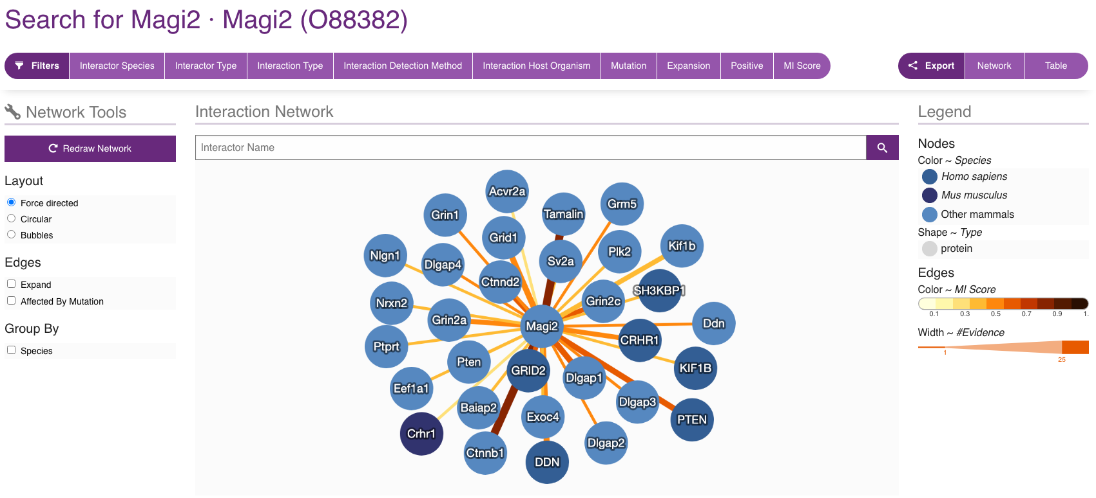
Demonstration Snapshots

Slide 8
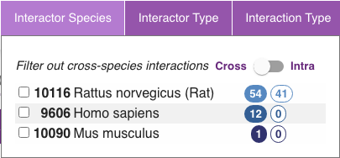
Demonstration Snapshots

Slide 9
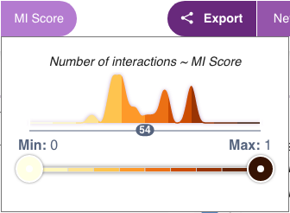
Demonstration Snapshots

Slide 10
Demonstration Snapshots

Slide 11
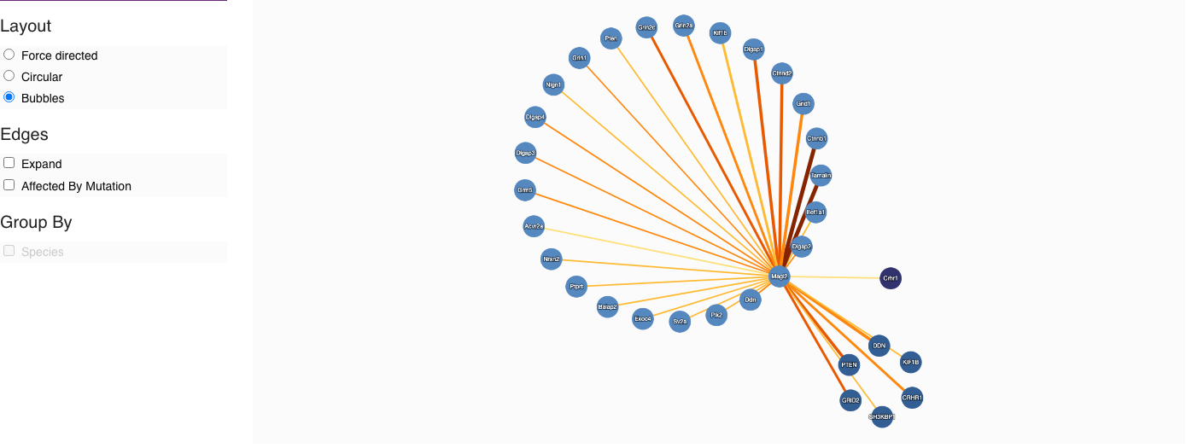
Demonstration Snapshots

Slide 12
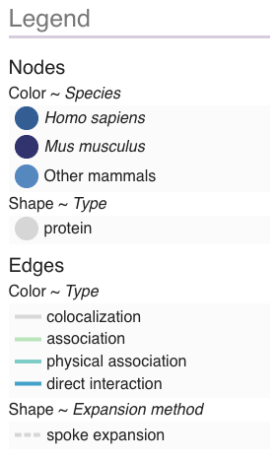
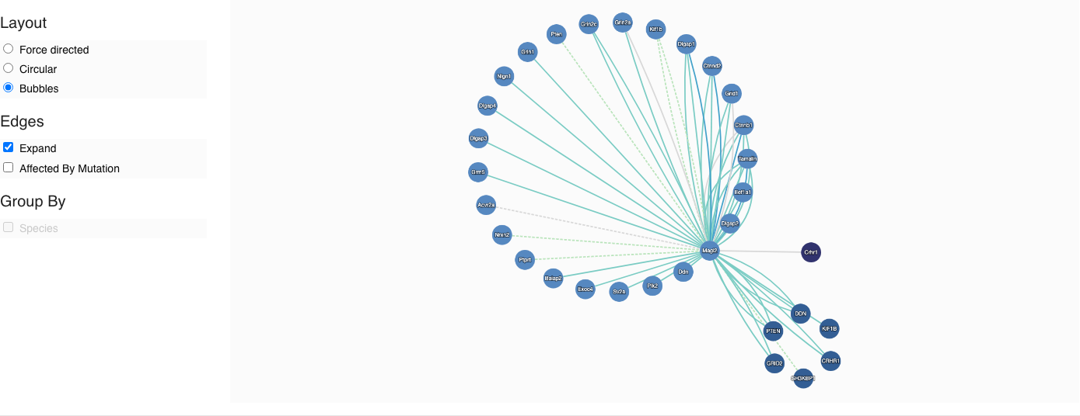
Demonstration Snapshots

Slide 13
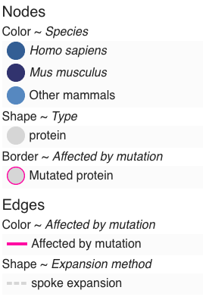
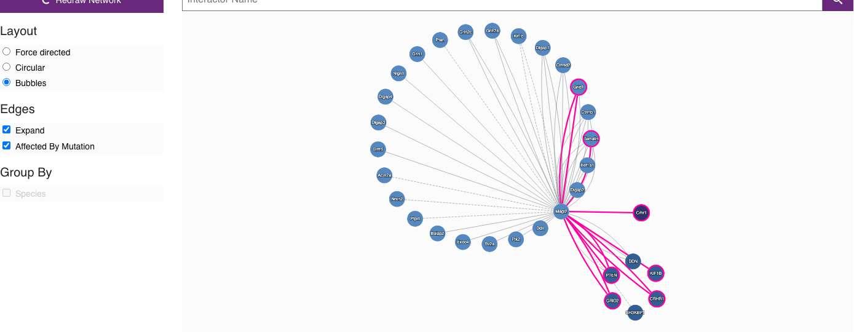
Demonstration Snapshots

Slide 14
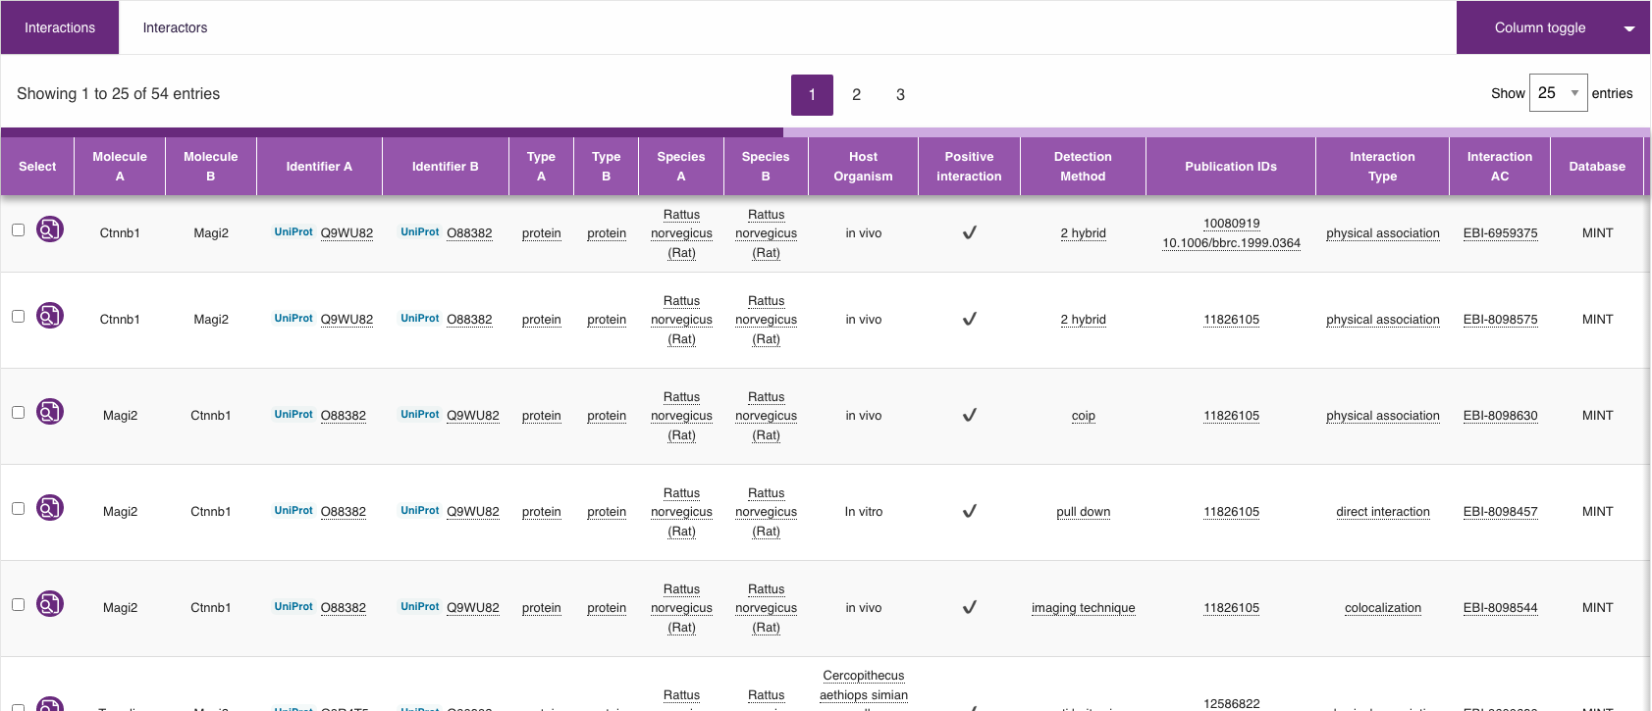
Demonstration Snapshots

Slide 15
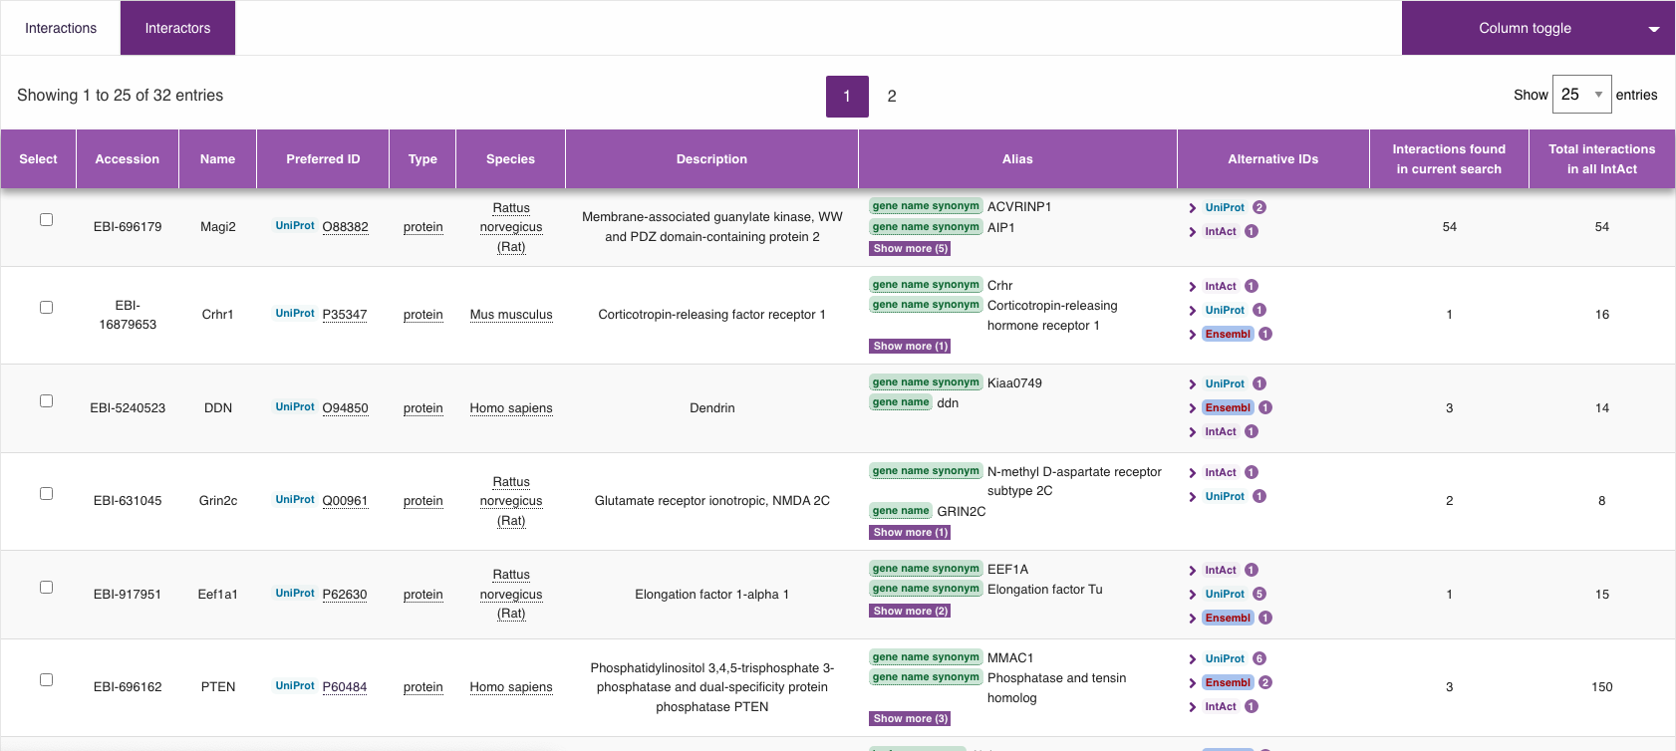
Demonstration Snapshots

Slide 16
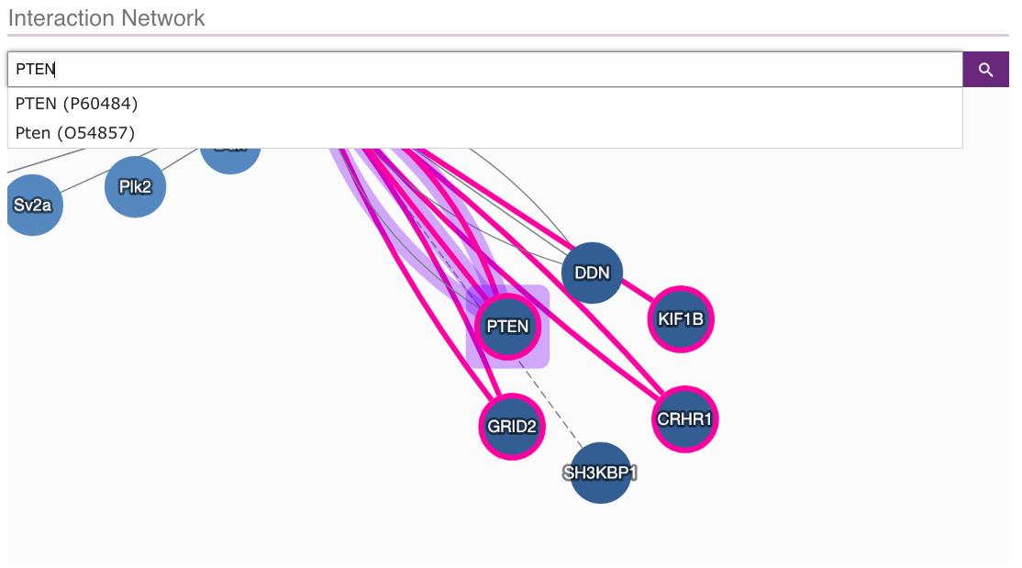
Demonstration Snapshots

Slide 17
Demonstration Snapshots

Slide 18
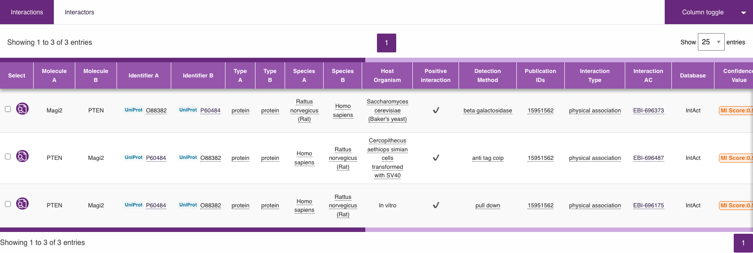
Demonstration Snapshots

Slide 19
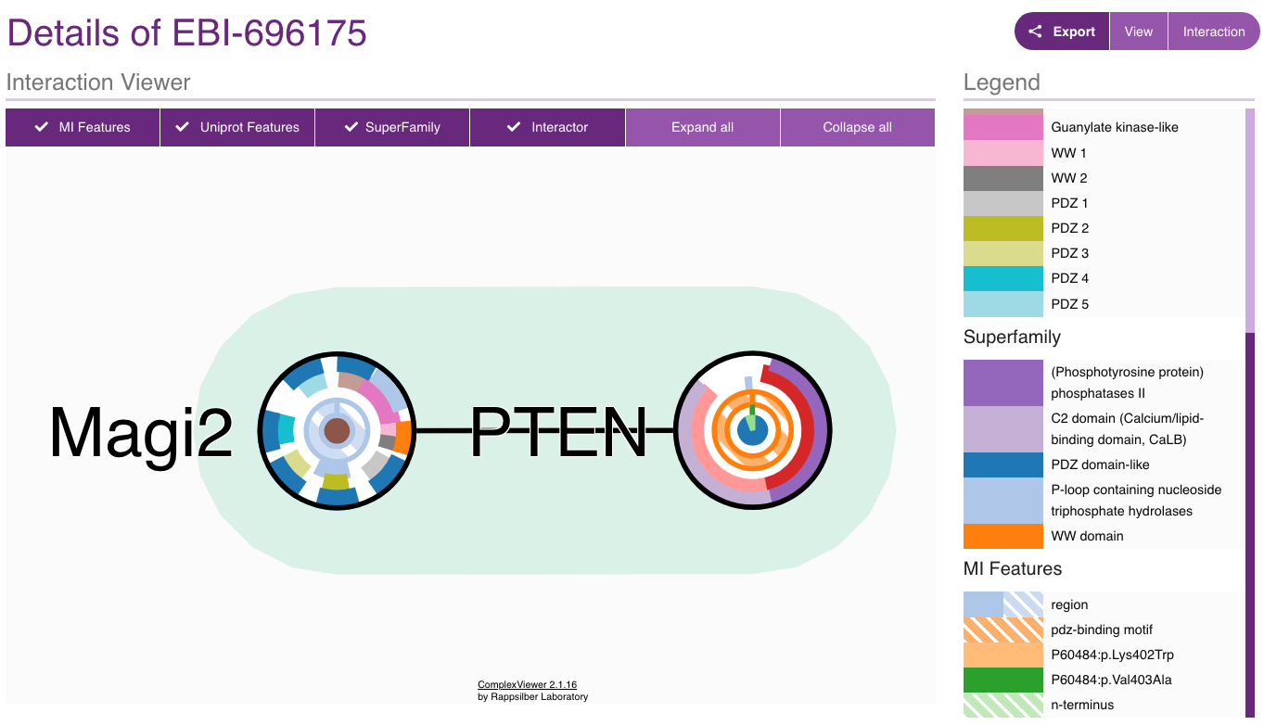
Demonstration Snapshots

Slide 20
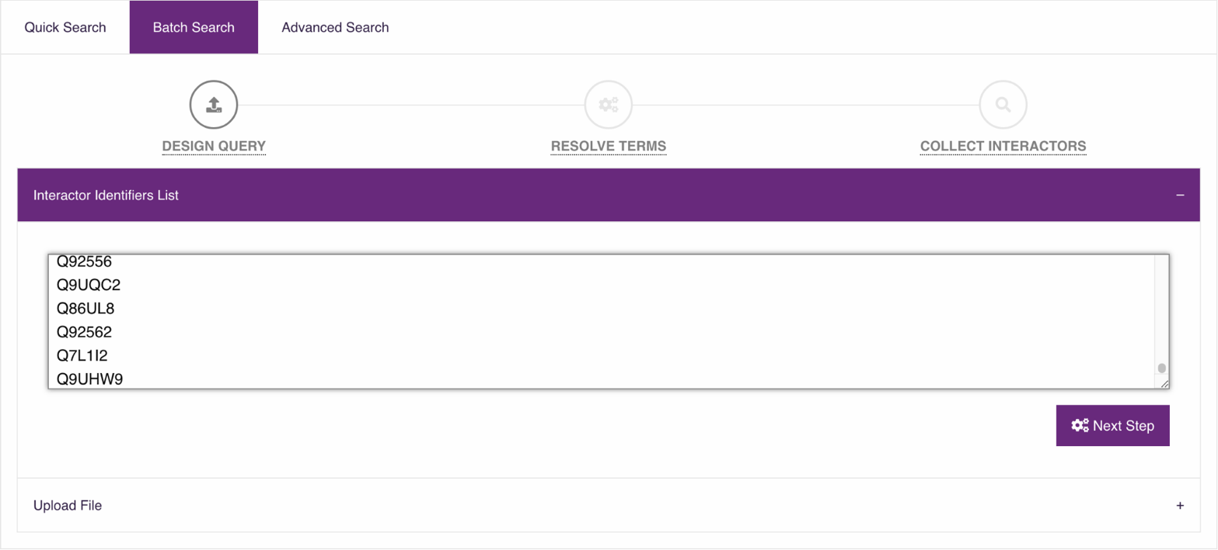
Demonstration Snapshots

Slide 21
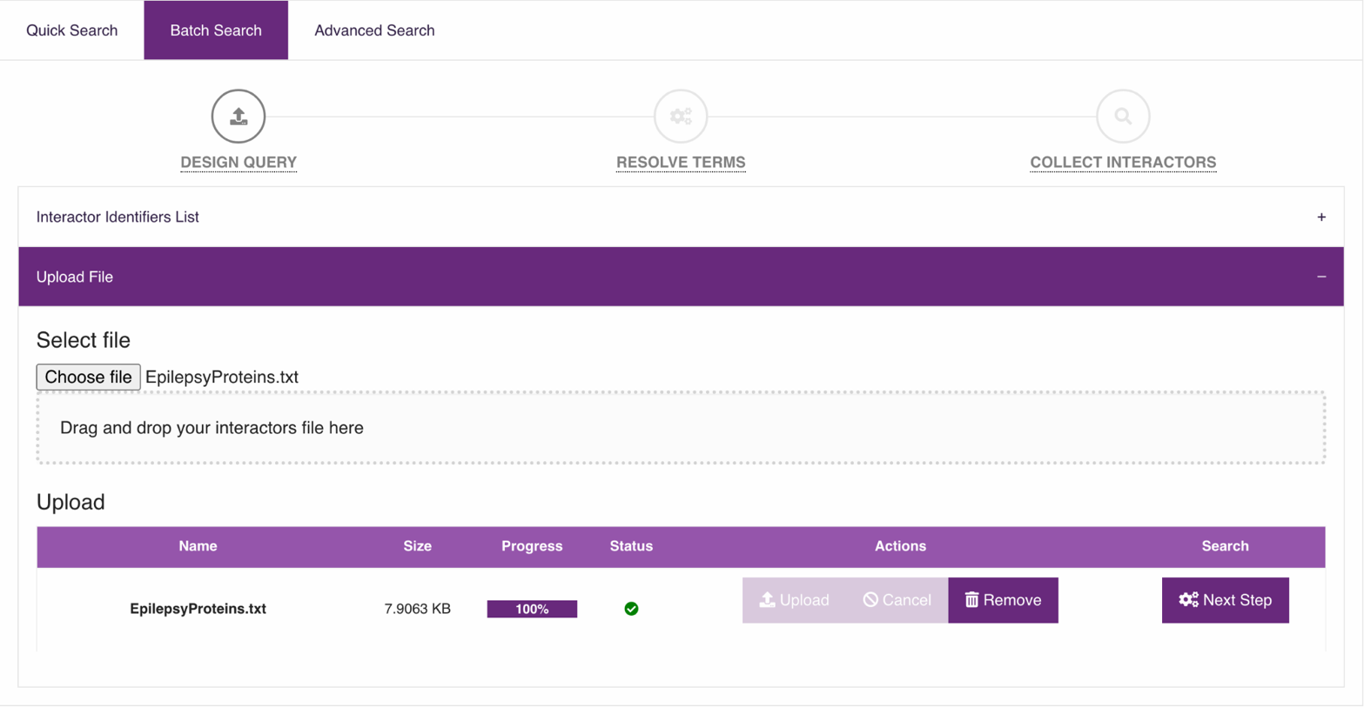
Demonstration Snapshots

Slide 22
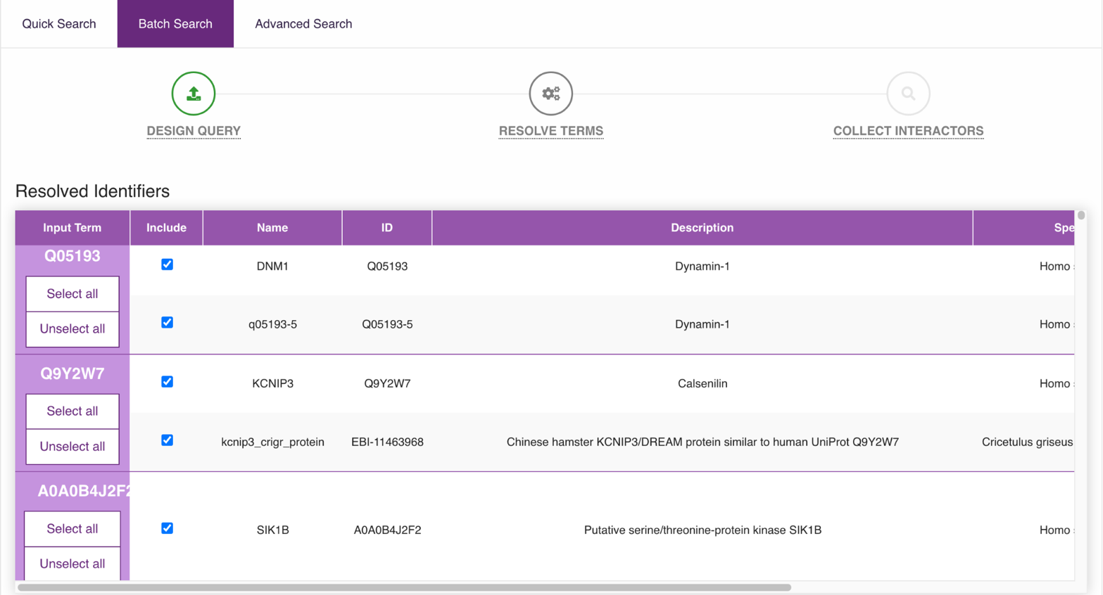
Demonstration Snapshots

Slide 23
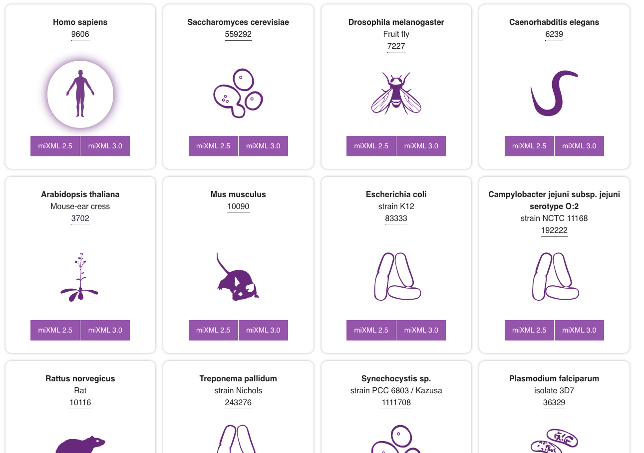
Demonstration Snapshots

Slide 24
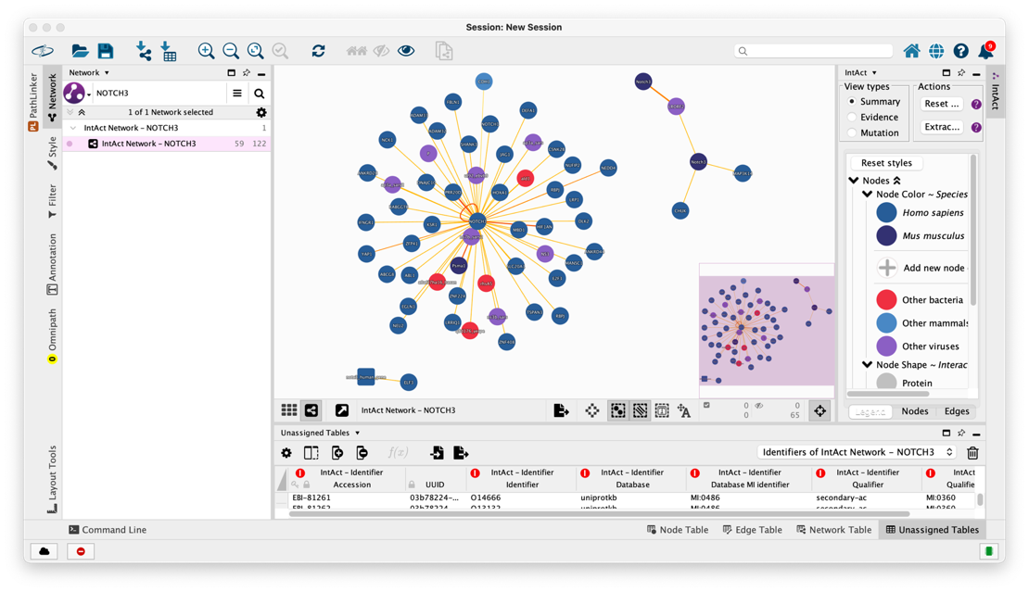
Extracting networks from the IntAct APP

Slide 25
SIGNOR

Slide 26
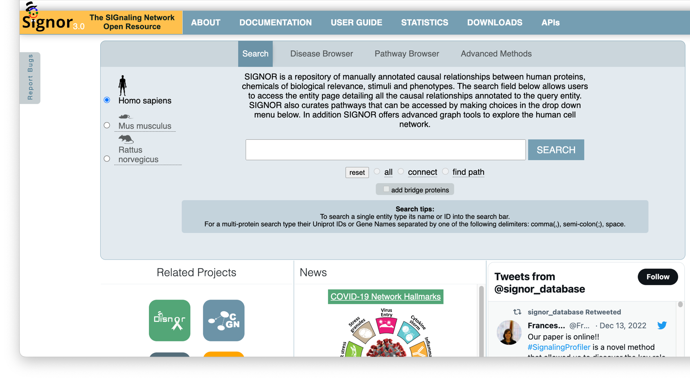
The website: signor.uniroma2.it

Slide 27
Single entity search

Slide 28
Single entity search

Slide 29
Single entity search

Slide 30
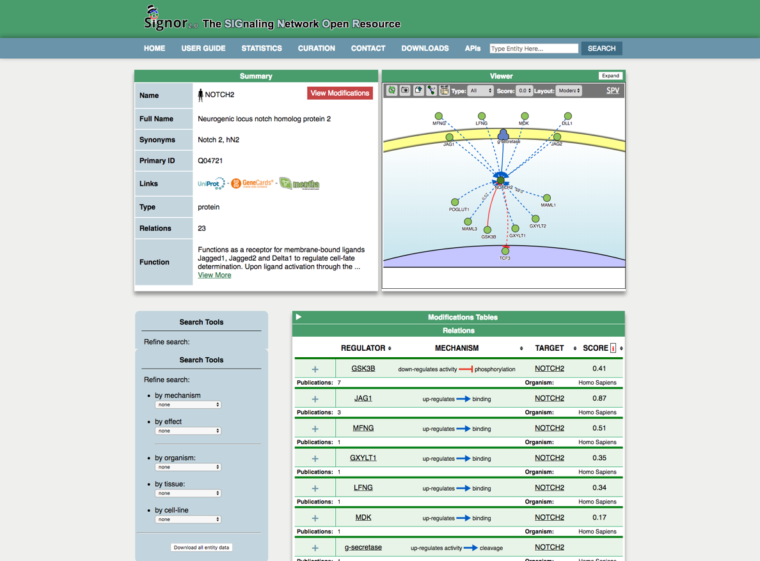
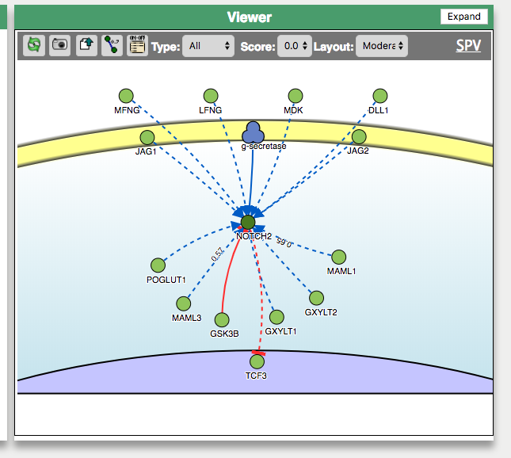
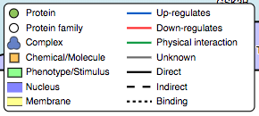
Single entity search, the viewer
The viewer allows:
Intuitive picture of interactions
Filtering
Downloading
Browsing details
Extracellular space
Plasma membrane
Cytoplasm/Cytosol
Nucleus

Slide 31
Single entity search

Slide 32
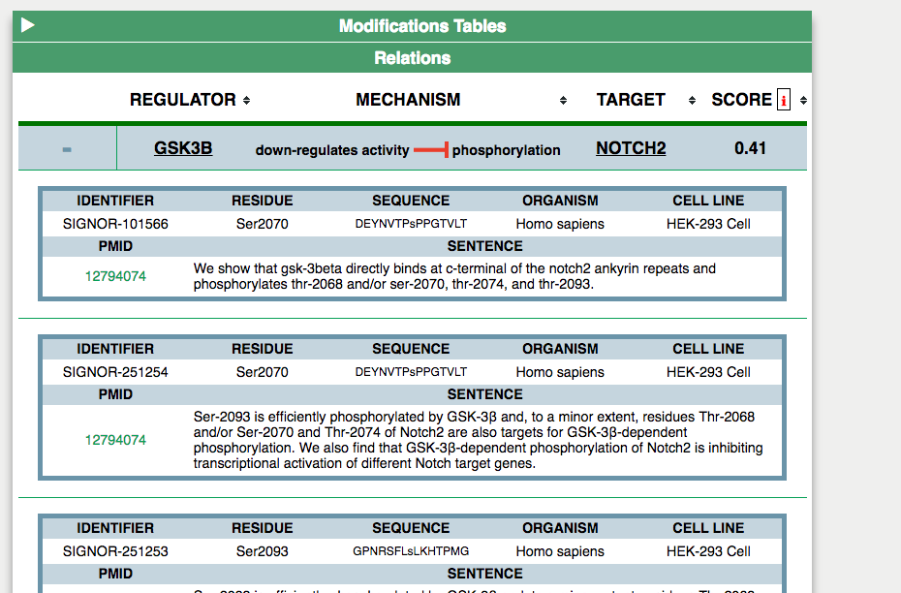
Interaction detail and Modifications

Slide 33
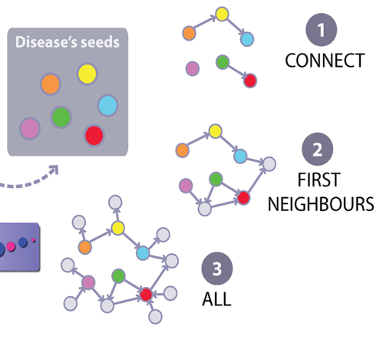
Multiple entities search
Different multi-entity search methods in SIGNOR
QUERY PROTEINS
(ENTITIES)
HHIP PTCH1 GLI3 SMO KIF7
Q96QV1 Q13635 P10071 Q99835 Q2M1P5
Example: Q96QV1(HHIP) Q13635(PTCH1) P10071(GLI3) Q99835(SMO) Q2M1P5(KIF7)

Slide 34
Querying Methods in SIGNOR
CONNECT
function linking seed proteins/genes

Slide 35
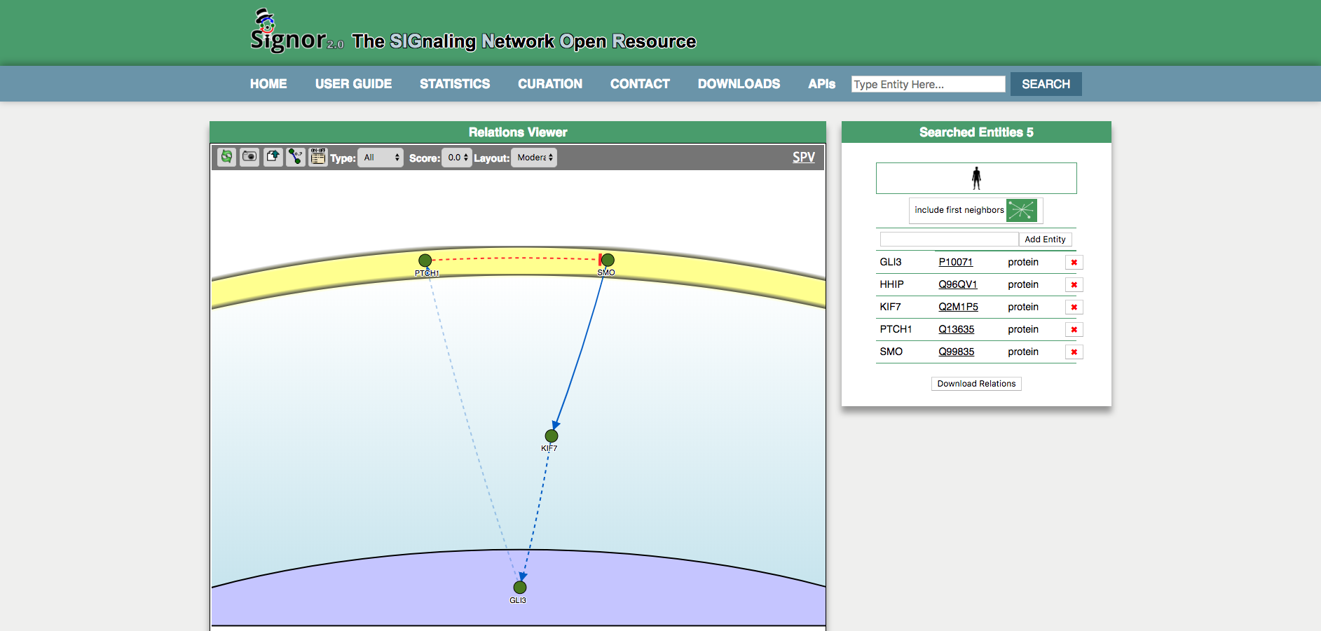
Multiple entities search: connect

Slide 36
Multiple entities search
Different multi-entity search methods in SIGNOR
QUERY PROTEINS
(ENTITIES)
HHIP PTCH1 GLI3 SMO KIF7
Example: Q96QV1(HHIP) Q13635(PTCH1) P10071(GLI3) Q99835(SMO) Q2M1P5(KIF7)

Slide 37
Querying Methods in SIGNOR
ALL
function retrieving any interaction involving seed proteins/genes

Slide 38
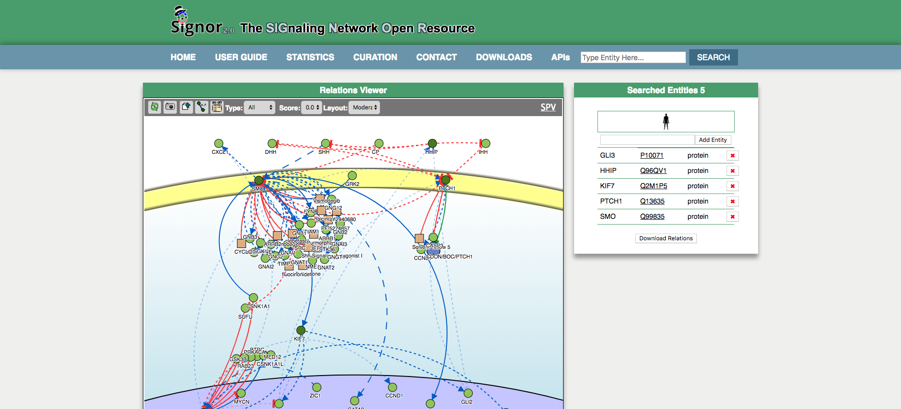
Multiple entities search: all

Slide 39
Multiple entities search
Different multi-entity search methods in SIGNOR
QUERY PROTEINS
(ENTITIES)
HHIP PTCH1 GLI3 SMO KIF7
Example: Q96QV1(HHIP) Q13635(PTCH1) P10071(GLI3) Q99835(SMO) Q2M1P5(KIF7)

Slide 40
Querying Methods in SIGNOR
FIRST NEIGHBOURS
is a multi-step algorithm that initially performs a search through SIGNOR of ALL interactions involving any of the seed entities. Leafs (degree-1 nodes ) are, then, excluded through a pruning process;

Slide 41
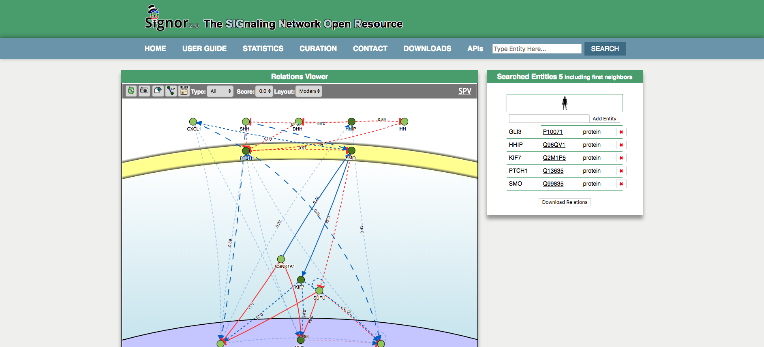
Multiple entities search: include first neighbours

Slide 42
The website: signor.uniroma2.it - disease browser-

Slide 43
The website: signor.uniroma2.it - disease browser-

Slide 44
The website: signor.uniroma2.it - disease browser-

Slide 45
The website: signor.uniroma2.it - pathway browser-
Pathways
Canonical pathways (33)
Cancer Pathways (8)
Disease Pathways (4)

Slide 46
Pathway search result: EGFR signalling

Slide 47
Additional Info

Slide 48
Extracting networks from the SIGNOR APP

Slide 49
Extracting networks from the SIGNOR APP - single and multi entities search-

Slide 50
Extracting networks from the SIGNOR APP - Pathway search-

Slide 51
?

