Slide 1
Methods in building and analysing biological networks.
Livia Perfetto, PhD
Assistant Professor, rtdB and SIGNOR database coordinator
livia.perfetto@uniroma1.it

Slide 2
Summary
PART 1:
Intro to Systems Biology and Network representation
Graph theory concepts
Network analysis: a brief overview

Slide 3
what’s next…
PART 2:
Intro to Cytoscape
Molecular Interaction Databases
Protein-protein interaction (PPI) resources: IMEx/IntAct DB
Signaling Interaction Resources: SIGNOR

Slide 4
Network part 2

Slide 5
Cytoscape, a tool for Network Visualization and analysis

Slide 6
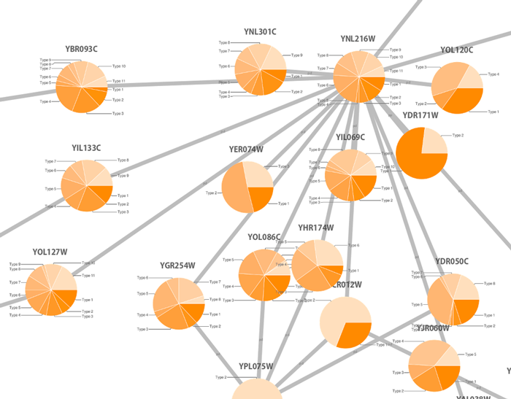
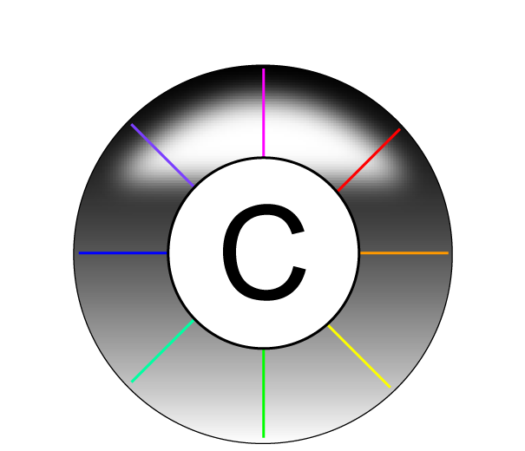
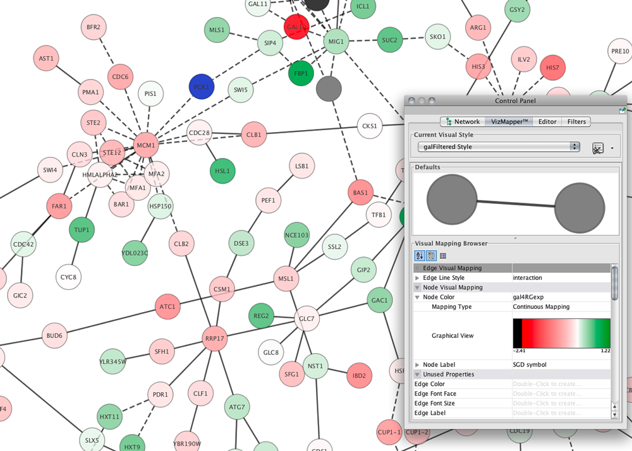
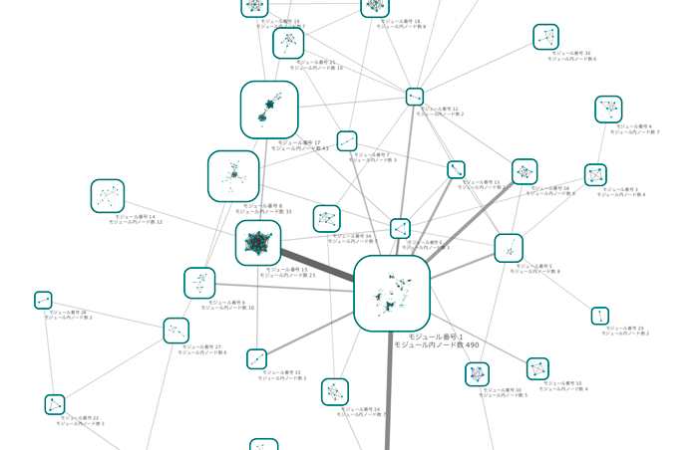
Cytoscape: open-source network representation and analysis tool
www.cytoscape.org
2.8
3.6

Slide 7
Why Cytoscape?
www.cytoscape.org
It can make use of several visual features that can effectively highlight key aspects of the network.
It can integrate global datasets and functional annotations.
It has a wide variety of advanced analysis and modelling tools in the form of apps that can be easily installed and applied to different approaches.
frameworks that integrate several additional Applications/plugin
you can use ClueGO and MCODE apps to perform GO enrichment analysis and try to identify the functional modules underlying our network.
you can use PathLinker to understand the molecular mechanisms underlying cell phenotype.

Slide 8
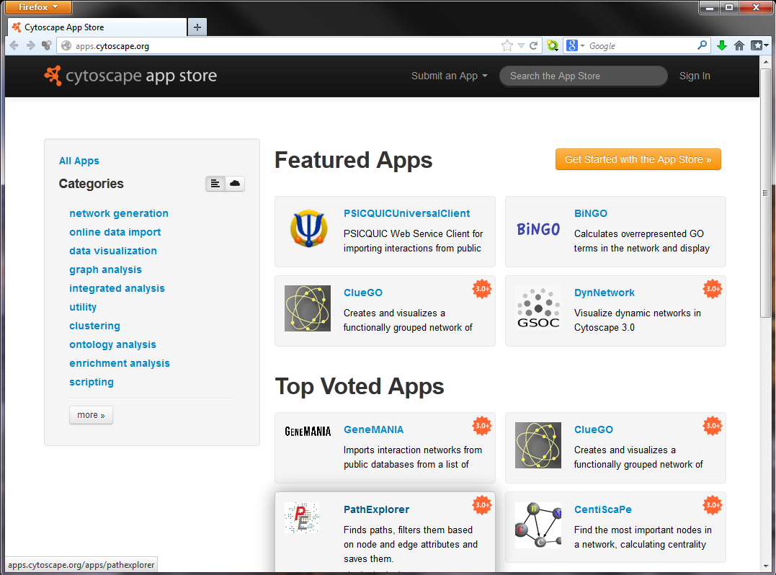
Cytoscape apps/apps
Large variety of apps/plugins (~330)
Great flexibility, adaptable to multiple types of analysis, in various domains of knowledge: bioinformatics, social network analysis, semantic web…
Possibility to create your own.
Some deprecated or obsolete
Different functionality depending on the Cytoscape version
“A travel guide to Cytoscape plugins.”
Saito et al., 2012, Nature Methods, PMID: 23132118.

Slide 9
A network analysis approach requires a Network, where can we extract it from?
We can import in Cytoscape:
a user custom precompiled Network
Path: File > Import > Network from file
PPI network from PSICQUIC-based interaction import client in Cytoscape
Path: File > Import > Network from Public Databases
A Network from a NDEx collection (e.g. SIGNOR)
Path: File > Import > Network from NDEx
Ad hoc APPs (e.g. IntAct and SIGNOR APPs)

Slide 11
Databases

Slide 12
Biology

Slide 13
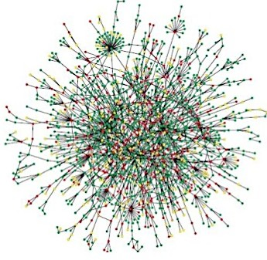
…to understand Biology we need to mesure things up…
DEP-1 dephosphorylates and inactivates ERK2
reality
experiments
conclusions
x thousands of publications
information digitalization
publications

Slide 14
How can I build a network to start with?
Neworks can be retrieved:
1 )Manually -> you can yourself annotate the interactions in a table and visualize them with appropriate tools (e.g. Cytoscape)… Good Luck!!
Use Biological databases -> query a database that annotates interactions
…

Slide 15
Molecular interaction resources
547 resources!
www.pathguide.org/

Slide 16
Molecular interaction resources

Slide 17
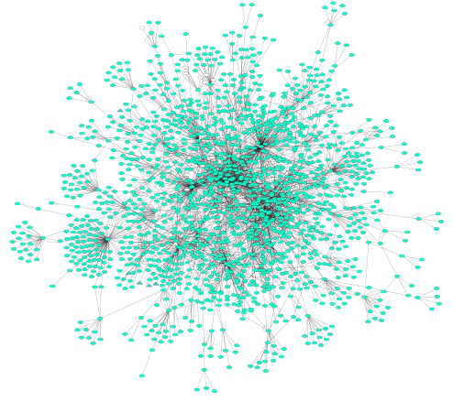
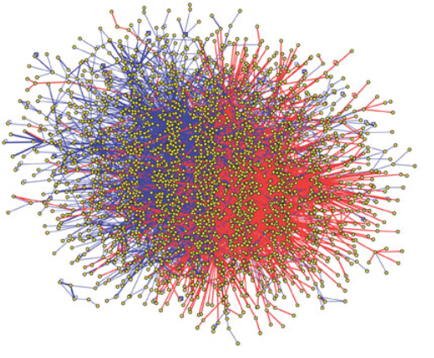
A couple of definitions…
Protein-protein interactions (PPIs): physical and selective contacts that happen between pairs of proteins, in certain molecular regions and in a defined biological context.
Interactome: the totality of PPIs that happen in a cell / in an organism / in a specific biological context...
Protein-protein interaction network: Graphical representation of a group of PPIs in which proteins are represented as nodes and interactions as edges.

Slide 18
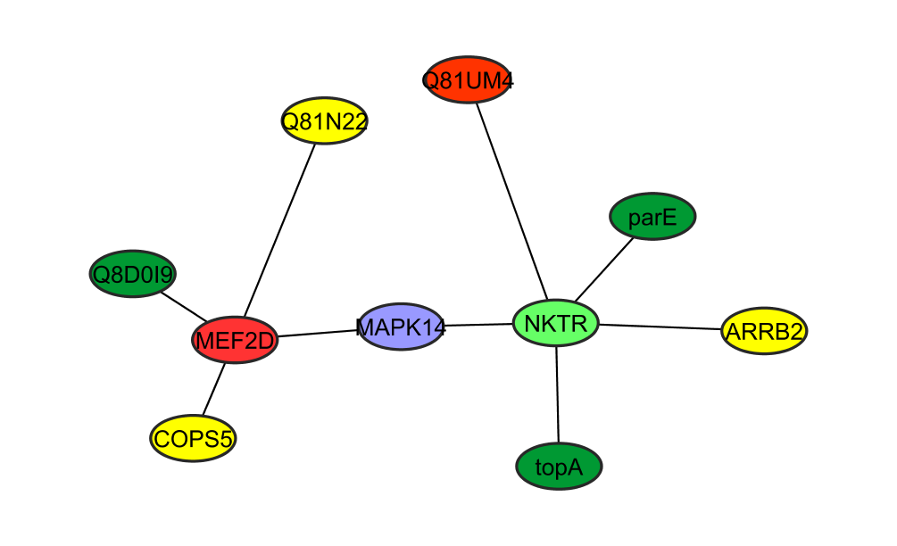
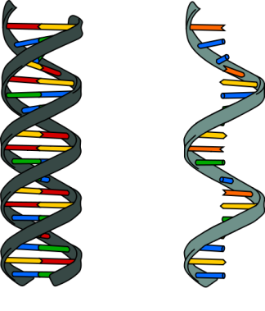
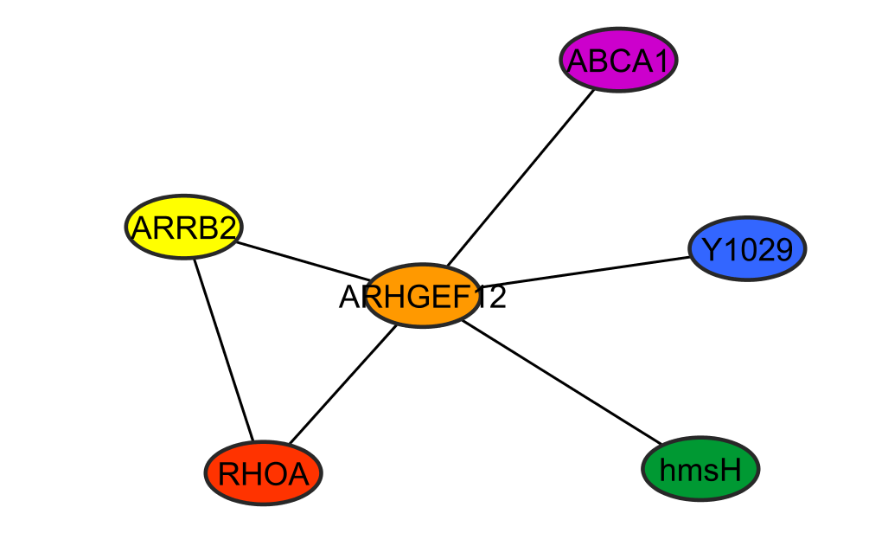
Why protein-protein interactions?
Gene level
Protein level
DNA
RNA
1 protein
=
n functions
=
n networks!
1 protein
=
1 function
To predict the biological function of a protein
proteins that cluster together should have similar functions
→ “guilt by association”
To improve characterization of protein complexes and pathways
interaction networks work as a draft map that brings detail to biological processes and pathways

Slide 19
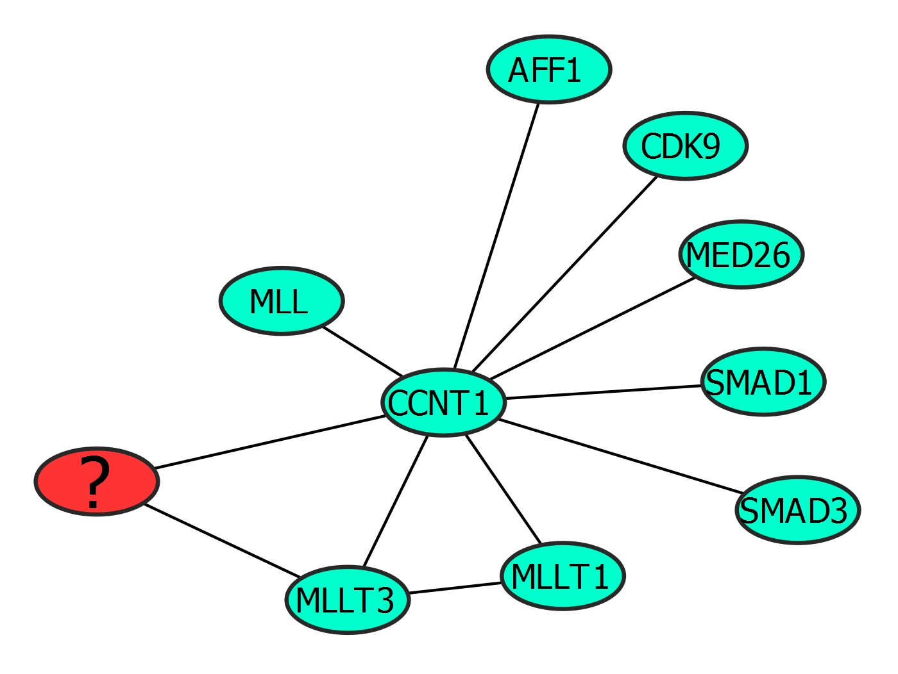
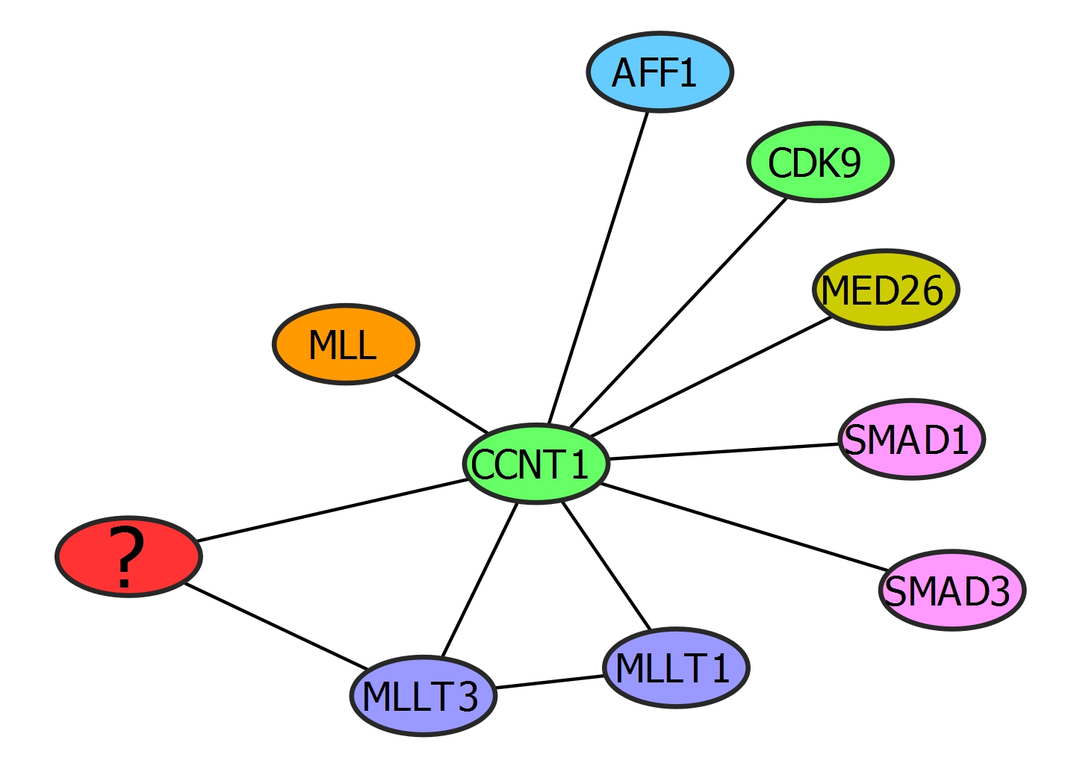
Guilt by association

Slide 20
Guilt by association
Cyclin-dependent kinase
Role in transcription regulation
Proto-oncogene
Transcription factor
Mediator of RNA polymerase transcription activity
Role in transcription regulation
Histone methyltransferase
Role in early development and hematopoiesis
Cyclin
Regulation of cyclin kinase, transcription regulation and cell cycle control
Transcriptional modulator
Transcription regulation dependent on kinases
Something to do with transcription and cell cycle control
Receptor-activated transcription modulator
Transcription modulation, signal transduction, activated by kinases.
Role in inhibition of wound healing
Putative oncoprotein
Involved in transcription regulation
Putative oncoprotein
Transcription activation

Slide 21
Systems Medicine
mechanistic hypotheses
biomarker discovery
patient stratification
personalised treatments
Notes:
Systems medicine is an interdisciplinary and olistic approach to understanding disease through an integration of large patient datasets. It offers the possibility for personalized strategies for healthcare through the development of a new taxonomy of disease

Slide 22
Why PPIs are important? Just few examples
Diagnosis and Prognosis: High-throughput gene expression profiling technologies have allowed researchers to characterize molecular differences between healthy and disease states which has led to the identification of an increasing amount of disease related genes.
*
‘Disease’ network
-high risk-
‘Healthy’ network
‘Disease’ network
-low risk-
*

Slide 23
Why PPIs are important? Just few examples
Drug discovery: Interaction map of a given disease can help in elucidating its mechanism and can suggest potential points for drug targets.
*

Slide 24
Why PPIs are important? Just few examples
Biomarker identification and gene prioritization: Different studies have been performed on omics platforms at various levels to identify, predict or prioritize disease genes.
Candidate disease-genes
Known disease-genes
GWAS

Slide 25
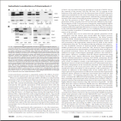
Interactions databases: types
Primary databases
Meta-databases
Predictive databases
De Las Rivas & Fontanillo, PLoS Computational biology, PMID: 20589078.

Slide 26
Data integration problems
Many data resources
Many to maintain
New appearing
Just 20% has a sustained future*
Not easy to find them
Different query interfaces
Variable results
Formats
Schemas
Controlled vocabularies
Minimum information guidelines
Redundancy
Inconsistency
data integration?
* Merali et al., 2005, Nature, PMID: 15973369.

Slide 27
Data integration
Combining data residing in different sources
… providing users with a unified view of these data.
Ideally
Reality
Compromise
DB
DB
DB
DB
DB
DB
DB
DB
DB
I
I
I
I
I
STANDARDS AND ONTOLOGIES
I
Database
I
Interface
User

Slide 28
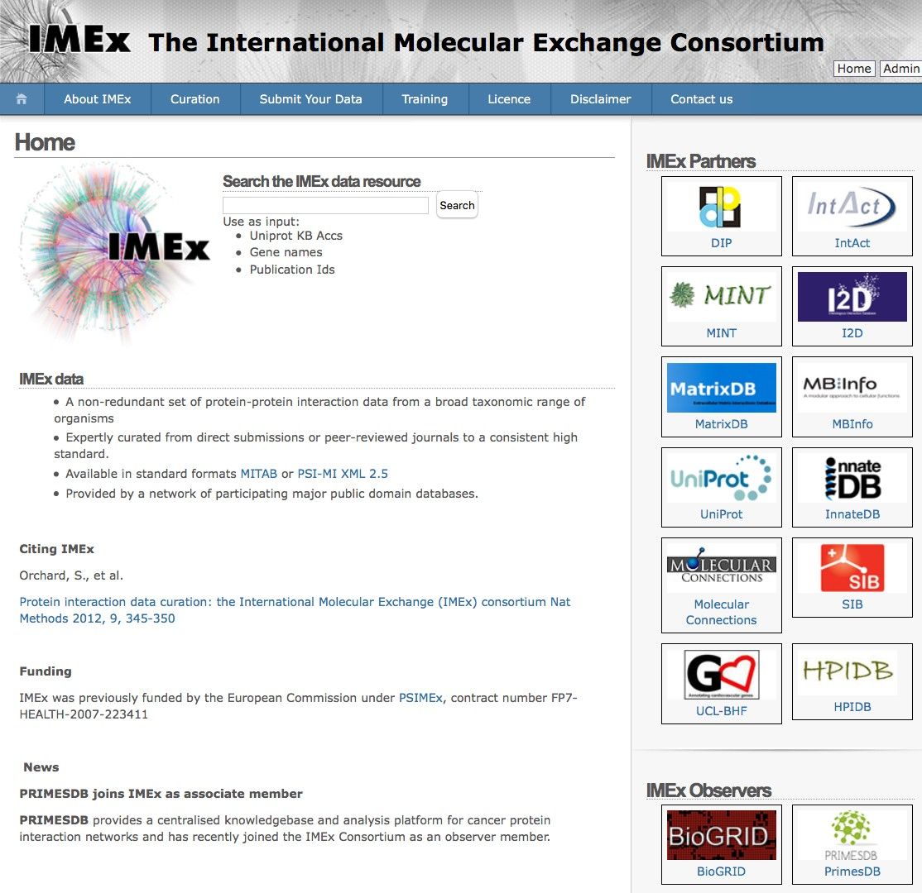
IMEx Consortium
IMEx Members:
They share the curation effort (not redundant)
They use the same detailed curation model
Common rules of curation (high precision and quality control)
Common export format
Single dataset

Slide 29
IMEx Consortium
Publicly available repository of molecular interactions (mainly PPIs).
Release 243 - July 2022
Publications : 22,954
Interactors : 118,924
Interactions : 750,480
Binary Interactions : 1,194,594

Slide 30
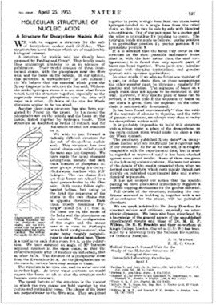
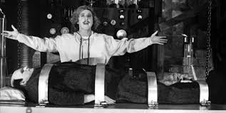
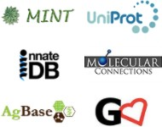
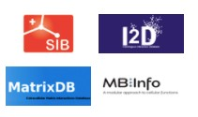
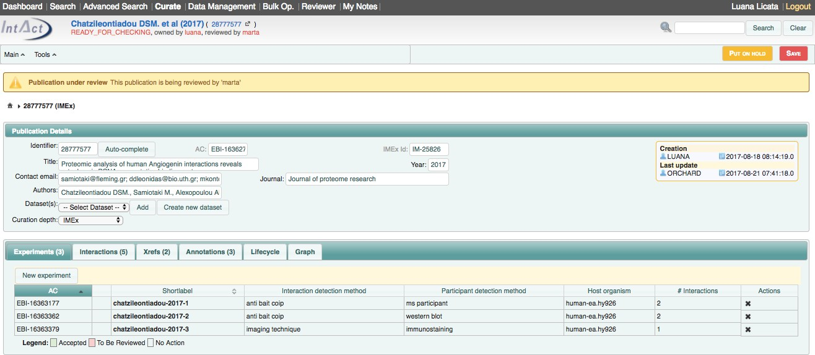
IMEx Curation Workflow
Wet Lab Scientists
Publication
IMEx Curators
Manual annotation (CVs and Curation rules)
IntAct web site
Double check
Common Curation interface

Slide 31
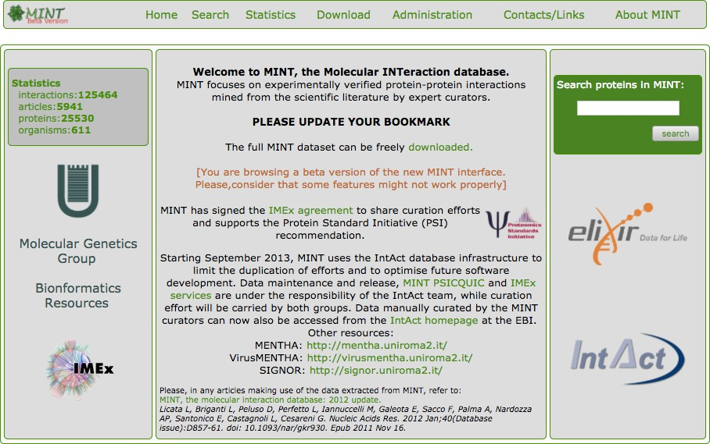
MINT, the Molecular INTeraction Database (http://mint.bio.uniroma2.it/mint/)
MINT is a public database developed at the University of Tor Vergata,
it contains manually curated protein-protein interactions (PPIs) reported in peer-reviewed journals.
IMEx curation standard

Slide 32
What can I do with PPI data from IMEx resources?
Find the molecules that interact with your protein of interest.
Know the experimental details related to each single interaction
See the interaction networks graphically.
Query other resources via PSICQUIC.
Quickly transfer data to Cytoscape for further analysis.
Download data in standardised and tabular format.

Slide 33
IntAct: The molecular interactions database at the EBI

Slide 34
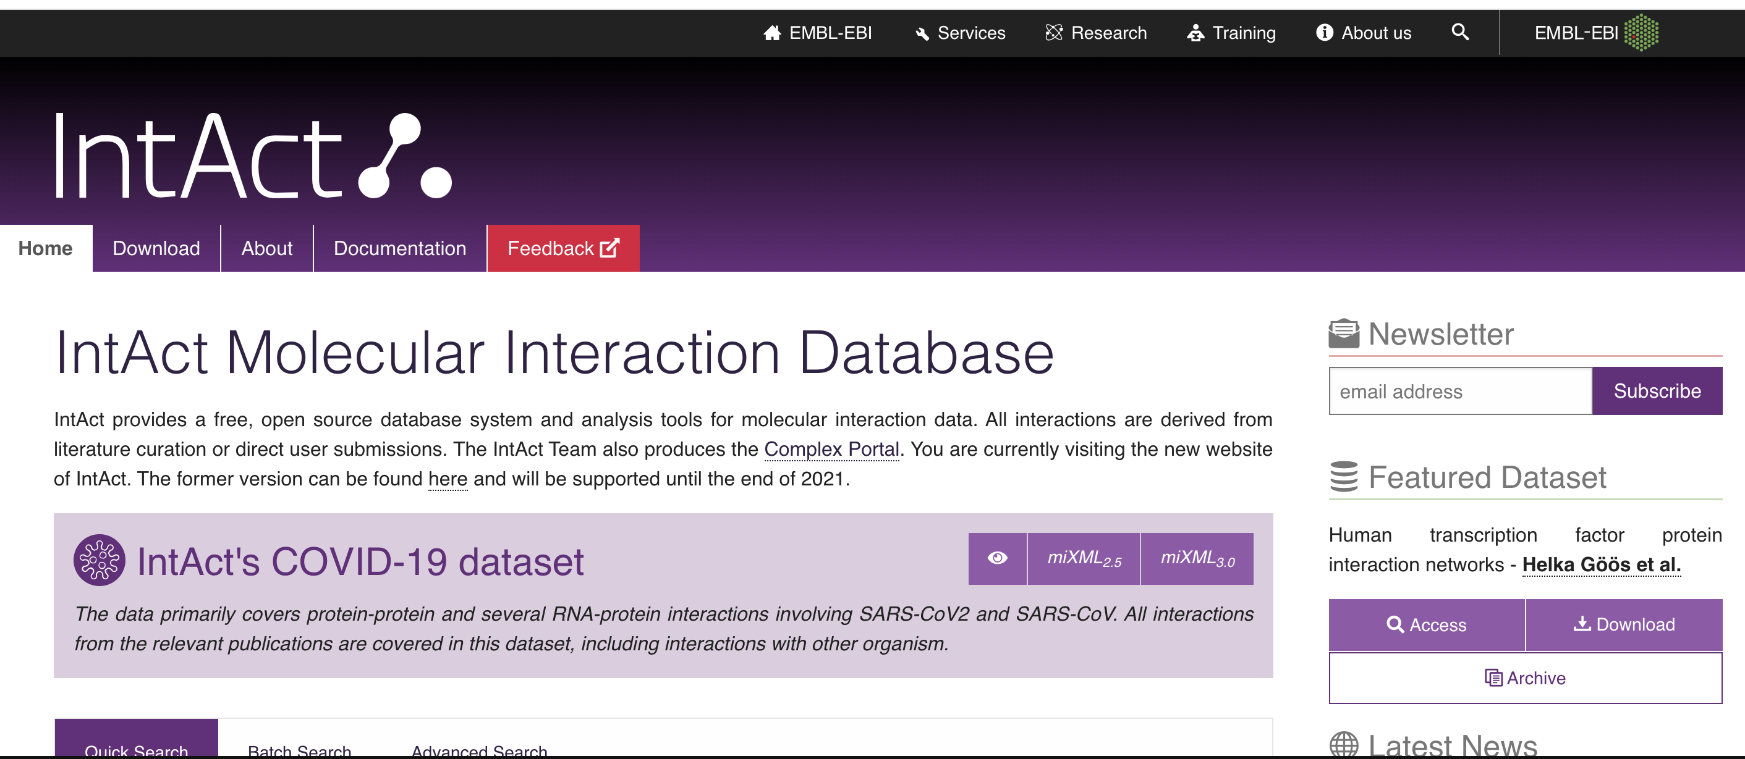
Primary database example: IntAct
www.ebi.ac.uk/intact
Holds molecular interaciton data curated to IMEx standards (high detail).
~ 1.1 M protein interactions
No specific organism focus.
Results shown as one line per evidence.
Data available via ftp, website and PSICQUIC.
Curation platform for all members of the IMEx Consortium.
Double curator process for quality control.

Slide 35
Extracting networks from the IntAct APP

Slide 36
More details in the hand-on session!!

Slide 37
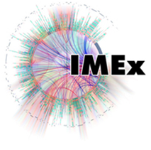
Collaboration among data providers
More data coverage
Less redundancy
Less inconsistency
Better data management
Access, exchange, sharing, portability, interoperability, annotation, comparison, verification, representation, integration, reusability.
IntAct
…
Control vocabulary
Schema
InnateDB
Format
MINT
Reporting
guideline
DIP
Data distribution
Molecular interactions
IMEx
PSI-MI standards
www.psidev.info/MI

Slide 38
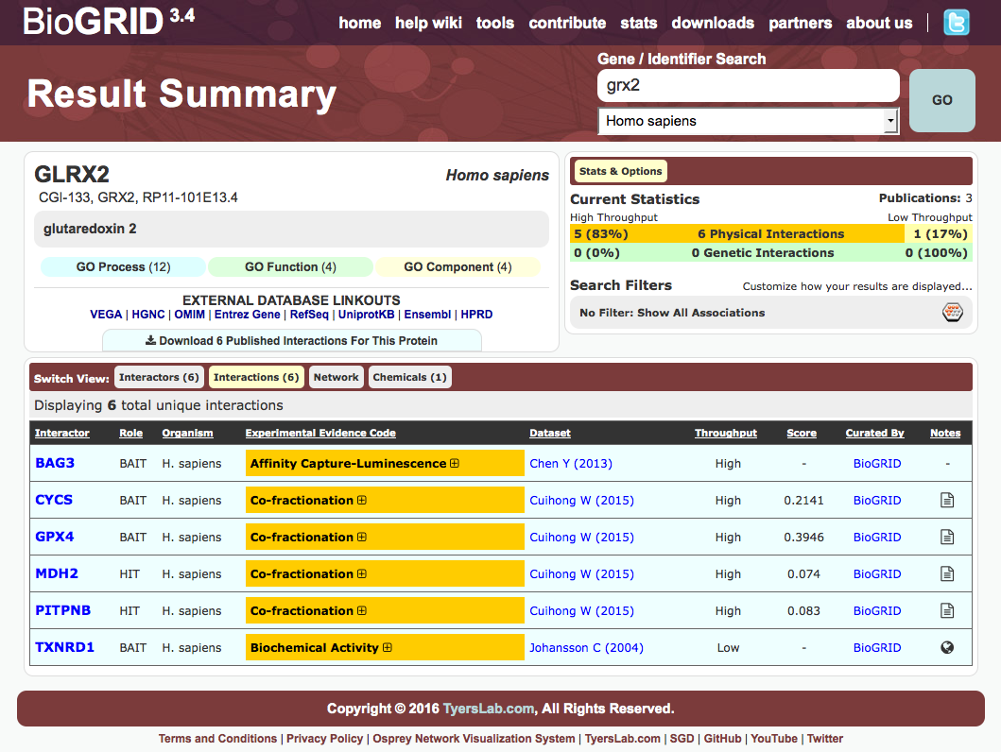
Primary database example: BioGRID results

Slide 39
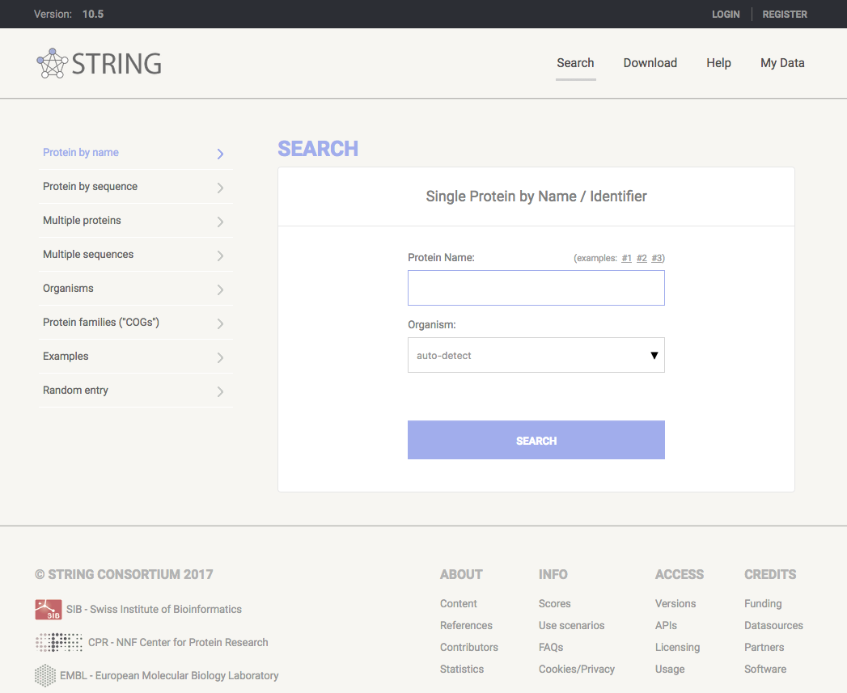
Predictive database example: STRING
http://string-db.org/
Holds physical and functional interactions.
Covers over 9.6 M proteins from over 2000 organisms.
Results show a pre-filtered summary of multiple evidence types: experimental, gene fusion, co-occurrence, co-expression, text mining…
Website allows individual and multiple gene/protein/sequence searches.
Data available also via download from their website and a Cytoscape app.

Slide 40
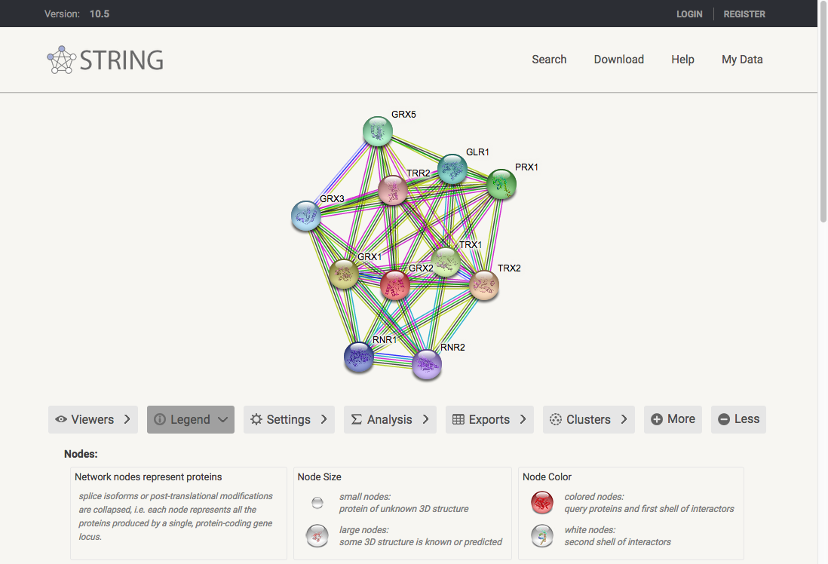
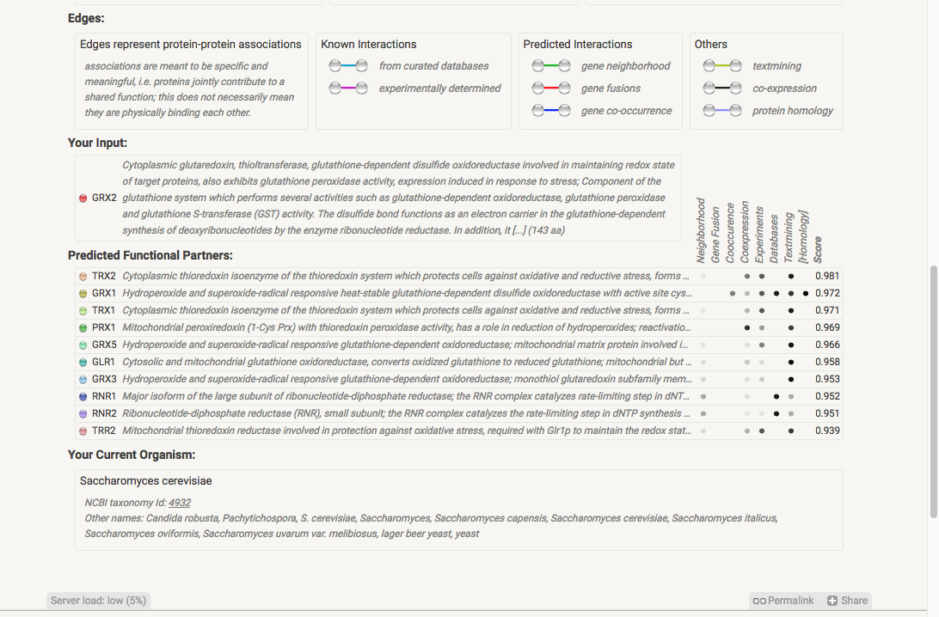
Predictive database example: STRING results

Slide 41
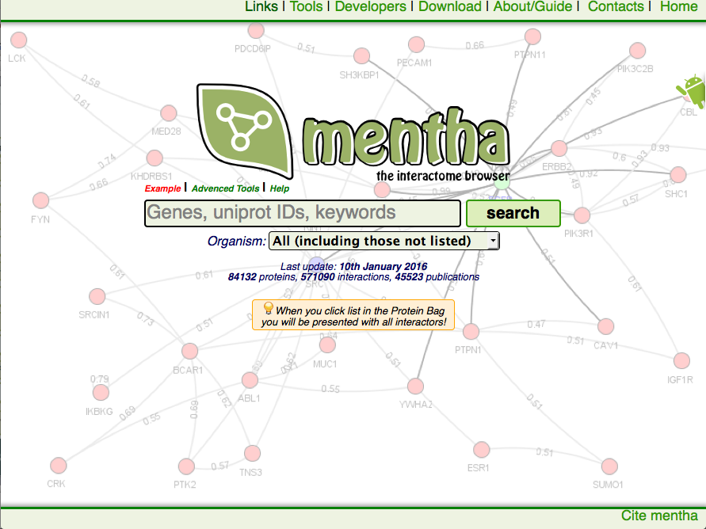
Meta-database using PSICQUIC: mentha
http://mentha.uniroma2.it/
Updated every week using an automated procedure that uses PSICQUIC.
Holds protein interactions aggregated from 5 different primary databases: MINT, IntAct, DIP, MatrixDB and BioGRID.
Over 1.1M protein interactions reported.
No specific organism focus, although it offers full interactomes for 8 organisms.
Website allows individual and batch gene/protein searches and has tools for specific types of search (search within a list, for example).
Data available also via PSICQUIC, RESTful API and direct download from website.

Slide 42
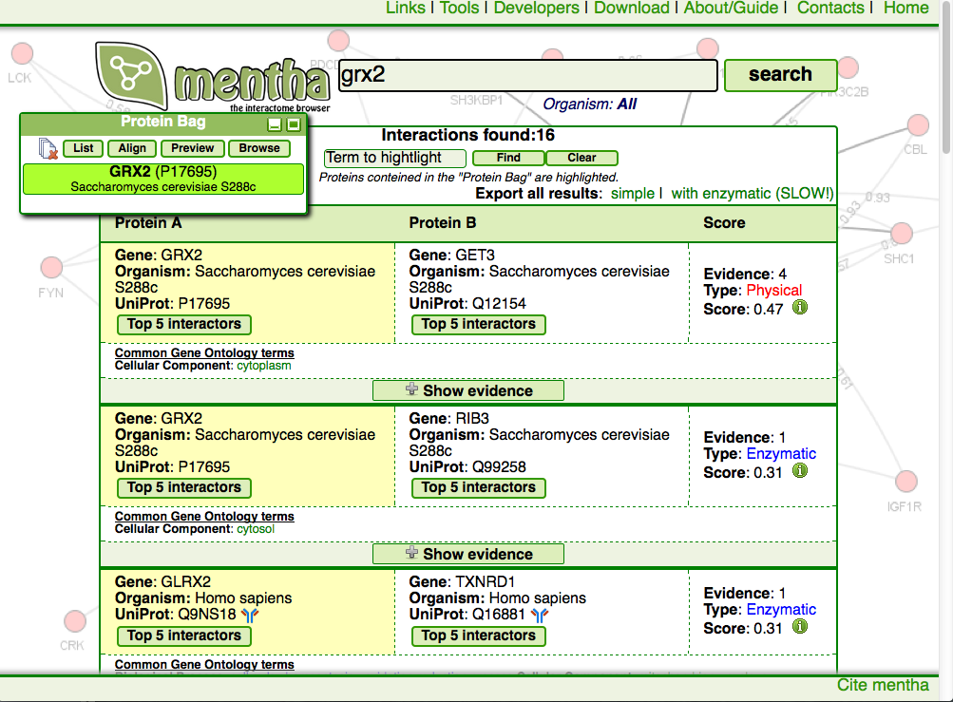
Meta-database using PSICQUIC: mentha results

Slide 43
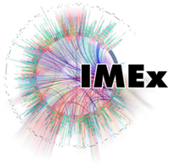
PPI data sources: choices, choices…
Non-model organisms
OK with ‘fuzzier’ data
Need for highest possible interactome coverage
No great need for most up-to-date data
Model organisms
Experimental data only
Need for highest possible interactome coverage
No interest in detail, just connections
Model / non-model organisms
Leverage detailed information (binding regions, mutation effects, isoforms & variants…)

Slide 44
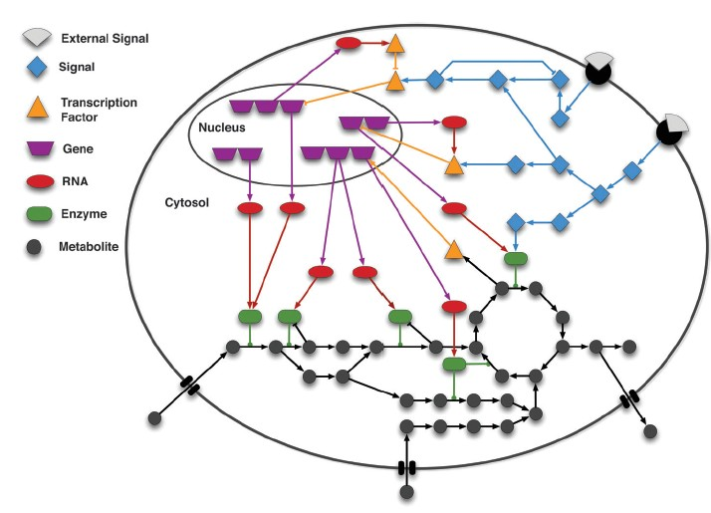
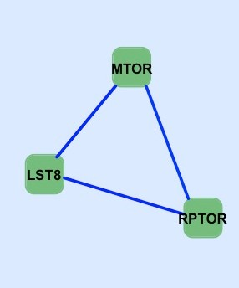
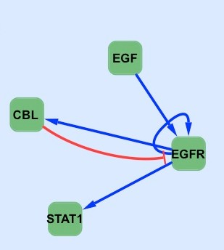
Signal Transduction
Protein-protein interaction networks provide information about cell organization
PPIs are the static representation of a biochemical event, without providing evidence on the dynamics and causality of the interaction
PPI networks are not sufficient to support a functional analysis of the signal
A second type of functional relationships between entities must be considered, the causal relationships between interacting molecules

Slide 45
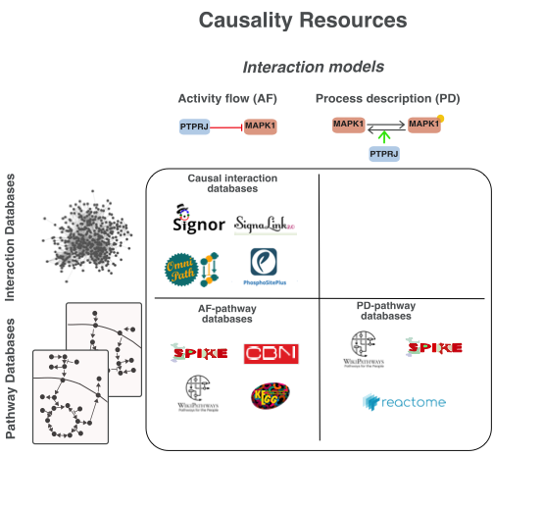
Databases of Signalling
Grafo orientato
A
B
C
D
E
F

Slide 46
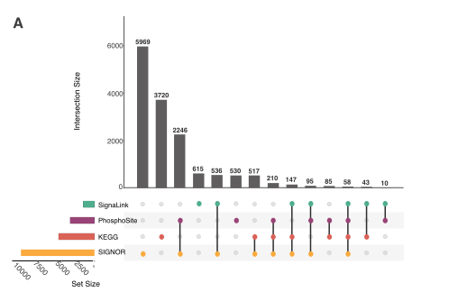
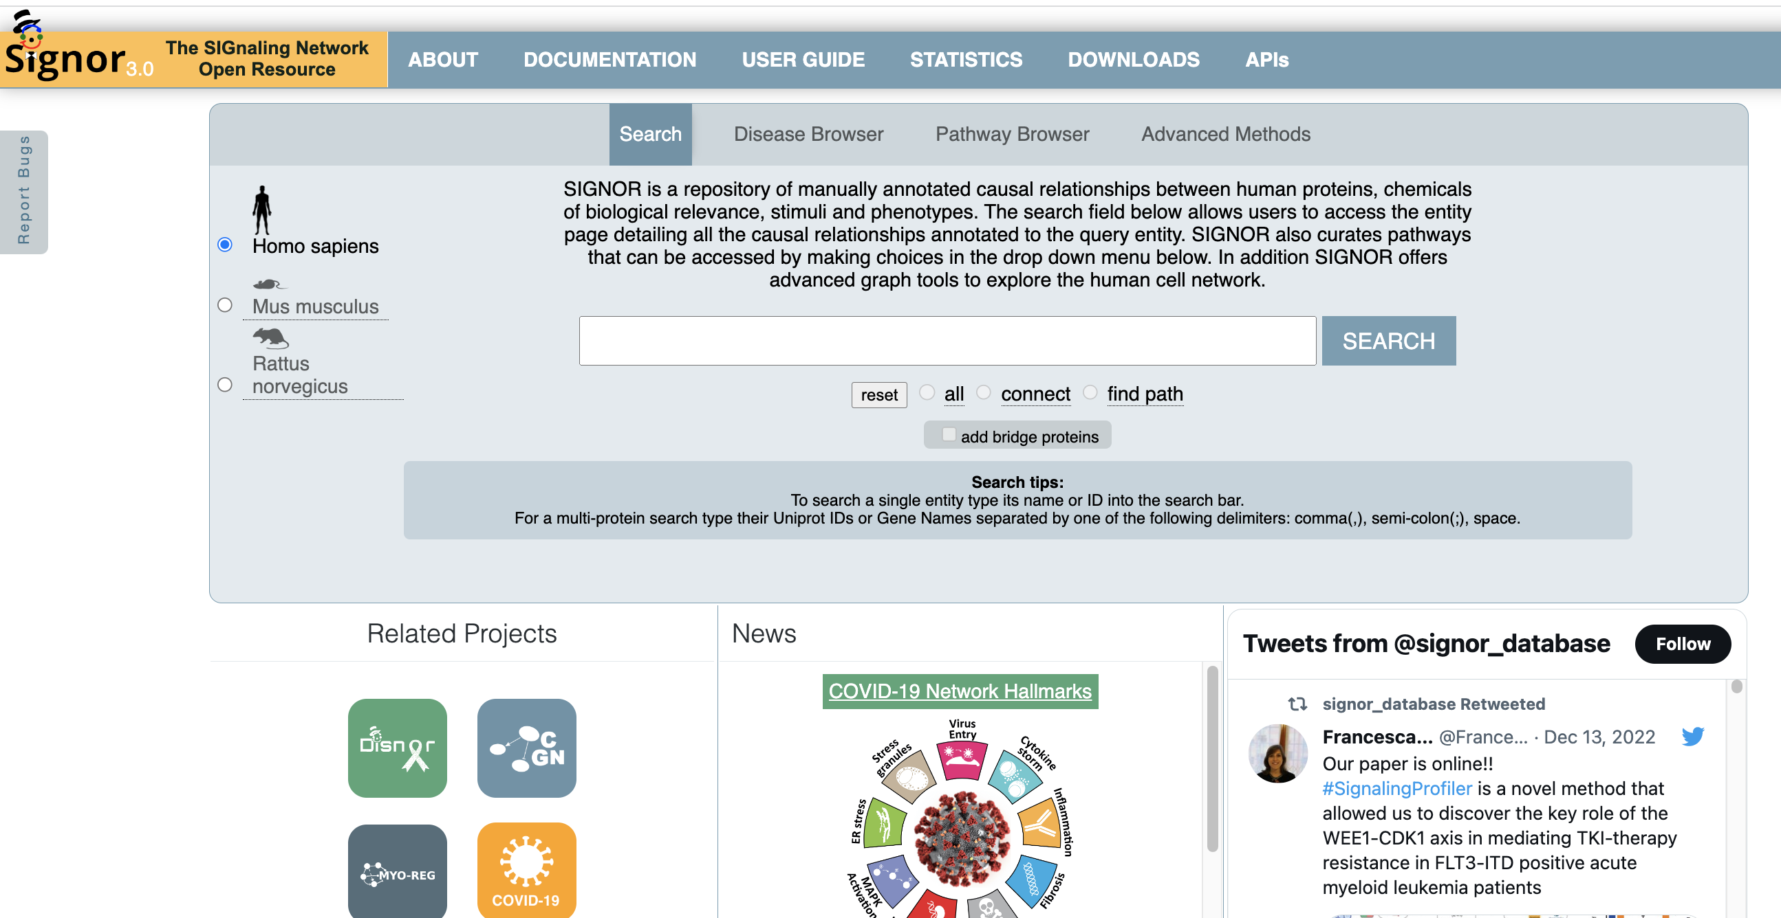
SIGNOR, https://signor.uniroma2.it/
SIGNOR is the largest interactome DB that annotates interactions in the AF model

Slide 47
SIGNOR:The SIGnaling Network Open Resource (https://signor.uniroma2.it/)
The SIGnaling Network Open Resource
A database that collects manually annotated data
Capture, organize, and display signaling interactions as binary causal relationships between biological entities.
Provides details of the mechanism of logical relationships
It is a public database developed at the University of Tor Vergata
Data representation: Activity flow

Slide 48
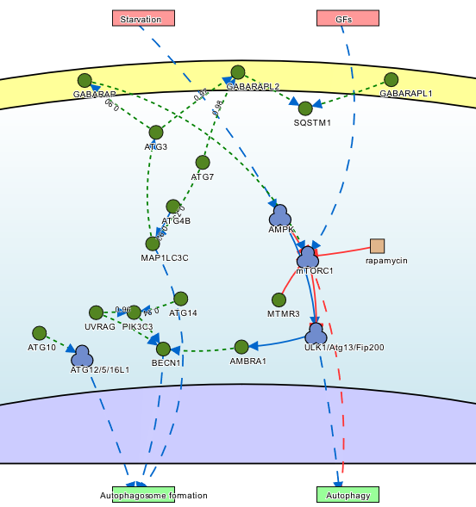
Biological networks
which type of graph is this?

Slide 49
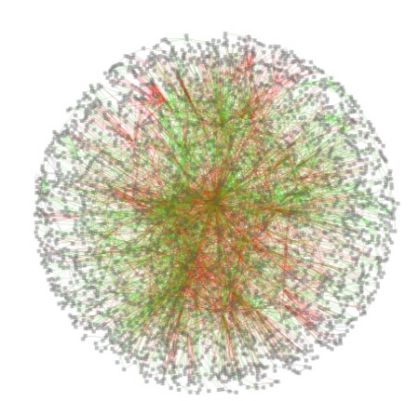
SIGNOR – signor.uniroma2.it
LOGIC RELATIONSHIPS
MANUALLY CURATED
HIGH COVERAGE 34,500 INTERACTIONS
10,500 PUBLICATIONS
PTM-MAPPING
approx. 10,000 MODIFIED RESIDUES
FREELY ACCESSIBLE

Slide 50
SIGNOR :una banca dati curata manualmente
1) Text mining
2) Expert curators
3) Database annotation
4) Quality control
Double-checked
IDENTIFICARE L’INFORMAZIONE RILEVANTE
CONVERTIRE L’INFORMAZIONE IN UN FORMATO STANDARDIZZATO LEGGIBILE/INTERPRETABILE DA MACCHINA
CONTROLLARE/CORREGGER E
COMPLETARE

Slide 51
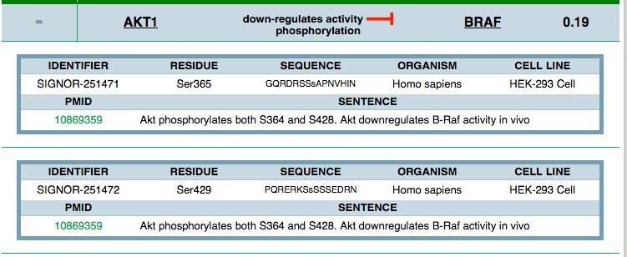
SIGNOR – Data structure
ENTITIES
Molecule Type (e.g. Chemical, Proteins)
Molecule identifiers (e.g.UniprotKB id)
RELATIONSHIPS
Effect (up/down- regulates);
Mechanism (e.g. phosphorylation);
Modified residue (i.e. Ser36)
Cell lines/tissues
REFERENCE
PubMedID;
Short sentence

Slide 52
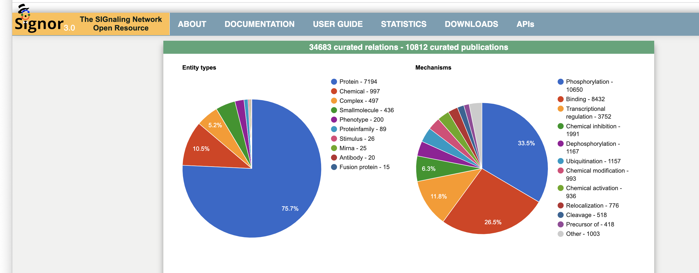
SIGNOR: statistics, March 2023

Slide 53
Causal What are causal Interaction used for?
wet biologist
system biologist
clinicians
interpretation and validation
of experimental results
simulations
new experiment setup
pathway browsing
modelling approaches
custom multi-entity search
data export
identification of chemical compounds affecting patho-pathway behaviour
single entity information
integration of GWAS results
-omic studies
diseases
biomolecular studies
in silico studies

Slide 54
More details in the hand-on session!!

Slide 55
Process descriptions
Pro
Suitable for modelling approaches on small scale;
They contain information about the kinetics;
They contain directionality and sign;
Cons
Information spread in different databases;
Limited coverage (proteins, species, interactions);
They don’t benefit of graph theory principles and in general of Network based approaches
Difficult simulation on large scale
Standards: SBML, SBGN, BioPAX
(Le Novere, Nat Rev Genet, 2015 and Turei, Nat Methods, 2016 )
Notes:
Not sure, maybe delete it

Slide 56
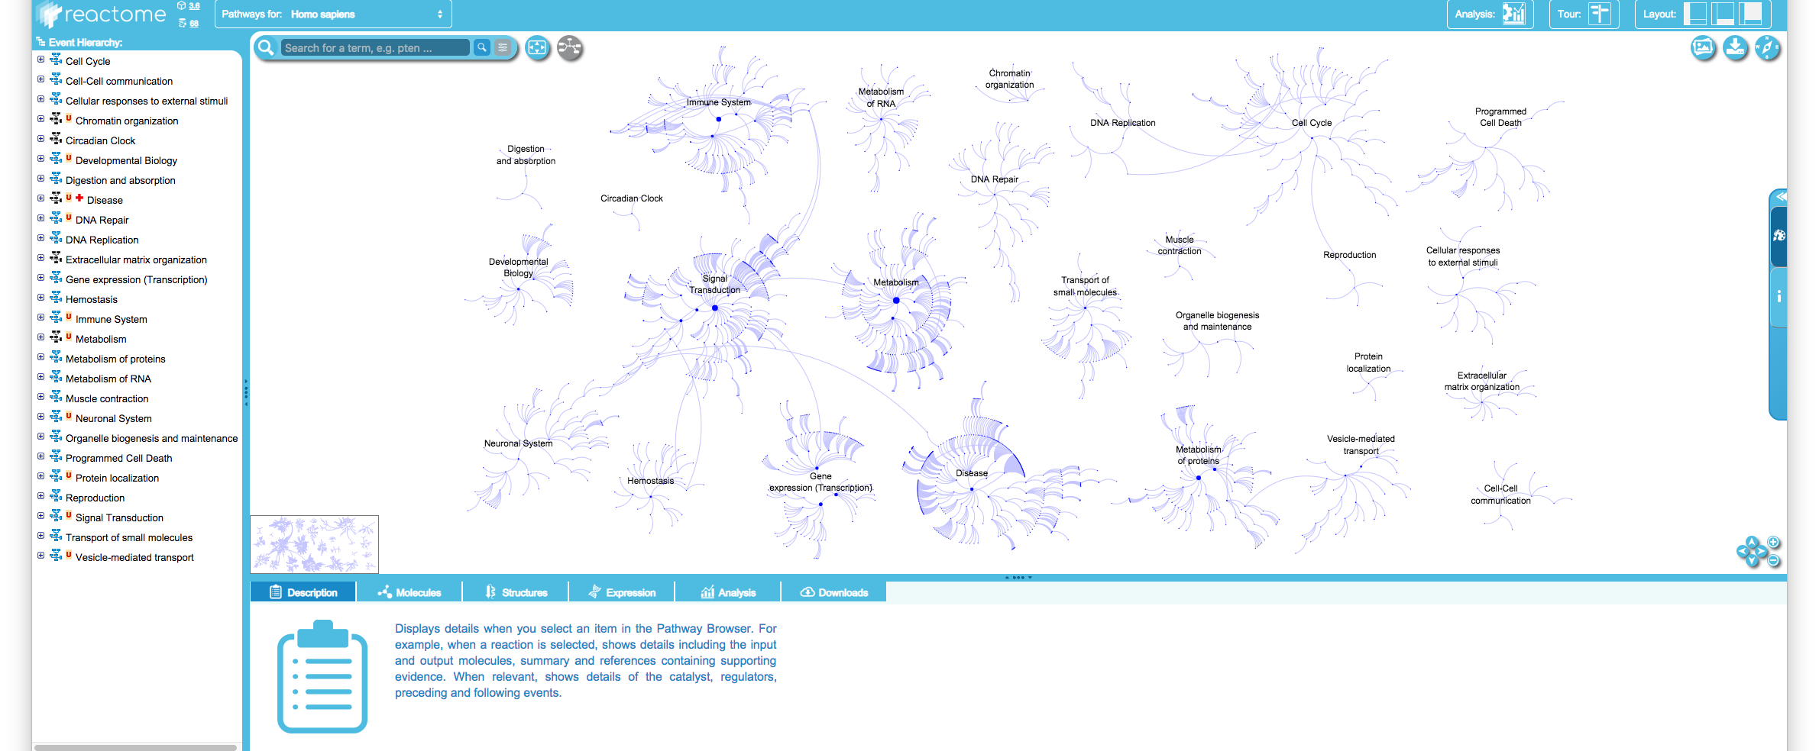
Reactome
Manually curated and peer-reviewed
Open source
Unit is reaction, reactions form pathway
Pathways are hierarchically organized
Users can graphically browse a pathway or use the table

Slide 57
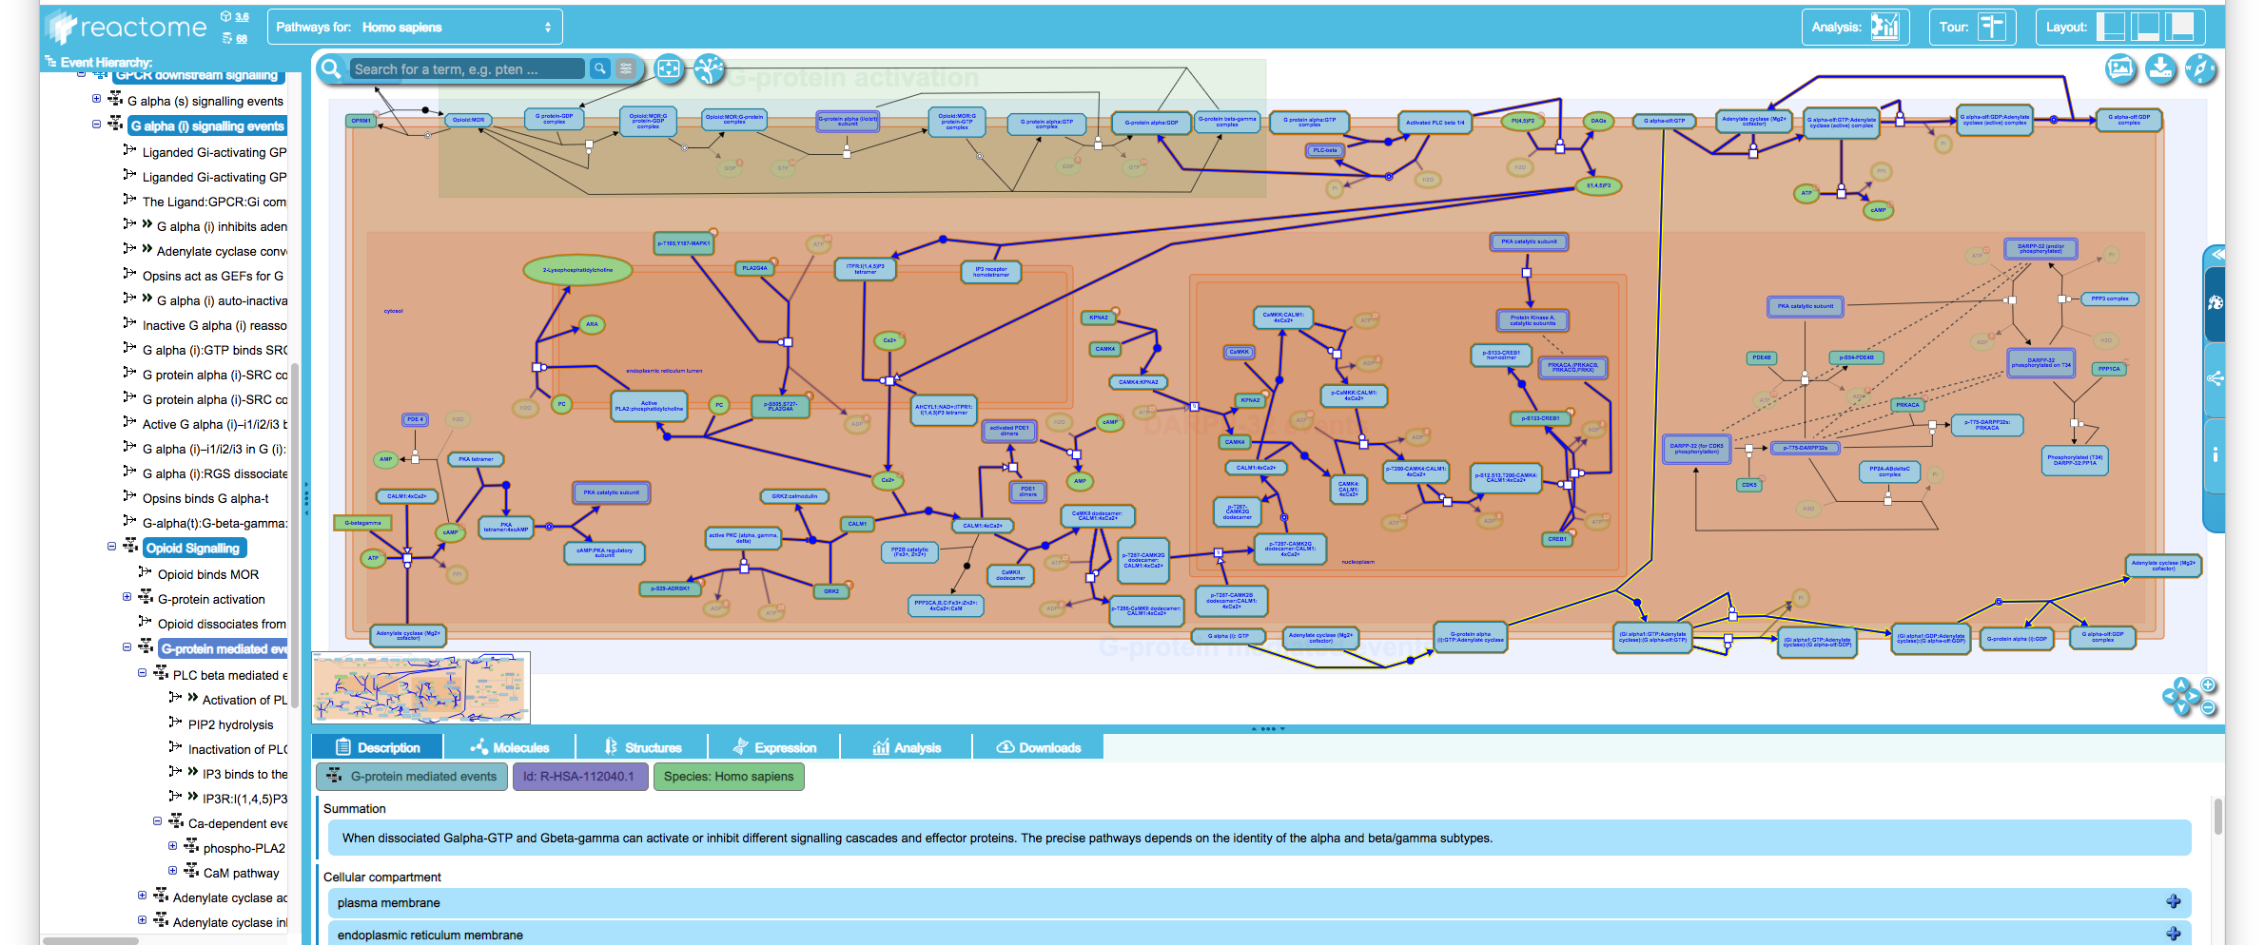
Reactome

Slide 58
Reactome
User friendly interface to perform Pathway enrichment analysis
Graphical output

Slide 59
Summary
PART 2:
Intro to Cytoscape
Molecular Interaction Databases
Protein-protein interaction (PPI) resources: IMEx/IntAct DB
Signaling Interaction Resources: SIGNOR

Slide 60
what’s next…
PART3:
practical: retrieving PPI from IMEx/IntAct DB
practical: Signaling Interactions from SIGNOR

