Slide 1
Methods in building and analysing biological networks.
Livia Perfetto, PhD
Assistant Professor, rtdB and
SIGNOR database coordinator
livia.perfetto@uniroma1.it

Slide 2
Course outline
PART 1:
Intro to Systems Biology and Network representation
Graph theory concepts
Network analysis: a brief overview
PART 2:
Intro to Cytoscape
Molecular Interaction Databases
Protein-protein interaction (PPI) resources: IMEx/IntAct DB
Signaling Interaction Resources: SIGNOR
PART3:
practical: retrieving PPI from IMEx/IntAct DB
practical: Signaling Interactions from SIGNOR

Slide 3
Network part 1

Slide 4
Systems Biology, reductionist vs holistic approaches

Slide 5
Global picture of disease mechanisms
Omic level:
Genome
Transcriptome
Proteome
Metabolome
Technique :
NGS
RNAseq
MassSpec
MassSpec
Notes:
Advances in omic techniques are providing an unprecedented capacity to measure RNA (coding and non-coding), protein, and post-translational modification levels under different biological contexts such as time, cell states, tissues, or organisms [5, 6, 7, 8]. Systematic integration of such datasets is essential to identify molecular networks controlling normal and disease states, and, ultimately, predict complex phenotypes from molecular markers

Slide 6
Global picture of disease mechanisms… at the molecular-resolution level
Notes:
put order in caos and help understanding how differentially modulated molecules are related in a given condition i.e. in a disease or upon drug tretment

Slide 7
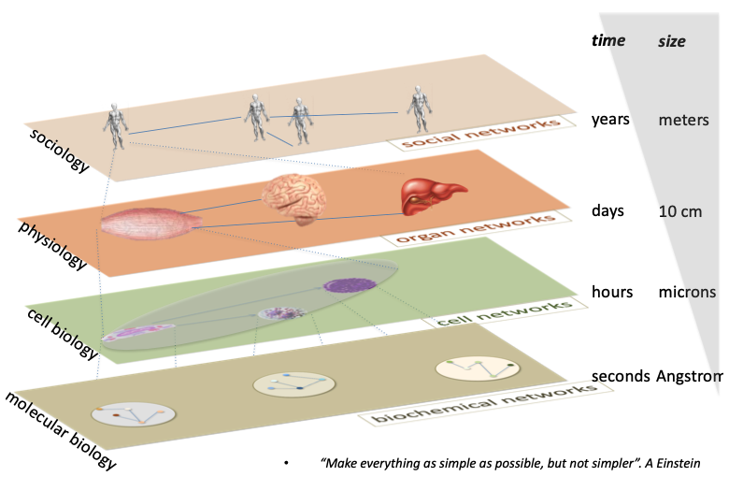
Modelling at different levels

Slide 8
The Systems Biology workflow

Slide 9
Network representation and analysis:
strategies and limitations

Slide 10
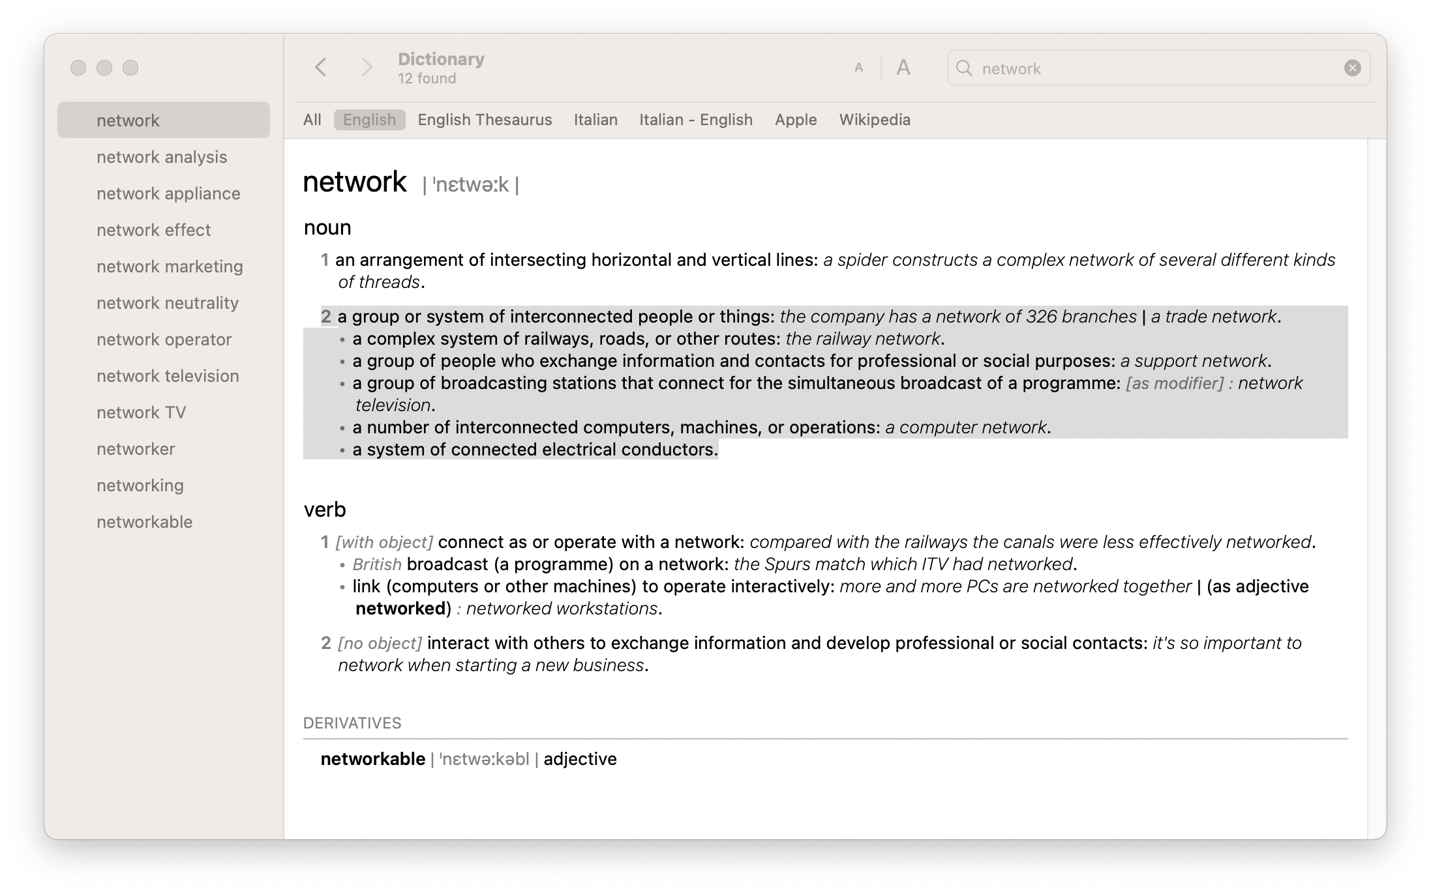
Network – the definition

Slide 11
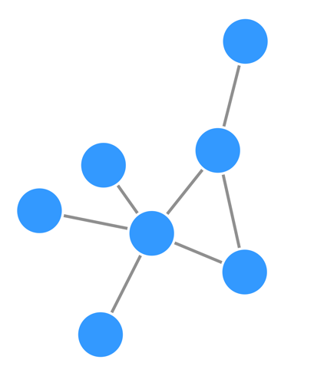
Network, different types of representation
G
Interactor 1 | Interactor 2
A | C
A | D
A | E
A | B
A | F
F | B
F | G
 | A | B | C | D | E | F | G
A | 0 | 1 | 1 | 1 | 1 | 1 | 0
B | 1 | 0 | 0 | 0 | 0 | 1 | 0
C | 1 | 0 | 0 | 0 | 0 | 0 | 0
D | 1 | 0 | 0 | 0 | 0 | 0 | 0
E | 1 | 0 | 0 | 0 | 0 | 0 | 0
F | 1 | 1 | 0 | 0 | 0 | 0 | 1
G | 0 | 0 | 0 | 0 | 0 | 1 | 0
E
F
D
A
B
C
Graph
Matrix
Table

Slide 12
Graph
In discrete mathematics, and more specifically in graph theory, a graph is a structure amounting to a set of objects in which some pairs of the objects are in some sense "related". The objects correspond to mathematical abstractions called vertices (also called nodes or points) and each of the related pairs of vertices is called an edge (also called link or line)
A graph is the set of V and E, where
V represents the set of nodes or vertexes v₁, v₂,…,v_{n},
E represents the set of edges e₁₂, e₁₃,…e_{nm} that connect the nodes.
G = (V, E)

Slide 13

Graph
G
A graph is a structure made of:
  nodes
  edges
F
E
D
A
B
C

Slide 14
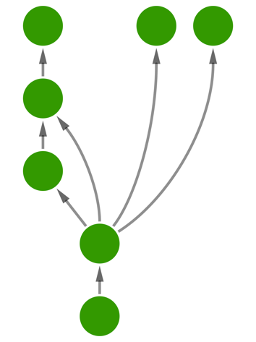
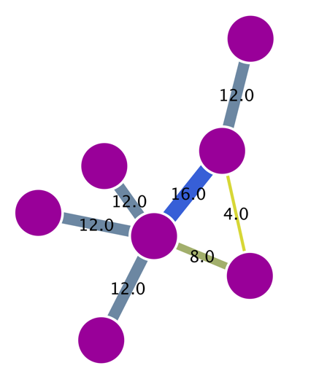
Graph types depending on edge properties
Undirected
Directed
Weighted
G
E
F
G
G
D
E
F
E
F
C
D
A
D
B
A
B
B
C
A
C
 | A | B | C | D | E | F | G
A | 0 | 1 | 1 | 1 | 1 | 1 | 0
B | 1 | 0 | 0 | 0 | 0 | 1 | 0
C | 1 | 0 | 0 | 0 | 0 | 0 | 0
D | 1 | 0 | 0 | 0 | 0 | 0 | 0
E | 1 | 0 | 0 | 0 | 0 | 0 | 0
F | 1 | 1 | 0 | 0 | 0 | 0 | 1
G | 0 | 0 | 0 | 0 | 0 | 1 | 0
Degree
 | A | B | C | D | E | F | G
A | 0 | 1 | 0 | 0 | 0 | 0 | 0
B | 0 | 0 | 1 | 1 | 0 | 1 | 1
C | 0 | 0 | 0 | 1 | 0 | 0 | 0
D | 0 | 0 | 0 | 0 | 1 | 0 | 0
E | 0 | 0 | 0 | 0 | 0 | 0 | 0
F | 0 | 0 | 0 | 0 | 0 | 0 | 0
G | 0 | 0 | 0 | 0 | 0 | 0 | 0
Degree
 | A | B | C | D | E | F | G
A | 0 | 8 | 12 | 12 | 12 | 16 | 12
B | 8 | 0 | 0 | 0 | 0 | 4 | 0
C | 12 | 0 | 0 | 0 | 0 | 0 | 0
D | 12 | 0 | 0 | 0 | 0 | 0 | 0
E | 12 | 0 | 0 | 0 | 0 | 0 | 0
F | 16 | 4 | 0 | 0 | 0 | 0 | 12
G | 12 | 0 | 0 | 0 | 0 | 12 | 0
Degree
5
5
72
2
2
12
1
1
12
1
1
12
1
1
12
3
3
32
1
1
24
Adjacency matrices
Notes:
Networks can represent many different types of data, as we have seen already. Apart from the nodes representing different entities (proteins, genes, people…), the edges can convey information beyond a simple link between nodes. Depending on the nature of this information, different types of analysis can be performed. For this reason, it is useful to highlight the main types of edges that can be found in a network.
[fig5]
Undirected edge: This is the typo of edge we will find in PPINs. The relationship between the nodes is a simple connection, without a given flow of signal implied.
Directed edges: This is the kind of connection you will find in metabolic networks or gene regulation networks, for example. There is a clear flow of signal implied and the network can then be organized hierarchically.
Weighted edges: directed or undirected edges can also have weight or quantitative value associated with them. This is used to depict concepts such a reliability of an interaction, the quantitative expression change that a gene induces over another or even how closely related are two genes in terms of sequence similarity or even expression values. Edges can also be weighted by their centrality values or several other topological parameters.
Finally, it is important to point out that every network can be expressed mathematically in the shape of an adjacency matrix, where the row and columns get assigned to the nodes in the network and the presence of an edge is symbolized by a numerical value. A network with undirected, unweighted edges will only contain the values 1, when a connection is present between the nodes represented by the given row and column, and 0, when there is no connection. Directed and weighted networks can make use of different numerical values in the matrix to express these more complex relationships.
Matt: The underlying mathematical representation of every network is an adjacency matrix, which for undirected networks is characteristically symmetric. Thanks to this representation we can calculate network properties such as degree (shown) and other centralities (later slides) very easily by applying basic concepts from linear algebra.

Slide 15
… And a mix…

Slide 16

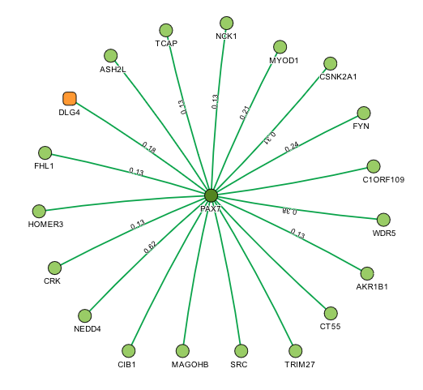
Biological networks
which type of graph is this?

Slide 17

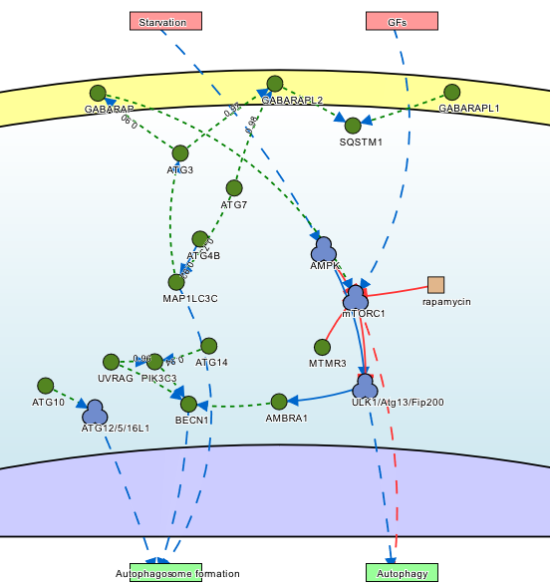
Biological networks
which type of graph is this?

Slide 18
Graph
G
A graph is a structure made of:
  nodes
  edges
F
E
D
A
B
C

Slide 19
Different types of network
With GRAPH THEORY we can study the interactions between different entities…
They exist tons of different networks that represent different types of interactions
• Biological networks(pathways, metabolic network… network of molecules, cells, organisms…)
• social networks (networks of people)
• road networks
• ...

Slide 20
Social network

Slide 21
Small-world effect median network distance – 6 steps
The theory of the six degrees of separation in semiotics and sociology is a hypothesis according to which each person can be connected to any other person or thing through a chain of acquaintances and relationships with no more than 5 intermediaries.
Stanley Milgram, 1967 – Teoria del mondo piccolo (esperimento sociale)

Slide 22
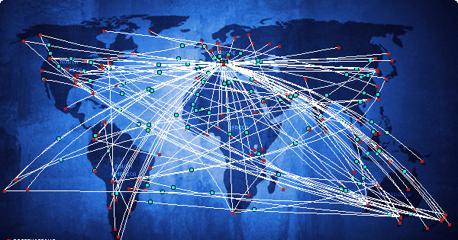
International airline network

Slide 23
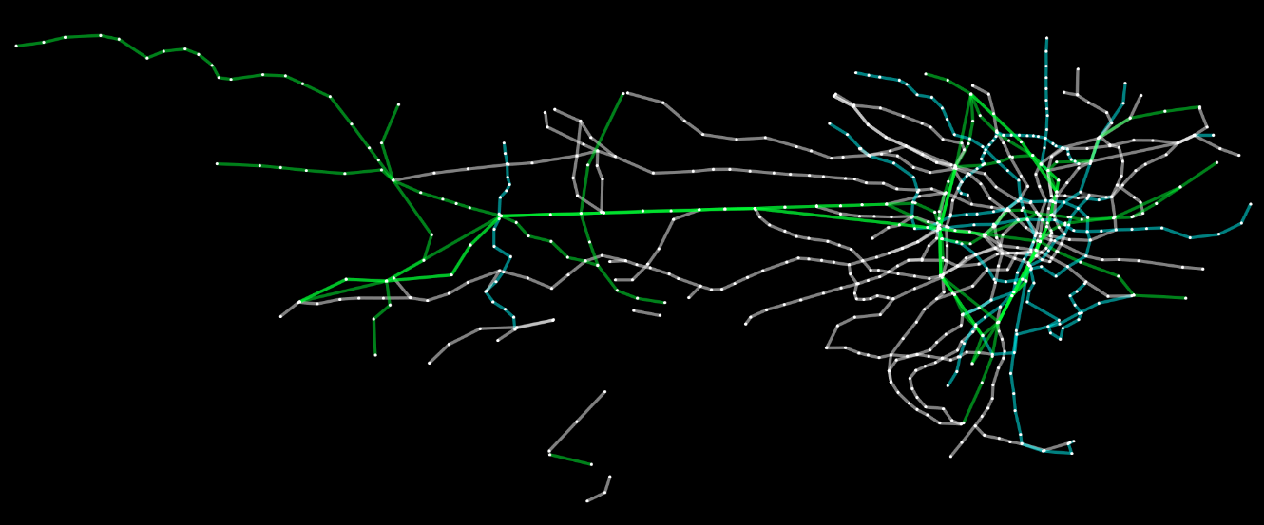
Tokyo railway network

Slide 24
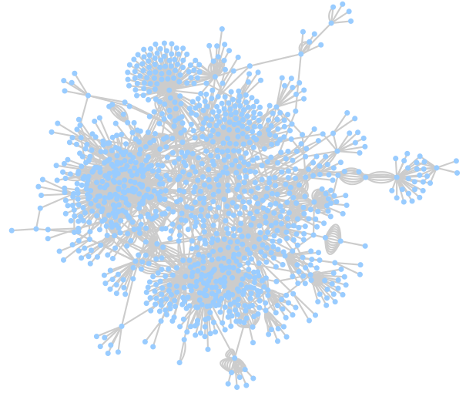
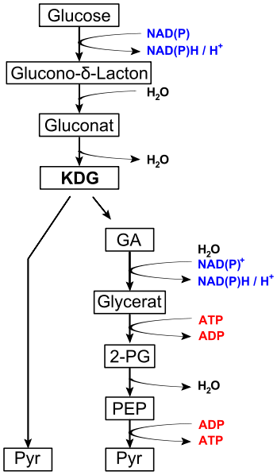
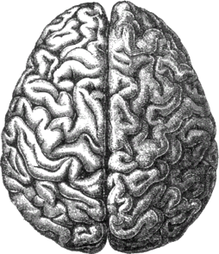

Network analysis in biology
Complex biological systems can be represented and analysed as networks, using the tools that graph theory gives us:
Ecological networks (food webs, species interaction networks…)
Neurological networks
Metabolic networks
Signalling networks
Genetic interaction networks
Gene regulatory networks
Protein-protein interaction networks
…
Images taken under Creative Commons Attribution-Share Alike 3.0 Unported license from:
http://commons.wikimedia.org/wiki/File:Lions_hunting_Africa.jpg
http://commons.wikimedia.org/wiki/File:Entner%E2%80%93Doudoroff_pathway_non-phosphorylative.svg
http://commons.wikimedia.org/wiki/File:Gene_Regulatory_Network_for_Initiation_of_Sporulation_in_Bacillus_subtilis.png

Slide 25
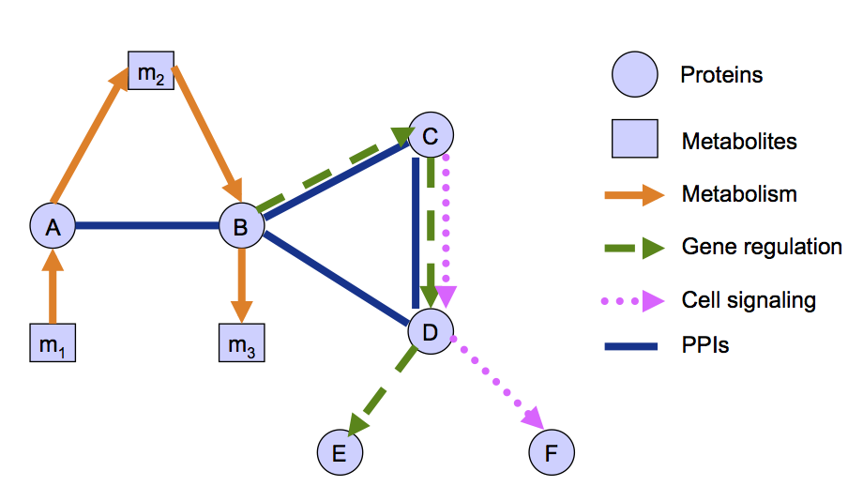
Networks of cell biology: a summary
Based on slides by Dr. Nataša Pržulj, Imperial College, London
Notes:
Different types of information can be represented in the shape of networks in order to model the cell. Some of the most used ones are:
1.- Metabolic networks:
a. They are used to study the biochemical reactions that allow an organism to grow, reproduce, respond to the environments and maintain its structure.
b. They are formed by metabolites and enzymes taking the role of nodes and the reactions describing their transformations being represented as directed edges.
c. They have been thoroughly characterized and well studied for quite some time now and built upon a solid base of knowledge.
2. Genetic interaction networks:
a. “Genetic interaction is the phenomenon where the effects of one gene are modified by one or several other genes.” (from http://www.nature.com/subjects/genetic-interaction).
b. These networks represent a functional relationship between different genes, rather than a physical one.
c. The genes are represented as nodes and their relationships as edges. Depending on the type of evidence behind the interaction, directionality can be inferred for the edges.
d. They can be built upon large- or small-scale experimental datasets.
3. Gene / transcriptional regulation networks:
a. They aim to represent how gene expression is controlled.
b. Genes and transcription factors are represented as nodes, while their relationship is depicted by different types of directional edges.
c. Usually generated via databases representing consensus knowledge (knowledgebases such as Reactome or KEGG), although some large-scale experimental datasets are also available.
d. Regulatory RNAs and other mechanisms are coming to form an integral part of this type of networks.
4. Cell signaling networks:
a. Cell signaling is the communication system that controls cellular activities.
b. Conceptually, this can be represented in the form of signaling pathways, ordered sequences of events that model the information flow within the cell.
c. Elements in the pathway (proteins, nucleic acids, metabolites) are represented as nodes and the directed edges linking them represents the flow of information.
d. Systematically represented in pathway databases such as Reactome, KEGG or Wikipathways. These aim to provide with a formal representation of current scientific consensus on how cell signaling works.
5. Protein-protein interaction networks:
a. They will be the subject of this course and they represent the physical relationships between proteins. They are then central to practically every process that takes place in the cell.
b. Proteins are represented as nodes that are linked by undirected edges.
c. More on PPINs in the next slide.
[fig 3]
Finally, this online course is focused on protein-protein interaction networks (PPINs), which will be described in detail later on, as one of the data types most frequently used in biological network analysis nowadays. You can learn more about protein-protein interactions in this introductory online course also offered at the EBI train online page: [http://www.ebi.ac.uk/training/online/course/protein-interactions-and-their-importance].
Now, let’s have a look at protein-protein interaction networks.

Slide 26
Example of a PPI Network
Undirected edges
>80% of proteins are all connected in one giant cluster of PPI network
Small-world effect median network distance – 6 steps
Nodes – proteins
Edges – interactions

Slide 27
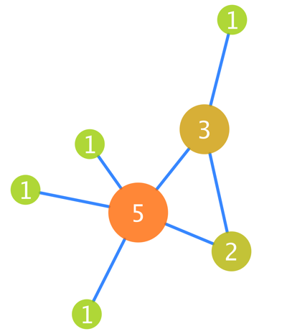
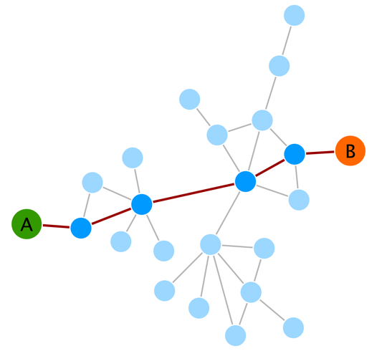
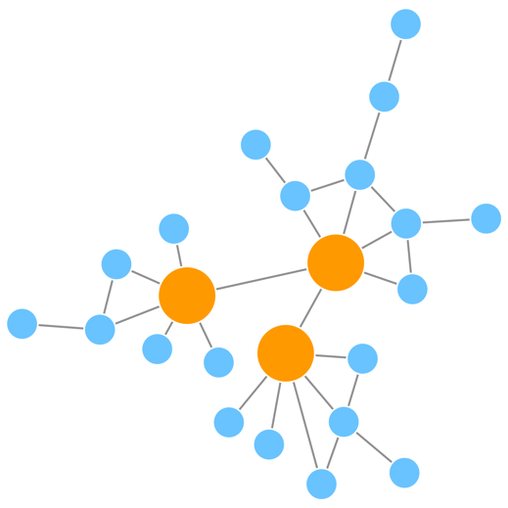
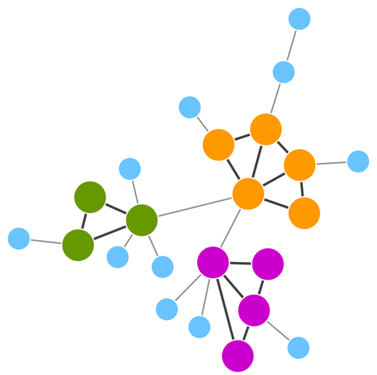
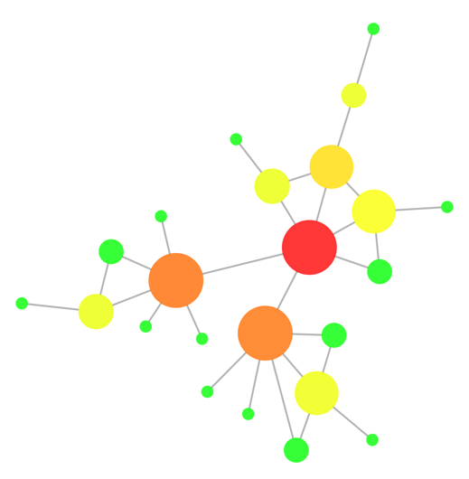
Graph theory: some basic definitions
Degree
Shortest paths
Scale-free network
Transitivity
Centrality
Notes:
Graphs have some properties that have great applicability when it comes to unravel the underlying information they contain. It is important to realize that main issue with any type of network analysis is to handle the complexity of the network and be able to extract meaningful information that you would not have if the individual components are examined separately. Network properties, and particularly its topological properties, can help us identifying relevant sub-structures within an network.
[fig6]
Some of the most used properties and concepts are illustrated in figure 6 and summarized here:
Degree: It is the number of edges that connect a node. It is a fundamental parameter that influences other characteristics, such as the centrality of a node. The degree distribution of all nodes in the network helps defining whether a network is scale-free or not, as we will see later. In the image, you can see the degree of each node indicated and reflected in its size and colour.
Shortest paths: The shortest distance between any two nodes in the network. It is specially relevant in networks that aim to model information flows, as it will often be the case for biological networks. In the example, you have to take 5 steps to go from nodes A to B.
Scale-free networks: In a scale-free network, most of the nodes are connected to a low number of neighbours and there is a small number of high-degree nodes (hubs) that provide high connectivity to the network. In the example, hubs are highlighted in orange.
Transitivity: There are tightly interconnected communities inside the network, groups of nodes that are more internally connected than they are with the rest of the network. These groups are also called topological clusters and are highlighted in the example.
Centralities: As we will see later, there are different flavours of centrality, each representing different concepts. Centrality can be measured for nodes and for edges and gives an estimation on how important that node/edge is for the connectivity or the information flow of the network. The degree of a node has a direct influence on most centralities measures, most prominently on the ‘degree centrality’, which is no more that the degree that given node. In the figure, most central nodes according to their betweenness centrality are highlighted in warm colours and the node size reflects its degree.
Now let’s have closer look at these characteristics and their implications for the biology represented by the network.

Slide 28
Local topological properties of a network

Slide 29
The degree of a node (k)
The degree of a node represents the number of connections that a node has

Slide 30
The degree of a node (k)
The degree of a node represents the number of connections that a node has
Fo directed graphs we have:
in–degree (number of entering edges in a node, k_{in} of C = 2
out–degree (number of exiting edges from a node, k_{out} of C = 1

Slide 31
The degree of a node (k), a small exercise
in-degree of A?
out-degree of E?

Slide 32

Clustering coefficient
the local clustering coefficient, K, measures the local density of edges in the neighborhood of a node
L_{i} represents the number of links between the k_{i} neighbors of node i.
C_{i} is between 0 and 1
C_{i} = 0 if none of the neighbors of node i link to each other.
C_{i} = 1 if the neighbors of node i form a complete graph, i.e. they all link to each other.
In summary C_{i} measures the network’s local link density: The more densely interconnected the neighborhood of node i, the higher is its local clustering coefficient.
The probability that a pair of nodes that share an interaction partner are also connected to each other.

Slide 33
A small exercise…

Slide 34
Global topological properties of a network

Slide 35
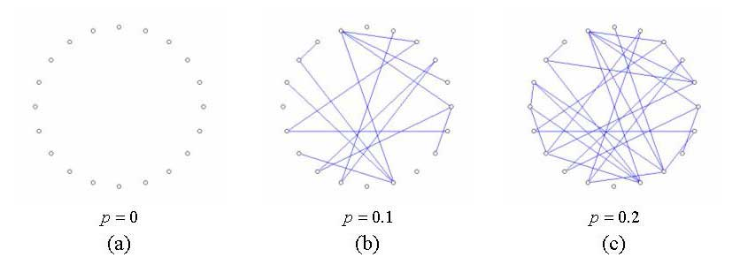
Random network
– random –
A random network is a network with N nodes connected by n edges, picked randomly among any possible combination

Slide 36
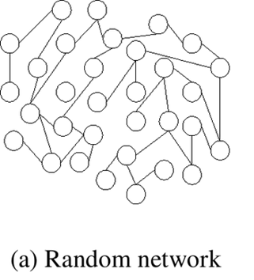
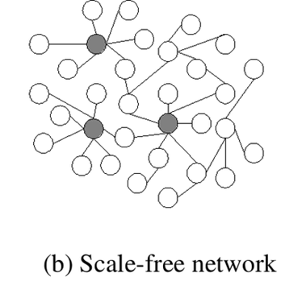
Properties of PPI networks: scale-free networks
Scale-free effect - the majority of nodes in a scale-free network have only a few connections to other nodes, whereas some nodes (hubs) are connected to many other nodes in the network

Slide 37
Scale free networks
lots of nodes with low degree
few nodes with high degree

Slide 38
Properties of PPI networks: scale-free networks

Slide 39
Properties of PPI networks: scale-free networks
Scale-free networks are stable - if failures occur at random and the vast majority of proteins are those with a small degree of connectivity, the likelihood that a protein hub would be affected is small.
Even if a hub-failure occurs, the network will generally not lose its connectedness, due to the remaining hubs.
However, if we loose a few major hubs from the network, the network is turned into a set of rather isolated graphs (so they are vulnerable to targeted attack).
Many cancer-linked proteins are hub proteins (e.g. P53).
Given the current limited coverage levels and variable quality of interaction data, the observed scale-free topology of existing interactome maps cannot be confidently extrapolated to complete interactomes:
  Strong effect of the ‘popularity bias’
  Some cancer networks appear to behave this way, some not
  See Schaefer et al. 2016 (PMID: 26300911)

Slide 40

Properties of PPINs: Small-world effect
Notes:
As we said before, a network showing a small world effect has great connectivity between its nodes. In other words, it can be said that its diameter (the maximum number of steps separating any two nodes) is small, no matter how big the network is. This usually translates in any two nodes being separated by less than 6 steps, more or less, reflecting the now widely popularized “six degrees of separation” theory used in social sciences.
[fig7]
Such connectivity has important biological consequences, since it allows for an efficient and quick flow of signal within the network. However, it also poses an interesting question: if the network is so tightly connected, how come perturbations in a single node do not have dramatic consequences for the network? Biological systems are extremely robust and can cope with a relatively high amount of perturbations in single genes/proteins. In order to explain how can this happen, we need to have a look at another fundamental property of PPINs: they are scale-free networks.

Slide 41
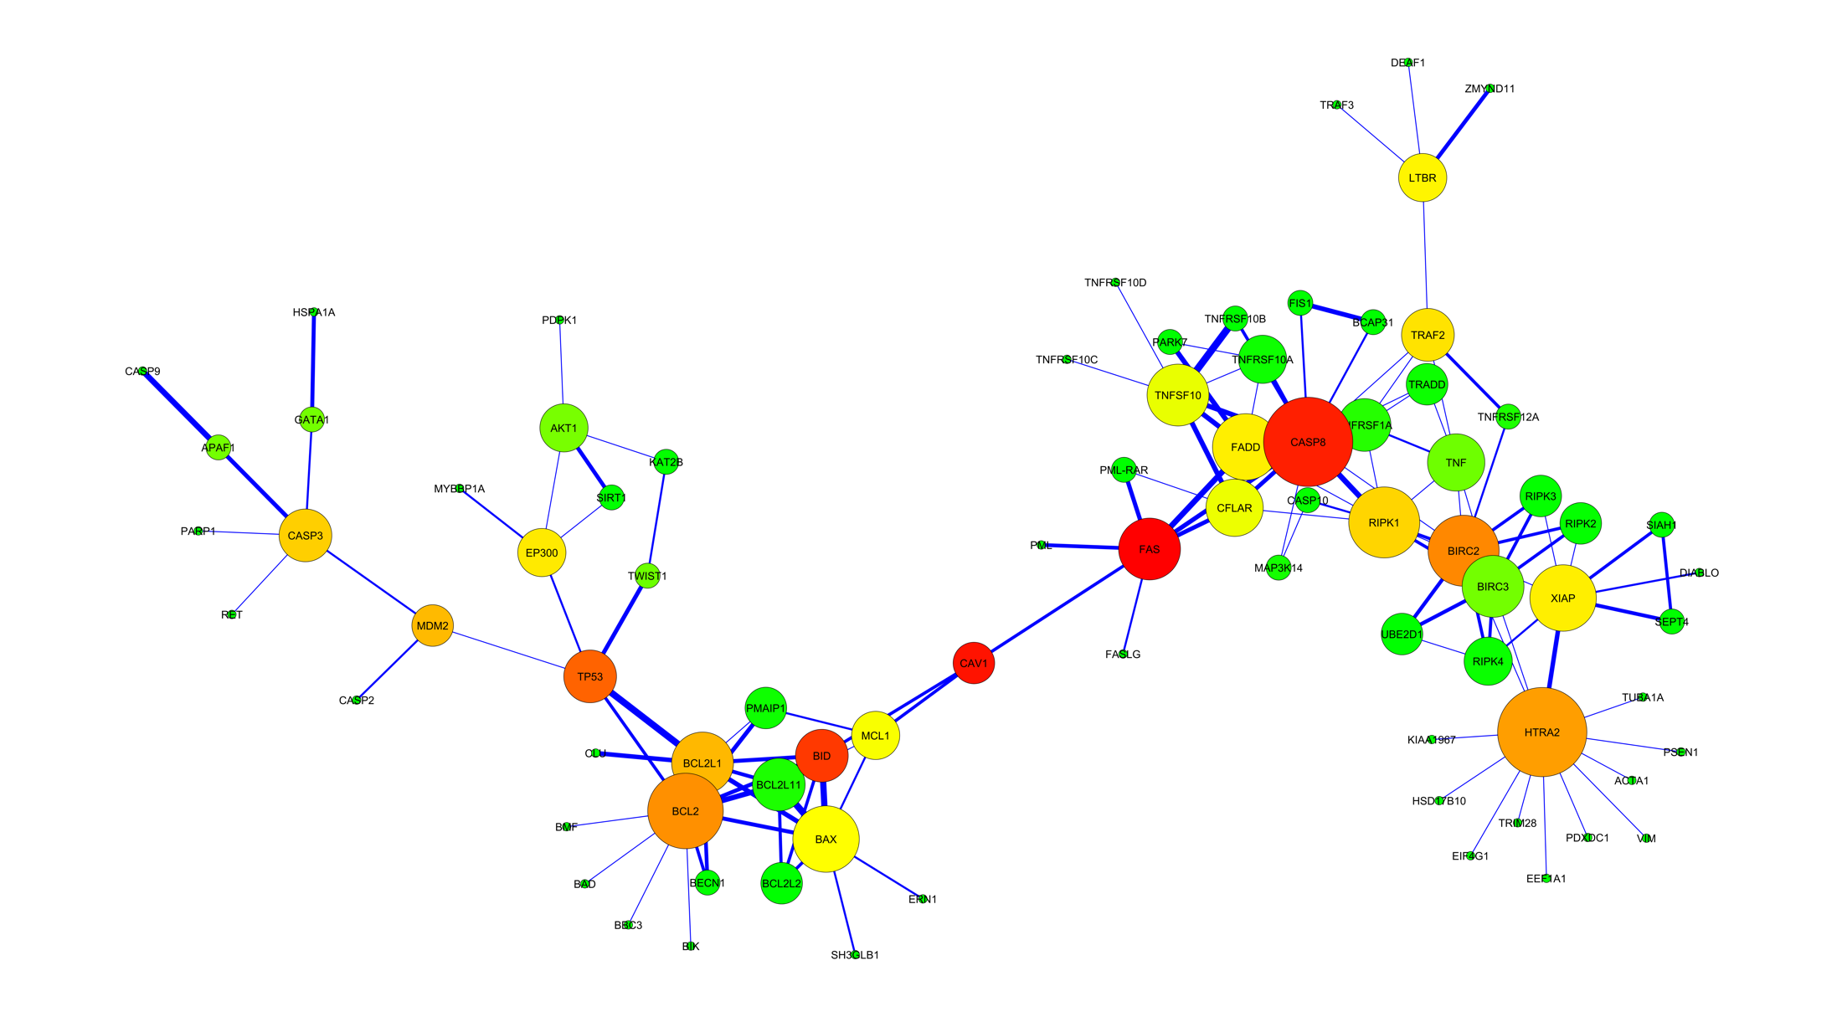
Properties of PPI networks: centralities
Betweenness centrality:
One type of measure of a node's centrality in a network.
Number of shortest paths from every end of the network that pass through that node.
Gives a good estimation of the importance of a node (protein) in a network (signalling, scaffolding…).

Slide 42
shortest path
optimized/shortes path to link an input node to an output node
Shortest path A-F:
  A-F
Shortest path A-E
  A-B-D-E
A
B
C
D
E
F

Slide 43
shortest path
optimized/shortes path to link an input node to an output node
the shortes path depends on the type of graph!!
Grafo non orientato
Grafo orientato
Grafo pesato
A
A
A
3
B
B
B
5
6
C
D
C
D
C
D
3
4
E
F
E
F
E
F

Slide 44
A cell is a little bit like google maps
The cell always try to save energy
The shortest path is the less expensive/timely way to trigger a phenotype
Example: google maps:
searches for the fastest route (Saves time and petrol)
Not always the shortest in terms of lenght (it weghts edges based on speed limits and traffic intensity)
Takes into account one-way streets (is directional)
Grafo pesato
A
3
B
5
6
C
D
3
4
E
F

Slide 45
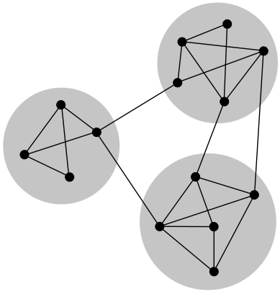
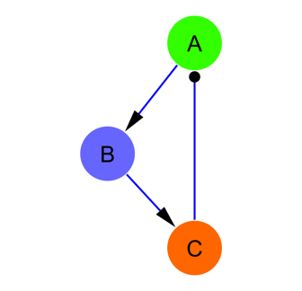
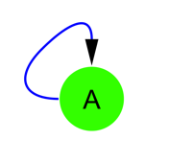
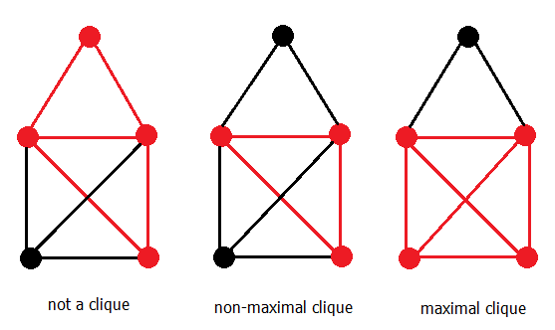
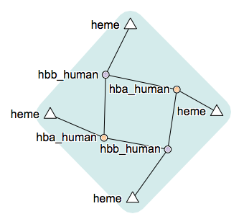
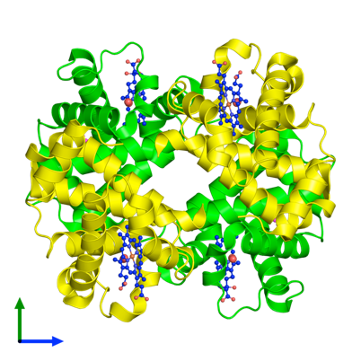
Properties of PPI networks: communities
Motifs
Network
communities
Cliques
Protein
complexes
Network communities figure by j_ham3 - Own work, CC BY-SA 3.0, https://commons.wikimedia.org/w/index.php?curid=17125894
Hemoglobin 3D structure from http://www.ebi.ac.uk/pdbe/entry/pdb/2dn1 and complex diagram from http://wwwdev.ebi.ac.uk/intact/complex/details/EBI-9008420
Notes:
As we have stated before, looking for communities in a network is a nice strategy used to reduce its complexity and extract functional modules reflecting the biology behind it. There are several terms that we will use:
[fig17]
Community / Cluster: A general, catch-all term, it can be defined as a group of nodes that is more connected within themselves than they are with the rest of the network. The precise definition for a community will depend on the method or algorithm used to define it. When talking about PPINs, communities can be classified in two categories: functional modules and protein complexes.
Module: Exchangeable functional unit where the nodes (proteins) involved do not have to be interacting at the same time or space. Its most important characteristic is that when placed in a different context, its intrinsic functional properties do not change.
Complex: Group of proteins that interact together at the same time and in the same space, forming a relatively stable multi-protein machinery.
There are also a couple of terms that you might encounter and that are also useful to understand how clusters are found in a network:
Clique: Subset of nodes where every node is connected with every other member of the clique. A maximal clique is a clique that cannot be extended by adding an additional node not previously included in the clique.
Motif: Statistically over-represented sub-graph in a network. It corresponds to a pattern of connections that generates a characteristic dynamical response (e.g. a negative feedback loop).
When exploring a PPIN for clusters we are often just looking for functional modules or maybe protein complexes that execute defined biological functions. There are many different methods that can help us find clusters, we will briefly introduce a couple of them.

Slide 46
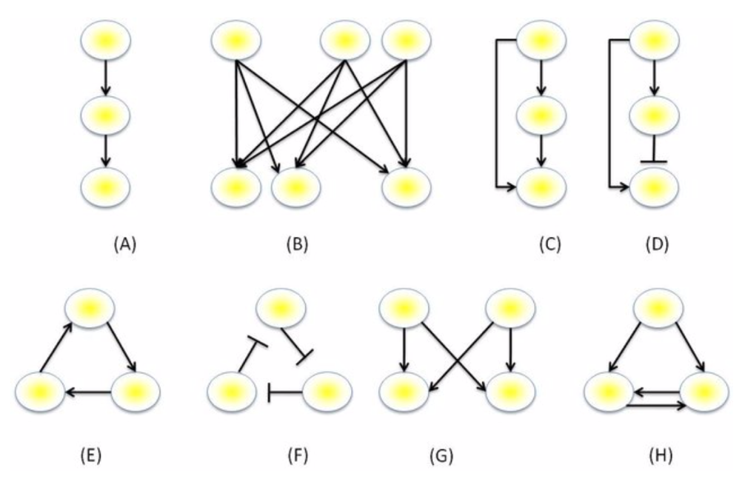
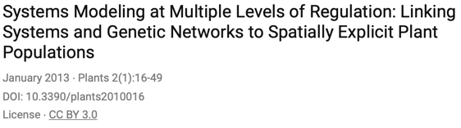
network motifs
Motivo a singolo input
Motivo a multipli input
Feed-forward loop coerente: il motivo consiste in un percorso diretto ed uno indiretto per attivare un nodo a valle.
Feed-forward loop incoerente: il segno dei percorsi diretto ed indiretto sono diversi.
Feed-back loop positivo a ciclo di 3 nodi,
Feed-back loop negativo a ciclo di 3 nodi,
Motivo bi-fan.
Feed-back loop doppio positivo.
evolution selected the feedback loops, as a key homeostasis regulator

Slide 47
Feedback loop
positive feedback loop
negative feedback loop
A
A
B
B
C
C

Slide 49
network analysis, why?
GET INFORMATION THAT I COULDN'T HAVE BY ANALYZING THE INDIVIDUAL COMPONENTS:
identify 'important' proteins, called HUBs (i.e. that have a high number of connections)
identify communities of proteins, related to each other (for example proteins that belong to the same pathway)
formulate hypotheses about the function of a protein
find proteins 'guilty' of causing disease
I can do in silico simulations of the behavior of a cell

Slide 50
network analysis, the workflow
Key steps in network analysis
STEP 1: define a biological question!!
STEP 2: retrive a network of interest
STEP 3: Topological analysis of the network
STEP 4: Functional analysis of the network
STEP 5: we use the analysis results to set up a new experiment in the lab

Slide 51
STEP 1: define a biological question!!

Slide 52


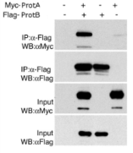
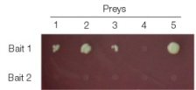

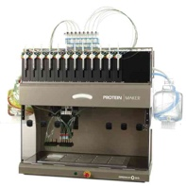


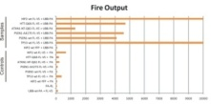
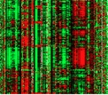



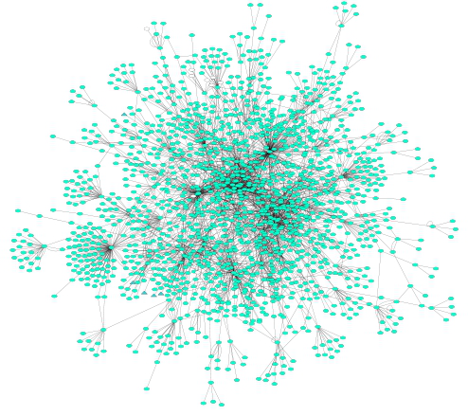
STEP 2: retrive a network of interest
primary databases
experimental data
meta-databases and predictive databases
Challenges:
Identifiers
Redundancies
Selection of the data
  Type
  Quality
Mapping external information

Slide 53
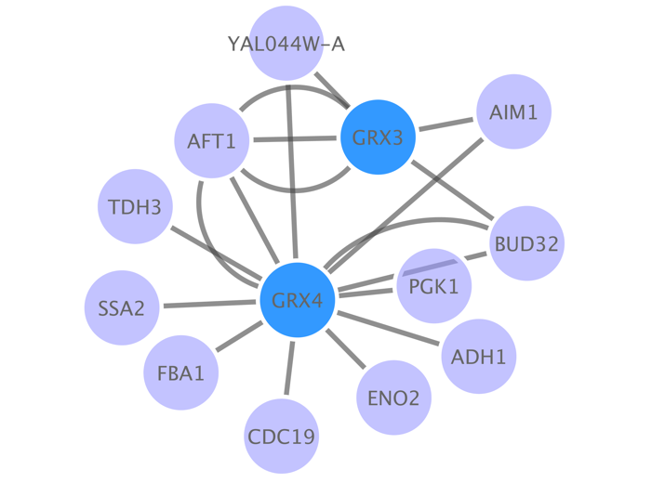
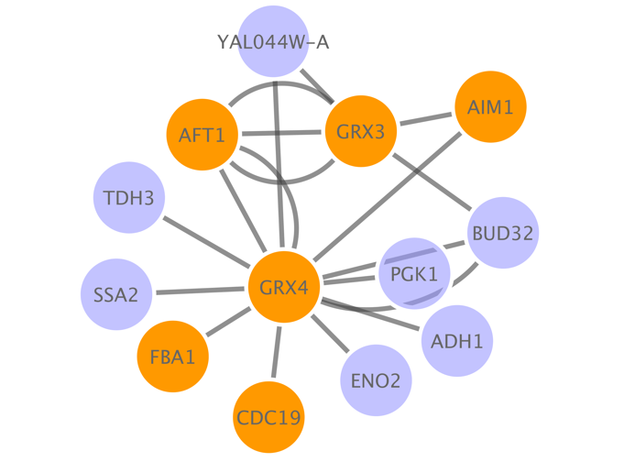
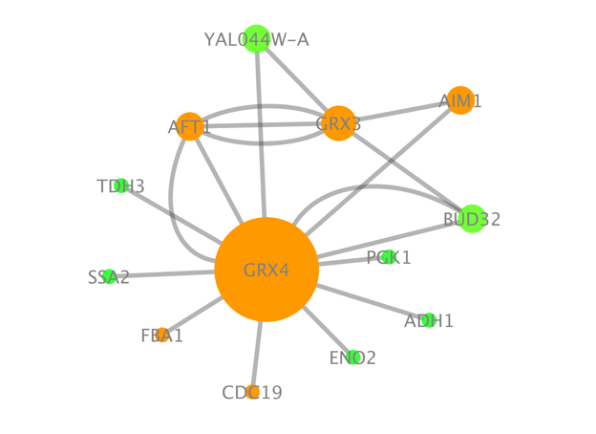
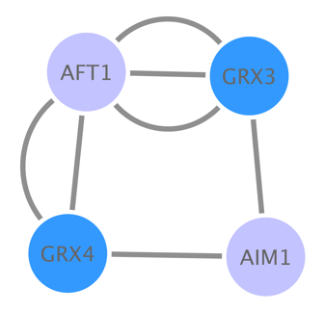
STEP 3-4: Topological and Functional analysis of the network
Base PPI network
Annotation enrichment
Others:
Shortest paths
Motif search (directed networks)
Integrate external information
…
Centrality analysis
Topological clustering
Notes:
There are many different strategies used to extract information from a network and these are strongly dependent on the problem at hand and the nature of the data represented, so it would be useless to give a fully comprehensive list. However, there is a number of commonly used tools that are commonly used to analyze PPINs, highlighted in figure 13.
[fig12]
Annotation enrichment analysis: Also known as gene set enrichment analysis (GSEA) uses gene/protein annotations provided by resources such as the Gene Ontology (GO, www.geneontology.org) or Reactome (www.reactome.org) to infer which annotations are over-represented in a list of genes. This can be used in the context of a network or just with a simple list, so it is not strictly speaking a network analysis strategy, but it is often used to analyze either full PPINs or parts of them.
Centrality analysis: As we introduced before, the centrality of a node/edge gives an estimation on how important it is for the connectivity or the information flow of the network. It is a relevant parameter specially in signalling networks and it is often used when trying to find targets for drug treatment.
Topological clustering: Finding interconnected communities inside the network can help us identify functional modules within it.
Other methods: We will not devote much room to explore these strategies, but they are worth mentioning nevertheless.
Shortest paths: Finding the shortest paths between given nodes in a network is a way to highlight the most important routes in the flow of information in the network.
Motif search: Motifs are recurred, statistically significant patterns within a network. They are specially relevant in directed networks, where they can represent small functional entities, such as a positive feedback loop, for example.
Integrate external information: A fundamental part of any network analysis is the need to overlay information external to the network, such as expression data, variant annotation, quantitative proteomics data, etc… Integrating this information allows to identify sub-regions in the network with a given expression pattern, for example.

Slide 54
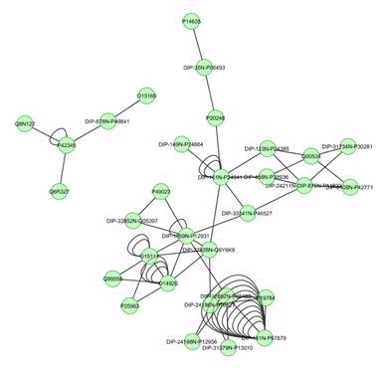
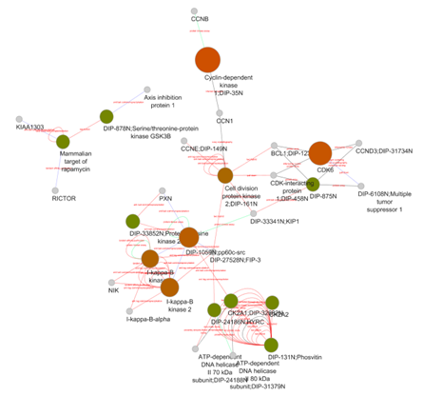
PPI Network analysis: building a network (II) filtering and enriching your data
Confidence filtering
Detection method
Number of publications
Confidence score
...
Overlaying external information
Expression data
Protein abundance
Enzymatic assay values
...

Slide 55
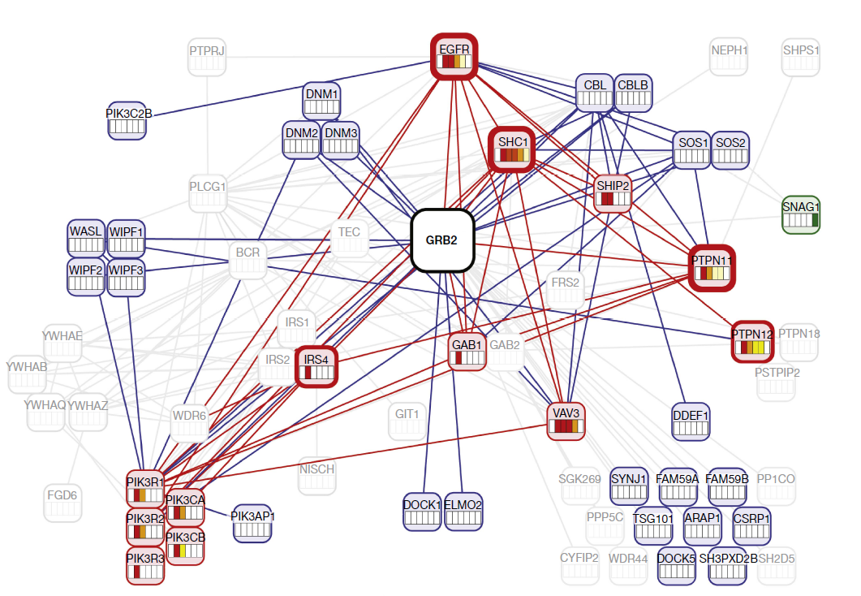
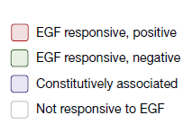
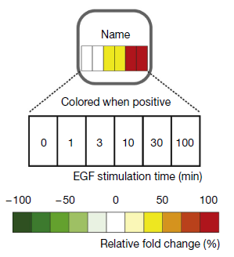
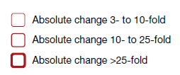
PPI Network representation challenges
Blisson et al., 2011, Nature Biotechnology, PMID: 21706016.

Slide 56
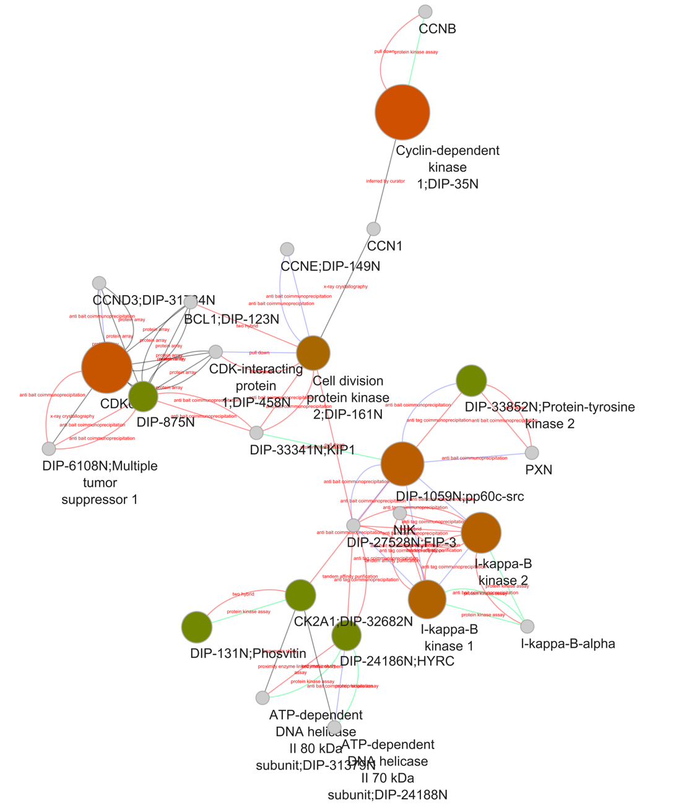


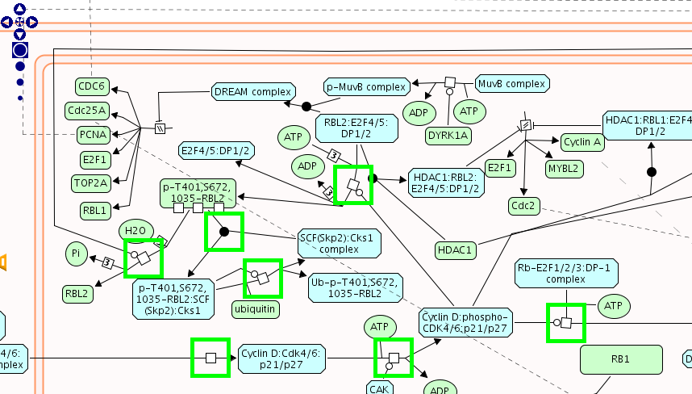
Annotation enrichment analysis
GO:0019908:
nuclear cyclin-dependent protein kinase holoenzyme complex
REACT_821.2:
Cyclin D associated events in G1
Notes:
As we introduced before, annotation enrichment analysis uses gene/protein annotations provided by knowledge-bases such as GO or Reactome to infer which annotations are over-represented in a network. Essentially, the tools available perform some type of statistical test (usually a hypergeometric test, often also a binomial test) that tries to answer the following question: 'When sampling X proteins (test set) out of N proteins (reference set; graph or annotation), what is the probability that x or more of these proteins belong to a functional category C shared by n of the N proteins in the reference set.¹’. The result of this test provides us with a list of terms that describe the list/network or rather a part of it as a whole.
[fig 13]
This type of analysis is most frequently performed using GO annotation as a reference, but tools such as the Cytoscape apps ClueGO and ClueGO can also manage other annotation databases such as Reactome and KEGG [REFS AND LINKS]. This is a widely used technique that helps characterizing the network as a whole or sub-sets of it, such as inter-connected communities found through topological clustering analysis.
The main limitations of this approach come from the annotations themselves. Focusing on GO as an example, certain areas of the ontology are more thoroughly annotated and better described than others, with more detail and more accurate terms for well-known processes. This of course has an impact when performing the statistics and introduces a certain bias.
At the level of the proteins annotated there is also a bias, with more "popular" proteins being better annotated. It is also important to know that GO terms are assigned either by a human curator that performs manual, careful annotation or by computational approaches that use the basis of manual annotation to infer which terms would properly describe uncharted gene products. They use a number of different criteria always referred to annotated gene products, such as sequence or structural similarity or phylogenetic closeness. The importance of the computationally derived annotations is quite significant, since they account for roughly 99% of the annotations that can be found in GO.
Finally, the last limitation fo this approach is that often, if you analyze a relatively large network, the results of the analysis are quite complex, since resources such as Reactome and especially GO can be very complex and detailed in their annotation. For that reason, many tools offer the option to use simplified versions of the ontologies where a fine detailed terms are removed and assigned to borader, more general parent terms. In GO in particular, these simplified ontologies are called GOslims.
In summary, it is important to know the annotation resource you are using to perform this type of analysis, as well as to be aware of the limitations of the statistical tool used to perform the test. [NEED TO ADD MORE ON THAT].
http://www.ebi.ac.uk/training/online/course/uniprot-goa-quick-tour
http://www.ebi.ac.uk/training/online/course/go-quick-tour
http://www.ebi.ac.uk/training/online/course/reactome-exploring-and-analysing-biological-pathwa-1
1.- Taken from the website of ClueGO, a Cytoscape app for GO enrichment analysis (http://www.psb.ugent.be/cbd/papers/ClueGO/User_Guide.html).

Slide 57
Summary
PART 1:
Intro to Systems Biology and Network representation
Graph theory concepts
Network analysis: a brief overview

Slide 58
what’s next…
PART 2:
Intro to Cytoscape
Molecular Interaction Databases
Protein-protein interaction (PPI) resources: IMEx/IntAct DB
Signaling Interaction Resources: SIGNOR

