Slide 1
Intro to systems biology

Slide 2
Systems Biology, reductionist vs holistic approaches

Slide 3
Systems Biology, reductionist vs holistic approaches
cosa intendiamo per Sistema biologico?

Slide 4
Systems Biology, reductionist vs holistic approaches
cosa intendiamo livello di Sistema?

Slide 5
Systems Biology, reductionist vs holistic approaches
cosa rende la biologia dei sistemi possible?

Slide 6
The Systems Biology workflow

Slide 7
Multi-experiment, example 1: testing multiple drug effects
sample 1
CTRL
sample 2
24h treatment
DRUG1
sample 3
24h treatment
DRUG2
…
RNAseq
Gene | Sample 1 | Sample 2 | Sample 3 | …
Gene 1
Gene 2
Gene 3
…

Slide 8
Multi-experiment, example 2: testing multiple time-points/ concentrations of the same drug
Multi-experiment
sample 1
CTRL
sample 2
24h treatment
DRUG1
sample 3
48h treatment
DRUG3
…
RNAseq
Gene | Sample 1 | Sample 2 | Sample 3 | …
Gene 1
Gene 2
Gene 3
…

Slide 9
Multi-experiment, example 3: comparing disease samples to healthy samples
Multi-experiment
sample 1
healthy
CTRL
sample 2
patient 1
sample 3
patient 2
…
RNAseq
Gene | Sample 1 | Sample 2 | Sample 3 | …
Gene 1
Gene 2
Gene 3
…

Slide 10
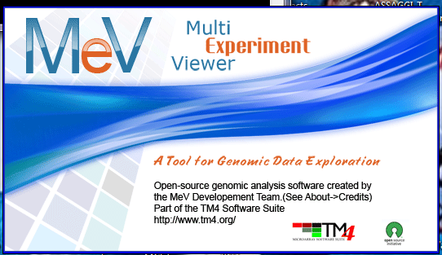
Multi-experiment, example 3: comparing disease samples to healthy samples
Multi-experiment
sample 1
healthy
CTRL
sample 2
patient 1
sample 3
patient 2
…
ANALYSIS:
statistical tests (find significant differences)
clustering
find biomarkers
RNAseq
Gene | Sample 1 | Sample 2 | Sample 3 | …
Gene 1
Gene 2
Gene 3
…
find BIOLOGICALLY- MEANINGFUL INFORMATION

Slide 11
Global picture of disease mechanisms
Omic level:
Genome
Transcriptome
Proteome
Metabolome
Technique :
NGS
RNAseq
MassSpec
MassSpec
Notes:
Advances in omic techniques are providing an unprecedented capacity to measure RNA (coding and non-coding), protein, and post-translational modification levels under different biological contexts such as time, cell states, tissues, or organisms [5, 6, 7, 8]. Systematic integration of such datasets is essential to identify molecular networks controlling normal and disease states, and, ultimately, predict complex phenotypes from molecular markers

Slide 12
What do we do with all these tables???
HTP Experiments
Results

Slide 13
Extract biologically meaningful information from large lists of genes

Slide 14
Global picture of disease mechanisms
Omic level:
Genome
Transcriptome
Proteome
Metabolome
Technique :
NGS
RNAseq
MassSpec
MassSpec
Notes:
Advances in omic techniques are providing an unprecedented capacity to measure RNA (coding and non-coding), protein, and post-translational modification levels under different biological contexts such as time, cell states, tissues, or organisms [5, 6, 7, 8]. Systematic integration of such datasets is essential to identify molecular networks controlling normal and disease states, and, ultimately, predict complex phenotypes from molecular markers

Slide 15
Global picture of disease mechanisms… at the molecular-resolution level
Notes:
put order in caos and help understanding how differentially modulated molecules are related in a given condition i.e. in a disease or upon drug tretment

Slide 16
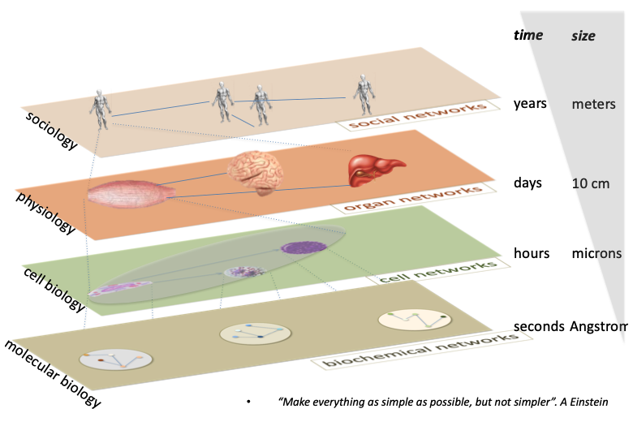
Modelling at different levels

Slide 17
Bioinformatics
The science of storing, retrieving and analyzing large amounts of biological information
An interdisciplinary science, involving biologists, computer scientists and mathematicians
At the heart of modern biology
Notes:
Probably won’t need this slide - it’s aimed at the true nonspecialist!

Slide 18
“Large-scale” focus
Data explosion and new types of data
High-throughput biology
Emphasis on systems, not reductionism
Large community of users with no training in bioinformatics
Growth of applied biology – molecular medicine, agriculture, food, environmental sciences…
Notes:
Explains why scientists need bioinformatics

Slide 19
Database Biologici

Slide 20
Cos’è la curazione dei dati?
- come funziona la ricerca scientifica-
Osservazione -> conoscere lo stato dell’arte
ipotesi
Esperimenti
Conclusioni e nuove leggi
Occorre condividere le scoperte con la comunità scientifica, attraverso:
conferenze
pubblicazioni

Slide 21
In PubMed ci sono più di 33 Milioni di Articoli!!!

Slide 22
Per fortuna ci sono i curatori…

Slide 23
Curazione e mantenimento di Database
Che cos’ è una banca dati?
È un archivio in formato elettronico
tutte le informazioni sono inserite in una struttura organizzata allo scopo di facilitarne il recupero
le informazioni contenute sono di tipo omogeneo

Slide 24


Slide 25
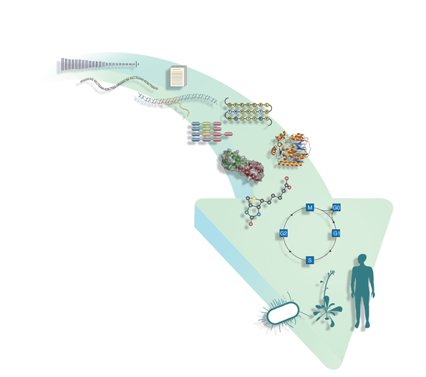
I dati
Literature and ontologies
Genomes
Protein sequence
DNA & RNA sequence
Protein structure
Gene expression
Chemical entities
Protein families,
motifs and domains
Protein interactions
Pathways
Systems
Notes:
The EBI is probably unique in the world for its range of data resources and tools, spanning everything from DNA and protein sequence to complex pathways and networks. At the EBI, we separate resource development and provision, which we call services, and research although these two are closely related. Both the research areas and services follow the different areas of focus as shown on the slide.
Some of the types of data that are now being collected in a high-throughput way, presenting new challenges for how we organise and store this data.

Slide 26
Grandi infrastrutture di database biologici

Slide 27
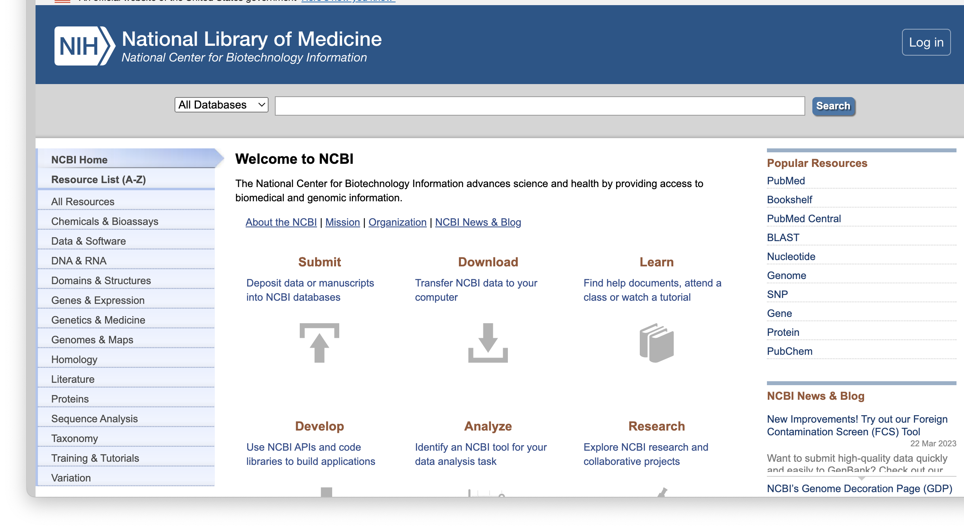
NCBI
Databases
Strumenti di analisi

Slide 28
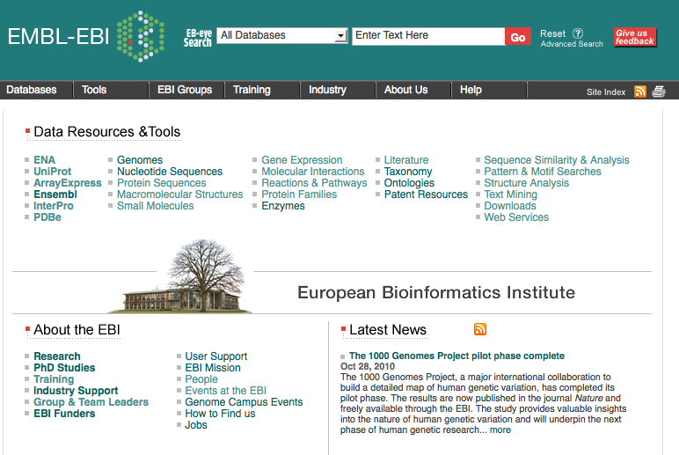
EBI
Databases
Strumenti di analisi
website: www.ebi.ac.uk

Slide 29
Database dell’EBI
www.ebi.ac.uk

Slide 30
New types of data
Literature and ontologies
Genomes
Protein sequence
DNA & RNA sequence
Protein structure
Gene expression
Chemical entities
Protein families,
motifs and domains
Protein interactions
Pathways
Systems
Notes:
The EBI is probably unique in the world for its range of data resources and tools, spanning everything from DNA and protein sequence to complex pathways and networks. At the EBI, we separate resource development and provision, which we call services, and research although these two are closely related. Both the research areas and services follow the different areas of focus as shown on the slide.
Some of the types of data that are now being collected in a high-throughput way, presenting new challenges for how we organise and store this data.

Slide 31
Databases: molecules to systems
Literature and ontologies
CiteXplore, GO
Genomes
Ensembl
Ensembl Genomes EGA
Protein families,
motifs and domains
InterPro
Nucleotide sequence
EMBL-Bank
Microarray & gene expression data
ArrayExpress
Protein structure
PDBe
Protein interactions
IntAct
Pathways
Reactome
Proteomes
UniProt, PRIDE
Chemical entities
ChEBI
Systems
BioModels
31
Notes:
31
The slide shows the core resources at the EBI mapped on to the same arrow to show the range of data you can access through the EBI. The EBI is the European centre for the collection and dissemination of biological data; we do this in collaboration with other global centres such as NCBI, the Institute of Genetics in Japan, the Swiss Institute of Bioinformatics and Cold Spring Harbor.

Slide 32
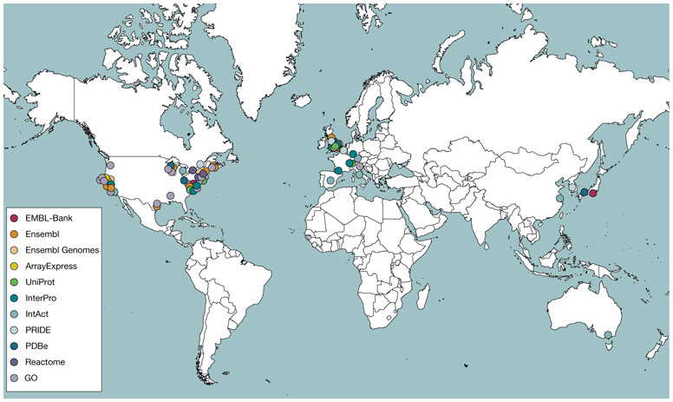
Database collaborations
32
Notes:
32
Many of the EBI’s data resources are members of international consortia, Some, such as the International Nucleotide Sequence Collaboration, exchange data on a regular basis; others, such as the UniProt Consortium and the GO Cosnortium, work together to produce a single resource.

Slide 33
Standards development – international collaborations
Genomics Standards Consortium (GSC)
http://gensc.org
Genome annotation
www.geneontology.org
Nucleotide sequence
www.insdc.org
Protein sequence
www.uniprot.org
HUPO- Proteomics
Standards Initiative (PSI)
www.psidev.info
Protein structure
www.wwpdb.org
Microarray and Gene Expression Data (MGED)
www.mged.org
Cheminformatics
www.ebi.ac.uk/chebi
Pathways
www.reactome.org
www.biopax.org
Systems modeling standards
www.sbml.org
Metabolomics Standards Initiative (MSI)
www.metabolomicssociety.org
33

Slide 34
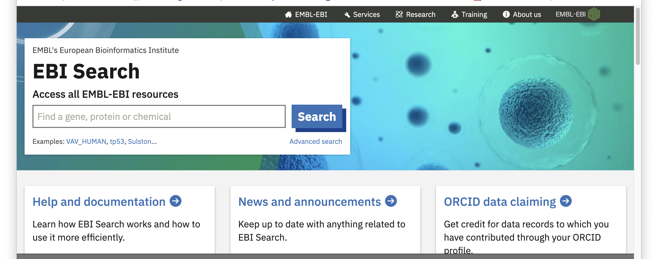
EB-eye
Ricerca tutti i database EBI in una volta
https://www.ebi.ac.uk/ebisearch/about
Notes:
New website and search engine launching on 11 December; integrated searching of our core data resources.

Slide 35
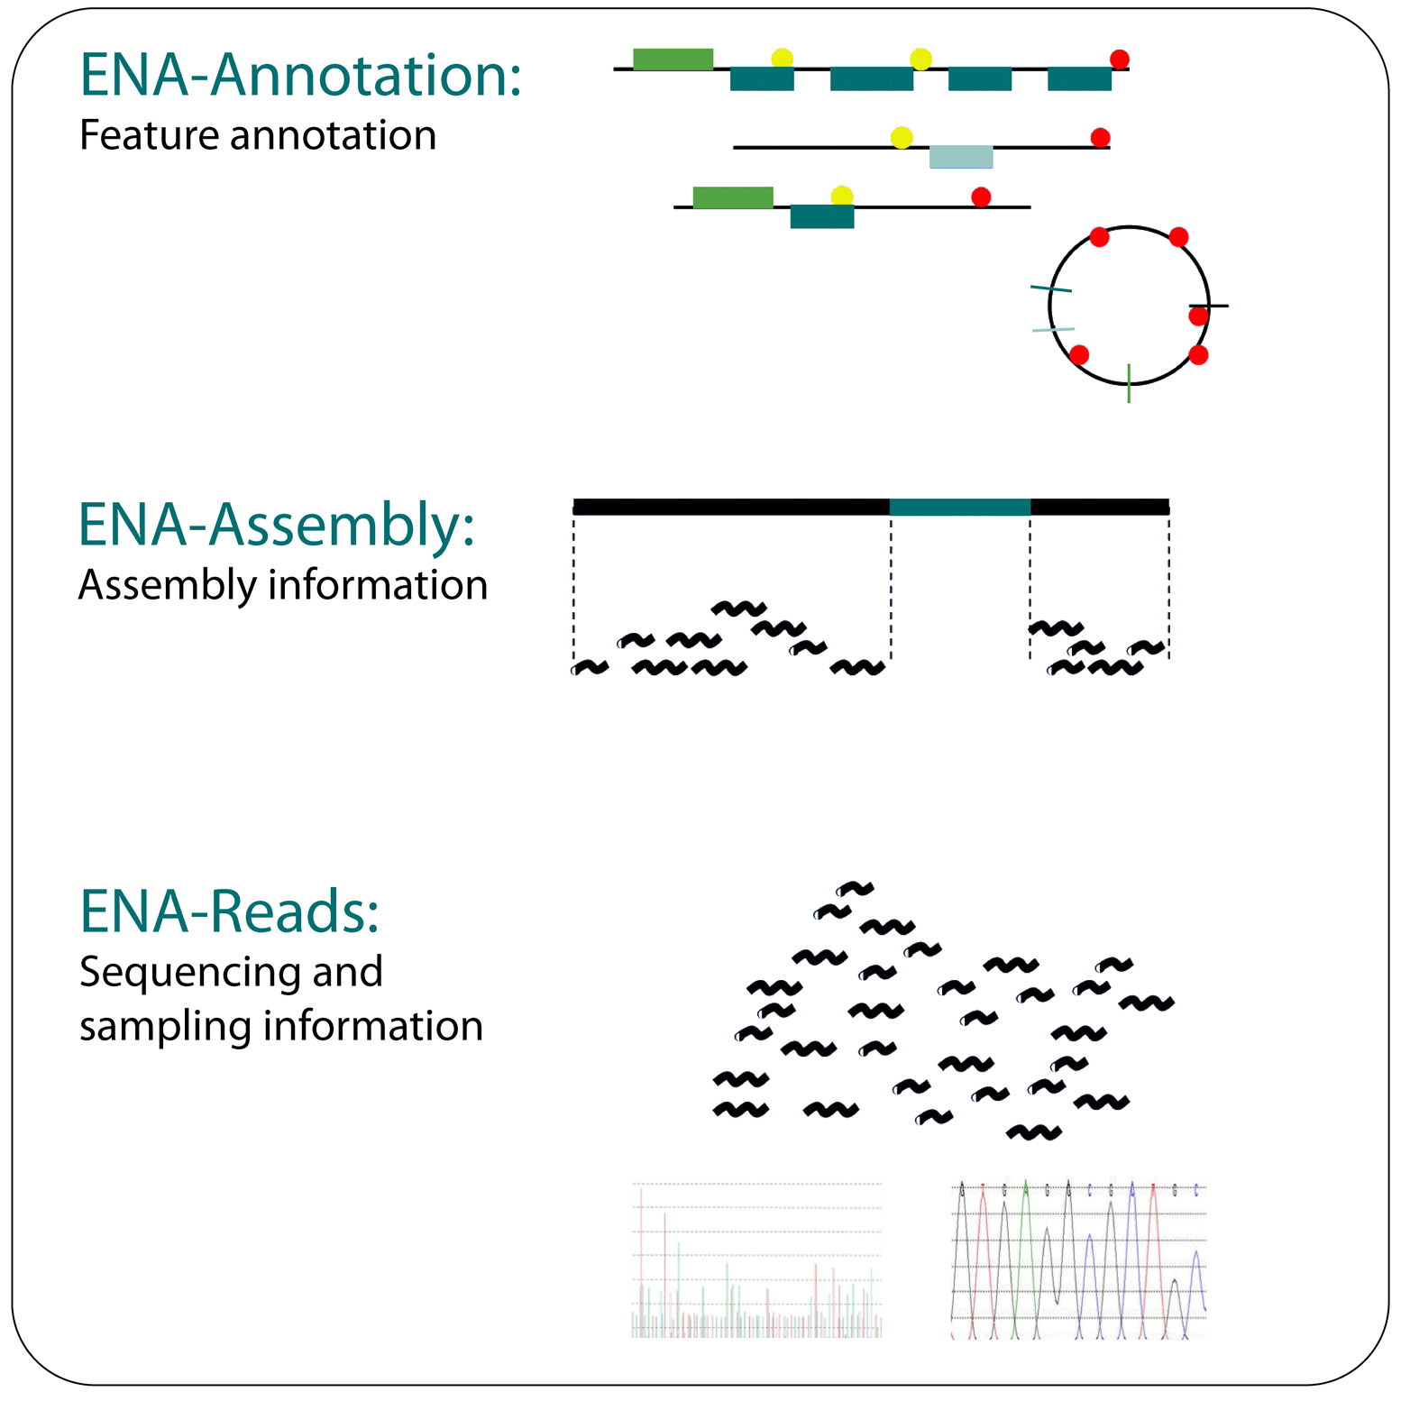
Nucleotides: European Nucleotide Archive (ENA)
ENA provides a comprehensive, accessible and publicly available repository for nucleotide sequence data
Collaboration with GenBank and DDBJ for data sharing
It consolidates information from EMBL-Bank, the European Trace Archive (containing raw data from electrophoresis-based sequencing machines) and the Sequence Read Archive (containing raw data from next-generation sequencing platforms)
Provides access to the whole scale of sequencing information: from raw data, through assembly and mapping information, through to high-level functional annotation (see figure).
Notes:
EMBL-Bank is Europe's primary nucleotide sequence resource. The database is produced in an international collaboration (the International Sequence Database Collaboration, INSDC) with GenBank (USA) and the DNA Database of Japan (DDBJ). Main sources of DNA and RNA sequences are direct submissions from individual researchers, genome sequencing projects and patent applications. Users can search the data using either keyword-based searches or using sequence homology tools such as BLAST and FASTA to compare their own sequence with the contents of EMBL-Bank. There’s also a map-based search (EMBLWorld) for exploring sequences derived from environmental genome sequencing projects. The data belong to the submitter and can only be updated by the submitter, but other researchers can submit ‘third party annotations’ to EMBL-Bank if they’re associated with a peer-reviewed publication.

Slide 36
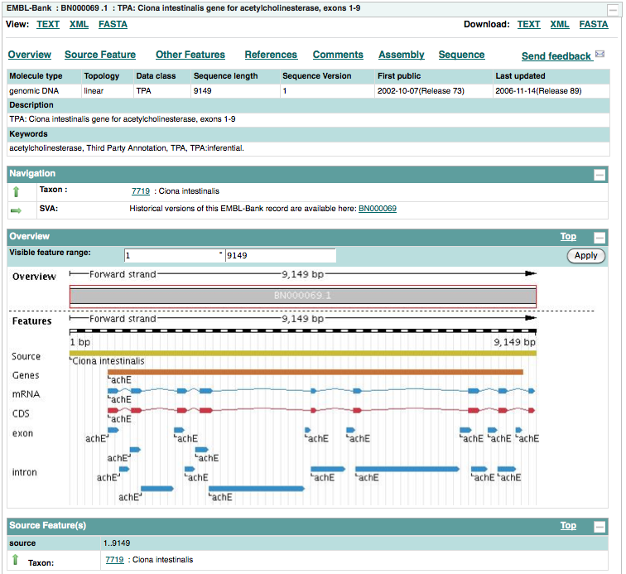
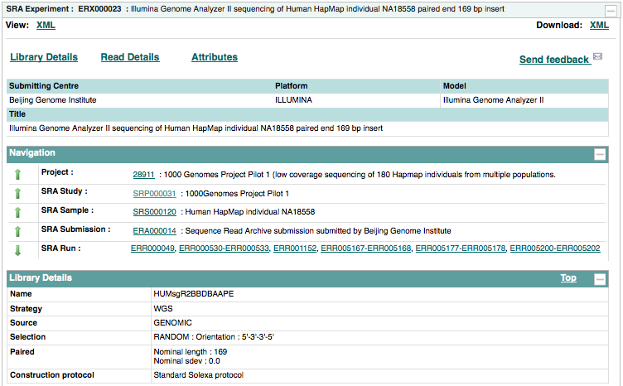
Nucleotides: ENA
Download data
Navigate to view related data, e.g. taxon-specific data
Other type of data include SRA experiments

Slide 37
Genomes: Ensembl & Ensembl Genomes
Genome browser providing free access to the complete sequences of higher and model organism
With Ensembl you can:
  Retrieve all or part of a genome sequence
  Perform sequence alignment using BLAST or BLAT
  Link to genome annotation from microarray results
  View expressed mRNA, protein, etc. in a chromosomal region
  View variations such as SNPs across strains or populations
  View all alternative splicing for a gene
  Explore homologues and phylogenetic tree across > 30 species
  View conserved regions across species
Ensembl Genomes extends to non-vertebrate genomes

Slide 38
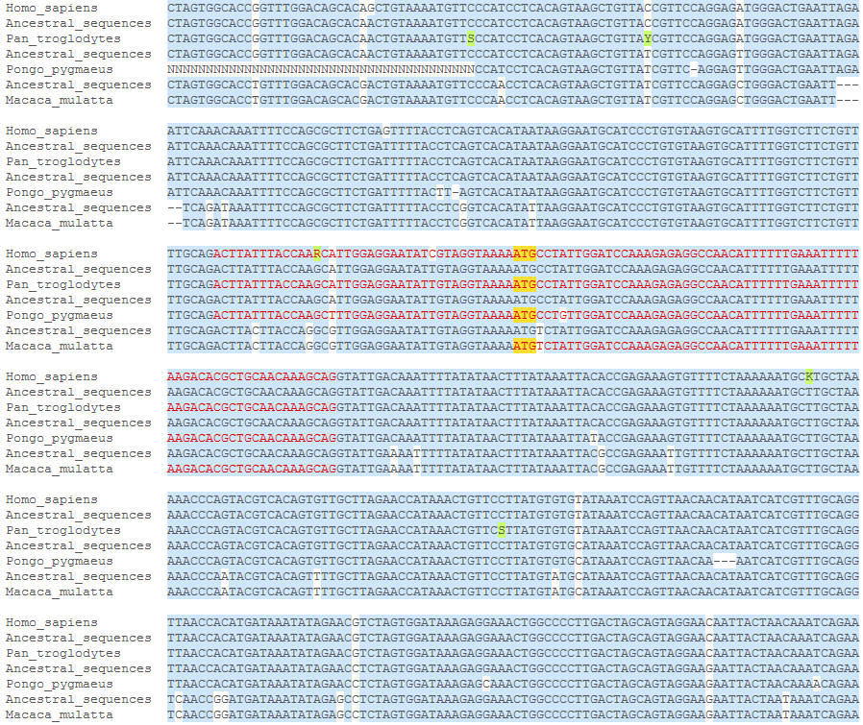
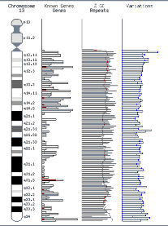
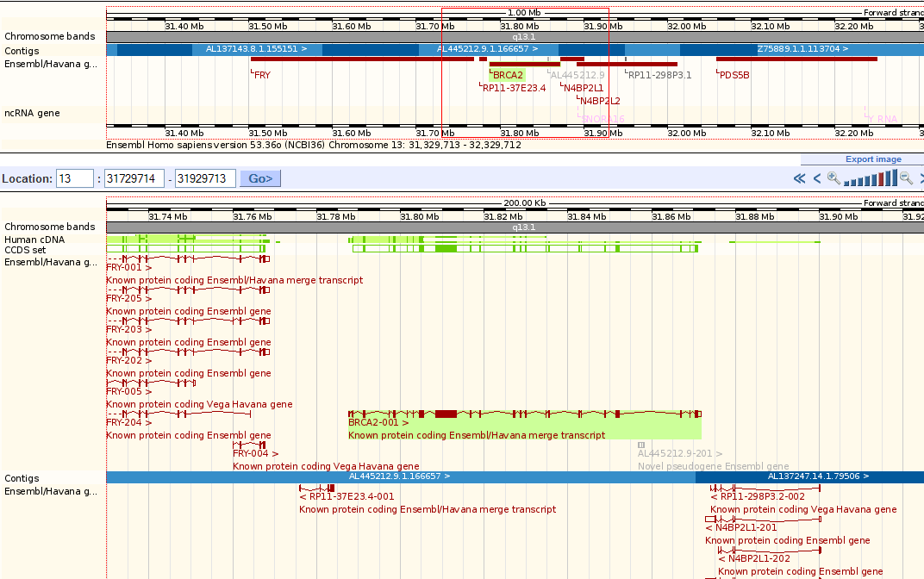
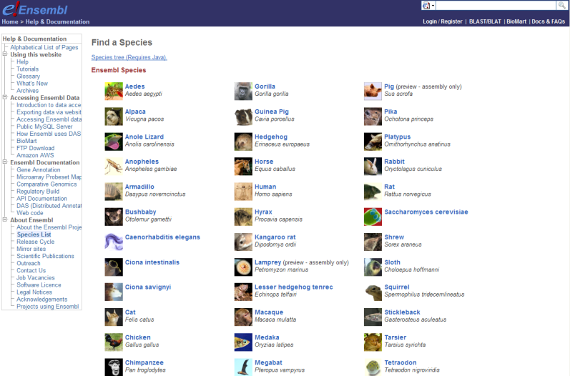
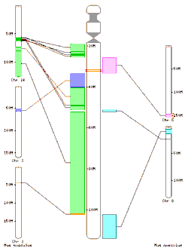
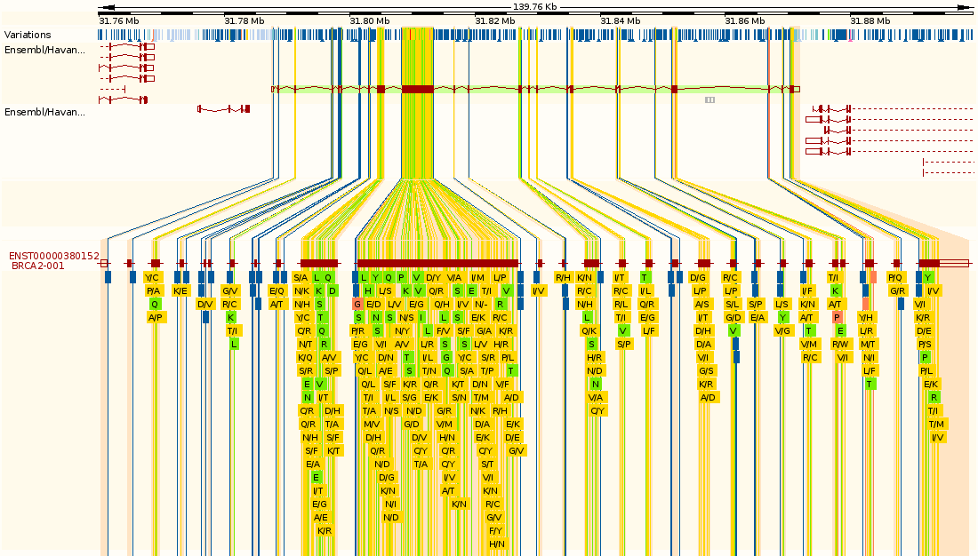
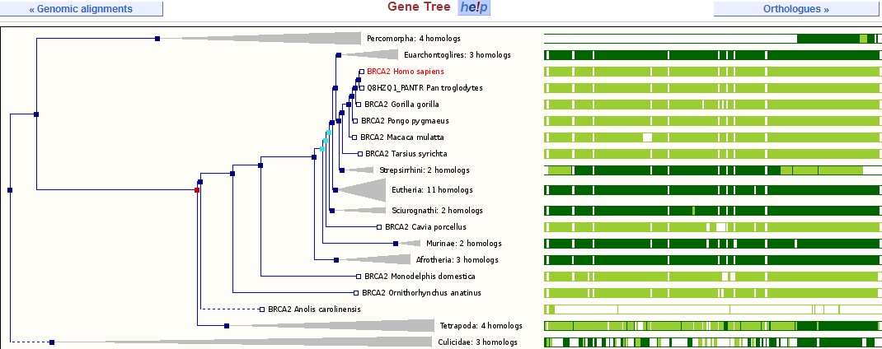
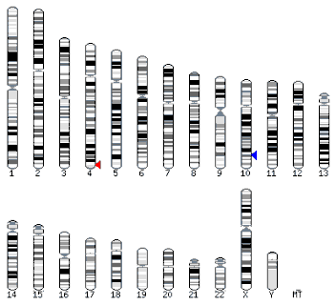
Genomes: Ensembl
Genomic alignments
Chromosomes
Genes
Pick a genome
Synteny
Gene families
SNPs
Across species
Orthology
Within species
Notes:
Ensembl provides a framework for working with the genomes of higher animals (metazoans). It presents, via an interactive website, the human genome together with other genomes that are important for addressing questions in medical research and molecular biology. It uses automated methods for gene prediction and annotation to provide a consistent view of completely sequenced genomes. Users can view the data at many levels, from entire chromosomes down to single nucleotide polymorphisms. As well as accessing a wealth of data for each species, users can also perform cross-species comparisons.

Slide 39
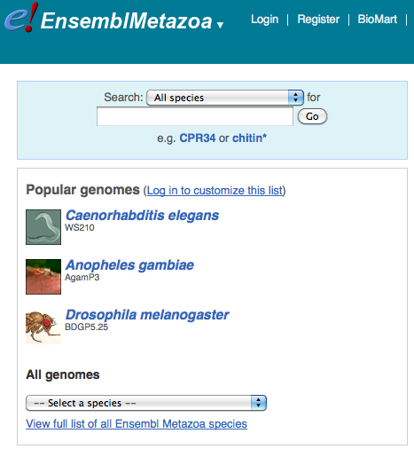
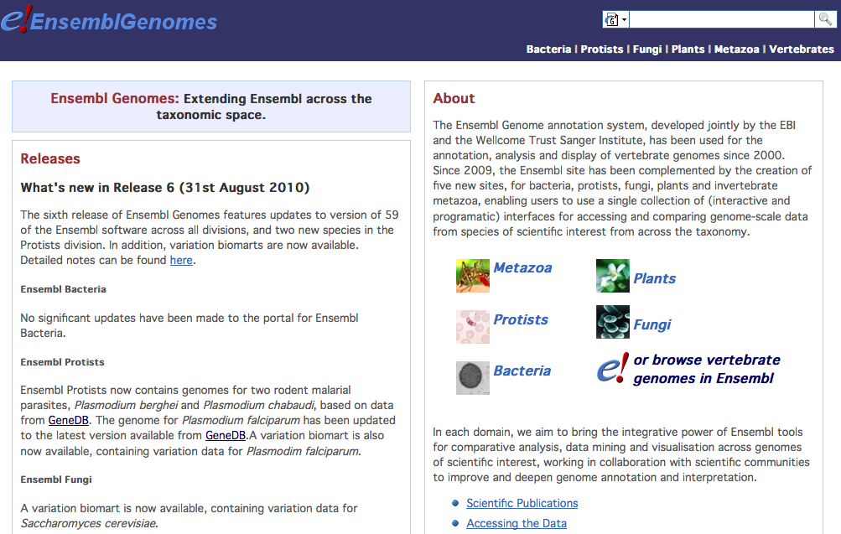
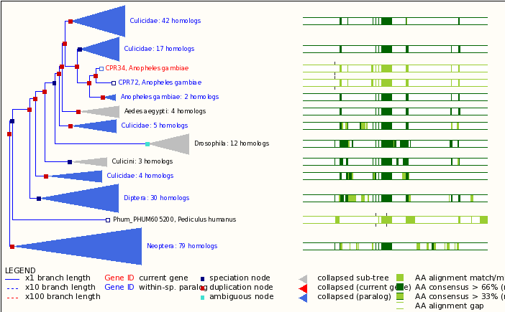
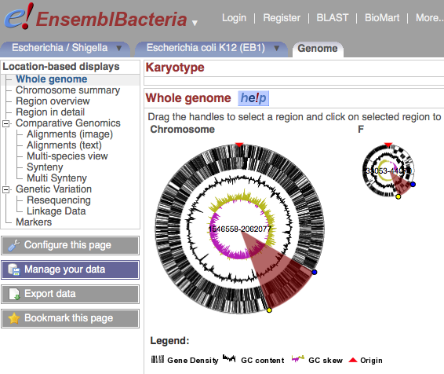
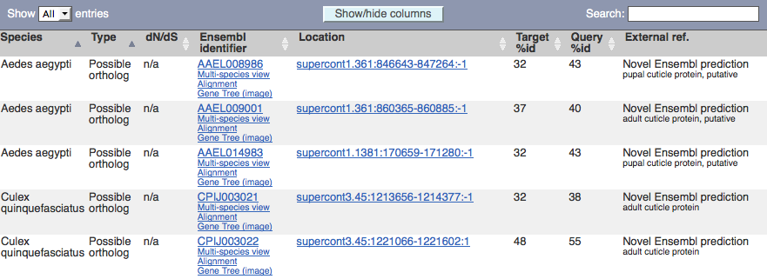
Genomes: Ensembl Genomes
Ensembl-like genome browser for non-vertebrate species
Using view options, you can select to view only the current gene or the entire expanded gene tree
Ensembl
Metazoa
Ensembl Bacteria
Select Orthologue view to see putative orthologues
Across species
View options
Notes:
Ensembl Genomes is the combined repository for non-vertebrate genome data, consisting of five resources: Ensembl Bacteria, Ensembl Fungi, Ensembl Metazoa, Ensembl Plants, and Ensembl Protists, bringing the power of the Ensembl system to all branches of life. Ensembl Genomes re-uses and extends software developed for vertebrate genomes in the context of the Ensembl project, and replaces several pre-existing resources (Integr8, Genome Reviews and ASTD) thereby unifying services and simplifying data access for users.

Slide 40
un po’ di pratica con ENSEMBL
https://www.ensembl.org/index.html

Slide 41
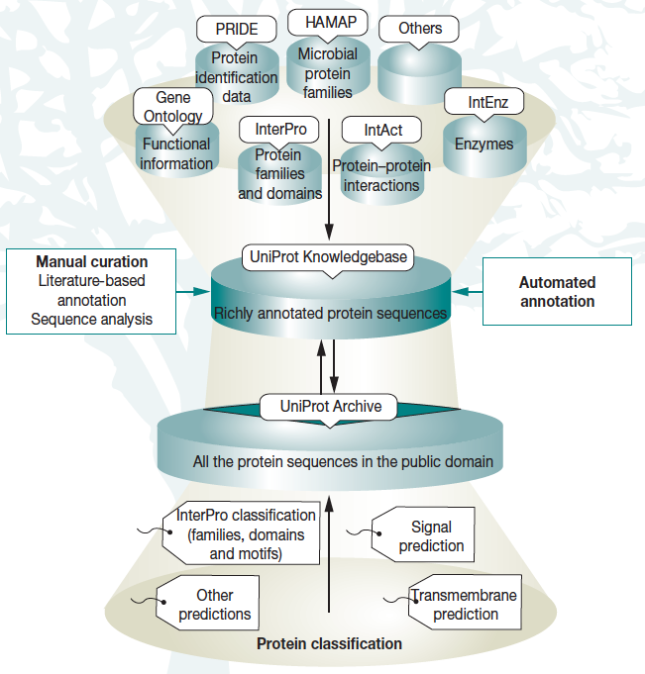
Protein sequence: UniProt
Provides the scientific community with a comprehensive, richly curated, high-quality and freely accessible resource of protein sequence and functional information
Users can perform simple and complex text-based queries, run sequence-based searches, perform multiple sequence alignments, etc.
Consists of:
  UniProtKB/Swiss-prot, manually annotated
  UniProtKB/TrEMBL, computationally analyzed records
  Uniref, clustered by sequence identity
  UniParc, most comprehensive publicly available non-redundant protein sequence db, un-annotated
  UniMES, protein sequence from metagenomic and environmental data
Notes:
UniProt is the gold-standard resource for information on proteins. It comprises three different databases, but I haven’t shown all three here for the sake of simplicity. UniProtKB is the central database of protein sequences with accurate, consistent, and rich sequence and functional annotation. It comprises the manually annotated UniProtKB/Swiss-Prot section and the automatically annotated UniProtKB/TrEMBL section. The UniProt archive is an archive of all the protein sequences in the public domain, and the UniRef databases are a series of three databases that store sequences of 100%, 90% and 50% identity in the same records to speed up searching without losing information. UniProtKB contains more than 29 million cross references to over 100 other data resources; a few key ones are shown here.

Slide 42
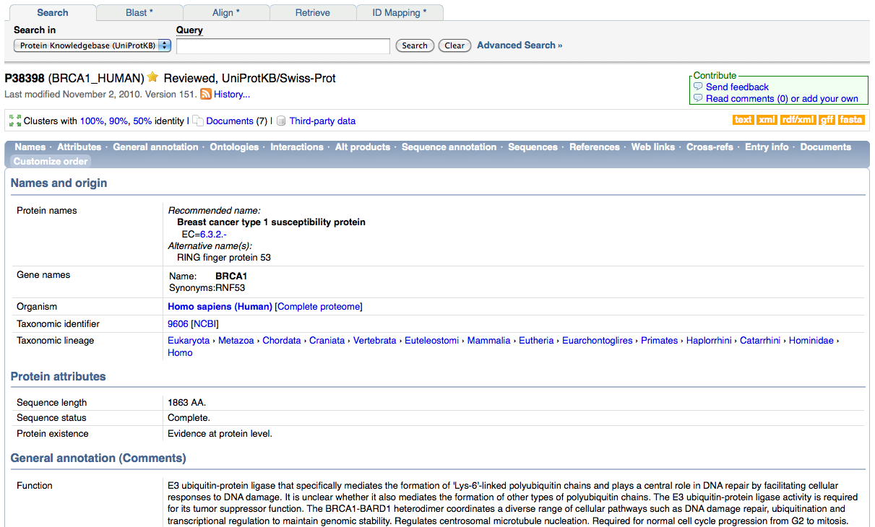
UniPort: Brca1

Slide 43
un po’ di pratica con UniProt

Slide 44
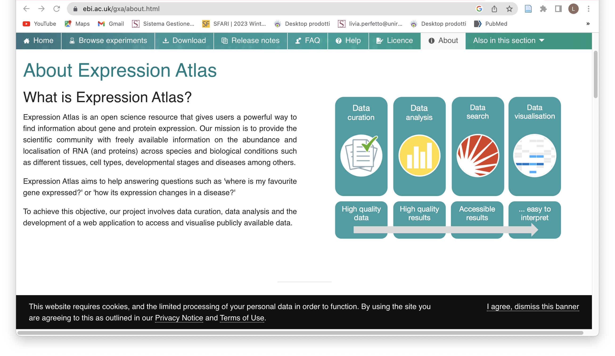
Expression Atlas

Slide 45
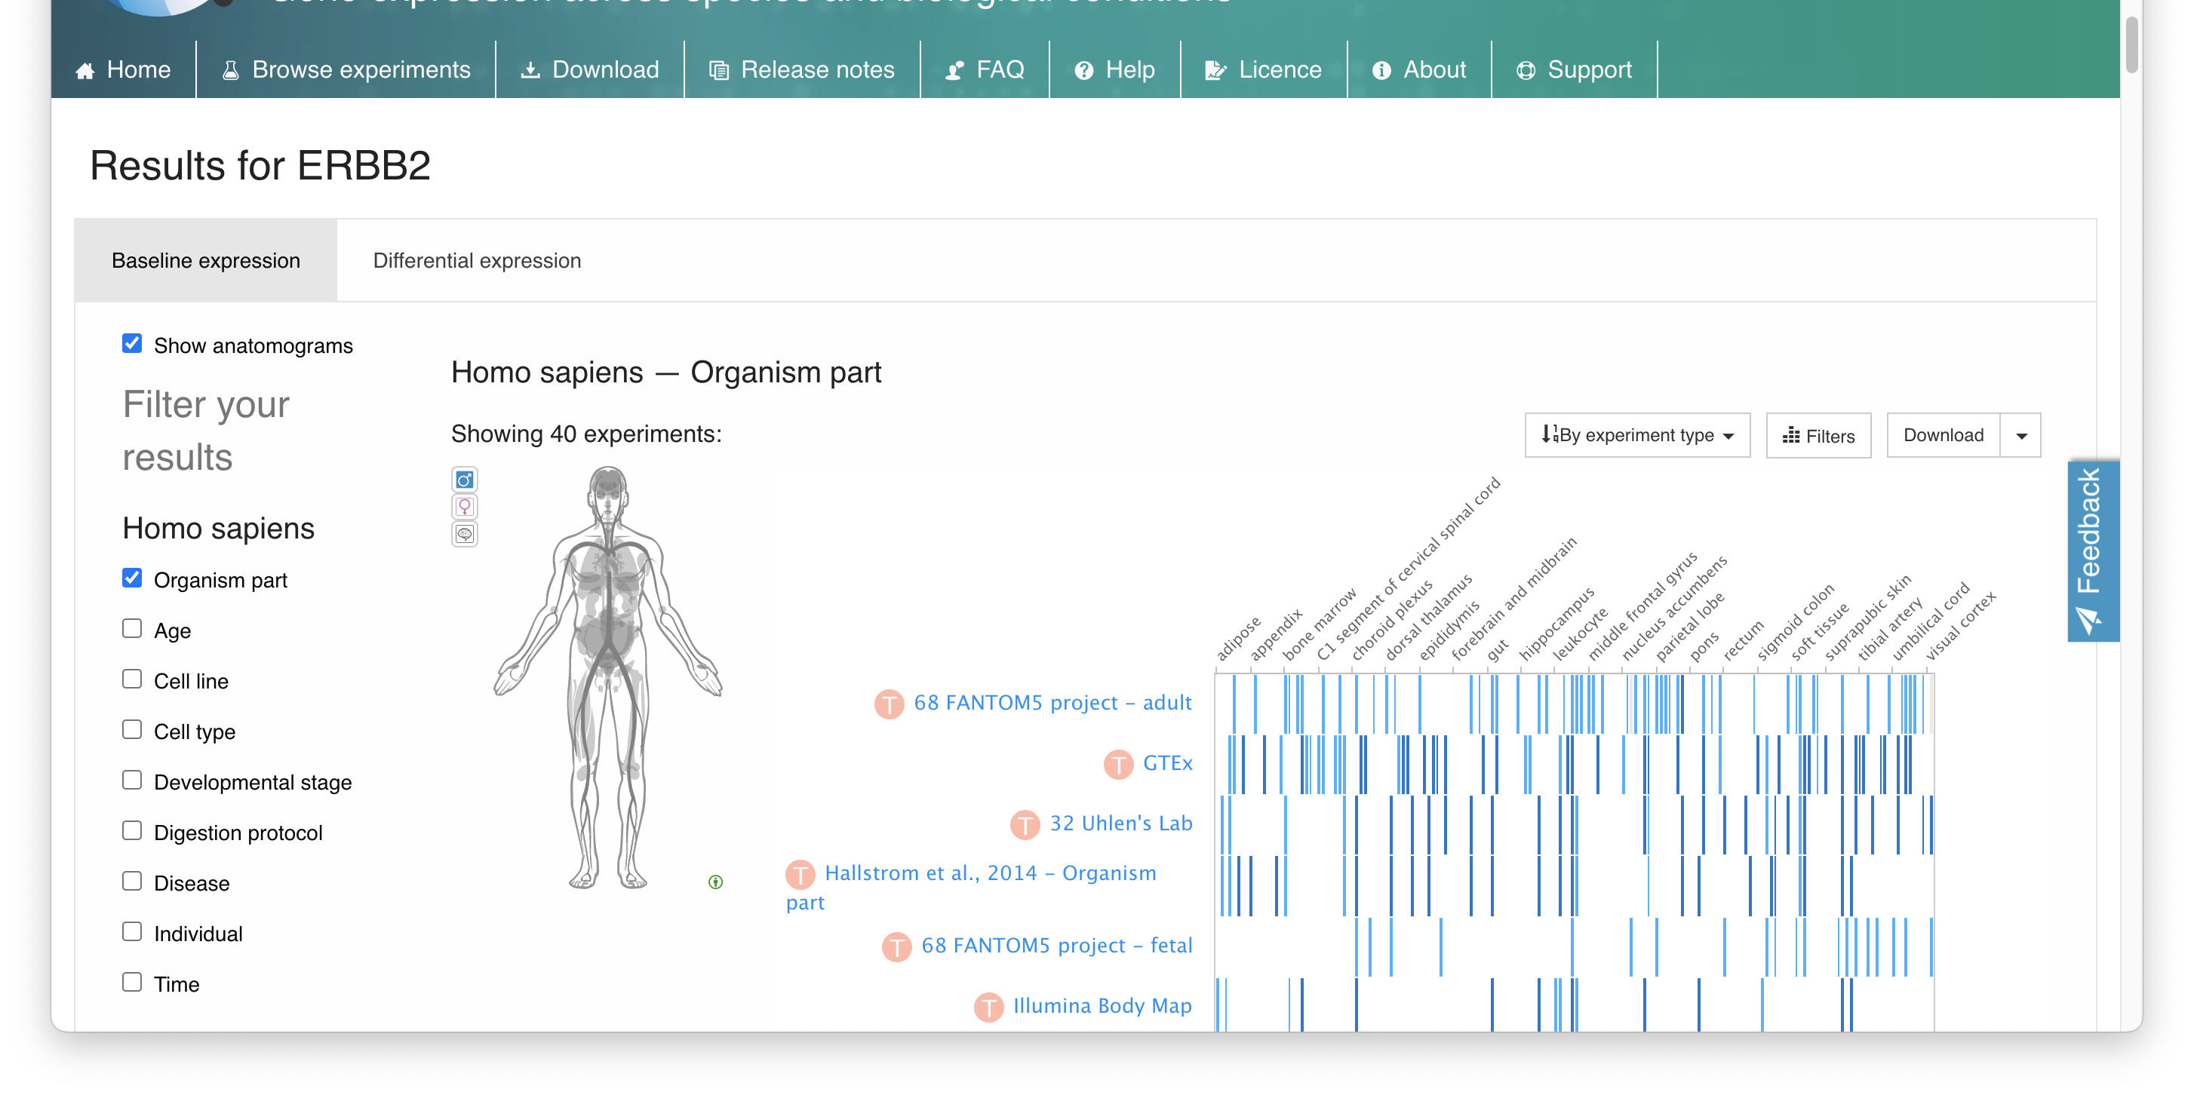
Expression Atlas

Slide 46
un po’ di pratica con Expression Atlas

Slide 47
New types of data
Literature and ontologies
Genomes
Protein sequence
DNA & RNA sequence
Protein structure
Gene expression
Chemical entities
Protein families,
motifs and domains
Protein interactions
Pathways
Systems
Notes:
The EBI is probably unique in the world for its range of data resources and tools, spanning everything from DNA and protein sequence to complex pathways and networks. At the EBI, we separate resource development and provision, which we call services, and research although these two are closely related. Both the research areas and services follow the different areas of focus as shown on the slide.
Some of the types of data that are now being collected in a high-throughput way, presenting new challenges for how we organise and store this data.

Slide 48
New types of data
Literature and ontologies
Genomes
Protein sequence
DNA & RNA sequence
Protein structure
Gene expression
Chemical entities
Protein families,
motifs and domains
Protein interactions
Pathways
Systems
Notes:
The EBI is probably unique in the world for its range of data resources and tools, spanning everything from DNA and protein sequence to complex pathways and networks. At the EBI, we separate resource development and provision, which we call services, and research although these two are closely related. Both the research areas and services follow the different areas of focus as shown on the slide.
Some of the types of data that are now being collected in a high-throughput way, presenting new challenges for how we organise and store this data.

Slide 49
Database di Dati multi-omici

Slide 51
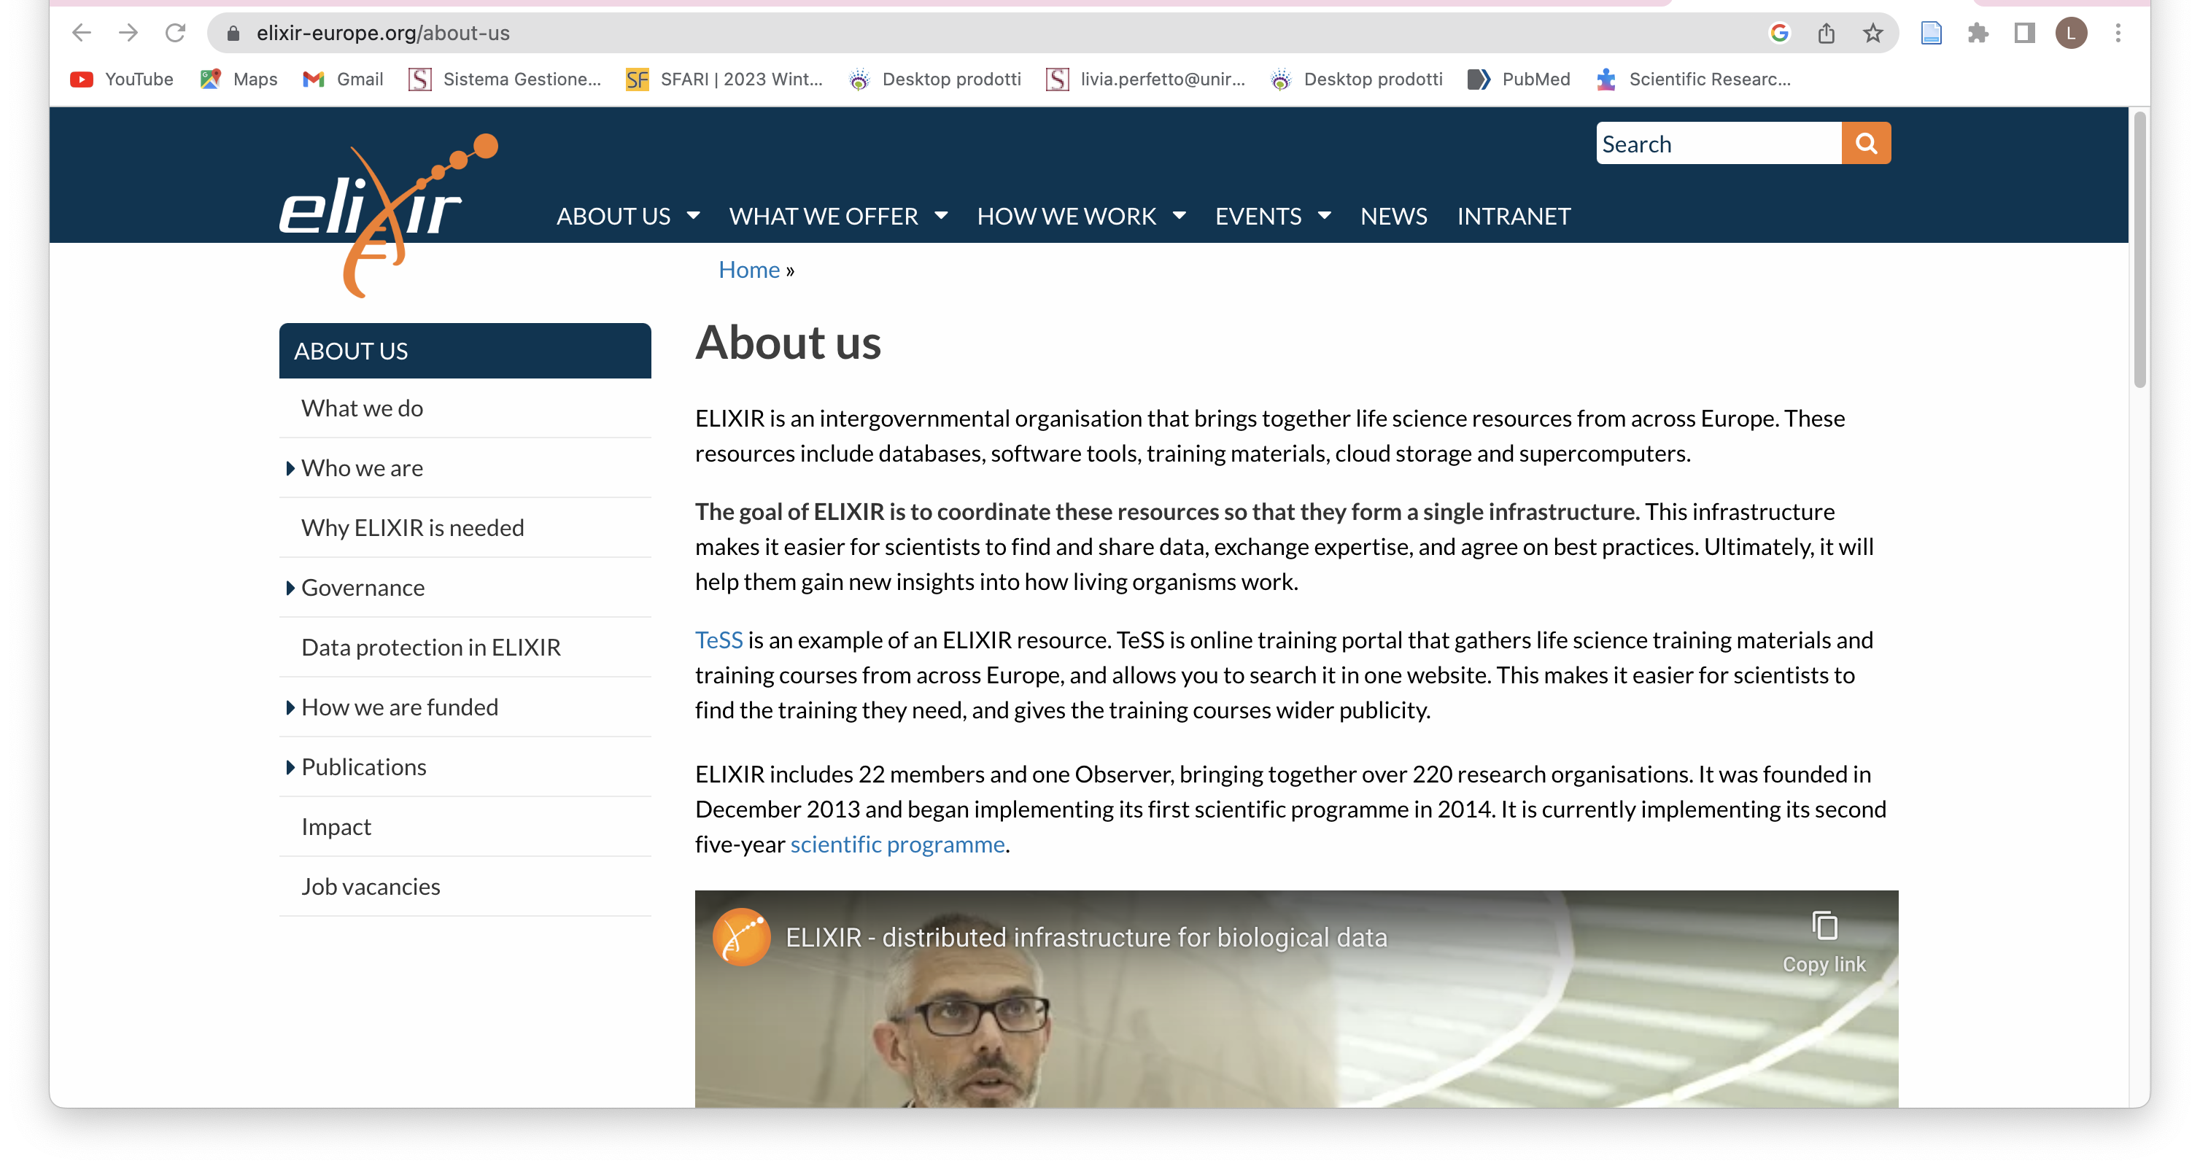
collezione di tool e database

