Slide 2
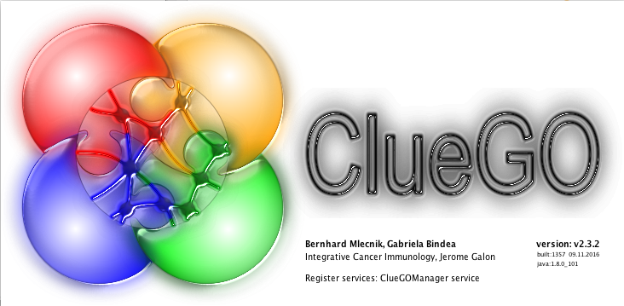
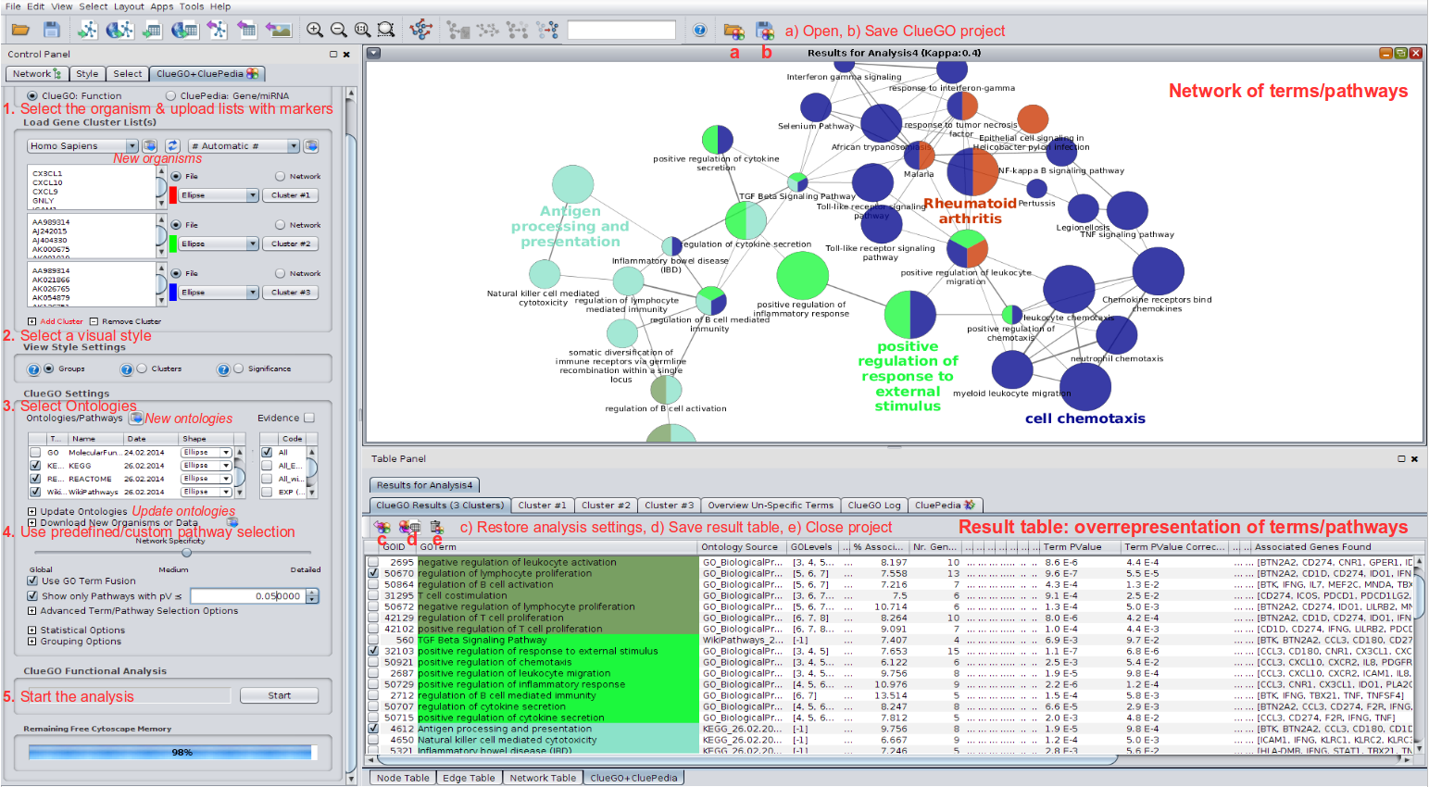
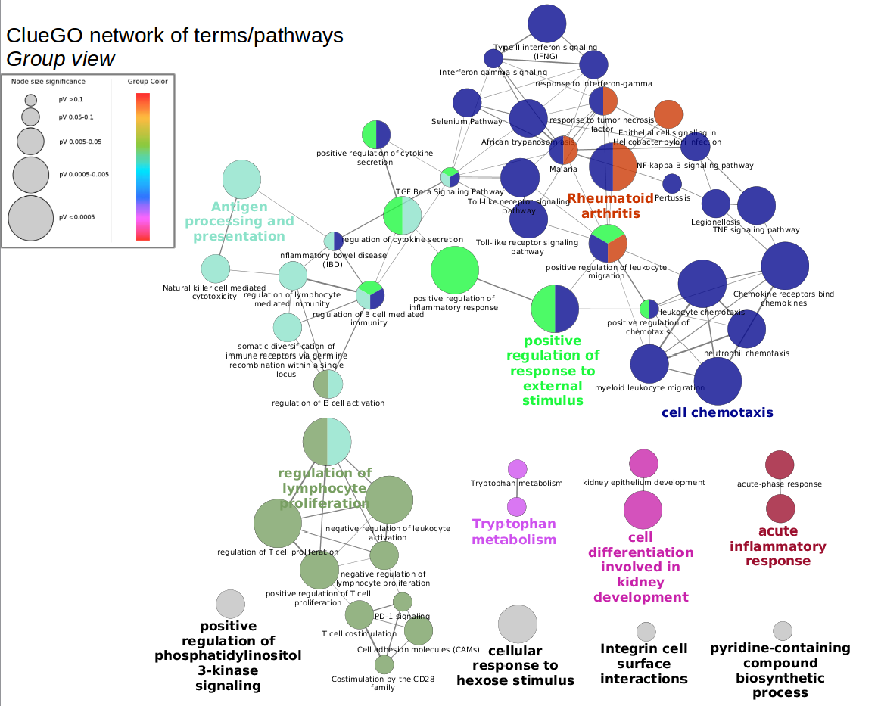
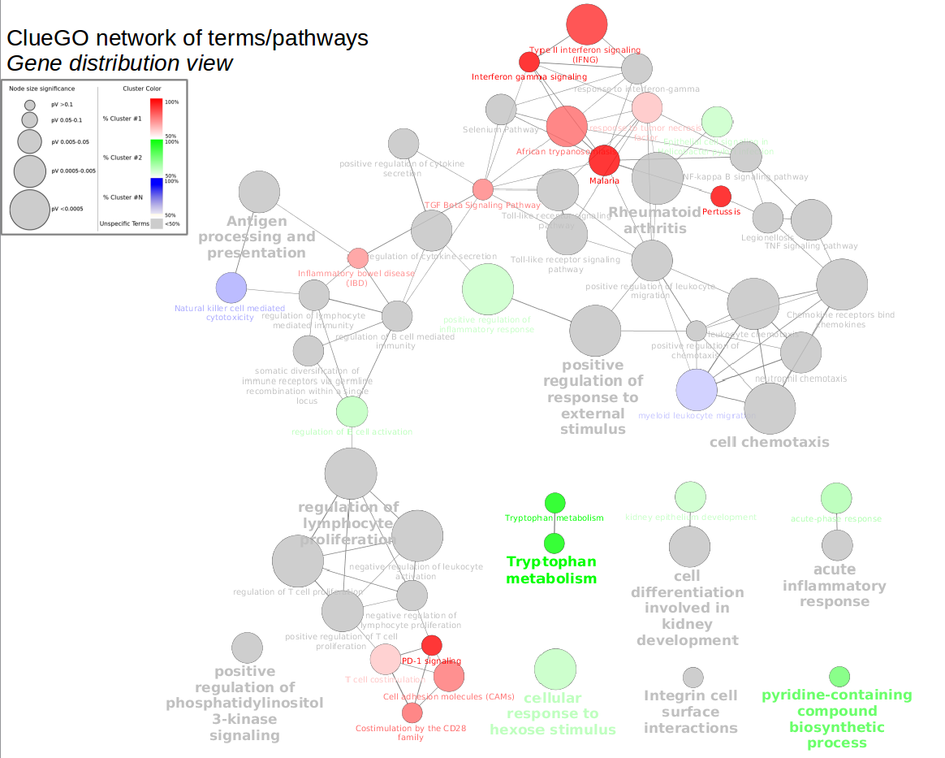
Gene ontology enrichment analysis

Slide 3
Gene ontology enrichment analysis
ClueGO performs a hypergeometric test to find out which functional categories are over- / under-represented in a dataset and which proteins are annotated with such categories, giving a table of results as an output. The test can be referenced to the whole ontology, to the network itself or to a custom reference set.
On top of that, ClueGO makes use of the kappa statistic to group together terms that annotate the same proteins and are related.
ClueGO provides multiple tweaking options for both the enrichment test and the terms grouping.
Additionally, ClueGO draws the over-represented categories as a Cytoscape graph, in which the relationships inferred from the kappa statistic between different terms is depicted, and provides plots summarizing the results.
ClueGO can be used with lists of genes/proteins, whole networks or network sub-sections, making it easy to combine with other Cytoscape functionalities.

Slide 4
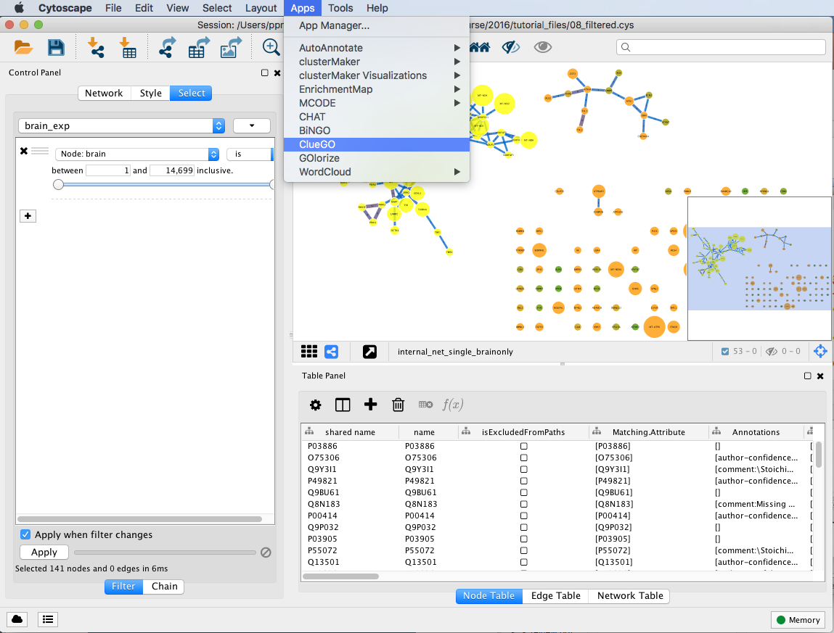
Gene ontology enrichment analysis
Apps → ClueGO -> REQUIRES FREE LICENCE

Slide 5
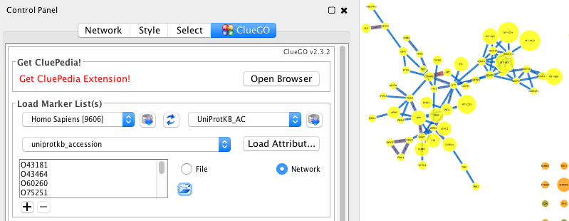
ClueGO: selecting test set
Incolliamo la lista di geni UP-regolati
2
3
1
Seleziona IDs dal network:
2
3
1
4
Potete caricare gli IDs o dal network, o da un file o con copy/paste nel box

Slide 6
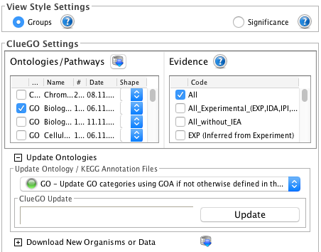
ClueGO: Visual settings, selecting ontology

Slide 7
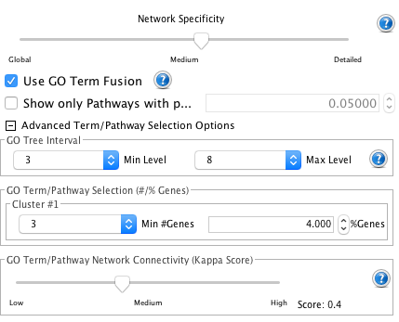
ClueGO: Ontology depth/grouping options

Slide 8
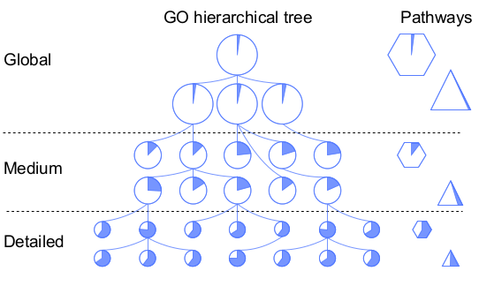
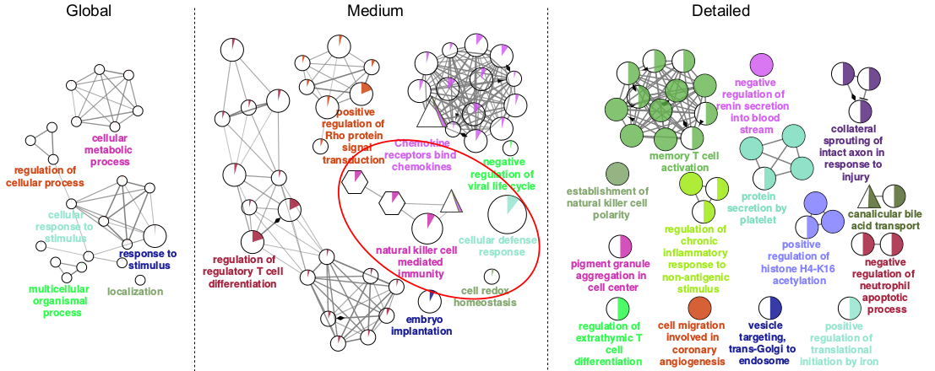
ClueGO: Ontology granularity

Slide 9
ClueGO: Ontology depth/grouping options

Slide 10
ClueGO: kappa score
Cohen’s kappa coefficient measures inter-rater agreement (concordance) between qualitative items.
More robust that percent agreement because it takes into account agreement occurring by chance.

Slide 11
ClueGO: Ontology depth/grouping options
Add a file with the proteome dataset for the background

Slide 12
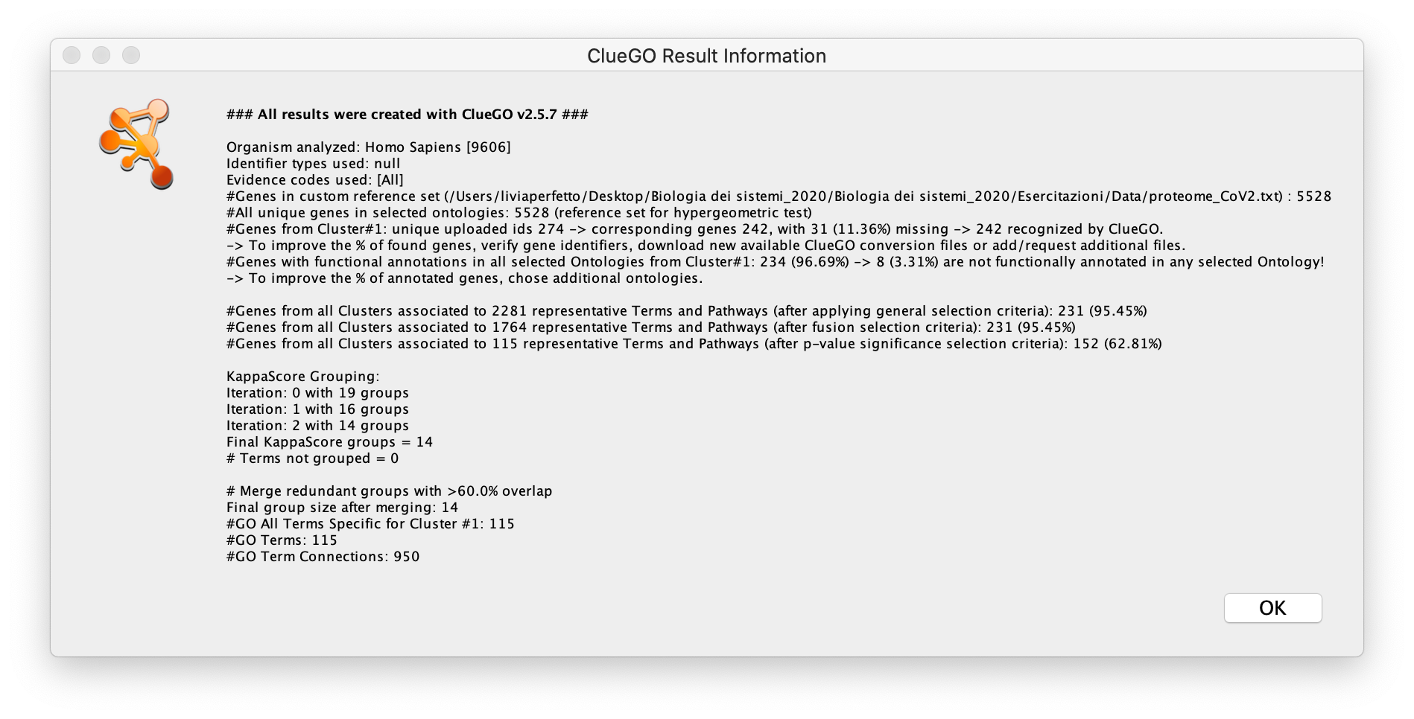
ClueGO: Results log

Slide 13
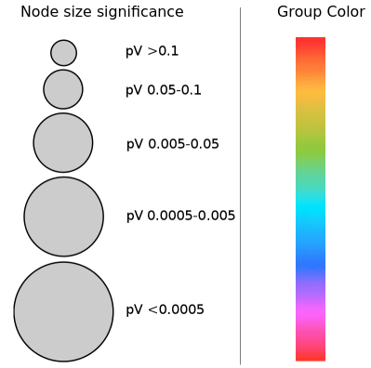
ClueGO: Results network groups view

Slide 14
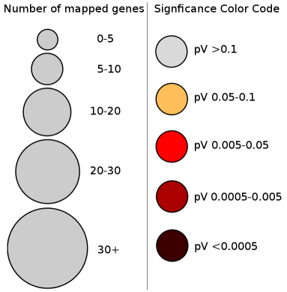
ClueGO: Results network significance view

Slide 15
ClueGO: Summary plots

Slide 16
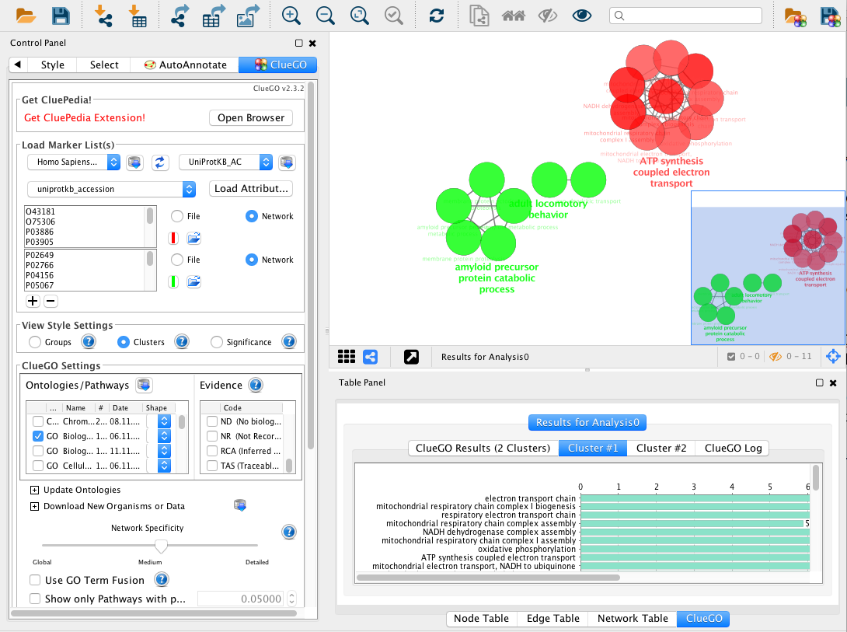
ClueGO: Analyzing two test sets (clusters)
Analisi comparativa: proteine up-regulate versus down-regolate
up
down

