Slide 1
Cytoscape, a tool for Network Visualization and analysis

Slide 2
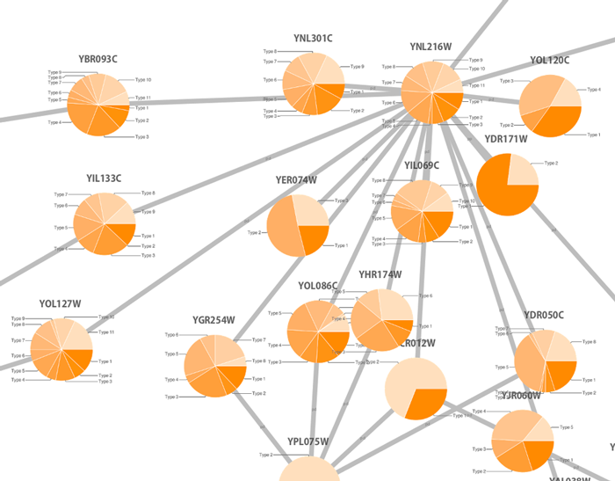
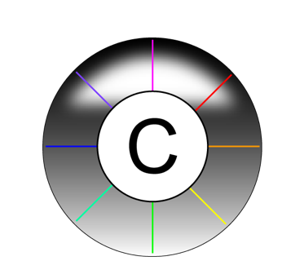
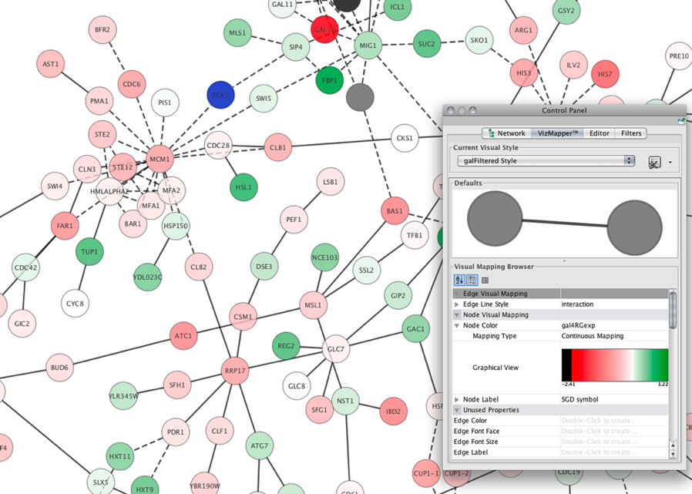
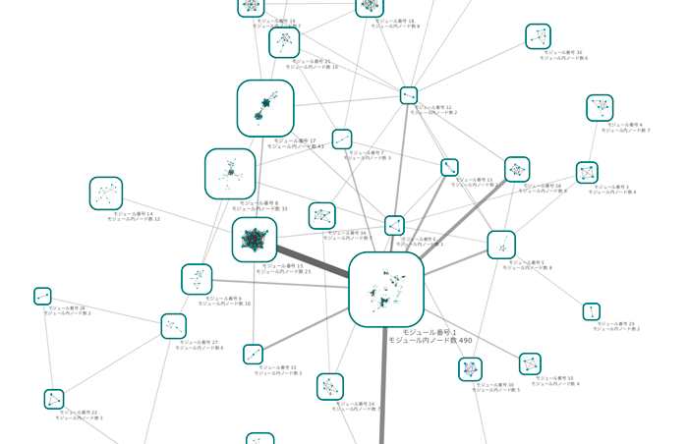
Cytoscape: open-source network representation and analysis tool
www.cytoscape.org
2.8
3.6

Slide 3
Why Cytoscape?
www.cytoscape.org
It can make use of several visual features that can effectively highlight key aspects of the network.
It can integrate global datasets and functional annotations.
It has a wide variety of advanced analysis and modelling tools in the form of apps that can be easily installed and applied to different approaches.
frameworks that integrate several additional Applications/plugin
you can use ClueGO and MCODE apps to perform GO enrichment analysis and try to identify the functional modules underlying our network.
you can use PathLinker to understand the molecular mechanisms underlying cell phenotype.

Slide 4
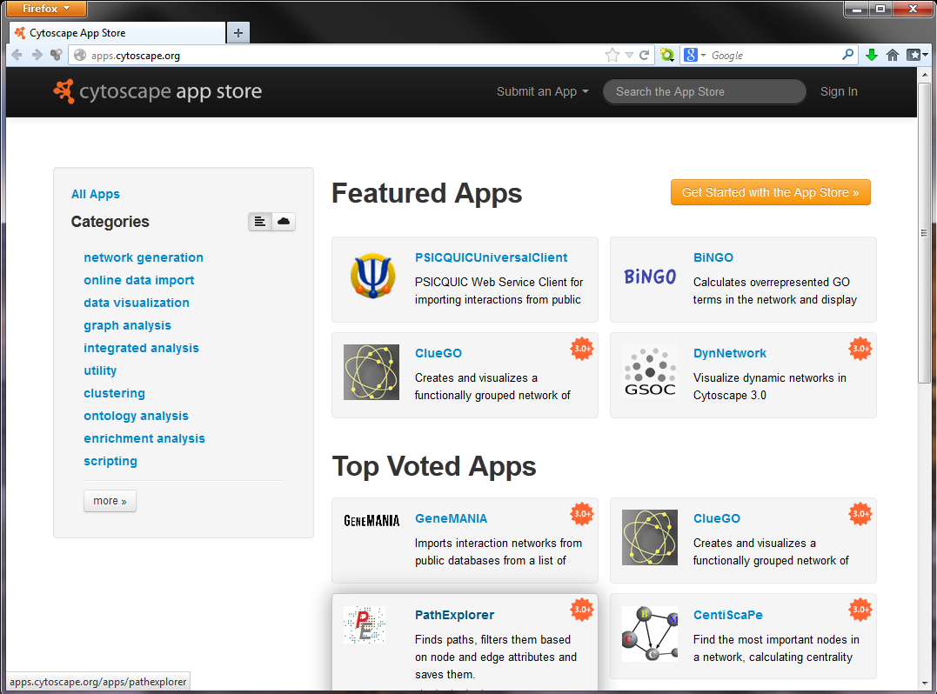
Cytoscape apps/apps
Large variety of apps/plugins (~330)
Great flexibility, adaptable to multiple types of analysis, in various domains of knowledge: bioinformatics, social network analysis, semantic web…
Possibility to create your own.
Some deprecated or obsolete
Different functionality depending on the Cytoscape version
“A travel guide to Cytoscape plugins.”
Saito et al., 2012, Nature Methods, PMID: 23132118.

Slide 5
A network analysis approach requires a Network, where can we extract it from?
We can import in Cytoscape:
a user custom precompiled Network
Path: File > Import > Network from file
PPI network from PSICQUIC-based interaction import client in Cytoscape
Path: File > Import > Network from Public Databases
A Network from a NDEx collection (e.g. SIGNOR)
Path: File > Import > Network from NDEx
Ad hoc APPs (e.g. IntAct and SIGNOR APPs)

Slide 6
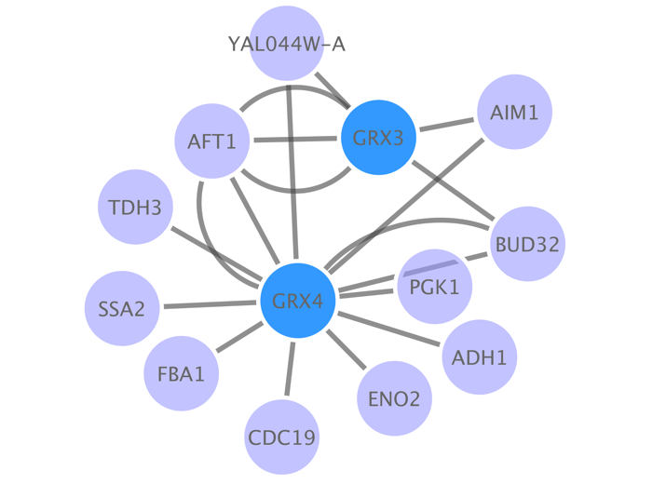
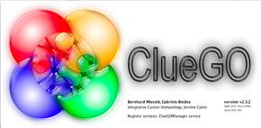
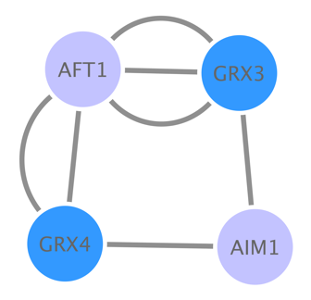
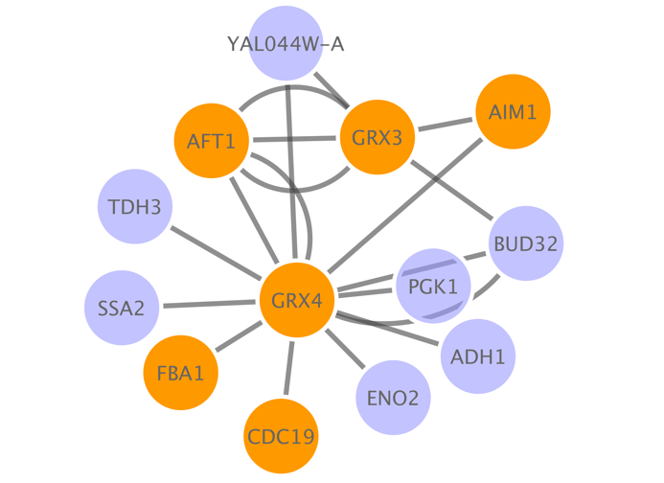
Cytoscape Workflow
Base PPI network
Annotation enrichment
List of proteins (seed)
Topological clustering
Shortest path

Slide 7
COSA FAREMO
IMPORTEREMO UN NETWORK DI PPI
usando la SIGNOR APP e la IntAct APP
IMPORTEREMO UN PATHWAY DI SIGNOR
COME SI IMPORTANO GLI ATTRIBUTI?
CONDURREMO UNA NETWORK ANALISI DI TIPO BASE
USEREMO PATHLINKER per trovare i percorsi che collegano proteine di interesse

Slide 8
Cytoscape Interface

Slide 9
About the SIGNOR app
it mirrors the major search modes available in the web resource
single entity search
multi entity search
pathway search
path search
same data
same visual style
it complements the web resource with
interactome search
the PTM view

Slide 11
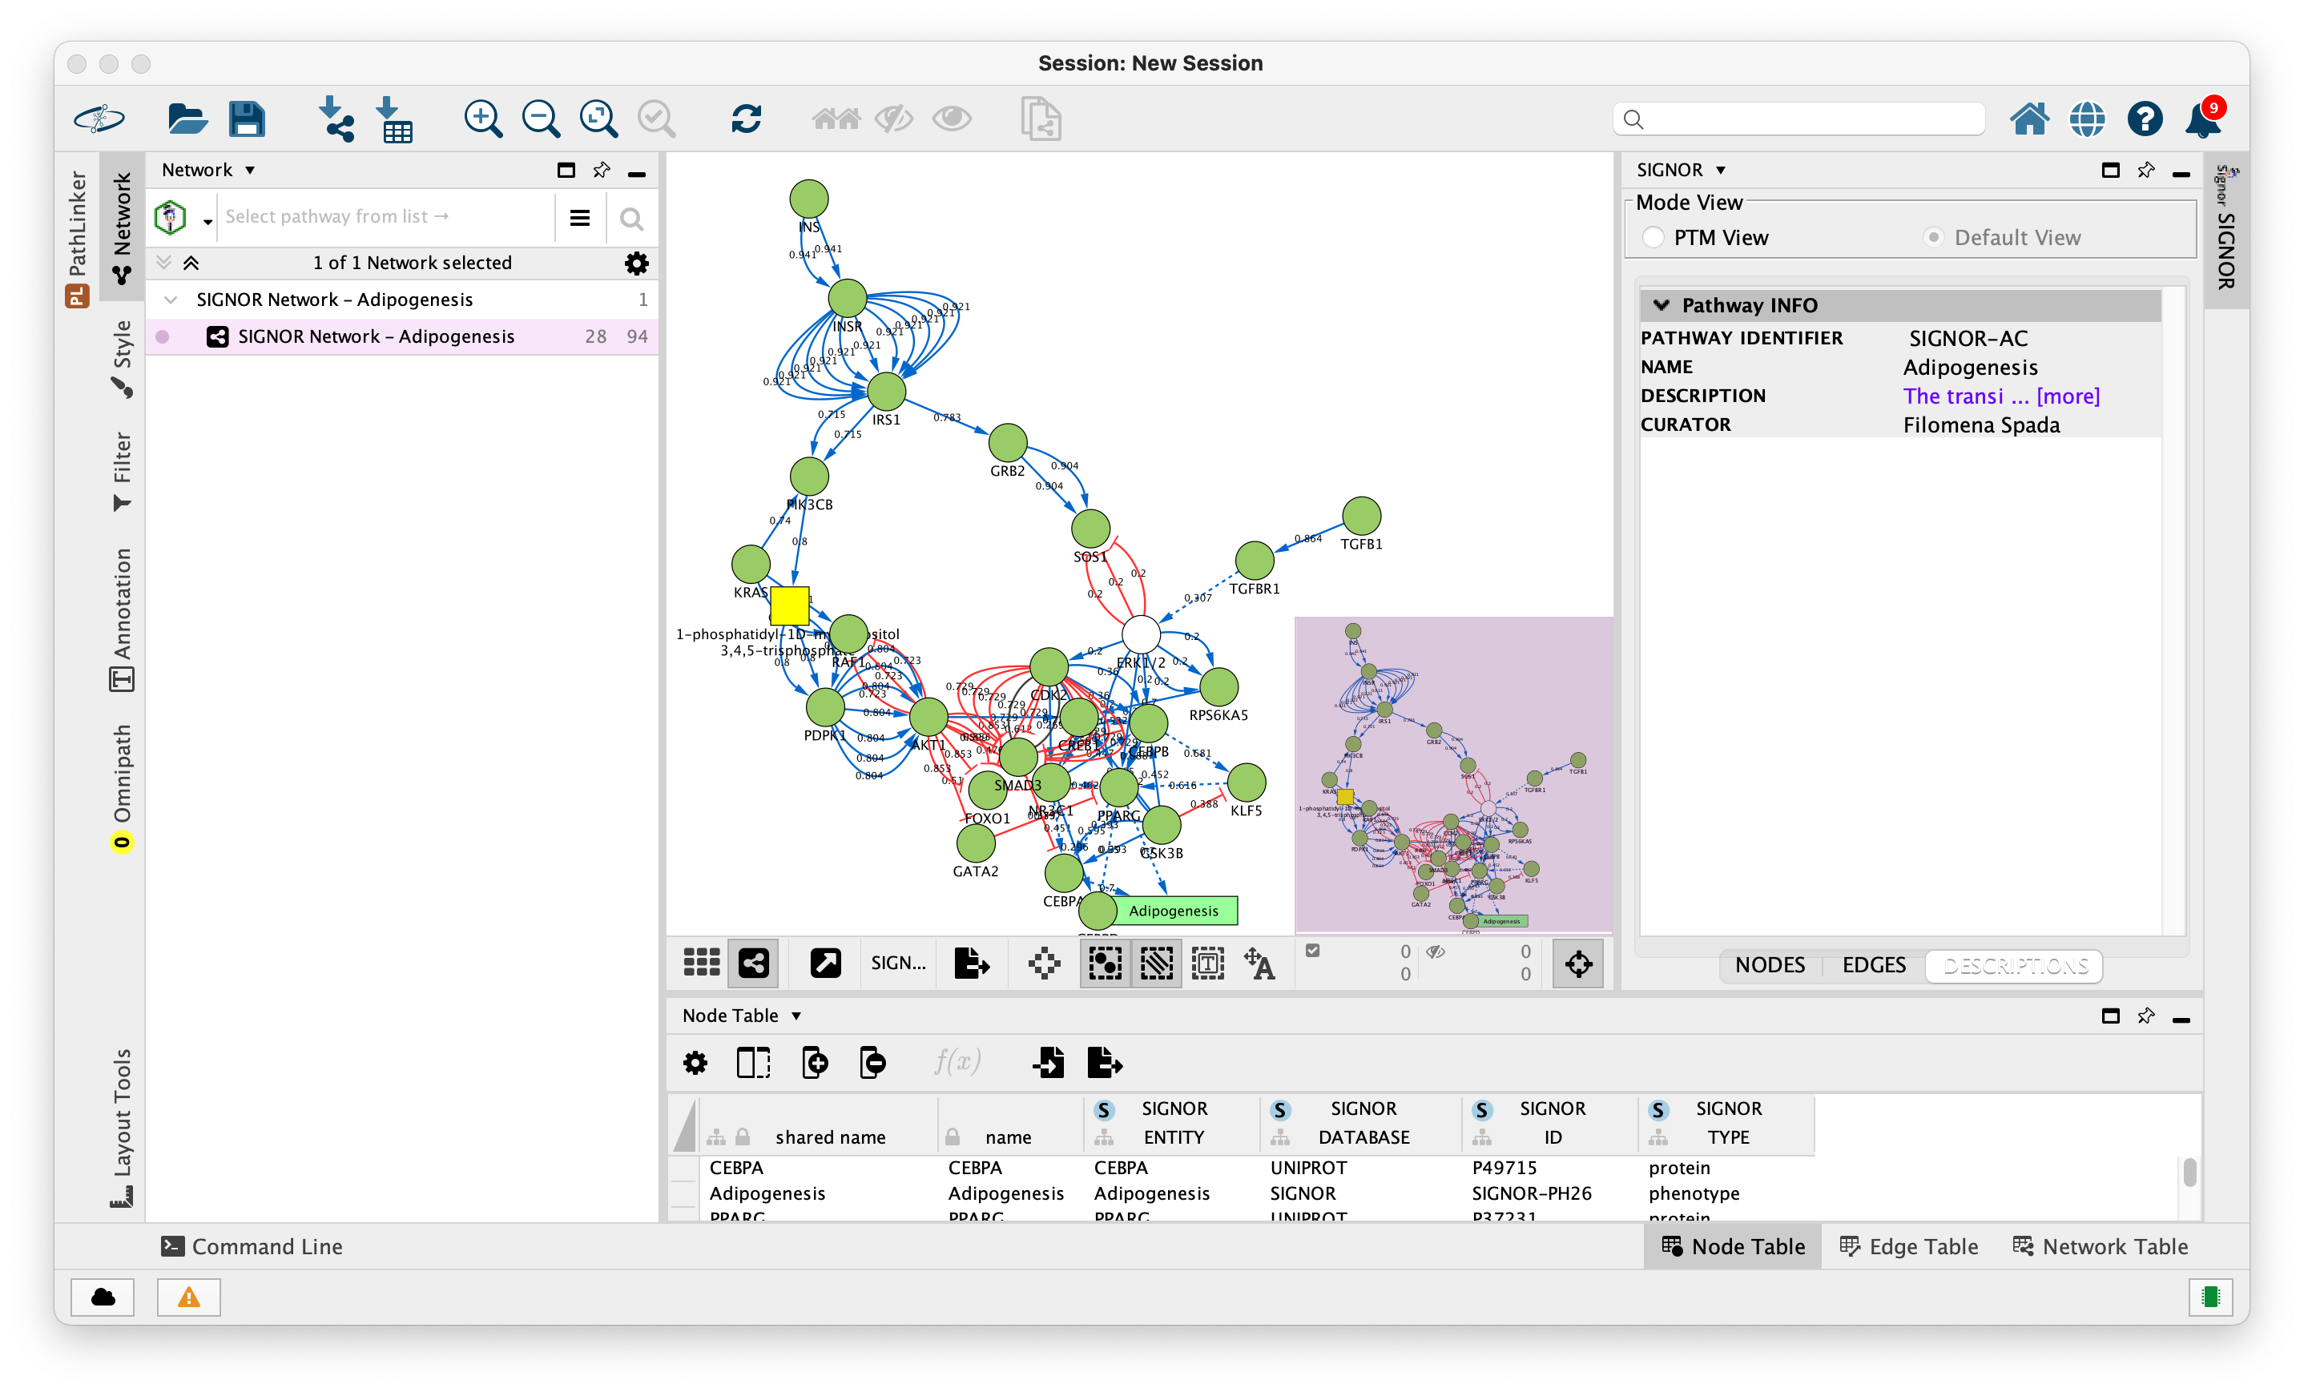

Slide 12
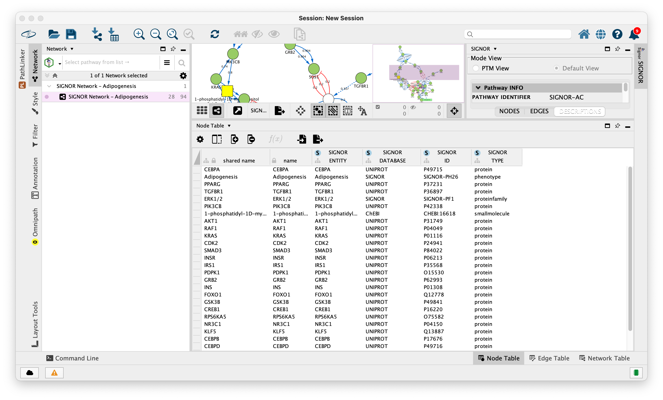

Slide 13
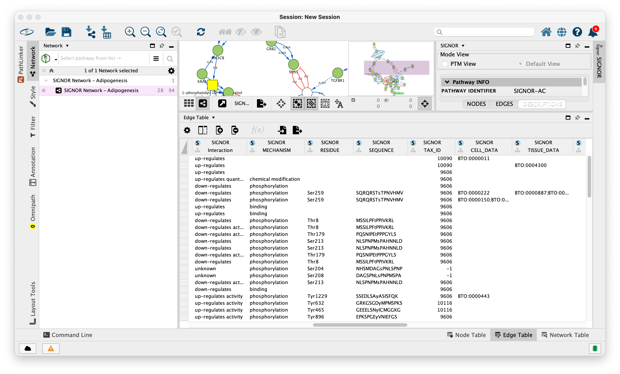

Slide 15
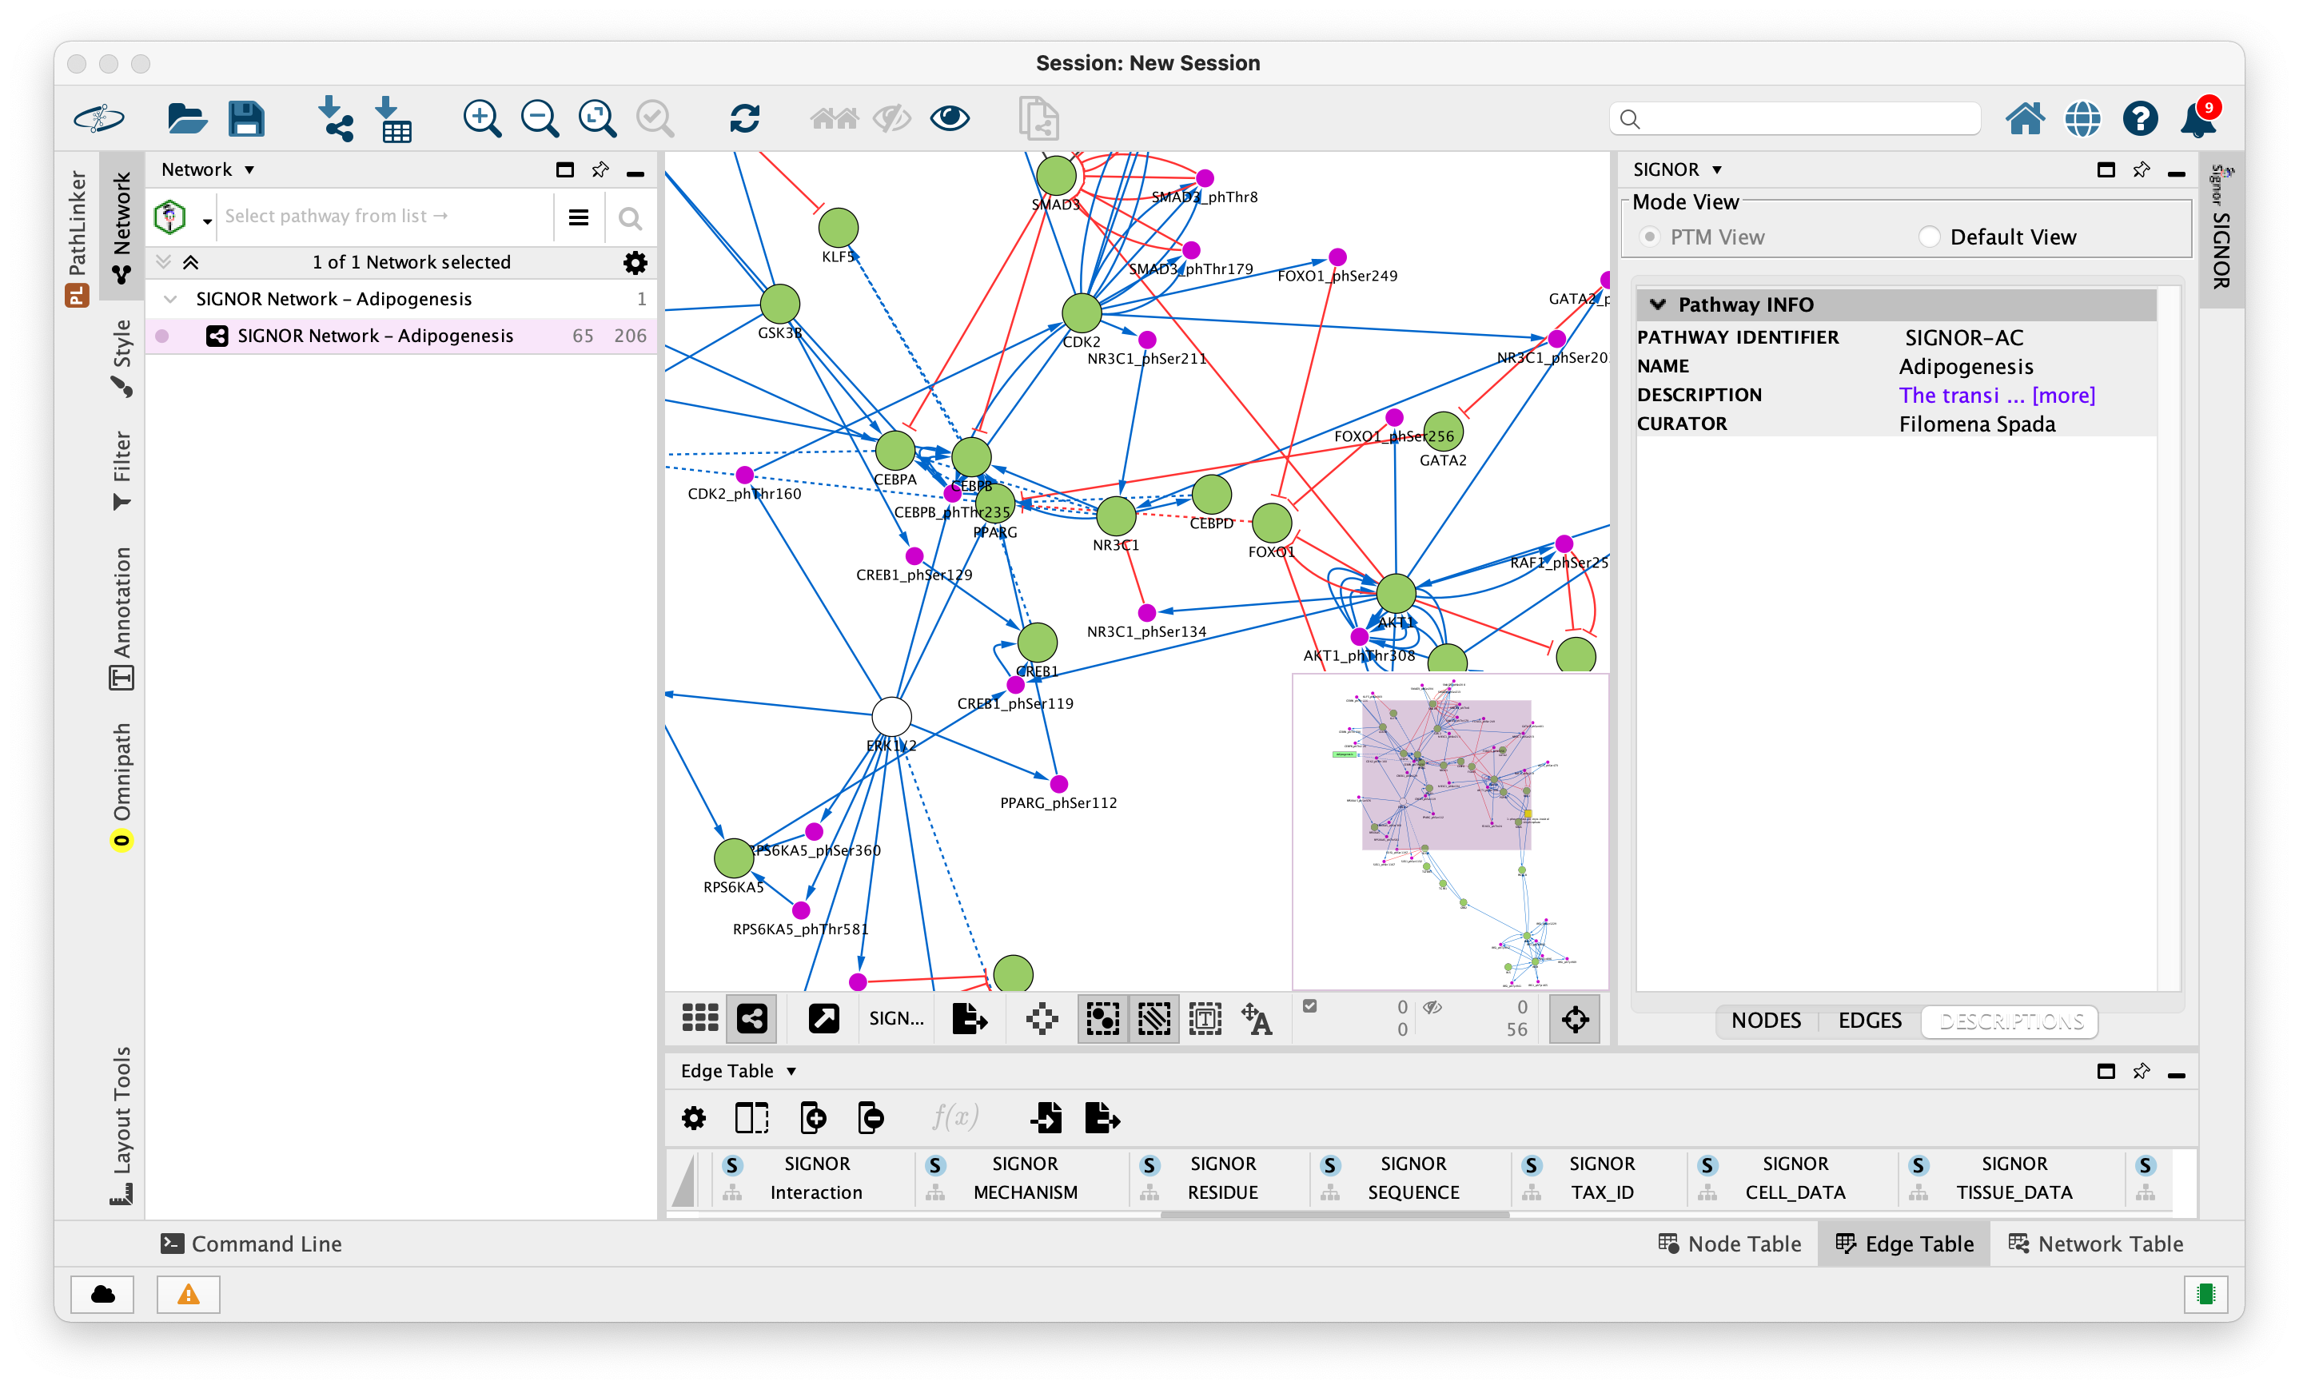

Slide 16
about PTM visualization mode…

Slide 17
multi entity search

Slide 18
Interactome

Slide 19
Interactome with PTM

