Slide 2
Moral hazard and its policy implications

Slide 3

Moral hazard in health sector
Conditions for (ex post)MH
  Asymmetric information between patient and third-party payer (the insurance company or the NHS)
  Price reduction at the point of use due to insurance
  Price-sensitive demand
Notes:
As we have discussed before, the evidence from randomized experimentss suggests that health insurance affects medical spending
Health policy has long been preoccupied with the problem that health insurance stimulates spending (“moral hazard”).
The term “moral hazard” was used for the first time in the context of health insurance by K.J. Arrow in his seminal 1963 article on medical care to characterize the fact that the insured use more health care services to treat a given illness than the uninsured (Arrow, 1963)
Moral hazard in health care and health insurance markets, where asymmetric information is widespread, occurs if following a Reduction of price at the point of use due to insurance, the individual responds by demanding more (demand is price sensitive) or more expensive goods.

Slide 4
On moral hazard: Arrow vs Pauly
Different views and policy implications
Arrow
  “It is frequently observed that widespread medical insurance increases the demand for medical care.”
  “MH in physician’s control” [of patients’ demand for medical care]
  Policy implication: “the need for a third-party control” (public insurance with gatekeeping)
Pauly
  under an insurance contract that reduces the price there is nothing unethical in using more services; the insured individual simply reacts to the change in the price.
  Policy implication: (optimal rate of) cost-sharing (co-payment, deductible, co-insurance)
Notes:
Arrow argues that moral hazard was a potential problem for health insurance, both private and public. According to Arrow, moral hazard has something to do with trust and social institutions. Moral hazard as a “moral” issue, not so much in the ethical as in the social sense (moral reflecting “mores” the social norms of a society).
In Arrow (1963), moral hazard is a “practical limitation” of insurance ( we would now describe it as a market failure) in the sense that individuals cannot get something (full coverage) they would be willing to pay for. Because of moral hazard, full coverage is not marketed.
Pauly (1968) stated that, under an insurance contract that reduces the price at the point of use, there is nothing unethical or immoral in the response by an insured individual to use more services than when uninsured.
Rather, the insured individual simply reacts as any rational individual would do faced with a change in the price of a commodity for which he/she has a demand (conditional on the level of income). Because coverage generates a welfare loss due to moral hazard and increases the cost of insurance, some individuals prefer not to buy coverage. There is no market failure because individuals “rationally” choose not to buy insurance given the premium offered.
Arrow describes MH a market failure (even though he does not use the term,) whereas Pauly states the market delivers exactly what individuals want.
Pauly thinks that the product that the health insurance market should deliver is not full coverage but, rather, optimal coverage given the incentive to use more medical care when covered.
In contrast, because people would purchase full coverage at the actuarially fair price, but the market can’t deliver it, Arrow sees partial coverage as market failure.
The role of physicians
How much of MH comes from the patient and how much of it comes from the physician? Arrow argues that it is the physician who tells the patient how much medical care to get. So there is not such a thing as “patient demand” and no consumer’s sovereignty.
Arrow emphasizes supply-side issues; Pauly demand-side

Slide 5
On moral hazard: Arrow vs Pauly
Different views and policy implications
Arrow
  “It is frequently observed that widespread medical insurance increases the demand for medical care.”
  “MH in physician’s control” [of patients’ demand for medical care]
  Policy implication: “the need for a third-party control” (public insurance with gatekeeping)
Pauly
  under an insurance contract that reduces the price there is nothing unethical in using more services; the insured individual simply reacts to the change in the price.
  Policy implication: (optimal rate of) cost-sharing (co-payment, deductible, co-insurance)
Notes:
Policy implications:
Arrow: public insurance with gatekeeping with the right incentives for physicians
If physicians (and providers) are paid based on how much care they deliver, not on the patient health status or health outcome, then they have an incentive to prescribe healthcare.
In 1983, Medicare led the way in moving from a fee‐for‐service reimbursement system to a prospective reimbursement system, where they paid hospitals, not based on what the hospitals did to you, but based on what was wrong with you. When they did so, there was an enormous change almost overnight. The average length of stay at the elderly hospitals fell by 15%, within one year. With no effect on elderly health
Pauly: co-payment, deductible, co-insurance. Conventional welfare analysis consisted in estimating a trade-off between the benefit of risk avoidance (valued as the risk premium) and the welfare loss of moral hazard. Balancing this trade-off leads to an optimal rate of cost-sharing given the elasticity of demand for health care. If individuals income heterogeneity is not considered, access to healthcare falls out of the picture, even though it is well known that some treatment costs may exceed total wealth for a large portion of the population.
POSSIBLE NEGATIVE EFFECTS OF COST-SHARING ON ACCESS AND HEALTH INEQUALITIES (by age and income and other vulnerabilities)

Slide 6
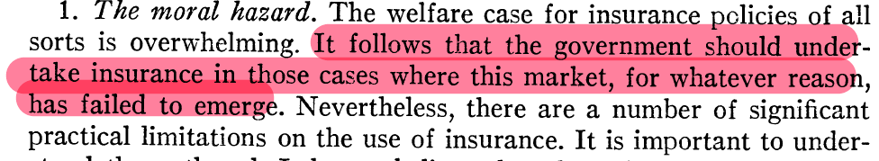
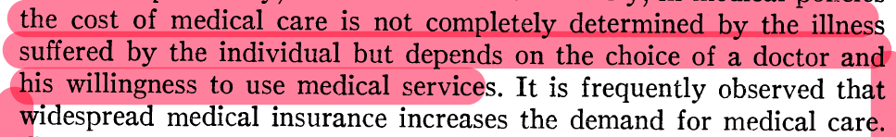
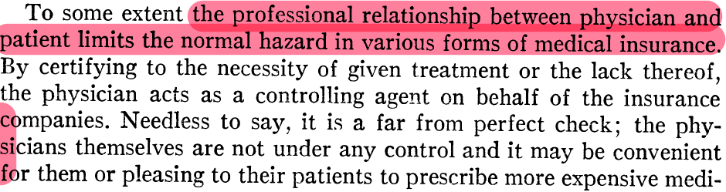
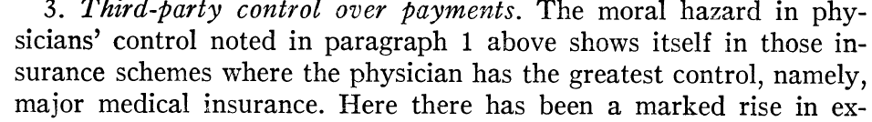
Arrow
Notes:
Leggi pag. 22/34
Practical limitations
One of these limits … is the effect of insurance on incentives

Slide 7
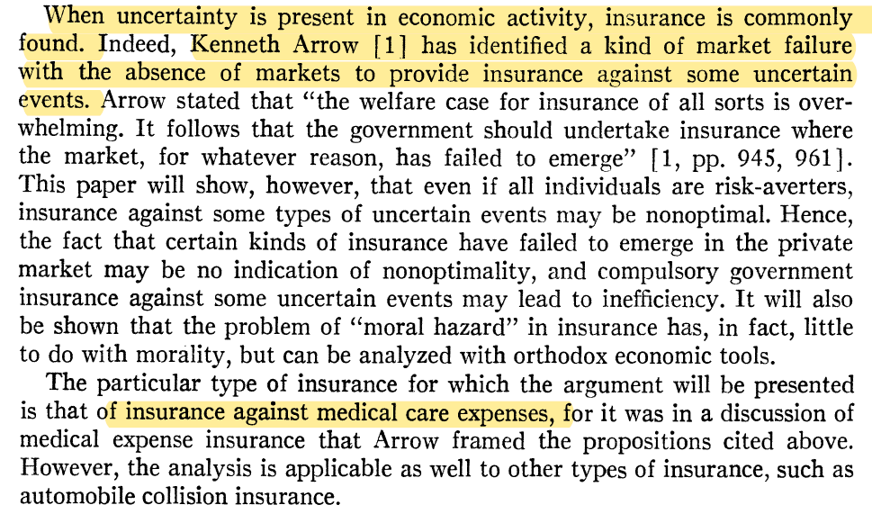
Pauly

Slide 8
On moral hazard: Neyman
The reason to demand health-insurance is an income transfer from the healthy to the sick state → co-insurance is a reduction in income exactly when income is needed (i.e. when sick).
The change in healthcare utilization due to an increase in price (co-insurance) can be decomposed into an income and a substitution effect and only the second produces a welfare loss as in the traditional analysis of moral hazard.
To understand the effects of health insurance, this must be compared to the alternative, or counterfactual
Notes:
Because all individuals are the same in this model, including having the same level of income, income falls out of the picture, even though it is well known that some treatment costs may exceed total wealth for a large portion of the population.
Health insurance provides a beneficial income effect to customers in addition to risk reduction.
Neyman: the reason to demand health-insurance is an income transfer from the healthy to the sick state -> co-insurance is a reduction in income exactly when income is needed (i.e. when sick). The change in healthcare utilization due to an increase in price (co-insurance) can be decomposed into an income and a substitution effect and only the second produces a welfare loss as in the traditional analysis of moral hazard.
Income and substitution effects. More generally, think of the fact that on the one hand, the price of medical care is changing. On the other hand, when you have insurance, you have just been given a gift of money should you get sick, and you may choose to spend some of that money on your treatment. That is not a distortion of the system; that’s just how you choose to spend your money. This is what we call liquidity effect. That is probably what is partly going on when we get people health insurance and they spend more. People would always like to spend medical care, but they are constrained from doing so. By giving them money when they are sick, we allow them to afford that expensive operation they could not otherwise. That is not a distortion in our system; that is just getting rid of the problem of liquidity constraints that people face in our system. (J. Gruber)
HE argues that people buy health insurance not just to spread the risk of large expenses; they seek access to healthcare they otherwise could not afford to consume. In addition to insufficient wealth, illness often causes income loss, which thus reduces how much healthcare sick persons could buy out of pocket. The additional spending could be beneficial to welfare, since it provides individuals with the necessary purchasing power to access valuable care.
To understand the effects of health insurance, this must be compared to the alternative, or counterfactual.
Traditionally, health insurance has been compared with having no insurance, when a person pays the full market price.
While the uninsurance counterfactual is arguably appropriate for low-price consumption (e.g., a generic drug) that is available to both insured and uninsured people alike, it may not be appropriate for high-cost care or poor consumers
In such cases where the care is unaffordable, an uninsured or underinsured patient’s “choice” not to consume arguably does not reveal anything about their valuation of the non-consumed goods and services.

Slide 9
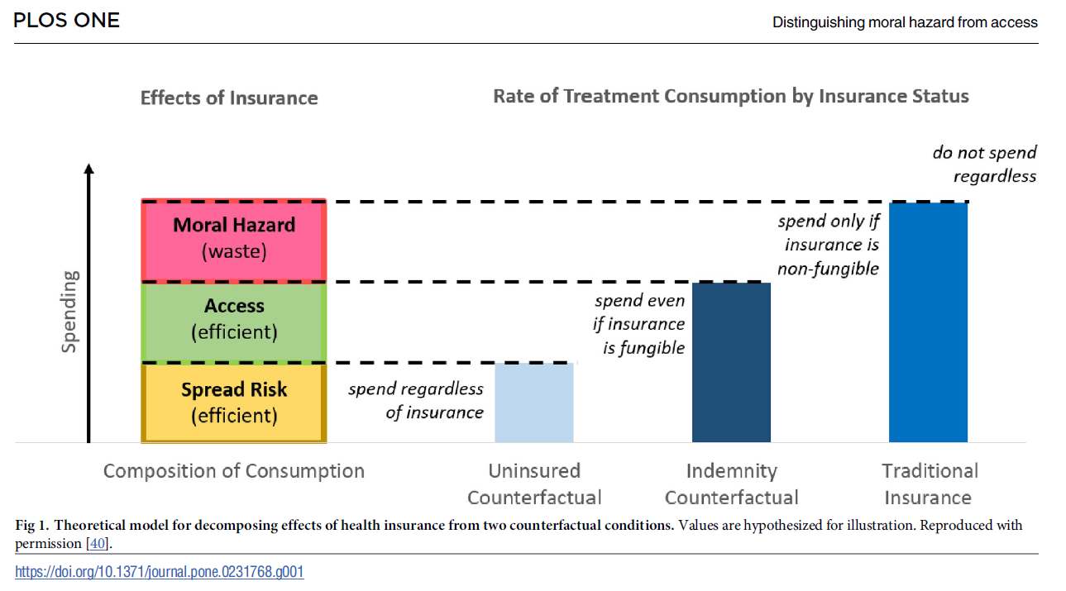
Notes:
A recent paper (Robertson CT, Yuan A, Zhang W, Joiner K (2020) Distinguishing moral hazard from access for high-cost healthcare under insurance. PLoS ONE 15(4): e0231768. https://doi.org/10.1371/journal.pone.0231768)
argues that field studies comparing those with more or less insurance cannot disaggregate moral hazard versus access. Moreover, studies of patients consuming routine low-dollar healthcare are not informative for the high-dollar healthcare that drives most of aggregate healthcare spending in the United States.
Through a survey experiment, they test indemnities as an alternative theory-driven counterfactual. Such conditional cash transfers would maintain an opportunity cost for patients, unlike standard insurance, but
also guarantee access to the care. They find that most of the spending due to insurance would occur even under an indemnity. The waste attributable to moral hazard is thus undetectable.
For high-cost care, policymakers should be more concerned about the foregone efficient spending for those lacking full insurance, rather than the wasteful spending that occurs with full insurance.

Slide 10
Summing up
Is it “unnecessary” expenses?
Which is the correct counterfactual?
  Income vs substitution effects
Whose MH?
  Patients or providers?
  This has implications for policy (co-insurance/copayment vs incentives for providers)
Long-run effects on health, including preventive care
Results are context specific (external validity)
  Institutions matter (rent seeking)
Notes:
Is it really unnecessary expenses? Is systems where there is gatekeeping, the physician should decide. Either it is physician MH, maybe due to patients pressure, or it might be that although the physician suggests a specialist visit, because of budget constraint, the patient does not take up the visit and what we observe is a difference in healthcare utilization. Or it might be that because of cost-sharing a low income patient does not even go to the family doctor knowing that he will not take up a specialist visit because of liquidity constraint.
All these possibilities are consistent with empirical evidence of a price-sensitive demand for healthcare.

