Slide 1
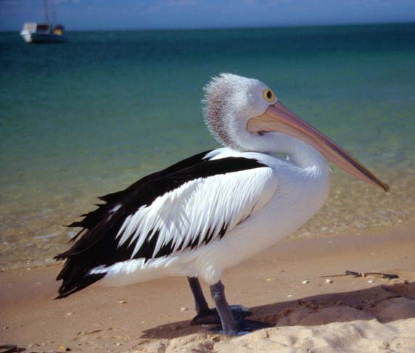
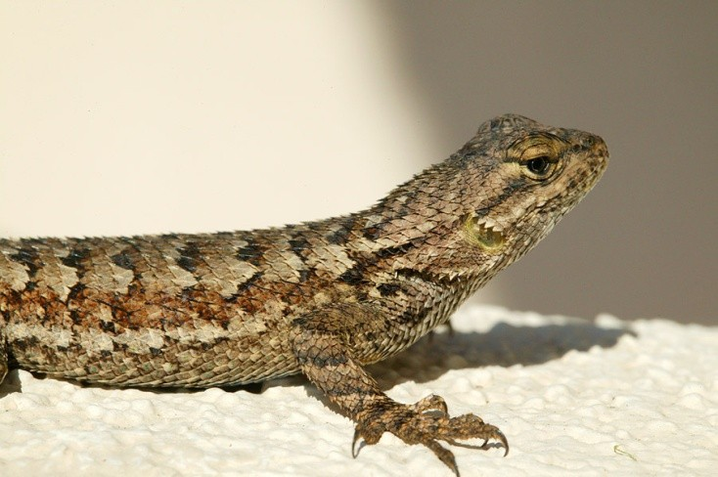
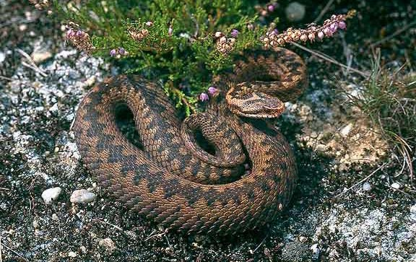
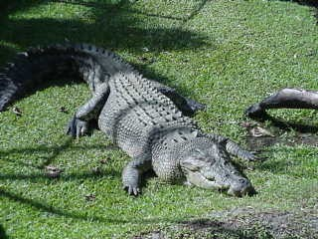
Diapsida

Slide 2
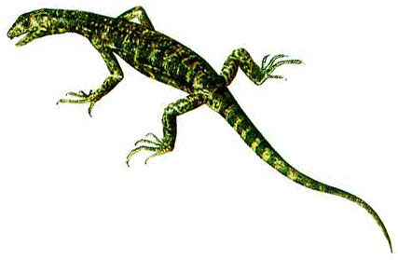
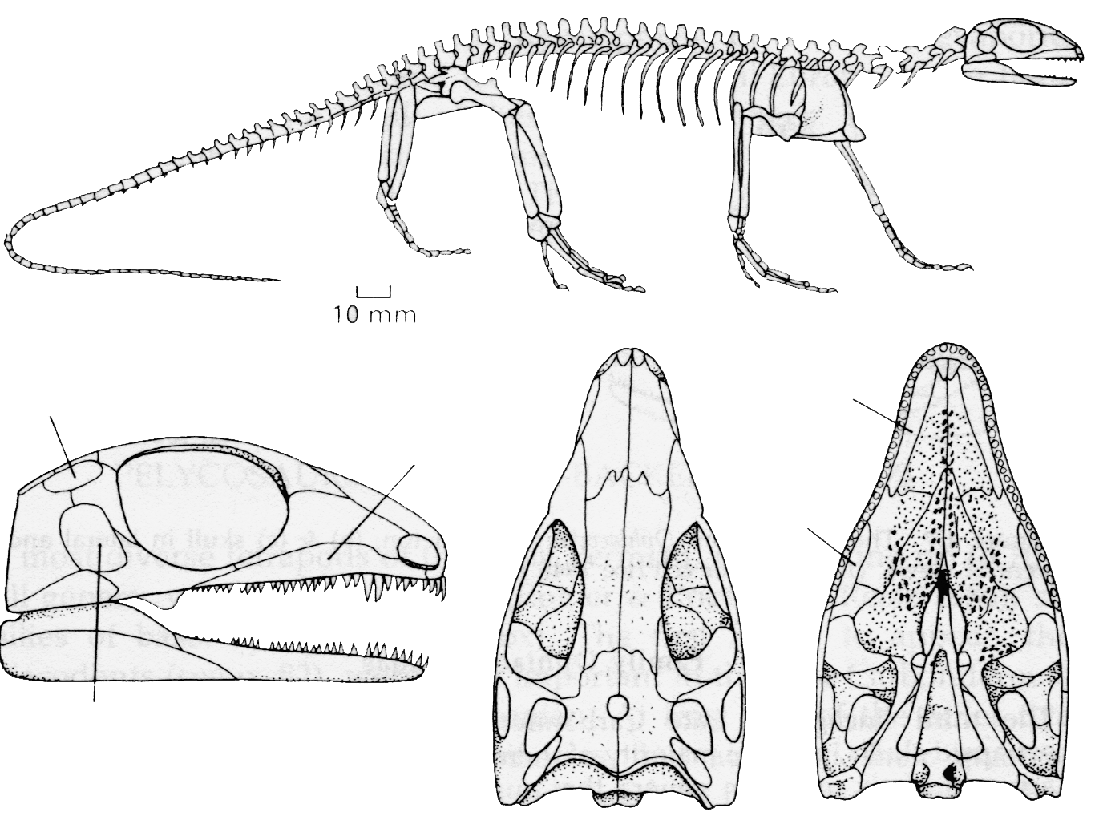
Un Diapside primitivo (tardo Carbonifero)
Petrolacosaurus, un Araeoscelidae, è il primo diapside conosciuto
Assenza di timpano
Petrolacosaurus kansansis
Finestra temporale
superiore
coana
mascellare
Finestra
suborbitale
Finestra temporale
inferiore

Slide 3
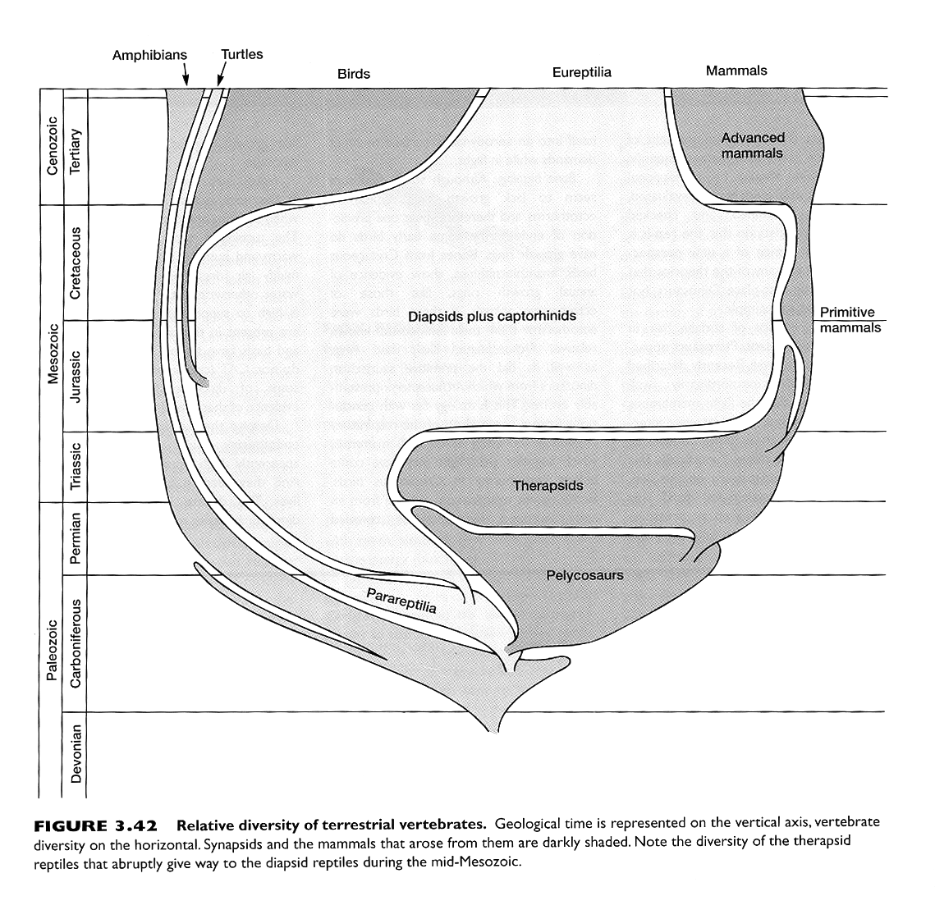
diapsidi

Slide 4
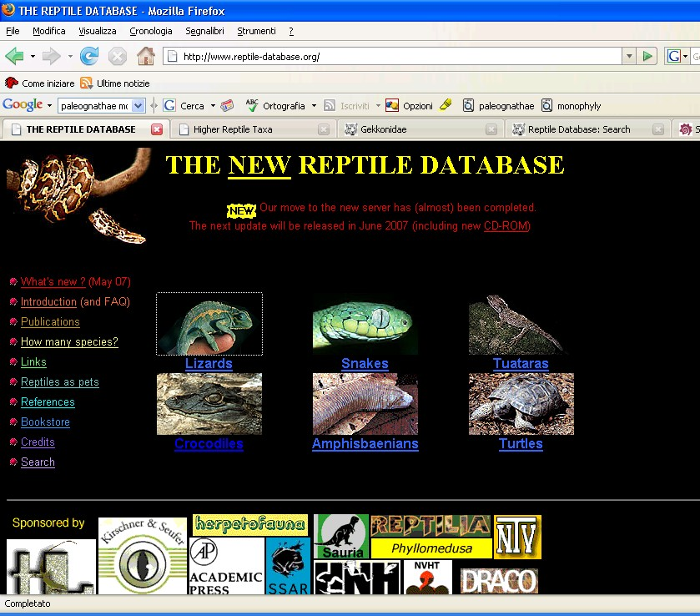
http://www.reptile-database.org/

Slide 5
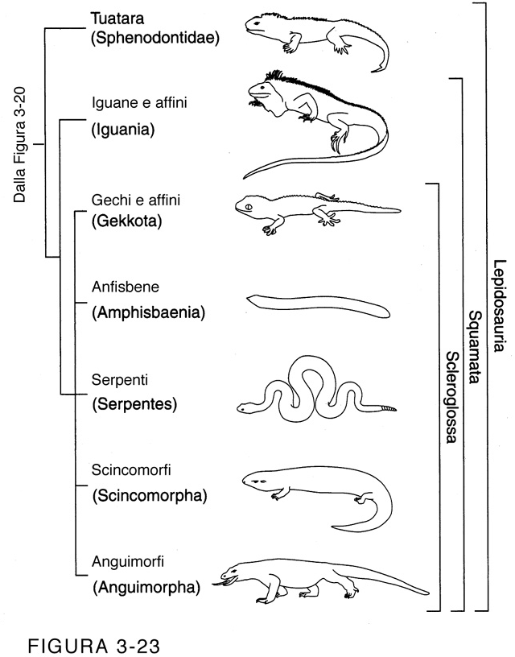
Diapsidi viventi: due finestre temporali
Lepidosauri
Lepidosauri:
Fessura cloacale trasversale
Squame epidermiche embricate
Autotomia
•Crescita determinata
Squamati:
Organi copulatori pari
Perdita barra temporale inferiore
Scleroglossi:
Lingua modificata
3000 specie di “sauri” 2500 specie di serpenti
2 specie di rincocefali
Una filogenesi «sbagliata»

Slide 6
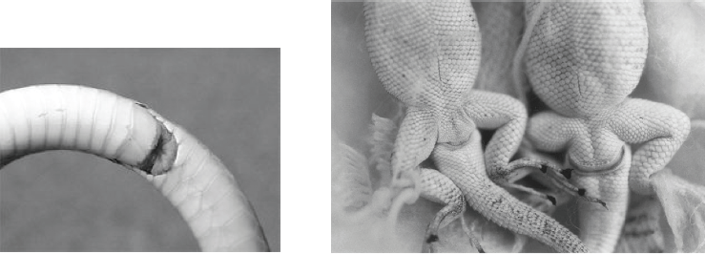
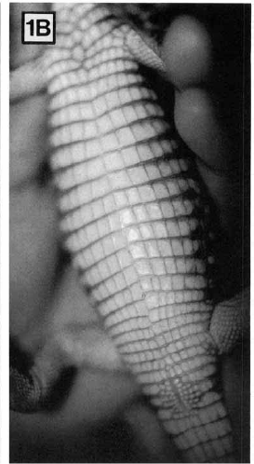

Slide 7
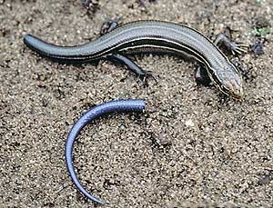
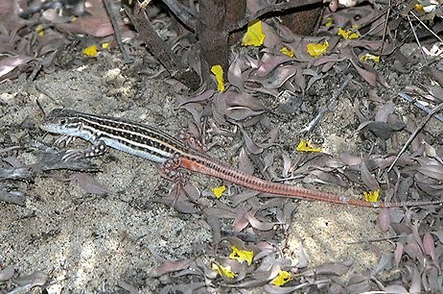
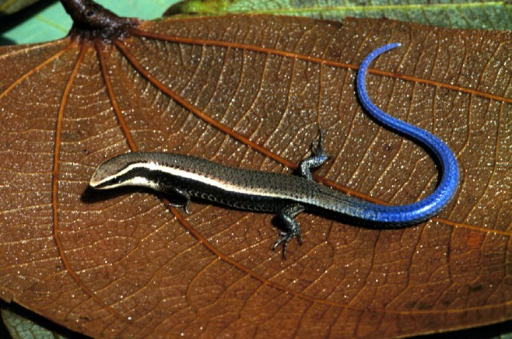

Slide 8
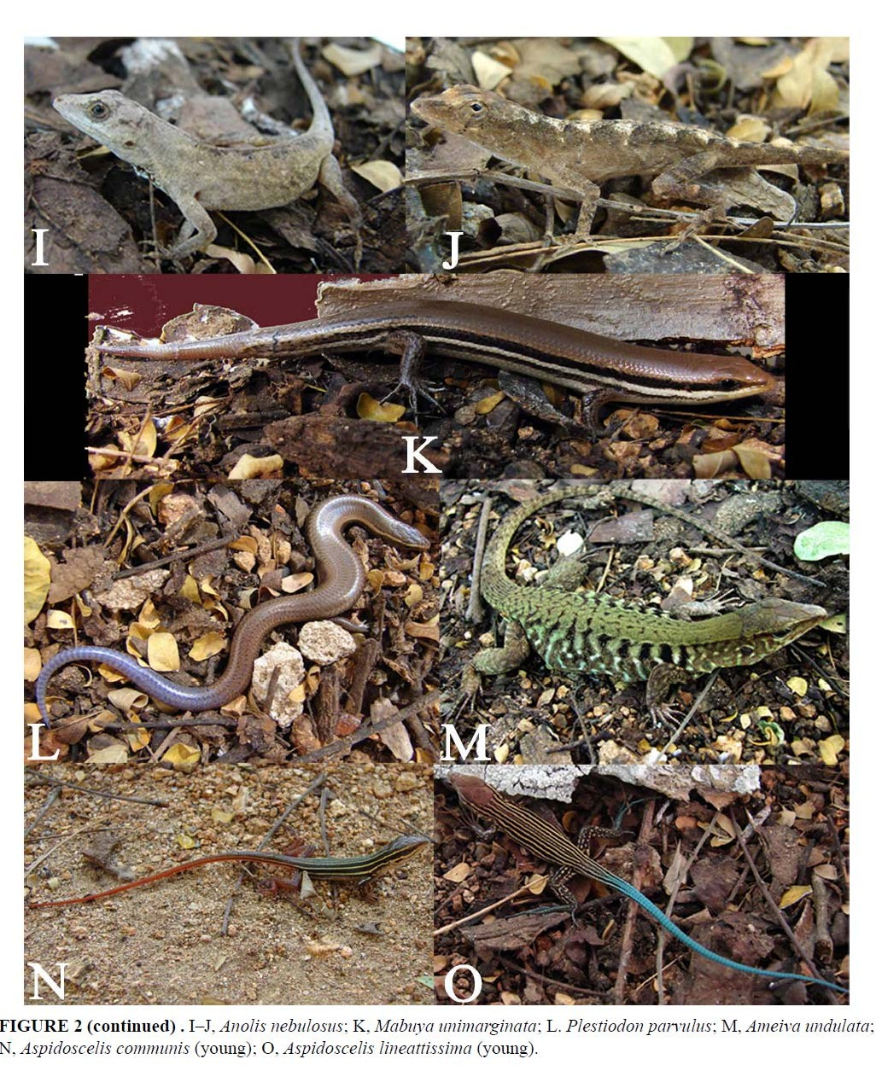
Coda giovani adulti

Slide 9
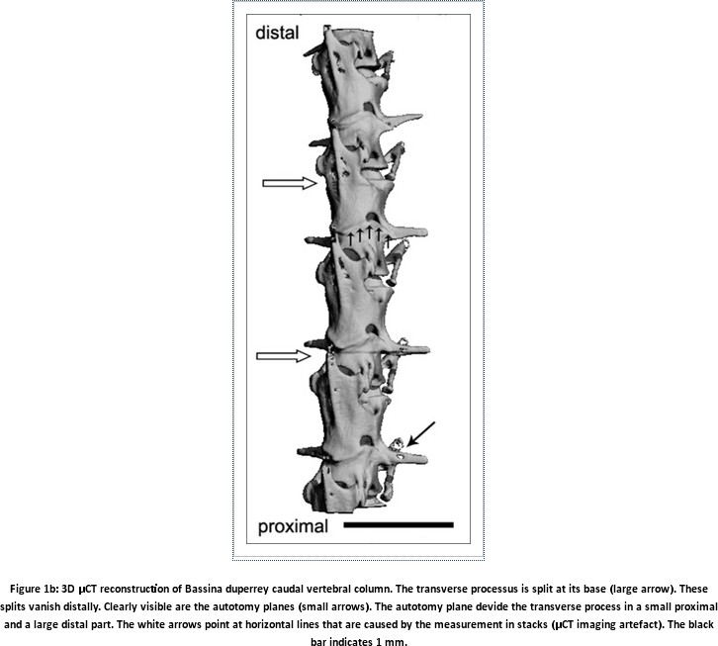

Slide 10
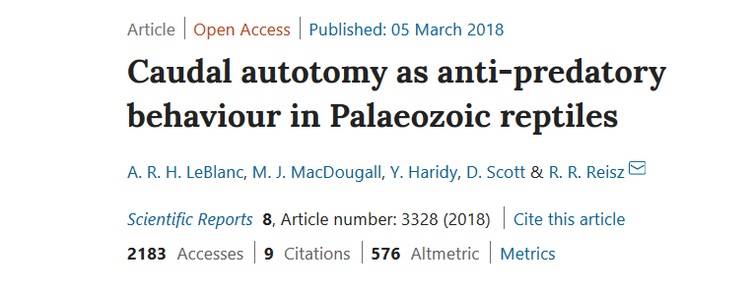
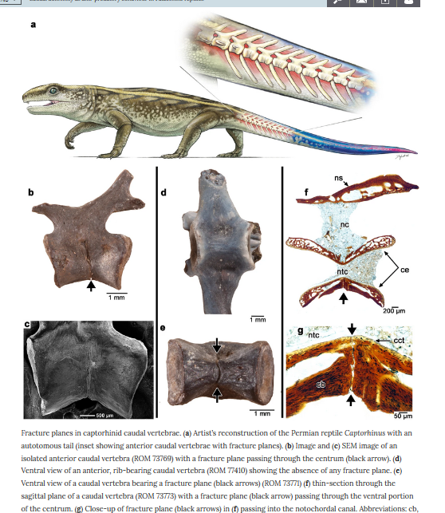

Slide 11
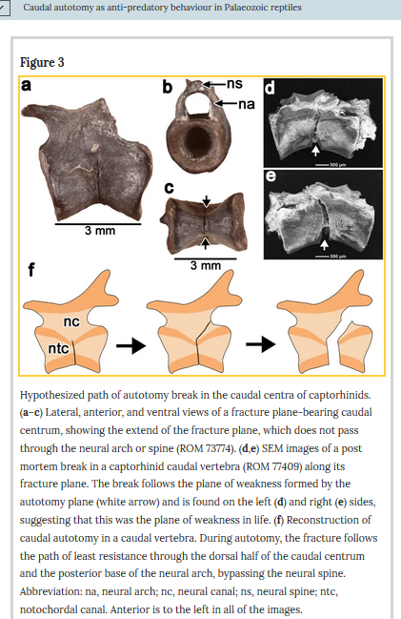
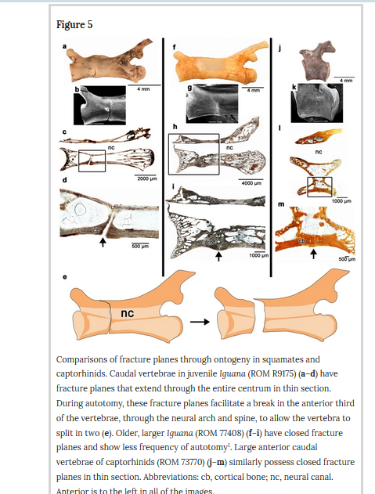

Slide 12
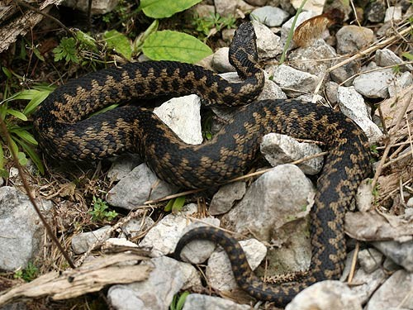
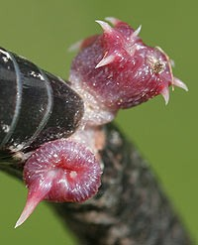

Slide 13
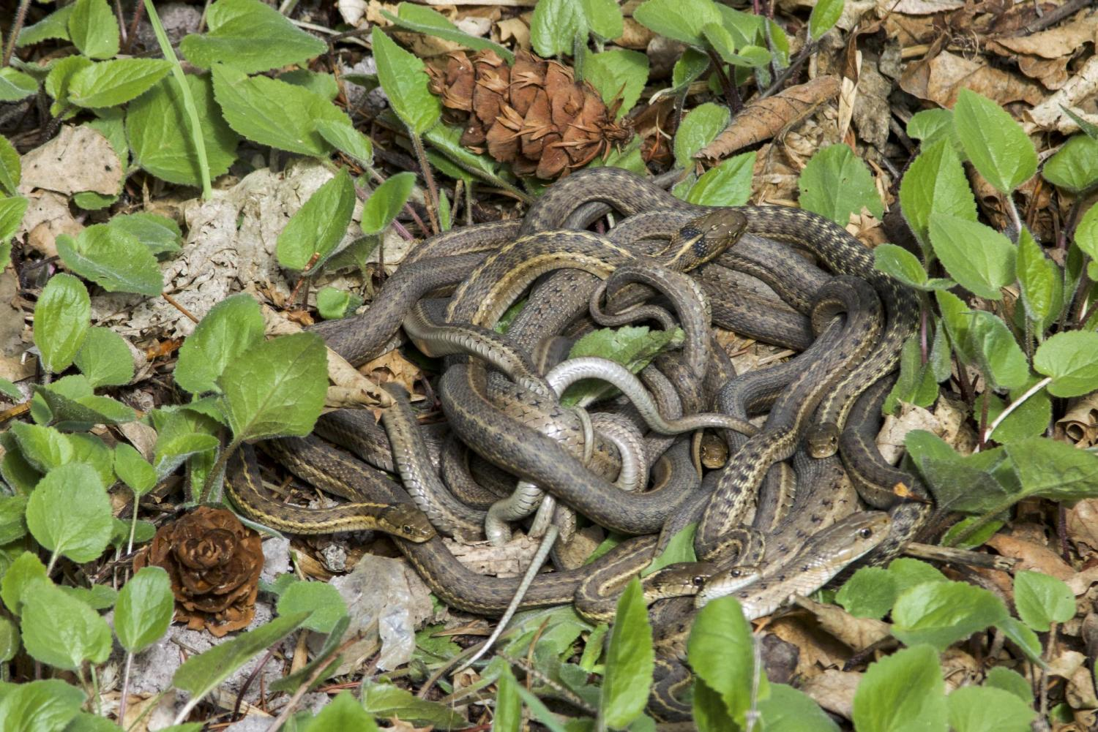

Slide 14
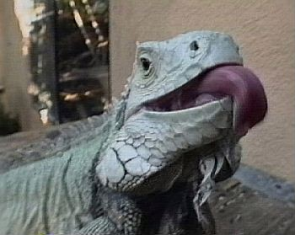
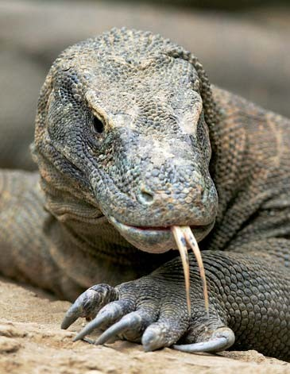

Slide 15
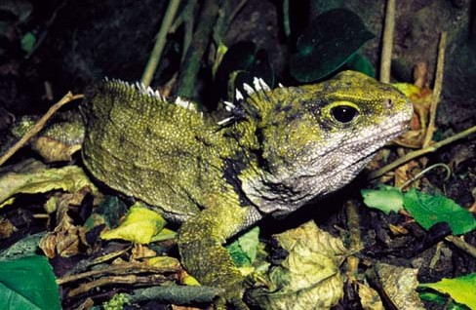
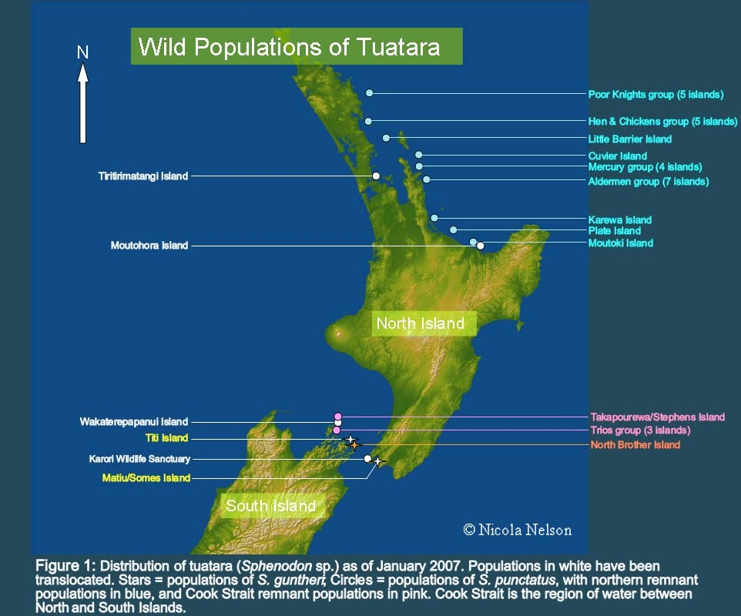
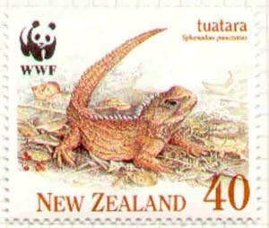
Order Rhynchocephalia
Suborder Sphenodontida Family Sphenodontidae (Tuataras)

Slide 16
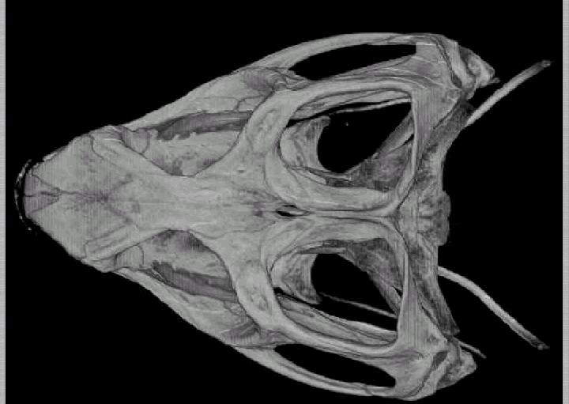
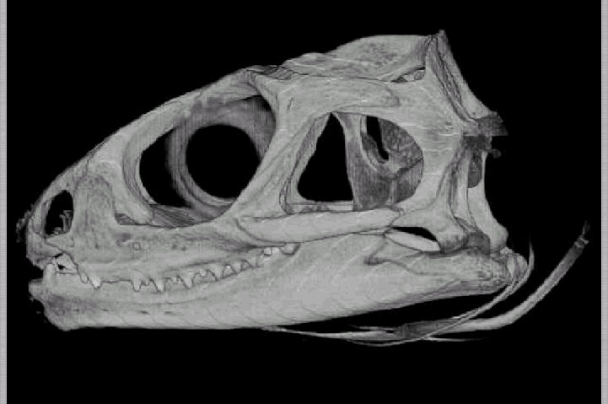
Sphenodon
Cranio “primitivo”
Occhio parietale
Dentatura particolare (masticazione)
Assenza di timpano

Slide 17
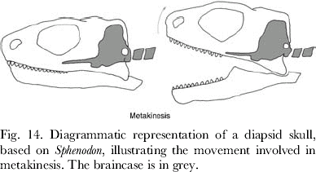
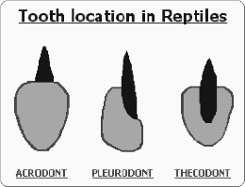

Slide 18
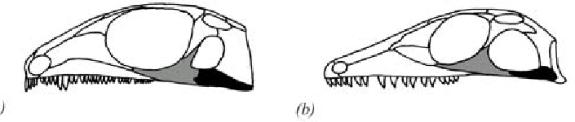
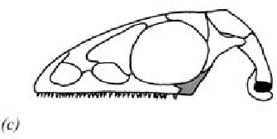
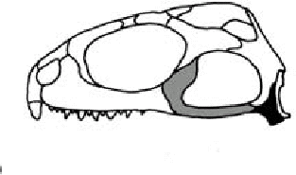
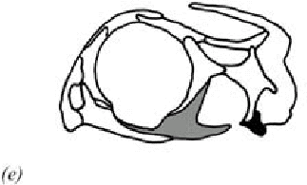
Primitivi diapsidi
giugale
quadratogiugale
tutara adulto
embrione di tuatara

Slide 19
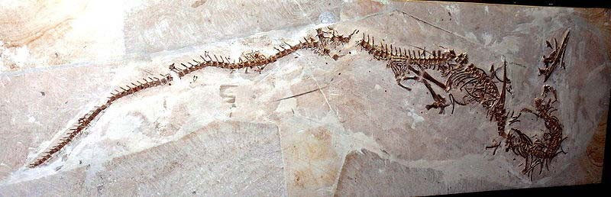
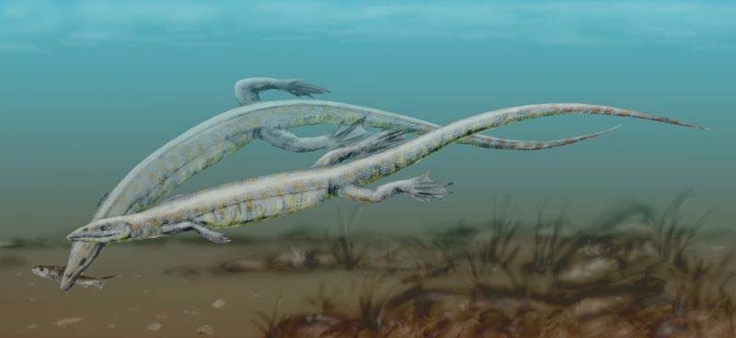
Sphenodontidae del triassico
Pleurosaurus

Slide 20
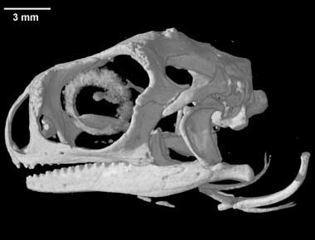
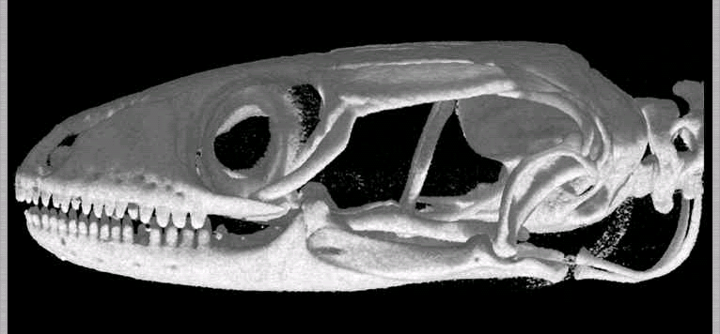
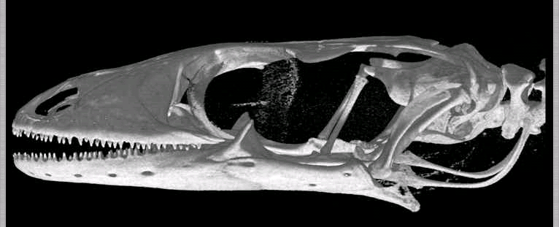
Iguania
Anguimorpha
Gekkonidae

Slide 21
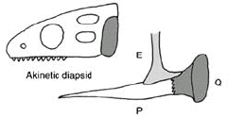
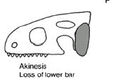
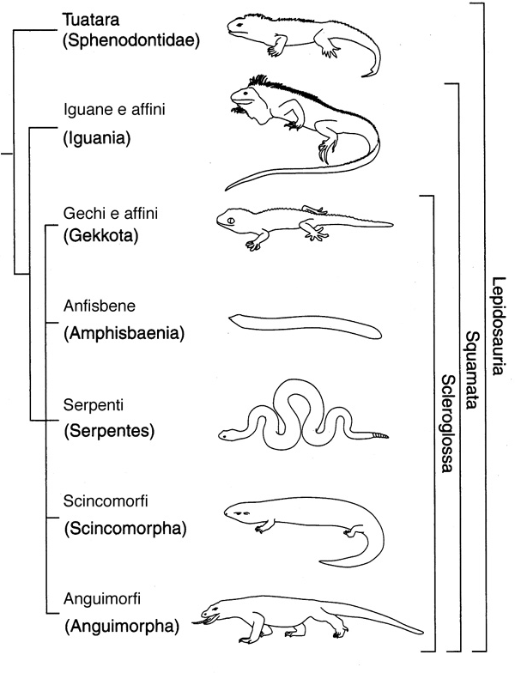
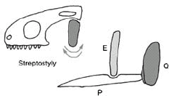


Slide 22
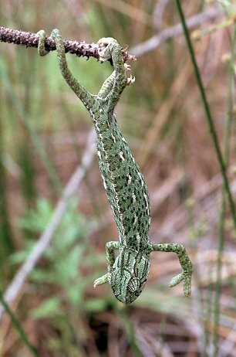
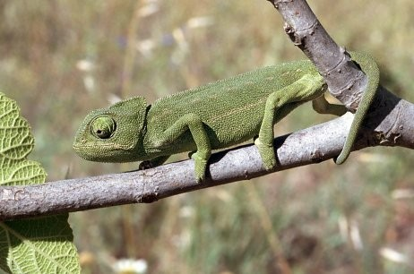
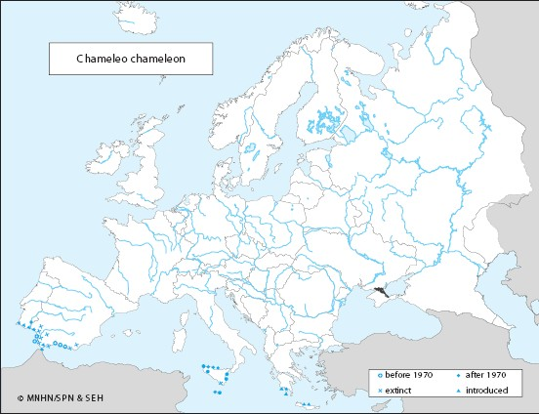
Order Squamata
Suborder Sauria (Lacertilia) Infraorder Iguania
Chamaeleo chamaeleon
Piedi zigodattili, Occhi indipendenti, Coda prensile

Slide 23
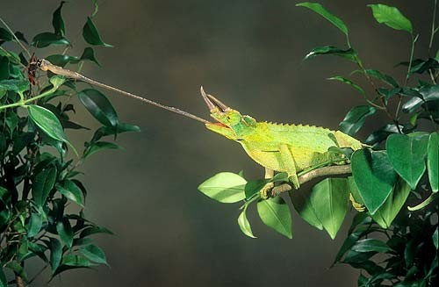
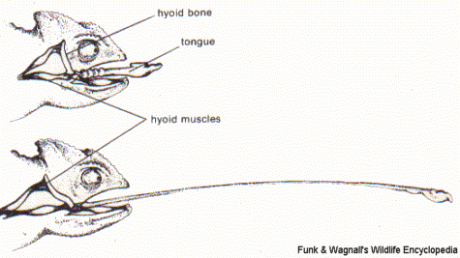


Slide 24


Slide 25


Order Squamata Suborder Sauria Infraorder Iguania
Iguana iguana

Slide 26




Order Squamata Suborder Sauria Infraorder Iguania
Amblyrhynchus cristatus

Slide 27




Conolophus marthae

Slide 28

Infraorder IGUANIA
Family Polychrotidae (Anoles)
The genus Anolis includes nearly 380 species of neotropical lizards and is the most species-rich amniote genus (Uetz 2013).
Anoles have been thoroughly investigated in various ecological, behavioral, and evolutionary studies (Losos 2009)

Slide 29
Ecology-Evolution
The ‘ecomorphs’, habitat-specialized species

Slide 30
The “twig” ecomorph
The “trunk-ground” ecomorph

Slide 31


Dewlap diversity, Ethology-Evolution

Slide 32


The green anole lizard Anolis carolinensis is the first reptilian genome to be sequenced

Slide 33


Slide 34






Order Squamata
Suborder Sauria (Lacertilia) Infraorder Gekkota
Tarentola mauritanica
Euleptes europaea
Hemidactylus turcicus
Cranio cinetico
«Toe pads»
Vita notturna

Slide 35




Slide 36




Slide 37


Slide 38

The most likely hypothesis suggests that adhesive toepads evolved 11 times and were lost nine times

Slide 39


INFRAORDER: Gekkota Family Pygopodidae

Slide 40

https://www.youtube.com/watch?v=gzm7yD-JuyM

Slide 41


Order Squamata
Suborder Sauria (Lacertilia) Infraorder Scincomorpha
Podarcis muralis
Podarcis siculus

Slide 42


Order Squamata
Suborder Sauria (Lacertilia) – Infraorder Scincomorpha
Chalcides ocellatus

Slide 43



Slide 44



Slide 45


Order Squamata
Suborder Sauria (Lacertilia) Infraorder Diploglossa Family Anguidae
Anguis fragilis

Slide 46


Infraorder Platynota (Varanoidea)
Heloderma suspectum
Venom is produced in glands in the lower jaw and expressed along grooved teeth as the animal bites.
Once the lizard bites, it generally holds on and chews more of the venom into its victim
Varanus komodensis

Slide 47


Slide 48



Suborder Amphisbaenia
Family Amphisbaenidae
Blanus cinereus
Blanus strauchi

Slide 49


Slide 50



Slide 51

I serpenti
Carnivori. Assenza di arti.
Assenza di palpebre mobili. Assenza di timpano. “Risistemazione” degli organi interni.
Termorecettori.
Alethinophidia Scolecophidia Anilioidi

Slide 52



Forte Asimmetria degli organi interni

Slide 53


cerniere

Slide 54


Alethinophidia
Mancano entrambe le arcate temporali

Slide 55


Slide 56



Slide 57

Proteroglifi/solenoglifi
Opistoglifi
Aglifi

Slide 58


https://www.youtube.com/watch?v=b0N06mEtm2Q&t=1891s

Slide 59

Superfamily Xenophidia
Natrix natrix

Slide 60


Hierophis viridiflavus

Slide 61




Zamenis longissimus
Zamenis longissimus
Zamenis lineatus

Slide 62



Elaphe quatuorlineata

Slide 63



Vipera aspis

Slide 64



Suborder Ophidia (Serpentes) - Snakes (Scolecophidia) Superfamily Typhlopoidea
Typhlops vermicularis
FOSSORI

Slide 65


Slide 66


Leptotyphlops dulcis

Slide 67



Suborder Ophidia (Serpentes) – Snakes Anilioidea
FOSSORI
Close-up showing the rounded, blunt head - ideal for burrowing.
The tail is short and thick and ends in a blunt point.

