Slide 1
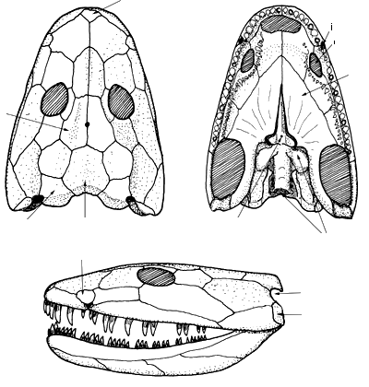
Ichthyostega - scheletro del cranio
Rostrale
mediale
Coana interna
Coana esterna
pterigoide
parietale
tabulare
postparietale
Forame ipofisario
Tectale anteriore
neurocranio
Incisura temporale
preopercolare

Slide 2
Una nuova interpretazione di Ichthyostega: la colonna vertebrale
Diversificata colonna vertebrale che consente movimenti dorsoventrali del corpo.
Mentre Achantostega nuota come un pesce Ichthyostega doveva nuotare in modo diverso

Slide 3
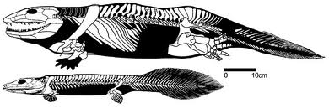
Confrontando l’ittiostega con acantostega:
La morfologia dei cinto scapolare e pelvico (soprattutto) sembra più robusta e meglio adattata a vita sulla terra.
L'ittiostega era anche fornito di un maggior numero di costole
di supporto e di vertebre più forti, con zigapofisi più sviluppate rispetto ad Acanthostega

Slide 4
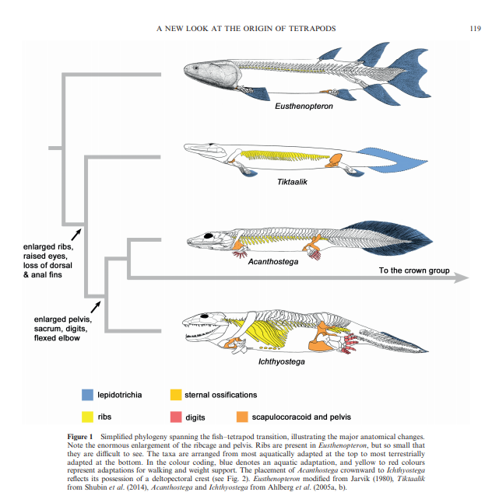

Slide 5
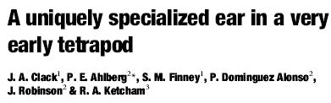
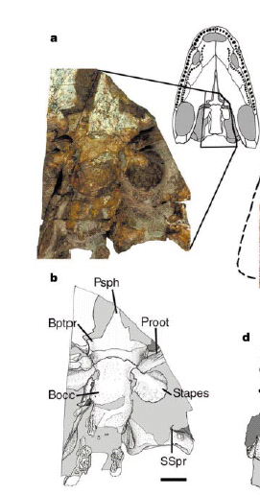
Una nuova interpretazione di Ichthyostega: una columella specializzata

Slide 6
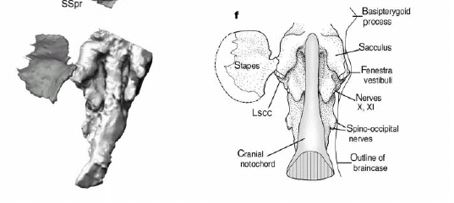
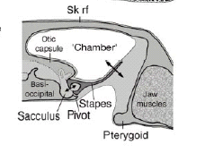
Una nuova interpretazione di Ichthyostega: una columella specializzata

Slide 7
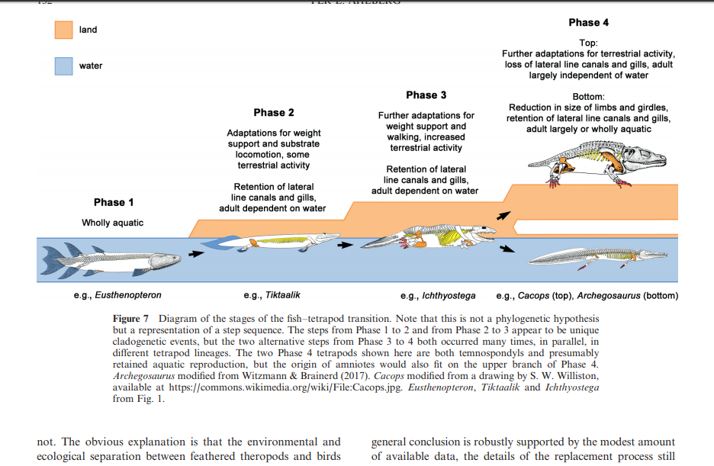

Slide 8
Morphology of the earliest reconstructable tetrapod Parmastega aelidae
The known diversity of tetrapods of the Devonian period has increased markedly in recent decades, but their fossil record consists mostly of tantalizing fragments. The framework for interpreting the morphology and palaeobiology of Devonian tetrapods is dominated by the near complete fossils of Ichthyostega and Acanthostega; the less complete, but partly reconstructable, Ventastega and Tulerpeton have supporting roles. All four of these genera date to the late Famennian age (about 365–359 million years ago)—they are 10 million years younger than the earliest known tetrapod fragments^{5,10}, and nearly 30 million years younger than the oldest known tetrapod footprints³⁵. Here we describe Parmastega aelidae gen. et sp. nov., a tetrapod from Russia dated to the earliest Famennian age (about 372 million years ago), represented by three-dimensional material that enables the reconstruction of the skull and shoulder girdle. The raised orbits, lateral line canals and weakly ossified postcranial skeleton of P. aelidae suggest a largely aquatic, surface-cruising animal. In Bayesian and parsimony-based phylogenetic analyses, the majority of trees place Parmastega as a sister group to all other tetrapods.

Slide 9
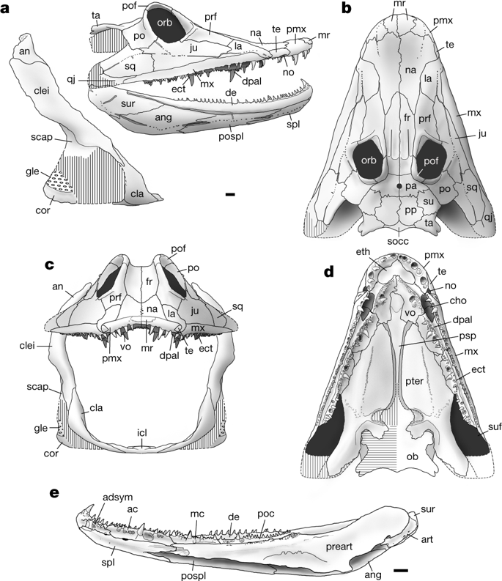

Slide 10
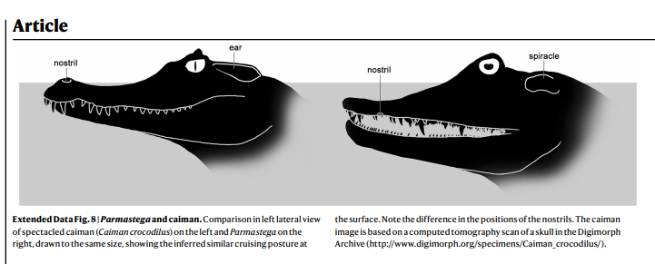

Slide 11
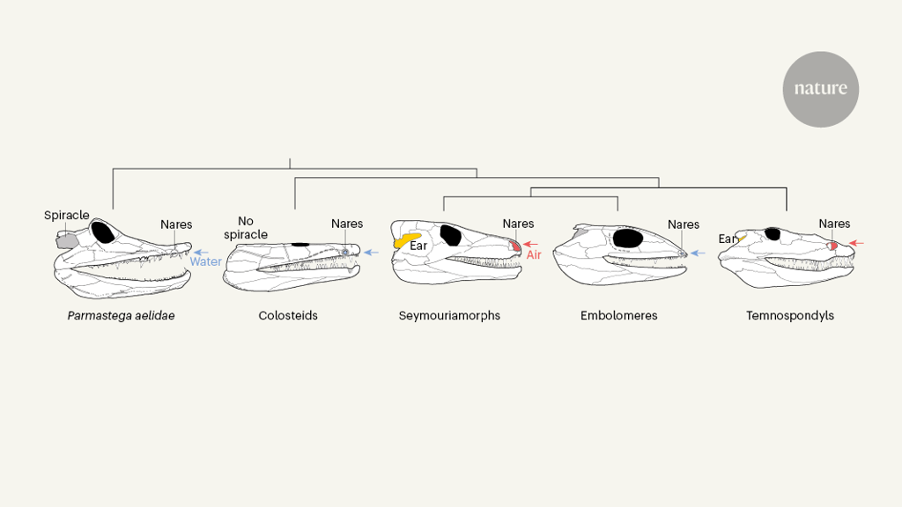
The evolution of tetrapod skulls. Beznosov et al.¹ report 372-million-year-old fossils of a four-limbed vertebrate (tetrapod) from just before the time when tetrapods moved onto land. They call this newly discovered species Parmastega aelidae. Its nasal passages (nares) are close to its jaw and would have been positioned under water. Water passing though the nares (blue arrow) would have been used for breathing when it reached the gills (not shown). P. aelidae could also breathe air directly through a skull opening called a spiracle (grey). Comparing these ancestral features of P. aelidae with other tetrapods reveals patterns of evolutionary change. The other tetrapods shown are: an early tetrapod group called colosteids; seymouriamorphs and embolomeres, members of a lineage that gave rise to amniotes (birds, reptiles and mammals); and temnospondyls, which gave rise to modern amphibians (such as frogs and salamanders). Colosteids lacked spiracles and breathed solely through their gills using water taken up through the nares. Compared with P. aelidae, seymouriamorphs and temnospondyls had larger and higher nares, which they would have used to breathe air (red arrow). These tetrapods lacked spiracles, and had ears (yellow) instead in that area of their skull. Embolomeres retained the breathing system used by P. aelidae.

Slide 12
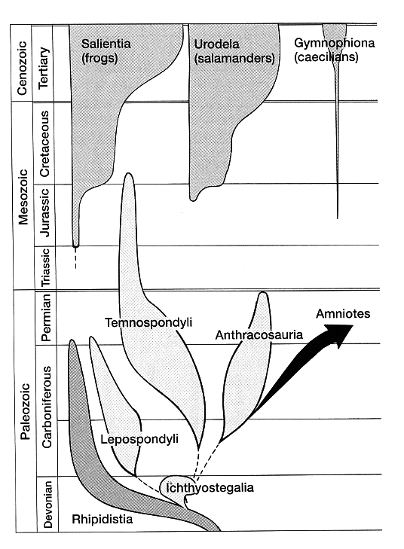
I tetrapodi anamni

Slide 13
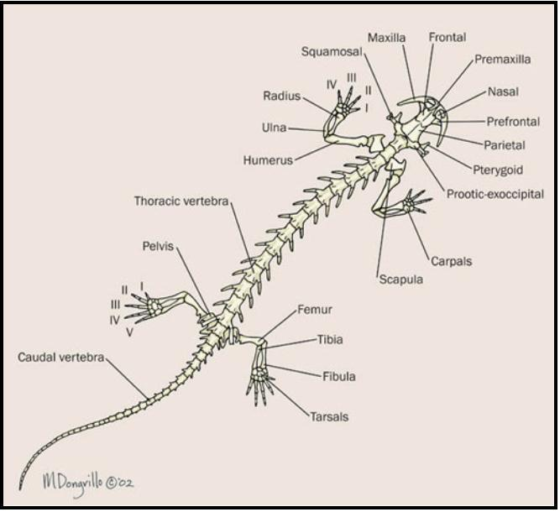
Polmoni sacciformi
Respirazione cutanea
Larve acquatiche
Escrezione ammoniotelica-ureotelica

