Slide 1
Nucleic acid labelling and RNA-DNA/protein interaction
REGE

Slide 2
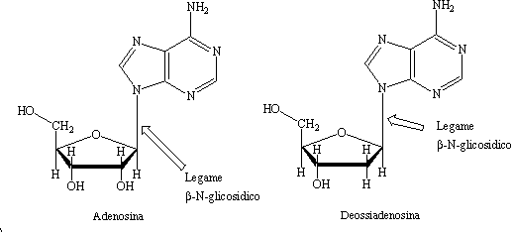
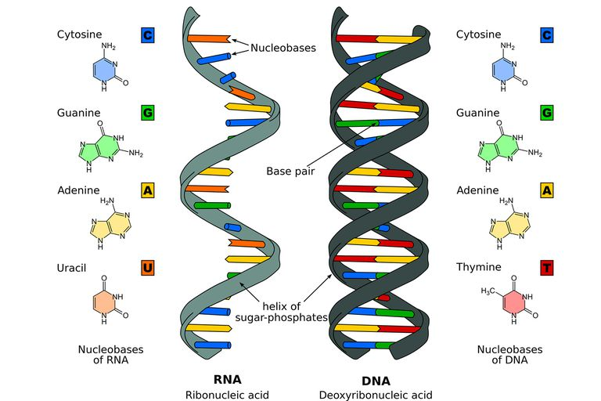
The nucleic acids: RNA and DNA
Ribose vs Desossiribose
Uracile in place of Timine
Single strand vs double strand

Slide 3
How to get your Nucleic Acids
Organic Nucleic Acid extraction
Cell Lysis (using detergents)
Protein extraction and separation from the nucleic acid phase (e.g. using Phenol/chloroform)
Precipitation of nucleic acids (using Ethanol of isopropanol)
The purified RNA or DNA has to be stored at -20/-80 °C

Slide 4
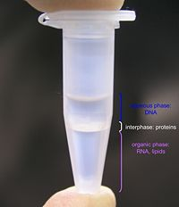
How to get your Nucleic Acids
Genomic DNA isolation
Organic extraction methods
The cells are lysed using a detergent, and then mixed with phenol, chloroform, and isoamyl alcohol.
Invert several times to mix
Centrifuge
Transfer as much of each aqueous layer as possible to new tubes
Residual protein and RNA contamination can be eliminated by proteinase K and Rnase treatment
Aqueous phase: DNA /RNA
interphase: proteins
organic phase: lipids
Precipitation by NaAC and Ethanol addition
Note:
The pH of the mixture determines which nucleic acids get purified. Under neutral conditions (pH 7-8), both DNA and RNA partition into the aqueous phase.

Slide 5
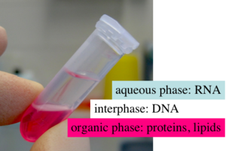
How to get your nucleic Acids
RNA isolation
Phenol/Chloroform Extraction
or
Guanidinium thiocyanate-phenol-chloroform extraction
Add an equal volume (0.5 mL) of water-saturated phenol:chloroform:isolamyl alcohol (25:24:1)
Invert several times to mix
Centrifuge
Transfer as much of each aqueous layer as possible to new tubes
Precipitation by LiCl and Ethanol addition
Note:
The pH of the mixture determines which nucleic acids get purified. Under acidic conditions (pH 4-6), DNA partitions into the organic phase while RNA remains in the aqueous phase.
Guanidinium thiocyanate denatures proteins, including RNases
LiCl is preferred to NaAc becouse it precipitates DNA ineficiently leading to more pure RNA pellet

Slide 6
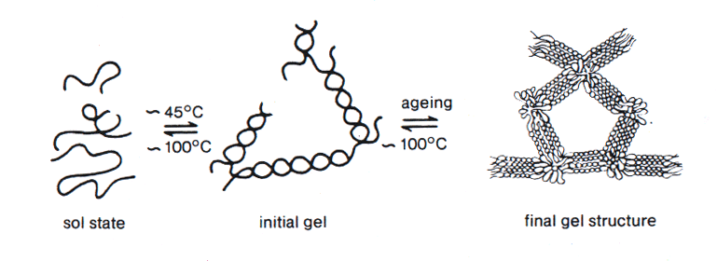
How to see your Nucleic Acids
The agarose is a polysaccharide composed of D-galactose and 3,6-anhydro-L-galactose residues
The polyacrylamide gel is formed by the copolymerization of acrylamide and of an agent which forms crosslinks (usually N, N'-methylene bisacrilamide) to form a three-dimensional lattice

Slide 7
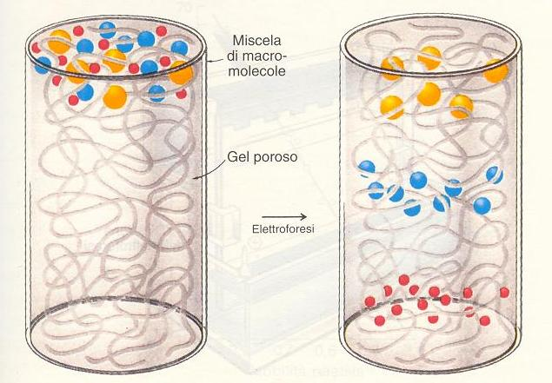
How to see your Nucleic Acids
Sieve effect
-
For linear fragments of DNA and/or RNA the migration distance is inversely proportional to the size of the molecule (that corresponds to its length in bases)
+

Slide 8
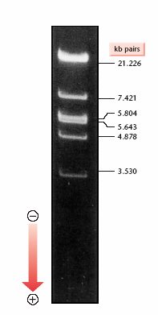
How to see your Nucleic Acids
Electrophoresis of nucleic acids
Electrophoresis is a biochemical technique which allows to separate molecules with charge based on their different molecular weight. The electrophoretic separations is carryed out through a gel.
The gel can be made by:
✔agarose (separation range : 0.5-20 kb)
✔polyacrylamide (separation range 10-500 bp)

Slide 9
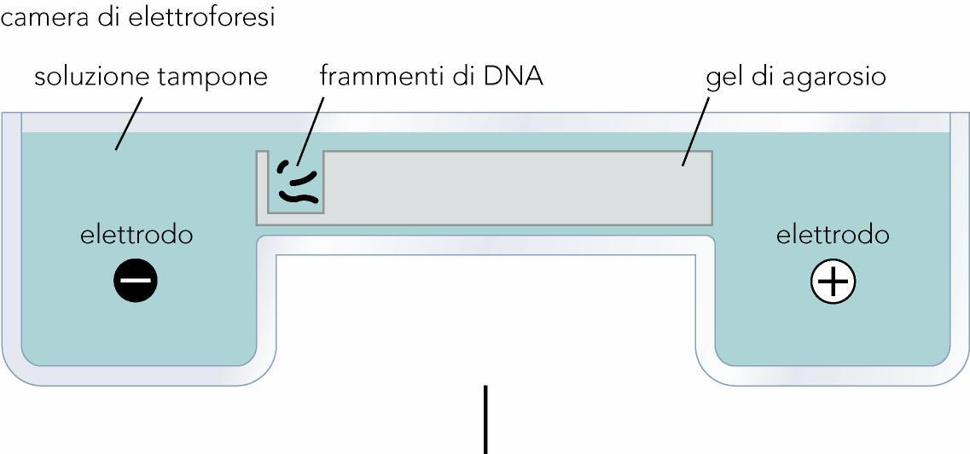
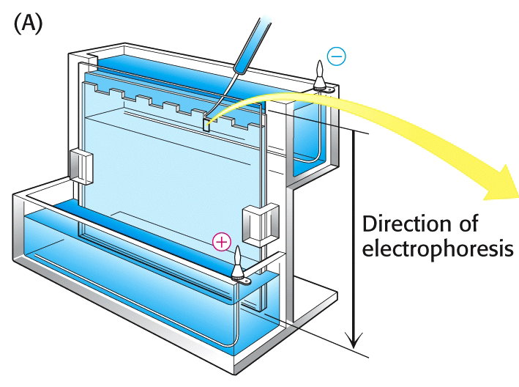
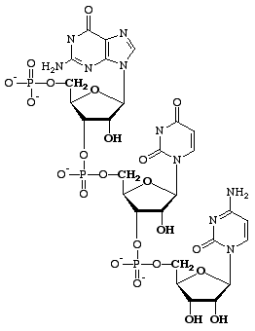
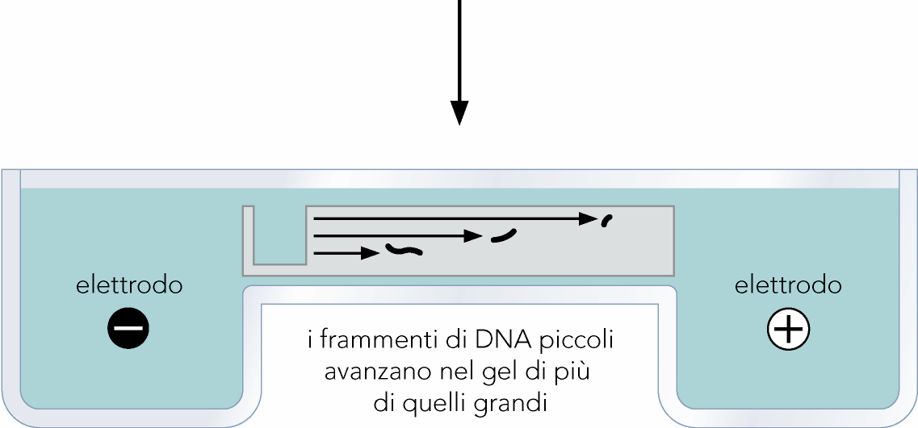
How to see your Nucleic Acids
Electrophoresis
✔ horizzontal
agarose
✔ vertical
acrylamide

Slide 10
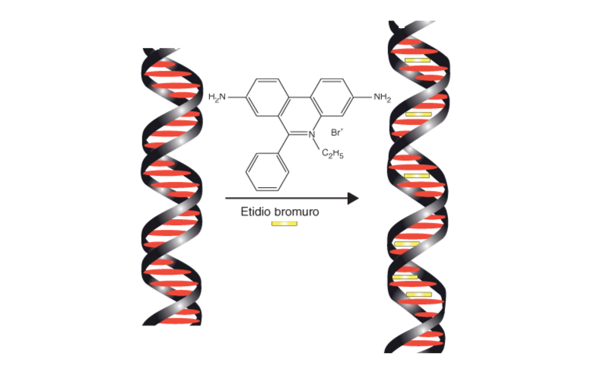
How to see your Nucleic Acids
ethidium bromide (EtBr):
fluorescent dye that
absorbs UV light at 300 nm resulting yellow-orange
Useful both for visualise and quantify the sample: the intensity of the fluorescence is, in fact, proportional to the amount of the sample.

Slide 11
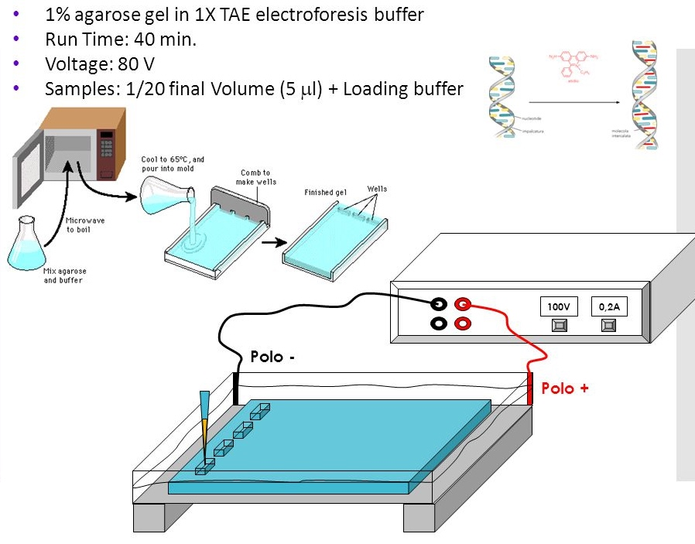
How to prepare agarose gel:
add ethidium bromide
dissolve the agarose powder in a buffer solution at 100°C
https://www.youtube.com/watch?v=wXiiTW3pflM

Slide 12
ON
100V
0,2A
Polo -
Polo +

Slide 13
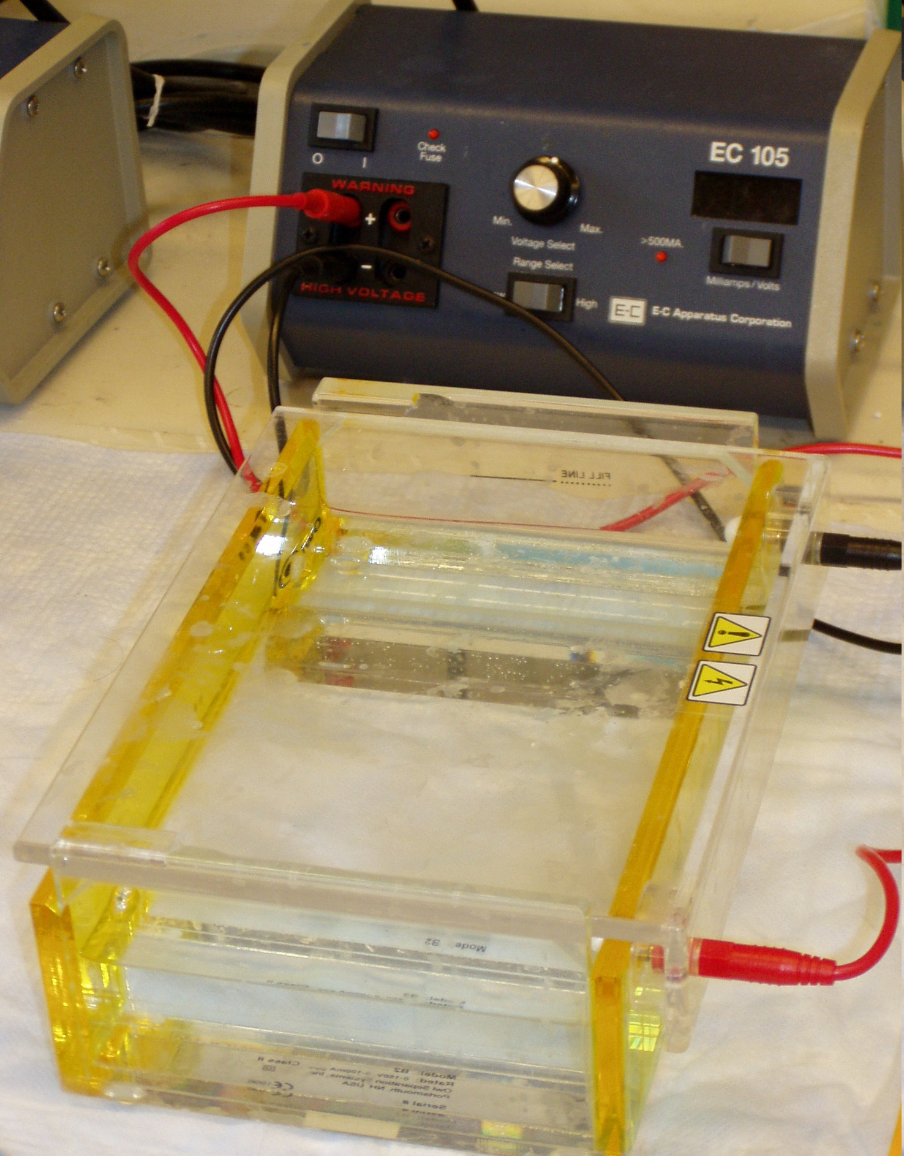
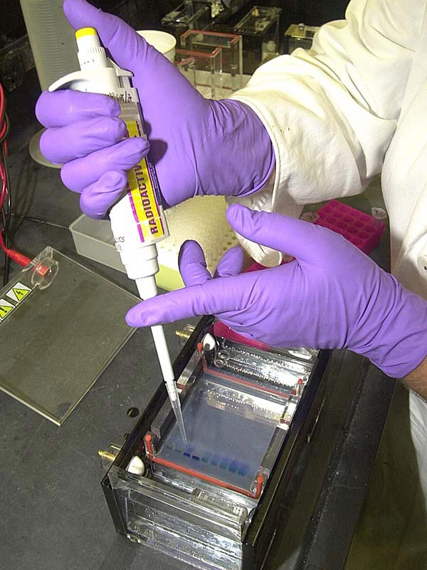
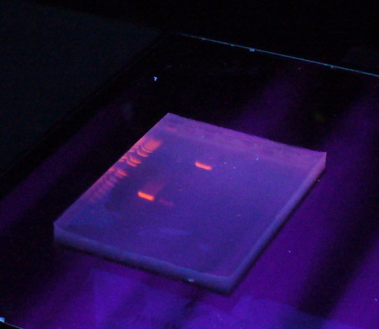
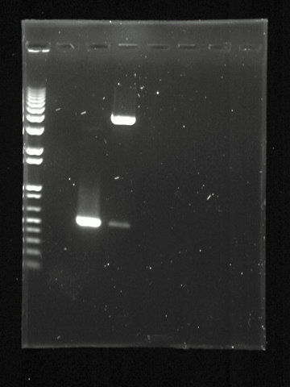
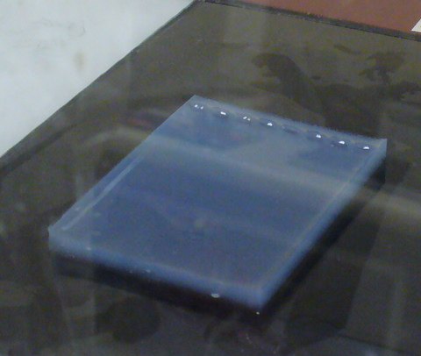

Slide 14
How to see Nucleic Acids
Visualizing nucleic acids:
Nucleotides labeling
Southern blot
Northern blot
EMSA

Slide 15
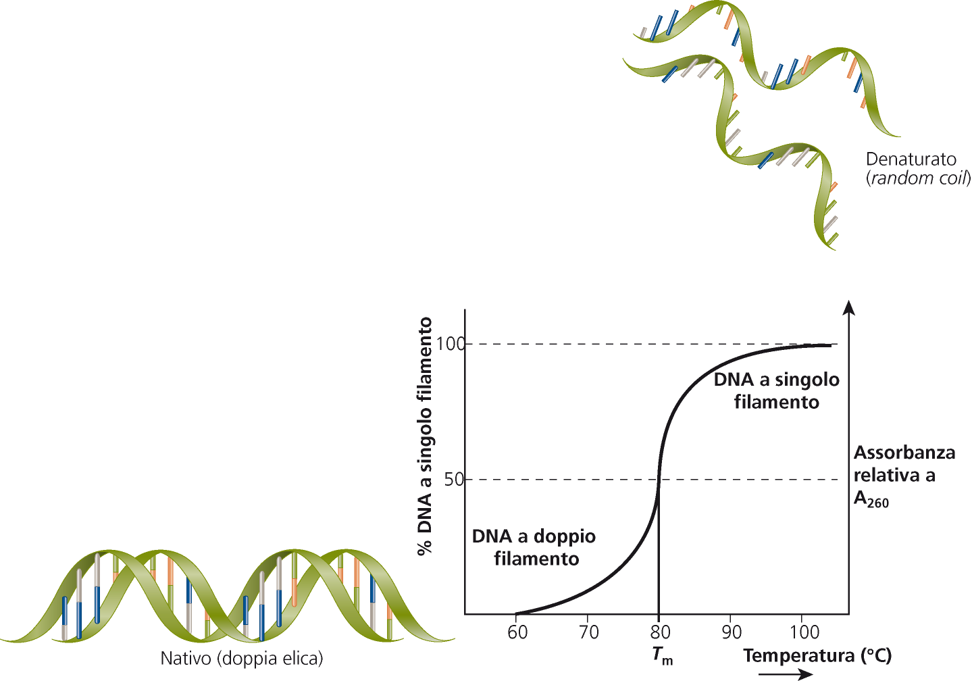
Preliminary: Nucleic acid can be denaturated and renaturated
denaturated DNA (random coil)
DNA single
strand
% DNA single helix
Relative
Absorbance
Tm
DNA double
strand
Native DNA (double helix)
Temperature °C

Slide 16
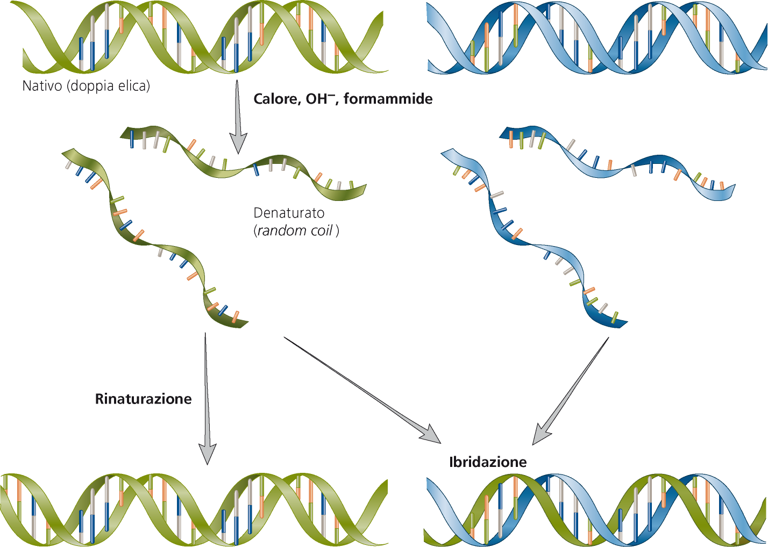
Native DNA (double helix)
Temperature, OH⁻, formamide
DNA
denaturated DNA (random coil)
RNA
renaturation
hybridation

Slide 17
How to see your Nucleic Acids
Labelled probes
The labelling is a basic technique of molecular biology, represents a preliminary stage for applications related to the study of gene expression.
The labelling allows to determine the position of a particular nucleic acid molecule on a membrane or on a gel, on a chromosome, within a tissue or in a cell.
The labelling produces a signal that can be appropriately detected and allows the viewing of the specific nucleic acid molecule

Slide 18
How to see your ”specific” Nucleic Acids
Making labelled probes
✔ Radioactive tracer
non radioactive tracer
(Fluorescence, Chemioluminescence)
✔ Terminal labelling
internal labelling
✔ DNA probe
RNA probe

Slide 19
How to see your ”specific” Nucleic Acids
✔ Radioactive tracer
benefits: high sensitivity
disadvantages: dangerous because mutagenic
short life
non radioactive tracer
benefits: safety
long life
disadvantages: lower sensitivity

Slide 20
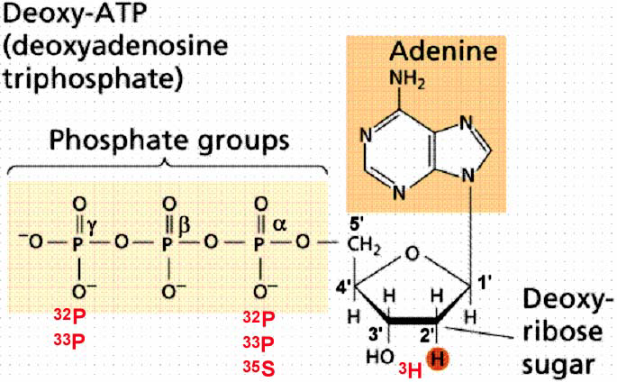
Labelling nucleotides with radioisotopes
To label the DNA are used radioisotopes that become
part of the nucleotides.
It is possible to synthesize nucleotides in which:
A phosphorus atom is replaced with ³²P or ³³P
An oxygen atom of the phosphate group is replaced with ³⁵S
- One or more H atoms are replaced with ³H
Autoradiography is a means of detecting radioactive compounds with a photographic emulsion. The form of emulsion favored by molecular biologists is a piece of x-ray film.

Slide 21
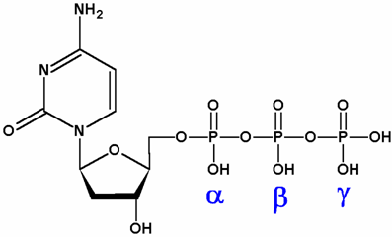
Labelling nucleotides with radioisotopes
The radioactive atom in a labelled nucleotides or they can be:
- Added to one end of the probe (external labelling)
or
- Inserted into the nucleic acid chain (internal labelling).
³²P
dNTP labelled at position α (dATP e dCTP)
NTP labelled at position γ (ATP) e α (ATP, UTP, CTP e GTP)

Slide 22
Non radioactive tracers
✔ fluorochromes (direct labelling)
✔ digoxigenin or Biotin (undirect labelling)

Slide 23
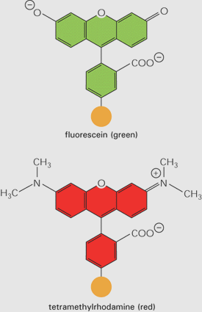
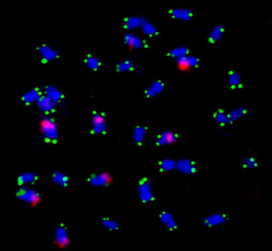
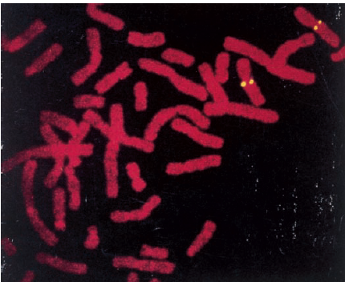
Non radioactive tracers
Fluorescence
It works with nucleotides linked to fluorochromes (Fluorescein, rhodamine) that can be detected a fluorescence microscope or other fluorescence detectors

Slide 24
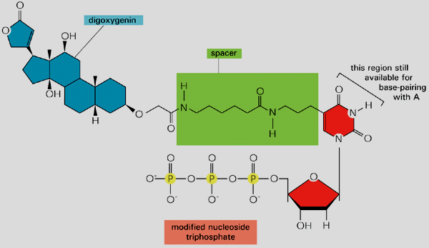
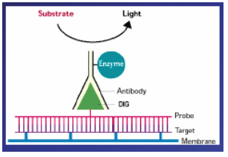
Non radioactive tracers
Chemiluminescence
Nucleotides digoxigenin marked:
Digoxigenin is a cardiotonic steroid isolated from the Digitalis purpurea.
The probe is bound and recognized by an immuno-enzimatic system that uses an antibody against the digoxigenin (anti-DIG). The antibody is ligated to an alkaline phosphatase. The presence of such a complex is reveiled by adding a chromogenic or luminogenic substrate that only “emits” when is processed by the alkaline phosphatase.
The high specificity of the antibody ensures the high specificity of the detection.

Slide 25
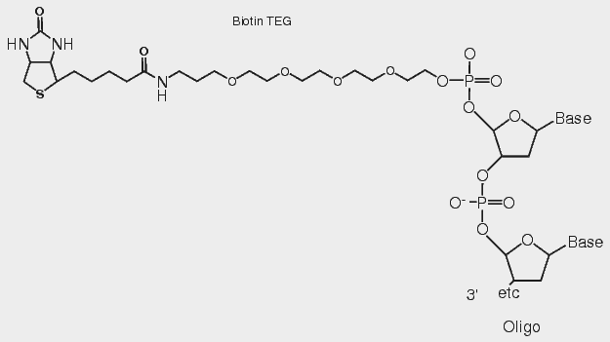
Non radioactive tracers
Biotinilated nucleotides
Biotinilated nucleitides can be incorporated in the DNA both terminally and internally.
The Biotin is specifically bound by avidin or streptavidin. Therefore it is possible to use avidin or spreptavidin marked with fluorophores or linked to enzymes (phosphatases or peroxidases). Providing chromogenic or fluorogenic substrates for these enzymes you allow the production of a measurable signal.
Avidin
Biotin

Slide 26
Labelled Nucleic Acids
DNA/RNA Oligonucleotides probes can be terminally labelled with radioactive tracer
Double stranded DNA probes can be internally labelled with radioactive tracer
RNA probes can be in vitro transcribed and internally labelled with radioactive tracer

Slide 27
How to label DNA/RNA oligonucleotides
T4 Kinase enzyme is employed to transfer a radioactive phosphorus atom from γ ATP to the 5’ end of the DNA/RNA oligonucleotides

Slide 28
How to label DNA
Nick translation
Random priming

Slide 29
Nick translation
DNasi I breaks the phosphodiester bond and creates a nick on one strand.
Nick with free 3’OH
DNA polymerase I synthetises a new labelled DNA strand starting from the free 3’OH
DNA pol I 5’➔3’ sinthesys activity
DNA polymerase I exonuclease activity removes nucleotides from the 5’ toward the 3’ end
DNA pol I 5’➔3’ exonuclease activity
The result of these activities in presence of lablelled nucleotides is the generation of labelled DNA fragments.

Slide 30
Random priming
DNA denaturation and primer hybridization
The Klenow polymerase sinthetyses a DNA strand starting from the primers. It is used in this assay beacause it lacks the 5’-3’ exonuclease activity avoiding the degradation of the primers.
By adding α³²PdNTP to this reaction the new sinthetised DNA filament will result labelled.

Slide 31
How to label RNA
In vitro transcription:

Slide 32
Southern Blot
Procedure
- Genomic DNA isolation
- Digestion with restriction enzymes for generating short fragments (from hundreds to some Kilo bases)
- Electrophoresis of DNA fragments on agarose gel
- Denaturation of complementary DNA filaments
- Transfer the DNA from the gel to the membrane
- Hybridation with specific labelled probe
Sir Edwin Southern

Slide 33
Southern Blot
X-ray film

Slide 34
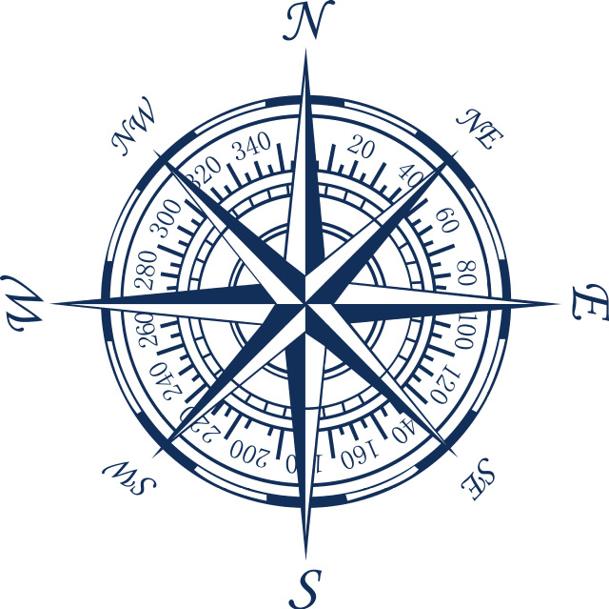
Blotting compass
RNA
DNA

Slide 35
Blotting compass

Slide 36
Northern blot
Procedure
RNA extraction
Remove secondary structures
Electrophoresis (agarose or acrylamide)
Transfer the RNA on membrane (nylon)
hybridization with labelled complementary probe
Notes:
36

Slide 37
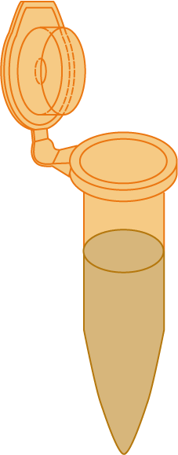
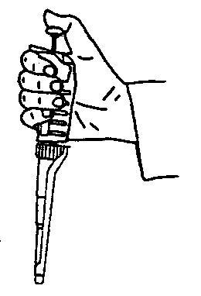
+
Loading dye
100V
0,2A
Polo -
Polo +
Loading dye helps the sample loading in the well
It contains glycerol, bromophenol Blu and xilencianol Blu that migrate in the gel at different speeds.

Slide 38
ON
100V
0,2A
Polo -
Polo +

Slide 39
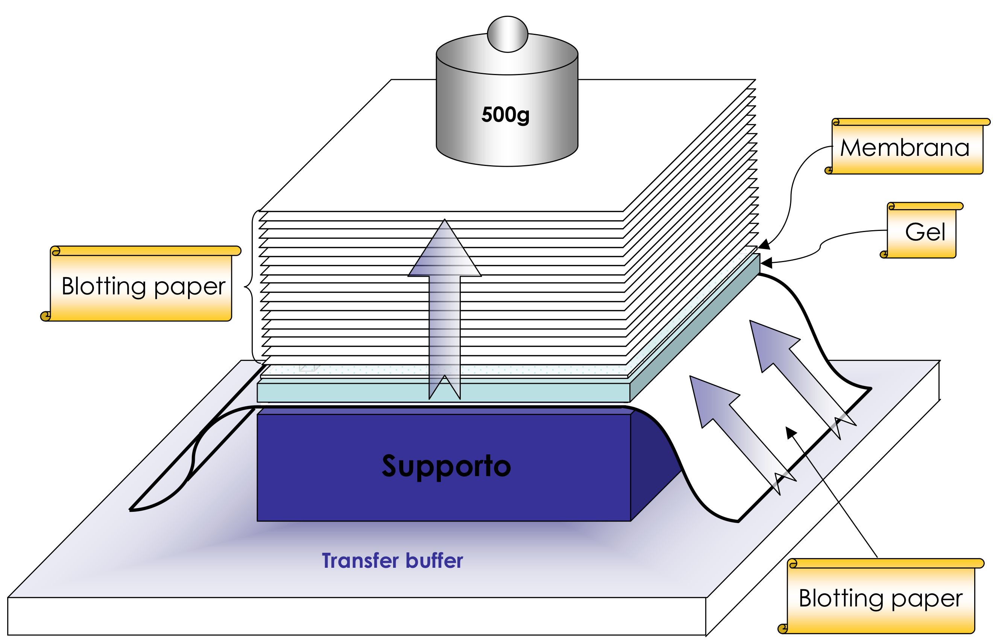
BLOT: transfer the nuclei acids from the gel to the membrane by diffusion
(for agarose gel)

Slide 40
The nucleic acids will be fixed to the membrane by:
-UV irradiation for nylon membrane
-boiling for 2hrs at 80°C for cellulose nitrate membrane

Slide 41
Elettroblot
(for acrylamide gel)
ON
10V
80 mA
Membrana (nylon)
gel
blotting paper
Buffer
TB 0.5X
Polo -
Polo +
blotting paper
Membrana
(nylon)
gel
(acrilammide)
blotting paper
Notes:
41

Slide 42
Ethidium bromide staining helps to check the proper RNA transfer on the membrane
28S rRNA
before
18S rRNA
after
Gel
Membrane
Notes:
42

Slide 43
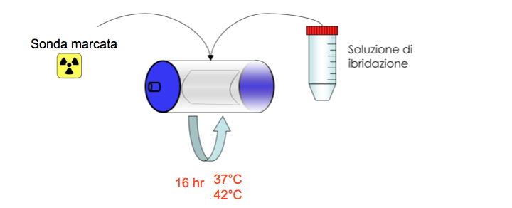
Hybridisation
A specific labelled probe is added to the membrane in the hybridisation tube for 16 hrs at 37-42 °C in the hybridisation buffer
Labelled probe
Hybridisation buffer

Slide 44
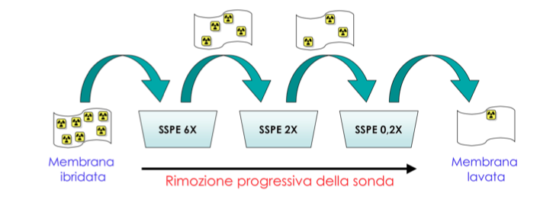
Washes
Several washes are needed in order to wash out the unspecific binding to the membrane. The unspecific hybridisation is not facilitated by high temperature and low salt. In this way will be removed the molecules weakly bound to the membrane
membrane
Washed
membrane
Removal of unspecific hybridisation

Slide 45
Detection of the signal
Develop
solution
Fixative
solution
X-ray film
Develop solution
A
B
C
D
A
B
C
D
Target RNA
Gel
X-ray
Notes:
45
Wherever an mRNA complementary to the
probe exists on the blot, hybridization will occur, resulting
in a labeled band that you can detect with x-ray fi lm. If you
run marker RNAs of known size next to the unknown
RNAs, you can tell the sizes of the RNA bands that “light
up” when hybridized to the probe.

Slide 46
Detection of the signal
In which tissue is the RNA expressed?
Develop
solution
Fixative
solution
X-ray film
Develop solution
muscle
kidney
muscle
kidney
heart
brain
heart
brain
Target RNA
Gel
X-ray
Notes:
46
.

Slide 47
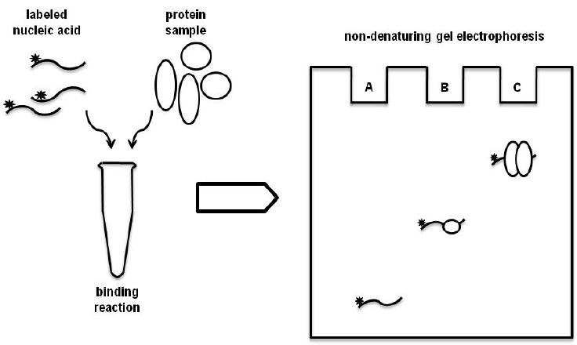
Electrophoretic mobility shift assay - Band shift assay
Does this protein bind this RNA/DNA?

