Slide 1
Comparative and European Public Law
Prof. Angelo Schillaci
angelo.schillaci@uniroma1.it
Lesson II – Western Constitutionalism: an Overview

Slide 2
Legal Technique of Freedom
Limitation of Power
Constitutionalism
Foundation
Legitimacy

Slide 3
Déclaration des droits de l’homme et du citoyen (August 26th, 1789)
“Toute société dans laquelle la garantie des droits n'est pas assurée, ni la séparation des pouvoirs déterminée, n'a point de constitution.”
Any society in which the guarantee of rights is not assured, nor the separation of powers determined, has no constitution.
→ Prescriptive Constitutionalism ←

Slide 4
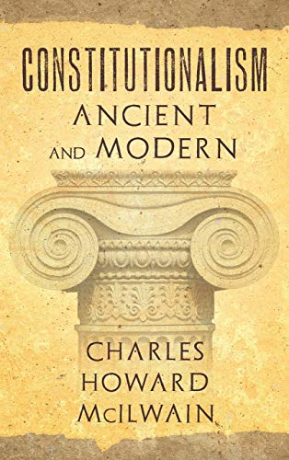
ANCIENT CONSTITUTIONALISM
“Constitutionalism. Ancient and Modern”
(Charles Mc Ilwain, 1940)

Slide 5
A first contribution of ancient times to modern constitutionalism is a certain idea of the possible organization of powers (or form of government).
How to live with order and peace in one single society?

Slide 6
PERICLES
(Athens, V century BC)

Slide 7
Our form of government does not imitate the laws of the neighbouring states. On the contrary, we are rather a model to others.
Our form of government is called a democracy because its administration is in the hands, not of a few, but of the whole people. […]
And not only in our public life are we free and open, but a sense of freedom regulates our day-today life with each other. […] In public affairs we take great care no to break laws because of the deep respect we have for them. We give obedience to the men who hold public office form year to year.
And we pay special regard to those laws that are for the protection of the oppressed and to all the unwritten laws that we know bring disgrace upon transgressor when they are broken.

Slide 8
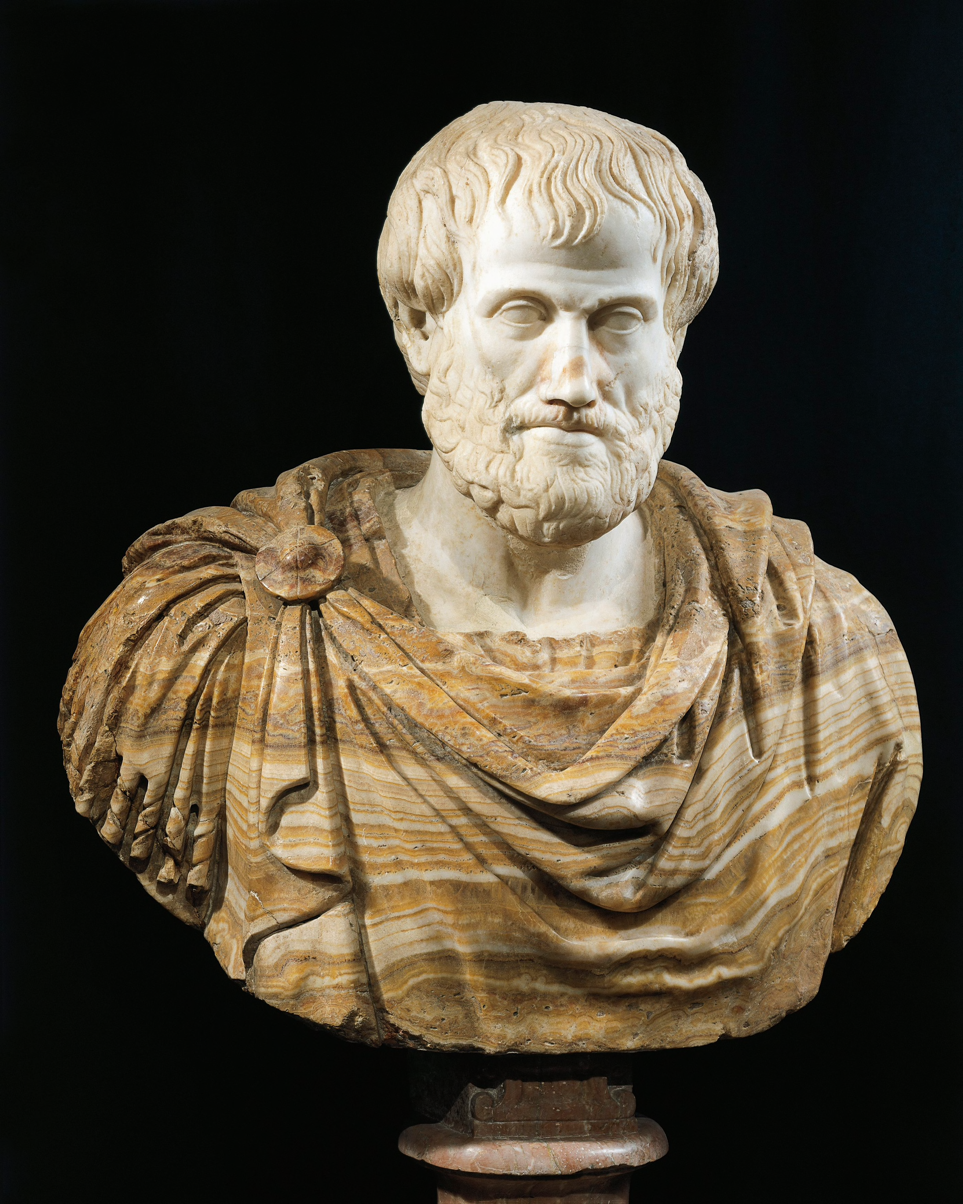
ARISTOTLE
(Politikà – IV century BC)
Politikà means Politics, which means “the things concerning the polis”

Slide 9
ARISTOTLE
Monarchy → Tyranny
Aristocracy → Oligarchy
Democracy → Anarchy
Mixed form of government: all social classes are represented and share powers through different institutions, which are closely linked to each other. Aristotle calls this balanced form of government “Politeia”

Slide 10
Antigone’s laws (442 BC, Sophocles)
Beyond the Law: the tragedy and the City
Positive law and Unwritten law (agrapta nomima)
The dialogue between Antigone and Creon
I was born to share love, not hatred

Slide 11
MARCUS TULLIUS CICERO
(De Re Publica – around 50 BC)

Slide 12
CICERO
The regal form of government is in my opinion much to be preferred of those three kinds. Nevertheless, one which shall be well tempered and balanced out of all these three kinds of government is better than that; yet there should be always something royal and pre-eminent in a government, at the same time that some power should be placed in the hands of the better class, and other things reserved for the judgment and will of the multitude.
Now we are struck first with the great equability of such a constitution, without which a people cannot be free long; next with its stability.
The three other kinds of government easily fall into the contrary extremes: as a tyrant grows out of a king; factions from the better class; and mobs and confusion from the people.

Slide 13
A second contribution of the ancient times to modern constitutionalism regards the idea of the boundaries of the law and political authority (especially thanks to the Christian and Roman philosophy).
IDEA OF A HIGHER LAW
SHAPED BY NATURE OR HUMAN REASON
OR GIVEN BY GOD
JUSNATURALISM = THE EXISTENCE OF A NATURAL AND RATIONAL LIMIT TO THE LAW OF MEN

Slide 14
CICERO
(De Re Publica – around 50 BC)
True law is right reason in agreement with nature; it summons to duty by its commands and averts from wrongdoing by its prohibitions. […] it is impossible to abolish it entirely. We cannot be freed from its obligations by senate or people, and we need not look outside ourselves for an […] interpreter of it.
And there will be not different laws in Rome and in Athens, or different laws now and in the future, but one eternal and unchangeable law will be valid for all nations and times, and there will one master and ruler, […] God, over us all, for he is the author of this law, its promulgator, and its enforcing judge.

Slide 15
A third contribution of ancient times to modern constitutionalism comes from the doctrine of CONTRACTARIANISM
THE IDEA THAT THE STATE AND ITS POLITICAL INSTITUTIONS WERE BORN ON THE BASIS OF AN ORIGINARY AGREEMENT AMONG FREE MEN
Origins:
Bible (ancient alliance between God and men)
Middle Ages – Feudalism (compacts)

Slide 16
Contractarianism introduced one of the main basis of modern constitutionalism:
• The idea of equality of human beings
• The need for a just government to rest upon the consent of the people
• The existence of a superior legal framework to be respected by government

Slide 17
Jusnaturalism and Contractarianism led to the affirmation of superior and intangible limits to the commands of the political powers.
This also led to a radical outcome: the theorization of a right of resistance against political authorities, in the form of disobedience to unjust commands and norms, as well in the form of rebellions against tyrant.

Slide 18
God
Reason
Sovereign
State
Modern
Constitutionalism
Ancient Constitutionalism

Slide 19
1689: Bill of Rights
1610: Bonham’s Case
1215: Magna Charta Libertatum
English Tradition (I)
The fight against
Absolute Sovereignty

Slide 21
XIII Century AD: attempt to establish, also in England, an absolute monarchy, aimed at removing the feudal social structures (especially ancient privileges and immunities of aristocracy).
MAGNA CHARTA LIBERTATUM was aimed at protecting privileges of social classes rather than individual rights.
- It was a feudal compact.
- It contributed to the settlement of the conception of individual rights as constraints to the political power of monarchs.
[Compacts ≈ agreements between lords and vassals typical of the feudal system]

Slide 22
[e.g.] HABEAS CORPUS
Art. 39 the Magna Charta
No freeman shall be taken or imprisoned, or be disseized of his Freehold, or Liberties, or free Customs, or be outlawed, or exiled, or any other wise destroyed; nor will We not pass upon him, nor condemn him, but by lawful judgement of his Peers, or by the Law of the land
→ Compare with contemporary guarantees of personal freedom

Slide 23
The expression “habeas corpus” is the Latin abbreviation for “we command that you have the detainees’ body brought to court”.
It is a common law writ through which a person could report an unlawful detention or imprisonment to a court: it is addressed to the person who hold a prisoner in custody, ordering the former to bring the body of the latter before the court in order to verify if the detention was unlawful or arbitrary.
This method of judicial review of imprisonment has gradually been connected to the concept of due process of law, that refers to the right of anyone to a fair and judicial trial before an independent judge.

Slide 24
SIR EDWARD COKE

Slide 25
During the XVII century, the judges of courts of Common Law declared the supremacy of the principles of Common Law over the government, recalling the ancient theory of the rule of law, according to which no power can be exerted beyond what is provided by the law.
Edward Coke wrote in Dr. Bonham’s case (1610):
It appears in our book, that in many cases, the common law will controul the Acts of Parliament, and sometimes adjudge them to be utterly void: for when an Act of Parliament is against common right and reason, or repugnant, or impossible to be performed, the common law will control it, and adjudge such Act to be void.
→ The basis of the judicial review of legislation

Slide 26
Also the Parliament changed in shape, in this period, to counteract the claims for absolute powers by the King.
PARLIAMENT OF WESTMINSTER
House Lords (aristocracy & clergy, lifelong tenure)
House of Commons (representative at the local level, linked to the electors by a mandate)
[1492 → new powers for merchant
more flexibility is required to the law
more freedom is asked by the king]

Slide 27
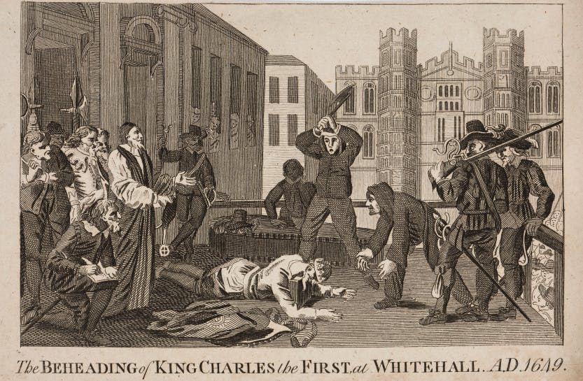
XVII CENT. ENGLISH REVOLUTIONS
• Civil War (1642–1651)
Republic led by Oliver Cromwell (1649-1659)
It improved republican thought
It broadened the approach of radical movements, believing in the equality of men and proposing a constitution based upon popular sovereignty

Slide 28
• Charles II (1660-1685)
James II (1685-1688)
Glorious Revolution (1689) → Bill of Rights
The Convention Parliament in Jan. 1689 transferred the Crowns of England to William III of Orange, who swore to govern according to «the statutes in Parliament agreed on»
Beginning of a Constitutional Monarchy, based on a balance of powers between legislative and executive branches

Slide 29
With the Glorious Revolution a set of Parliament’s prerogative has been set:
Regular and free parliament elections
The autonomy of the chambers of Parliaments as to the verification of the results of the elections and the validity of the elections of its members
The power of each chamber to approve its internal rules of procedure (so-called “standing orders”)
The exclusive power to syndicate the acts of its internal bodies (so-called interna corporis), without any interference from external authorities and powers
The freedom of speech of members of Parliament, and the ban of any impeachment or questioning of their debates before courts or other places outside of Parliament
The prerogative of Parliament to be held frequently, to uphold the laws
The unlawfulness of any act of the regal authority intended to suspend, dispense or execute laws without consent of the Parliament
The unlawfulness of the imposition of any taxes by the Crown without the approval of the Parliament

Slide 30
Bracton
Hobbes
Locke
English Tradition (II)

Slide 31
HENRY DE BRACTON
(De Legibus et Consuetudinibus Angliae – XIII century AC)
• Gubernaculum = the discretionary powers of the King, including administrative powers.
In this sphere the King acted for the good of the country, based only on his discretionary prerogative, and was not subjected to anyone, except to God’s power is absolute (sub Deo, but not sub lege).
• Iurisdictio = the power to “ speak the justice” (iuris dicere)
In this sphere the King was subject to the law.
The iurisdictio is both “internally” limited by the law and it represents a limit to power, subordinating the king to the law.

Slide 32
THOMAS HOBBES
(The Leviatan – 1651)
Assumptions:
- Freedom is related to the specific individuals, not to the society.
- Man is considered in the state of nature, i.e. free from class o corporative links.
- Freedom is understood as freedom from constraints and external oppositions (negative freedom).
- But the state of nature is state of constant war: Bellum omnium contra omnes (the war of all against all).

Slide 33
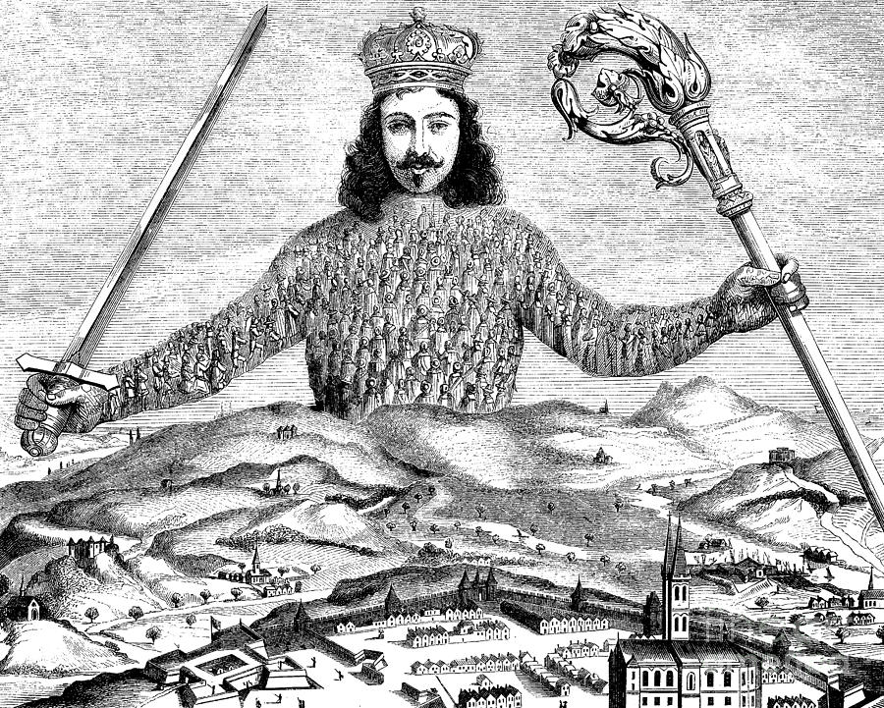
There is no power on earth to be compared to him (Job 41 . 24)

Slide 35
SOCIAL CONTRACT
PACTUM UNIONIS
PACTUM SUBIECTIONIS
sacrifice of freedom, in order preserve peace and security

Slide 36
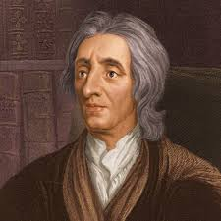
JOHN LOCKE
(The Two Treaties on Government – 1690)

Slide 37
– An “English” expression of the modern separation of powers doctrine (legislative, executive, federative: and the judiciary?)
– Men, from a state of nature, shape the state through a contract among themselves
But this contract is not intended to annul the right of people to control government’s behaviour and decide the political ends (≠ Hobbes)
On the contrary, the people continue to maintain the power to oversee legitimacy of the acts of the government and their consistency with the wellness of the people and the protection of their freedom

Slide 38
[…] whoever has the legislative or supreme power of any common-wealth, is bound to govern by established standing laws, promulgated and known to the people, and not by extemporary decrees; by indifferent and upright judges, who are to decide controversies by those laws; and to employ the force of the community at home [executive power], only in the execution of such laws, or abroad to prevent or redress foreign injuries, and secure the community from inroads and invasion [federative power].
And all this to be directed to no other end but the peace, safety, and public good of the people. […]

Slide 39
And where the body of the people, or any single man, is deprived of their right, or is under the exercise of a power without right, and have no appeal on earth, then they have a liberty to appeal to heaven, whenever they judge the cause of sufficient moment.
And therefore, though the people cannot be judge, so as to have, by the constitution of that society, any superior power, to determine and give effective sentence in the case; yet they have, by a law antecedent and paramount to all positive laws of men, reserved that ultimate determination to themselves which belongs to all mankind, where there lies no appeal on earth, viz. to judge, whether they have just cause to make their appeal to heaven.

Slide 40
Locke provides a synthesis among:
- contractarianism (i.e., the idea of a social compact establishing community and political institutions on the consent of the people)
jusnaturalism (i.e., the idea of a law antecedent and paramount to all positive laws)
modern claim for individual liberties (e.g., property, intended as life, liberty and estate)

Slide 41
Customary Constitution
Common Law
Parliament

Slide 42
1776: Declaration of Independence
US Tradition (I)
1787: US Constitution
1791: Bill of Rights
1803: Marbury v. Madison

Slide 43
1620 – The Pilgrim Fathers

Slide 44
Backgrounds to the Revolution
Colonies administered through a governor, appointed by the king
Colonies given in concession to private companies and administered by company according to a charter granted by the king
Colonies whose land belonged to individual landowners, usually also governors
In all the colonies, self-government institutions (such as assemblies) were established

Slide 45
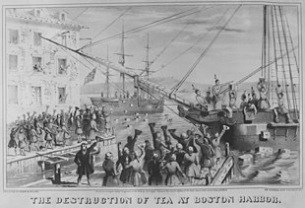
NO
TAXATION
WITHOUT
REPRESENTATION
1773, December 16
Boston Tea Party

Slide 46
1776
Declaration of Independence
(written by Thomas Jefferson)
US Tradition (II)
a
We hold these truths to be self-evident, that all men are created equal, that they are endowed by their Creator with certain unalienable Rights, that among these are Life, Liberty and the pursuit of Happiness. That to secure these rights, Governments are instituted among Men, deriving their just powers from the consent of the governed

Slide 47
Double nature of the American Revolution:
On the one hand, elements of modern theory of natural law (learned by the colonists from the works of Locke and the puritan religion)
On the other hand, the basis of democratic theories

Slide 48
Written Constitution
Judicial Review of Legislation
Federalism

Slide 49
WRITTEN CONSTITUTION
Colonial charters
Articles of Confederation (1776)
Constitution (1787)

Slide 50
Art. VI, par. 2, U.S. Constitution
This Constitution, and the Laws of the United States which shall be made in Pursuance thereof; and all Treaties made, or which shall be made, under the Authority of the United States, shall be the supreme Law of the Land; and the Judges in every State shall be bound thereby, any Thing in the Constitution or Laws of any State to the Contrary notwithstanding.

Slide 51
JUDICIAL REVIEW
Idea of common law as a superior law
The writing of charters and of a Constitution
The rigidity of the Constitution (art. V on the amendment procedure) opposed to the flexibility of ordinary pieces of legislation
Hierarchical supremacy of the Constitution
Who has the power and the responsibility to enforce it?

Slide 52
MARBURY VS. MADISON (1803-4)
by Chief Justice John Marshall
The powers of the Legislature are defined and limited; and that those limits may not be mistaken or forgotten, the Constitution is written.
To what purpose are powers limited, and to what purpose is that limitation committed to writing, if these limits may at any time be passed by those intended to be restrained?
The distinction between a government with limited and unlimited powers is abolished if those limits do not confine the persons on whom they are imposed, and if acts prohibited and acts allowed are of equal obligation.
It is a proposition too plain to be contested that the Constitution controls any legislative act repugnant to it, or that the Legislature may alter the Constitution by an ordinary act.

Slide 53
Between these alternatives there is no middle ground. The Constitution is either a superior, paramount law, unchangeable by ordinary means, or it is on a level with ordinary legislative acts, and, like other acts, is alterable when the legislature shall please to alter it.
If the former part of the alternative be true, then a legislative act contrary to the Constitution is not law; if the latter part be true, then written Constitutions are absurd attempts on the part of the people to limit a power in its own nature illimitable.
Certainly, all those who have framed written Constitutions contemplate them as forming the fundamental and paramount law of the nation, and consequently the theory of every such government must be that an act of the Legislature repugnant to the Constitution is void.

Slide 54
And the power to apply judicial review is shared with all the courts of the Union:
It is emphatically the province and duty of the Judicial Department to say what the law is. Those who apply the rule to particular cases must, of necessity, expound and interpret that rule. If two laws conflict with each other, the Courts must decide on the operation of each.

Slide 55
→ THE ISSUE OF CONSTITUTIONAL INTERPRETATION ←
- Original intent, originalism, history
Hard cases: the interpretation of the XIV Amendment («No state shall make or enforce any law which shall abridge the privileges or immunities of citizens of the United States; nor shall any state deprive any person of life, liberty, or property, without due process of law; nor deny to any person within its jurisdiction the equal protection of the laws») and the federal incorporation of fundamental rights
«But a constitution is not intended to embody a particular economic theory, whether of paternalism and the organic relation of the citizen to the State or of laissez faire. It is made for people of fundamentally differing views, and the accident of our finding certain opinions natural and familiar or novel and even shocking ought not to conclude our judgment upon the question whether statutes embodying them conflict with the Constitution of the United States» (Holmes, Dissenting in Lochner v. New York, 1905).

Slide 56
FEDERALISM
Under the Articles of Confederation, the Confederation had no powers over economics, neither in internal improvements (e.g. roads, channels) nor in relation with Indian tribes and other territories
PHILADELPHIA CONVENTION ←
Divide between the largest states and the smallest states:
- Largest states (e.g. Virginia, New York) were calling for a stronger Union, in order to protect economics and trade and ensuring territorial expansion
- Smallest states feared that in this way, largest states would have been reinforced, limiting the autonomy of smallest state

Slide 57
Divide between northern states and southern states:
Northern states (New England) shared economic system based on maritime trade, fishing, small farms; and, above all, a young and fragile industry, which required protection from importation from Europe → they supported tariffs on imported goods, in order to reduce the prices of American goods in their internal market
Southern states’ economy was based on the plantation system: huge lands owned by rich men, using slaves as the main force of work → the need to export

Slide 58
The Virginia Plan provided a strong Federal Government, holding several legislative competences and entrusted with the power to nullify state laws; the federal legislature should have been elected according to the population of each states (which would have put the largest state in control of the legislature)
The New Jersey Plan, drafted by the delegates from smallest states, proposed to maintain the structure of the Congress of the Confederation, articulated in a single House composed of a single delegate for each state (i.e., independently from its population)
→ Connecticut Compromise (July 16, 1787) - Bicameral Legislature and the role of the Senate

Slide 59
The pragmatism of the Federalist Movement prevailed: the Constitution was to be a system of instruments for the guarantee of individual liberties and grant minorities rights against the abuses committed by the government, i.e., against the risk of tyranny by the majority.
James Madison

Slide 60
If men were angels, no government would be necessary. If angels were to govern men, neither external nor internal controls on government would be necessary.
In framing a government which is to be administered by men over men, the great difficulty lies in this:
you must first enable the government to control the governed;
and in the next place oblige it to control itself.
A dependence on the people is, no doubt, the primary control on the government; but experience has taught mankind the necessity of auxiliary precautions.
The Federalist Papers, n. 51

Slide 61
Montesquieu
Rousseau
Sieyés
FrenchTradition (I)

Slide 62
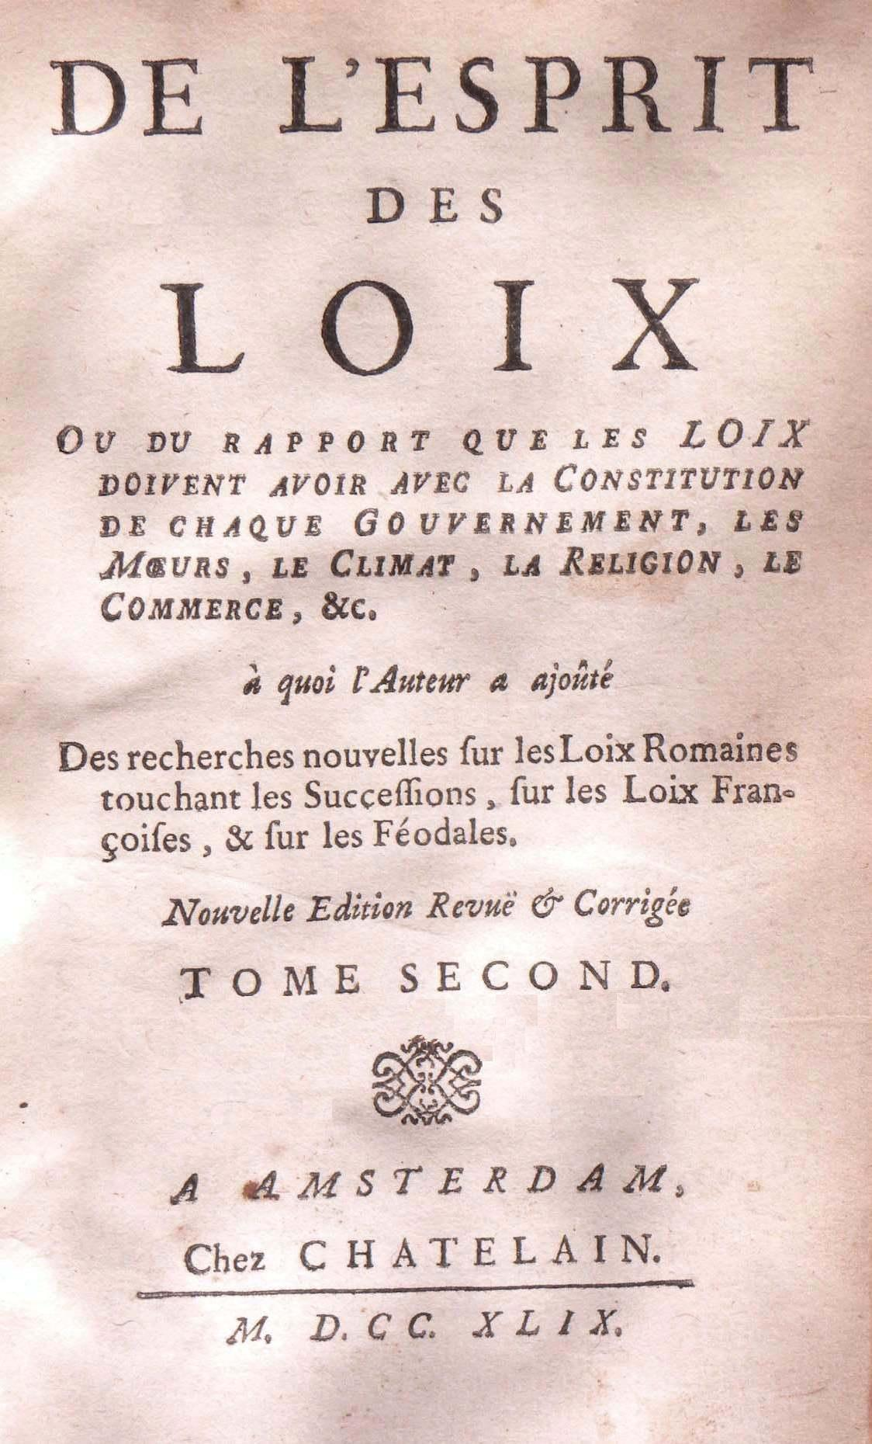
Montesquieu (1689-1755)

Slide 63
Esprit des lois (1734)
«Comparative» approach: relevance of history, geography and culture in analyzing constitutional and political experiences
Separation of powers:
«le pouvoir arrête le pouvoir»
legislative, executive, judiciary
Balance

Slide 64
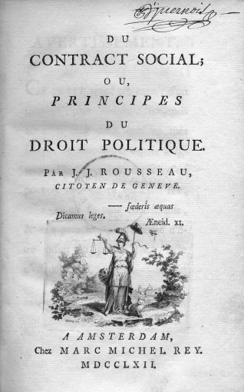
Rousseau (1712-1778)
Citizen of Geneve

Slide 65
Le contrat social (1762)
State of Nature (compare with Hobbes)
Aim and structure of the social compact: liberty and equality
La volonté générale
The democratic component of French tradition (I): absolute or balanced democracy?

Slide 66
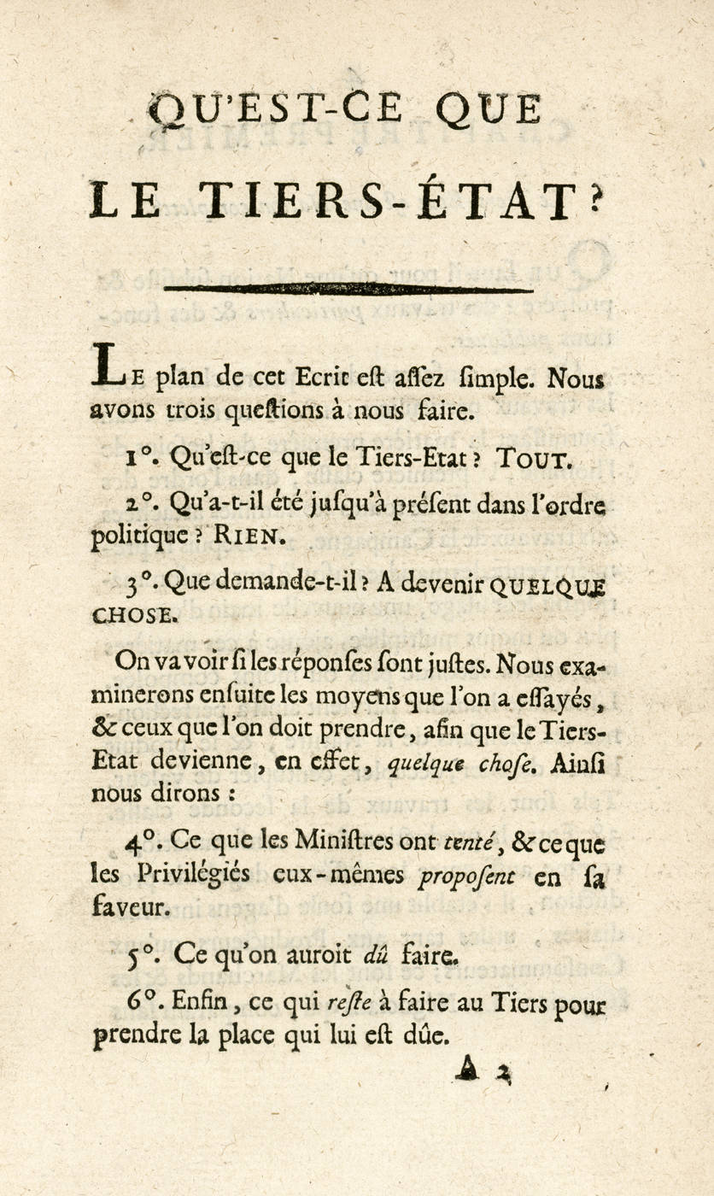
Sieyès (1748-1836)

Slide 67
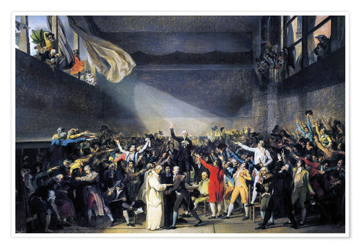
What is the Third Estate? (1789)
Mind the date!
Revolutionary component of French tradition
National representation: but what is the Nation?
Democracy and Revolution

Slide 68
The French Revolution – Key Dates
1789
May, 5 – the opening of the Estates-General
June 20 – Pallacorda (Ballgame Hall) Oath – National Constituent Assembly
July 14 – The storming of the Bastille
August – Agrarian Reform
August 26th – Declaration
1791, September 4th – Constitution
1793, January 21 – Beheading of Louis XVI

Slide 69
The French Revolution – Key Dates
1793 – Constitution of the Year I – never into force
1793-1795 – The Terror
1795 – Constitution of the Year III (weak executive)
1799 – Constitution of the Year VIII – The Consulate
→ NAPOLEON

Slide 70
1789
Declaration of the Rights of Man and Citizen
French Tradition (II)
a
Toute société dans laquelle la garantie des droits n'est pas assurée, ni la séparation des pouvoirs déterminée, n'a point de Constitution.

Slide 71
Written Constitution – Social Compact
Rule of Law - Parliament
Fundamental Rights

Slide 72
Liberal Constitutionalism
Democratic Constitutionalism
Social-Democratic Constitutionalism

Slide 73
Liberal Constitutionalism
State and Society
Individualism - Bourgeousie
Negative Rights
Constitution as Mere Limit
Rule of Law

Slide 74
Crisis
Social Struggle
Right to Vote
Reaction

Slide 75
Democratic Constitutionalism
Pluralism - Inclusion
State and Society
Fundamental Rights
Rule of Law
Constitutional Legitimation of Power
Judicial Review of Legislation

Slide 76
Social Democratic Constitutionalism
State and Society
Equality
Social Rights
Constitutional State
Constitutionalism Beyond State

