Slide 1
Comparative and European Public Law
Prof. Angelo Schillaci
angelo.schillaci@uniroma1.it
Lesson V – Semipresidential Government – French Experience

Slide 2
Political Direction
President
Separation of Powers
Direct Election
Head of State
Parliament
Judiciary
Dualistic Executive
Cooperation between Legislative and Cabinet: Confidence, Dissolution
Countersignature
Confidence
Semipresidential Government

Slide 3
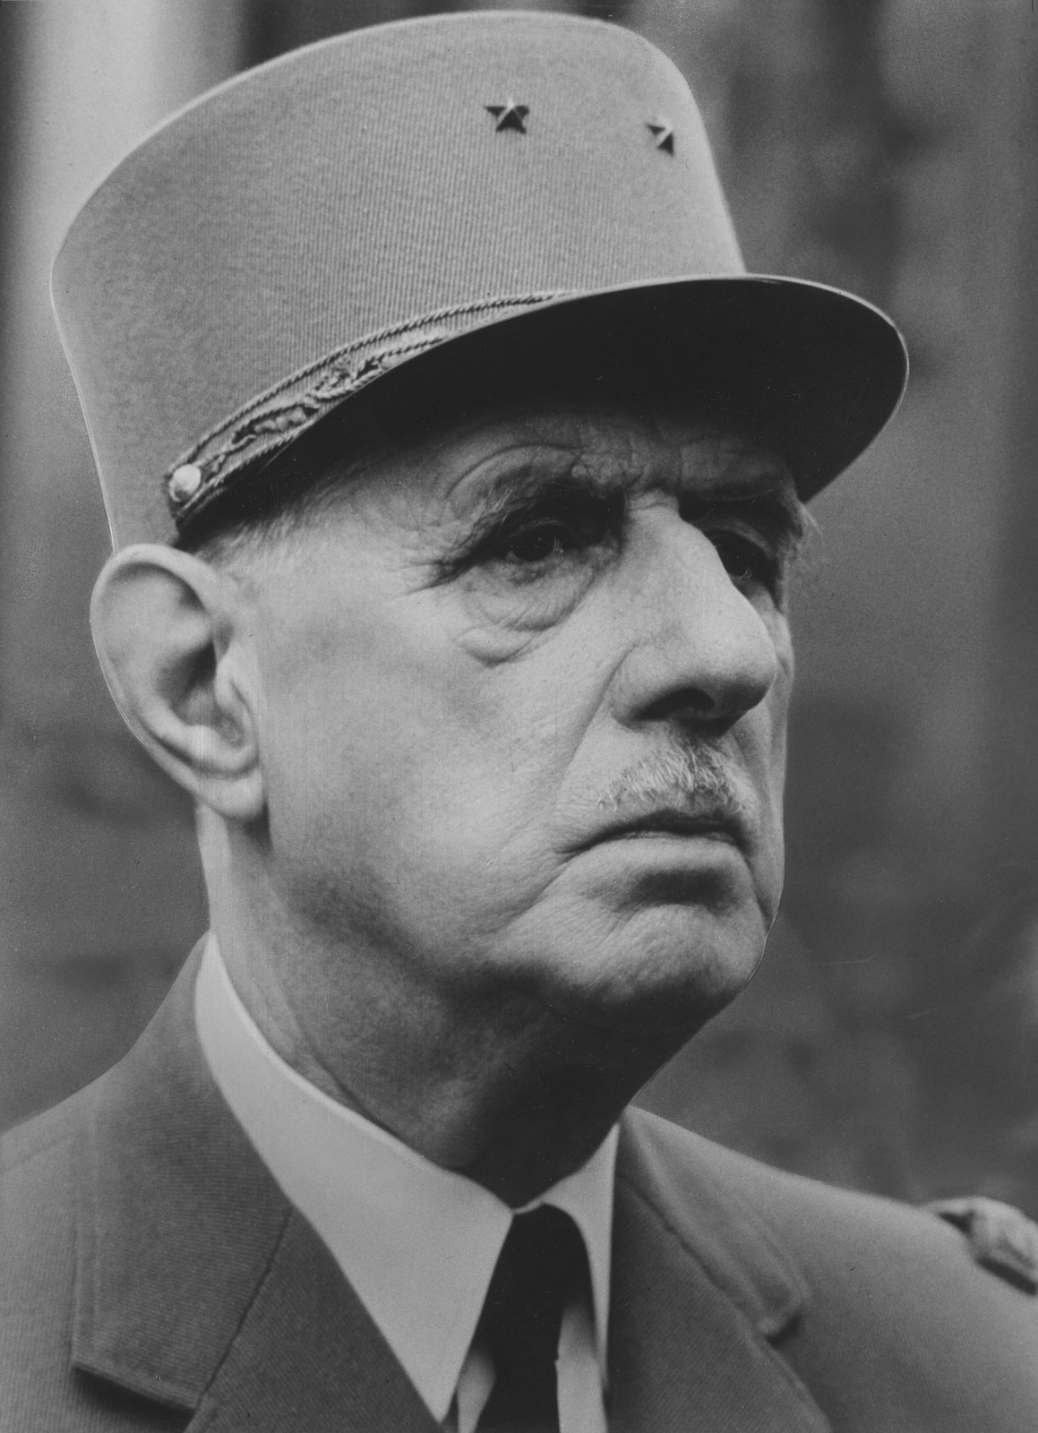
In 1958 a crisis exploded in Algeria, a French colony: in 1954 a war for independence had begun.
French political institutions were too weak to manage this increasing conflict and asked General Charles de Gaulle to assume leadership of the Cabinet.
De Gaulle was the military hero of the French resistance during the Nazi occupation: he was respected by the people, even if he retired from political business after the war.

Slide 4
De Gaulle accepted the mandate of Parliament to lead the executive branch under the condition of a general reform of the Constitution:
- to be drafted by the Cabinet itself
- to be ratified by the people through a referendum
< to oust the Parliament
In 1958 the new Constitution was approved and the Fifth French Republic begun

Slide 5
Form of Government of the Fifth Republic
According to the original structure of the Fifth Republic, a great balance would have been settled between a multi-partitism Parliament and a strong President of the Republic with significant popular legitimation (elected by also by a body of 80.000 electors, among which municipalities and local entities) and many powers (like those to call referendum.
A very important change occurred in 1962
De Gaulle wanted to strengthen the direct connection between the President and the people
So he proposed a constitutional amendment directly to the people, through a referendum (art. 11 Const.)
He employed this tool to avoid the opposition of the Parliament (which plays a significant role in constitutional reform)
But, doing so, he violated the same Constitution: art. 11 describes a mechanism that can be used to modify the institutional framework on ordinary legislation
However de Gaulle was able to force the system and address the people

Slide 6
According to the amendment proposed by the President of the Republic would have been elected directly by the people
Thanks this reform, the form of government of the Fifth Republic became a clear model of semi-presidential government
I.e., mixed form of government, which includes features of both parliamentary and presidential systems (≈ Weimar constitution)

Slide 7
President
Parliament (National Assembly – Senate)
PM and Cabinet
France 1958

Slide 8
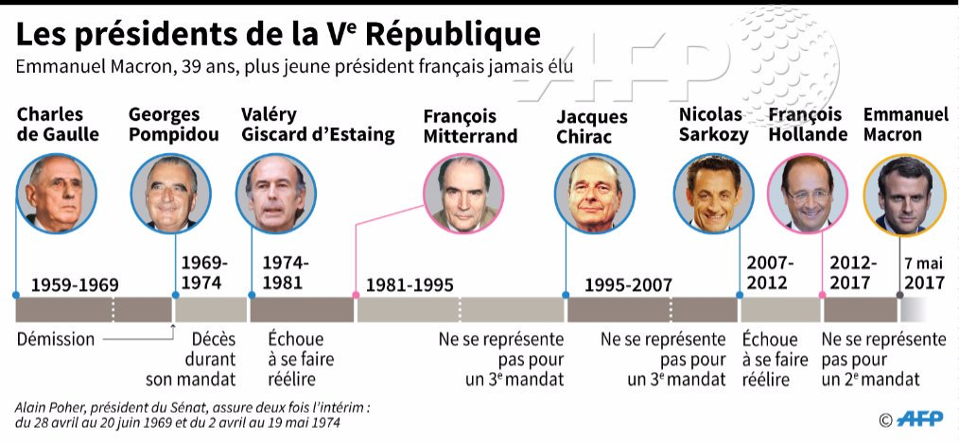
France 1958
V Republic
Direct Election (since 1962)
Main Powers
Chair of Cabinet (Formally/Substantially) and Appointment of the PM
Dissolution of the National Assembly
Art. 16
7 Years Term (5 Years since 2000)
Referendum

Slide 9
Parliament
Confidence (art. 49)
Domain de la loi
(art. 34)
Cabinet
Art. 44.3 Vote bloqué*
Domain du reglement (art. 37)
Pouvoir d’ordonnance (art. 38)
France 1958
* If the Government so requests, the House before which the Bill is tabled shall proceed to a single vote on all or part of the text under debate, on the sole basis of the amendments proposed or accepted by the Government.

Slide 10
President
Countersignature (Art. 19)*
Appointment of PM
Referendum
Dissolution of the Assembly
Cabinet
Cohabitation
(Before and after 2000)
Mitterrand/Chirac 1986-1988
Mitterrand/Balladur 1993-1995
Chirac/Jospin 1997-2002
Political Direction
France 1958
* Instruments of the President of the Republic, other than those provided for under articles 8 (paragraph one), 11, 12, 16, 18, 54, 56 and 61, shall be countersigned by the Prime Minister and, where required, by the ministers concerned.

Slide 11
The President of the Republic can exercise powers without the countersignature of the ministers
Among these powers are
- the power to early dissolve the Parliament
- the power to carry out extraordinary measures in case of emergency
- the power to appoint the Prime Minister and the other Ministers

Slide 12
The Cabinet, as just seen, is appointed by the President of the Republic
BUT
The Cabinet is also responsible to the National Assembly
because it must also receive the confidence of the NA
→ The President cannot appoint PM based only on his personal political vision
→ The President must always take into account the results of the general elections of the NA and respect the parties’ coalitions and leadership

Slide 13
The President of the Republic and the Cabinet share the executive power
The executive power has “two heads” (dual executive branch)
The case of cohabitation between the President and the Cabinet
Cohabitation Cases
Mitterrand/Chirac 1986-1988
Mitterrand/Balladur 1993-1995
Chirac/Jospin 1997-2002

Slide 14
Today cohabitation is almost impossible to be experienced, thanks to:
2000 reform: the term of the presidential mandate has been reduced from 7 to 5 years
2001: modification of electoral timetable

Slide 15
The aim of de Gaulle’s reforms was to diminish the powers of the parliamentary assembly, despite the central role that it had played in the French history
→ He wanted to overrule the parliamentary supremacy typical of the previous Republics
He succeeded in this through the introduction of several innovations:
1. It is not necessary for the Cabinet to obtain the preliminary vote of confidence by the NA. However, the Cabinet usually appears before the Parliament in order to present its program
2. The rejection of confidence needs an absolute majority of the NA to be passed
3. The Cabinet can present the question of confidence to a bill: if the NA does not ask to discuss the bill, the bill is automatically approved (i.e., without an express vote of the parliament)
(!!!!!)

Slide 16
Article 49
The Prime Minister, after deliberation by the Council of Ministers, may make the Government's programme or possibly a general policy statement an issue of a vote of confidence before the National Assembly.
The National Assembly may call the Government to account by passing a resolution of no-confidence. Such a resolution shall not be admissible unless it is signed by at least one tenth of the members of the National Assembly. Voting may not take place within forty-eight hours after the resolution has been tabled. Solely votes cast in favour of the no-confidence resolution shall be counted and the latter shall not be passed unless it secures a majority of the Members of the House. Except as provided for in the following paragraph, no Member shall sign more than three resolutions of no-confidence during a single ordinary session and no more than one during a single extraordinary session.
The Prime Minister may, after deliberation by the Council of Ministers, make the passing of a Finance Bill or Social Security Financing Bill an issue of a vote of confidence before the National Assembly. In that event, the Bill shall be considered passed unless a resolution of no-confidence, tabled within the subsequent twenty-four hours, is carried as provided for in the foregoing paragraph. In addition, the Prime Minister may use the said procedure for one other Government or Private Members' Bill per session.
The Prime Minister may ask the Senate to approve a statement of general policy.
France 1958
Relation of
Confidence

Slide 17
4. Strict separation in the sources of law between statutory law and regulations: both must be related to specific matters
(Domain du reglement – art. 37)
→ Rejection of the principle of supremacy of the law over regulations
5. The executive has the power to organize the Parliament agenda
→ Rejection of the principle of parliamentary autonomy in planning its own agenda
6. The executive has the power to stop the amendment power of singles members of the NA: the so called ”blocked vote” forces the NA to vote on the bill as a whole, without discussing the amendment proposed to it
7. Parliamentary standing orders are submitted to preliminary review by the Constitutional Council

Slide 18
Art. 44.3 Vote bloqué
If the Government so requests, the House before which the Bill is tabled shall proceed to a single vote on all or part of the text under debate, on the sole basis of the amendments proposed or accepted by the Government.

Slide 19
OTHER FEATURES OF THE FIFTH REPUBLIC OF FRANCE
No Declaration or catalogue of rights
This does not mean the rejection of fundamental rights
It underlines the deep link to the French constitutional tradition established in the Declaration of Rights of 1789
All the republican constitutions that had been adopted throughout the French constitutional history were based upon the acknowledgment of the basic role played by the first Declaration of Rights
Actually the 1789 Declaration is expressly acknowledged as legal source in the preamble of the Fifth Republican Constitution and is still in force and applied by judges

Slide 20
The Fifth Republic established, for the first time in French history, an effective constitutional review of legislation
With the creation of the Constitutional Council, de Gaulle inverted the tradition according to which the parliamentary law was the primary source, and couldn’t be ruled void by judges.
In a first design, the CC appears as a political body, providing only advice to Parliament, rather than adopting actual judgements (not even the form of judgements):
- 9 members appointed by political bodies, selected among legal experts or politicians
- former Presidents of the Republic were lifelong members

Slide 21
However, the actual functioning of the CC, and the rulings it has produced, make it very similar to other European constitutional courts.
E.g.
- In 1964 some important rulings extended the scope of constitutional review by including the provisions regarding fundamental rights settled in the 1789 Declaration (< acknowledgment in the Const. Preamble).
- In the following years, adopting the same approach, the CC built a larger constitutional parameter, called bloc de constitutionalité

Slide 22
The BoC is the ensemble of constitutional norms applied by the Constitutional Council in its review of legislation. These norms are:
• The very text of 1958 Constitution
• Explicit or unwritten supplementary laws, explicit or written, i.e.:
- the preamble to the 1946 and 1958 Constitutions
- the 1789 Declaration
- the2004 Charte de l'environnement
• Implicit or unwritten supplementary laws, i.e.
- the fundamental principles recognized by the laws of the Republic
- other principles or objectives of constitutional value

Slide 23
Who can raise the constitutional review of legislation? Who can address the Constitutional Council?
Originally the subjects authorized to raise constitutional issues were only institutions that were representative of the political party who gained the majority in parliamentary and presidential elections. I.e.
- President of the Republic
- Prime Minister
- President of the NA
- President of the Senate
Thanks to a constitutional amendment approved in 1974, also 60 members of the NA and 60 members of the Senate can address the CC
< to grant parliamentary opposition (and political minorities, generally speaking) the power to claim the CC intervention over the laws adopted by the majority

Slide 24
How to address the Constitutional Council?
All the methods of raising the constitutional review to the CC deal with acts that have obtained the parliamentary approval but have not yet been signed by the President
> ex-ante review model (≠ ex-post review models)
< untouchable character of the law formally adopted by the Parliament
In 2008 a constitutional amendment introduced the incidental appeal to the CC (≈ Italy and Germany)
But only through the preliminary advice by the Supreme Court of Cassation or the Council of State

Slide 25
Overview
“Parliamentarian” Features
Presidential Features (After 2000 – 2008 Reform)
Flexibility and Balance – Political System
France 1958

