Slide 1
Recap…

Slide 2
ANCIENT CONSTITUTIONALISM

Slide 3
PERICLES
(Athens, IV century BC)

Slide 4
Our form of government does not imitate the laws of the neighbouring states. On the contrary, we are rather a model to others.
Our form of government is called a democracy because its administration is in the hands, not of a few, but of the whole people. […]
Election to public office is made on the basis of ability, not on the basis of membership in a particular class. No man is kept out of public office by the obscurity of his social standing because of his poverty, as long as he wishes to be of service to the state.
And not only in our public life are we free and open, but a sense of freedom regulates our day-today life with each other. […] In public affairs we take great care no to break laws because of the deep respect we have for them. We give obedience to the men who hold public office form year to year.
And we pay special regard to those laws that are for the protection of the oppressed and to all the unwritten laws that we know bring disgrace upon transgressor when they are broken.

Slide 5
MODERN CONSTITUTIONALISM
(Liberal State)

Slide 6
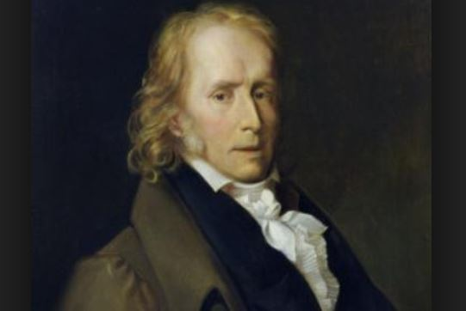
B. CONSTANT
(The Liberty of the Ancients Compared with That of the Moderns – 1819)

Slide 7
First ask yourselves, what an Englishman, a Frenchman, and a citizen of the United States of America understand today by the word “liberty.”
For each of them it is the right to be subjected only to the laws, and to be neither arrested, detained, put to death or maltreated in any way by the arbitrary will of one or more individuals. It is the right of everyone to express their opinion, choose a profession and practice it, to dispose of property, and even to abuse it; to come and go without permission, and without having to account for their motives or undertakings.
It is everyone’s right to associate with other individuals, either to discuss their interests, or to profess the religion which they and their associates prefer, or even simply to occupy their days or hours in a way which is most compatible with their inclinations or fancies.
Finally it is everyone’s right to exercise some influence on the administration of the government, either by electing all or particular officials, or through representations, petitions, demands to which the authorities are more or less compelled to pay heed.

Slide 8
Now compare this liberty with that of the ancients.
The latter consisted in exercising collectively, but directly, several parts of the complete sovereignty; in deliberating, in the public square, over war and peace; in forming alliances with foreign governments; in voting laws, in pronouncing judgments; in examining the accounts, the acts, the stewardship of the magistrates; in calling them to appear in front of the assembled people, in accusing, condemning or absolving them.
But if this was what the ancients called liberty, they admitted as compatible with this collective freedom the complete subjection of the individual to the authority of the community.

Slide 9
CONTEMPORARY CONSTITUTIONALISM
(Social-Democratic State)

Slide 10
SOCIAL RIGHTS!
Job
Education
Health care
Environment

Slide 11
