Slide 1
Comparative and European Public Law
Prof. Angelo Schillaci
angelo.schillaci@uniroma1.it
Lesson I – Aims and Methods of Legal Comparison

Slide 2
Comparative Law
Legal Comparison
-

Slide 3
Government
Comparative Constitutional Law
Administrative Law
Public Law
Constitutional Adjudication
Fundamental Rights
Private Law
Property
Contracts
Torts
Commercial Law…

Slide 4
Common Law
Civil Law

Slide 5
Micro-Comparison
Macro-Comparison

Slide 6
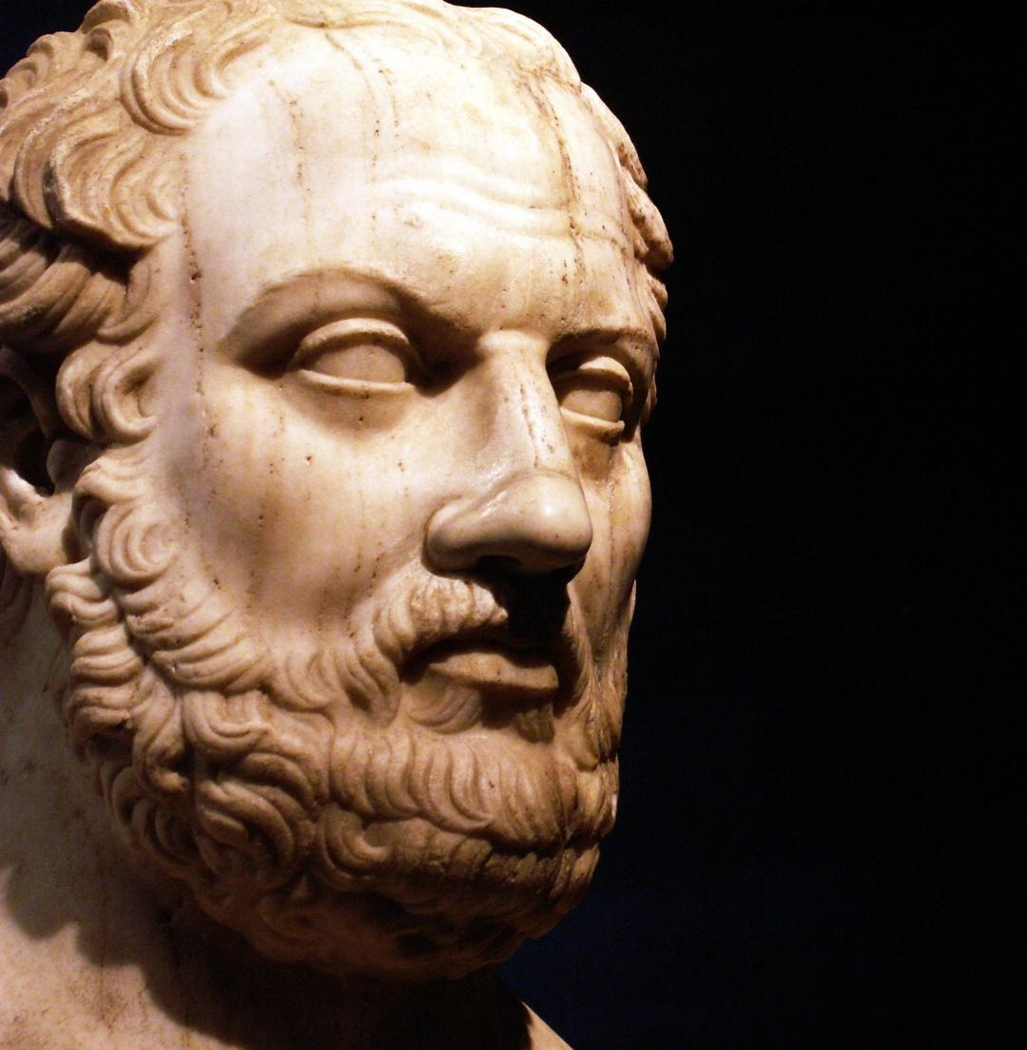
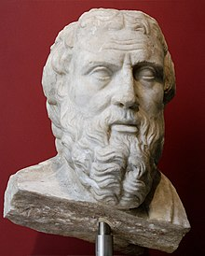
Historical Remarks (I)
Comparison in Ancient Times: looking for the Ideal City
Herodotus
Thucydides

Slide 7
“Our form of government does not imitate the laws of the neighbouring states. On the contrary, we are rather a model to others. “
Here in Athens, we do this.
“Our constitution is called a democracy because power is
in the hands not of a minority but of the whole people”.
Here in Athens, we do this.
“The laws here ensure equal justice for all in their private disputes
but we never ignore the merits of excellence.”
Here in Athens we do this.
“We give our obedience to those whom we put in positions of authority, and we
obey the laws themselves, especially those which are for the protection of the oppressed, and those unwritten laws which it is an acknowledged shame to break.”
Pericles
Discourse to the Athenians
[From Thucydides, The Peloponnesian War, V –IV century BC]

Slide 8
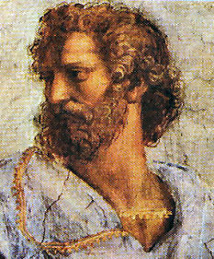
Monarchy
Aristocracy
Democracy
Plato
Aristotle
Tyranny
Oligarchy
Ochlocracy

Slide 9
Historical Remarks (II)
Comparison and Universalism in the Middle Age – The Idea of Empire
Legal Comparison and the rise of the modern State: from XVII to XIX Century
Modern Universalism: Grotius and Kant
Montesquieu and Tocqueville
Constitutional Comparison and National State in XIX Century
Liberal State, statualism and Legal Dogmatism
Unicity and Exclusiveness of national Legal Order
Different Traditions
statualism (and resistance to it) in Germany and Italy

Slide 10
1900, Paris: First Congress of Comparative Law
Why?
- Industrial Revolution, “First” Globalization, Interdependence and Growth of International Cooperation
- Legal Comparison and International Law
- Legal Comparison and Legal Pluralism

Slide 11
Constitutional Comparison after World War I
The rise of interdependence
Society of Nations
Mirkine Guetzevich (Droit constitutionnel international, 1933)
Constitutional Comparison after World War II
From international to supranational cooperation
The European integration process
Common constitutional traditions and Constitutional Comparison

Slide 12
METHODS

Slide 13
UNIVERSALISM
An important form of comparative analysis is the effort to discover through comparative study, principles of justice and political obligation that transcend the culture bound opinions and conventions of a particular political community
This approach has been termed a ‘universalist’ approach to comparative constitutional study → it has normative aspiration.

Slide 14
COMPARISON, UNIVERSALISM AND INTERNATIONAL LAW
Universalist justice-seeking approaches to comparative constitutional law most typically entail comparative work on rights, often linked with literature on human rights.
Universalist scholarship about rights has tended to bring together work on comparative constitutional law with work on international law and especially international human rights and humanitarian law.
Yet the search for ‘just principles’ of human rights law may be no more theoretical or universalist than the search for ‘good’ principles of government design.

Slide 15
STRUCTURALISM
Comparing the “Structure” of Legal Institutions
- Legal “Formants” (Statutory Law, Case-Law, Legal Doctrine)
- Cryptotipes (non-expressed formants)
- Meta-formants (context)

Slide 16
FUNCTIONALISM
• Scholars may identify an institution that exists in multiple constitutional systems and explore its function(s).
• Or scholars may identify one or more functions performed by constitutions or constitutional institutions or doctrines in some societies and analyze whether in fact the constitutional institution or doctrine believed to perform a valid function does so or may analyze whether and how that function is performed elsewhere.

Slide 17
Although functionalism represents the dominant approach in comparative constitutional study, it has been subject to serious critique.
A number of scholars have cautioned against the misleadingly homogenizing and obscuring perils of functionalism.
According to Günter Frankenberg, it is all too easy for a comparativist unconsciously to assume the categories of legal thought with which she is familiar, and thus to see foreign law only as either similar or different, without being able to grasp the conceptual or sociological foundations of other legal orders.
Similar functions may mean quite different things in a practice that is shaped by more particular contexts.

Slide 18
Overcoming Functionalism? The critical approach to comparison
Substaining difference (Glenn)
Relation avec l’alterité en droit – comparative research as a «mesearch» (Legrand)
Comparison as an «intellectual» and «learning experience» (Frankenberg)
Comparison as critique (Frankenberg)
La fonction subversive de la comparation (Muir Watt)
Overcoming the exclusiveness of an «internal» point of view (Ascarelli)

Slide 19
CULTURES AND CONTEXTS
Contextual approaches problematize the sense of ‘false necessity’ that may emerge from functional or universalist approaches.
The content of a country's expressive identity may be complex and multi-stranded and may shift over time.
But it is also important to avoid the tendency of expressivist approaches to assume a fixed national identity (Dixon)
“The dilemma of understanding foreign (legal) cultures and of transcending -the domestic (legal) culture can neither be resolved by "going rational" nor by "going native.” (Frankenberg)
Considering the plurality of understandings and interpretive possibilities within a single national constitutional culture may yield important degrees of nuance, complicating and perhaps defeating efforts to generalize from particular cases.
Democratic constitutional comparison (Dixon) = acknowledgment on equal basis and mutual respect.

Slide 20
Comparison and legal «experience»
Comparison and interaction between law, history and culture (Häberle)
The role of the interpreter (Ridola)
Models or paradigmas?
Critical rationalisation of complexity and differences through recognition of otherness

Slide 21
Is there just one method?
Scarciglia: methodological pluralism
As an expression of legal (and cultural!) pluralism
The «good» method (if there can be such a thing) is the result of the interaction between different approaches (context-specific; historically and culturally sensitive) in a critical perspective.

Slide 22
Overcoming Exclusiveness of Self; Relation to the “Legal Other”
Cooperation, Opening up,
Cross-Fertilization
Why compare?
Self-knowledge
Through Comparison
Critical Approach
Knowledge
Approach new Issues

Slide 23
Compare What?
Text
Context
Experience

Slide 24
History
Culture
Experience
How?

Slide 25
CHALLENGES
• A first goal of constitutional comparison is to develop a better intellectual understanding of one or more other systems.
For this purpose, the challenges include time, the need to develop expertise, language barriers, and the need to understand the broader context – both legal and social – in which law operates.
All these challenges are about the risks of error or oversimplification.
However difficult it is to become bilingual, bilegalism is even harder to achieve. Not only is it necessary to understand foreign languages, or find reliable translations of foreign legal materials, but in order to understand one doctrine or institution of another legal system it is necessary to have at least some understanding of the broader canvas on which it exists.

Slide 26
• A second goal for comparative constitutional study is to enhance capacity for self-reflection, to develop a better understanding of one's own system. In this regard, there are all of the challenges set out above, plus the following.
While ‘the unnoticed in our practices may become visible in the contrast with other cultural practices of law’, which ‘can help us to understand who we are’, comparison alone ‘cannot … tell us whether we should remain what we have been’.
• A third goal goes beyond simple self-reflection and aims at developing an understanding of normatively preferable ‘best practices’.
• A fourth goal may be to answer questions, asked by domestic constitutional doctrine or text, that are comparative in their nature.

Slide 27
Resistance
Convergence
Engagement
Comparison And Relation Among Legal Orders
(Jackson, 2010)

Slide 28
An Example: Dealing with borders in the EU
Universalism vs. Particularism
Engagement and Legal Pluralism
Comparison and European Integration Process (both EU and ECHR)

Slide 29
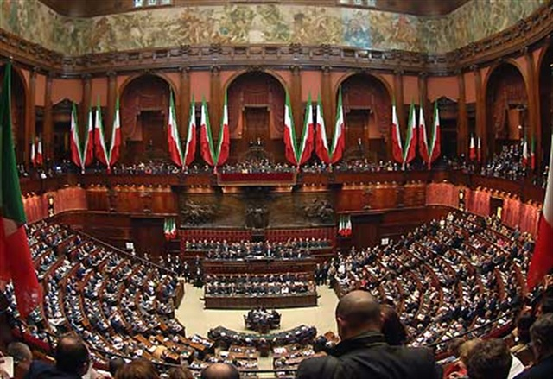
Comparison in Legal Reasoning and Experience
Teaching Method
Adjudication
Law Making Process

