Slide 1
FORENSIC DECISION MAKING
December 4th, 2023
Exterior of the old Atocha Station in Madrid (Gryffindor / CC BY-SA)

Slide 2
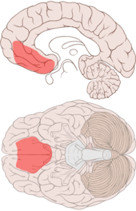
Antonio Damasio’s Somatic Marker Hypothesis
Originated from the observation of individuals who had sustained damage to the ventromedial prefrontal cortex.

Slide 3
Antonio Damasio’s Somatic Marker Hypothesis
These patients had normal intellectual function, normal neuropsychological functions.
Severe impairment in personal and social decision making and conduct.
No longer able to make personally advantageous decisions.
Often sustain social, personal, economic losses.

Slide 4
Antonio Damasio’s Somatic Marker Hypothesis
These individuals didn’t display emotions in situations in which emotion would be normatively expected.
This led Damasio to posit that these individuals manifest a deficit in reasoning that is secondary to deficits in emotional processing.
Within Damasio’s theory, the concept of convergence areas is important
Convergence areas are structures in the brain in which inputs from disparate regions are integrated.
For example, information from primary sensory regions (including somatosensory cortex), secondary sensory regions, association cortices, the hippocampus, the amygdala, and other prefrontal regions.

Slide 5
Antonio Damasio’s Somatic Marker Hypothesis
The VMPFC is one of these areas for its extensive bi-directional connections with brain regions responsible for the processing of the characteristics of complex situations.
Especially the VMPFC receives projections from all the brain structures needed to link the characteristics of complex situations to particular emotional states and somatosensory response patterns.
Also, the VMPFC is the only frontal lobe structure to have access to autonomic control regions (amygdala, hypothalamus, and brain stem), in order to cause bodily changes through activation of the ANS and consequent changes in the viscera, and endocrine system.

Slide 6
Antonio Damasio’s Somatic Marker Hypothesis
Thus Damasio believes that the VMPFC is involved in learning the association between the characteristics of certain complex situations and the emotional state (and thus the somatosensory pattern) that has been associated with that situation in an individual’s past (through learning).
When a situation occurs again, the VMPFC can reactivate the somatosensory pattern of the relevant emotion.
These represent the ‘gut feelings’ that we have when we encounter particular stimuli or situations.

Slide 7
Antonio Damasio’s Somatic Marker Hypothesis
This can occur in two ways:
1) Through a ‘body loop’ in which bodily changes actually occur, and the information is relayed back to the somatosensory cortex.
2) Through an ‘as if’ loop in which the information about the relevant somatosensory patterns are conveyed directly to the somatosensory cortex, and thus bypass the bodily route.
Damasio believes that the experience of a somatosensory (feeling state) appropriate to particular situations (based on an individual’s learning history) allows us to reason about what is the most appropriate course of action by constraining the process of reasoning over multiple options and outcome scenarios.

Slide 8
Antonio Damasio’s Somatic Marker Hypothesis
If you consider an option-outcome scenario, the somatic changes that are elicited by the VMPFC mark the scenario as one that is good or bad, and help you to make your decision.
Thus, the somatic changes triggered by the VMPFC help to constrain the ‘problem space’ by allowing us to reason among fewer option-outcome scenarios… this biases us away from particular scenarios and towards others, based on our previous experience with these situations, and the feelings that are engendered when we consider or experience them again.

Slide 9
Antonio Damasio’s Somatic Marker Hypothesis
Evidence for Damasio’s hypothesis
1) Psychophysiological investigation of emotional arousal in patients with damage to the VMPFC. Measured Skin Conductance Reponse in normal controls, in brain damaged controls, and patients with VMPFC damage when presented with neutral or emotionally charged visual images.
Normal and brain damaged control subjects showed SCRs to emotionally evocative stimuli, while VMPFC patients did not. Damasio suggests that these results support that VMPFC patients cannot generate somatic markers to emotionally arousing stimuli.

Slide 10
Antonio Damasio’s Somatic Marker Hypothesis
2) Gambling Experiments: Patients with VMPFC damage continue to select cards from the decks that incur losses, while normal controls sample from all decks for a while, but then gradually begin playing more frequently from the good decks (net gain) than from the bad decks. This is analogous to VMPFC patients’ inability to decide upon an advantageous course of action, when contingencies / future outcomes are uncertain.
It is not possible to cognize the ‘rules’ or contingencies for the decks, so subjects must rely on their intuition or ‘gut instinct’ of which decks to play from.

Slide 11
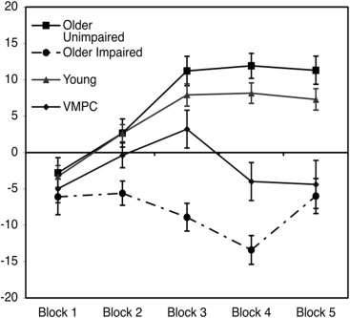
Antonio Damasio’s Somatic Marker Hypothesis

