Slide 1
Messenger RNA maturation

Slide 2
Eucaryotic gene expression
transcription
START site
exons
gene
upstream
elements
promoter
elements
introns
TRANSCRIPTION
CAPPING
m⁷G
pre-mRNA
SPLICING
POLYADENYLATION
m⁷G
AAAAAAAAAn
polyadenylated pre-mRNA
nucleus
m⁷G
AAAAAAAAAn
mature mRNA
TRANSPORT
cytoplasm
TRANSLATION
Notes:
2

Slide 3
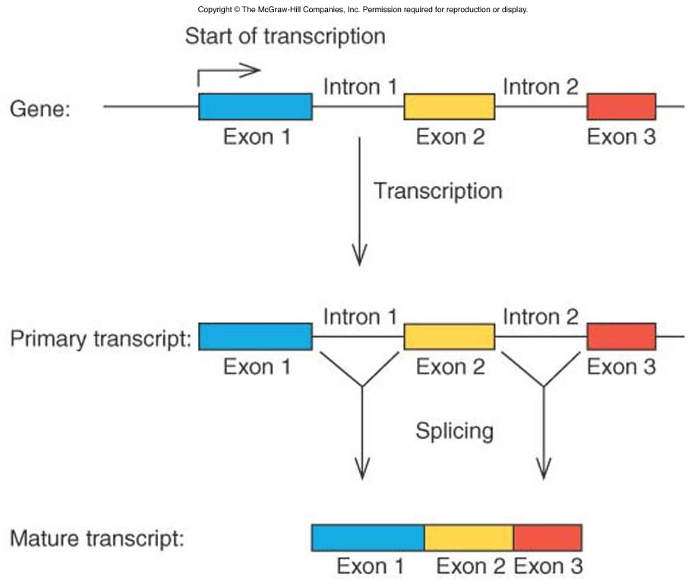
Eukaryotic genes contain introns

Slide 4
The discovery of discontinuous genes
No correspondence between cDNA and genomic sequences
mRNA
R-loops – direct visualization at the electron microscope of the pairing between the mRNA and the genomic DNA
promoter
exon
intron
exon
AAGCTGGCTAGCGCCCAATGGCTAGCTTACAGgtaacacgtggtcttttaaatttcttccagGTAAATACTTTCTGAATTC
GCCCAAUGGCUAGCUUACAGGUAAAUACUUUCUGAAUUC

Slide 5
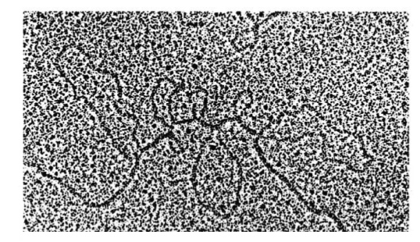
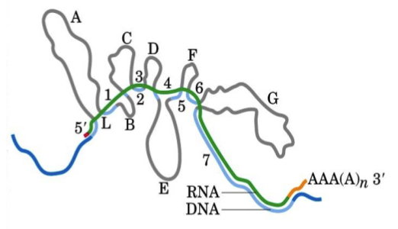
Identification of introns by R-looping
Ovalbumin gene hybridized to its mRNA and visualized at the electron microscope
Exon:intron organization of the ovalbumin gene
Exon
Intron

Slide 6
Specific sequences inside the pre-mRNA indicate where the splicing event takes place.
These sequences indicate the boundary between introns and exons.

Slide 7
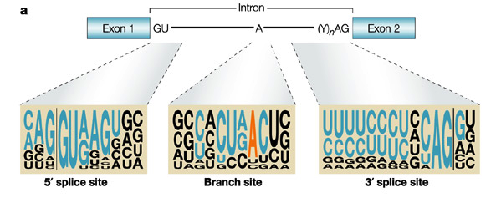
Consensus Sequences Surrounding the 5’ and 3’ Splice Sites

Slide 8
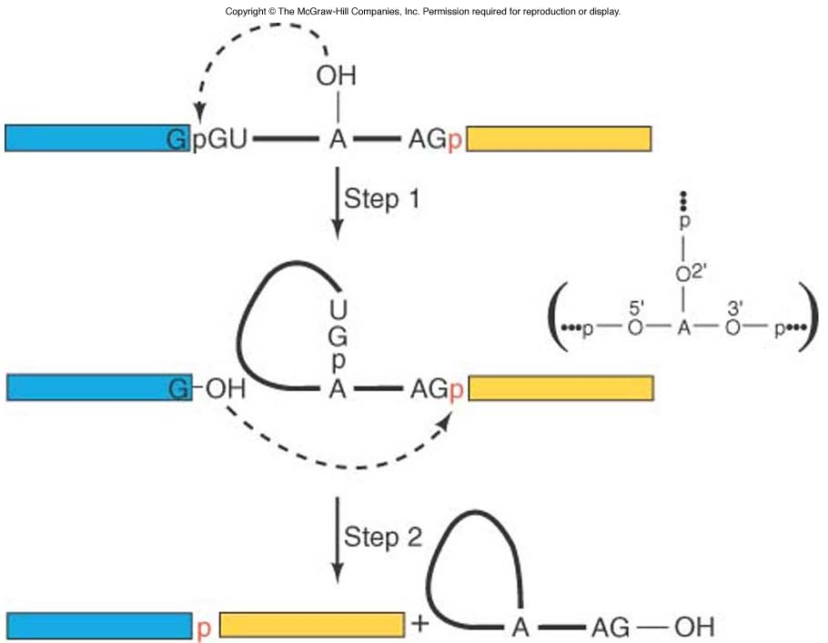
Nuclear pre-mRNA splicing proceeds through two trans-esterification reactions
Fig. 14.4

Slide 9
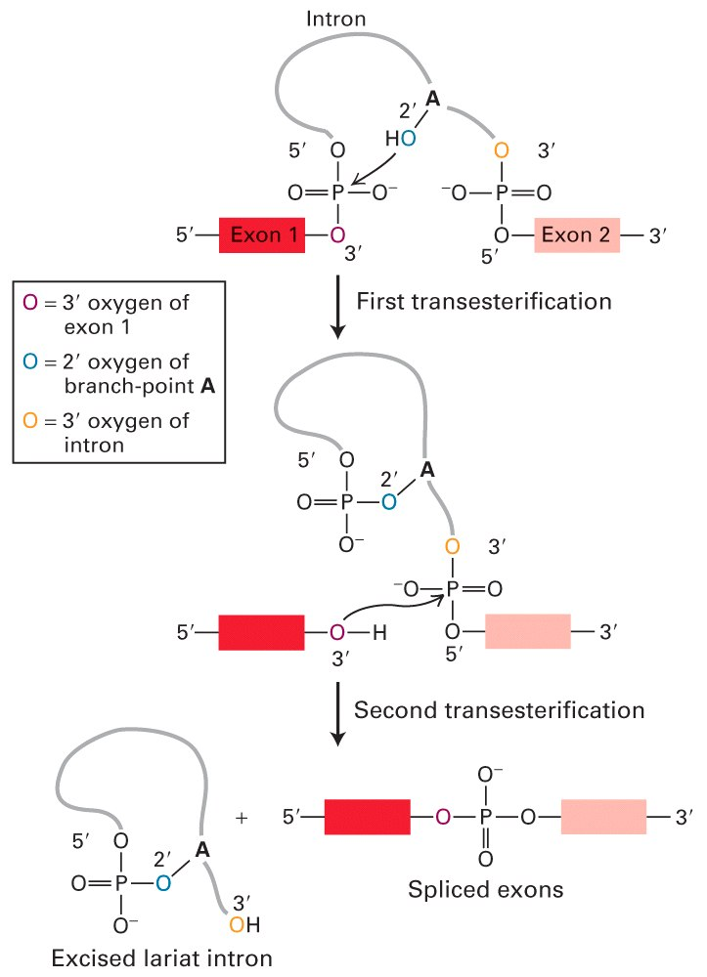
The intron is removed in a Form Called Lariat and the Flanking Exons are joined
Two trans-esterifications:
Step 1: The OH of the conserved A at the branch site attacks the phosphoryl group of the conserved G in the 5’ splice site. As result, the 5’ exon is released and the 5’-end of the intron forms a three-way junction structure.
Step 2: The OH of the 5’ exon attacks the phosphoryl group at the 3’ splice site. As a consequence, the 5’ and 3’ exons are joined and the intron is released in a lariat shape

Slide 10
Splicing takes place on a complex called spliceosome. snRNAs identified with antibodies derived from the sera of patients affected by Lupus erythematosus – they recognize the protein component of snRNPs
When antibodies were injected into X.laevis oocytes
splicing was inhibited
Immunoprecipitation allowed to discover that several
small RNAs were associated to the Sm proteins

Slide 11
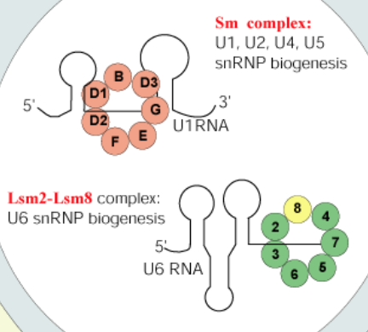
Splicing takes place on a complex called spliceosome. snRNAs identified with antibodies derived from the sera of patients affected by Lupus erythematosus – they recognize the protein component of snRNPs

Slide 12
Splicing takes place on a complex called spliceosome. snRNAs identified with antibodies derived from the sera of patients affected by Lupus erythematosus – they recognize the protein component of snRNPs
spliceosome
(~100 proteins + 5 small RNAs)
U1, U2, U4/U5/U6
Splicing works similarly in different organisms, for example in yeast, flies, worms, plants and animals.
pre-mRNA
spliced mRNA

Slide 13
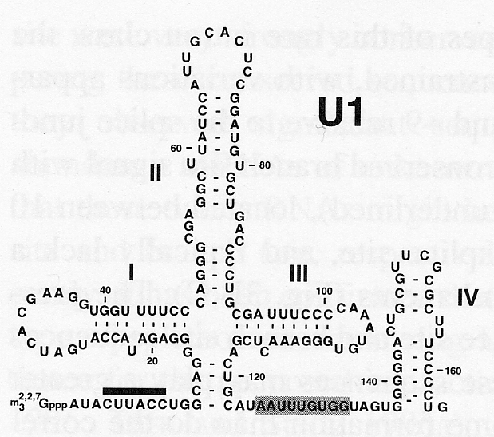
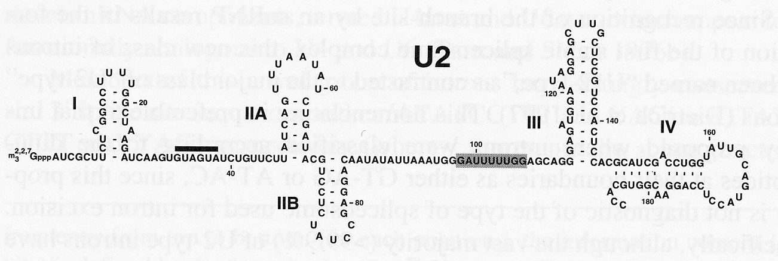
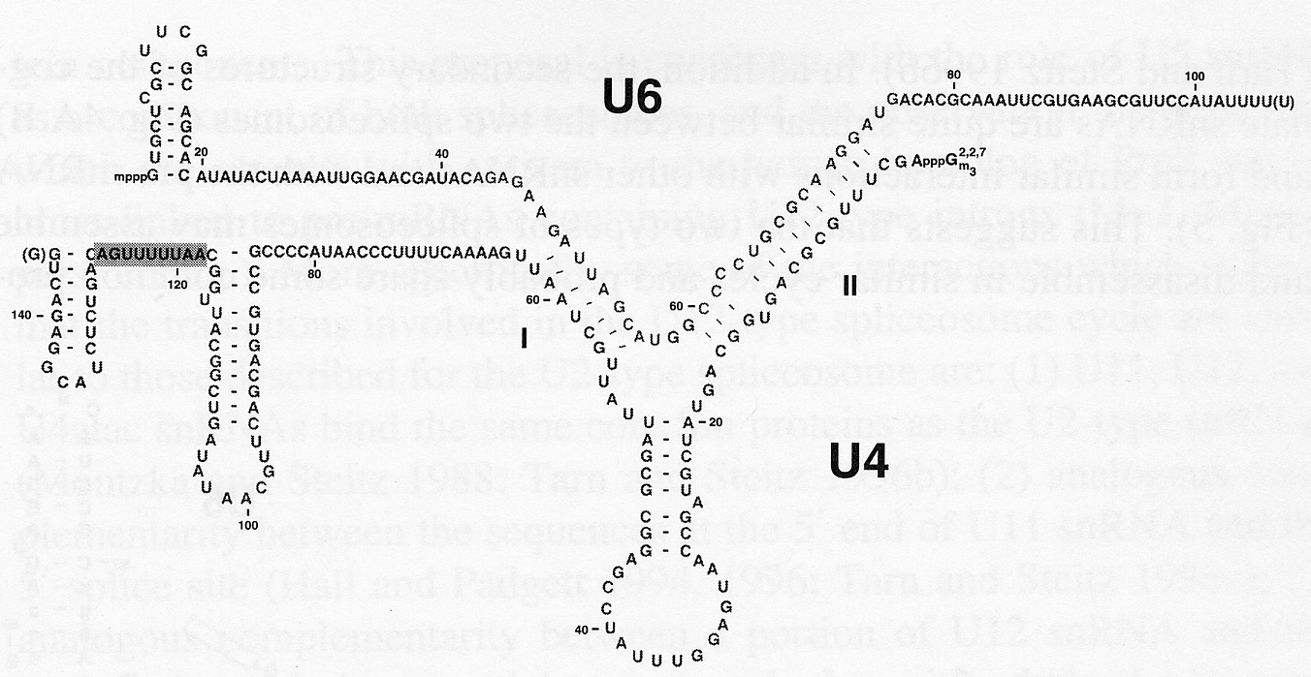
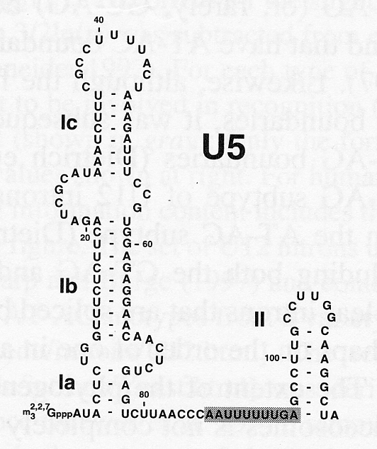
Five snRNAs are involved in pre-mRNA splicing

Slide 14
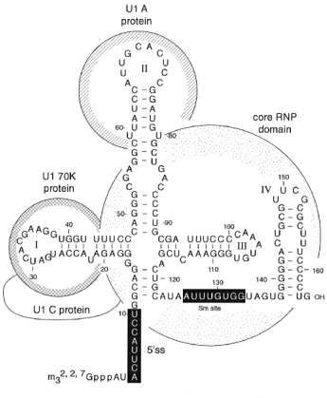
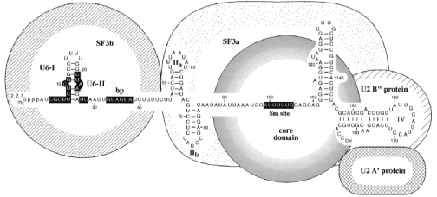
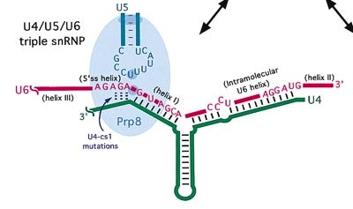
U1 and U2 snRNPs
U4/U5/U6 tri-snRNPs

Slide 15
Ⅰ Assembly, rearrangement, and catalysis within the spliceosome: the splicing pathway
Assembly step 1
1. U1 recognizes 5’ splice site.
2. One subunit of U2AF binds to Py tract and the other to the 3’ splice site. The former subunits interacts with BBP and helps it to bind to the branch point.
3. Early (E) complex is formed
E complex
U1
U2AF65
35
BBP
5’
pG
A
3’
Py-tract

Slide 16
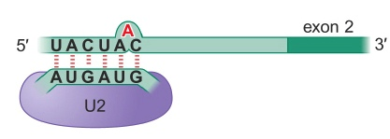
Assembly step 2
1. U2 binds to the branch site, and then A complex is formed.
2. The base-pairing between the U2 and the branch site is such that the A is extruded. This A residue is available to react with the 5’ splice site.
A complex
U1
35
U2AF65
5’
pG
A
3’
U2

Slide 17
Assembly step 3
1. U4, U5 and U6 form the tri-snRNP Particle.
2. With the entry of the tri-snRNP, the A complex is converted into the B complex.
U1
35
A complex
U2AF65
5’
pG
A
3’
U2
U5
35
U2AF65
U6
U4
U1
U5
U2
B complex
U6
U4
A

Slide 18
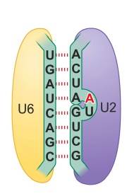
U1
U5
U2
B complex
U6
U4
A
U1
U5
U2
C complex in which the catalysis has not occurred yet
A
U6
U4
A
U4
U5
U2
U6
A

Slide 19
Catalysis Step 1
●Formation of the C complex produces the active site, with U2 and U6 RNAs being brought together.
●Formation of the active site juxtaposes the 5’ splice site of the pre-mRNA and the branch site, allowing the branched A residue to attack the 5’ splice site to accomplish the first transesterfication reaction.
U4
U5
U2
U6
A

Slide 20
Catalysis Step 2
U5 snRNP helps to bring the two exons together, and aids the second transesterification reaction, in which the 3’-OH of the 5’ exon attacks the 3’ splice site.
Final Step
Release of the mRNA product and the snRNPs.
U6
U2
U5
U5
A
U6
U2
A

Slide 21
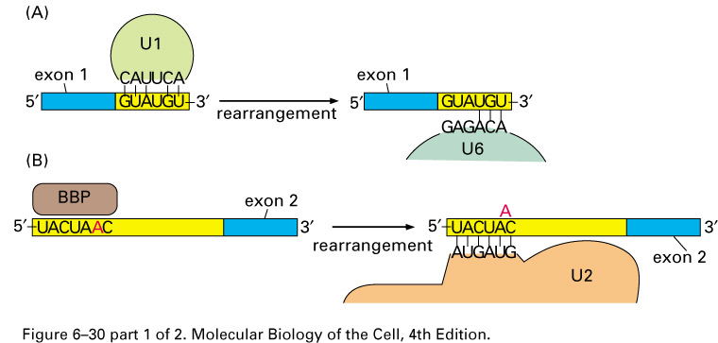
Spliceosome & ATP → RNA-RNA
Rearrangements - I

Slide 22
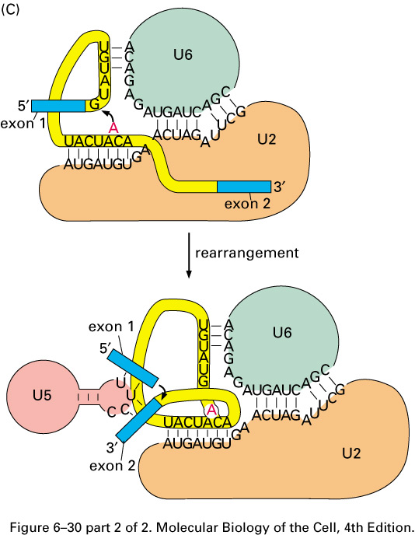
Spliceosome & ATP →
RNA-RNA
Rearrangements - II

Slide 23
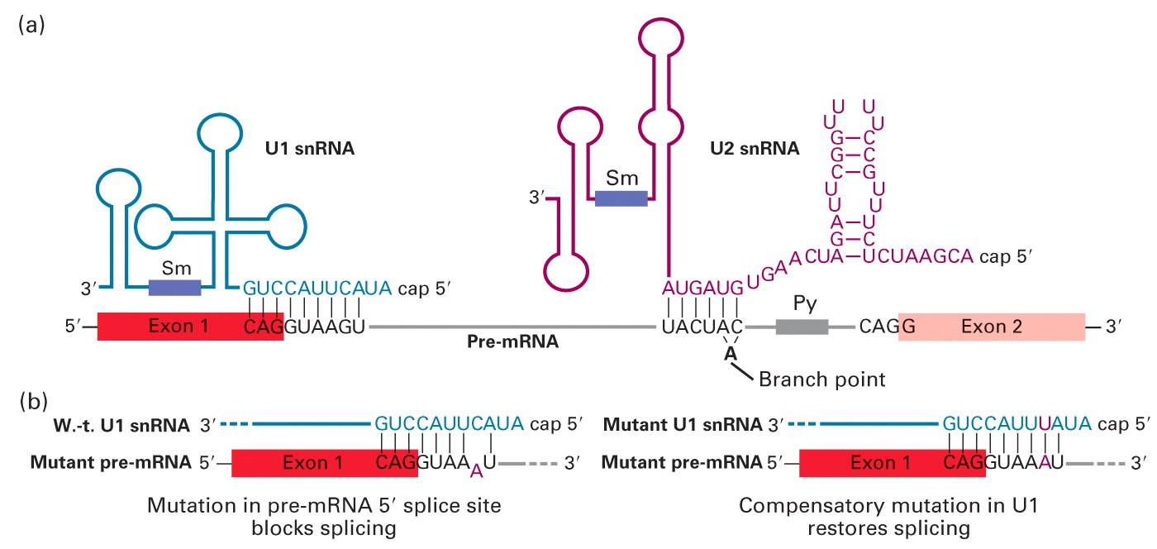
Pre-mRNA Splicing is Accelerated by RNA-RNA Basepairing: snRNPs

Slide 24
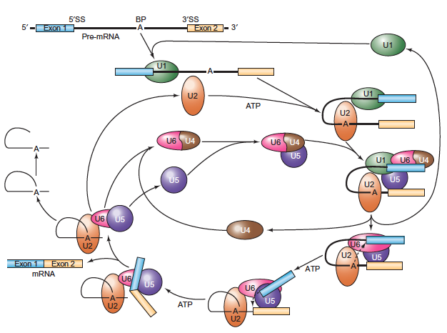
The spliceosome cycle

Slide 25
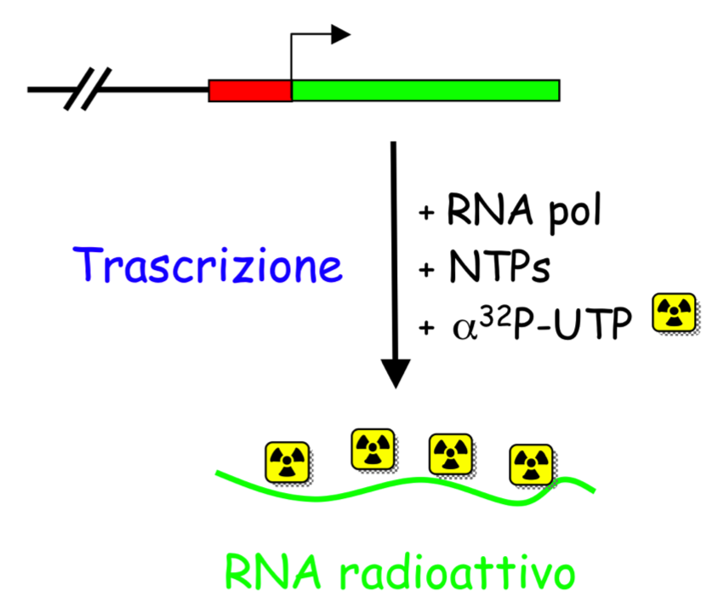
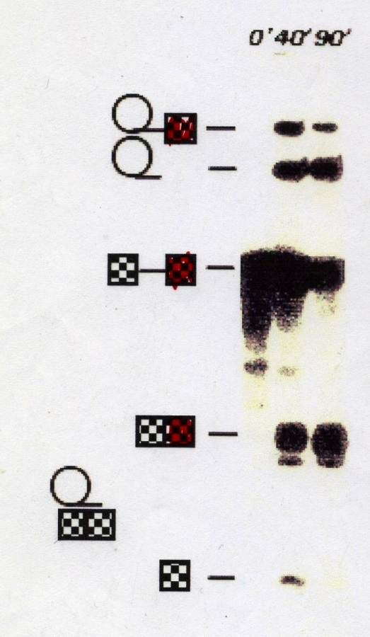
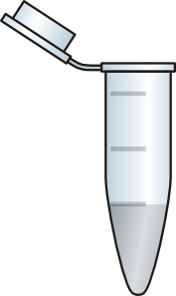
How to study splicing in vitro
procedure
-in vitro transcribed RNA
-RNA plus nuclear extract
-RNA isolation ot different time points
-elettrophoresis for the analysis of the reaction products
RNA analysis
RNA isolation
nuclear extract
Notes:
25
Come si studia lo splicing

Slide 26
in vitro analysis of splicing complexes formation
gel nativo
1 - time 0’
3 - time 30’
2 - time 90’

Slide 27
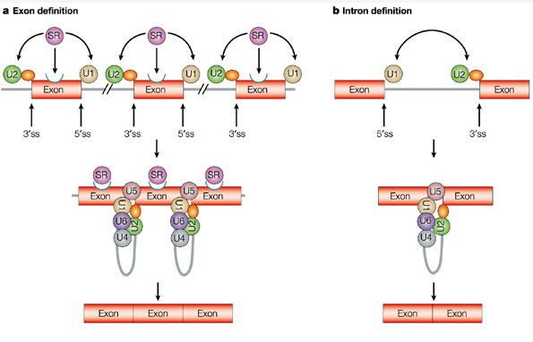
How Are Short Exons Flanked by Long Introns Defined and Committed to Splicing?
Intron > 250 nt
Intron < 250 nt
Notes:
Thus a puzzling issue is how the spliceosome successfully defines exons, which are on average about 150 nucleotides long in humans [13], and distinguishes between the pseudo-SSs found across vast intronic sequences and bona fide ones.
Two important recent studies in human cells used
NET-seq to generate global maps of the 3′ ends of
nascent transcripts at single nucleotide resolution
[21,22] . Strikingly, these studies revealed a high
frequency of 3′ ends, very close to 3′ and 5′ splice
sites, which flank exons. Since splicing intermediates
were computationally filtered from the NET-seq
datasets, the results suggest that splice sites are
potent pol II pausing signals. Pausing at 3′ splice
sites at the beginning of exons is particularly
remarkable because it occurs before exon definition
[60] , while the splice site is sequestered within the
pol II ternary complex. These observations therefore
suggest the surprising conclusion that the 3′ splice
site is recognized by the transcription machinery as a
pause site before it is recognized by the splicing
machinery as a processing site. NET-
NET-seq employing
immunoprecipitation with phospho-specific anti-CTD
antibodies suggests that pol II paused at 3′ and 5′
splice sites is Ser5 hyperphosphorylated. In addition,
CTD Ser2-P appears to increase as pol II is released
from the 3′ splice site and moves into the exon [22]
(Fig. 3 ). Release from splice-site-associated pauses
might be stimulated by U2AF65 that associates with
pol II elongation complexes and inhibits pausing in
vitro [61] .

Slide 28
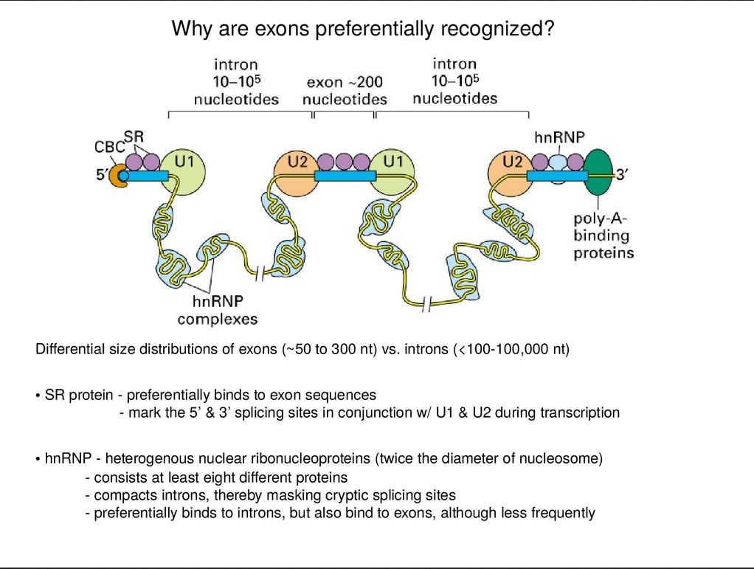

Slide 29
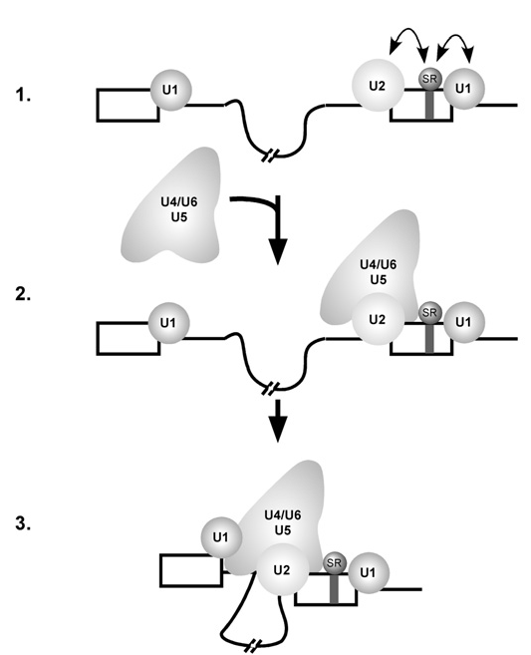
From cross-exon to cross-intron complex
cross-exon interactions are disrupted and the cross-exon complex is converted into
a cross-intron A complex, where a molecular bridge now forms between U2 and U1 bound to an upstream 5’SS
This step is decisive in determining which 5’ and 3’ exon will ultimately be spliced together;
the tri-snRNP binds after exon definition, interacting with the cross-intron A complex, thereby generating a B complex.

Slide 30
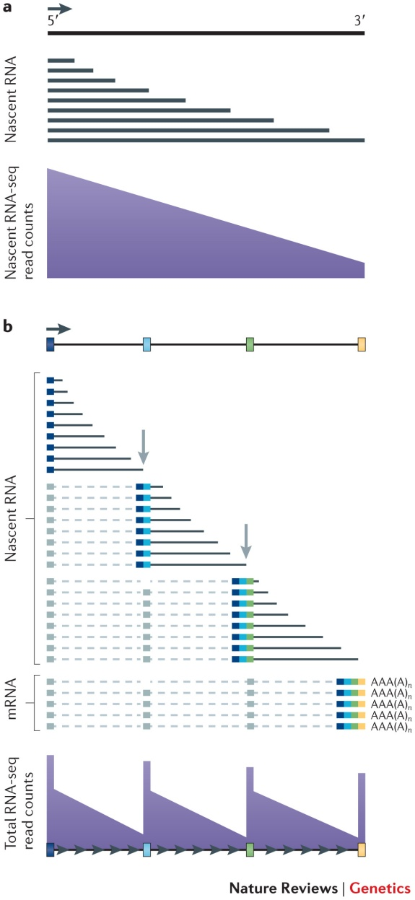
Coupling mRNA processing with transcription in time and space
Introns
direction
of transcription
'Miller spread' electron micrograph (left) and its interpretation (right) are shown for a Drosophila melanogaster embryonic gene
Notes:
Transcription of a gene and co-transcriptional processing of nascent transcripts are shown. 'Miller spread' electron micrograph (left) and its interpretation (right) are shown for a Drosophila melanogaster embryonic gene. The electron micrograph shows the DNA template with several engaged RNA polymerase II (Pol II) molecules and their associated nascent RNA transcripts with bound proteins (seen as dark blobs) that extend on either side of the DNA. Grey and white arrows mark introns that are spliced out co-transcriptionally. The black arrow indicates the direction of transcription along the DNA template
Nascent transcripts are mostly incomplete, and 5′ sequences are therefore over-represented relative to 3′ sequences across the gene in nascent RNA sequencing (RNA-seq) profiles. b | Co-transcriptional splicing of nascent transcripts causes a saw-tooth profile in read counts from sequencing of total RNA owing to rapid removal and degradation of sequences from the 3′ ends of introns shortly after the 3′ splice site has been transcribed. Figure is modified, with permission, from Ref. 74 © (2011) Macmillian Publishers Ltd. All rights reserved

Slide 31
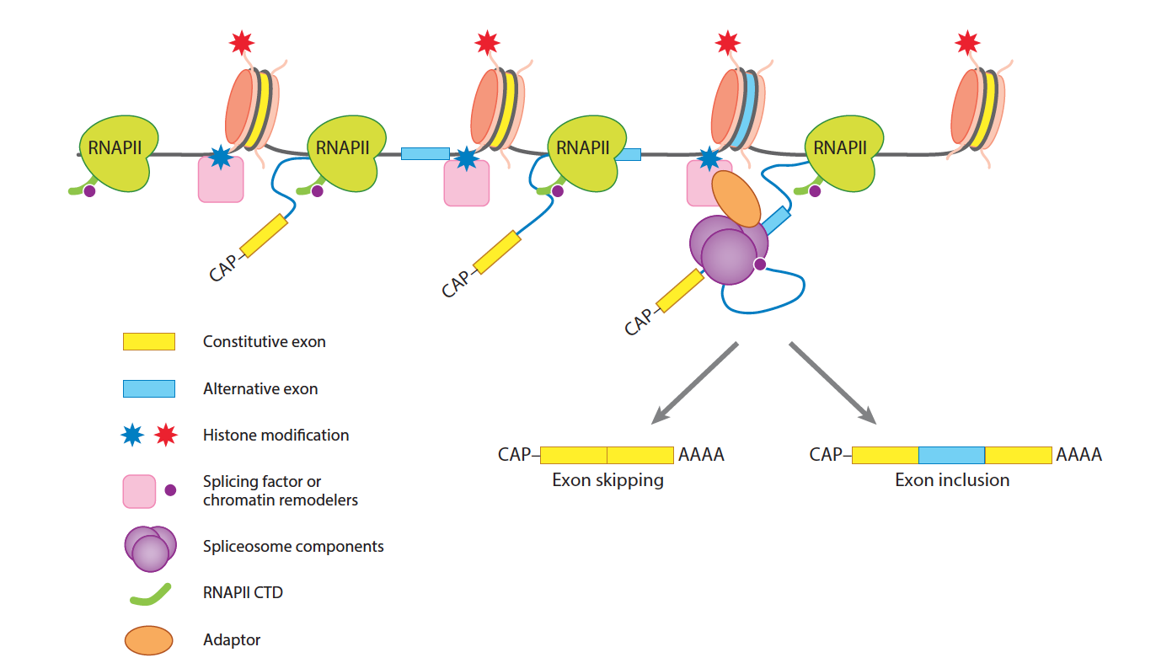
When chromatin meets splicing
Notes:
The most important
regulators of co-transcriptional histone dynamics
within genes are the H2A/H2B chaperone facilitates
chromatin transcription (FACT) and the H3 chaperone
Spt6, which both increase the rate of pol II
elongation through chromatin [98–100] .

Slide 32
Exons of expressed genes are associated with specific chromatin states
levels of nucleosome positioning
DNA methylation
specific histone modifications
How the machineries responsible for chromatin remodeling/histone modification and DNA methylation are guided specifically
to exonic sequences?
Evidence suggests that such guidance is provided both by intrinsic differences in nucleotide composition between introns and exons and by direct interactions between writers of epigenetic marks and the splicing Machinery.

Slide 33
The close association between chromatin and splicing leads to a significant cross-talk in which pre-mRNA splicing influences the chromatin state, while the chromatin state facilitates pre-mRNA splicing and controls the rate of alternative exon inclusion.
Two models explain how pre-mRNA splicing is controlled by the chromatin state
1- ‘kinetic’ model: the chromatin state controls exon inclusion by modulating the rate of transcription elongation
2- ‘recruitment’ model: histone modifications associated with the exons in cooperation with the C-terminal domain of RNAPII function as a ‘landing pad’ to load the spliceosome components necessary for splice site recognition onto the emerging nascent transcript

Slide 34
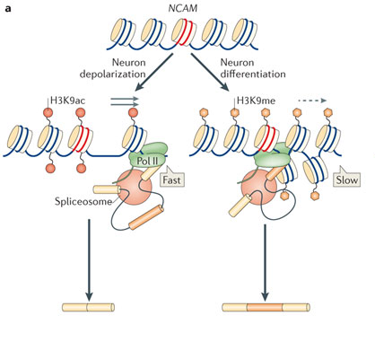
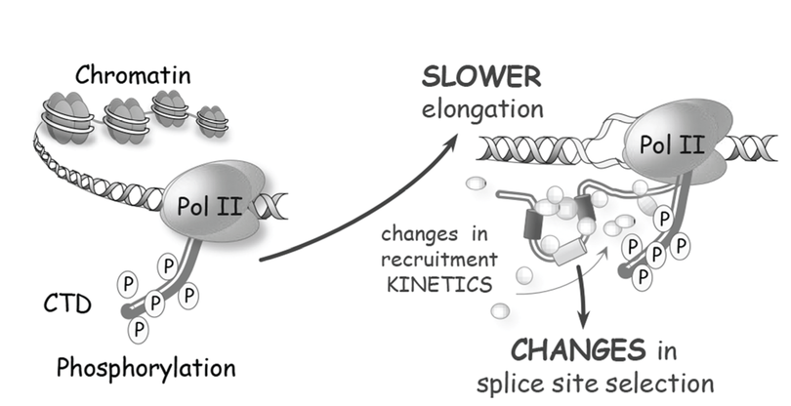
kinetic model
the chromatin state controls exon inclusion by modulating the rate of transcription elongation
H2B monoubiquitylation correlates with cotranscriptional splicing and the RNAPII elongation rate.
Exonic depletion of H2Bub1 is highly correlated with RNAPII pausing at exons.
Conversely, histone hyperacetylation leads to increased local RNAPII elongation rates and decreased inclusion of exons .
The average pol II elongation rate in mammals is 0.5–4.0 kb/min; however, it varies extensively between genes and even between different regions within a gene.
The “ window of opportunity” model predicts that elongation rate controls splicing by modulating the competition between upstream and downstream 3′ splice sites
Depolarization of neuronal cells triggers hyperacetylation surrounding exon 18 of the gene encoding the neural cell adhesion molecule (NCAM), increasing transcriptional elongation and resulting in the skipping of this exon, together with a decrease of U2AF65 recruitment to 3’ ss.
Notes:
The
average pol II elongation rate in mammals is 0.5–
4.0 kb/min; however, it varies extensively between
genes and even between different regions within a
gene [9,11,17,51] . The “ window of opportunity”
model predicts that elongation rate controls alternative
splicing by modulating the competition between
upstream and downstream 3′ splice sites
Changing the elongation rate can
potentially alter the window of opportunity for binding
of both positive and negative splicing factors, which
accounts for why slow elongation can also favor
exon skipping.

Slide 35
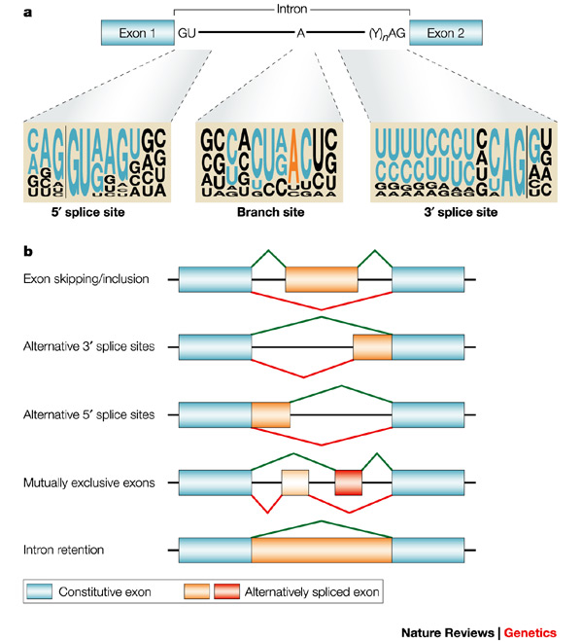
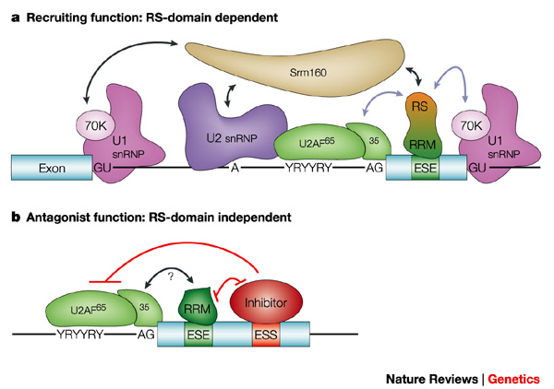
Alternative splicing
The presence of multiple introns in many eukaryotic genes permits expression of multiple, related proteins from a single gene by means of alternative slicing, an important mechanism for the production of different forms of proteins, called isoforms, by different types of cells.
Nearly 75% of all human genes are expressed as alternatively spliced mRNAs, leading to an expansion of the coding capacity of our genome.

