Slide 1
Genome editing
3-11-2022

Slide 2
How to study a gene
Forward and reverse genetics approaches are aimed to connect genotype with
phenotype. They begin with the development of a suitable mutagenized population.
Forward genetics:
to find the genetic basis of a phenotype
Reverse genetics: to find what phenotypes arise as a result of particular genetic sequences perturbation

Slide 3
Homologous recombination
You can modify precisely a DNA sequence trough homologous recombination:
It is a phenomenon in which nucleotide sequences are exchanged between two similar or identical molecules of DNA
Physiologically happens in:
-meiosis
-double strand repair
-collapsed fork

Slide 4
First attempts of genome engineering in Saccharomyces cerevisiae
His3⁺Ura3⁻
His3 gene
Ura3 gene
His3⁻Ura3⁺
This system relies on the ability to introduce DNA into a cell (by transformation or other processes), to achieve integration mediated by homologous recombination, and to have available suitable selective markers as cloned DNA fragments.
Notes:
His3: Imidazoleglycerol-phosphate dehydratase; catalyzes the sixth step in histidine biosynthesis; mutations cause histidine auxotrophy
Ura3: Orotidine-5'-phosphate (OMP) decarboxylase; catalyzes the sixth enzymatic step in the de novo biosynthesis of pyrimidines, converting OMP into uridine monophosphate (UMP); converts 5-FOA into 5-fluorouracil, a toxic compound

Slide 5
First attempts of genome engineering in Saccharomyces cerevisiae
His3⁺Ura3⁻
His3 gene
Ura3 gene
His3⁻Ura3⁺
This system relies on the ability to introduce DNA into a cell (by transformation or other processes), to achieve integration mediated by homologous recombination, and to have available suitable selective markers as cloned DNA fragments.
Notes:
His3: Imidazoleglycerol-phosphate dehydratase; catalyzes the sixth step in histidine biosynthesis; mutations cause histidine auxotrophy
Ura3: Orotidine-5'-phosphate (OMP) decarboxylase; catalyzes the sixth enzymatic step in the de novo biosynthesis of pyrimidines, converting OMP into uridine monophosphate (UMP); converts 5-FOA into 5-fluorouracil, a toxic compound

Slide 6
First attempts of genome engineering in Saccharomyces cerevisiae
His3⁺Ura3⁻
His3 gene
Ura3 gene
His3⁻Ura3⁺
His3 gene is now disrupted and Ura3 gene sequences has been inserted in the genome.
This system relies on the ability to introduce DNA into a cell (by transformation or other processes), to achieve integration mediated by homologous recombination, and to have available suitable selective markers as cloned DNA fragments.
Notes:
His3: Imidazoleglycerol-phosphate dehydratase; catalyzes the sixth step in histidine biosynthesis; mutations cause histidine auxotrophy
Ura3: Orotidine-5'-phosphate (OMP) decarboxylase; catalyzes the sixth enzymatic step in the de novo biosynthesis of pyrimidines, converting OMP into uridine monophosphate (UMP); converts 5-FOA into 5-fluorouracil, a toxic compound

Slide 7
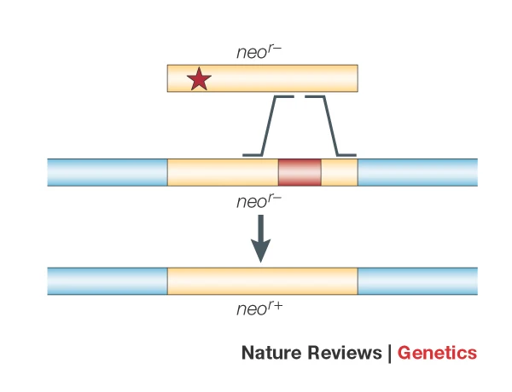
Genome engineering in cultured mammalian cells
Neo Amber is now replaced with a functional copy of Neo gene, conferring resistance to G418.
They obtained an efficiency of recombination of 1 on 1000 transfected cells.
They microinjected nuclei and used linearized vector.
Notes:
His3: Imidazoleglycerol-phosphate dehydratase; catalyzes the sixth step in histidine biosynthesis; mutations cause histidine auxotrophy
Ura3: Orotidine-5'-phosphate (OMP) decarboxylase; catalyzes the sixth enzymatic step in the de novo biosynthesis of pyrimidines, converting OMP into uridine monophosphate (UMP); converts 5-FOA into 5-fluorouracil, a toxic compound

Slide 8
Genome engineering in mouse model

Slide 9
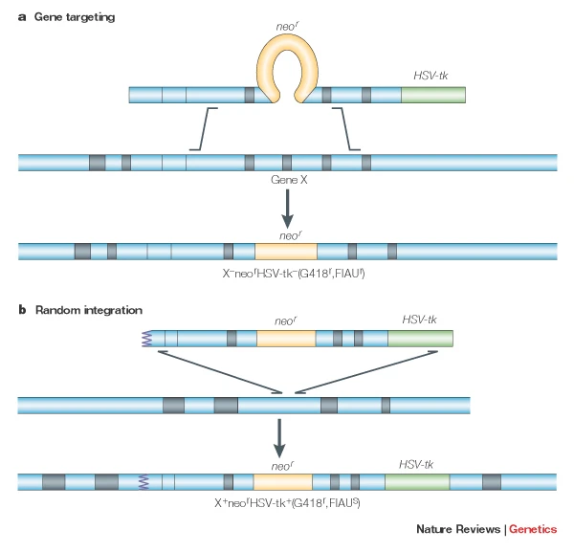
Positive–negative-selection-mediated gene targeting

Slide 10
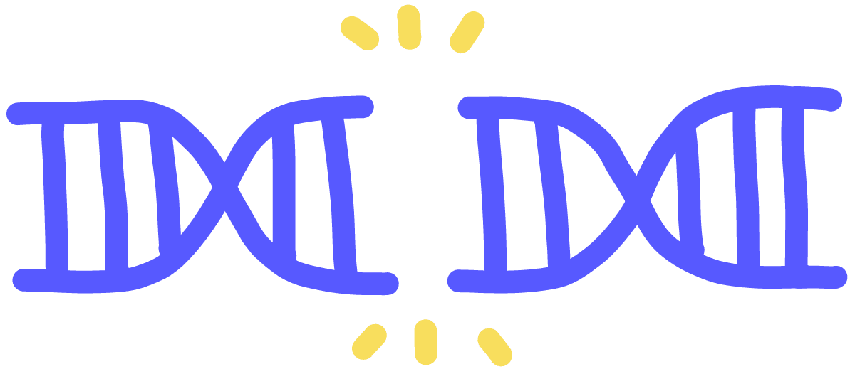
A crucial moment in genetic engeneering: the DNA double strand break is editogenic!!
The greatest impediment to efficient targeting is the fact that an intact target is essentially inert. → Studies show that a single double-strand break (DSB) dramatically increases the frequency of local recombination. These experiments were inspired by the discovery that
natural recombination events, including meiotic crossing over and mating-type switching in yeast, are initiated by DSBs.

Slide 11
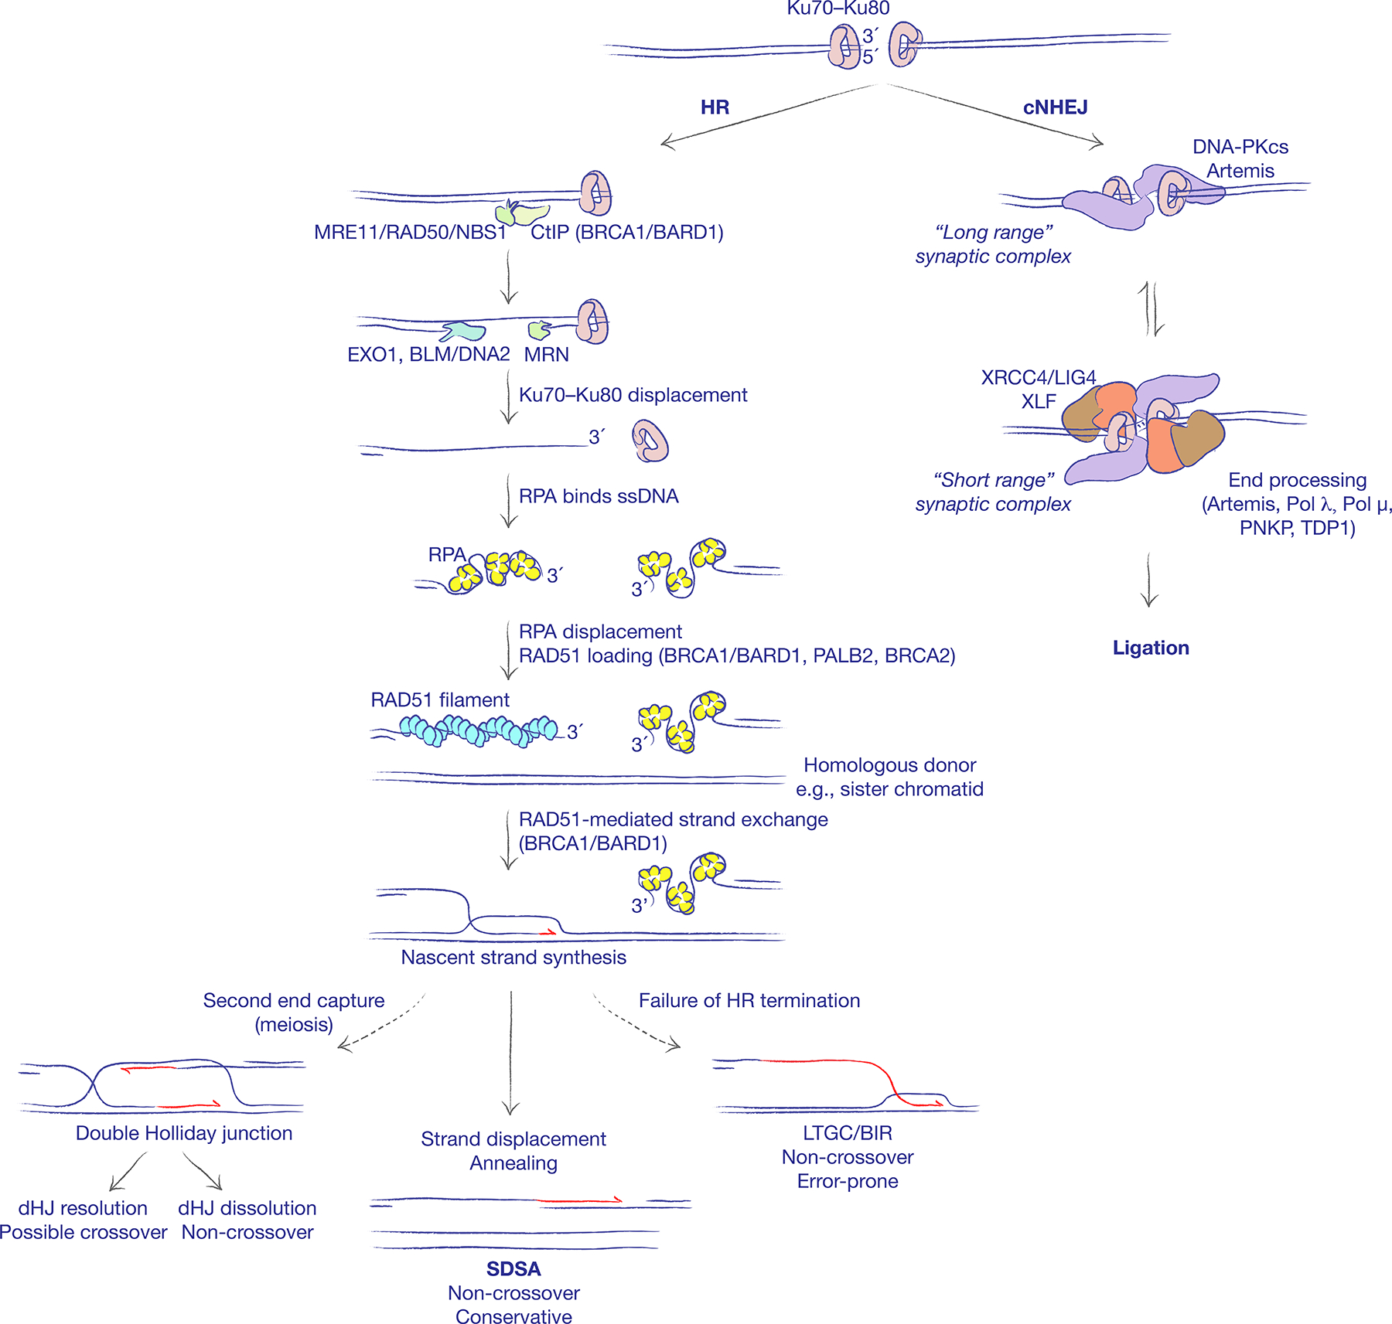
DSB repair mechanisms
Notes:
You understand that if you give to the cell a plasmid DNA with homologous sequences it will be used in place of sister chromatid to repair the DNA lesion.
In this way you can take advantage of this repair mechanism to
What do we need together with a substrate to gene editing a precise locus via HR repair?
programmable endonuclease: scissors able to cut the DNA precisely where we want.

Slide 12
DSB repair mechanisms
Homologous recombination
Non homologous end joining
Gene
Gene
Vector
Notes:
You understand that if you give to the cell a plasmid DNA with homologous sequences it will be used in place of sister chromatid to repair the DNA lesion.
In this way you can take advantage of this repair mechanism to
What do we need together with a substrate to gene editing a precise locus via HR repair?
programmable endonuclease: scissors able to cut the DNA precisely where we want.

Slide 13
Programmable endonucleases
The prototype enzymes for demonstrating DSB stimulation of gene targeting were I-SceI and HO, both of which have long recognition sites (18 bp for I-SceI, 24 bp for HO). While they provided very useful information on the efficiency and mechanisms of DSB repair, they were limited in their utility because their recognition sites had to be inserted in the genome by a low-efficiency process before they could be used to effect high-efficiency recombination
1)
2)
Site
3)
Site
4)
NHEJ or HR
In order to modify a specific locus, you need programmable endonucleases able to cut the genome in a precise region.

Slide 14
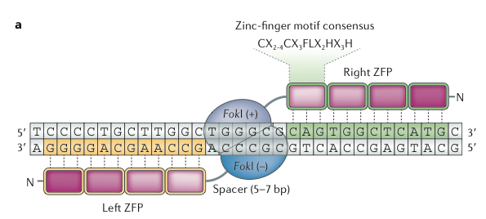
Zinc-finger nucleases (ZFNs)
A ZFN has a modular structure that is composed of two domains: a DNAbinding zinc-finger protein (ZFP) domain and the nuclease domain derived from the FokI restriction enzyme. Two ZFN monomers are required to form an active nuclease.
The sequence specificity of ZFNs is determined by ZFPs, which consist of tandem arrays of C2H2 zinc-fingers, the most common DNA-binding motif in higher eukaryotes. Each zinc-finger recognizes a 3-bp DNA sequence, and 3–6 zinc-fingers are used to generate a single ZFN subunit that binds to DNA sequences of 9–18 bp. Various computer programs are available that
search for possible ZFN target sites in a given DNA sequence.

Slide 15
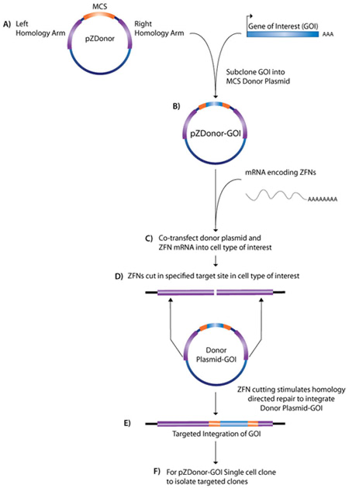
Zinc-finger nucleases (ZFNs)
Targeted Integration
ZFNs are used to rapidly integrate a userspecified gene of interest (GOI) into preferred sites of integration in either the human, mouse or rat genome. In the human genome the adeno-associated virus (AAVS1) locus on human chromosome 19 is the preferred site, while the Rosa26 locus is located on chromosome 6 in the mouse and chromosome 4 in the rat. The ZFNs target each site with high specificity, creating a double strand break. ZFN treated cells then use a Donor plasmid with homology arms to either the AAVS1 or Rosa26 genomic regions to replace the natural locus by the repair process of homology directed repair. The Donor plasmid can be engineered to contain your GOI and will direct targeted integration of your GOI into the AAVS1 or Rosa26 loci.

Slide 16
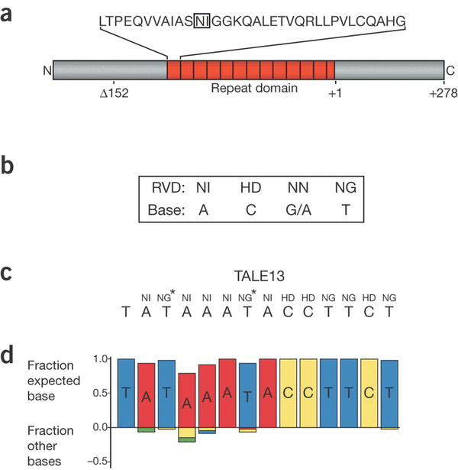
Transcription Activator-Like Effector Nucleases (TALEN)
The first component is the TALE domain.
TALEs are naturally-occurring transcription factors first discovered in the plant pathogen Xanthomonas. In the nucleus they bind specific
sequences within gene promoters to modulate
host resistance mechanisms. Each TALE contains a highly conserved central region consisting of varying numbers of repeat units of typically 33 to 35 amino acids that confer specific DNA sequence recognition to the TALE protein. Remarkably, these repeat units contain high levels of identity with the exception of two variable amino acids at positions 12 and 13. These residues, termed the Repeat-Variable Diresidues (RVDs), confer DNA-binding specificity to the repeat region.
N= Apsparagine
I=Isoleucine
H= Histidine
D=Aspartic acid
G=Glycine

Slide 17
Transcription Activator-Like Effector Nucleases (TALEN)
TALENs are similar to ZNFs in that they use DNA binding motifs to direct the same non-specific nuclease to cleave the genome at a specific site, but instead of recognizing DNA triplets, each domain recognizes a single nucleotide.
Functional endonuclease FokI is artificially fused to DNA-binding domains to cut the targeting sequences and generate a DSB.
Since FokI works as a dimer, two TALE binding sites which are separated by a spacer sequence are needed to locate opposing DNA target sites.
The interactions between the TALEN-derived DNA binding domains and their target nucleotides are less complex that those between ZNFs and their target trinucleotides, and designing TALEN is generally more straightforward than ZNFs.

Slide 18
Transcription Activator-Like Effector Nucleases (TALEN)

Slide 19
Transcription Activator-Like Effector Nucleases (TALEN)

Slide 20
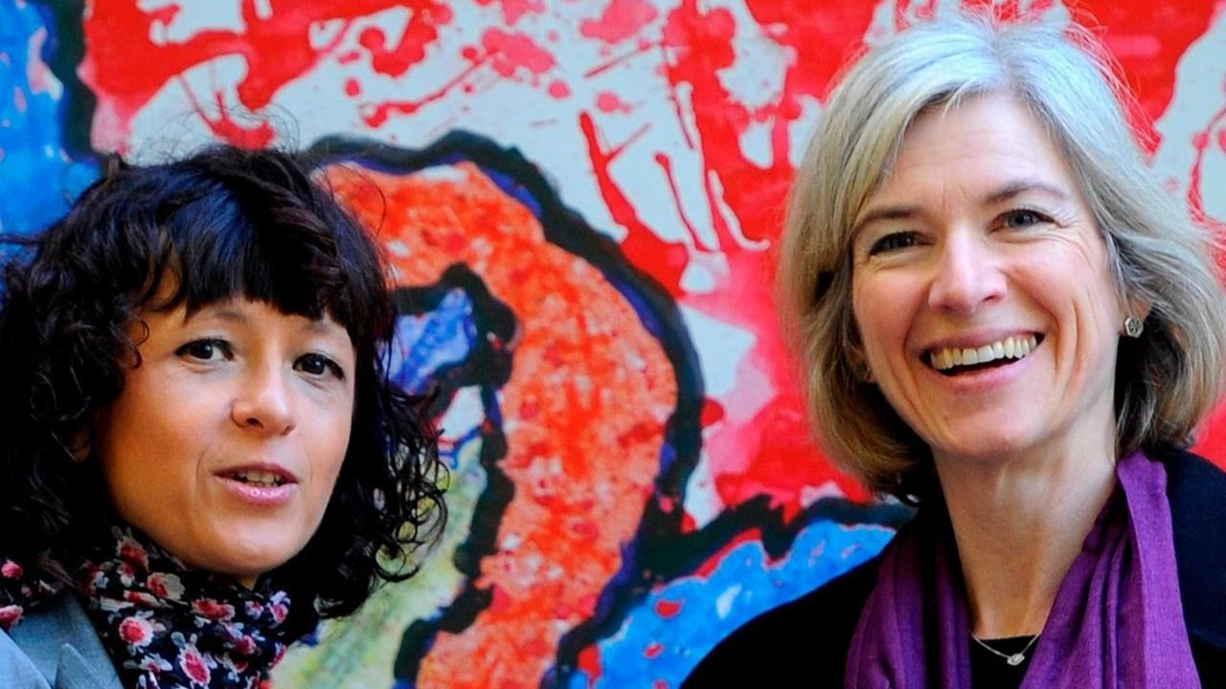
Clustered Regurarly interspaced Short Palyndronic Repeats (CRISPR) and CRISPR-associated (Cas) genes
The CRISPR/Cas9 system is a prokariotic immune system that confers resistance to foreign genetic elements such as plasmid and phages, and provides a form of acquired immunity. CRISPRs are used in concert with specific endonuclease enzymes, Cas, for genome editing and gene regulation.
Emmanuelle Charpentier and Jennifer Doudna have been awarded the 2020 Nobel Prize in Chemistry for their development of CRISPR/Cas9 genetic editing.

Slide 21
The process in bacteria

Slide 22
The CRISPR/Cas9 system
The CRISPR/Cas system can thereby be retargeted to cleave virtually any DNA sequence by redesigning the crRNA. Significantly, the CRISPR/Cas system has been shown to be directly portable to human cells by co-delivery of plasmids expressing the Cas9 endonuclease and
the necessary crRNA components. New plasmids for genome editing are easily prepared by cloning 20-bp guide DNA sequences in a vector that encodes crRNA. Complicated protein engineering is not necessary for making new RGENs because Cas9 remains the same.

Slide 23
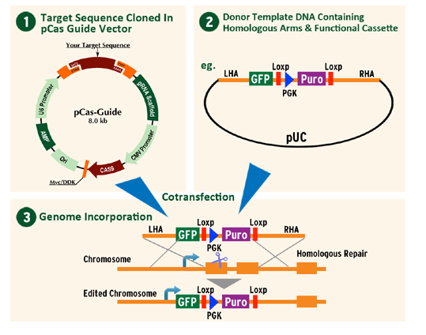
Gene editing with the CRISPR/Cas9 system
The Cas9, tracrRNA and crRNA can be combined in a single plasmid (1)
It is co-transfected with a donor DNA with homologous arms (2)

Slide 24
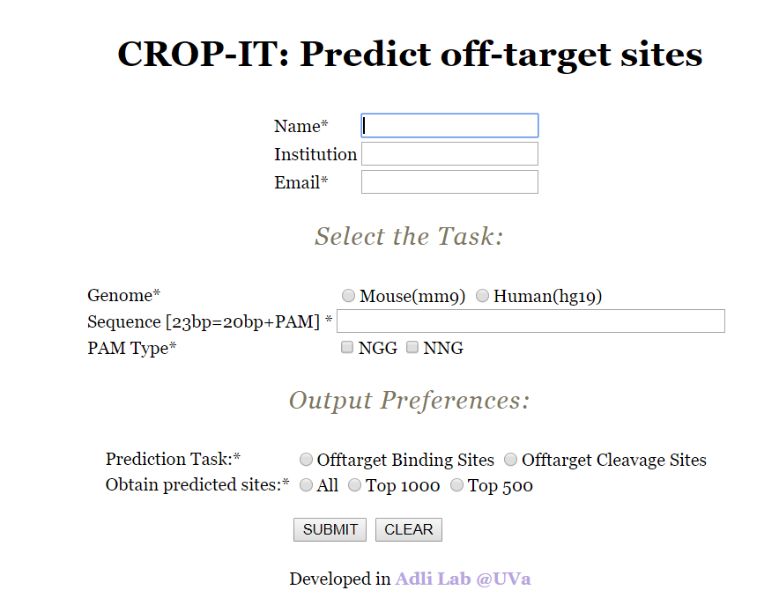
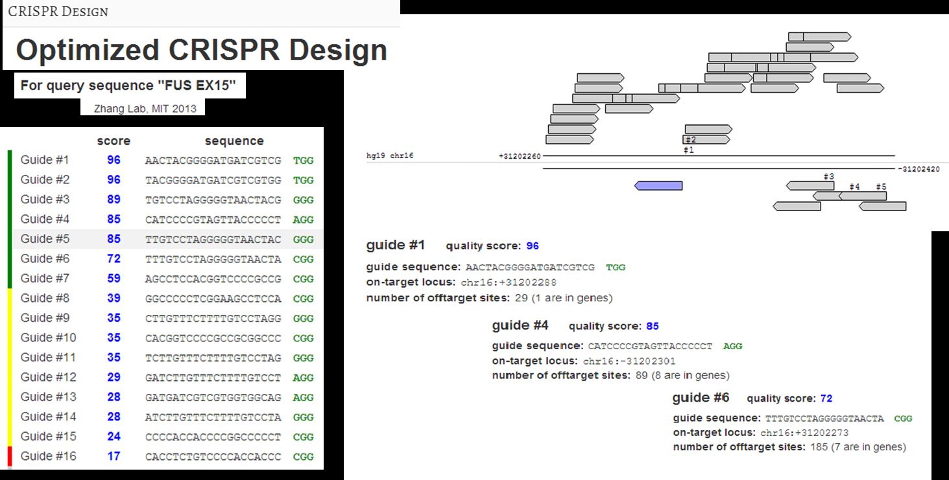
Off targeting

Slide 25
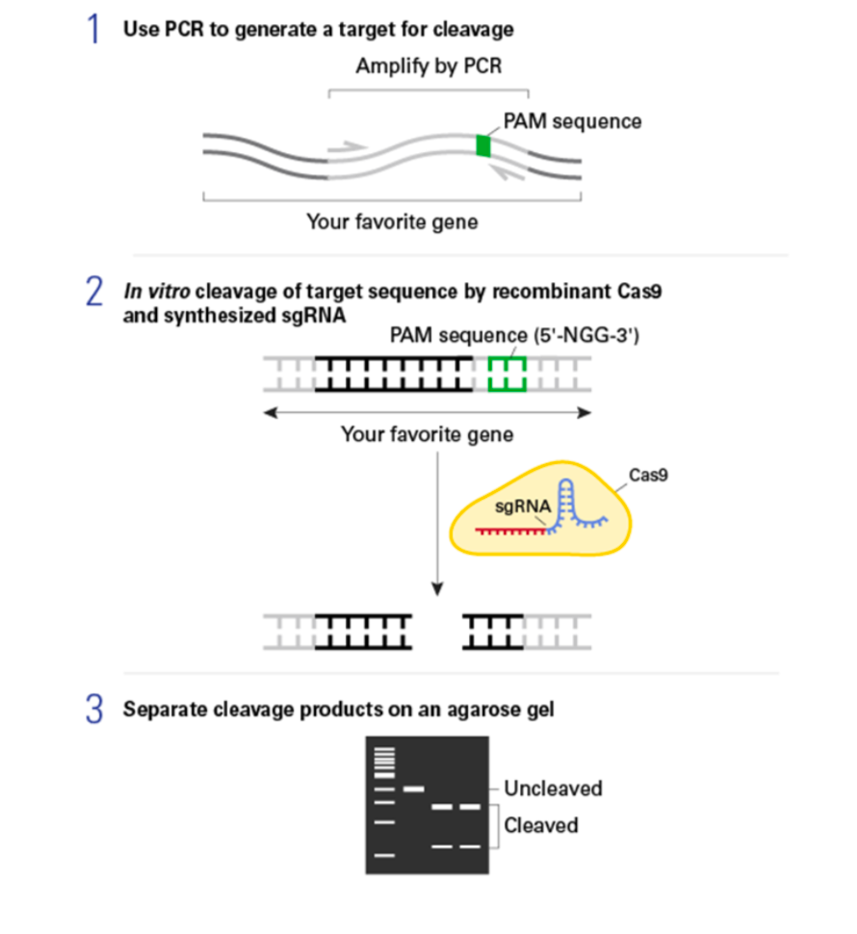
Test of sgRNA efficiency in vitro

Slide 26
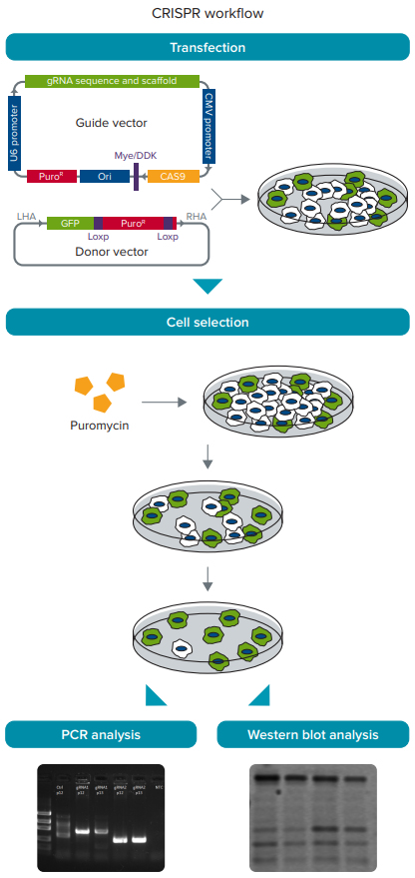
CRISPR/Cas9 experimental workflow

Slide 27
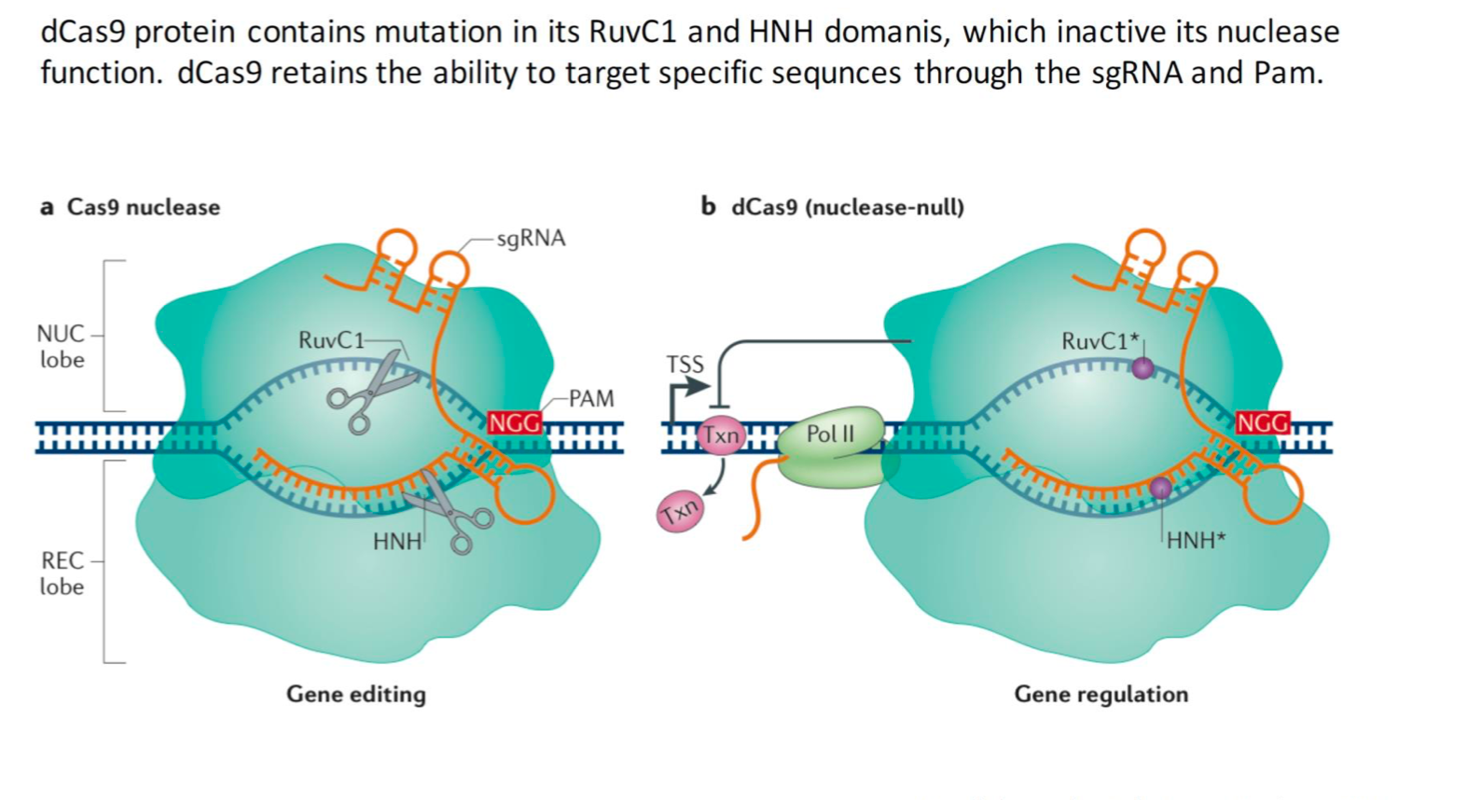
Nuclease-deficient Cas9

Slide 28
Nuclease-deficient Cas9
Catalytically inactive dCas9 provides a platform for probing genomic function. dCas9 can be fused to any number of different effectors to allow for the visualization of where specific DNA sequences localize, the repression or activation of transcription, or the immunoprecipitation of the bound chromatin.

Slide 29
Programmable RNA recognition and cleavage by CRISPR/Cas9
Cas9 binds with high affinity to single-stranded RNA (ssRNA) targets matching the Cas9-associated guide RNA sequence when the PAM is presented in trans as a separate DNA oligonucleotide. Using specially designed PAMmers, Cas9 can be specifically directed to bind or cut RNA targets while avoiding corresponding DNA sequences

Slide 30
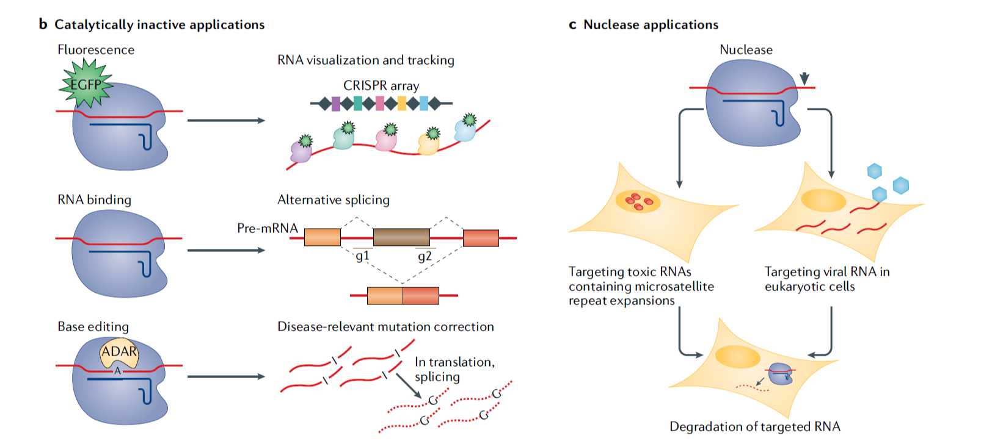
RNA-targeting tools and their applications

Slide 31
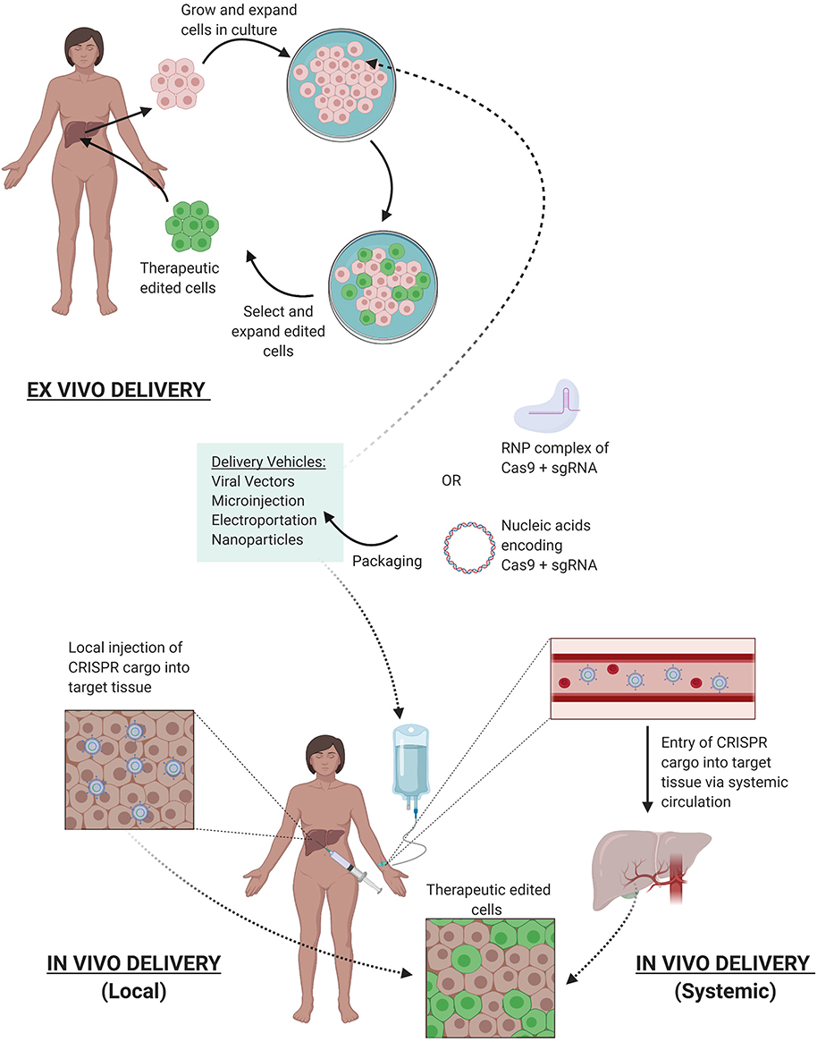
Gene therapy with CRISPR/Cas9
The goal of gene therapy for genetic diseases is to achieve durable expression of the therapeutic gene or “transgene” at a level sufficient to ameliorate or cure disease symptoms with minimal adverse events. There are two basic strategies: an integrating vector is introduced into a precursor or stem cell so that the gene is passed to every daughter cell (the vector is designed to integrate at one or more loci in the patient’s chromosomes) or the gene is delivered in a nonintegrating vector to a long-lived postmitotic or slowly dividing cell, ensuring the expression of that gene for the life of the cell. In the latter case, integration of the therapeutic DNA into chromosomes of the patient’s cells is not required; instead, the
transferred DNA is stabilized extrachromosomally. Transduction of stem cells is generally an ex vivo process and requires an integrating vector, whereas delivery to long-lived postmitotic cells is usually achieved through in vivo gene delivery.

Slide 32
Ex vivo CRISPR Gene Therapy
CRISPR/Cas9 in cancer immunotherapy

Slide 33
Ex vivo CRISPR Gene Therapy
CRISPR/Cas9 to treat Duchenne muscular dystrophy

Slide 34
Ex vivo CRISPR Gene Therapy
CRISPR/Cas9 to treat Duchenne muscular dystrophy

Slide 35
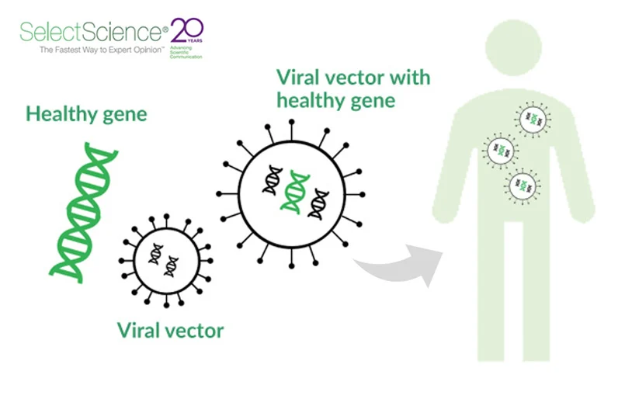
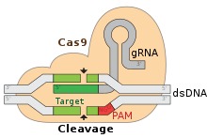
In vivo CRISPR/Cas9 gene therapy
Points that has to be addressed:
Elimination of off targets
Requirement for a PAM near the target site
Immunotoxicity
Delivery
5′NGG3′
5′NNGRRT3’

Slide 36
Precision Gene Editing With CRISPR
CRISPR/Cas9-HDR. Cas9 induces a DSB. The exogenous ssODN carrying the sequence for the desired edit and homology arms is used as a template for HDR-mediated gene modification.
Base Editor. dCas9 or Cas9n is tethered to the catalytic portion of a deaminase. Cytosine deaminase catalyzes the formation of uridine from cytosine. DNA mismatch repair mechanisms or DNA replication yield an C:G to T:A single nucleotide base edit. Adenosine deaminase catalyzes the formation of inosine from adenosine. DNA mismatch repair mechanisms or DNA replication yield an A:T to G:C single nucleotide base edit.

Slide 37
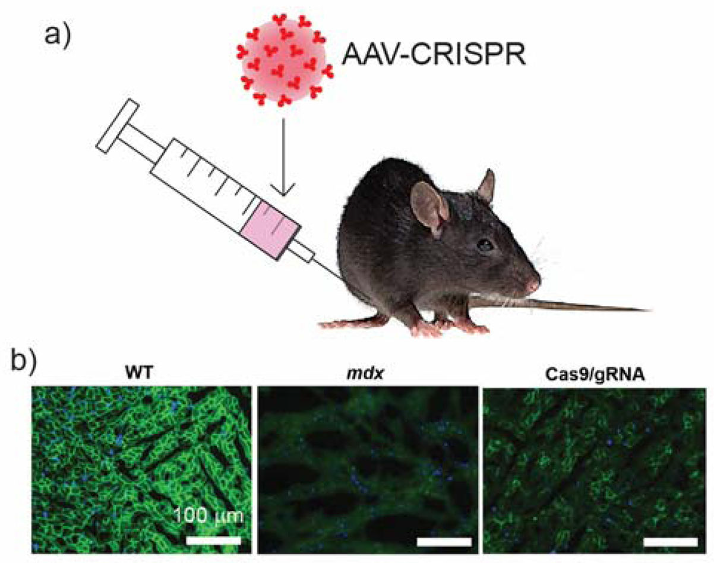
In vivo CRISPR Gene Therapy

Slide 38
In vivo CRISPR Gene Therapy

Slide 39
CRISPR/Cas9 based de novo discovery

Slide 40
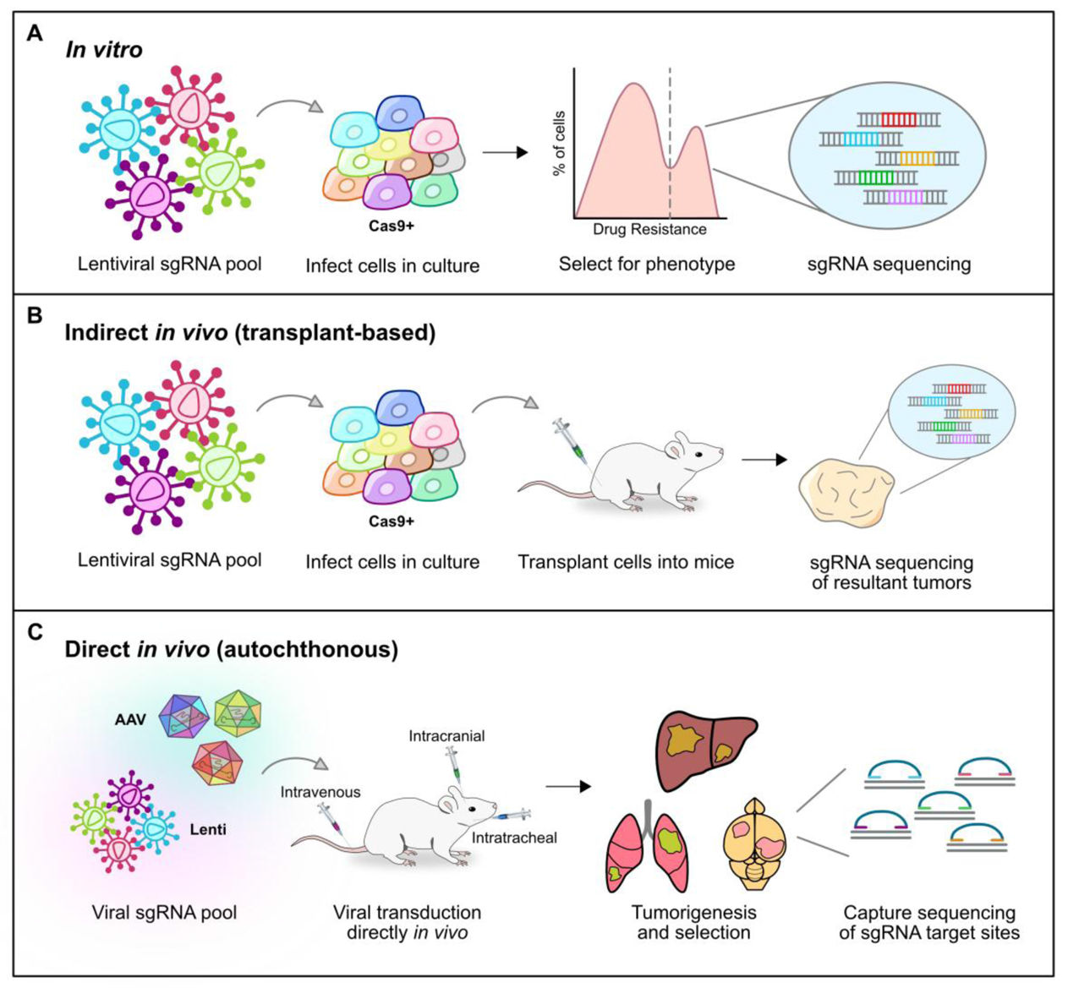
Cancer CRISPR screens

Slide 41
Gene editing in human embryos
UK approves CRISPR for editing human embryonic genome
Kathy Niakan, a biologist at the Francis Crick Institute, will use the CRISPR/Cas9 gene-editing system to study donated embryos in the first seven days after fertilization, then discard them. Tweaking the genes in those cells will help her team understand how an embryo develops into a healthy baby, research that could lead to improved success rates for in vitro fertilization.
It remains illegal for the scientists to implant the altered embryos into women, but the decision represents a huge landmark in the use of the revolutionary gene-editing technology.

Slide 42
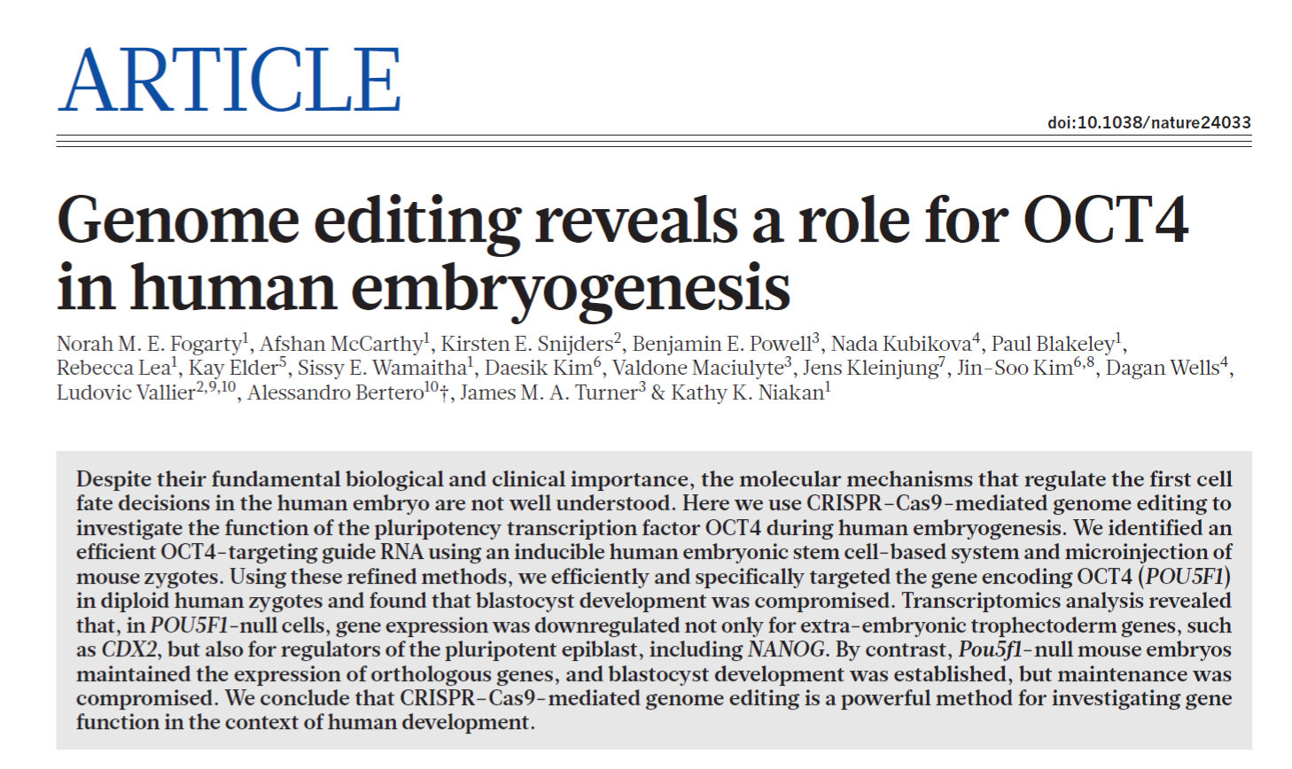
Gene editing in human embryos

Slide 43
Gene editing in human embryos
The insights gained from these investigations advance our understanding of human development and suggest that OCT4 has an earlier role in the progression of the human blastocyst compared to the mouse, and therefore that there are distinct mechanisms of lineage specification between these species.

Slide 44
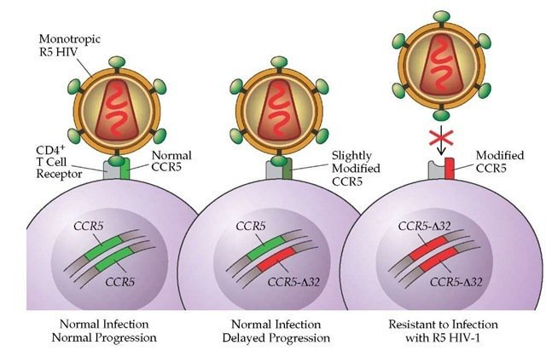
Genome-edited baby claim provokes international outcry
CRISPR/Cas9 enabled CCR5Δ32 deletion mutation

Slide 45
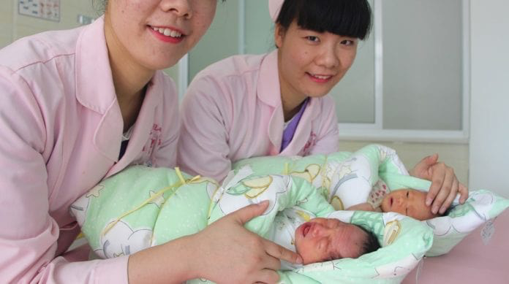
Genome-edited baby claim provokes international outcry
In November 2018, He Jiankui, a Chinese biology professor at Southern University of Science and Technology (SUST) in Shenzhen (Guangdong Province) announced that he and his team had created the World’s first “genetically edited babies” to make them resistant to HIV: twin babies Lula and Nana.

Slide 46
Genome-edited baby claim provokes international outcry
They tried to reproduce the human CCR5 mutation, close to the Δ32 mutation.
As a result, they generated different mutations, of which the effects are unknown. It may or may not confer HIV resistance, and may or may not have other consequences.
A second source of errors could have been that the editing was not perfectly efficient. This means that not all cells in the embryos were necessarily edited.
When an organism has a mixture of edited and unedited cells, it is called a "mosaic". While the available data are still limited, it seems that both Lulu and Nana are
mosaic.
CCR5 32 region
*
CCR5-modification

Slide 47
CRISPR systems: Novel approaches for detection and combating COVID-19
SHERLOCK (Specific High-Sensitivity Enzymatic Reporter unLOCKing): combines RPA pre-amplification, Cas13 detection and colorimetric reporter for visualized readout.
Viral infection of a host cell via endocytosis results in the entrance of ABACAS into the infected cell along with the virus. Release of ABACAS activates the Cas13 portion which recognize the viral RNA and mediates its degradation. In addition, masking of virus s protein by ABACAS inhibits the entry of virus to the target cells.

