Slide 1
Messenger RNA maturation

Slide 2
Features of RNA molecule
Synthesized from a DNA template (transcription)
Single stranded molecule
Contains ribose in place of deoxyribose
Contains Uracil in place of Thymine
Coding RNA which are translated into proteins: messenger RNA(mRNA)
Non coding RNA which are not translated into protein but work as RNA with structural and/or regulatory function.
Types of RNA molecules

Slide 3
Messenger RNA

Slide 4
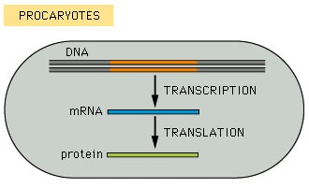
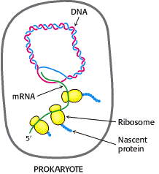
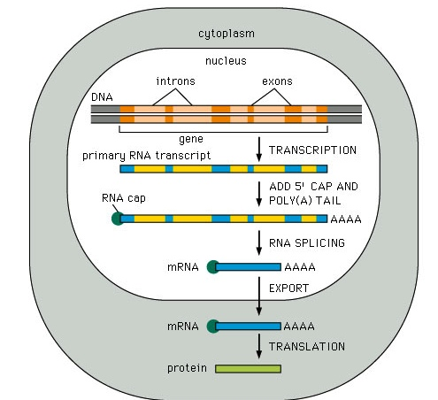
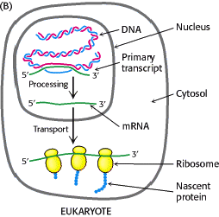

Slide 5
mRNA structure
AUG
UAA
cap
AAAAAAAAAAAAA
5’ UTR
3’ UTR
ORF

Slide 6
Eucaryotic gene expression
transcription
START site
exons
gene
upstream
elements
promoter
elements
introns
TRANSCRIPTION
CAPPING
m⁷G
pre-mRNA
SPLICING
POLYADENYLATION
m⁷G
AAAAAAAAAn
polyadenylated pre-mRNA
nucleus
m⁷G
AAAAAAAAAn
mature mRNA
TRANSPORT
cytoplasm
TRANSLATION
Notes:
6

Slide 7
Eucaryotic gene expression
transcription
START site
exons
gene
upstream
elements
promoter
elements
introns
TRANSCRIPTION
CAPPING
m⁷G
pre-mRNA
SPLICING
POLYADENYLATION
m⁷G
AAAAAAAAAn
polyadenylated pre-mRNA
nucleus
m⁷G
AAAAAAAAAn
mature mRNA
TRANSPORT
cytoplasm
TRANSLATION
Notes:
7

Slide 8
Why the Cap structure is important?
RNA stability
Favours mRNA transport to the cytoplasm
Increases translation (it binds to eIF4E that belongs to translation initiation complex)

Slide 9
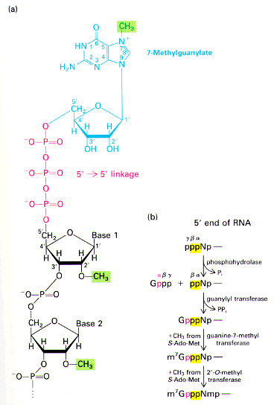
5' CAP:
3'-G-5'ppp5'-N-3'p
This involves the addition of a modified guanine base to the 50 end of the RNA. Specifically, it is a methylated guanine, and it is joined to the RNA transcript by an unusual 5‘–5’ linkage involving three phosphates
7-metilguanosina
CAP is added at very early stage of transcription initiation
The 5’-5’ phosphodiester bond makes the molecule resistant to the exonuclease activity.
I vitro synthetized RNA without CAP are rapidly degraded
estremità 5’
della RNA catena
Notes:
9

Slide 10
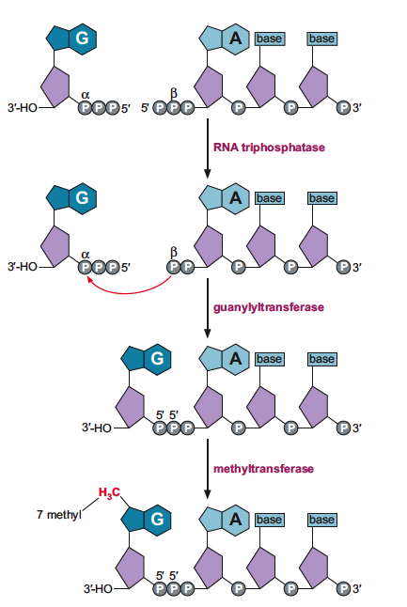
pre-mRNA capping
The 5’ cap is created in three enzymatic steps:
a phosphate group is removed from the 5’ end of the transcript.
GMP moiety is added.
GMP nucleotide is modified by the addition of a methyl group.
RNA triphosphatase
RNA guanylyltransferase
RNA(G-7-) methyltransferase

Slide 11
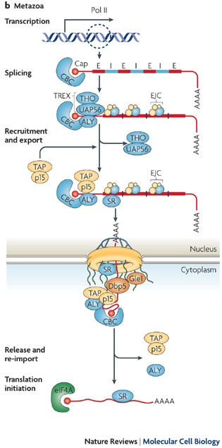
5’ CAP favours the mRNA transport to the cytoplasm
CBC: CAP binding complex

Slide 12
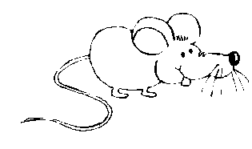
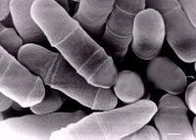
1 2 3 4 5 6 7
RNApol II
Glu Gly Ala Met Ser Pro Ser
Tyr Ser Pro Thr Ser Pro Ala
Tyr Glu Pro Arg Ser Pro Gly Gly
Tyr Thr Pro Gln Ser Pro Ser
Tyr Ser Pro Thr Ser Pro Ser
Tyr Ser Pro Thr Ser Pro Ser
Tyr Ser Pro Thr Ser Pro Asn
Tyr Ser Pro Thr Ser Pro Ser
Tyr Ser Pro Thr Ser Pro Ser
Tyr Ser Pro Thr Ser Pro Ser
Tyr Ser Pro Thr Ser Pro Ser
Tyr Ser Pro Thr Ser Pro Ser
Tyr Ser Pro Thr Ser Pro Ser
Tyr Ser Pro Thr Ser Pro Ser
Tyr Ser Pro Thr Ser Pro Ser
Tyr Ser Pro Thr Ser Pro Ser
Tyr Ser Pro Thr Ser Pro Ala
Tyr Ser Pro Thr Ser Pro Ser
Tyr Ser Pro Thr Ser Pro Ser
Tyr Ser Pro Thr Ser Pro Ser
Tyr Ser Pro Thr Ser Pro Ser
Tyr Ser Pro Thr Ser Pro Ser
Tyr Ser Pro Thr Ser Pro Asn
Tyr Ser Pro Thr Ser Pro Asn
Tyr Thr Pro Thr Ser Pro Ser
Tyr Ser Pro Thr Ser Pro Ser
Tyr Ser Pro Thr Ser Pro Asn
Tyr Ser Pro Thr Ser Pro Asn
Tyr Ser Pro Thr Ser Pro Ser
Tyr Ser Pro Thr Ser Pro Ser
Tyr Ser Pro Thr Ser Pro Ser
Tyr Ser Pro Ser Ser Pro Arg
Tyr Thr Pro Gln Ser Pro Thr
Tyr Thr Pro Ser Ser Pro Ser
Tyr Ser Pro Ser Ser Pro Ser
Tyr Ser Pro Thr Ser Pro Lys
Tyr Thr Pro Thr Ser Pro Ser
Tyr Ser Pro Ser Ser Pro Glu
Tyr Thr Pro Ala Ser Pro Lys
Tyr Ser Pro Thr Ser Pro Lys
Tyr Ser Pro Thr Ser Pro Lys
Tyr Ser Pro Thr Ser Pro Thr
Tyr Ser Pro Thr Thr Pro Lys
Tyr Ser Pro Thr Ser Pro Thr
Tyr Ser Pro Thr Ser Pro Val
Tyr Thr Pro Thr Ser Pro Lys
Tyr Ser Pro Thr Ser Pro Thr
Tyr Ser Pro Thr Ser Pro Lys
Tyr Ser Pro Thr Ser Pro Thr
Tyr Ser Pro Thr Ser Pro Lys Gly Ser Thr
Tyr Ser Pro Thr Ser Pro Gly
Tyr Ser Pro Thr Ser Pro Thr
Tyr Ser Leu Thr Ser Pro Ala
Ile Ser Pro Asp Asp Ser Asp Glu Glu Asn
m⁷G
C
T
D
arbossi
erminal
omain
Mouse
1 2 3 4 5 6 7
Glu Ala Pro Thr Ser Pro Gly
Phe Gly Val Ser Ser Pro Gly
Phe Ser Pro Thr Ser Pro Thr
Tyr Ser Pro Thr Ser Pro Ala
Tyr Ser Pro Thr Ser Pro Ser
Tyr Ser Pro Thr Ser Pro Ser
Tyr Ser Pro Thr Ser Pro Ser
Tyr Ser Pro Thr Ser Pro Ser
Tyr Ser Pro Thr Ser Pro Ser
Tyr Ser Pro Thr Ser Pro Ser
Tyr Ser Pro Thr Ser Pro Ser
Tyr Ser Pro Thr Ser Pro Ser
Tyr Ser Pro Thr Ser Pro Ser
Tyr Ser Pro Thr Ser Pro Ser
Tyr Ser Pro Thr Ser Pro Ser
Tyr Ser Pro Thr Ser Pro Ser
Tyr Ser Pro Thr Ser Pro Ala
Tyr Ser Pro Thr Ser Pro Ser
Tyr Ser Pro Thr Ser Pro Ser
Tyr Ser Pro Thr Ser Pro Ser
Tyr Ser Pro Thr Ser Pro Ser
Tyr Ser Pro Thr Ser Pro Ser
Tyr Ser Pro Thr Ser Pro Asn
Tyr Ser Pro Thr Ser Pro Ser
Tyr Ser Pro Thr Ser Pro Gly
Tyr Ser Pro Thr Ser Pro Ala
Tyr Ser Pro Lys Gln Asp Glu Gln Lys His Asn Glu Asn Glu Asn Ser Arg
Yeast

Slide 13
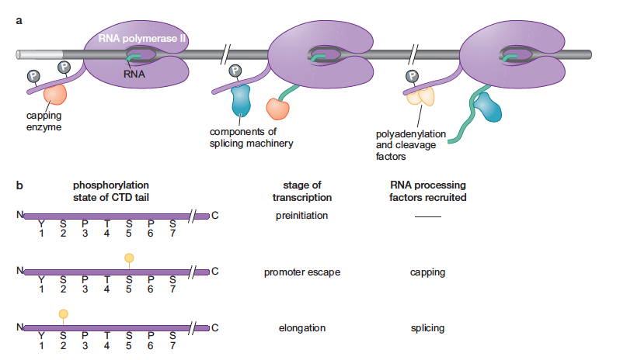
Phosphorylation state of the CTD of RNA polymerase II along transcription cycle
Ser 5
Ser 2
Ser 2

Slide 14
Pol II
Pol II
N
N
N
N
+1
N
N
N
+1
N
N
N
N
N₂₀₋₃₀
N
N
N
N
N
N
N
N
N
p CTD
N
p CTD
Ser5
RTP
Ser5
Ser5
TFIIH
Ser5
N
Ser5
P
N
GT
Ser5
P
P
N₁
P-P-P
P
N₁
P-P-
P
P
P-G
P
P-P-P-G
Dissociation of transcription
initiator factors- recruitment of the
capping machinery
P-G
Pol II
N
N
+1
N
N
N
N
N
N
N
N
N
N
N
N
N
N
N
N
N
p CTD
N
N
N N N N N N
Ser5
Ser5
N
Ser5
P
N
N₁
P
P
N
P-P-
P-G
m⁷
MT
P-P-
CBC
P-G
m⁷

Slide 15
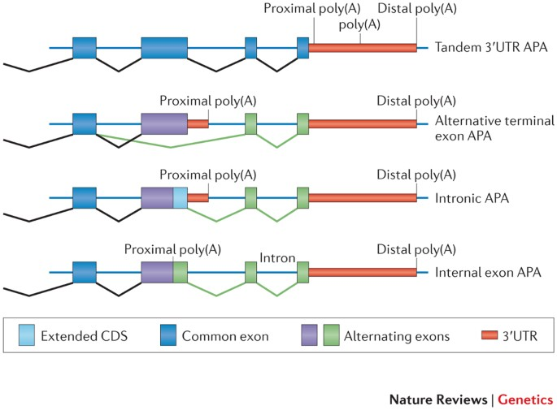

Slide 16
Eucaryotic gene expression
transcription
START site
exons
gene
upstream
elements
promoter
elements
introns
TRANSCRIPTION
CAPPING
m⁷G
pre-mRNA
SPLICING
POLYADENYLATION
m⁷G
AAAAAAAAAn
polyadenylated pre-mRNA
nucleus
m⁷G
AAAAAAAAAn
mature mRNA
TRANSPORT
cytoplasm
TRANSLATION
Notes:
16

Slide 17
What is the function of the polyA tail?
RNA stability
Favours the mRNA transport to the cytoplasm
Increases translation efficiency by favouring the loading of ribosomal 40S subunit
mRNA 3’ end formation allows efficient transcription termination.

Slide 18
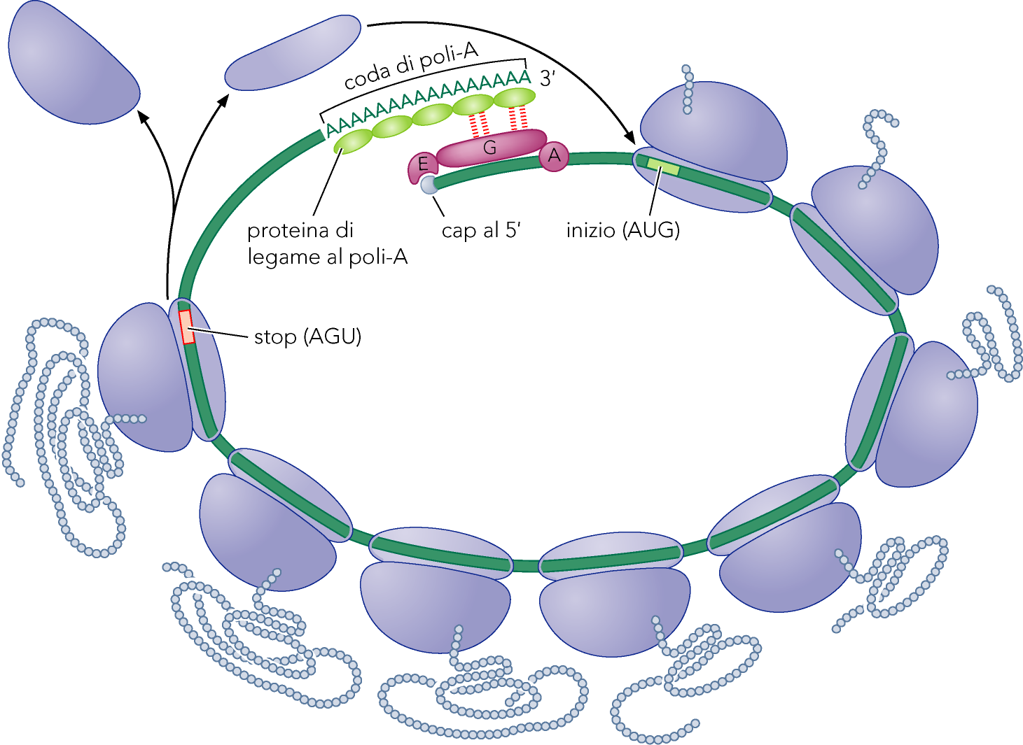
Inizio della Traduzione

Slide 19
Looking for consenus sequences
SEQUENCE ALIGNEMENT OF cDNAs STARTING FROM THE POLYA TAIL
15-20 nt
5’UTR
3’UTR
globin
AUG
UAA
GGUUAUCCAUCAAUAAA…….GCUAUACGCAAAA_{n}
Ig
AUG
UAA
CCACUGGGCCAAUAAA…….GCUAUACGCAAAA_{n}
Ovoalbumin
AUG
UAA
GCAACCUCGAAUAAA…….GCUAUACGCAAAA_{n}
Polymerase
AUG
UAA
AUCUGGAGGAAUAAA…….GCUAUACGCAAAA_{n}
Myc
AUG
UAA
UAUAGAUCCAAUAAA…….GCUAUACGCAAAA_{n}
AAUAAA
consensus

Slide 20
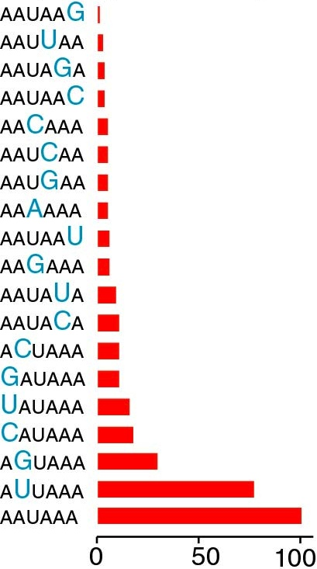
consensus
Polyadenylation efficiency
Influence of consensus sequence AAUAAA
Efficiency

Slide 21
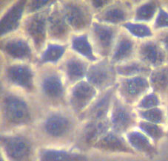
Site-specific mutation
Recombinant DNA preparation
mutation
*
transfection
mut1
mut2
mut3
WT
polyA
HeLa cells
Northern blot
RNA extraction
After 24 h

Slide 22
3’ end formation in mammalian cells
Cleavage and polyadenylation site
5’
AAUAAA
GU rich
3’
15-20 nt
5’
AAUAAA
OH
P
GU rich
3’
degradation
5’
AAUAAA
A₂₅₀

Slide 23
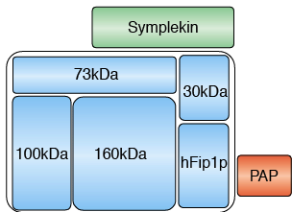
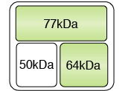
SPECIFIC COMPLEXES ARE INVOLVED IN mRNA 3’END PROCESSING
Cleavage and Polyadenylation Specific Factor
CPSF
sito di taglio
5’
AAUAAA
CA
Cleavage Stimulation Factor
CstF
CFII
CFI
3’
GU-rich
PAP
Poly-A polymerase
Curr Opin Cell Biol. 2004 Jun;16(3):272-8

Slide 24
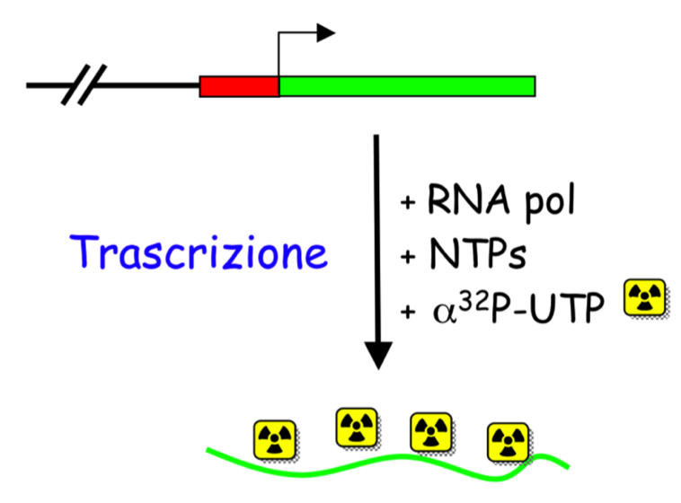
band shift/EMSA assay: to study RNA-protein interaction in vitro
2
In vitro transcription
Labelled RNA
Purified protein
1
Labelled RNA
Notes:
24

Slide 25
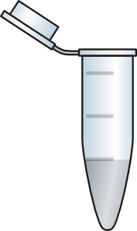
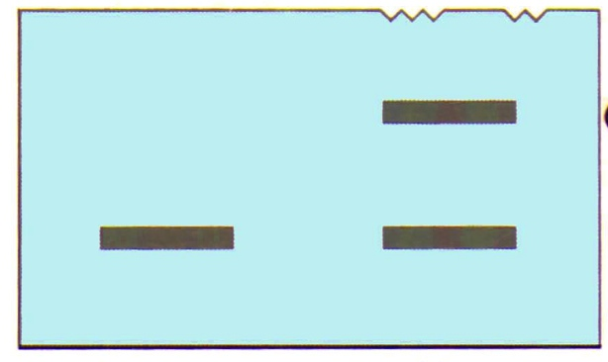
band shift/EMSA assay: to study RNA-protein interaction in vitro
2
1
Purified protein
Labelled RNA
RNA-protein complex
Free RNA
Notes:
25

Slide 26
SPECIFIC COMPLEXES ARE INVOLVED IN mRNA 3’END PROCESSING
Cleavage and Polyadenylation Specific Factor
CPSF
sito di taglio
EMSA assay for testing the interaction between CPSF 160 and consensus sequence AAUAAA
5’
AAUAAA
CA
Cleavage Stimulation Factor
CstF
CFII
CFI
3’
GU-rich
PAP
Poly-A polymerase
AAUAAA
AAGAAA
HeLa NE
Curr Opin Cell Biol. 2004 Jun;16(3):272-8
complex
sito di taglio
free RNA

Slide 27
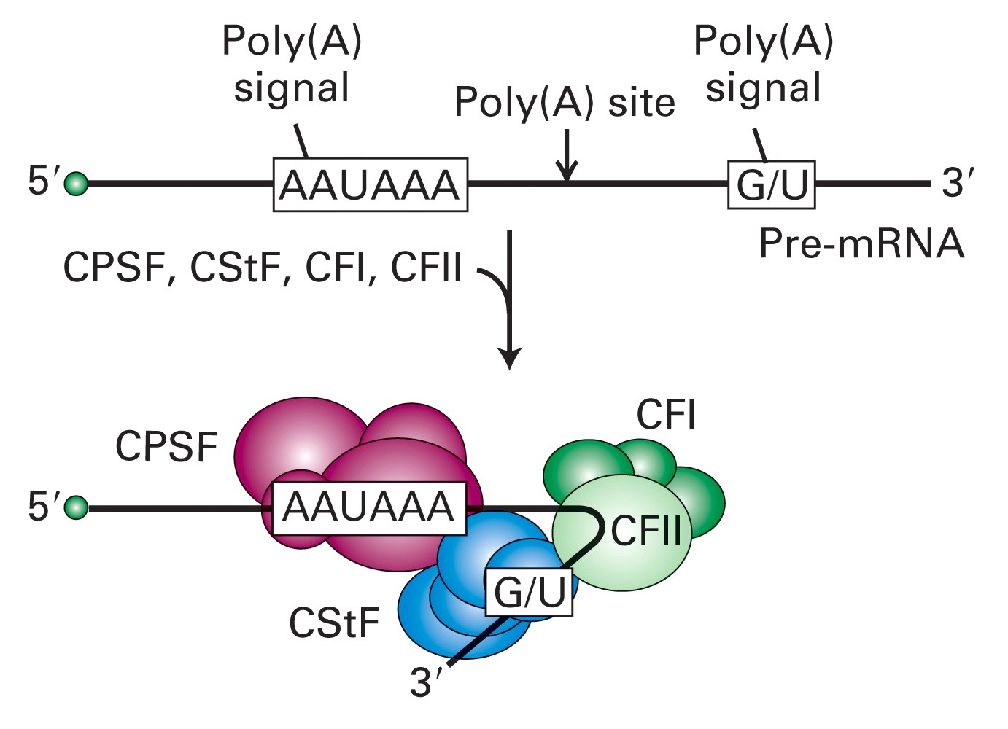
3’-End Formation: RNA Processing
Cleavage and Polyadenylation Specific Factor
Cleavage Factors
Cleavage Stimulation Factor

Slide 28
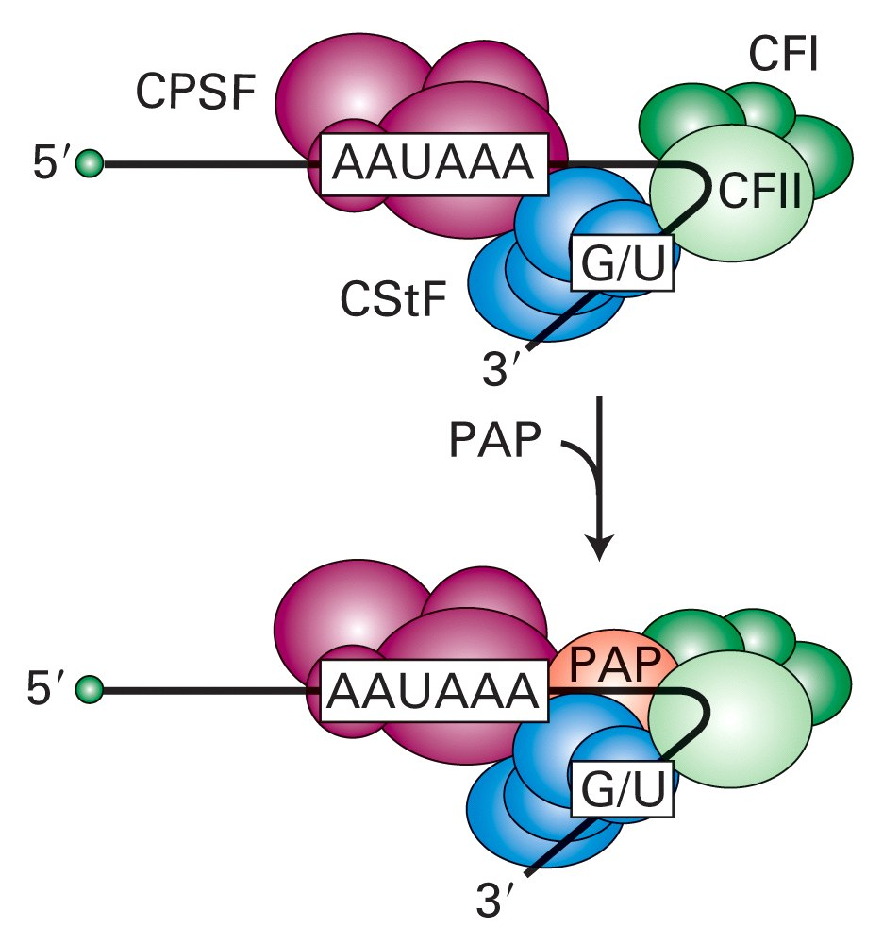

Slide 29
CPSF 73 has endonuclease activity and functions
as mRNA 3'-end-processing endonuclease

Slide 30
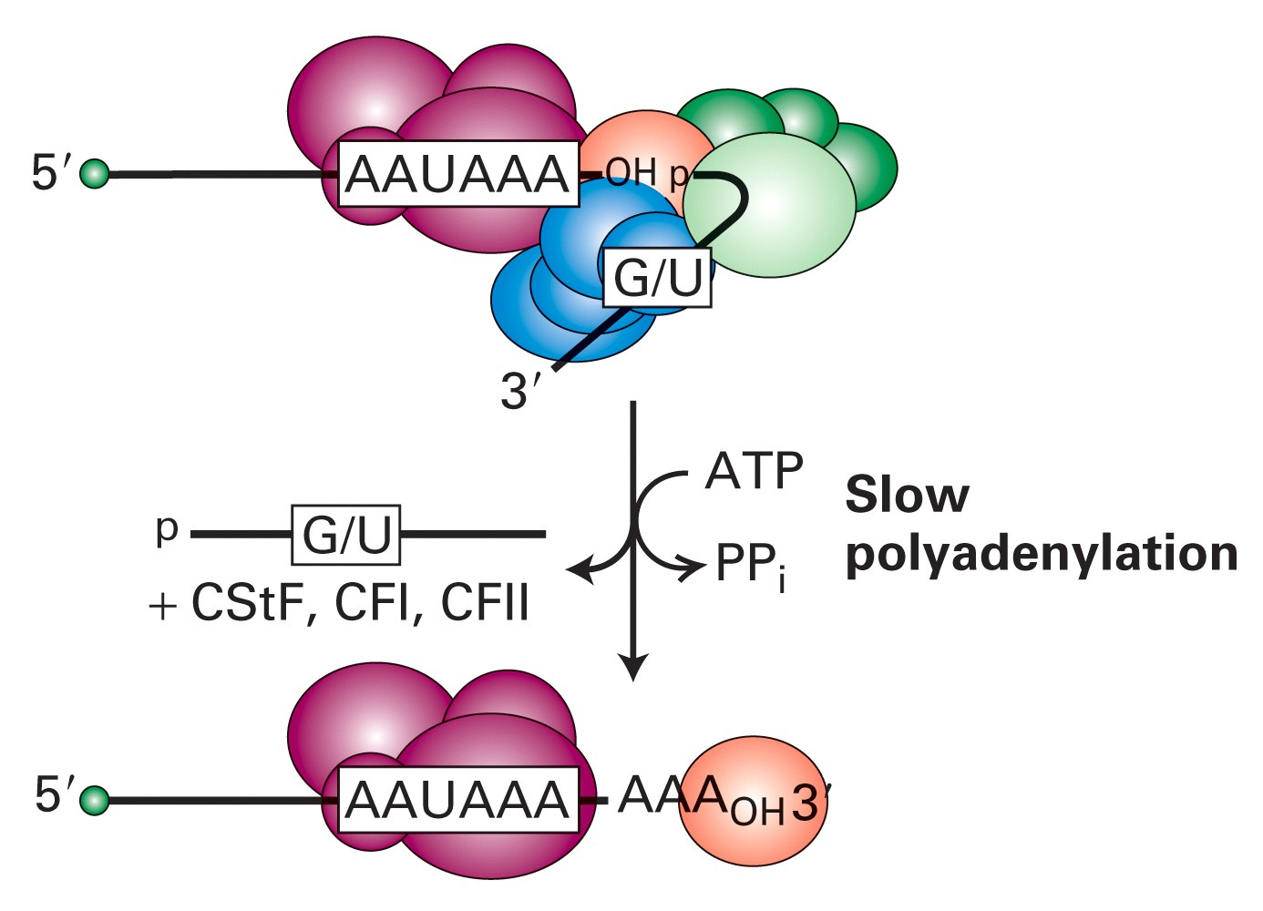
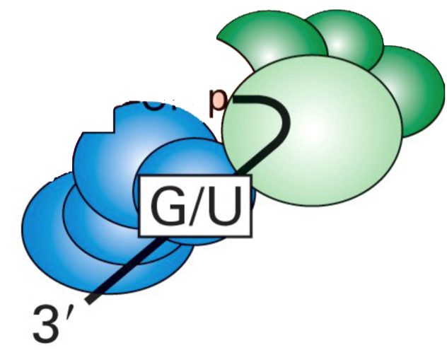
degradation

Slide 31
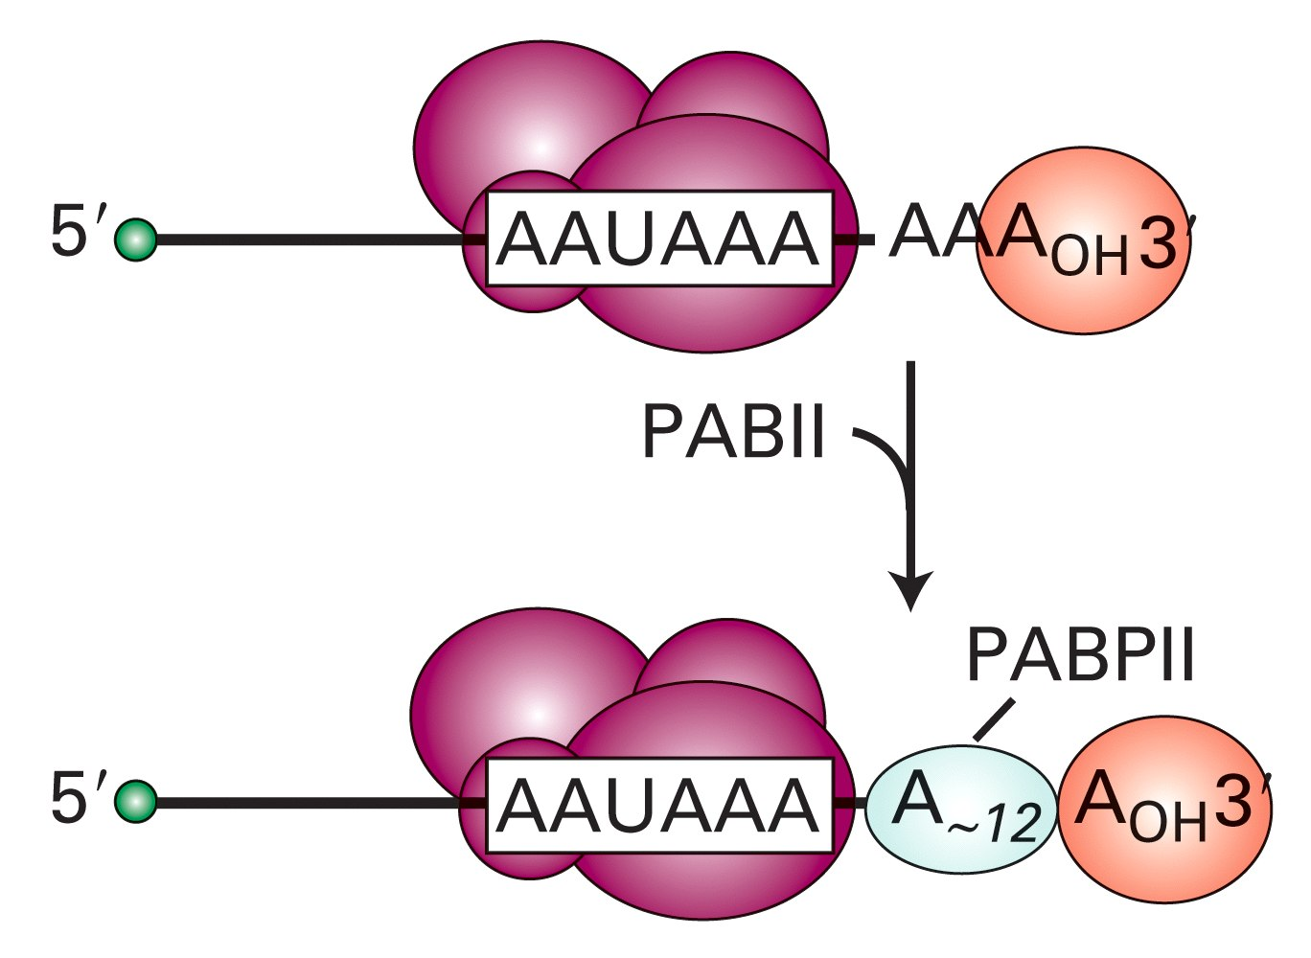

Slide 32
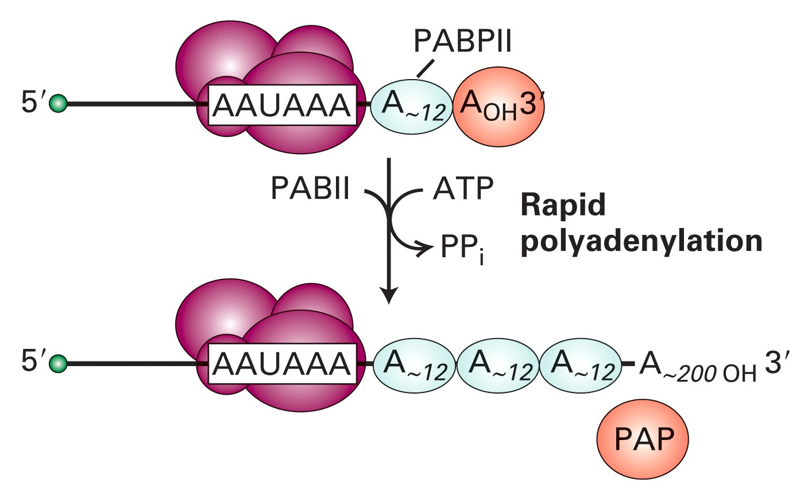

Slide 33
CAP and polyA tail influence efficient translation

Slide 34
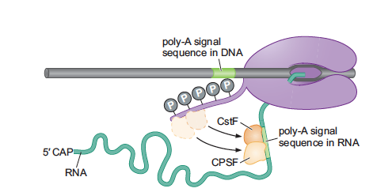
3’ end formation occurs during transcritpion
Ser2
Ser2

Slide 35
Polyadenylation is linked to termination
Torpedo Model
Ex 1
mRNA
Ex 2
Ex 3
Ex 1
AAAAAAAAA
pre-mRNA
Ex 2
CPSF
pA
Ex 3
Xrn2
CstF
RNAPII
RNAPII

Slide 36
Polyadenylation is linked to termination
Torpedo Model
Ex 1
mRNA
Ex 2
Ex 3
AAAAAAAAA
pre-mRNA
Xrn2
RNAPII
RNAPII

Slide 37
Polyadenylation is linked to termination
Torpedo model

Slide 38
Checkpoint model for coupling the 5’ pre-mRNA capping and transcription elongation
RNAPII initiates transcription and is phosphorylated on ser5-CTD by TFIIH
DSIF binds RNAPII soon after initiation and recruits NELF.NELF arrests RNAPII
The repressive action of NELF is neutralized and RNAPII resumes elongation
20-30 nucl.
capping enzymes
join the
complex via
interactions with
the ser5-CTD
and DSIF
P-TEFb is recruited
by the capping enzyme,
phosforylates ser2 of
the CTD and DSIF
A cap structure is added
To the 5’ end of the nascent RNA

Slide 39
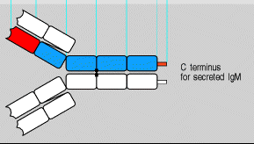
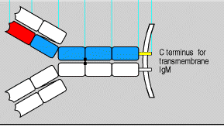
Alternative polyadenylation of the immunoglobulin μ heavy chain gene
sub obtimal pA
obtimal pA
Secreted
terminus
Membrane bound terminus
Secreted
terminus
Membrane bound terminus

Slide 40
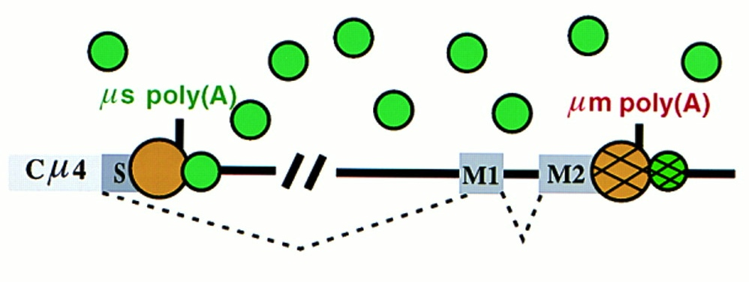
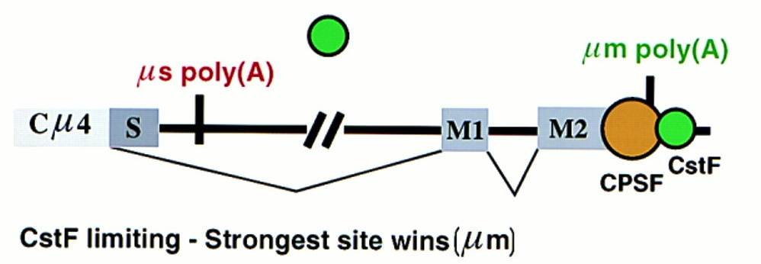
CSTF-64 levels control the alternative 3’ end formation of mRNA.
In not activated B cells the limiting concentration of CSTF allows the recognition of the stronger polyadenylation signal. The immuglobulin produced will then contain a transmembrane domain required for retention on the membrane.
After the activation of B cells CSTF levels are increased and this allows the use of the weaker polyadenylation site that will be preferentially used because it will be the first to be transcribed.
CstF-64
The polyadenylation factor CstF-64 regulates alternative processing of IgM heavy chain pre-mRNA during B cell differentiation.
Takagaki Y, Seipelt RL, Peterson ML, Manley JL. Cell 1996 Nov 29;87(5):941-52
Notes:
the CstF-64 levels control μ mRNA alternative processing (Fig. 3). In resting B cells, the limiting concentration of CstF results in preferred recognition of the strong downstream (μm) poly(A) site. Upon activation of the cells, some unknown event triggers enhanced CstF-64 expression, and because the other components of CstF are present in excess, this results in an increased level of CstF. This permits preferential use of the weaker upstream (μs) poly(A) site simply because it is transcribed first.

Slide 41
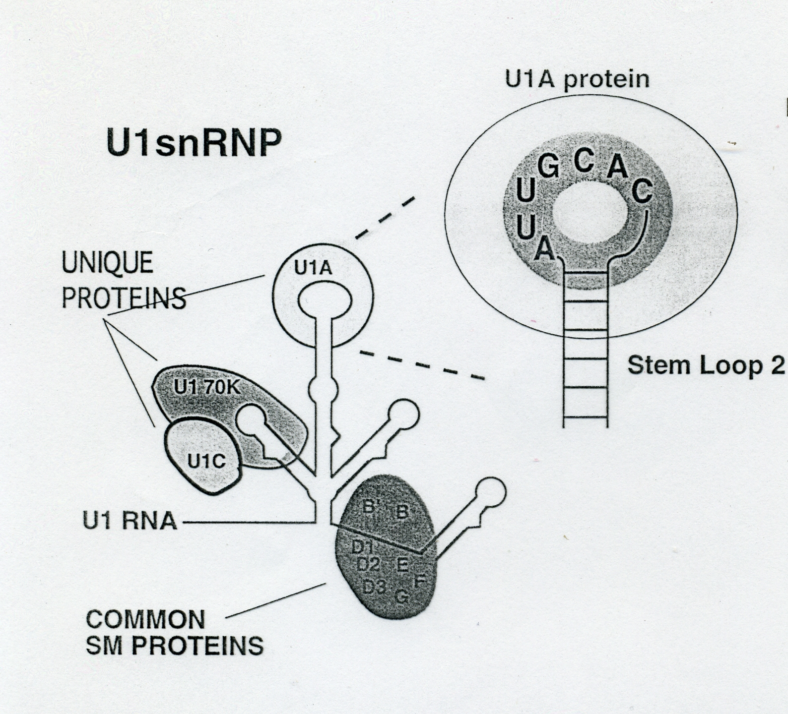
U1A: an example of on-off regulation of the cleavage and polyadenylation step in RNA processing
U1A is a protein bound to U1snRNA
Obtimal U1A binding site

Slide 42
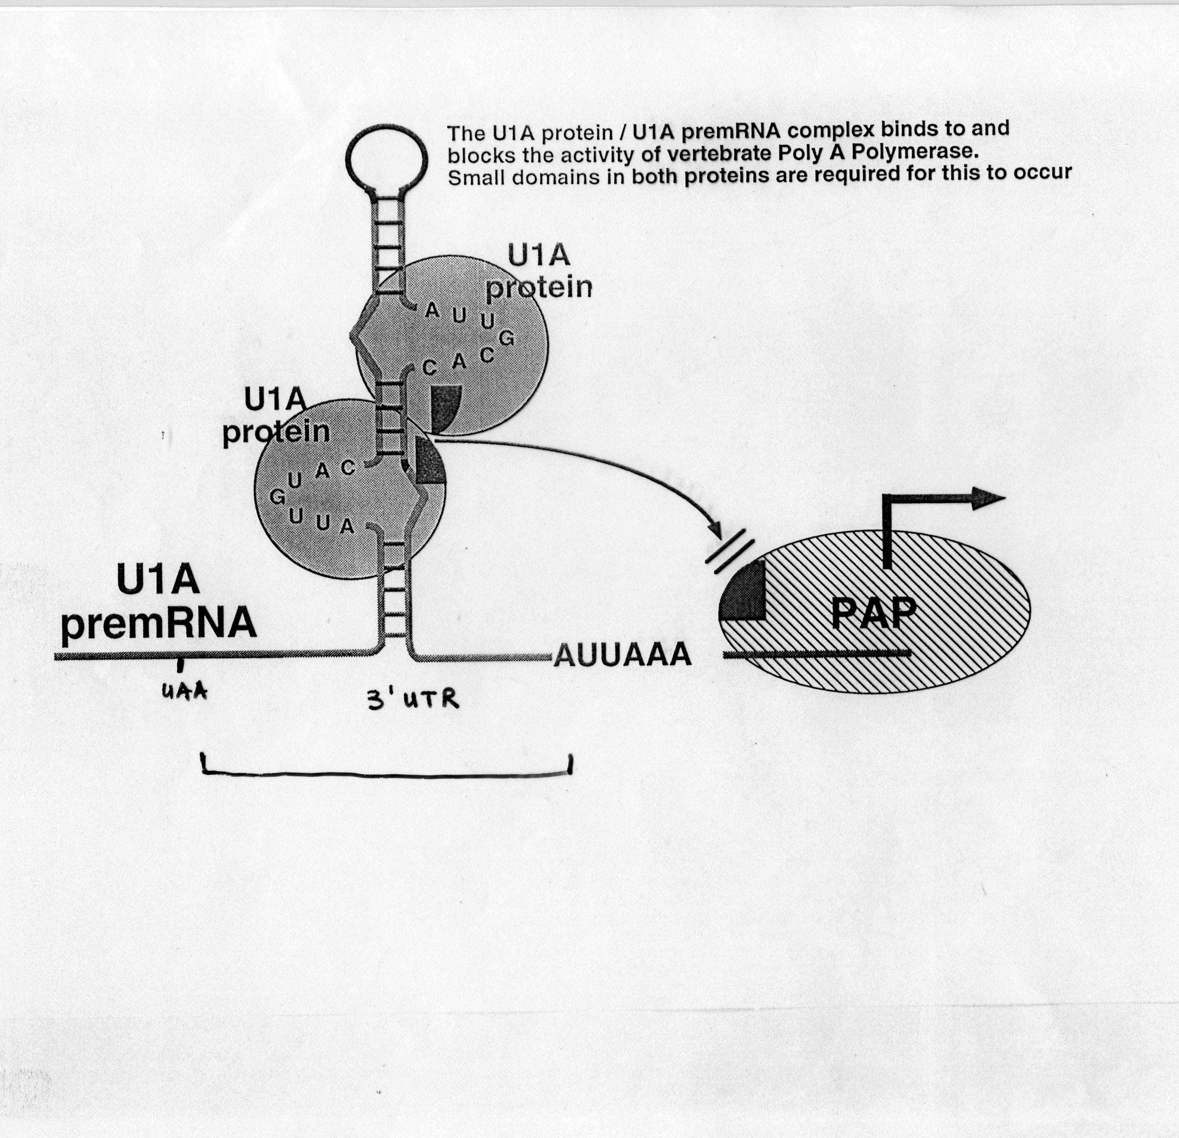
U1A autoregulation
When the level of U1A exceeds that of U1 snRNA, the excess U1A protein binds to two sites in the U1A 3’UTR. Since U1A binding does not prevent cleavage of the pre-mRNAs, free 3′ ends are generated in the normal fashion. However polyadenylation is inhibited
In the absence of polyadenylation cleavage products are rapidly degraded by an exonuclease, so no functional U1A mRNA is produced. As a result, synthesis of U1A protein is decreased until all the excess is used in formation of new U1 snRNPs.
Sub-obtimal U1A binding site
sub-obtimal site

Slide 43
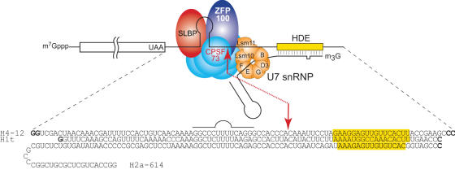
Histone mRNA are not polyadenylated
3’ end formation occurs through cleavage without polyadenylation

Slide 44
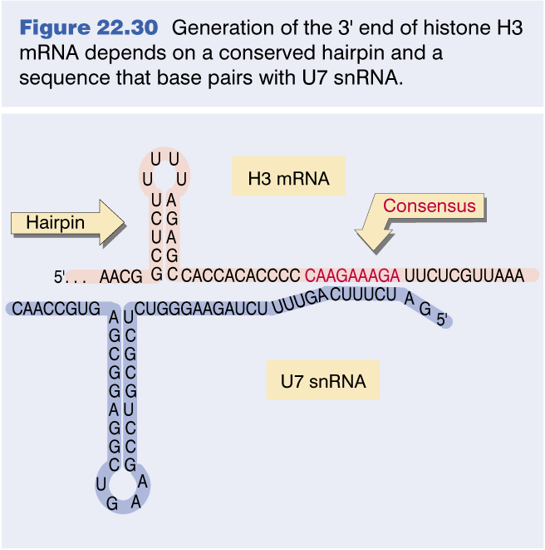
Histone mRNAs are not polyadenylated
Pairing with U7 snRNA is required for 3’ end formation

Slide 45
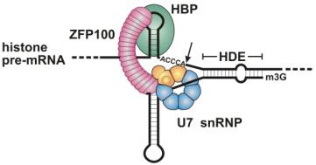

Slide 46
Common factors in RNA processing pathways
CPSF-73 endonucleolytic activity
Poly(A)⁺ mRNAs
Histone mRNAs
CPSF-73 also displays 5′ → 3′ exoribonucleolytic activity that is responsible for the decay of the downstream cleavage product

