Slide 1
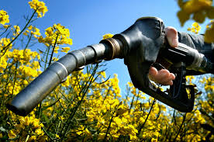
Trade in natural resources
Sustainability criteria for biofuels

Slide 2
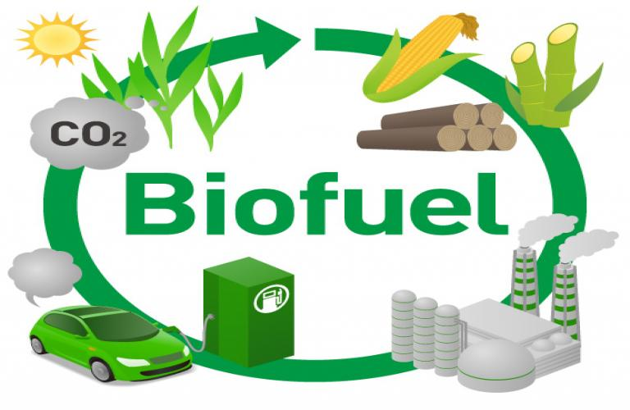
Sustainability criteria

Slide 3
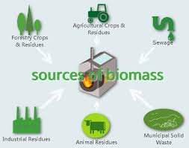
Biomass

Slide 4
Bioethanol and biodiesel
Bioethanol usually made of starch plants such as corn and sugarcane
Biodiesel made out of oil seeds like soybeans, palm oil, rape seeds, sunflower seeds

Slide 5
New generation biofuels
Agricultural or wood residues
Urban waste
algae

Slide 6
Problems
Deforestation
Land-use change, bothe direct and indirect (direct conversion of land for planting biofuel feedstocks and conversion of land for food production or other purposes which is indirectly triggered by biofuel production); land-grabbing
Impact on food security and food prices
Use of chemical fertilisers and pesticides
Cost of the use of new generation biofuels.

Slide 7
RED I and II
Renewable Energy Directive 2009/28/EC
Revised Renewable Energy Directive 2018/2001/EU
Directive 2015/1513/EU, aimed at reducing the indirect land-use change for biofuels and bioliquids (ILUC) through the reduction of the share of biofuels grown on agricultural land.
LULUCF (Land-use, land-use change and forestry) Regulation, 2018/841.

Slide 8
Sustainability criteria for biofuels in the RED II
Article 26. they include GHG emissions saving criteria and LULUCF (land-use, land-use change, forestry) criteria.
Biomass from waste and residues must only meet the GHG emission saving criteria.
they apply irrespective of the origin of the biomass, i.e. also to biomass imported from third countries. This will affect international trade.
Unsustainable biofuels do not contribute for the target and are not eligible for financial support

Slide 10
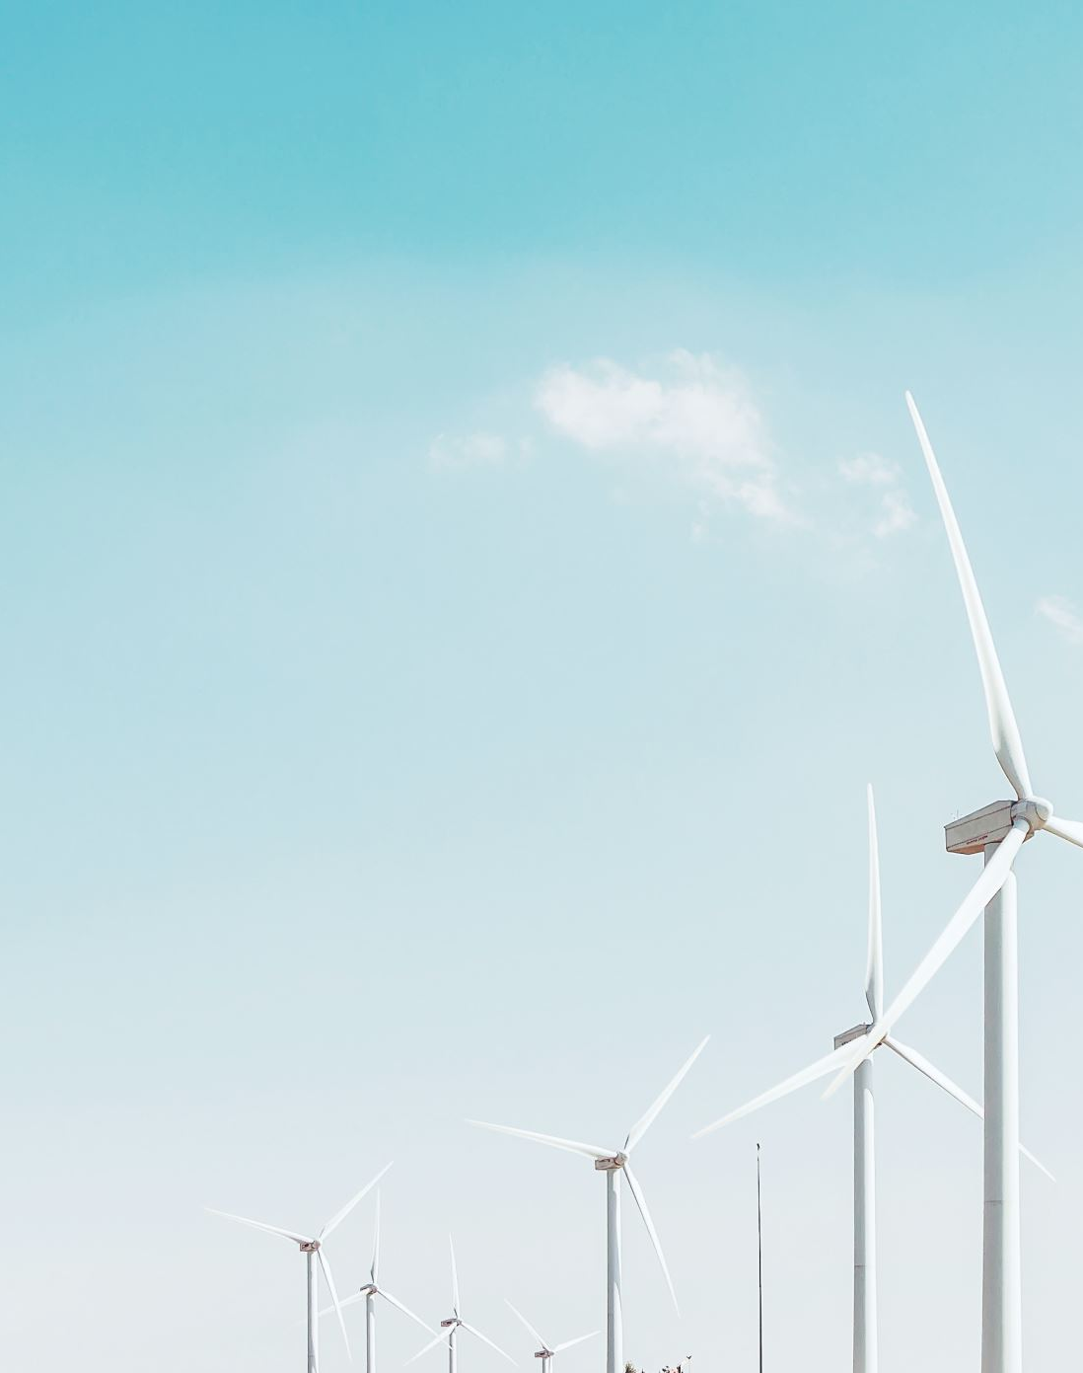
Sustainability criteria for biofuels and WTO law
Impact on international trade
Argentina filed a complaint in 2013 against the EU about the default value established by the RED for the GHG emissions of soybean biodiesel from Argentina. The case was updated after RED II and a panel was established. Case still pending.

Slide 11
Indonesia is against the RED II and ILUC for palm oil. Another WTO case was filed. Still pending

Slide 12
Sustainability criteria for biofuels and WTO law
Problems:
1) unilateral character of the sustainability criteria (disguised protection of domestic biofuel production)

Slide 13
Sustainability criteria for biofuels and WTO law
2) extraterritorial effects
Possible justifications: Article XX (b), protection of human, animal and plant life and health; (g), conservation of exhaustible natural resources.

Slide 14
Sustainability criteria for biofuels and WTO law
Lack of a territorial nexus and problem of the nature of the environment as a global good
Article XX (a), public morals: Preamble of the RED: «Consumers in the Communityy would find it morally unacceptable that their increased use of biofuels and bioliquids could have the effect of destroying biodiverse lands»

