Slide 1
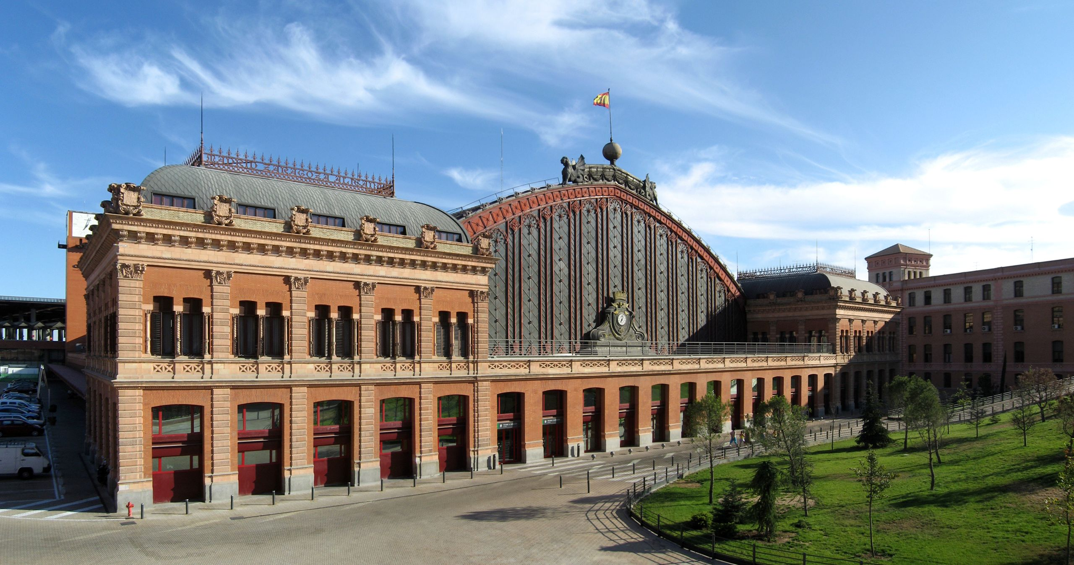
FORENSIC DECISION MAKING
October 16th, 2023
Exterior of the old Atocha Station in Madrid (Gryffindor / CC BY-SA)

Slide 2
PERCEPTION

Slide 3
Probably, the single most important thing to know about perception is:
The brain builds our experience of the outside world
(perception is an active process)

Slide 4
Scientists do not know exactly how perceptual processes work

Slide 5
Perception is an active process.
thus
there is not a necessary, obligatory identity between the world and our perception of the world

Slide 6
The sensory systems
They share the same general principles:
Receptors: specialized and selective cells that transduce energies
Receptive fields: the part of the world the neurons respond to
A number of structures (nuclei, cortical areas) within the brain that process information from the receptors

Slide 7
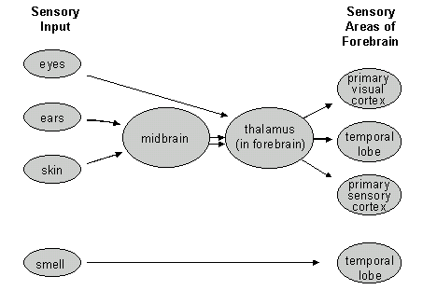
The sensory systems

Slide 8
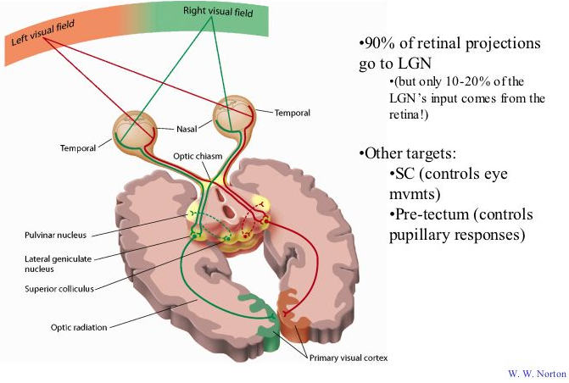
The visual system

Slide 9
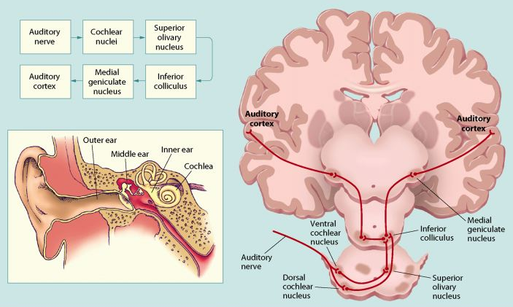
The auditory system

Slide 10
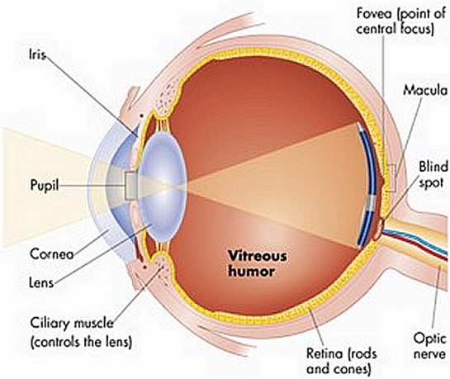
The eye
The lenses of the eye focus the light emitted by objects in the world onto the retina at the back of the eye, where the retina is located.
The retina contains light sensitive cells which convert light to bio-electrical activity, and
a network of neurons that process visual information and transmit it down the optic nerve to the brain.

Slide 11
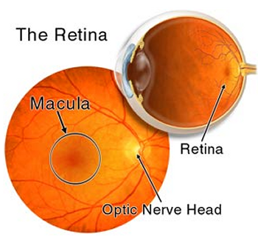

Slide 12
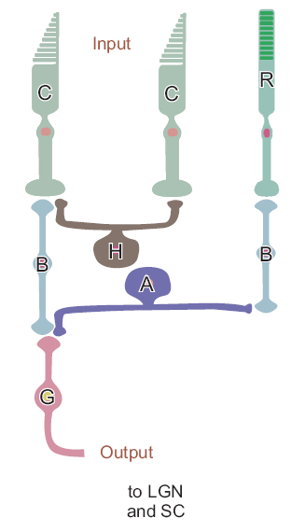
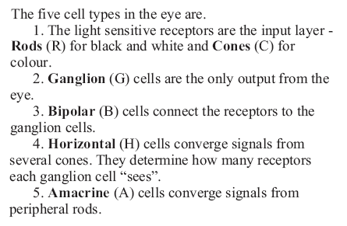
The Retina 2

Slide 13
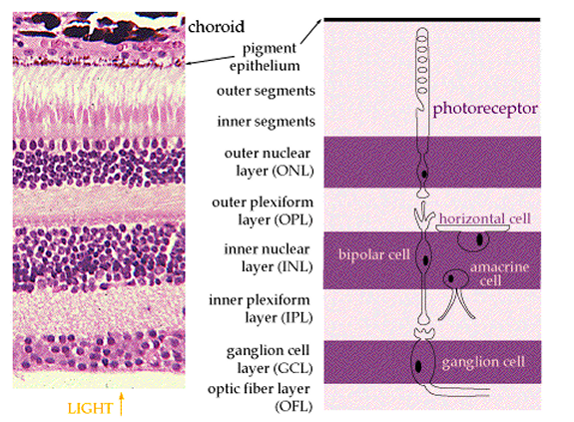
The Retina 3

Slide 14
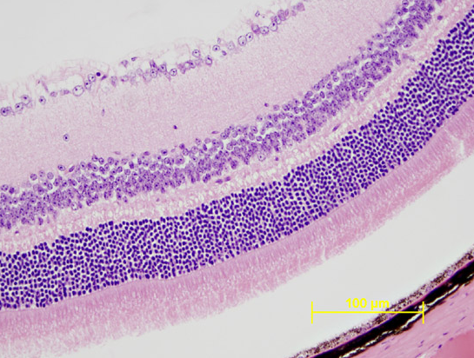
The Retina 4

Slide 15
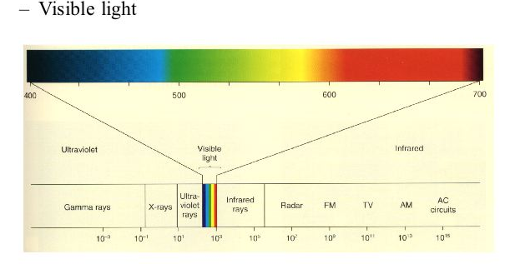
The Retina (5)

Slide 16
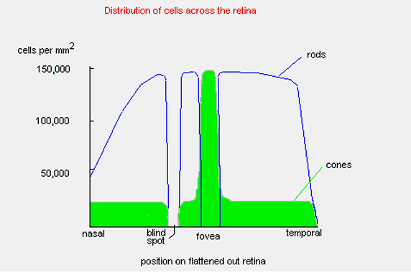
Distribution of cones and rods

Slide 17
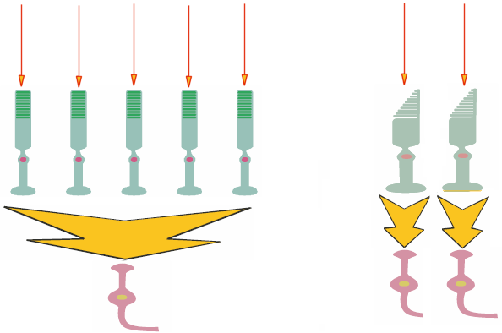
Connections of cones and rods (simplified)
Light
Light
Rods
Cones
Ganglion cells
Ganglion cells
Large convergence
Small convergence

Slide 18
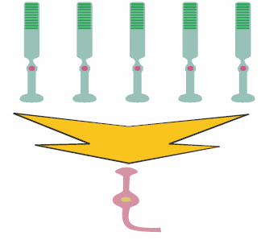
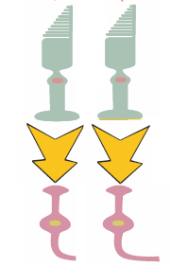
Two “visual systems”
Rods system
(scotopic vision)
Cones system
(photopic vision)
Low acuity (due to large spacing and convergence)
High sensitivity (due to large convergence)
Black and white vision
Peripheral vision
High acuity (due to reduced spacing and convergence)
Low sensitivity (due to small convergence)
Colour vision
Central vision (fovea)

Slide 19
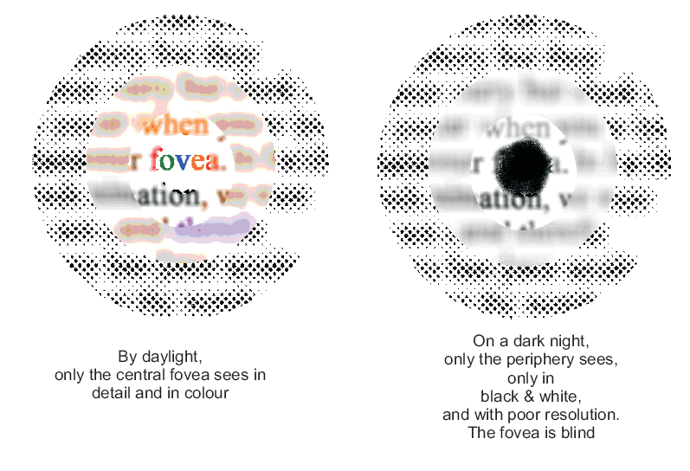

Slide 20
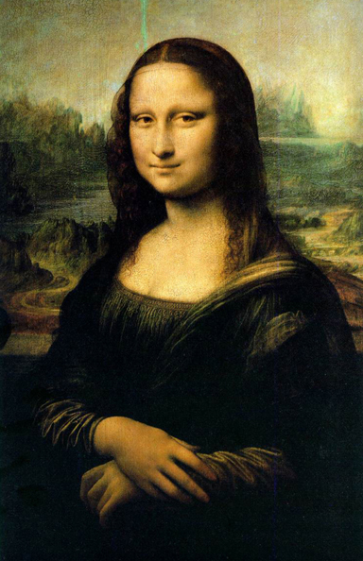
Mona Lisa smile

Slide 21
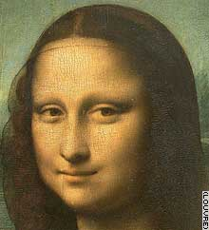
Why is the smile so elusive?
At least two hypotheses ground onto the physiology of the visual system

Slide 22
Effect of spatial frequencies
Livingstone, M.S. (2000) Is It Warm? Is It Real? Or Just Low Spatial Frequency? Science, 290 (5495), 1299
“our central vision is dominated by significantly higher spatial frequencies than is our peripheral vision. Conversely, vision only a few degrees from the center of gaze is much blurrier than in the fovea”
The “sfumato” technique makes the smile more apparent in the low spatial frequency range, and therefore more apparent to peripheral vision than to central vision.

Slide 23
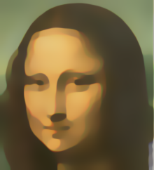
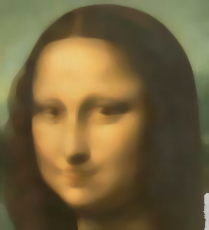
Effect of spatial frequencies
Livingstone, M.S. (2000) Is It Warm? Is It Real? Or Just Low Spatial Frequency? Science, 290 (5495), 1299
High frequencies enhanced
(mimicking central vision)
Original
Low frequencies enhanced
(mimicking peripheral vision)

Slide 24
Receptive fields
(functional organization within the retina, and beyond)
Horizontal cells
Amacrine cells
Horizontal connections among retinal cells create functional structures

Slide 25
Receptive fields
(Lateral Inhibition)
Horizontal cells
Amacrine cells
Through the horizontal connections one active cell (photoreceptor or bipolar cell) may inhibit adjacent cells

Slide 26
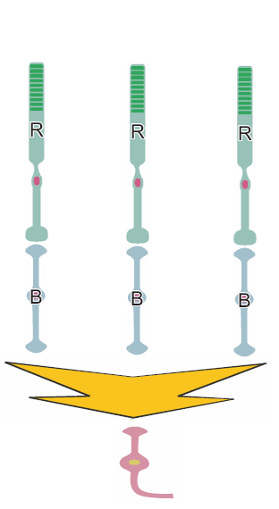
Receptive fields
(Lateral Inhibition)

Slide 27
Receptive fields
(Lateral Inhibition)

Slide 28
Receptive fields
(Lateral Inhibition)

Slide 29
Receptive fields
(Lateral Inhibition)

Slide 30
Receptive fields
(Lateral Inhibition)

Slide 31
Receptive fields
(Lateral Inhibition)
Center ON
(periphery OFF)
Center OFF
(periphery ON)
More complex receptive fields exist in the visual cortex

Slide 32
Lateral Inhibition
One effect of the lateral inhibition is that the signal-to-noise ratio is enhanced
Actual light profile
Ganglion cell activity

Slide 33
Mach bands (1866)

Slide 34
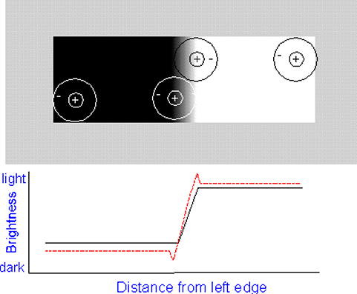
Mach bands

Slide 35
Mach bands

Slide 36
Mach bands

Slide 37
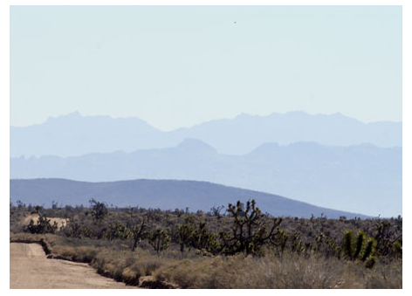
Mach bands
http://www.hutchinsoncenter.umaine.edu:16080/perceive

Slide 38
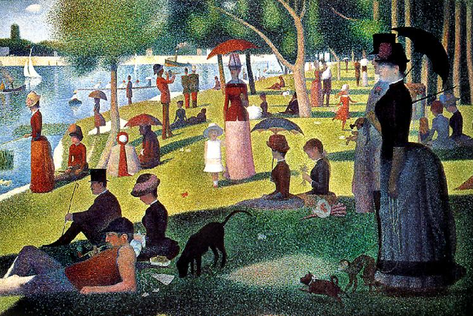
“Mach bands”
Georges Seurat Sunday Afternoon on the Island of La Grande Jatte
1884-86, oil on canvas, Art Institute of Chicago

Slide 39
Hermann’s grid illusion (1870)

Slide 40
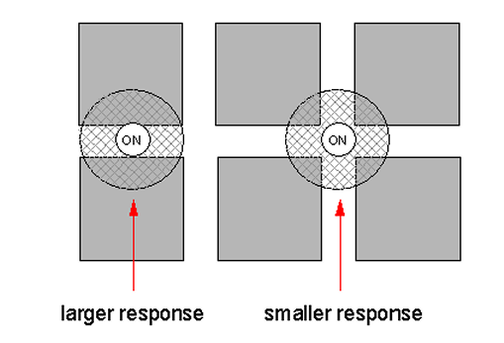
Hermann’s grid illusion (1870)
This is the classic explanation, but others exist as well

Slide 41
Is perception due to the simple summation of elementary physiological processes that occur in the brain (bottom-up process)?

Slide 42
Hubel and Wiesel – receptive fields in the visual cortex
simple cells - respond to "bars" of light of a
particular orientation (orientation selective)

Slide 43
Hubel and Wiesel - cells of visual cortex
+
+
+
+
-
-
-
-
-
-
(15 spikes)
on
off
+
+
+
+
-
-
-
-
-
-
(9 spikes)
+
+
+
+
on
off
-
-
-
-
-
-
(3 spikes)
on
off

Slide 44
Hubel and Wiesel - cells of visual cortex
+
+
+
+
+
+
+
+
+
+
+
+
+
+
+
+
-
-
-
-
-
-
-
-
-
-
-
-
-
-
-
-
-
-
-
-
-
-
-
-
+
+
+
+
+
+
+
+
+
+
+
+
+
+
+
+
-
-
-
-
-
-
-
-
-
-
-
-
-
-
-
-
-
-
-
-
-
-
-
-

Slide 45
Hubel and Wiesel – receptive fields in the visual cortex
simple cells - respond to "bars" of light of a
particular orientation (orientation selective)
complex cells - respond to "bars" of light of a
particular orientation, moving in particular
direction (direction selective)

Slide 46
Hubel and Wiesel - cells of visual cortex
++
+++
++
++
+++
++
+++
+++
+++
+++
+++
+++
+++
+++
+++
+++
+++
+++
+++
+++
+++
+++
+++
+++
+++
+++
+++
+++
+++
+++
+++
+++
+++
off
++
+++
++
on
++
+++
++
+++
+++
++
+++
++
++
+++
++
+++
+++
+++
+++
+++
+++
+++
+++
+++
+++
+++
+++
+++
+++
+++
+++
+++
+++
+++
+++
+++
+++
+++
+++
+++
+++
+++
++
+++
++
on
off
++
+++
++
+++

Slide 47
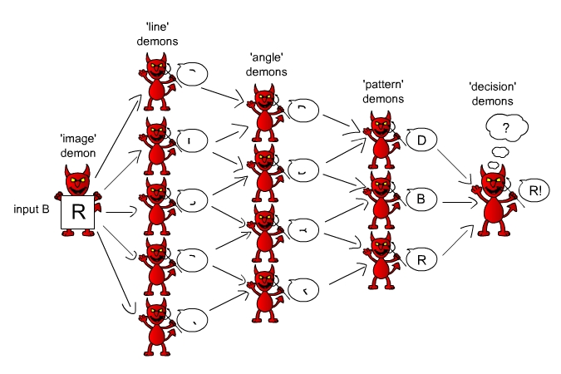
Pandemonium Model of Selfridge (1959) for letter recognition

Slide 48
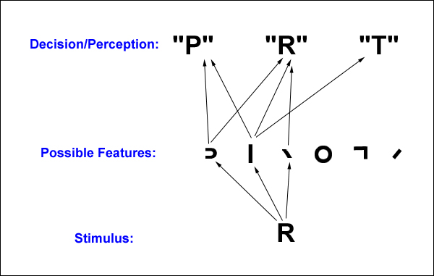
Pandemonium Model of Selfridge (1959) for letter recognition
A model for recognizing letters by analyzing their features. The stimulus, R, activates three feature-units. These feature-units cause strong activation of the R letter-unit and weaker activation of units for letters such as the P and the T, which lack some of R’s features. The R is identified by the high level of activation of the R letter-unit.

Slide 49
Pandemonium Model of Selfridge (1959) for letter recognition
The Pandemonium model would have difficulty identifying all of these as A’s.

Slide 51
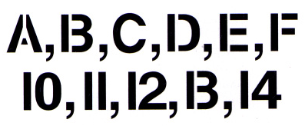

Slide 52
Gestalt Psychology (Wertheimer, Koffka)
Stimuli contain more structure than what is in the simple parts
“The whole is more than the sum of the parts”
central aspect of perception is the formation of “Gestalts” (configuration)
i.e., configurations emerge from arrangements of items

Slide 53
Gestalt Psychology - Perceptual Organization
"The whole is different than the sum of the parts"

Slide 54
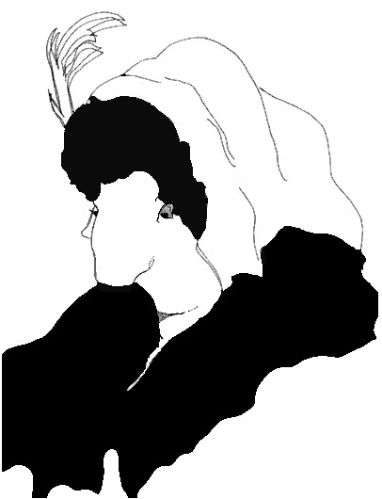

Slide 55
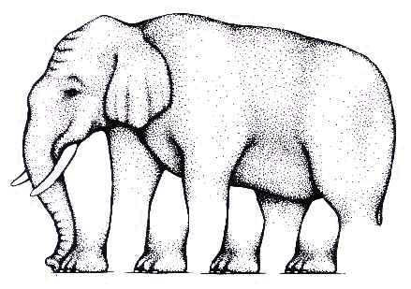

Slide 56
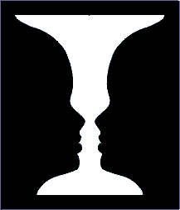

Slide 57
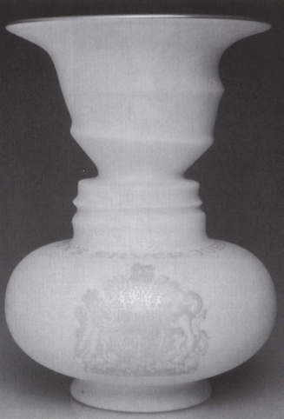

Slide 58
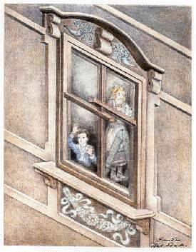

Slide 59
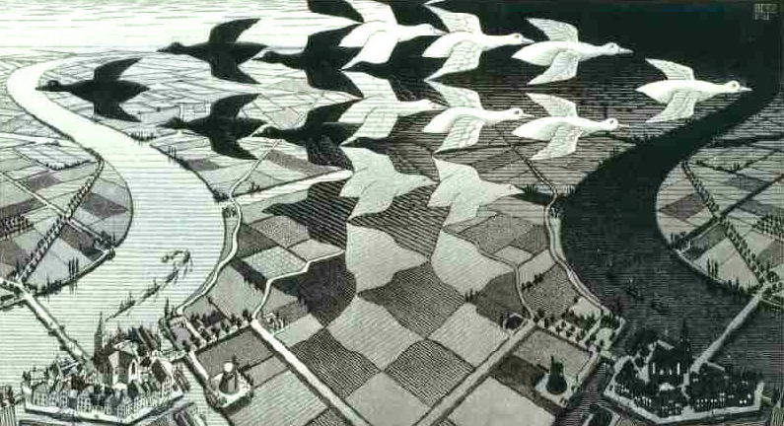
Maurits C. Escher
(1898-1972)
"Day and Night"
M. C. Escher woodcut, 1938

Slide 60
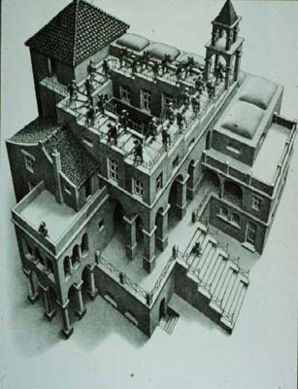
Maurits C. Escher
(1898-1972)
Ascending and descending
Lithograph, 1960
“Drawing hands"

Slide 61
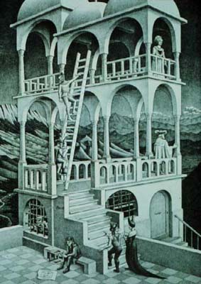
Maurits C. Escher
(1898-1972)
Belvedere
Lithograph, 1958

Slide 62
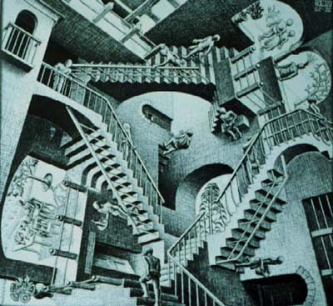
Maurits C. Escher
(1898-1972)
Relativity
Lithograph, 1953

Slide 63
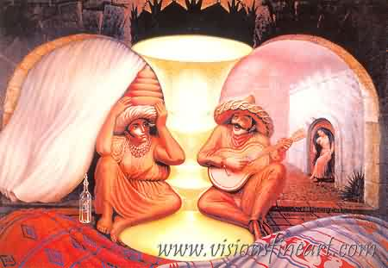
Octavio Campo
(1943)
Forever always

Slide 64
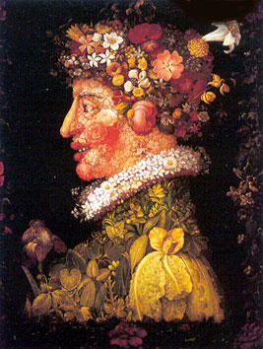
Giuseppe Arcimboldo
Spring, oil on canvas

Slide 65
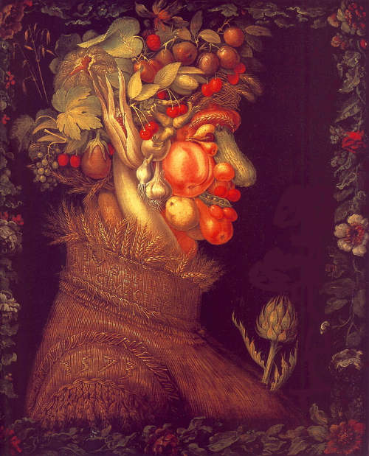
Giuseppe Arcimboldo
Summer, oil on canvas

Slide 66
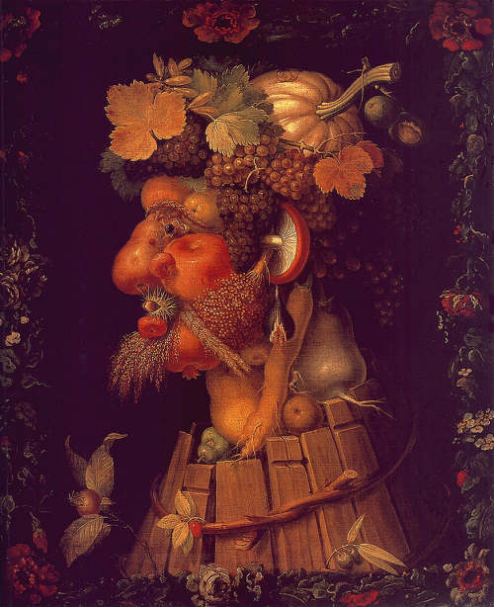
Giuseppe Arcimboldo
Autumn, oil on canvas

Slide 67
Giuseppe Arcimboldo
Winter, oil on canvas

Slide 68
DEPTH PERCEPTION
The problem:
The retinal image (the projection of the visual scene over the retina) is 2-dimensional.
How can we retrieve information about depth/distance?

Slide 69
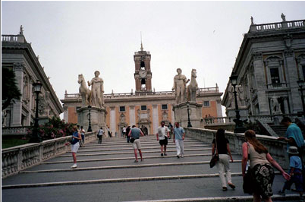
DEPTH PERCEPTION

Slide 70
DEPTH PERCEPTION

Slide 71
Depth Cues
Binocular (oculomotor)
Eye Convergence
Stereoscopic depth (binocular disparity)
Monocular
Perspective Cues
Relative Size
Occlusion
Cast Shadows
Shape from Motion

Slide 72
Depth Cues
Convergence
You converge your eyes when looking at close objects and diverge to look at distant objects
The amount of convergence can be used as cues for absolute depth (for objects not too far away from you)

Slide 73
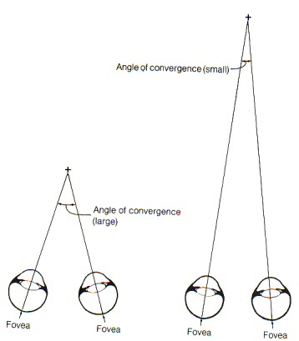
Depth Cues
Convergence

Slide 74
Depth Cues
Binocular disparity
Each eye gets a slightly different view of the world because the two eyes are in slightly different positions.
Retinal (binocular) disparity is the difference between the lateral position of object in the left and right eyes

Slide 75
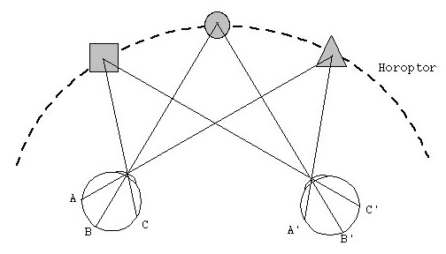
The Horopter
Horopter: images are fused (single image)
Region of fused images: Panum’s Fusion Area

Slide 76
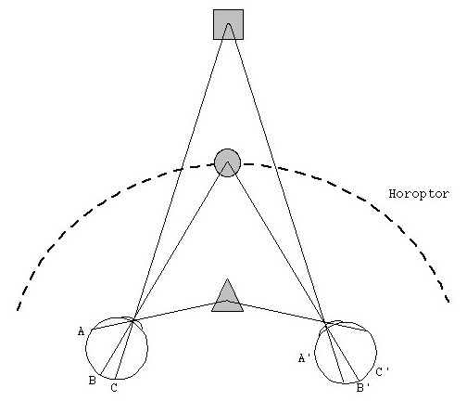
Out of the horopter
Images not fused: images fall on non-corresponding points
Not fused: Diplopia
Binocular disparity

Slide 77
Depth Cues
- Perspective cues:
Linear perspective: Lines that are parallel in the real world appear to converge in a drawing.
The greater the distance, the greater the convergence.
At infinity, lines meet at the vanishing point.

Slide 78
Depth Cues
Linear Perspective

Slide 79
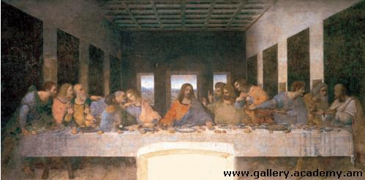
Depth Cues
Linear Perspective

Slide 80
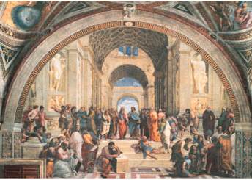
Depth Cues
Linear Perspective

Slide 81
Depth Cues
Perspective cues:
- Height in the Field
“Elevation” or “relative height”
Objects below horizon: higher objects appear farther
Objects above horizon: lower objects appear farther

Slide 82
Depth Cues
Perspective cues:
- Height in the Field

Slide 83
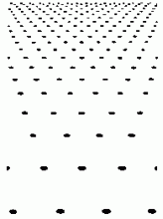
Depth Cues
- Texture gradients: Surface texture gets smaller and denser with distance

Slide 84
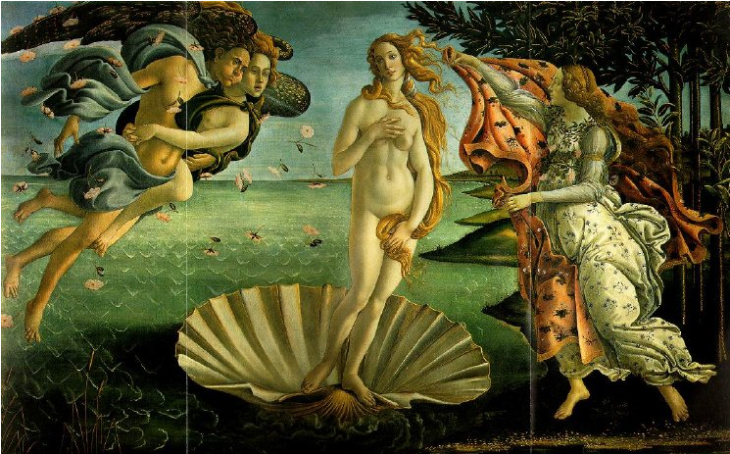
Depth Cues
- Texture gradients: Surface texture gets smaller and denser with distance

Slide 85
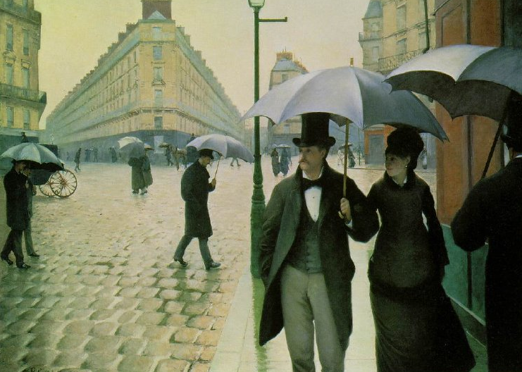
Depth Cues
- Texture gradients: Surface texture gets smaller and denser with distance

Slide 86
Depth Cues
- Aerial perspective: distant objects appear less clear
Worthington Whittredge - Fight Below the Battlements, 1849

Slide 87
Depth Cues
- Aerial perspective: distant objects appear less clear
Georges Seurat, Bathing at Asnières, 1883-1884

Slide 88
Depth Cues
Relative size: If 2 objects are same size, closer one casts larger retinal image
Eduard Manet, Le Dejeuner sur l'herbe

Slide 89
Depth Cues
Partial occlusion or interposition

Slide 90
Depth Cues
Partial occlusion or interposition
Musicians and dancers, c. 1350 B.C

Slide 91
Depth Cues
Partial occlusion or interposition
Lascaux (France), 18,000 Years before Present

Slide 92
Depth Cues
- Shading and Lighting: default assumption: light from above

Slide 93
Depth Cues
Binocular (oculomotor)
Eye Convergence
Stereoscopic depth (binocular disparity)
Monocular
Perspective Cues
Relative Size
Occlusion
Cast Shadows
Shape from Motion

