Slide 1
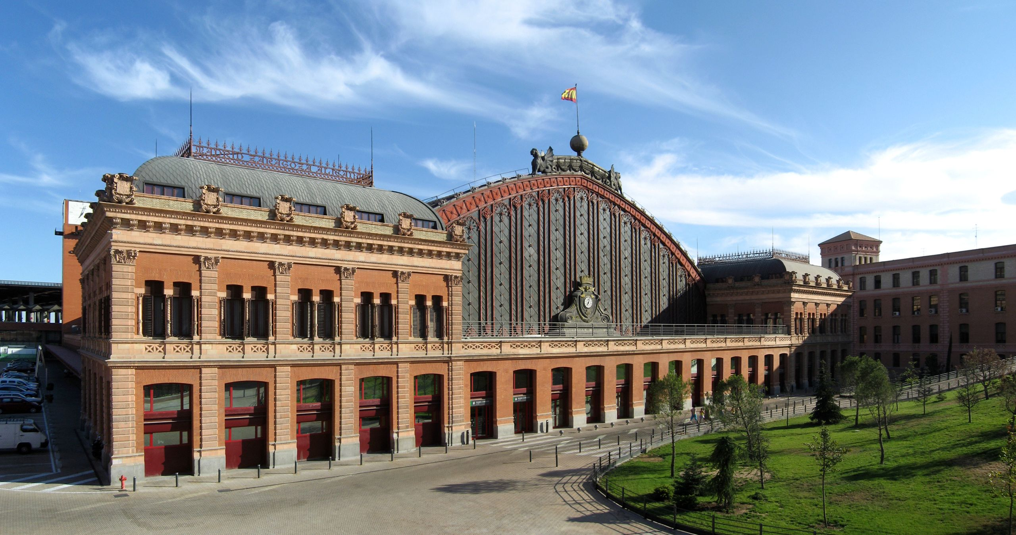
FORENSIC DECISION MAKING +
EPISTEMOLOGY AND PROFESSIONAL ETHICS
Fabio Ferlazzo
Exterior of the old Atocha Station in Madrid (Gryffindor / CC BY-SA)

Slide 2
FORENSIC DECISION MAKING
Lectures will be devoted at analyzing the following general topics:
Cognitive and neurophysiological bases of decision-making (8 hours)
Theories and models of decision-making processes, from the normative approach to the naturalistic approach (26 hours)
Application of the theoretical models to different operational contexts, with case studies and analysis of the scientific literature (14 hours).
TEXTBOOKS
1) Newell, Lagnado, Shanks (2015), Straight choices: the psychology of decision making, London: Psychology Press (second edition).
2) Six scientific papers in English. They will be chosen at the beginning of the course.

Slide 3
EPISTEMOLOGY AND PROFESSIONAL ETHICS
Epistemological models: Bacon, von Neurath, Popper, Lakatos, Kuhn, Feyerabend
Professional ethics
Discussion of case studies
TEXTBOOKS
1) Three scientific papers provided at the beginning of the course
2) Case studies provided during the classes

Slide 4
EPISTEMOLOGY AND PROFESSIONAL ETHICS
EXAM
The course includes an intermediate exam (in written form with open questions)
and a final exam with a written test (open questions and/or multiple-choice questionnaire) with an oral integration.

Slide 5
TimeTable
Monday 10.00 – 12.00 (Forensic decision-making)
Tuesday 11.00 – 12.00, 13-00 – 15-00 (Epistemology and professional ethics)
Wednesday 8.00- 10.00 (Forensic decision-making)

Slide 6
Prof. Fabio Ferlazzo office hours
Thursday: 10.00 to 12.00 office 211 psychology building
Email: fabio.ferlazzo@uniroma1.it
Study material on Moodle Sapienza (ForDec_23_24)

Slide 7
It is commonly held that humans are very poor at making decisions
because they are not rational agents
Solutions:
Let’s go to mathematics (since 17th century)
2) Let’s investigate the reason why (20th century)
3) let’s value scientific evidence
4) Let’s move to big data/algorithms

Slide 8
3) let’s value scientific evidence
https://www.ted.com/talks/simona_francese_your_fingerprints_reveal_more_than_you_think?language=it&subtitle=it

Slide 9
Exterior of the old Atocha Station in Madrid (Gryffindor / CC BY-SA)

Slide 10
Interior plaza in old Atocha station (Daderot / Public domain)

Slide 11
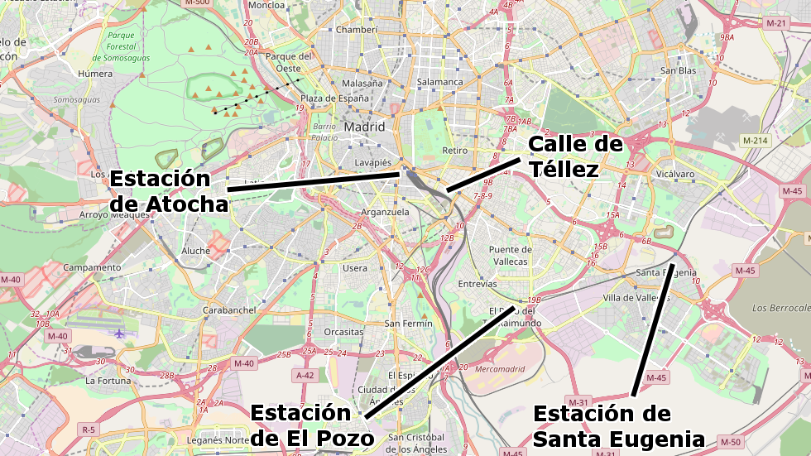
11 marzo 2004 7:37 - 7:40
4 bombe
3 bombe
2 bombe
1 bomba

Slide 12
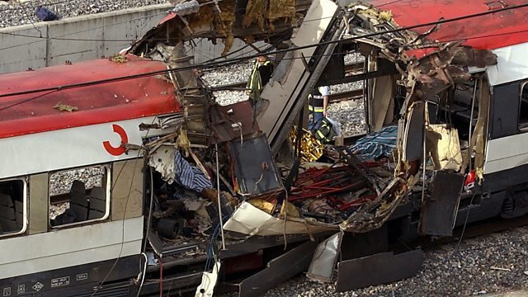
BBC News

Slide 13
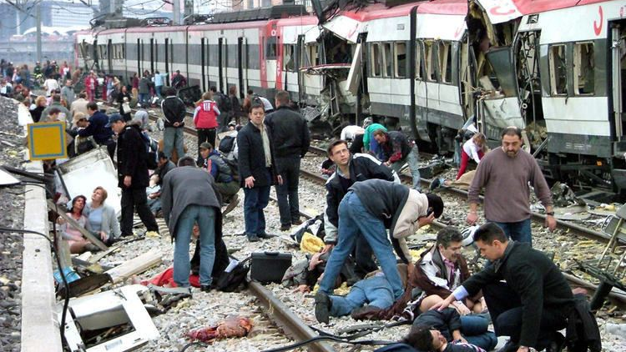

Slide 14
Reuters (Pablo Torres Guerrero – El Pais)

Slide 15
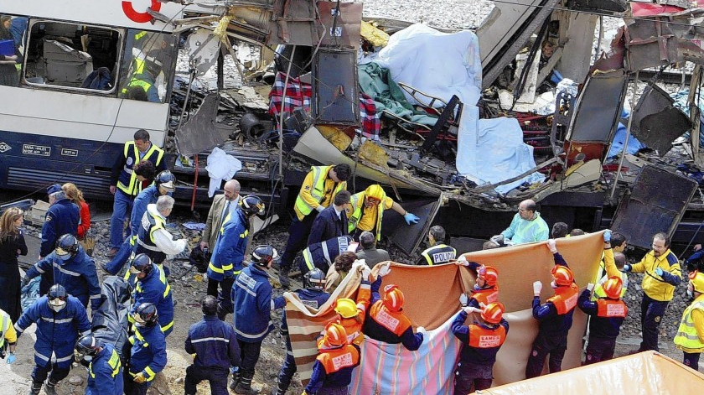
Los Angeles Times (Christophe Simon / AFP/Getty Images)

Slide 16
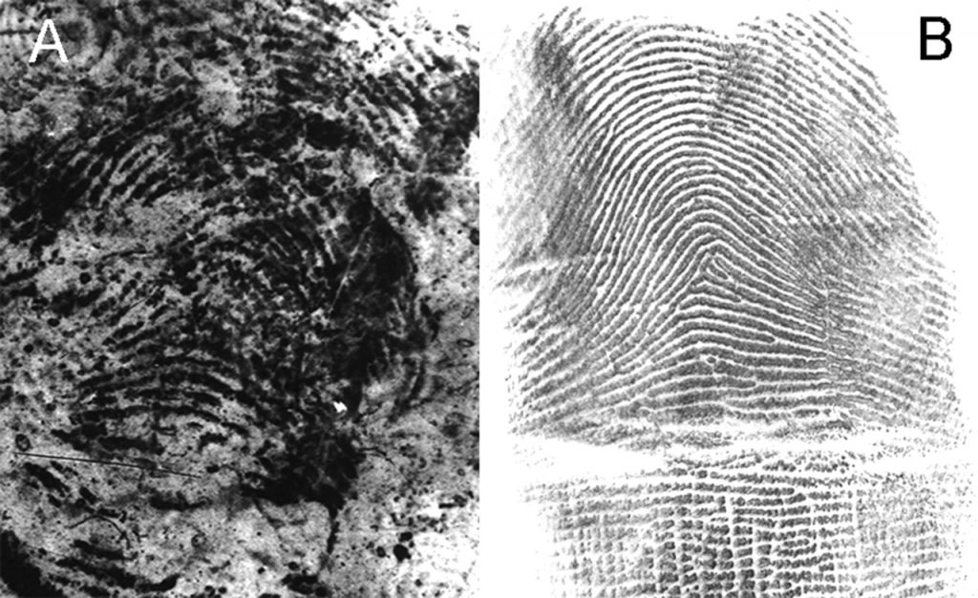
Los Angeles Times (Christophe Simon / AFP/Getty Images)

Slide 17
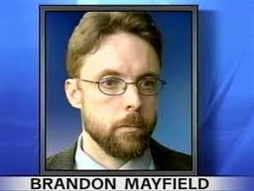
Los Angeles Times (Christophe Simon / AFP/Getty Images)

Slide 18
Los Angeles Times (Christophe Simon / AFP/Getty Images)
https://www.youtube.com/watch?v=wTa-PWdjX-Q&ab_channel=TomMauriello

Slide 19
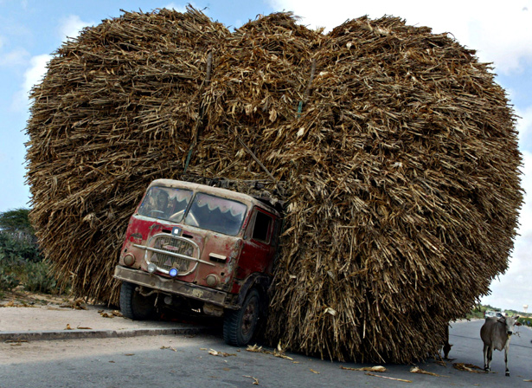
BIG DATA

Slide 20
BIG DATA
4) Predictive algorithms and criminal justice
(e.g., probability of reoffending: France, USA)
https://www.youtube.com/watch?v=p-82YeUPQh0&ab_channel=TEDxTalks

Slide 21
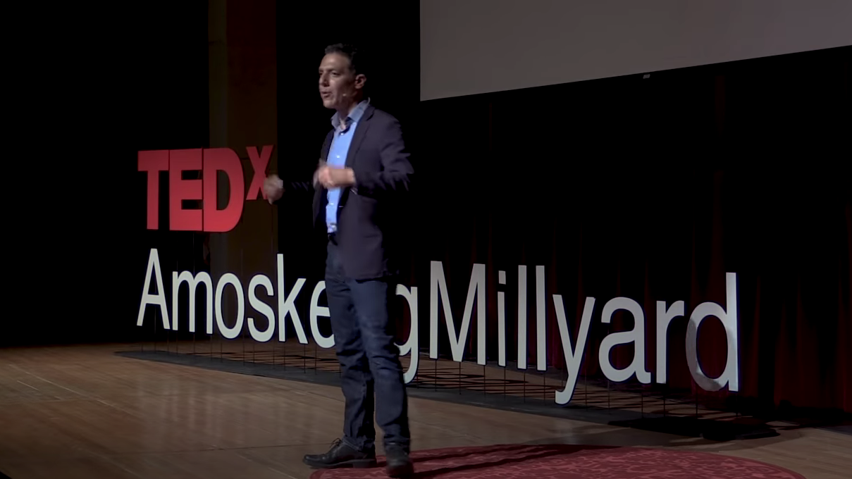
Los Angeles Times (Christophe Simon / AFP/Getty Images)

Slide 22
Los Angeles Times (Christophe Simon / AFP/Getty Images)

Slide 23
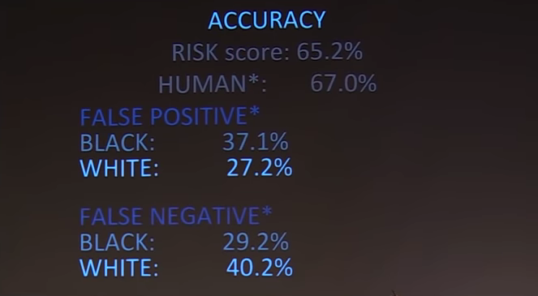
Los Angeles Times (Christophe Simon / AFP/Getty Images)

Slide 24
https://www.youtube.com/watch?v=GTz_ZoeH7_g&ab_channel=WellcomeCollection

Slide 25
Decision making process
Chosing among alternative courses of action.
Each option may lead to certain outcomes, with some probability
Risk
Uncertainty
We know both the outcomes
and their probabilities
(gambling)
We do not know for sure

Slide 26
Probability theory
Event:
Any fact that may or may not occur
Probability of an event:
Number that measures the possibility that the event occurs
Sure event = 1
Impossible event = 0

Slide 27
Probability theory
Classical definition of probability
Ratio between the number of favourable cases and the number of possible cases
Event (A) = flipping a coin, it lands on heads
Favourable cases = 1 (heads)
Possible cases = 2 (heads and tails)
p(A) = ½ = 0.5

Slide 28
Probability theory
Frequentist definition of probability
Ratio between the number m of trials wherein the event A occurred
and the number n of trials
As the number n increses, the relative frequency of A converges to its probability
p(A) = m/n

Slide 29
Probability theory
Subjective definition of probability
The probability of an event A is the degree of confidence an individual has that the event will occur.

Slide 30
Probability theory
Theorems: sum
The sum of two incompatible events A and B is
an event C that consists of the occurrence of
A or B
(union of A and B)
Sum of probabilities: p(A or B) = p(A) + p(B)
(incompatible events)

Slide 31
Probability theory
Theorems: product
The product of two events A and B is
an event C that consists of the occurrence of
A and B
Independent events
Product of probabilities: p(AB) = p(A) * p(B)
Dependent events (conditional probability)
Product of probabilities: p(AB) = p(A) * p(B|A)

Slide 32
Probability theory
Mean: expected value of A
$$\overline{X}\left(A\right)= \frac{\sum_{i=1}^{N}{A_{i}}}{N}$$
$$\overline{X}\left(A\right)=\sum_{i=1}^{N}{A_{i}p_{i}}$$

Slide 33
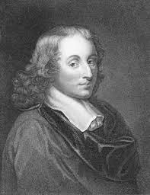
Flip a coin: if it lands on heads, you win 100 euro, if it lands on tails, you win nothing
2) Choose among three envelops, containing 90, 30, and 15 euro: you get the amount in the chosen envelop
Blaise Pascal (1623-1662)

